Slide 1
Answers to the Midterm Final Review

Slide 2
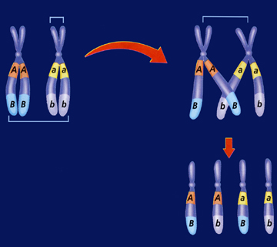
Semester 1 Term 1 Biology Final Study Guide
Chapter 10 Mendel & Meiosis
Crossing over is the pairing of homologous chromosomes that break an exchange genetic information/ material during Prophase 1 of Meiosis, * Adds Genetic Recombination/ Variation to the species.
Crossing over
The result of crossing over is that new combinations of alleles on a chromosome that adds genetics variation/ recombination to a species.
A. Along the sides of a Punnett Square are the alleles or genotypes or gametes for a trait. Sex Cells – Egg or Sperm - Haploid
B. Zygote is a fertilized egg – 2n & Diploid
C. Offspring – the result of a fertilied egg – 2n – diploid
D. Homozygous – two alleles that are the same – AA or aa
E. If an organism has a genotype Bb, then they are hybrid or Heterozygous.

Slide 3
F. Heredity is the term for the passing on of traits/ genes from parents to offspring.
g. Diploid – a cell with 2 sets/ copies of chromosomes – One from mom & one from Dad.
H. Haploid – a cell with 1 set/ copy of chromosomes from mom or dad.
Allele – letter that represents a trait or gene. A or a
j. Gene – located on chromosomes, inherited from parents, and are traits.

Slide 4
Mendel’s 1st law is the Law of Segregation, how the alleles separate during Meiosis. Monohybrid Cross
Mendel’s 2nd Law of Independent assortment “In Meiosis, the way in which a chromosome pair separates does not effect the way other pairs separate” is another way of expressing Mendel’s Law of Independent Assortment.
A gamete has only one allele for each trait - Haploid

Slide 5
8. Zygote has 2 alleles for each trait – Diploid
9.An adult human has 2 alleles for each trait – Diploid.
10. A person’s genotype is determined by punnett square.
11. A person’s phenotype is determined by looking at it.
12. P – Pointy Ears; p – Floppy
a. Heterozygous – Pp
b.
c.PP 25% Pointy d.Pp 50% Pointy e. pp 25% Floppy
d. 75% Pointy Ears
e. 25% Floppy Ears
 | P | p
P | PP - Pointy | Pp - Pointy
p | Pp – Pointy | pp-Floppy

Slide 6
13. Smallest –nucleotide, DNA, Chromosome, nucleus, Cell, organism
14. Macromolecules – Proteins (Amino Acids), Lipids (Fatty Acids), Carbohydrates (Saccharides), Nucleic Acids (Nucleotides)
15. The basic function of an enzyme is to speed up a reaction by lowing the activation energy of a chemical reaction, without being used up in the process. There is a specific enzyme for every reaction based on the active site. pH, Temp. & [Substrate]

Slide 7
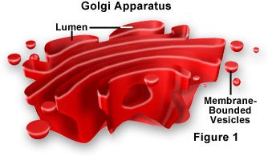
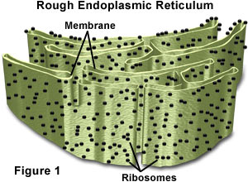
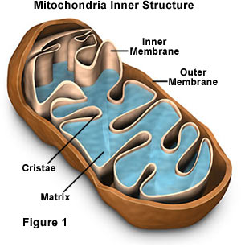
16. An enzyme is a protein. 17. Enzymes in general work better at high temperatures than at low temperatures because at high temperatures the molecules move faster. 18. When a Protein denatures, it loses it’s structure which means it will no longer function. If an enzymes shape changes, it’s active site no longer functions. 19. Cell walls 20. Folded Membranes increase the surface area and therefore allow for more chemical reaction to happen, small compartments can form increasing the rate of chemical reactions. 21. More Chemical reactions can happen when there is more surface area.

Slide 8
22. Eukaryotic
Nucleus
More complicated
Animal & Plant Cells
Prokaryotic Always has a cell wall
DNA Floats in Cytoplasm
Building Blocks for Life
These Cells are Bacteria
Both
Cell Membrane is present

Slide 9
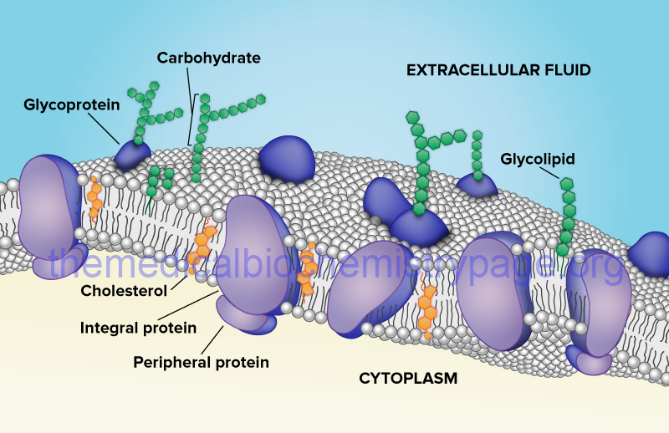
23. Selectively Permeability or semi permeable are the same and mean that some molecules can pass through the plasma membrane and others can’t.
The plasma membrane is made of Phospholipid Bilayer.
fsjkfjdlk
Jfsdfjsl
photosynthesis,
Chloroplasts, Chlorophyll

Slide 10
 | Photosynthesis | Cellular Respiration
Organelles | Chloroplast | Mitochondria Cytoplasm
Location | Chlorophyll
Reactants | CO₂, H₂O & Sun | O₂ & C₆H₁₂O₆
Products | O₂ & Glucose | CO₂ & H₂O & ATP & Heat
Organisms | Plant | Animal & Plant
28.
29. A – T ; G – C
30. Backbone:DNA= Deoxyribose Sugar & Phosphate
RNA: Ribose & Phosphate

Slide 11
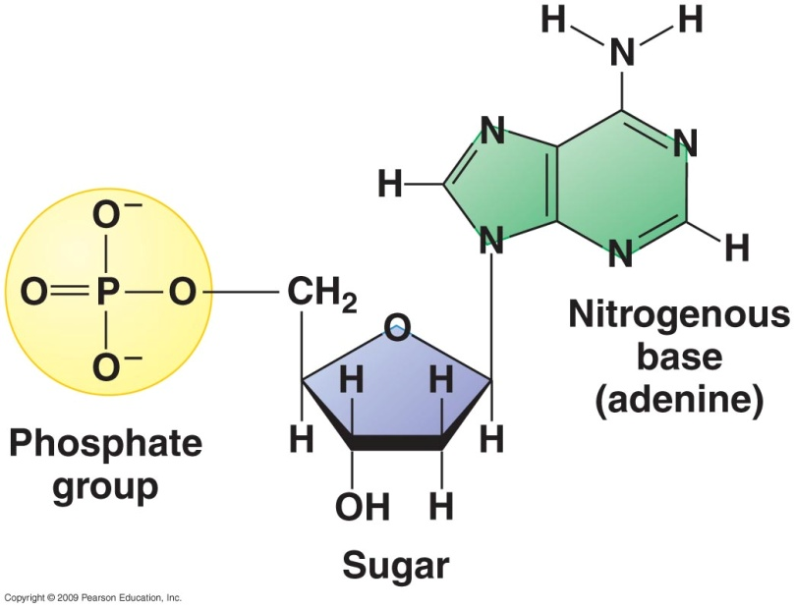
31. DNA Replication = Semi Conservative Replication
Step 1 Enzymes unzip DNA strands
Step 2: Free Nucleotides Match up
Step 3: Backbone is formed
Step 4: Enzymes rezip and 2 replicated DNA are Formed
32.Nucleotide – sub unit of DNA
33. mRNA – DNA instructions to
The Ribosome
tRNA – transfer AA to the Ribosome
rRNA – assemble the Amino Acids

Slide 12
34. Two types of mutations are Point & Frameshift. Point mutation – one nucleotide base is exchanged for the incorrect one. The result is one Amino Acid is changed. Frameshift mutation the complete nucleotide is deleted or added, resulting in every amino acid changing after that deletion or addition. Frameshift is much worse. AATTAGAAATAG is a Frame Shift mutation to make: ATTAGAAATAG.

Slide 13
35. (37) Lysosomes: contain digestive enzymes in animal cells
Golgi – tubular compartments that package and transport proteins.
Mitochondria – the energy transforming organelle responsible for parts of Cellular Respiration in Plants & animals
Chloroplasts-organelle in plants that converts light energy into chemical energy
Nucleus – eukaryotic cells of plants, animals, fungi, and protists that control the cells functions.

Slide 14
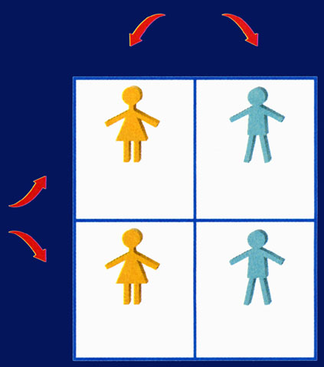
36.(35.) Codons code for 20 amino acids. The different combinations of nucleotides can make 64 different codons for those 20 amino acids. There can be an infinite amount of different Proteins due to the fact that amino acids can be in any order or any length.
37. (36.) A piece of DNA is: TAC CCA AAT TCC AAA ATT
mRNA: AUG GGU UUA AGG UUU UAA
The Amino Acid String: Methionine; Glycine; Leucine; Arginine; Phenoalanine; Stop
38. (37.)XX – Female 2/4 = 50%
XY – Male 2/4 = 50%
XY Male
XX Female

Slide 15
39. (38.) You could not control the variation in the radish seeds.
40. (39.) DNA is a Double Helix
41. (40.) Genetic Engineering includes:
Putting DNA from on thing into another ( making “transgenic” organisms.
Cloning
Deciding the sex of your children
Making corn that will grow better and is resistant to pesticides.
42. (41.) This process is Meiosis
The four steps are: DNA replicates during Interphase (Diploid)
Then during Prophase 1 – Crossing Over occurs (Genetic Recombination) (Diploid), Two daughter cells are produced after the first division. (Diploid), After the Second Division 4 (Haploid) gamete cells ( eggs or sperm) are produced.

