Slide 1
Color Changing Milk Lab (pg. 39 in NB) “Every time I eat food coloring, I dye a little inside”
Materials:
Plate, Milk, Food Coloring, Q-tips, & dish soap.
Procedure:
Pour enough milk onto the plate to just cover the bottom completely.
Add food coloring using 4-5 drops for each spot.
Take a Q-tip and dip it soap.
Gently place Q tip, soap side down, into the milk & food coloring mixture. Make observations.
Keep the Q-tip in mixture until movement stops.
Be sure to record your work for this lab in your new, handy dandy, Experimental Design Graphical Organizer!
You may use your phones to take pictures of the color changing milk if you wish.

Slide 2
Warm Up 02/16 Obj: TSW make observations & develop an experiment in order to explain what was observed in the Color Changing Milk Demo.(pg. 40 NB)
Write down 3 things you observed from the Color Changing Milk Demo.

Slide 3
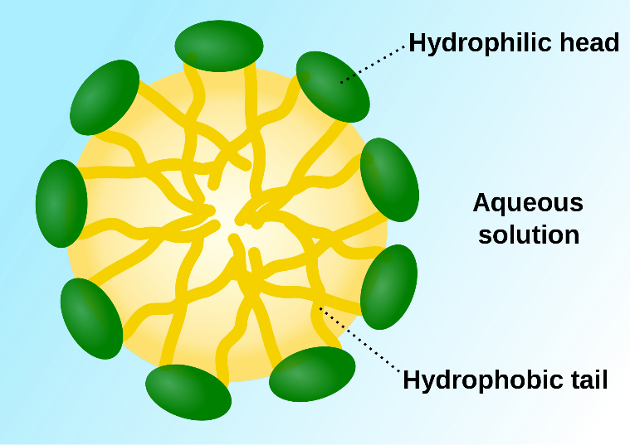
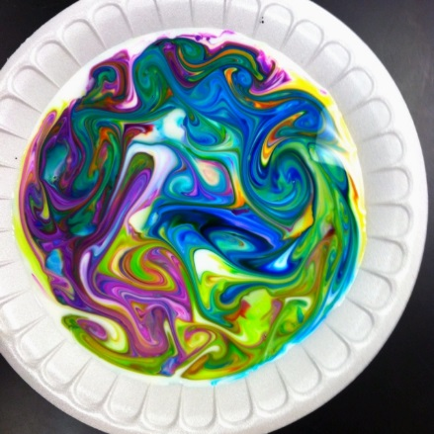
Reflection Milk Lab: The structure of a biomolecule will help determines its properties and functions. P. 41NB
Yesterday in the Milk Lab, you noticed movement of the food coloring when you placed the soap covered Q-tip into the milk.
What is milk made of?
From what you know about our Bio/macromolecules, which ones does milk have?
Do oil and water mix?
How can this help explain the movement of the colored dye in the milk?

Slide 4
02/17 Biomolecules CH 6.3 Obj. TSW analyze the similarities and differences between the 4 types of Biomolecules. P. 42 NB
What elements make up each of the 4 Biomolecules?
How do cells use each of the Biomolecules?
What biomolecules are in milk?

