Slide 1
Biology UNIT Genetic Inheritance
October 19th – October 30th
March 27th – March 31st

Slide 2
Female Karyotype
*Karyotype: the complete set of chromosome in the cells of an organism

Slide 3
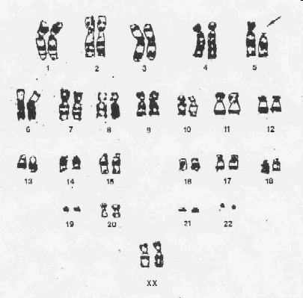
*Homologous chromosomes: there are two copies of each chromosome; same size, same shape, same genes
Each pair is known as homologous chromosomes p. 73NB

Slide 4
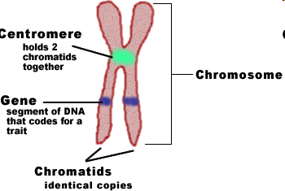
Draw this Diagram P. 73NB

Slide 5
Actual Stained Chromosome

Slide 6
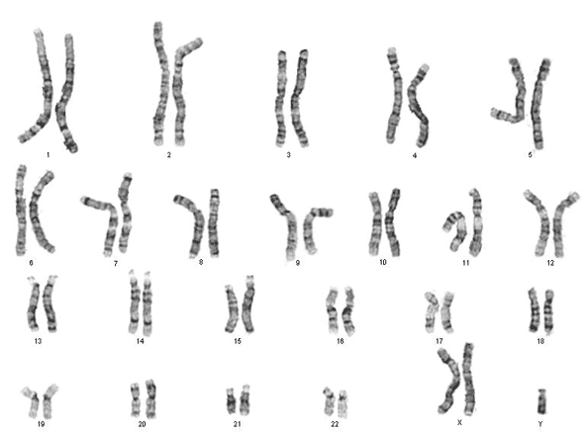
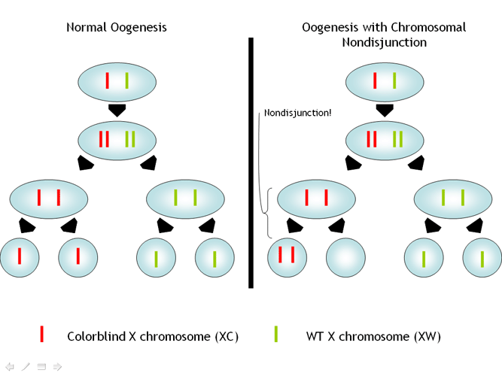
Klinefelter’s Syndrome - XXY
A condition in which males have an extra X sex chromosome
the most common sex chromosome disorder
the second most common condition caused by the presence of extra chromosomes.
1 out of every 1000 males.
1 out of every 500 has an extra X chromosome but does not have the syndrome
Symptoms: almost always infertile, smaller testicles, some neurophysiological deficits, long lanky build, more severe cases have breast tissue and osteoporosis
Treatment: usually just testosterone

Slide 7
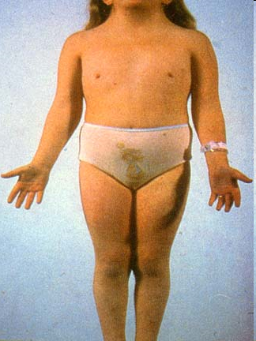
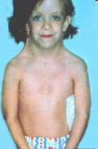
Turner Syndrome
When a female is missing all or part of one of the X chromosomes (X0)
1 out of every 2500 girls are affected
Symptoms: short stature, swelling broad chest, low hairline, low set ears, webbed necks, gonadal dysfunction, sterility
High risk of: congenital heart disease, diabetes, vision problems, hearing problems

Slide 8
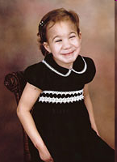
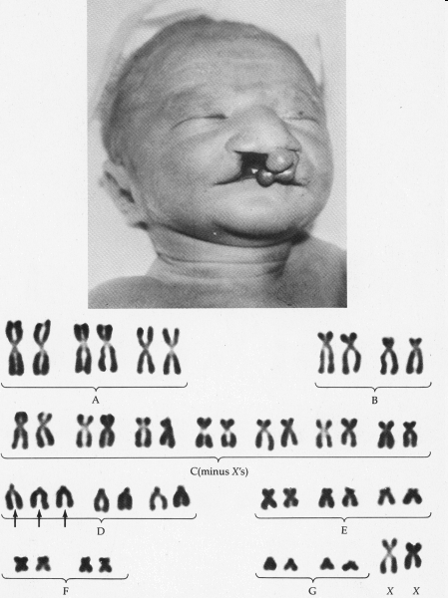
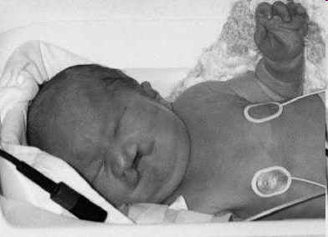
Patau’s Syndrome
also known as trisomy 13, a syndrome in which a patient has an additional chromosome 13 due to a nondisjunction of chromosomes during meiosis.
Affects 1 in 25,000 live births; risk increases with age of female pregnancy
Causes heart and kidney defects, mental and motor challenged, extra digits, low set ears, structural eye defects, abnormal genetalia

Slide 9
XYY Syndrome
Most often, the extra Y chromosome causes no unusual physical features or medical problems.
boys have an increased growth velocity during earliest childhood, with an average final height approximately 7 cm above expected final height.
1 in 1000 boys affected
Increased learning disabilities, delayed speech/language skills, behavioral problems such as anger/agression

Slide 10
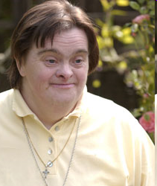
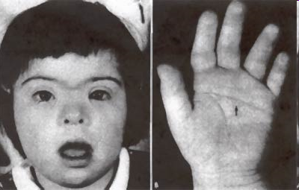
Down’s Syndrome
Down's syndrome AKA trisomy 21, or trisomy G is a chromosomal disorder caused by the presence of all or part of an extra 21st chromosome.
1 out of 1000 births are affected
Small chin, round face, oversized tongue, shorter limbs, poor muscle tone, ear infections, heart defects,

Slide 11
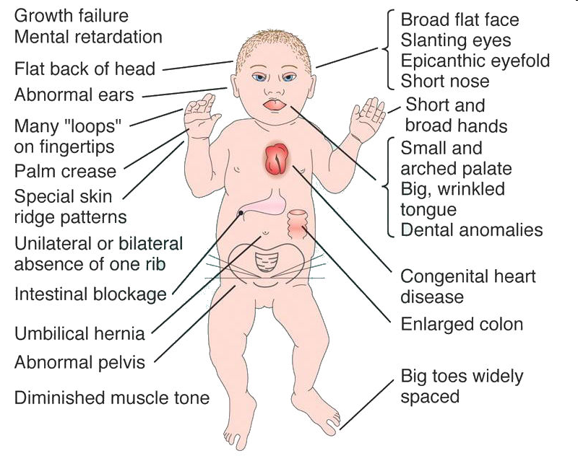

Slide 12
Triple X Syndrome
a form of chromosomal variation characterized by the presence of an extra X chromosome in each cell of a human female.
1 in 1000 births
only one X chromosome is active at any time in a female cell. Thus, triple X syndrome most often causes no unusual physical features or medical problems.
Females with the condition may have menstrual irregularities, and, have an increased risk of learning disabilities, delayed speech, deficient language skills, and delayed development of motor skills.

Slide 13
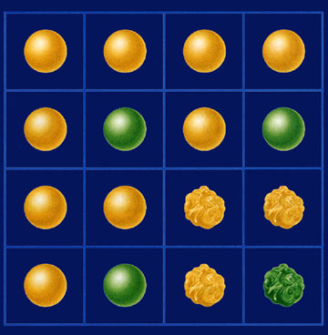
Section 10.1 Summary – pages 253-262
The law of independent assortment
2. Mendel’s second law states that genes for different traits—for example, seed shape and seed color—are inherited independently of each other.
This conclusion is known as the law of independent assortment.

Slide 14
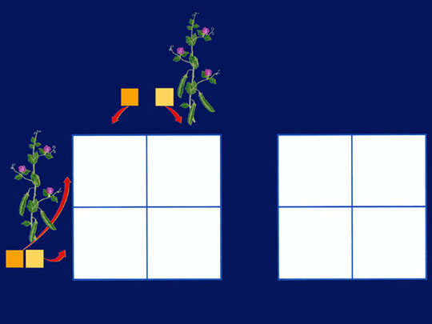
Section 10.1 Summary – pages 253-262
Monohybrid crosses
A Punnett square for this cross is two boxes tall and two boxes wide because each parent can produce two kinds of gametes for this trait.
Heterozygous
tall parent
T
t
T
t
T
t
T
T
TT
Tt
t
t
Tt
tt
T
t
Heterozygous
tall parent

Slide 15
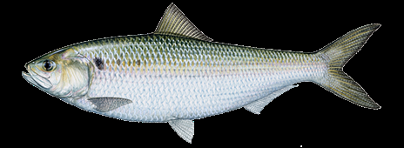
Frankenfish Activity Due by the end of the class, turn in for credit
Materials:
Have a partner, a piece of White paper, a penny, and colored pencils
Procedure:
For each Trait flip two pennies.
Heads/ Heads, Both Big Letters = BB
Heads/ Tails, Hybrid Letters = Bb
Tails/ Tails, Both Small Letters = bb
3. Draw the appropriate shape for that trait according to the genotype.
4. Where does your fish live? What does it eat? What is unique to your fish?
5.What was your favorite genotype, and phenotype?

Slide 16
Chromosomes & Inheritance p. 13NB
Do to http://learn.genetics.utah.edu/
Click on chromosomes & Inheritance
Click on Make a Karyotype Write the sex of the offspring & how you know.
Click on Using Kayotypes to detect genetic disorders.
After reading the page, write a summary that includes Homologous Chromosome, Autosomes, Sex Chromosomes, and Karyotype.
How can Karyotypes be used to diagnose genetic disorders?

Slide 17
Section 10.1 Summary – pages 253-262
Phenotypes and Genotypes
An organism is homozygous for a trait if its two alleles for the trait are the same. RR,ss, HH
The true-breeding tall plant that had two alleles for tallness (TT) would be homozygous for the trait of height.

Slide 18
Section 10.1 Summary – pages 253-262
Phenotypes and Genotypes
An organism is heterozygous for a trait if its two alleles for the trait differ from each other. Tt, Ss, XY
Therefore, the tall plant that had one allele for tallness and one allele for shortness (Tt) is heterozygous for the trait of height.
Hybrid - Mm

Slide 19
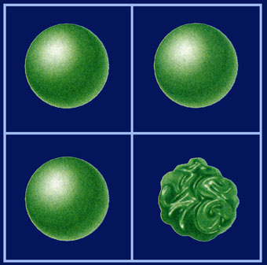
Section 10.1 Summary – pages 253-262
Probability
R
r
The Punnett square shows three plants with round seeds out of four total plants, so the probability is ³/4.
RR
Rr
R
Rr
rr
r

Slide 20
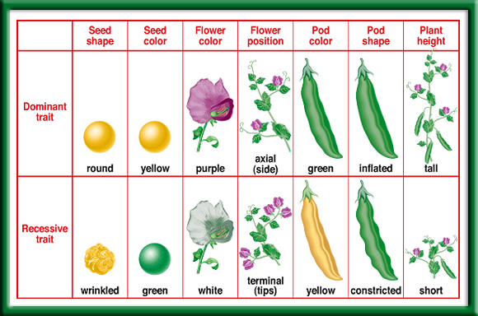
Complete Dominance
– the Dominant completely masks the recessive, only 2 versions of a trait.
Mendel’s Seven Pea Traits
What would be appropriate alleles to use for each trait?
To return to the chapter summary click escape or close this document.

Slide 21
Punnett Square Practice Activity p.265 Biology Book
Make 7 Punnett square boxes on P.77
Choose different genotypes for each of the different Pea Traits and perform Punnett square crosses with different compbinations of genotypes.
Write to the side the % probability of the Homozygous Recessive, Heterozygous, Homozygous Dominant

Slide 22
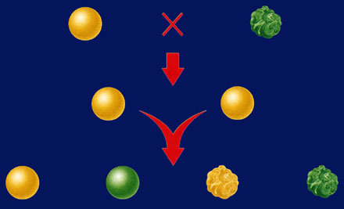
Section 10.1 Summary – pages 253-262
The first generation
Dihybrid Cross
round yellow x wrinkled green
P1
Round yellow
Wrinkled green
F1
All round yellow
F2
9
3
3
1
Round yellow
Round green
Wrinkled yellow
Wrinkled green

Slide 23
Section 10.1 Summary – pages 253-262
Punnett Square of Dihybrid Cross
Dihybrid crosses
Gametes from RrYy parent
RY
Ry
rY
ry
RRYY
RRYy
RrYY
RrYy
A Punnett square for a dihybrid cross will need to be four boxes on each side for a total of 16 boxes.
RY
RRYy
RRYy
RrYy
Rryy
Ry
Gametes from RrYy parent
RrYY
RrYy
rrYY
rrYy
rY
RrYy
Rryy
rrYy
rryy
ry

Slide 24
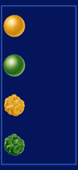
Section 10.1 Summary – pages 253-262
Punnett Square of Dihybrid Cross
Dihybrid crosses
Gametes from RrYy parent
RY
Ry
rY
ry
RRYY
RRYy
RrYY
RrYy
RY
F1 cross: RrYy ´ RrYy
RRYy
RRYy
RrYy
Rryy
Ry
round
yellow
Gametes from RrYy parent
RrYY
RrYy
rrYY
rrYy
round
green
rY
wrinkled
yellow
RrYy
Rryy
rrYy
rryy
ry
wrinkled
green

Slide 25
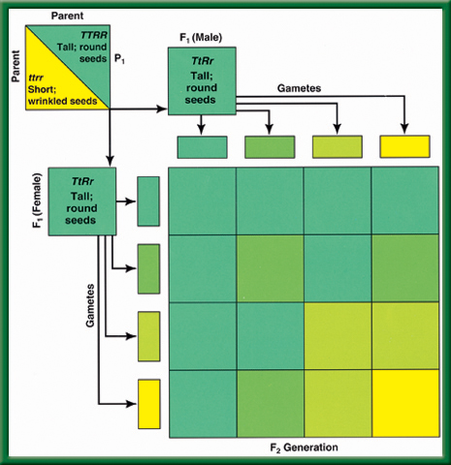
P. 25NB
Use ¾ of paper, ¼ to write an AXES paragraph
Law of Independent Assortment
Dihybrid
Cross

Slide 26
Meiosis – Gamete Formation Activity with beads. Simulate the process of Meiosis with a partner. Show us your simulation. Explain in your notebook page 29 Chapter 10 BB How does Meiosis add genetic variation to the population? Use these words: gamete, sex cell, haploid, homologous chromosomes, division, egg or sperm cell. DRAW your Gametes formed from Meiosis with 2 different colors.
.
Mitosis vs. Meiosis video demonstration

Slide 27
Mitosis vs Meiosis P. 27 NB
Somatic Cell (Body Cell)
2N (Diploid)
46 Chromosomes
1 Division
Produces 2 identical cells, same as the parent cell
Gametes (Sex Cell)
2N -> 1N (Haploid)
23 Chromosomes
2 Divisions
Produces 4 Haploid cells, all different from each other and the parent cells. (Crossing Over)
Increases Genetic Variation

Slide 28
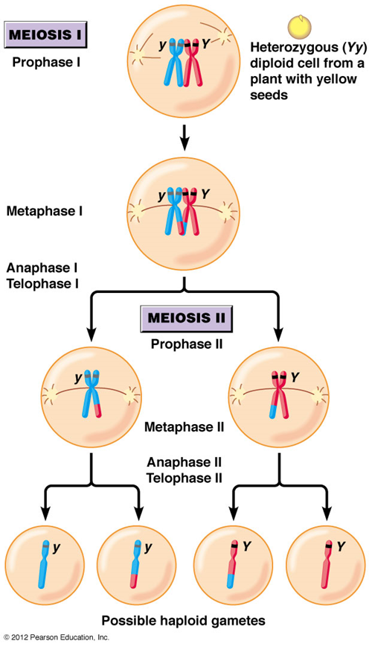
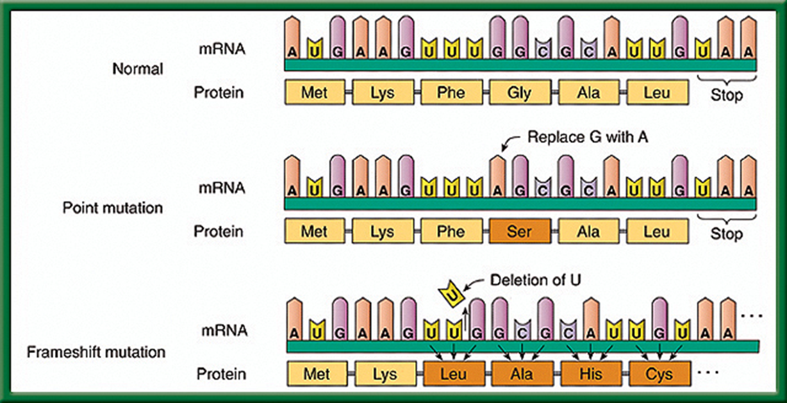
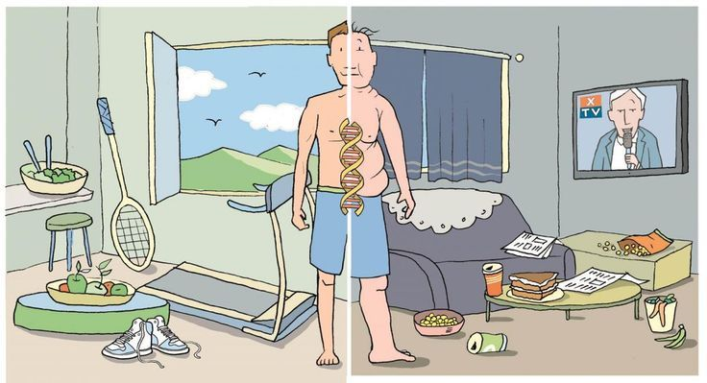
Genetic Variation P. 37 NB How and When does it happen?
Mutations during DNA Replication
Crossing Over Meiosis
Mutations influenced by the environment

Slide 29
Date | Title/ Topic | Page
10/19 | WU – Chromosomes CH 10.1 | 8
10/19 | Activity: Human Traits Checklist | 9
10/21 | WU – Mendel’s Two Laws CH 10.1 | 10
10/20 | HW – 1 page Notes CH 10 Notes: GATTACA | 11
10/22 | WU – Meiosis CH 10.2 | 12
10/22 | Karyotyping & Punnett Square Practice | 13
10/23 | WU – Genetic Inheritance CH 10.1 – 10.2 | 14
10/22 QUIZ | Concept Map: Mendel & Meiosis w/ summary Meiosis Paragraph from Meiosis Bead Activity | Notebook Check P. 8 – 15 (40 points)

Slide 30
Genetic Inheritance Why are there different Blood Types?
Week 12

Slide 31
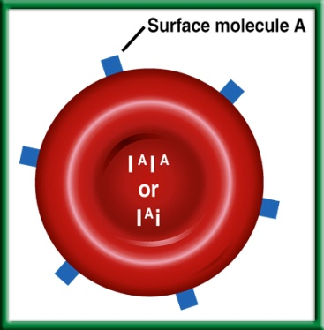
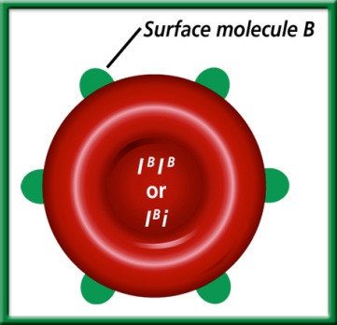
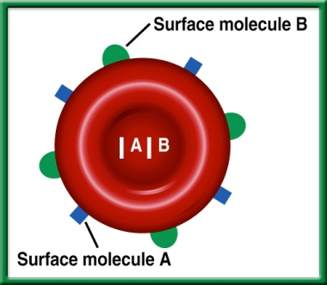
3/24 Modes of Inheritance: Multiple Allelic CH 12 Obj. TSW learn how different traits are inherited in the body. P. 86NB
What are the 6 genotypes for blood?
What are the 4 phenotypes for blood?
Do a punnett square cross between two heterozygotes for A Blood and B blood.
Blood Typing Game

Slide 32
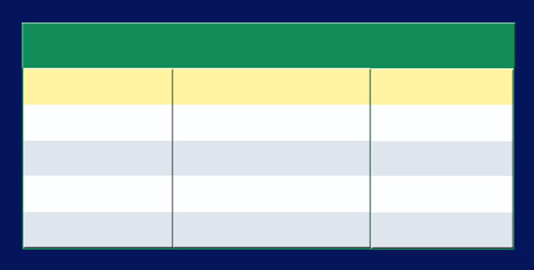
Section 12.3 Summary – pages 323 - 329
Multiple Alleles Govern Blood Type
Answers #1 & 2
Human Blood Types
Genotypes
Surface Molecules
Phenotypes
l^{A} l^{A} or l^{A}i
A
A
l^{B} l^{B} or l^{B}i
B
B
l^{A} l^{B}
A and B
AB
ii
None
O

Slide 33
Genotypes: Phenotypes: Probability of A Blood? B Blood? AB Blood? O Blood?
Question #3.
 | I^{A} | i
I^{B} | I^{A}I^{B} | I^{B}i
i | I^{A}i | ii

Slide 34
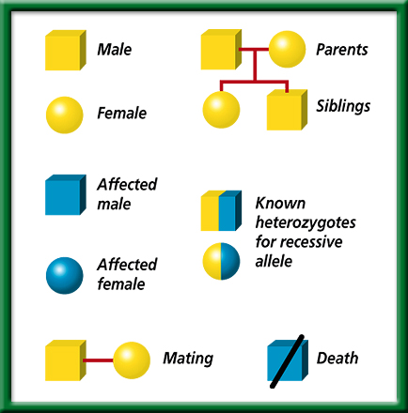
Pedigree P. 309
Symbols
Used by
Geneticists
To return to the chapter summary click escape or close this document.

Slide 35
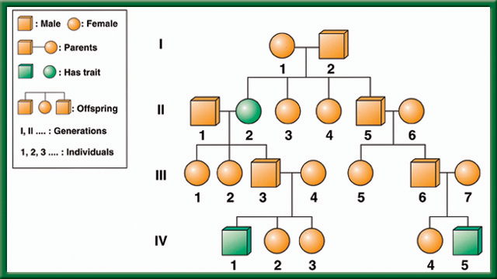
What is the Mode of Inheritance? Dominant/ Recessive? Autosomal or Sex-Linked?
To return to the chapter summary click escape or close this document.

Slide 36
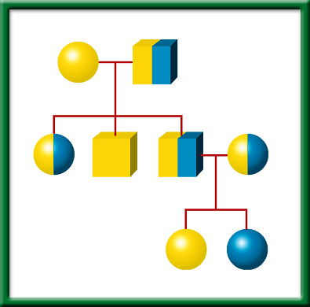
Who is affected?
What generation?
What does it mean to only be shaded ½ way?
What Does the Punnett Square look like for Person 3 & 4 of Generation II?
Simple
Pedigree
To return to the chapter summary click escape or close this document.

Slide 37
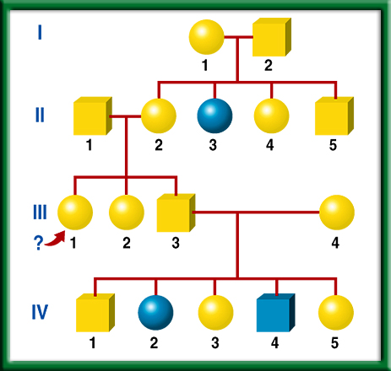
Fictional
Pedigree
To return to the chapter summary click escape or close this document.

Slide 38
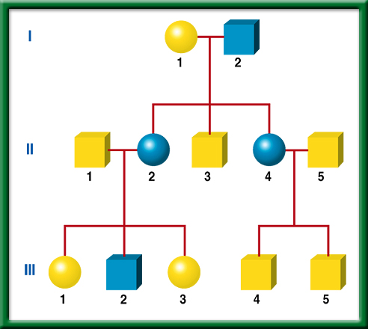
What is the Mode of Inheritance? Dominant/ Recessive? Autosomal or Sex-Linked?
Pedigree-
Huntington
Disease
To return to the chapter summary click escape or close this document.

Slide 39
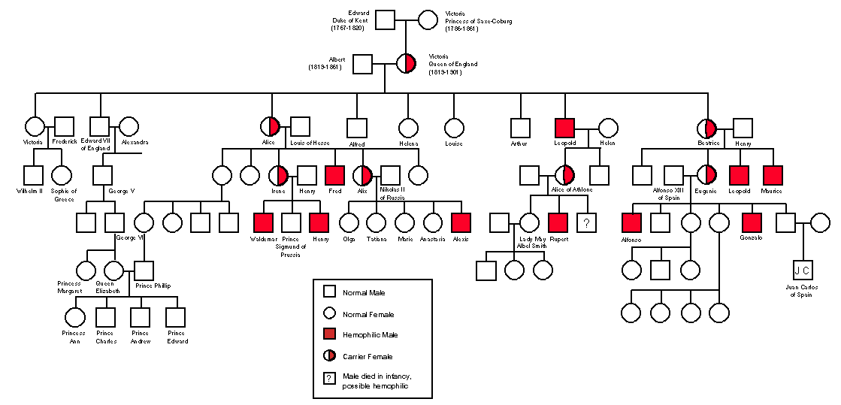
Who is affected?
Who are the carriers?
Dominant or recessive?
Autosomal or Sex Linked?
Draw the Punnett Square for a mom who is a carrier, and an unaffected father.

Slide 40
Genetic Inheritance Notes P. 31 NB
1.Homozygous: when identical alleles of the gene are present on both chromosomes
Said to be true breeding
Homo means same
Can be homozygous recessive (bb) or homozygous dominant (BB)
Heterozygous: when two different alleles occupy the gene's position on the chromosomes
Heterozygous: Bb
2. Crossing Over adds genetic variation to the species. It is an example of Genetic Recombination and happens during Prophase 1 of Meiosis.
3. Haploid Cells are the gametes, Egg & Sperm Cells. They have 1 set of chromosomes from mom or dad.
Diploid Cells are the Body Cells, heart, muscle cells. They have 2 sets of chromosomes from Mom & Dad.

Slide 41
P. 29 NB
4 Sentence Summary
Tay – Sachs Disease
Recessive allele
Phenylketonuria
Dominant allele
Lungs & pancreas
Central Nervous System
Cystic Fibrosis
DRAW a Punnett Square showing from one of these 4 diseases with parents that are Heterozygous for the trait.

Slide 42
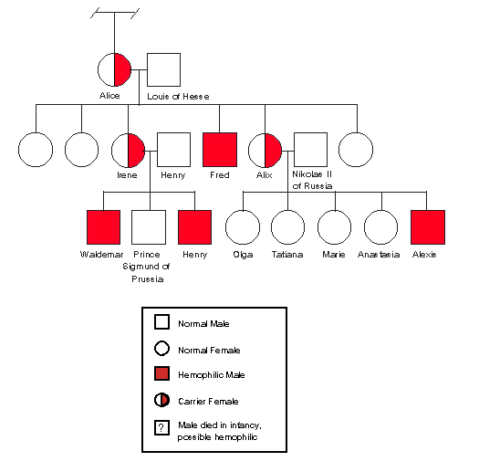
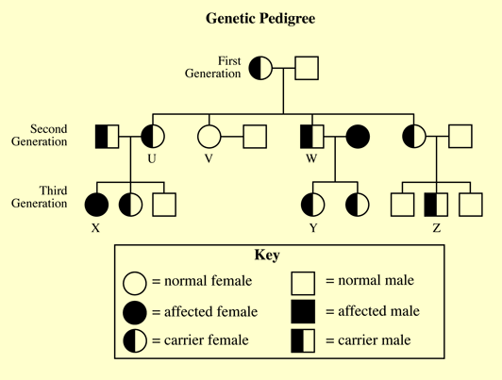
03/31 Pedigrees 12.1 Obj. TSW determine the mode of inheritance of a trait by examining a pedigree in a partner pedigree project. P.26 NB
Identify and explain the Mode of Inheritance for each of these three pedigrees. State whether they are:
Dominant or Recessive
Autosomal or Sex – Linked
Genetic Counseling https://www.youtube.com/watch?v=Li4IpVF50-o
Pedigree 1
Pedigree 3
Pedigree 2

Slide 43
Guided Practice Family Pedigree p. 33 NB Right or Left Handedness
Show 3 Generations
Include at least 12 individuals
Show only 1 trait – Autosomal (one of the Human Traits checklist)
Show the key of what the traits are (Shade affected Individuals)
Show affected individuals with the trait (color)
Label Autosomal or Sex-linked
Label Dominant or Recessive
Write Genotypes

Slide 44
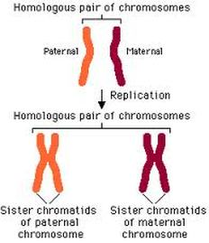
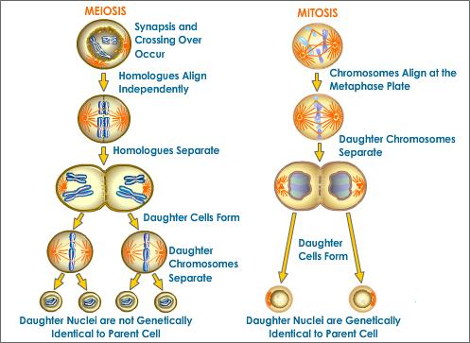
4/3 Genetic Inheritance 10.1 & 10.2 Obj. TSW demonstrate understanding of homologous chromosomes Mendel’s laws, Mitosis & Meiosis by doing a concept map and a foldable. p. 28 NB
http://www.cde.ca.gov/ta/tg/sr/documents/cstrtqbiology.pdf
Compare & Contrast Homozygous and Heterozygous genotypes.
Explain what crossing over is during Meiosis and why it is important?
Compare & Contrast haploid and diploid cells.
HW Read CH 12
1 page Notes
Page 25 NB

Slide 45
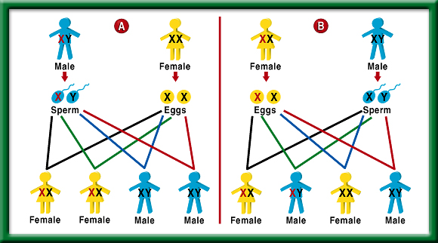
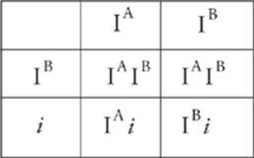
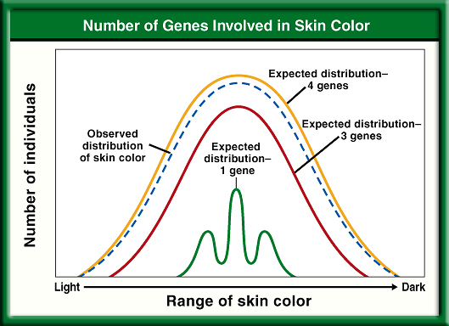
4/4 Complex & Polygenic Inheritance 12.3 Obj. TSW predict possible combinations of alleles in a zygote from the genetic makeup of the parents during classroom activities. P.30 NB
Determine the possible blood types of the children of parents that both have type AB.
Explain why a male with a recessive X – linked trait usually produces no female offspring with the trait. Show the Punnett Square.
Explain polygenic inheritance. Give an example. Draw the graph below.

Slide 47
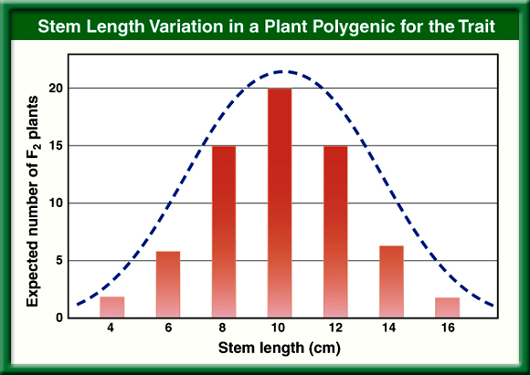
Stem Length Variation in Plants
To return to the chapter summary click escape or close this document.

Slide 48
Number of
Genes
Involved in
Skin Color
To return to the chapter summary click escape or close this document.

Slide 49
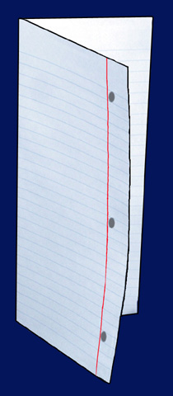
Fold a vertical sheet of notebook paper from side to side.
To return to the chapter summary click escape or close this document.

Slide 50
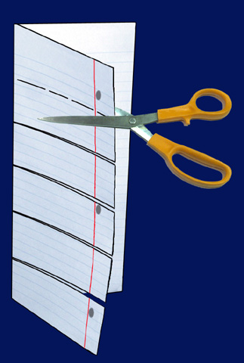
Cut along every fifth line of only the top layer to form tabs.
To return to the chapter summary click escape or close this document.

Slide 51
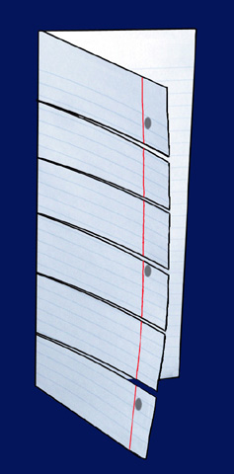
Explain how the traits are inherited by giving an
example of a punnett square for each.
Make sure you write the key for the genotypes.
Label each tab.
Modes of Inheritance
P. 83 NB
Complete Dominance
Incomplete Dominance
Codominance
Sex Determination
Sex - Linked
Multiple Allelic
To return to the chapter summary click escape or close this document.

Slide 53
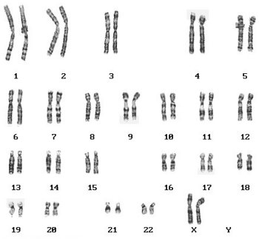
Genetic Inheritance Review
Draw a Chromosome and label a trait.
Draw a Punnett Square
Write the genotype XX for Mom
Write the genotype XY for Dad
Complete the Punnett square
What is the Probability of having a girl?
Write the gamete for mom
Write the gamete for dad
Explain what a zygote is, draw a picture if you need to.
Examine the Karyotype above, Is it a girl or a boy, How do you know?

Slide 54
Practice Karyotype learn.genetics.utah.edu

Slide 55
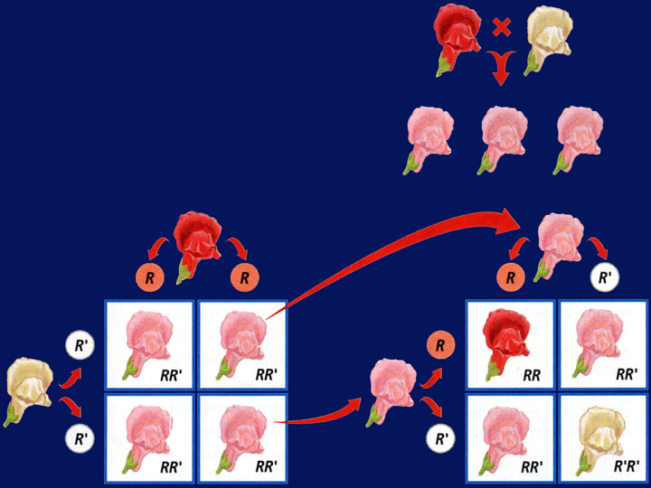
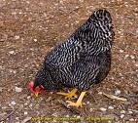
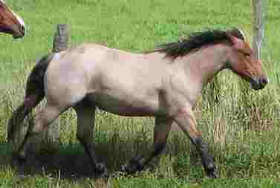
4/6 Incomplete Dominance & Codominance 12.2 Obj. TSW demonstrate understanding of Pedigrees by finishing the study guide. P.34 NB
Draw a Punnett square and explain how incomplete dominance is inherited in Snap Dragon flowers.
Draw a Punnett square and explain how Codominance is inherited in Checkered chickens.
What color would the chicken be if feather color were inherited by incomplete dominance?

Slide 56
TABOO
Dominant
Allele
Heterozygous
Phenotype
Karoytype
Pure – Breeding

Slide 57
TABOO
Recessive
Genotype
Homozygous
Zygote
Chromosome
Hybrid

Slide 58
TABOO
Probability
Haploid
Offspring
Ratio
DNA
Meiosis

Slide 59
TABOO
Diploid
Punnett Square
Mitosis
Protein
Gametes
Homologous Chromosomes

Slide 60
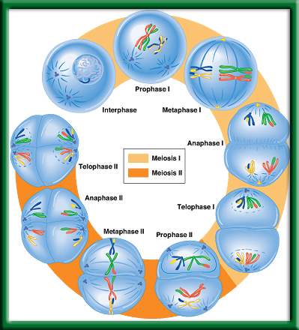
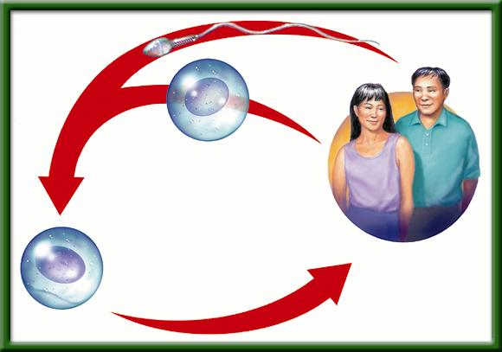
3/21 Genetic Inheritance 10.1 & 10.2 Obj. TSW demonstrate understanding of genetic inheritance by doing well on the mendelian genetics quiz. P. 84NB
Draw the process of Meiosis (P.267BB) and explain it’s purpose.
Explain and draw fertilization using an egg (n) & sperm (n).
Using a Punnett Square, show how sex determination is 50%.

Slide 61
For every question you missed…
Write 1 sentence: Why is the right answer right?
Write 1 sentence: What was wrong about your answer?
Staple to your quiz. Turn in.
Finish your Study guide – due tomorrow.

Slide 62
Rules
BE in your assigned seat when the bell rings, or you will be marked tardy with your Biology Book and Notebook out and ready to learn.
Cell Phone are off and away.
Ear buds are out, not listening to music.
You are responsible for your learning, stop copying off f the “smarter students” or waiting for me to show you the answers.
You will be graded for your role & your work when working in partners. The project may be a 10/10, but your grade may be a 2/10 if you did not do your part for the project.

Slide 63
4/6 Patterns of Heredity & Human Genetics 12.1 – 12.3 Obj. TSW discover how multiple alleles are inherited by doing their warm up and competing a Foldable. P. 34
Write all the symbols used for a pedigree. Draw a pedigree of just your mom & dad and any siblings. (Youngest to the left)
Compare & contrast Incomplete Dominance and Codominance.
Write the 6 genotypes for the 4 phenotypes for blood. Make a Punnett square with two crosses.

Slide 65
Section 12.2 Summary – pages 315 - 322
Incomplete dominance: Appearance of a third phenotype p. 77NB
When inheritance follows a pattern of dominance, heterozygous and homozygous dominant individuals both have the same phenotype.
When traits are inherited in an incomplete dominance pattern, however, the phenotype of heterozygous individuals is intermediate between those of the two homozygotes.

Slide 66
Section 12.2 Summary – pages 315 - 322
Incomplete dominance: Appearance of a third phenotype
For example, if a homozygous red-flowered snapdragon plant (RR) is crossed with a homozygous white-flowered snapdragon plant (R′ R′), all of the F₁ offspring will have pink flowers.

Slide 68
Section 12.2 Summary – pages 315 - 322
Incomplete dominance: Appearance of a third phenotype
Red
White
All pink
Red (RR)
Pink (RR’)
White (R’R’)
Pink (RR’)
All pink flowers
1 red: 2 pink: 1 white

Slide 69
Section 12.2 Summary – pages 315 - 322
Sex-linked inheritance
White-eyed male (X^{r}Y)
F₂
Females:
Red-eyed female (X^{R}X^{R})
all red eyed
Males:
1/2 red eyed
1/2 white eyed
F₁ All red eyed

Slide 70
Section 12.2 Summary – pages 315 - 322
Codominance: Expression of both alleles
Codominant alleles cause the phenotypes of both homozygotes to be produced in heterozygous individuals. In codominance, both alleles are expressed equally.

Slide 71
Roles for Genetics Counselor Letter Test
Letter Writer
Write the ½ - 1 page letter citing evidence from the family history & pedigree. Explain how you know the affected person may or may not have the disease and how you know it is Dominant or Recessive; Autosomal or Sex-linked.
Pedigree Developer
Create the Pedigree, Key, State whether Tay Sachs is Dominant or Recessive; Autosomal or Sex-Linked
Write the genotypes for the family members.
Write your name on your part of the test.

Slide 72
Karyotyping Chromosomes P. 81NB P.329 BB
How many chromosomes are present in Spread #1? 46 Spread#2 46 Spread #3 46 Set A 47 Set B 47
Sperm 23 Chromosomes/egg 23 chromosomes
3 &4 Spread #1 Girl (XX) Spread #2 Boy(XY) Spread #3 Girl (XX) Spread A Boy (XY) Spread B Boy (XXY)
5 & 6. Yes, Spread A is Trisomy 21, Spread B is XXY Chr 23.
7. Possible Problems for Trisomy 21- Down’s Syndrome, XXY is Kleinfelter’s Syndrome
8. In today’s medicine Karyotyping is used to determine the sex of the child and to see is there are abnormalities in the chromosomes.

Slide 73
Section 12.1 Summary – pages 309 - 314
Huntington’s disease
Huntington’s disease is a lethal genetic disorder caused by a rare dominant allele.
It results in a breakdown of certain areas of the brain.

Slide 74
Section 12.1 Summary – pages 309 - 314
Huntington’s disease
Ordinarily, a dominant allele with such severe effects would result in death before the affected individual could have children and pass the allele on to the next generation.
But because the onset of Huntington’s disease usually occurs between the ages of 30 and 50, an individual may already have had children before knowing whether he or she is affected.

Slide 75
Pedigree-
Tay Sachs
Disease
To return to the chapter summary click escape or close this document.

Slide 76
http://learn.genetics.utah.edu/ http://www.cde.ca.gov/ta/tg/sr/documents/cstrtqbiology.pdf Karyotyping Activity http://www.biology.arizona.edu/human_bio/activities/karyotyping/karyotyping.html
Heredity & Traits
Make a Karyotype
Using Karyotypes to predict genetic disorders
Genetic Disorders Library
Cystic Fibrosis
Down’s Syndrome
Huntington’s disease
Sickle Cell Anemia
PKU
Duchenne’s Muscular Dystrophy
Osteogenesis Imperfecta
Leukemia
Achondroplasia
CDE Website –2008 Biology Released Test Questions

Slide 77
Section 12.3 Summary – pages 323 - 329
Multiple Alleles Govern Blood Type
Human Blood Types
Genotypes
Surface Molecules
Phenotypes
l^{A} l^{A} or l^{A}i
A
A
l^{B} l^{B} or l^{B}i
B
B
l^{A} l^{B}
A and B
AB
ii
None
O

Slide 78
Section 12.2 Summary – pages 315 - 322
Multiple phenotypes from multiple alleles
Although each trait has only two alleles in the patterns of heredity you have studied thus far, it is common for more than two alleles to control a trait in a population.
Traits controlled by more than two alleles have multiple alleles.

Slide 79
Section 12.3 Summary – pages 323 - 329
The importance of blood typing
Determining blood type is necessary before a person can receive a blood transfusion because the red blood cells of incompatible blood types could clump together, causing death.

Slide 80
Section 12.3 Summary – pages 323 - 329
The ABO Blood Group
The gene for blood type, gene l, codes for a molecule that attaches to a membrane protein found on the surface of red blood cells.
The l^{A} and l^{B} alleles each code for a different molecule.
Your immune system recognizes the red blood cells as belonging to you. If cells with a different surface molecule enter your body, your immune system will attack them.

Slide 81
Section 12.3 Summary – pages 323 - 329
Phenotype A
Surface molecule A
The l^{A} allele is dominant to i, so inheriting either the l^{A}i alleles or the l^{A} l^{A} alleles from both parents will give you type A blood.
Surface molecule A is produced.

Slide 82
Section 12.3 Summary – pages 323 - 329
Phenotype B
Surface molecule B
The l^{B} allele is also dominant to i.
To have type B blood, you must inherit the l^{B} allele from one parent and either another l^{B} allele or the i allele from the other.
Surface molecule B is produced.

Slide 83
Section 12.3 Summary – pages 323 - 329
Phenotype AB
Surface molecule B
The l^{A} and l^{B} alleles are codominant.
This means that if you inherit the l^{A} allele from one parent and the l^{B} allele from the other, your red blood cells will produce both surface molecules and you will have type AB blood.
Surface molecule A

Slide 84
Section 12.3 Summary – pages 323 - 329
Phenotype O
The i allele is recessive and produces no surface molecules.
Therefore, if you are homozygous ii, your blood cells have no surface molecules and you have blood type O.

Slide 85
Question 2
According to the table, if you inherit the I^{A} allele from one parent and the I^{B} allele from the other parent, you will have type _______ blood.
Human Blood Types
A. A
C. AB
Genotypes
Surface Molecules
Phenotypes
l^{A} l^{A} or l^{A}i
A
A
l^{B} l^{B} or l^{B}i
B
B
B. B
D. O
l^{A} l^{B}
A and B
AB
ii
None
O
To return to the chapter summary click escape or close this document.
CA: Biology/Life Sciences 3a

Slide 86
The answer is C. The I^{A} and I^{B} alleles are codominant. Your red blood cells would produce both surface molecules and you would have type AB blood.
Human Blood Types
Genotypes
Surface Molecules
Phenotypes
l^{A} l^{A} or l^{A}i
A
A
l^{B} l^{B} or l^{B}i
B
B
l^{A} l^{B}
A and B
AB
ii
None
O
To return to the chapter summary click escape or close this document.
CA: Biology/Life Sciences 3a

Slide 87
Section 2 Check
Question 1
What is the difference between simple Mendelian inheritance and codominant inheritance?
CA: Biology/Life Sciences 3a

Slide 88
Section 2 Check
In Mendelian inheritance, heterozygous individuals will display the inherited dominant trait of the homozygotes. When traits are inherited in a codominant pattern the phenotypes of both homozygotes are displayed equally in the heterozygotes.
CA: Biology/Life Sciences 3a

Slide 89
Section 12.3 Summary – pages 323 - 329
Sickle-cell disease
The change in shape occurs in the body’s narrow capillaries after the hemoglobin delivers oxygen to the cells.
Normal red blood cell
Sickle cell

Slide 90
Section 12.3 Summary – pages 323 - 329
Sickle-cell disease
Abnormally shaped blood cells, slow blood flow, block small vessels, and result in tissue damage and pain.
Normal red blood cell
Sickle cell

Slide 91
Symbols
Used by
Geneticists
To return to the chapter summary click escape or close this document.

Slide 95
Pedigree
Chart
To return to the chapter summary click escape or close this document.

Slide 96
Classroom Family Pedigree
Work by yourself, with a partner or two other people.
Come up and get a Family Scenario of an Inherited Trait
Draw a Rough Family Pedigree on Binder paper, with affected people shaded, carriers half shaded, and unaffected not shaded. Include all names.
Include a Key showing all the possible combinations of the trait for each sex.
What is the Disease/ Trait? Give a definition.
Is the Disease/ Trait Dominant or Recessive?
Is the trait Autosomal or Sex – Linked?
Show all Genotypes

Slide 97
4/7 Complex Inheritance of Human Traits 12.3 Obj. TSW predict possible combinations of alleles in a zygote from the genetic make up of the parents by working on a pedigree. P.36 NB
Reading the Pedigree at the Right, Is this an autosomal or sex- linked disorder? How do you know?
Using the same pedigree, What would be the probability of the individual III-1 having a daughter that is a carrier, and a son inheriting the disorder?
Compare & Contrast Autosomes and Sex Chromosomes.

