Slide 1
Energy
Week 7

Slide 2
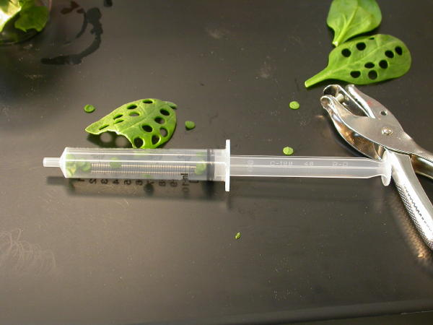
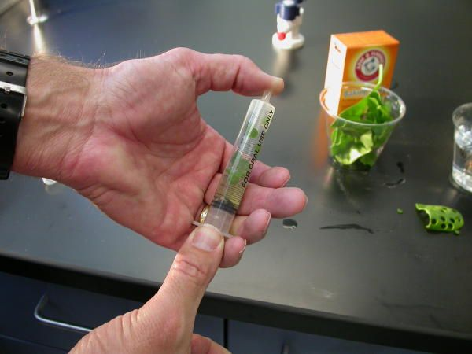
9/22 Floating Leaf Disk Assay Obj. TSW learn about how rate of photosynthesis is determined by light intensity and sodium bicarbonate. P. 58 NB
Read the lab procedure for Leaf Disk Lab. What is the purpose of the lab? What do we want to know/ learn?
What is the Independent Variable? What factor do we change to test whether photosynthesis is happening? What is the dependent Variable? What are we measuring?
What is the control group? What are we testing against?

Slide 3
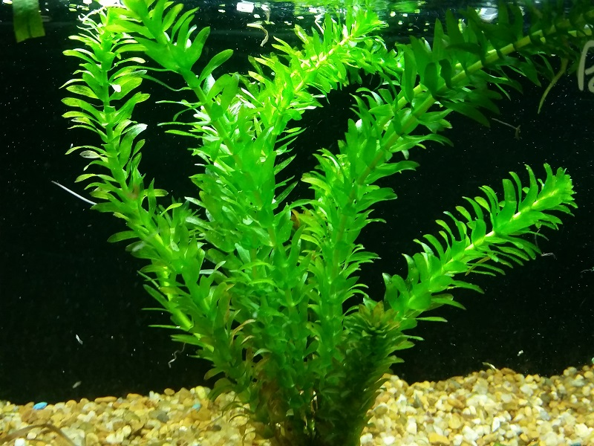
9/25 How is CO2 involved with plants? Obj. TSW watch a demonstration with Brom Thymol Blue and Anacharis plant P. 60 NB
Brom Thymol Blue is a indicator of pH (High – base 8 – 14; Low – acid 1 – 6 ). Diluted with water, it has a pH of 7. Describe what happens when someone blows into the beaker.
Notice the color change. Is the pH higher or lower now? What gas was blown into the test tube?
What do you predict will happen when an Anacharis plant is placed in the solution and placed under a light source? Will the BTB liquid turn back to blue? If so, why? What does the plant have to do with it?

Slide 4
Leaf Disk Assay Lab P. 57, 59, or 61NB
Hypothesis:
If I put 10 leaf disks (no O2) in a beaker with Sodium Bicarbonate then they will rise faster than just the water (control).
 | Sodium Bicarbonate # Floating Leaf disks | Water # of Floating Leaf disks
0 Minute | 0 | 0
5 Minutes
10 minutes
15 minutes
20 minutes
25 minute
35 minutes

Slide 5
Computer Lab Write Up for Leaf Disk Assay Lab
Enter data into Google: Sheets & Docs
Make a scatter plot graph to show the 50% floating point.
Data Analysis: What does the graph mean? Error analysis
Conclusion: Discuss why measuring the photosynthesis can be a problem. What competing process is occurring at the same time? Include in your discussion the relationship between Photosynthesis and Cellular Respiration by comparing and contrasting the equations.

Slide 6
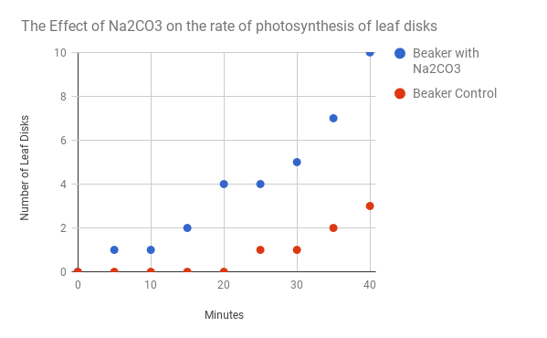
Data: Table #1 Graph #1
Minutes | Beaker with Na2CO3 | Beaker Control
0 | 0 | 0
5 | 1 | 0
10 | 1 | 0
15 | 2 | 0
20 | 4 | 0
25 | 4 | 1
30 | 5 | 1
35 | 7 | 2
40 | 10 | 3

Slide 7
Photosynthesis & Cellular Respiration AXES Paragraph READ & highlight parts of your article, Write an AXES paragraph on page 57, 59 or 61NB Assertion eXample Explanation Significance
The mechanisms for P & CR are related because they are essentially opposite reactions. Photosynthesis transforms energy from the sun and Cellular Respiration makes use of chemical bond energy and converts it to ATP & Heat
Photosynthesis = Chloroplast
Cellular Respiration = Cytoplasm, Mitochondria
6CO₂ +6H₂0 → C₆H₁₂O₆ + 6O₂ Photosynthesis
C₆H₁₂O₆ + 6O₂ → 6CO₂ +6H₂0 + 36 ATP + Heat Cellular Respiration

Slide 8
Molecular Genetics
Week 7
2016 - 2017

Slide 9
9/26 DNA: The Model of Heredity 11.1 Obj. TSW examine DNA from Strawberries through a process of DNA extraction. P.62 NB
http://learn.genetics.utah.edu/
What Nucleic Acid is responsible for all of our genetic information, please spell it out.
What are the three components (nitrogen bases and backbone) to this Nucleic Acid?
Draw the structure of DNA, describe it in words and label the 3 parts.
HW – Read CH 11 , 1 pg. Notes P. 65 NB

Slide 10
Section 11.1 Summary – pages 281 - 287
The structure of nucleotides
#1. The simple sugar in DNA, called deoxyribose (dee ahk sih RI bos), gives DNA its name— deoxyribonucleic acid.
The phosphate group is composed of one atom of phosphorus surrounded by four oxygen atoms, it has a negative charge.

Slide 11
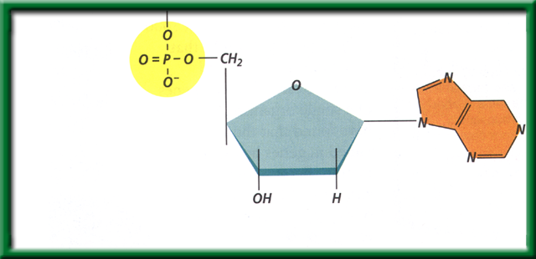
Section 11.1 Summary – pages 281 - 287
The structure of nucleotides
#2. DNA is a polymer made of repeating subunits called nucleotides. The backbone is made up of the Sugar and Phosphate group.
Nitrogenous base
Phosphate group
Sugar (deoxyribose)
Nucleotides have three parts: a simple sugar, a phosphate group, and a nitrogenous base.

Slide 12
Section 11.1 Summary – pages 281 - 287
#2. What are the two functions DNA?
Although the environment influences how an organism develops, the genetic information that is held in the molecules of DNA ultimately determines an organism’s traits.
DNA achieves its control by determining the structure of proteins.

Slide 13
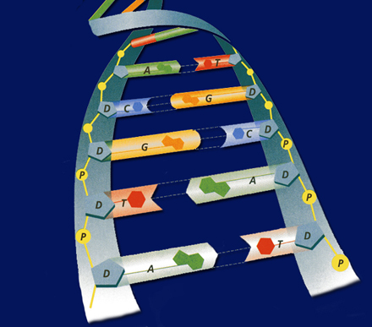
#3. Deoxyribonucleic Acid
Shape= a Double Helix
Backbone =
Sugar & Phosphate
Nitrogen base
Guanine
Thymine
Adenine
Cytosine

Slide 14
Strawberry DNA Extraction Lab p. 57 NB
Write the title in your Notebook
Will we extract DNA from the strawberries? If so, what will the DNA look like?
Hypothesis:
If, then statement that is testable & measurable. For example: If I crush strawberries and add the buffer, then I will extract 2 tablespoons of DNA.)
Materials:
Ziplock bag
Strawberries
Soap: used to dissolve phospholipid bilayers of the cell membrane
Salt: break up protein chains around the DNA
Ethanol: DNA is NOT soluble in ethanol (what does this mean?)
Funnel
Cheese cloth
Test tube
Stirring rod

Slide 15
Procedure
1. Place one strawberry in the plastic bag. Close the plastic bag. Now, squish the strawberry! (*make sure not to break the bag*)
2. Add 10 mls of buffer solution and mix.
3. Place the funnel in the test tube and place cheesecloth on top of the funnel.
4. Strain strawberry mixture
5. OBSERVE MIXTURE in the test tube. Remove Strawberry mush into the trashcan from the cheesecloth. Rinse the cheese cloth in the sink.
6. Add 5 mls of rubbing alcohol.
7. OBSERVE MIXTURE and record results.
8. Place stir rod into test tube to extract DNA.

Slide 16
Continued
DNA Extraction Buffer Contains in 600ml Beaker:
450 mls of water
50 mls of soap
1 tsp salt
As you do the lab, make sure you make your observations!

Slide 17
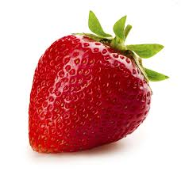
Strawberry DNA Extraction Lab
Prediction: What do you THINK we will have to do in order to extract DNA from a strawberry? Write in complete sentences.

Slide 18
Conclusion And Analysis Answers
To Precipitate DNA from Solution D
Separate components of the cell A
Break open the cells C
Break up proteins and dissolve cell membranes B

Slide 19
Conclusions! P. 59 Strawberry DNA Extraction AXES Paragraph
What did the DNA look like? What is it’s shape?
How were we able to see it?
Why was it essential to add buffer?
Why was it essential to add ethanol?
What is an example of a Nucleic Acid?
Why is DNA important?

Slide 20
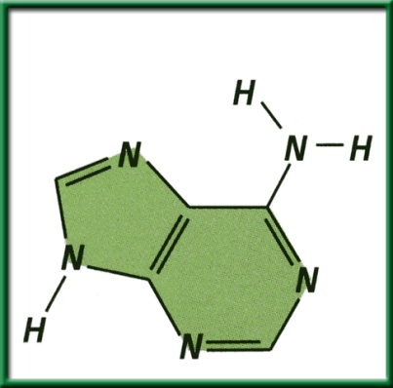
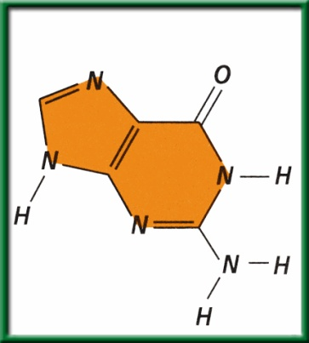
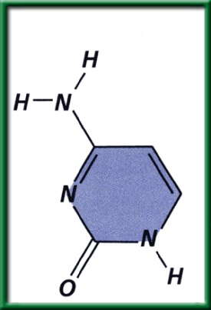
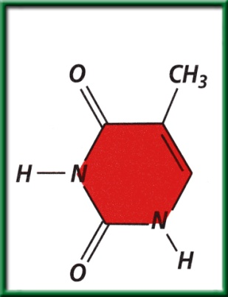
Section 11.1 Summary – pages 281 - 287
The structure of nucleotides
A nitrogenous base is a carbon ring structure that contains one or more atoms of nitrogen.
In DNA, there are four possible nitrogenous bases: adenine (A), guanine (G), cytosine (C), and thymine (T).
Adenine (A)
Guanine (G)
Cytosine (C)
Thymine (T)

Slide 21
#3. (DNA)Nitrogen Base Pairing Rules
ADENINE = THYMINE
CYTOSINE = GUANINE
G = ?
T = ?
A = ?
C = ?

Slide 22
DNA/ RNA Beads p. 59NB
Backbone= Phosphate & Sugar (Red & White)
Nitrogen Bases= Adenine (Blue)=Thymine (Green)
Cytosine (Yellow )=-Guanine (Orange)
Uracil (Pink) RNA
Hydrogen bond (clear barbell)
http://learn.genetics.utah.edu/
WS - DNA Model Discussion questions

Slide 23
DNA Model Discussion Questions p. 59NB Please write in complete sentences.
What is the general Structure of the DNA molecule?
What are the 3 parts of a nucleotide?
Name the 2 molecules which alternate to make the sides or “backbone” of the DNA molecule.
Name the 4 nitrogen bases.
To which molecules does the nitrogenous base attach?
What are the base – pairing rule for DNA?
If there are three thymine bases on your model, how many adenine bases will there be?

Slide 24
DNA Model Discussion Questions
8. Draw a picture of your DNA. Label the sugar, a phosphate, and all the bases on the left and right side of the molecule you constructed.
9. If you were to open the entire DNA molecule along the hydrogen bonds and attached new bases to the sides you would have two new DNA molecules. Would these 2 DNA strands have the same base pairs?
10. Would the two DNA molecules that resulted from replication be the exact copies of each other? Explain. Why is this important?

Slide 25
9/27 DNA Structure & Function CH. 11.1 Obj: TSW review DNA structure & function. Pg. 64 NB
Name two functions of DNA.
Draw a nucleotide and label the three components.
Use the base pairing rules you learned yesterday to determine the complimentary sequence of this DNA strand:
5’-TACGGTACT-3’

Slide 26
Learn.genetics.utah.edu
P. 59 NB
Write a summary paragraph about DNA. Write 3 – 5 sentences about the shape of DNA, the nitrogen bases, the bond that holds them together and what a nucleotide is.
Build a DNA Molecule
Match the nucleotide base pair
What bases always pair together?
What holds the base pairs together?

Slide 27
Question
If there is one strand of DNA with the code:
AATCCGGATA
What would its complimentary strand (strand across from it) look like?

Slide 28
Answer
AATCCGGATA
TTAGGCCTAT
A always pairs with T C always pairs with G

Slide 29
9/28 DNA Replication 11.1 Obj. TSW demonstrate base pairing rules of DNA Replication by constructing a 2-D model of DNA with paper. P. 66 NB
What is DNA replication?
Why does DNA replicate?
Diagram the of DNA being replicated
Replication Video
HW CH 11 1 page Notes P. 65 NB
Show video DNA Replication

Slide 30
Section 11.1 Summary – pages 281 - 287
#1. Replication of DNA
Before a cell can divide by mitosis or meiosis, it must first make a copy of its chromosomes.
The DNA in the chromosomes is copied in a process called DNA replication.
Without DNA replication, new cells would have only half the DNA of their parents.

Slide 31
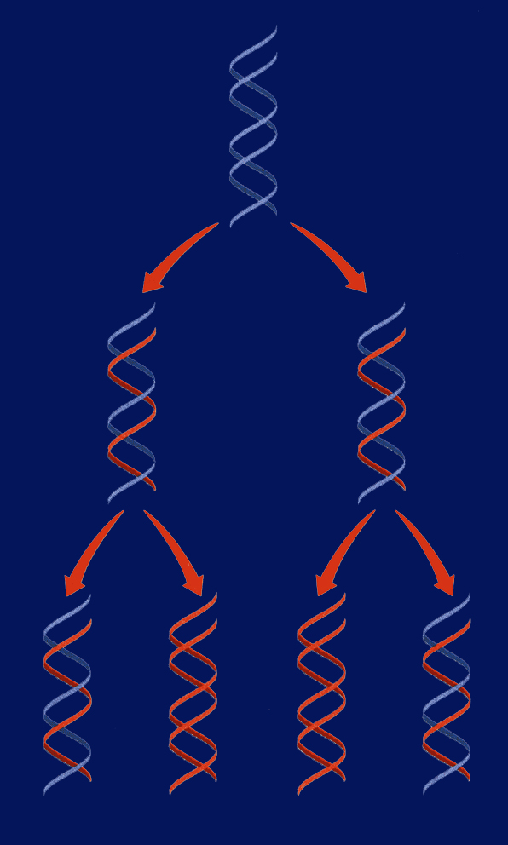
Section 11.1 Summary – pages 281 - 287
DNA
Replication
Replication of DNA
Replication

Slide 32
DNA Replication
DNA replication: the DNA in chromosomes is copied in this process
If I say a strand contains: AATTCC on one side, what will the complementary strand be? You can predict what the bases will be on the other side! Part of replication uses this logic.
During DNA replication, each strand serves as a pattern, or template, to make a new DNA strand.

Slide 33
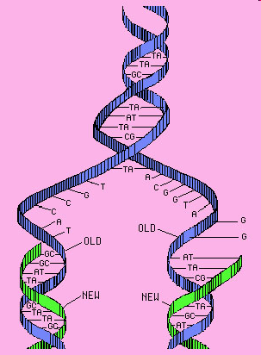
#3. Steps of DNA Replication
STEP 1. Separation of Strands: When a cell begins to copy DNA, the DNA unwinds, and the hydrogen bonds are broken. This allows the bases of nucleotides to be exposed.
Unwinding!
Hydrogen bonds broken!
(like unzipping!)
STEP 2. A new Sugar- Phosphate
backbone forms along the new
strand forms.

Slide 34
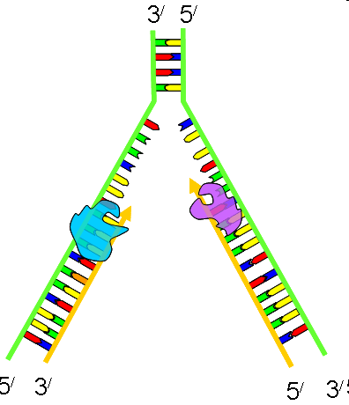
DNA Replication 3’ to 5’ RULE
DNA strands go from 3’ to 5’ or 5’ to 3’
When DNA strands pair,
it is opposite
STEP 3. Base pairing: Free nucleotides pair
with the exposed DNA bases.
STEP 4. Two molecules of DNA are
Formed; each is half original &
Half complementary.

Slide 35
Semi-conservative Replication p. 61 NB Half of the DNA is Original the other half is new (Complementary)

Slide 36
DNA Replication Practice p. 61 NB
Directions: Using one half of the a DNA helix, show what the correct pairing would be, skip lines in your NB.
ATT CGT TAC CAC CTC
TAT TAG GCA ATA TTC
GTG TGA TTA ATA GCC
CTA AAG GAA TAG GAT
GAT GAA TAC CCA CGA
TAA TAT GCA CAT TAC
GAA CCT TAC GGG GTG
TAT AAC CAG GAG TTT
ATC CGT AGT GTA AAT
GGA TTA CCC TTA CCA

Slide 37
DNA Replication Lab p. 63 NB
Materials:
Scissors, tape, DNA template (on white piece of paper), blank white piece of paper, 4 of each nitrogenous bases (each one different color of paper).
Procedures:
Pair up with a partner
Get supplies: 2 Original Strands of DNA backbone (White), & 1 paper of 4 of each of the Nitrogen Bases
Base pair the nitrogen bases to the Deoxyribose sugar.
Draw your Hydrogen Bonds A=T; C=G
Write Original Strand on the two white DNA Backbones.
After McAllister reviews your model, she will give you 2 Yellow Backbones that are the complementary strands to base pair your Original strand to.
Cut your Original Strand in ½, and base pair the complementary strand to it.
When you have finished your model, answer the questions below in your notebook P.47NB
Questions:
List the 3 functional groups & the 4 nitrogenous bases found in DNA.
List the rules for base pairing in DNA.
What are the two main functions of DNA?
Draw DNA Replication with two different colors.

Slide 38
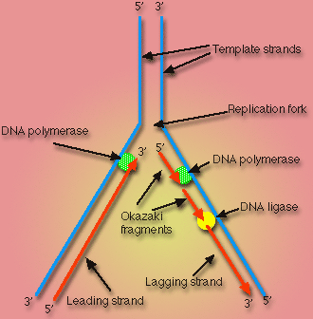
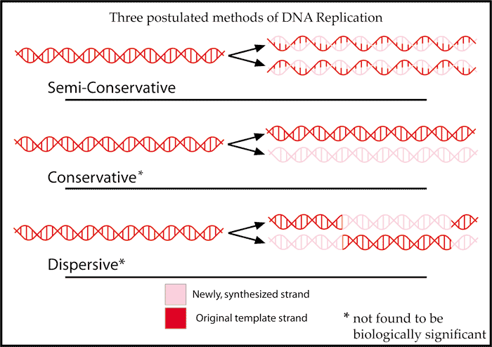
DNA Replication Activity Tape your Replicated DNA p. 63 NB
What is Semi–Conservative Replication?
What are the two main functions of DNA?
Why is DNA Replication important?
List the 3 functional groups & the 4 nitrogenous bases found in DNA.
Draw DNA Replication with two different colors.
List the rules for base pairing in DNA.

Slide 39
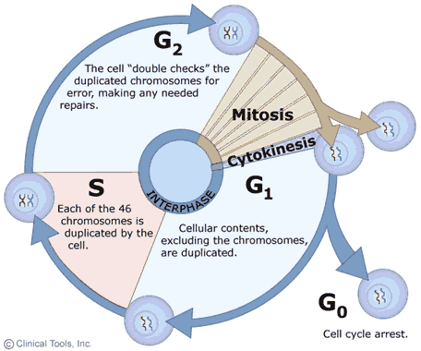
9/29 Cell Growth & Reproduction: Mitosis CH 8.2 Obj. TSW understand the cell cycle and processes at each stage. P. 68 NB
What is mitosis?
Draw the Cell Cycle.
What is the result of Mitosis?

Slide 40
Problem Solving Lab 8.2 P. 204BB p. 61 NB
Read the Observe & Infer section.
Read the Solve the Problem.
Answer the three “Thinking Critically” questions p. 61NB
Growth 1 phase- Rapid Growth & metabolism of Interphase is the most variable in length.
The two types of cells have different functions and one is more complex than the other.
The cycle of some types of cells is faster then others because of the complexity of the proteins made by the cell or the need to produce cells due to rapid wear and tear – like skin cells compared to muscles cells or nerve cells in the spine (do not regenerate).

Slide 41
Mitosis Practice p. 65NB Get 2 white boards/ lab station Get 1 Expo marker / 2 students Draw a nucleus and place your replicated chromosomes inside the nucleus.
With the yellow and red chromosomes, practice the 4 stages of Mitosis, drawing and erasing the nucleus as the stages dictate.
After you show them to me/us, Then draw the phases of Mitosis on
page 63 NB.

Slide 42
Mitosis Rules p. 65 NB
Create a Mental model of how a cell cycle works that shows an end result of 2 identical cells after Mitosis with the same number of chromosomes.
Set up rules for what a cell can and can not do.
What steps does the cell have to go through to create two new identical cells.
Result of Mitosis: 2 identical cells with the same # of chromosomes that make tissues, that form organs, that are part of an organ system and make an organism.

