Slide 1
Levels of Organization
Physiology

Slide 2
Science Notebook
Front Cover:
Name, Biology, Rm.3 Bryte McAllister, Spring Term, 2017
Table of Contents: page 1 - 7:
Date, Title, Page #
Page 8, 1st Warm – Up
Biology – Levels of Organization

Slide 3
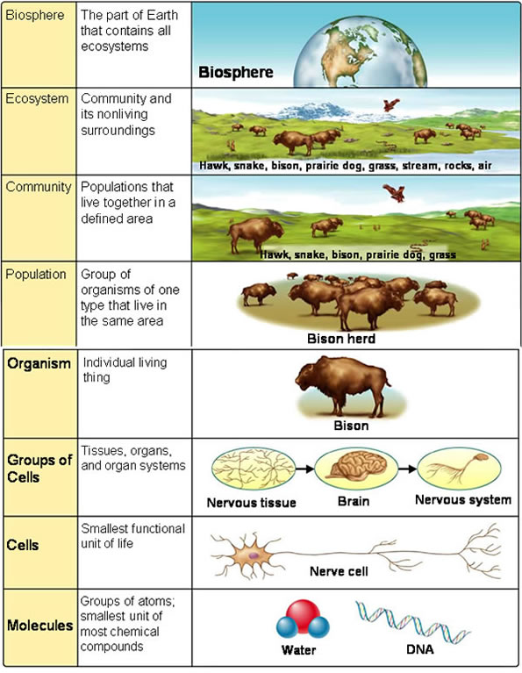
1/18 Levels of Organization Obj: TSW organize the physiological levels associated with life. P. 8NB
What is Biology?
What is Physiology?
How is the body organized?

Slide 5
Biology Bingo Blackout
Get a Bingo sheet & a pen
Write your name in the center
Walk around and meet your new classmates, make friends and try and find people to fill in your blanks for a Bingo.
When you have all your squares filled in, you have a Blackout and tell me.

Slide 7
Level of Organization – Activity P.9NB
With your card sort, organize them from smallest to largest.
After your card order is approved, write the order in the pyramid from smallest to largest.
Then write the definition and an example for each level or organization.
Color each level a different color.

Slide 8
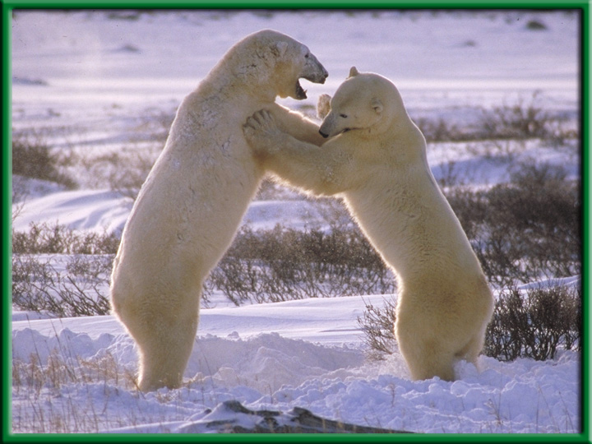
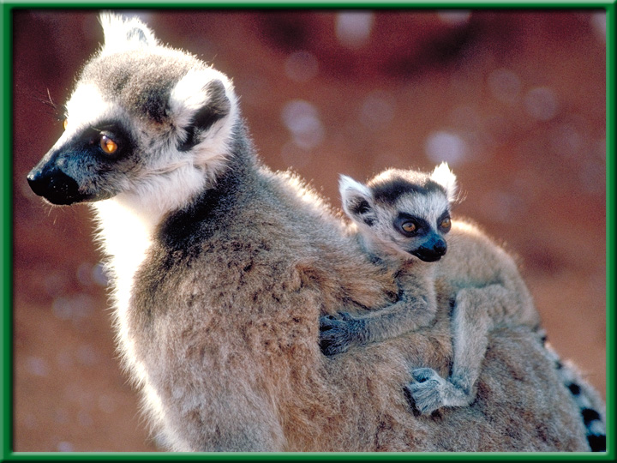
Section 1.1 Summary – pages 3-10
Characteristics of Living Things
All living things:
have “Cells”
produce offspring “Reproduction”
Grow and Develop
Stimulus & Response
Homeostasis
Energy to maintain Metabolism
Adaptation (Evolution)
Heredity

Slide 9
Characteristics of Life – Biology – Kahoots?
Heredity
Reproduction
Growth and Development
Adaptation through Evolution
Cells (Cellular organization)
Homeostasis
Energy & Metabolism
Stimulus & Response

Slide 10
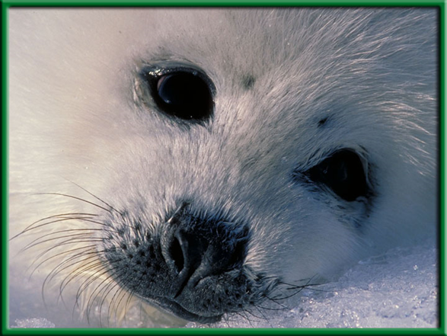
1/19 Biology – The Study of Life Obj. TSW learn about biology and how it is part of life. P. 10NB
What are the characteristics of life?
Why is Biology important?
How is Biology part of your life?

Slide 11
Level of Organization – Activity
With your card sort, organize them from smallest to largest.
After your card order is approved, write the order in the pyramid from smallest to largest.
Then write the word on one side, the definition on another side and an example for each level or organization for the third side.
Color each level a different color.
Due by the end of the Period

Slide 12
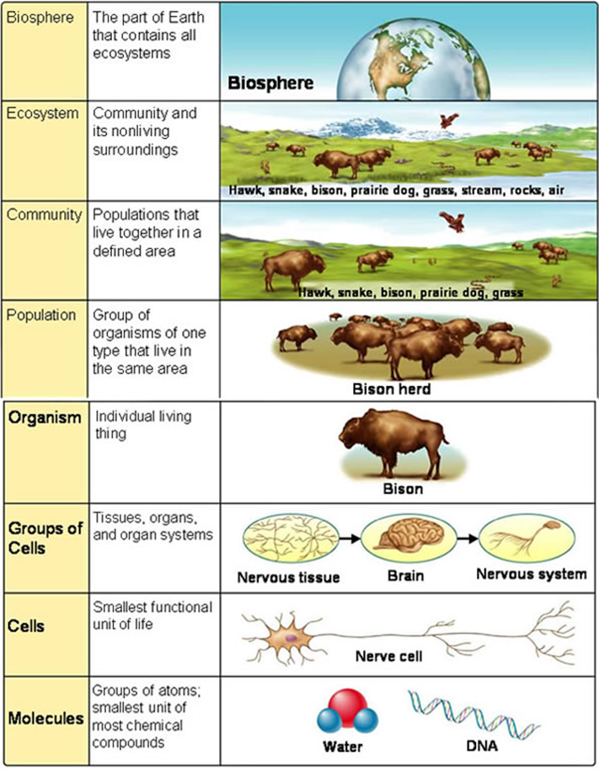
Levels of Organization

Slide 13
How to make a Data Table & Graph in Excel Activity
Check out a Laptop.
Log In
Open Excel (Windows Office)
New Spreadsheet
Wait for McAllister to give specific instructions.

Slide 14
Show Biology Website

