Slide 1
Envisioning your Future
BFFS
Week 2 Ch1 Who am I?

Slide 2
Warm Up: Vision + Energy = Success 8/21 Obj. The student will discover more of who they are through reading stories about successful people. P. 12 NB
What three CH 1 vocabulary words do you need to understand better?
Who is successful in your eyes?
Explain: Vision + Energy = Success, What does it mean, and how does it help you understand who you are?

Slide 3
Why you are here…

Slide 4
Decorate your Workbook

Slide 5
Voice of America
Michelle Obama

Slide 6
Career Choices & Changes
Read Page 10 – 12
Using Page 5 of your BFFS workbook “Vision + Energy = Success”
Complete the charts about successful individuals

Slide 7
Envisioning Your Future P. 6 Workbook

Slide 8
Everybody Works P. 7 Workbook, page 17 in CC
Read Pages 15 – 16 in Career Choices

Slide 9
Warm Up: Why People Work 8/23 Obj. The student will discover more of who they are through reading stories about successful people. P. 16 NB
Use 3 CH 1 vocabulary words in a sentence.
After reading the 6 reasons why people work, Page 15 in CC, which do you identify with the most? Rank them from 6 being what you find least matches your motivation for work, 1 being the highest match to your motivation for working.
How happy would you be, if you had to work in a job that you ranked a 6?

Slide 10
WU: Defining Success 8/24 Obj. TSW take a survey to assess how they define success. P. 18NB
Planning to be successful means thought in developing the person you want to be. Why does being successful not just happen?
The lottery today is like a gazillion $, how happy would that make you if you won?
Would it make you successful? How?

Slide 11
Defining Success Page 8 WB; 18 in CC
Complete the survey about defining success, Making Career Choices and finally write your definition of Success.
Compare your definition now to your warm up answer from Tuesday 8/22, question #3. How much growth can you see in you discovering “Who you are?” If you don’t, please note that you are responsible for who you become and when that happens.

Slide 12
TED Talks – 8 secrets to success
Notes Page 17 NB

Slide 13
8/25 Your personal Profile Obj. TSW learn about their passions, values, strengths, skills, and roles. P. 20 NB
Name a passion of yours.
Name a strength of yours.
Name a role your play in life.

Slide 14
8/28 Vocabulary of Success TSW learn new vocabulary to use in their everyday life. P. 22 NB
Write three sentences using your vocabulary.
What did you do this weekend that you consider a success?
Which of the 8 Secrets to success did you use?

Slide 15
8/29 5 Love Languages Obj. TSW learn about what is meaningful to you in a relationship. P. 24 NB
Discuss with your shoulder partner your top two language
What did you learn about yourself?
Are there a relationships you have that could benefit from gaining this understanding?
Would be willing to go home and ask your family to take this quiz???

Slide 16
Warm Up: Envisioning your Future 8/22 Obj. The student will discover more of who they are through reading stories about successful people. P. 14 NB
Use 3 CH 1 vocabulary words in a sentence.
Walt Disney once said, “If you can dream it, you can do it.” What does that mean to you?
How do you define success?

Slide 17
CCC Accounts
Students log onto the account: www.scc.losrios.edu

Slide 18
Passwords & Usernames & Pin #’s
Username: 1st name1st initial& last 4 digits of lunch #
Password: 5 digit lunch number
Email: 1st name1st initial & last 4 digits of lunch # @wusd.students.org
CCC Username: Same as Above
CCC Password: 1st Name & Lunch #
Pin#: 4 digits = last four digits of lunch #

Slide 19
8/31 Do you have your Los Rios ID #? Page 28 NB
Did you turn in the yellow permission slip for the College Credit?
Did you turn in the white permission slip that you list your LRID#?
Open your Google account and the document that you can type all your usernames and passwords on.

Slide 20
Log onto the Computer
Open Chrome
Open Google
Click on the Waffle
Open your Gmail
Sign in:
1st Name, 1st initial of last name and last 4 digits of your Lunch ID#
Password is your 5 digit lunch #
Check you email messages
Open your Drive
Check to see if you have a document from me

Slide 21
9/1 Grade Check Obj. TSW fill out the Grade Check Form, List any missing assignments, and explain how to improve your grade. P. 30 NB
Fill it out, I will call you up if you have any missing assignments.

Slide 22
9/5 Identifying your passions Obj. TSW identify some of their passions that may lead to an inspiring career. P. 32 NB
The book defines passion as “Energy and enthusiasm webbed to a sense of purpose.” Why do you agree or not?
List 3 passions:
Write about a time when you were patient with someone or a situation.

Slide 23
My10yearplan.com
USERNAME: 1st name,1st initial of last name and last 4 digits of lunch #
Password: 5 digit lunch number
1st Entry: Envisioning Your Future
2nd Entry: Your Definition of Success
3rd Entry: Your Personal Profile

Slide 24
9/6 Check in Obj. TSW answer the following questions so I can have a better gauge on how to keep them up to task and on schedule. P. 34 NB
Do you have your CCCID#, Write it in your Workbook. If not, how do you plan to get it? Have you turned in the yellow paper yet?
Do you have your LRID#, Write it in your Workbook. If not, how do you plan to get it? Have you turned in the white paper yet?
Are you able to log onto My10yearplan.com and enter your workbook information? What suggestions do you have for me?

Slide 25
9/7 Work Values Obj. TSW discover the motivation behind their work values. P. 36NB
What are your values?
Would you rather help people? How?
Do you want to exercise your power? How?

Slide 26
9/8 What do you value? Obj. TSW finish the work values survey to determine what line of work might be more satisfying. P. 38 NB
What do you value most? Why?
What do you value least? Why?
What Careers might align with your values, write three.

Slide 27
Friday…
Grade Check – Get a laptop
Try and finish to get your CCCID# & your LSID #
Research your “Passion Project”- You will Present it October 9th - 11th
Finish your Values Survey – enter it into My 10 Year Plan.com
If your are all done, practice your typing! Log onto www.typingtest.com

Slide 28
9/11 Strength’s & Personality Obj. TSW review the values category from their survey, then determine their individual strengths and personality types. P. 40 NB
What was your value? Did it match with the description on page 3 & 37 in the Career Choices Book?
Write about a time you showed strength.
List three words to describe your personality.

Slide 29
9/12 Positive Empowering Messages Obj. TSW learn how to do positive self talk to help in difficult situations. P. 42 NB
How can positive empowering messages help you?
Write about some significant people in your life.
What messages have society given you?

Slide 30
9/13 Relationships Obj. TSW learn about healthy relationships. P. 44 NB
List the relationships you have: best friend, girl friend, sister, etc.
What are some characteristics of a healthy relationships?
What are some characteristics of unhealthy relationships?

Slide 31
9/14 Relationships… Obj. TSW learn how to empower themselves in positive relationships. P. 46 NB
What do you want in life?
How do you expect to change in the next 5 years?
How do you expect to change in the next 10 years?

Slide 32
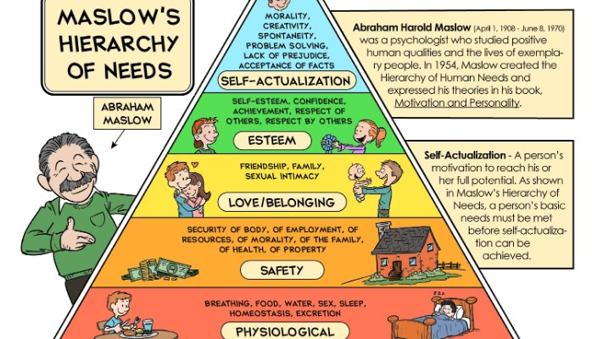
9/15 Maslow’s Hierarchy of Needs Triangle Obj. TSW learn about their internal and external Needs to reach “Self-Actualization”. P. 48 NB
Copy the picture of Maslow’s Triangle on page 49.
The first need is simply to survive. Give some examples of what you need to survive.
What is Self – Actualization?

Slide 33
Week 6
Chapter 3

Slide 34
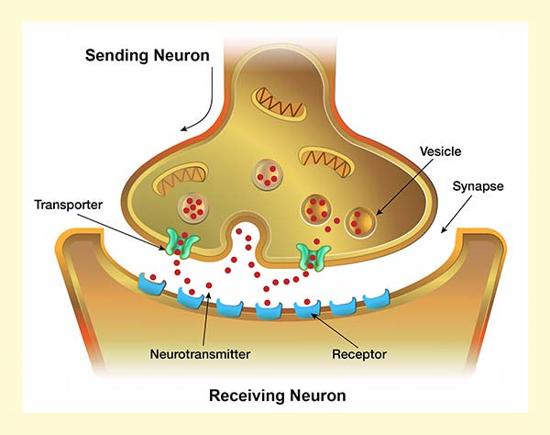
9/18 Drugs Obj. TSW learn how drugs disrupt the natural action of neurotransmitters at the synapse, and how different drugs act on the body. P. 50 NB
Draw this picture on Page 51NB
Title: Nerve Impulse
Name some drugs.
What do you know about these drugs and how they effect the body?
What is a neurotransmitter and a synapse?

Slide 35
Check out a laptop
Log onto: learn.genetics.utah.edu
Click on Mouse Party
Worksheet goes on page 53 NB
The new science of addition: Genetics and the Brain

Slide 36
9/19 Where are you now? & What are the components of your lifestyle? Obj. TSW discuss where they are now and their lifestyle they want. P. 52 NB
Review your Maslow’s Triangle. What is one of your external survival needs? Internal survival needs?
How is the third level different from the first two levels?
How is the top level different from the bottom levels?

Slide 37
9/20 Passion Project Obj. TSW explore and research ideas and start your passion project. P. 54 NB
Maslow’s heirachy of needs is important to find balance in life and reach self actualization. How might doing the passion project help with that?
“Life is not in having and getting, but in being and becoming.” Matthew Arnold How does this quote relate to Maslow’s Triangle.
How can personal relationships and private interests develop your self actualization?

Slide 38
Final Presentation #1 → The Passion Project
Goes in “Final Presentation” grading category (10%)
Options:
“Greater good” option. Do something tangible for the greater good. Make the world a better place.
“Teach us” option. Learn all about one of your passions, or something you want to learn more about. Teach us.
Failure is an option. A big-and-difficult idea is better than a small-and-easy idea. Be ambitious.
Let’s discuss “greater good” (option #1)

Slide 39
9/21 What Cost this Lifestyle? CH 4 Obj. TSW learn how every career choice involves sacrifices and rewards. P. 56 NB
In this section you get to focus on what you want in life. What is a budget?
What happens if your outflow of money is more than the inflow.
How much money do you think you want to make?

Slide 40
9/22 Cost of Living Obj. TSW learn about the cost of living. P. 58 NB
What does the Cost of living mean?
Make a list of the things your family pays for that you might take for granted.
What are sundries?

Slide 41
9/25 The Affordability of one’s lifestyle Obj. TSW budget out 3 different lifestyles today. P.60 NB
Using 3 words from your CH 4 Voc, write sentences using them.
How can dividends help you in your budget? How do you get them?
Although we are all hoping for an extensive windfall, we have to be realistic with our budget. What do I mean by this?

Slide 42
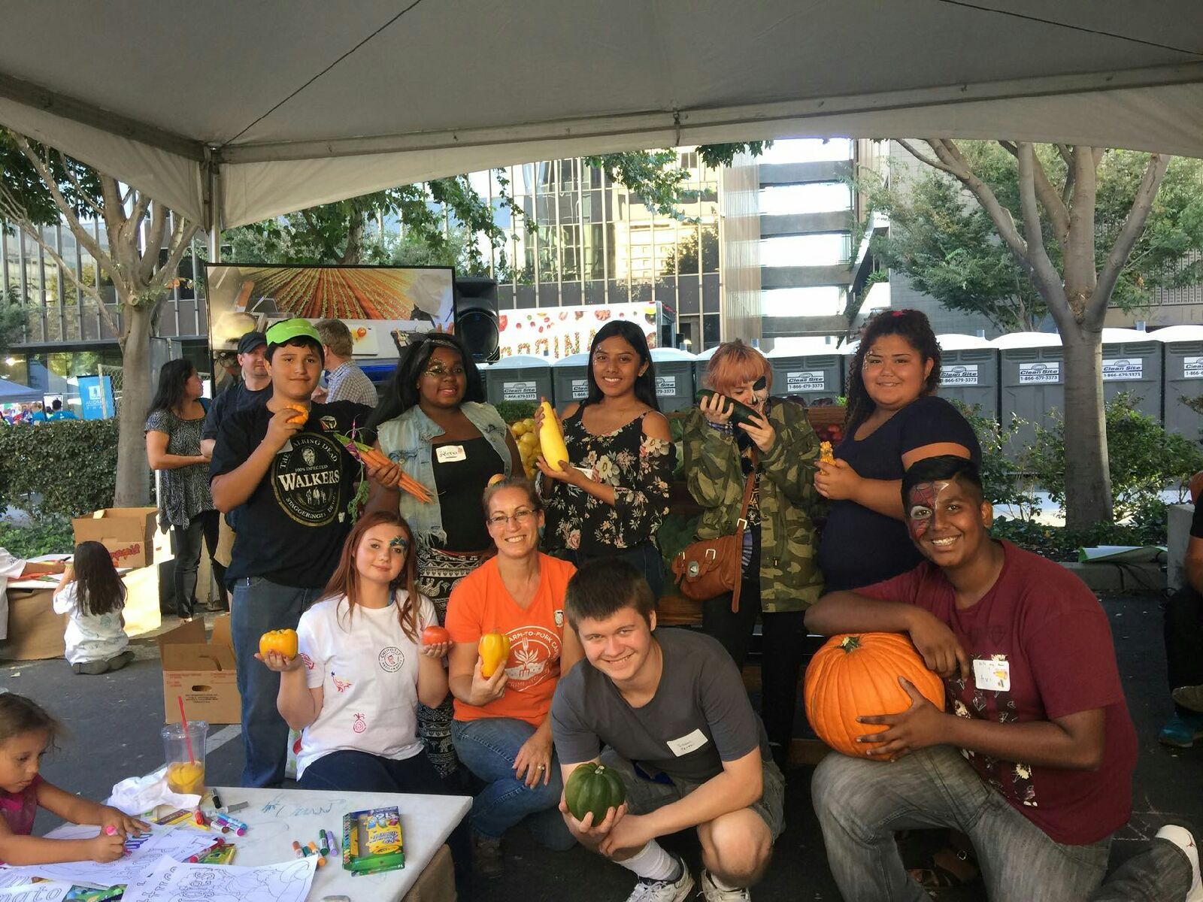

Slide 43
9/26 Housing Budget Obj. TSW learn the difference from owning and renting a home and the cost of insurance, utilities, etc. P. 62 NB
What is the difference between renting and owning a home?
What is Home Equity?
What are amenities?
Mortgage Calculator

Slide 44
9/27 Transportation Budget Obj. TSW learn how to budget for transportation issues. P. 64 NB
Give an example of public transportation.
How do you envision getting to work.
Why do you have to have insurance on your car?

Slide 45
Transportation Budget
Cars.com
Car fax
Hertz Car sales, Enterprise Car Sales
Autotrader
Craig’s list
Manufacture website
Trucar.com
Yolo Transportation
Cal trans
Kelley Blue Book

Slide 46
9/28 Transportation Obj. TSW about the responsibly of getting to work, taking care sundries & groceries. P. 66NB
What surprised you about transportation and cars?
What is a sundries?
What groceries would you buy if it were up to you?

Slide 47
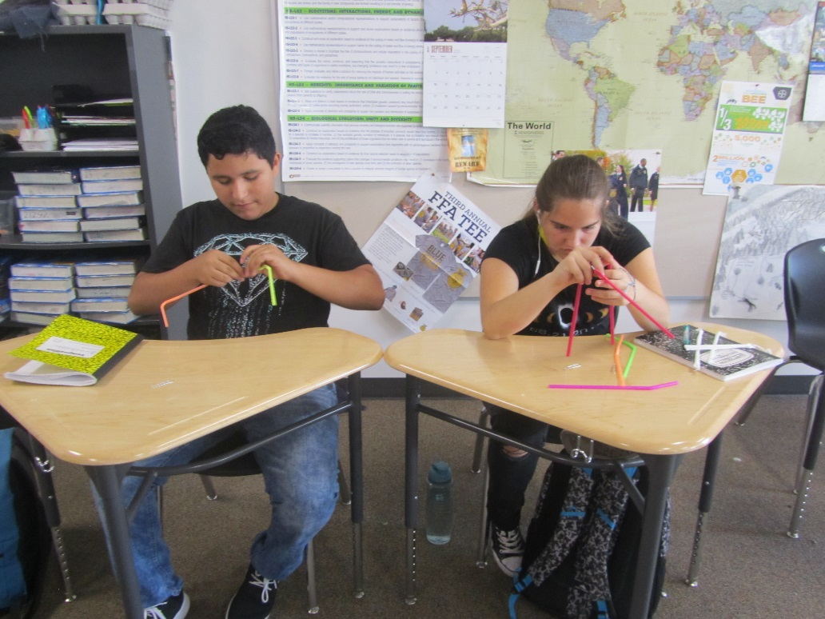

Slide 48
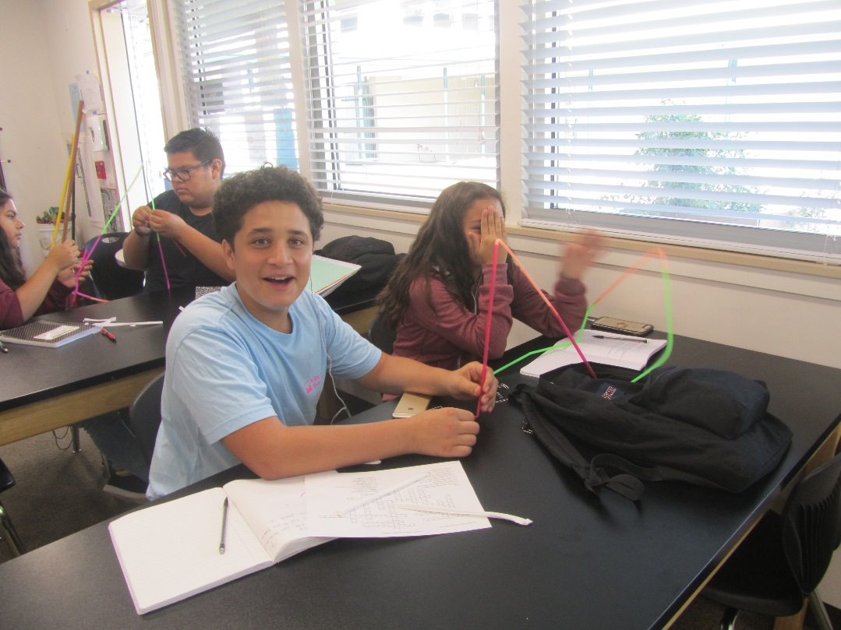

Slide 49
9/29 Budgeting Obj. TSW how to budget for clothing and food. P. 68 NB
How much money have you or will you budget for clothing?
How much money have you or will you budget for food?
What sacrifices will you have to make?

Slide 50
Career Searches
https://www.onetonline.org/

Slide 51
10/2 Spending Money – Budgeting Obj. TSW realize all the nuances of having to budget. P. 70 NB
Besides having a place to live and having to get to work to earn a living, food, sundries, what else might you spend money on?
How much money should you save every month for retirement?
How much money should you save for Health Care?

Slide 52
10/3 The cost of life Obj. TSW estimate their meal plan for three different budgets. P. 72 NB
Which meal of the day is the cheapest?
Do you really only eat three meals a day? What is the reality of your diet?
How does your diet change between the three different budgets?

Slide 53
Passion Project Ideas:
Cars – Avneet 1st
Animals-Melissa 2nd - parrot
Football-Malakai 3rd
Video Games-Marcelino 4th
Programming video games-Jordan 5th
Fashion – Olivia 6th
Basketball- Derrick 7th
Soccer-Brianda 8th
Robotics- Ezekial 9th
Music – Lennon 10th
Baseball-Ryan- 11th
Money- Izaac 12th
Service Dog – Brianna 13th
Family-Dulce 14th
Maliyah 15th
Friendship-Maria 16th
Clothes- Samuel 17th
Cheerleading
Mental Health
Technology
Politics
Extra – Lifestyles of Famous People
Shoes
Farming
Gardening
Horses
Hobby – Drawing, Reading, Running
Singing
Beat Boxing
Signing
Memes
Being Healthy
Care Giver

