Slide 1
Ag Biology
Week 3 Jan. 30th – Feb. 3rd
Body Systems – Nervous, Immune, Circulatory and Respiratory, FFA – Officer Responsibilities, Choose SAE, Prepare 8th grader visit

Slide 2
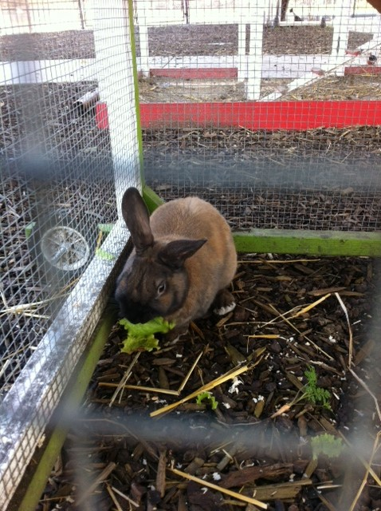
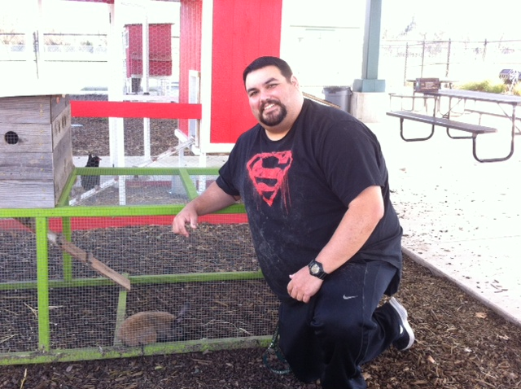
Vinnie & Tank

Slide 3
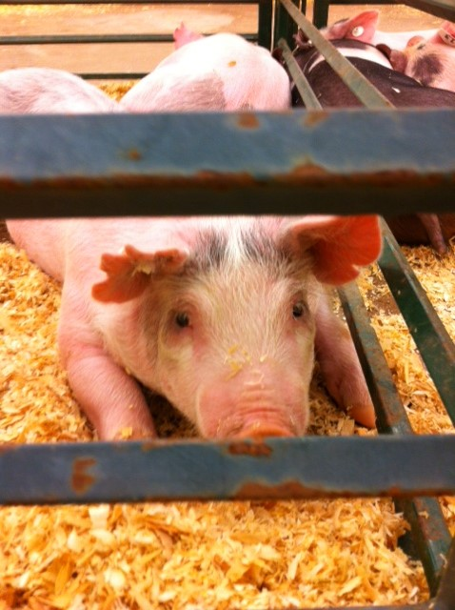
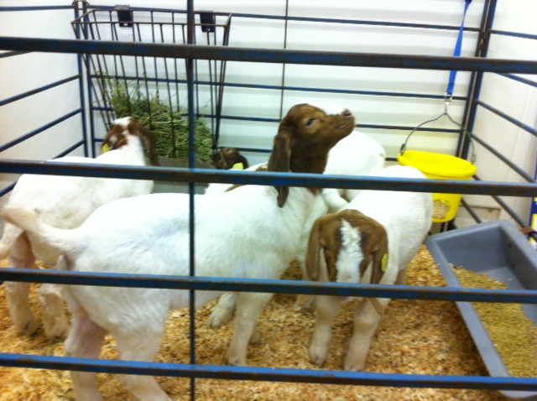
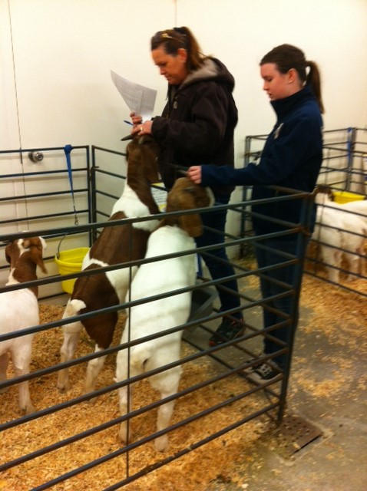
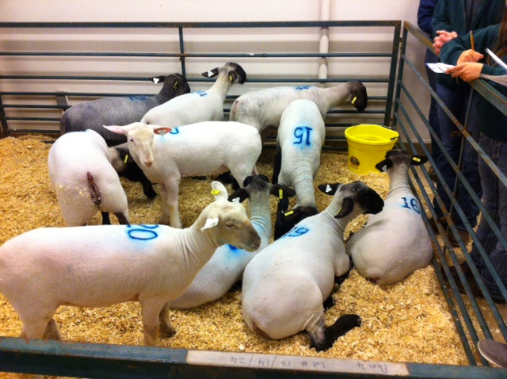
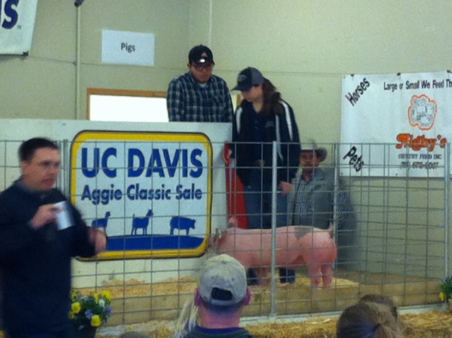
UC Davis Classic Prospect Sale

Slide 4
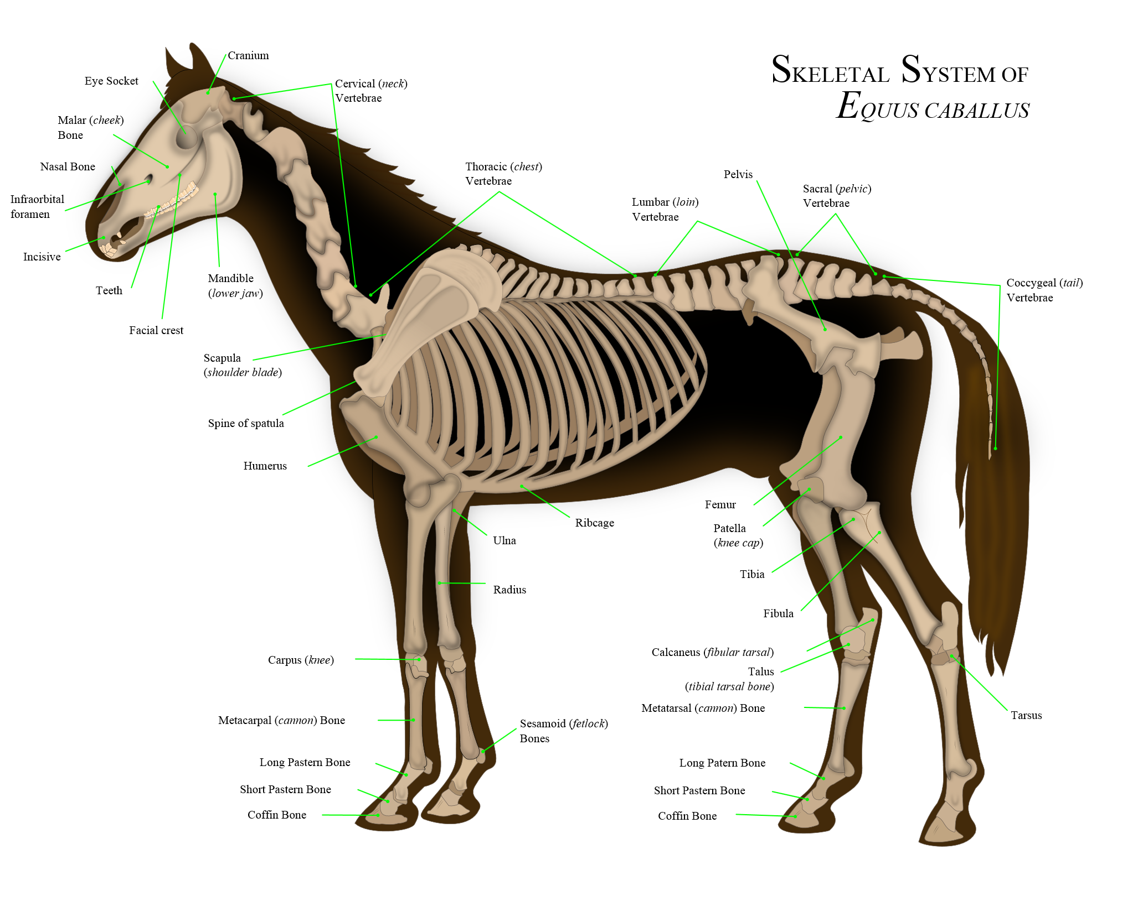
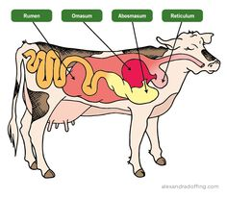
1/30 Physiology – Ag Style
Obj. TSW apply what they have learned about the body systems to what they need to know to care for animals and plants. P. 20 NB
What are the 11 body systems?
What is your favorite body system that you would like to learn more about?
What domesticated farm animal would you like to study? Why?

Slide 5
Animal and Body Systems Project
50 point Project Due February 9th
You may work alone or with a partner.
Choose a domestic farm Animal, choose a Body System.
On a Poster Board, or Power Point Show both systems, label the parts. You can use pictures or draw.
During your presentation explain how the systems are similar, and how they are different.
Explain in detail why it is important that we understand that system in your animal, and for us as a human.
Have a works cited page.

Slide 6
6 Types of SAE’s
Ownership/ Entrepreneurship – caring for Chickens, Bunnies, Guinee Pigs, other animals
Placement/ Internship – Fiery Ginger Farms, Dave Vierra Farms, Andrew Codd
Research- best fertilization methods in plants, Aquaculture project
Exploratory – Research possible Careers in AFNR
School Based Enterprise – After or before school, managing working school garden, fresh food drive, research in a greenhouse, Biodigestion, Composting, Tower Gardens, Recycling program
Service Learning – Farm to Fork Festival, Bryte Community Parking Lot Sale

Slide 7
Ag Ed Term Quiz
Supervised Agricultural Experience B
Placement SAE A
Entrepreneurship SAE E
Exploratory SAE F
Supplemental SAE G
Program of Activities (POA) C
Improvement SAE H
Research SAE D

Slide 8
Page 21 NB
E
H
B
C
F
D
A
G

Slide 9
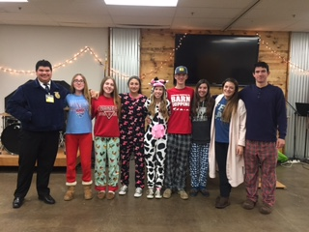
West Sacramento FFA & Woodland Christian FFA
Pancake & Pajama Night

Slide 10
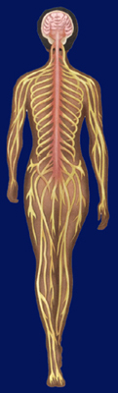
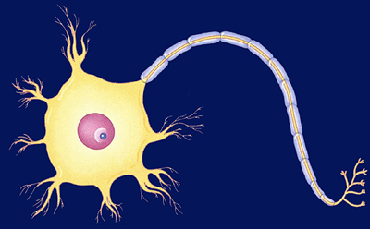
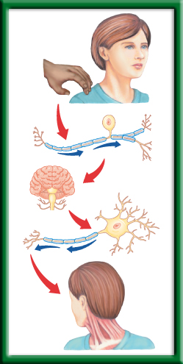
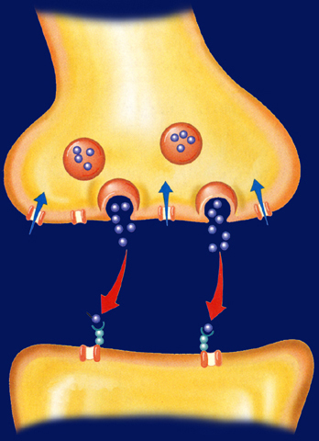
1/31 Nervous System 36.1
Obj. TSW explain the roles of the sensory neurons, interneurons, and motor neurons in sensation, thought and response by doing a lab on reaction response. P.22 NB
Describe, draw, and label a neuron.
Explain the functions of each type of neuron: sensory, interneuron, and motor.
What is a reflex, write an example?

Slide 11
Ag Work Day
This Saturday at RCHS, 10am – 2 pm in the Garden
Yes! This is 4 hours of Service learning
Yes! It counts as part of an SAE. Enter what you did in The AET.com Record Book
Wear your old cloths you don’t mind getting dirty.
Bring Gloves, or McAllister can bring you a pair.

Slide 12
Learning about FFA Activity
Match each of the following FFA words to what they are: P. 15 NB
SALUTE
Written By E. M. Tiffany
I believe in the future of agriculture,…
National Blue and Corn Gold
MOTTO
This consists of 5 symbols: cross section of Corn, the rising Sun, the Plow, the Eagle, the Owl
EMBLEM
Learning to Do, Doing to Learn,
Earning to Live, Living to Serve.
CREED
I pledge allegiance to the Flag of the United States of America and to the Republic for which it stands, …
COLORS

Slide 13
I love my neighbor who…
Everyone clear the center tables to the sides of the classroom.
Place the chairs in a circle, 1 less than the number of people.
McAllister starts, standing in the center, & says “I love my neighbor who…
Then everyone who can agree or has see that, done that, has that, gets to get up from their chair and move to a chair that is NOT next to the chair they are currently sitting in.
If you are the one who is left out, you are the next person to stand in the center and say “ I love my neighbor who…”
If you are in the center, you can not go back to the previous chair you were sitting in before you were the last one without a chair.

Slide 14
Inventory what needs to be fixed in our program with the Bunny Hutch and Chicken Tractors and Garden Beds
Students use measuring tapes and phones to take pictures.
Our Ag Advisory Panel will be here in February. We have to have everything up to snuff.
Clean Chicken Tractors, Bunny hutch, Evaluate Tank – New Bunny☺, Sweep concrete, spray “Bugs” stain. Pull any dead or yellowing leaves & feed to chickens – Yes you can let them out.

Slide 15
Experimental Design Practice p. 17 NB
#1
The independent variable (What Margaret changed) is the amount of moisture.
The dependent variable ( What she measured) is the number of worms.
The correct X axis label for a graph of Margaret’s data is the “Amount of Moisture, (mL)”
The correct Y axis label for a graph Margaret’s data would be “ The number of Worms present”.
The Correct title for Margaret’s graph would be,” The Effect of Moisture on the Number of Worms Present”.

Slide 16
Winnie & the Frogs p. 17 NB

Slide 17
Scientific Method Sponge Bob
Group B are the Control Group, because they are the original, not the new sauce.
The independent Variable is the New Sauce.
The Dependent Variable is the amount of gas production.
Mr. Krab’s conclusion is that the new sauce decreases gas production.
The 8 people in Group B reported feeling better due to the placebo effect, they felt better because they wanted to feel better.

Slide 18
Scientific Method
Independent Variable: The mass of the paper clip.
Dependent Variable: The length the paper airplane would fly.
Control: The airplant flown without any paper clips
Constants (things kept the same): airplane, paper clips, location.

Slide 19
Opening and Closing Ceremony Activity
Name the Officers:
Everyone should have an FFA Manual
Choose your role, We will do a dry run through.
All Official FFA Officers are expected to memorize their parts, and be in Official dress during meetings.
Our next meeting is Feb. 8th at RCHS room 310 at 3:30.

Slide 20








Section 36.1 Summary – pages 943 - 950
#1. Neurons: Basic Units of the Nervous System
Neurons conduct impulses throughout the nervous system. Draw this picture
Dendrite
Myelin sheath
Axon
Nucleus
Axon endings
Cell body

Slide 21
Section 36.1 Summary – pages 943 - 950
#2.Neurons: Basic Units of the Nervous System
Neurons fall into three categories: sensory neurons, motor neurons, and interneurons.
Sensory neurons carry impulses from the body to the spinal cord and brain.

Slide 22
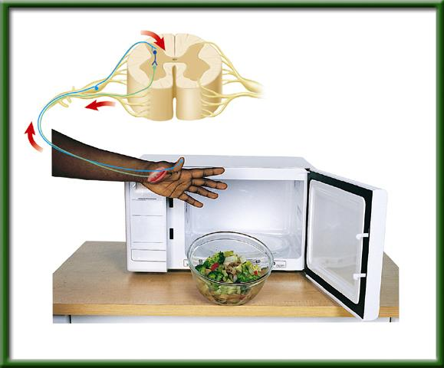
Section 36.1 Summary – pages 943 - 950
Neurons: Basic Units of the Nervous System
Interneurons are found within the brain and spinal cord.
Sensory neuron
Interneuron
Spinal cord
Motor neuron
Receptor in skin
Direction of impulse
Muscle contracts

Slide 23
Section 36.1 Summary – pages 943 - 950
Neurons: Basic Units of the Nervous System
Motor neurons carry the response impulses away from the brain and spinal cord to a muscle or gland.
Sensory neuron
Interneuron
Spinal cord
Motor neuron
Receptor in skin
Direction of impulse
Muscle contracts

Slide 24

Sensory Neuron
-You sense the touch
How the Central Nervous System Works
Interneuron
-The brain processes that you have been touched.
Motor Neuron
-You turn your head to see who touched your shoulder

Slide 25
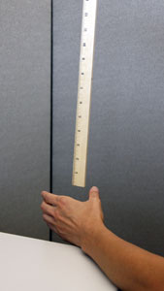
2/1 Distraction/ Reaction Lab CH 36
Obj. TSW calculate reaction times under different conditions. P. 24 NB
What type of neurons will you use in the distraction/ reaction lab?
Is this lab an example of a reflex reaction? Why or why not?
What other body systems work together with your nervous system to help you catch the meter stick?

Slide 26
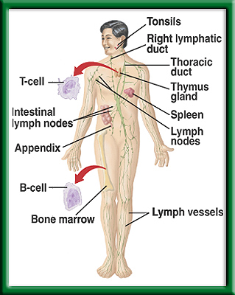
Defense Against Infectious Diseases 39.1 & 39.2
2/2 TSW understand and explain the role of antibodies in the body’s response to a bacterial infection during the warm up. P. 26 NB
What is a pathogen?
Identify cells, tissues and organs that make up the immune system.
Explain the role of antibodies in response to infection.
T – cell production

Slide 27
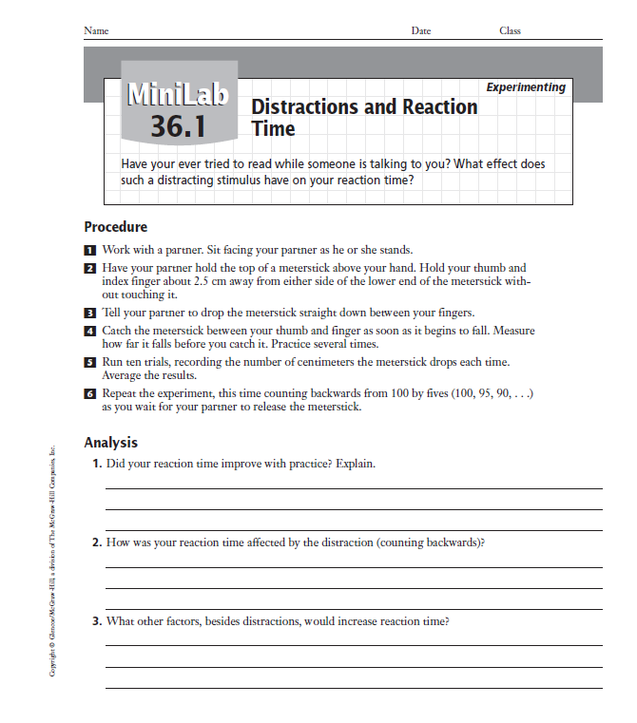
Copy this table on page 17NB. p.948BB
Trials | Without Distraction (cm) | With Distraction (cm) | Opposite hand (cm)
1
2
3
4
5
6
7
8
9
10
Average

Slide 28
What does it mean to have a relationship?
Why are relationships important?
Do animals count?
How can animals make a positive difference in our lives?
Can they make us healthier?

Slide 29
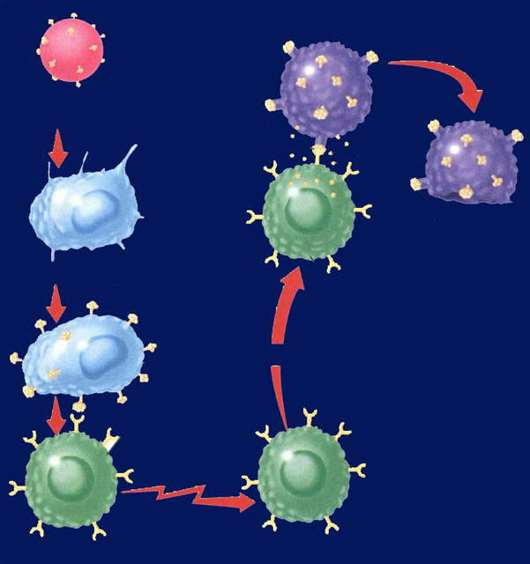
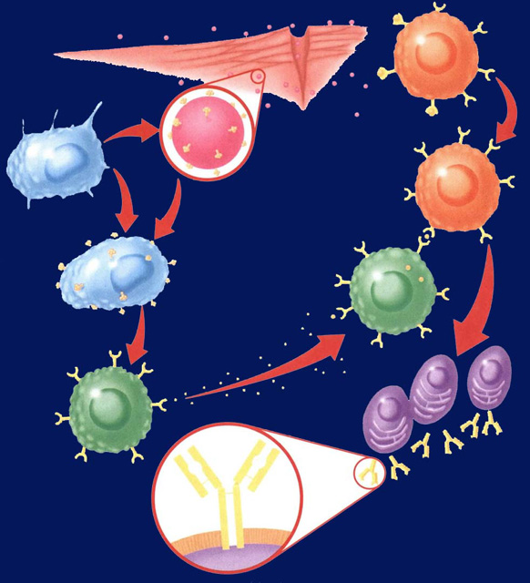
Immune System Responses 39.2
2/3 Obj. TSW compare and contrast Antibody Immunity and Cellular Immunity by diagraming the process in their NB and drawing a Cartoon applying nonspecific & specific immune responses. P.28 NB
? Immunity
? Immunity
Identify two types of lymphocytes in Antibody Immunity.
Explain the process of Antibody Immunity.
Explain the process of Cellular Immunity.

Slide 30
Data:
Table 1:
Explanation Sentence (10 Font):

Slide 31

Learning about FFA Officer Positions Activity
Obj. TSW distinguish between different officer positions after reviewing each positions’ responsibilities online. P. 29 NB
Use the FFA.org website or the Official Manual P. 48 and Name 5 of the 9 Officer positions.
What responsibilities/ behavior would you expect from the all the River City High School Bryte CCT Chapter FFA officers?
Would you like to run for an office next year in Farm to Fork 1?
Why or why not?

Slide 32
FFA Officer Responsibility Activity
Use FFA.org
FFA Manual
Page 48 in online Manual
Write down 3 key responsibilities for each of the offices on 3x 5 cards
We will use flashcards and travel around to say the responsibilities and see if another person can name that officer position.
Tape your card to page P. 19 NB
Play Kahoots! FFA Officer Responsibilities

Slide 33
Allelopathy Lab
Objective: Using the Scientific Method, test whether different seeds (Radish and Lettuce) impact each others growth.
Essential Question: Can radish seeds impact the growth of lettuce seeds?
Background: (Paragraph) Explain Vocabulary: Germination, Competition for Resources
  Cite Sources: Allelopathy: How Plants Suppress Other Plants (Ferguson, Rathinasabapathi, Chase, 2013)
Hypothesis/ Purpose: If radish seeds are grown with lettuce seeds, then the lettuce seeds will not germinate.

Slide 34
Allelopathy Lab
Materials: Petri Dishes, Pipettes (2mL), Petri dish paper, Radish seeds, Lettuce seeds
Procedure: (Make sure your procedure can be duplicated exactly by someone who has never done this lab – Be very specific.)
  Step 1:
  Step 2:
  Step 3:
  Step 4:
  Step 5:

Slide 35
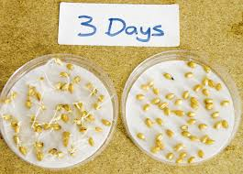
Allelopathy Lab
Data: (Qualitative & Quantitative – numbers, values)
  Table 1: The table below shows the different germination rates of radish and lettuce seeds when grown together and separately. (10 font)

Slide 36
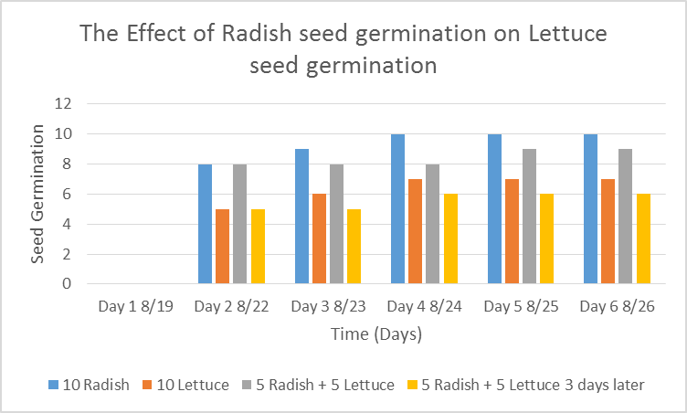
Allelopathy Lab
Data: (Qualitative & Quantitative-numbers, values)
  Graph 1:
  The radish seeds over 6 days showed increased germination compared to the lettuce seeds. (10 Font)

Slide 37
Allelopathy Lab
Data: (Qualitative – descriptive words & Pictures)
  The radish seeds looked …… they smelled….
  The lettuce seeds roots were longer and had more root hairs.

Slide 38
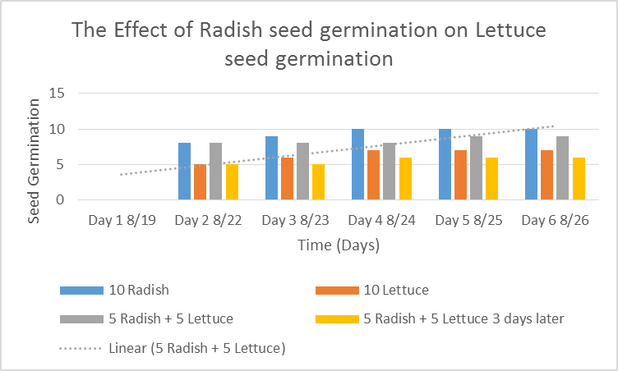
Allelopathy Lab
  Data Analysis: (Paragraph)
  Explain your data - results. Why did we see the results in the graph? Discuss any trends.
  Cite Sources: Allelopathy: How Plants Suppress Other Plants (Ferguson, Rathinasabapathi, Chase, 2013)

Slide 39
Allelopathy Lab
Conclusion: (Paragraph)
  Restate hypothesis and explain if it was supported or not. Tie your Data Analysis to your Background and hypothesis. Did your data support what you thought would happen? How? Explain why allelopathy is important. At the very least, write an AXES paragraph about Allelopathy between radish and lettuce seeds and how it applies to Agriculture.
  Cite Sources: Allelopathy: How Plants Suppress Other Plants (Ferguson, Rathinasabapathi, Chase, 2013)

Slide 40
Works Cited
James J. Ferguson, emeritus professor; Bala Rathinasabapathi, professor; and Carlene A. Chase, associate professor, Horticultural Sciences Department, Cooperative Extension Service, Institute of Food and Agricultural Sciences, University of Florida, Gainesville, FL 32611.
Yes – one more
Yes – still one more ☺
Done!

Slide 41
Quiz Today – Biology Only
Notebook Check
Pages 8 – 23 (80 Points)
Study Warm ups

Slide 42
FFA Officer Responsibility Activity
Use FFA.org
FFA Manual
Page 48 in online Manual
Write down 3 key responsibilities for each of the offices on 3x 5 cards
We will use flashcards and travel around to say the responsibilities and see if another person can name that officer position.
Tape your card to page P. 19 NB

Slide 43


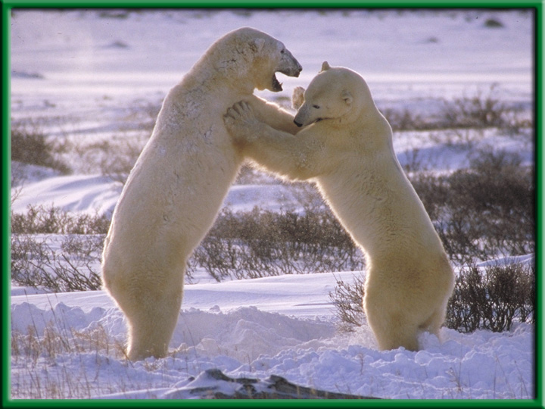
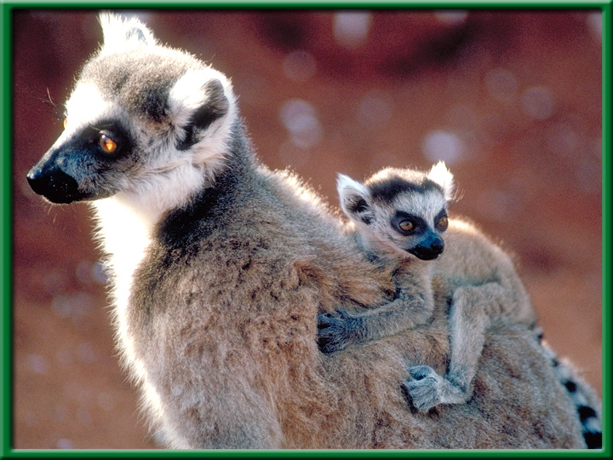
Section 1.1 Summary – pages 3-10
Characteristics of Living Things
All living things:
have “Cells”
produce offspring “Reproduction”
Grow and Develop
Stimulus & Response
Homeostasis
Energy to maintain Metabolism

Slide 44
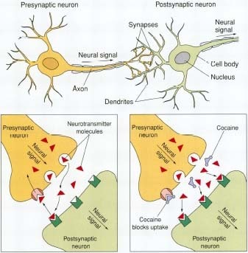
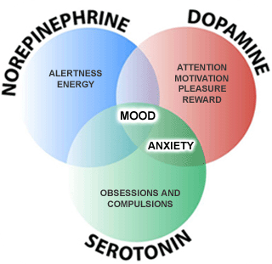
8/31 Neurotransmitters & Addiction CH 36.1 & 36.3
Obj. TSW learn about neurotransmitters and how drugs impact how the neurotransmitters work. P. 28 NB
What is a neurotransmitter?
Why is it important in communication of neurons?
How do drugs affect the function of neurotransmittors?

Slide 45
Mouse Party Activity
With a partner go to a computer and log onto it using your new User name and password.
Once you are logged onto the computer go to: http://learn.genetics.utah.edu/content/addiction/
Click on Mouse Party
Take a few notes about how addiction happens on page 17 NB.
Worksheets:
http://teach.genetics.utah.edu/content/addiction/

Slide 46
Nerve Impulse Poster p. 944, 949 BB
Write the standard (9E): Students will know the roles of sensory neurons, interneurons, & motor neurons in sensation, thought & response.
Draw the three neurons, labeling all the parts, define each on the poster.
Show an Impulse (Ex. Bright light, touch, pie or hot plate) that includes the sensory, interneuron, and motor neuron response.
Make sure to describe a Reflex Reaction.

Slide 47
Distraction Reaction Lab
Create your title page today
Start your Background information by doing online research and cite your sources.
Copy and Paste Excel Data Table 1 and Graph 1 into word document.
Bar graphs are used not line.
Page 23NB
Notes CH 39

Slide 48
Notebook – Specific Immunity
P. 25 NB Antibody Immunity P. 1037BB
P. 27 NB Cellular Immunity P. 1038 BB
Write a 4 – 5 sentence summary using specific vocabulary to explain the process.
Antibody Immunity
Cellular Immunity

Slide 49

Section 39.2 Summary – pages 1031-1041
Antibody Immunity – Specific Immune Response, Builds Antibodies
E. B cells can bind to antigens directly.
Pathogens enter
tissues through a wound.
B cell
F. Helper T cells bind to antigens on B cells.
B. They are attacked
by macrophages
at the infection site.
Pathogen
Macrophage
G. T cells release chemicals that cause B cells to produce
clones of plasma cells.
C. Antigens of the pathogen are displayed
on the surface of the macrophage.
Antigen
receptor
site
H. Each plasma cell secretes more than 2000 antibodies per second in the blood. Memory B cells and antibodies remain in the blood and respond to future invasions by the same pathogen.
D. Helper T cells have
receptor sites that
recognize and bind to the antigens on the
macrophage.
T cell
Plasma
cells
Antibody
Surface of
plasma cell

Slide 50
Section 39.2 Summary – pages 1031-1041
#3.Cellular Immunity
Specific Immune Response that blows up infected body cells.
Infected cells
Pathogen
engulfed by
Perforin
Foreign
antigen
Infected cell lyses
Macrophage
Cytotoxic T cell
Displays antigens
on surface and
stimulates T cell
Attacks infected
cell
Stimulates
Helper T cell
Cytotoxic T cell

Slide 51
Immune System Poster
Make a cartoon with captions, showing the body’s Immune Response to an infection.
Make 4 Stages:
  Stage 1: How the Pathogen gets into the body.
  Stage 2: Show the Nonspecific Immune Response.
  Stage 3: Show the Specific Immune Response.
  Stage 4: Show the Memory Cells Warding off a previous infection.

Slide 52
Foldable (29 NB) P. 1037BB
Macrophage – Definition & Picture inside
  A white Blood cell that is nonspecific against pathogens.
T – Cell
B – Cell
Plasma Cell
Antibodies
Antigens

Slide 53
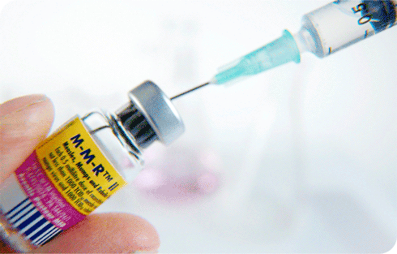
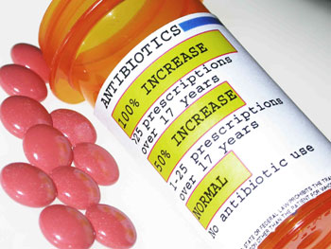
9/6 Specific and Nonspecific Immune Responses CH 39.2
Obj. TSW differentiate between nonspecific & specific immune responses. P. 30 NB
What is a vaccine?
Why do people who have AIDS have complications with normal colds and flu diseases?
What pathogen does antibiotics kill?

Slide 54
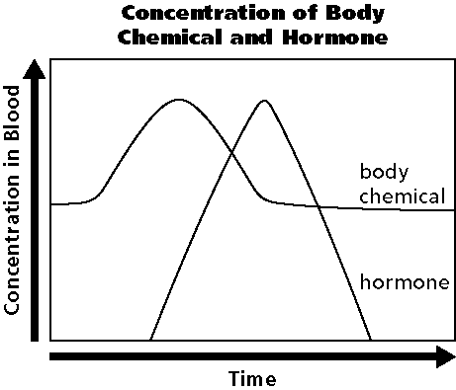
9/7 Homeostasis & Endocrine System CH 35.3
Obj. TSW draw and describe a Negative Feedback System involving the Endocrine System. P. 32 NB
What are the functions of the Endocrine system?
Draw the graph, explain how the body maintains homeostasis.
Why does the hormone production increase?

Slide 55


Section 35.3 Summary – pages 929-935
Control of the Body
Internal control of the body is directed by two systems: the nervous system and the endocrine system.
#1. The endocrine system is made up of a series of glands, called endocrine glands, that release chemicals directly into the bloodstream and stimulates other glands to release theirs.

Slide 56
Section 35.3 Summary – pages 929-935
#2. Control of blood glucose levels
Another example of a negative feedback system involves the regulation of blood glucose levels.
When you have just eaten and your blood glucose levels are high, your pancreas releases the hormone insulin.

Slide 57
#3. The production of the hormone increases due to the level of the body chemical. When the body chemical is back to normal the Hormone is not released any more – Negative Feedback system.

Slide 58
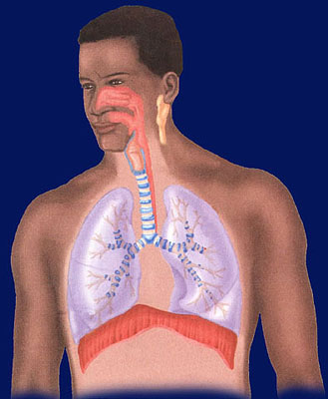
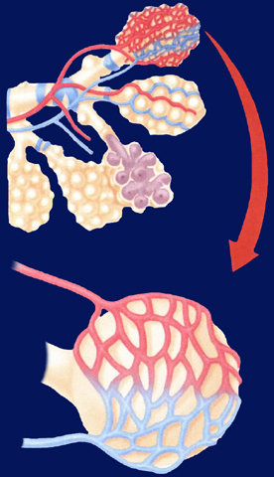
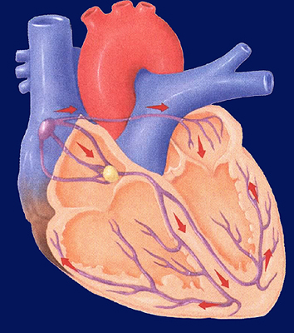
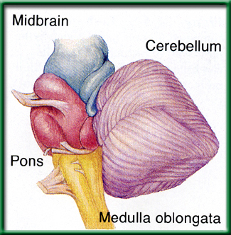
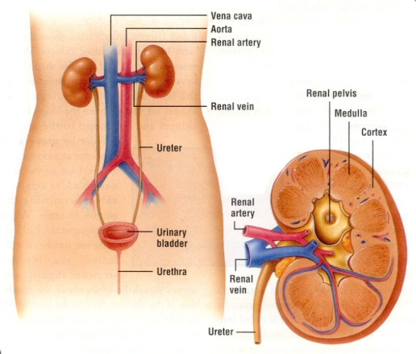
9/8 Respiratory, Circulatory & Excretory Systems CH 37.1 – 37.3
Obj. TSW explain in your warm up how the respiratory, circulatory and excretory systems complement each other to maintain Homeostasis. P. 34 NB
Explain the process of how gas is exchanged (Alveoli) in the lungs.
The level of CO₂ in the blood affects breathing rate. How would you expect high levels of CO₂ to affect heart rate?
How does the kidney maintain homeostasis in the body?

Slide 59
Measuring your Pulse & Respiration P.31 NB
Respiration – Breaths / minute
Pulse – Heart Beats/ minute
Measure your pulse & respiration and write them down on page 29 NB.

Slide 60
Exercise Lab p. 31 NB
Choose a partner
Choose an exercise
  1 minute in length (5 times)
    Count strides, Jumping Jacks, Push ups
  Duration (Time)- (5 repetitions) or (Time minutes)
    Plank, Wall Sit
Control?
What was constant?

Slide 61
Data Table & Graph
When do muscles fatigue? P. 31 NB
Time (minutes) | Number of repetitions Sit ups, Push ups, Jumping Jacks Calf Raises Squats
1st minute 1 minute | 10
2nd minute 1minute | 20
3rd minute 1minute | 30
4th minute 1minute | 40
5th minute 1minute | 50
Intervals Wall Sit Plank Superman | Time (seconds)
1 | 30
2 | 45
3 | 50
4 | 20
5 | 15

Slide 62
Muscle Fatigue Lab p. 31 NB
Trials | Number of Repetition | Pulse
1
2
3
4
5

Slide 65
Data Table for Pulse P. 31 NB
 | Trial 1 | Trial 2 | Trial 3 | Trial 4 | Trial 5
Pulse | 68 | 68 | 69 | 72 | 75

Slide 66
Graph your Pulse Rate P. 31NB
When does muscle fatigue set in?

Slide 67
The Heart, Lungs & Components of the Blood P. 65 NB P. 982 BB
Draw & Label & Color the components of the Heart & Lungs.
Copy the following Notes:
  Red Blood Cells -transports O₂ & CO₂
  White Blood Cells- T & B cells Immune system
  Platelets – cell fragments involved in blood clotting (Vitamin K)
  Plasma – Most of the liquid of blood- proteins, nutrients, enzymes, hormones, salts

Slide 68
Blood Cells
Red Blood Cells
  Made in the Red Marrow
  Circulatory & Respiratory System
  Smaller
  More numerous
  No nucleus
  O2 & CO2
  Contain Hemoglobin (Iron – Fe)
White Blood Cells
  Made in the Yellow Marrow
  Circulatory & Immune System
  Larger
  Fewer cells
  Nucleus
  T & B & Macrophage Cells

Slide 69
Exercise Lab
Title: Short – 5 words
Introduction: Exercise & Cardiovascular/ Respiratory system, O₂ & CO₂, pH, pulse
Objective
Hypothesis
Materials: List
Procedure: Specific. Step 1, Step 2, Step 3…
Safety concerns: don’t run with scissors.

Slide 70
Exercise Lab
Constants
Control:1st data point
Data table: Independent & Dependent Variable
Graph:
Data Analysis: What happened over time and why is it important?
Error Analysis:
Conclusion:

Slide 71
Questions to answer in the conclusion
Yes in addition to the one’s in the lab report.
How did your steps change with the different activities you did?
What effect did repeating the exercise over time have on the muscle group.
How did your muscles feel?
What physiological factors are responsible for fatigue?
How does the amount of rest you have affect the recovery of the muscles?
How did your results compare to others.

Slide 72
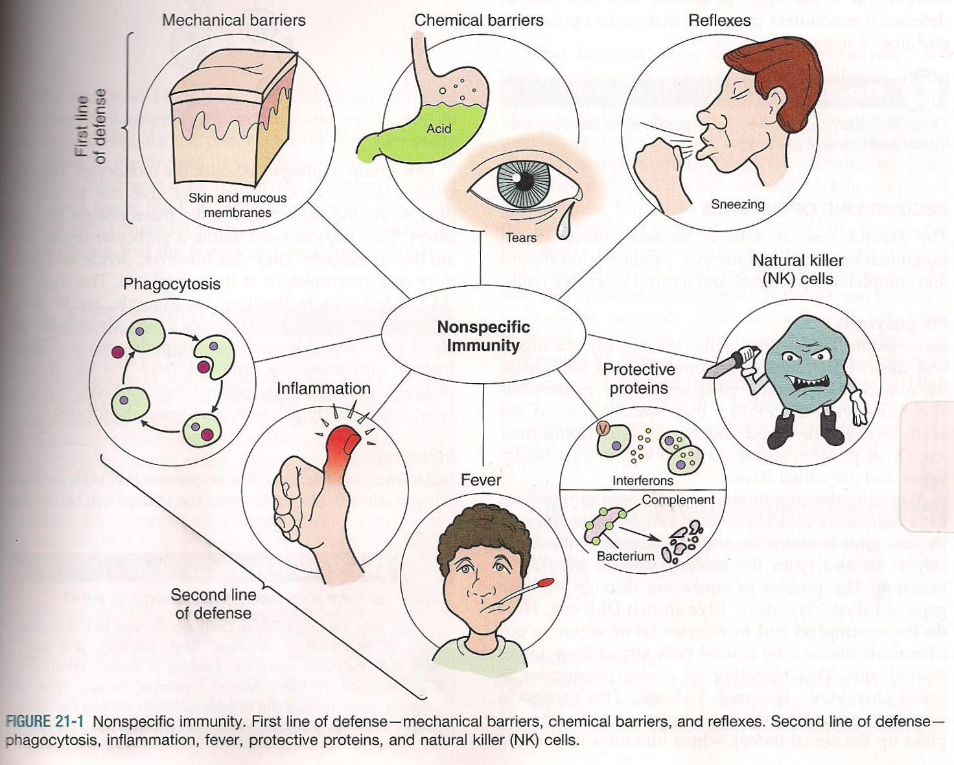
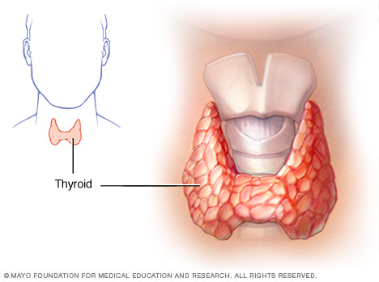
9/9 Metabolism & Homeostasis CH 35
Obj. TSW understand how the body regulates chemical reactions to maintain homeostasis. P. 36NB
Define metabolism.
The thyroid controls what process in the body?
How does the immune system respond to an infection in a nonspecific way?

