Slide 1
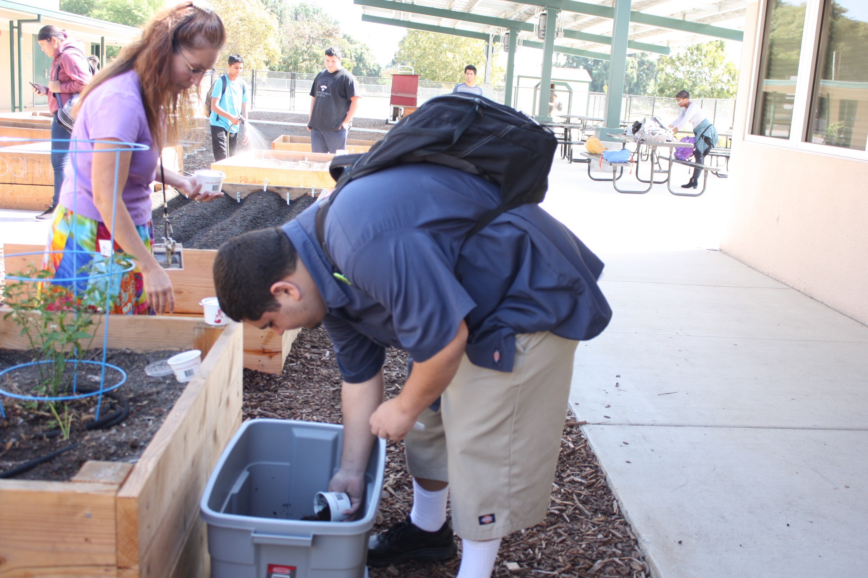

Slide 2
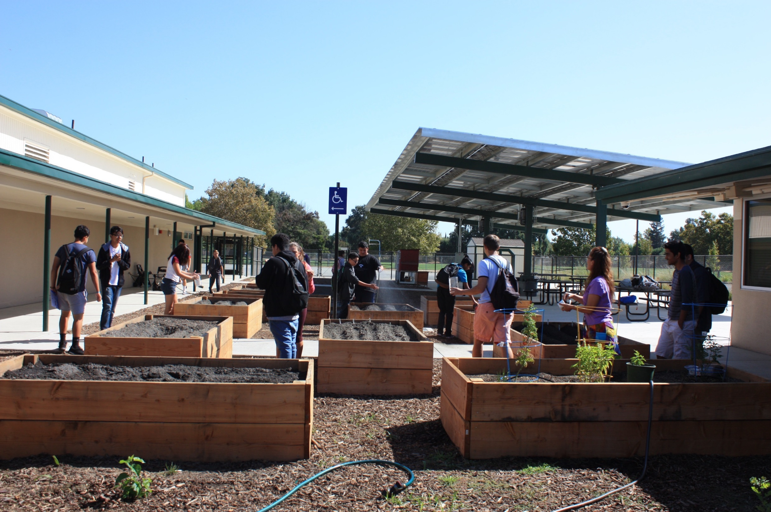

Slide 3
George!

Slide 4
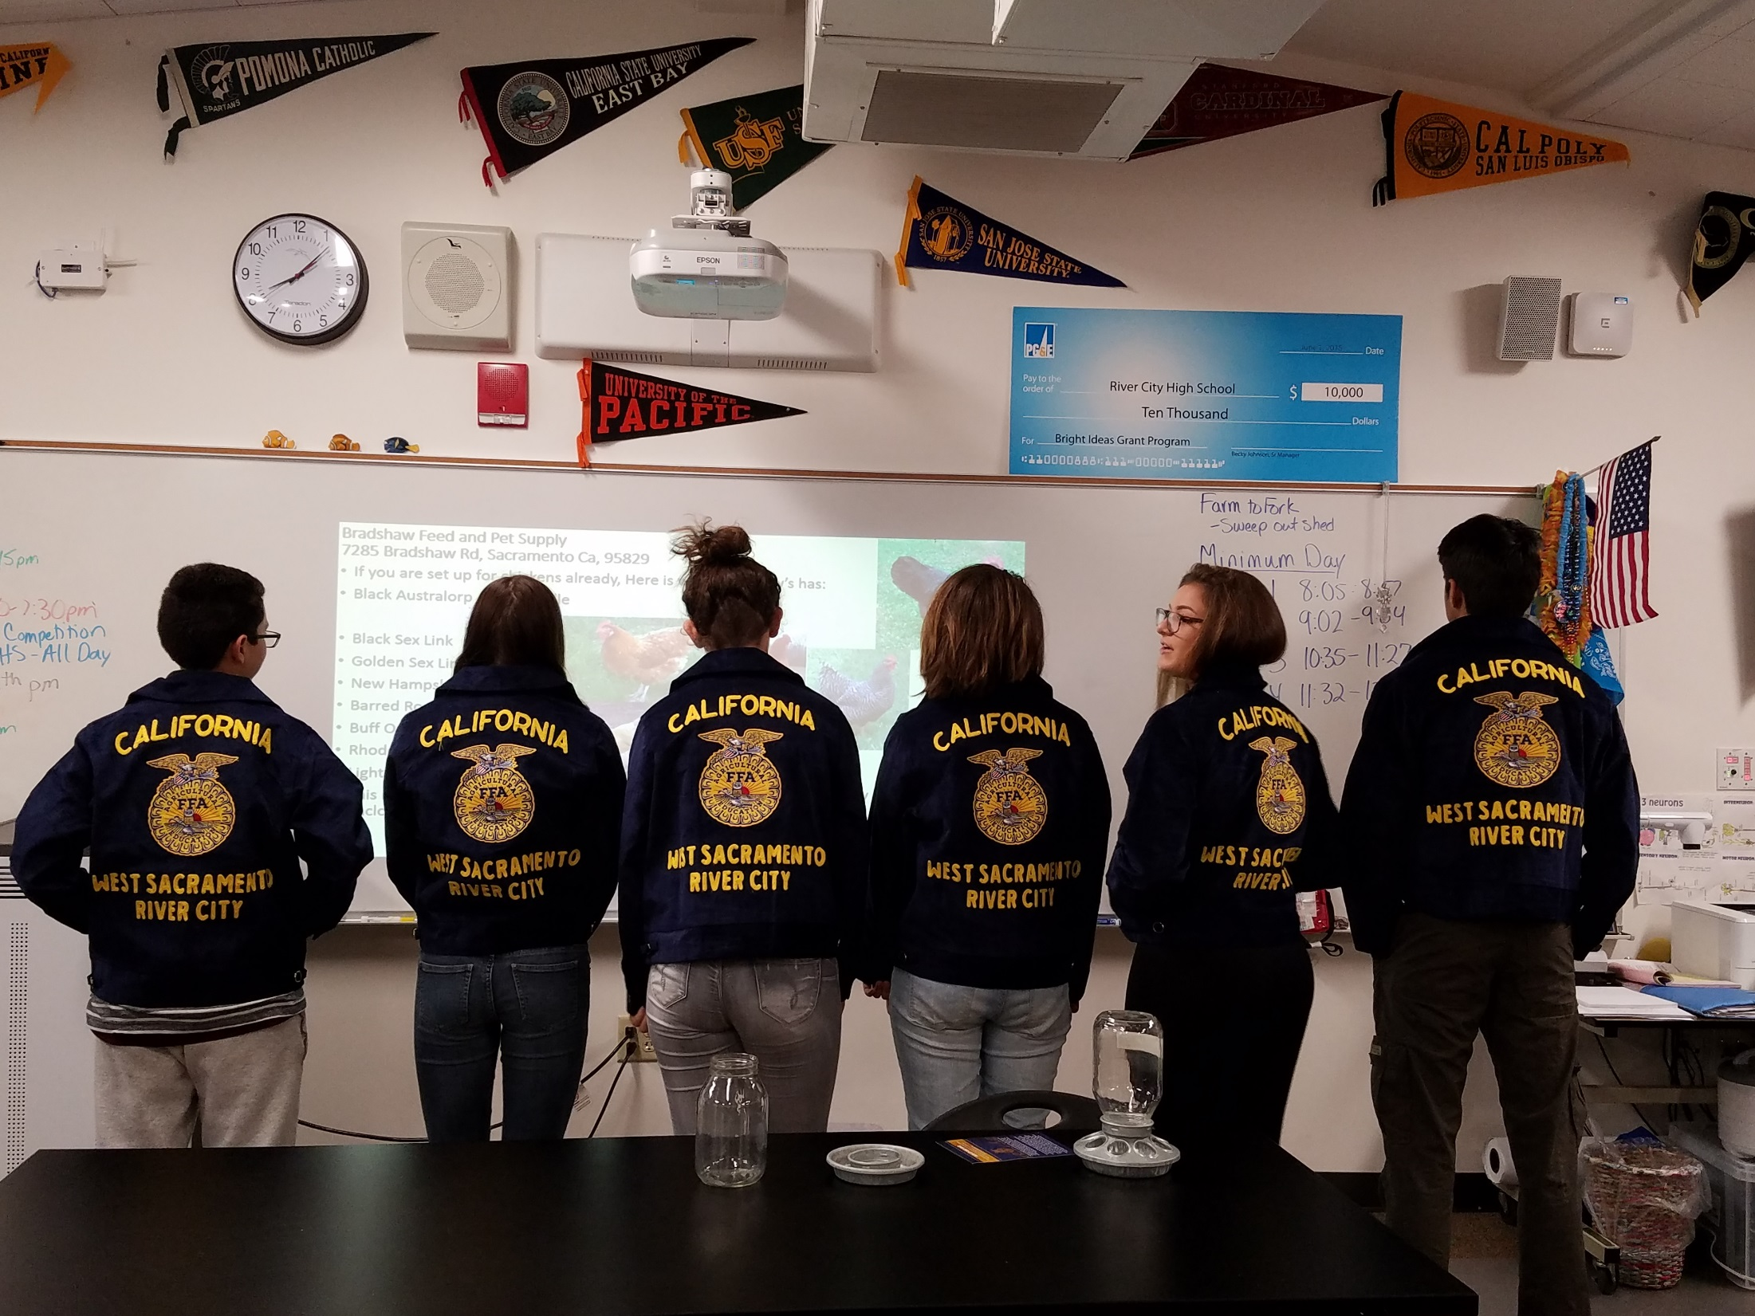

Slide 5
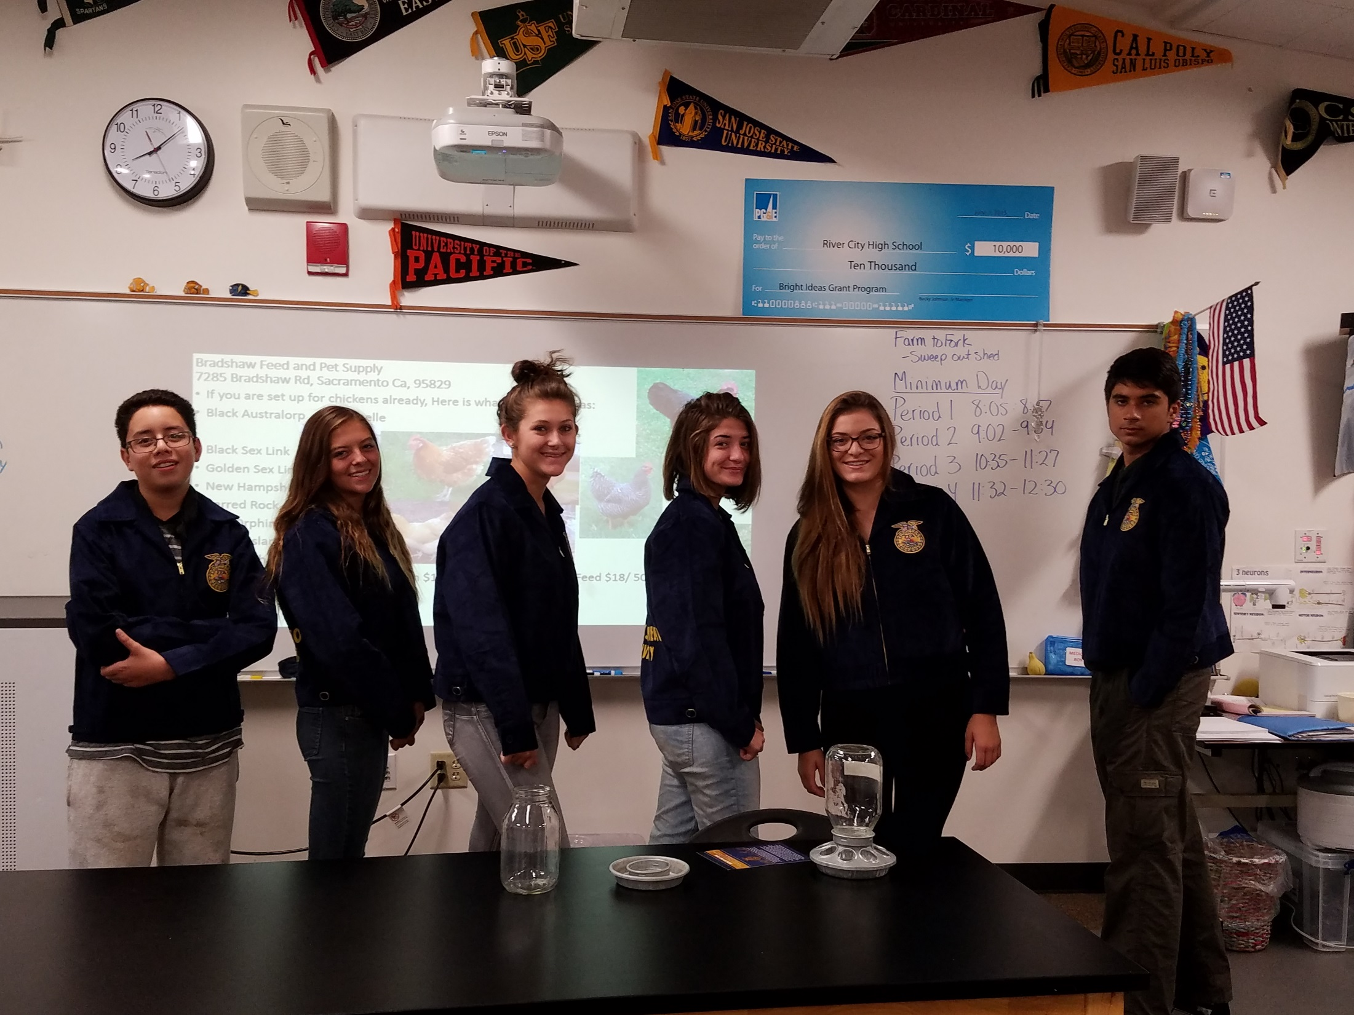

Slide 6
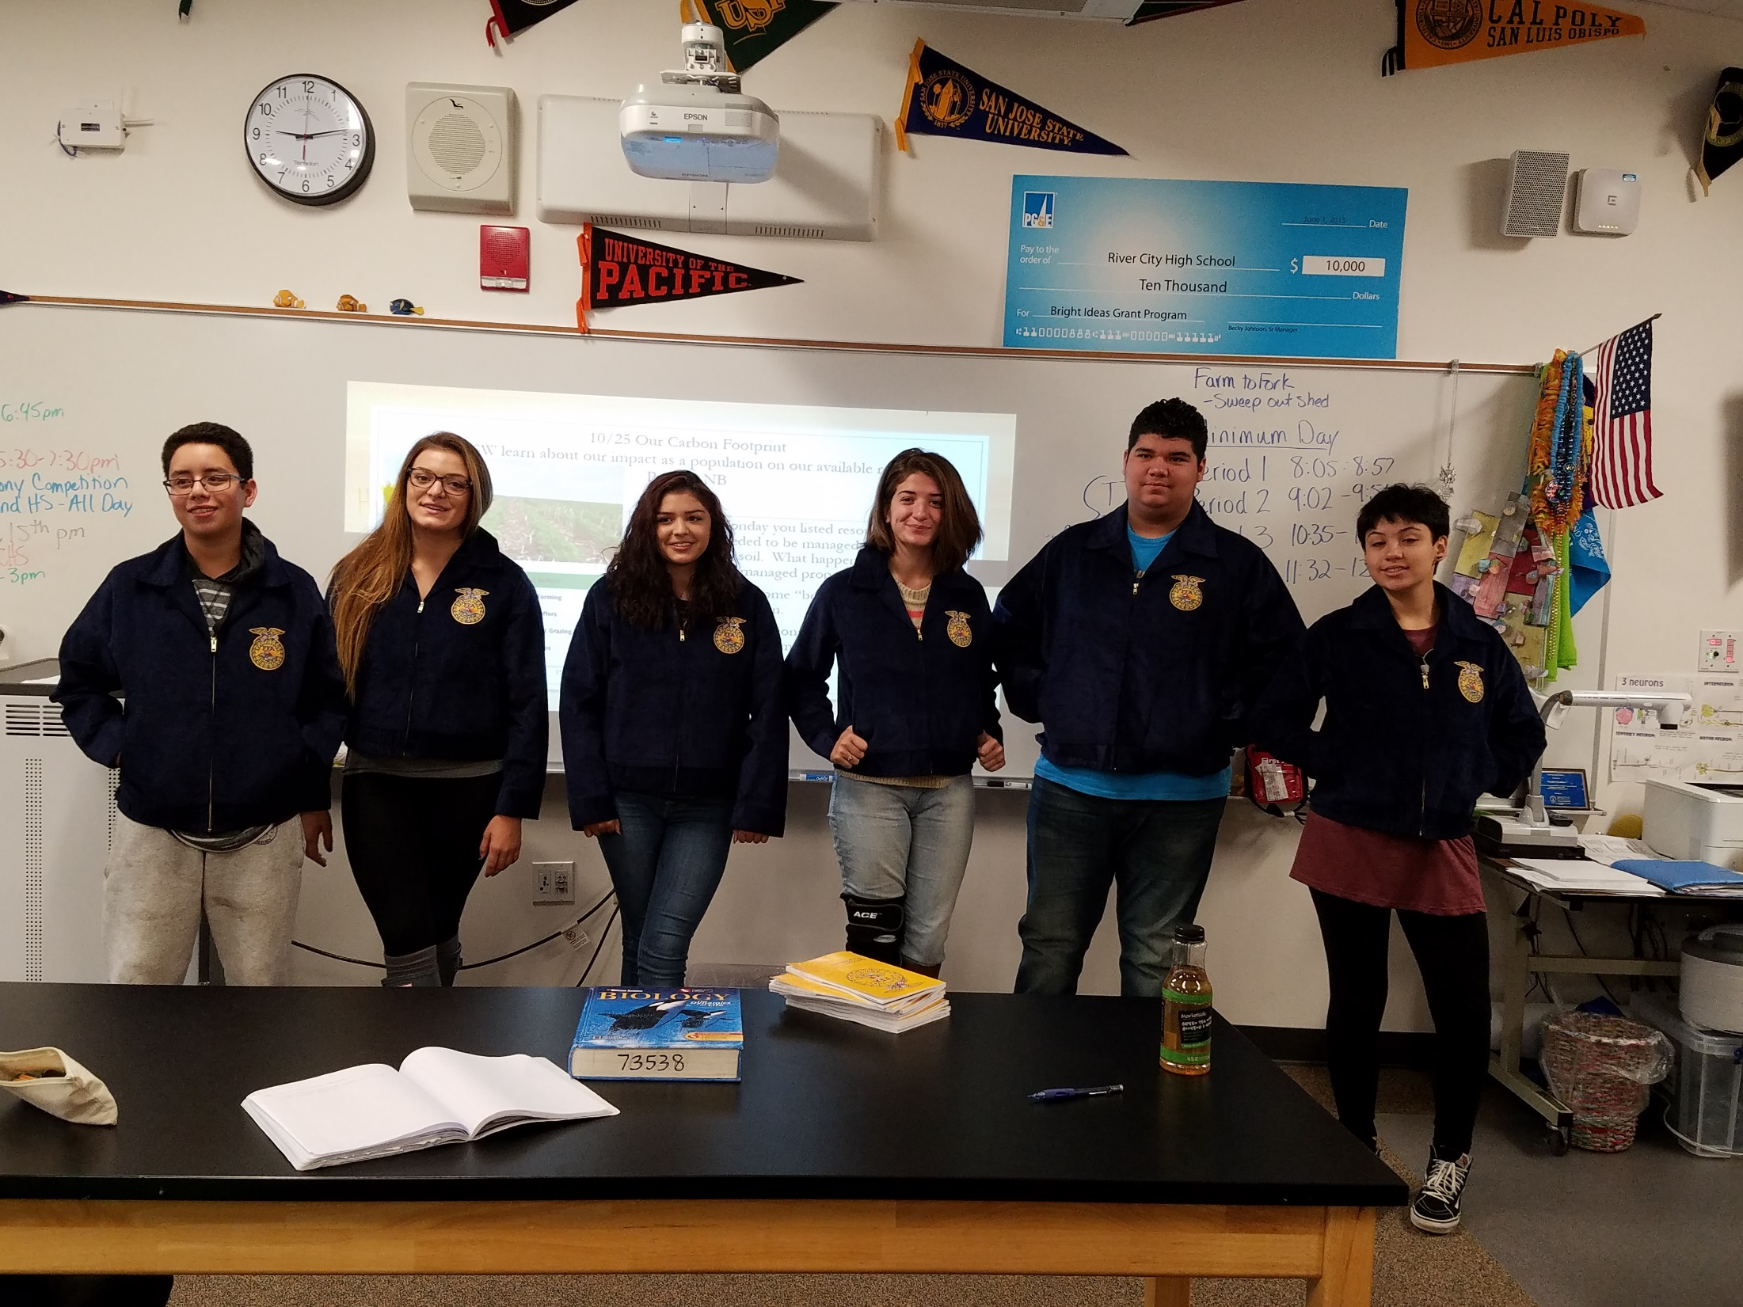

Slide 7
RCHS West Sacramento FFA Chapter

Slide 8
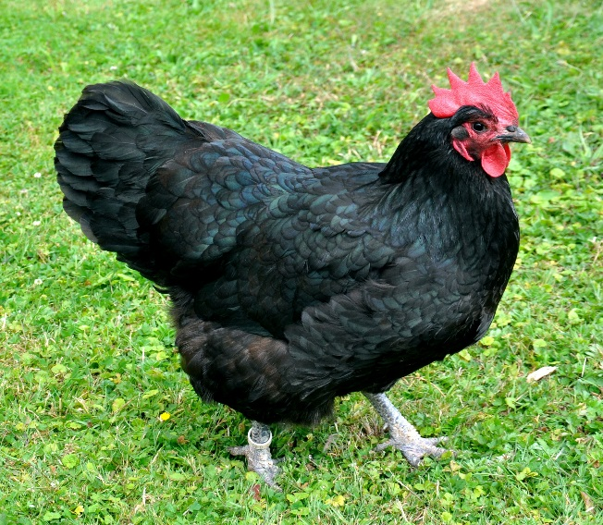
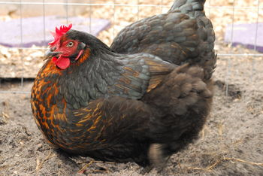
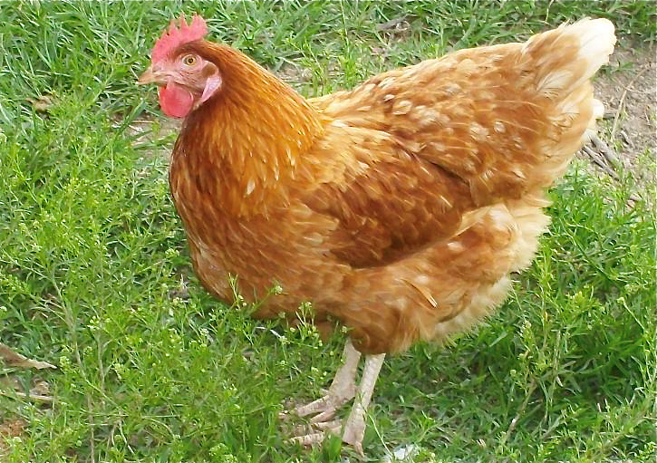
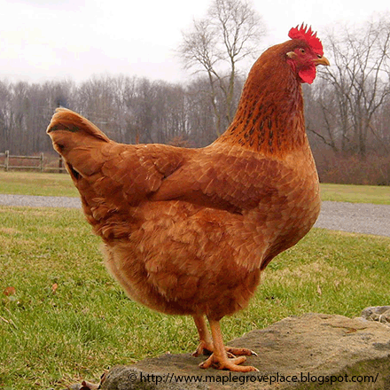
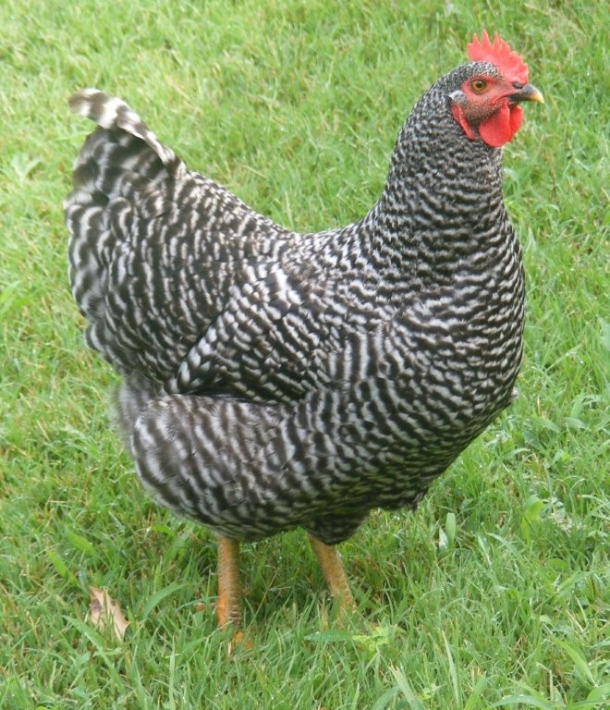
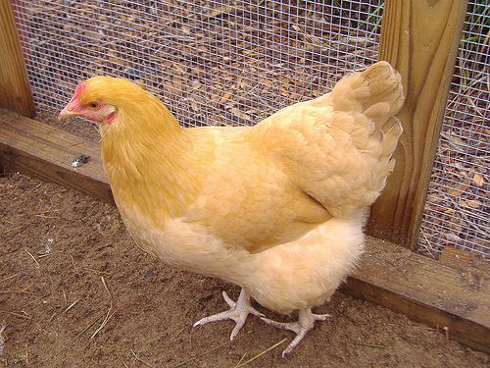
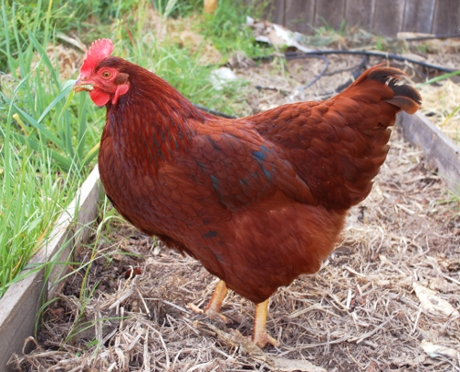
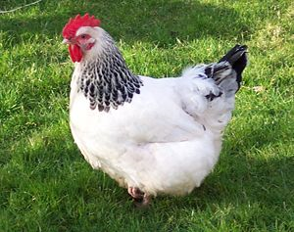
Bradshaw Feed and Pet Supply 7285 Bradshaw Rd, Sacramento Ca, 95829
If you are set up for chickens already, Here is what Bradshaw’s has:
Black Australorp = Annabelle
Black Sex Link
Golden Sex Link
New Hampshire Red
Barred Rock
Buff Orphington
Rhode Island Red
Light Brahma
This is what you need: Watering can $10 – 30, Feeder $10 – 30, Feed $18/ 50#, Enclosure, Nesting box $16.

Slide 9
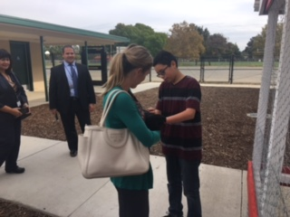

Slide 10
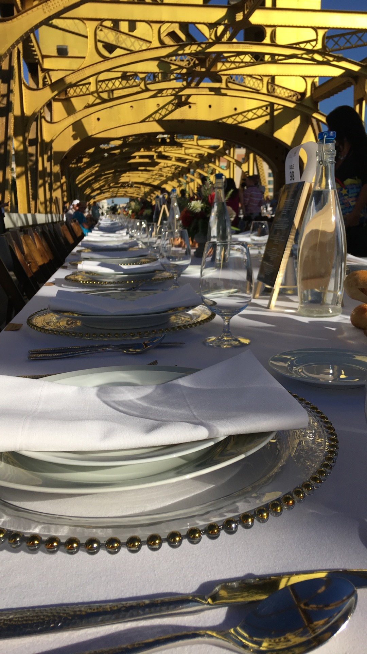

Slide 11
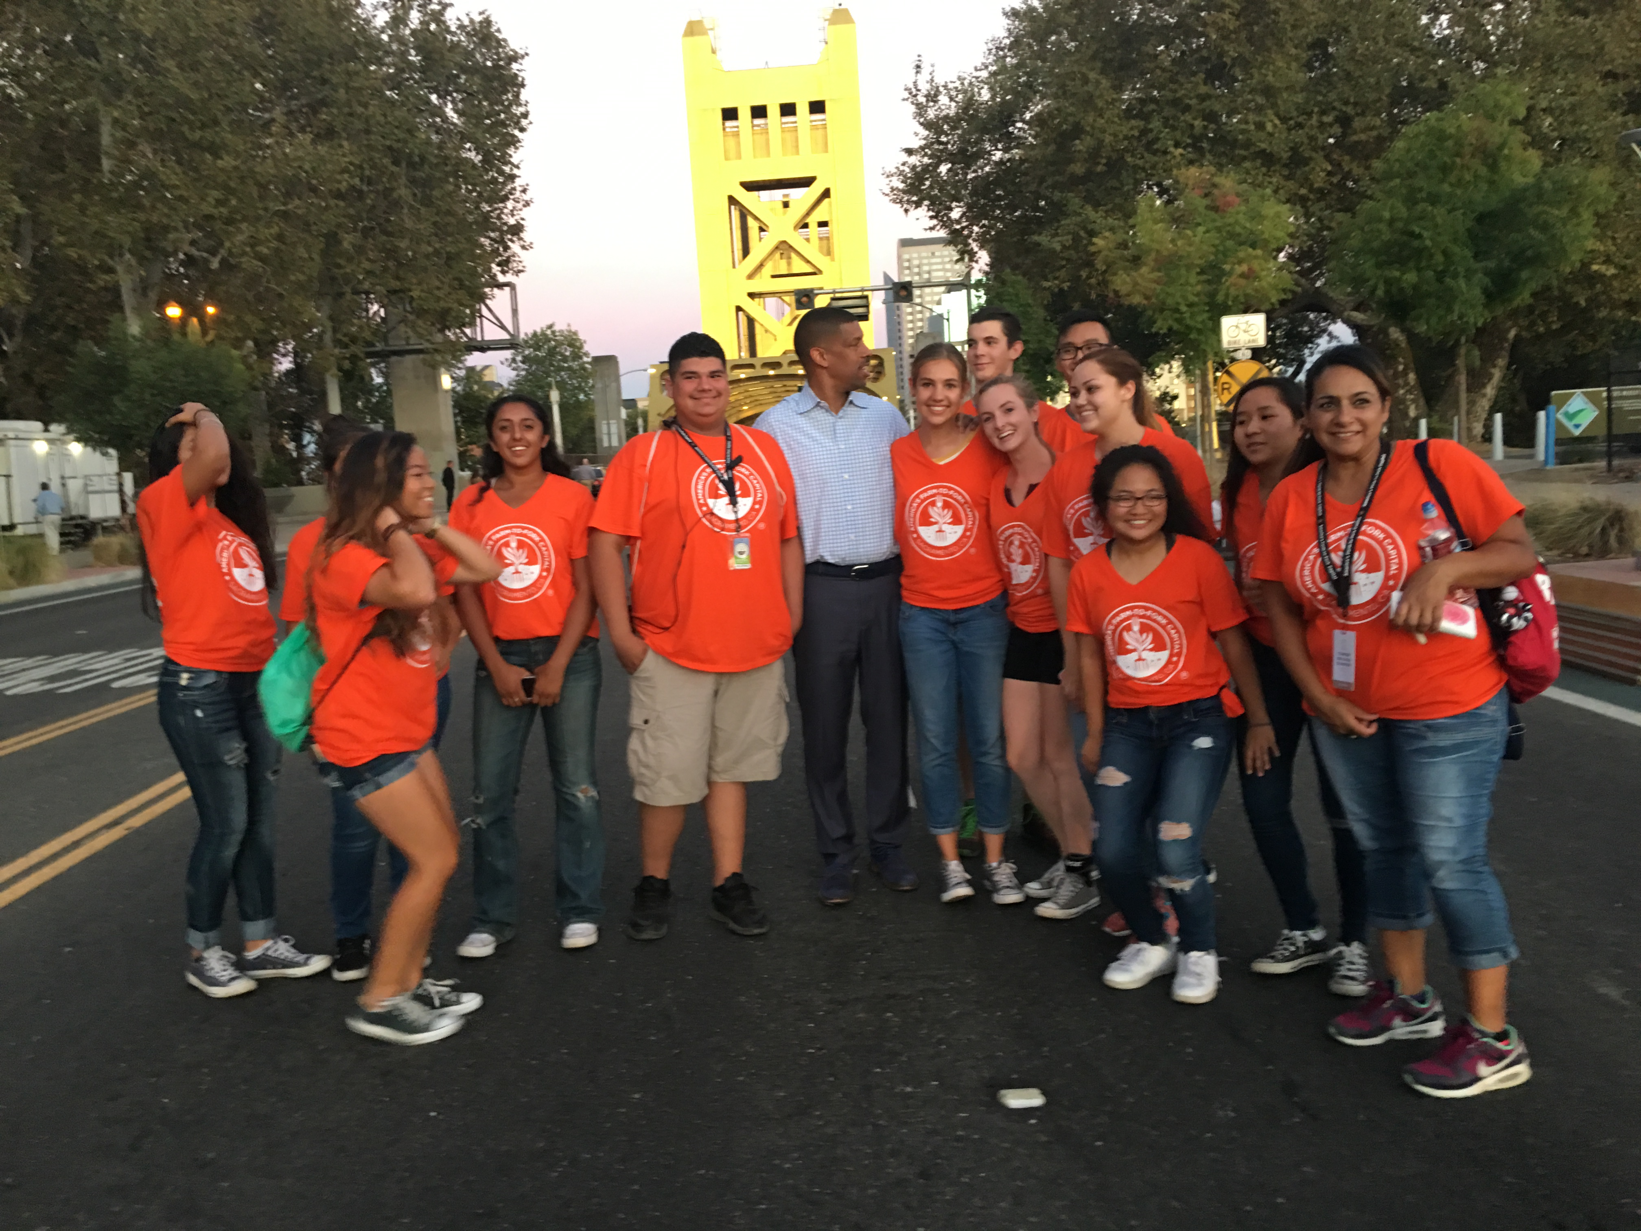

Slide 12
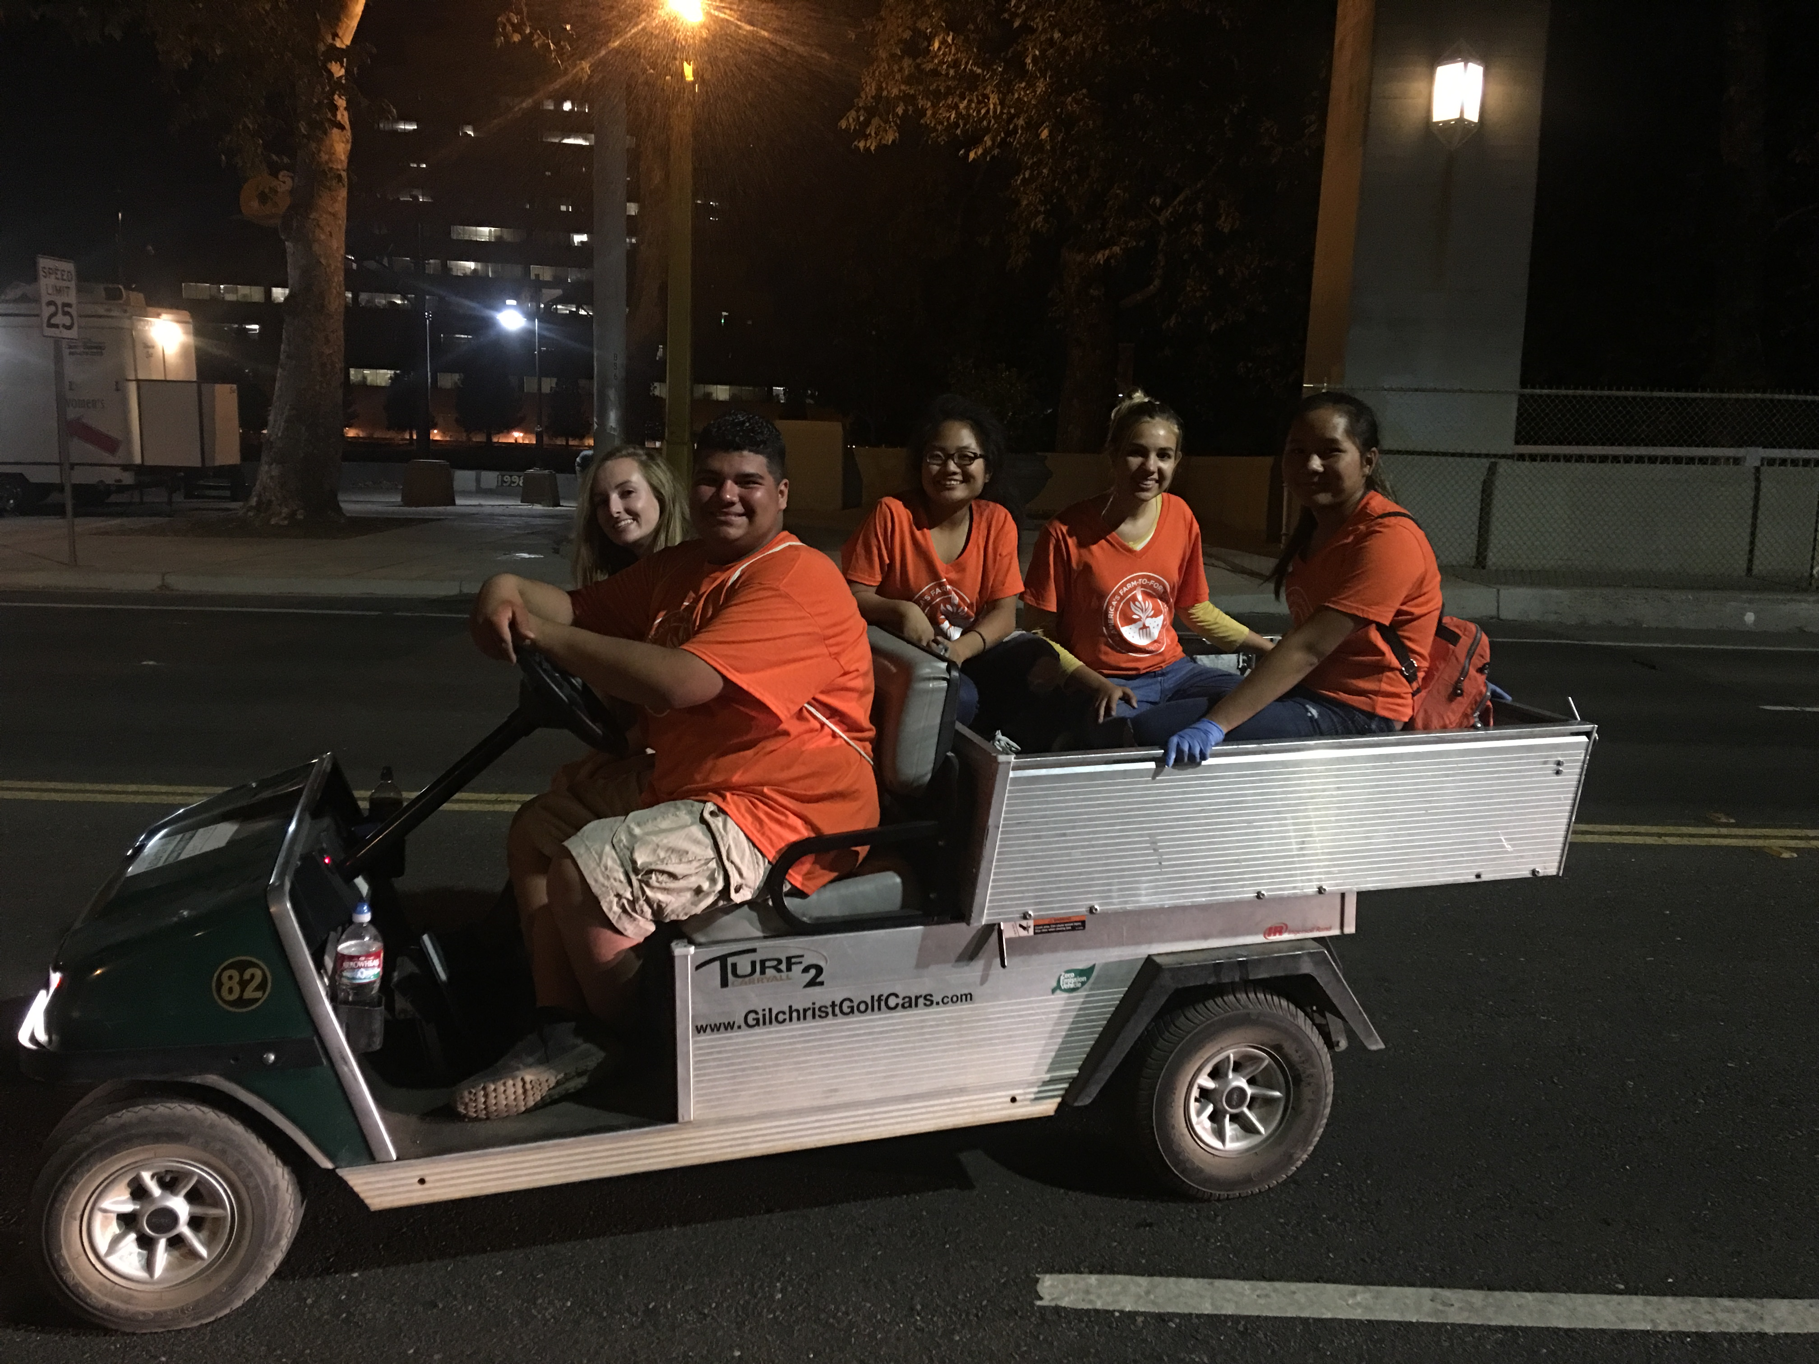

Slide 13
Ag Biology Notebook
Open your Notebook to the Center where the book is sewn.
Number the Right side of the page 1
Turn the page, number the left side of the page 2
Odd’s on the right, Evens on the left
Number to page 8

Slide 14
Biology UNIT Genetic Inheritance
March 20th – April 7th
Week 12

Slide 15
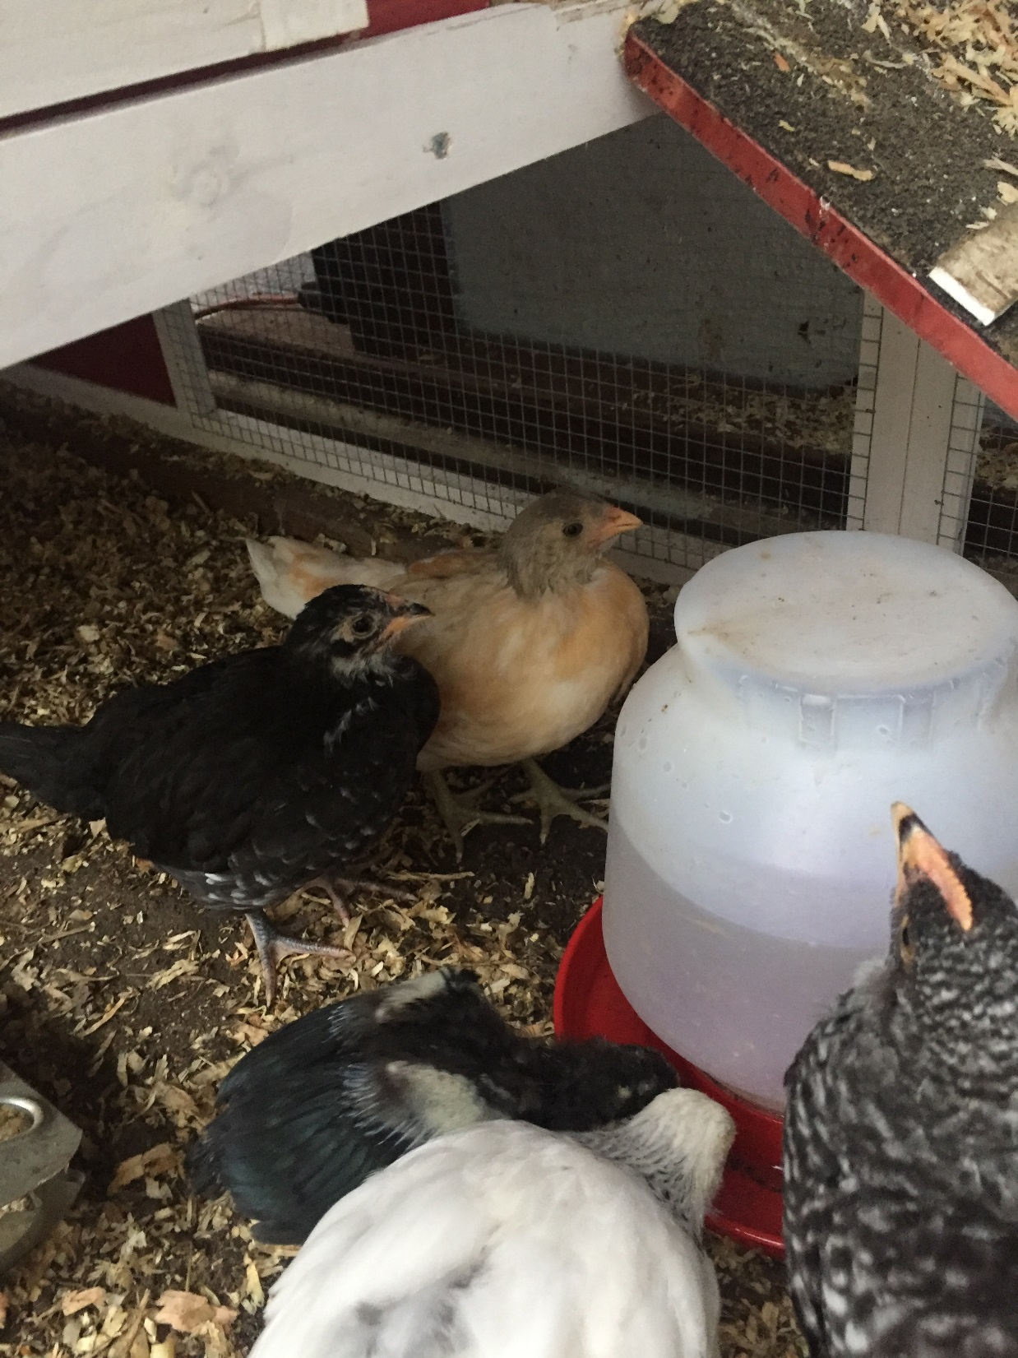
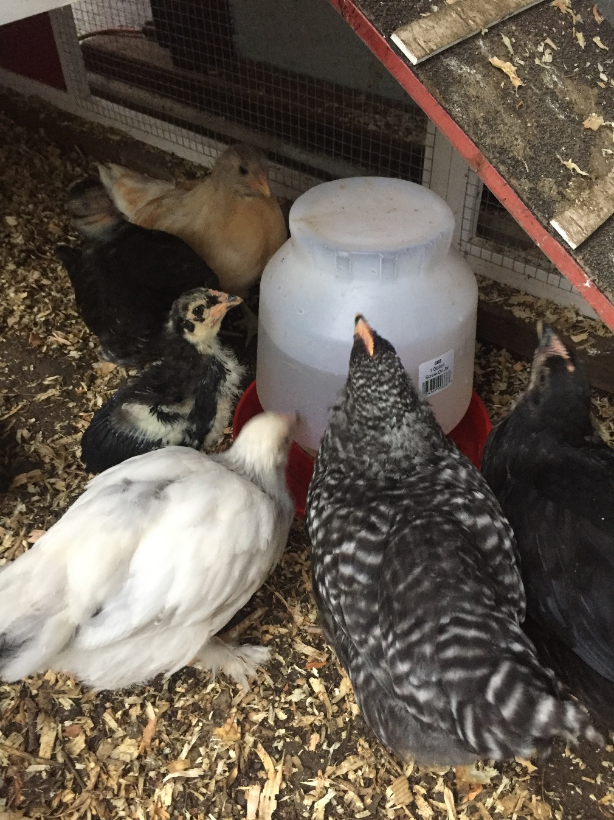
Samantha’s Hens

Slide 16
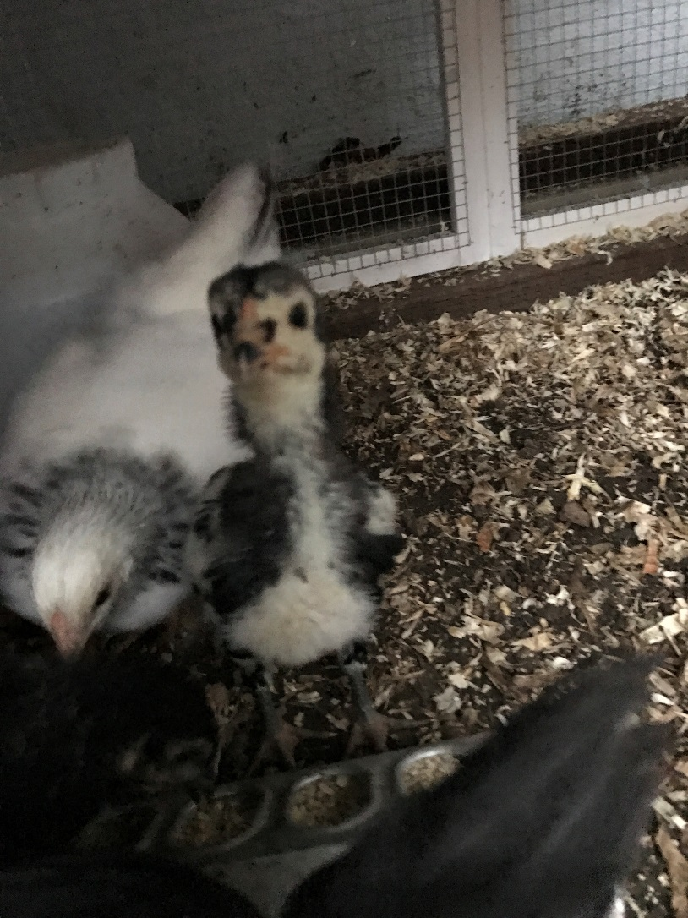
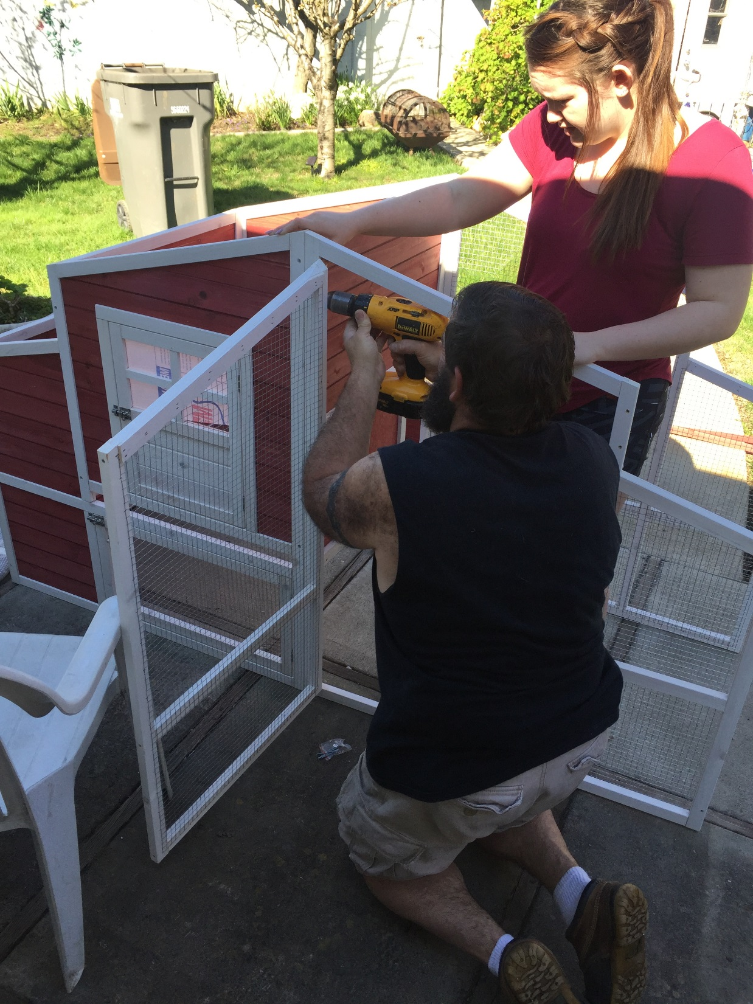

Slide 17
FFA Creed Practice P. 15 NB
Open the Official FFA Manual to page 35.
How does the FFA Creed support the FFA Mission in making a positive difference in lives of students?
One Officer practice with a partner(s) to recite 2 paragraphs of your choosing. Students have the FFA Manual open, follow along and only correct if they pronounce the word wrong or pause or say the wrong word.

Slide 18
Punnett Square Practice Activity p.265 Biology Book
Make 7 Punnett square boxes on P.13 NB
Choose different genotypes for each of the different Pea Traits and perform Punnett square crosses with different compbinations of genotypes.
Write to the side the % probability of the Homozygous Recessive, Heterozygous, Homozygous Dominant

Slide 19
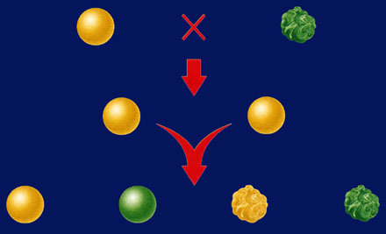
Section 10.1 Summary – pages 253-262
The first generation
Dihybrid Cross
round yellow x wrinkled green
P1
Round yellow
Wrinkled green
F1
All round yellow
F2
9
3
3
1
Round yellow
Round green
Wrinkled yellow
Wrinkled green

Slide 20
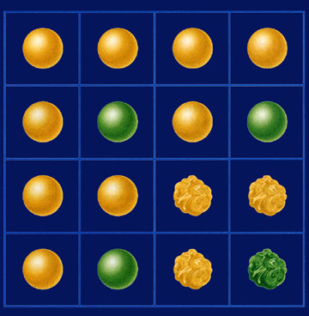
Section 10.1 Summary – pages 253-262
Punnett Square of Dihybrid Cross
Dihybrid crosses
Gametes from RrYy parent
RY
Ry
rY
ry
RRYY
RRYy
RrYY
RrYy
A Punnett square for a dihybrid cross will need to be four boxes on each side for a total of 16 boxes.
RY
RRYy
RRYy
RrYy
Rryy
Ry
Gametes from RrYy parent
RrYY
RrYy
rrYY
rrYy
rY
RrYy
Rryy
rrYy
rryy
ry

Slide 21
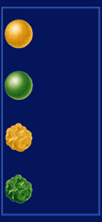
Section 10.1 Summary – pages 253-262
Punnett Square of Dihybrid Cross
Dihybrid crosses
Gametes from RrYy parent
RY
Ry
rY
ry
RRYY
RRYy
RrYY
RrYy
RY
F1 cross: RrYy ´ RrYy
RRYy
RRYy
RrYy
Rryy
Ry
round
yellow
Gametes from RrYy parent
RrYY
RrYy
rrYY
rrYy
round
green
rY
wrinkled
yellow
RrYy
Rryy
rrYy
rryy
ry
wrinkled
green

Slide 22
Section 12.3 Summary – pages 323 - 329
Multiple Alleles Govern Blood Type
Answers #1 & 2
Human Blood Types
Genotypes
Surface Molecules
Phenotypes
l^{A} l^{A} or l^{A}i
A
A
l^{B} l^{B} or l^{B}i
B
B
l^{A} l^{B}
A and B
AB
ii
None
O

Slide 23
Genotypes: Phenotypes: Probability of A Blood? B Blood? AB Blood? O Blood?
Question #3.
 | I^{A} | i
I^{B} | I^{A}I^{B} | I^{B}i
i | I^{A}i | ii

Slide 24
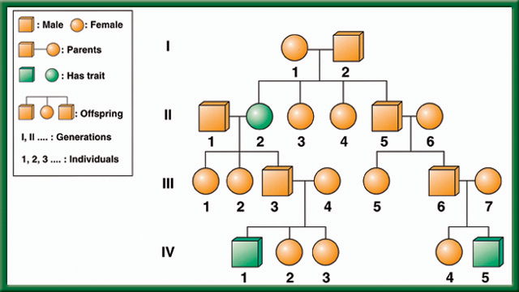
What is the Mode of Inheritance? Dominant/ Recessive? Autosomal or Sex-Linked?
To return to the chapter summary click escape or close this document.

Slide 25
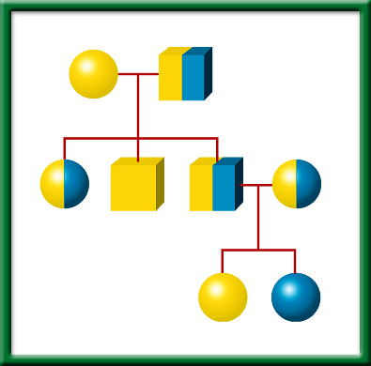
Who is affected?
What generation?
What does it mean to only be shaded ½ way?
What Does the Punnett Square look like for Person 3 & 4 of Generation II?
Simple
Pedigree
To return to the chapter summary click escape or close this document.

Slide 26
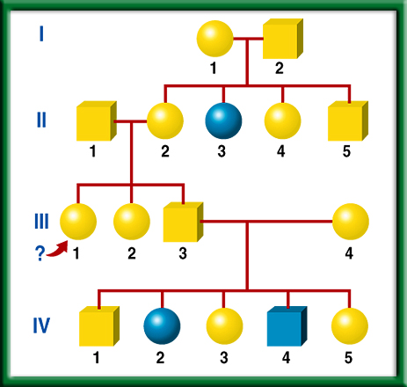
Fictional
Pedigree
To return to the chapter summary click escape or close this document.

Slide 27
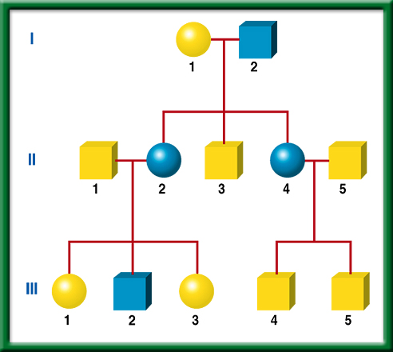
What is the Mode of Inheritance? Dominant/ Recessive? Autosomal or Sex-Linked?
Pedigree-
Huntington
Disease
To return to the chapter summary click escape or close this document.

Slide 28
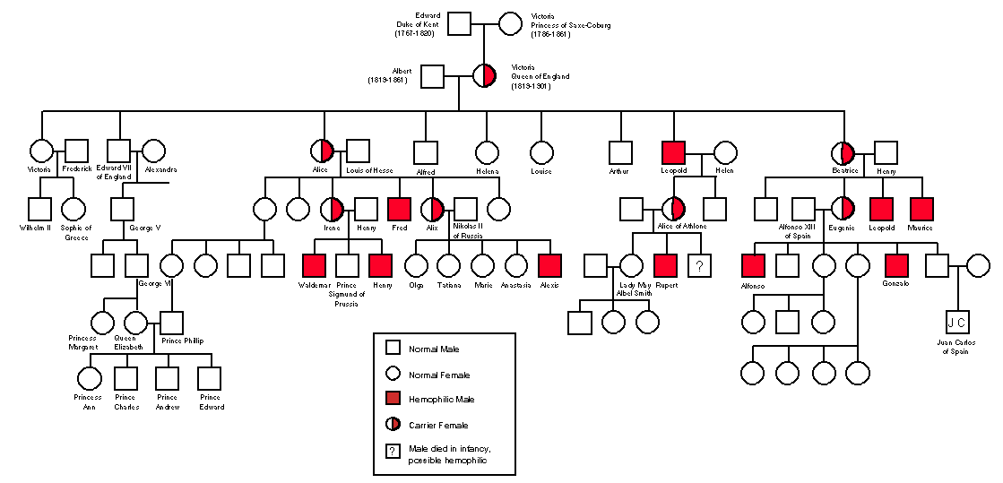
Who is affected?
Who are the carriers?
Dominant or recessive?
Autosomal or Sex Linked?
Draw the Punnett Square for a mom who is a carrier, and an unaffected father.

Slide 29
Write a 4 sentence summary
P. 15 NB
Diploid
One cell division
Four haploid cells
Original cell
Two cell divisions
Body cell
Same
Chromosome
Gamete-producing cell
Half
Two diploid cells

Slide 30
Meiosis Activity with beads. Simulate the process of Meiosis with a partner. Show us your simulation. Explain in your notebook page 27 How does Meiosis add genetic variation to the population? Use these words: gamete, sex cell, haploid, homologous chromosomes, division, egg or sperm cell. DRAW your Gametes formed from Meiosis with 2 different colors.
.
Mitosis vs. Meiosis video demonstration

Slide 31
Mitosis vs Meiosis P. 27 NB
Somatic Cell (Body Cell)
2N (Diploid)
46 Chromosomes
1 Division
Produces 2 identical cells, same as the parent cell
Gametes (Sex Cell)
2N -> 1N (Haploid)
23 Chromosomes
2 Divisions
Produces 4 Haploid cells, all different from each other and the parent cells. (Crossing Over)
Increases Genetic Variation

Slide 32
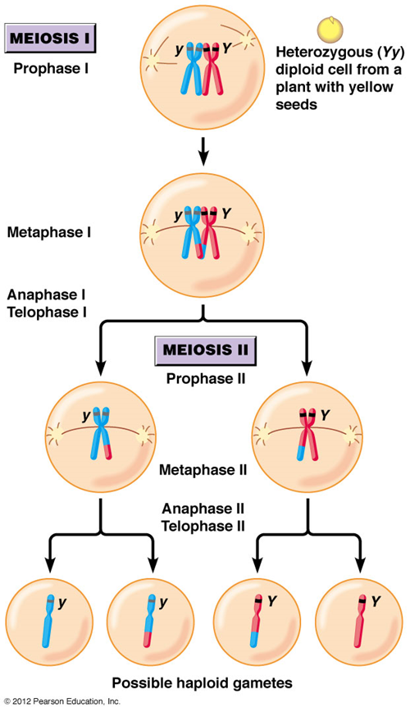
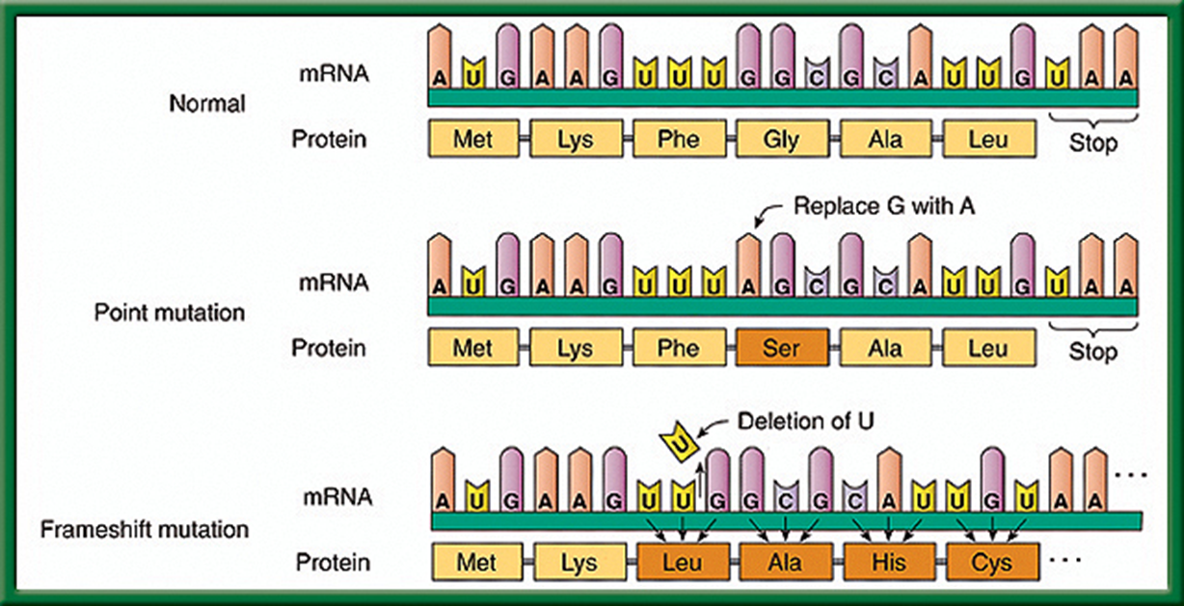
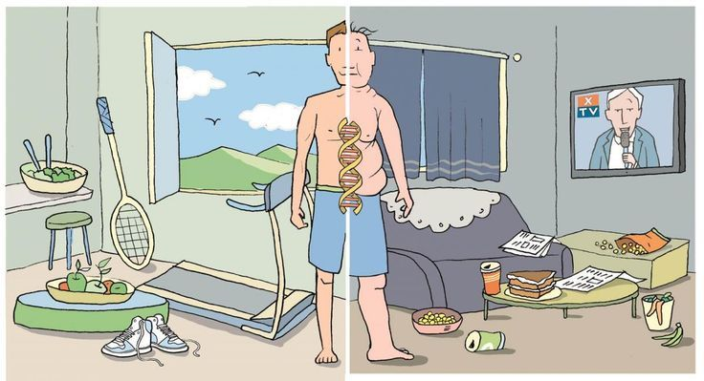
Genetic Variation P. 27 NB How and When does it happen?
Mutations during DNA Replication
Crossing Over Meiosis
Mutations influenced by the environment

Slide 33
Genetic Inheritance Notes P. 31 NB
1.Homozygous: when identical alleles of the gene are present on both chromosomes
Said to be true breeding
Homo means same
Can be homozygous recessive (bb) or homozygous dominant (BB)
Heterozygous: when two different alleles occupy the gene's position on the chromosomes
Heterozygous: Bb
2. Crossing Over adds genetic variation to the species. It is an example of Genetic Recombination and happens during Prophase 1 of Meiosis.
3. Haploid Cells are the gametes, Egg & Sperm Cells. They have 1 set of chromosomes from mom or dad.
Diploid Cells are the Body Cells, heart, muscle cells. They have 2 sets of chromosomes from Mom & Dad.

Slide 34
P. 29 NB
4 Sentence Summary
Tay – Sachs Disease
Recessive allele
Phenylketonuria
Dominant allele
Lungs & pancreas
Central Nervous System
Cystic Fibrosis
DRAW a Punnett Square showing from one of these 4 diseases with parents that are Heterozygous for the trait.

Slide 35
Getting set up

Slide 36
What good students!!

Slide 37
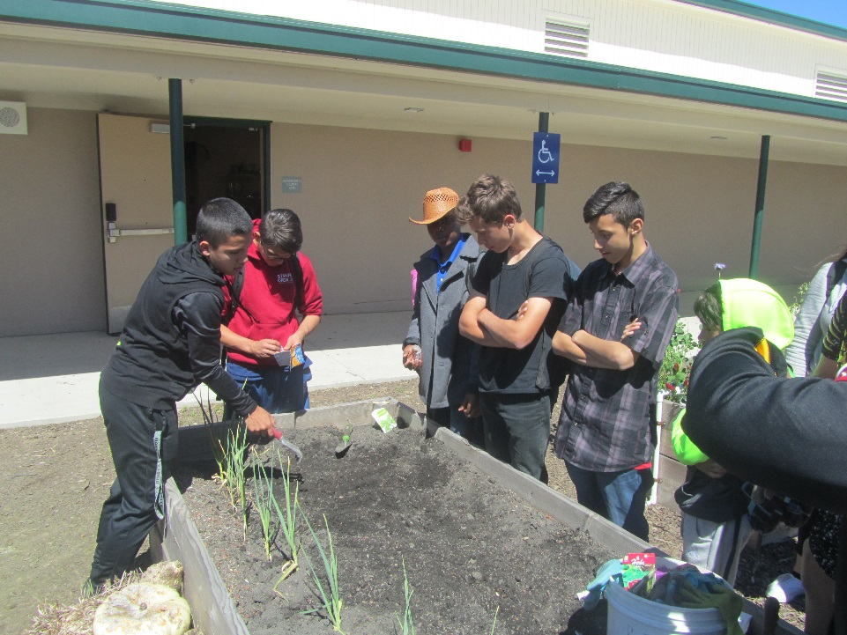
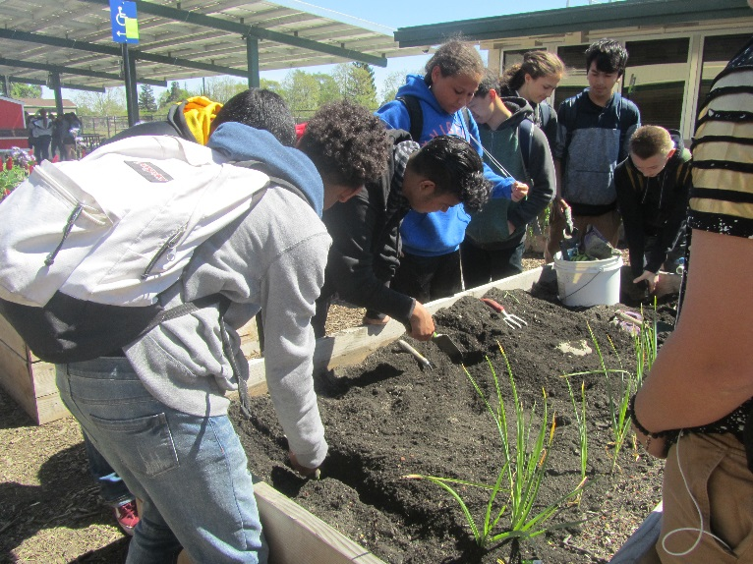
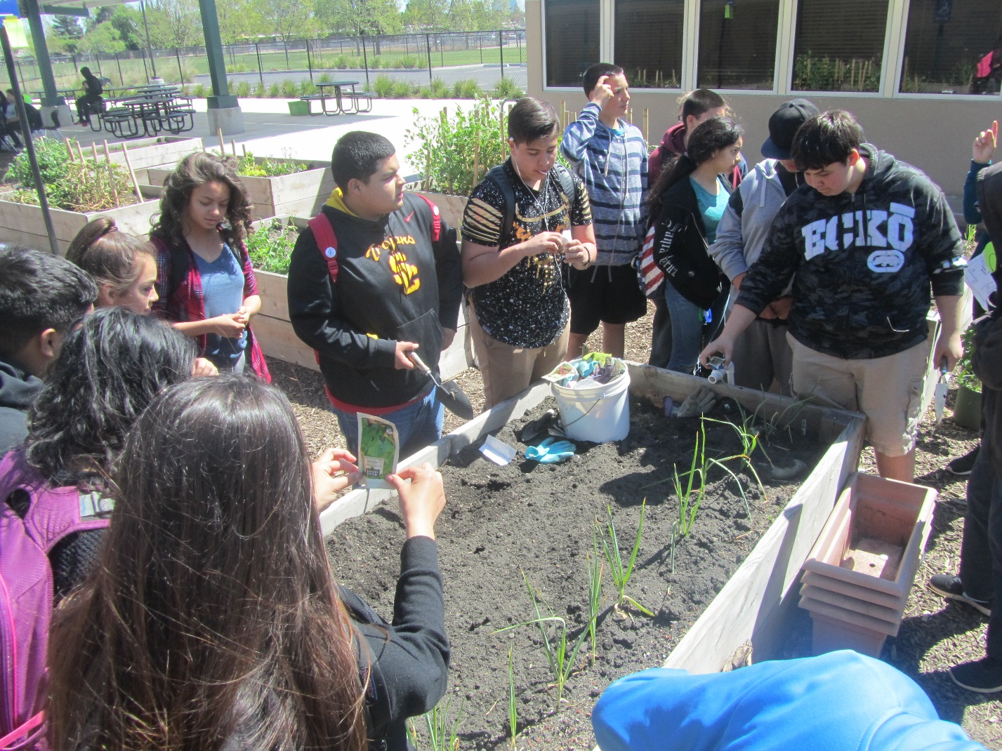
Diggin’ in

Slide 38
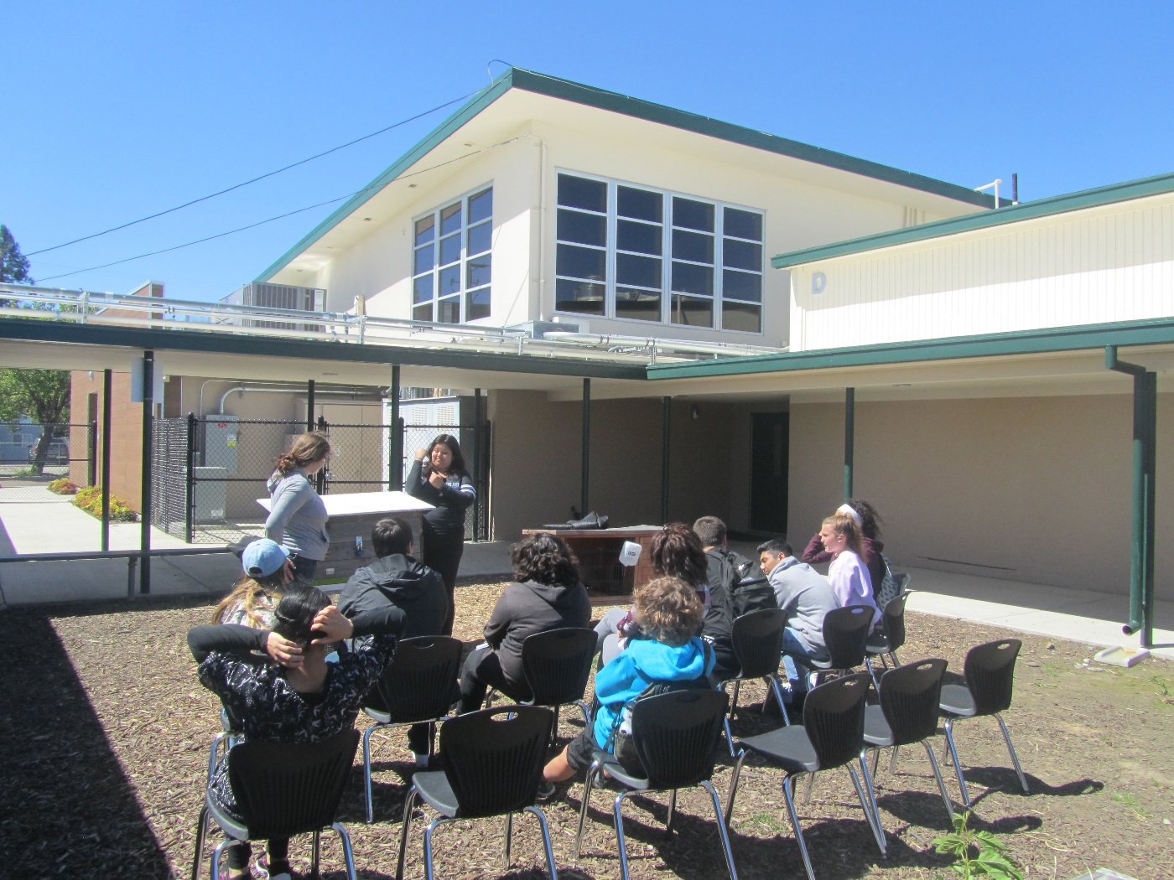
Teaching about bunnies

Slide 39
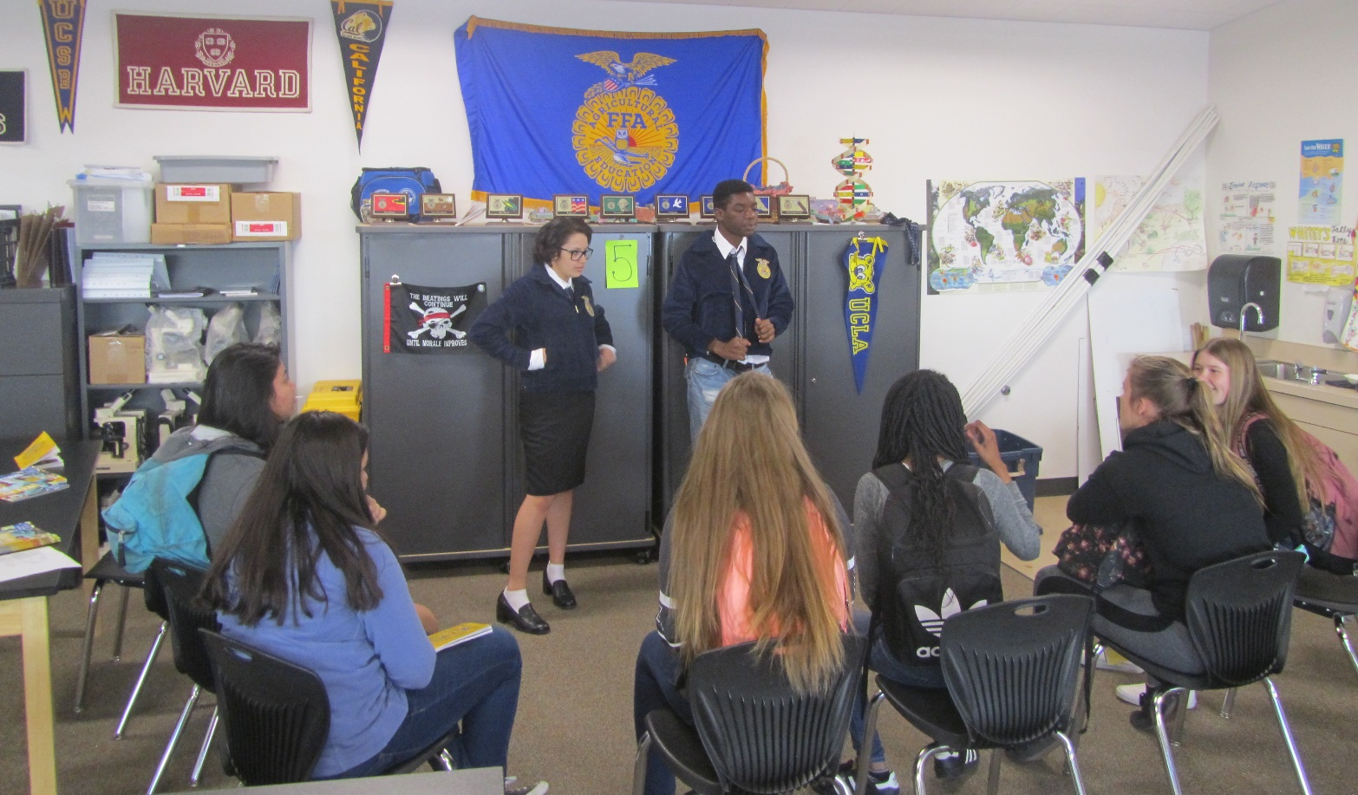
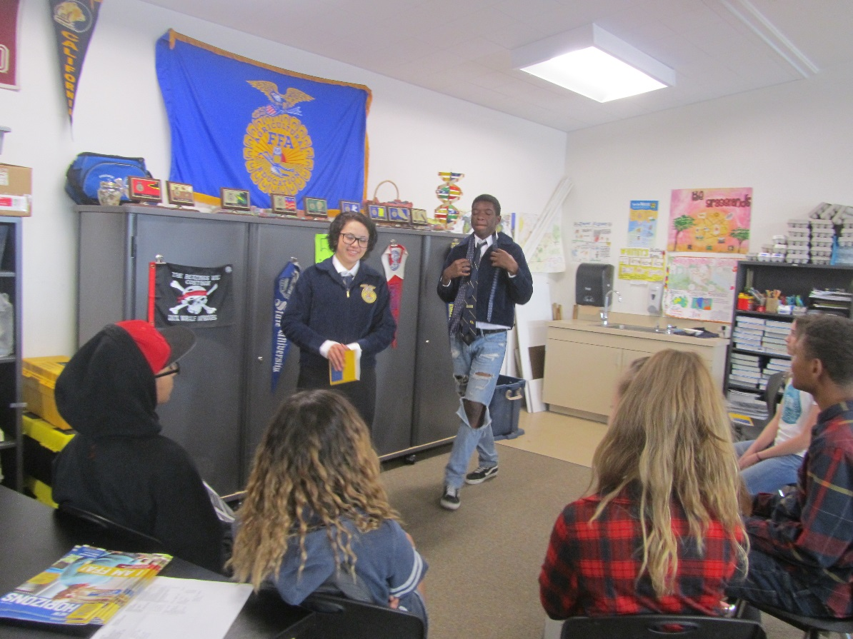
Teaching about FFA

Slide 40
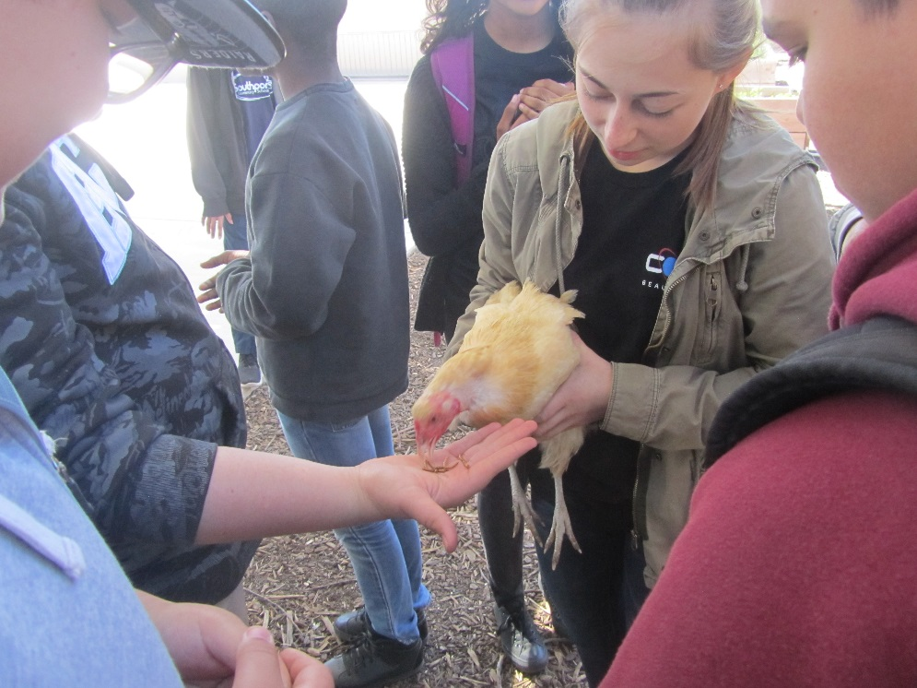
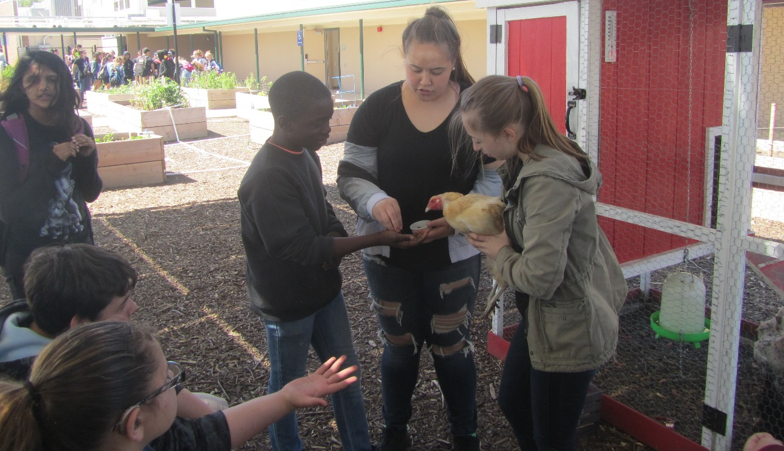
Teaching about the Chickens

Slide 41
Teaching about Composting and Hydroponics

Slide 42
Teaching about the Tower Gardens

Slide 43
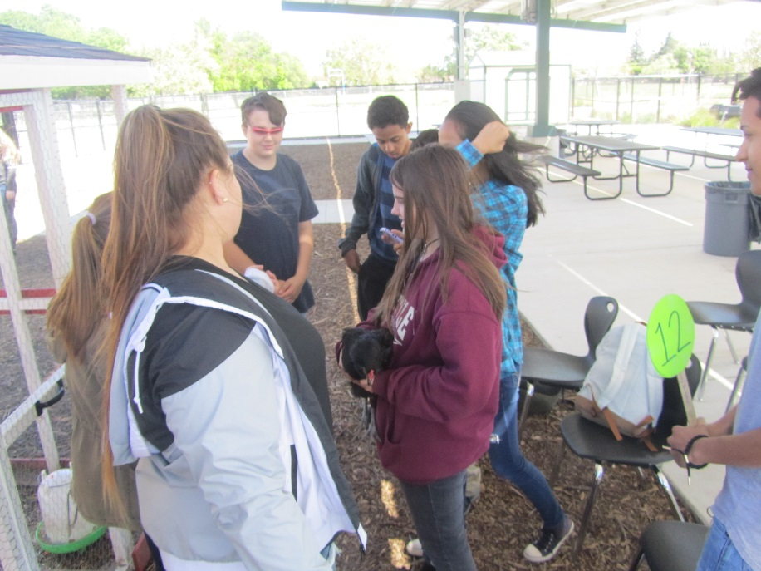
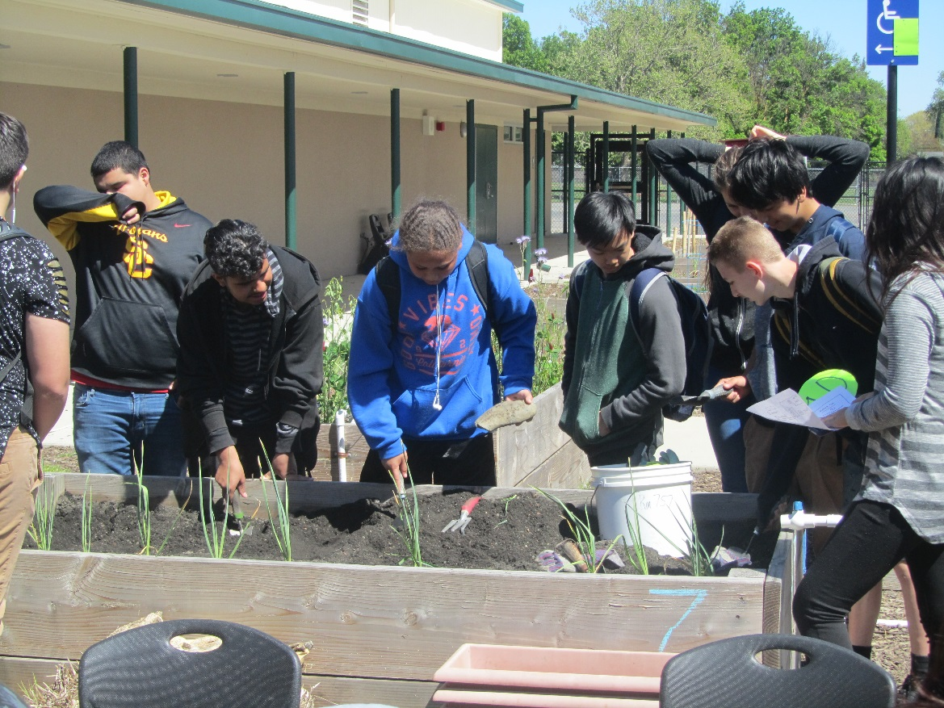
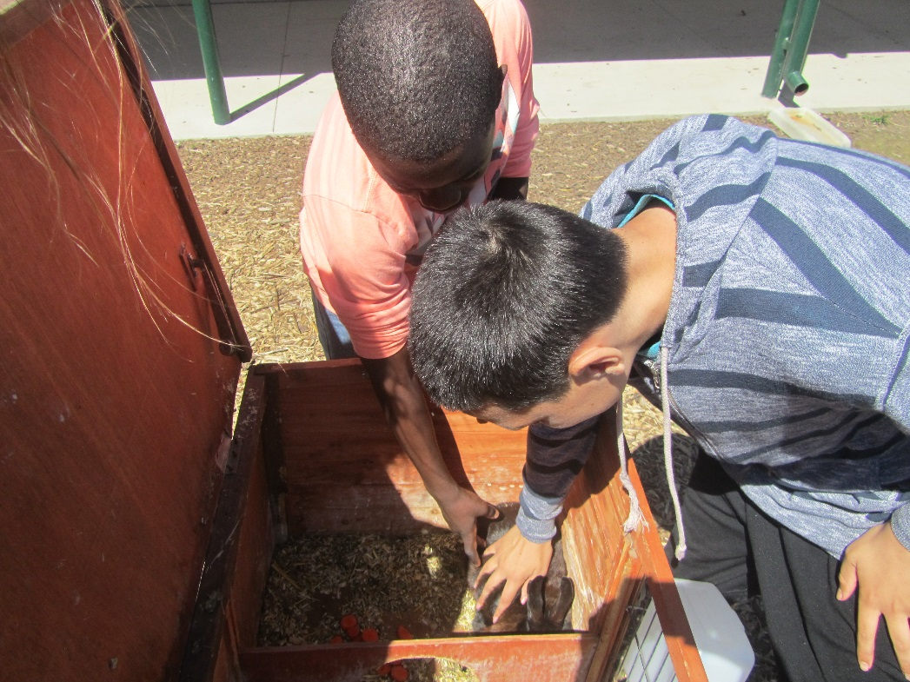
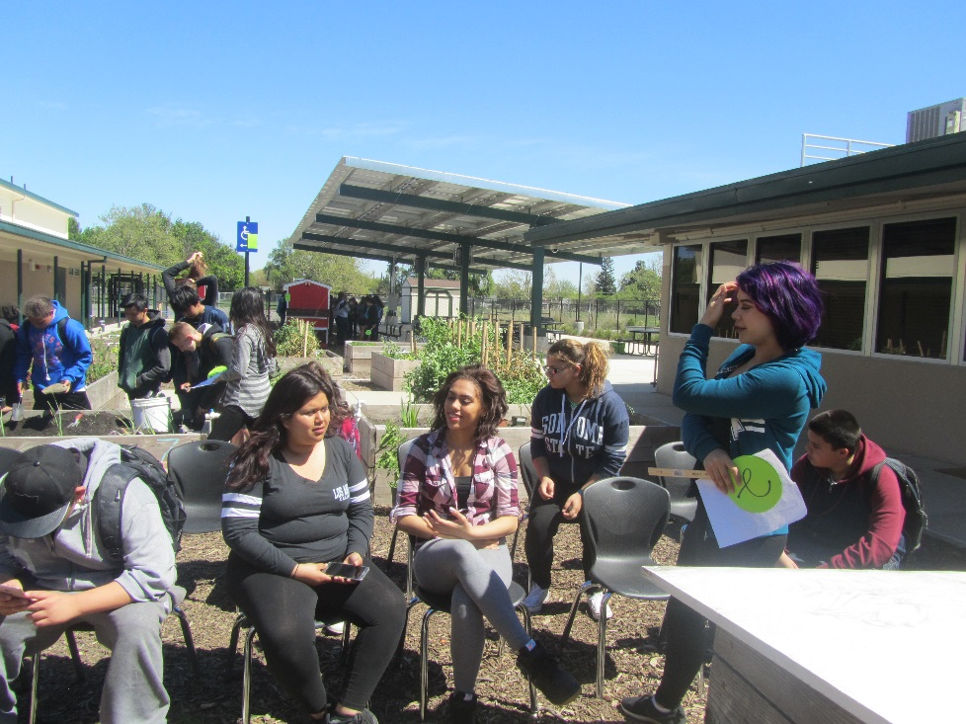
Thank you

Slide 44
Great Job West Sacramento FFA!

Slide 45
Feedback Good Things: Areas of Improvement :
Interested in Culinary – burgers
Tower Garden
Listening
Being Guides
Good Effort
Asking questions
Construction engaged
Participation
Patient
Organized
Disrespectful
More involvement/ attention
Attitude
Stay with group
Throwing Carrots
Need more questions
More interaction with students
Constructive Conversation

Slide 46
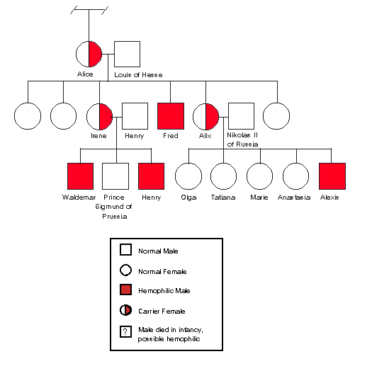
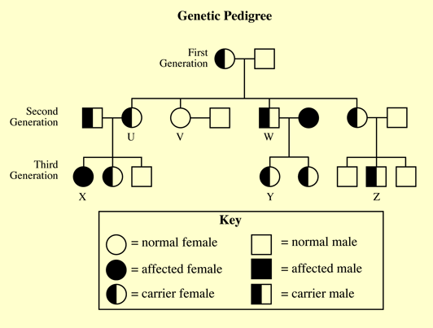
4/3 Pedigrees 12.1 Obj. TSW determine the mode of inheritance of a trait by examining a pedigree in a group pedigree project. P.26 NB
Pedigree 1
Identify and explain the Mode of inheritance for each of these three pedigrees.
Dominant or Recessive
Autosomal or Sex - Linked
Pedigree 3
Pedigree 2

Slide 47
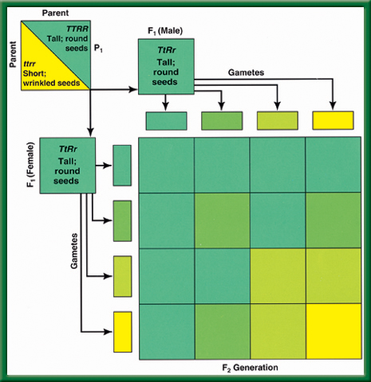
P. 27 NB
Use ¾ of paper, ¼ to write an AXES paragraph
Law of Independent Assortment
Dihybrid
Cross

Slide 48
Meiosis Activity with beads. Simulate the process of Meiosis with a partner. Show us your simulation. Explain in your notebook page 27 How does Meiosis add genetic variation to the population? Use these words: gamete, sex cell, haploid, homologous chromosomes, division, egg or sperm cell.
Mitosis vs. Meiosis video demonstration

Slide 49
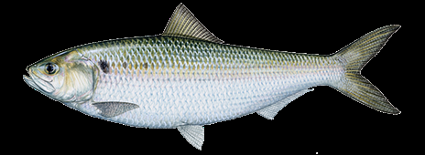
Frankenfish Activity Due by the end of the class, turn in for credit
Materials:
Have a partner, a piece of White paper, a penny, and colored pencils
Procedure:
For each Trait flip two pennies.
Heads/ Heads, Both Big Letters = BB
Heads/ Tails, Hybrid Letters = Bb
Tails/ Tails, Both Small Letters = bb
3. Draw the appropriate shape for that trait according to the genotype.
4. Where does your fish live? What does it eat? What is unique to your fish?

Slide 50
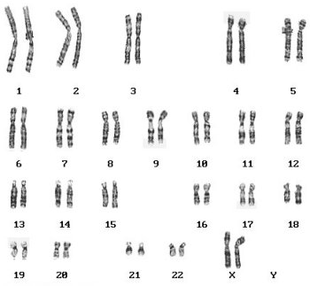
Genetic Inheritance Quiz
Draw a Chromosome and label a trait.
Draw a Punnett Square
Write the genotype XX for Mom
Write the genotype XY for Dad
Complete the Punnett square
What is the Probability of having a girl?
Write the gamete for mom
Write the gamete for dad
Explain what a zygote is, draw a picture if you need to.
Examine the Karyotype above, Is it a girl or a boy, How do you know?

Slide 51
Date | Title/ Topic | Page
10/19 | WU – Chromosomes CH 10.1 | 8
10/19 | Activity: Human Traits Checklist | 9
10/21 | WU – Mendel’s Two Laws CH 10.1 | 10
10/20 | HW – 1 page Notes CH 10 Notes: GATTACA | 11
10/22 | WU – Meiosis CH 10.2 | 12
10/22 | Karyotyping & Punnett Square Practice | 13
10/23 | WU – Genetic Inheritance CH 10.1 – 10.2 | 14
10/22 QUIZ | Concept Map: Mendel & Meiosis w/ summary Meiosis Paragraph from Meiosis Bead Activity | Notebook Check P. 8 – 15 (40 points)

Slide 52
FFA Creed Practice P. 35 NB
Open the Official FFA Manual to page 35.
How does the FFA Creed support the FFA Mission in making a positive difference in lives of students?
One Officer practice with a partner(s) to recite 2 paragraphs of your choosing. Students have the FFA Manual open, follow along and only correct if they pronounce the word wrong or pause or say the wrong word.

Slide 53
Practice Karyotype learn.genetics.utah.edu

Slide 54
Homozygous and Heterozygous
1.Homozygous: when identical alleles of the gene are present on both chromosomes
Said to be true breeding
Homo means same
Can be homozygous recessive (bb) or homozygous dominant (BB)
Heterozygous: when two different alleles occupy the gene's position on the chromosomes
Heterozygous: Bb
2. Crossing Over adds genetic variation to the species. It is an example of Genetic Recombination and happens during Prophase 1 of Meiosis.
3. Haploid Cells are the gametes, Egg & Sperm Cells. They have 1 set of chromosomes from mom or dad.
Diploid Cells are the Body Cells, heart, muscle cells. They have 2 sets of chromosomes from Mom & Dad.

Slide 55
P. 81NB
4 Sentence Summary
Tay – Sachs Disease
Recessive allele
Phenylketonuria
Dominant allele
Lungs & pancreas
Central Nervous System
Cystic Fibrosis

Slide 56
Genetic Inheritance Why are there different Blood Types?
Week 10

Slide 57
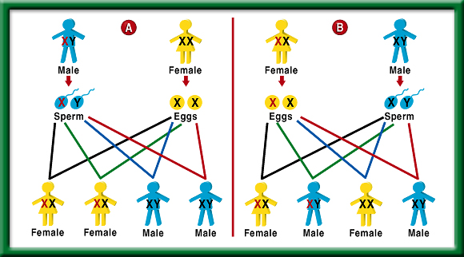
4/4 Complex & Polygenic Inheritance 12.3 Obj. TSW predict possible combinations of alleles in a zygote from the genetic makeup of the parents during classroom activities. P.30 NB
Determine the possible blood types of the children of parents that both have type AB.
Explain why a male with a recessive X – linked trait usually produces no female offspring with the trait.
Explain polygenic inheritance. Give an example. Draw the graph below.

Slide 59
Stem Length Variation in Plants
To return to the chapter summary click escape or close this document.

Slide 60
Number of
Genes
Involved in
Skin Color
To return to the chapter summary click escape or close this document.

Slide 61
Fold a vertical sheet of notebook paper from side to side.
To return to the chapter summary click escape or close this document.

Slide 62
Cut along every fifth line of only the top layer to form tabs.
To return to the chapter summary click escape or close this document.

Slide 63
Explain how the traits are inherited by giving an
example of a punnett square for each.
Make sure you write the key for the genotypes.
Label each tab.
Modes of Inheritance
P. 83 NB
Complete Dominance
Incomplete Dominance
Codominance
Sex Determination
Sex - Linked
Multiple Allelic
To return to the chapter summary click escape or close this document.

Slide 64
Rules
BE in your assigned seat when the bell rings, or you will be marked tardy with your Ag Biology Notebook & Biology Book out and ready to learn.
Cell Phone are off and away.
Ear buds are out, not listening to music.
You are responsible for your learning, stop copying off of the “smarter students” or waiting for me to show you the answers.
You will be graded for your role & your work when working in partners. The project may be a 10/10, but your grade may be a 2/10 if you did not do your part for the project.

Slide 65
4/5 Incomplete Dominance & Codominance 12.2 Obj. TSW demonstrate understanding of Pedigrees by finishing the study guide. P.30 NB
Draw a Punnett square and explain how incomplete dominance is inherited in Snap Dragon flowers.
Draw a Punnett square and explain how Codominance is inherited in Checkered chickens.
What color would the chicken be if feather color were inherited by incomplete dominance?

Slide 66
TABOO
Dominant
Allele
Heterozygous
Phenotype
Karoytype
Pure – Breeding

Slide 67
TABOO
Recessive
Genotype
Homozygous
Zygote
Chromosome
Hybrid

Slide 68
TABOO
Probability
Haploid
Offspring
Ratio
DNA
Meiosis

Slide 69
TABOO
Diploid
Punnett Square
Mitosis
Protein
Gametes
Homologous Chromosomes

Slide 70
3/21 Genetic Inheritance 10.1 & 10.2 Obj. TSW demonstrate understanding of genetic inheritance by doing well on the mendelian genetics quiz. P. 84NB
Draw the process of Meiosis (P.267BB) and explain it’s purpose.
Explain and draw fertilization using an egg (n) & sperm (n).
Using a Punnett Square, show how sex determination is 50%.

Slide 71
4/6 Patterns of Heredity & Human Genetics 12.1 – 12.3 Obj. TSW discover how multiple alleles are inherited by doing their warm up and competing a Foldable. P. 32 NB
Write all the symbols used for a pedigree. Draw a pedigree of just your mom & dad and any siblings. (Youngest to the left)
Compare & contrast Incomplete Dominance and Codominance.
Write the 6 genotypes for the 4 phenotypes for blood. Make a Punnett square with two crosses.

Slide 73
Section 12.2 Summary – pages 315 - 322
Incomplete dominance: Appearance of a third phenotype p. 77NB
When inheritance follows a pattern of dominance, heterozygous and homozygous dominant individuals both have the same phenotype.
When traits are inherited in an incomplete dominance pattern, however, the phenotype of heterozygous individuals is intermediate between those of the two homozygotes.

Slide 74
Section 12.2 Summary – pages 315 - 322
Incomplete dominance: Appearance of a third phenotype
For example, if a homozygous red-flowered snapdragon plant (RR) is crossed with a homozygous white-flowered snapdragon plant (R′ R′), all of the F₁ offspring will have pink flowers.

Slide 76
Section 12.2 Summary – pages 315 - 322
Incomplete dominance: Appearance of a third phenotype
Red
White
All pink
Red (RR)
Pink (RR’)
White (R’R’)
Pink (RR’)
All pink flowers
1 red: 2 pink: 1 white

Slide 77
Section 12.2 Summary – pages 315 - 322
Sex-linked inheritance
White-eyed male (X^{r}Y)
F₂
Females:
Red-eyed female (X^{R}X^{R})
all red eyed
Males:
1/2 red eyed
1/2 white eyed
F₁ All red eyed

Slide 78
Section 12.2 Summary – pages 315 - 322
Codominance: Expression of both alleles
Codominant alleles cause the phenotypes of both homozygotes to be produced in heterozygous individuals. In codominance, both alleles are expressed equally.

Slide 79
Karyotyping Chromosomes P. 81NB P.329 BB
How many chromosomes are present in Spread #1? 46 Spread#2 46 Spread #3 46 Set A 47 Set B 47
Sperm 23 Chromosomes/egg 23 chromosomes
3 &4 Spread #1 Girl (XX) Spread #2 Boy(XY) Spread #3 Girl (XX) Spread A Boy (XY) Spread B Boy (XXY)
5 & 6. Yes, Spread A is Trisomy 21, Spread B is XXY Chr 23.
7. Possible Problems for Trisomy 21- Down’s Syndrome, XXY is Kleinfelter’s Syndrome
8. In today’s medicine Karyotyping is used to determine the sex of the child and to see is there are abnormalities in the chromosomes.

Slide 80
Mitosis vs Meiosis
Somatic Cell (Body Cell)
2N (Diploid)
46 Chromosomes
1 Division
Produces 2 identical cells, same as the parent cell
Gametes (Sex Cell)
2N -> 1N (Haploid)
23 Chromosomes
2 Divisions
Produces 4 Haploid cells, all different from each other and the parent cells. (Crossing Over)
Increases Genetic Variation

Slide 81
Pedigree P. 309
Symbols
Used by
Geneticists
To return to the chapter summary click escape or close this document.

Slide 82
To return to the chapter summary click escape or close this document.

Slide 83
Simple
Pedigree
To return to the chapter summary click escape or close this document.

Slide 84
Fictional
Pedigree
To return to the chapter summary click escape or close this document.

Slide 85
Pedigree-
Huntington
Disease
To return to the chapter summary click escape or close this document.

Slide 86
Section 12.1 Summary – pages 309 - 314
Huntington’s disease
Huntington’s disease is a lethal genetic disorder caused by a rare dominant allele.
It results in a breakdown of certain areas of the brain.

Slide 87
Section 12.1 Summary – pages 309 - 314
Huntington’s disease
Ordinarily, a dominant allele with such severe effects would result in death before the affected individual could have children and pass the allele on to the next generation.
But because the onset of Huntington’s disease usually occurs between the ages of 30 and 50, an individual may already have had children before knowing whether he or she is affected.

Slide 88
Pedigree-
Tay Sachs
Disease
To return to the chapter summary click escape or close this document.

Slide 89
http://learn.genetics.utah.edu/ http://www.cde.ca.gov/ta/tg/sr/documents/cstrtqbiology.pdf Karyotyping Activity http://www.biology.arizona.edu/human_bio/activities/karyotyping/karyotyping.html
Heredity & Traits
Make a Karyotype
Using Karyotypes to predict genetic disorders
Genetic Disorders Library
Cystic Fibrosis
Down’s Syndrome
Huntington’s disease
Sickle Cell Anemia
PKU
Duchenne’s Muscular Dystrophy
Osteogenesis Imperfecta
Leukemia
Achondroplasia
CDE Website –2008 Biology Released Test Questions

Slide 90
Section 12.3 Summary – pages 323 - 329
Multiple Alleles Govern Blood Type
Human Blood Types
Genotypes
Surface Molecules
Phenotypes
l^{A} l^{A} or l^{A}i
A
A
l^{B} l^{B} or l^{B}i
B
B
l^{A} l^{B}
A and B
AB
ii
None
O

Slide 91
Section 12.2 Summary – pages 315 - 322
Multiple phenotypes from multiple alleles
Although each trait has only two alleles in the patterns of heredity you have studied thus far, it is common for more than two alleles to control a trait in a population.
Traits controlled by more than two alleles have multiple alleles.

Slide 92
Section 12.3 Summary – pages 323 - 329
The importance of blood typing
Determining blood type is necessary before a person can receive a blood transfusion because the red blood cells of incompatible blood types could clump together, causing death.

Slide 93
Section 12.3 Summary – pages 323 - 329
The ABO Blood Group
The gene for blood type, gene l, codes for a molecule that attaches to a membrane protein found on the surface of red blood cells.
The l^{A} and l^{B} alleles each code for a different molecule.
Your immune system recognizes the red blood cells as belonging to you. If cells with a different surface molecule enter your body, your immune system will attack them.

Slide 94
Section 12.3 Summary – pages 323 - 329
Phenotype A
Surface molecule A
The l^{A} allele is dominant to i, so inheriting either the l^{A}i alleles or the l^{A} l^{A} alleles from both parents will give you type A blood.
Surface molecule A is produced.

Slide 95
Section 12.3 Summary – pages 323 - 329
Phenotype B
Surface molecule B
The l^{B} allele is also dominant to i.
To have type B blood, you must inherit the l^{B} allele from one parent and either another l^{B} allele or the i allele from the other.
Surface molecule B is produced.

Slide 96
Section 12.3 Summary – pages 323 - 329
Phenotype AB
Surface molecule B
The l^{A} and l^{B} alleles are codominant.
This means that if you inherit the l^{A} allele from one parent and the l^{B} allele from the other, your red blood cells will produce both surface molecules and you will have type AB blood.
Surface molecule A

Slide 97
Section 12.3 Summary – pages 323 - 329
Phenotype O
The i allele is recessive and produces no surface molecules.
Therefore, if you are homozygous ii, your blood cells have no surface molecules and you have blood type O.

Slide 98
Question 2
According to the table, if you inherit the I^{A} allele from one parent and the I^{B} allele from the other parent, you will have type _______ blood.
Human Blood Types
A. A
C. AB
Genotypes
Surface Molecules
Phenotypes
l^{A} l^{A} or l^{A}i
A
A
l^{B} l^{B} or l^{B}i
B
B
B. B
D. O
l^{A} l^{B}
A and B
AB
ii
None
O
To return to the chapter summary click escape or close this document.
CA: Biology/Life Sciences 3a

Slide 99
The answer is C. The I^{A} and I^{B} alleles are codominant. Your red blood cells would produce both surface molecules and you would have type AB blood.
Human Blood Types
Genotypes
Surface Molecules
Phenotypes
l^{A} l^{A} or l^{A}i
A
A
l^{B} l^{B} or l^{B}i
B
B
l^{A} l^{B}
A and B
AB
ii
None
O
To return to the chapter summary click escape or close this document.
CA: Biology/Life Sciences 3a

Slide 100
Section 2 Check
Question 1
What is the difference between simple Mendelian inheritance and codominant inheritance?
CA: Biology/Life Sciences 3a

Slide 101
Section 2 Check
In Mendelian inheritance, heterozygous individuals will display the inherited dominant trait of the homozygotes. When traits are inherited in a codominant pattern the phenotypes of both homozygotes are displayed equally in the heterozygotes.
CA: Biology/Life Sciences 3a

Slide 102
Section 12.3 Summary – pages 323 - 329
Sickle-cell disease
The change in shape occurs in the body’s narrow capillaries after the hemoglobin delivers oxygen to the cells.
Normal red blood cell
Sickle cell

Slide 103
Section 12.3 Summary – pages 323 - 329
Sickle-cell disease
Abnormally shaped blood cells, slow blood flow, block small vessels, and result in tissue damage and pain.
Normal red blood cell
Sickle cell

Slide 104
Symbols
Used by
Geneticists
To return to the chapter summary click escape or close this document.

Slide 107
Family Pedigree Project
Show 3 Generations
One side of the family
Include at least 12 individuals
Show only 1 trait
Show the key of what the traits are
Show affected individuals with the trait (color)
Label Autosomal or sex-linked
Label Dominant or recessive
Write Genotypes

Slide 110
Pedigree
Chart
To return to the chapter summary click escape or close this document.

Slide 111
Classroom Family Pedigree
Work by yourself, with a partner or two other people.
Come up and get a Family Scenario of an Inherited Trait
Draw a Rough Family Pedigree on Binder paper, with affected people shaded, carriers half shaded, and unaffected not shaded. Include all names.
Include a Key showing all the possible combinations of the trait for each sex.
What is the Disease/ Trait? Give a definition.
Is the Disease/ Trait Dominant or Recessive?
Is the trait Autosomal or Sex – Linked?
Show all Genotypes

Slide 112
3/26 Complex Inheritance of Human Traits 12.3 Obj. TSW predict possible combinations of alleles in a zygote from the genetic make up of the parents by working on a pedigree. P.86 NB
Reading the Pedigree from the Problem Solving Lab 12.3 p. 326, Is this an autosomal or sex- linked disorder? How do you know?
Using the same pedigree as above, What would be the probability of the individual IV-1 having a daughter that is a carrier, and a son inheriting the disorder?
Compare & Contrast Autosomes and Sex Chromosomes.

Slide 113
4/7 Pedigree Practice CH 12 Obj. TSW practice how to make pedigrees to show the mode of inheritance and probability of inheriting the trait. The pedigree below is just a sample pedigree. P. 34 NB
Draw 3 generations of family. Bob and Susan are married and have 3 children: Elaine, Stephen, and Tony.
Susan has two siblings: Jose and Tom
Susan’s parents are Elijah and Gaby
Gaby, Susan and Tony have the trait.
How is the trait inherited? Autosomal or Sex-Linked?
Dominant or Recessive?
What is the % chance of Tony having the trait?

