Slide 1
Ecology
Jan. 3rd – Jan 5th
Ecosystem Project Due Dec 16th
Ecology UNIT Test Jan, 5th

Slide 2
Everyone Memorize Please!
To practice brotherhood, honor agricultural opportunities and responsibilities, and develop those qualities of leadership which an FFA member should possess.

Slide 3
Ward’s Groundwater Model

Slide 4
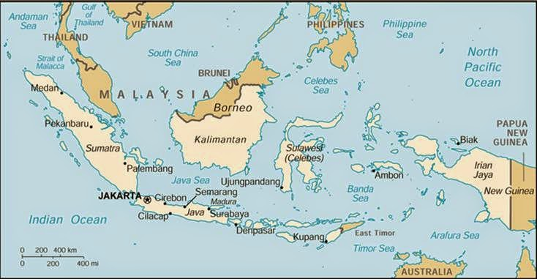
The Day WHO Parachuted Cats into Borneo
Place the events in chronological order
Aerial view of Borneo:

Slide 5
Parachuting Cats in Borneo p. 61 NB
The Day WHO Parachuted Cats into Borneo
Some time ago, World Health Organization sent supplies of DDT to Borneo to Fight mosquitoes that spread malaria among the people. The mosquitoes were quickly wiped out. But billions of roaches moved into the villages and they simply stored the DDT in their bodies. One kind of animal that fed on the roaches was a small lizard. When these lizards ate the roaches, they also eat a lot of DDT. Instead of killing them, DDT only slowed them down. This made it easier for the cats to catch the lizards, one of their favorite foods. About the same time, people also found that hoards of caterpillars had moved into feed on the roofing materials of their homes. They realized the lizards that previously had kept the caterpillars population under control had been eaten by the cats. And now, all over North Borneo, cats that ate the lizards died from DDT poisoning. Then rats moved in because there were no cats to control their population. With the rats came a new danger, THE Plague,. Officials sent out emergency call for cats. Cats were sent in by airplane and dropped by parachute to control the rats.
Biomagnification
Human activity with the best of intentions can have untended consequences.
Map of Borneo

Slide 6
Questions for pg. 29
1. Explain your thinking process in relation to DDT, biomagnification, and ecosystem connections.
2. How did one simple change to an ecosystem set off a whole chain of events?
3. Give another example of an unintended consequence of human intervention on the Natural World.

Slide 7
SAE Qualification Questionnaire Your SAE must be agriculturally related, created by you, invested time of 8 hours, supervised by your Ag Teacher and be part of your grade.
How does your SAE provide real work situations?
What careers is it related to?
How is it part of your career goal?
List the skills, knowledge and attitudes you need for this career that your SAE might apply to.
How can you grow, and become more competent each year in the Ag program with this SAE?
How does your SAE allow for expansion, and/or change?
Have you kept records of your money, and time?

Slide 8
AET website
Enter your username
Create a password
Create your user profile.

Slide 9
Bill Nye – Food Web Notes p. 77 NB
All living things depend on plants (Autotrophs-gets energy from the sun- Photosynthesis).
Everything on Earth is connected together in a Food Web.
Food Web (many food chains) starts with Plants.
Food Chain= Leaf->Caterpillar-> Bird->Snake->Fox
Decomposers (eat dead organisms) – worms, fungi, & bacteria.
Energy Pyramid Δ – Plants (bottom) →Herbivore→ Omnivores→Carnivores (top)

Slide 10
Activity – Cycles in Nature
In groups of 3, choose a Cycle in Nature: Water, Nitrogen, Carbon or Phosphorus.
Write the Name of the Cycle at the top of the page
List the abiotic factors in that Cycle.
Explain how that abiotic factor is cycled through the system.
Write a paragraph showing how and why this cycle is important to us.
Draw a picture, identifying & labeling the processes involved in the cycle or at least a part of the cycle.
Due by the end of class.

Slide 11
Cycles in Nature 3 groups/cycle
Water: Gabbi, Claudia
Carbon: Valerie, Sopear, Abby
Nitrogen: Paige, Martin, Mallory
Phosphorus: Carol, Alex, Ilya

Slide 12
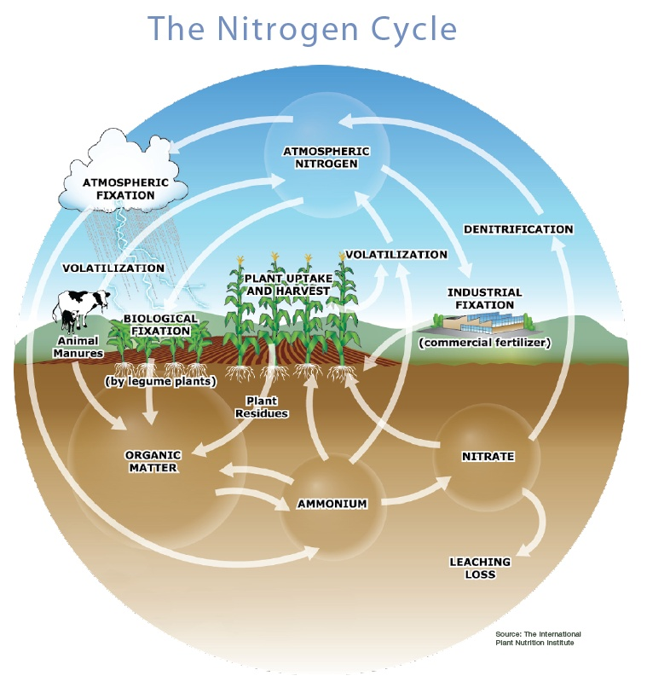

Slide 13
Matter of Fact Notes
Matter, mass, space.
Atom -Ex: H, Hydrogen; N, Nitrogen; Na, Sodium
Molecule, Substance- Ex. N₂ Nitrogen Gas; H₂ Hydrogen gas; O₂ Oxygen Gas
Compound, at least two different, millions.
H₂O water, NH₄⁺ Ammonium, NO₃⁻ Nitrate
5. Oxygen gas, O₂ & Nitrogen Gas N₂ are not considered compounds because they are each composed of the same element. Water, H₂O, is a compound because it is composed of more than one element.
6. Chemical formula, elements, subscripts. Ex: C₆H₁₂O₆ - Glucose

Slide 14
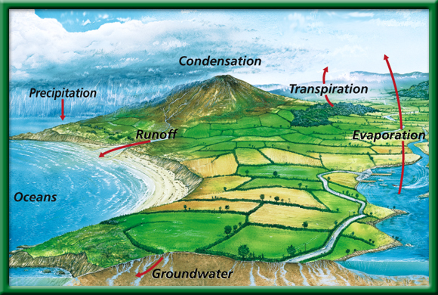
The Water Cycle
P.53 BB
Be able to explain at least 5 parts of the cycle.
Does water leave the planet?
To return to the chapter summary click escape or close this document.

Slide 15
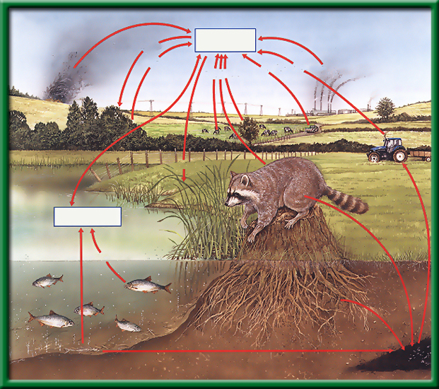
Section 2.2 Summary – pages 46 - 57
The carbon cycle
Open burning
Atmospheric CO₂
Photosynthesis
Respiration
Fuel Combustion
Respiration
What is the role of the autotroph?
What is a carbon sink?
What is the role of the heterotroph?
Fuel Combustion
Photosynthesis
Dissolved CO₂
Respiration
Death and decay
Death and decay
Fossil fuels

Slide 16
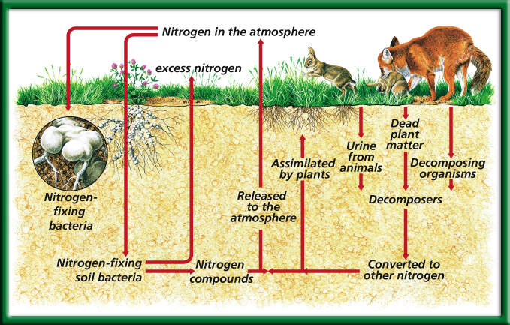
The Nitrogen Cycle
What organism is essential for this cycle?
To return to the chapter summary click escape or close this document.

Slide 17
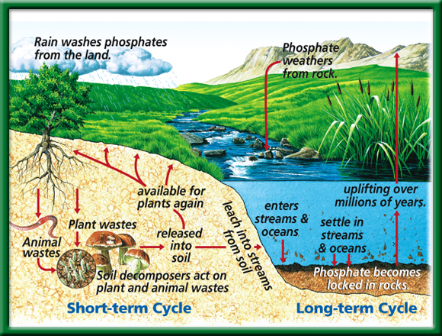
The Phosphorous Cycle
What role do humans play in these cycles?
To return to the chapter summary click escape or close this document.

Slide 18
Cycles in Nature: Conclusion Questions
Summarize the water cycle in at least 5 sentences.
Do you think water is ever lost or gained? Explain.
What is the role of an autotroph in the carbon cycle? A heterotroph? Explain.
What do you think is the most important “player” in the nitrogen cycle? Why?
How do humans play a role in all of the cycles? Do we help or hinder them? Explain.
Why are all three of these processes ( Water, Carbon and Nitrogen cycles) called cycles? Why are they not shown in a pyramid? Explain.

Slide 19
Period 4 Quiz Answers
Possible options: Tree->Squirrel-> Fox
Trees->Beaver -> Mountain Lion
Grasses ->Mouse ->Owl
Grasses-> mouse -> Hawk
Grasses-> grasshopper-> Bird
Etc.

Slide 20
Ecosystem Activity Directions: Make Food Chain, a Food Web, and Energy Pyramid and a Title for this Ecosystem
Tree
Squirrel
Fox
Beaver
Mountain Lion
Mouse
Owl
Grasses
Hawk
Grasshopper
Bird

Slide 21
Period 4 Quiz Answers
2. Possible answer: Grass-> Mouse-> Fox-> Mountain Lion
3. Beaver, Squirrel, Rabbit, Mouse, Grasshopper
4. Mountain Lion, Hawk, Owl, snake
5. Worms, Fungi, Bacteria – anywhere, even grass gets decomposed.
6. Arrows indicate the direction of the flow of energy from what just got eaten to who eat it.

Slide 22
Period 4 Quiz Answers
7. Table 1 Classifying Organisms in Trophic Levels.
PRODUCERS | PRIMARY CONSUMERS | SECONDARY CONSUMERS | TERTIARY CONSUMERS
TREES | BEAVER | FOX | MOUNTAIN LION
GRASS | SQUIRREL | BIRD | HAWK
 | RABBIT | SNAKE | SNAKE
 | MOUSE | FROG | OWL
 | GRASSHOPPER

Slide 23
Period 4 Quiz Answers
CONSUMER 3 – MOUNTAIN LION, HAWL, OWL
CONSUMER 2 – FOX, BIRD, SNAKE, FROG
CONSUMER 1 – BEAVER, SQUIRREL, RABBIT, MOUSE, GRASSHOPPER
PRODUCERS – TREES, GRASSES

Slide 24
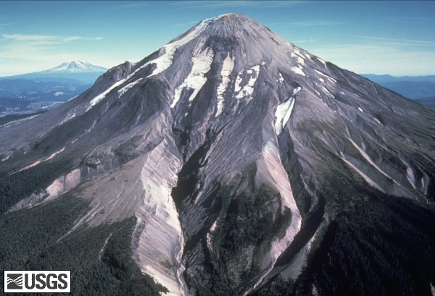
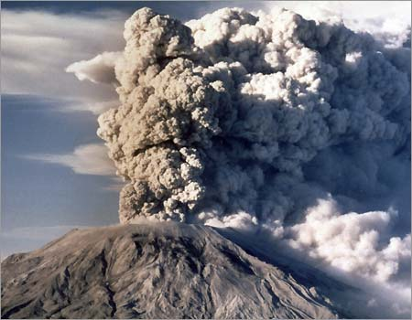
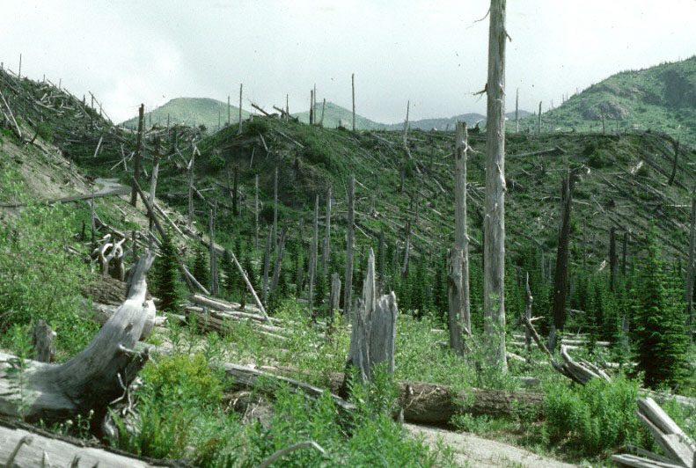
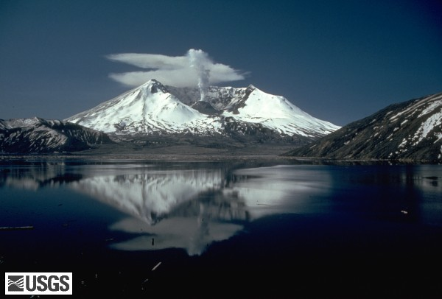
Succession Mt. St. Helens
2010
Pre 1980
2010
Eruption 1980

Slide 25
Succession – Mt. St. Helens
WS – Mt. St. Helens
Back from the Dead
Follow along with the movie in order to fill in the blanks & answer the questions on this worksheet. The answers appears in the order they will appear on screen. I will grade this worksheet on Friday when you take your quiz.

Slide 26
Succession
*Primary succession→ the colonization of barren land by communities of organisms
Takes place on land where there are NO other organisms
Ex. Volcanoes errupting
*secondary successions→ sequence of changes that take place after an existing community is severely disrupted in some way
*Ex. Lichens→grasses→shrubs→trees
*Climax community→ stable, mature community that undergoes little/no change

Slide 27
Problem Solving Lab 3.1 P. 67 NB P. 68 BB
1.Line 2 is primary succession because it begins with no species.
Line 1 is Secondary Succession because it has some existing species, also it has a drop from a climax community.
C = Climax Community they exist before a disturbance
D – is Pioneer Species have low species diversity.
3. A sudden, disruptive event such as a fire followed by a community recovery.

Slide 28
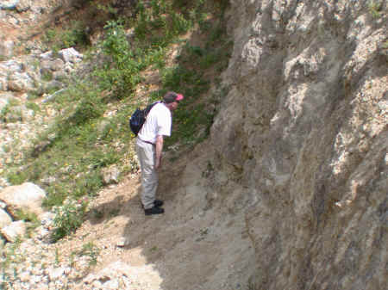
What type of succession is this?
Primary succession is the series of community changes which occur on an entirely new habitat which has never been colonized before.
Examples of such habitats would include newly exposed or deposited surfaces, such as landslips, volcanic lava and debris, elevated sand banks and dunes, quarried rock faces.
A number of stages take place where'pioneer' community will gradually develop through a number of different communities into a 'climax' community, which is the final stage.

Slide 29
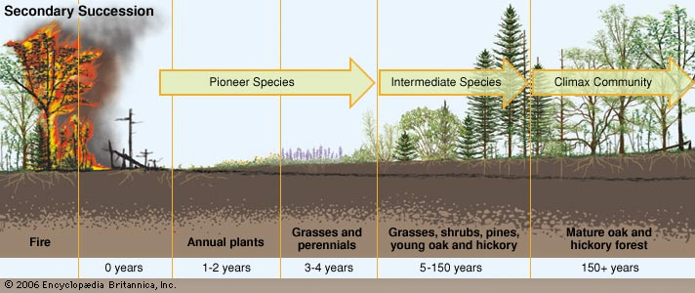
What type of Succession is this?
Secondary succession.
Soil was already formed, and it was a natural disaster that happened before the pioneer species started to take over.

Slide 30
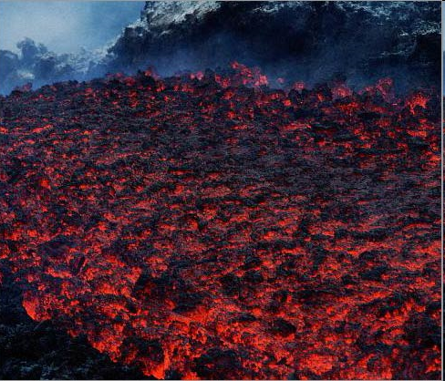
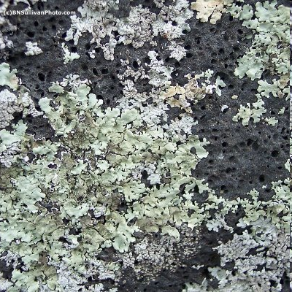
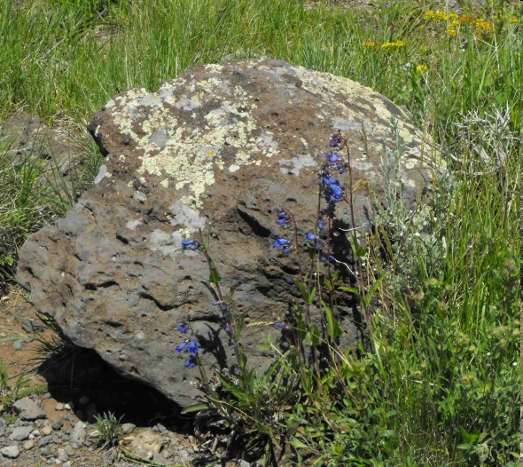
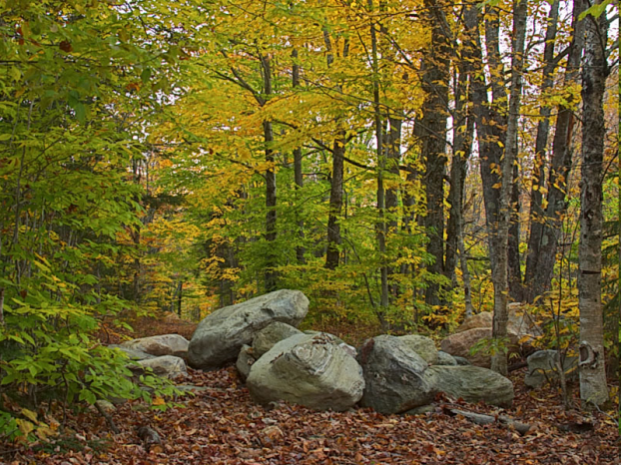
Succession
PRIMARY SUCCESSION
SECONDARY SUCCESSION
LAVA
LAVA COOLED WITH LICHEN
GRASSES/SHRUBS
FOREST
CLIMAX COMMUNITY!

Slide 31
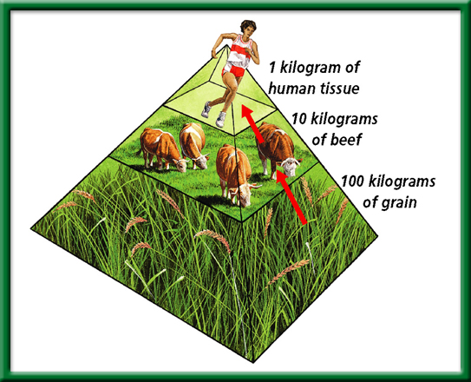
Pyramid of Biomass

Slide 32
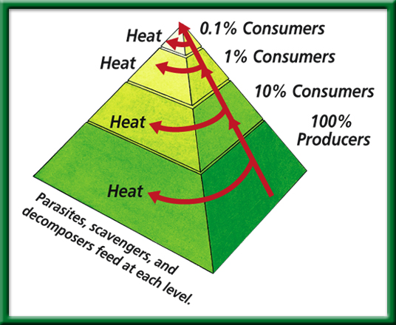
Pyramid of Energy
10 units
Suppose 10,000 units of energy are available at the level of the grasses. What is the total number of energy units lost by the time energy reaches the coyote?
100units
1,000 units
10,000 units of energy

Slide 33
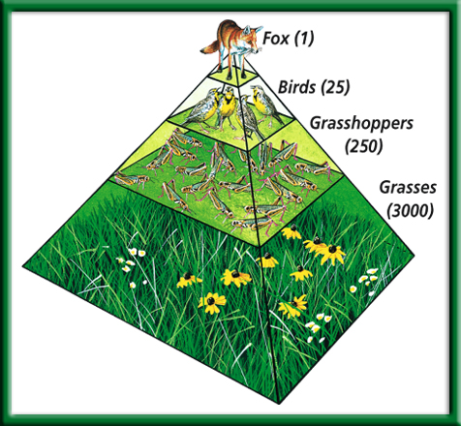
Pyramid of Numbers

Slide 34
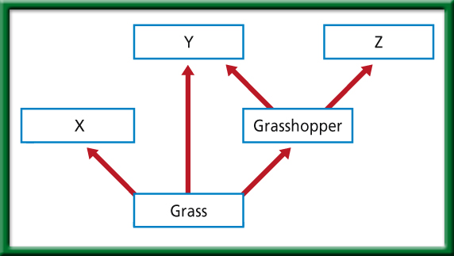

Slide 35
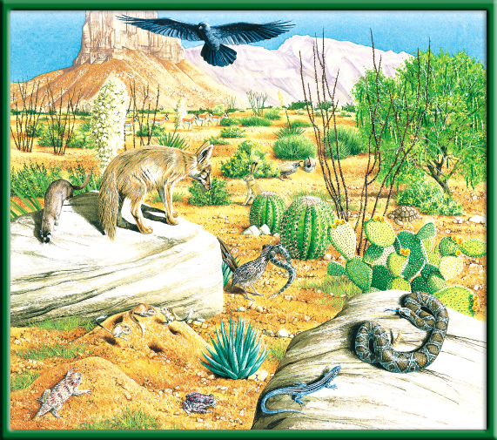
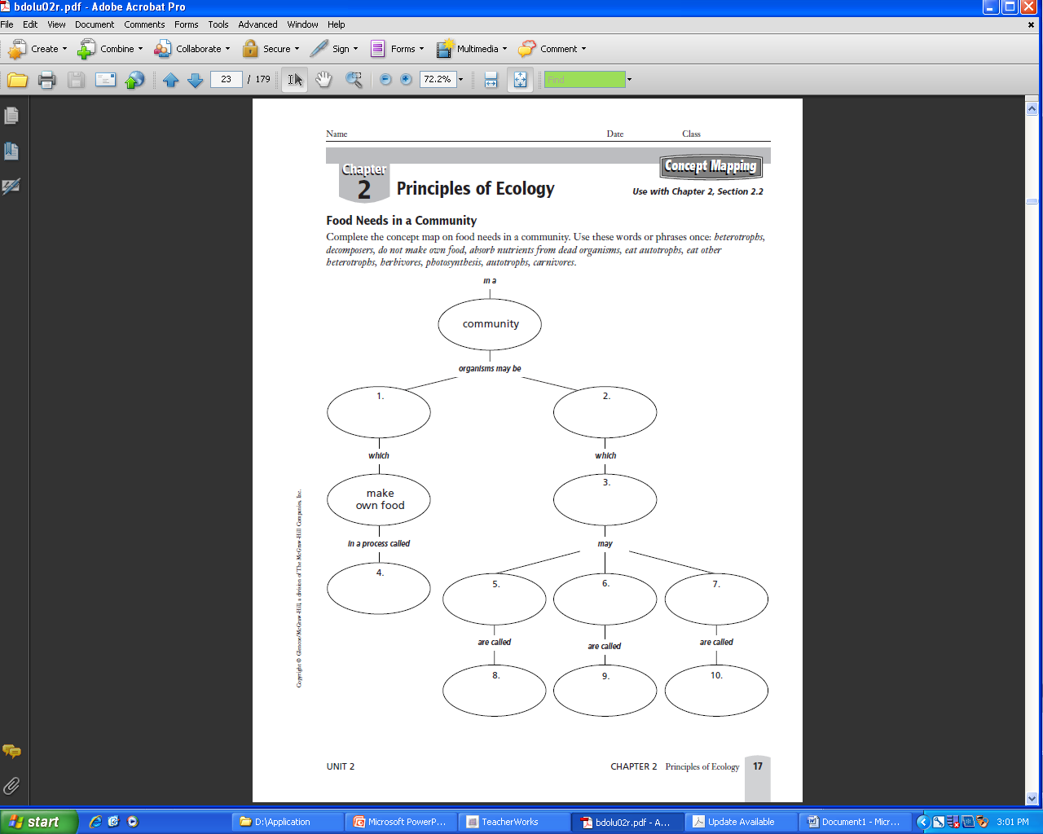
Food Web p.51BB
p.65 NB
Draw 1 Food chain.
Now add two more to make a Food Web.

Slide 36
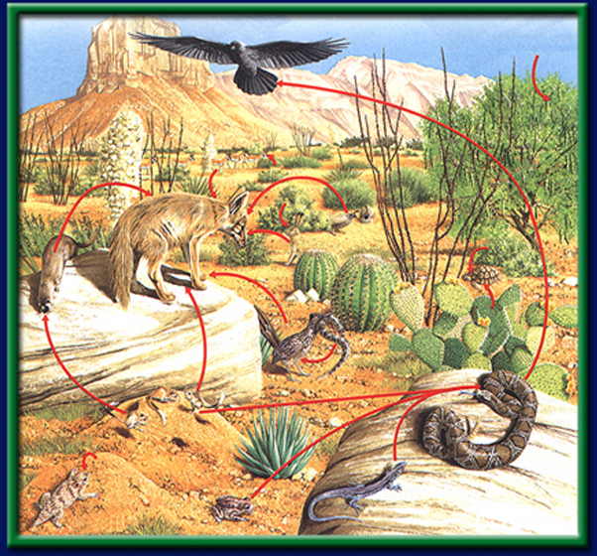
Section 2 Check
Chihuahuan raven
Honey mesquite (pods eaten by beetles)
What would happen to the raven, if all the Rattle snakes were hunted and killed?
Pronghorn antelope
Gambel quail
Jackrabbit
Desert tortoise
Coyote
(top carnivore)
Prickly pear cactus
Long-tail weasel
Roadrunner
Kangaroo rat (seed eater)
ants
Red spotted toad
Mojave rattlesnake
Texas horned lizard
Mexican whiptail lizard
CA: Biology/Life Sciences 6f

Slide 37
Oh, Deer!
What do you think happens to a population when resources change?
½ of you will start as RESOURCES; ½ of you start as DEER.
Each generation the resources choose if you are “water,” “food,” or “shelter.”
Water = hands on throat Food = hands on stomach Shelter = make a tent shape with hands
Each generation the deer choose if you’re searching for “water,” “food,” or “shelter.”
Water = hands on throat Food = hands on stomach Shelter = make a tent shape with hands
All deer and all resources will start in lines facing AWAY from each other.
When we say go, deer will race to get to the resource they need! NO CHEATING! Stick to the resource that you started with!
If a deer “catches” the resource that they were looking for, the resource they caught becomes a deer for the next generation! (The deer that got the resource “reproduced” and the resource became its offspring).
If a deer does NOT get the resource they were looking for, they die. ☹ Any dead deer become a resource during the next generation.
Before each generation we will record the # of deer and the # of resources, and see what happens over time!
Predators! One person will be the Wolf. The Wolf will stand in the middle between the resources & the deer. If the wolf catches you then you become a wolf also.

Slide 38
Period 4 Oh Deer Data
What are the limiting factors for the Deer?

Slide 39
Period 1 Honors Biology P. 43 NB What are some limiting factors in this environment?
Environmental Factor – Drought & loss of food

Slide 40
Demonstration – Greenhouse Effect Carbon Cycle – Wed.
2 – liter bottles

Slide 41
Fold a sheet of paper in half lengthwise. Make the back edge about 2.5 cm longer than the front edge.
P. 69 NB
To return to the chapter summary click escape or close this document.

Slide 42
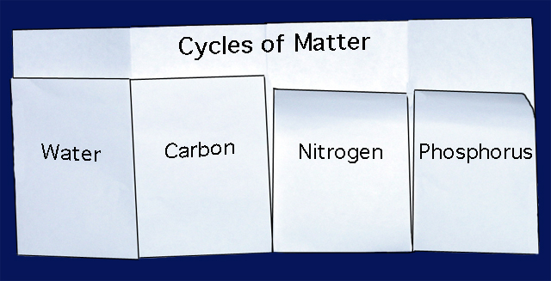
Label the Foldable as shown. For each tab, Draw the cycle, explain how the abiotic factor is cycled through the biotic factor.
P. 57 NB
To return to the chapter summary click escape or close this document.

Slide 43
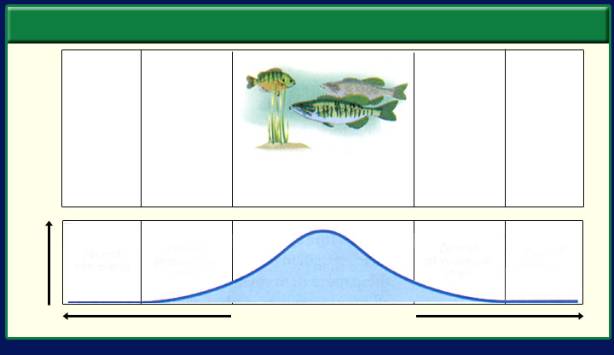
Section 3.1 Summary – pages 65-69
Ranges of tolerance
#1. List 8 Limiting factors in your notebook.
#2. The ability of an organism to withstand fluctuations in biotic and abiotic environmental factors is known as tolerance.
Limits of Tolerance
Organisms absent
Organisms infrequent
Organisms absent
Organisms infrequent
Greatest number of organisms
Population
Zone of Physiological stress
Zone of Physiological stress
Zone of intolerance
Zone of intolerance
Optimum range
Lower limit
Range of tolerance
Upper limit

Slide 44
Water is lost to the abiotic parts of the biosphere from the biotic parts by the process of:
Infiltration
Transpiration
Photosynthesis
Precipitation

Slide 45
Transpiration Cougars are predators that often eat weakened or diseased animals. This is a description of the __ of cougars.
Ecosystem
Habitat
Niche
Population

Slide 46
Niche Where is the Biosphere?
Earth’s Crust
Upper Mantle
Core
Mantle

Slide 47
Earth’s crust A relationship between cats and mice could best be described as:
Consumer – Producer
Parasite – Host
Scavenger – Carrion
Predator - Prey

Slide 48
Predator – Prey If coyotes eat a cat that eats a mouse that eats grass, the coyote would be:
Decomposers
Second – order consumers
Third – order consumers
Herbivores

Slide 49
Third- order Consumer A pod of Killer whales (Orca’s) is known as:
Biosphere
Population
Ecosystem
Community

Slide 50
Population Draw an Energy Pyramid including grasses, flowers, grasshoppers, birds, and a fox. Which level has the smallest number of organisms?
Grass
Grasshoppers
Birds
Fox

Slide 51
Biotic (living organisms) 10
Abiotic (non-living) 5
Does it eat (or drink water)
Does it grow and develop
Does it stimulus and response
Does it reproduce
Example: Humans, fish, trees, grass, flowers, giraffe, bear, etc.
If it doesn’t do any of those ← then it is non-living
Example: rock, sand, water, sun, mud, light, heat, etc.

Slide 52
5 Ways Abiotic factors affect Biotic factors. P.135NB
Rocks- Rocks can be a habitat for worms.
Light- Plants need light to grow. (photosynthesis)
Air- We need air to breathe. (Cellular Respiration)
Temperature- Temperature makes a habitat livable for living things. (Zone of Tolerance)
Water- Water can be a habitat and is also used to stay hydrated.

Slide 53
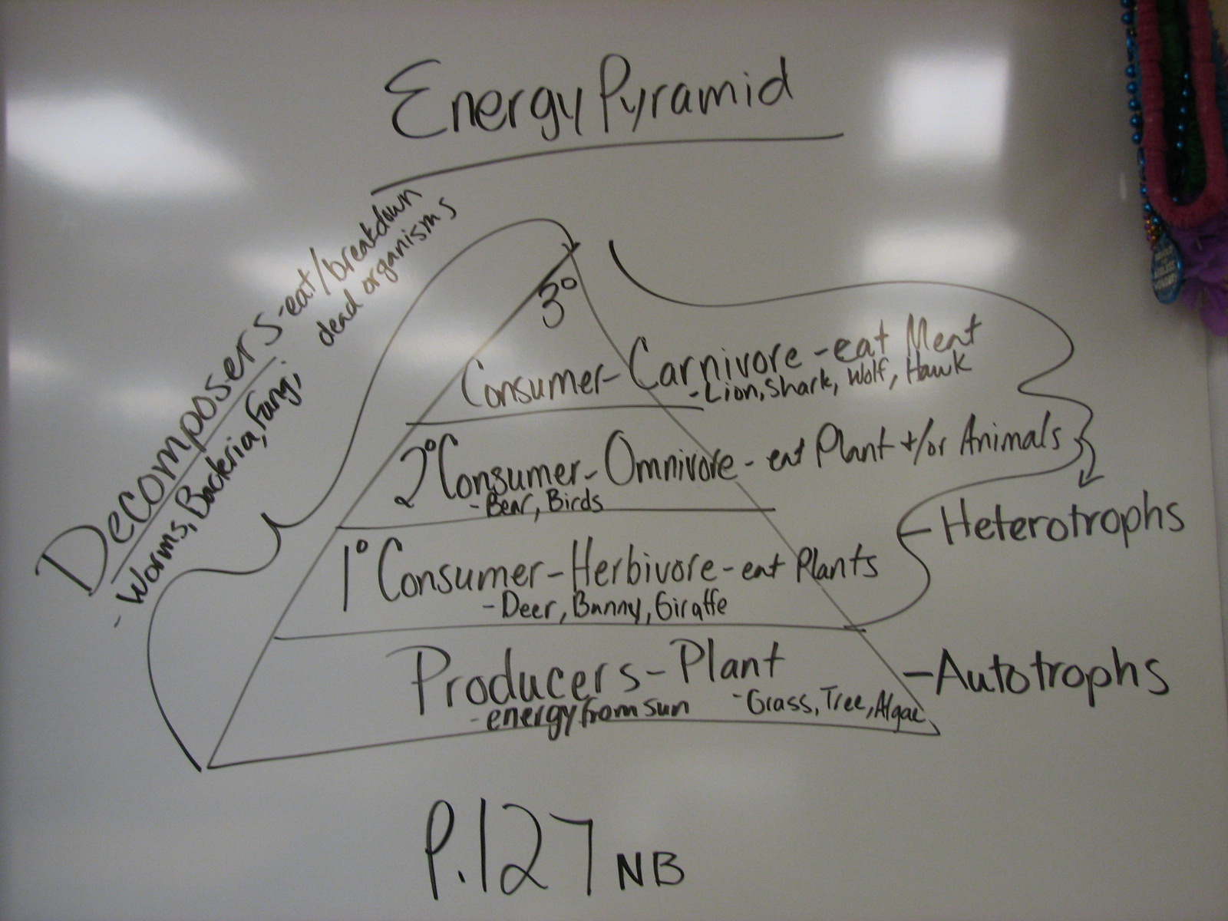
Example:
Back of Ecosystem Poster
5 abiotic factors
10 biotic factors
How abiotic factors impact biotic factors?
Energy pyramid
http://library.thinkquest.org/11353/ecosystems.htm

Slide 54
Collect 4 sheets of paper and layer them about 1.5 cm apart vertically. Keep the edges level.
P. 39 NB
.

Slide 55
Fold up the bottom edges of the paper to form 8 equal tabs.
P. 39 NB
To return to the chapter summary click escape or close this document.

Slide 56
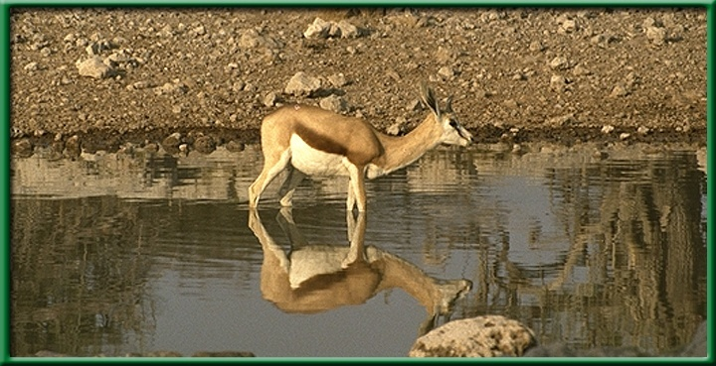
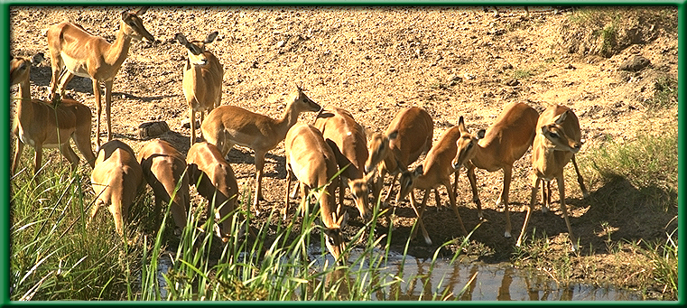
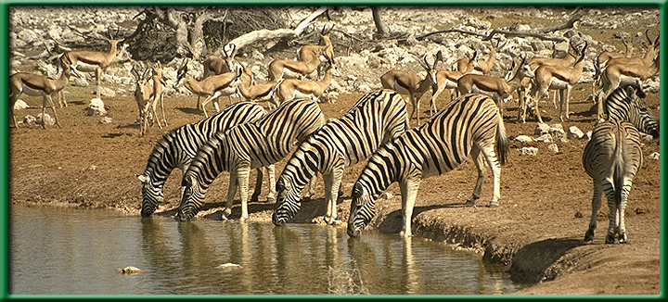
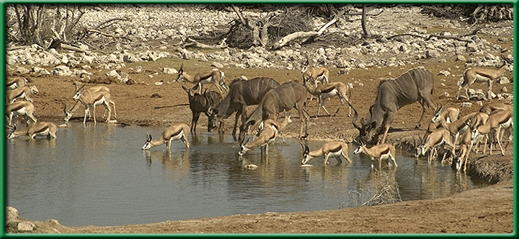
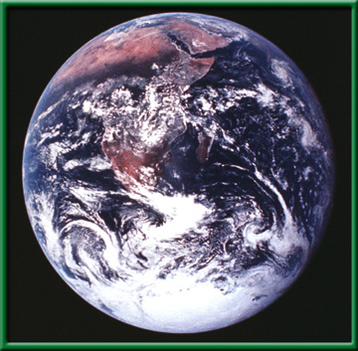
organism
population
community
Ecosystem
Biosphere

Slide 57
Producers- Plants
1st Consumer- Eats plants
2nd Consumer- Eats plants and other animals
3rd Consumer- Eats other animals

Slide 58
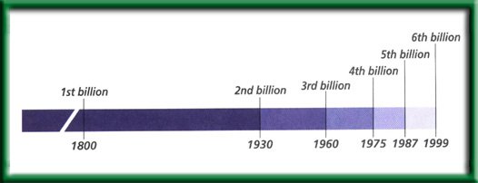
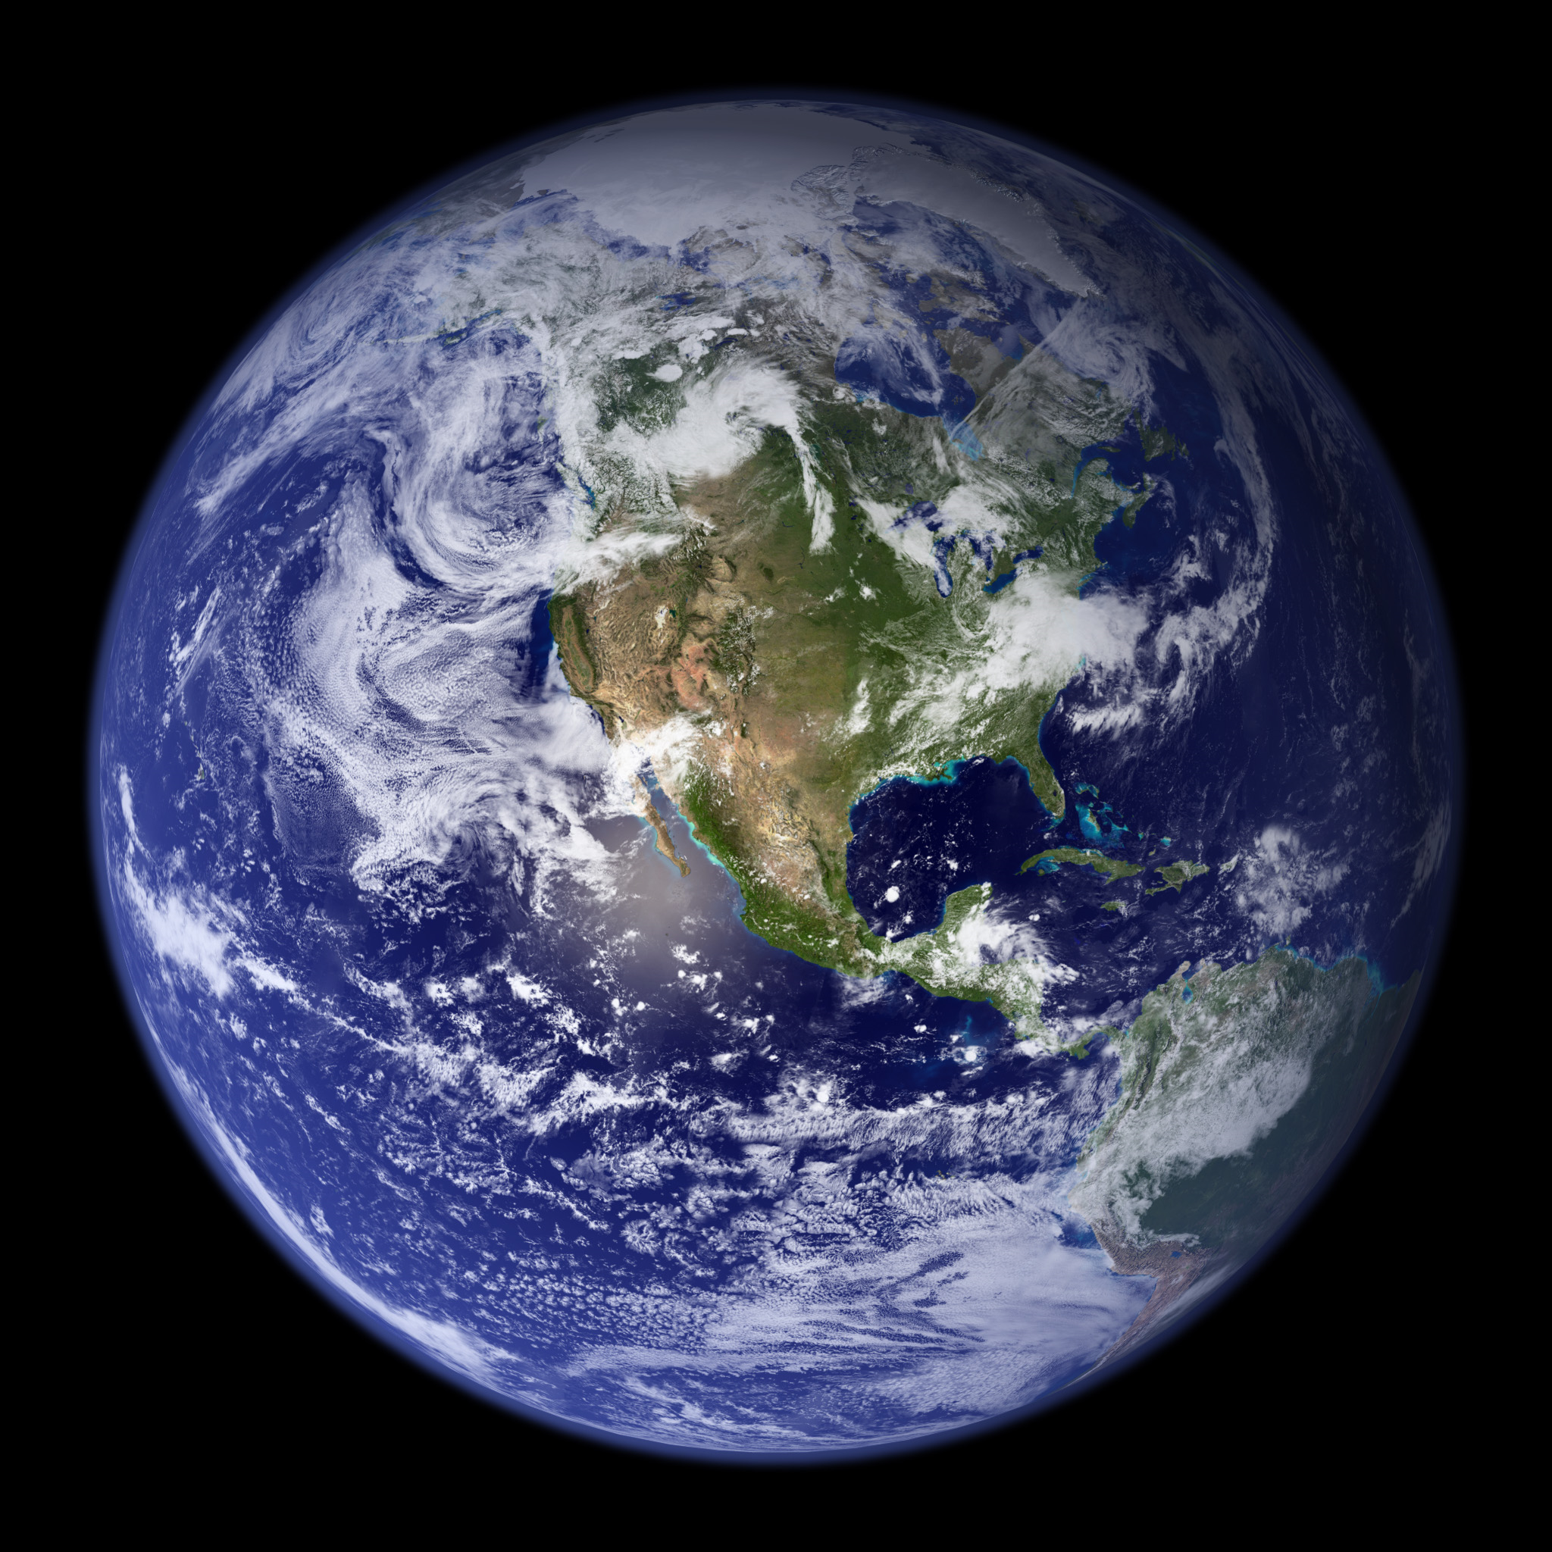
1/03 Human Population 4.2 Obj.:TSW understand effects of growth in the U.S. and other countries and their ecological implications by having a class discussion. P.66 NB
Population Distribution Per Age Range for Several Countries
What characteristics of populations do demographers study? Why?
What clues can an age structure graph provide about the future of a country’s population growth?
Explain the relationship between a growing population and the environment.
HW – CH 4 Notes, 1 page, Page 71 NB
Foldable: Cycles in Nature P. 69NB
Stable growth
Rapid growth
Slow growth
Male
Reproductive years
Female
Age
Population (percent of total for each country)

Slide 59
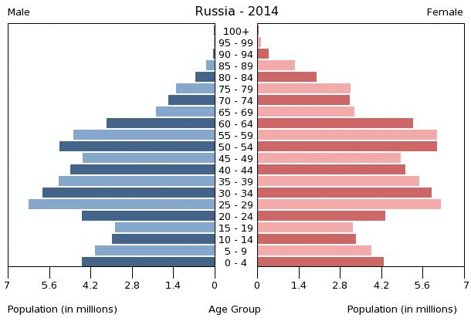
Section 4.2 Summary – page 100-103
World Population (Answer to question #1)
In the United States, a census is taken every ten years.
One of the most useful pieces of data is the rate at which each country’s population is growing or declining.
Demographers study the human population size, density and distribution, movement, and its birth and death rates.

Slide 60
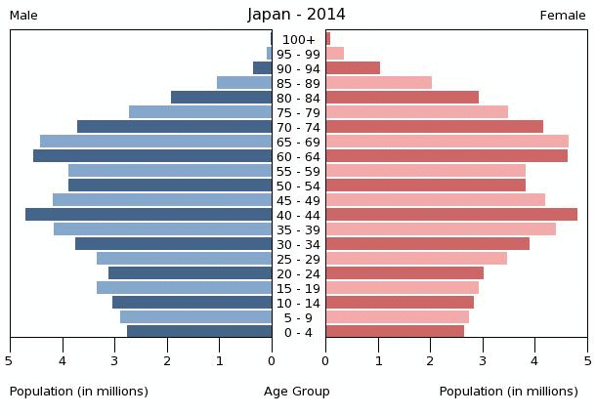
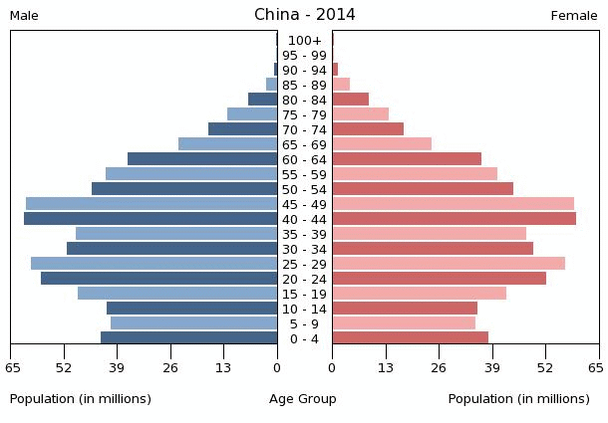
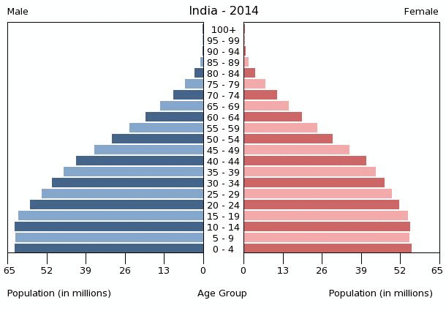

Slide 61
Age Structure Graph
Answer # 2
The graph tells you how a population is growing and possible resource needs for city development in the future, such as schools, hospitals, grocery stores, energy needs.

Slide 62
#3. Relationship between a growing population and the environment.
As populations grow the demand on available resources increases as well. Increasing the awareness of a healthy environment can help ensure that future generations have enough resources as well.
Sustainability.

Slide 63
Carbon Cycle p. 69NB
What happens if we increase our greenhouse gases? CO2, Water Vapor, and Methane
22.5 degrees centegrade

Slide 64
How do Lichen get to the barren rock to start making soil? P. 69 NB
Lichen is a symbiotic relationship between Fungi and Algae. This mutualistic relationship helps colonize new land. Both Fungi and Algae are spread by spores, which are airborne.

Slide 65
Write a 3 – 5 sentence summary.
Climax Community
Pioneer species
Colonization of new sites
Secondary succession
Larger plants
Rocks
Primary Succession
Disruption
Soil
Natural Disaster
Human Action
P. 61 NB

Slide 66
Ecosystem Poster Project
Brian & A’Donnis – Ocean
Crista & Jacquelline Forest
Zack & Mark– Tropical Rain Forest
Nick – Savannah
Steven & Bobby – Tropical Rain Forest
Sophie & Daren- Woods
Taly & Nick – Desert
Jaylyn & Vicki – Ocean
Zoe & Ravyn – Grasslands
Jasmine & Ukia – Savanna
Guillermo & Nayeli – Ocean
Brandon & David -Ocean
Daisy & Nadine – Tropical Rain Forest

Slide 67
WS – Ecology p. 57NB

Slide 68
CH 2 Principles of Ecology
Mice to cats
Coyotes are third order heterotrophs.
The food chain includes 4 trophic levels.
Always decreases but population size may increase or decrease.
Total number of energy units lost by the time energy reaches the coyote are 9990 units.

Slide 69
Student: ______Biology Class______________________
On a Poster paper Create an Ecosystem. DO NOT use the Desert,p. 51 BB. You may work by yourself or have 1 – 2 people to work with. Use your resources such as: p.51,75 – 83 Biology Book, Notebook, and the Internet. This Ecosystem Poster Project is due Friday May 2nd, and is worth 50 points. Keep this paper to staple to the back of your poster for grading.
Ecosystem Poster Rubric
Name of Ecosystem (Front) | 5points
Artwork/ Drawing | 5 points
On the back of the Poster, List 10 Biotic and 5 Abiotic Factors for your Ecosystem | 10 points
On the back of the Poster, Describe 5 ways Biotic & Abiotic Factors help each other. | 5 points
On the front of the poster, Label and identify the Producers, 1st, 2nd, & 3rd Level Consumers, & Decomposers (3) Include all Energy Arrows between the related Biotic factors. | 15 points
On the back of the Poster, Draw the Energy Pyramid. Include in your Energy Pyramid each level of your biotic factors for your Ecosystem. | 10 points
Total | 50 points

Slide 70
Homework
Read CH 4 & 5
Take 1 page notes CH 4 P. 49 NB

Slide 71
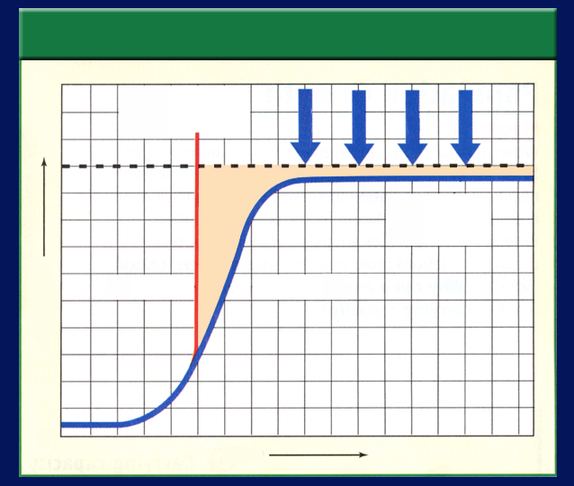
NB
1/04 Population Dynamics 4.1
Obj. TSW understand how fluctuation in population size in an ecosystem is determined by limiting factors such as disease, predation, space, & resources by completing the doing the Problem Solving Lab 4.2 . P. 68 NB
Graph 1
Exponential Growth
Draw, label & ID the two graphs representing the two ways populations grow.
What is Carrying Capacity (Graph 2) and what factors limit it (the arrows).
Describe how density – dependent and density –independent factors regulate population growth.
Graph 2
Linear Growth

Slide 72
Answers to WU #1
Exponential Growth
J – Shape Curve
Rapid Life History Pattern – r Strategist
Ideal conditions – No limiting Factors
1.
Linear Growth
S – Shape Curve
Slow Life History Pattern – K Strategist
Limiting Factors Determine the Carrying Capacity of the population

Slide 73
Section 4.1 Summary – pages 91-99
How fast do populations grow
with unlimited resources?
Population Growth of Houseflies
1 million
500,000
Population size
100
One year

Slide 74
Section 4.1 Summary – pages 91-99
Is growth unlimited?
A J-shaped growth curve illustrates exponential population growth.
Exponential growth means that as a population gets larger, it also grows at a faster rate.
Exponential growth results in unchecked growth.

Slide 75
Section 4.1 Summary – pages 91-99
How fast do populations grow?
The initial increase in the number of organisms is slow because the number of reproducing individuals is small.
Soon, however, the rate of population growth increases because the total number of individuals that are able to reproduce has increased.

Slide 76
Answers to WU #2
#2. Carrying Capacity is the number of organisms that can be supported in that environment indefinitely.
Limiting Factors determine the Carrying Capacity. Examples are: Food water, Shelter, Space, Temperature.

Slide 77
Section 4.1 Summary – pages 91-99
What can limit growth?
Limiting factors, such as availability of food, disease, predators, or lack of space, will cause population growth to slow.
Under these pressures, the population may stabilize in an S-shaped growth curve.

Slide 78
Section 4.1 Summary – pages 91-99
What can limit growth?
Characteristics of Population Growth
Exponential growth
PREDA-TORS
DISEASE
SPACE
FOOD
Carrying capacity
J curve
S curve
Population
0
Time

Slide 79
Section 4.1 Summary – pages 91-99
Carrying capacity
The number of organisms of one species that an environment can support indefinitely is its carrying capacity.
When a population overshoots the carrying capacity, then limiting factors may come into effect.
Click image to view movie.

Slide 80
Section 3.1 Summary – pages 65-69
Limiting factors
Factors that affect an organism’s ability to survive in its environment, such as the availability of water and food, predators, and temperature, are called limiting factors.

Slide 81
Section 3.1 Summary – pages 65-69
Limiting factors
Common Limiting Factors
A limiting factor is any biotic or abiotic factor that restricts the existence, numbers, reproduction, or distribution of organisms.
Sunlight
Climate
Atmospheric gases
Temperature
Water/ Flood/ Drought
Nutrients/Food
Fire
Soil chemistry
Space
Other organisms

Slide 82
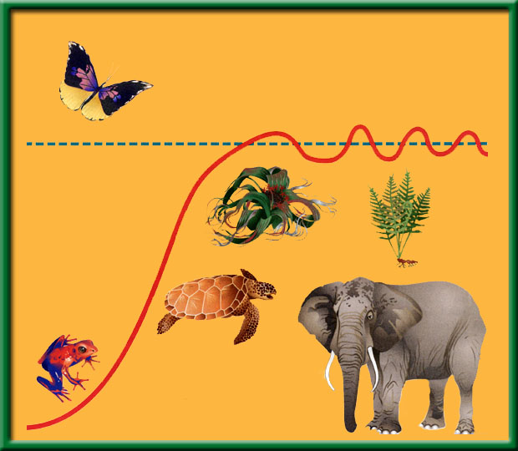
Section 4.1 Summary – pages 91-99
Carrying capacity
Deaths begin to exceed births and the population falls below carrying capacity.
Carrying capacity

Slide 83
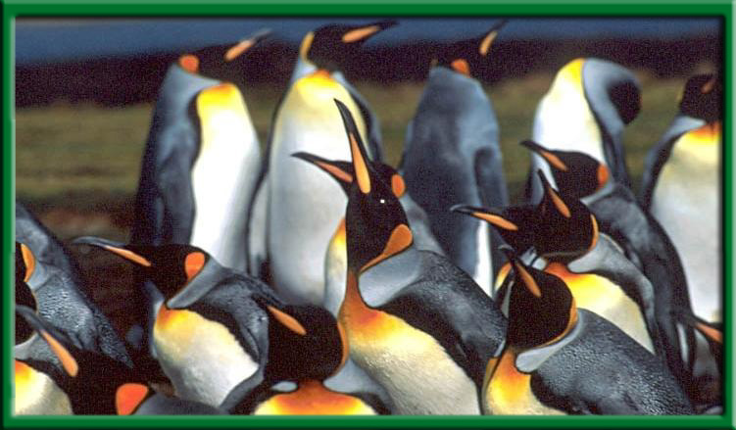
Chapter Summary – 4.1
Population Dynamics
Under normal conditions, with limiting factors, populations show an S-shaped curve as they approach the carrying capacity of the environment where they live.

Slide 84
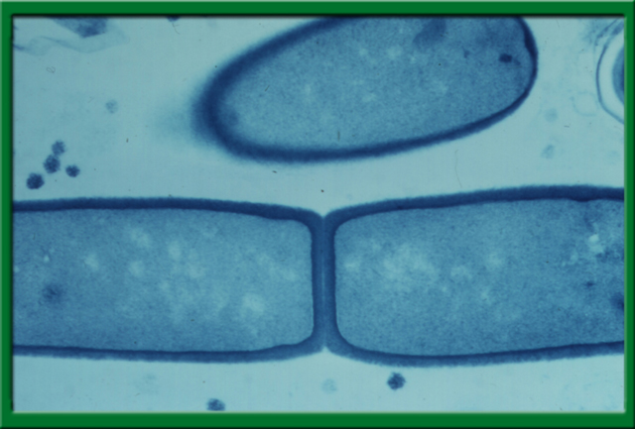
Section 4.1 Summary – pages 91-99
Rapid life-history patterns
Rapid life-history patterns are common among organisms from changeable or unpredictable environments.
Rapid life-history organisms have a small body size, mature rapidly, reproduce early, and have a short life span.

Slide 85
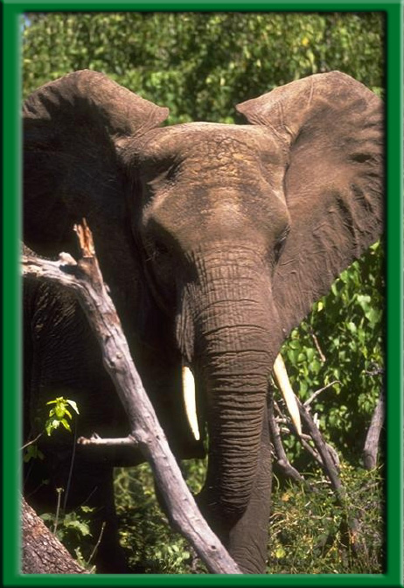
Section 4.1 Summary – pages 91-99
Slow life-history patterns
Large species that live in more stable environments usually have slow life-history patterns.

Slide 86
Section 4.1 Summary – pages 91-99
Density factors and population growth
Density-dependent factors include disease, competition, predators, parasites, and food.
Disease, for example, can spread more quickly in a population with members that live close together.
The larger the population the greater the impact on the population with Density Dependent factors..

Slide 87
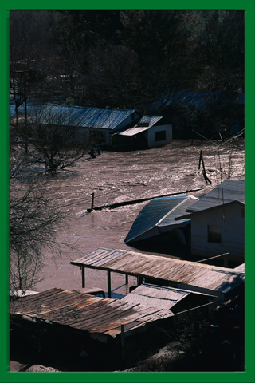
Section 4.1 Summary – pages 91-99
Density factors and population growth
Density-independent factors can affect all populations, regardless of their density.
Most density-independent factors are abiotic factors, such as temperature, storms, floods, drought, and major habitat disruption.

Slide 88
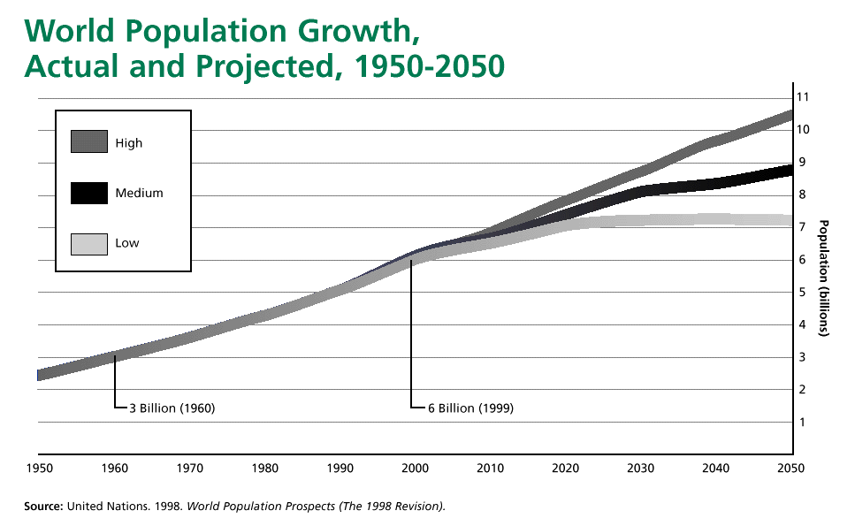
Problem Solving Lab 4.2 p. 101BB P. 49NB
The trend of the graph is Rising.
The population growth increased.
The world Population could do any of the following, more than likely it will increase.

Slide 89
Human Population Growth p. 73 NB
Year A.D. | Number of People (in Billions)
1650 | .5
1750 | .7
1850 | 1.0
1925 | 2.0
1956 | 2.5
1966 | 3.3
1970 | 3.6
1974 | 3.9
1976 | 4.0
1980 | 4.4
1991 | 5.5
2000 | 6.0
2004 | 6.4
2010 | 7.0
2015 | 7.2
2020 | Predict- Continue drawing the line
2050 | Predict – Continue drawing the line

Slide 90
Word Bank
Temperature
Density – Dependent
Disease
Food Supply
Limiting Factors
More intense as population increases
Habitat disruption
Parasitism
Predation
Same regardless as population size
p. 75NB
3 Sentence Summary

Slide 91
Problem Solving Lab 3.1 P. 57 NB P. 68 BB
1.Line 2 is primary succession because it begins with no species.
Label the Graph
Line 1 is Secondary Succession because it has some existing species, also it has a drop from a climax community. Label the Graph
C = Climax Community they exist before a disturbance. Label
D – is Pioneer Species have low species diversity. Label
3. A sudden, disruptive event such as a fire followed by a community recovery. Secondary Succession recovers faster due to previous species.

Slide 92
(BIOLOGY) HW 1page notes CH 4 P. 43NB
Honors Biology, in addition to the Notes above:
CH 4 WS – page 39 NB
CH 2,3,4 HW Page 37NB
Human Population Graph Activity P. 49NB
Answer the questions to Earth’s Carrying capacity on Page 49 with the answers to the Analysis questions.

Slide 93
p
Notes & questions p.45NB

Slide 94
CH 2 HW Principles of Ecology Chapter Assessment p.31HW
Decomposer
Heterotroph
Trophic Level
Habitat
Parasitism
Autotroph
Community
Food Chain
Scavenger
Biosphere
Commensalism
Food Web
Mutualism
Ecology
1.Rocks
2. Decomposers
3.Biomass
4.Decomposers
5. Heat
6. Decomposition
7.Mutualism
8.FoodWeb
9.Symbiosis
10.Ecosystem
11.Biosphere
12.Consumer
13.Water Cycle
Mice to cats
Third order heterotrophs
Four
C
9990 Units

Slide 95
Demonstration Succession/ Carrying Capacity
11/16/10 P.137NB
Fresh water
0 organisms
11/17/10
0 organisms
20% Pond Water
0 organisms
0 organism

Slide 96
CH 3 Communities & Biomes RFSG P135
True
Limiting Factors
Restricts or affects
Small, shallow-rooted mosses, ferns & lichens
True
True
Smaller
True
Species
Succession
Decades
Succeed
pioneer
Primary
Slows down
Climax
B-Primary succession
D – Secondary Succession
E – Climax Community
C – Amount of Plant Growth
A – A severe drought
4
3
1
5
2

Slide 97
CH 3 Communities & Biomes RFSG p. 47 Section 3.2
Climax community, biomes
Water, aquatic biomes
Salty
Biomass, small
Photic zone
Aphotic zone
C – an ocean or a sea
A – an Estuary
C – wave action
D – there are many nutrients
B – Plankton
Sunlight
Temperature & Precipitation
Tundra
Desert plants have developed narrow leaves & waxy coatings to reduce water loss; ability to germinate from seed & quickly mature after sporadic rainfall; spines, thorns or poisons that discourage desert herbivores, branches and roots that store water.
Canopy: treetops, monkeys, birds;
Understory: ferns, shrubs, palms, insects, amphibians, reptiles, birds, bats,
Ground :leaves, decaying materials, ants, worms, rodents, decomposers

Slide 98
CH 3 Communities & Biomes RFSG P. 139 NB
17. Desert
Grassland
Tundra
Tropical Rain Forest
Taiga (Christmas tree forest)
Temperate Forest/ Deciduous Forest

Slide 99
Review for CH 2 Quiz
Tiny organisms that break down and absorb nutrients from dead organisms:
Autotroph
Decomposer
Parasite
Ecology

Slide 100
Decomposer
Obtains energy by feeding on other living organisms
Heterotrophs
Habitat
Autotroph
food chain

Slide 101
Heterotroph
Step in the passage of energy & matter through an ecosystem
Habitat
Niche
Community
Trophic Level

Slide 102
Trophic Level
A Place where an organism lives
Food web
Food Chain
Niche
Habitat

Slide 103
Habitat
Relationship between species in which one species benefits at the expense of another.
Symbiosis
Commensalism
Parasitism
Mutualism

Slide 104
Parasitism
Collection of interacting populations
Organism
Population
Biological Community
Ecosystem

Slide 105
Biological Community
Portion of Earth that supports life
Autotroph
Biosphere
Trophic Level
Ecology

Slide 106
Biosphere

Slide 107
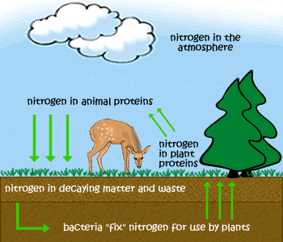
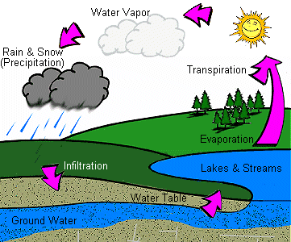
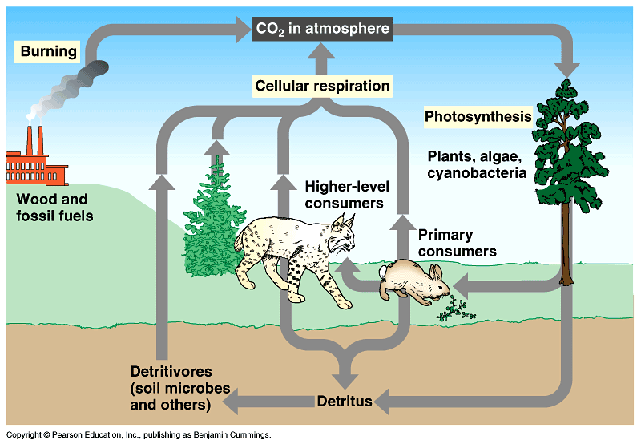
11/18 Cycles of Nature 2.2 OJB. Stds. Will demonstrate understanding of the Cycle in Nature by making a drawing the Water, Carbon and Nitrogen cycles in their notebook. P. 136 NB
Vocabulary Word | Definition (2 word chunks) | Use word in a sentence | Draw a Picture
Water Cycle Carbon Cycle Nitrogen Cycle | Precipitation, Evaporation, Transpiration, Condensation. CO2 → Plants → Animals→ Atmosphere Fossil Fuels → Atmosphere Atmosphere N2 → Bacteria → Plants → Animals → Atmosphere

Slide 108
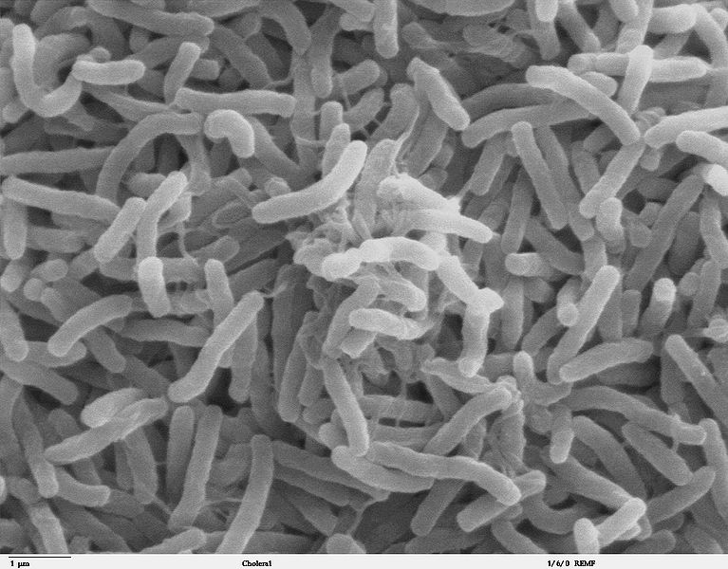
Cholera

Slide 109
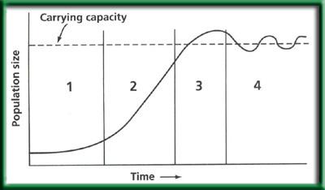
Chapter Assessment
Question 1
CA: Biology/Life Sciences 6b, 6c

Slide 110
The answer is B. The graph of exponential growth is a J-shaped curve.
CA: Biology/Life Sciences 6b, 6c
Chapter Assessment

Slide 111
Chapter Assessment
Question 2
What shape of age structure graph represents a rapidly growing population?
A. steep triangle
B. thin rectangle
C. circle
D. square
CA: Biology/Life Sciences 6b, 6c

Slide 112
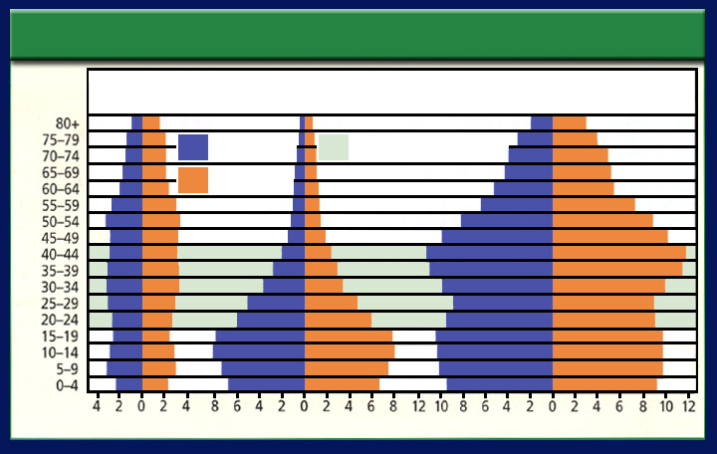
The answer is A.
Population Distribution Per Age Range for Several Countries
Stable growth
Rapid growth
Slow growth
Male
Reproductive years
Female
Age
Population (percent of total for each country)
CA: Biology/Life Sciences 6b, 6c
Chapter Assessment

Slide 113
Chapter Assessment
Question 3
Population Growth of Houseflies
1 million
What type of growth is shown in this graph?
500,000
Population size
100
One year
A. slowly increasing
C. exponential
B. slowly decreasing
D. equilibrium
CA: Biology/Life Sciences 6b, 6c

Slide 114
The answer is C. Exponential growth is rapid and is represented on a graph by a J-shaped curve.
Population Growth of Houseflies
1 million
500,000
Population size
100
One year
CA: Biology/Life Sciences 6b, 6c
Chapter Assessment

Slide 115
Chapter Assessment
Question 4
Assume that each time interval on the graph is equal to one year. How long did it take this population to reach carrying capacity?
Characteristics of Population Growth
A. 2 years
Exponential growth
DISEASE
SPACE
PREDATORS
FOOD
B. 4 years
Carrying capacity
C. 5 years
J curve
S curve
Population
D. 9 years
0
Time
CA: Biology/Life Sciences 6b, 6c

Slide 116
The answer is D. After 9 years, this population has nearly reached carrying capacity.
Characteristics of Population Growth
Exponential growth
PREDA-TORS
DISEASE
SPACE
FOOD
Carrying capacity
J curve
S curve
Population
0
Time
CA: Biology/Life Sciences 6b, 6c
Chapter Assessment

Slide 117
Chapter Assessment
Question 5
Which of the following is characteristic of a species having a slow life-history pattern?
A. short life span
B. long life span
C. small body size
D. mature rapidly
CA: Biology/Life Sciences 6b, 6c

Slide 118
The answer is B. Rapid life-history organisms have a small body size, short life span, and mature rapidly.
CA: Biology/Life Sciences 6b, 6c
Chapter Assessment

Slide 119
Chapter Assessment
Question 6
During which time period was population growth the most rapid?
A. 1800 to 1930
B. 1930 to 1960
C. 1960 to 1975
D. 1975 to 1987
CA: Biology/Life Sciences 6b, 6c

Slide 120
The answer is D. World population grew by 1 billion in just 12 years.
CA: Biology/Life Sciences 6b, 6c
Chapter Assessment

Slide 121
Chapter Assessment
Question 7
If the birthrate is 125 and the death rate is 135, what is the population growth rate?
A. 260
B. -260
C. 10
D. -10
CA: Biology/Life Sciences 6b, 6c

Slide 122
The answer is D. Use the formula:
Birthrate – Death rate = Population Growth Rate
CA: Biology/Life Sciences 6b, 6c
Chapter Assessment

Slide 123
Biological Diversity and Succession 5.1 1/05 Obj. Stds. will know biodiversity is the sum total of different kinds of organisms and is affected by alteration of habitats by completing their warm up. P.70 NB
Explain Biodiversity in your own words.
Why is biodiversity important?
Explain the 7 threats to Biodiversity.

Slide 124
Symbiosis – species interactions p.73NB Place a (+) in the species box if that species benefits. Place a (–) in the box if that species is harmed. Place a (O) in the box if that species neither benefits or is harmed.
Symbiotic Relationship | Species 1 | Species 2
Competition
Mutualism
Parasitism
Commensalism

Slide 125
Northern California Biomes

Slide 126
Section 5.1 Summary – pages 111-120
Importance to nature
#1. Biodiversity is the variety of life or the different types of species
Living things are interdependent.
Living things can be niches for other living things.
Populations are adapted to live together in communities.

Slide 127
Section 5.1 Summary – pages 111-120
#2. Biodiversity brings stability
Biodiversity can bring stability to an ecosystem.
A pest could easily destroy all the corn in a farmer’s field, but it would be far more difficult for a single type of insect or disease to destroy all individuals of a plant species in a rain forest.
Ecosystems are stable if their biodiversity is maintained.

Slide 128
Section 5.1 Summary – pages 111-120
#2. Importance to people
Preserving biodiversity ensures there will be a supply of living things, some of which may provide future drugs.
Penicillium

Slide 129
Section 5.1 Summary – pages 111-120
Loss of Biodiversity
Extinction is the disappearance of a species when the last of its members dies.
Extinction is a natural process and Earth has experienced several mass extinctions during its history.

Slide 130
Section 5.1 Summary – pages 111-120
Loss of Biodiversity
A species is considered to be an endangered species when its numbers become so low that extinction is possible.

Slide 131
Section 5.1 Summary – pages 111-120
Loss of Biodiversity
When the population of a species is likely to become endangered, it is said to be a threatened species.

Slide 132
Cycles of Nature Posters
1 – 3 people may work on the Poster
Draw the Carbon, Water or Nitrogen Cycle
Answer the following questions for your poster.
How does Carbon, Water or Nitrogen return to the Biotic parts of the Ecosystem?
The burning (CO2), evaporation (H2O)or leaching (N2) of each of these returns them where?

Slide 133
Section 5.1 Summary – pages 111-120
#3. Habitat loss
One of the biggest reasons for decline in biodiversity is habitat loss.

Slide 134
#3. Habitat
Fragmentation
To return to the chapter summary click escape or close this document.

Slide 135
Section 5.1 Summary – pages 111-120
Habitat fragmentation
Habitat fragmentation is the separation of wilderness areas from other wilderness areas.

Slide 136
Section 5.1 Summary – pages 111-120
Edge and size
The edge of a habitat or ecosystem is where one habitat or ecosystem meets another.

Slide 137
Section 5.1 Summary – pages 111-120
Edge and size
If a road is cut through a wooded area, the shape of the wooded area changes and the edge is changed.
Now there is less distance between the edge and the interior. Some plants might die out.

Slide 138
Section 5.1 Summary – pages 111-120
Habitat degradation
Another threat to biodiversity is habitat degradation, the damage to a habitat by pollution.
Three types of pollution are air, water, and land pollution.

Slide 139
Section 5.1 Summary – pages 111-120
#3. Habitat degradation
Pollutants enter the atmosphere in many ways—including volcanic eruptions and forest fires.

Slide 140
Section 5.1 Summary – pages 111-120
Habitat degradation
Burning fossil fuels is also a major source of air pollutants such as sulfur dioxide.
Acid precipitation—rain, snow, sleet, and fog with low pH values—has been linked to the deterioration of some forests and lakes.

Slide 141
Section 5.1 Summary – pages 111-120
Water pollution
Water pollution degrades aquatic habitats in streams, rivers, lakes, and oceans.
A variety of pollutants can affect aquatic life.

Slide 142
Section 5.1 Summary – pages 111-120
Water pollution
Excess fertilizers and animal wastes are often carried by rain into streams and lakes.
The sudden availability of nutrients causes algal blooms, the excessive growth of algae.

Slide 143
Section 5.1 Summary – pages 111-120
Land pollution
Trash, or solid waste, is made up of the cans, bottles, paper, plastic, metals, dirt, and spoiled food that people throw away every day.

Slide 144
Section 5.2 Summary – pages 121-125
Habitat corridors
A general strategy for protecting the biodiversity of an area probably is to protect the largest area possible.
However, research is showing that keeping wildlife populations completely separate from one another may be resulting in inbreeding within populations.

Slide 145
Section 5.2 Summary – pages 121-125
Habitat corridors
Therefore, another strategy for preserving biodiversity is to connect protected areas with habitat corridors.

Slide 146
#3. Invasive species
Species that do not belong, and take over, crowding out or out competing the native species.

Slide 147
#3. Global Warming – Climate Change
Rise in CO2 concentration
Increase melting of Polar ice caps
Increase average temperature of ocean
Increase in severe weather events

Slide 148
#3. Overharvesting of Resources

Slide 149
CH 4 Population Biology Critical Thinking – the Effect of Predators on Prey Populations
a. The number of deer increased from about 7000 to about 100,000.
b. With fewer predators, more young deer survived to become breeding adults. The lack of predators may have make it possible for older and less fit deer to survive longer.
a. From 100,000 to 40,000, or 60%
b. From 100,000 to 20,000, or 80%
c. From 100,000 to 10,000, or 90%

Slide 150
CH 4 Population Biology Critical Thinking – the Effect of Predators on Prey Populations
Predators no longer kept the deer population within the carrying capacity of the land. By the early 1920’s, most of the food available in the area had been consumed, so many deer starved.
The rapidly increasing deer population had consumed most of the food supply. As a result, the land’s carrying capacity was reduced.

Slide 151
5/1 Food web Ch 2 & 3
Obj. TSW demonstrate understanding of Energy Pathways by making a Food Web. P.44 NB
What is the source of all energy in this ecosystem?
What path does this energy take to get to the hawk?
Identify 10 Biotic and 5 Abiotic Factors in this Ecosystem.
Draw a Food Chain.
Start with the producers, include all three levels of consumers.
Students write answers on the board.

Slide 152
Conservation of Biodiversity 5.1 & 5.2 5/12 Obj. TSW understand the importance of conservation Biology for the protection of biodiversity by going over the Concept Map and doing critical thinking problems. P. 74 NB
How can habitat degradation cause changes in an area’s biodiversity?
How might Habitat corridors help overcome problems with habitat fragmentation?
What three Habitat problems have accelerated the rate of extinctions?

Slide 153
Warm Up Answers
Habitat degradation harms biodiversity, because it decreases available resources for the organisms.
Habitat corridors help overcome habitat fragmentation by allowing large predators to continue hunting.
Three problems that have increased extinction rates are: Habitat Loss, Invasive Species, Pollution, Climate Change, Overharvesting

Slide 154
CH 5 Biological Diversity & Conservation – Critical Thinking DDT & The Food Chain
The organisms may continue to take in DDT long after it has been applied. Also, once DDT gets inside an organism’s body, it affects the body for a long time.
The DDT collects in the insect’s fat tissues.
DDT could have been applied directly to the water or it could be carried by run-off from fields and carried to the oceans by rivers.

Slide 155
CH 5 Biological Diversity & Conservation – Critical Thinking DDT & The Food Chain
When the zooplankton took in the contaminated water, the DDT collected in their fatty tissues & became more concentrated.
DDT becomes more concentrated in the successive links of a food chain.
The thin- shelled eggs cracked easily, reducing the number of offspring produced & consequently decreasing the size of the pelican population.

Slide 156
P. 71 NB Word Bank
Pollution
Nature
Large Predators
Trash
Variety of Foods
Native Species
Habitat degradation
People
Chemical in runoff
Medicines
Food Webs
Introduction of Exotic Species
Habitat Fragmentation
Stability of Ecosystems

Slide 157
Biodiversity Activity Page 43 NB Read your article, take notes on the white board. Present your findings about the Biodiversity in your Ecosystem
What are some abiotic & biotic characteristics of your ecosystem?
What is an example of Biodiversity in your Ecosystem?
What does it say about California’s Biodiversity?

Slide 158
Ecology Vocab A to Z
Decomposer
Producer
Competition
Biotic
Habitat
Niche
consumer
Population Size
Abiotic
Ecology
Community
Biome
Limiting Factors
Predator

Slide 159
5/4 Ecosystems 2.1 Obj. TSW demonstrate that a vital part of an ecosystem is the stability of its producers, consumers and decomposers in their Ecology Study Guide and class discussion & Problem Solving Lab. P.46NB
Compare and Contrast Heterotrophs and Autotrophs with examples of each.
What factors make this picture an Ecosystem, name 3?
How are decomposers important to an ecosystem, name 3.
Trees
Bear
Turtle
Deer
Sleeping
Forever Fish

Slide 160
What is Ecology
*Study of relationships among living organisms and their interactions with the physical environment
relationships are in a constant state of flux
*Even small changes can cause MAJOR effects in the ecosystem
*HUMANS ARE PARTICIPANTS IN THE ECOSYSTEM RELATIONSHIPS!

Slide 161
What is the biosphere?
The portion of earth that supports living things
Extends from high in the atmosphere to the bottom of the oceans

Slide 162
Biodiversity
The number of species in a specific area
Biodiversity increases as you move toward
the equator
Where are some places that would have
more biodiversity?

Slide 163
Studying Biodiversity: Islets
If I removed all of the organisms, minus the trees, from below what would happen? What organisms would come back first?
*Insects and spiders would return first
The farther away the islet was from the mainland, the longer it will take to re-populate (Less biodiversity)
*larger the islet=more biodiversity! (draw graph)

Slide 164
Importance of Biodiversity
*Important to nature
*Living things → interdependent
(animals could not exist without
green plants)
Populations are adapted to
live together in communities
*biodiversity brings stability
A pest could easily destroy all of a farmer’s corn crops, but it would be difficult for just one pest to destroy multiple kinds of vegetation.
Think about this like variation…
*importance to people
Humans depend on other organisms for their needs…
Can you name some?

Slide 165
Loss of Biodiversity
Extinction: the disappearance of a species when the last of its members dies
Natural process
But today its exceeding the rate it should be at due to: human needs, habitat loss, and land exploitation
Endangered species: when its numbers become so low that extinction is possible

Slide 166
Ecosystem
*ecosystem: made up of interacting populations (communities) and the abiotic factors
An ecosystem is generally an area within the natural environment

Slide 167
Abiotic and Biotic Factors
*abiotic components are non-living chemical and physical factors in the environment
Ex. Rocks, soil, oxygen, carbon
*biotic components are living factors
Ex. Plants, animals

Slide 168
Communities vs Populations
*community→ collection of several interacting populations that inhabit a common environment
*population→ group of organisms all of the same species which interbreed and live in the same place at the same time

Slide 169
Limiting Factors
*any biotic or abiotic factor that restricts the existence, numbers, reproduction, or distribution of organisms
*Ex. Sunlight, climate, temperature, water, nutrients/food, fire, soil chemistry, space, other organisms

Slide 170
5/16 Global Warming CH 5 Obj. TSW have a greater understanding of what global warming is and it’s possible effects on us through a class discussion on solutions. P. 76 NB
What is Global Warming?
How does the Carbon Cycle play a role (if any) in Global Warming.
Explain the Greenhouse Effect
Page 128 in Biology Book

Slide 171
Global Warming
Global Warming is the gradual increase in temperature for the planet, due to an increase in CO₂.
The carbon cycle plays a role in taking CO₂ into plants in the process of photosynthesis. However, if there is deforestation, then there is not the availability of plants (trees) to take in CO₂ and it stays in the atmosphere.
The greenhouse effect is how the gas CO₂ traps solar radiation at the lower atmosphere and reradiates it back to the surface, warming the planet in general. However, we see radical severe events in weather instead of just a gradual increase.

Slide 172
The Greenhouse Effect on Natural Systems p. 79 NB
Get into groups of four.
Get a White Board, Expo Marker & Eraser
Read the assigned article and take notes on the board to present to the class.
Students will take notes on page 79 NB
Group 1 - Climate Change in the Golden State Page 2 - 4
Group 2 – Climate Change in the Golden State Page 4 - 6
Group 3 – Water Vapor: A GHG p.7-8
Group 4 – Carbon Dioxide: A GHG p. 9-10
Group 5 – Methane: A GHG p. 11-12
Group 6 – Nitrous Oxide: A GHG p. 13 - 14
Group 7 – What Can Ice Tell Us About the Past Climate? P.15
Group 8 – California’s Global Warming Solutions of 2006 p.16 - 20

Slide 173
Climate Change in the Golden State
Measured temperature wind patterns
Greenhouse gases impact the climate
Earth’s Climate system: Biosphere, Atmosphere, Geosphere, Hydrosphere
Natural
Sierra snowpack is melting earlier
More Air pollution & health effects
Record warmer temperatures
Evidence - Ice ages & Warming, Fossil Record

Slide 174
Water Vapor – A GHG
Water has a bigger influence on Earth’s climate than any other greenhouse gas.
Sources: Evaporation from water sources.
Sinks: Oceans, Ice sheets, claciers, Aquifers, Soil

Slide 175
Carbon Dioxide – a GHG
Soils, Forests and Ocean are sinks for Carbon dioxide.
Sources: Respiration, Forest Fires, Volcanoes, Decomposition, Fossil Fuels
Sinks: Fossil Fuel Deposits, Oceans, Forests, Wetlands, Photosynthesis

Slide 176
Methane – a GHG
Sources: Atmospheric, Produced by cattle, Released during decomposition
Landfill release Methane, we use it for energy
Fossil fuel, stored in the Earth for millions of years
Sinks: Permafrost peat bogs, wetlands, soils

Slide 177
Nitrous Oxide: A GHG
Sources: Atmosphere, Nitrogen based fertilizer, Soil management – Denitrification by Bacteria, decomposition
300 x greater “global warming potential that CO2”
Sink: Photolytic reactions in the stratosphere

Slide 178
CA Global Warming Solutions Act of 2006
Greenhouse gases increasing in the atm.
Increase in .5 Degrees C in one century.
1990’s was the hottest decade in a thousand years.

Slide 179
Footprint network
Video – Global Warming
How many earth’s does it take to support your lifestyle? P 79 NB
Record the number and give to Mrs. McAllister.
Concept map – CH 5 slide 231
Work on study guide.
Foldable – biodiversity.
Classtime – work on project?
Mt. St. Helen’s Video slide 41

Slide 180
The Greenhouse Effect on Natural Systems p. 79 NB
Consider how climate has changed in the past and the fact that climate is continuing to change. How could life be different in the future? What are some of the issues people need to consider when examining climate change?
Use the article you just read and the Graph of the Greenhouse Effect to answer your question.
Here is a picture of America’s
Largest Aquifer – underground
Body of water.

Slide 181
Fold the top of a vertical piece of paper down and the bottom up to divide the paper into thirds.
To return to the chapter summary click escape or close this document.

Slide 182
Turn the paper horizontally. Unfold and label the three columns as shown.
P. 53 NB
Research Biodiversity online.
Include a written answer and a picture or example for each.
To return to the chapter summary click escape or close this document.

Slide 183
Chapter 5 Assessment p.131BB 5/17 Obj. Stds. Will understand how humans impact biodiversity by completing their warm up questions & going over answers on their study guide. P.78 NB
Explain the difference between a threatened and an endangered species.
What is the danger of introducing an Exotic species into an area?
How do you predict Global Warming will affect biodiversity in the future, why?

Slide 184
Warm Up Answers
The Endangered Species Act
Introducing an exotic species into an area is dangerous to the existing native organisms because the new non-native species may not have any existing predators and may outcompete the native species for resources.
Biodiversity is the number of different types of species. With global warming the extreme weather may diminish the available resources to organisms. For example, too much water in a flood might wash away a home for an animal.

Slide 185
CH 4 RFSG Population Biology p. 143NB
Exponential Growth
Graph B – “S” curve
Graph A – “J” curve
When there are more births than deaths the population over shoots the carrying capacity due to the limiting factors- food, space, water.
Carrying Capacity
Under
Exceed
Grows
Above
Deaths
Births
Below
Reproductive Pattern
Have a short life span, have small bodies, reproduce early
Reproduce slowly
Competition

Slide 186
CH 4 HW P. 143 NB
17.The lynx population increases because it has more food.
18 As more hares are eaten, there is less food for the lynx, then there population decreases.
19. Predator – Prey Relationship
20. When the demand for resources exceeds supply.
21. When populations become overcrowded; aggression, decrease in parental care, decrease in fertility, decrease resistance to disease.

Slide 187
CH 4 HW P. 143NB
True
Size or growth
Increased
Decrease
True
True
True
Different or vary greatly
True
Low
Proportion
Age Levels
Rapid
Stable
Fertility
Age Structure
Immigration
Emigration
World
a Country’s

Slide 188
5/8 Standards Practice Countdown p. CA17, CA22 Obj. TSW demonstrate their knowledge & understanding of Ecological concepts by playing jeopardy. P. 58NB
The diagram to the side shows a food ____, If environmental pollution, and hunting were to decrease the number of rattle snakes in the desert, how might that affect the other organisms? P. 51BB
Which organism in the figure at the side is a 1st order consumer? P.51BB
Correctly sequence the Ecological levels of organization in nature from smallest to largest. P.40BB
Page 51 Bio Book
http://www.footprintnetwork.org/en/index.php/GFN/page/calculators/

Slide 189
Warm up Answers
The picture shows a Food Web.
Kangaroo Rat
Organism ->Population-> Community->Ecosystem
-> Biosphere.

Slide 190
Source of all energy the Sun!
C3: FOX EAGLE
The arrow towards the animal that gets the energy. (photosynthesis)
C2: Snake, bird and frog
Consumer 1: Bunny,
Butterfly, squirrel, Worm
Producers: Plants, Tree

Slide 191
Chapter 3 Assessment (Quiz)
Page 63 • Reviewing Vocabulary
1. desert 8. limiting factors
2. plankton 9. true
3. permafrost 10. primary
4. estuary 11. biome
5. true 12. true
6. true 13. secondary
7. intertidal zone
Page 64 • Understanding Main Ideas (Part A)
1. Tolerance
2. pioneer species
3. photic zone
4. tropical rain forest
5. grassland
6. secondary succession
7. tundra
8. Climax communities
9. abiotic
10. salinity
11. taiga
12. soil
13. optimum
4. Primary succession; the pond is an undisturbed
site that underwent change from its original
condition. New soil was created.

Slide 192
Reinforcement and Study Guide CH 5 Biological Diversity & Conservation
Page 111 • Section 5.1
Biological diversity 2. Variety 3. Species 4. Greater 5. Increase 6. Equator 7. Space 8. Niches 9. True
10. False 11. False 12. True 13. False 14. True 15. true
16. f 17. C 18. B 19. A 20. E 21. d
22. Habitat Fragmentation
23. Habitat Loss
24. Habitat Fragmentation
25. Habitat Degradation
26. Habitat Degradation
27. Habitat Loss
28. Habitat Degradation
29. d 30. C 31. B 32. D 33. A 34. D 35. B 36. c
Reinforcement and Study Guide
Page 114 • Section 5.2
1. Conservation biology is a field of biology that
studies methods and implements plans to protect
biodiversity.
2. The law prohibits people from harming any
species on the endangered or threatened species
lists. It also prohibits federal agencies from funding
projects that harm organisms on those lists.
3. Nature preserves help protect biodiversity by preserving
the habitats of organisms.
4. There usually is greater biodiversity within large
areas than within small areas.
5. The habitat corridors allow organisms to migrate
from one area to another.
6. Their decline was due to the destruction of prairie
dog habitat. Prairie dogs were the ferrets’ main
source of food.
7. A litter of ferrets was captured, bred in captivity,
and then returned to their original habitat.
8. Seeds from endangered or threatened plant
species can be stored in seed banks for long periods
of time. If the plant species become extinct,
the seeds can be used to reintroduce the species to
their original habitats.
9. Keeping animals in captivity is expensive. While
in captivity, animals may lose the behaviors they
need to survive in their original habitats.

Slide 193
Review for Ecology Benchmark
An example of a Producer is:
Tiger
Tree
Ostrich
Bunny

Slide 194
Tree
What is the likely order of succession after a volcanic eruption?
Shrubs-> grasses-> lichens-> trees
Lichens-> trees-> grasses-> mosses
Lichens-> mosses-> grasses-> shrubs
Mosses-> grasses-> lichens -> trees

Slide 195
Lichens-> mosses-> grasses-> shrubs
Match each picture to what it is
and its trophic level.
Daphnia (crustacean)
Spirogyra (green algae)
Bluegill (small fish)
Small Mouth Bass (a larger fish)
D
C
A
B

Slide 196
What is Carrying Capacity?
A. The maximum # of organisms that are in their reproductive years
B. The maximum # of organisms that the species could reach in a given period if all the offspring survive & reproduce
C. The maximum # of organisms that could be supported by a given environment indefinitely
D. The maximum # of organisms that could be supported by any environment over a period of one year

Slide 197
The maximum # of organisms that could be supported by a given environment indefinitely
Which of the following is a true statement about the flow of energy in an ecosystem?
A. Smaller organisms need less energy per gram of body weight than do larger organisms
B. Energy transfer between organisms normally involves conservation of heat energy
C. Energy flow between trophic levels is inefficient
D. Both A & C

Slide 198
Smaller organisms need less energy per gram of body weight than do larger organisms
As the carrying capacity of an environment is reached by a population
A. Deaths begin to exceed births
B. Births begin to exceed deaths
C. The rate of reproduction increases
D. Population growth begins to be exponential

Slide 199
Deaths begin to exceed births
Energy flow in an ecosystem is not cyclic because energy is
A. Increased as you go up the energy pyramid
B. Destroyed as it is used
C. No longer useful when it is converted to heat
D. Converted to many kinds of useful energy

Slide 200
No longer useful when it is converted to heat
Looking at the figure to the right, as matter and energy move from the producers to the 3rd level consumers, the amount of available energy ___.
Decreases
Increases
Decreases then increases
Does nothing

Slide 201
Decreases
In the energy pyramid shown in the figure, which level has the smallest number of organisms?
Fox
Birds
Grasshoppers
Grasses

Slide 203
Fox
Which organism in the pyramid receives the highest percentage of energy from the sun?
Fox
Birds
Grasshoppers
Grasses

Slide 204
Grasses
What type of succession is this?
Primary
Secondary
Tertiary
None

Slide 205
Primary
What stage would a deer be most successful in a Plant community?
Pioneer species
Climax Community
Mosses
Ferns, Shrubs & Grasses
Pioneer Species
Climax Community

Slide 206
5/9 Ecology Review Obj. Stds. Will perform excellently on their Ecology benchmark with 90% Proficient & Advanced☺. P.52 NB
http://www.cde.ca.gov/ta/tg/sr/documents/rtqbio.pdf
Compare & contrast Biodiversity and Ecology.
How does water, carbon, and nitrogen cycle in an ecosystem between abiotic and organic matter?
Draw a food web of the following animals, include energy arrows and label D,P,C₁C₂C₃. Lion, zebra, grass, mushroom, worm, tree, giraffe, gazelle, hyena, snake.

Slide 207
Pg 145
Secondary succession
Primary Succession
Because soil already exists, secondary succession may take less time than primary succession to reach a climax community
The first species to take hold in an area like this are called pioneer species
A stable, mature community that undergoes little or no change in species is a climax community

Slide 208
Ecology Review Sheet
Parasitism-one org. benefits at the expense of another. Leech and human, has to have a host. Virus
Commensalism- One org. is benefited and one is unaffected. Spanish moss & tree
Mutualism- both species benefit. Bee & orchid
Competition- Organisms compete for resources, food, water.
Population-same species of org. living in the same place at the same time.
Community – many species living in an area at the same time.
Species- an organism that can interbreed and produce fertile offspring.
Extinction-species no long exists on planet Earth.
Abiotic – Nonliving Biotic - Living

Slide 209
Ecology Review Sheet
Precipitation – water falling from the sky in the form of rain, sleet, hail, snow
Evaporation – Water changes phase from a liquid to a gas.
Condensation – Water changes phase from gas to liquid
Photosynthesis – plants get light energy from the sun and convert it into chemical energy.
Transpiration – loss of water through plants
Water Cycle – water goes from the previous “tions”.
Carbon Cycle -carbon goes from the air to the plants and ground and is used as fossil fuels.
Nitrogen Cycle – N2 from the atm. is absorbed into the ground and converted by Nitrogen Fixing Bacteria, that use it as fertilizer.
Primary Succession – soil is made from barren rock, pioneer species is Lichens
Secondary Succession – natural disaster or man –made destroys and area, soil existed before.

Slide 210
Ecology Review Sheet
Immigration – movement into an area
Emigration – movement out of an area
Age structure – is stable without a lot of growth.
Unstable with a lot of growth.
Fossil Fuels – Deep in the ground, remains dead animals, un-renewable resource-Coal,Gas,Oil
Consumers – eat producers and can’t produce their own food. Heterotroph
Producers – plants, make their own food from sunlight. Autotrophs

Slide 211
Ecology Review Sheet
A food chain is different from a food web by a food chain just being a succession of 4 trophic levels.
Carrying Capacity – the amount of organisms that a area can support indefinitely.
Exponential – J shape curve and org. would be Bacteria, Bugs
Linear Growth – S shape curve and org. would be Polar Bears, Humans, Sharks, Elephants
Biodiversity - A lot of different species live in a the same ecosystem, it provides stability.
Habitat Fragmentation – an ecosystem is separated from other areas, natural and man-made.

Slide 212
Ecology Review Sheet
Habitat loss – Natural or man-made, building a city, cutting down a forest
Habitat Degradation-Pollution (Water, land, air), Decreases biodiversity
Conservation Biology – To save the ecosystem and /or organisms in it.

