Slide 1
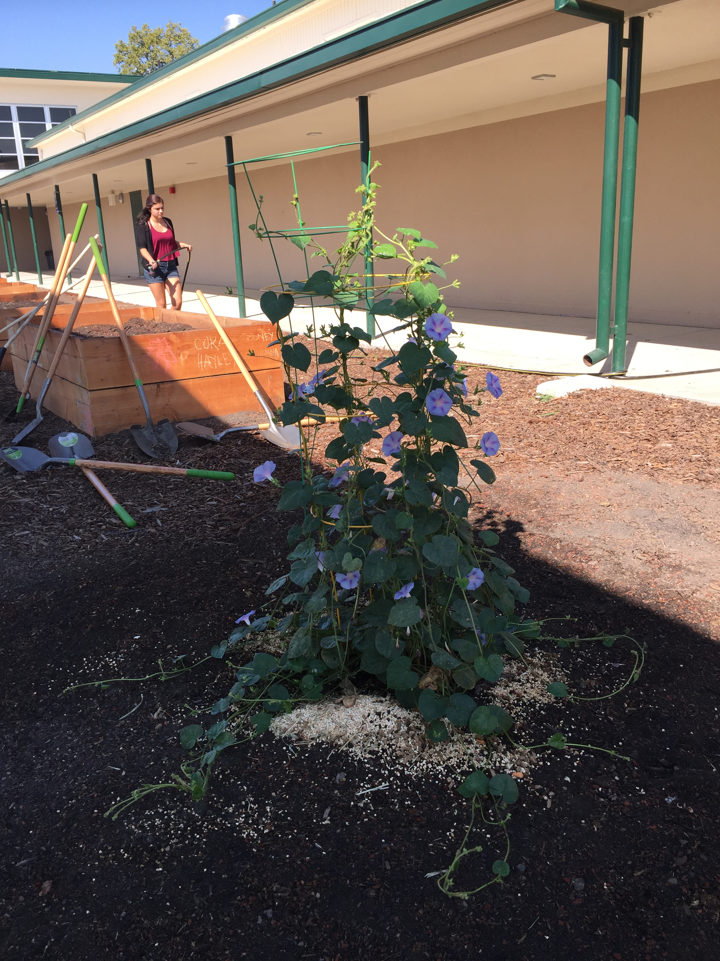
Ag Biology
Week 4
Body Systems – Nervous, Immune, Circulatory and Respiratory, FFA – Officer Responsibilities, Choose SAE, Prepare for F2F Service Learning, Possible FT to Fiery Ginger Farms
Digestive System Project
Compare and Contract a domesticated animal to the Human digestive system, Slide 14

Slide 2
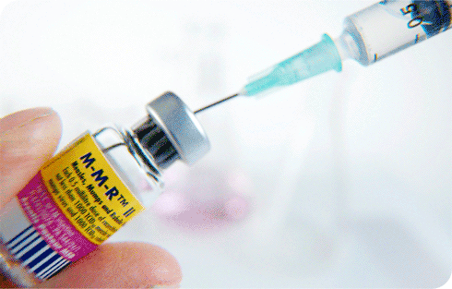
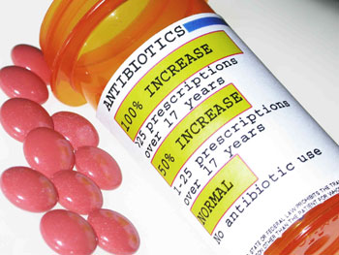
2/6 Specific and Nonspecific Immune Responses CH 39.2
Obj. TSW differentiate between nonspecific & specific immune responses. P. 30 NB
What is a vaccine?
Why do people who have AIDS have complications with normal colds and flu diseases?
What pathogen does antibiotics kill?
Why are antibiotics given in CAFO, even though the animals are healthy?

Slide 3
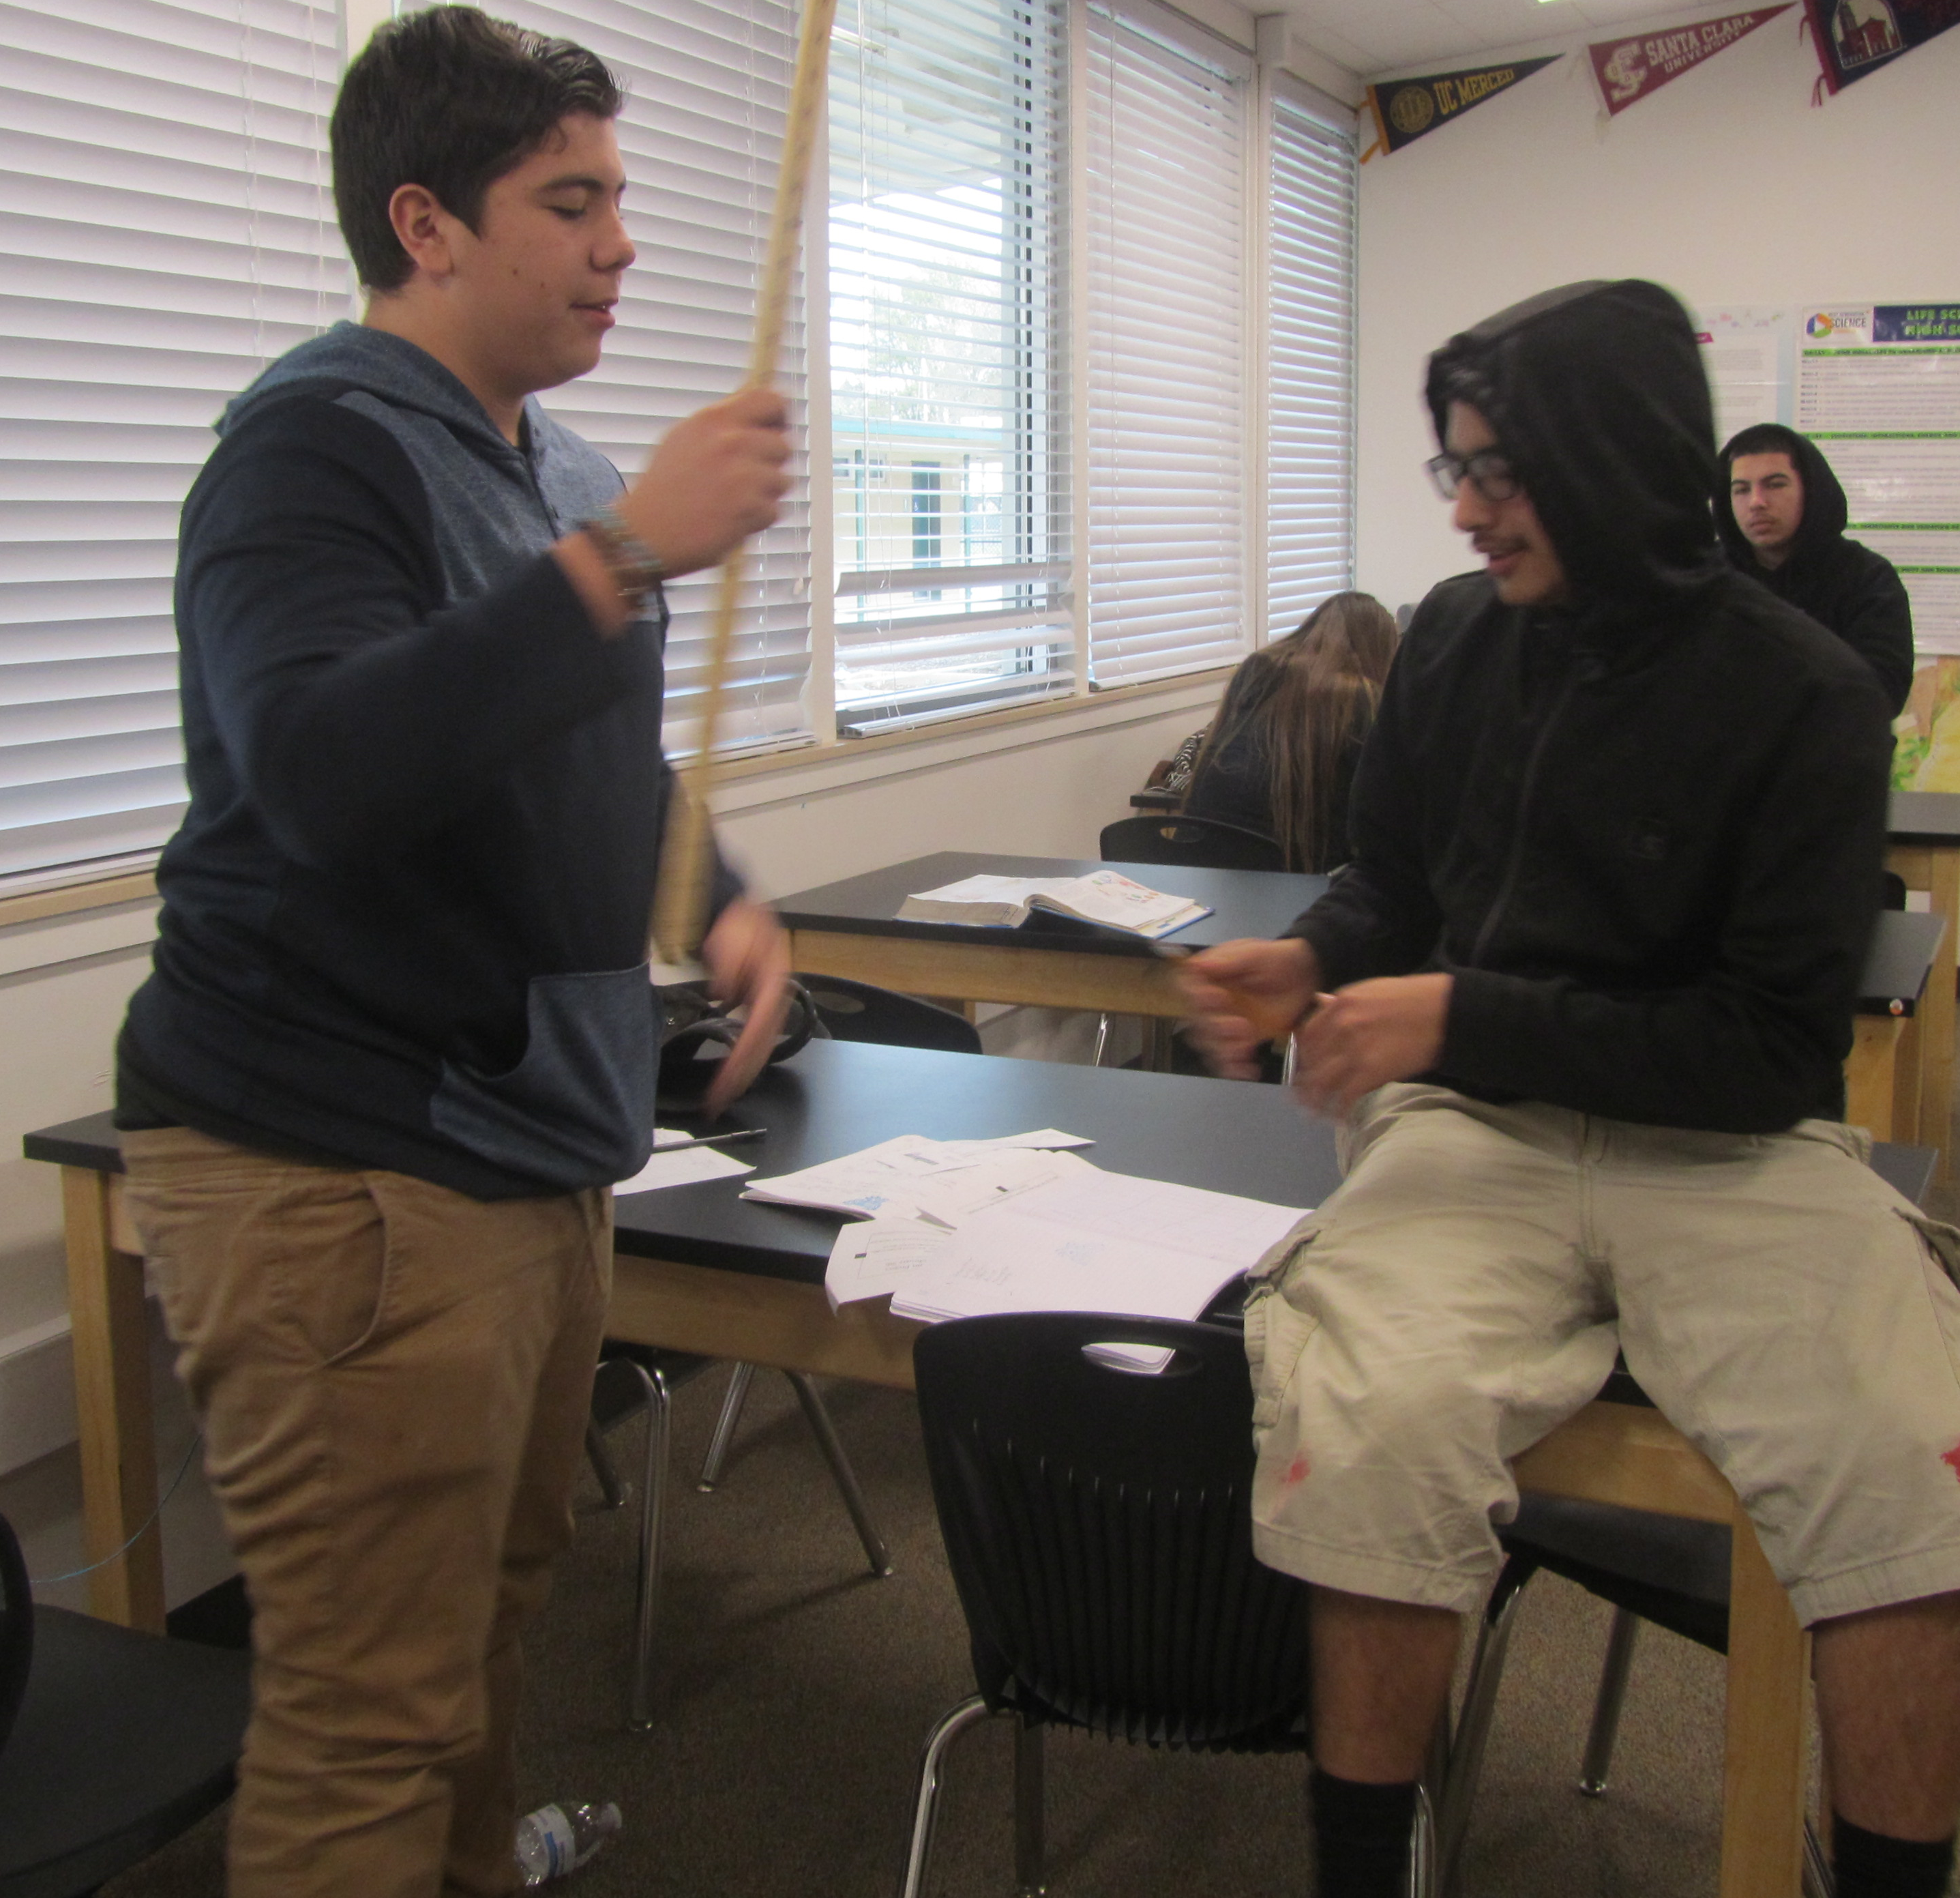
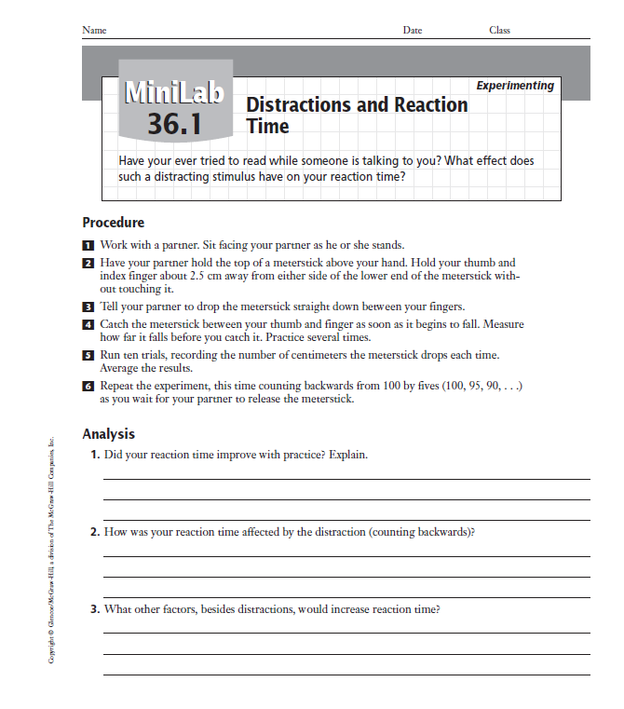
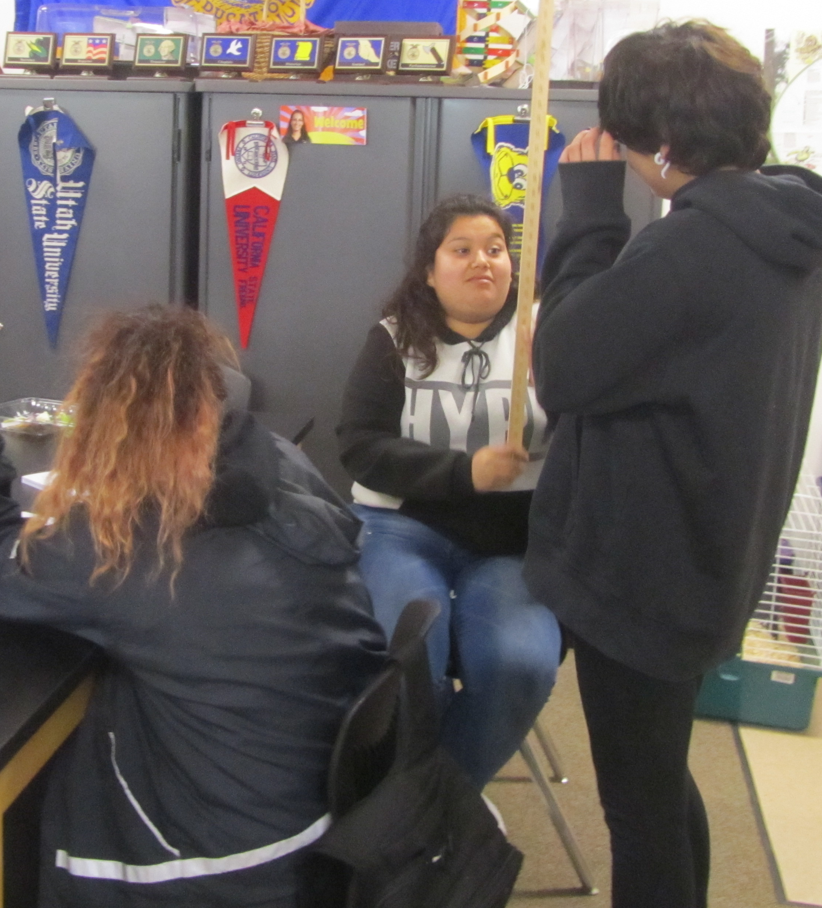
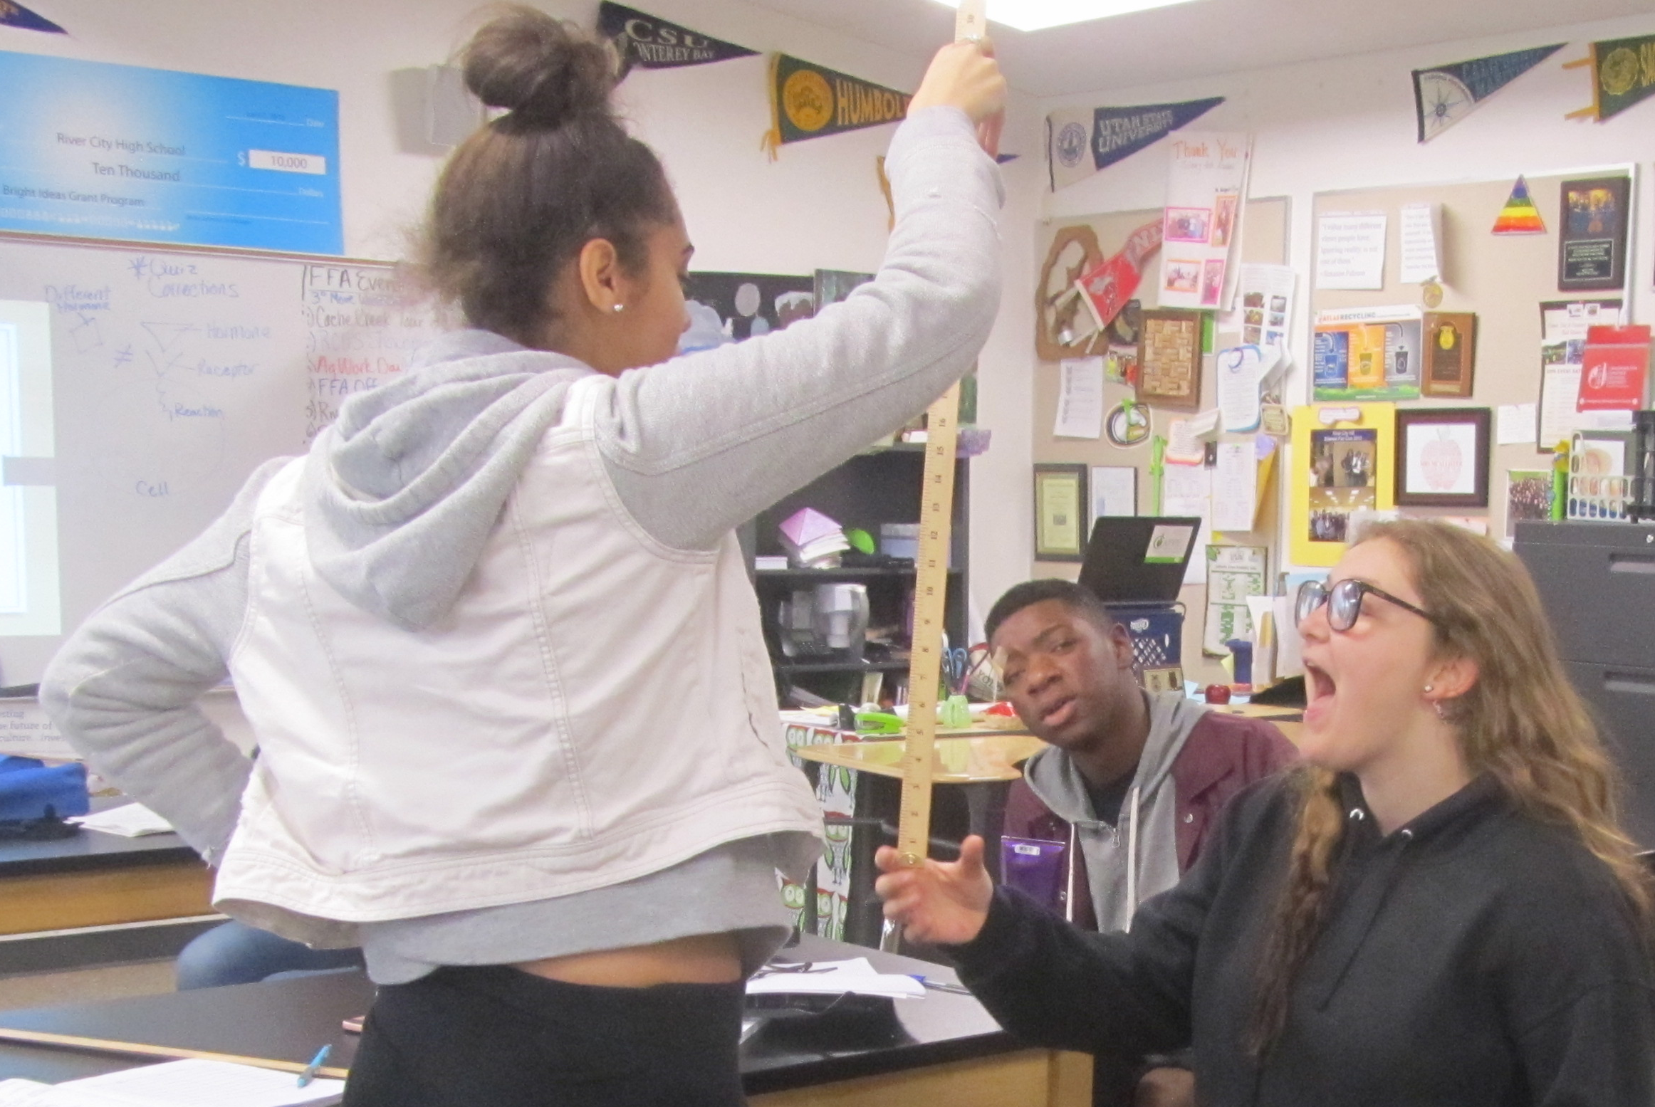
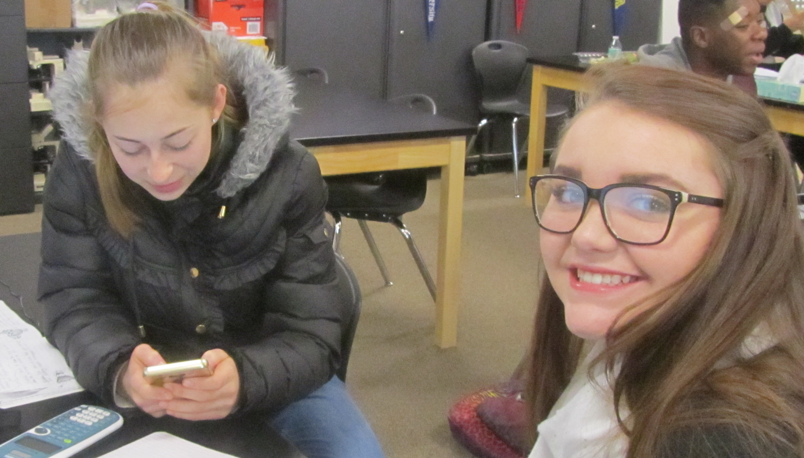
Copy this table on page 17NB. p.948BB
Trials | Without Distraction (cm) | With Distraction (cm) | Opposite hand (cm)
1
2
3
4
5
6
7
8
9
10
Average

Slide 4
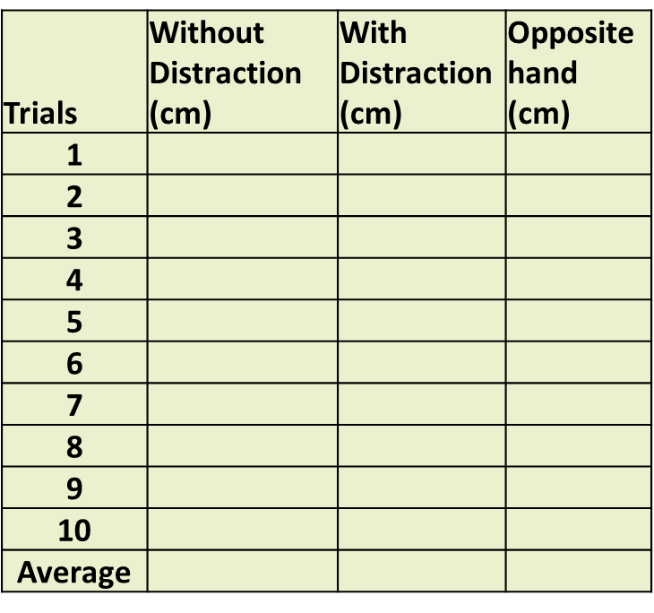
HW – send me (Email) the Data section of the Distraction Reaction Lab
Data: (12 Font, Times new roman)
  Table 1: (12 Font, Times new roman)
  Distance in (cm) measured with no Distraction, with Distraction and Opposite hand catching a meter stick. (10 font, TNR)

Slide 5
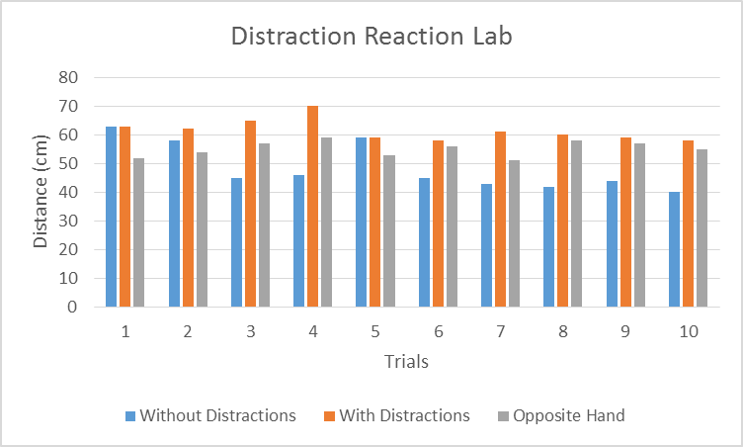
Data: (12 Font Times New Roman)
Graph 1
Catching the meter stick without distractions, with distraction and with the opposite hand varied over the trials, however without distraction did get faster by the last trial. (10 font TNR)

Slide 6
Guest Speaker Andrew Codd p. 25 NB
Internships – Why you need them.
Notes P. 23 NB
What is an Internship?
Write 3 examples of Internships,
Explain how it works.
Explain how you benefit from the Internship.

Slide 7
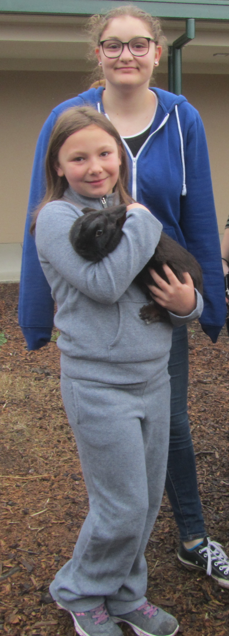
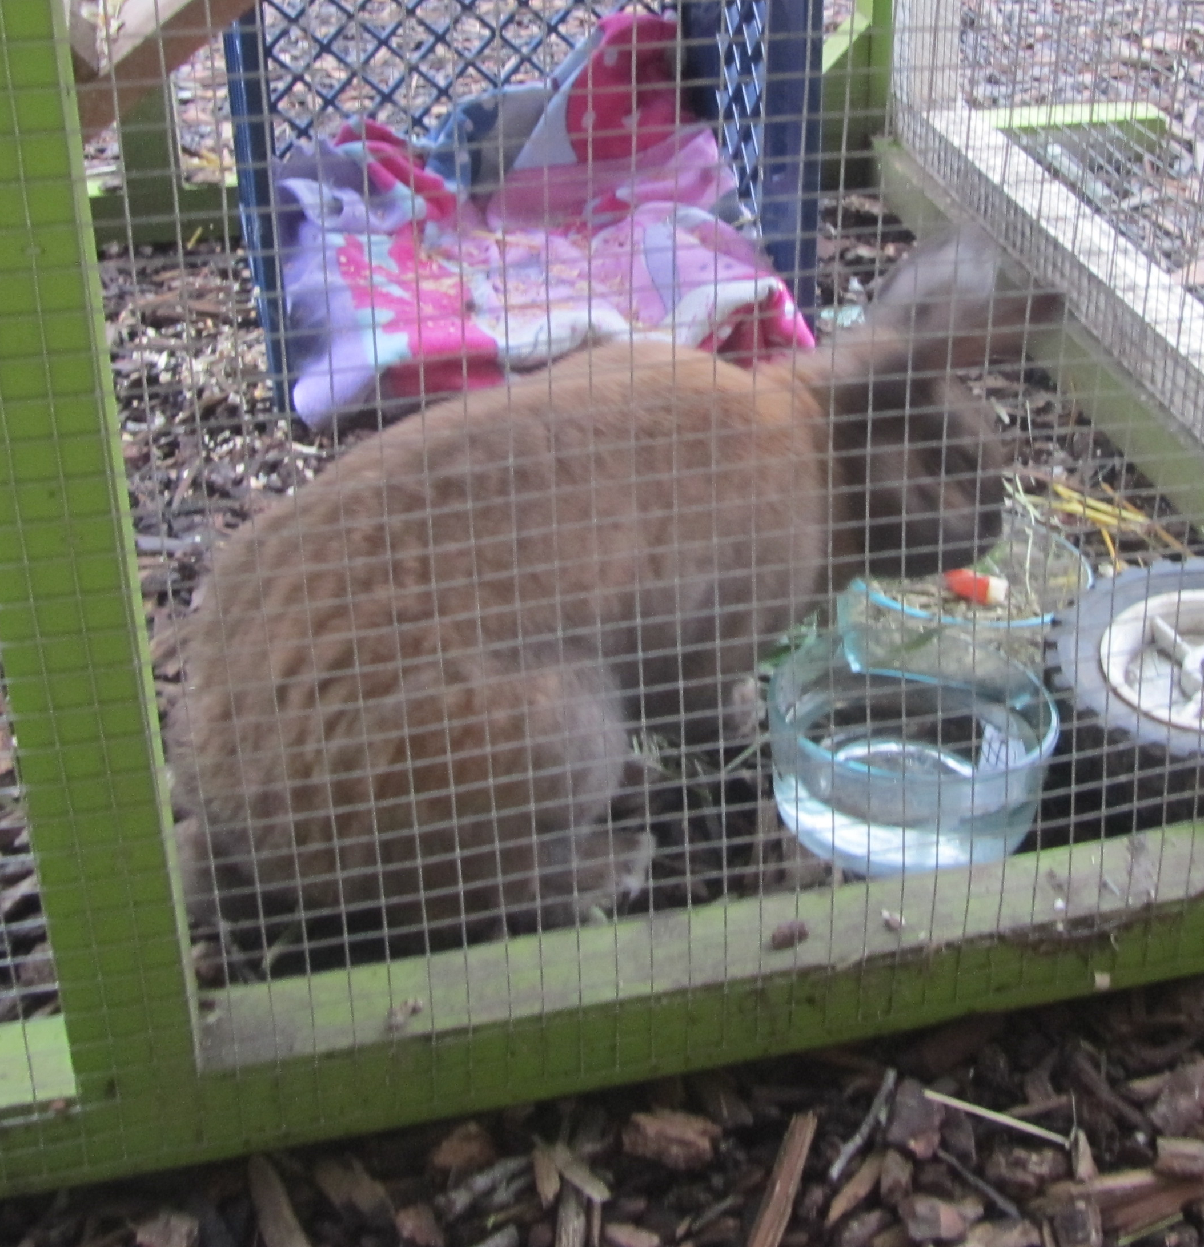
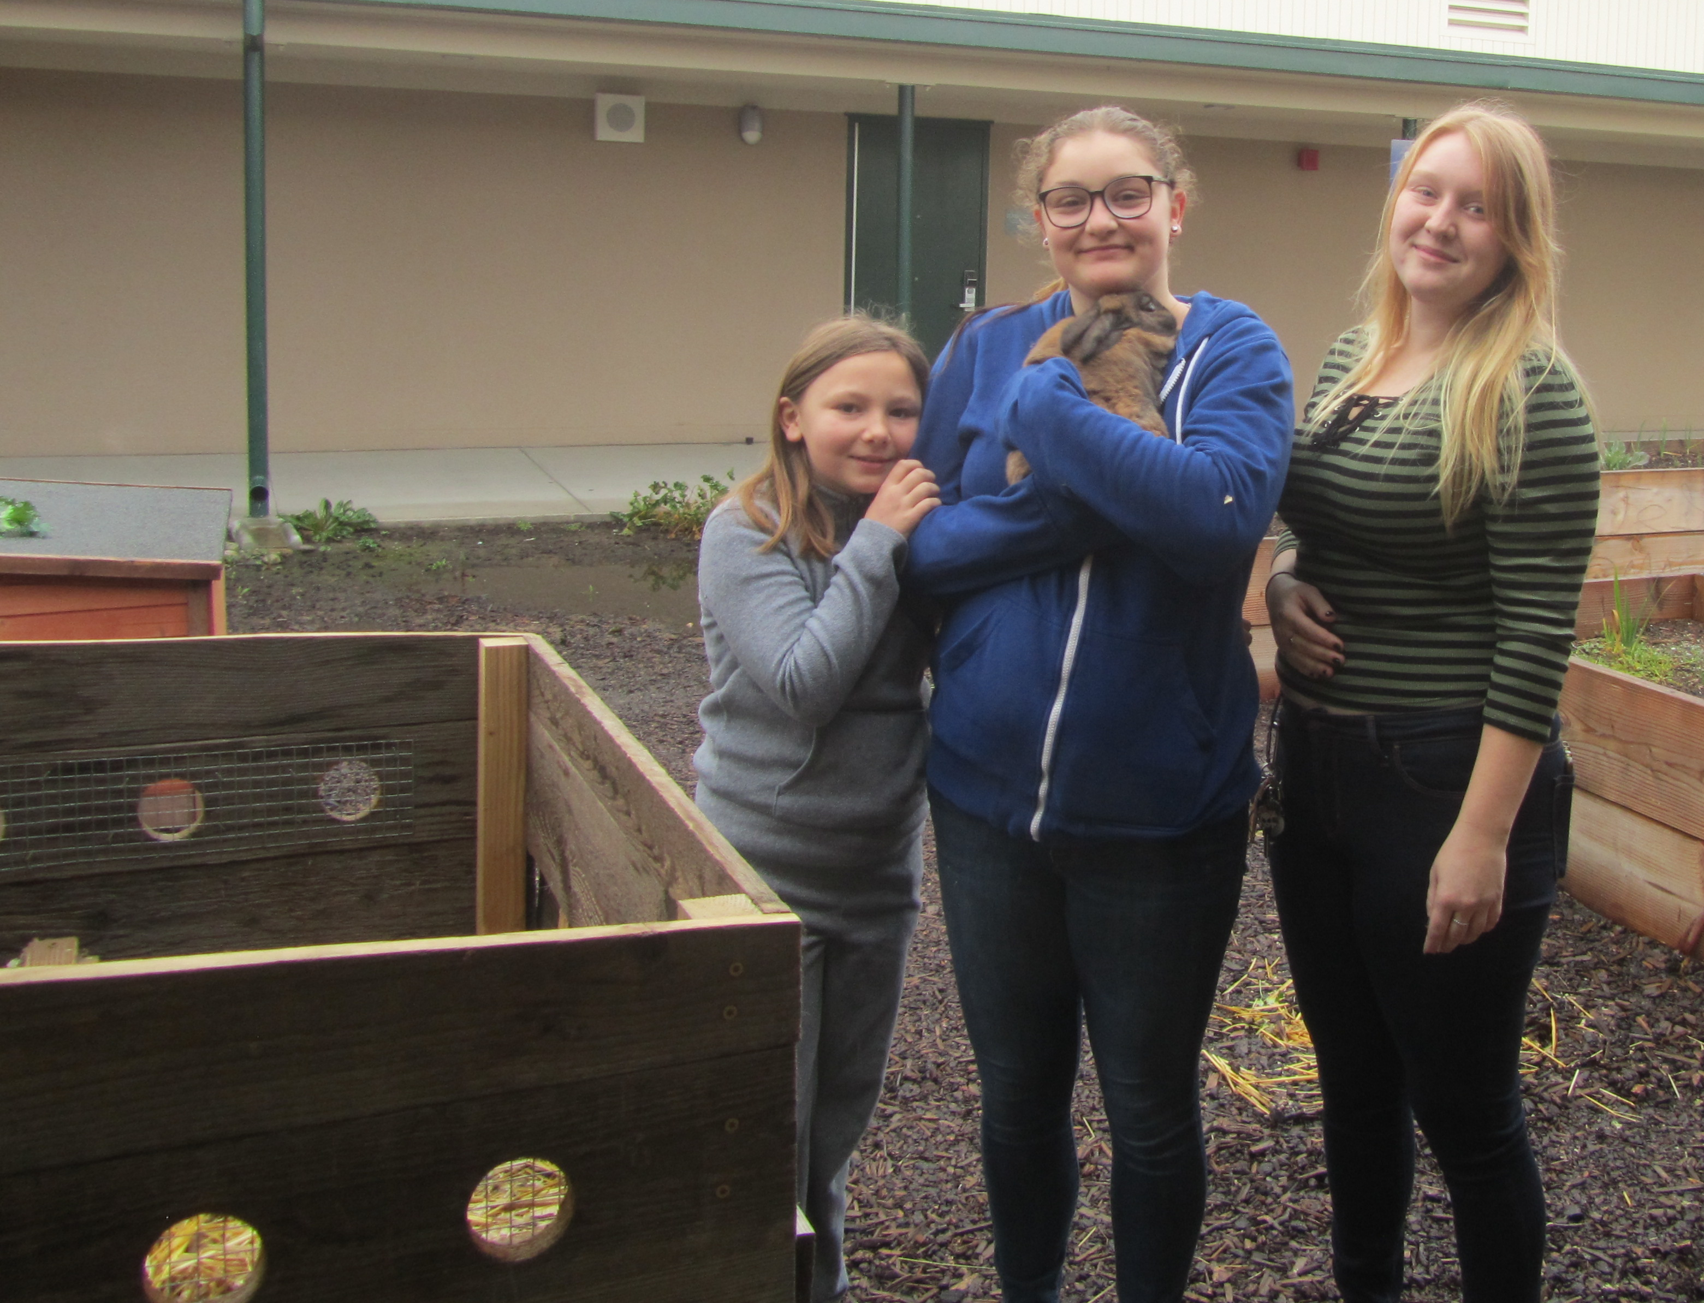
Your SAE
Internship?

Slide 8
Scientific Method Patty Power p. 27 NB
Control group is Group B
The Independent Variable is the NEW Sauce.
The measurement of gas production is the Dependent Variable.
Mr. Krab’s conclusion be that the new sauce helped decrease gas production in the customers.
The 8 people in Group B had a Placebo effect.

Slide 9
Scientific Method p. 27 NB
The number of paper clips is the Independent Variable.
The distance the plane will fly is the Dependent Variable.
The plane without the paper clips is the Control.
The plane itself, the types of paper clips, the same person threw the plane.

Slide 10
Finishing touches on your Agriculture/ Body System Project.
DUE Thursday 3rd period, everyone presents☺
Samantha presents Tuesday☺

Slide 11
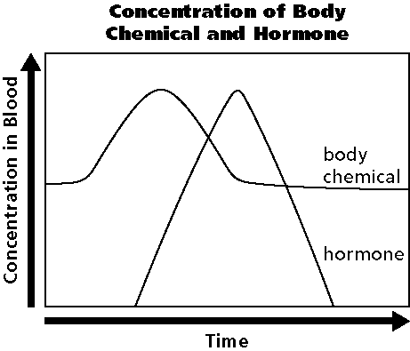
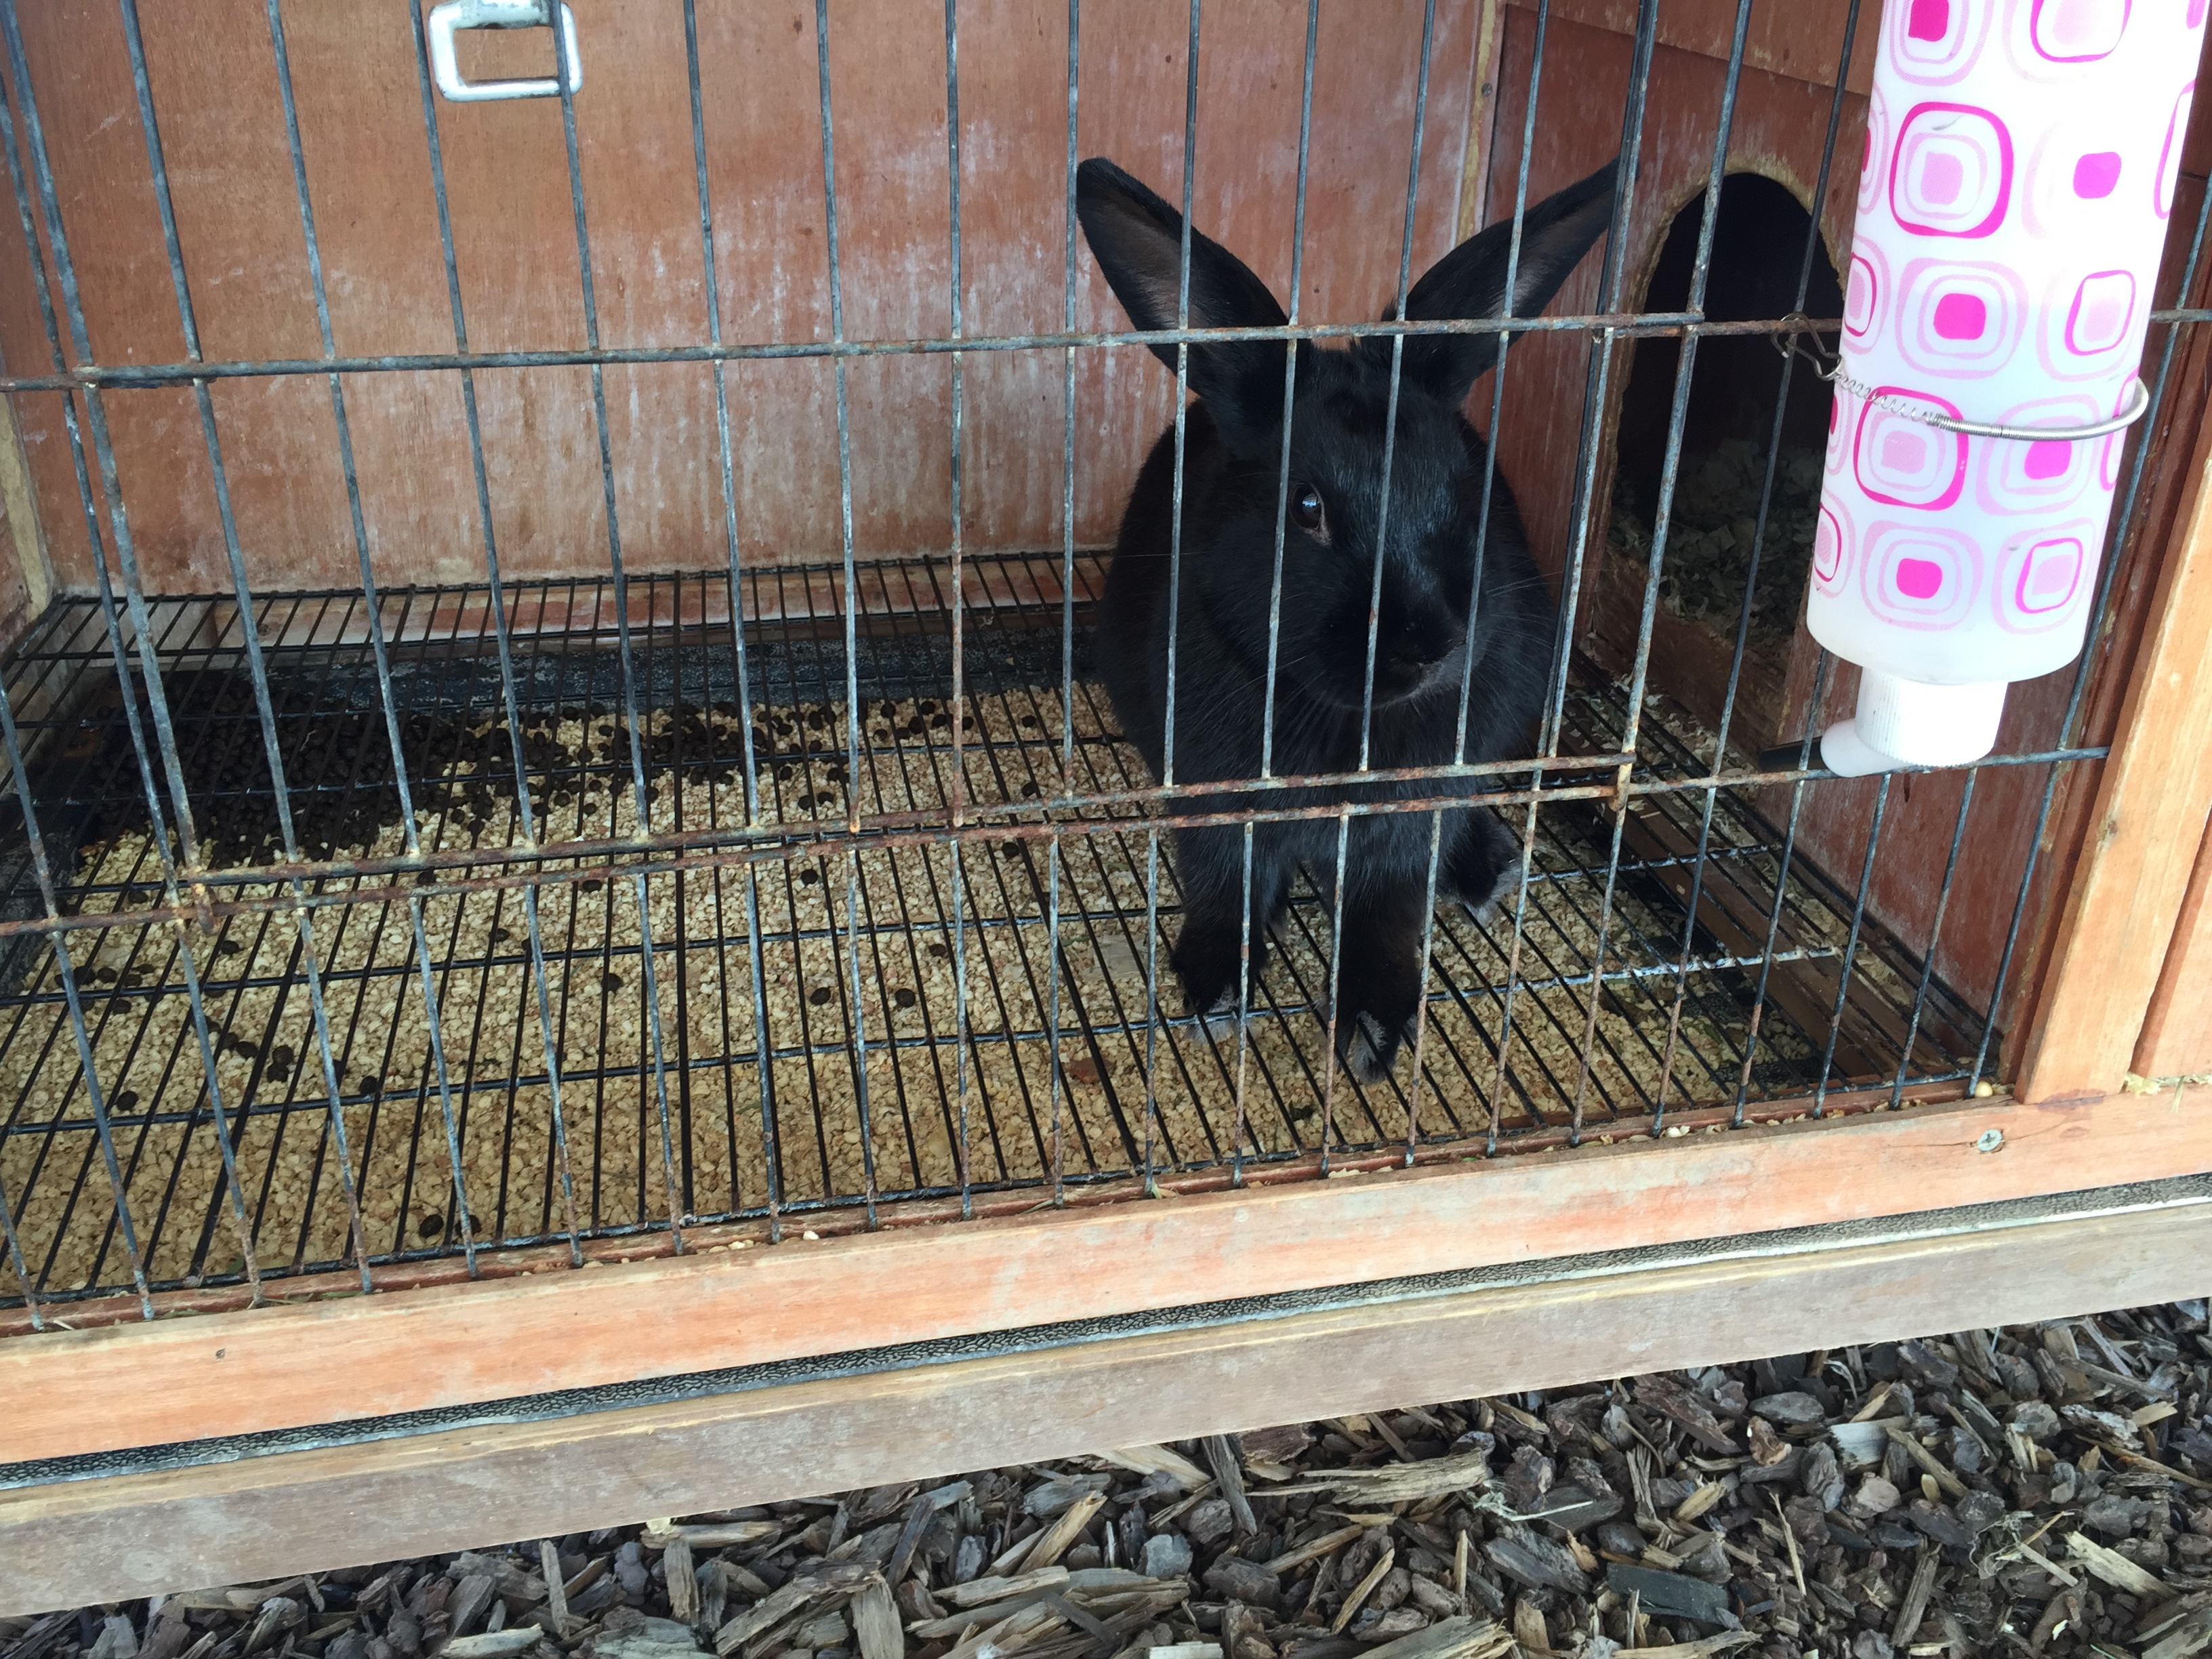
2/7 Homeostasis & Endocrine System CH 35.3
Obj. TSW draw and describe a Negative Feedback System involving the Endocrine System. P. 32 NB
What are the functions of the Endocrine system?
Draw the graph, explain how the body maintains homeostasis.
Why does the hormone production increase?

Slide 12








Section 35.3 Summary – pages 929-935
Control of the Body
Internal control of the body is directed by two systems: the nervous system and the endocrine system.
#1. The endocrine system is made up of a series of glands, called endocrine glands, that release chemicals directly into the bloodstream and stimulates other glands to release theirs.

Slide 13
Section 35.3 Summary – pages 929-935
#2. Control of blood glucose levels
Another example of a negative feedback system involves the regulation of blood glucose levels.
When you have just eaten and your blood glucose levels are high, your pancreas releases the hormone insulin.

Slide 14
#3. The production of the hormone increases due to the level of the body chemical. When the body chemical is back to normal the Hormone is not released any more – Negative Feedback system.

Slide 15
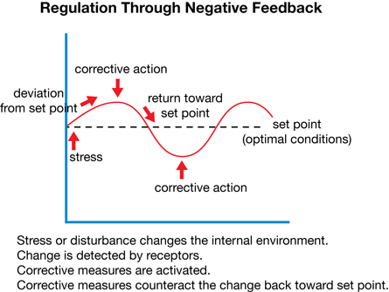
Negative Feedback
Negative Feedback system is the relationship that maintains homeostasis in the body between the body chemical and hormones.

Slide 16
Section 35.3 Summary – pages 929-935
Control of the Body
Ultimately, the functions of all body systems are controlled by the interaction between the nervous and endocrine systems.
Because there are two control systems within the body, coordination between the two systems is needed.

Slide 17
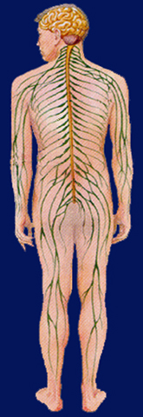
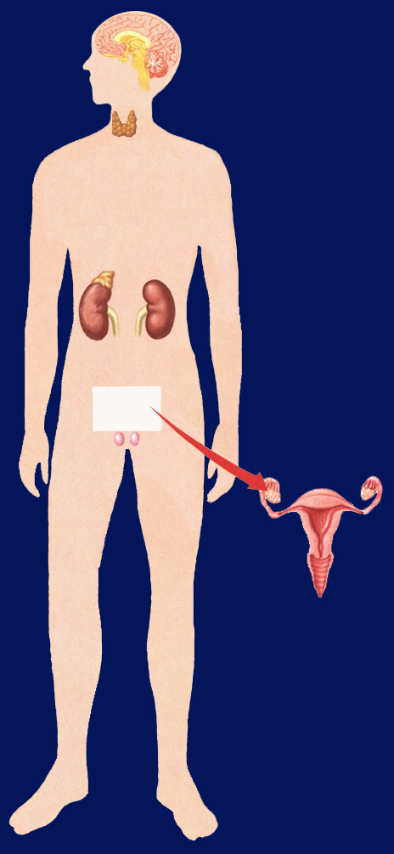
Section 35.3 Summary – pages 929-935
Pituitary
Hypothalamus
Brain (CNS)
Control of the Body
Parathyroid gland
Thyroid gland
Spinal cord (CNS)
Adrenal medulla
Spinal nerves (PNS)
Adrenal cortex
Ovary in female
Thyroid Gland regulates Metabolism in the body.
Testis in male

Slide 18
The Effect of growing Lettuce Seeds with Radish Seeds
Germination of lettuce seeds when grown with Radish seeds
My First & Last Name
Date
Mrs. McAllister
Class & Period
12 Font only

Slide 19
Allelopathy Lab
Objective: Using the Scientific Method, test whether different seeds (Radish and Lettuce) impact each others growth.
Essential Question: Can radish seeds impact the growth of lettuce seeds?
Background: (Paragraph) Explain Vocabulary: Germination, Competition for Resources
  Cite Sources: Allelopathy: How Plants Suppress Other Plants (Ferguson, Rathinasabapathi, Chase, 2013)
Hypothesis/ Purpose: If radish seeds are grown with lettuce seeds, then the lettuce seeds will not germinate.

Slide 20
Allelopathy Lab
Materials: Petri Dishes, Pipettes (2mL), Petri dish paper, Radish seeds, Lettuce seeds
Procedure: (Make sure your procedure can be duplicated exactly by someone who has never done this lab – Be very specific.)
  Step 1:
  Step 2:
  Step 3:
  Step 4:
  Step 5:

Slide 21
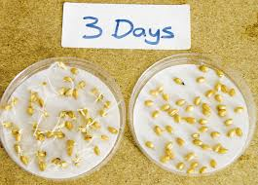
Allelopathy Lab p. 27 NB
Data: (Qualitative –words & Quantitative – numbers, values)
  Table 1: The table below shows the different germination rates of radish and lettuce seeds when grown together and separately. (10 font)

Slide 22
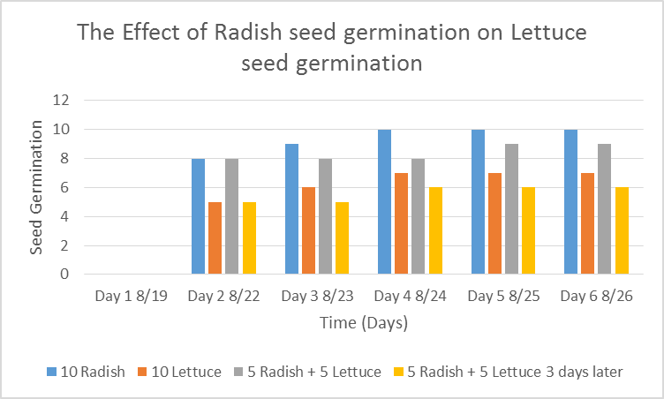
Allelopathy Lab
Data: (Qualitative & Quantitative-numbers, values)
  Graph 1:
  The radish seeds over 6 days showed increased germination compared to the lettuce seeds. (10 Font)

Slide 23
Allelopathy Lab
Data: (Qualitative – descriptive words & Pictures)
  The radish seeds looked …… they smelled….
  The lettuce seeds roots were longer and had more root hairs.

Slide 24
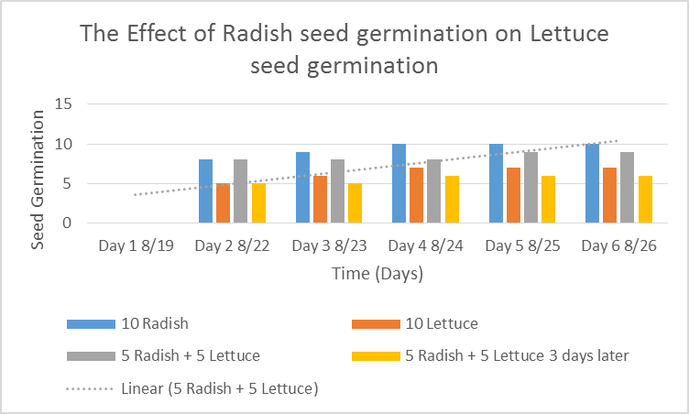
Allelopathy Lab
  Data Analysis: (Paragraph)
  Explain your data - results. Why did we see the results in the graph? Discuss any trends.
  Cite Sources: Allelopathy: How Plants Suppress Other Plants (Ferguson, Rathinasabapathi, Chase, 2013)

Slide 25
Allelopathy Lab
Conclusion: (Paragraph)
  Restate hypothesis and explain if it was supported or not. Tie your Data Analysis to your Background and hypothesis. Did your data support what you thought would happen? How? Explain why allelopathy is important. At the very least, write an AXES paragraph about Allelopathy between radish and lettuce seeds and how it applies to Agriculture.
  Cite Sources: Allelopathy: How Plants Suppress Other Plants (Ferguson, Rathinasabapathi, Chase, 2013)

Slide 26
Works Cited
James J. Ferguson, emeritus professor; Bala Rathinasabapathi, professor; and Carlene A. Chase, associate professor, Horticultural Sciences Department, Cooperative Extension Service, Institute of Food and Agricultural Sciences, University of Florida, Gainesville, FL 32611.
Yes – one more
Yes – still one more ☺
Done!

Slide 27
FFA Officer Elections
Present Video/ Presentation 3 – 5 minutes on week of September 12th.
  Who you are?
  What positions you are running for.
  Presentation for each different office to run for.
  Why you want the officer position.
Hold our meeting during 2nd class for Election. Sept. 16th.

Slide 28
Opening and Closing Ceremony Practice
Where are the Officers Located in the room?
What dictates where the officer’s positions are located?
Everyone get an FFA Manual.
Choose an Officer to be. Read your part.
Add: Chaplain, Parliamentarian, and Historian before Advisor

Slide 29
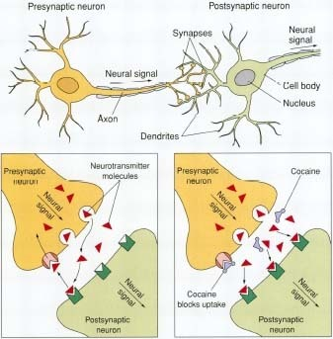
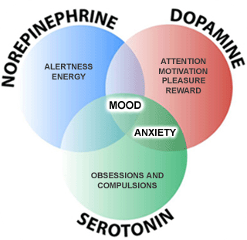
9/1 Neurotransmitters & Addiction CH 36.1 & 36.3
Obj. TSW learn about neurotransmitters and how drugs impact how the neurotransmitters work. P. 24 NB
What is a neurotransmitter?
Why is it important in communication of neurons?
How do drugs affect the function of neurotransmittors?

Slide 30
Mouse Party Activity
With a partner go to a computer and log onto it using your new User name and password.
Once you are logged onto the computer go to: http://learn.genetics.utah.edu/content/addiction/
Click on Mouse Party
Take a few notes about how addiction happens on page 17 NB.
Worksheets:
http://teach.genetics.utah.edu/content/addiction/

Slide 31
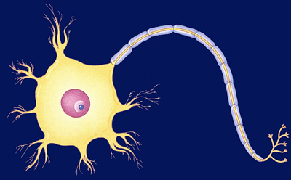
Nerve Impulse Poster p. 944, 949 BB
Write the standard (9E): Students will know the roles of sensory neurons, interneurons, & motor neurons in sensation, thought & response.
Draw the three neurons, labeling all the parts, define each on the poster.
Show an Impulse (Ex. Bright light, touch, pie or hot plate) that includes the sensory, interneuron, and motor neuron response.
Make sure to describe a Reflex Reaction.

Slide 32
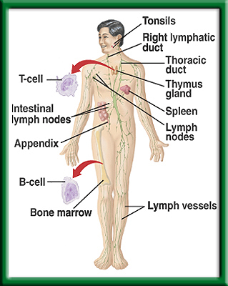
Defense Against Infectious Diseases 39.1 & 39.2
2/2 TSW understand and explain the role of antibodies in the body’s response to a bacterial infection during the warm up. P. 26 NB
What is a pathogen?
Identify cells, tissues and organs that make up the immune system.
Explain the role of antibodies in response to infection.
T – cell production

Slide 33
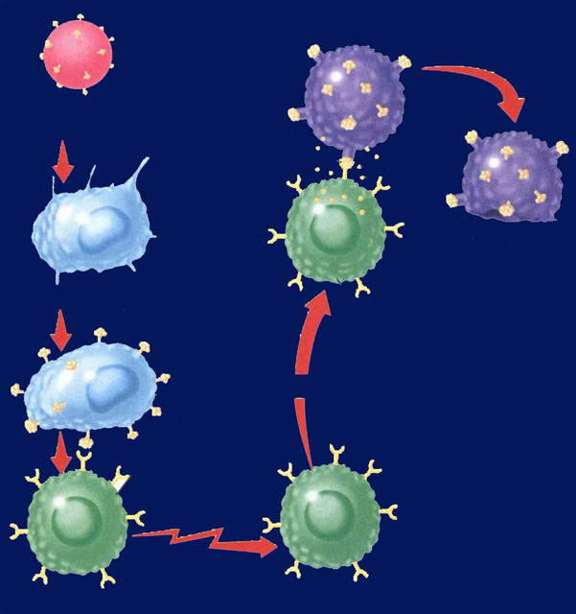
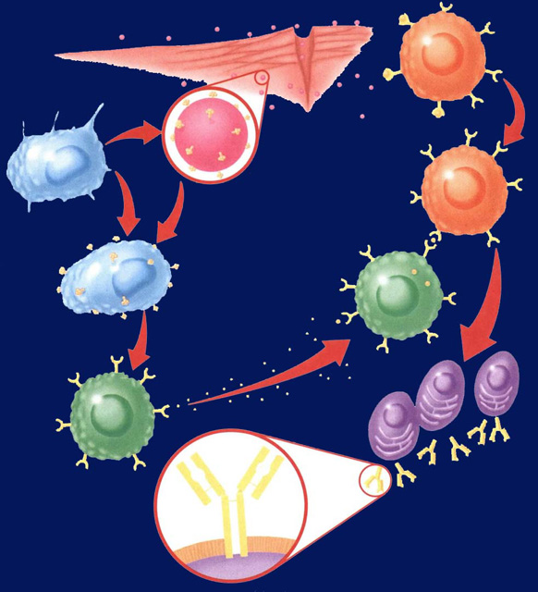
Immune System Responses 39.2
2/3 Obj. TSW compare and contrast Antibody Immunity and Cellular Immunity by diagraming the process in their NB and drawing a Cartoon applying nonspecific & specific immune responses. P.28 NB
? Immunity
Identify two types of lymphocytes in Antibody Immunity.
Explain the process of Antibody Immunity.
Explain the process of Cellular Immunity.
In Agriculture, why are antibiotics used in large scale Production – CAFLO?
? Immunity

Slide 34
Distraction Reaction Lab
Create your title page today
Start your Background information by doing online research and cite your sources.
Copy and Paste Excel Data Table 1 and Graph 1 into word document.
Bar graphs are used, not line.
Page 23NB
Notes CH 39

Slide 35
Notebook – Specific Immunity
P. 25 NB Antibody Immunity P. 1037BB
P. 27 NB Cellular Immunity P. 1038 BB
Write a 4 – 5 sentence summary using specific vocabulary to explain the process.
Antibody Immunity
Cellular Immunity

Slide 36

Section 39.2 Summary – pages 1031-1041
Antibody Immunity – Specific Immune Response, Builds Antibodies
E. B cells can bind to antigens directly.
Pathogens enter
tissues through a wound.
B cell
F. Helper T cells bind to antigens on B cells.
B. They are attacked
by macrophages
at the infection site.
Pathogen
Macrophage
G. T cells release chemicals that cause B cells to produce
clones of plasma cells.
C. Antigens of the pathogen are displayed
on the surface of the macrophage.
Antigen
receptor
site
H. Each plasma cell secretes more than 2000 antibodies per second in the blood. Memory B cells and antibodies remain in the blood and respond to future invasions by the same pathogen.
D. Helper T cells have
receptor sites that
recognize and bind to the antigens on the
macrophage.
T cell
Plasma
cells
Antibody
Surface of
plasma cell

Slide 37
Section 39.2 Summary – pages 1031-1041
#3.Cellular Immunity
Specific Immune Response that blows up infected body cells.
Infected cells
Pathogen
engulfed by
Perforin
Foreign
antigen
Infected cell lyses
Macrophage
Cytotoxic T cell
Displays antigens
on surface and
stimulates T cell
Attacks infected
cell
Stimulates
Helper T cell
Cytotoxic T cell

Slide 38
Immune System Poster
Make a cartoon with captions, showing the body’s Immune Response to an infection.
Make 4 Stages:
  Stage 1: How the Pathogen gets into the body.
  Stage 2: Show the Nonspecific Immune Response.
  Stage 3: Show the Specific Immune Response.
  Stage 4: Show the Memory Cells Warding off a previous infection.

Slide 39
Foldable (29 NB) P. 1037BB
Macrophage – Definition & Picture inside
  A white Blood cell that is nonspecific against pathogens.
T – Cell
B – Cell
Plasma Cell
Antibodies
Antigens

Slide 40
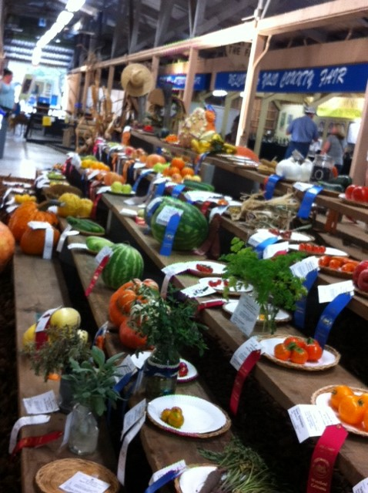
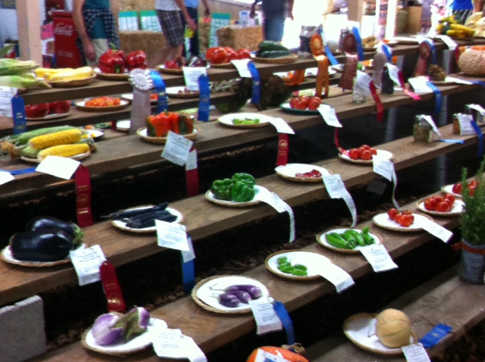
Farm to Fork Food Drive
Breaking the world record in donated fresh food to others.

Slide 41
Sub
Notes Page 25 NB
Full page notes

Slide 42
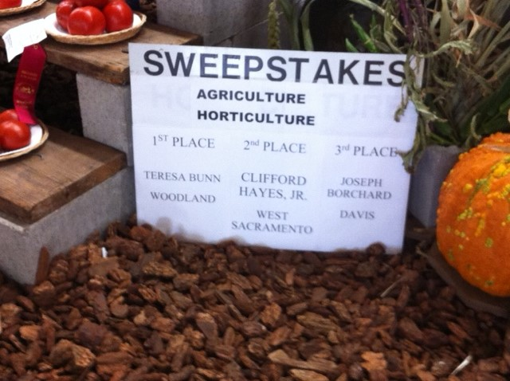
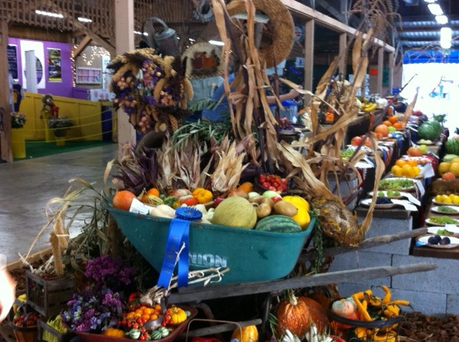
Agricultural displays
Does anyone know Clifford Hayes Jr?

Slide 43
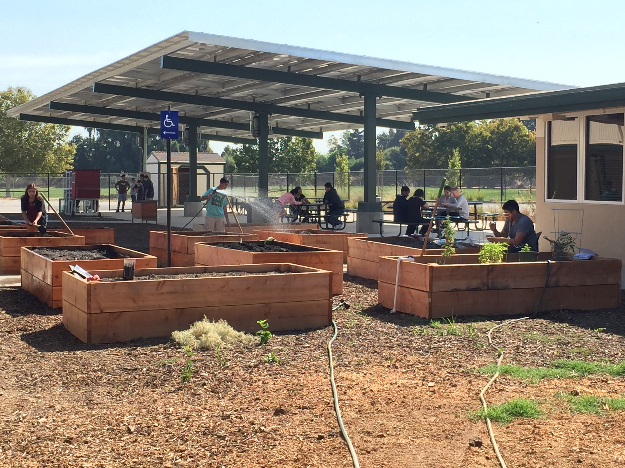
Just another day at work ☺

Slide 44
Section 35.3 Summary – pages 929-935
Control of the Body
Internal control of the body is directed by two systems: the nervous system and the endocrine system.
#1. The endocrine system is made up of a series of glands, called endocrine glands, that release chemicals directly into the bloodstream and stimulates other glands to release theirs.

Slide 45
Section 35.3 Summary – pages 929-935
#2. Control of blood glucose levels
Another example of a negative feedback system involves the regulation of blood glucose levels.
When you have just eaten and your blood glucose levels are high, your pancreas releases the hormone insulin.

Slide 46
#3. The production of the hormone increases due to the level of the body chemical. When the body chemical is back to normal the Hormone is not released any more – Negative Feedback system.

Slide 47
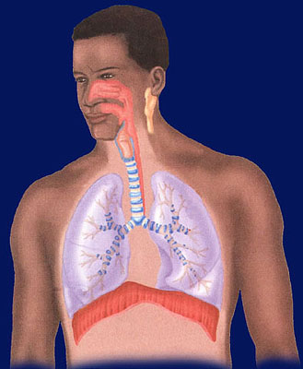
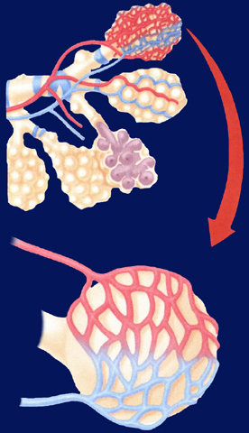
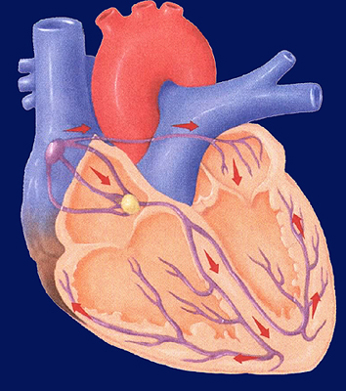
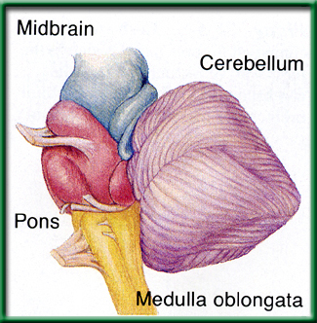
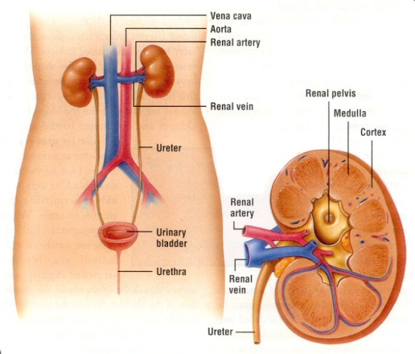
2/9 Respiratory, Circulatory & Excretory Systems CH 37.1 – 37.3
Obj. TSW explain in your warm up how the respiratory, circulatory and excretory systems complement each other to maintain Homeostasis. P. 34 NB
Explain the process of how gas is exchanged (Alveoli) in the lungs.
The level of CO₂ in the blood affects breathing rate. How would you expect high levels of CO₂ to affect heart rate?
How does the kidney maintain homeostasis in the body?

Slide 48
Measuring your Pulse & Respiration P.31 NB
Respiration – Breaths / minute
Pulse – Heart Beats/ minute
Measure your pulse & respiration and write them down on page 29 NB.

Slide 49
Exercise Lab p. 31 NB
Choose a partner
Choose an exercise
  1 minute in length (5 times)
    Count strides, Jumping Jacks, Push ups
  Duration (Time)- (5 repetitions) or (Time minutes)
    Plank, Wall Sit
Control?
What was constant?

Slide 50
Data Table & Graph
When do muscles fatigue? P. 31 NB
Time (minutes) | Number of repetitions Sit ups, Push ups, Jumping Jacks Calf Raises Squats
1st minute 1 minute | 10
2nd minute 1minute | 20
3rd minute 1minute | 30
4th minute 1minute | 40
5th minute 1minute | 50
Intervals Wall Sit Plank Superman | Time (seconds)
1 | 30
2 | 45
3 | 50
4 | 20
5 | 15

Slide 51
Muscle Fatigue Lab p. 31 NB
Trials | Number of Repetition | Pulse
1
2
3
4
5

Slide 54
Data Table for Pulse P. 31 NB
 | Trial 1 | Trial 2 | Trial 3 | Trial 4 | Trial 5
Pulse | 68 | 68 | 69 | 72 | 75

Slide 55
Graph your Pulse Rate P. 31NB
When does muscle fatigue set in?

Slide 56
The Heart, Lungs & Components of the Blood P. 35 NB P. 982 BB
Draw & Label & Color the components of the Heart & Lungs.
Copy the following Notes:
  Red Blood Cells -transports O₂ & CO₂
  White Blood Cells- T & B cells Immune system
  Platelets – cell fragments involved in blood clotting (Vitamin K)
  Plasma – Most of the liquid of blood- proteins, nutrients, enzymes, hormones, salts

Slide 57
Blood Cells
Red Blood Cells
  Made in the Red Marrow
  Circulatory & Respiratory System
  Smaller
  More numerous
  No nucleus
  O2 & CO2
  Contain Hemoglobin (Iron – Fe)
White Blood Cells
  Made in the Yellow Marrow
  Circulatory & Immune System
  Larger
  Fewer cells
  Nucleus
  T & B & Macrophage Cells

Slide 58
Exercise Lab
Title: Short – 5 words
Introduction: Exercise & Cardiovascular/ Respiratory system, O₂ & CO₂, pH, pulse
Objective
Hypothesis
Materials: List
Procedure: Specific. Step 1, Step 2, Step 3…
Safety concerns: don’t run with scissors.

Slide 59
Exercise Lab
Constants
Control:1st data point
Data table: Independent & Dependent Variable
Graph:
Data Analysis: What happened over time and why is it important?
Error Analysis:
Conclusion:

Slide 60
Questions to answer in the conclusion
Yes in addition to the one’s in the lab report.
How did your steps change with the different activities you did?
What effect did repeating the exercise over time have on the muscle group.
How did your muscles feel?
What physiological factors are responsible for fatigue?
How does the amount of rest you have affect the recovery of the muscles?
How did your results compare to others.

Slide 61
2/9 Reading a Table and Graph
Obj. TSW learn how to read a graph and interpret data from it. P. 34NB
Trials | Without Distractions | With Distractions | Opposite Hand
1 | 63 | 63 | 52
2 | 58 | 62 | 54
3 | 45 | 65 | 57
4 | 46 | 70 | 59
5 | 59 | 59 | 53
6 | 45 | 58 | 56
7 | 43 | 61 | 51
8 | 42 | 60 | 58
9 | 44 | 59 | 57
10 | 40 | 58 | 55
In the data table, What can be concluded from the data without distractions? With Distractions?
In the graph, What was the independent and dependent variables. What was the control for the lab?
Create a better title for the graph that represents the true nature of the lab.

Slide 62
Answers to WU
The conclusion to the data without distractions is that it got faster as more trials were done. With the distractions, the reaction time did not get faster.
The Independent Variable is the number of trials, (X – axis). The Dependent Variable is the Number of repetitions, (Y – axis). The control in the lab was my original resting respiration rate, or pulse rate.
A better title for the lab could be: Reaction Lab with meter sticks, Distraction/Reaction Meter Stick Lab, How quick can you catch a meterstick?

Slide 63
Animal and Body Systems Project
50 point Project Due February 9th
You may work alone or with a partner.
Choose a domestic farm Animal, choose a Body System.
On a Poster Board, or Power Point Show both systems, label the parts. You can use pictures or draw.
During your presentation explain how the systems are similar, and how they are different.
Explain in detail why it is important that we understand that system in your animal, and for us as a human.
Have a works cited page.

Slide 64

Learning about FFA Officer Positions Activity
Obj. TSW distinguish between different officer positions after reviewing each positions’ responsibilities online. P. 31 NB
Use the FFA.org website or the Official Manual P. 48 and Name 5 of the 9 Officer positions.
What responsibilities/ behavior would you expect from the all the River City High School Bryte CCT Chapter FFA officers?
Would you like to run for an office next year in Farm to Fork 1?
Why or why not?

Slide 65
FFA Officer Responsibility Activity
Use FFA.org
FFA Manual
Page 48 in online Manual
Write down 3 key responsibilities for each of the offices on 3x 5 cards
We will use flashcards and travel around to say the responsibilities and see if another person can name that officer position.
Tape your card to page P. 31 NB

Slide 66
P. 29 NB Notes on Food Matters.
Get your stamp

Slide 67
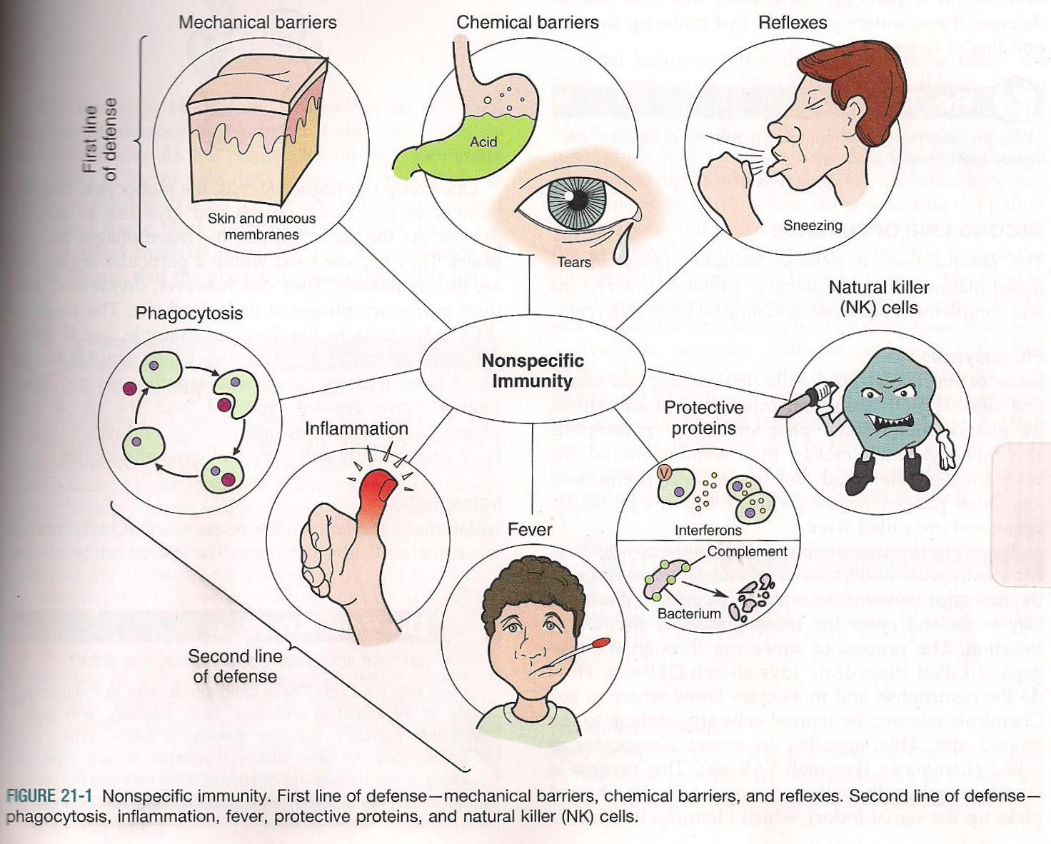
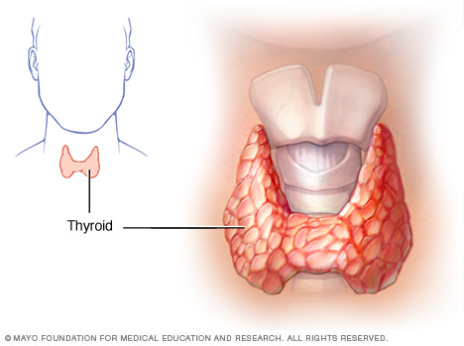
2/10 Metabolism & Homeostasis CH 35
Obj. TSW understand how the body regulates chemical reactions to maintain homeostasis. P. 36NB
Define metabolism.
The thyroid controls what process in the body?
How does the immune system respond to an infection in a nonspecific way?

Slide 68
Quiz Today –
Notebook Check
Pages 22 – 35 ( Points)
Study Warm ups
Read Dairy Herd Management Article
  CERC- Claim, Example, Explanation, Conclusion (AXES Paragraph)

