Slide 1
Ag Biology
Energy Unit
Week 6
Sept. 18th – 22nd

Slide 2
Agriculture can be the solution to many of today’s problems:
Stopping Mass Extinction/
Improving Biodiversity/ Improving Farmland/ Healthy Soil
Agricultural Issues:
  Monocropping
  Eutrophication
  Releasing Nitrous Oxides into the air
  Barren Land – Does not hold CO2
  Synthetic Fertilizers – feed plant but not nourish soil
  Methane Production from Cattle
  Deforestation to grow farms
  Energy – Biodigestion of Animal Waste
  Choose an Agricultural Setting
  Choose an Agricultural Issue in that Setting
  Research a solution to that issue, How can Agriculture be the Hero to major problems that contribute to Habitat Loss, Global Warming, Climate Change, Pollution, Extinction of Species

Slide 3
Agriculture can be the solution
Wildlife Corridors
Wildlife Habitats
Cover Cropping
Introducing Biodiversity into the Farm

Slide 4
SAE Qualification Questionnaire
Your SAE must be agriculturally related, created by you, invested time of at least 8 hours, supervised by your Ag Teacher and be part of your grade.
How does it provide real work situations?
What careers is it related to?
How is it part of your career goal?
List the skills, knowledge and attitudes you need for this career that your SAE might apply to.
How can you grow, and become more competent each year in the Ag program with this SAE?
How does your SAE allow for expansion, and/or change?
Have you kept records of your money, and time?

Slide 5
Cycles in Nature
2 groups/cycle
Water: Taylor, Zarinna & Breanna; Paulina, Angela, & Carmen
Carbon: Jason, Avi; Charline; Chris; Nathan
Nitrogen: Estaban, Isaac, Jenna
Phosphorus: Viri, Jaiden, Anna
Oxygen: Tyler, Ronny, Andrik; Carolina Samantha, Daniella

Slide 6
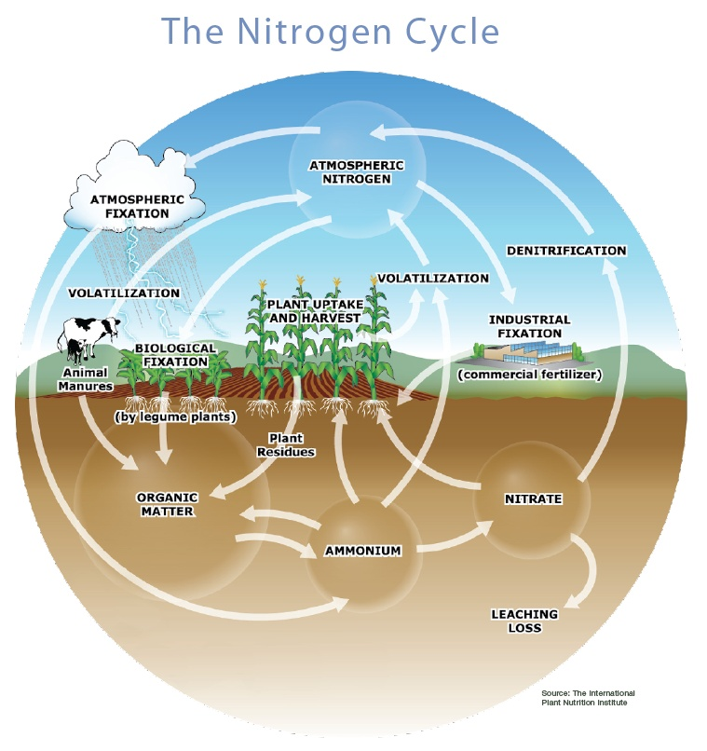

Slide 7
Matter of Fact Notes
Matter, mass, space.
Atom -Ex: H, Hydrogen; N, Nitrogen; Na, Sodium
Molecule, Substance- Ex. N₂ Nitrogen Gas; H₂ Hydrogen gas; O₂ Oxygen Gas
Compound, at least two different, millions.
H₂O water, NH₄⁺ Ammonium, NO₃⁻ Nitrate
5. Oxygen gas, O₂ & Nitrogen Gas N₂ are not considered compounds because they are each composed of the same element. Water, H₂O, is a compound because it is composed of more than one element.
6. Chemical formula, elements, subscripts. Ex: C₆H₁₂O₆ - Glucose

Slide 8

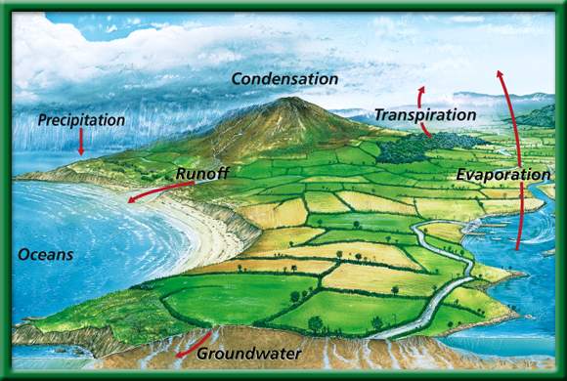






The Water Cycle
P.53 BB
Be able to explain at least 5 parts of the cycle.
Does water leave the planet?
To return to the chapter summary click escape or close this document.

Slide 9


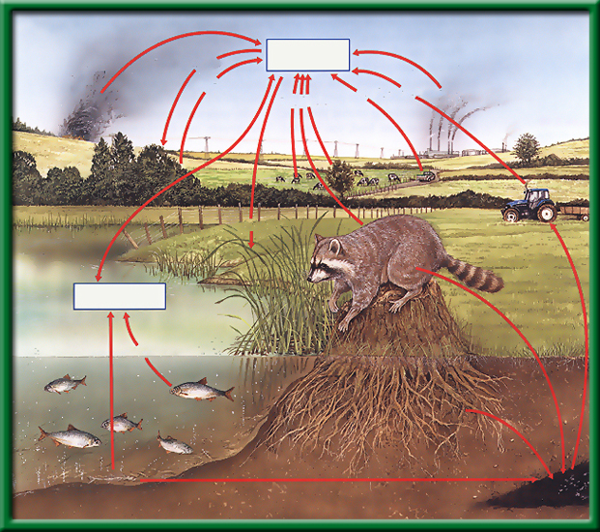
Section 2.2 Summary – pages 46 - 57
The Carbon Cycle
Open burning
Atmospheric CO₂
Photosynthesis
Respiration
Fuel Combustion
Respiration
Fuel Combustion
What is the role of the autotroph?
What is a carbon sink?
What is the role of the heterotroph?
Photosynthesis
Dissolved CO₂
Respiration
Death and decay
Death and decay
Fossil fuels

Slide 10
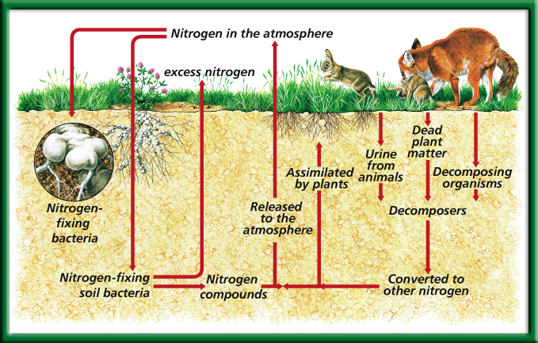
The Nitrogen Cycle
What organism is essential for this cycle?
To return to the chapter summary click escape or close this document.

Slide 11
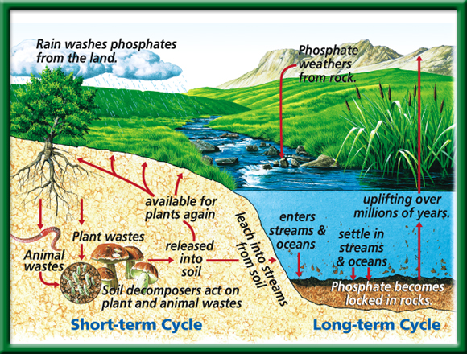
The Phosphorous Cycle
What role do humans play in these cycles?
To return to the chapter summary click escape or close this document.

Slide 12
Cycles in Nature: Conclusion Questions
Summarize your cycle in at least 5 sentences.
Do you think the element (compound) is ever lost or gained? Explain.
What is the role of an autotroph in the your cycle? A heterotroph? Explain.
What do you think is the most important “player” in the your cycle? Why?
How do humans play a role in all of the cycles? Do we help or hinder them? Explain.
Why are all of these processes ( Water, Carbon, Oxygen, Phosphorus and Nitrogen cycles) called cycles? Why are they not shown in a pyramid? Explain.

Slide 13
Water is lost to the abiotic parts of the biosphere from the biotic parts by the process of:
Infiltration
Transpiration
Photosynthesis
Precipitation

Slide 14
Transpiration
Cougars are predators that often eat weakened or diseased animals. This is a description of the __ of cougars.
Ecosystem
Habitat
Niche
Population

Slide 15
Niche
Where is the Biosphere?
Earth’s Crust
Upper Mantle
Core
Mantle

Slide 16
Earth’s crust
A relationship between cats and mice could best be described as:
Consumer – Producer
Parasite – Host
Scavenger – Carrion
Predator - Prey

Slide 17
Predator – Prey
If coyotes eat a cat that eats a mouse that eats grass, the coyote would be:
Decomposers
Second – order consumers
Third – order consumers
Herbivores

Slide 18
Third- order Consumer
A pod of Killer whales (Orca’s) is known as:
Biosphere
Population
Ecosystem
Community

Slide 19
Population
Draw an Energy Pyramid including grasses, flowers, grasshoppers, birds, and a fox.
Which level has the smallest number of organisms?
Grass
Grasshoppers
Birds
Fox

Slide 20
Agriculture & Cycle in Nature Project
Present 1 minute about an aspect of your Cycle in Nature & why it is important to Agriculture
Include a diagram/picture.
Show/Explain the processes of the cycle.
Choose one process of your cycle and show how Symbiosis (Competition, Mutualism, Parasitism, and Commensalism) is a part of your cycle.
Demonstrate how Agriculture has been impacted from this cycle or how the cycle in agriculture will impact then Environment.

Slide 21
How Wolves Change Rivers
The need for Keystone Species in ecosystems p.33 NB NOTES

Slide 22
Theaet.com
Profile
Manage your Resume Information
Reference:
  Mrs. McAllister
  Ag/ FFA Teacher
  Bryte Career and College Training
  637 Todhunter Ave.
  West Sacramento, Ca 95605
  (916) 375 - 7901

Slide 23
Profile
Your Activities
  Experience Manager (SAE)
    Add New
Fill out your experience
Pencil
Journal
Classroom Experience
Write about what you have learned in class/ activities.

Slide 24
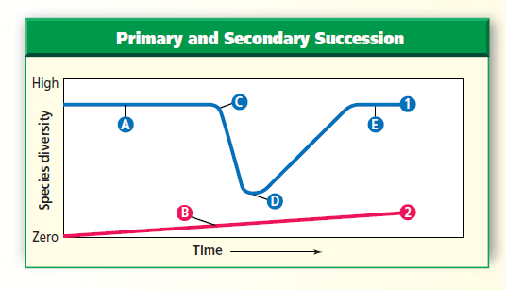
Problem Solving Lab 3.1 P. 33 NB P. 68 BB
1.Line 2 is primary succession because it begins with no species.
Line 1 is Secondary Succession because it has some existing species, also it has a drop from a climax community.
C = Climax Community they exist before a disturbance
D – is Pioneer Species have low species diversity.
3. A sudden, disruptive event such as a fire followed by a community recovery.

Slide 25


Section 5.1 Summary – pages 111-120
Importance to nature
#1. Biodiversity is the variety of life or the different types of species
Living things are interdependent.
Living things can be niches for other living things.
Populations are adapted to live together in communities.

Slide 26
Section 5.1 Summary – pages 111-120
#2. Biodiversity brings stability
Biodiversity can bring stability to an ecosystem.
A pest could easily destroy all the corn in a farmer’s field, but it would be far more difficult for a single type of insect or disease to destroy all individuals of a plant species in a rain forest.
Ecosystems are stable if their biodiversity is maintained.

Slide 27
Cycles of Nature Posters
1 – 3 people may work on the Poster
Draw the Carbon, Water or Nitrogen Cycle
Answer the following questions for your poster.
  How does Carbon, Water or Nitrogen return to the Biotic parts of the Ecosystem?
  The burning (CO2), evaporation (H2O)or leaching (N2) of each of these returns them where?

Slide 28
#3. Global Warming – Climate Change
Rise in CO2 concentration
Increase melting of Polar ice caps
Increase average temperature of ocean
Increase in severe weather events

Slide 29
CH 4 Population Biology
Critical Thinking – the Effect of Predators on Prey Populations p.37NB
a. The number of deer increased from about 7000 to about 100,000.
b. With fewer predators, more young deer survived to become breeding adults. The lack of predators may have make it possible for older and less fit deer to survive longer.
a. From 100,000 to 40,000, or 60%
b. From 100,000 to 20,000, or 80%
c. From 100,000 to 10,000, or 90%

Slide 30
CH 4 Population Biology
Critical Thinking – the Effect of Predators on Prey Populations
Predators no longer kept the deer population within the carrying capacity of the land. By the early 1920’s, most of the food available in the area had been consumed, so many deer starved.
The rapidly increasing deer population had consumed most of the food supply. As a result, the land’s carrying capacity was reduced.

Slide 31
The Greenhouse Effect on Natural Systems p. 39 NB
Get into groups of four.
Get a White Board, Expo Marker & Eraser
Read the assigned article and take notes on the board to present to the class.
Students will take notes on page 79 NB
Group 1 - Climate Change in the Golden State Page 2 - 4
Group 2 – Climate Change in the Golden State Page 4 - 6
Group 3 – Water Vapor: A GHG p.7-8
Group 4 – Carbon Dioxide: A GHG p. 9-10
Group 5 – Methane: A GHG p. 11-12
Group 6 – Nitrous Oxide: A GHG p. 13 - 14
Group 7 – What Can Ice Tell Us About the Past Climate? P.15
Group 8 – California’s Global Warming Solutions of 2006 p.16 - 20

Slide 32
Climate Change in the Golden State
Measured temperature wind patterns
Greenhouse gases impact the climate
Earth’s Climate system: Biosphere, Atmosphere, Geosphere, Hydrosphere
Natural
Sierra snowpack is melting earlier
More Air pollution & health effects
Record warmer temperatures
Evidence - Ice ages & Warming, Fossil Record

Slide 33
Water Vapor – A GHG
Water has a bigger influence on Earth’s climate than any other greenhouse gas.
Sources: Evaporation from water sources.
Sinks: Oceans, Ice sheets, claciers, Aquifers, Soil

Slide 34
Carbon Dioxide – a GHG
Soils, Forests and Ocean are sinks for Carbon dioxide.
Sources: Respiration, Forest Fires, Volcanoes, Decomposition, Fossil Fuels
Sinks: Fossil Fuel Deposits, Oceans, Forests, Wetlands, Photosynthesis

Slide 35
Methane – a GHG
Sources: Atmospheric, Produced by cattle, Released during decomposition
Landfill release Methane, we use it for energy
Fossil fuel, stored in the Earth for millions of years
Sinks: Permafrost peat bogs, wetlands, soils

Slide 36
Nitrous Oxide: A GHG
Sources: Atmosphere, Nitrogen based fertilizer, Soil management – Denitrification by Bacteria, decomposition
300 x greater “global warming potential that CO2”
Sink: Photolytic reactions in the stratosphere

Slide 37
CA Global Warming Solutions Act of 2006
Greenhouse gases increasing in the atm.
Increase in .5 Degrees C in one century.
1990’s was the hottest decade in a thousand years.

Slide 38
Footprint network
Video – Global Warming
How many earth’s does it take to support your lifestyle? P 79 NB
Record the number and give to Mrs. McAllister.
Concept map – CH 5 slide 231
Work on study guide.
Foldable – biodiversity.
Classtime – work on project?
Mt. St. Helen’s Video slide 41

Slide 39
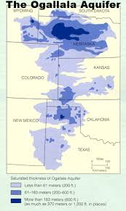
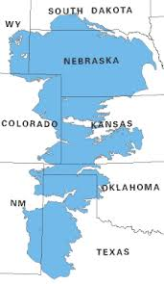
The Greenhouse Effect on Natural Systems p. 79 NB
Consider how climate has changed in the past and the fact that climate is continuing to change. How could life be different in the future? What are some of the issues people need to consider when examining climate change?
Use the article you just read and the Graph of the Greenhouse Effect to answer your question.
Here is a picture of America’s
Largest Aquifer – underground
Body of water.

Slide 40
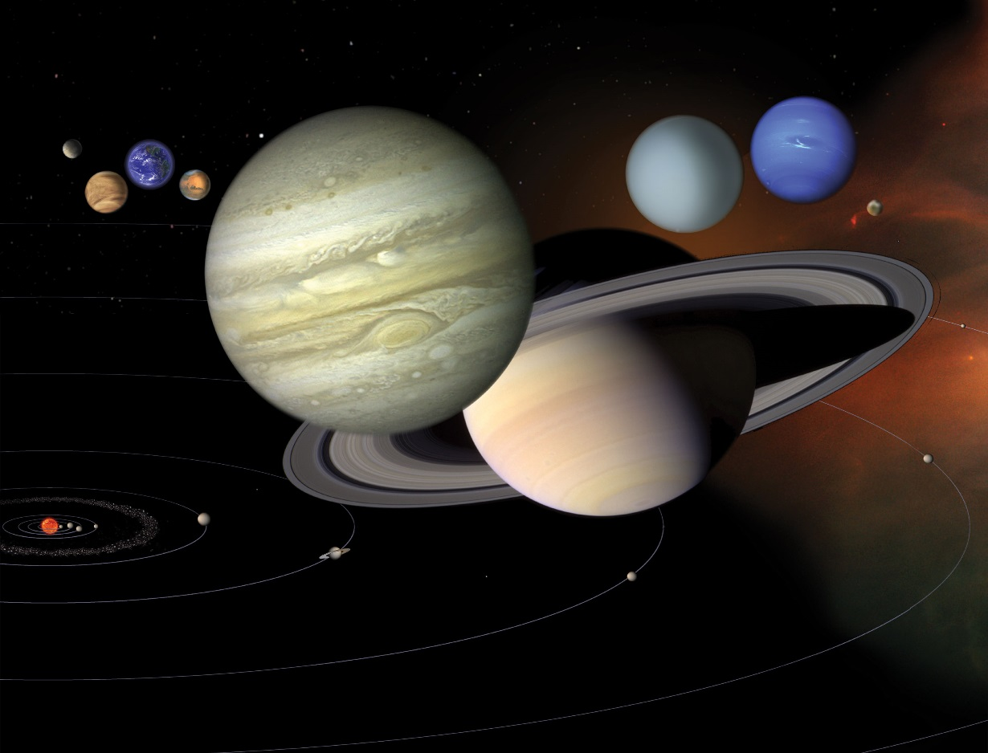
9/12 Where do planets come from?
Obj. TSW learn about the formation of our solar system, our planet and specifically Earth. P. 42 NB
Where does most of the energy come from in our solar system?
What planets make up our solar system?
How old is our Solar System? Earth? How do we know?
Video Earth

Slide 41
Garden Planning sheet
Make sure to pick tomatoes! Quality – inspect them. Give to Ms. Sutton
Refresh all the flowers-get Mr. Smith’s flask. Longer stems please, more water. Deliver
Take out garden bed close to culinary doors, cut up greens for compost. Cut Basil
Add water to 3rd compost bin, push down, add new compost.
Finish Tower Gardens. Add all pots and reseed, add water and label. Zoe
Take pictures of students working and of your garden to upload onto Theaet.com Record book. Arina?
Plant the best 8 trees and place along the east side of garden beds.

Slide 42
Nominations for FFA Officers
1 – 3 minute speech
President: Andrik, Melina
Vice President: Zoe
Secretary: Isaac
Treasurer: Avi, Estaban
Reporter: Jason, Arina
Sentinel:
Chaplain:
Parliamentarian
Historian: Arina

Slide 43
Research Activity P. 41 NB
https://solarsystem.nasa.gov/planets/solarsystem
If you had to be one of our planets in our solar system, which one would you be and why?
List 5 facts about it

Slide 44
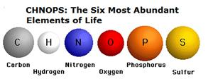
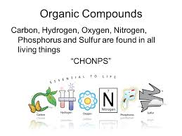
9/13 Building Molecules CH 6.3
Obj. TSW identify the macromolecules living things are made of and describe their properties. P. 44NB
What are the 6 main elements that make up the 4 macromolecules?
What is an Enzyme?
What three environmental factors determine the enzymes function?

Slide 45
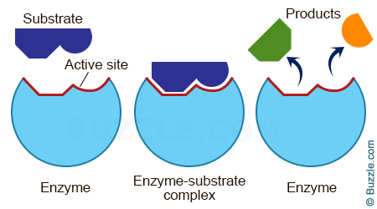
Temperature, pH, Amount of substrate or enzyme, Ionic Conditions (Salt)

Slide 46
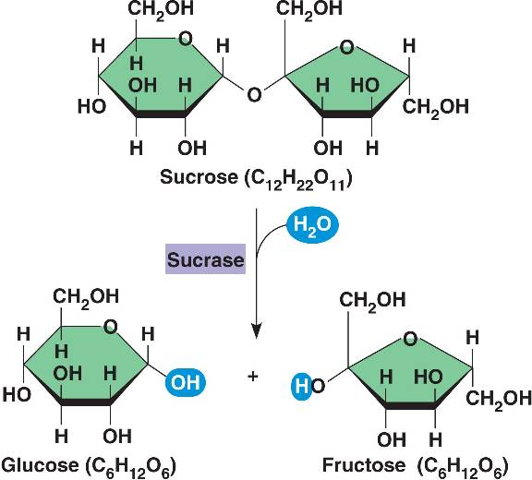
Build a Monosaccharide!
Show me a correct monosaccharide for extra credit!
Some Helpful Hints:
Black atoms are Carbon (C).
  Carbon always needs to be bonded to 4 other atoms.
White atoms are Hydrogen (H).
  Hydrogen only bonds to 1 atom.
Red atoms are Oxygen (O)
  Oxygen bonds to 2 atoms.
Every unidentified corner is a Carbon atom.
  For example, look at the which identifies the corner on Sucrose. That is a carbon atom.

Slide 47
Enzymatic Reaction of Sucrase on Sucrose

Slide 48
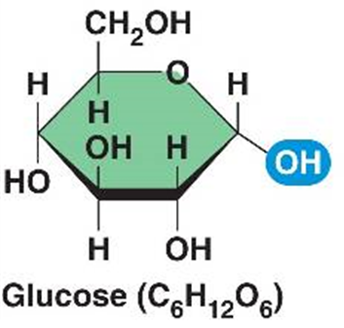
Using your Cycles in Nature, build the molecule that is most evident for your cycle:
H2O, CO2, NH3, NO, NO2, NO3, O2, CH4, C6H12O6
Carbon = Black
Oxygen = Red
Hydrogen = White
Nitrogen = Blue

Slide 49
Google: Molecule Building
Unit 2 Energy

Slide 50
Theaet.com
What is your SAE type?
Describe your SAE idea on the blank space on the paper P. 43 NB
Click on Experience Manager in the Profile section of AET.
  ADD NEW
  Add the project name
  The level
  The Type of SAE
  Your experience

Slide 51
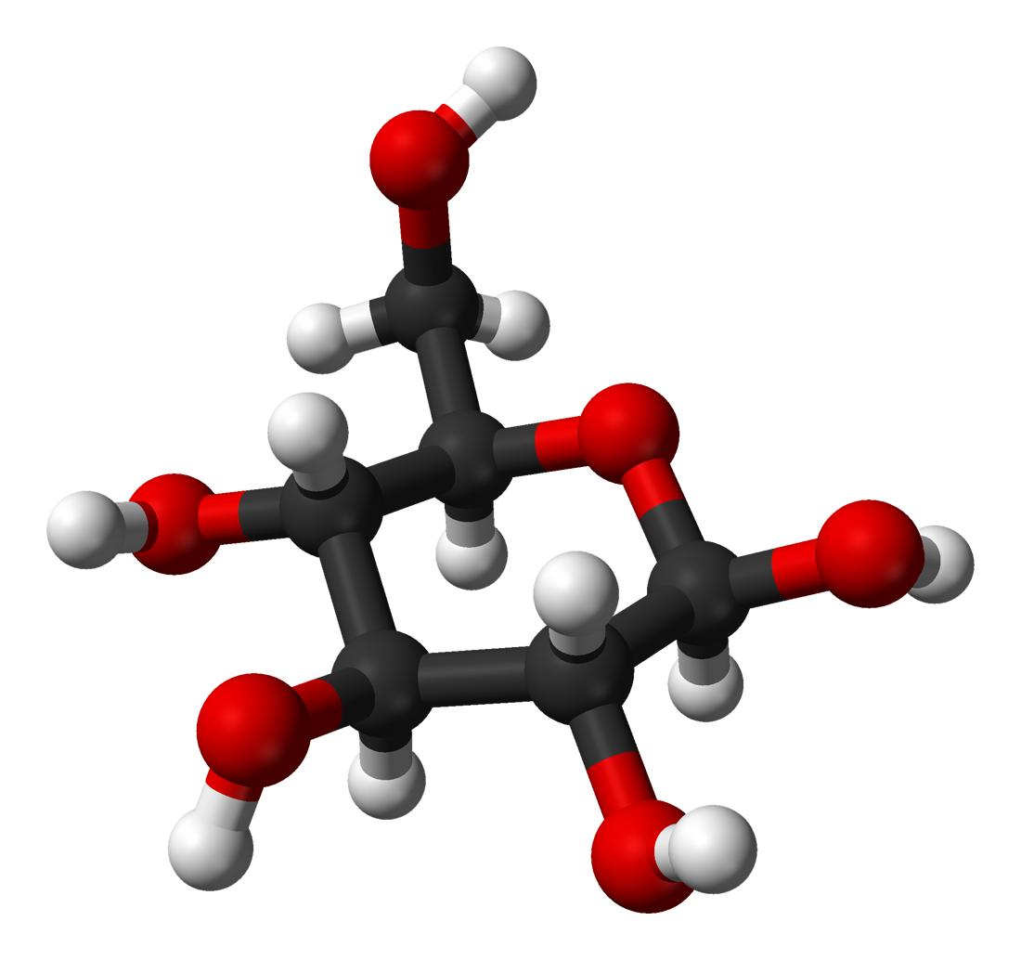
Elements & Molecules
Carbon
Hydrogen
Oxygen
Nitrogen
Build O₂, CO₂, H₂O, C₆H₁₂O_{6,} Sucrose, N₂, NH3, NO2, NO3

Slide 52
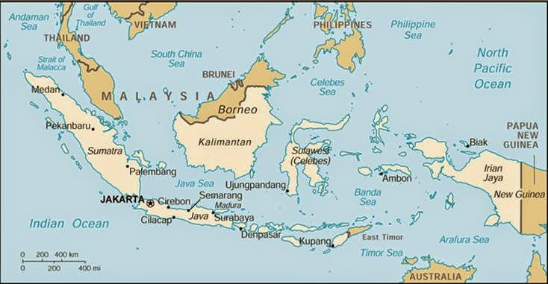
The Day WHO Parachuted Cats into Borneo
Place the events in chronological order
Aerial view of Borneo:

Slide 53
Parachuting Cats in Borneo p. 61 NB
The Day WHO Parachuted Cats into Borneo
Some time ago, World Health Organization sent supplies of DDT to Borneo to Fight mosquitoes that spread malaria among the people. The mosquitoes were quickly wiped out. But billions of roaches moved into the villages and they simply stored the DDT in their bodies. One kind of animal that fed on the roaches was a small lizard. When these lizards ate the roaches, they also eat a lot of DDT. Instead of killing them, DDT only slowed them down. This made it easier for the cats to catch the lizards, one of their favorite foods. About the same time, people also found that hoards of caterpillars had moved into feed on the roofing materials of their homes. They realized the lizards that previously had kept the caterpillars population under control had been eaten by the cats. And now, all over North Borneo, cats that ate the lizards died from DDT poisoning. Then rats moved in because there were no cats to control their population. With the rats came a new danger, THE Plague,. Officials sent out emergency call for cats. Cats were sent in by airplane and dropped by parachute to control the rats.
Biomagnification
Human activity with the best of intentions can have untended consequences.
Map of Borneo

Slide 54
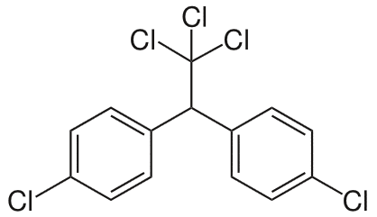
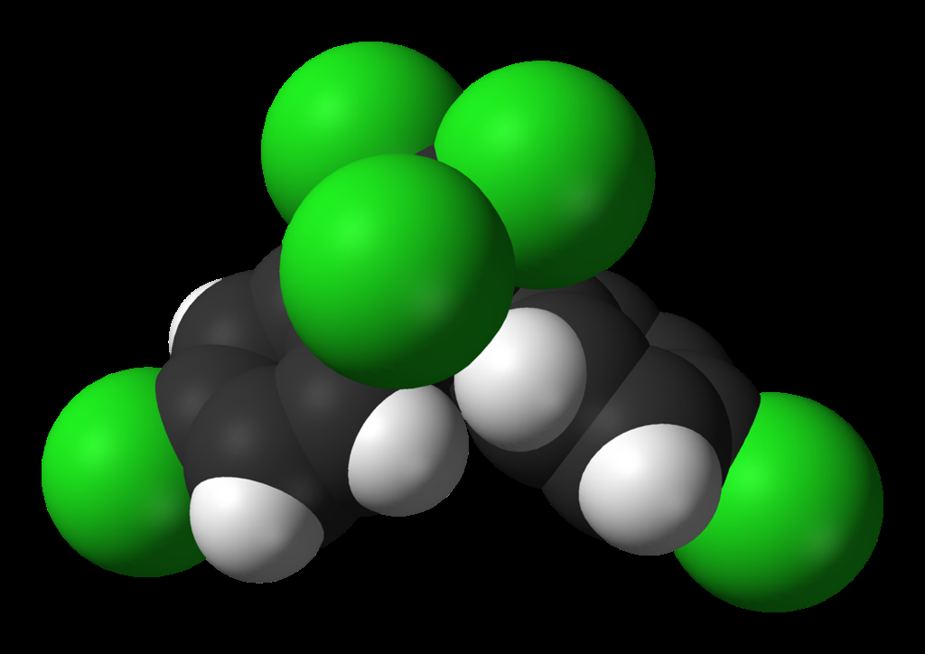
Questions for pg. 29
1. Explain your thinking process in relation to DDT, biomagnification, and ecosystem connections. Dichlorodiphenyltrichloroethane (DDT)
2. How did one simple change to an ecosystem set off a whole chain of events?
3. Give another example of an unintended consequence of human intervention on the Natural World.

Slide 55
Catalase Lab
ml H2O2 | Person 1 | Person 2 | Person 3 | Person 4 | Person 5
5 | 100
6
7 |  | 120
8 |  |  | 120
9 |  |  |  | 170
10 |  |  |  |  | 140

Slide 56
Catalase Lab P. 27
1 flask / 2 people
GLX
Pressure Probe
Yeast – 1 tsp.
Hydrogen Peroxide 5ml
Swirl
Make observations.
Write a summary paragraph about the function of enzymes with a picture of a substrate & enzyme & active site. What factors allow for the enzyme to function? What volume of H2O2 did Catalase work the best? Why does the enzyme speed up chemical reactions? Enzymes can be used again & again (Catalytic), how is this important in chemical reactions? At what volumes (ml) did the Catalase work the best? Write the chemical equation.

Slide 57
AXES Paragraph – Catalase Lab
Assertion What is Exothermic Reactions? Use vocabulary.
eXample Discuss an example of an enzyme. Include details from the lab.
Explanation Describe the function of the enzyme, and factors that influence it.
Significance Why are enzymes important for us?

Slide 58
Macromolecules
Protein | Lipids | Carbohydrates | Nucleic Acids

Slide 59
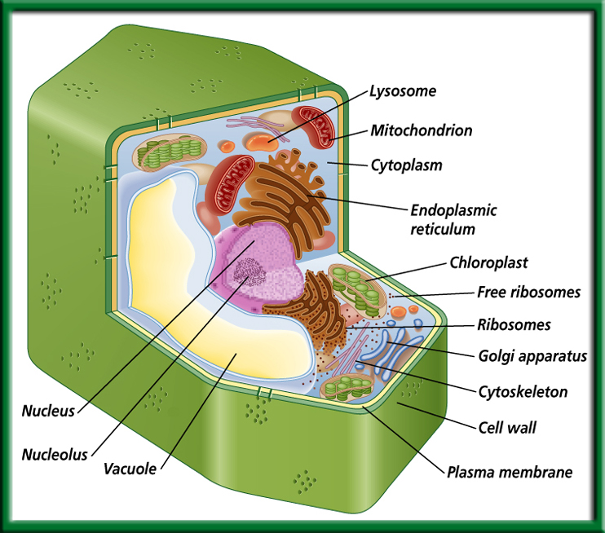
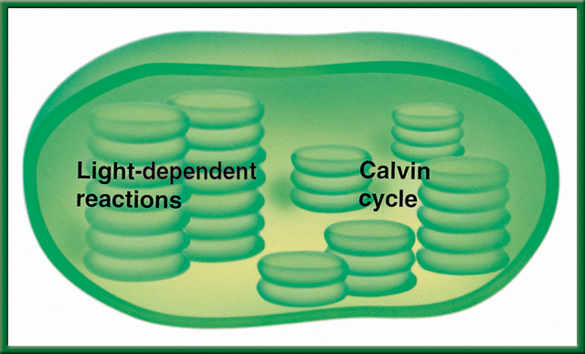
9/14 Photosynthesis: Trapping the Sun’s Energy 9.2
Obj. TSW demonstrate how usable energy is captured from sunlight by chloroplasts and is stored through the synthesis of sugar by completing the warm up and participating in a photosynthesis class activity. P.46 NB
Cellsalive.com
What organelle in the plant cell traps the suns energy, what is that process called?
Write and memorize the equation for photosynthesis.
What are the Reactants and the Products for Photosynthesis, what is the catalyst for this process?
Show Photosynthesis video
Osmosis AXES

Slide 60
#1 Chloroplast - Photosynthesis
#2. 6CO₂ + 6H₂0 --→ 6O₂ + C₆H₁₂O₆
#3. Reactants Products

Slide 61

9/15 Light-Dependent & Light-Independent Reactions CH 9.2
Obj. TSW demonstrate how light energy is captured by chloroplasts and converted to chemical energy (glucose) from CO₂ and H₂0 by doing a flow chart. 48 NB
Why is Photolysis important?
Compare and Contrast Light Dependent reactions and Light Independent reactions.
Where does the Calvin Cycle happen in the cell and what does it produce?
Study guide is due tomorrow! P. 59NB
Read CH 6.3, 7, 8.1 & 9
Show Videos
Cellsalive.com

Slide 62

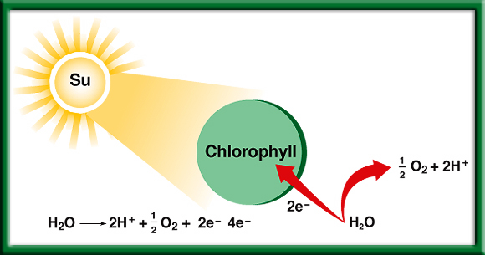
#1. Photolysis – Breaks up H₂O (Water) to release O, that makes O₂.
To return to the chapter summary click escape or close this document.

Slide 63


Section 9.2 Summary – pages 225-230
Restoring electrons
The oxygen produced by photolysis is released into the air and supplies the oxygen we breathe.
The electrons are returned to chlorophyll.
The hydrogen ions are pumped into the thylakoid, where they accumulate in high concentration.

Slide 64
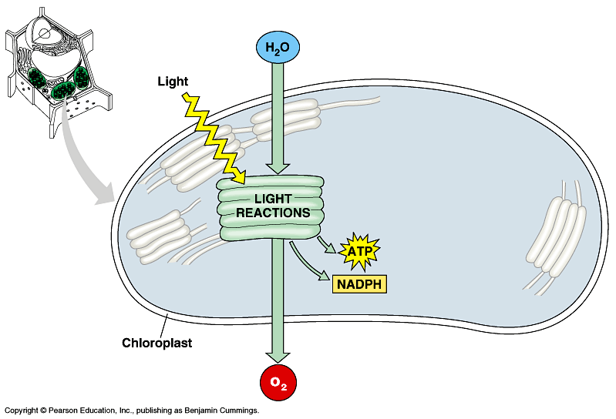
#2. How does light energy become chemical energy?
Light Dependent Reaction happens in the light when the light hits the Grana and splits water to make O₂.

Slide 65
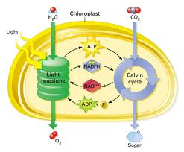
#2. How does light energy become chemical energy?
Light Independent Reaction happens in the light or the dark and converts CO₂ in the Calvin Cycle to Sugar – Glucose.

Slide 66
Section 9.2 Summary – pages 225-230
Trapping Energy from Sunlight
Photosynthesis happens in two phases.
The light-dependent reactions convert light energy into chemical energy.
2. The molecules of ATP produced in the light-dependent reactions are then used to fuel the light-independent reactions that produce simple sugars.
The general equation for photosynthesis is written as 6CO₂ + 6H₂O→C₆H₁₂O₆ + 6O₂

Slide 67
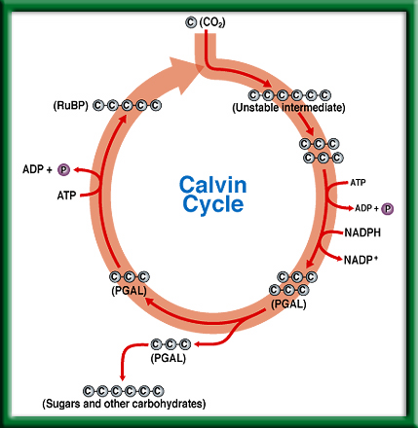
Calvin
Cycle
#3. The Calvin Cycle happens in the Stroma of the Chloroplast, and produces the glucose for the plant.
To return to the chapter summary click escape or close this document.

Slide 68
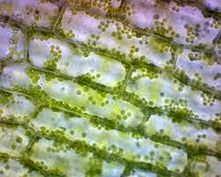
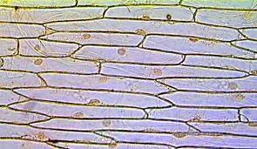
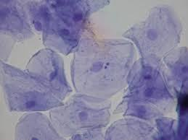
Cell Lab p.47NB
4x- Red Objective lens = 40
10x – Yellow Objective lens = 100
Label on your picture of Cheek Cell, Onion Cell & Elodea Leaf Cell:
Cell Wall
Nucleus
Cytoplasm
Chloroplast
Plasma Membrane
Onion Cell
Elodea Cell
Cheek Cell

Slide 69
Lab – Scientific Method using Elodea Leaf, Onion Cells & Cheek Cells p. 49 NB
Observation(s):
Questions:
Hypothesis: If, Then, & Testable
Materials: 1 glass slide, 1 cover slip, one toothpick, 1 piece of onion, forceps, Methyl Blue, Iodine
Procedure:
  Get 1 glass slide, 1 cover slip, put 3 drops of Iodine on the slide for the onion, peal the inner membrane off & lay onto the Iodine, then put on the cover slip.
  Get 1 glass slide, 1 cover slip, put 3 drops of Methyl Blue on the slide for the cheek cell, get a toothpick and just touch the inside of your cheek, then swirl the toothpick around in the MB and put on the cover slip.
  Get 1 glass slide, 1 cover slip, put 3 drops of water on the slide, place 1 elodea leaf on the slide, then put on the cover slip.

Slide 70
Cont. Lab Onion & Cheek Cells p. 49 NB
Data:
Qualitative (words, pictures, descriptions) & Quantitative (#’s, graphs, tables) Label the nucleus, plasma membrane, cytoplasm, chloroplast, & cell wall
Control Group: What are you comparing your cheek cells to?
Independent Variable: Brushing teeth, or how many times you touched your cheek.
Dependent Variable: The amount of Cheek Cells
Conclusion: 3 – 5 sentences Accept or Reject your hypothesis, what you learned, what would you do differently? Why did you not see chloroplasts in the onion cell? What was different about the cheek cell? Were the chloroplasts moving in the Elodea Leaf?

Slide 71
Conclusion P. 49 NB
sentences Accept or Reject your hypothesis, what you learned, what would you do differently? Why did you not see chloroplasts in the onion cell? What was different about the cheek cell? Were the chloroplasts moving in the Elodea Leaf?
Accept or Reject? We learned that there are cells in plants and animals. The onion cells look like bricks. The Cheek cells were circular, and the plant cells looked like bricks. I would change nothing about the lab. There were no chloroplasts in the onion cell because it was underground. The Chloroplasts were green in the Elodea Leaf.

Slide 72
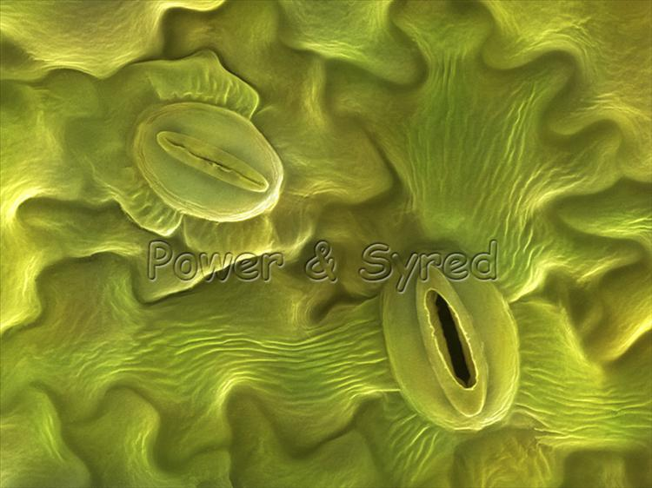
How to Make Carbohydrates Activity p. 51NB
6 CO₂ + 6 H₂O -> C₆H₁₂O₆ + 6 O
Carbon Dioxide + Water = Glucose + Oxygen
2. Sunlight – Catalyst
3. The chlorophyll inside the chloroplast
4. There were 6 molecules of O2 left over.
5. The extra oxygen atoms give air to other organisms.
The O2 diffuse into the atmosphere through the stomata.
6 H₂O + 6 CO₂ →(light) Catalyst → C₆H₁₂O₆ + O₂

Slide 73
Glucose Synthesis Activity
Photosynthesis: 6 CO₂ + 6 H₂O -> C₆H₁₂O₆ + 6 O
Black = Carbon
White = Hydrogen
Red = Oxygen
Person 1 – Root = H₂O
Person 2 – Stomata = CO₂
Person 3 – Chloroplast = Light Energy (Sun)
Person 4 – Glucose Synthesis/ O₂
Person 5 – Get ATP for Cellular Respiration
Cellular Respiration: C₆H₁₂O₆ + 6O₂→ 6CO₂ +6H₂0 + 36 ATP + Heat
Glucose
C₆H₁₂O₆

Slide 74
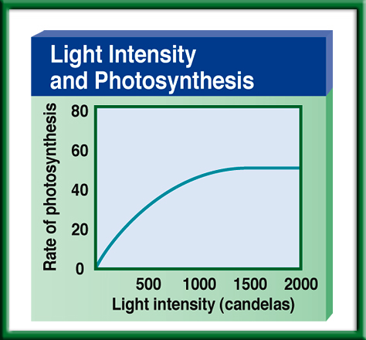
p. 47 NB
Copy this graph and explain what it means in a short paragraph.
Use your knowledge of Independent and Dependent Variables to explain what happens.
Explain the relationship between the two variables
Come up with a better title
To return to the chapter summary click escape or close this document.

Slide 75
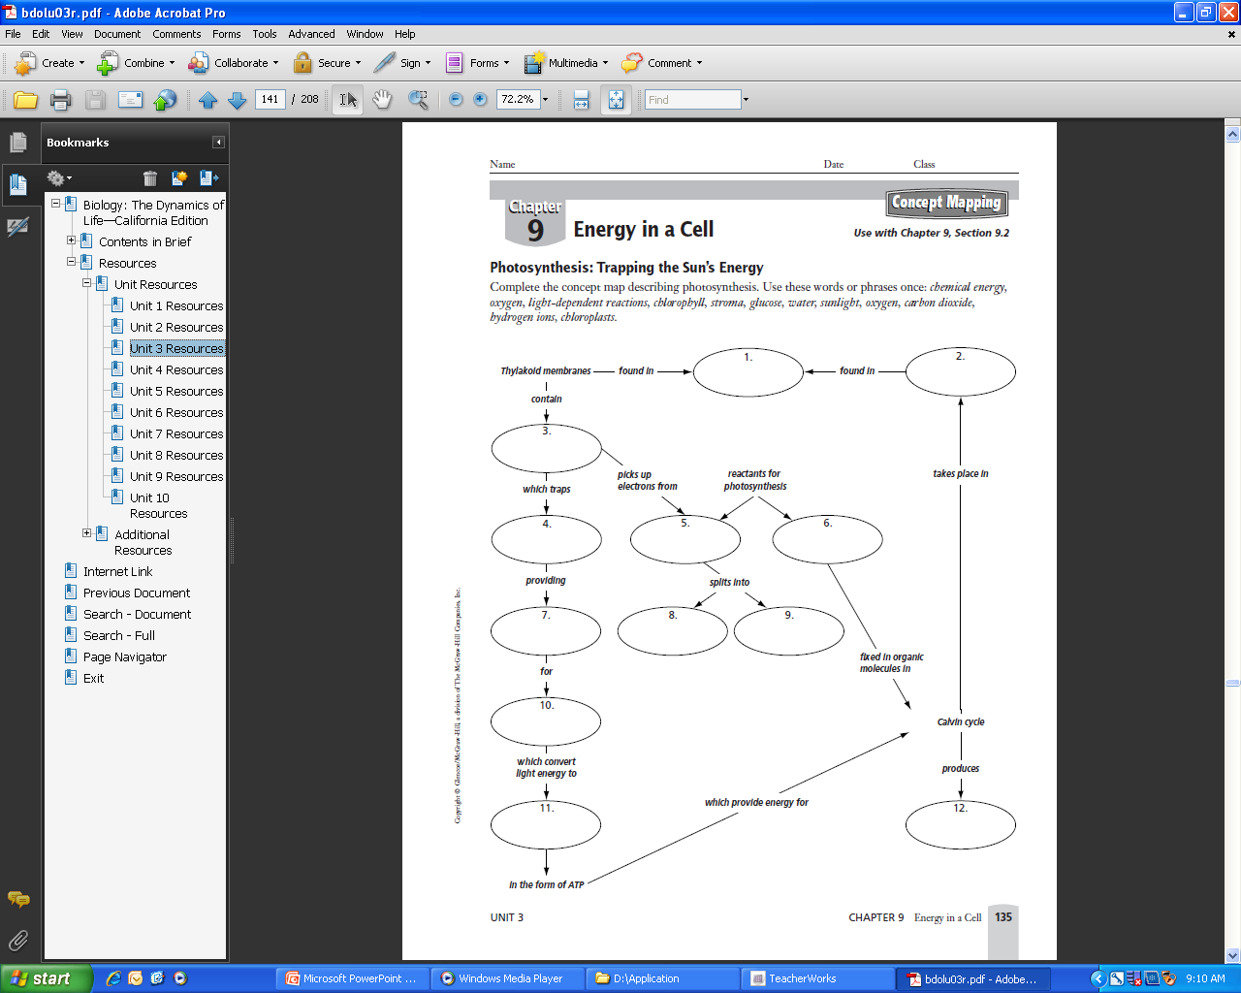
Word Bank
Chemical energy
Oxygen
Light Dependent Reactions
Chlorophyll
Stroma
Glucose
Water
Sunlight
Carbon Dioxide
Hydrogen ions
Chloroplasts
Energy
p. 47 NB
Write a 3 – 5 sentence summary

Slide 76
Taboo
Chloroplast
Cell Wall
Plasma Membrane
Passive transport
Active Transport

Slide 77
Taboo
Cellular Respiration
Photosynthesis
Mitochondria
Theory
Scientific Method
Nucleic Acid

Slide 78
Honors Biology
Do the Math
What is the Percent change in temperature of your Catalase Reaction?
V1 – V2 x 100%
V1
21 – 36 x 100% = ?
21
76%
Include this in your Data Analysis.

Slide 79


Section 2 Check
Question 1
The process that uses the sun’s energy to make simple sugars is ________.
A. cellular respiration
B. glycolysis
C. photosynthesis
D. photolysis
CA: Biology/Life Sciences
1f

Slide 80
Section 2 Check
The answer is C. Photosynthesis happens in two phases to make simple sugars and convert the sugars into complex carbohydrates for energy storage.
CA: Biology/Life Sciences
1f

Slide 81

Question 1
Why do you add baking soda solution to the water containing the Elodea plants?
Answer
The baking soda supplies carbon dioxide, a necessary component of photosynthesis.
To return to the chapter summary click escape or close this document.

Slide 82
Question 2
Why does the experiment use aquatic plants?
Answer
The oxygen given off by an aquatic plant will form visible bubbles in the water that can be easily observed.
To return to the chapter summary click escape or close this document.

Slide 83
Question 3
What is the independent variable in this experiment?
Answer
The independent variable in this experiment is the color of light that is directed on the Elodea.
To return to the chapter summary click escape or close this document.

Slide 84

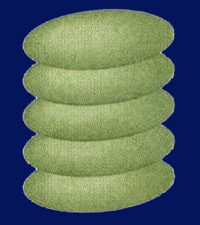
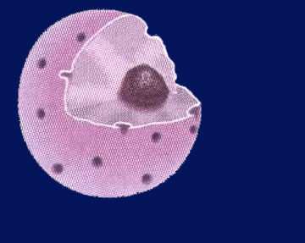
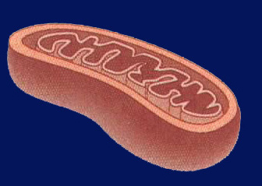
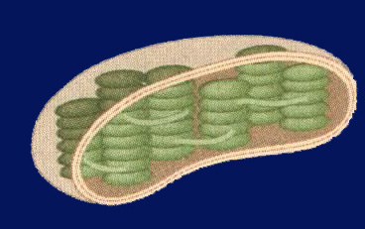
Chapter Assessment
Question 4
In which of the following structures do the light-dependent reactions of photosynthesis take place?
A.
C.
B.
D.
CA: Biology/Life Sciences
1f

Slide 85
The answer is D. The light-dependent reactions of photosynthesis take place in the thylakoid membranes of chloroplasts.
CA: Biology/Life Sciences
1f
Chapter Assessment

Slide 86
Quote of the Day
Everything you can imagine is real.
- Pablo Picasso

Slide 87
Kahoots Energy Quiz

Slide 88
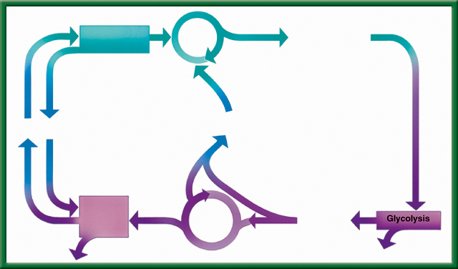
9/18 Cellular Respiration & Fermentation 9.3
Obj: TSW be able to compare and contrast photosynthesis and cellular respiration by completing the flow chart activity. pg. 50 NB
1) What is Cellular Respiration? Identify the three stages.
2) How is it related to Photosynthesis?
3) What is fermentation, where does it happen in the cycle?

Slide 89
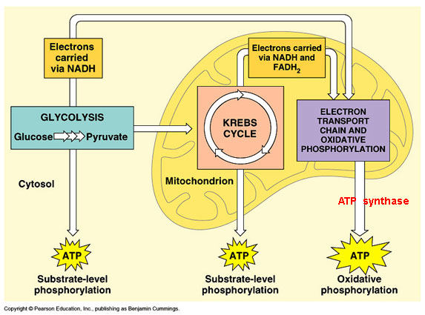
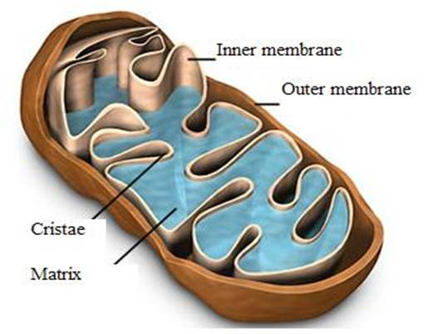
1. Cellular Respiration – converts glucose in to ATP and Heat in the mitochondria.
All living organisms perform Cellular Respiration, including plants.

Slide 90
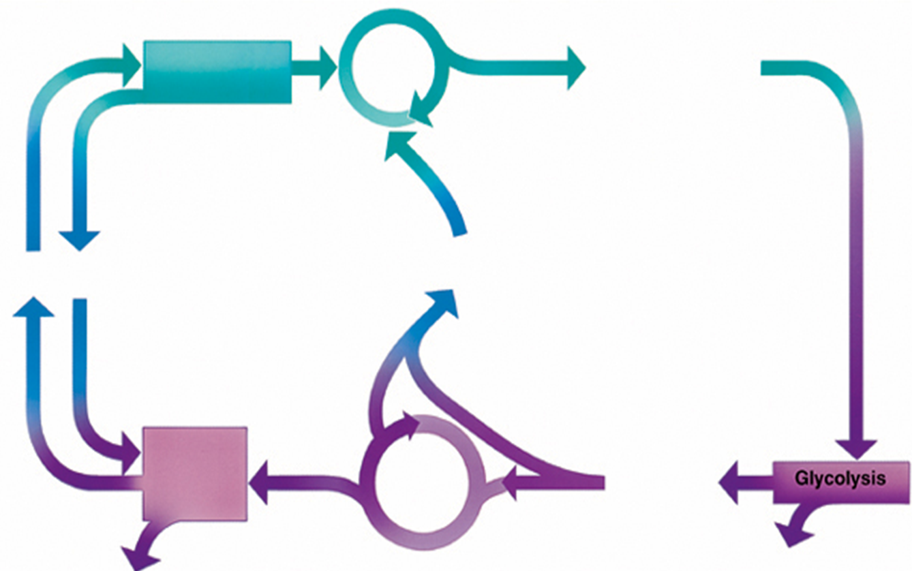
#2. The reactants for Photosynthesis (CO2 & H2O) are the Products for Cellular Respiration.

Slide 91

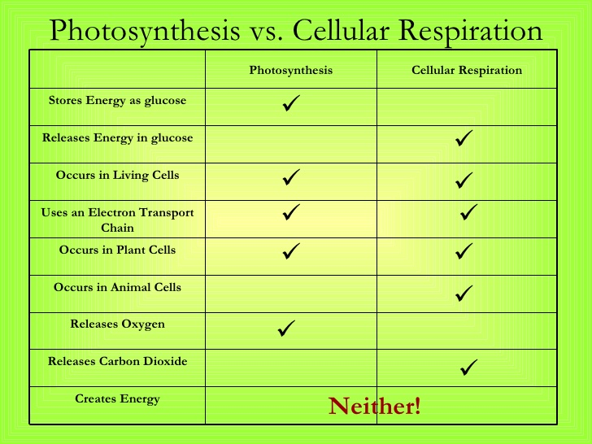
2. P.50 NB Compare and contrast cellular respiration and photosynthesis.
3. Fermentation happens during glycolysis when not enough oxygen is present.
To return to the chapter summary click escape or close this document.

Slide 92
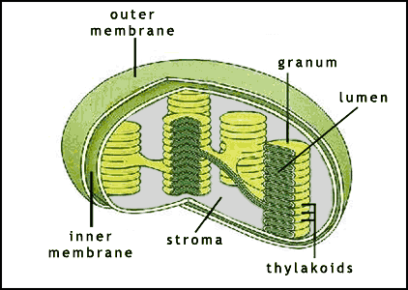
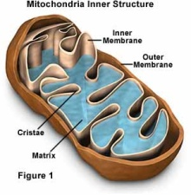
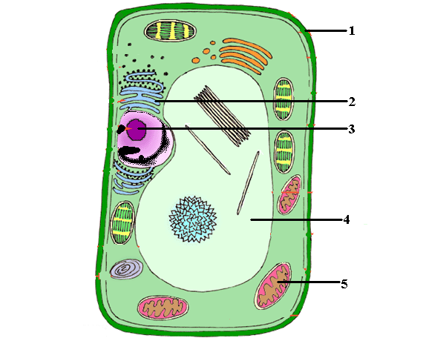
P. 51 NB Write a summary paragraph
PHOTOSYNTHESIS (in the chloroplast)
Calvin cycle
Glucose is made
Photolysis
Uses energy from photolysis and CO₂ to produce sugar = glucose → C₆H₁₂O₆
Does not need light!
Uses light energy to break water (H₂O) down to oxygen (O₂ ).
Needs light!
CO₂
H₂O
O₂
Where most of your energy is made. Needs Oxygen
Breaks down sugar into pyruvic acid → 2*(C₃H₆O₃) and ATP (energy) Cytoplasm
Electron
Transport
chain
Citric acid
Or Krebs
Cycle
Pyruvic
acid
36 ATP
Heat
2 ATP
  CELLULAR RESPIRATION (in cytoplasm and mitochondria)

Slide 93
Taboo
Cellular Respiration
Vacuole
Prokayotic
Osmosis
Passive Transport
Macromolecule

Slide 94
Taboo
Photosynthesis
Nucleus
Eukaryotic Cell
Active Transport
DNA
Protein

Slide 95
Taboo
Scientific Method
Independent Variable
Plasma Membrane
Bacteria
Prokaryotic
Chloroplast

Slide 96
Dependent Variable
Control
Selective Permeability
Endoplasmic Reticulum
Cell Wall
Vacuole

Slide 97

Section 9.3 Summary – pages 231-237
Comparing Photosynthesis and Cellular Respiration Notes p. 53 NB
Table 9.1 Comparison of Photosynthesis and Cellular Respiration
Photosynthesis
Cellular Respiration
Food synthesized = Endergonic
Food broken down = Exergonic
Energy from sun stored in glucose
Energy of glucose released
Carbon dioxide taken in
Carbon dioxide given off
Oxygen given off
Oxygen taken in
Produces sugars = C₆H₁₂O₆
Produces CO₂, H₂O, ATP & Heat
Requires light
Does not require light
Occurs only in presence of chlorophyll
Occurs in all living cells,
including plants

Slide 98
Photosynthesis & Cellular Respiration AXES Paragraph Bottom of page 51NB
The mechanisms for P & CR are related because they are essentially opposite reactions. Photosynthesis transforms energy from the sun and Cellular Respiration makes use of chemical bond energy.
Photosynthesis = Chloroplast
Cellular Respiration = Cytoplasm, Mitochondria
6CO₂ +6H₂0 → C₆H₁₂O₆ + 6O₂ Photosynthesis
C₆H₁₂O₆ + 6O₂ → 6CO₂ +6H₂0 + 36 ATP + Heat Cellular Respiration

Slide 99
Gallery Walk – Cell UNIT Review
Describe, Draw, and Explain the importance of each of the following concepts/ processes on a poster paper, for a Gallery Walk review. Page 51NB
Osmosis
Plasma Membrane
Eukaryotic Cell
Prokaryotic Cell
Photosynthesis
Cellular Respiration
Folded Membranes
Active & Passive Transport
Macromolecules
Scientific Method

Slide 100
Warm Up Answers
1) Cellular Respiration: process by which mitochondria break down food molecules (glucose) to produce ATP. The stages are: glycolysis, citric acid cycle, electron transport chain.
2) Glycolysis: series of chemical reactions in the cytoplasm of the cell that breaks down glucose into (2) pyruvic acids- C₃H₆O₃.
3). Fermentation – in the absence of Oxygen during glycolysis, Lactic acid (animals) or alcohol (plants) are produced.
Table 9.1 in text
Cellular Respiration: Food broken down, energy of glucose released, CO2 given off, O2 taken in, does not require light, occurs in all living cells
They both produce Energy.
  Photosynthesis: Food synthesized, energy from sun stored in glucose, CO2 taken in, O2 released, requires light, occurs only cells that contain chlorophyll
  Both: use electron carriers, have cycles of chemical reactions, and form ATP

Slide 101
Cellular Respiration & Yeast Lab
Get into groups of 3 people. Get 1 flask, 1 balloon, 1 sugar cube, and ½ tsp. of Yeast, combine with 50 ml warm water.
Place Balloon on the end of the Flask
Record results
What happens to the balloon?
Why? What is the process called? What are the Products?

Slide 102
Cellular Respiration & Yeast Lab P. 55
Question: How much Carbon Dioxide will be produced?
Independent Variable: Changed the number of sugar (C6 H12 O6) cubes.
Dependent Variable: More Carbon Dioxide was produced.
Control: 1 sugar cube was the control.

Slide 103
Constant: Same Sugar, Yeast, balloons, Flasks
Materials & Equipment: Yeast – ½ tsp., water – 100 ml, sugar, balloons, Hot plate, Flask
Experimental Set up: Draw only
Safety Concerns: Don’t eat the sugar cubes.
Procedure : Write the steps…. Step 1, Step 2, Step 3,

Slide 104
Enzymes, Cataylase & Potatoes Page 47 NB
Get into groups of 3 people. Get 1 flask, 1 balloon, H2O2, and 1 piece of Potato – raw, 1 piece of potato cooked.
Place Balloon on the end of the Flask
Record results
What happens to the balloon?
What do you know about enzyme function?
Under what conditions do they function best?
Why? What is the process called? What are the Products?

Slide 105
Enzyme Lab P. 47NB
Question: How much Carbon Dioxide will be produced?
Independent Variable: Changed the number of pieces of potato, or more H2O2.
Dependent Variable: More Carbon Dioxide was produced.
Control: 10 mL of H2O2 & 1 piece of potato.

Slide 106
Enzyme – Catalyse Lab Page 55 NB
Constant: Same potato, H2O2, balloons, Flasks
Materials & Equipment: H2O2½ tsp., balloons, Hot plate, Flask
Experimental Set up: Draw only
Safety Concerns: Don’t eat the potatos.
Procedure : Write the steps…. Step 1, Step 2, Step 3,
Answer Analysis questions on the lab.

Slide 107
Leaf Disk Assay Lab
Honor Biology Due Friday
Enter data into Excel
Make a scatter plot graph to show the 50% floating point.
Data Analysis: What does the graph mean? Error analysis
Conclusion: Discuss why measuring the photosynthesis can be a problem. What competing process is occurring at the same time? Include in your discussion the relationship between Photosynthesis and Cellular Respiration by comparing and contrasting the equations.

Slide 108
STAGE 1: GLYCOLYSIS
Takes place in the cytoplasm of the cell
Process where glucose is broken down and some energy is released
In the absence of Oxygen, fermentation happens.

Slide 109
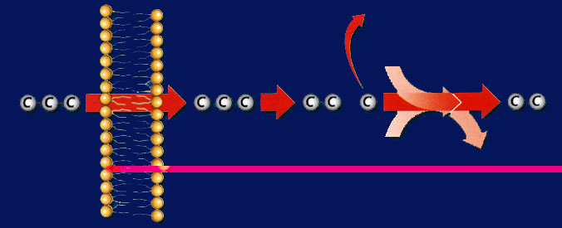
Section 9.3 Summary – pages 231-237
Glycolysis
Before citric acid cycle and electron transport chain can begin, pyruvic acid undergoes a series of reactions in which it gives off a molecule of CO₂ and combines with a molecule called coenzyme A to form acetyl-CoA.
Mitochondrial membrane
Outside the mitochondrion
Inside the mitochondrion
CO₂
Coenzyme A
- CoA
Pyruvic acid
Pyruvic acid
Intermediate by-product
Acetyl-CoA
NAD⁺
NADH + H⁺

Slide 110
STAGE 2: CITRIC ACID CYCLE
AKA Krebb’s cycle
Happens in the mitochondria
Produces: carbon dioxide and some ATP

Slide 111
STAGE 3: ELECTRON TRANSPORT CHAIN
Happens in the mitochondria
Series of proteins that transfers energy
Net creation of whole process: 36 ATP

Slide 112
PROBLEM
What happens when our cells run out of oxygen? Can cell respiration occur?

Slide 113
FERMENTATION
Without oxygen cell respiration can not occur.
However, instead of giving up and dying, our cells have another way to create energy without using oxygen→ FERMENTATION
Occurs after glycolysis
Lactic acid fermentation: animal cells (us!)
Alcoholic Fermentation: plant cells

Slide 114

To return to the chapter summary click escape or close this document.

Slide 115
The Effect of growing Radish Seeds with Lettuce Seeds
Germination of lettuce seeds when grown with Radish seeds
My First & Last Name
Date
Class & Period
Mrs. McAllister
12 Font only

Slide 116
Allelopathy Lab
Objective: Using the Scientific Method, test whether different seeds (Radish and Lettuce) impact each others growth.
Essential Question: Can radish seeds impact the growth of lettuce seeds?
Background: (Paragraph) Explain Vocabulary: Germination, Competition for Resources
  Cite Sources: Allelopathy: How Plants Suppress Other Plants (Ferguson, Rathinasabapathi, Chase, 2013)
Hypothesis/ Purpose: If radish seeds are grown with lettuce seeds, then the lettuce seeds will not germinate.

Slide 117
Allelopathy Lab
Materials: Petri Dishes, Pipettes (2mL), Petri dish paper, Radish seeds, Lettuce seeds
Procedure: (Make sure your procedure can be duplicated exactly by someone who has never done this lab – Be very specific.)
  Step 1:
  Step 2:
  Step 3:
  Step 4:
  Step 5:

Slide 118
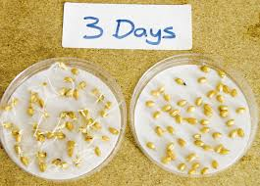
Allelopathy Lab
Data: (Qualitative & Quantitative – numbers, values)
  Table 1: The table below shows the different germination rates of radish and lettuce seeds when grown together and separately. (10 font)

Slide 119
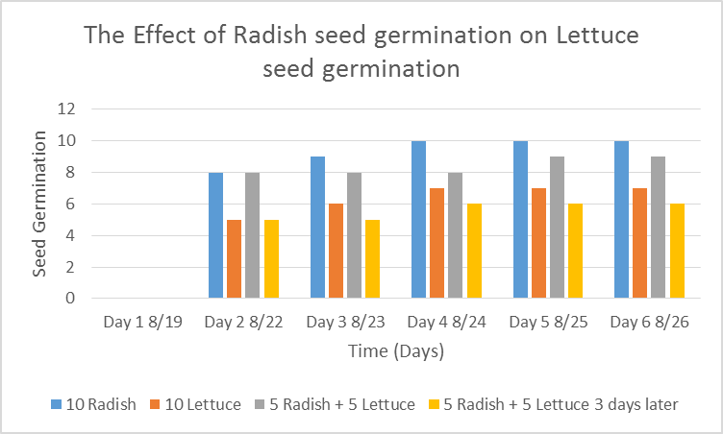
Allelopathy Lab
Data: (Qualitative & Quantitative-numbers, values)
  Graph 1:
  The radish seeds over 6 days showed increased germination compared to the lettuce seeds. (10 Font)

Slide 120
Allelopathy Lab
Data: (Qualitative – descriptive words & Pictures)
  The radish seeds looked …… they smelled….
  The lettuce seeds roots were longer and had more root hairs.

Slide 121
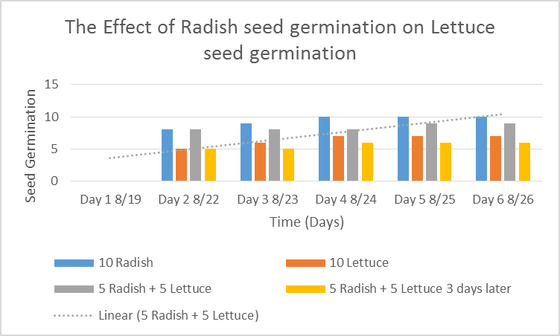
Allelopathy Lab
  Data Analysis: (Paragraph)
  Explain your data - results. Why did we see the results in the graph? Discuss any trends.
  Cite Sources: Allelopathy: How Plants Suppress Other Plants (Ferguson, Rathinasabapathi, Chase, 2013)

Slide 122
Allelopathy Lab
Conclusion: (Paragraph)
  Restate hypothesis and explain if it was supported or not. Tie your Data Analysis to your Background and hypothesis. Did your data support what you thought would happen? How? Explain why allelopathy is important. At the very least, write an AXES paragraph about Allelopathy between radish and lettuce seeds and how it applies to Agriculture.
  Cite Sources: Allelopathy: How Plants Suppress Other Plants (Ferguson, Rathinasabapathi, Chase, 2013)

Slide 123
Works Cited
James J. Ferguson, emeritus professor; Bala Rathinasabapathi, professor; and Carlene A. Chase, associate professor, Horticultural Sciences Department, Cooperative Extension Service, Institute of Food and Agricultural Sciences, University of Florida, Gainesville, FL 32611.
Yes – one more
Yes – still one more ☺
Done!

Slide 124
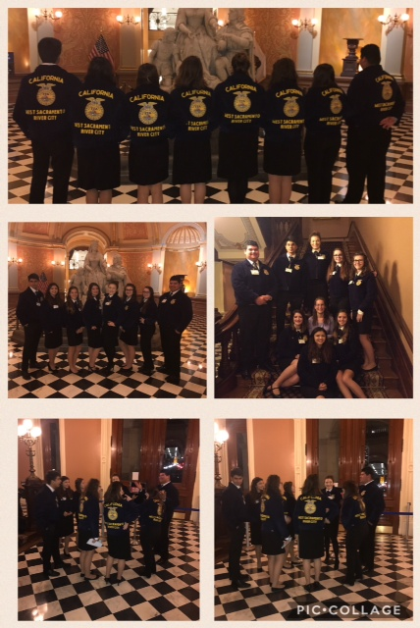
Feb. 23rd West Sacramento FFA Officer Meeting at the Ca State Capital

Slide 125
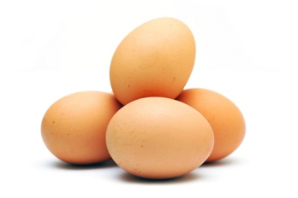
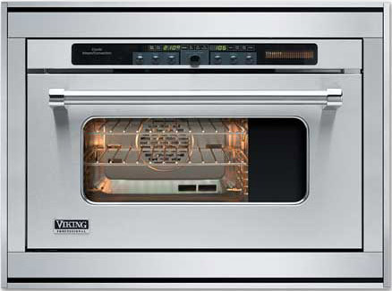
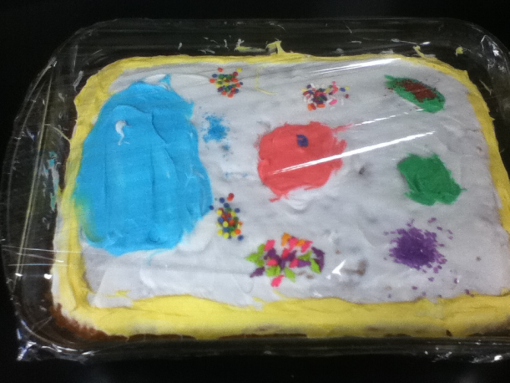



Reactants and Products : Making a cake
Reactants
Catalyst
Product
Angelica’s cake!

Slide 126


Making of Carbohydrates & Cellular Respiration p.57NB
Working with three other students: answer questions 1 – 3. Each students gets to have a job.
Photosynthesis
6 CO₂ + 6 H₂O -> C₆H₁₂O₆ + 6 O₂
Hydrogen
Carbon
Oxygen
Cellular Respiration
C₆H₁₂O₆ + 6 O₂ -> 6 CO₂ + 6 H₂O + 36 ATP + Heat
Disassemble your Glucose & O₂ to the proper carts.
1 Roots – collect 6 H₂O
2 Stomata – Collect 6 CO₂
3 Chloroplasts – collect 6 light energy convert to chemical energy
4 Product of Photosynthesis- make Glucose & 6 O2

Slide 127
How to Make Carbohydrates Activity p. 57NB
6 CO₂ + 6 H₂O -> C₆H₁₂O₆ + 6 O
Carbon Dioxide + Water = Glucose + Oxygen
2. Sunlight – Catalyst
3. The chlorophyll inside the chloroplast

Slide 128
Glucose Synthesis Activity
Photosynthesis: 6 CO₂ + 6 H₂O -> C₆H₁₂O₆ + 6 O₂
Black = Carbon
White = Hydrogen
Red = Oxygen
Person 1 – Root = H₂O
Person 2 – Stomata = CO₂
Person 3 – Chloroplast = Light Energy (Sun)
Person 4 – Glucose Synthesis/ O₂
Person 5 – Get ATP for Cellular Respiration
Cellular Respiration: C₆H₁₂O₆ + 6O₂→ 6CO₂ +6H₂0 + 36 ATP + Heat
Glucose
C₆H₁₂O₆

Slide 129


Slide 130


Slide 131


Slide 132


Slide 133


Slide 134


9/19 Energy in Cells
Obj. TSW learn how energy is stored in the bonds of molecules and released when bonds are broken. P. 52 NB
Copy this graph of an endothermic reaction. Describe in complete sentences how energy is stored using the Independent and dependent variables.
Copy this graph of an exothermic reaction. Describe in complete sentences how energy is released using the Independent and dependent variables in our explanation.
What molecule in plants stores energy, what is the product we feel in an exothermic reaction?
Exothermic Reaction

Slide 135

Endothermic Reaction – Photosynthesis p. 45 NB
Stores energy in Chemical Bonds - Glucose

Slide 136

Exothermic Reaction – Yeast + Hydrogen Peroxide
Cellular Respiration P. 45NB
Releases Heat

Slide 137

9/20 Monomers & Polymers CH 6.3
Obj. TSW learn the 4 macromolecules and the subunits that make them. P. 54 NB
Review your notebook or CH 6.3 and write the 4 Macromolecules/ Biomolecules or Life Molecules.
Read carefully through the book and write the subunits (monomers) for each of the Biomolecules. What are each of the Biomolecules made of?
What elements make each of the monomers?

Slide 138


Slide 139


Macromolecules & Subunits Notes p. 31NB
Lipid _{(pm)} – Fatty Acids
Carbohydrate_{(pm)} - Saccharides
Protein _{(pm)} ( Enzymes)– Amino Acids
  Temperature
  pH
  [Substrate ] & [Enzymes]
  [Salt]
Nucleic Acid - Nucleotides

Slide 140

Enzyme Activity
You will be given a substrate or a part of an enzyme.
Find the matching part, that fits your active site.
Bring your matching Enzyme/ Substrate combinations (Lock & Key) to McAllister
I will quiz you on your knowledge of monomers and polymers in endergonic & exergonic reactions.

Slide 141
Expectations of Myself…
List 3 expectations you have of yourself on page 59 NB

Slide 142
Expectations of My West Sacramento FFA Chapter (CA0577)…
List 3 expectations you have of your Chapter on page 59 NB

Slide 143
Expectations of My Advisor
List 3 expectations you have of your Advisor on page 59 NB

Slide 144
Elections Tomorrow!!!!

Slide 145
Garden Planning sheet 9/20
Make sure to pick tomatoes! Quality – inspect them. Give to Ms. Sutton
Refresh all the flowers-get missing flasks. Longer stems please, more water. Deliver
Take out garden bed to the right of our classroom, cut up greens for compost.
Add water to 3rd compost bin, push down, add new compost, Use shovel to cut up compost.
Add water to Tower Gardens. Add all pots, rock wool and reseed, and label. Zoe
Take pictures of students working and of your garden to upload onto Theaet.com Record book. Arina?
Water the 8 trees along the east side of garden beds.
Inspect irrigation – Tyler & Chris
Thin the Radishes Feed the hens, add nutrients to water. Bring potatoes & garlic to plant next week.

Slide 146

9/21 Reading a Photosynthesis Graph
Obj. TSW review variables and the control in a lab and analyze the graph. P. 46 NB
Compare & Contrast Independent and Dependent Variables by identifying each and explaining what they are.
Why is the Control important?
Using the graph, what is the trend? How do you know?

Slide 147


9/22 Floating Leaf Disk Assay
Obj. TSW learn about how rate of photosynthesis is determined by light intensity and sodium bicarbonate. P. 58 NB
Read the lab procedure for Leaf Disk Lab. What is the purpose of the lab? What do we want to know/ learn?
What is the Independent Variable? What factor do we change to test whether photosynthesis is happening? What is the dependent Variable? What are we measuring?
What is the control group? What are we testing against?

Slide 148
Leaf Disk Assay Lab P. 57, 59, or 61NB
Hypothesis:
  If I put 10 leaf disks (no O2) in a beaker with Sodium Bicarbonate then they will rise faster than just the water (control).
 | Sodium Bicarbonate # Floating Leaf disks | Water # of Floating Leaf disks
0 Minute | 0 | 0
5 Minutes
10 minutes
15 minutes
20 minutes
25 minute
35 minutes

Slide 149
Computer Lab Write Up for Leaf Disk Assay Lab
Enter data into Excel
Make a scatter plot graph to show the 50% floating point.
Data Analysis: What does the graph mean? Error analysis
Conclusion: Discuss why measuring the photosynthesis can be a problem. What competing process is occurring at the same time? Include in your discussion the relationship between Photosynthesis and Cellular Respiration by comparing and contrasting the equations.

Slide 150
Photosynthesis & Cellular Respiration AXES Paragraph READ & highlight parts of your article, Write an AXES paragraph on page 57, 59 or 61NB
Assertion eXample
Explanation
Significance
The mechanisms for P & CR are related because they are essentially opposite reactions. Photosynthesis transforms energy from the sun and Cellular Respiration makes use of chemical bond energy and converts it to ATP & Heat
Photosynthesis = Chloroplast
Cellular Respiration = Cytoplasm, Mitochondria
6CO₂ +6H₂0 → C₆H₁₂O₆ + 6O₂ Photosynthesis
C₆H₁₂O₆ + 6O₂ → 6CO₂ +6H₂0 + 36 ATP + Heat Cellular Respiration

