Slide 1
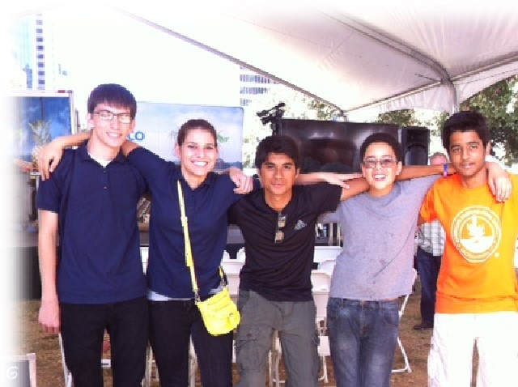
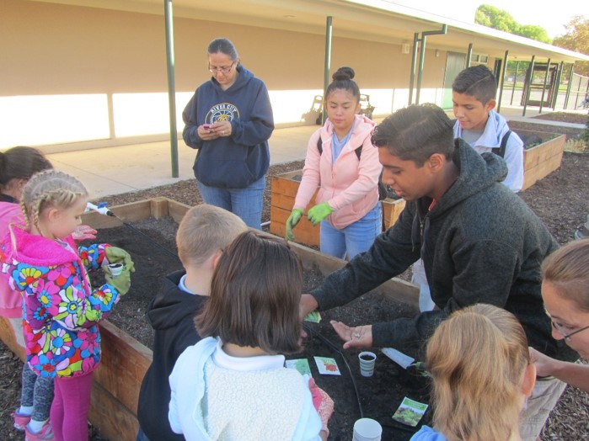
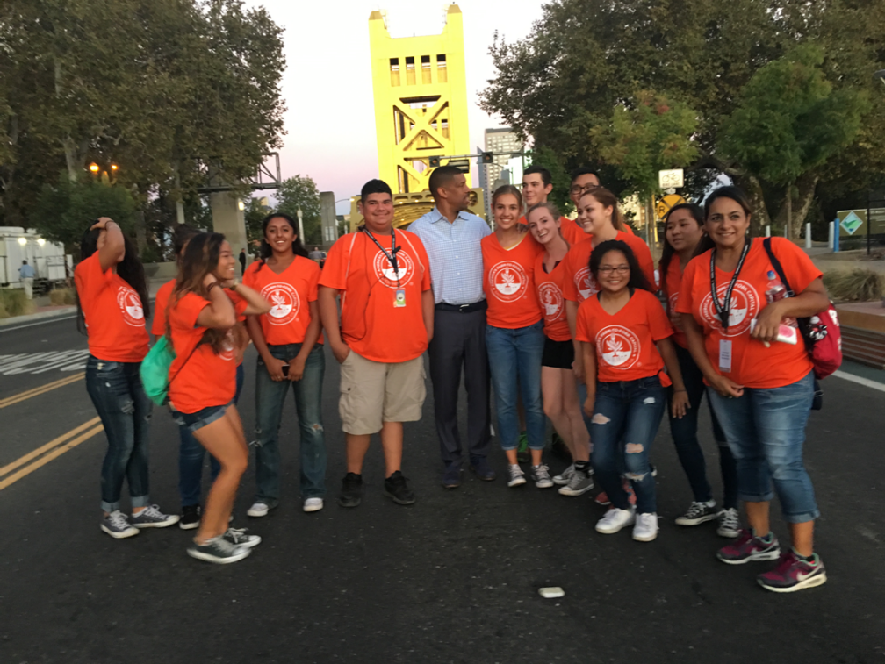
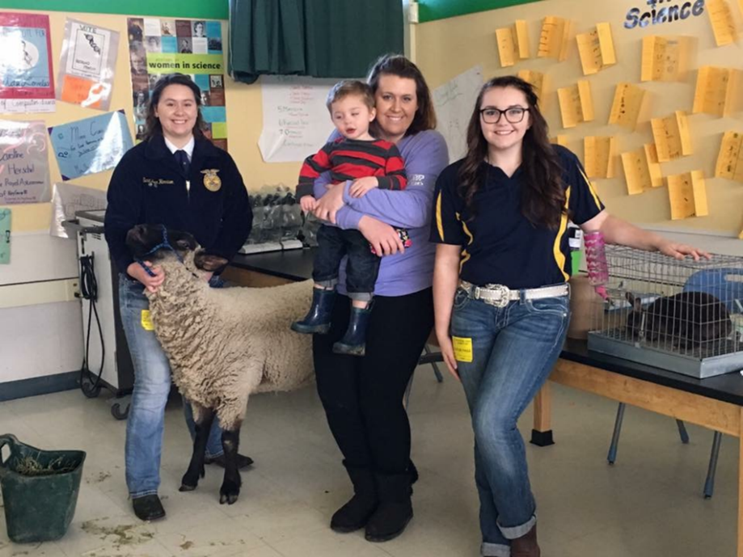
Welcome to Room 3 Bryte
Ag Biology

Slide 2
Mrs. McAllister Biology Rules & Syllabus 2012/ 2013
Welcome to Room 757. Together during the coming year you will have the opportunity to increase your knowledge and experience in Biology.
You will learn how biology affects you and your everyday life. Your success is my concern; however, it is really up to you. Biology is not a
spectator sport – you must work hard and participate actively in the process. In order to graduate from River City High School you must
pass this course. This Biology class meets the first of a two-year lab science A- G requirement for California State and University of
California Schools.
The Goal:
All of my Biology students will engage in the learning process about Biology and develop into independent learners that feel confident with
reading, writing and exploring science by developing reading strategies that will facilitate their learning in all academic classes.
CLASS RULES
Be considerate of the rights of others to learn/ respect other students’ and their property.
NO Put – Downs! No food, drink, candy, or gum is to be consumed during class. No make – up applied in class.
No personal stereo equipment, pagers, cell phones, i-pods, etc. to be used during class.
Raise your hand to ask questions and participate in class, show respect to others.
I dismiss you, not the bell.
Be in your seat when the tardy bell sounds or you will be marked tardy.
Failure to follow the class rules will result in a warning, detention(s), changing of seat, phone call home, ISS (In School Suspension) –
period or day, Conference(s) (with &/ or without parent(s), counselors, teachers, or administration members), suspensions.
Please refer to the student manual for more specifics.
BIOLOGY NOTEBOOK
Composition Style Notebook with sewn pages will be used everyday and will need to be purchased As Soon As Possible.
It will contain, but not limited to: Biology Warm – Ups, State Standards, Reading Strategies, Notes, Agenda, Class Activities, and Lab Work.
GRADES
The grade scale is:
100% - 90% = A; 89% - 80% = B; 79% - 70% C; 69%- 60% = D; 59% - 0% = F
Tests/ Quizzes will comprise 60% of your overall grade. Grades will be cumulative for the semester.
Assignments will be written daily on the board and posted on line at: http://rivercity.wusd.k12.ca.us/ Homework will be
given 3 – 5 days a week. It is expected that the Biology chapter assigned will be read as homework. Homework, Quizzes, Notes, Projects,
Posters, Tests, and Finals will be given only if the absence is excused.
COURSE OUTLINE
BIOLOGY: This course is an introductory course in biology. It will survey biological principles such as: Cell Biology, Genetics, Ecology,
Evolution and Physiology. Critical thinking skills will be taught in conjunction with subject matter by use of preparing unit portfolios, writing,
drawing, performing labs, discussion and inquiry techniques. Dissections second semester will add as enrichment.
The Units of study are:
Semester 1 Semester 2
What is Biology? Evolution
The life of a Cell Ecology
Genetics The Human Body- Physiology
I have read and understand these class rules:
Parents/ Guardians, your young adult should have homework at least 3 – 5 days a week and should be reading a section of the Biology
chapter three nights a week. Your young adult will need to check out a Biology Book from the Library on their own time unless you have a
computer with Internet access. The web site for the Biology book is: Glencoe.com. The username and password is on my website.
Please notify me at school if there is not biology homework being done on a regular basis or if you have any questions or concerns.
(916) 375 – 7800 Thank you. Mrs. McAllister
Student: __________________________________________ Date: ____________________________
Parent(s)/ Guardian(s): ______________________________________________________________________

Slide 4
On the back of your Biology rules & Syllabus:
Please tell me if you need to sit in front for any reason. ie. Sight, hearing, able to focus better.
Write three goals you have for Biology Class this term. ie. I want to earn an A.
Return this Rules & Syllabus back to me signed by you and your parents/ guardians by tomorrow for 10 points.

Slide 5
Heading Paper &
What to bring to class
On the Left Side of the Paper:
Name: Jeremy Smith
Period: 1
Assignment: Quiz-Rules & Heading
Class: Biology McAllister
Date: 8/21/2014
Bring to Class:
  Sewn Composition Style Notebook
  Pencil
  EXPO
  Eraser
  Binder Paper
  Homework
  Colored Pencils
  Glue Stick
  Stapler
  Ruler
  Highlighter
  Scissors

Slide 6
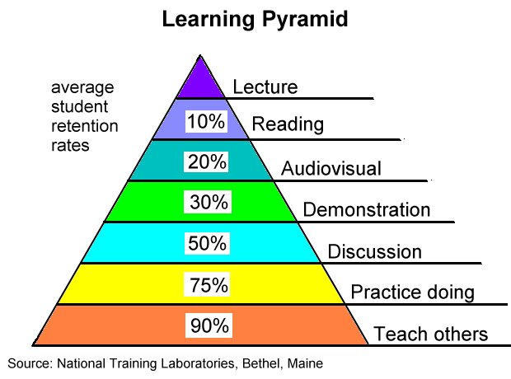

Slide 7


Slide 8
Biology Book online & McAllister’s Website
Glencoe.com
Click on California, Click the Student/ Parent Box, & Science.
At the next page select Biology; Biology Dynamics of Life ©2004.
Then click on the Online student edition until the "Sample Full Version" comes up and click on it.
Type in the username: BDOLCA05 & Password: th3cr8ye
Finally, click on "Interactive Student Edition" "Contents" and go to the Chapter to read, do research and homework.
Link is on my website: http://rivercity.wusd.k12.ca.us/

Slide 9
3 x 5 Card
Color your Name, 1st & Last
What would you like me to know about you?
What is your favorite sport?
What do you want to be when you grow up?
If you want to go to college, what college do you want to go to?

Slide 10

Science Notebook
Front Cover:
Name, Biology, Rm.3, McAllister, Fall Term, 2017
Table of Contents page: 1 - 7
Date, Title, Page #
Page 8, 1st Warm – Up
Scientific Method

Slide 11
Table of Contents
Date | Title/ Topic | Page #
8/17/17 | Warm Up: Scientific Method | 8
8/17/17 | Notes on Scientific Method Video Worksheet: Basic Lab Report | 9
8/17/17 | Worksheet: Scientific Method Controls & Variables | 11

Slide 12
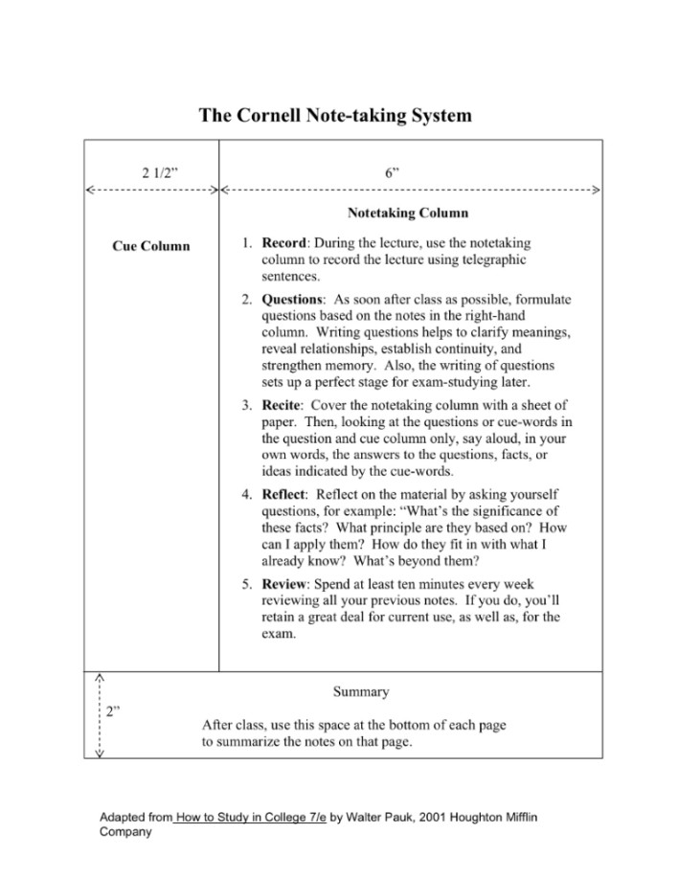

Slide 13
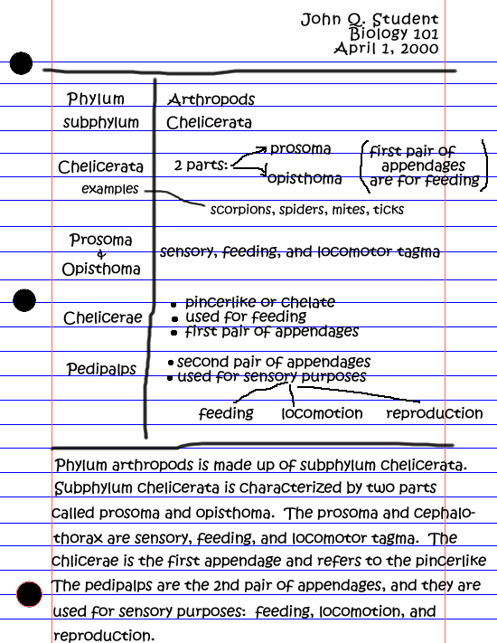

Slide 14
Biology Bingo Blackout
Get a Bingo sheet & a pen
Write your name in the center
Walk around and meet your new classmates, make friends and try and find people to fill in your blanks for a Bingo.
When you have all your squares filled in, you have a Blackout and tell me.

