Slide 1
DNA Structure, DNA Replication, Mitosis, Protein Synthesis
Week 8

Slide 2
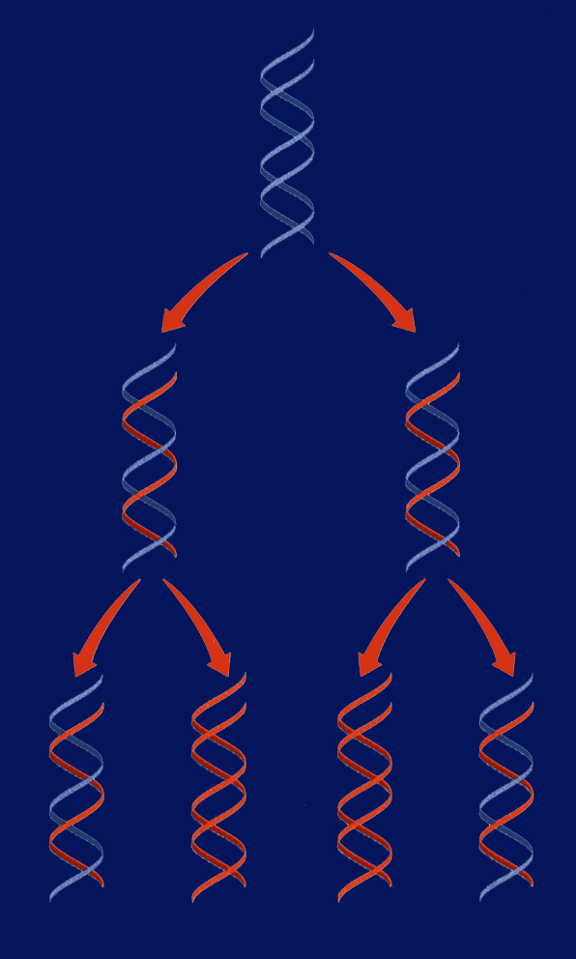
9/29 DNA Replication 11.1
Obj. TSW demonstrate base pairing rules of DNA Replication by constructing a 2-D model of DNA with paper. P. 68 NB
What is DNA replication?
Why does DNA replicate?
Diagram the of DNA being replicated
Replication Video
HW CH 11 1 page Notes P. 65 NB
Show video DNA Replication

Slide 3







Section 11.1 Summary – pages 281 - 287
#1. Replication of DNA
Before a cell can divide by mitosis or meiosis, it must first make a copy of its chromosomes.
The DNA in the chromosomes is copied in a process called DNA replication.
Without DNA replication, new cells would have only half the DNA of their parents.

Slide 4
Section 11.1 Summary – pages 281 - 287
DNA
Replication
Replication of DNA
Replication

Slide 5
DNA Replication
DNA replication: the DNA in chromosomes is copied in this process
If I say a strand contains: AATTCC on one side, what will the complementary strand be? You can predict what the bases will be on the other side! Part of replication uses this logic.
During DNA replication, each strand serves as a pattern, or template, to make a new DNA strand.

Slide 6
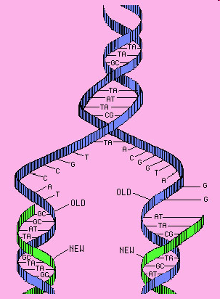
#3. Steps of DNA Replication
STEP 1. Separation of Strands: When a cell begins to copy DNA, the DNA unwinds, and the hydrogen bonds are broken. This allows the bases of nucleotides to be exposed.
Unwinding!
Hydrogen bonds broken!
(like unzipping!)
STEP 2. A new Sugar- Phosphate
backbone forms along the new
strand forms.

Slide 7
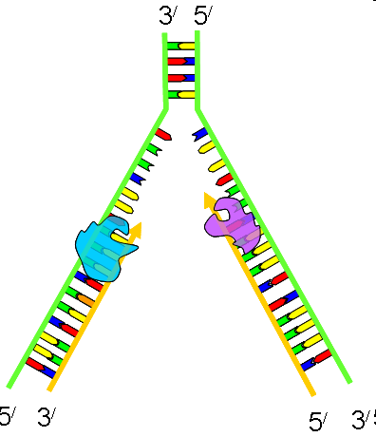
DNA Replication 3’ to 5’ RULE
DNA strands go from 3’ to 5’ or 5’ to 3’
When DNA strands pair,
it is opposite
STEP 3. Base pairing: Free nucleotides pair
with the exposed DNA bases.
STEP 4. Two molecules of DNA are
Formed; each is half original &
Half complementary.

Slide 8
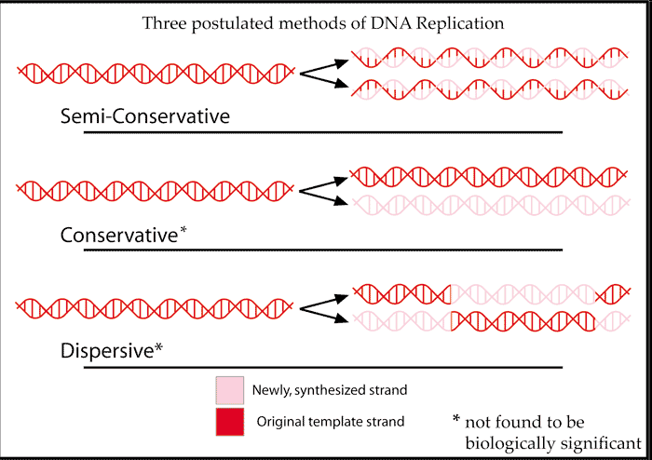
Semi-conservative Replication p. 65 NB
Half of the DNA is Original the other half is new (Complementary)

Slide 9
DNA Replication Practice p. 65 NB
Directions: Using one half of the a DNA helix, show what the correct pairing would be, skip lines in your NB.
ATT CGT TAC CAC CTC
TAT TAG GCA ATA TTC
GTG TGA TTA ATA GCC
CTA AAG GAA TAG GAT
GAT GAA TAC CCA CGA
TAA TAT GCA CAT TAC
GAA CCT TAC GGG GTG
TAT AAC CAG GAG TTT
ATC CGT AGT GTA AAT
GGA TTA CCC TTA CCA

Slide 10
DNA Replication Lab p. 67 NB
Materials:
Scissors, tape, DNA template (on white piece of paper), blank white piece of paper, 4 of each nitrogenous bases (each one different color of paper).
Procedures:
Pair up with a partner
Get supplies: 2 Original Strands of DNA backbone (White), & 1 paper of 4 of each of the Nitrogen Bases
Base pair the nitrogen bases to the Deoxyribose sugar.
Draw your Hydrogen Bonds A=T; C=G
Write Original Strand on the two white DNA Backbones.
After McAllister reviews your model, she will give you 2 Yellow Backbones that are the complementary strands to base pair your Original strand to.
Cut your Original Strand in ½, and base pair the complementary strand to it.
When you have finished your model, answer the questions below in your notebook P.47NB
Questions:
List the 3 functional groups & the 4 nitrogenous bases found in DNA.
List the rules for base pairing in DNA.
What are the two main functions of DNA?
Draw DNA Replication with two different colors.

Slide 11
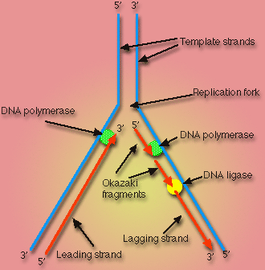
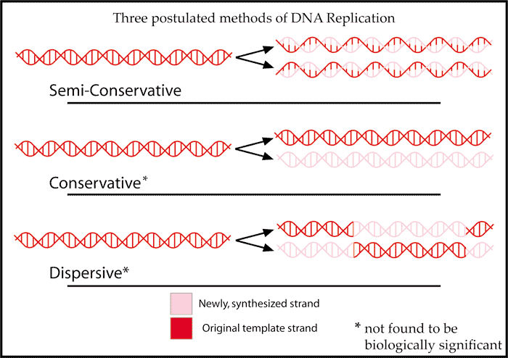
DNA Replication Activity Tape your Replicated DNA p. 67 NB
What is Semi–Conservative Replication?
What are the two main functions of DNA?
Why is DNA Replication important?
List the 3 functional groups & the 4 nitrogenous bases found in DNA.
Draw DNA Replication with two different colors.
List the rules for base pairing in DNA.

Slide 12
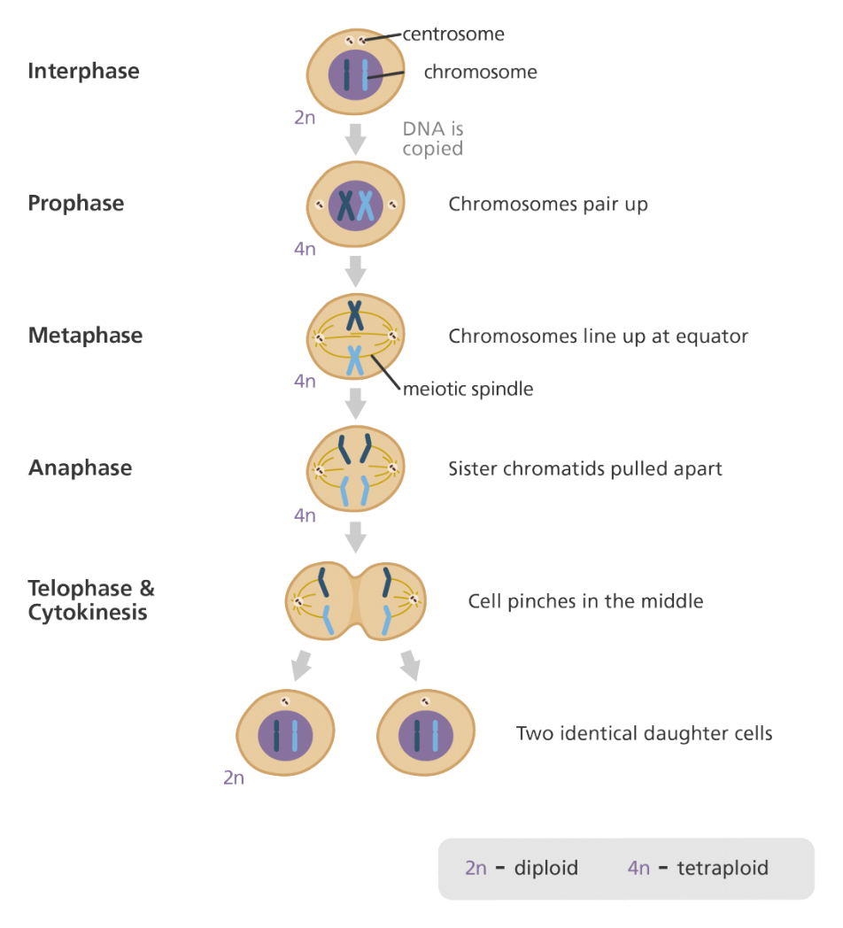
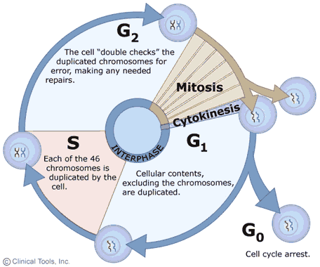
9/29 Cell Growth & Reproduction: Mitosis CH 8.2
Obj. TSW understand the cell cycle and processes at each stage. P. 68 NB
What is mitosis?
Draw the Cell Cycle.
What is the result of Mitosis?

Slide 13
Problem Solving Lab 8.2 P. 204BB p. 69 NB
Read the Observe & Infer section.
Read the Solve the Problem.
Answer the three “Thinking Critically” questions p. 61NB
  Growth 1 phase- Rapid Growth & metabolism of Interphase is the most variable in length.
  The two types of cells have different functions and one is more complex than the other.
  The cycle of some types of cells is faster then others because of the complexity of the proteins made by the cell or the need to produce cells due to rapid wear and tear – like skin cells compared to muscles cells or nerve cells in the spine (do not regenerate).

Slide 14
Mitosis Practice p. 65NB
Get 2 white boards/ lab station
Get 1 Expo marker / 2 students
Draw a nucleus and place your replicated chromosomes inside the nucleus.
With the yellow and red chromosomes, practice the 4 stages of Mitosis, drawing and erasing the nucleus as the stages dictate.
After you show them to me/us, Then draw the phases of Mitosis on
page 63 NB.

Slide 15
Mitosis Rules p. 65 NB
Create a Mental model of how a cell cycle works that shows an end result of 2 identical cells after Mitosis with the same number of chromosomes.
Set up rules for what a cell can and can not do.
What steps does the cell have to go through to create two new identical cells.
Result of Mitosis: 2 identical cells with the same # of chromosomes that make tissues, that form organs, that are part of an organ system and make an organism.

Slide 16
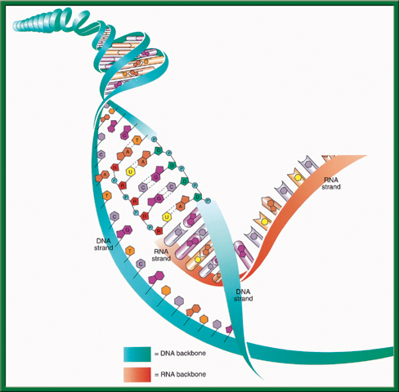
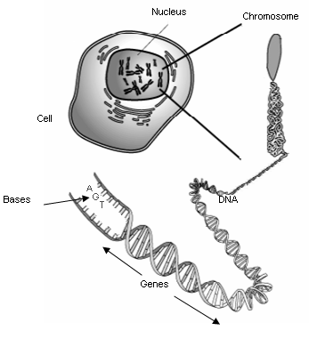
10/3 RNA (Ribonucleic Acid) CH 11.2
Obj. TSW compare and contrast the structure and function of DNA and RNA in the Warm Up, and from the video. P. 72 NB
Describe how RNA’s structure differs from DNA’s structure in three ways?
Identify and describe the functions of the three types of RNA.
What is the main difference between Transcription and DNA Replication?
Study for DNA Quiz: CH 11 Tuesday
Work on your Lab – Final Lab due Friday

Slide 17
Science Article: Endosymbiotic Theory p. 65 NB
Read the article quietly.
Read the article out loud.
Pair up and write the Claim, Evidence and Reasoning
Discuss as a class: Endosymbiotic Theory
Turn the Paper over and write the AXES Paragraph on Endosymbiotic Theory

Slide 18


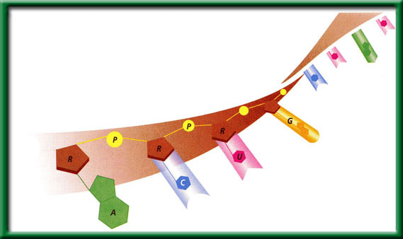
Section 11.2 Summary – pages 288 - 295
#1. RNA
RNA like DNA, is a nucleic acid. RNA structure differs from DNA structure in three ways.
First, RNA is single stranded—it looks like one-half of a zipper —whereas DNA is double stranded.

Slide 19
#1. Transcription
To return to the chapter summary click escape or close this document.

Slide 20
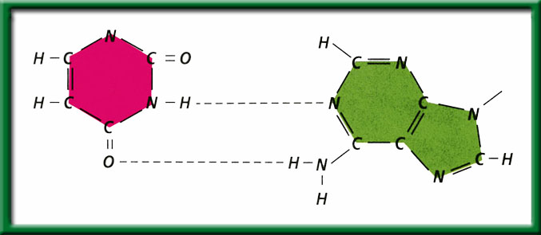
Section 11.2 Summary – pages 288 - 295
#1. RNA
Both DNA and RNA contain four nitrogenous bases, but rather than thymine, RNA contains a similar base called uracil (U).
Uracil forms a base pair with adenine in RNA, just as thymine does in DNA.
Uracil
Hydrogen bonds
Adenine

Slide 21

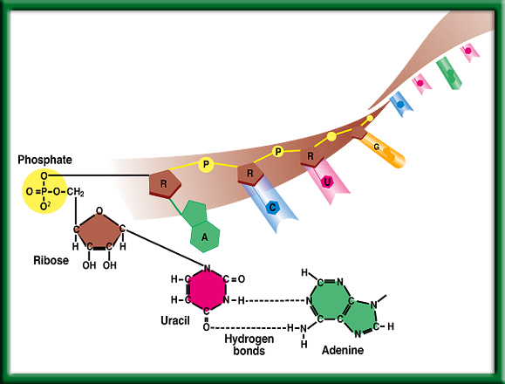
#1. Second: Chemical Difference of DNA and RNA
Uracil is the Nitrogen base that replaces Thymine
To return to the chapter summary click escape or close this document.

Slide 22
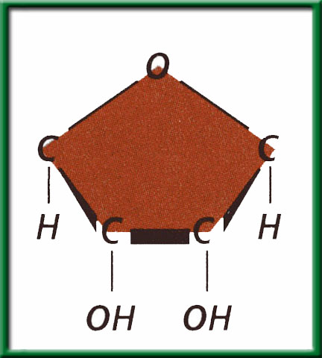
Section 11.2 Summary – pages 288 - 295
#1. RNA
Third: The sugar in RNA is Ribose; DNA’s sugar is deoxyribose.
Ribose

Slide 23
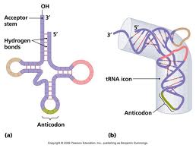
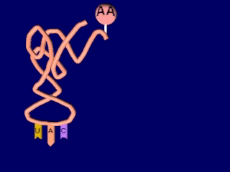
Section 11.2 Summary – pages 288 - 295
#2. RNA
Transfer RNA (tRNA) is the supplier. Transfer RNA delivers amino acids to the ribosome to be assembled into a protein.
Click image to view movie

Slide 24
Section 11.2 Summary – pages 288 - 295
#2. RNA
There are three types of RNA that help build proteins.
Messenger RNA (mRNA), brings instructions from DNA in the nucleus to the cell’s factory floor, the cytoplasm.
On the factory floor, mRNA moves to the assembly line, a ribosome.

Slide 25
Protein Synthesis – Monday!!!!! 10/3
1 large bag of M & M’s –
1 large bag of Gummy Bears –
4 bags of Marshmallows-
1 stick of Butter – McAllister
1 box Rice Krispy Cereal -

Slide 26
DNA Quiz Thursday 10/5
1 piece of Binder Paper & pencil or pen. Write your name on the top right hand side.
1. What is the name of the molecule that holds our genetic information?
2. What is the shape of that molecule?
3. Where is that molecule located in the cell?
4. What are the 4 Nitrogen Bases that code for Amino Acids?
5. Write how the Nitrogen base pair together.
What is the bond that holds the nitrogen bases together?
Draw & Write the three parts of a nucleotide.
8. What is DNA Replication?
9. What are the two functions of DNA?
10. How is RNA different from DNA?

Slide 27
Section 11.2 Summary – page 2888- 295
Genes Expression = Proteins
You learned earlier that proteins are polymers of amino acids.
The sequence of nucleotides in each gene contains information for assembling the string of amino acids that make up a single protein.

Slide 28
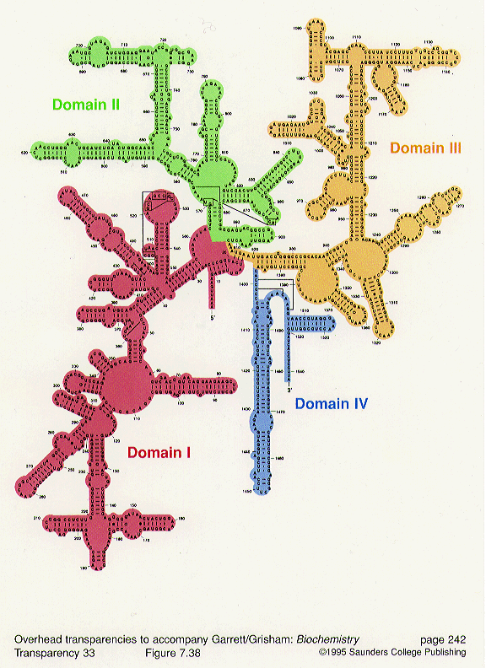
Section 11.2 Summary – pages 288 - 295
#2. RNA
The ribosome, made of ribosomal RNA (rRNA), binds to the mRNA and uses the instructions to assemble the amino acids in the correct order.

Slide 29

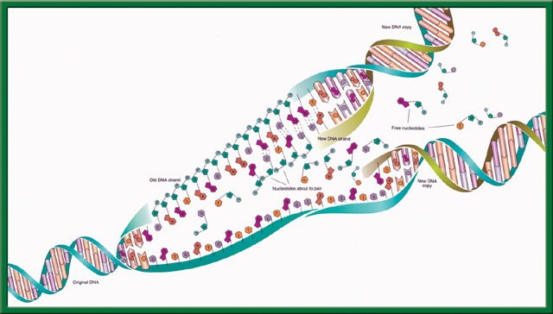
What Process is this?
What are the steps?
What is the name for this particular type of process?
To return to the chapter summary click escape or close this document.

Slide 30
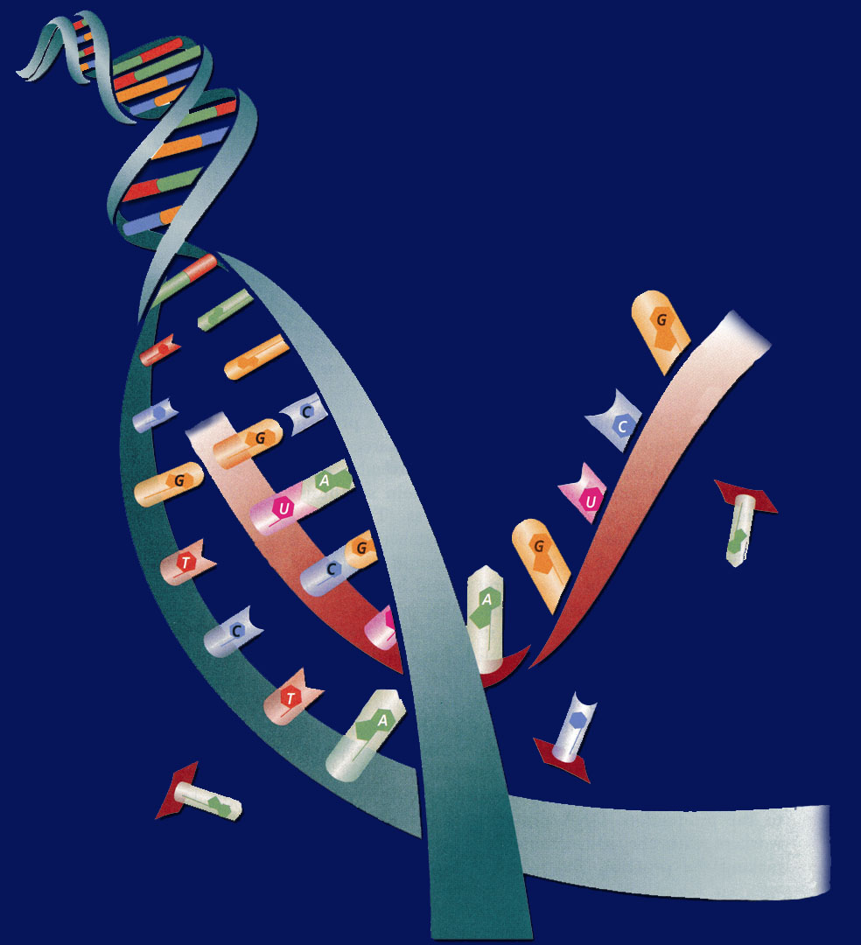
#3. The difference of DNA Replication & Transcription (Making Proteins)
Transcription – first process of making proteins.
DNA Replication – makes more DNA for more cells.

Slide 32
Record Book Time!!!
We love theaet.com
CA0577
Objective: By Wednesday October 11th, I have everyone’s SAE Agreement. 20 points.
Log on: Explore AET.com if you don’t know what your SAE is yet to help you make a decision. Also talk to McAllister.
Log on: theaet.com if you know your SAE to get started entering your description, time, objectives, finances. Please always write in complete sentences, this will be part of your agreement, signed by me and your parents.
  Click Profile, Your Activities Experience Manager SAE(Add New) Enter you Description, Time, Finances, and Learning Objective
  When you are done entering all your information for your SAE, Click on the Blue “PDF Agreement”& read it. Edit what you need. Tell me to Print, Take Home and get signed.
  Don’t forget your PICTURES!!!! Load them into your Project.

Slide 33
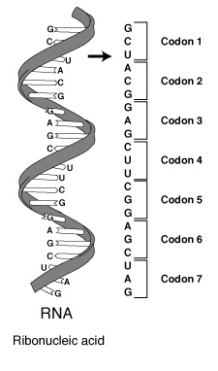
10/4 Protein Synthesis: Transcription 11.2 Week 8
Obj. TSW be able to explain the process of Transcription by making mRNA strand from DNA through practice. P.74 NB
What is transcription?
Where does Transcription happen?
Why is a codon important to making a protein?
Learn.genetics.utah.edu/

Slide 34
Cracking the Code
Answer the Questions on the ½ sheet of paper

Slide 35
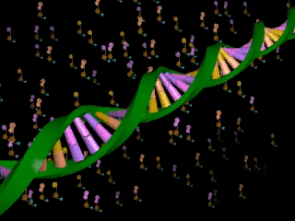
Section 11.2 Summary – pages 288 - 295
Transcription
In the nucleus, enzymes make an RNA copy of a portion of a DNA strand in a process called transcription.
Click image to view movie

Slide 36
Section 11.2 Summary – pages 288 - 295
Transcription
A
DNA strand
RNA strand
RNA strand
C
B
DNA strand

Slide 37
Section 11.2 Summary – pages 288 - 295
Transcription
The main difference between transcription and DNA replication is that transcription results in the formation of one single-stranded RNA molecule rather than a double-stranded DNA molecule.

Slide 38
Section 11.2 Summary – pages 288 - 295
RNA Processing = Gene Expression
Not all the nucleotides in the DNA of eukaryotic cells carry instructions—or code—for making proteins.
Genes usually contain many long noncoding nucleotide sequences, called introns, that are scattered among the coding sequences.

Slide 39


Chapter Assessment
Question 1
How does DNA control the structures and functions of a cell?
Answer
DNA determines the structure of proteins. Some proteins become important cell structures. Other proteins, such as enzymes, control chemical reactions that perform key life functions.
CA: Biology/Life Sciences
5a

Slide 40
HW CH 11 DNA & Genes p.41 NB
Deoxyribose
Nitrogenous Base
Nucleotide
Base Pair
Hydrogen Bond
Phosphate
Adenine (A) & Nitrogen Bases
Cytosine
*Nucleotides
DNA Replication
Double Helix

Slide 41
HW CH 11 DNA &Genes*
DNA – Double RNA – single
DNA – Deoxyribose RNA – Ribose
DNA – ATCG RNA – AUCG
Amino Acids
Amino Acids
Proteins
Codon*
Threonine

Slide 42
QUIZ
8. What is DNA Replication?
9. What are the two functions of DNA?
10. What are three differences of RNA from DNA?
11. What RNA has stop codons, and what is their function?
12. How are codons and anticodons different?
13. Write the equation for Protein Synthesis.
14. Transcribe & Translate the DNA sequence:ATC, TCA, TAC

Slide 43
DNA Quiz
7. What is the backbone of the molecule made of?
8. What is a gene?
9. What does DNA code for? What is it’s purpose?
10. Write the formula for Protein Synthesis
When you are finished turn you paper upside down and wait quietly to
have me pick it up.

Slide 44
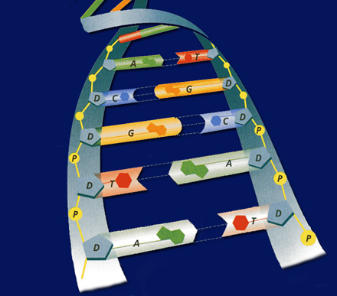
POP QUIZ Write your name on your binder paper.
What is this molecule? Spell it out.
What is the shape of the molecule?
What are the two purposes/ functions of this molecule?
Write the three names for the parts of a nucleotide. Be specific.
The Nitrogen bases are: Adenine, Cytosine, Guanine, & Thymine – Base Pair them together correctly.
What holds the Nitrogen bases together?
DNA is a Nucleic Acid, write an example of another one.
Can a Nucleic Acid leave the nucleus?
9. What is DNA Replication?
What is the name for how DNA
Replications?

Slide 45
Chapter Assessment
Question 2
The process through which the order of bases in messenger RNA codes for the order of amino acids in a protein is:
A. transcription
B. translation
C. replication
D. point mutation
The answer is B.
CA: Biology/Life Sciences
4f

Slide 46
Chapter Assessment
Question 3
Why would scientists use nucleotide sequences to identify bodies of crime victims?
Answer
In comparing nucleotide sequences in the DNA of a crime victim with nucleotide sequences from a possible close relative of the crime victim, scientists can determine if the two are related.
CA: Biology/Life Sciences
4e

Slide 47
HW CH 11
9.Phenylalanine Codon are (UUU) (UUC)
10. Codon
11. Amino Acid
12. Amino Acid
13. Stop codons = UGA, UAG, UAA
14. Tryptophan & Methionine

Slide 48
Making RNA p. 71 NB
Backbone= Phosphate & Sugar (Red & White)
Nitrogen Bases= Adenine (Blue)=Thymine (Green)
            Cytosine (Yellow )=-Guanine (Orange)
            Uracil (Pink) RNA
Hydrogen bond (clear barbell)
http://learn.genetics.utah.edu/
WS - DNA Model Discussion questions P. 71 NB
How is RNA different from DNA, Name 3 ways.
What Nitrogen base replaces Thymine in RNA?
Why is RNA made, if DNA holds the genetic code?

Slide 49
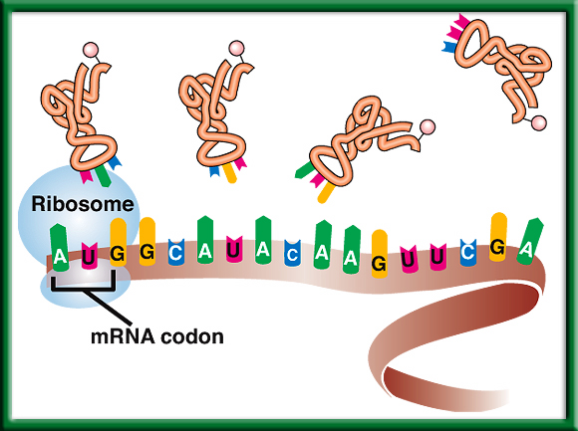
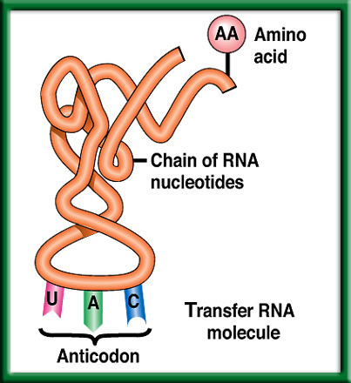
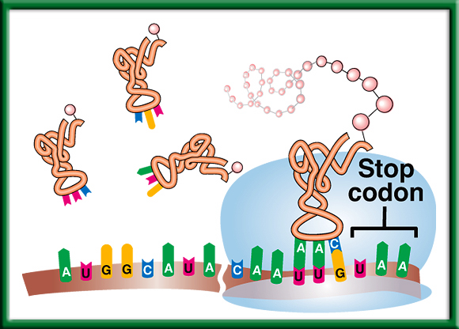
10/5 Protein Synthesis: Translation 11.2
Obj. TSW explain the process of Protein Synthesis by working on their Protein Synthesis foldable and transcribing and translating DNA sequences from their Mini Lab 11.1 P. 76NB
Learn.genetics.utah.com.edu/
Compare & Contrast Codon and Anticodon.
What is the role of tRNA in Protein Synthesis?
Why are Stop Codons important in Translation?
http://www.dnatube.com/video/3448/DNA-Replication

Slide 50
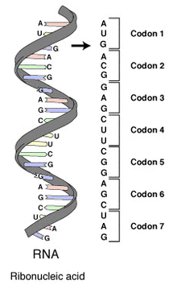
#1. Codon & Anticodon
A Codon is a nucleotide triplet sequence on mRNA, it codes for an amino acid.
  AUG ACG GAG
An Anticodon is a nucleotide triplet sequence on tRNA that carries the Amino acid
  UAC
Both are RNA & Each triplet pairs to code for a particular Amino acid to form a protein.

Slide 51
Section 11.2 Summary – pages 288 - 295
#2. The role of transfer RNA - tRNA
As translation begins, a ribosome attaches to the starting end of the mRNA strand. Then, tRNA molecules, each carrying a specific amino acid, approach the ribosome.
When a tRNA anticodon pairs with the first mRNA codon, the two molecules temporarily join together.
Usually, the first codon on mRNA is AUG, which codes for the amino acid methionine.

Slide 52
#3. Stop Codons
Without the stop codon, the protein would continuously be made.
More Protein is not necessarily better.
Name the 3 codons for STOP:
  UAA, UAG, UGA

Slide 53
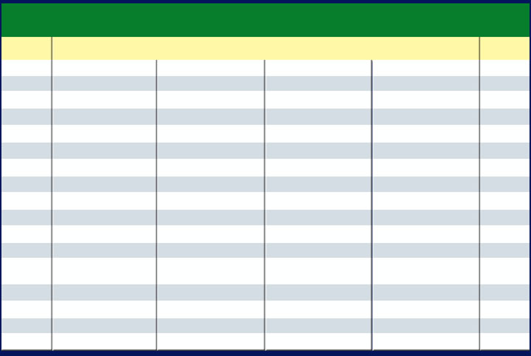
Section 11.2 Summary – pages 288 - 295
The Genetic Code P.292 BB
The Messenger RNA Genetic Code
First Letter
Second Letter
Third Letter
U
C
A
G
U
Phenylalanine (UUU)
Serine (UCU)
Tyrosine (UAU)
Cysteine (UGU)
U
Phenylalanine (UUC)
Serine (UCC)
Tyrosine (UAC)
Cysteine (UGC)
C
Leucine (UUA)
Serine (UCA)
Stop (UAA)
Stop (UGA)
A
Leucine (UUG)
Serine (UCG)
Stop (UAG)
Tryptophan (UGG)
G
C
Leucine (CUU)
Proline (CCU)
Histadine (CAU)
Arginine (CGU)
U
Leucine (CUC)
Proline (CCC)
Histadine (CAC)
Arginine (CGC)
C
Leucine (CUA)
Proline (CCA)
Glutamine (CAA)
Arginine (CGA)
A
Leucine (CUG)
Proline (CCG)
Glutamine (CAG)
Arginine (CGG)
G
A
Isoleucine (AUU)
Threonine (ACU)
Asparagine (AAU)
Serine (AGU)
U
Isoleucine (AUC)
Threonine (ACC)
Asparagine (AAC)
Serine (AGC)
C
Isoleucine (AUA)
Threonine (ACA)
Lysine (AAA)
Arginine (AGA)
A
Methionine;Start (AUG)
Threonine (ACG)
Lysine (AAG)
Arginine (AGG)
G
G
Valine (GUU)
Alanine (GCU)
Aspartate (GAU)
Glycine (GGU)
U
Valine (GUC)
Aspartate (GAC)
Glycine (GGC)
Alanine (GCC)
Glycine (GGC)
C
Valine (GUA)
Alanine (GCA)
Glutamate (GAA)
Glycine (GGA)
A
Valine (GUG)
Alanine (GCG)
Glutamate (GAG)
Glycine (GGG)
G

Slide 54
10/9 Protein Synthesis: Translation 11.2
Obj. TSW explain the process of Protein Synthesis by diagramming all the steps in their notebook. P. 78 NB
When making proteins, If a template DNA strand read TAC GGT, AGT what would a complementary strand of mRNA be?
What Amino Acids would the 3 codons code for?
Do the same for: GCA, TGC, ATC (DNA).
Learn.genetics.utah.edu/

Slide 55
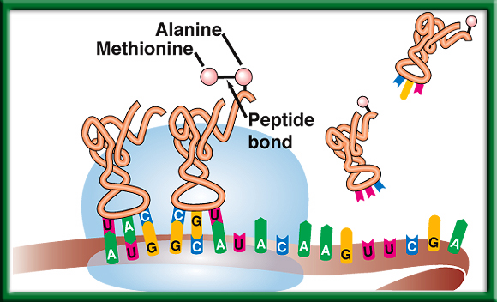
Protein Synthesis p. 59 NB
DNA -> transcription -> RNA -> translation -> Proteins

Slide 56
Mini Lab 11.1 P. 67NB P. 293 BB
DNA → transcription →RNA →translation → Protein
Copy this table in your notebook.
 | A | B | C | D | E
DNA Base Sequence | Process | mRNA Codon | Process | tRNA Anticodon | Amino Acid
AAT
GGG
ATA
AAA
GTT

Slide 57
Mini Lab 11.1 P. 67 NB P. 293 BB
DNA → transcription →RNA →translation → Protein
 | A | B | C | D | E
DNA Base Sequence | Process | mRNA Codon | Process | tRNA Anticodon | Amino Acid
AAT | Transcription | UUA | Translation | AAU | Leucine
GGG |  | CCC |  | GGG | Proline
ATA |  | UAU |  | AUA | Tyrosine
AAA |  | UUU |  | AAA | Phenylalanine
GTT |  | CAA |  | GUU | Glutamine
Answer Analysis Questions 1 – 3
A.DNA instructions are located in the nucleus.
Transcription happens in the nucleus.
Translation happens in the Ribosome.
tRNA looks like a triangle with an Amino Acid on the end, and the other side has the Anticodon that base pairs with the codon on the mRNA.
Mutations would be more common, if the sequence of DNA was not strictly adhered to.

Slide 58
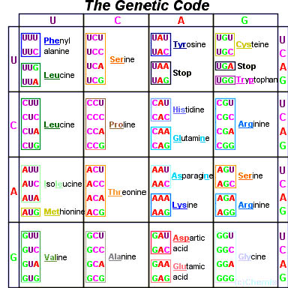
Page 292 Biology Book

Slide 59
Molecular Genetics p. 69 NB
DNA Replication – make more DNA for more cells to replace other cells.
Protein Synthesis – to make proteins
DNA-DNA
A = T
T = A
C = G
G = C
DNA RNA
A = U
T = A
C = G
G = C
Protein Synthesis
DNA: TAC CAC AAC
Transcription (nucleus)
mRNA: AUG GUG UUG
Translation (ribosome)
Protein: Methionine, ________, ________ Amino Acid Sequence

Slide 60
Protein Synthesis
Transcription Practice p. 69NB
Directions: Using the DNA strand as a template, transcribe mRNA. Make sure to use the correct Nitrogen bases.
ATA CCT TAA CGC GTC
TAT TAG GCA AAA TTC
GTG TGA TTA ATA GCC
CTA AAG GAA TAG GAT
GAT GAA TAC CCA CGA
TAA TAT GCA CAT TAC
GAA CCT TAC GGG GTG
TAT AAC CAG GAG TTT
ATC CGT AGT GTA AAT
GGA TTA CCC TTA CCA

Slide 61
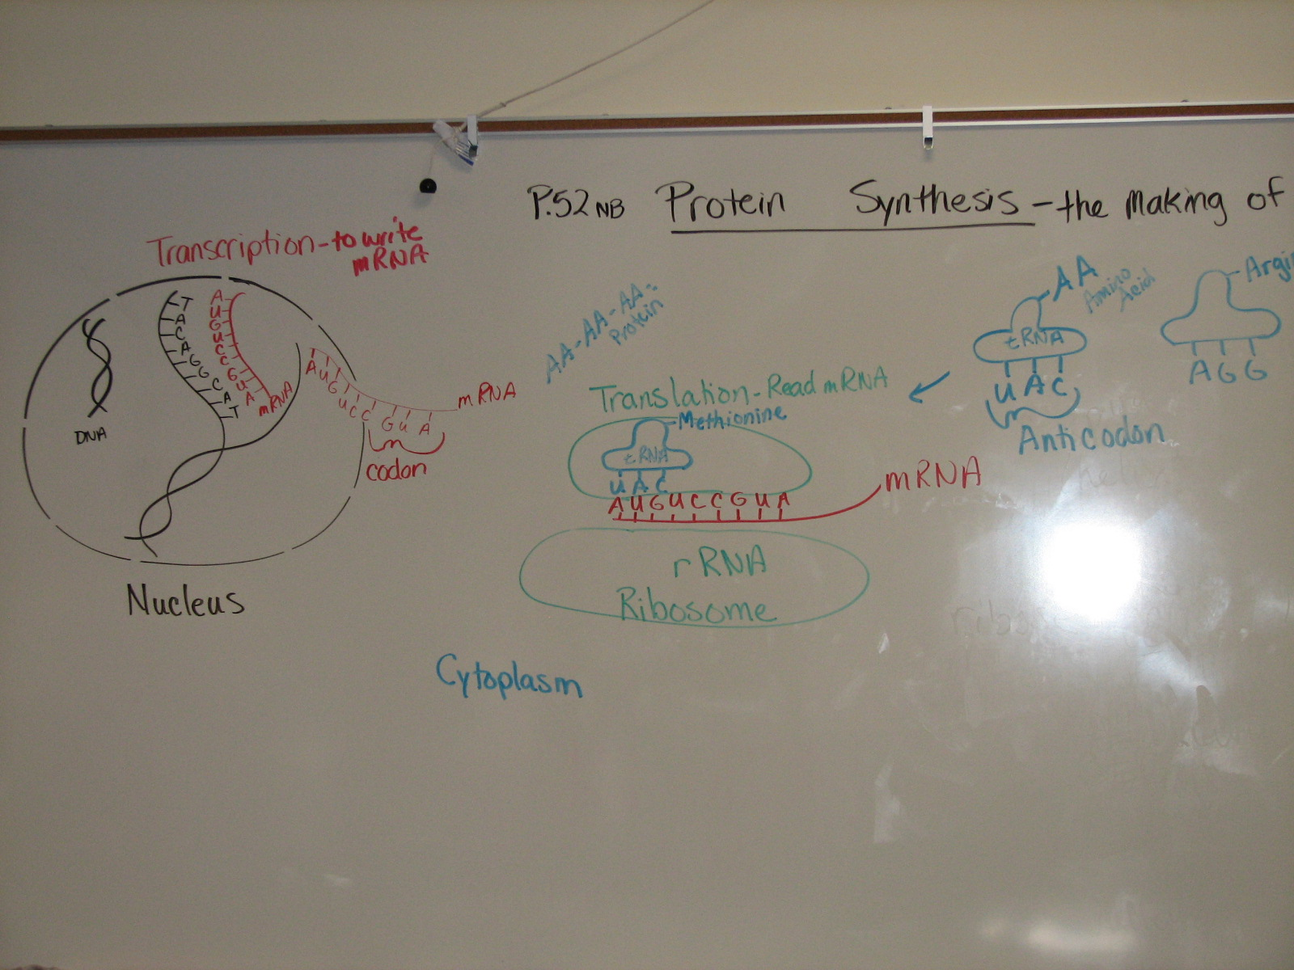

Slide 62
Protein Synthesis – Gene Expression
1. DNA: ATA CCT TAA CGC GTC
2. DNA: TAT TAG GCA AAA TTC

Slide 63
AXES Paragraph P. 71 NB
Write a paragraph after building your DNA molecule that include the vocabulary words: Double helix, Nitrogen bases, Hydrogen bond, Nucleotide, Backbone, Deoxyribose, Phosphate, Adenine, Thymine, Cytosine, Guanine.

Slide 64



Collect 3 sheets of paper and layer them about 1.5 cm apart vertically. Keep the edges level.
P. 53 NB
To return to the chapter summary click escape or close this document.

Slide 65


Fold up the bottom edges of the paper to form 6 equal tabs.
P. 53NB
To return to the chapter summary click escape or close this document.

Slide 66

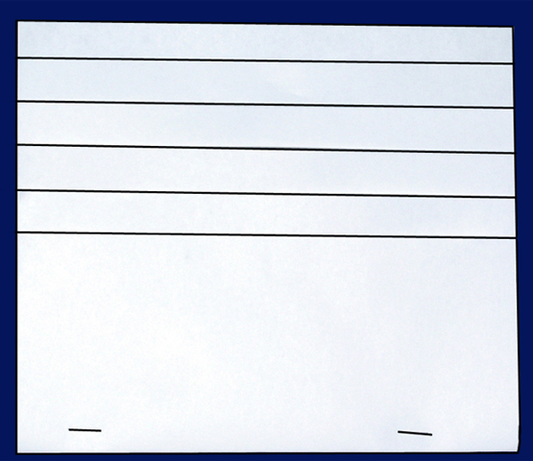
Fold the papers and crease well to hold the tabs in place. Staple along the fold. Label each tab.
P. 53NB
RNA – draw & label 3 differences from DNA p. 289
TRANSCRIPTION: from DNA to RNA P. 290
RNA Processing (Introns & Exons) P.291
The Genetic Code p. 291 - 292
TRANSLATION: from mRNA to PROTEIN p. 294 11.9A
PROTEIN SYNTHESIS
DNA->transcription->RNA ->translation->Protein
To return to the chapter summary click escape or close this document.

