Slide 1
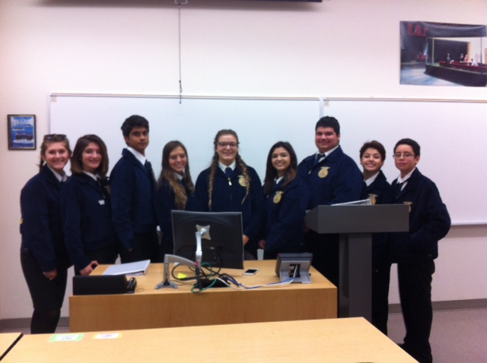
West Sacramento FFA Chapter
2016 – 2017 Officer Team

Slide 2
That’s Right! West Sacramento Baby!

Slide 3
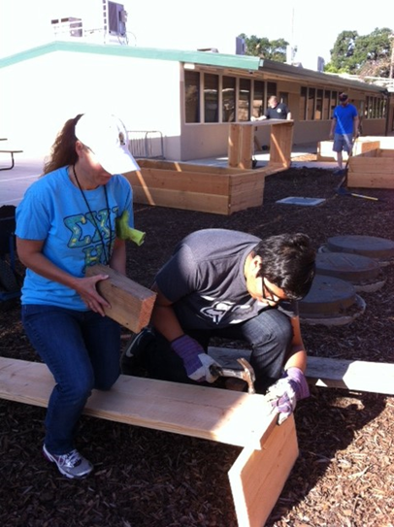
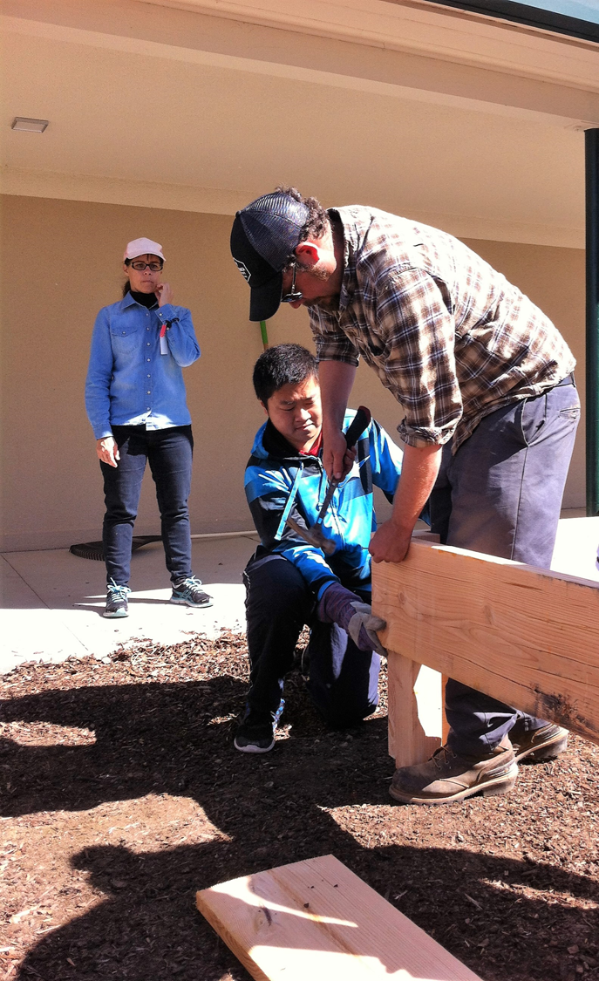
Building our Garden Beds & filling them with soil Everyone helps – even the puppy dog. May 15th, 2016

Slide 4
McAllister gets to play in the soil!!! ☺ Silly Goose…

Slide 5
Thank you West Sacramento Rotary Centennial for helping us build our Garden beds!

Slide 6
Mr. Mojsich, our RCHS Principal, helps out building garden beds.

Slide 7
Broderick/ Bryte is a community and it cares, Thank You for your help.

Slide 8
Planning where the Garden Beds go at Bryte.

Slide 9
Thank You Moses!

Slide 10
Dinner at the Barn Event September 11th, 2016

Slide 11
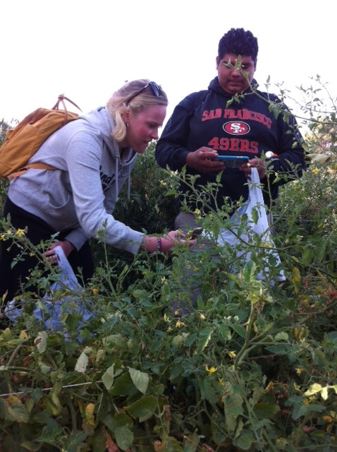
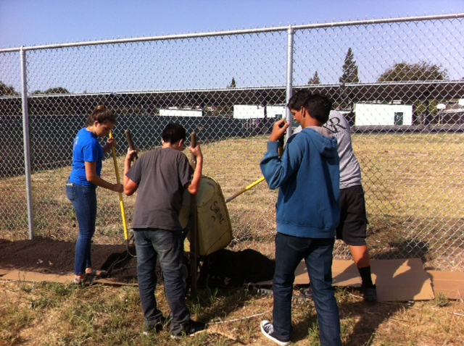
Fiery Ginger Urban Farm Fieldtrip September 13th, 2016

Slide 12
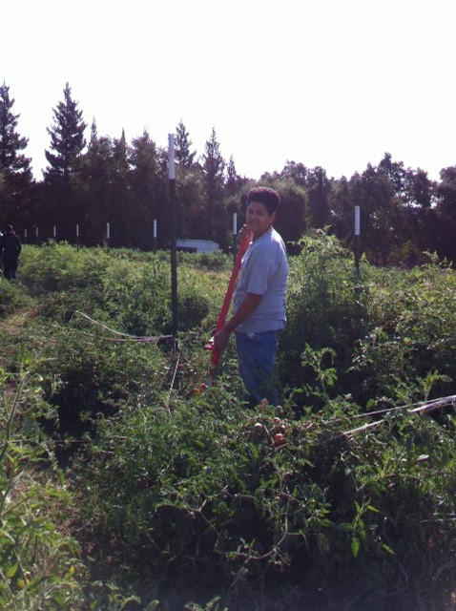
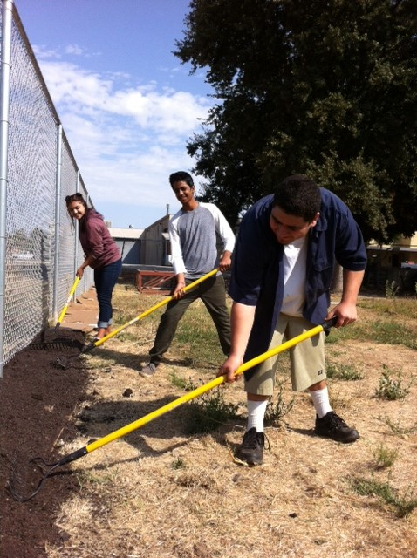
Thank you Shayne and Hope! We love Fiery Ginger Farms!

Slide 13
Jacob’s baby chicks

Slide 14
Thank you Mrs. Sutton!

Slide 15
Farm Tank Sept. 22nd 2016 Quincy Gonzalez FFA President & Nicole Rodgers Farm to Fork Festival Organizer

Slide 16
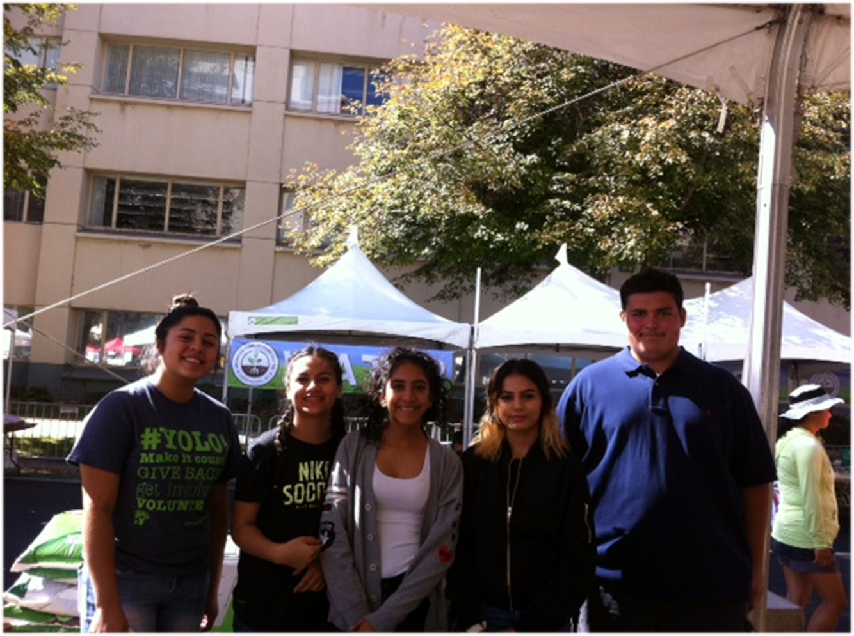
Farm to Fork Festival September 24th, 2016

Slide 17
Making New Friends at the Farm to Fork Festival September 24, 2016

Slide 18
Working at the Plant a Seed Table (F2F Festival)

Slide 19
Public Speaking Go Emiliano!

Slide 20
Learning to plant a seed…

Slide 21
Farm to Fork Festival Dinner on the Tower Bridge Sept.25th, 2016

Slide 22
Kevin Johnson at the Tower Bridge Dinner with Farm to Fork Event Crew Staff & Emiliano – Of course.

Slide 23
Thank you Mrs. Collins

Slide 24
Former RCHS student Chris Starr visits Sept. 26th, 2016

Slide 25
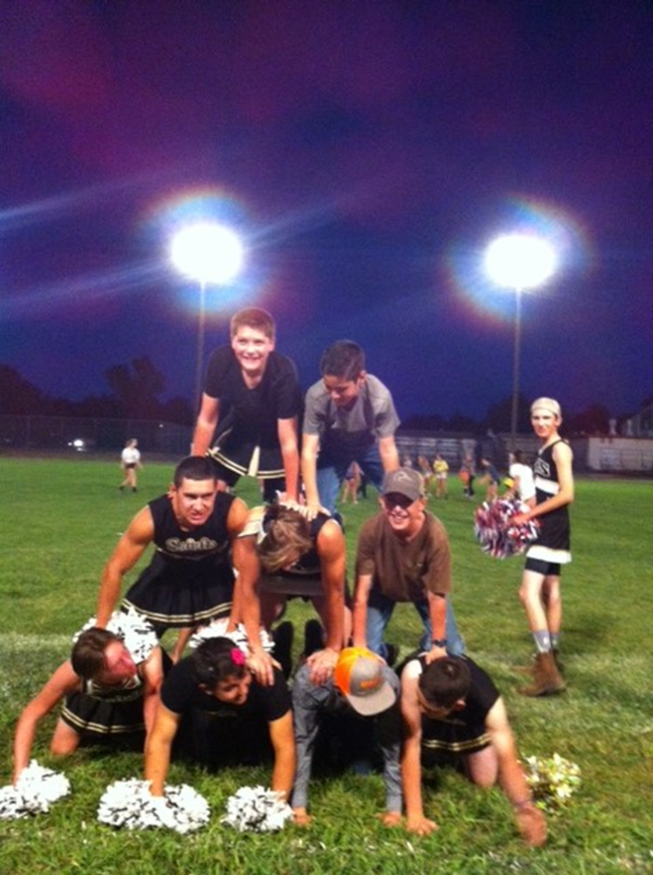
Delta FFA Powderpuff Football Event

Slide 26
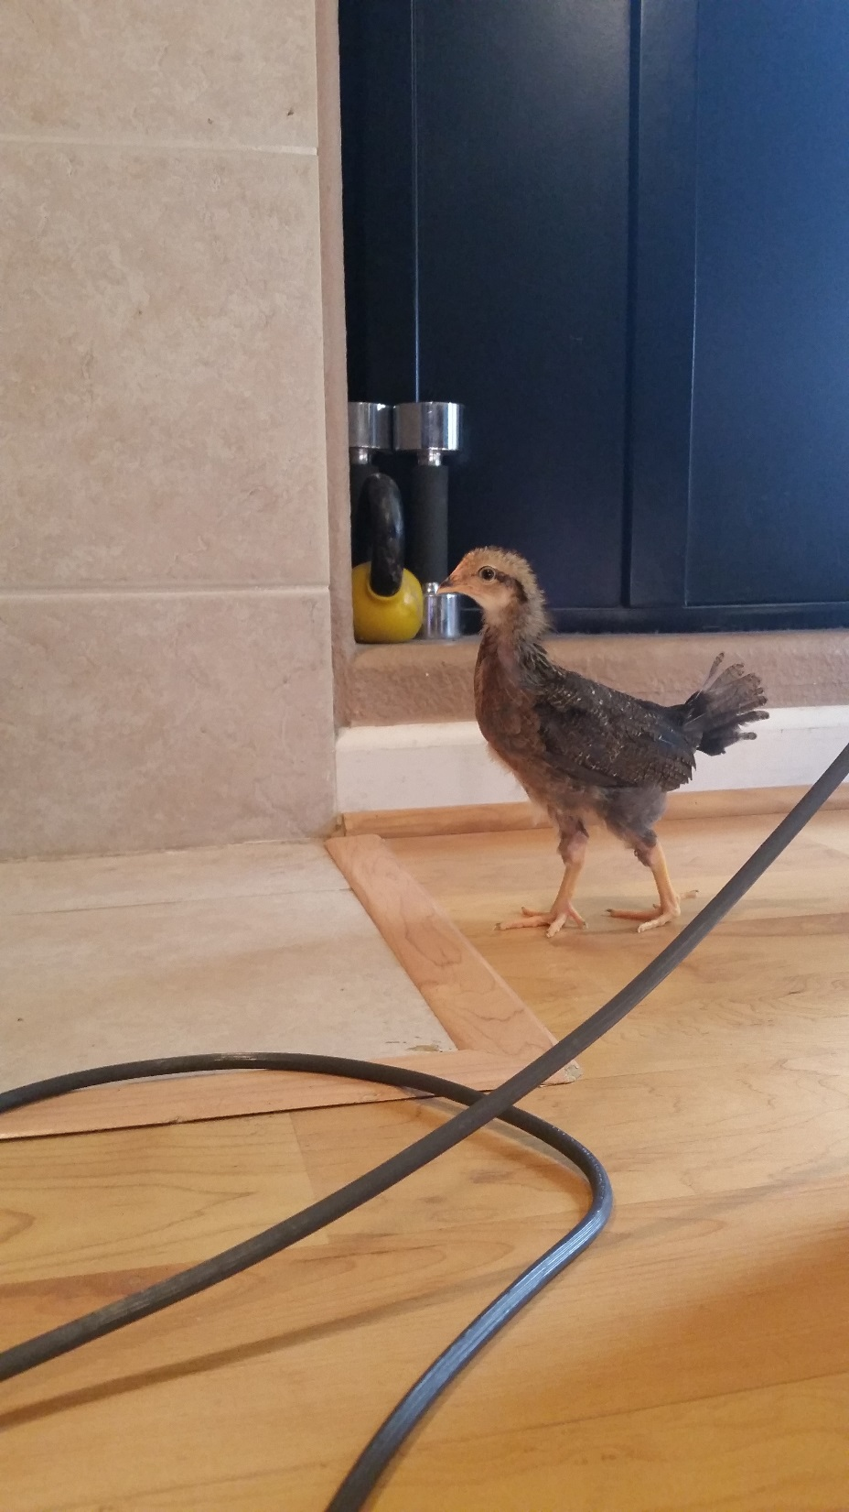
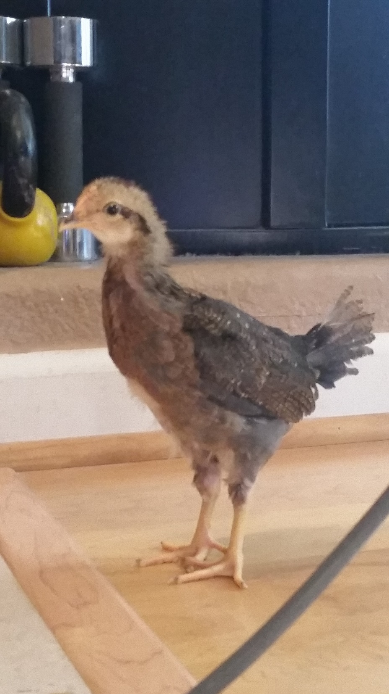
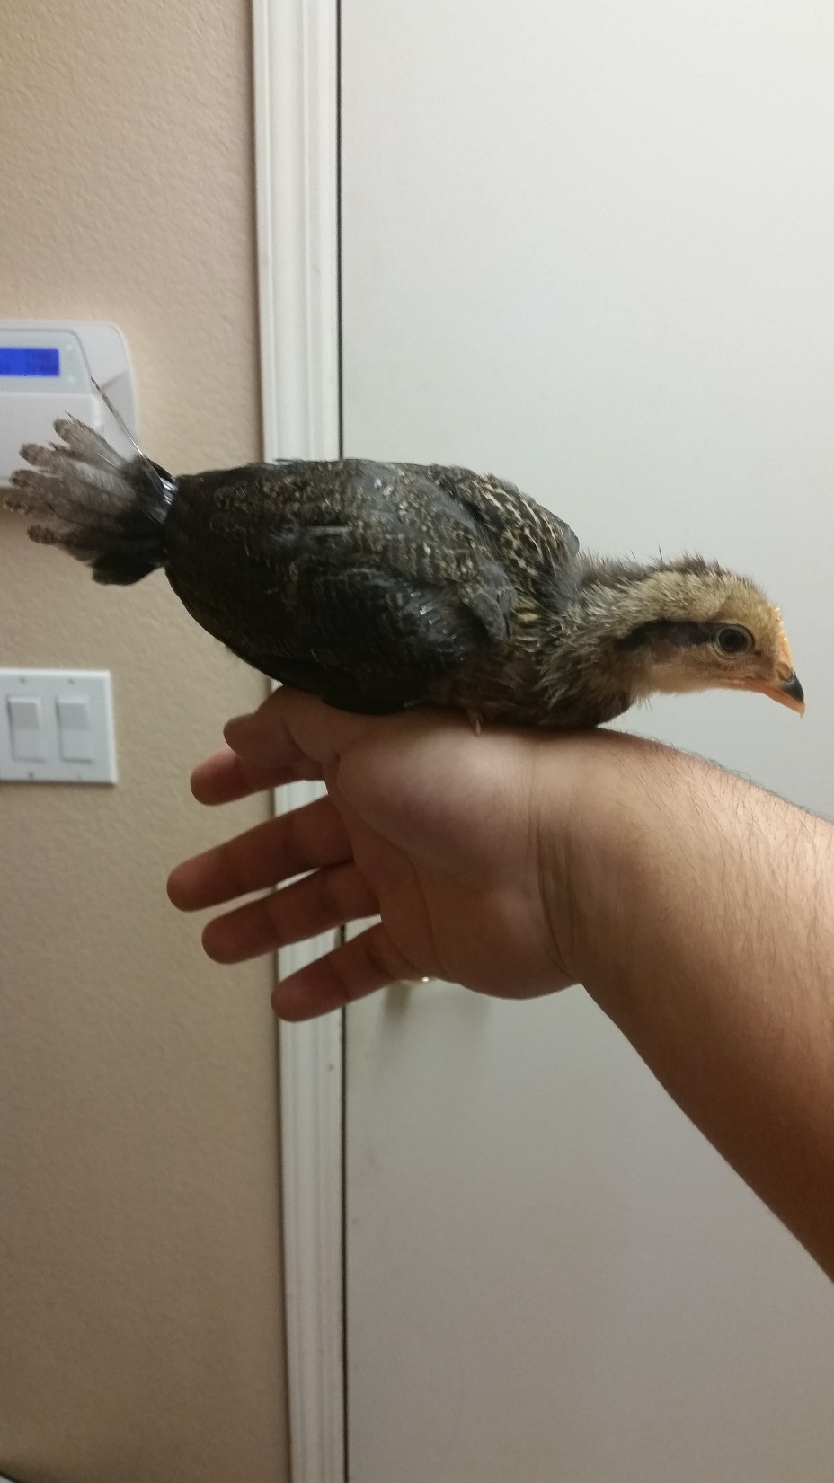
Jacob’s Hens are Growing

Slide 27
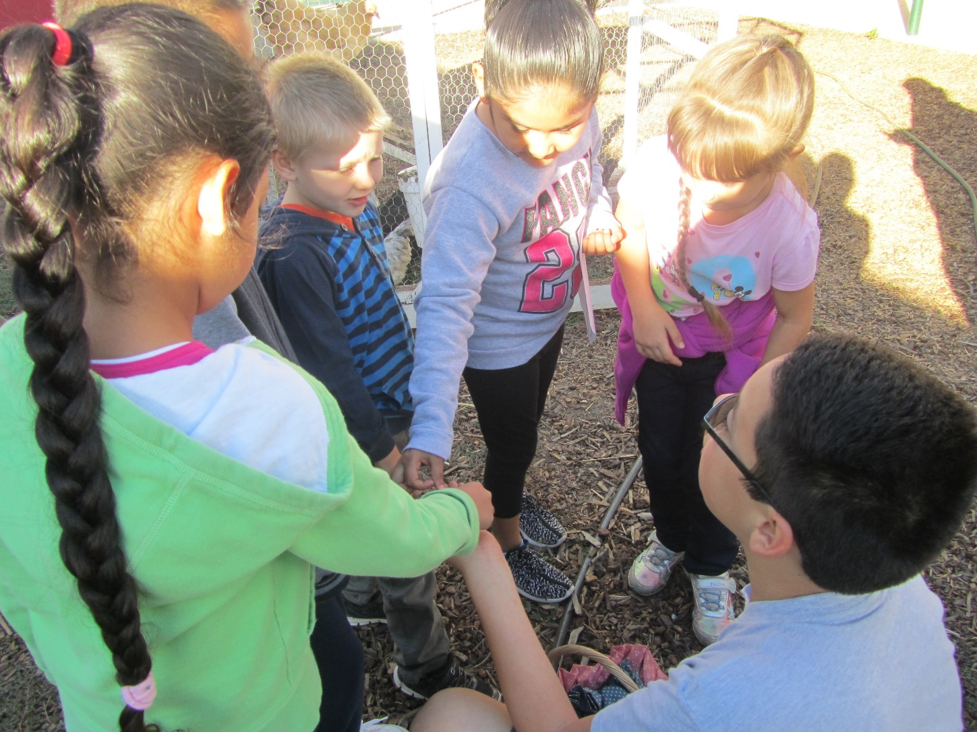
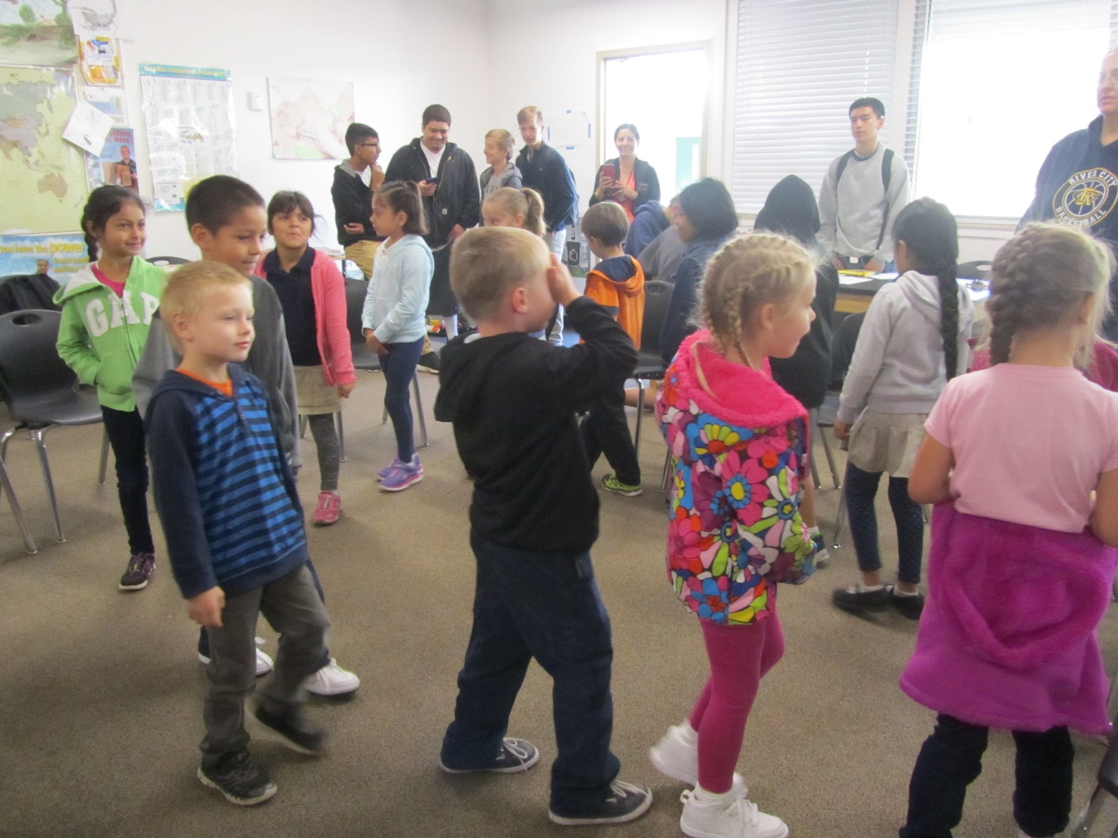
1st Graders visit from Riverbank October 7th, 2016

Slide 28
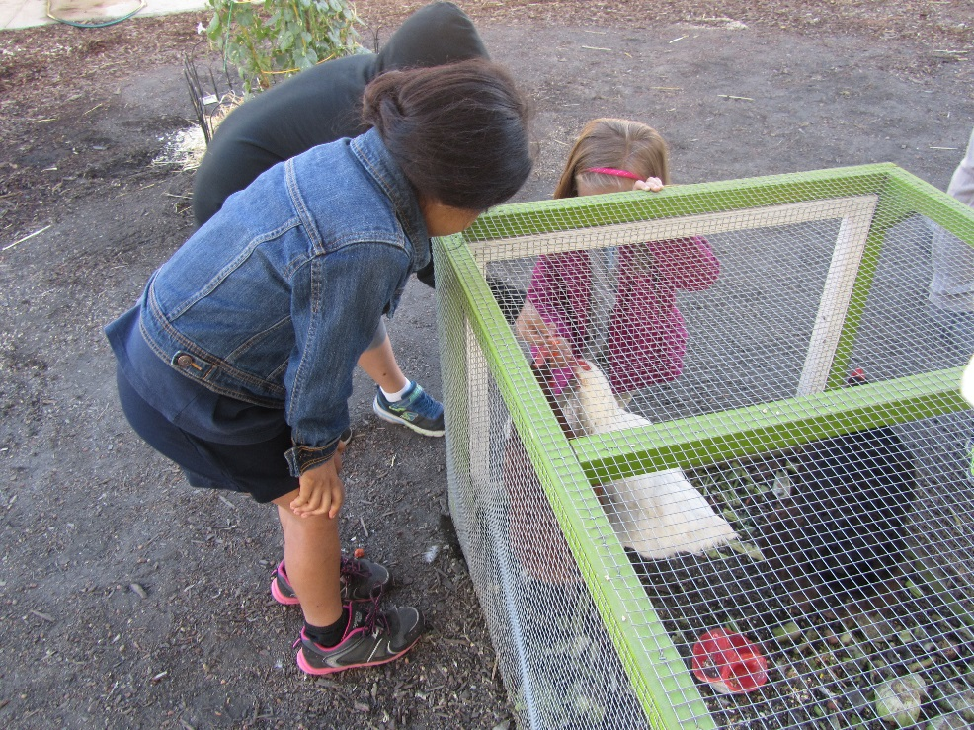
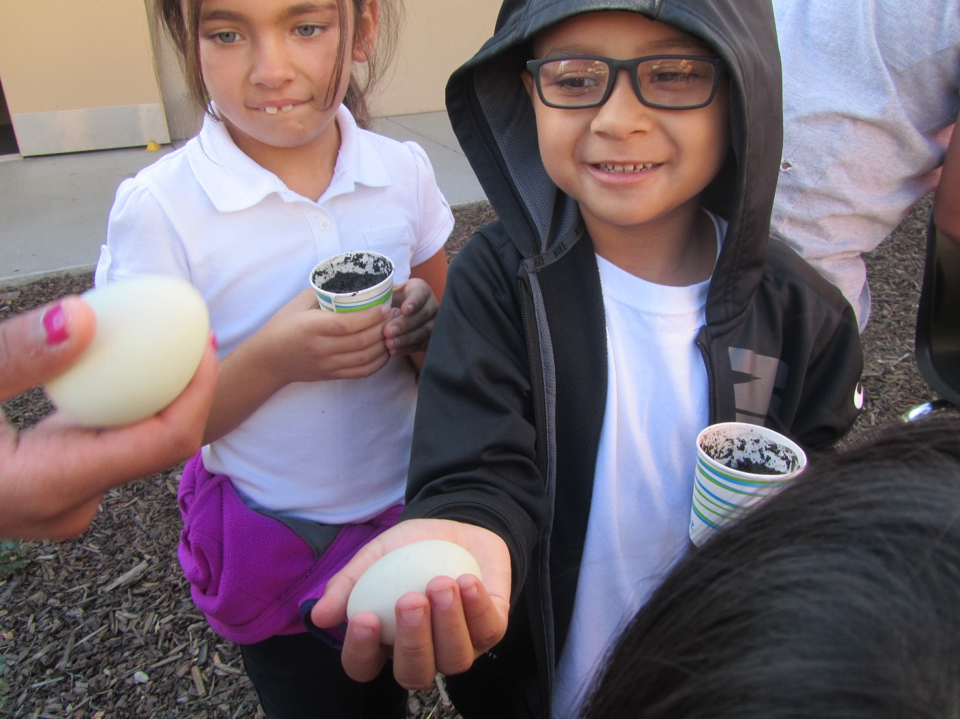
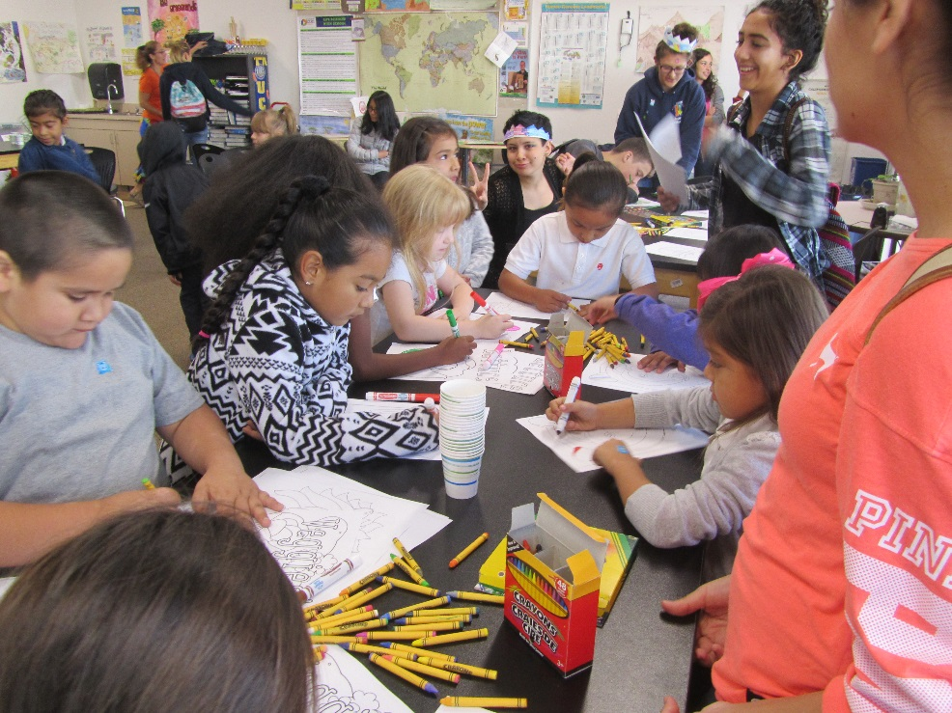

Slide 29
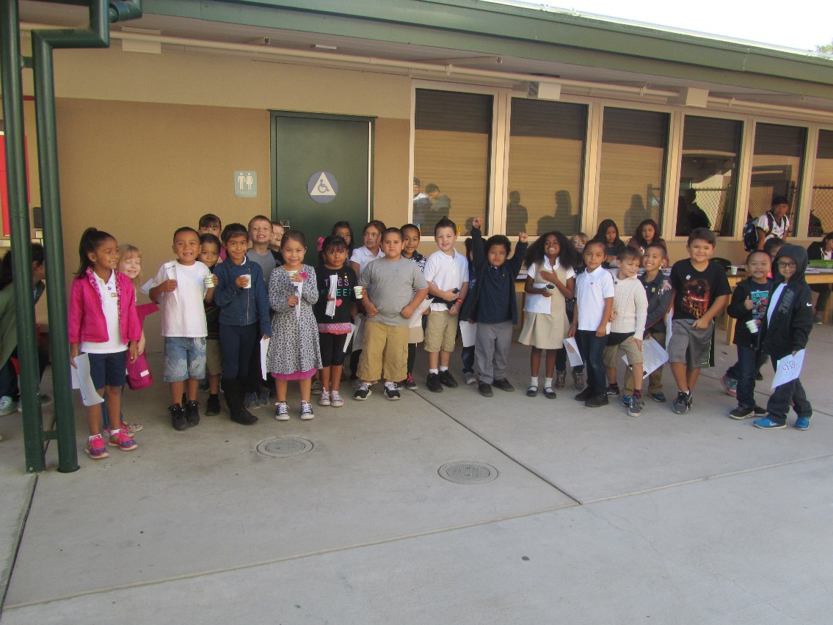
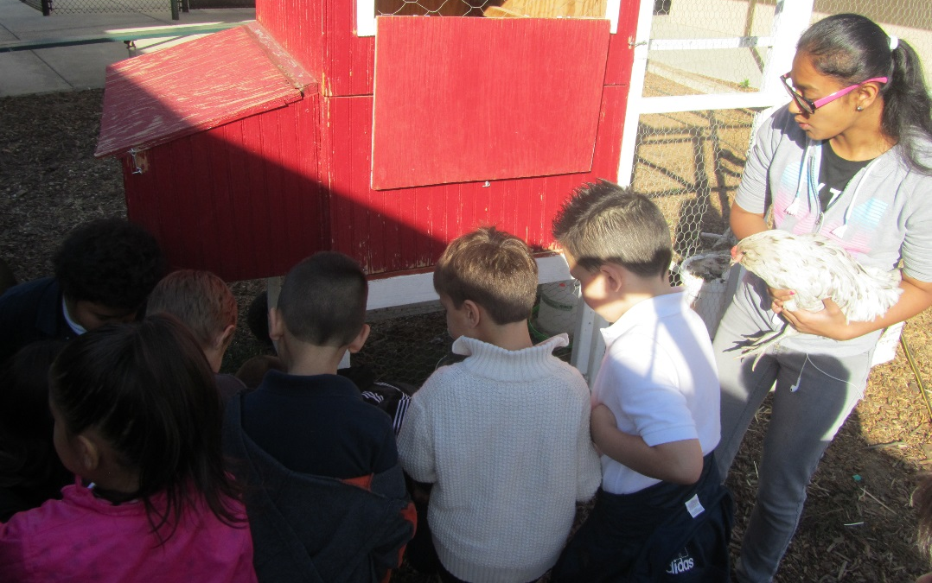
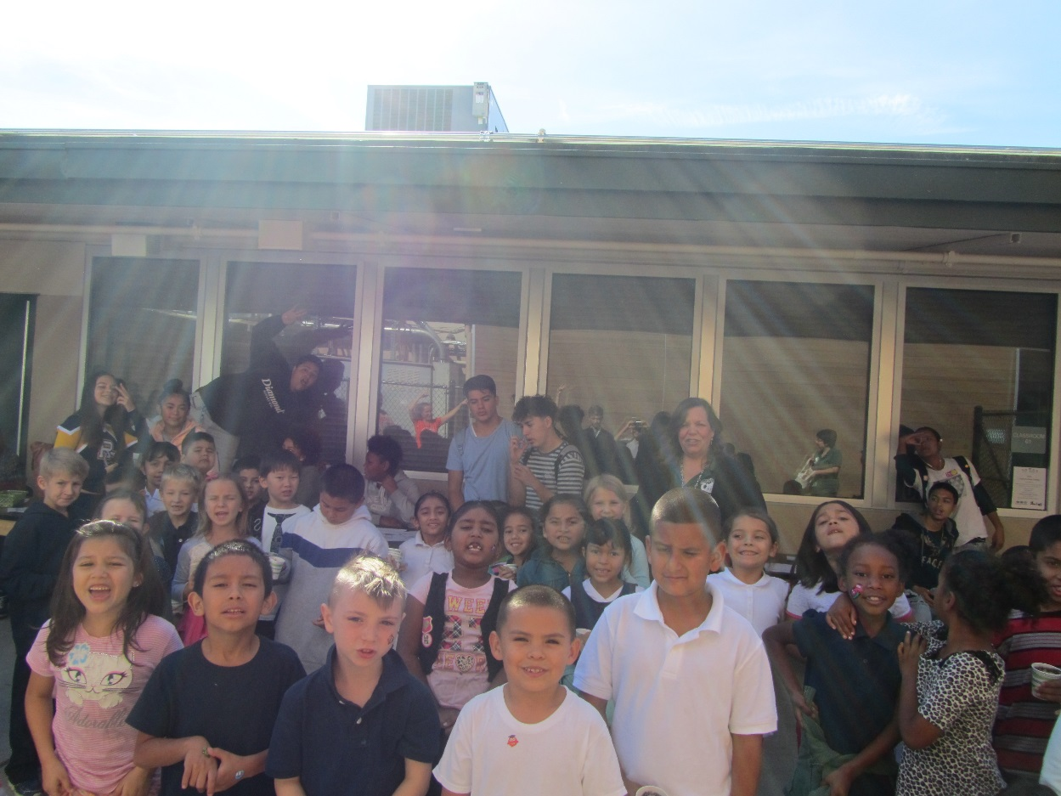

Slide 30
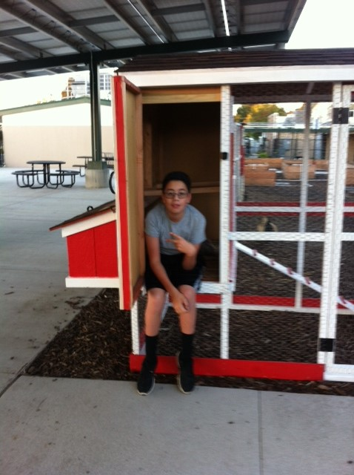
Chicken Tractor Finished Oct. 19th, 2016 RCHS Construction students & Mr. Billington. Thank you Mr. Billington for supporting our FFA.

Slide 31
Thank you Ms. Koerowitz

Slide 32
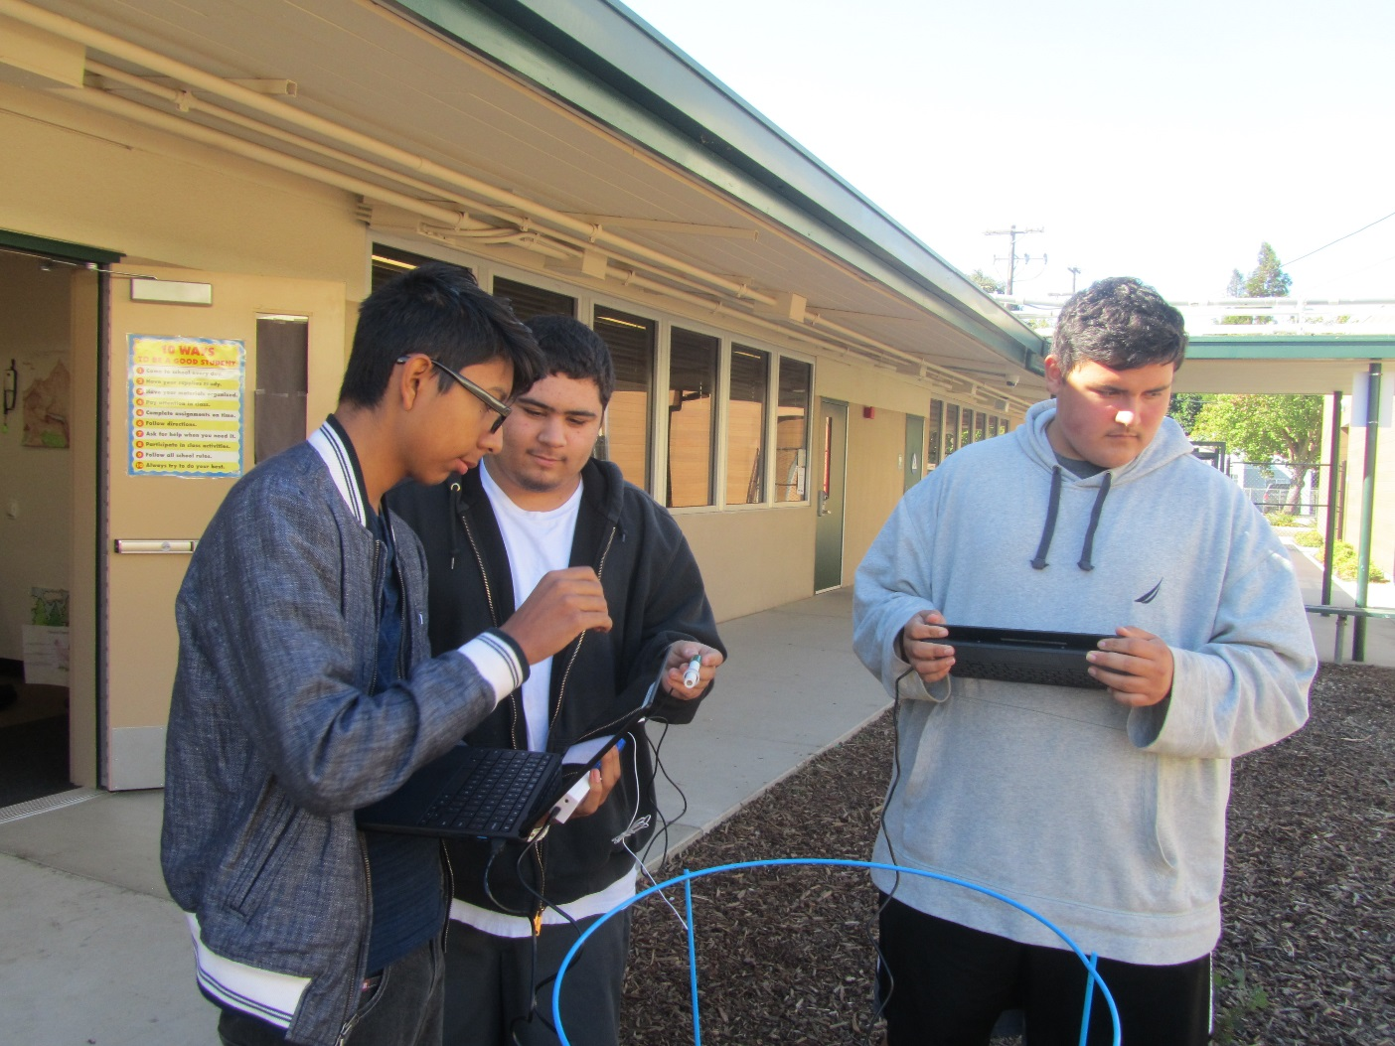
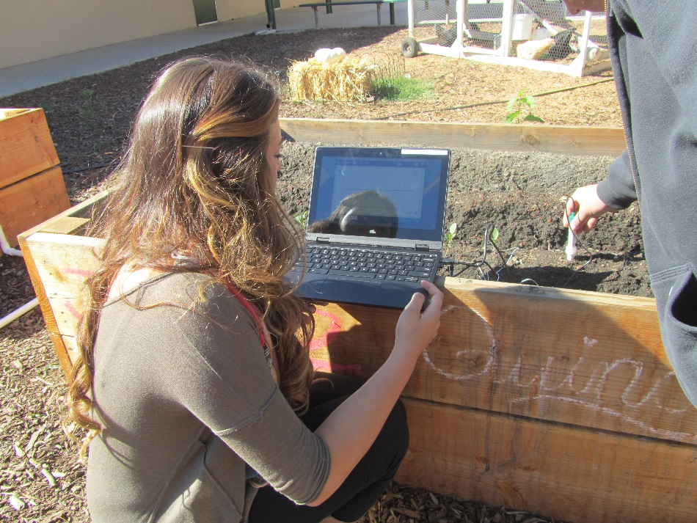
Gathering Electronic Data of the Soil – pH, Temperature, Nitrate, Phosphate and Water Content

Slide 33
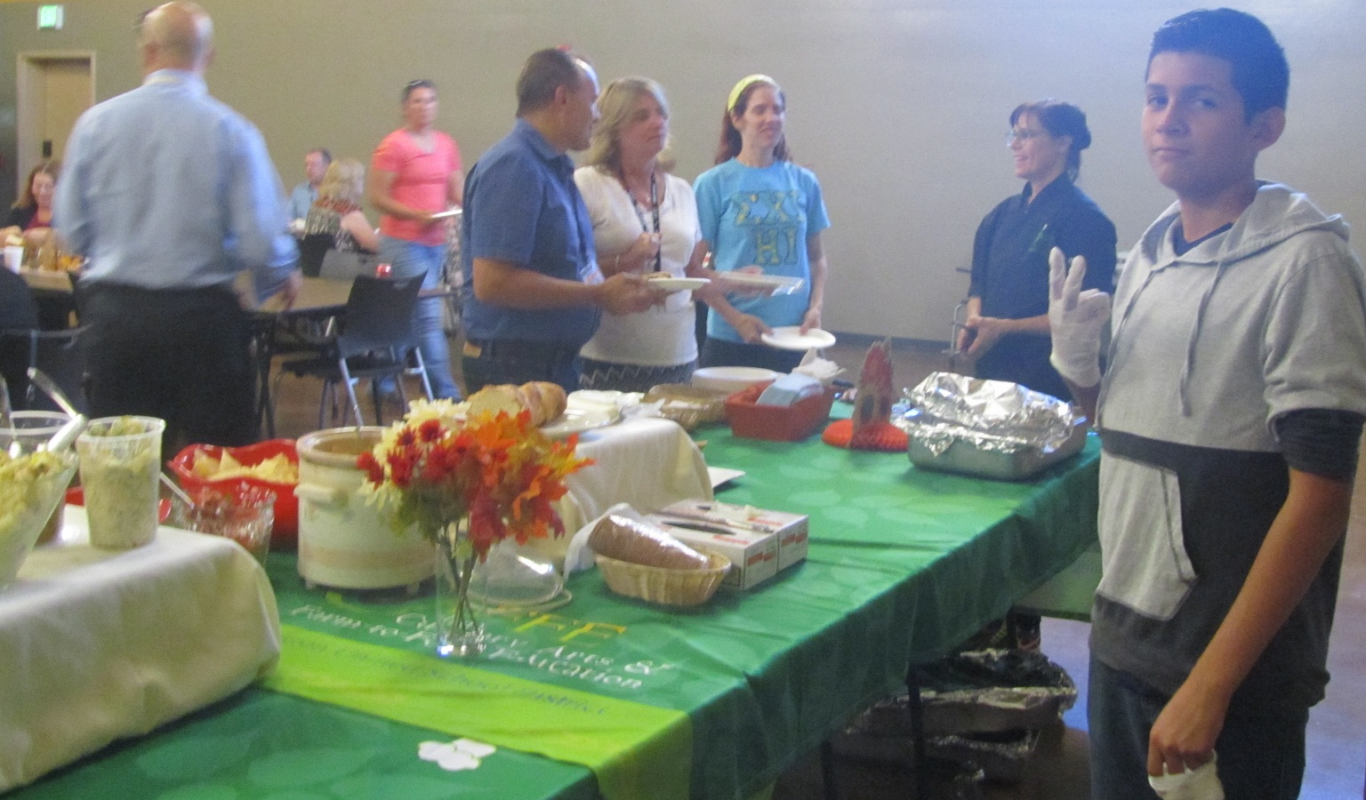
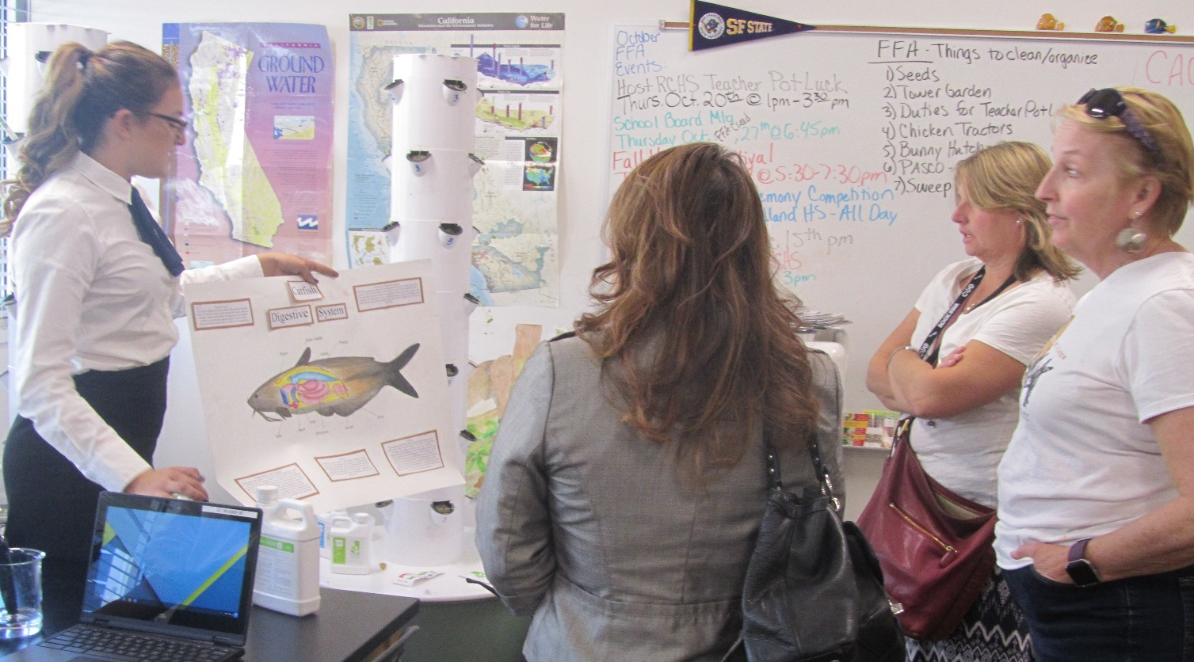
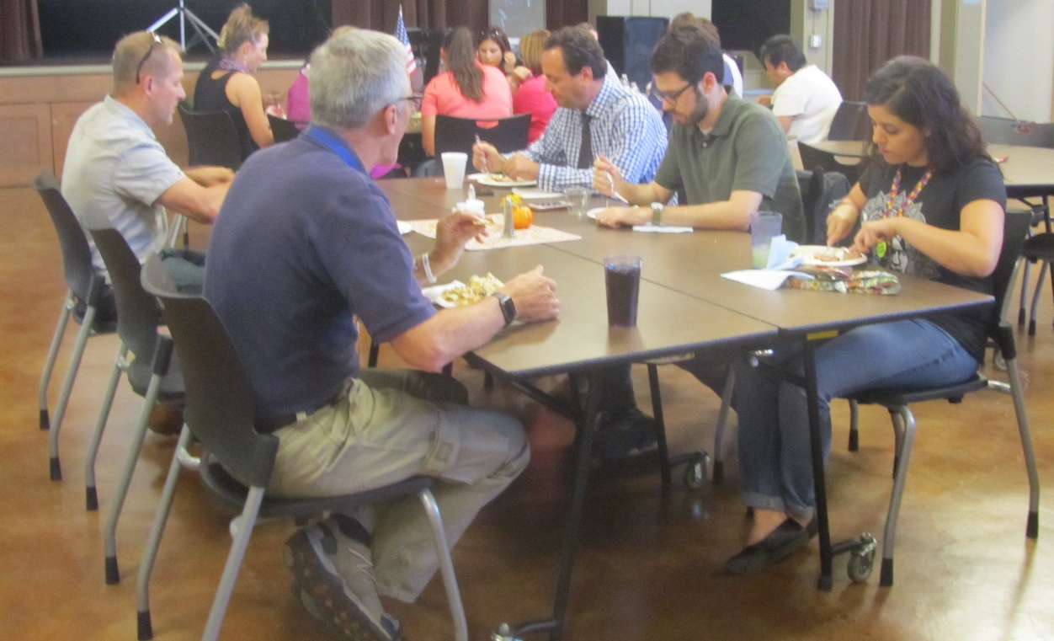
RCHS Teacher Potluck October 20th, 2016

Slide 34
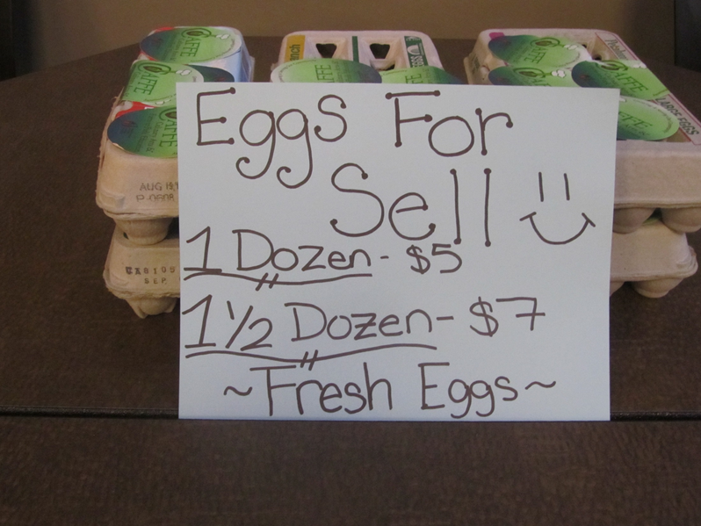

Slide 35
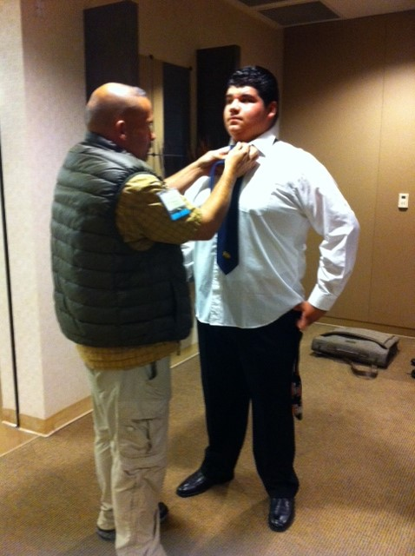
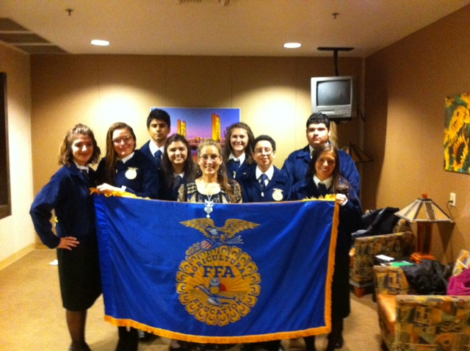
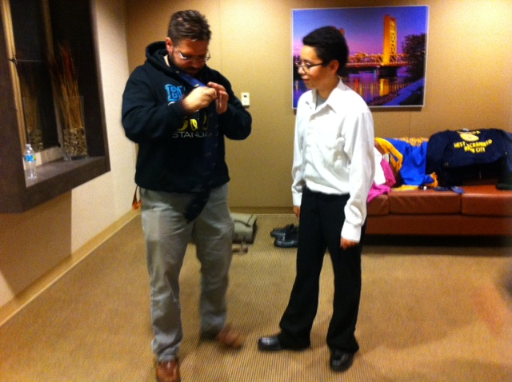
West Sacramento FFA Presents the FFA Creed at the School Board Meeting October 27th, 2016 Thank you Mr. Mojsich, Mr. Malec!

Slide 36
Fall Harvest Festival November 3rd, 2016

Slide 37
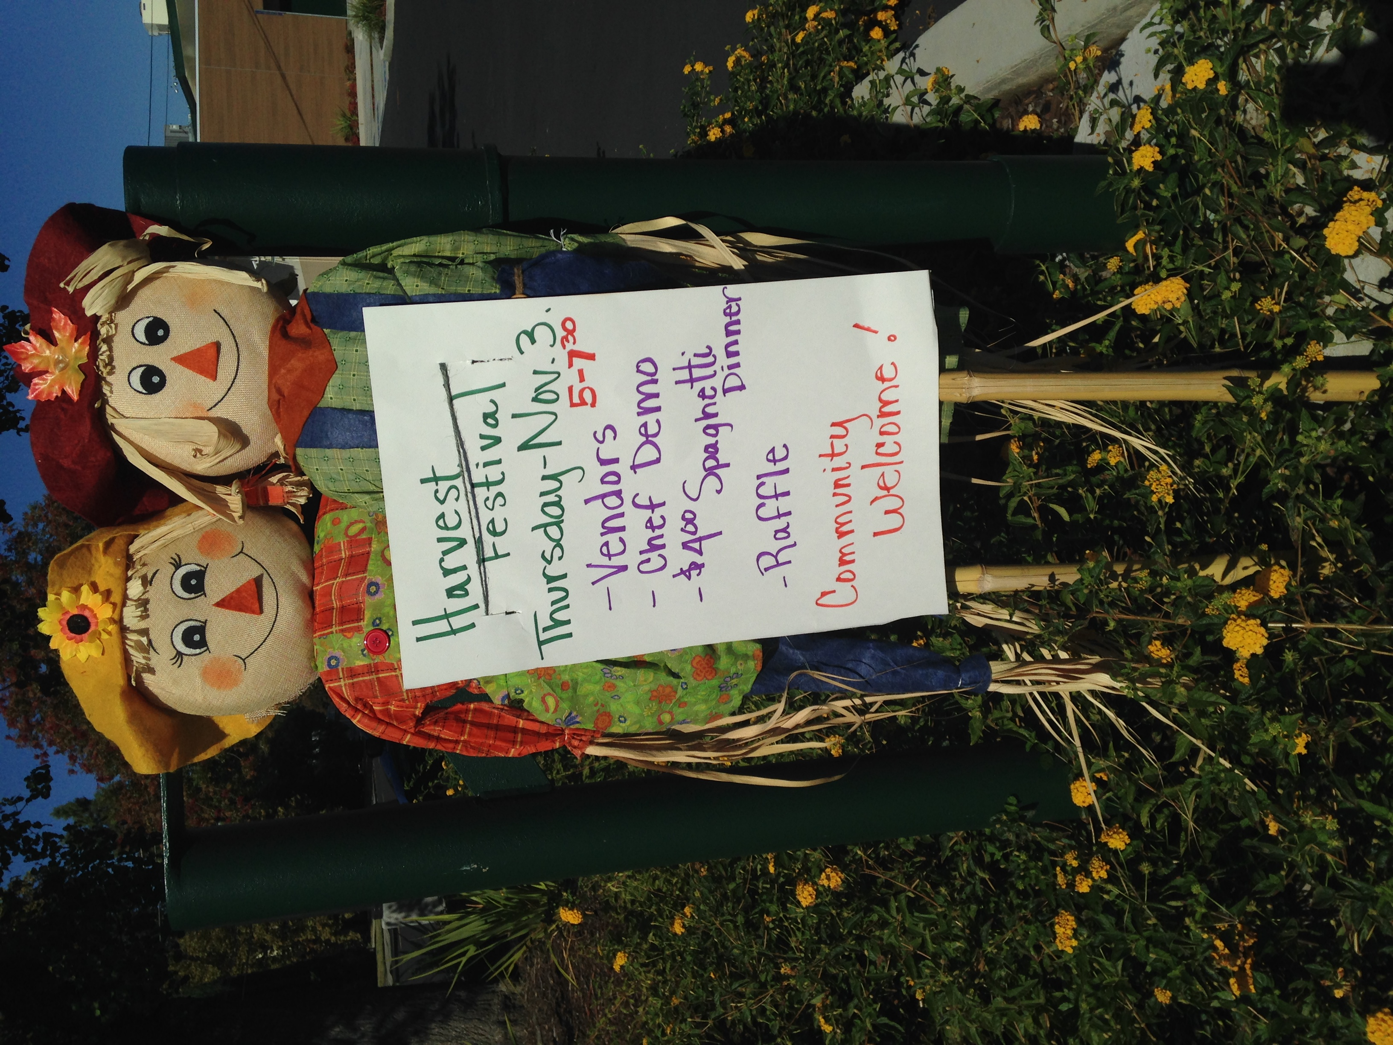

Slide 39
Preparing for the Fall Harvest Festival

Slide 40
FFA Opening/Closing Ceremony Competition & Best Informed Greenhand Test @ Woodland Community College November 4th, 2016

Slide 41
Thank you Mrs. Mejia

Slide 42
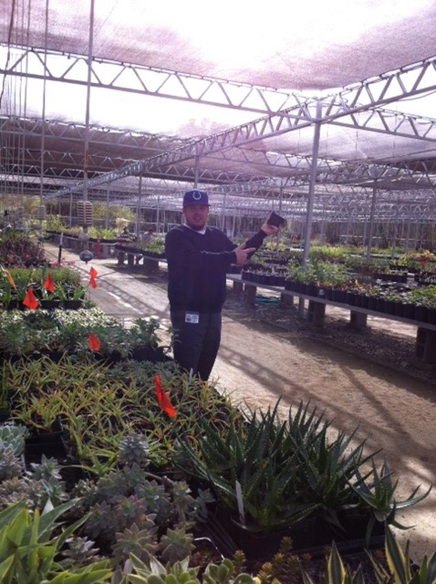
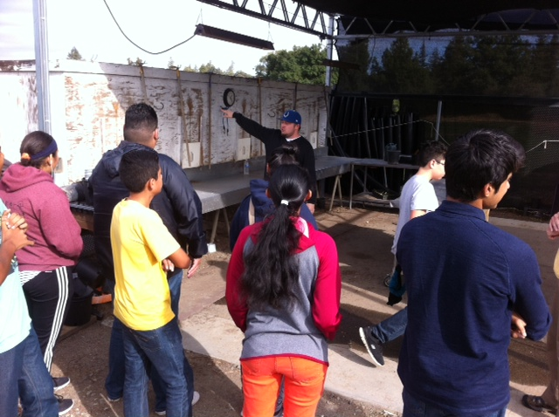
Agricultural Sustainability Fieldtrip November 15th, 2016 Thank you Andrew Codd!

Slide 43
Thank you Marissa Juhler for giving us a tour of the Yolo County Landfill. West Sacramento will do a better job of recycling and disposing of toxic waste!

Slide 44
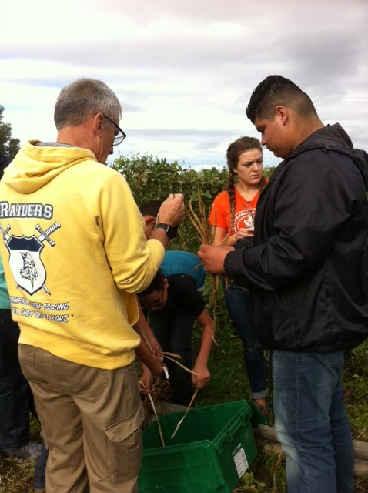
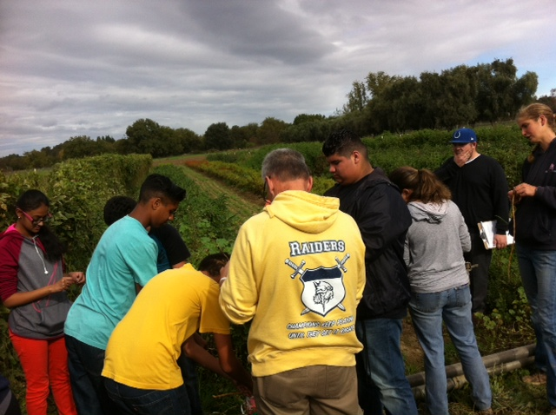
Thank you Mr. Stauffer for being our Chaperone!

Slide 45
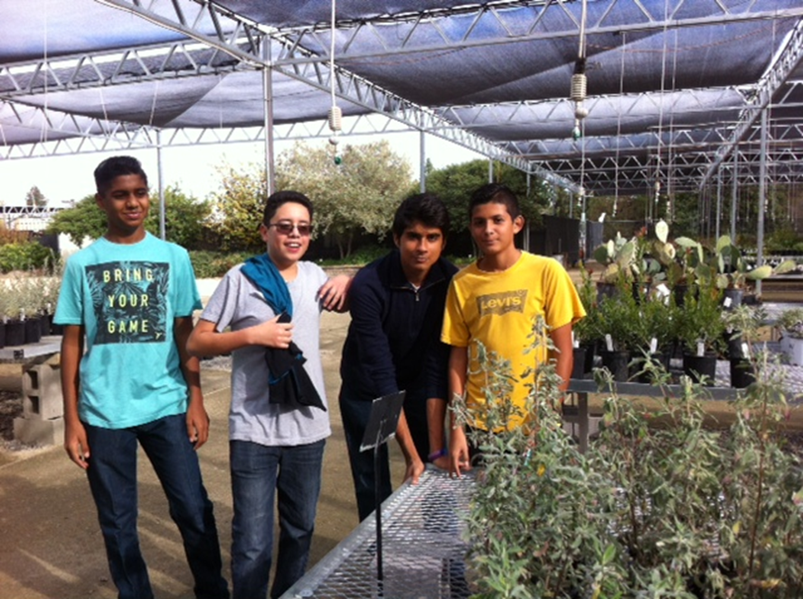
More Fieldtrip Pictures

Slide 46
Assemblyman McCarty visits Bryte CAFFE and meets “Roxie”.

Slide 47
Mrs. McAllister’s Partner in Crime☺ Thank you Mrs. Sutton for all you do!

Slide 48
Farm to Fork Working in the Garden

Slide 49
Cristal finds George!

Slide 50
The Henhouses

Slide 51
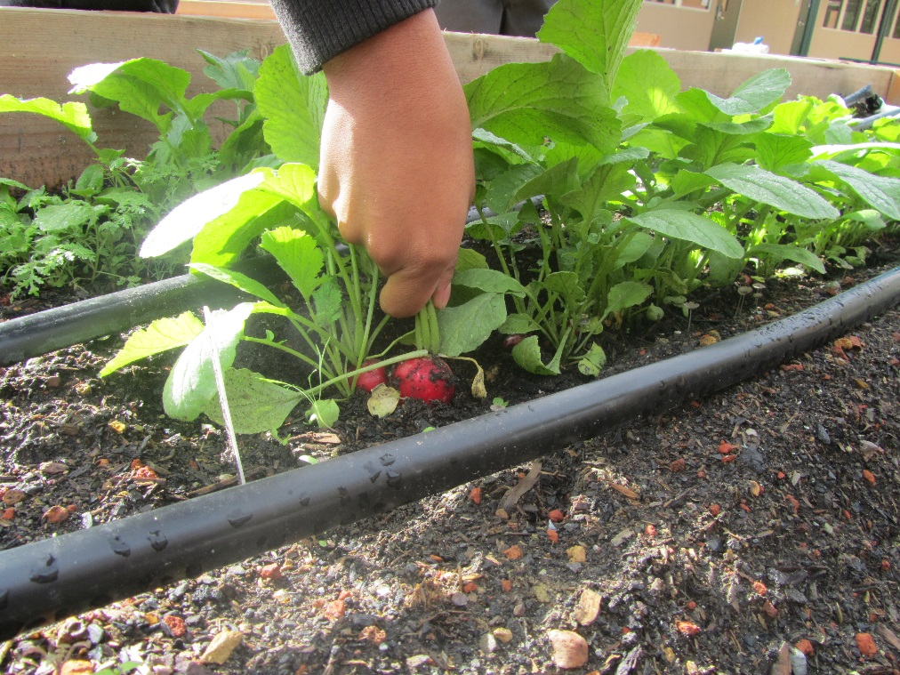
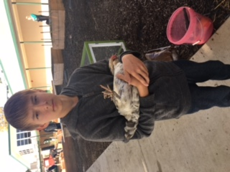
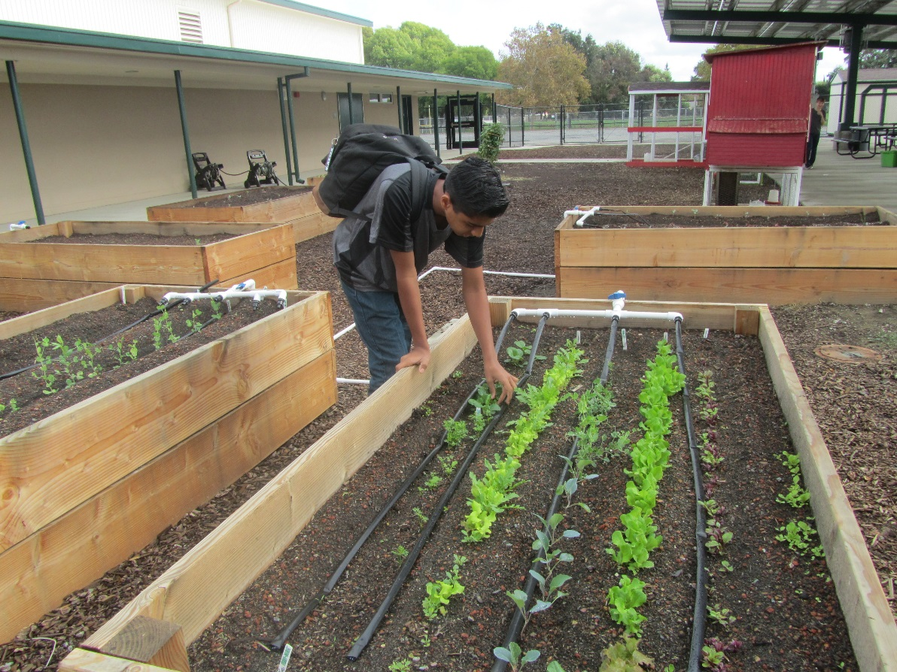
Working in the garden

Slide 52
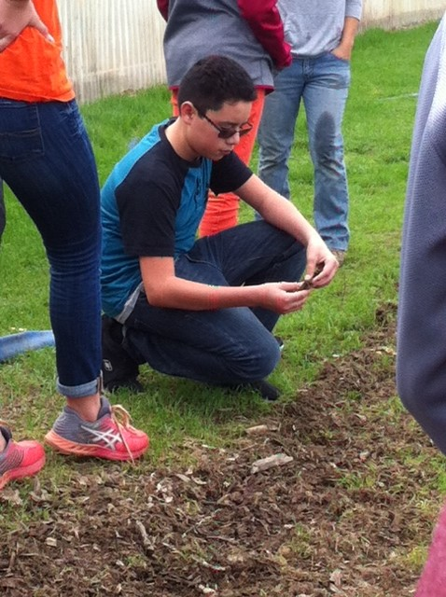
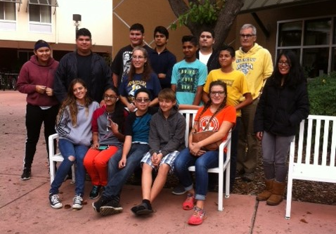
Sustainability FT November 15th, 2016

Slide 53
FFA students advertise the Ag Program at Westmore Oaks December 1st, 2016

Slide 54
Jacob’s Hens & 1 Rooster Dec., 1st,

Slide 55
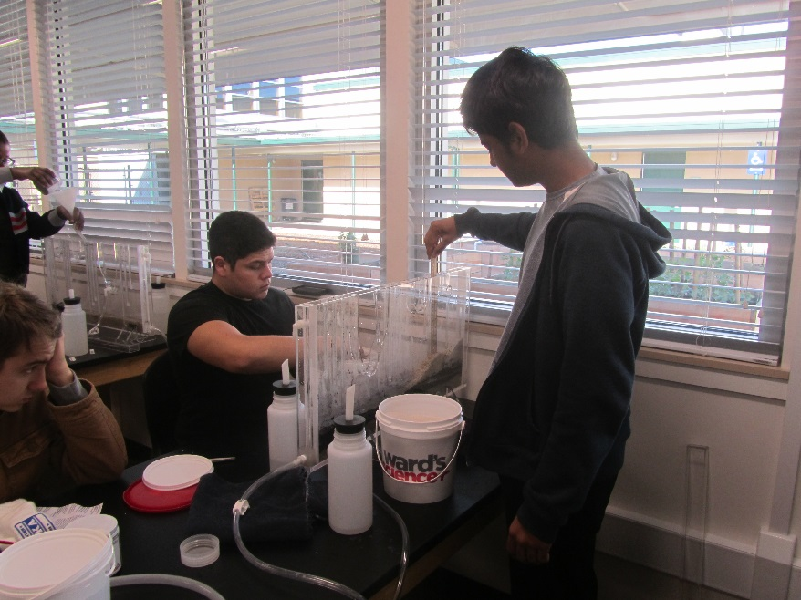
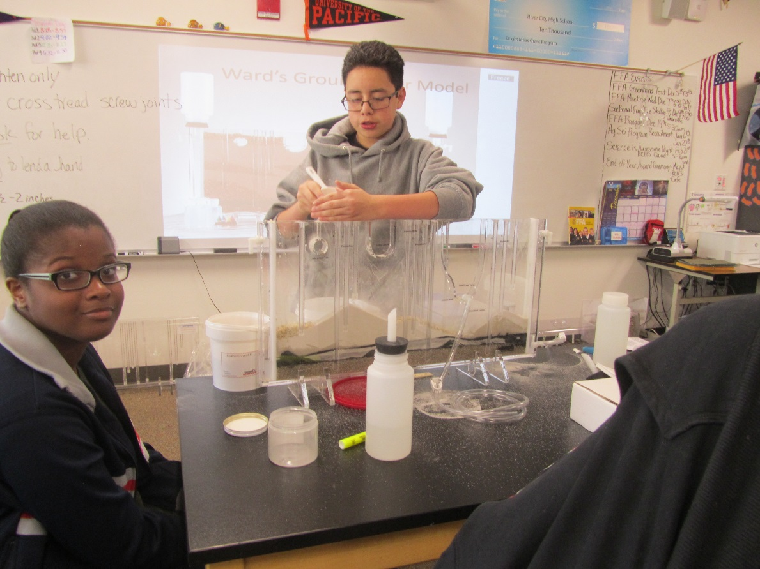
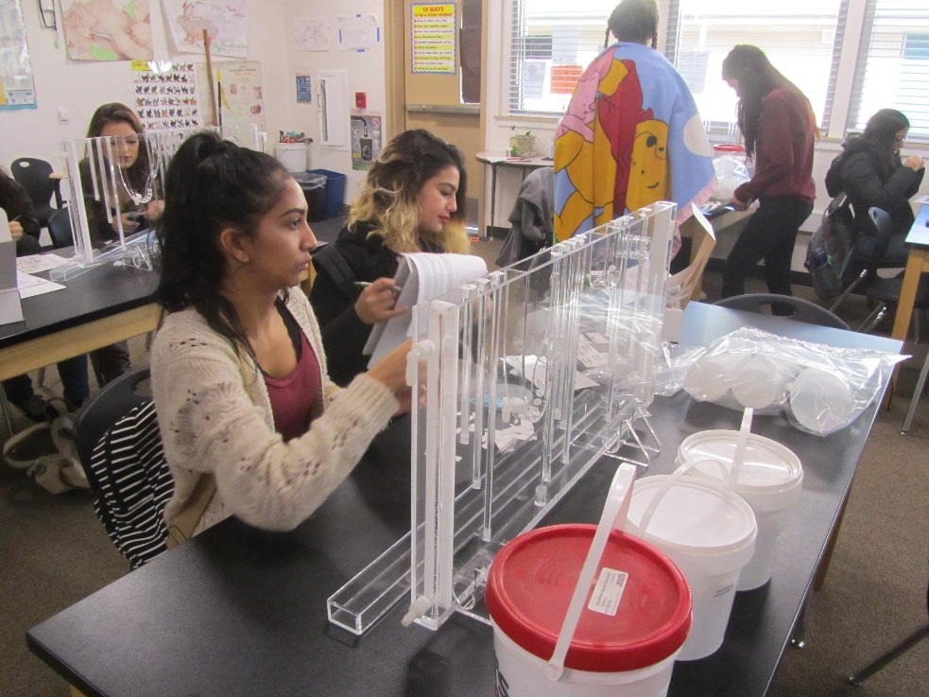
Ground Water Model Assembly December 7th, 2016

Slide 56
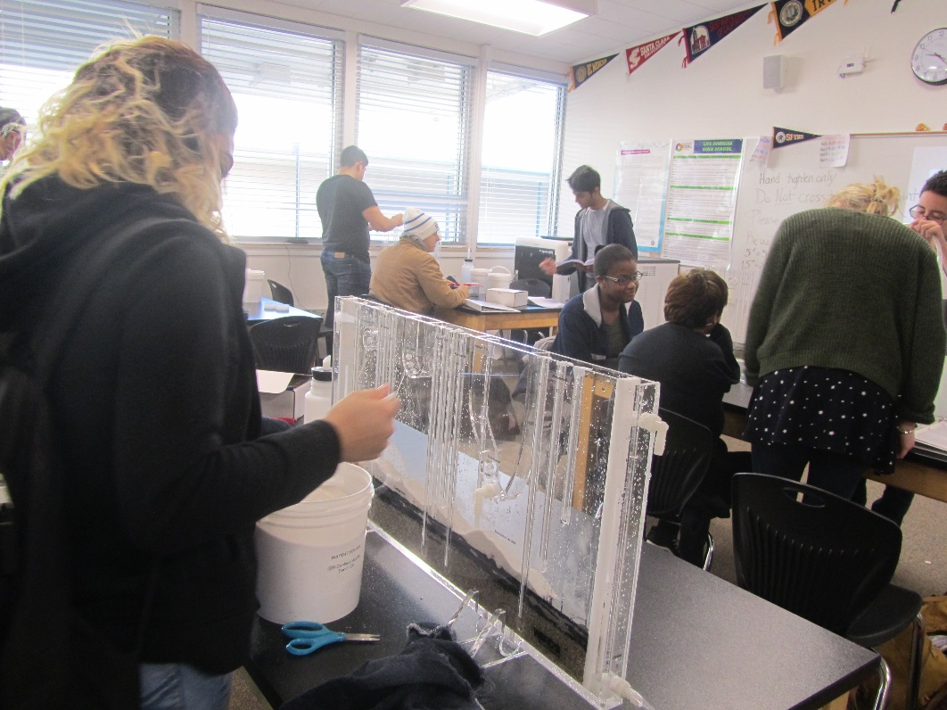
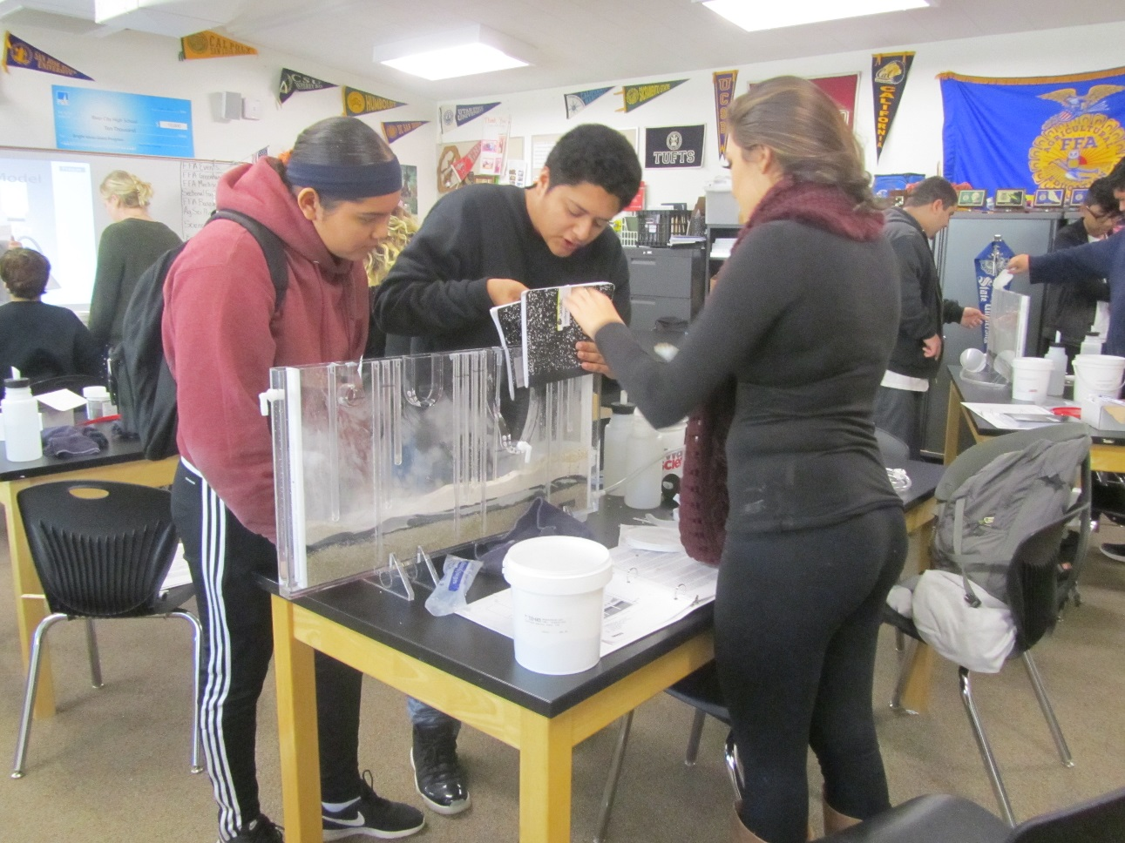
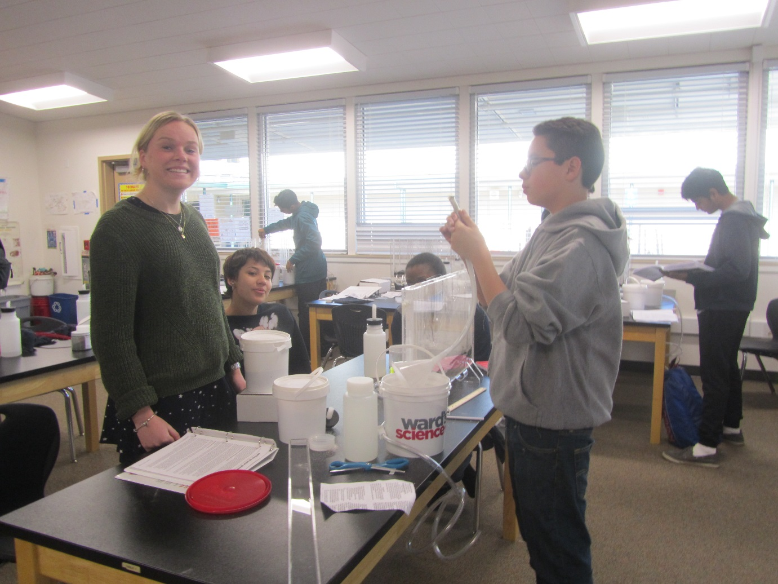
Ground Water Model Assembly

Slide 57
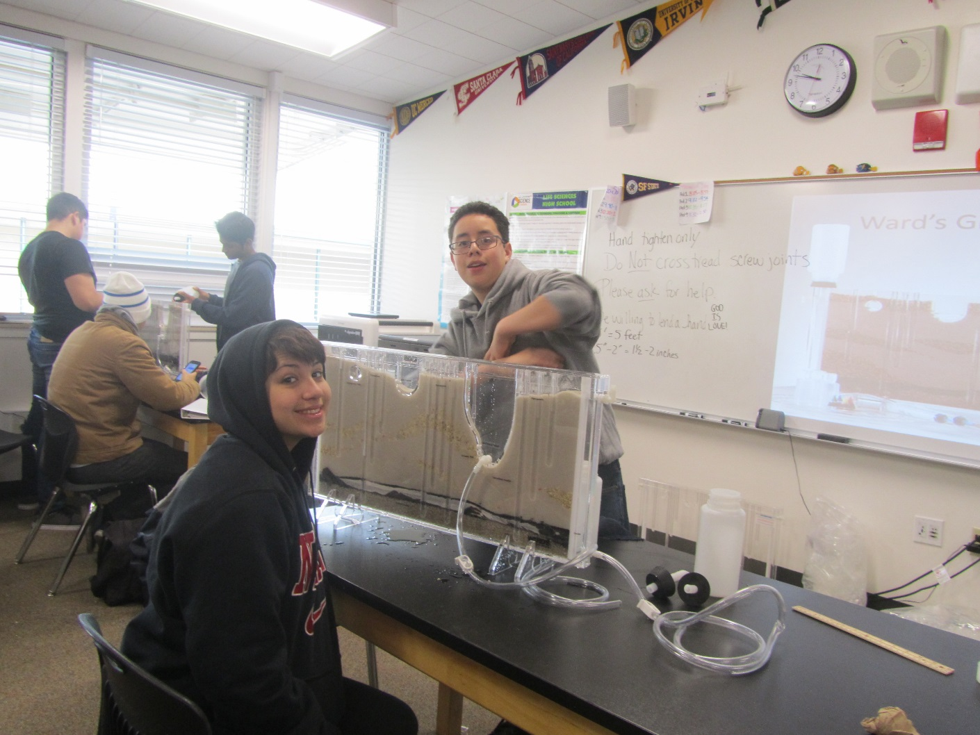
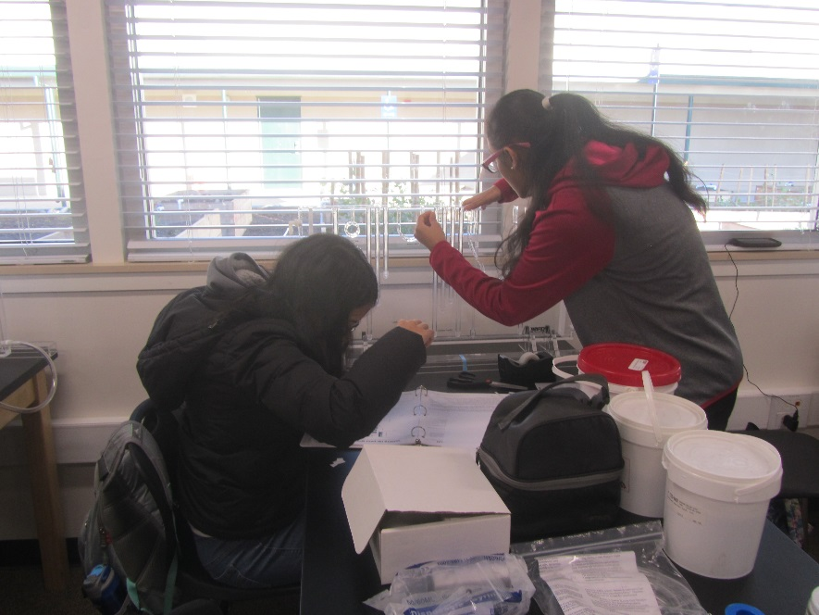

Slide 58
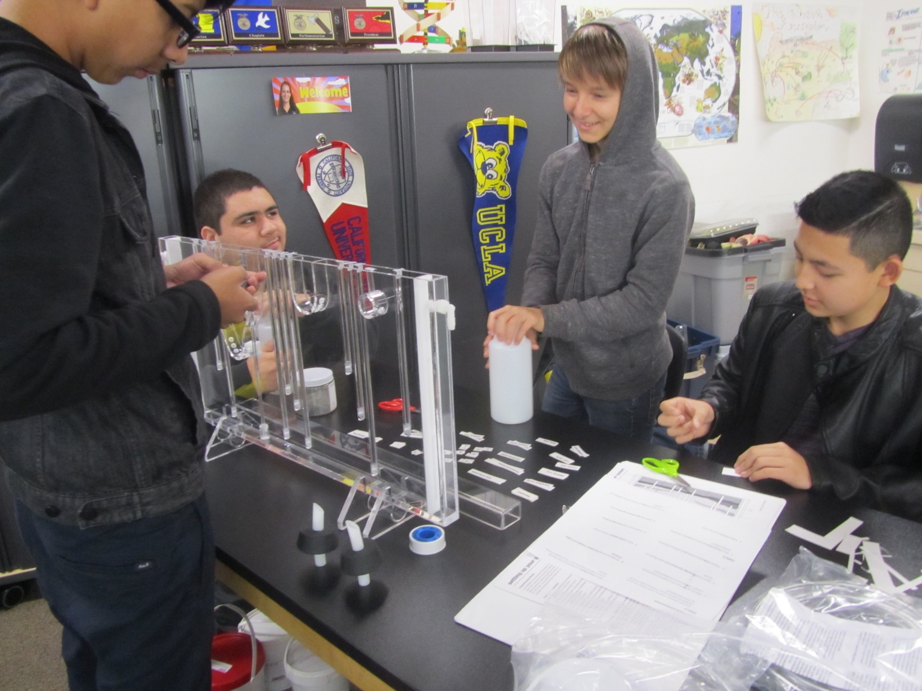
Happy Ag Students being productive

Slide 59
West Sacramento FFA Chapter Meeting at City Hall December 7th, 2016

Slide 60
Emiliano’s Future? Thank you Mr. Lantsberger for your support & comedy! December 8th, 2016

Slide 61
Thank you Washington Unified for your support!

Slide 62
Kevin Johnson is a huge supporter of FFA & F2F– whether he knows it or not!

Slide 63
The West Sacramento FFA Chapter needs a goat… Hee Hee! & promotion of our FFA program for future Ag students so they can have awesome learning opportunities too. Please spread the word.

