Slide 1
Cells
Plasma Membrane & Organelles, Structure of DNA
Week 6

Slide 2
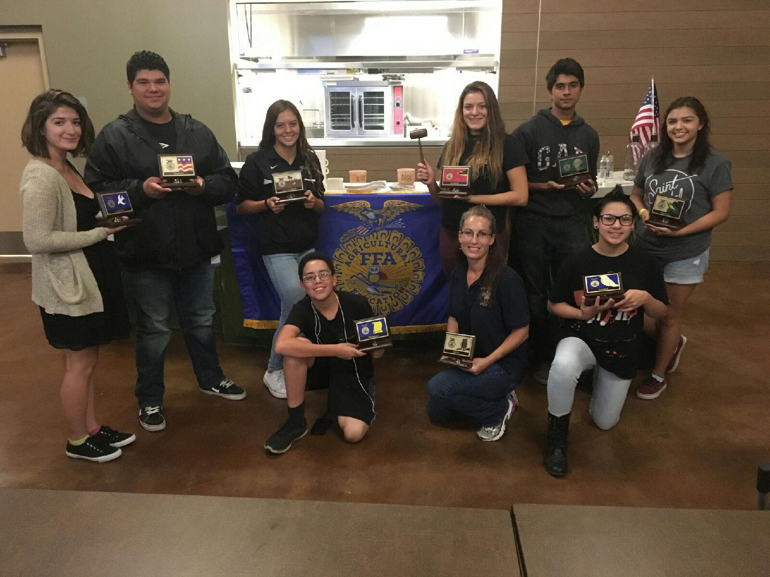

Slide 3
Quiz Today –
Notebook Check
Pages 22 – 35 ( Points)
Study Warm ups
Read Dairy Herd Management Article
  CERC- Claim, Example, Explanation, Conclusion (AXES Paragraph)

Slide 4
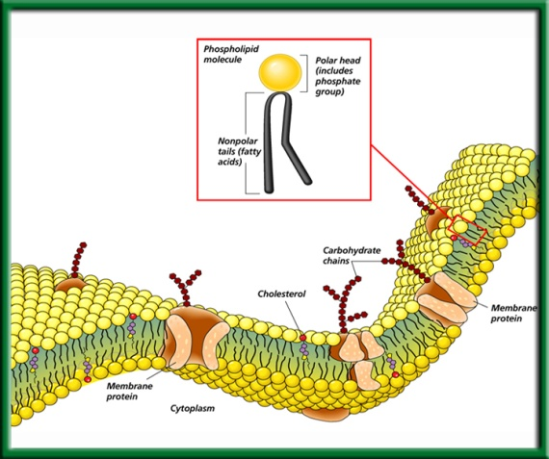
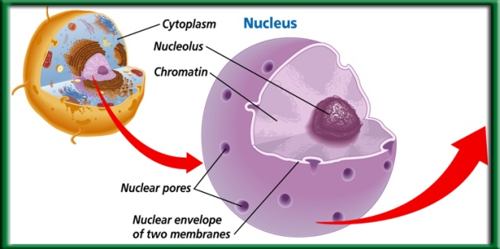
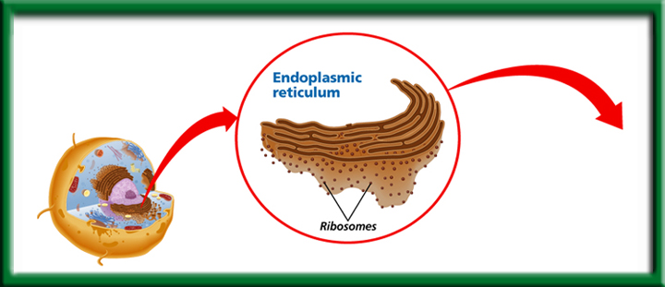
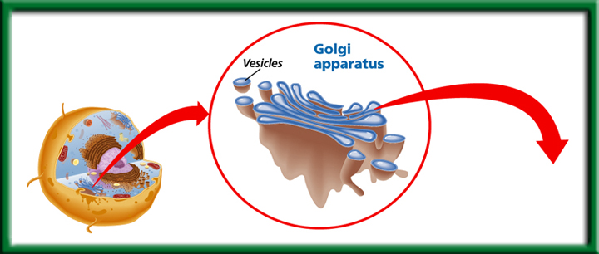
2/21 Plasma Membrane and Cell Organelles CH 7.1 – 7.3
Obj. TSW learn how the macromolecules are important in maintaining homeostasis for the cell. P. 42 NB
Draw, color and label the plasma membrane with proteins, carbohydrates and cholesterol embedded in it.
How does the nucleus control the cell, name the essential parts.
Compare & Contrast the Endoplasmic Reticulum & the Golgi Apparatus in the Assembly, Transport & Storage of proteins.

Slide 5
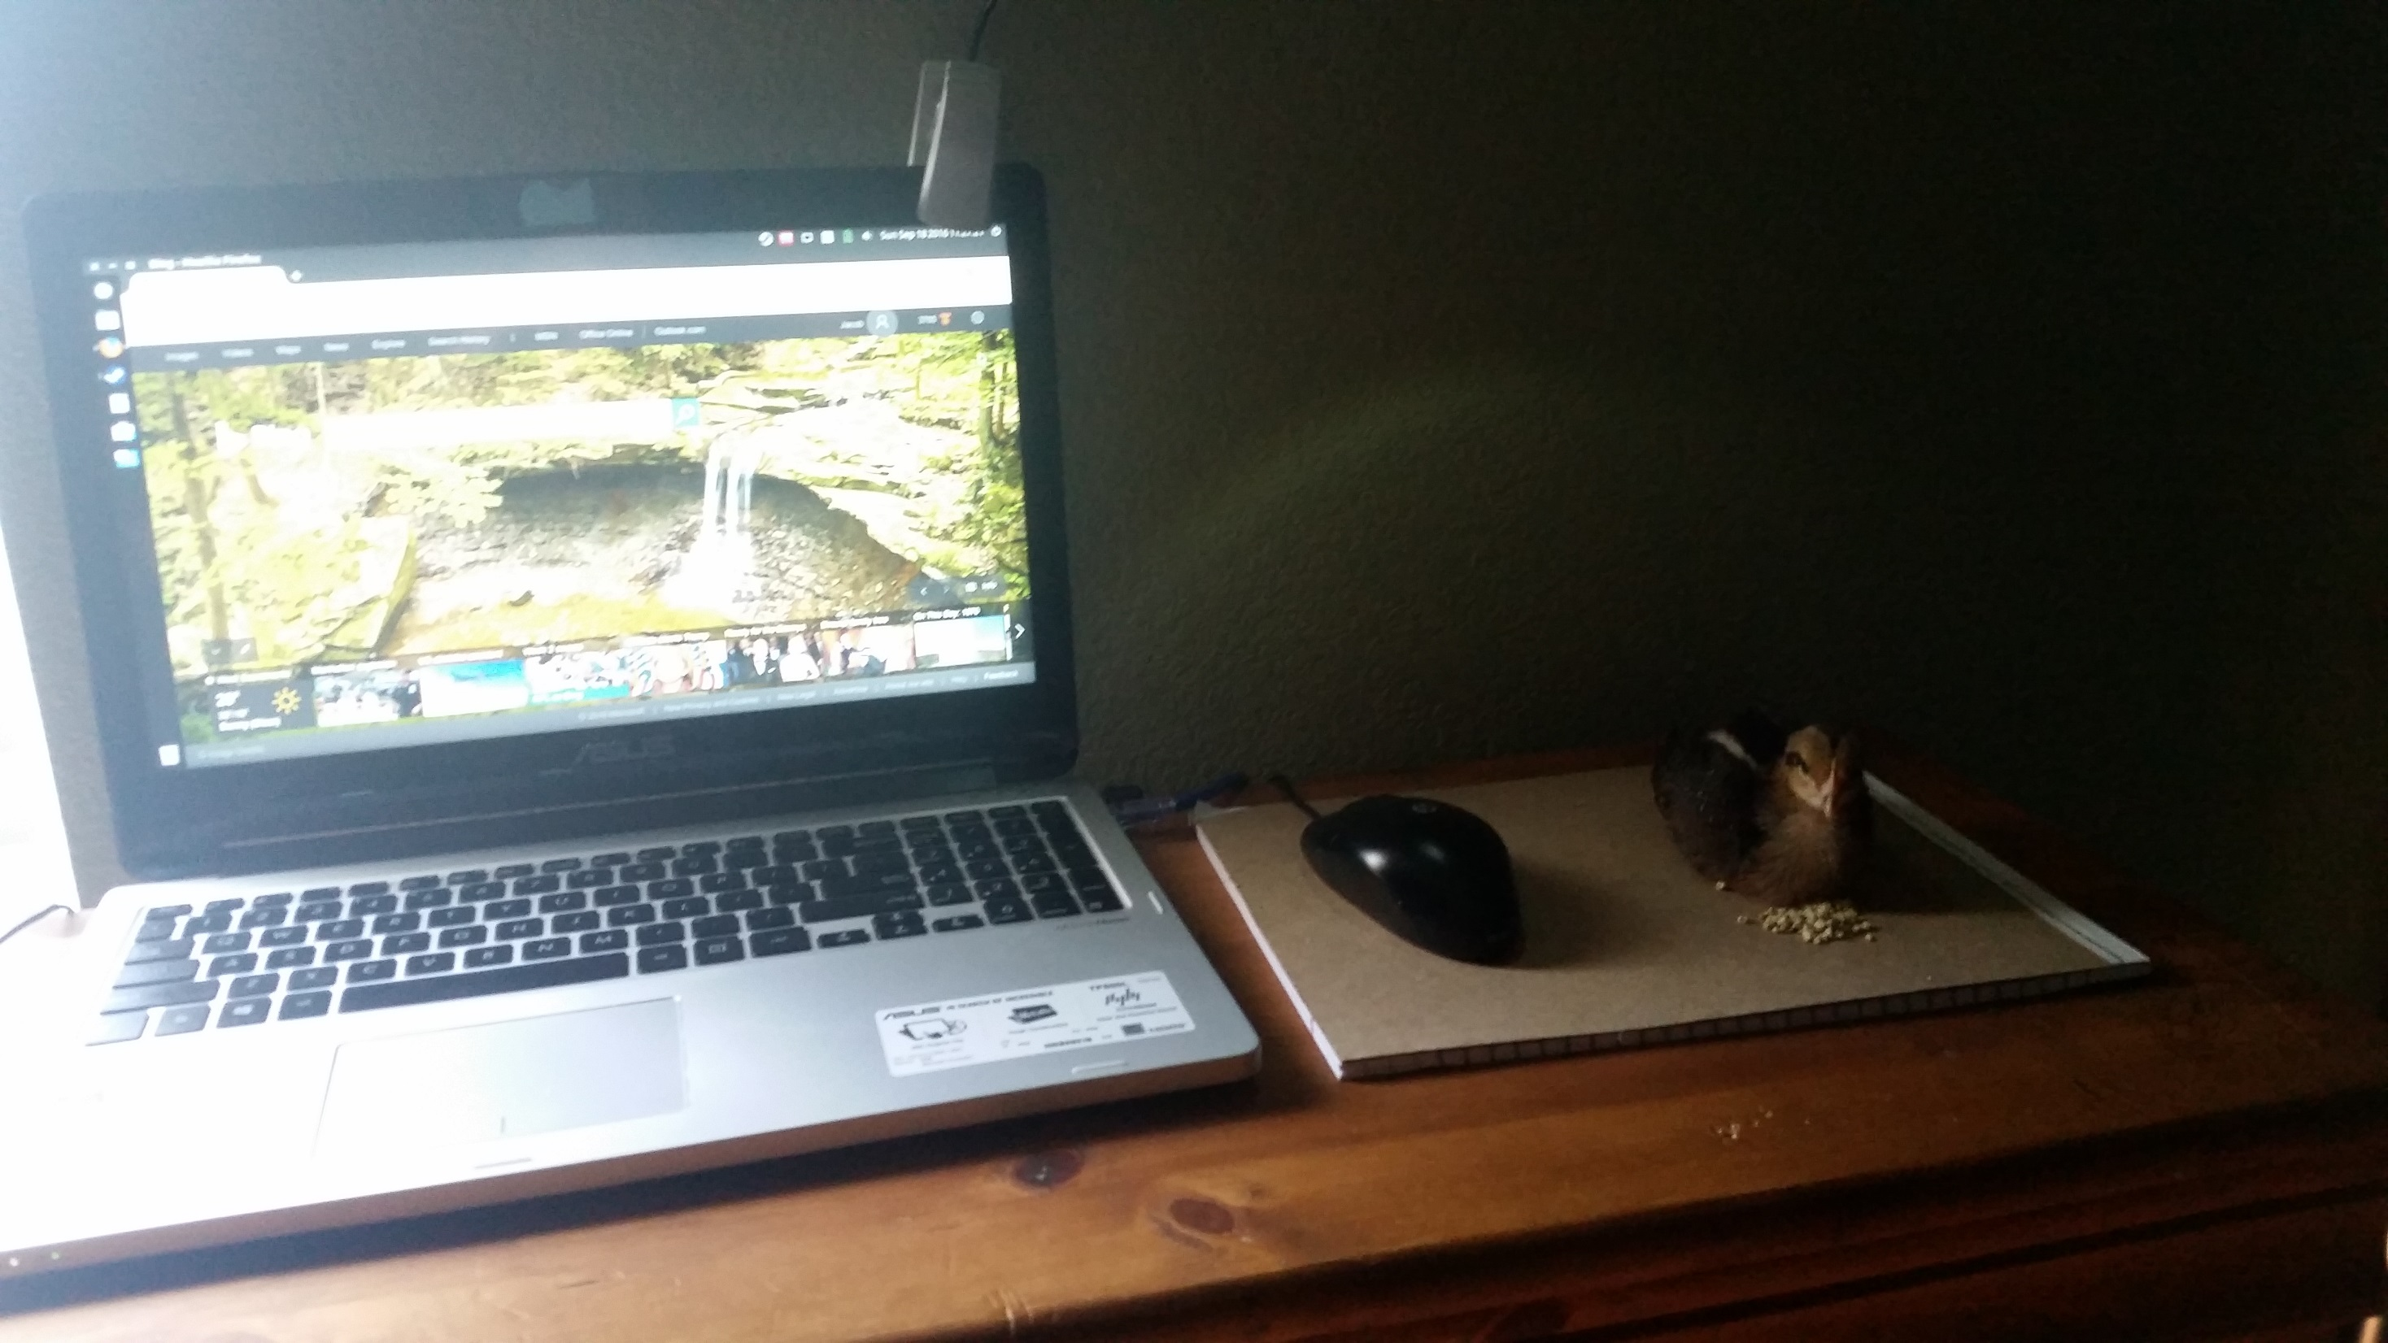

Slide 6
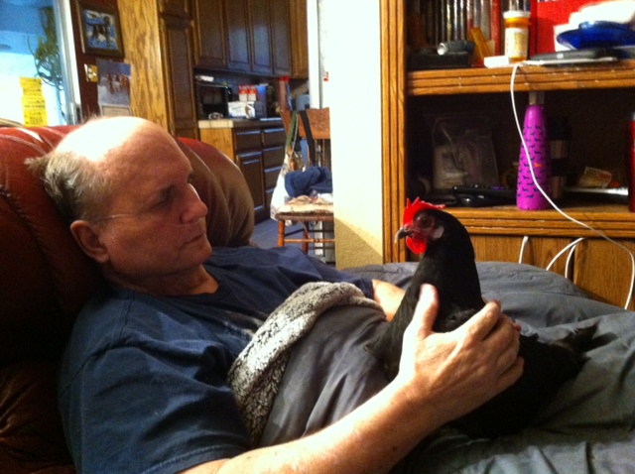

Slide 7
Theaet.com
Profile
Manage your Resume Information
Reference:
  Mrs. McAllister
  Ag/ FFA Teacher
  Bryte Career and College Training
  637 Todhunter Ave.
  West Sacramento, Ca 95605
  (916) 375 - 7901

Slide 8
Profile
Your Activities
  Experience Manager (SAE)
    Add New
Fill out your experience
Pencil
Journal
Classroom Experience
Write about what you have learned in class/ activities.

Slide 9
1. Plasma Membrane – maintains homeostasis
Macromolecules in the plasma membrane:
  Proteins
  Lipids
    Cholesterol
  Carbohydrates

Slide 10
2. Nucleus – Eukaryotic Cell

Slide 11
3. Endoplasmic Reticulum & Golgi Apparatus
Folded membranes increase surface area
Has Ribosomes and is where proteins are assembled
Proteins are transported and stored in the Golgi Apparatus

Slide 12
Agenda 9/21
WU
Review for Quiz
Turn in NB Grade Page 38 - 47
Students take quiz – Macromolecules
After quiz stds. Work quietly on The role of membranes in Cells WS & the structure of Membranes P. 49 NB
Take home project: Cell Simile Due: Sept. 25th Individual work.

Slide 13
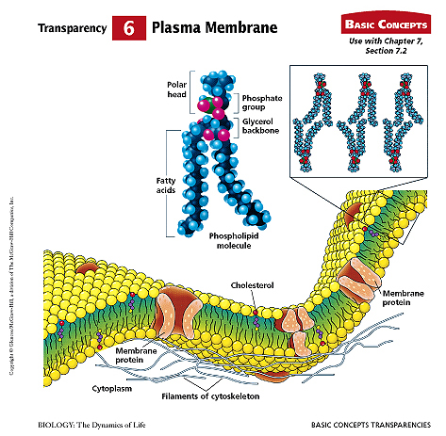
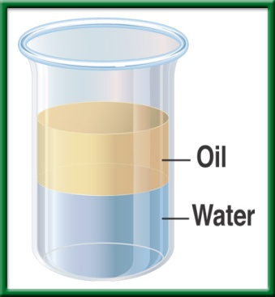
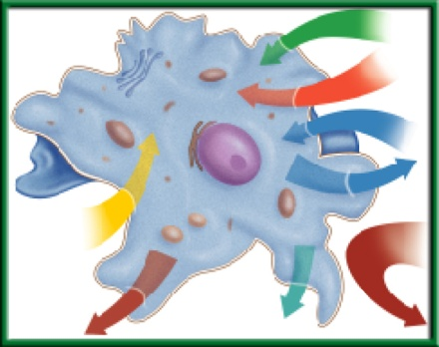
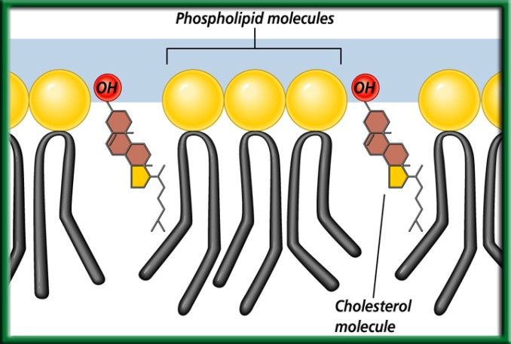
The Plasma Membrane 7.2
Obj. TSW demonstrate their knowledge and understanding of how to write a scientific lab report by going through the steps today and taking notes. P.NB
Cellsalive.com
Explain what selectively permeable (semi-permeable) means.
Why is the plasma membrane called a Fluid Mosaic Model?
Draw, color and label the plasma membrane with proteins, carbohydrates and cholesterol embedded in it.
Bacteria Lab Report due Wednesday Feb. 4th.

Slide 14
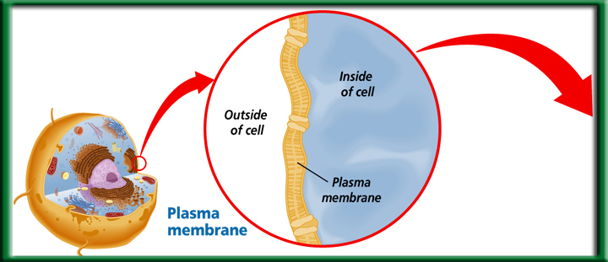
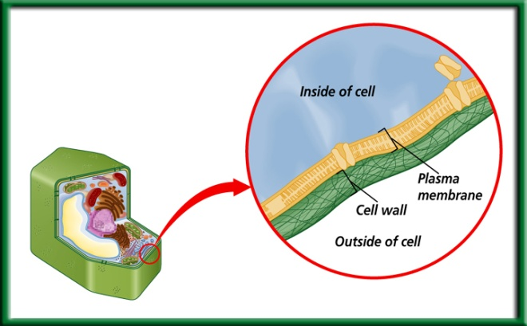
The Eukaryotic Cell Structure 7.3
Obj. TSW learn the macromolecule properties of the plasma membrane by making a 3 – D model. P NB
http://www.susanahalpine.com/anim/Life/memb.htm
Cellsalive.com
What is a cell wall, and what four kinds of organisms have a cell wall?
How does the nucleus control the cell, name the essential parts.
Compare & Contrast the Endoplasmic Reticulum & the Golgi Apparatus in the Assembly, Transport & Storage of proteins.
Watch Cell Video
HW - Read CH 7 Take 1 page Notes- Cells p.23NB

Slide 15
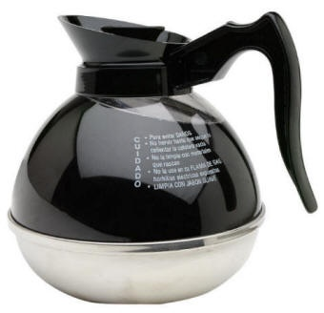
Coffee time
How is the coffee filter similar to a cell membrane?

Slide 16
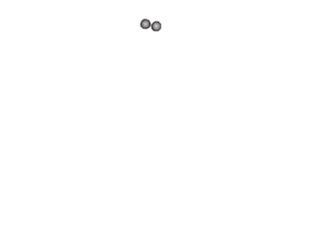
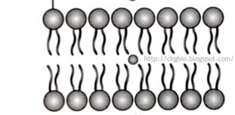
Cell/plasma membrane
Outside of the cell
Inside the cell
#1. Selective permeability: how certain substances can enter the cell while other substances can’t

Slide 17
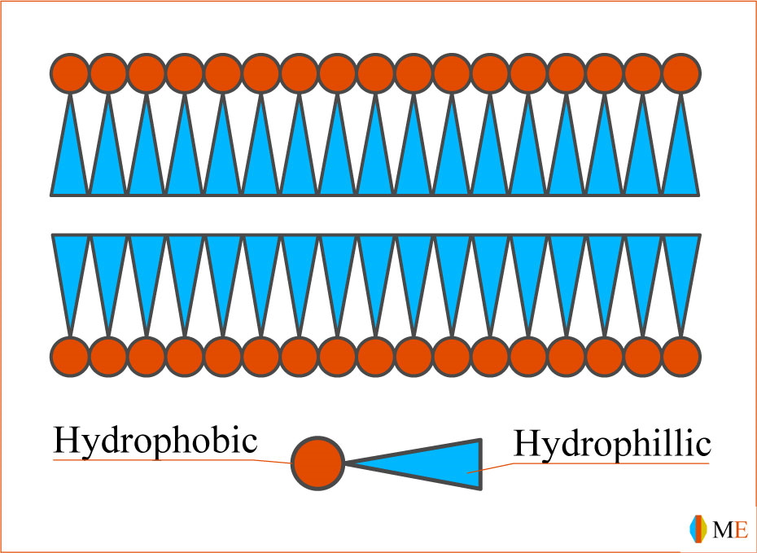
Cell membrane is like a filter
Wastes
Water
Oxygen
Glucose
Outside cell
Wastes
Carbon dioxide
Inside cell
Water

Slide 18
Plasma/cell membrane structure
Phospholipid bilayer: Two layers of phospholipid molecules that form the cell membrane

Slide 19
Phospholipids
`
Polar head: Likes water
Nonpolar tail: Dislikes water
`
Hydrophilic: Likes water. (Polar)
Hydrophobic: Hates water. Will repel it. (Nonpolar)

Slide 20
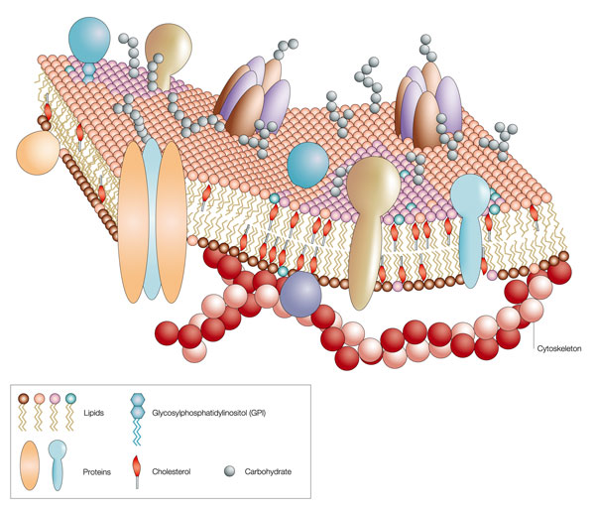
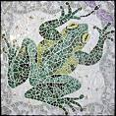
#2. Fluid Mosaic Model p. 21NB
Plasma Membrane- Phospholipid Bilayer
  Polar layers are on the outside
  Non-polar layer are on the inside
Moves like a wave of water on a lake
The proteins/carbohydrates on the outside surface of the cell look like a Mosaic.

Slide 21
#3. Macromolecules are part of the Cell/ Plasma Membrane
Lipids
  helps keep the cell fluid
  Cholesterol (a type of Lipid)
  Helps provide structure & support to cell membrane
Proteins
  Transmit signals, Maintain homeostasis
  Move substances in and out of the semi- permeable
Carbohydrates
  Helps cells identify other cells, not give energy for the cell.

Slide 22
ID the Carbohydrates, Proteins, Lipids, & Cholesterols
What is the function of each of these Macromolecules in the Plasma Membrane?

Slide 23







Plasma Membrane – Selectively Permeable
Phosopholipid Bilayer
Maintains Homeostasis by controlling the movement of materials into & out of cells.
To return to the chapter summary click escape or close this document.

Slide 24
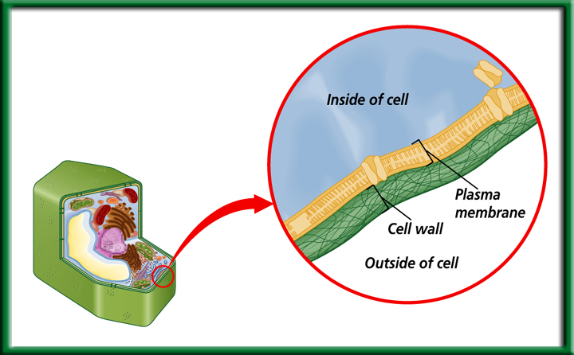
Cell Wall
Made of cellulose, not digestible by humans.
Provides protection and support.
Found in:
Plant Cells, Bacteria, some Protists, and Fungi
To return to the chapter summary click escape or close this document.

Slide 25

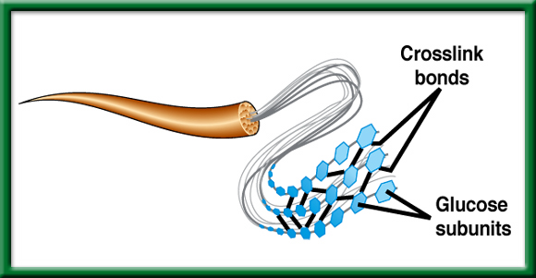
Structure of Cellulose – Cell Wall of Plants
We call it Fiber.
To return to the chapter summary click escape or close this document.

Slide 26
Quote of the Day
Hard work beats talent when talent doesn’t work hard.
- Shreya

Slide 27
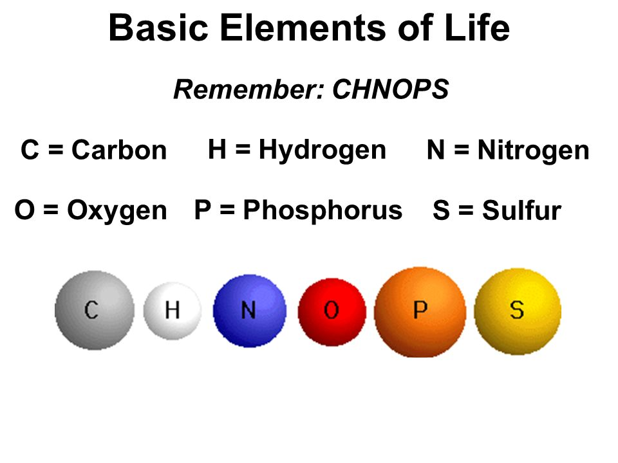
2/22 Building Molecules & Enzymes Ch 6.3
Obj. TSW identify the macromolecules living things are made of and describe their properties. P. 44 NB
What are the 6 main elements that make up the 4 macromolecules?
What is an Enzymes?
What are the three environmental factors that determine the enzymes ability to function?

Slide 28
8th Grader Visit
Ideas

Slide 29
Theaet.com
What is your SAE type?
Describe your SAE idea on the blank space on the paper P. 43 NB
Click on Experience Manager in the Profile section of AET.
  ADD NEW
  Add the project name
  The level
  The Type of SAE
  Your experience

Slide 30
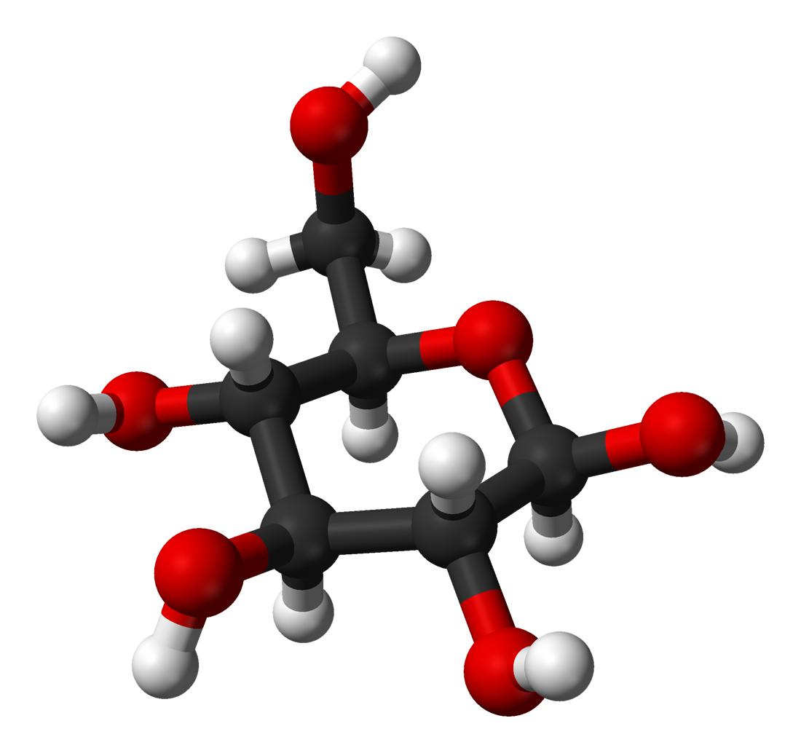
Elements & Molecules
Carbon
Hydrogen
Oxygen
Nitrogen
Build O₂, CO₂, H₂O, C₆H₁₂O_{6,} Sucrose, NH3, NO2, NO3

Slide 31
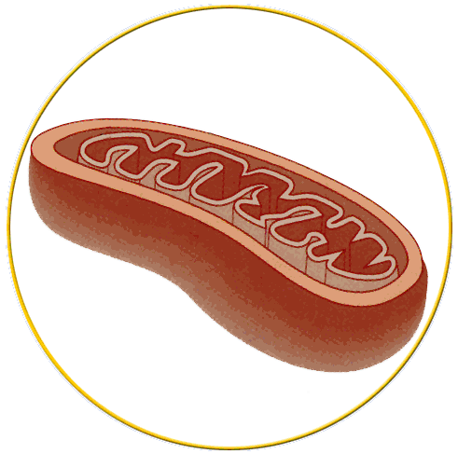
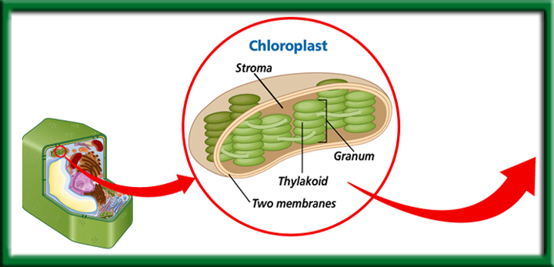
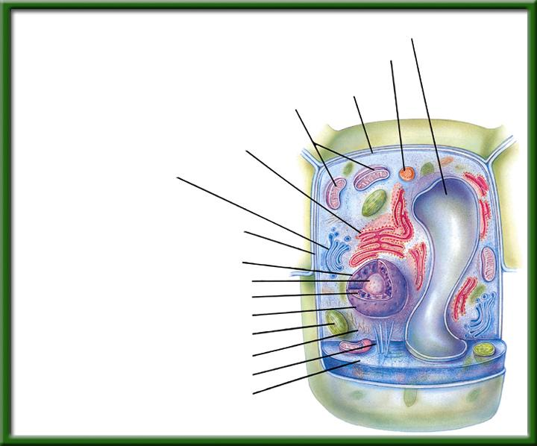
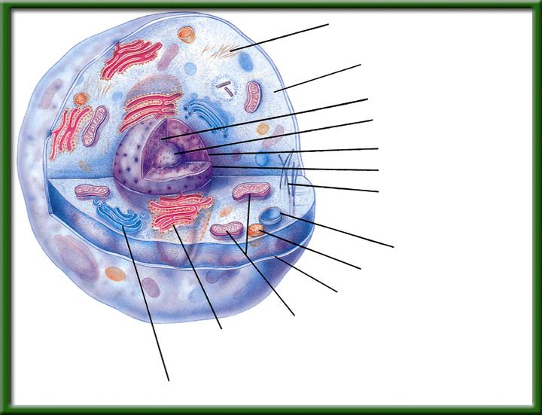
2/23 Energy Transformers CH 7.3
Obj. TSW demonstrate understanding of the function of Chloroplasts and Mitochondria in a cell by completing the plant/ animal cell Lab. P.46 NB
Cellsalive.com
Compare & Contrast Chloroplasts & Mitochondria.
Why are the inner membranes folded?
Compare & Contrast Animal & Plant cells.
Show web site cellsalive.com
Quiz Friday & NB Check p.38 - 49
Cell Video

Slide 32
1. Chloroplast- converts light energy to chemical energy in a process called Photosynthesis
Eukaryotic Cell
To return to the chapter summary click escape or close this document.

Slide 33
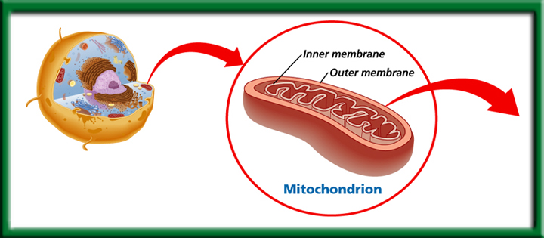
Mitochondria
Transforms chemical Energy into ATP & heat.
1.Found in Plants & Animals
Folded membranes are a must.
*Endosymbiosis* Each mitochondria has its own DNA which is passed down by your mother.
To return to the chapter summary click escape or close this document.

Slide 34
2.Folded Membranes P.45 NB
Make cell processes more efficient for chemical reactions to happen
The membrane provides a large surface area
The membranes form interconnected compartments.

Slide 35
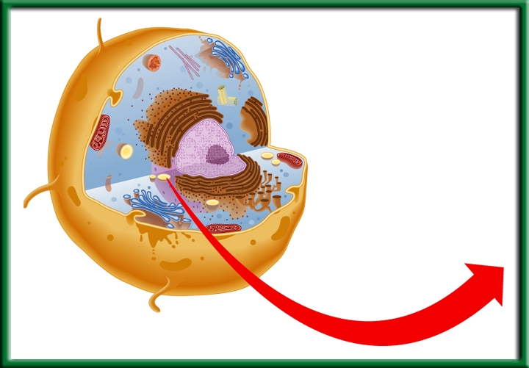
3. Animal Cell - Eukaryotic
Small Vacuole
Round
Centriole
Lysosomes
To return to the chapter summary click escape or close this document.

Slide 36
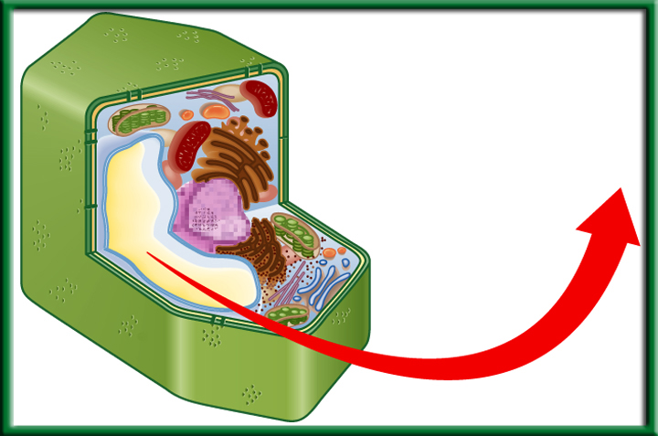
3. Plant Cells - Eukayotic
Cell Wall
Chloroplast
Large Vacuole
Plant Vacuole
To return to the chapter summary click escape or close this document.

Slide 37
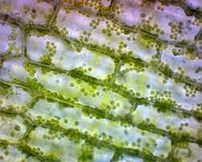
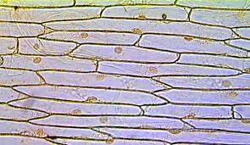
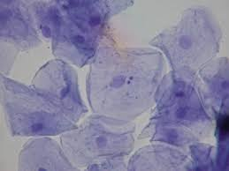
Cell Lab p.47NB
4x- Red Objective lens = 40
10x – Yellow Objective lens = 100
Label on your picture of Cheek Cell, Onion Cell & Elodea Leaf Cell:
Cell Wall
Nucleus
Cytoplasm
Chloroplast
Plasma Membrane
Onion Cell
Elodea Cell
Cheek Cell

Slide 40
Lab – Scientific Method using Elodea Leaf, Onion Cells & Cheek Cells p. 47 NB
Observation(s):
Questions:
Hypothesis: If, Then, & Testable
Materials: 1 glass slide, 1 cover slip, one toothpick, 1 piece of onion, forceps, Methyl Blue, Iodine
Procedure:
  Get 1 glass slide, 1 cover slip, put 3 drops of Iodine on the slide for the onion, peal the inner membrane off & lay onto the Iodine, then put on the cover slip.
  Get 1 glass slide, 1 cover slip, put 3 drops of Methyl Blue on the slide for the cheek cell, get a toothpick and just touch the inside of your cheek, then swirl the toothpick around in the MB and put on the cover slip.
  Get 1 glass slide, 1 cover slip, put 3 drops of water on the slide, place 1 elodea leaf on the slide, then put on the cover slip.

Slide 41
Cont. Lab Onion & Cheek Cells p. 47 NB
Data:
Qualitative (words, pictures, descriptions) & Quantitative (#’s, graphs, tables) Label the nucleus, plasma membrane, cytoplasm, chloroplast, & cell wall
Control Group: What are you comparing your cheek cells to?
Independent Variable: Brushing teeth, or how many times you touched your cheek.
Dependent Variable: The amount of Cheek Cells
Conclusion: 3 – 5 sentences Accept or Reject your hypothesis, what you learned, what would you do differently? Why did you not see chloroplasts in the onion cell? What was different about the cheek cell? Were the chloroplasts moving in the Elodea Leaf?

Slide 42
Conclusion P. 47 NB
sentences Accept or Reject your hypothesis, what you learned, what would you do differently? Why did you not see chloroplasts in the onion cell? What was different about the cheek cell? Were the chloroplasts moving in the Elodea Leaf?
Accept or Reject? We learned that there are cells in plants and animals. The onion cells look like bricks. The Cheek cells were circular, and the plant cells looked like bricks. I would change nothing about the lab. There were no chloroplasts in the onion cell because it was underground. The Chloroplasts were green in the Elodea Leaf.

Slide 43


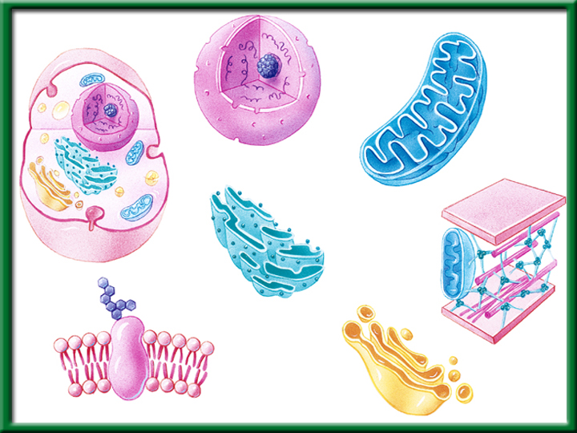
To return to the chapter summary click escape or close this document.

Slide 44
Activity: Make your Desk a Cell p. 51NB
After researching Cellsalive.com for the following organelles: Nucleus, Cytoplasm, Endoplasmic Reticulum, Golgi Body, Vacuole, Mitochondria, Plasma Membrane, Chloroplast & Cell Wall (Plant cell) take notes on page3 NB. Title: Cell Organelles
Then with a partners and one desk, make a plasma membrane around the desk. On the inside of the desk, Draw and ID the listed organelles above on your desk.
It can be a plant or animal cell
Mrs. McAllister must grade your “cell”.

Slide 45
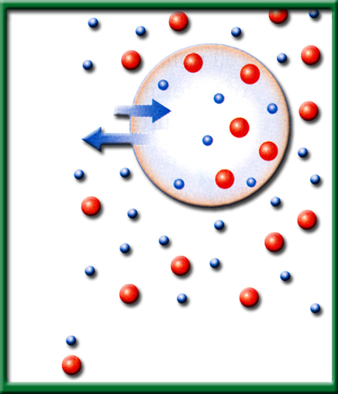
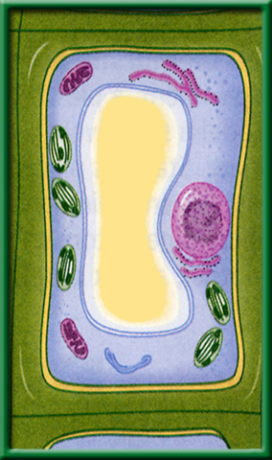
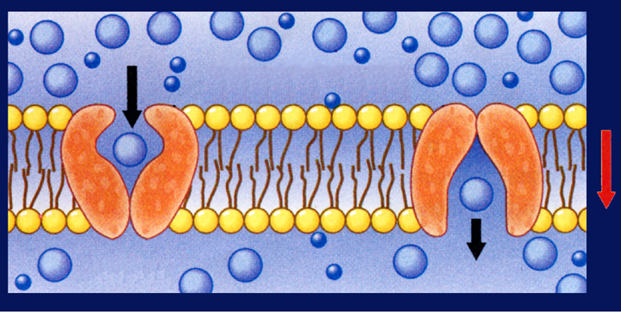
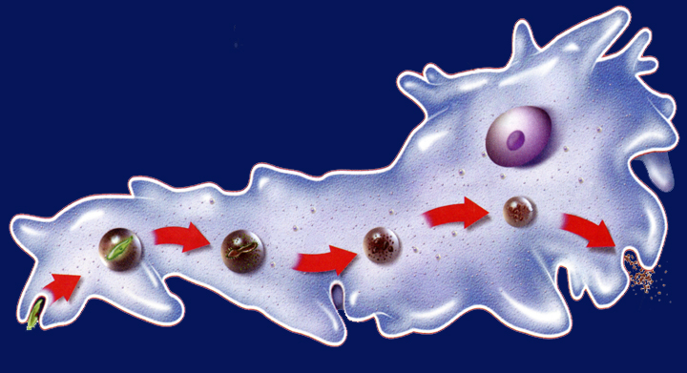
2/23 Cellular Transport 8.1
Obj. TSW explain how cells regulate their surroundings through their semi permeable membranes by comparing and contrasting organelles in a plant and animal cell.
P. 46 NB
What is Osmosis?
Compare & Contrast Isotonic, Hypotonic, and Hypertonic Solutions.
Compare & Contrast Passive Transport & Active Transport.
  HW – Read CH 8.3, 1 page notes. P.53 NB

Slide 46
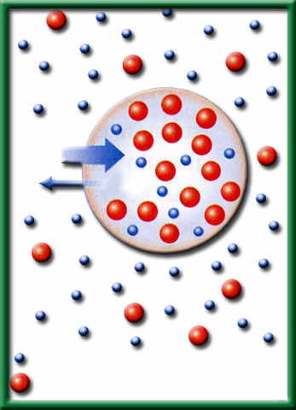
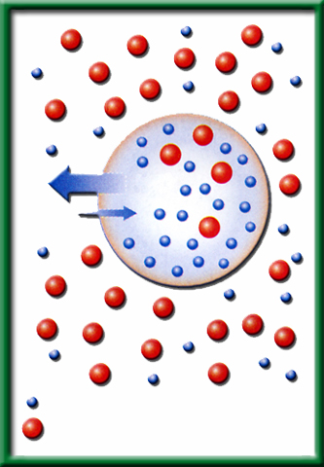
1/4 Osmosis CH 8.1 & 8.2
Obj. TSW learn how water moves through a plasma membrane by participating in a demonstration of Osmosis. P. 28 NB
Why do cells have to be small?
Explain what happens to a cell or egg in a Hypotonic solution. Use words like Solute and Solvent.
H. Biology. Explain plasmolysis, why does grass that has been salted in the winter along side roads die?

Slide 47


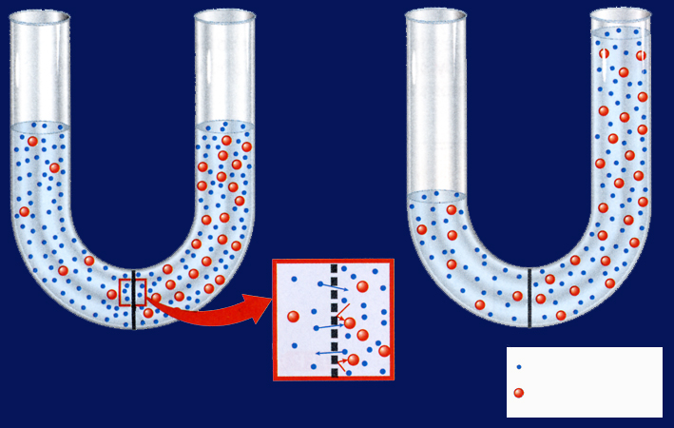
Section 8.1 Summary – pages 195 - 200
What controls osmosis?
#1.The movement of water.
Unequal distribution of particles, called a concentration gradient, is one factor that controls osmosis.
Before
Osmosis
After
Osmosis
Water molecule
Sugar molecule
Selectively permeable membrane

Slide 48
Section 8.1 Summary – pages 195 - 200
Cells in an isotonic solution
Water movement is Equal
In an isotonic solution, the concentration of dissolved substances in the solution is the same as the concentration of dissolved substances inside the cell.
H₂O
H₂O
Water Molecule
Dissolved Molecule

Slide 49
Section 8.1 Summary – pages 195 - 200
Cells in an isotonic solution
A plant cell has its normal shape and pressure in an isotonic solution.

Slide 50
Section 8.1 Summary – pages 195 - 200
Cells in a hypotonic solution
In a hypotonic solution, water enters a cell by osmosis, causing the cell to swell.
Lysed- to explode
H₂O
H₂O
Water Molecule
Dissolved Molecule

Slide 51
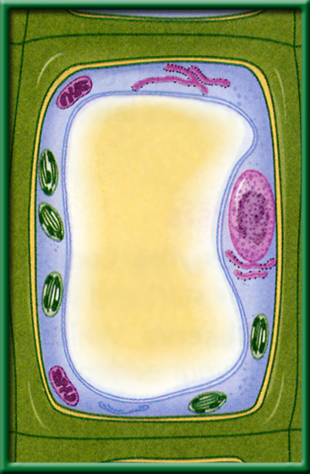
Section 8.1 Summary – pages 195 - 200
Cells in a hypotonic solution
Plant cells swell beyond their normal size as pressure increases.

Slide 52
Section 8.1 Summary – pages 195 - 200
Cells in a hypertonic solution
In a hypertonic solution, water leaves a cell by osmosis, causing the cell to shrink.
H₂O
H₂O
Water Molecule
Dissolved Molecule

Slide 53
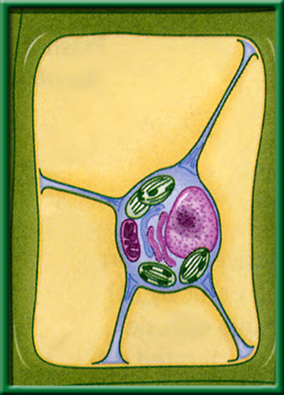
Section 8.1 Summary – pages 195 - 200
Cells in a hypertonic solution
Plant cells lose pressure as the plasma membrane shrinks away from the cell wall.

Slide 54
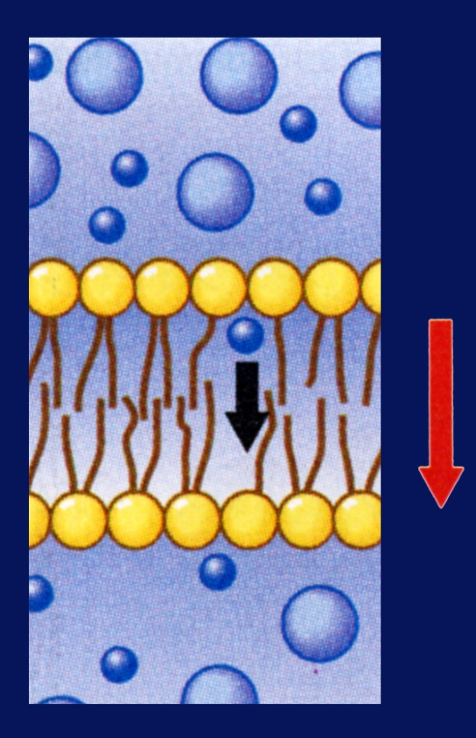
Section 8.1 Summary – pages 195 - 200
#2.Passive Transport
When a cell uses no energy to move particles across a membrane passive transport occurs.
Osmosis
Diffusion
Facilitated Diffusion
Moves from High Concentration to Low Concentration
Concentration gradient
Plasma membrane

Slide 55
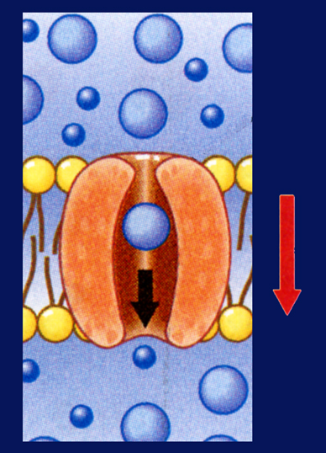
Section 8.1 Summary – pages 195 - 200
Passive Transport by proteins
Passive transport of materials across the membrane using transport proteins is called facilitated diffusion.
Channel proteins
Plasma membrane
Concentration gradient

Slide 56
Section 8.1 Summary – pages 195 - 200
Passive transport by proteins
The movement is with the concentration gradient (High to Low), and requires no energy input from the cell.
Carrier proteins
Plasma membrane
Concentration gradient
Step 1
Step 2

Slide 57
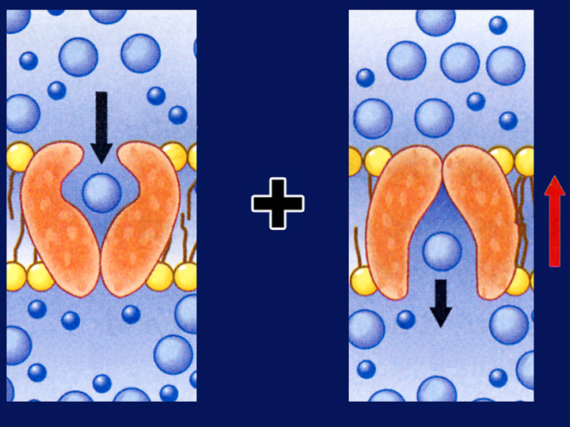
Section 8.1 Summary – pages 195 - 200
Active Transport
Movement of materials through a membrane against a concentration gradient (Low to High) is called active transport and requires energy from the cell.
Carrier proteins
Plasma membrane
Concentration gradient
Cellular energy
Step 1
Step 2

Slide 58
Section 8.1 Summary – pages 195 - 200
How active transport occurs
In active transport, a transport protein called a carrier protein first binds with a particle of the substance to be transported.
Exocytosis
Endocytosis
Carrier proteins
Plasma membrane
Concentration gradient
Cellular energy
Step 1
Step 2

Slide 59
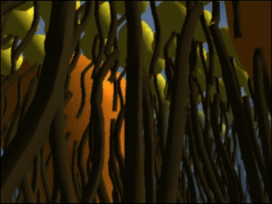
Section 8.1 Summary – pages 195 - 200
How active transport occurs
Click image to view movie.

Slide 60
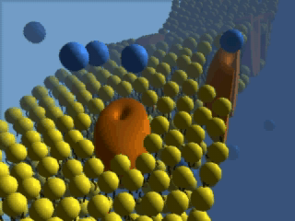
Section 8.1 Summary – pages 195 - 200
How active transport occurs
Click image to view movie.

Slide 61
Section 8.1 Summary – pages 195 - 200
Transport of Large Particles- Active Transport
Endocytosis is a process by which a cell surrounds and takes in material from its environment.
Nucleus
Wastes
Digestion
Endocytosis
Exocytosis

Slide 62
Section 8.1 Summary – pages 195 - 200
Transport of Large Particles
The material is engulfed and enclosed by a portion of the cell’s plasma membrane.
Nucleus
Wastes
Digestion
Endocytosis
Exocytosis

Slide 63
Section 8.1 Summary – pages 195 - 200
Transport of Large Particles – Active Transport
Exocytosis is the expulsion or secretion of materials from a cell.
Nucleus
Wastes
Digestion
Endocytosis
Exocytosis

Slide 64


Section 1 Check
Question 1
The diffusion of water across a selectively permeable membrane is called __________.
Water molecule
Selectively permeable membrane
Sugar molecule
C. exocytosis
D. osmosis
CA: Biology/Life Sciences
1a

Slide 65

Section 1 Check
Question 2
What is the expected result of having an animal cell in a hypertonic solution?
A. The cell shrivels up.
B. The plasma membrane shrinks away from
the cell wall.
C. The cell swells up.
D. The cell retains its normal shape.
CA: Biology/Life Sciences
1a

Slide 66
Section 1 Check
The answer is A. In a hypertonic solution, cells experience osmosis of water out of the cell. Animal cells shrivel because of decreased pressure in the cells.
H₂O
H₂O
Water molecule
Sugar molecule
CA: Biology/Life Sciences
1a

Slide 67
Section 1 Check
Question 3
A grocer mists the celery display with water to keep it looking fresh. What type of solution is the celery now in?
A. isotonic
B. hypotonic
C. hypertonic
D. exotonic
CA: Biology/Life Sciences
1a, 1j

Slide 68
Section 1 Check
The answer is B. Plant cells contain a rigid cell wall and do not burst even in a hypotonic solution.
CA: Biology/Life Sciences
1a, 1j

Slide 69

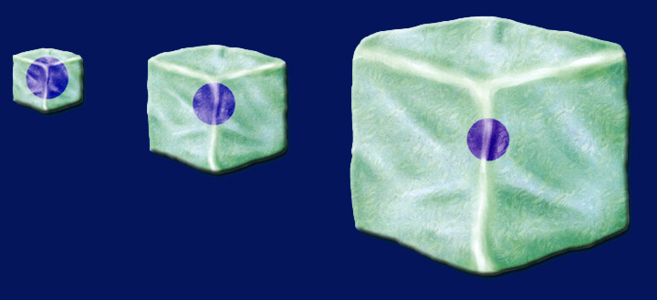
Section 8.2 Summary – pages 201 - 210
Surface area-to-volume ratio
4 mm
4 mm
1 mm
1 mm
2 mm
2 mm
1 mm
2 mm
Surface area = 1 mm² Volume = 1 mm³
4 mm
Surface area = 4 mm² Volume = 8 mm³
As a cell’s size increases, its volume increases much faster than its surface area.

Slide 70
Section 8.2 Summary – pages 201 - 210
Surface area-to-volume ratio
4 mm
4 mm
1 mm
1 mm
2 mm
2 mm
1 mm
2 mm
Surface area = 6 mm² Volume = 8 mm³
4 mm
Surface area = 24 mm² Volume = 8 mm³
If cell size doubled, the cell would require eight times more nutrients and would have eight times more waste to excrete.

Slide 71
Section 8.2 Summary – pages 201 - 210
Surface area-to-volume ratio
4 mm
4 mm
1 mm
1 mm
2 mm
2 mm
1 mm
2 mm
Surface area = 6 mm² Volume = 8 mm³
4 mm
Surface area = 24 mm² Volume = 8 mm³
The cell would either starve to death or be poisoned from the buildup of waste products.

Slide 72
Osmosis p. 47 NB
If we put an egg that the shell has been dissolved in vinegar for 24 hours into Karo Syrup, then the egg will __________.
If we put an egg that the shell has been dissolved in vinegar for 24 hours into water, then the egg will ___________.
If we put an egg that the shell has been dissolved in vinegar for 24 hours into salt water, then the egg will ___________.
By the third day you should have an AXES Paragraph written about Osmosis, and how cells are impacted by different solutions.

Slide 73
How Osmosis affects cells in…p.47NB
Directions: Draw a picture of a cell, and a description of if the cell swells, shrinks or stays the same. Explain the concentration gradient using the words solute and solvent.
Isotonic
Solution
Hypotonic
Solution
Hypertonic Solution
How Osmosis affects cells in…

Slide 74
Quote of the Day
It’s not what happens to you, but how you react that matters.
- Epictetus

Slide 75
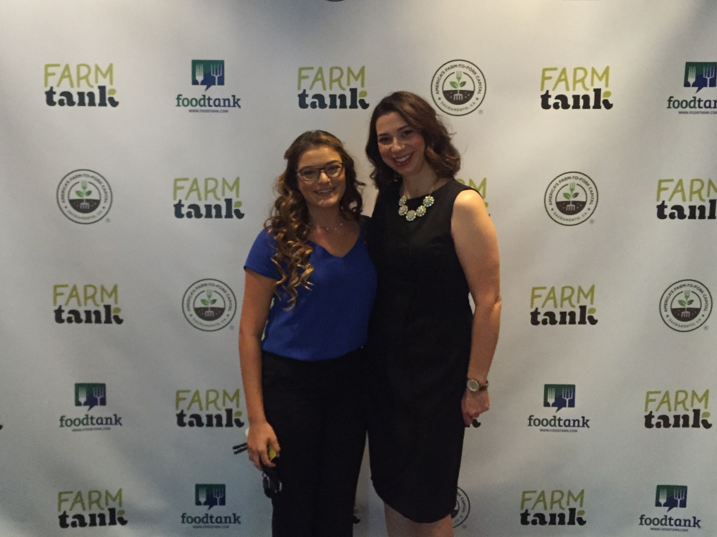

Slide 76
2/27 Osmosis CH 8.1 & 8.2
Obj. TSW learn how water moves through a plasma membrane by participating in a demonstration of Osmosis. P. 50 NB
Why do cells have to be small?
Solvent is a solution, solute is the substance like sugar and salt. Explain what happens to a cell or egg in a Hypotonic solution. Use words like Solute and Solvent.
Explain plasmolysis, why does grass that has been salted in the winter along side roads die?

Slide 77
Section 8.2 Summary – pages 201 - 210
1. Surface area-to-volume ratio
4 mm
4 mm
1 mm
1 mm
2 mm
2 mm
1 mm
2 mm
Surface area = 1 mm² Volume = 1 mm³
4 mm
Surface area = 4 mm² Volume = 8 mm³
As a cell’s size increases, its volume increases much faster than its surface area.

Slide 78
Section 8.2 Summary – pages 201 - 210
Surface area-to-volume ratio
4 mm
4 mm
1 mm
1 mm
2 mm
2 mm
1 mm
2 mm
Surface area = 6 mm² Volume = 8 mm³
4 mm
Surface area = 24 mm² Volume = 8 mm³
If cell size doubled, the cell would require eight times more nutrients and would have eight times more waste to excrete.

Slide 79
Section 8.2 Summary – pages 201 - 210
Surface area-to-volume ratio
4 mm
4 mm
1 mm
1 mm
2 mm
2 mm
1 mm
2 mm
Surface area = 6 mm² Volume = 8 mm³
4 mm
Surface area = 24 mm² Volume = 8 mm³
The cell would either starve to death or be poisoned from the buildup of waste products.

Slide 80
Section 8.1 Summary – pages 195 - 200
2. Cells in a hypotonic solution
In a hypotonic solution, water (solvent) enters a cell by osmosis, causing the cell to swell. There is a higher concentration of solute (sugar) in the cell. To reach equilibrium, the solvent must enter the cell.
Lysed- to explode
H₂O
H₂O
Water Molecule
Dissolved Molecule

Slide 81


3. Plasmolysis – The shrinking of the cell due to loss of water from increased solute concentration outside the cell. This is an example of Hypotonic solution

Slide 82

8th Graders Visit from Riverbank

Slide 83


Slide 84



Slide 85


Slide 86


Slide 87


Slide 88




Slide 89





Slide 90


Slide 91



Slide 92



Slide 93


Slide 94


Slide 95
Ag Advisory Meeting 2/22
Internships – Take advantage of them! Fiery Ginger Urban Farms-YOLO.
  Service Learning & SAE to earn your Greenhand Degree in May.
What do you bring to the table? What do you have to offer?
How long does an employer have to train you to learn a skill?
Are you trainable in a timely manner?
Fieldtrips – Minimum Days
  March 21^{st –} Golden 1 Arena
  May 16th – The Barn & STRS Building
Scholarships $$$$$
  Seniors $1500 Charlie Rominger Memorial Scholarship
  Write an essay

Slide 96
2/28 The Plasma Membrane 7.2
Obj. TSW demonstrate their knowledge and understanding of how the plasma membrane is semipermeable & taking notes. P.52NB
Cellsalive.com
Explain what selectively permeable (semi-permeable) means.
Why is the plasma membrane called a Fluid Mosaic Model?
Write the 4 Macromolecules/ biomolecules. For each one, explain it’s location and how it helps the cell function.
HW – NOTES CH 8.1 P. 53 NB

Slide 97
1. Plasma Membrane – Selectively Permeable, some things can go in , some go out, but not everything.
Phospholipid Bilayer
Maintains Homeostasis by controlling the movement of materials into & out of cells.
To return to the chapter summary click escape or close this document.

Slide 98
Cell Wall
Made of cellulose, not digestible by humans.
Provides protection and support.
Found in:
Plant Cells, Bacteria, some Protists, and Fungi
To return to the chapter summary click escape or close this document.

Slide 99
Structure of Cellulose – Cell Wall of Plants
We call it Fiber.
To return to the chapter summary click escape or close this document.

Slide 100

ID the Carbohydrates, Proteins, Lipids, & Cholesterols
2. The Plasma Membrane is a Fluid Mosaic Model because it moves like waves on a lake and the proteins & carbohydrates on the surface look like a mosaic.
3. What is the function of each of these Macromolecules in the Plasma Membrane?

Slide 101
Osmosis p. 51 NB
If we put an egg that the shell has been dissolved in vinegar for 24 hours into Karo Syrup, then the egg will __________.
If we put an egg that the shell has been dissolved in vinegar for 24 hours into water, then the egg will ___________.
If we put an egg that the shell has been dissolved in vinegar for 24 hours into salt water, then the egg will ___________.
If we put an egg that the shell has been dissolved in vinegar for 24hours into deionized water, then the egg will ____________.
By the third day you should have an AXES Paragraph written about Osmosis, and how cells are impacted by different solutions.

Slide 102
Kahoots - QUIZ
FFA Officer Positions
Everyone get an Official FFA Manual (Bookcase)
Take notes Page 53 NB

Slide 103
How Osmosis affects cells in…p.51 NB
Directions: Draw a picture of a cell, and a description of if the cell swells, shrinks or stays the same. Explain the concentration gradient using the words solute and solvent.
Isotonic
Solution
Hypotonic
Solution
Hypertonic
Solution
How Osmosis affects cells in…

Slide 104

P. 51NB
Simple Diffusion
Energy
Higher Concentration
Lower Concentration
Osmosis
Passive
Facilitated Diffusion
Write a 4 sentence summary

Slide 105
HW CH 8 Cellular Transport
 | Isotonic | Hypotonic | Hypertonic
1. Causes the cell to swell |  | ☺ This is the answer😐
2. Doesn’t change the shape of the cell | ☺
3.Causes Osmosis | ☺ | ☺ | ☺
4. Causes the cell to shrink |  |  | ☺
Channel Protein
Energy
Endocytosis
Passive Transport
Exocytosis
Facilitated Diffusion
Active Transport
Carrier Protein

Slide 106
Osmosis -(Movement of water) Demo Pg. 29NB
Qualitative Data:
  Egg in Karo syrup has shrunk and has a dent in it. Hypertonic Solution.
  Egg in Water has swelled and is stuck in the beaker. Hypotonic Solution.
  Egg in Salt Water* has stayed the same, and moves around in the beaker. Isotonic Solution.

Slide 107
Conclusion:
p. 49
An egg soaked in Salt water had no noticeable change. Therefore, the salt water solution is Isotonic. An egg soaked in water had part of the yolk sticking out and therefore, the solution was hypotonic because the egg swelled. An egg soaked in karo syrup shrunk and attracted a gazillion ants, therefore the solution was hypertonic.
Put egg in Karo syrup into water
Put water Egg into Karo Syrup
Concentration gradient
Solute
Solvent
Equilibrium

Slide 108
Compare & Contrast Cell Transport
Passive Transport Active Transport

Slide 109


3/1 Photosynthesis: Trapping the Sun’s Energy 9.2
Obj. TSW demonstrate how usable energy is captured from sunlight by chloroplasts and is stored through the synthesis of sugar by completing the warm up and participating in a photosynthesis class activity. P.54 NB
Cellsalive.com
HW – Study Guide
What organelle in the plant cell traps the suns energy, what is that process called?
Write and memorize the equation for photosynthesis.
What are the Reactants and the Products for Photosynthesis, what is the catalyst for this process?
Show Photosynthesis video
Osmosis AXES

Slide 110
#1 Chloroplast - Photosynthesis
#2. 6CO₂ + 6H₂0 --→ 6O₂ + C₆H₁₂O₆
#3. Reactants Products

Slide 111






Reactants and Products : Making a cake
Reactants
Catalyst
Product
Angelica’s cake!

Slide 112


Making of Carbohydrates & Cellular Respiration p.49NB
Working with three other students: answer questions 1 – 3. Each students gets to have a job.
Photosynthesis
6 CO₂ + 6 H₂O -> C₆H₁₂O₆ + 6 O₂
Hydrogen
Carbon
Oxygen
Cellular Respiration
C₆H₁₂O₆ + 6 O₂ -> 6 CO₂ + 6 H₂O + 36 ATP + Heat
Disassemble your Glucose & O₂ to the proper carts.
1 Roots – collect 6 H₂O
2 Stomata – Collect 6 CO₂
3 Chloroplasts – collect 6 light energy convert to chemical energy
4 Product of Photosynthesis- make Glucose & 6 O2

Slide 113

Endothermic Reaction – Photosynthesis p. 45 NB
Stores energy in Chemical Bonds - Glucose

Slide 114

Exothermic Reaction – Yeast + Hydrogen Peroxide
Cellular Respiration P. 45NB
Releases Heat

Slide 115


Macromolecules & Subunits Notes p. 31NB
Lipid _{(pm)} – Fatty Acids
Carbohydrate_{(pm)} - Saccharides
Protein _{(pm)} ( Enzymes)– Amino Acids
  Temperature
  pH
  [Substrate ] & [Enzymes]
  [Salt]
Nucleic Acid - Nucleotides

Slide 116

Enzyme Activity
You will be given a substrate or a part of an enzyme.
Find the matching part, that fits your active site.
Bring your matching Enzyme/ Substrate combinations (Lock & Key) to McAllister
I will quiz you on your knowledge of monomers and polymers in endergonic & exergonic reactions.

Slide 117

Feb. 23rd West Sacramento FFA Officer Meeting at the Ca State Capital

Slide 118

3/2 Light-Dependent & Light-Independent Reactions CH 9.2
Obj. TSW demonstrate how light energy is captured by chloroplasts and converted to chemical energy (glucose) from CO₂ and H₂0 by doing a flow chart. P. 56 NB
Why is Photolysis important?
Compare and Contrast Light Dependent reactions and Light Independent reactions.
Where does the Calvin Cycle happen in the cell and what does it produce?
Study guide is due friday! P.59NB
Read CH 6.3, 7, 8.1 & 9
Show Videos
Cellsalive.com

Slide 119


#1. Photolysis – Breaks up H₂O (Water) to release O, that makes O₂.
To return to the chapter summary click escape or close this document.

Slide 120


Section 9.2 Summary – pages 225-230
Restoring electrons
The oxygen produced by photolysis is released into the air and supplies the oxygen we breathe.
The electrons are returned to chlorophyll.
The hydrogen ions are pumped into the thylakoid, where they accumulate in high concentration.

Slide 121

#2. How does light energy become chemical energy?
Light Dependent Reaction happens in the light when the light hits the Grana and splits water to make O₂.

Slide 122

#2. How does light energy become chemical energy?
Light Independent Reaction happens in the light or the dark and converts CO₂ in the Calvin Cycle to Sugar – Glucose.

Slide 123
Section 9.2 Summary – pages 225-230
Trapping Energy from Sunlight
Photosynthesis happens in two phases.
The light-dependent reactions convert light energy into chemical energy.
2. The molecules of ATP produced in the light-dependent reactions are then used to fuel the light-independent reactions that produce simple sugars.
The general equation for photosynthesis is written as 6CO₂ + 6H₂O→C₆H₁₂O₆ + 6O₂

Slide 124

Calvin
Cycle
#3. The Calvin Cycle happens in the Stroma of the Chloroplast, and produces the glucose for the plant.
To return to the chapter summary click escape or close this document.

Slide 125
For your Note Card Period 4 Biology
Study Cells, organelles & functions, Transport – Active & Passive, ATP, Photosynthesis, Prokaryotes, Eukaryotes, Osmosis, Folded membranes are important.
Viruses – nonliving because it has a host cell to reproduce
CH 6.3, CH 7, CH 8.1, CH 9.1

Slide 126

How to Make Carbohydrates Activity p. 55NB
6 CO₂ + 6 H₂O -> C₆H₁₂O₆ + 6 O
Carbon Dioxide + Water = Glucose + Oxygen
2. Sunlight – Catalyst
3. The chlorophyll inside the chloroplast

Slide 127
Glucose Synthesis Activity
Photosynthesis: 6 CO₂ + 6 H₂O -> C₆H₁₂O₆ + 6 O
Black = Carbon
White = Hydrogen
Red = Oxygen
Person 1 – Root = H₂O
Person 2 – Stomata = CO₂
Person 3 – Chloroplast = Light Energy (Sun)
Person 4 – Glucose Synthesis/ O₂
Person 5 – Get ATP for Cellular Respiration
Cellular Respiration: C₆H₁₂O₆ + 6O₂→ 6CO₂ +6H₂0 + 36 ATP + Heat
Glucose
C₆H₁₂O₆

Slide 128

p. 59 NB
Copy this graph and explain what it means in a short paragraph.
Use your knowledge of independent and dependent variables to explain what happens.
Explain the relationship between the two variables
Come up with a better title
To return to the chapter summary click escape or close this document.

Slide 129

Word Bank
Chemical energy
Oxygen
Light Dependent Reactions
Chlorophyll
Stroma
Glucose
Water
Sunlight
Carbon Dioxide
Hydrogen ions
Chloroplasts
Energy
p. 35 NB
Write a 3 – 5 sentence summary

Slide 130
Taboo
Chloroplast
Cell Wall
Plasma Membrane
Passive transport
Active Transport

Slide 131
Taboo
Enzyme
Macromolecule
Eukaryotic
Vacuole
Independent Variable
Control

Slide 132
Taboo
Active Transport
Dependent Variable
Hypothesis
Carbohydrate
Lipids
Osmosis

Slide 133
Taboo
Cellular Respiration
Photosynthesis
Mitochondria
Theory
Scientific Method
Nucleic Acid

Slide 134
Honors Biology
Do the Math
What is the Percent change in temperature of your Catalase Reaction?
V1 – V2 x 100%
V1
21 – 36 x 100% = ?
21
76%
Include this in your Data Analysis.

Slide 135
Section 2 Check
Question 1
The process that uses the sun’s energy to make simple sugars is ________.
A. cellular respiration
B. glycolysis
C. photosynthesis
D. photolysis
CA: Biology/Life Sciences
1f

Slide 136
Section 2 Check
The answer is C. Photosynthesis happens in two phases to make simple sugars and convert the sugars into complex carbohydrates for energy storage.
CA: Biology/Life Sciences
1f

Slide 137

Question 1
Why do you add baking soda solution to the water containing the Elodea plants?
Answer
The baking soda supplies carbon dioxide, a necessary component of photosynthesis.
To return to the chapter summary click escape or close this document.

Slide 138
Question 2
Why does the experiment use aquatic plants?
Answer
The oxygen given off by an aquatic plant will form visible bubbles in the water that can be easily observed.
To return to the chapter summary click escape or close this document.

Slide 139
Question 3
What is the independent variable in this experiment?
Answer
The independent variable in this experiment is the color of light that is directed on the Elodea.
To return to the chapter summary click escape or close this document.

Slide 140





Chapter Assessment
Question 4
In which of the following structures do the light-dependent reactions of photosynthesis take place?
A.
C.
B.
D.
CA: Biology/Life Sciences
1f

Slide 141
The answer is D. The light-dependent reactions of photosynthesis take place in the thylakoid membranes of chloroplasts.
CA: Biology/Life Sciences
1f
Chapter Assessment

Slide 142
Quote of the Day
Everything you can imagine is real.
- Pablo Picasso

Slide 143

3/3 Photosynthesis, Cellular Respiration & Fermentation CH 9.3
Obj: TSW be able to compare and contrast photosynthesis and cellular respiration by completing the flow chart activity. pg. 58 NB
http://science.pppst.com/biology.html
1) What is Cellular Respiration? Identify the three stages.
2) How is it related to Photosynthesis?
3) What is fermentation, where does it happen in the cycle?
DRAW this diagram on Page 61 NB Landscape style
USE ¾ of the page, leave room at the bottom to write an AXES Paragraph

Slide 144


1. Cellular Respiration – converts glucose into ATP and Heat in the Mitochondria.
All living organisms perform Cellular Respiration

Slide 145

2.
P.57 NB Compare and contrast cellular respiration and photosynthesis.
3. Fermentation happens during glycolysis when not enough oxygen is present.
To return to the chapter summary click escape or close this document.

Slide 146



P. 57 NB Write a summary paragraph
PHOTOSYNTHESIS (in the chloroplast)
Calvin cycle
Glucose is made
Photolysis
Uses energy from photolysis and CO₂ to produce sugar = glucose → C₆H₁₂O₆
Does not need light!
Uses light energy to break water (H₂O) down to oxygen (O₂ ).
Needs light!
CO₂
H₂O
O₂
Where most of your energy is made. Needs Oxygen
Breaks down sugar into pyruvic acid → 2*(C₃H₆O₃) and ATP (energy) Cytoplasm
Electron
Transport
chain
Citric acid
Or Krebs
Cycle
Pyruvic
acid
36 ATP
Heat
2 ATP
  CELLULAR RESPIRATION (in cytoplasm and mitochondria)

Slide 147
Taboo
Cellular Respiration
Vacuole
Prokayotic
Osmosis
Passive Transport
Macromolecule

Slide 148
Taboo
Photosynthesis
Nucleus
Eukaryotic Cell
Active Transport
DNA
Protein

Slide 149
Taboo
Scientific Method
Independent Variable
Plasma Membrane
Bacteria
Prokaryotic
Chloroplast

Slide 150
Dependent Variable
Control
Selective Permeability
Endoplasmic Reticulum
Cell Wall
Vacuole

Slide 151

Section 9.3 Summary – pages 231-237
Comparing Photosynthesis and Cellular Respiration Notes p. 51 or 53 NB
Table 9.1 Comparison of Photosynthesis and Cellular Respiration
Photosynthesis
Cellular Respiration
Food synthesized = Endergonic
Food broken down = Exergonic
Energy from sun stored in glucose
Energy of glucose released
Carbon dioxide taken in
Carbon dioxide given off
Oxygen given off
Oxygen taken in
Produces sugars = C₆H₁₂O₆
Produces CO₂, H₂O, ATP & Heat
Requires light
Does not require light
Occurs only in presence of chlorophyll
Occurs in all living cells,
including plants

Slide 152
Photosynthesis & Cellular Respiration AXES Paragraph Bottom of page 57NB
The mechanisms for P & CR are related because they are essentially opposite reactions. Photosynthesis transforms energy from the sun and Cellular Respiration makes use of chemical bond energy.
Photosynthesis = Chloroplast
Cellular Respiration = Cytoplasm, Mitochondria
6CO₂ +6H₂0 → C₆H₁₂O₆ + 6O₂ Photosynthesis
C₆H₁₂O₆ + 6O₂ → 6CO₂ +6H₂0 + 36 ATP + Heat Cellular Respiration

Slide 153
Gallery Walk – Cell UNIT Review
Describe, Draw, and Explain the importance of each of the following concepts/ processes on a White Board, for a Gallery Walk review. Page 51NB
Osmosis – 3 Solutions
Plasma Membrane - Macromolecules
Eukaryotic Cell - Organelles
Prokaryotic Cell - Organelles
Photosynthesis – Equations, stages, Reactants & Products
Cellular Respiration – Equation, Stages, Reactants & products
Folded Membranes – Show 4 organelles & 3 benefits of folded membranes
Active & Passive Transport – examples of each, Concentration gradient
Macromolecules- name the 4, & their subunits
Scientific Method
  Theory & Hypothesis

Slide 154
Quiz Corrections
Staple the quiz to your Notebook paper
For each question you got wrong, Explain what was wrong about your answer.
Tell me the correct answer, and why it is the correct answer.
EX. Exocytosis is not part of Passive Transport. Exocytosis is part of Active transport because it requires energy to get rid of wastes.

Slide 155
Warm Up Answers
1) Cellular Respiration: process by which mitochondria break down food molecules (glucose) to produce ATP. The stages are: glycolysis, citric acid cycle, electron transport chain.
2) Glycolysis: series of chemical reactions in the cytoplasm of the cell that breaks down glucose into (2) pyruvic acids- C₃H₆O₃.
3). Fermentation – in the absence of Oxygen during glycolysis, Lactic acid (animals) or alcohol (plants) are produced.
Table 9.1 in text
Cellular Respiration: Food broken down, energy of glucose released, CO2 given off, O2 taken in, does not require light, occurs in all living cells
They both produce Energy.
  Photosynthesis: Food synthesized, energy from sun stored in glucose, CO2 taken in, O2 released, requires light, occurs only cells that contain chlorophyll
  Both: use electron carriers, have cycles of chemical reactions, and form ATP

Slide 156
Cellular Respiration & Yeast
Get into groups of 3 people. Get 1 flask, 1 balloon, 1 sugar cube, and ½ tsp. of Yeast, combine with 50 ml warm water.
Place Balloon on the end of the Flask
Record results
What happens to the balloon?
Why? What is the process called? What are the Products?

Slide 157
Cellular Respiration P. 31
Question: How much Carbon Dioxide will be produced?
Independent Variable: Changed the number of sugar (C6 H12 O6) cubes.
Dependent Variable: More Carbon Dioxide was produced.
Control: 1 sugar cube was the control.

Slide 158
Constant: Same Sugar, Yeast, balloons, Flasks
Materials & Equipment: Yeast – ½ tsp., water – 100 ml, sugar, balloons, Hot plate, Flask
Experimental Set up: Draw only
Safety Concerns: Don’t eat the sugar cubes.
Procedure : Write the steps…. Step 1, Step 2, Step 3,

Slide 159
Enzymes, Cataylase & Potatoes Page 47 NB
Get into groups of 3 people. Get 1 flask, 1 balloon, H2O2, and 1 piece of Potato – raw, 1 piece of potato cooked.
Place Balloon on the end of the Flask
Record results
What happens to the balloon?
What do you know about enzyme function?
Under what conditions do they function best?
Why? What is the process called? What are the Products?

Slide 160
Enzyme Lab P. 47NB
Question: How much Carbon Dioxide will be produced?
Independent Variable: Changed the number of pieces of potato, or more H2O2.
Dependent Variable: More Carbon Dioxide was produced.
Control: 10 mL of H2O2 & 1 piece of potato.

Slide 161
Enzyme – Catalyse Lab Page 47 NB
Constant: Same potato, H2O2, balloons, Flasks
Materials & Equipment: H2O2½ tsp., balloons, Hot plate, Flask
Experimental Set up: Draw only
Safety Concerns: Don’t eat the potatos.
Procedure : Write the steps…. Step 1, Step 2, Step 3,
Answer Analysis questions on the lab.

Slide 162
Leaf Disk Assay Lab
Honor Biology Due Friday
Enter data into Excel
Make a scatter plot graph to show the 50% floating point.
Data Analysis: What does the graph mean? Error analysis
Conclusion: Discuss why measuring the photosynthesis can be a problem. What competing process is occurring at the same time? Include in your discussion the relationship between Photosynthesis and Cellular Respiration by comparing and contrasting the equations.

Slide 163
STAGE 1: GLYCOLYSIS
Takes place in the cytoplasm of the cell
Process where glucose is broken down and some energy is released
In the absence of Oxygen, fermentation happens.

Slide 164

Section 9.3 Summary – pages 231-237
Glycolysis
Before citric acid cycle and electron transport chain can begin, pyruvic acid undergoes a series of reactions in which it gives off a molecule of CO₂ and combines with a molecule called coenzyme A to form acetyl-CoA.
Mitochondrial membrane
Outside the mitochondrion
Inside the mitochondrion
CO₂
Coenzyme A
- CoA
Pyruvic acid
Pyruvic acid
Intermediate by-product
Acetyl-CoA
NAD⁺
NADH + H⁺

Slide 165
STAGE 2: CITRIC ACID CYCLE
AKA Krebb’s cycle
Happens in the mitochondria
Produces: carbon dioxide and some ATP

Slide 166
STAGE 3: ELECTRON TRANSPORT CHAIN
Happens in the mitochondria
Series of proteins that transfers energy
Net creation of whole process: 36 ATP

Slide 167
PROBLEM
What happens when our cells run out of oxygen? Can cell respiration occur?

Slide 168
FERMENTATION
Without oxygen cell respiration can not occur.
However, instead of giving up and dying, our cells have another way to create energy without using oxygen→ FERMENTATION
Occurs after glycolysis
Lactic acid fermentation: animal cells (us!)
Alcoholic Fermentation: plant cells

Slide 169
To return to the chapter summary click escape or close this document.

Slide 170
The Effect of growing Radish Seeds with Lettuce Seeds
Germination of lettuce seeds when grown with Radish seeds
My First & Last Name
Date
Class & Period
Mrs. McAllister
12 Font only

Slide 171
Allelopathy Lab
Objective: Using the Scientific Method, test whether different seeds (Radish and Lettuce) impact each others growth.
Essential Question: Can radish seeds impact the growth of lettuce seeds?
Background: (Paragraph) Explain Vocabulary: Germination, Competition for Resources
  Cite Sources: Allelopathy: How Plants Suppress Other Plants (Ferguson, Rathinasabapathi, Chase, 2013)
Hypothesis/ Purpose: If radish seeds are grown with lettuce seeds, then the lettuce seeds will not germinate.

Slide 172
Allelopathy Lab
Materials: Petri Dishes, Pipettes (2mL), Petri dish paper, Radish seeds, Lettuce seeds
Procedure: (Make sure your procedure can be duplicated exactly by someone who has never done this lab – Be very specific.)
  Step 1:
  Step 2:
  Step 3:
  Step 4:
  Step 5:

Slide 173

Allelopathy Lab
Data: (Qualitative & Quantitative – numbers, values)
  Table 1: The table below shows the different germination rates of radish and lettuce seeds when grown together and separately. (10 font)

Slide 174

Allelopathy Lab
Data: (Qualitative & Quantitative-numbers, values)
  Graph 1:
  The radish seeds over 6 days showed increased germination compared to the lettuce seeds. (10 Font)

Slide 175
Allelopathy Lab
Data: (Qualitative – descriptive words & Pictures)
  The radish seeds looked …… they smelled….
  The lettuce seeds roots were longer and had more root hairs.

Slide 176

Allelopathy Lab
  Data Analysis: (Paragraph)
  Explain your data - results. Why did we see the results in the graph? Discuss any trends.
  Cite Sources: Allelopathy: How Plants Suppress Other Plants (Ferguson, Rathinasabapathi, Chase, 2013)

Slide 177
Allelopathy Lab
Conclusion: (Paragraph)
  Restate hypothesis and explain if it was supported or not. Tie your Data Analysis to your Background and hypothesis. Did your data support what you thought would happen? How? Explain why allelopathy is important. At the very least, write an AXES paragraph about Allelopathy between radish and lettuce seeds and how it applies to Agriculture.
  Cite Sources: Allelopathy: How Plants Suppress Other Plants (Ferguson, Rathinasabapathi, Chase, 2013)

Slide 178
Works Cited
James J. Ferguson, emeritus professor; Bala Rathinasabapathi, professor; and Carlene A. Chase, associate professor, Horticultural Sciences Department, Cooperative Extension Service, Institute of Food and Agricultural Sciences, University of Florida, Gainesville, FL 32611.
Yes – one more
Yes – still one more ☺
Done!

