Slide 1
Ag Biology
Week 2 August 21st – 25th
FFA, Biology, Scientific Method, SAE

Slide 2
Yolo County Fair
August 16 – 20th, 2016
Woodland FFA
May & June Fairs also – See flyer!

Slide 3
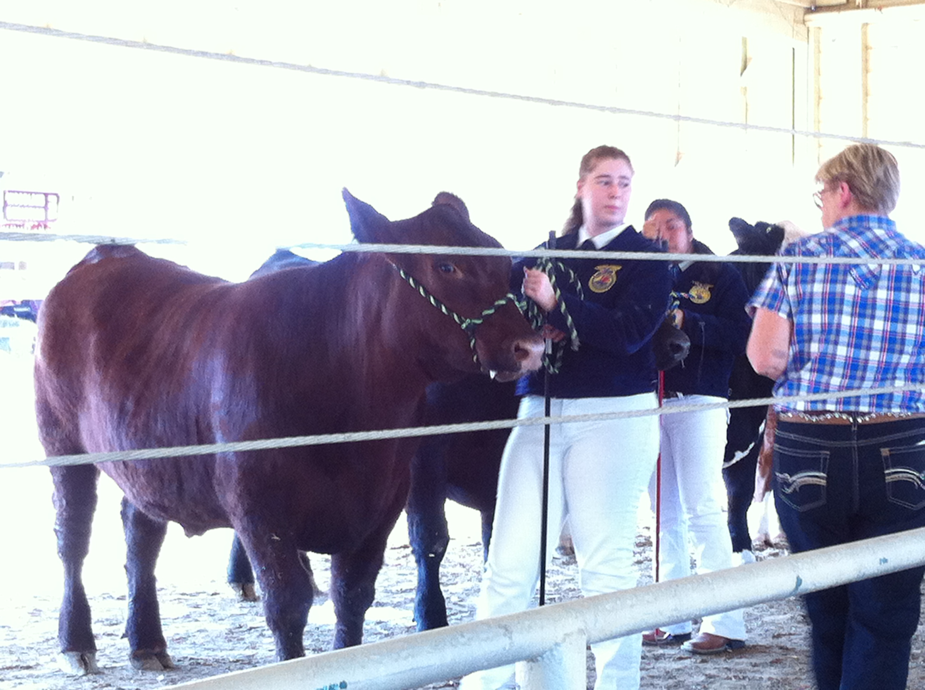
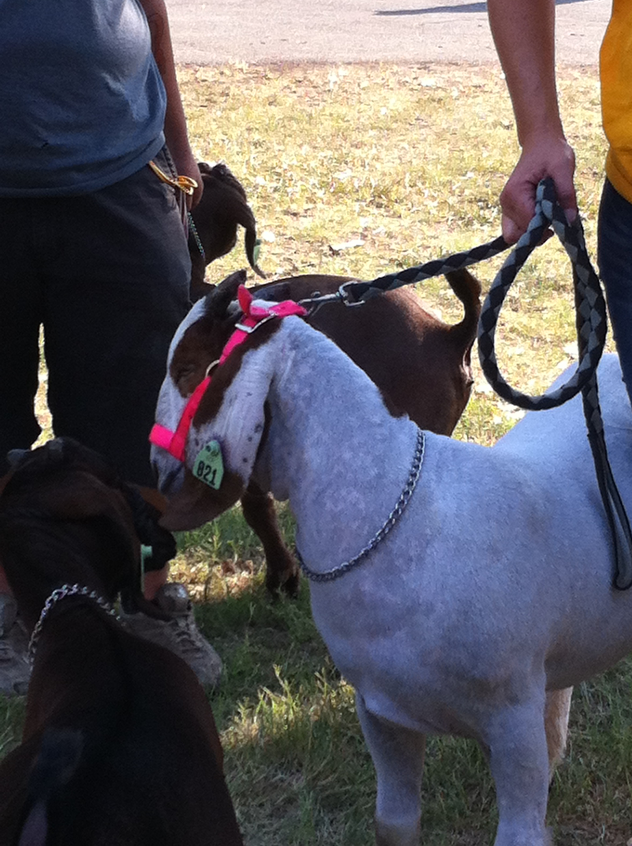
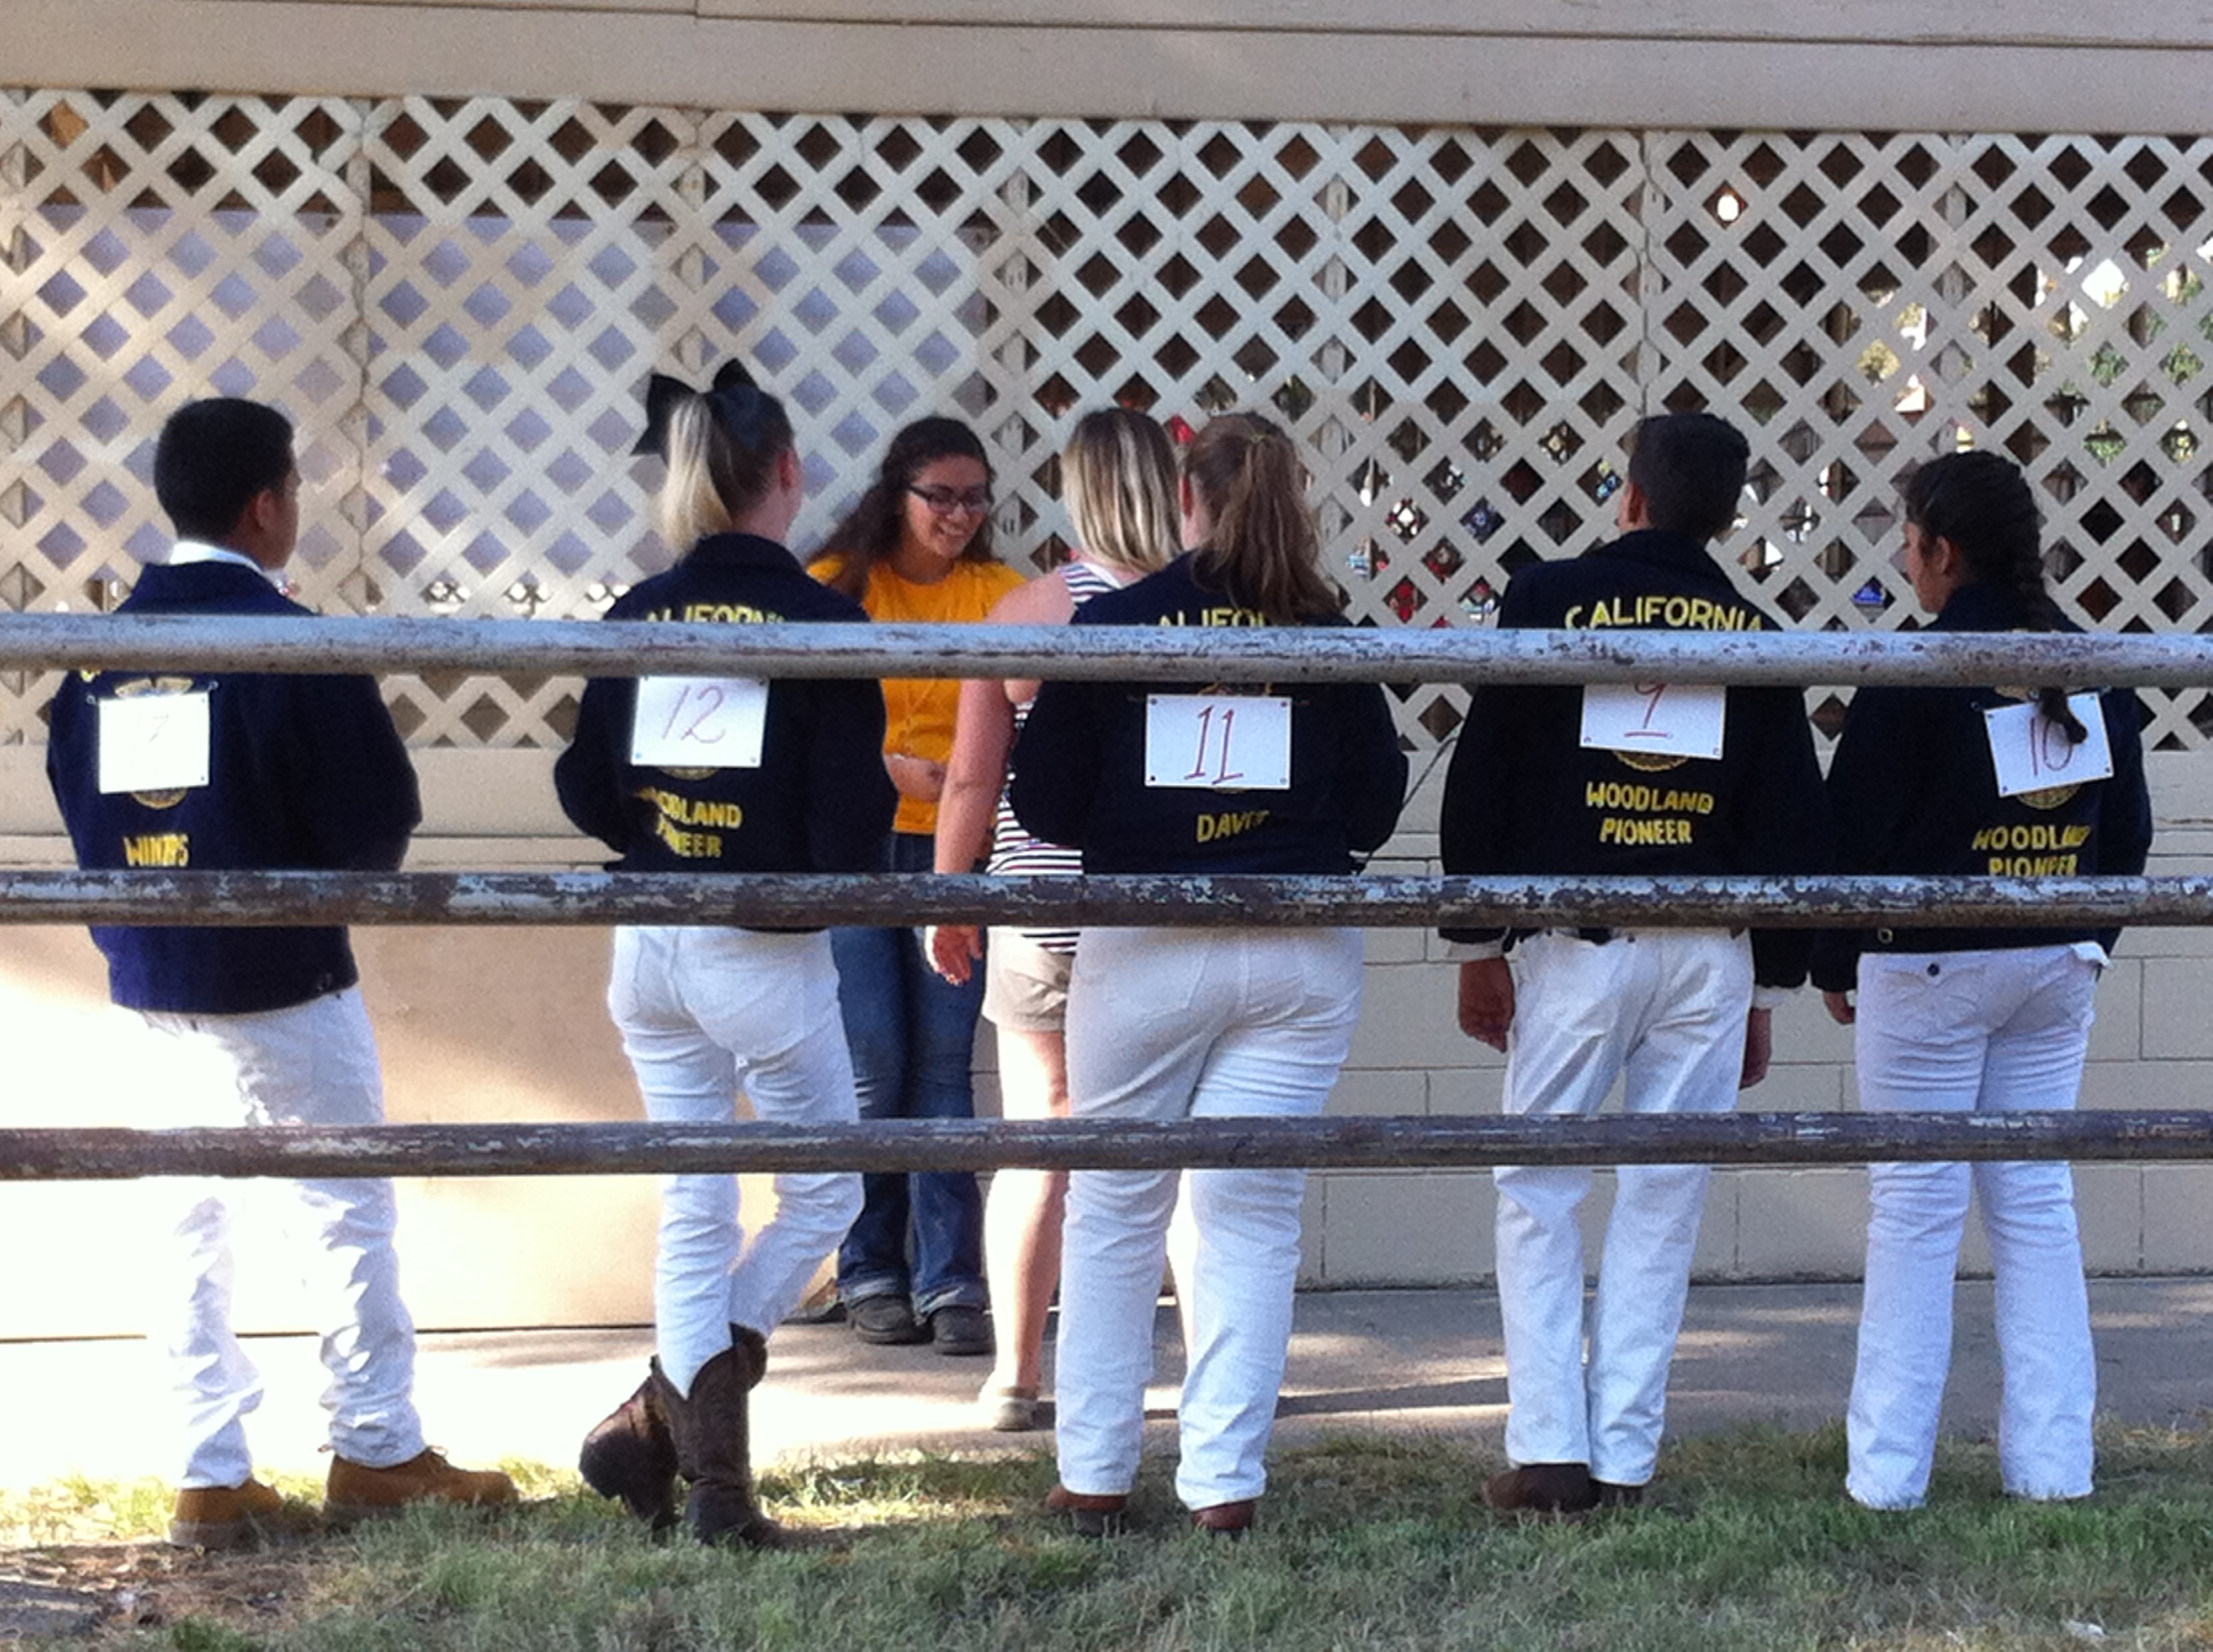
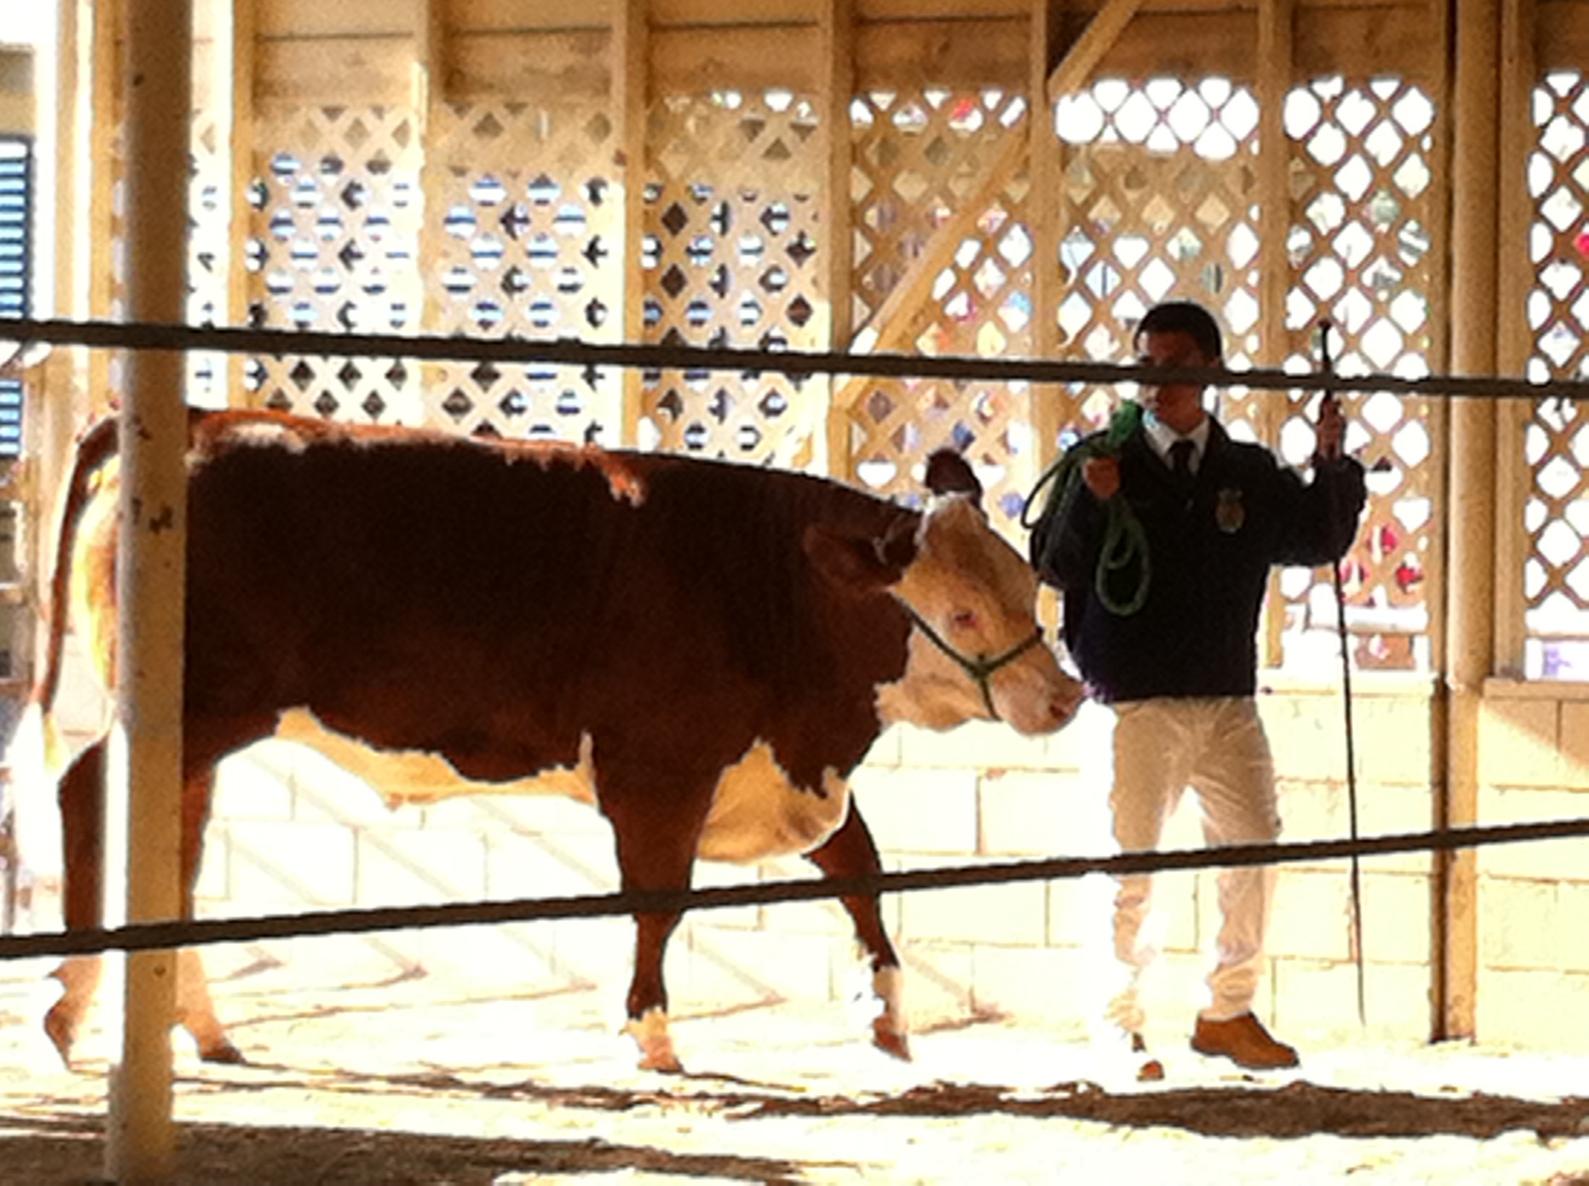
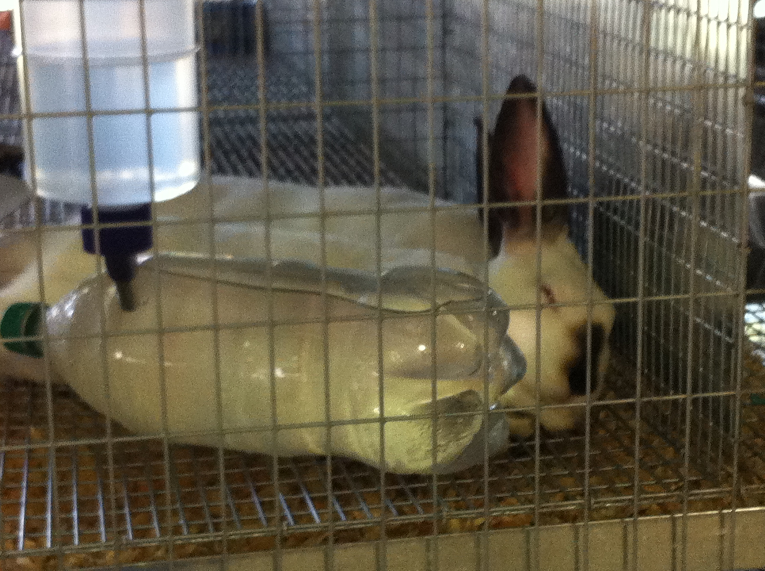
Yolo County Fair

Slide 4
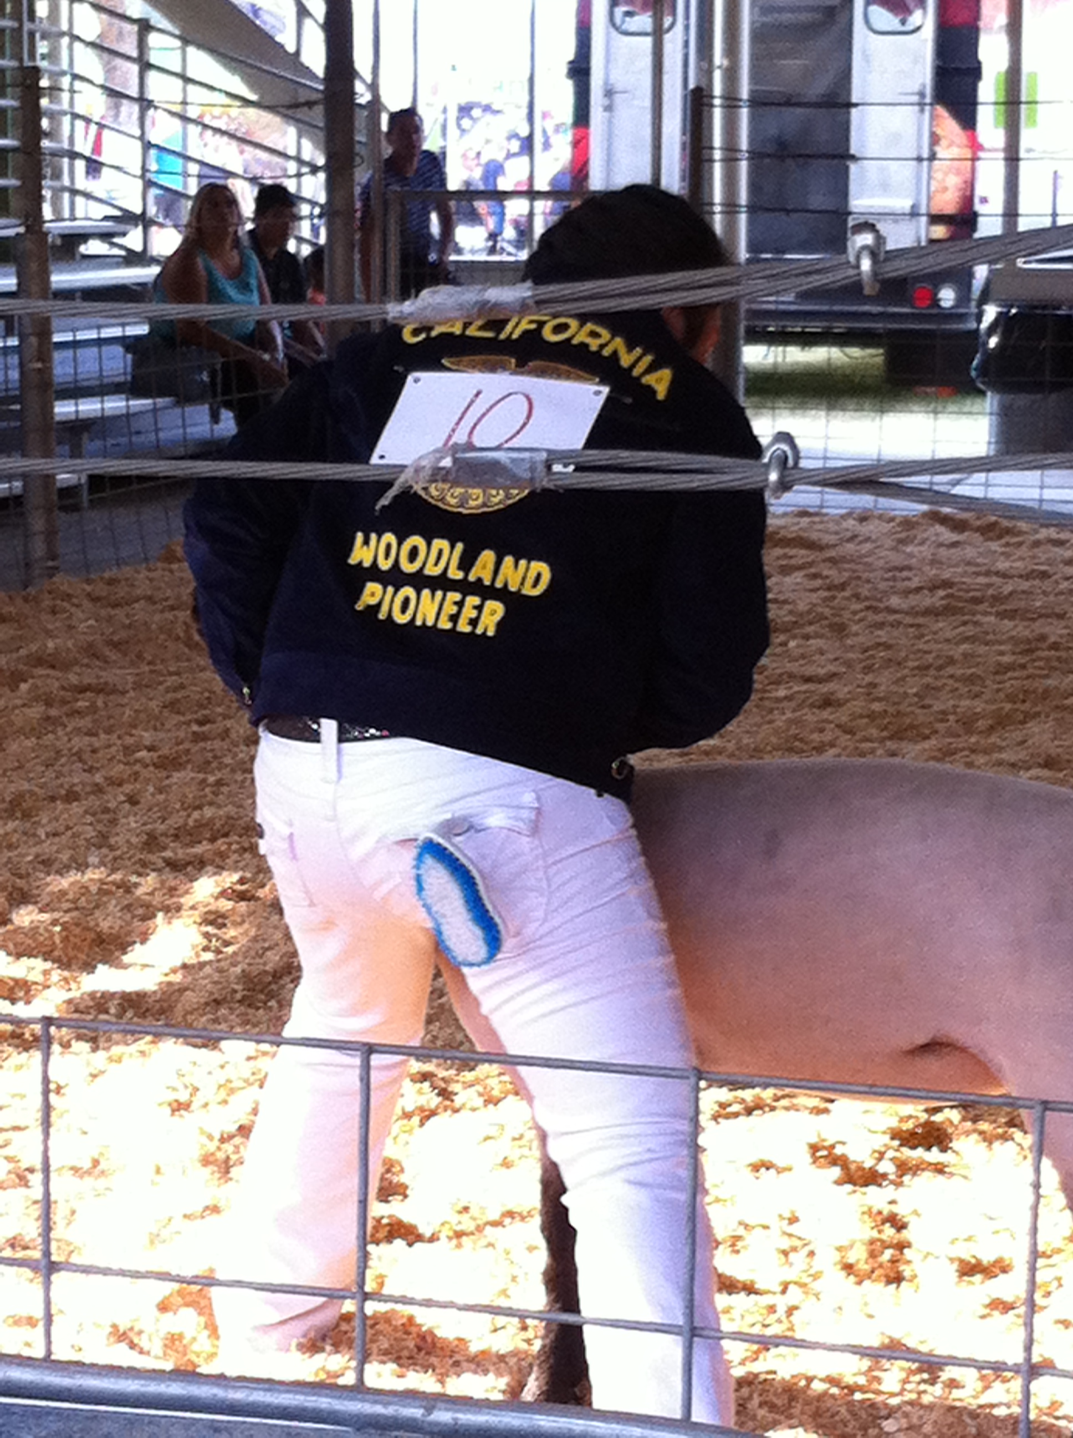
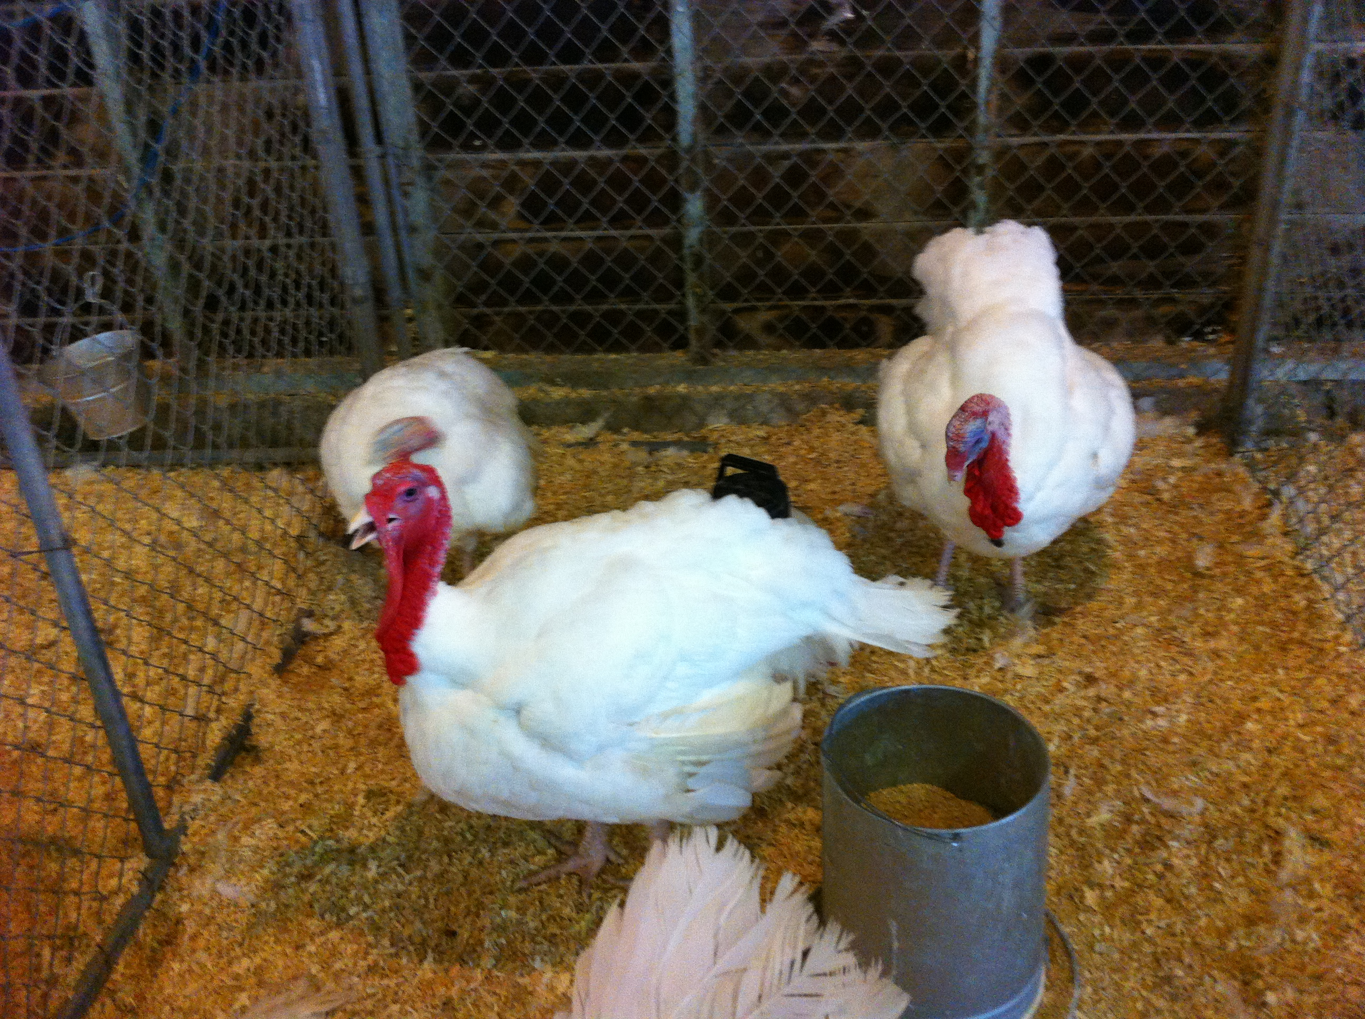
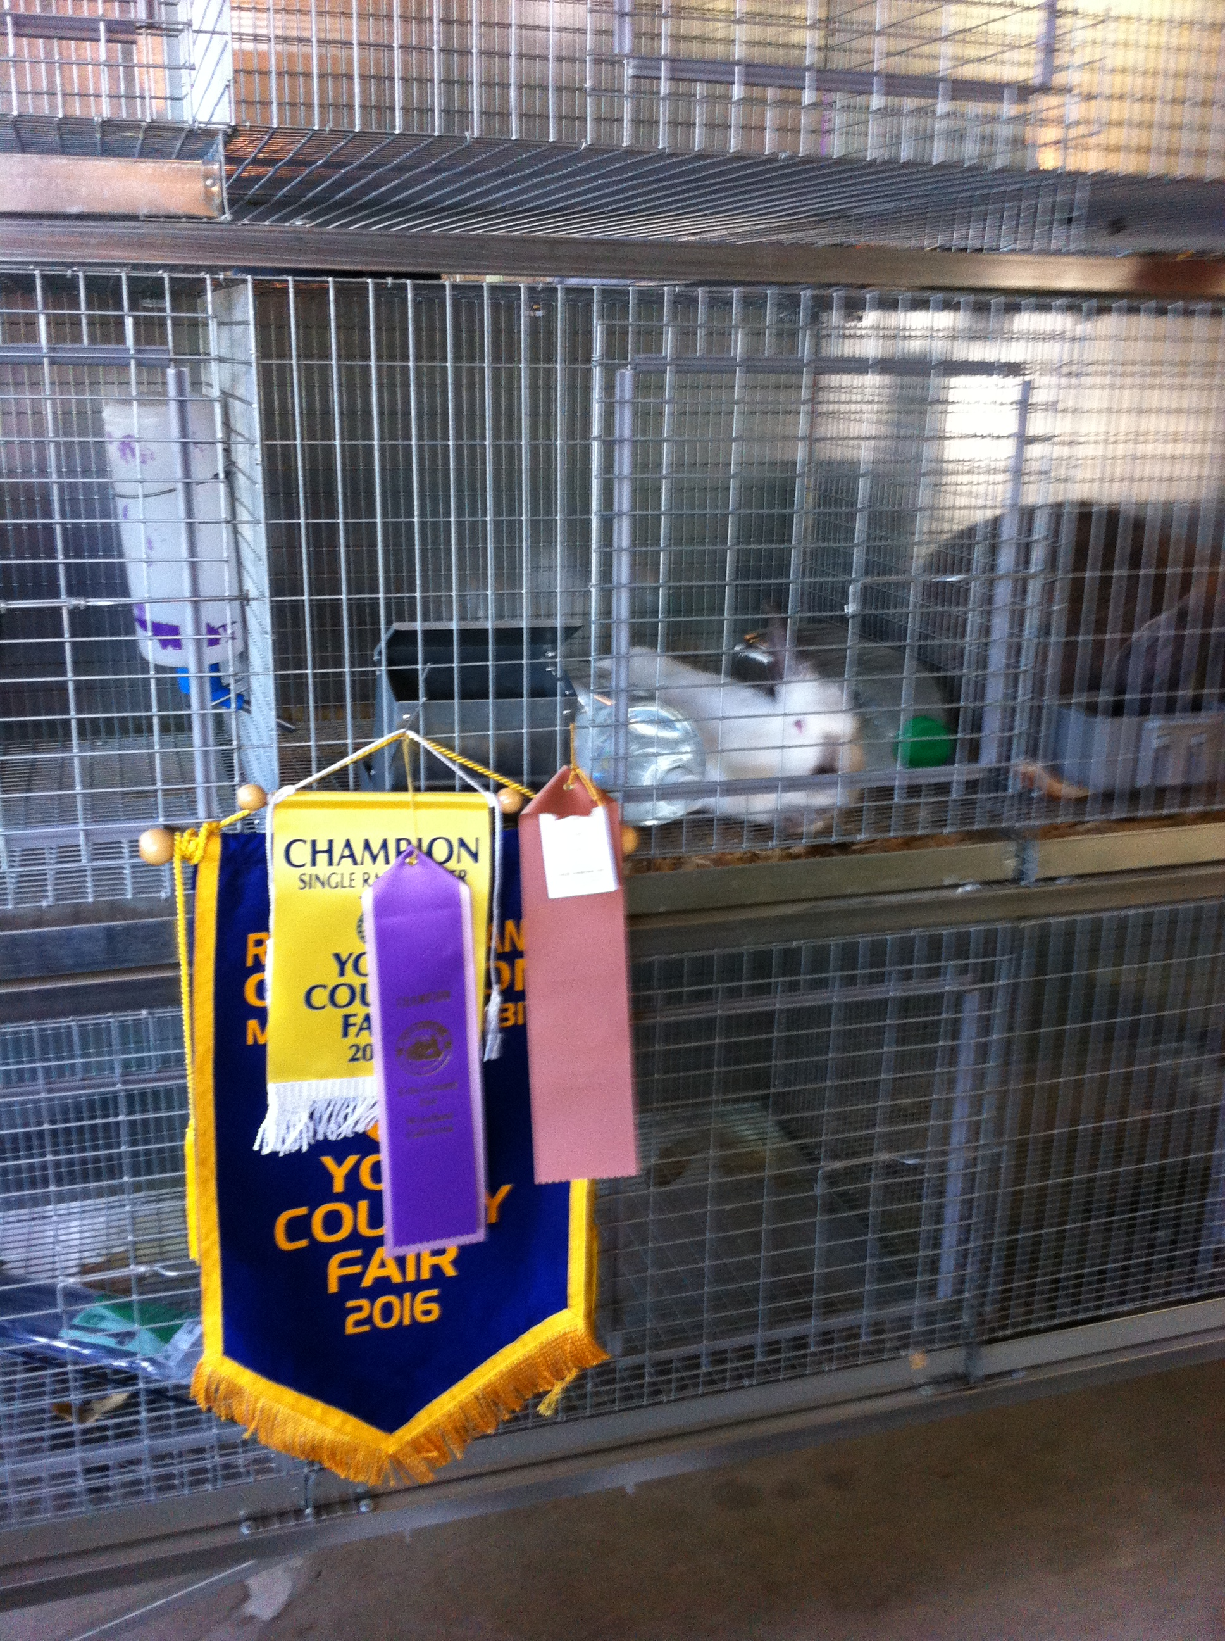
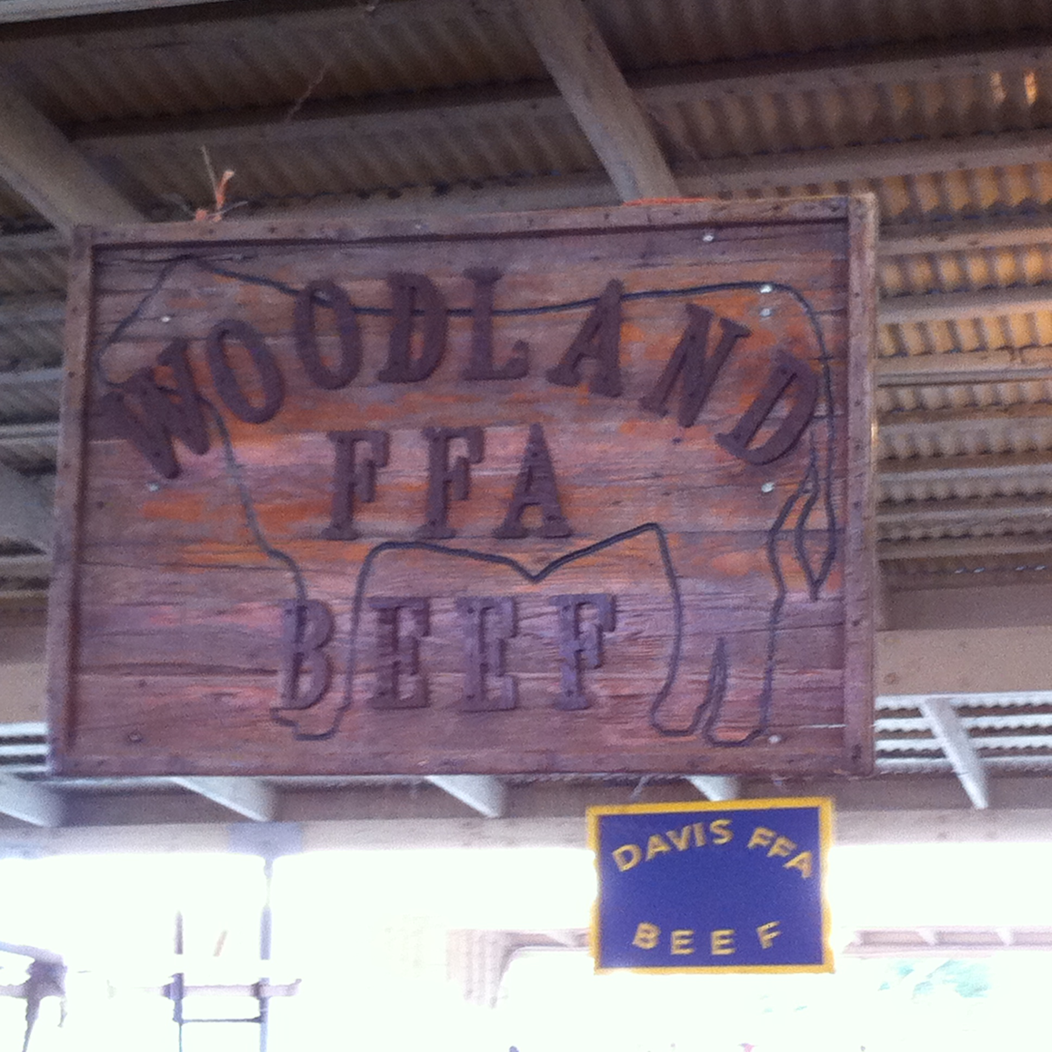
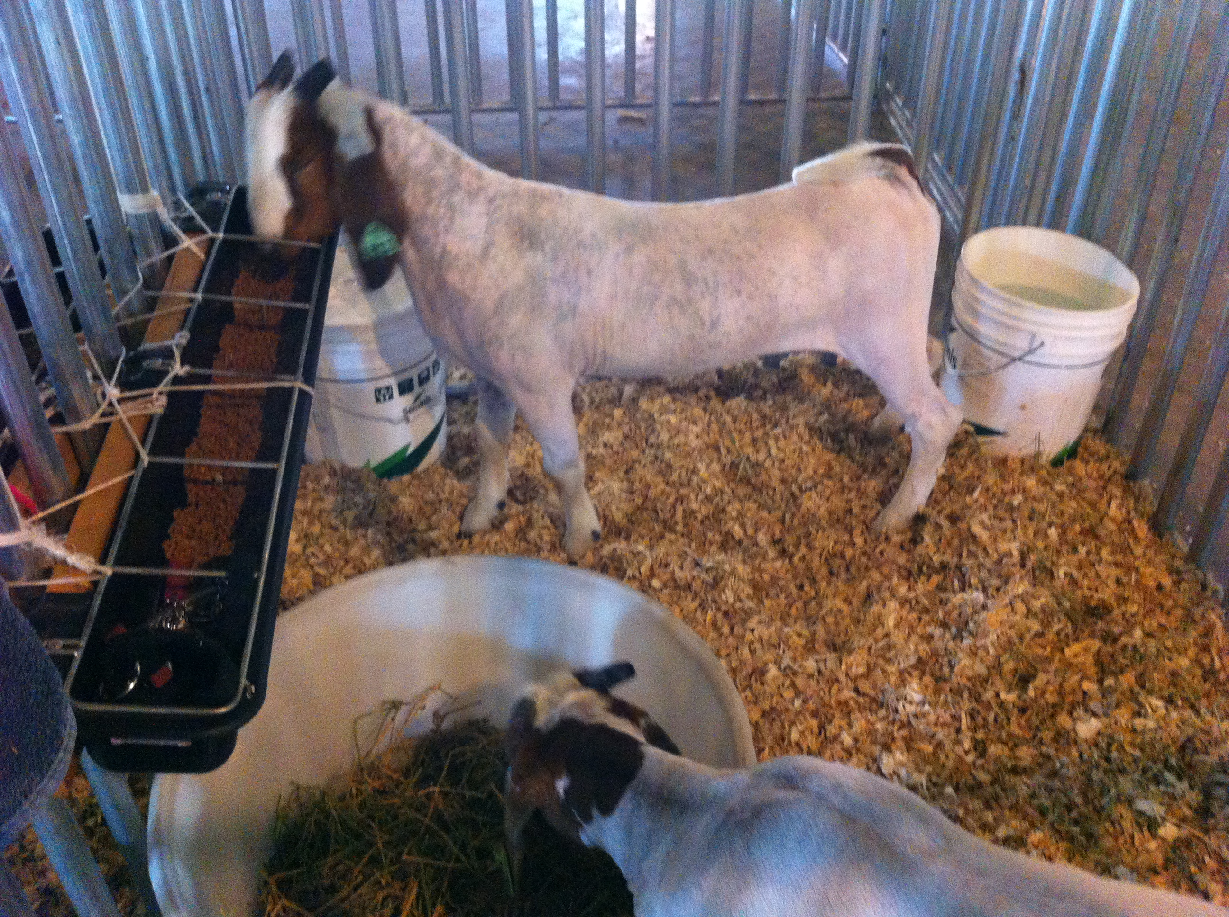
Yolo County Fair

Slide 5
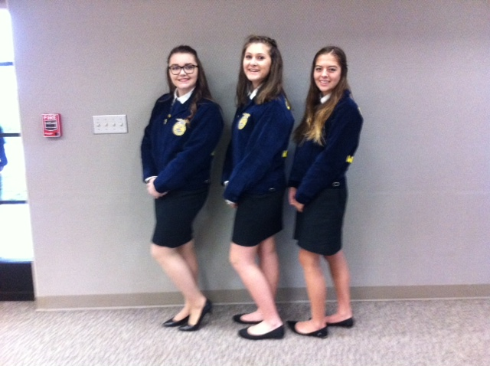
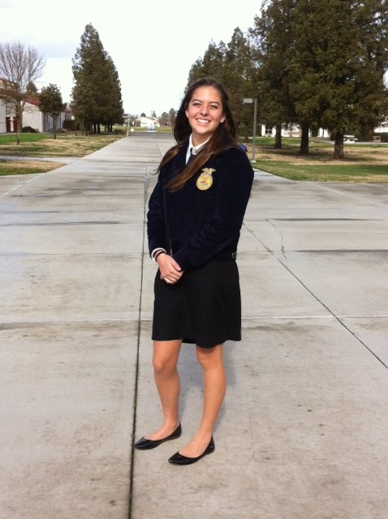
FFA Yolo Sectional Public Speaking Contest
January

Slide 6
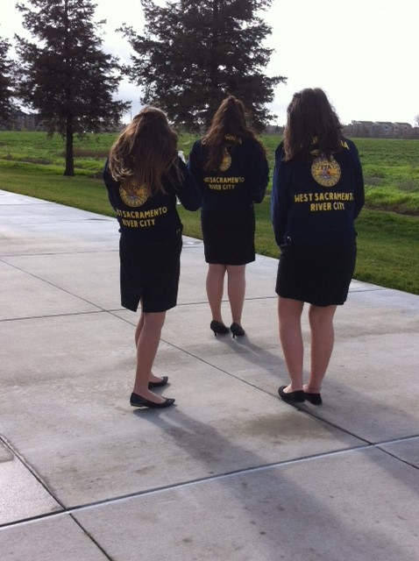
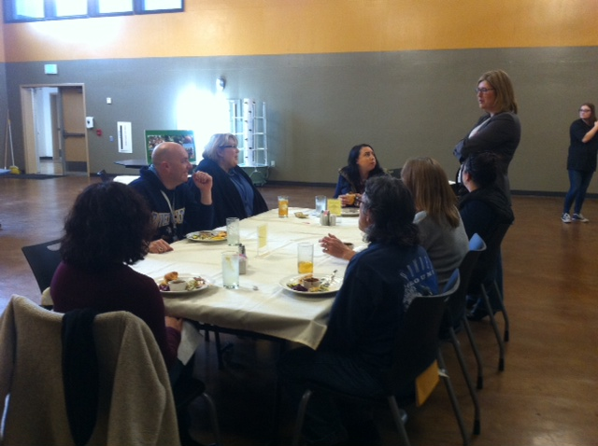
Proud of my Culinary Arts and FFA students!
Great Pulled Pork sandwiches.

Slide 7
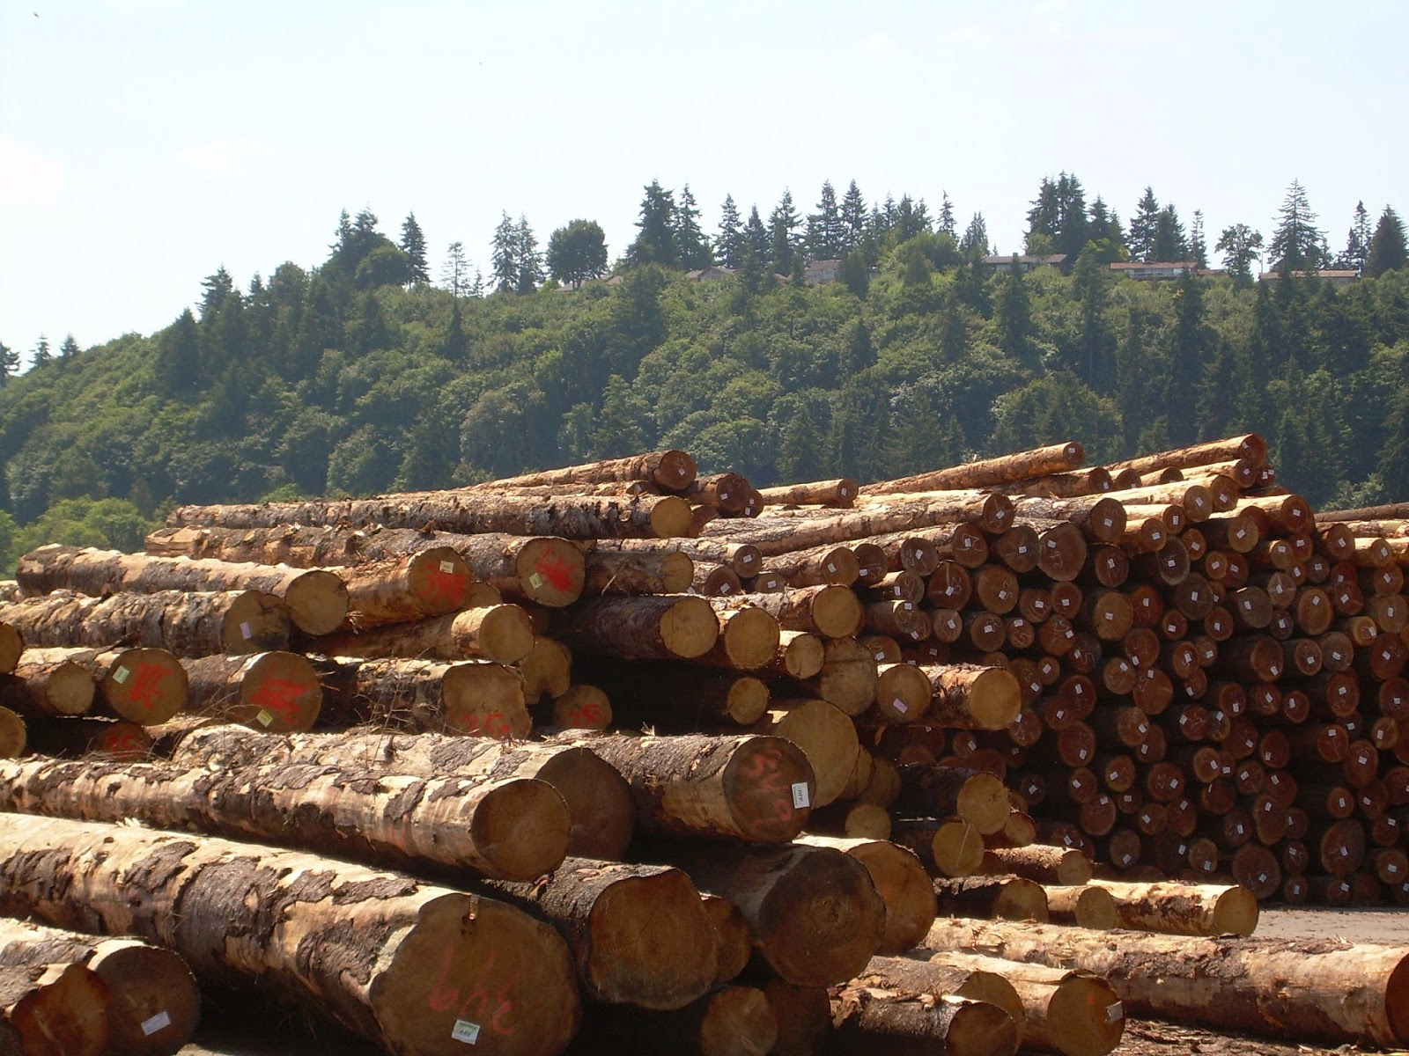

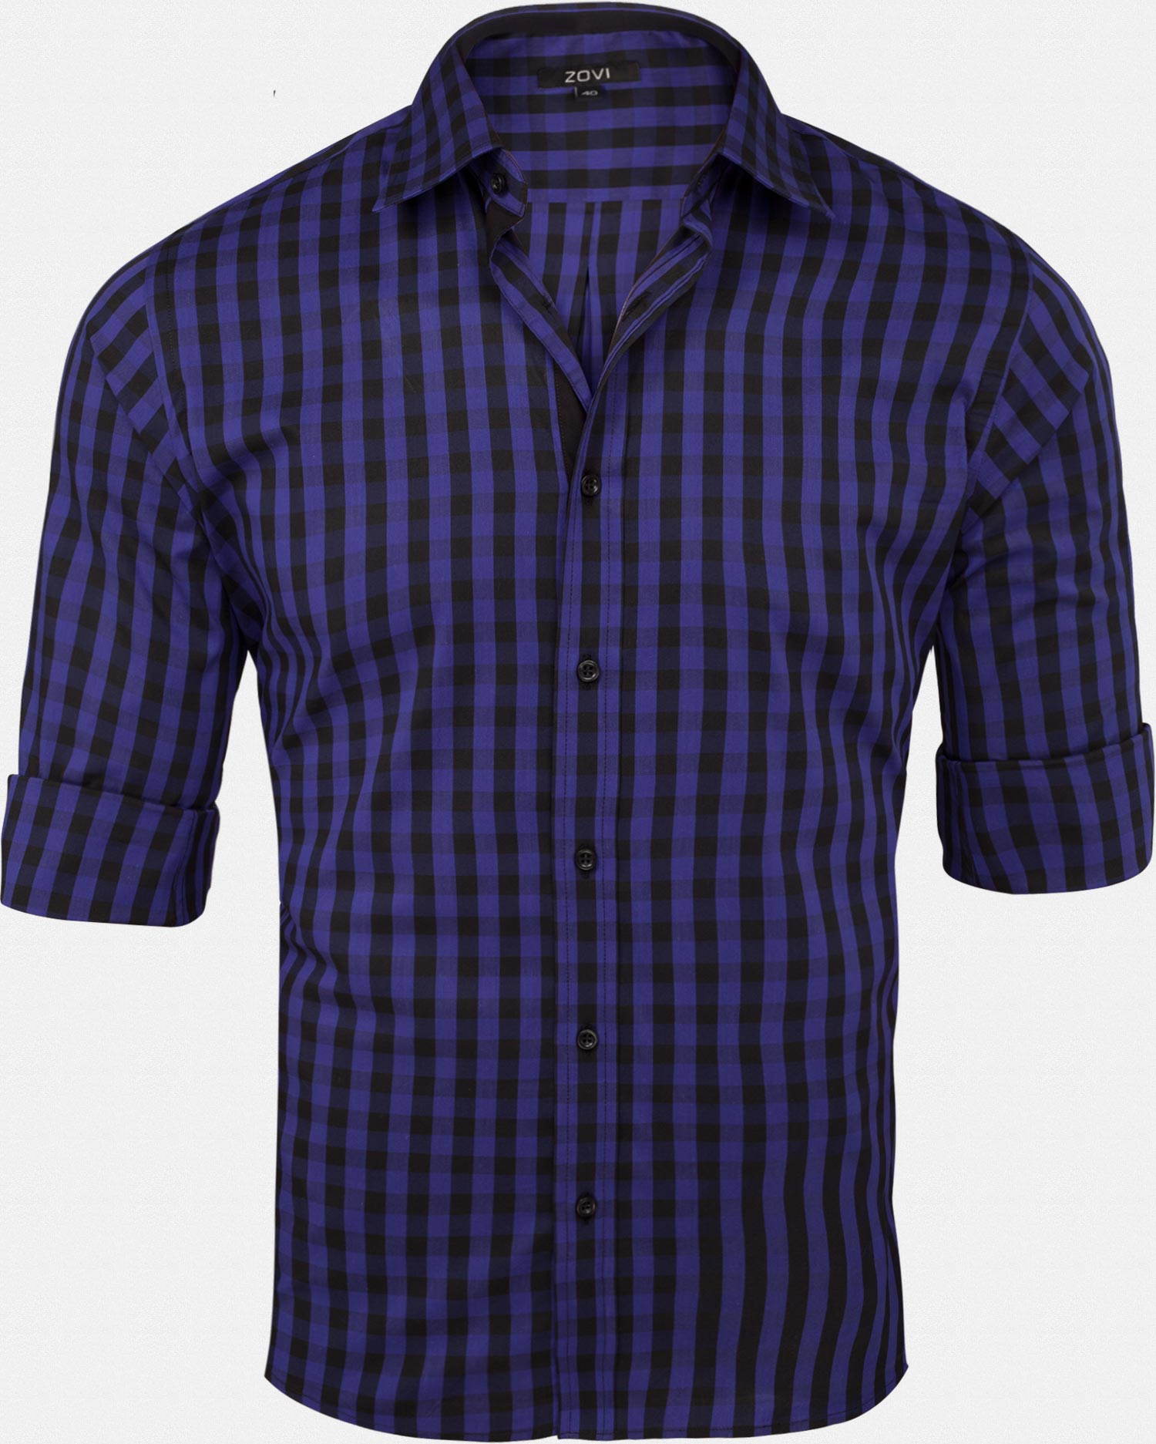
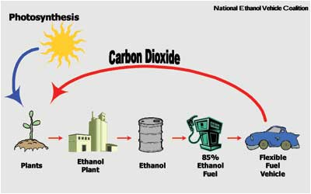
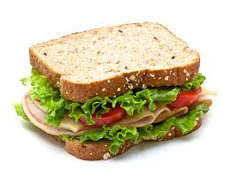
The 5 F’s of Agriculture
Food – Sandwich
Fiber – Shirt (cotton)
Flowers – S. Cal. Largest producer
Forest – Lumber
Fuel - Ethanol

Slide 8
Getting to know your fellow Agriculture student Activity
Working with a new friend, introduce yourself and EXPLAIN your favorite fruit.- Don’t say it.
Your partner has to guess the fruit. When they are right – Give them a High Five! Your turn.
Working together, discuss what you think the answers are and why? If you can’t come up with a good reason why – leave it blank, for now. NO GUESSING.
Now swap partners, Introduce yourself by sounding like your favorite animal☺ When they guess the animal, give them a another High Five! Your turn.
Lastly, work with this partner to go over any answers you may not have, or just to talk about the answers and reasons why your have those answers.

Slide 9
California Agriculture Quiz Answers
T
T
T
T
T
California $43 B, Iowa $29.9B, Texas $22.7 B
Milk & Cream, Almonds, Grapes, Cattle & Calves, Nursey Products, Strawberries, Hay, Lettuce, Walnuts, Tomatoes
78
81
312
420
43.5

Slide 10
Student Interest Survey
For your Interest Area:
Why did you choose what you chose?
How do your interests from the tour relate to the Interest Survey?
  What projects could you do?
  Ie. Care for a garden bed, or rabbits or tower garden, or build the Aquaponics unit on Saturdays, Farm to Fork Festival. Teach younger students about food, nutrients and disease.
Page 13 NB Write three SAE ( Supervised Agricultural Experiences) are:

Slide 11
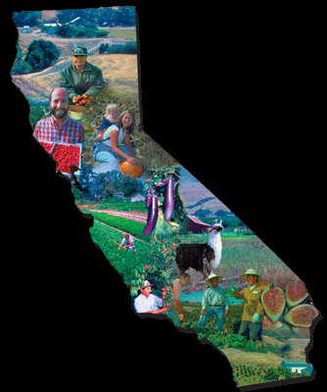
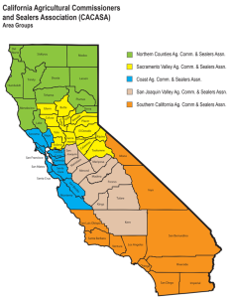
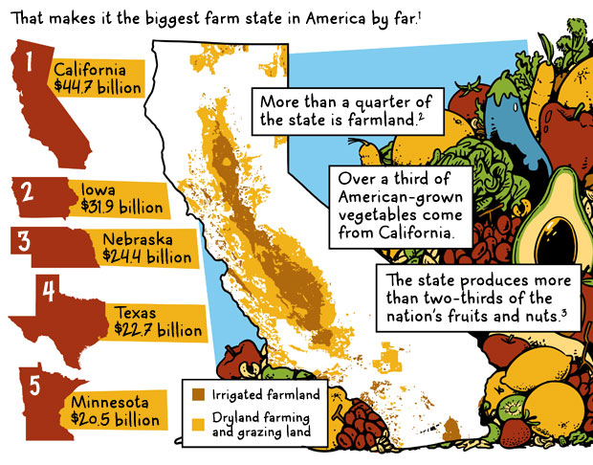
8/21 Agriculture in California
Objective: The Student will develop a better understanding of how Agriculture is important in California. P. 12 NB
Describe 3 of the 5 F’s in Agriculture.
Where does Ethanol come from?
Describe 3 of the top 10 Commodities produced in California.

Slide 12
FFA
Future Farmers of America Video
https://www.ffa.org/sitecollectiondocuments/ffa_official_manual_english.pdf
Search the above website or FFA.org
  What does FFA stand for?
  How can you benefit?
  How many FFA members are there in the US?
  Find the Emblem, Motto, Creed, Colors, Salute

Slide 13

8/22 Learning about FFA
Obj. TSW learn about the emblem, motto, creed, colors and salute of the FFA. P. 14 NB
After reviewing the website and seeing the video, What are the main parts to the emblem? What is their significance?
Write the FFA Motto.
Describe the colors and the salute of the FFA.

Slide 14
Learning about FFA Activity
Match each of the following FFA words to what they are: P. 15 NB
SALUTE
Written By E. M. Tiffany
I believe in the future of agriculture,…
National Blue and Corn Gold
MOTTO
This consists of 5 symbols: cross section of Corn, the rising Sun, the Plow, the Eagle, the Owl
EMBLEM
Learning to Do, Doing to Learn,
Earning to Live, Living to Serve.
CREED
I pledge allegiance to the Flag of the United States of America and to the Republic for which it stands, …
COLORS

Slide 15
Edible Plant Game
Have 1 or 2 partners.
Get 1 card to share among the 2 – 3 of you.
Someone starts by reading the description at the bottom.
Whoever’s description is on someone else’s card Identifies what it is: “ Carrot”
Then the “Carrot” reader reads the description on the bottom of their card, etc.

Slide 16
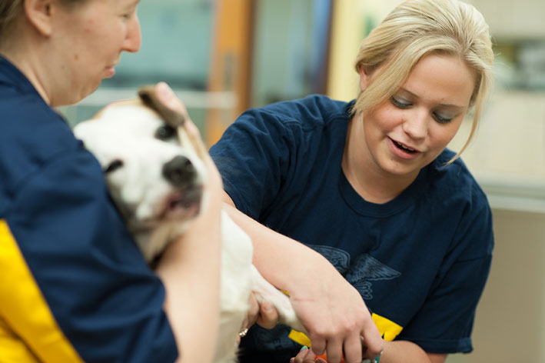
8/23 Supervised Agricultural Experience (SAE)
Obj. TSW familiarize themselves with the different types of SAE’s. P. 16 NB
Using the FFA Official Manual, Page 10 & 11 What are the six different types of SAE’s?
Which one are you most interested in? Why?
What other questions do you still have about SAE’s?

Slide 17
SAE’s
Service Learning – Farm to Fork Festival
Placement & Internship – Job & sometime it’s unpaid. Experience – Fiery Ginger Farms – Urban Farms
Ownership/ Entrepreneuship – Having a bunny, chickens or land Make$ or not.
Agriscience Research & Experimentation – Greenhouse, Scientific Method – Collect Data
School Based Enterprise – Tower Gardens, Garden beds, Greenhouse
Exploratory – Explore Ag opportunities

Slide 18
Tour the Garden
Develop talking points with people.
Never make up information or guess. It’s OK to say “I don’t know, but I will find you the answer.”
Always be polite, friendly and helpful. Listening is an important part to any conversation.
Emphase what we are about, “healthy food, knowing where our food comes from, and how it is grown.”
Heart Disease, Diabetes, and Obesity are the three chronic diseases directly linked to food, and how it is consumed.
7 out of 10 America deaths are from chronic diseases - “US Centers for Diseases Control and Prevention.”

Slide 19
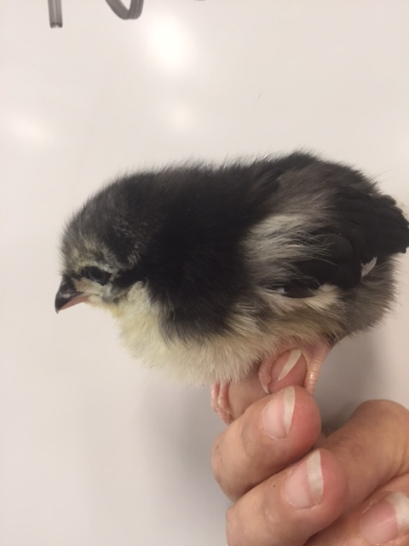
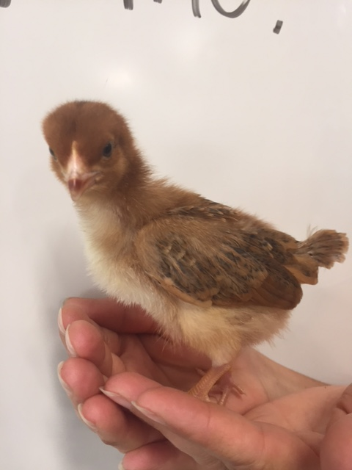
CHOOSE Three Names for each:
Bubbles, Cleo, Nike
Nugget, Penny, Ducky

Slide 20
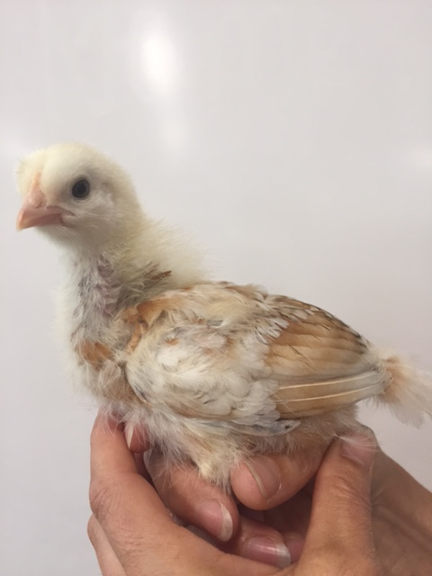
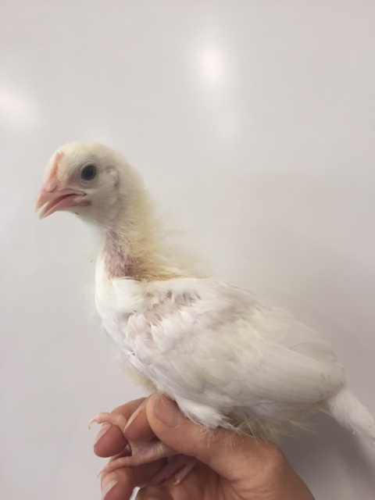
CHOOSE Three Names for each:
Vanilla, Daisy, Spice
Kiki, Sugar, Chica

Slide 21
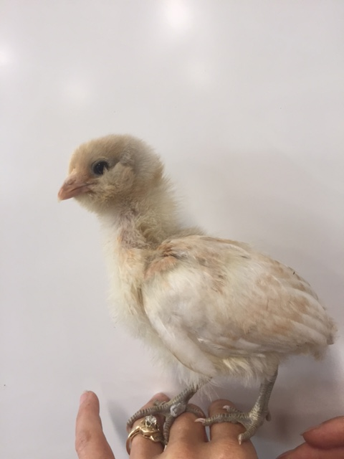
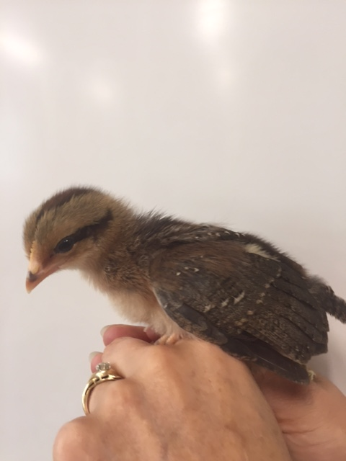
CHOOSE Three Names for each:
Tweety, Twinky, Monster
Butter Cup, Spike, Flower

Slide 22
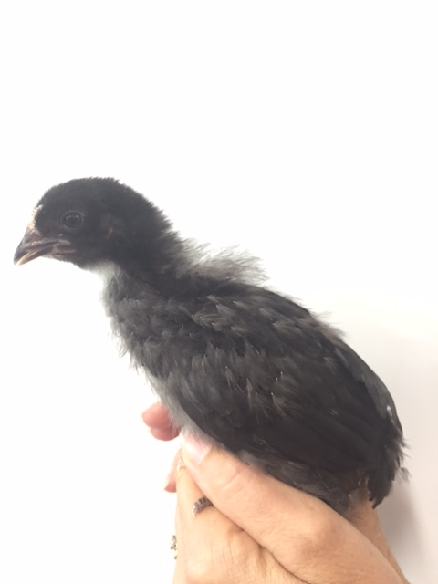
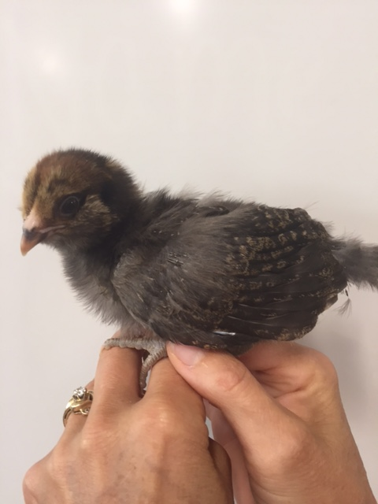
CHOOSE Three Names for each:
Toasty, Rocky, Olive
Mable, Edna, Mildrid

Slide 23
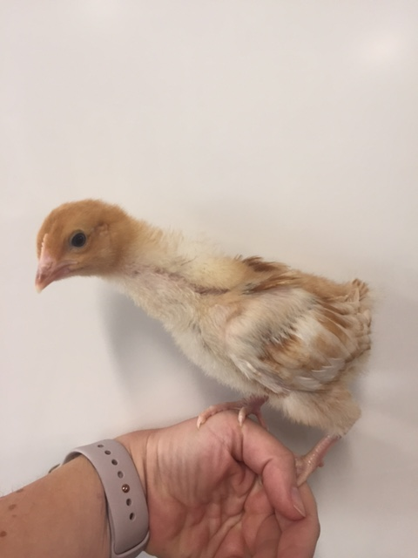
CHOOSE Three Names for each:
Penelope, Honey, Gin

Slide 24
What’s Growing On? Page 19 NB
Who are they?
What is their role in Agriculture?
  Think of the 5 F’s: Food, Fiber, Flower, Forest, Fuel
  Automation? Data analysis?
Would they be a good guest speaker? Fieldtrip?
Fun fact?

Slide 25
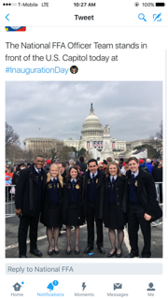

Slide 26


Slide 27
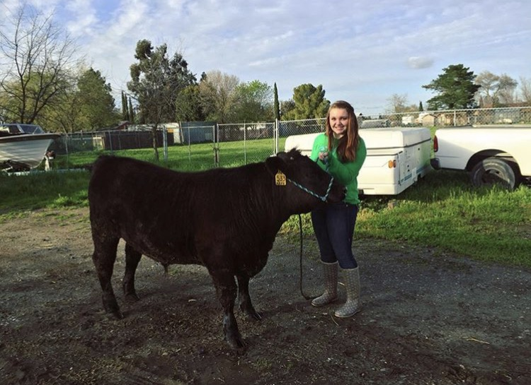

Slide 28
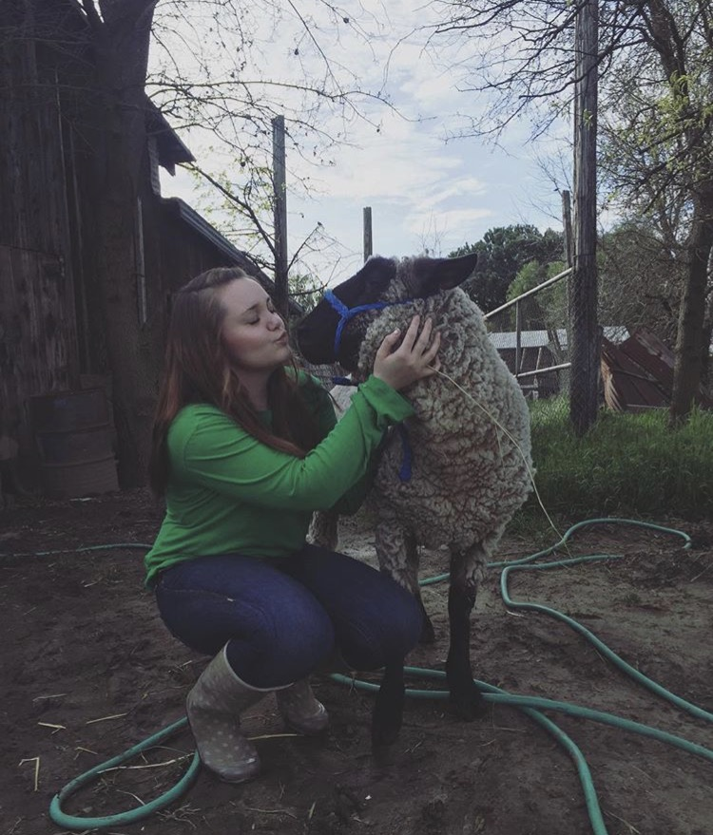

Slide 29
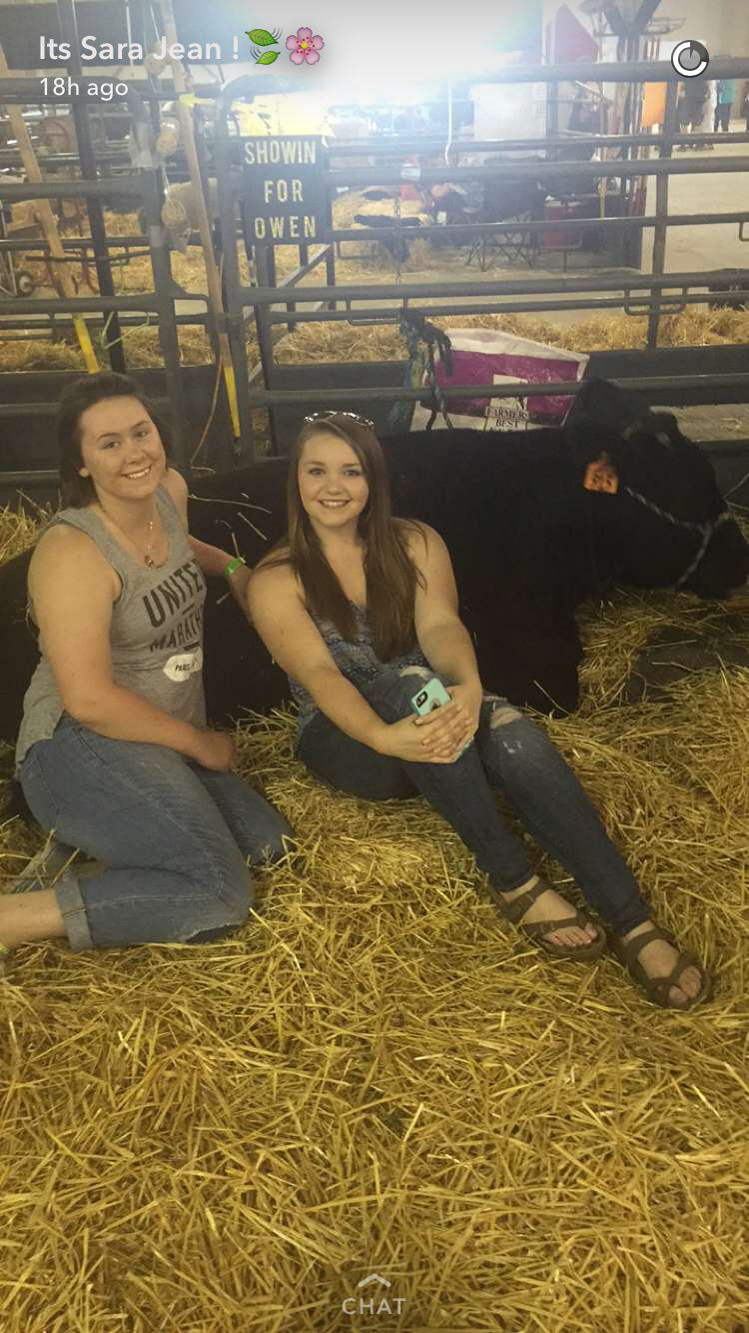
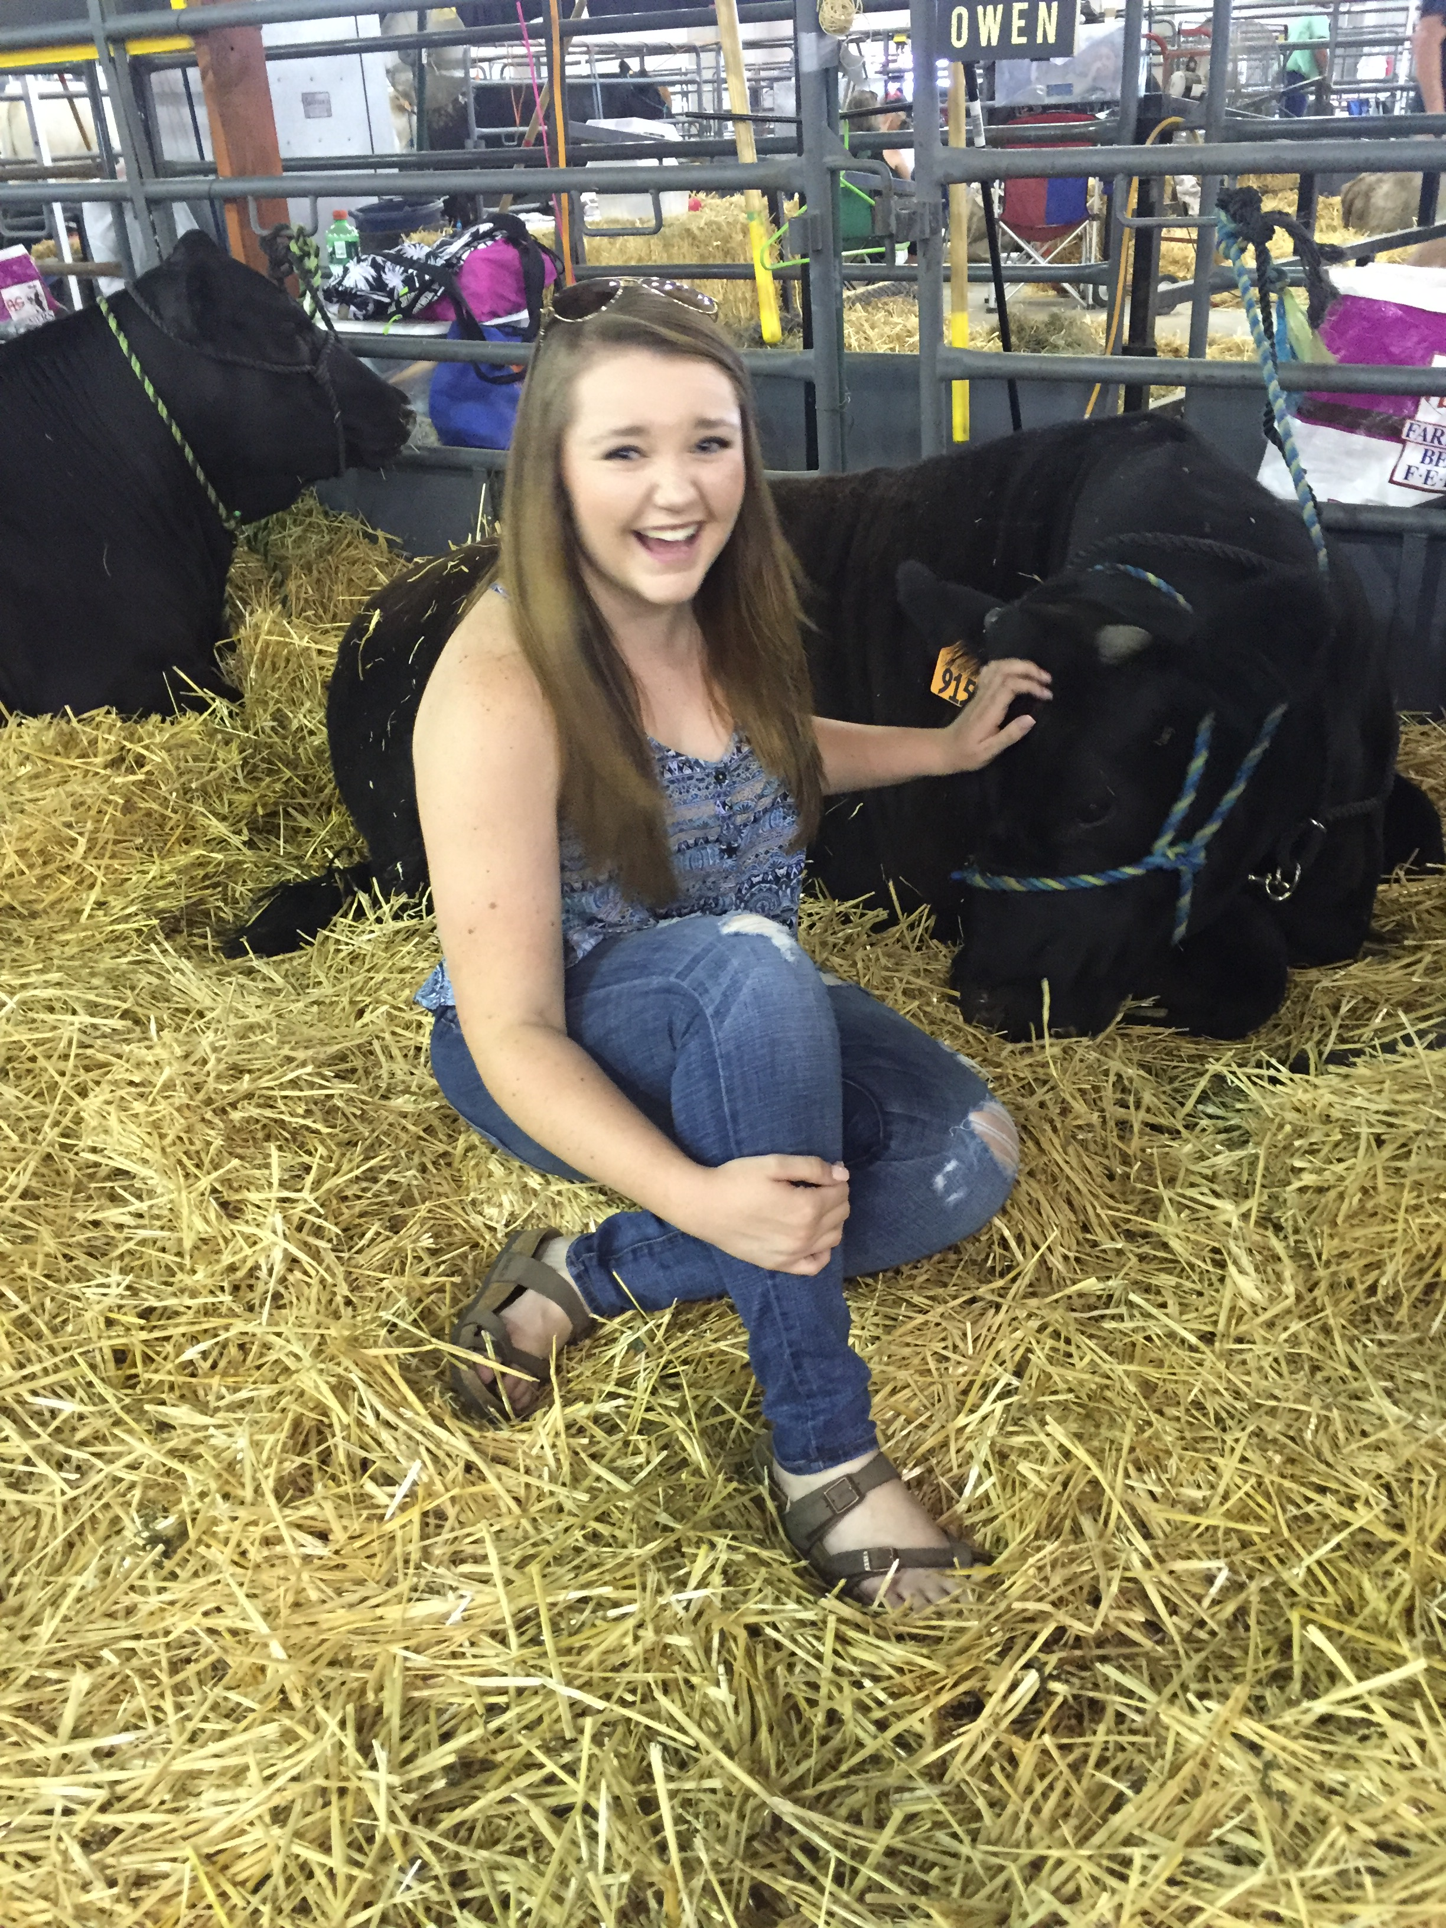

Slide 30
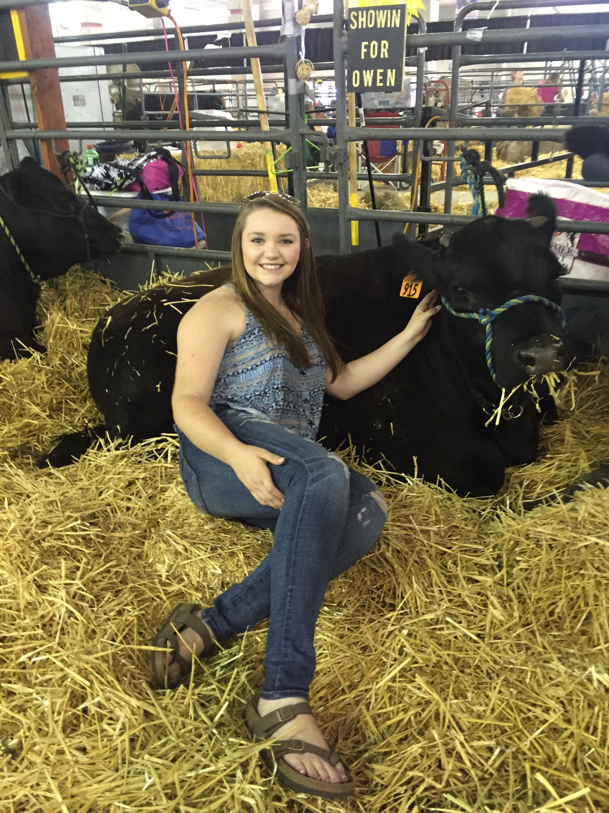
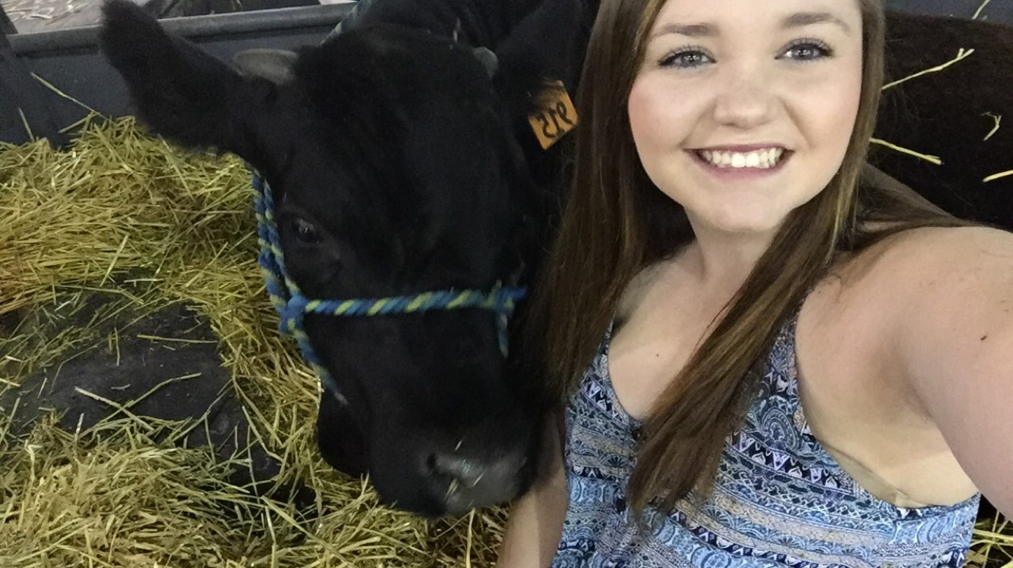
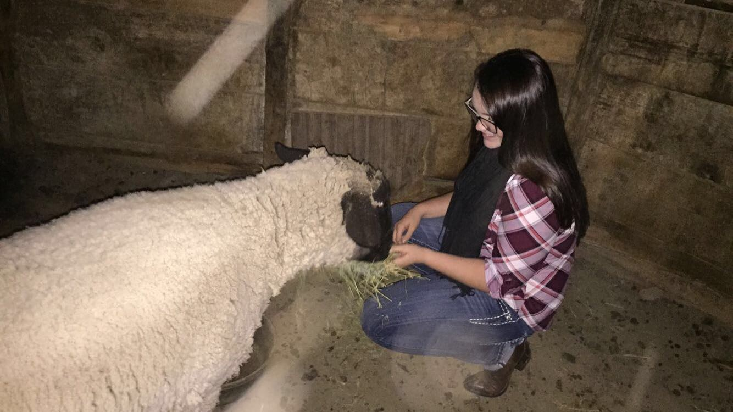

Slide 31
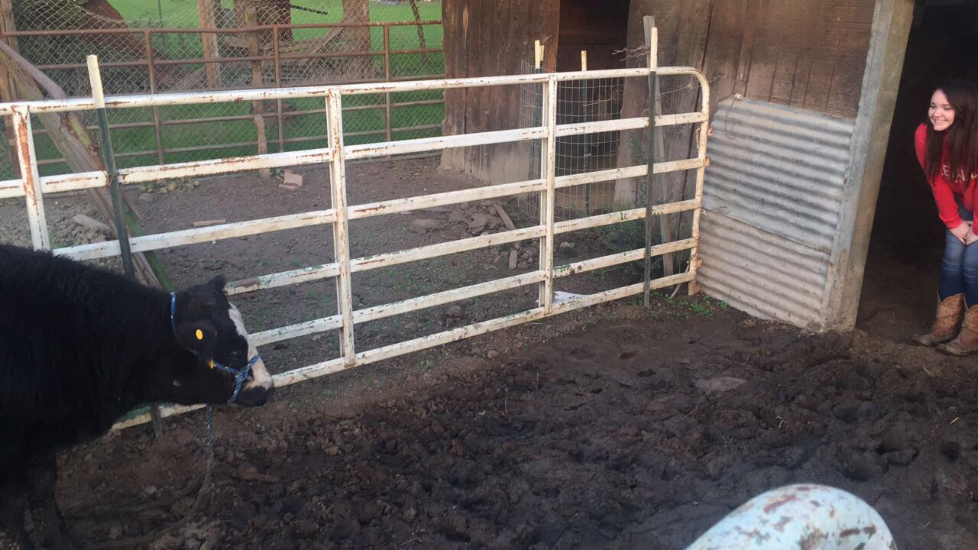

Slide 32
Squishy Fruit Name Game
Everyone stand in a circle.
McAllister starts by saying “Mandarine McAllister” and tosses the “squishy” to another student who says “Mandarine McAllister”, then they say their name with a “fruity” adjective before their name.
Each person has to say the persons before them.
The last person has to say everybody.
Then we add more “squishies!”

Slide 33
Check out our website.
Ag Biology

Slide 34
8/24 Theaet.com FFA Record Book
TSW learn how to keep accurate records of their work, hours involved with SAE’s & FFA. P. 18 NB
Why might it be a good idea to keep a record of your activities with your SAE?
How can a good record book help you get a job?
Awards are earned at the State level for quality record books.

Slide 35
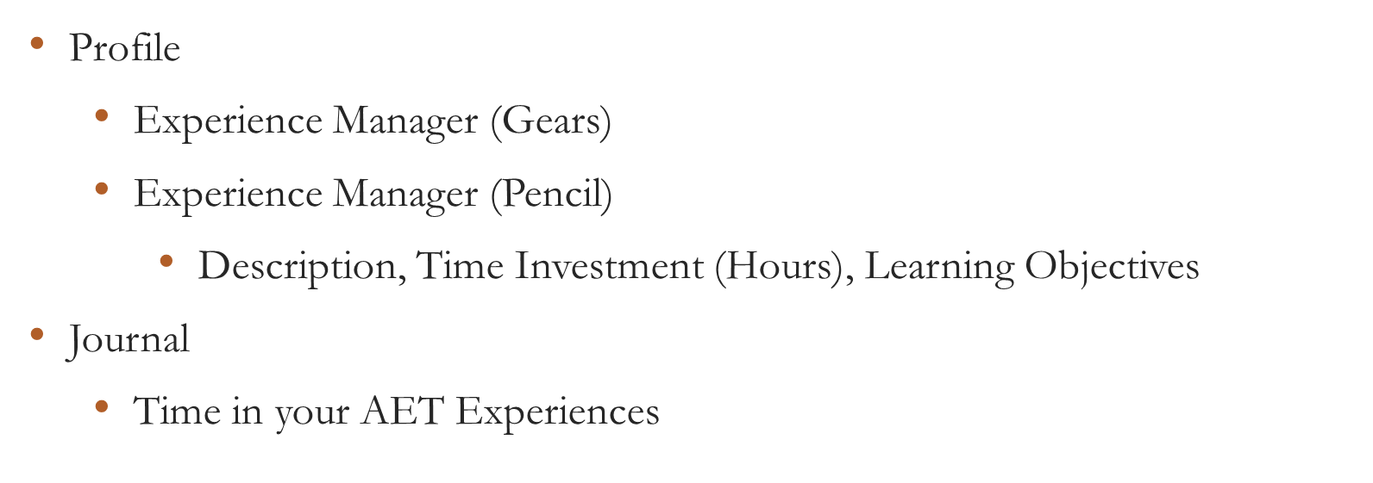
Exploresae.com
Set your password. Add Ag Biology as a class, Choose Ag Career & Pathway

Slide 36
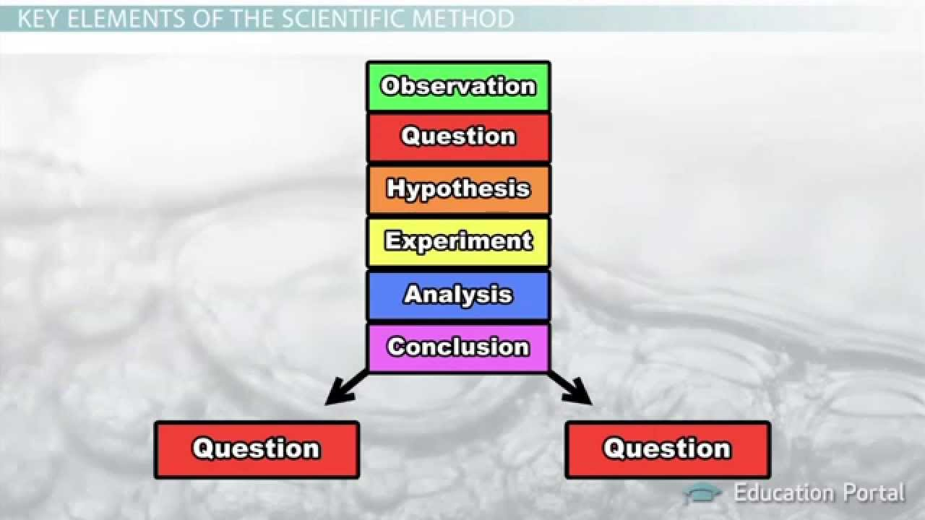
8/25 Scientific Method
Obj. TSW preform a lab using the scientific method. P. 20 NB
What are the parts of the scientific method?
Compare and Contrast a Control and a Variable (Experimental Group) in the scientific method.
Compare and Contrast an Independent Variable and a Dependent Variable.
Homework: Email me your definition of Agriculture and Leadership. Attach a picture that represents how you see Agriculture and Leadership. It can be your own picture too.
jmcallister@wusd.k12.ca.us

Slide 37
Edible Plant Game
Have 1 or 2 partners.
Get 1 card to share among the 2 – 3 of you.
Someone starts by reading the description at the bottom.
Whoever’s description is on someone else’s card Identifies what it is: “ Carrot”
Then the “Carrot” reader reads the description on the bottom of their card, etc.

Slide 38
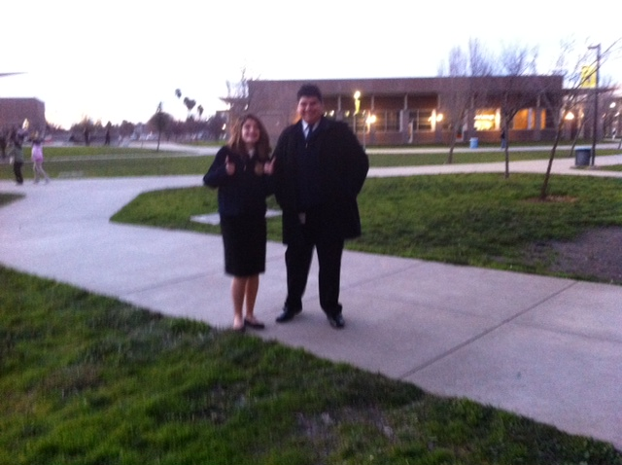

Slide 39
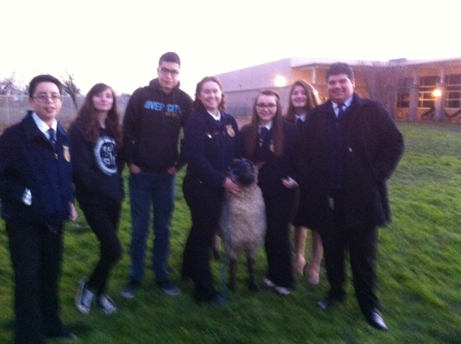

Slide 40
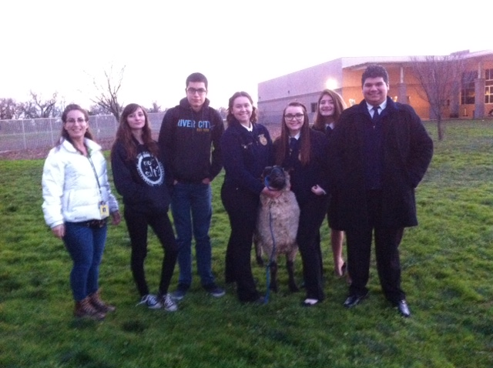

Slide 41
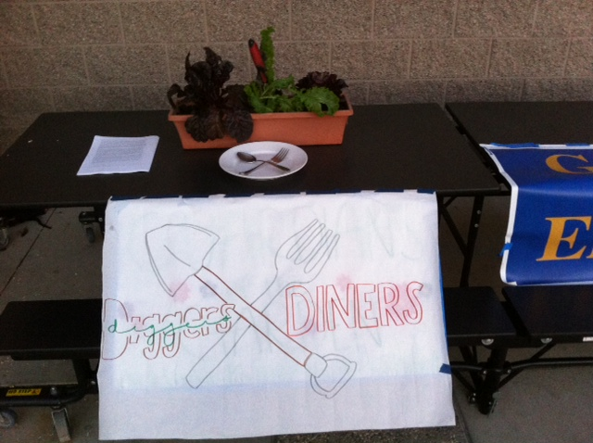

Slide 42
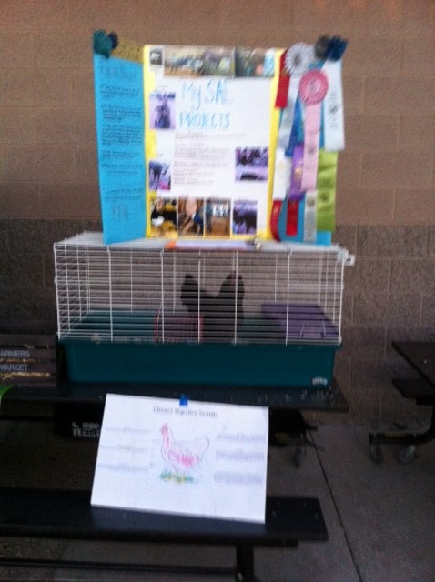

Slide 43
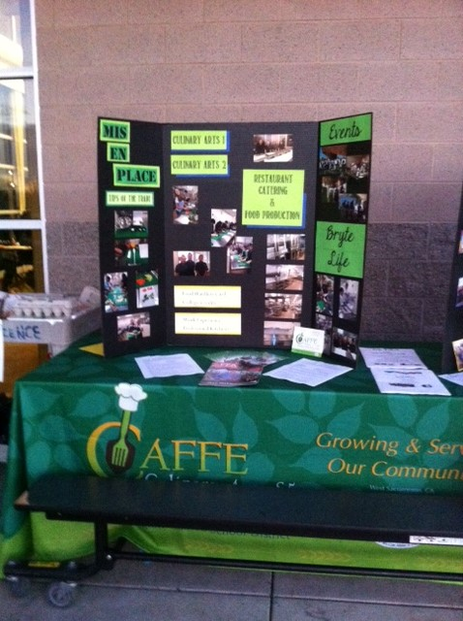

Slide 44
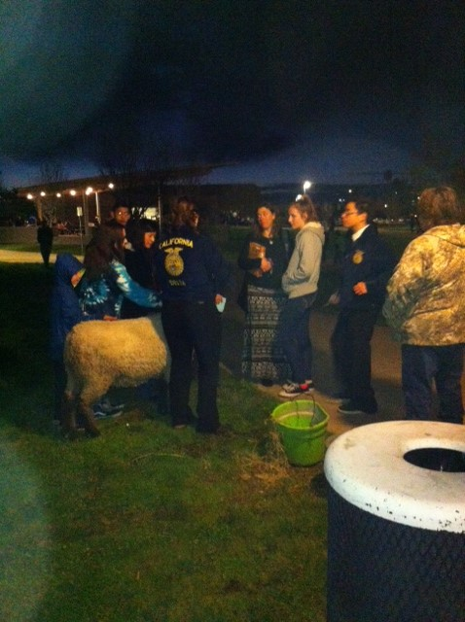

Slide 45

1/26 Body Systems p. 1048BB
Obj: TSW Understand how body systems interact to maintain homeostasis. Pg. 18 NB
Define homeostasis.
Name two body systems that you think of that interact to maintain homeostasis.
For each of the body systems you named in question #2, name a cell, tissue, and organ that make up that body system.

Slide 46
Kahoots
Ag Biology, BUT FIRST…
FFA Website= FFA.org Page 13 NB
What is Official Dress?
List all the parts.
When do you wear it?
Describe your conduct when wearing the Official Dress.
If you are involved in the Back to School Night table (Jan. 25th), and the 9th grade recruitment (Jan. 27th), I expect you to be in official dress.
Sign up with McAllister!☺

Slide 47
6 Types of SAE’s
Ownership/ Entrepreneurship – caring for Chickens, Bunnies, Guinee Pigs, other animals
Placement/ Internship – Fiery Ginger Farms, Dave Vierra Farms, Andrew Codd
Research- best fertilization methods in plants, Aquaculture project
Exploratory – Research possible Careers in AFNR
School Based Enterprise – After or before school, managing working school garden, fresh food drive, research in a greenhouse, Biodigestion, Composting, Tower Gardens, Recycling program
Service Learning – Farm to Fork Festival, Bryte Community Parking Lot Sale

Slide 48
I love my neighbor who…
Everyone clear the center tables to the sides of the classroom.
Place the chairs in a circle, 1 less than the number of people.
McAllister starts, standing in the center, & says “I love my neighbor who…
Then everyone who can agree or has see that, done that, has that, gets to get up from their chair and move to a chair that is NOT next to the chair they are currently sitting in.
If you are the one who is left out, you are the next person to stand in the center and say “ I love my neighbor who…”
If you are in the center, you can not go back to the previous chair you were sitting in before you were the last one without a chair.

Slide 49
Inventory what needs to be fixed in our program with the Bunny Hutch and Chicken Tractors and Garden Beds
Students use measuring tapes and phones to take pictures.
Our Ag Advisory Panel will be here in February. We have to have everything up to snuff.
Clean Chicken Tractors, Bunny hutch, Evaluate Tank – New Bunny☺, Sweep concrete, spray “Bugs” stain. Pull any dead or yellowing leaves & feed to chickens – Yes you can let them out.

Slide 50
Allelopathy Lab
Objective: Using the Scientific Method, test whether different seeds (Radish and Lettuce) impact each others growth.
Essential Question: Can radish seeds impact the growth of lettuce seeds?
Background: (Paragraph) Explain Vocabulary: Germination, Competition for Resources
  Cite Sources: Allelopathy: How Plants Suppress Other Plants (Ferguson, Rathinasabapathi, Chase, 2013)
Hypothesis/ Purpose: If radish seeds are grown with lettuce seeds, then the lettuce seeds will not germinate.

Slide 51
Allelopathy Lab
Materials: Petri Dishes, Pipettes (2mL), Petri dish paper, Radish seeds, Lettuce seeds
Procedure: (Make sure your procedure can be duplicated exactly by someone who has never done this lab – Be very specific.)
  Step 1:
  Step 2:
  Step 3:
  Step 4:
  Step 5:

Slide 52
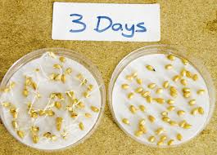
Allelopathy Lab
Data: (Qualitative & Quantitative – numbers, values)
  Table 1: The table below shows the different germination rates of radish and lettuce seeds when grown together and separately. (10 font)

Slide 53

Level of Organization – Activity P.9NB
With your card sort, organize them from smallest to largest.
After your card order is approved, write the order in the pyramid from smallest to largest.
Then write the definition and an example for each level or organization.
Color each level a different color.

Slide 54
Scientific Method
#2.
Control
Definition: the part of the experiment that is the standard that the results are compared. Does not change. Example: Radish & Lettuce Petri dish
Variable: The part of the experiment that is tested (changed)
Example: the 3 day old Radishes with new lettuce seeds

Slide 55
#3
Independent Variable:
  Experimental Group that is tested.
Dependent Variable
  The result of the experimental group. What we are measuring.
  Example: the growth of the lettuce seeds.

Slide 56
Agricultural/Physiology Project
Choose a domesticated farm animal.
Choose 1 of the 11 body systems from Physiology.
Make a Poster/ Presentation with pictures explaining the difference between the animal and the human for that body system.
Write about a disease or illness that affects that system for each the Farm animal and the human, how are they similar/ different.
Choose your animal and body system by Jan. 25th. Be prepared to share what you have learned by Feb 1st - 3rd.

Slide 57
Go to the Library & Check out a Biology Book.
Guest Speaker:
Andrew Codd Monday February 6th
Write down three Internships you might be interested in, page 15 NB.

Slide 58

Allelopathy Lab
Data: (Qualitative & Quantitative-numbers, values)
  Graph 1:
  The radish seeds over 6 days showed increased germination compared to the lettuce seeds. (10 Font)

Slide 59
Allelopathy Lab
Data: (Qualitative – descriptive words & Pictures)
  The radish seeds looked …… they smelled….
  The lettuce seeds roots were longer and had more root hairs.

Slide 60

Allelopathy Lab
  Data Analysis: (Paragraph)
  Explain your data - results. Why did we see the results in the graph? Discuss any trends.
  Cite Sources: Allelopathy: How Plants Suppress Other Plants (Ferguson, Rathinasabapathi, Chase, 2013)

Slide 61
Allelopathy Lab
Conclusion: (Paragraph)
  Restate hypothesis and explain if it was supported or not. Tie your Data Analysis to your Background and hypothesis. Did your data support what you thought would happen? How? Explain why allelopathy is important. At the very least, write an AXES paragraph about Allelopathy between radish and lettuce seeds and how it applies to Agriculture.
  Cite Sources: Allelopathy: How Plants Suppress Other Plants (Ferguson, Rathinasabapathi, Chase, 2013)

Slide 62
Works Cited
James J. Ferguson, emeritus professor; Bala Rathinasabapathi, professor; and Carlene A. Chase, associate professor, Horticultural Sciences Department, Cooperative Extension Service, Institute of Food and Agricultural Sciences, University of Florida, Gainesville, FL 32611.
Yes – one more
Yes – still one more ☺
Done!

Slide 63

1/27 Learning about FFA Officer Positions
Obj. TSW distinguish between different officer positions after reviewing each positions’ responsibilities online. P. 20 NB
Name 5 of the 9 Officer positions.
What responsibilities/ behavior would you expect from the all the River City High School Bryte CCT Chapter FFA officers?
Would you like to run for an office next year in Farm to Fork 1?
Why or why not?

Slide 64
FFA Officer Responsibility Activity
Use FFA.org
FFA Manual
Page 48 in online Manual
Write down 3 key responsibilities for each of the offices on 3x 5 cards
We will use flashcards and travel around to say the responsibilities and see if another person can name that officer position.
Tape your card to page P. 19 NB

Slide 65


1/30 Physiology – Ag Style
Obj. TSW apply what they have learned about the body systems to what they need to know to care for animals and plants. P. 22 NB
What are the 11 body systems?
What is your favorite body system that you would like to learn more about?
What domesticated farm animal would you like to study? Why?

Slide 66
Experimental Design Practice p. 17 NB
#1
The independent variable (What Margaret changed) is the amount of moisture.
The dependent variable ( What she measured) is the number of worms.
The correct X axis label for a graph of Margaret’s data is the “Amount of Moisture, (mL)”
The correct Y axis label for a graph Margaret’s data would be “ The number of Worms present”.
The Correct title for Margaret’s graph would be,” The Effect of Moisture on the Number of Worms Present”.

Slide 67
Scientific Method
A. The purpose of this experiment is to measure the plant growth by adding fertilizer.
B. The amount of fertilizer is the Independent Variable.
C. The plant growth is the Dependent Variable.
D. Line Graph because it is over a period of 5 days and you can see the relationship.
E. That plant B (500 ml) of fertilizer produces the most height.
F. Title: The Effect of Fertilizer on Plant Growth

Slide 68
Winnie & the Worms

Slide 69




1/31 Nervous System 36.1
Obj. TSW explain the roles of the sensory neurons, interneurons, and motor neurons in sensation, thought and response by doing a lab on reaction response. P.24 NB
Describe, draw, and label a neuron.
Explain the functions of each type of neuron: sensory, interneuron, and motor.
What is a reflex, write an example?

Slide 70








Section 36.1 Summary – pages 943 - 950
#1. Neurons: Basic Units of the Nervous System
Neurons conduct impulses throughout the nervous system. Draw this picture
Dendrite
Myelin sheath
Axon
Nucleus
Axon endings
Cell body

Slide 71
Section 36.1 Summary – pages 943 - 950
#2.Neurons: Basic Units of the Nervous System
Neurons fall into three categories: sensory neurons, motor neurons, and interneurons.
Sensory neurons carry impulses from the body to the spinal cord and brain.

Slide 72

Section 36.1 Summary – pages 943 - 950
Neurons: Basic Units of the Nervous System
Interneurons are found within the brain and spinal cord.
Sensory neuron
Interneuron
Spinal cord
Motor neuron
Receptor in skin
Direction of impulse
Muscle contracts

Slide 73
Section 36.1 Summary – pages 943 - 950
Neurons: Basic Units of the Nervous System
Motor neurons carry the response impulses away from the brain and spinal cord to a muscle or gland.
Sensory neuron
Interneuron
Spinal cord
Motor neuron
Receptor in skin
Direction of impulse
Muscle contracts

Slide 74

Sensory Neuron
-You sense the touch
How the Central Nervous System Works
Interneuron
-The brain processes that you have been touched.
Motor Neuron
-You turn your head to see who touched your shoulder

Slide 75

2/1 Distraction/ Reaction Lab CH 36
Obj. TSW calculate reaction times under different conditions. P. 26 NB
What type of neurons will you use in the distraction/ reaction lab?
Is this lab an example of a reflex reaction? Why or why not?
What other body systems work together with your nervous system to help you catch the meter stick?

