Slide 1
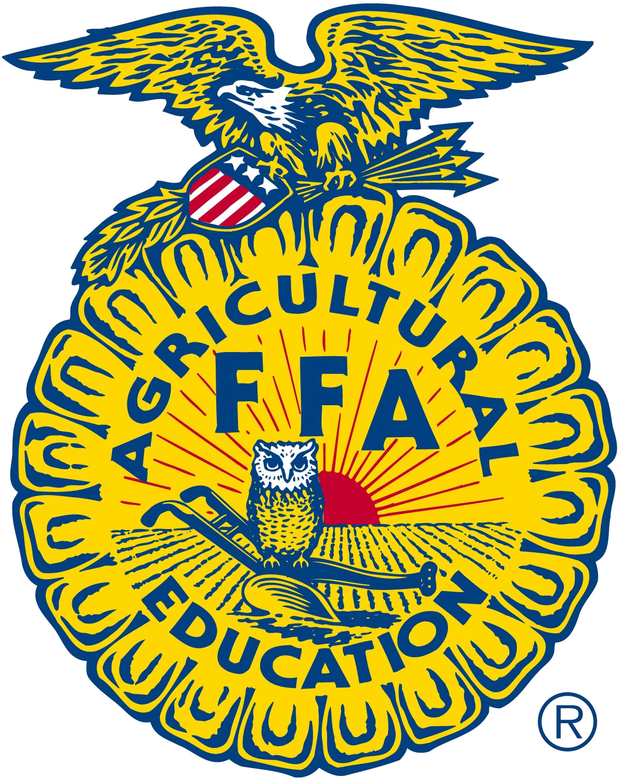
FFA Meeting today
10 am Bryte
Cristal – Agenda
    Approval of last meetings Minutes
      Needs a motion
      Needs to be seconded
Emiliano – PPT pictures
    Pictures of Fall Harvest Festival
    Pictures of Chapter Officers at Opening Closing Ceremony
Syed – Statement of Funds
    Announce how much $ our 9312 Account has from fundraising
Vice – President – Motion to discuss FFA Banquet
    Food
    Invitations

Slide 2
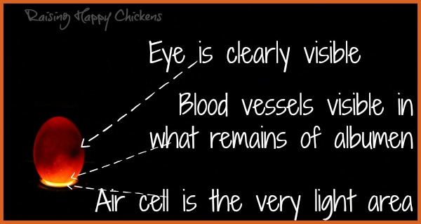
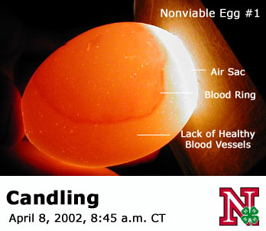
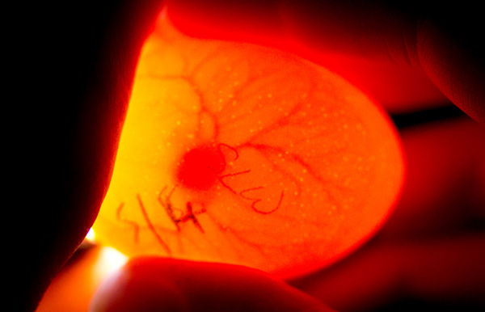
Candling Chicken Eggs

Slide 3
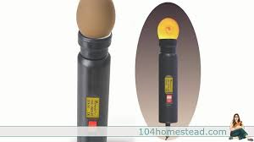

Slide 4
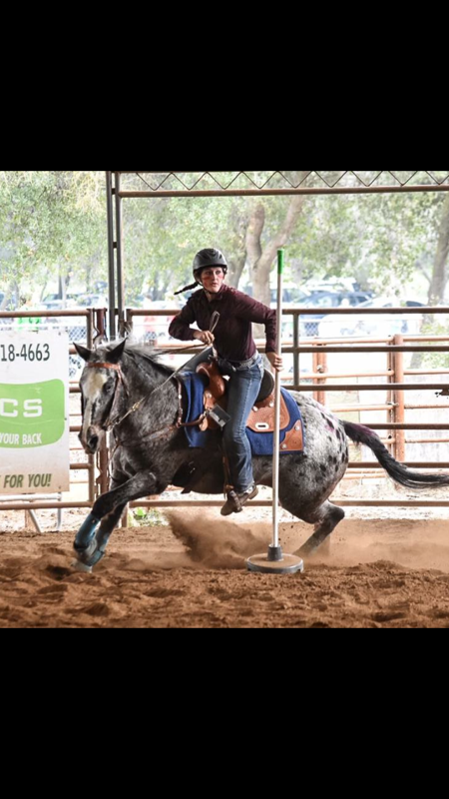
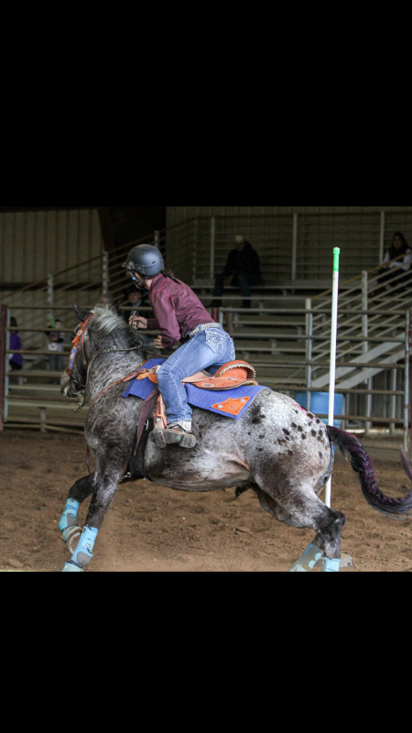
Go Zoe!

Slide 5
FT Form
Due THIS WEEK!!!!
GET all your teachers to sign your FT Form
Awesome Lunch
Great professionals to meet
The FT is Tuesday November 15th; 8 am – 2:20 pm
Wear Close toed shoes, long pants, bring a jacket in case it is cold.
We will be working in a greenhouse, wear comfortable clothes that are OK to get dirty.

Slide 6
Show evolution video dogs – pbs?
Elephants helping baby elephant.
Wildabeast and lions

Slide 7
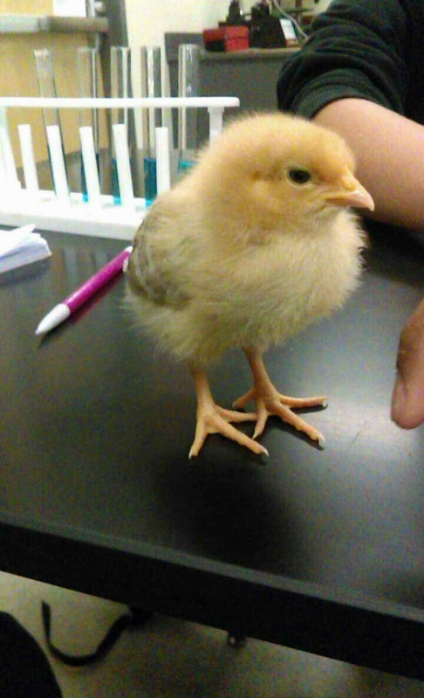
Goldilocks
Our Eggs have 10 more days!
They start hatching on the 17th of November!
Jacob, please read the directions, and make sure the incubator (Auto) will stop rotating on day 19.

Slide 8
Biology
Evolution
Week 13
Chapter 15 & 14

Slide 9
Evolution Term Paper Due November 18th
Write a term paper to answer the Driving Question: How do living things change over time?
Use your data from any of our labs from this UNIT to support the Observations and Inferences for Evolution.
Using your “Developing your Model” paper, include all 7 Observations and the 3 Inferences for Evolution.
Provide data to support at least 3 Observations and the 3 Inferences.
Introduction, Data, Research (Data Analysis), Conclusion.
Include Artificial Selection. Choose any domesticated farm animal and describe how we went about “creating” new breeds.

Slide 10
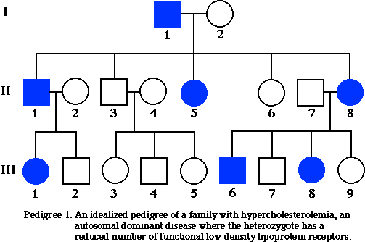
11/7 Pedigree Practice CH 12
Obj. TSW practice how to make pedigrees to prepare for the Genetic Inheritance Test. P. 26 NB
Draw 3 generations of family.
Bob and Susan are married and have 3 children: Elane, Stephen , Tony
Susan has two siblings: Jose and Tom
Susan’s parents are Elijah and Gaby
Gaby, Susan and Tony have the trait.
How is the trait inherited? Autosomal, or Sex-Linked
Dominant or Recessive?
What is the % chance of Tony having the trait?

Slide 11
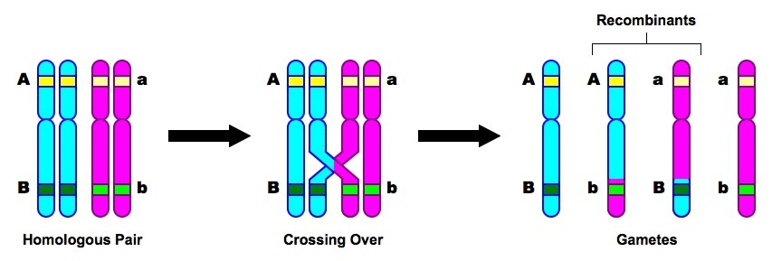
Study Guide for Genetic Inheritance Test p. 25 NB
Crossing over is when two sister chromatids cross over and exchange genetic information. It happens during Meiosis to increase genetic variation in the species.
Label the chromatid, centromere, homologous chromosome, genes

Slide 12
Genetic Recombination is the exchange of genetic material on the sister chromatids during Meiosis, it increases genetic variation.
Gamete: male and female sex cell = 1n
  Zygote: sperm fertilizes the egg = 2n
  Offspring: a person’s child.
  Homozygous: Same allele – both dominant or both recessive.
  Heterozygous: Different Alleles – One dominant and 1 recessive
  Heredity: passing on characteristics from parents to offspring
  Diploid: body cell, (2n), 2 sets of chromosomes
  Haploid: sex cell, (1n), 1 set of chromosome
  Allele: one or two forms of a gene
  Gene: a unit of heredity transferred from parents.

Slide 13
5. Mendel’s 1st law is the Law of Segregation. It states that the two alleles for a trait will separate into different gametes.
6. Mendel’s 2nd law is the Law of Independent Assortment. It states that traits are inherited independently of each other.
7. A gamete has one (1) allele for each trait. It is haploid.
A zygote has two (2) alleles for each trait. It is diploid.
An adult human has two (2) alleles for each trait. They are diploid.
Finding a persons genotype – Do a Punnett Square.
Finding a persons phenotype – Look at them.

Slide 14
Pointy Ears = A Floppy Ears = a
  Heterozygous = Aa
  Punnett Square
  AA 25% Pointy Ears
  Aa 50% Pointy Ears
  aa 25% Floppy Ears
  d. Pointy Eared puppy = 75%
  e. Floppy Eared puppy = 25%

Slide 15
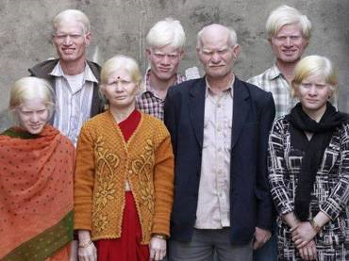
Albinism

Slide 16


Good Morning! Wed 4/2
Objective: You will be introduced to the process of natural selection by looking at a variety of examples. You will understand that variations in organisms can affect their ability to survive.p.12NB
Warm-up:
1. Which of the following would MOST likely cause a mutation?
The placement of ribosomes on the endoplasmic reticulum
The insertion of a nucleotide into DNA
The movement of transfer RNA out of the nucleus
The release of messenger RNA from DNA
2. Explain the difference between a species and a population.
Homework: Read CH 15, 1 page notes P. 11 NB

Slide 17
Answers:
A mutation is a change in a gene, so therefore, if there was an insertion of a nucleotide into DNA, it would change the gene. Point or Frameshift?
A species is an organism that can produce fertile offspring and interbreed. Wolf. A population is a group of the same species. Pack of wolves.

Slide 18
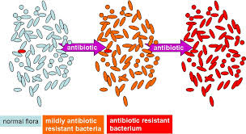
Agenda
Go over two interesting stories
Fill out doodle sheet #1
Come up with a driving question
Explore the moths- computer simulation

Slide 19
Two interesting stories...
Notes:
19

Slide 20
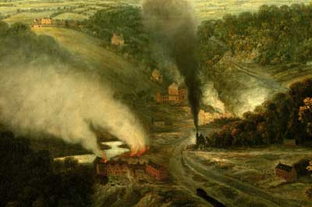
The Case of the
Peppered Moth
E. Coleman 2008

Slide 21
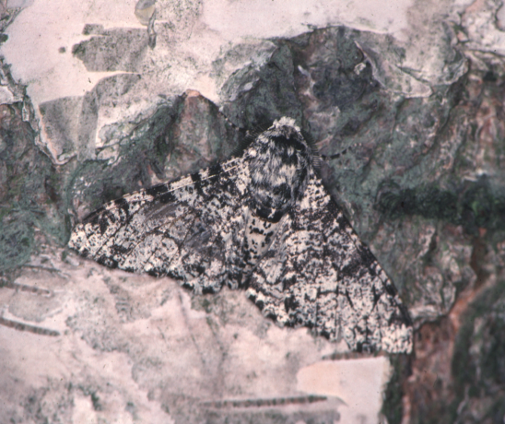
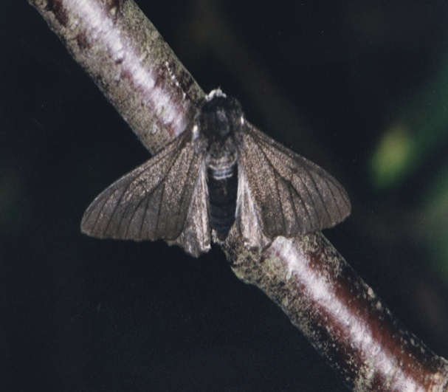
The peppered moth:
1850: mostly speckled;
a few dark
1900: mostly dark;
a few speckled
2000: mostly speckled;
a few dark

Slide 22
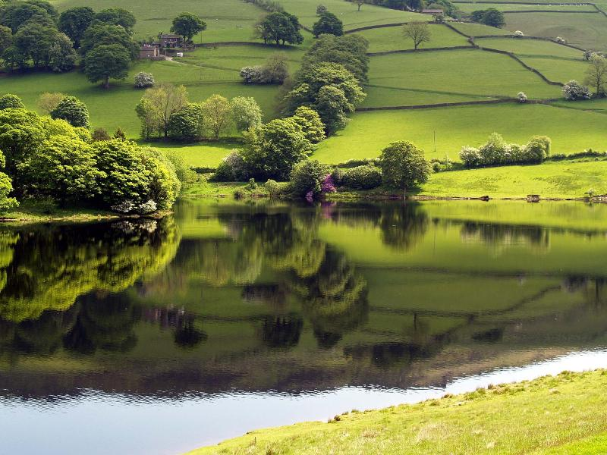
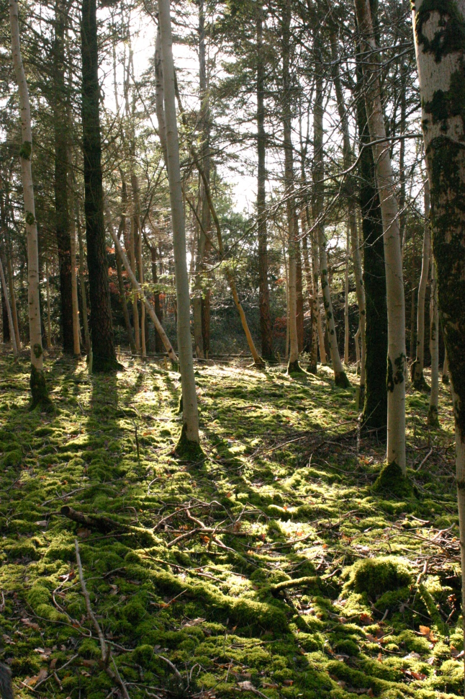
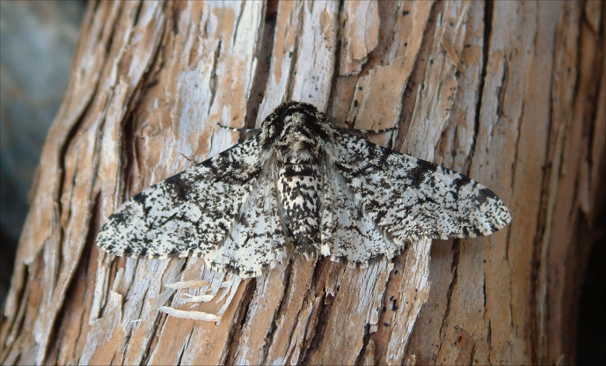
English Countryside -
Pre-Industrial Revolution.
Predominant tree species had
light-colored bark or
were covered with
light-colored lichen.
2. Peppered moths
were almost all
light in color.

Slide 23
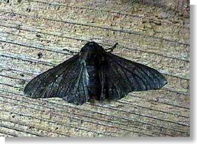
Though it was rare, occasionally a dark-colored peppered moth would appear.
What have we observed about traits within populations?

Slide 24
What allows for different variations of colors in these peppered moths?
Mutations
Mutations are changes in the genetic material (DNA) of an organism.
They sometimes result in offspring that are very different from their parents.
They are rare. The mutation that results in the dark form of the peppered moth occurs about 1 in every 200,000 offspring or .0005% of the time.
Mutations are the ORIGINAL source of all variation in species.

Slide 25
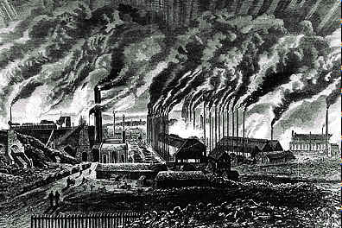
By the mid-1800’s the Industrial Revolution was in full force. Throughout England factories were spewing soot and smoke into the air.

Slide 26
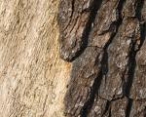
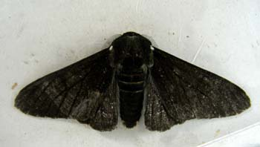
The bark of trees and the lichen growing on them darkened from the accumulated soot and pollution.
And observers noticed more and more peppered moths were of the dark variety.

Slide 27
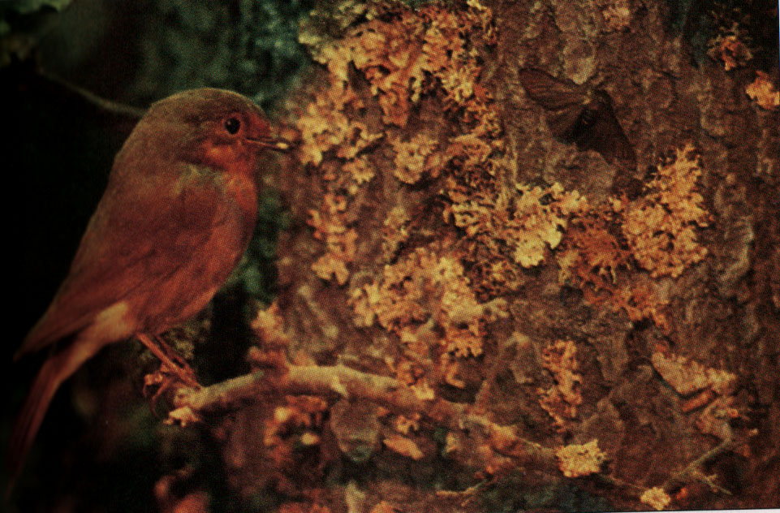
PRIMARY PREDATOR OF THE PEPPERED MOTH ?
BIRDS !
Where are the moths?

Slide 28
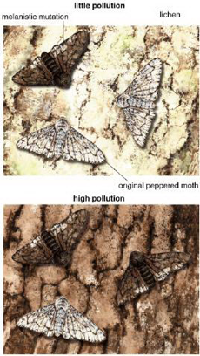
Within a few decades “dark” became the predominant form of the Peppered Moth.
What caused the change in the predominant coloring of
the Peppered Moth population?
How would Darwin explain it?
These are the questions you will explore in this unit.
BEFORE:
Light bark,
mostly
light moths
AFTER:
Dark bark,
mostly
dark moths

Slide 29
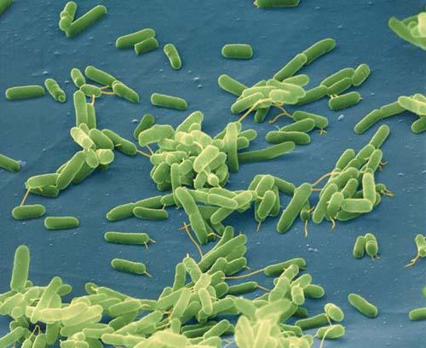
The story of the bacteria:
1st round of antibiotics:
most bacteria die
2nd round of
same antibiotic: some die
3rd round of
same antibiotic:
very few die

Slide 30
What do these two stories have in common? (1A) Doodle Sheet P. 27 NB
Notes:
Think, pair share. Hopefully they come up with the species changed.

Slide 31
What do these two stories have in common?
Species adapting to environment to survive
About living organisms
3 steps
About species changing
The environment puts pressure on organisms to survive
Notes:
Think, pair share. Hopefully they come up with the species changed.

Slide 32
Given the phenomena of these two stories, what are some questions you could ask?(1B)
Notes:
Work in groups. Hopefully come up with driving question: How do living things change over time?

Slide 33
Driving Question
How do living things change over time?
Notes:
Click on the fish picture - it is linked to the fish exponential growth simulation.

Slide 34
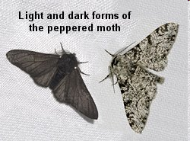
Pg 29: Peppered Moth Activity
Speaking of major environmental changes…
Natural selection at work!
http://www.techapps.net/interactives/pepperMoths.swf
  Prior to 1800, the typical peppered moth had a light pattern.
  Dark colored or melanic moths were rare and were therefore collectors' items.

Slide 35
Peppered Moth Activity p. 13 NB
Background Qs:
How is the peppered moth’s coloring an advantage for them?
What is the typical moth color?
What is the rare color?
Test it out! Click on the “bird’s eye view” icon. Follow the instructions. When done, click on the bird to start over. Complete 4 trials in the light forest (2 per partner) and 4 trials in the dark forest. Record your results after each trial and then compute your averages.
Starting Percentage: Light moths ______ Dark moths ______

Slide 36
P. 29 NB Copy Data Table 1 & 2
Data Table 1: Light forest (Pre-Industrial Revolution)
Data Table 2: Dark Forest
(Post Industrial Revolution)
http://www.techapps.net/interactives/pepperMoths.swf
Trial | % Dark Moths | % Light Moths
1
2
Average
Trial | % Dark Moths | % Light Moths
1
2
Average

Slide 37
Light Background |  | Dark Background
% Dark Moths | %Light Moths | % Dark Moths | % Light Moths
41 | 59 | 62 | 38

Slide 38
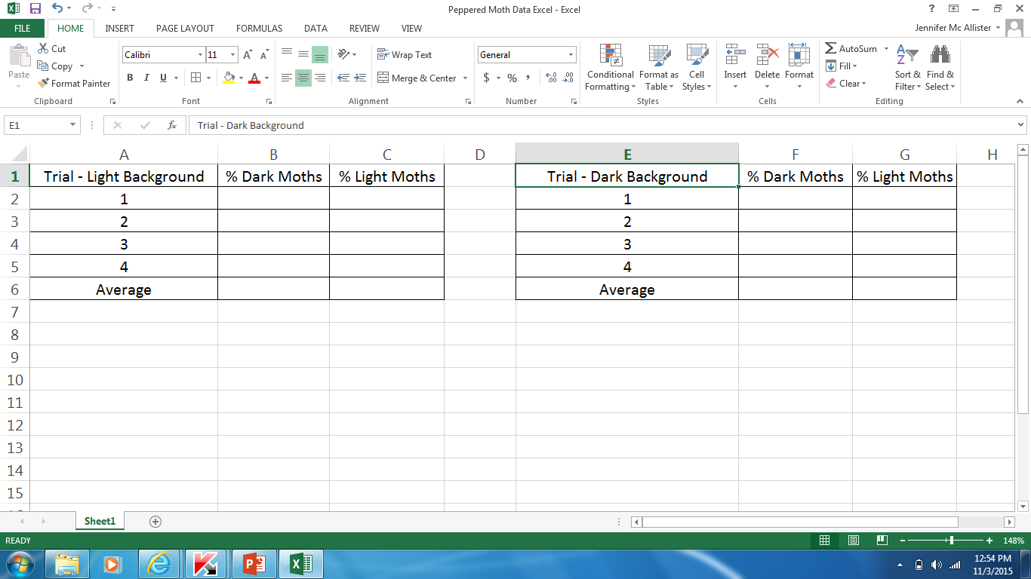

Slide 39
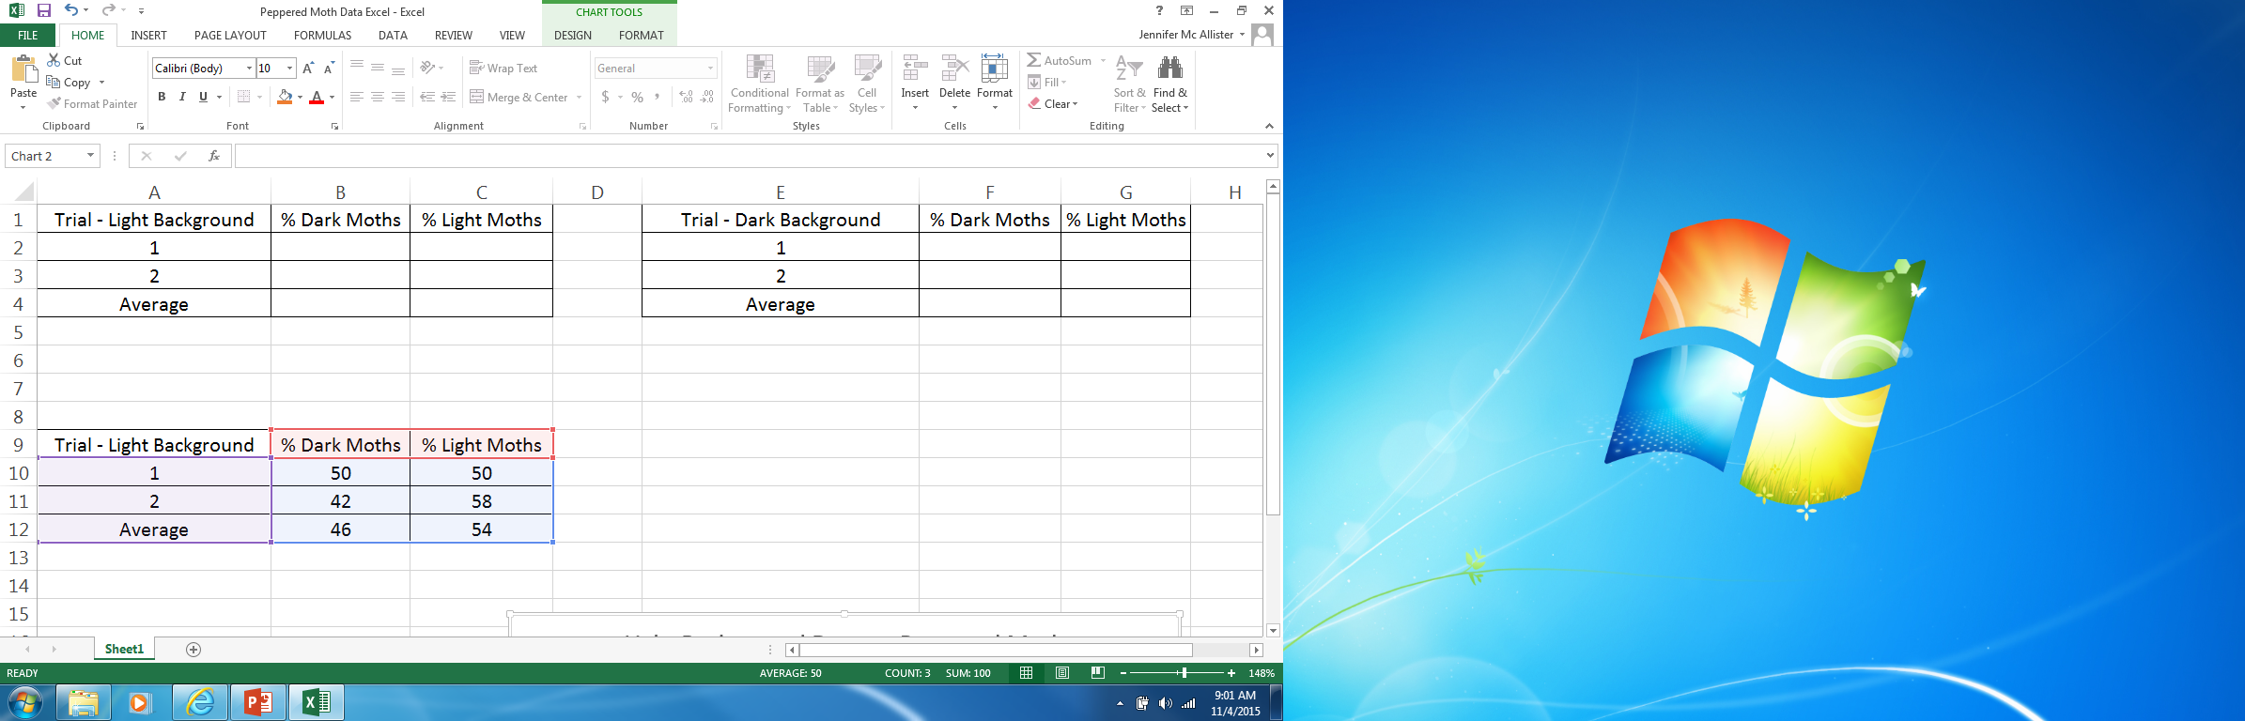

Slide 41
Extra Time
Show Malaria Video, or Emerald Jewel Wasp. Slide # 86 or # 20 H. Evolution ppt

Slide 42
Good Morning! Thur 4/3
Objective: You will be introduced to the process of natural selection by looking at a variety of examples. You will understand that variations in organisms can affect their ability to survive.p. 14NB
Warm-up: 1. Why are mutations important in a population?
2. What are some examples of mutations from yesterdays stories?
3. Is it important for all the offspring to survive every generation? Why?
Homework: CH 15 1 page notes P.11
Quiz – Evolution, Natural Selection, Variations, species, populations, mutations

Slide 43
Mutations are important in a population because it allows for variations in that environment.
Examples of mutations are the peppered moth and bacteria build a resistance against antibiotics.
No, not all offspring need to survive, only the ones that are best suited for their environment.

Slide 44
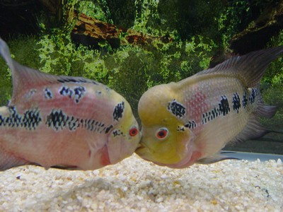
WHAT DO WE OBSERVE ABOUT POPULATIONS OF ORGANISMS?
A. What happens to population sizes over time?
If all offspring of two parent fish survive and reproduce, how many fish will there be after 4 generations?
http://www.otherwise.com/population/exponent.html
Notes:
Click on the fish picture - it is linked to the fish exponential growth simulation.

Slide 45
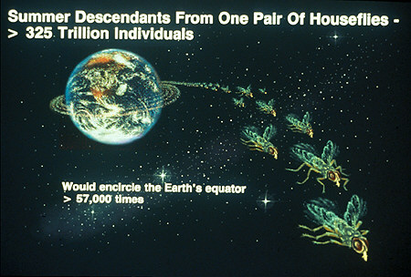
Another example:
How many flies would there be by the end of one summer if all offspring of a mating pair survived and reproduced?

Slide 46
Doodle Sheet 1C: Write down your thoughts
-What would happen if all offspring survived?
-If you graphed the growth, what would the graph look like?

Slide 47
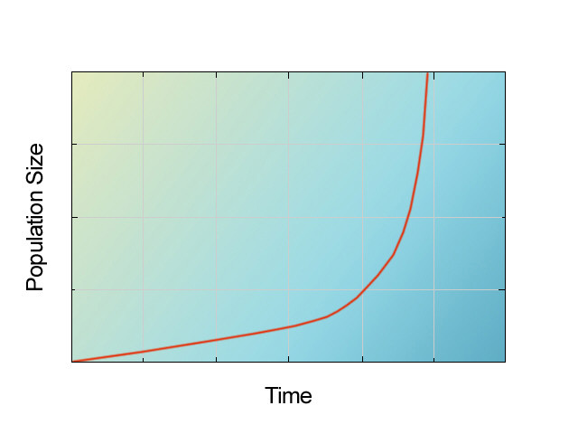
OBSERVATION #1:
Populations of organisms have the potential to grow exponentially.
Graph of exponential growth:

Slide 48
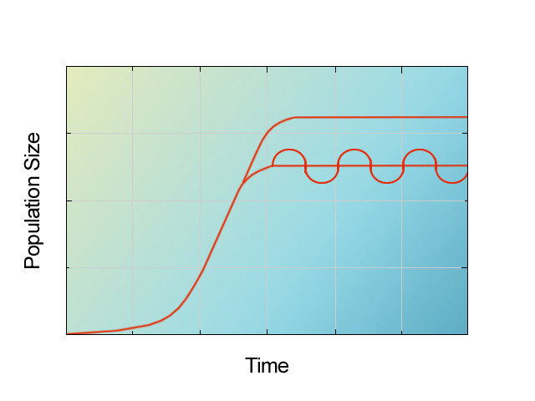
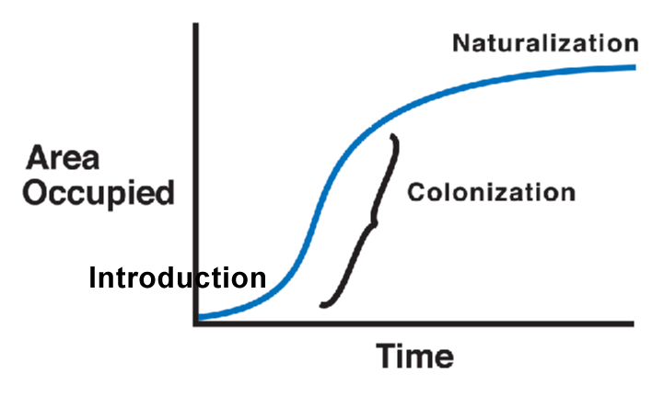
Is this what really happens?
Are we overrun by fish… or flies… or any
single species?
What really seems to happen? In other words, what do we observe in real life?
A species of grass
Biomass
of population
A species of fish

Slide 49
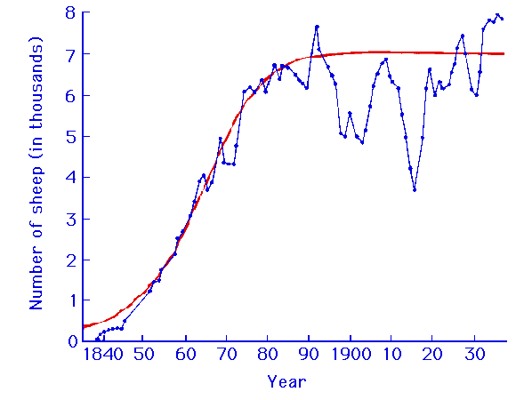
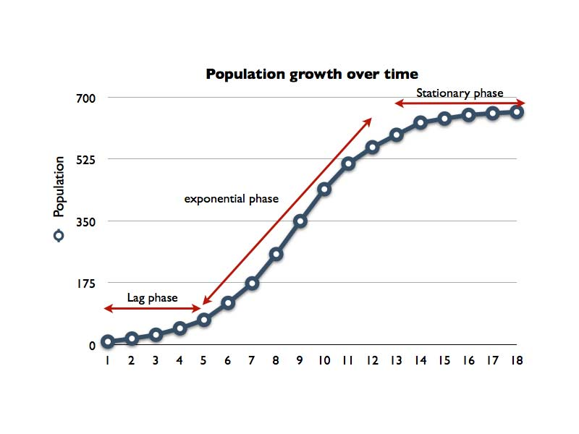
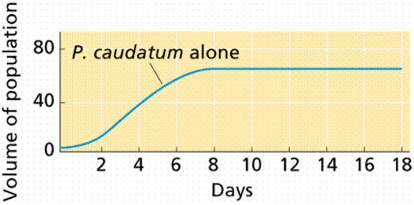
Sheep
Yeast
What is the pattern?
How would you describe
what populations really
seem to do? (1D)
Paramecium (a protist)

Slide 50
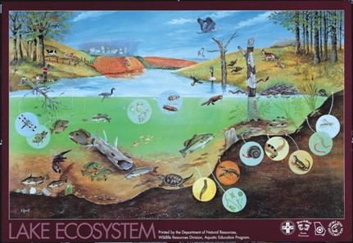
OBSERVATION #2:
Populations of organisms tend to stay relatively stable in size.

Slide 51
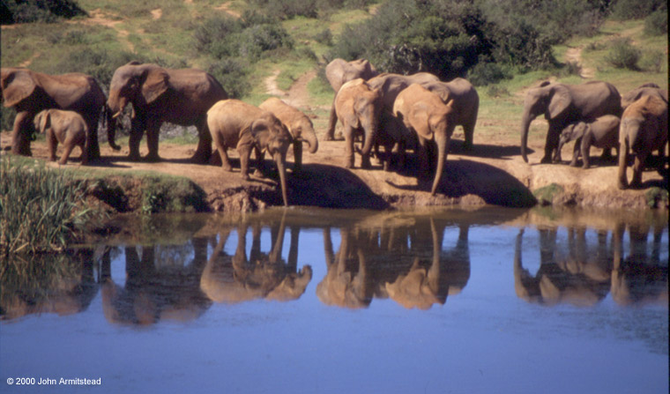
Potential population growth in elephants
Elephants are one of the slowest breeders on the planet.
One female will produce 6 young over her 100 year life span.
How many elephants could result from one male and one female in 750 years?
Notes:
Started day 2 with this to review.

Slide 52

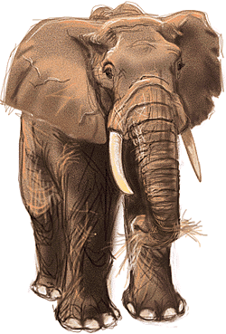
19,000,000 elephants!!!

Slide 53
OBSERVATION #2:
Populations of organisms tend to stay relatively stable in size.
Notes:
First 5 minutes of day 2

Slide 54
With your partner, brainstorm a list of possible reasons why populations stay stable instead of continuing to increase exponentially. (1E)
Notes:
List their ideas here.

Slide 55
What do we call all these things collectively?
RESOURCES!
OBSERVATION #3:
Populations are relatively stable in size due to limited resources in the environment.
Notes:
Hopefully the kids come up with the answer “RESOURCES”!

Slide 56
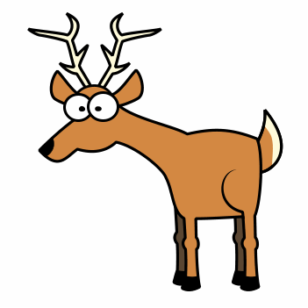
Lets play a game to see what happens when resources are limited!
Notes:
Play “Oh Deer!”

Slide 57
“OH DEER”
Even student #’s are DEER, odds are RESOURCES .
Signs for resources: FOOD = both hands over belly, WATER = both hands over mouth, SHELTER = make a tent over head.
Groups stand with backs to each other. Everyone picks a resource by making the appropriate sign. You must keep displaying your sign the whole time!
On teacher’s signal turn and face each other. DEER must find someone showing the same resource on the other side.
Each deer can only claim one resource.
No changing once you turn around!
If a deer finds a resource it can “reproduce”. The resource it caught becomes a deer for the next round.
Resources not claimed stay a resource.
Deer not able to find their resource die and become a resource for the next round.

Slide 58
DISCUSSION: (1F)
  1. Was it always easy to be a deer in the game? Why or why not?
2. When resources were limited, what did it feel like to be a deer?

Slide 61
Generation | Deer | Resources | Wolf
1 | 18 | 17 | 0
2 | 32 | 4 | 0
3 | 6 | 29 | 0
4 | 13 | 23 | 0
5 | 20 | 14 | 1
6 | 21 | 13 | 2
7 | 21 | 11 | 4
8 | 18 | 10 | 8
9 | 12 | 10 | 14
10 | 6 | 8 | 22
11 | 0 | 23 | 13
12 | 0 | 36 | 0
According to the graph, what is the carrying capacity for the population of Deer?

Slide 62
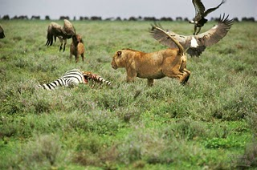
INFERENCE #1
Within populations of organisms there is a struggle to survive.

Slide 63
Good Morning! Fri 4/4
Objective: Students will learn about variation in a species that allows the population to survive changed environmental conditions. P. 16 NB
Warm-up:
What are differences in individuals in a population called?
Why is there a struggle to survive in a population of organisms?
What is a characteristic of the organisms that survive?
Homework: Finish Emerald Jewel Wasp video
Read CH 14 – Benchmark Test is Friday May 11th.

Slide 64
The differences in individuals in a population are called variations.
Organisms compete for available resources: Food, Water, Shelter, space, mates.
The organisms can out compete other individuals and survive because they are better adapted to their environment.

Slide 65
Sunflower Seed Lab p.31 NB
Do we count one side of the seed or both?
What color is the stripe?
Do we count the edges?
Does the strip have to go all the way down?
1.Now get a hand-full of sunflower seeds and with one partner count the stripes on your seeds.
2. Separate them by their number of stripes.
3. Record the # of seeds you have for each number of stripe.
Place that many seeds in the graduated cylander up front.
Graph the Variation in the population.

Slide 66
Sunflower Seed Lab P. 31 NB
Stripes | # of Seeds (your # of seeds) | (mL) of Seeds (class Variation)
0 |  | 32
1 |  | 50
2 |  | 49
3 |  | 39
4 |  | 26
5 |  | 20
6 |  | 8
7 |  | 5
8 |  | 1
9 |  | 3
10 |  | 1
Is there variation in the population of sunflower seeds?
Is this beneficial for the species?
Why would it be beneficial?
How would you predict the seeds are different if they are from a shady environment or a non shady environment?

Slide 67
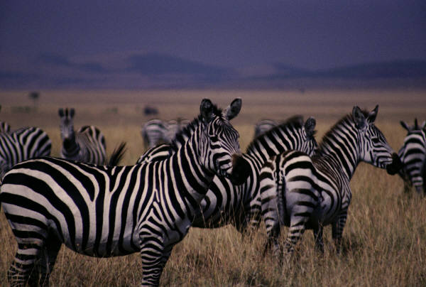
Natural Selection CH 15
Obj. To understand there is a struggle for existence that is part of Natural Selection.
P. 18 NB
In the sunflower seed lab, what were the most obvious variations in the seeds?
In a herd of Zebra, what struggles might exist?
How do you know who is the most “Fit” in the population?

Slide 68
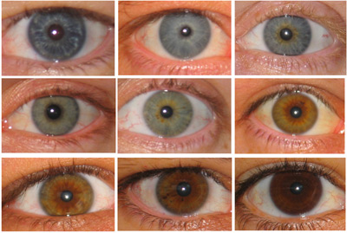
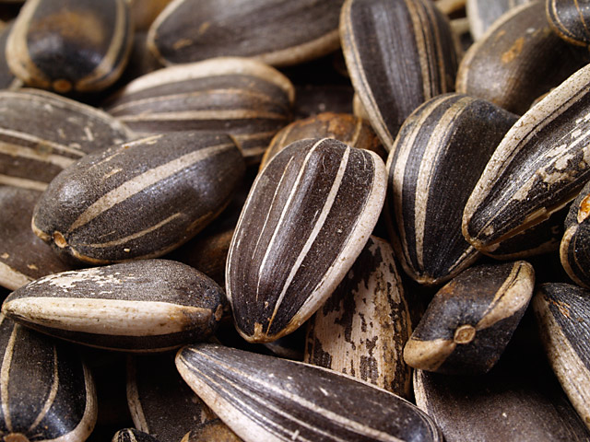
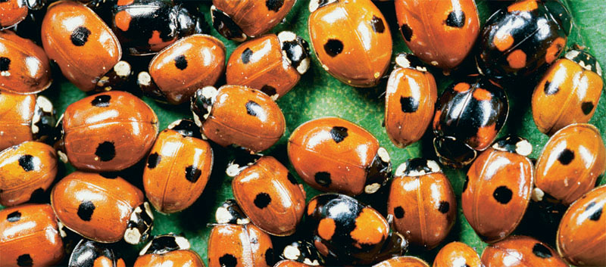
What do we observe when we compare individuals in a population?
OBSERVATION #4
There is variation among organisms in a population. Variation naturally exists.
Notes:
Do sunflower seed activity before showing “Observation #4”

Slide 69
Variation friendly talk: With a partner…
Is variation among organisms in a population the rule or the exception?
Is it more common for living things in nature to vary or for things to be identical?
Defend your answer with specific examples.

Slide 70
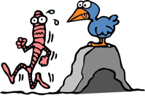
Wormeaters

Slide 71
What is going to happen to:
…the wormeater with the disadvantageous variation? (Doodle 2A)
…the wormeater that got the most food? (2B)
Per.

Slide 72
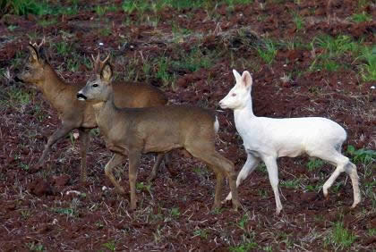
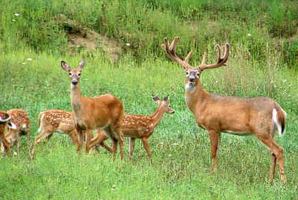
OBSERVATION #5:
Individuals with advantageous
variations have a better chance of
surviving than those with less
advantageous variations.
OBSERVATION #6
Survival allows reproduction

Slide 73
Planet Earth – Great Plains
Fire & Deer

Slide 74

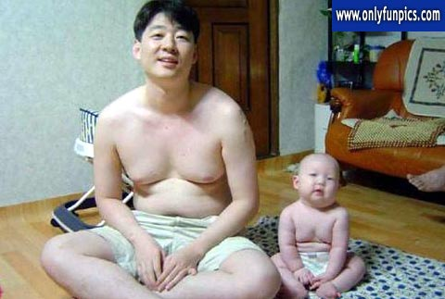
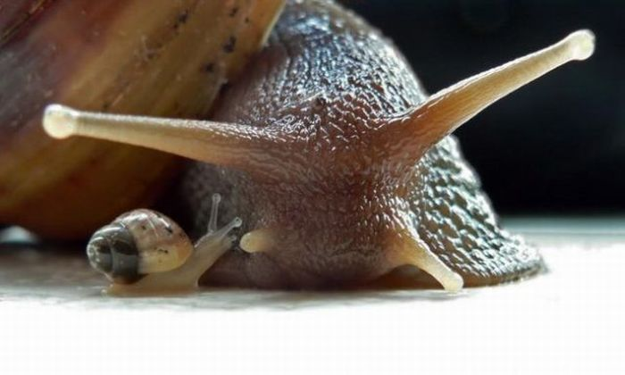
When the surviving wormeaters reproduce what kind of beaks will their offspring most likely have? (2C)
OBSERVATION #7:
Many variations are inherited (in other words,
offspring tend to resemble their parents).
Notes:
Think-pair-share before showing Obs. 7. Show Obs. 7 then: Can you think of other examples? Is it “Perfect”?

Slide 75

What do you predict would happen to the # of individuals with the advantageous variation in the next generation?
What about the # of individuals with the disadvantageous variations? (2D)
INFERENCE #2:
The # of individuals with advantageous variations will increase in each new generation. The # with disadvantageous traits will decrease.

Slide 76

What do you predict will happen to a species over many generations? (2E)
INFERENCE #3:
Over many generations the species changes, i.e. EVOLUTION occurs.

Slide 77
OVERVIEW of the MODEL
INFERENCE #1
Within populations of organisms
there is a struggle
to survive.
OBSERVATION #1
Populations of organisms have the potential to grow exponentially.
OBSERVATION #4
There is variation
among organisms in
a population.
Variation naturally
exists.
OBSERVATION #2
Populations of
organisms
tend to stay
relatively
stable in size.
OBSERVATION #5
Individuals with advantageous variations have a better chance of surviving than those with the less advantageous variations..
INFERENCE #2
The # of individuals with advantageous variations will increase in each new generation. The # with disadvantageous variations will decrease.
INFERENCE #3
Over many
generations the
species changes.
EVOLUTION
occurs!
OBSERVATION #3
Populations are
relatively stable in
size due to
limited resources
In the environment.
OBSERVATION #6
Survival allows reproduction.
OBSERVATION #7
Many variations
are inherited (in other words, offspring tend to resemble their parents).

Slide 78
Evolution Term Paper Due November 19th
Write a term paper to answer the Driving Question: How do species change over time?
Use your data from any of our labs from this UNIT to support the Observations and Inferences for Evolution.
Using your “Developing your Model” paper, include all 7 Observations and the 3 Inferences for Evolution.
Provide data to support at least 3 Observations and the 3 Inferences.
Introduction, Data, Research (Data Analysis), Conclusion.

Slide 79
Final Task - with group
Review each other’s explanations.
Notice the differences and similarities.
Develop an explanation that combines the best of everyone’s ideas.
Remember to follow Group Norms!
Choose someone with legible handwriting to record your explanation out on poster paper.
(You may add illustrations and try to make it look nice but don’t spend excessive time on it. Your thinking is what matters most! You will not have additional time to work on this.)

Slide 80
Evaluating the Explanation:
1. Underline in Blue & identify by letter (below) each part of our model in the poster you evaluate.
A. Populations have the potential to grow exponentially but stay relatively stable due to limited resources in the environment.
B. Within populations there is a struggle to survive.
C. Variation naturally exists among organisms in a population
D. Individuals with advantageous traits have a better chance of surviving than those with disadvantageous traits.
E. Survival allows reproduction.
F. Many variations are inherited. Offspring tend to resemble their parents.
G. The number of individuals with advantageous traits increases in each new generation. The # with disadvantageous traits decreases.
2. Underline in Red any statements that you think
contradict - or do not fit with - our model.
Notes:
Groups evaluate posters of other groups using this key. After this, give the tortoise assessment.

Slide 81




11/9 Darwin & the Theory of Evolution 15.1
Obj. TSW demonstrate how variation within a species influences natural selection with the Evolution story Activity and Moth Activity. P. 28 NB
What is the advantage of this snowshoe hare’s seasonal color change?
The adaptation that allows an animal to blend in with its environment is called camouflage. What examples of camouflage are you familiar with?
Summarize Natural Selection.
Snowshoe hare in summer
Snowshoe hare in winter
Artic Fox - Predator

Slide 82
Answers
The snowshoe hare is camouflaged from predators.
Chameleon, army gear.
Evolution is the change in species over time. The mechanism for Evolution happening is Natural Selection. Those organisms best adapted to their environment will live longer, hopefully have offspring with those successful traits.

Slide 83
HW – 1 page notes CH 15 Page 31 NB
Watch video on Darwin, notes on page 27NB.
http://www.pbs.org/wgbh/evolution/library/11/2/quicktime/e_s_2.html
Elephant video
Whale Evolution

Slide 84


Slide 85

How A Rainbow Works: Refraction and Reflection
Two physical phenomena are at work within a rainbow: refraction and reflection. Refraction occurs each time light passes across a boundary from one substance to another, such as from air into water. As light crosses that boundary, the rays bend at different angles depending on the wavelength (color) of light. This is the familiar prism effect wherein "white" sunlight is broken into a spectrum of different colors from red to blue-violet.
The same thing that happens in a rainbow: white sunlight enters a raindrop and is broken into different colors heading in slightly different directions. The light is then reflected (and magnified) off the back of the raindrop and passes back into the air again, in the process being further refracted.

Slide 86


Evidence of feathers in dinosaurs
Tyrannosaurus rex
Dilong paradoxus

Slide 87
And now for something completely different…
Cartoon activity!
Your task: use the evidence that is given to you to create a story with your group. Everyone must be involved!
Your story can be creative, but it must account for all the details you notice in the cards, put the cards in chronological order, and be “realistic” (ie. no “and then they magically appeared back at the house…”
On p. 9 of your notebook, write down the names of all your group members and an outline of your story ½ page. Be prepared to share with the class!

Slide 88
Cartoon Activity Questions, p. 27NB
Answer these in complete sentences.
How was looking at the cartoons similar to scientists looking at pieces of evidence?
Did everyone in your group agree on your story? Why?
What happened when you suddenly got 2 extra cards to put in your story? Did you make them fit in somewhere or did you have to start over completely?
Use the book to look up the definition of a “theory” in science. Write the definition. How is this definition different than the way we use the word theory in everyday life?
What do you think scientists studying evolution do when they find new evidence?

Slide 89

Darwin & the Galapagos Islands

Slide 90

Page 11 NB
Write your answers with your partners.

Slide 91


Slide 92
P.11 NB
Darwin’s Natural Selection Worksheet
The worm that natural selection selected against was: Diurnal For: Nocturnal
Populations have Variations: Nocturnal & Diurnal
Favorable Variation: Nocturnal
500 worms born, and only 100 worms lived to reproduce.
The worms that survived were nocturnal.
The population of worms became more Nocturnal.

Slide 93
Darwin’s Natural Selection Worksheet
The Bear that Natural Selection will select against is the thin or medium coat, FOR: Thick
Variations in the population: thin, medium and thick coat Bear.
Having a thick coat is favorable.
Two offspring are born, but only 1 survives.
Those that survive will have a thick coat.
The population of bears will have thick coats.

Slide 94






11/10 Evidence for Evolution 15.1
Objective: Students will perform the Sunflower Lab and discuss the results as to why Natural Selection acts on the phenotype rather than the genotype of an organism in their Notebook. p. 30 NB
Explain how mimicry and camouflage help species survive.
How do homologous structures provide evidence for evolution?
A parasite that lives in red blood cells causes the disease called malaria. In recent years, new strains of the parasite have appeared that are resistant to the drugs used to treat the disease. Explain how this could be an example of Natural Selection.
http://www.techapps.net/interactives/pepperMoths.swf

Slide 95

Natural Selection Simulation-
The Evolution of the Peppered
Moth p.31 NB
http://www.techapps.net/interactives/pepperMoths.swf
Using your own words, explain how Natural Selection relates to the “Survival of the Fittest” concept.
List the other defense systems organisms may have:
Based upon your studies, what could have originally caused the existence of two forms of the same species of moth?
Based upon your observations, what would happen to the moth populations if the pollution created by the Industrial Revolution were to be reversed?
Describe how you think the actual Peppered Moth situation would differ from this lab situation.
Why do you think this exercise involved 2 different background simulations?
****** Rework these answers for your Term Paper

Slide 96
Peppered Moth On – Line Lab P. 31 NB
1. Natural Selection relates to “Survival of the Fittest” because the best camouflaged moth was protected from predation by the birds.
http://www.techapps.net/interactives/pepperMoths.swf
2. Other defense systems that organisms have are camouflage, mimicry, chemical/ poisons.
3. Mutations can cause the existence of two forms/ traits for the same species of moth.
4. The moth population during the Industrial Revolution evolved to become darker, however, if the trees were to become light in the future then we would expect the moths to become light.
The actual situation of the peppered moth is different from the simulation because the process would take longer in the real world, Other factors are: Multiple predators, change in climate may change the situation, the # of moths would not be even in the real world.
This background simulated dark and light forests due to the two variations of moth- light and dark.
Apply answers to provide evidence for your Observations for Evolution.

Slide 97






11/14 Adaptations: Evidence for Evolution 15.1
Obj. TSW discuss evidence for Evolution by doing their concept map and variation in populations and by participating in the Peppered Moth lab. p.32NB
Compare & Contrast Homologous & Analogous structures.
Explain how the Structural adaptations (Homologous & Analogous) and Physiological adaptations (Genetic Resistance) of organisms relate to Natural Selection.
Distinguish among the types (direct & indirect) of evidence for Evolution.
Video Darwin’s Finches on the Galapagos Islands

Slide 98

11/15 Variation within a Species CH 15
Obj: Students will demonstrate how variation within a species increases the likelihood that at least some members of a species will survive under changed environmental conditions. P.34NB
Explain mutations and how they influence variations in a population.
Explain how a variation can impact a population if the environment changes.
Which type of evolution convergent or divergent shows a common ancestor and successive generations adapting to new environments, how?

Slide 99


Variations can be advantageous
The pocket mouse population lives in the desert
Originally they were white, but a mutation turned them black.
How is this an example of evolution?
Pocket mouse video

Slide 100



Section 15.1 Summary – pages 393-403
Structural adaptations arise over time –Mimicry
One organism adapts to look like another. Predators may learn quickly to avoid any organism with their general appearance. This helps them survive.
This is a Fly that looks like a Bee/ or Wasp

Slide 101



Examples of Camouflage & Mimicry
Camouflage is a type of structural adaptation that allows organisms to blend in with their surroundings. Mimicry helps them mask themselves by looking like other organisms.
Bambi’s spots blend in with the white flowers - Camouflage.
Bird Poop Caterpillar - Mimicry

Slide 102

Section 15.1 Summary – pages 393-403
Anatomy-Indirect Evidence for Evolution
Structural features with a common evolutionary origin/ ancestor are called homologous structures.
Homologous structures can be similar in arrangement, in function, or in both.
Crocodile
forelimb
Whale
forelimb
Bird
wing

Slide 103



Malaria
Variations in a population are caused by random mutations. A parasite species over time develops a resistance to medications due to random mutations that make the parasite more resistant than previous generations. As a result, offspring are more resistant.
A mutation story
Show both hyperlinked videos.
Pass out WS – CH 15, after videos & notes.

Slide 104
Sickle Cell Anemia Lab
AA = No Sickle Cell Anemia
AS = Carries for Sickle Cell Anemia
SS = Sickle Cell Anemia
Starting population 75 Red A’s; 25 White S’s

Slide 105
Survival of the Fittest
The Cricket Story!

Slide 106


Slide 107
Data Table

Slide 109
Section 15.1 Summary – pages 393-403
Anatomy-Indirect Evidence for Evolution
Structural features with a common evolutionary origin are called homologous structures.
Homologous structures can be similar in arrangement, in function, or in both.
Crocodile
forelimb
Whale
forelimb
Bird
wing

Slide 110


Section 15.1 Summary – pages 393-403
Anatomy- Analogous Structures
For example, insect and bird wings probably evolved separately when their different ancestors adapted independently to similar ways of life.

Slide 111

Section 15.1 Summary – pages 393-403
Structural adaptations arise over time
Another subtle adaptation is camouflage, an adaptation that enables species to blend with their surroundings.
Because well-camouflaged organisms are not easily found by predators, they survive to reproduce.

Slide 112
Section 15.1 Summary – pages 393-403
Physiological adaptations can develop rapidly and show direct evidence for Evolution.
Non-resistant
bacterium
Antibiotic
Resistant
bacterium
The bacteria in a population vary in their ability to resist antibiotics.
When the population is exposed to an antibiotic, only the resistant bacteria survive.
The resistant bacteria live and produce more resistant bacteria.

Slide 113
Section 15.1 Summary – pages 393-403
Fossils- Indirect Evidence for Evolution
Camel Evolution
Age
Eocene
54 million
years ago
Paleocene
65 million
years ago
Oligocene
33 million
years ago
Miocene
23 million
years ago
Present
Organism
Skull and
teeth
Limb
bones

Slide 114


Section 15.1 Summary – pages 393-403
Anatomy – Indirect Evidence for Evolution
Many organisms have vestigial structures.
Vestigial structures, such as pelvic bones in the baleen whale, are evidence of evolution because they show structural change over time.

Slide 115

Section 15.1 Summary – pages 393-403
Embryology- Indirect Evidence for Evolution
An embryo is the earliest stage of growth and development of both plants and animals.
The embryos of a fish, a reptile, a bird, and a mammal have a tail and pharyngeal pouches.
Pharyngea
pouches
Pharyngea
pouches
Tail
Tail
Fish
Reptile
Bird
Mammal

Slide 116




Embryology

Slide 117

Embryology

Slide 118


Section 15.1 Summary – pages 393-403
Biochemistry – Indirect Evidence for Evolution
Organisms that are biochemically similar have fewer differences in their amino acid sequences.
Biochemical Similarities of Organisms
Percent Substitutions
of Amino Acids in
Cytochrome c Residues
Comparison of Organisms
Two orders of mammals
5 and 10
Birds vs. mammals
8-12
Amphibians vs. birds
14-18
Fish vs. land vertebrates
18-22
Insects vs. vertebrates
27-34
Algae vs. animals

Slide 119
Sunflower Seed Lab P. 15NB
Objective: To see how variation exists in populations and how variation can lead to a different types of Natural selection.
Have a Class Copy of the sheet of paper where you will place sunflower seeds in a circle with the correct number of stripes.
After you have placed almost all the seeds from the cup, record the number of seeds in each circle, into your notebook. P. 15
Create a Data table of your data from your sunflower seeds. How much variation is there?
Record your results on the board with the class and put the seeds in the correct Graduated Cylinder.
Copy the graph created from the classes data.
Conclusion: Is there variation in the species? What do you notice? Why is it important? Standard 7d

Slide 120
Sunflower Seed Lab p.29 NB
Why is variation in a species important? Why does Natural Selection act on the phenotype not the genotype?
Stripes | 0 | 1 | 2 | 3 | 4 | 5 | 6 | 7 | 8 | 9 | 10
Seeds Yours
Seeds Classroom | 70 | 88 | 125 | 75 | 45 | 25 | 10 | 5 | 1 | 1 | 1
Rules for counting stripes on seeds.
  What color strip do you want to count? White, Grey or Black?
  Do you want to count one side or both sides of the seed?
  Do you want to count stripes that are full
  length?
  Do stripes on the edges count?

Slide 121
Period 1 Class Results p. 15 NB
Why is Genetic Variation important?

Slide 122
Period 4 Class Results Sunflower Lab P. 15NB
Why is Genetic Variation important?

Slide 123
Open Excel, Enter your class data into the Data Table, Create a Graph, write a Conclusion in Word.
Save your work on your H drive and on a Flash Drive. ( on sale at student store).
HW send the data table & graph to me as an attachment with a conclusion (Copy & paste from Excel to Word).
Decent Email name
Subject: Sunflower Variation Lab Biology McAllister YOUR NAME
Send as an attachment. – Every student
Using Word, Include a paragraph of the conclusion as an attachment also.

Slide 124


11/16 Mechanisms for Evolution 15.2
Obj. TSW demonstrate how Natural Selection affects populations differently depending on the environmental pressures by creating an Excel Graph from your Sunflower Seed Lab and doing a concept map. P. 36 NB
How do these two area of Yosemite National Park differ?
What variation in a population of squirrels might they need to survive the fire and how might they change over time?
Compare & contrast Convergent and Divergent Evolution. Which one results in Homologous Structures & which one results in Analogous Structures?

Slide 125
Welcome to Our ISLANDS!!!
Around the room there are islands (lab stations) that contain a food source. The kinds of foods are more for birds… so you will need a tool to collect the food- a beak! You each will have ONE tool throughout the Tour of the Islands, because just as birds cannot change their beaks, you cannot either.
You and your partner will go on a tour around the islands and see what habitats you could survive in. You will have one trial per island for 15 seconds. If you (using your beak) do not collect AT LEAST an average of 10 seeds at any island, your species will not have enough food and will have to go extinct at that island.
Name:
Tool:
Station one: _______________________ (food source)
*your name: T1: _____ T2: ____ *partner: T1: ___ T2: ___
Average: ________ Average: ______
Repeat for all stations around the room…

Slide 126

Variation in the population
http://evolution.berkeley.edu/evosite/evo101/IIIENaturalSelection.shtml

Slide 127

Variation in the population
Competition for survival
http://evolution.berkeley.edu/evosite/evo101/IIIENaturalSelection.shtml

Slide 128

Variation in the population
Competition for survival
Heredity
http://evolution.berkeley.edu/evosite/evo101/IIIENaturalSelection.shtml

Slide 129

Variation in the population
Competition for survival
Heredity
Advantageous trait
Is more common
http://evolution.berkeley.edu/evosite/evo101/IIIENaturalSelection.shtml

Slide 130


Lab 2: Natural Selection of Bird Beaks
“Stomach” – put
your food in here
“Beak” – pick up
your food with this

Slide 131


Lab 2: Natural Selection of Bird Beaks

Slide 132
Data Table 2. Fill in this table during class discussion, recording the average yield for each predator.
Class Results | BEAK TYPES
 |  | Chopsticks | Clothespins | Spoons | Tweezers | Scoopulas | Scissors
Prey Types | Popcorn Kernels
 | Packing Material
 | Toothpicks
 | Paper Clips
 | Rubber Bands
 | Small Red Beans
 | Sunflower Seeds
 | Wheat
 | Lentils
 | Rice

Slide 133
Data Table 2. Fill in this table during class discussion, recording the average yield for each predator.
Class Results | BEAK TYPES
 |  | Chopsticks | Clothespins | Spoons | Tweezers | Scoopulas | Scissors
Prey Types | Popcorn Kernels
 | Packing Material
 | Toothpicks
 | Paper Clips
 | Rubber Bands
 | Small Red Beans
 | Sunflower Seeds
 | Wheat
 | Lentils
 | Rice

Slide 134
Data Table 2. Fill in this table during class discussion, recording the average yield for each predator.
Class Results Period 1 | BEAK TYPES
 |  | Chopsticks | Clothes pins | Spoons | Tweezers | Scoopulas | Fingers | Knife | Straws
Prey Types | Popcorn Kernels | 4.5 | 10.75 | 10.25 | 19.5 | 11.5 | 17.25 | 5.7 | 5.5
 | Packing Material | 6.5 | 22.75 | 13 | 30.1 | 16.25 | 20 | 11 | 11.25
 | Toothpicks | 5.5 | 4.1 | 5 | 26 | 6.25 | 18.75 | 3.2 | 6.5
 | Paper Clips | 5.5 | 10 | 8.5 | 12.1 | 5.5 | 19.5 | 5.7 | 4.75
 | Rubber Bands | 8.7 | 18 | 8.5 | 24 | 3.75 | 18.5 | 11.7 | 25.25
 | Small Red Beans | 14.25 | 10.5 | 11.5 | 17.5 | 5.5 | 21.5 | 4 | 9.5
 | Sunflower Seeds | 12.25 | 12 | 13.25 | 28.2 | 8.75 | 24.5 | 9 | 6.25
 | Wheat | 9.2 | 18.75 | 11.75 | 33.2 | 47.5 | 11.5 | 15.75 | 26.5
 | Lentils CHANGED ENV. | 5 | 22.75 | 10 |  |  | 24.5
 | Rice CHANGED ENV. | 10 | 15.5 | 10.25 | 33.1

Slide 135
Data Table 2. Fill in this table during class discussion, recording the average yield for each predator.
Class Results Period 2 | BEAK TYPES
 |  | Chopsticks | Clothespins | Spoons | Tweezers | Scoopulas | Scissors
Prey Types | Popcorn Kernels
 | Packing Material
 | Toothpicks
 | Paper Clips
 | Rubber Bands
 | Small Red Beans
 | Sunflower Seeds
 | Wheat
 | Lentils
 | Rice

Slide 136
Data Table 2. Fill in this table during class discussion, recording the average yield for each predator.
Class Results Period 4 | BEAK TYPES
 |  | Chopsticks | Clothespins | Spoons | Tweezers | Scoopulas | Straws | Fingers
Prey Types | Popcorn Kernels
 | Packing Material
 | Toothpicks
 | Paper Clips
 | Rubber Bands
 | Small Red Beans
 | Sunflower Seeds
 | Wheat
 | Lentils
 | Rice

Slide 137
Data Table 2. Fill in this table during class discussion, recording the average yield for each predator.
Class Results Period 4 | BEAK TYPES
 |  | Chopsticks | Clothespins | Spoons | Tweezers | Scoopulas | Straws | Fingers
Prey Types | Popcorn Kernels | 2.5 |  | 5 | 7.3 | 19 | 6 | 13.6
 | Packing Material | 25 |  | 18.75 | 18.25 | 15.2 | 12 | 15
 | Toothpicks | 3.1 |  | 3.3 | 51.25 | 22 | 9 | 15
 | Paper Clips | 1.2 |  | 6 | 10.1 | 17 | 2 | 15
 | Rubber Bands | 2.36 |  | 12.33 | 37.25 | 14.6 | 15 | 13
 | Small Red Beans | 1.5 |  | 10.3 | 12 | 26.3 | 16 | 19
 | Sunflower Seeds | 1.3 |  | 10.6 | 40 | 27 | 5 | 21
 | Wheat | 2.2 |  | 2.6 | 58 | 20 | 6 | 13
 | Lentils | 1.46 |  |  |  | 14 |  | 17
 | Rice |  |  |  | 16.25 | 16

Slide 138


Slide 139
4/17 Variation within a Species
Obj: Students will demonstrate how variation within a species increases the likelihood that at least some members of a species will survive under changed environmental conditions by taking a quiz. P.38 NB
Variation in the population
What food type was your beak best adapted for according to your data?
What beak was well adapted to all food types?
How did the change in environment affect the birds?
Competition for survival
Heredity
Advantageous trait
Is more common

Slide 140
PhET Evolution Computer Simulation
Natural Selection Activity
You and a partner work at a computer together.
For the first 5 minutes-Just make Observations.
Write 3 observation on page 19 NB.
Then get an Evolution WS. Page 19 NB
Starting with Observation #1, write an example of it on the WS. Continue with compete sentences until the WS is completed.
Write a summary on page 19NB using the following words: Natural Selection, selective pressure, variation, survivability, advantageous traits, Population.

Slide 141
 | chopsticks | clothpens | spoons | tweezers | scoopulas | knife | straws | fingers | scissors
Popcorn Kernels | 1 | 7 | 10 | 9 | 7 | 8 | 9 | 20 | 3
Rubber Bands | 7 | 9 | 11 | 14 | 1 | 10 | 35 | 14 | 4
Small Red Beans | 0 | 12 | 12 | 8 | 7 | 3 | 9 | 24 | 5
Sunflower Seeds | 0 | 14 | 10 | 16 | 10 | 8 | 5 | 20 | 3
Wheat | 1 | 13 | 10 | 21 | 41 | 12 | 5 | 25 | 3
Lentils | 0 | 9 | 5 | 16 | 9 | 10 | 24 | 20 | 1
Small Red & White Beans
Large Kidney Beans |  |  |  | 7 | 10 | 4
Rice |  | 9 |  |  |  |  | 35 | 17 | 4
packing material | 7 | 10 | 11 | 15 | 7 | 10 | 9 | 23 | 4
toothpicks | 4 | 7 | 7 | 19 | 7 | 14 | 9 | 16 | 4
Paper | 5 |  | 14
Paper Clips | 7 | 5 | 11 | 15 | 2 | 19 | 5 | 13 | 3

Slide 144
How does the environment & the food available in that environment affect which species of birds live where?
Certain birds have beaks that are better suited for that particular food.
The birds would be certain to have enough food to be competitive.

Slide 145
Why does Natural Selection select the phenotype (Appearance) rather than the genotype?
The phenotype is what is affected most by the environment.
Only the best physically adapted to the environment will survive long enough to pass on their traits to their offspring.

Slide 146
Conclusion Questions In lab write up, Lab Write up due April 23rd.
What tools (Beaks) did you and your partners have? Did a tool (beak) seem to work better from your observation of those around you? Explain
What were the advantages of your beak? Disadvantages?
Which “food source(s)” were you able to grasp the best? Why?
Which “food source(s)” were more difficult to grasp? Why?
Based on the findings of this lab, do you think it is good to have variation in a species? Explain and give some examples.

Slide 147
Evolution Standard Project
A Assertion – Write the State Standard
X Example – Write, show and give an example of the state standard.
E Explanation – Write, show and give an explanation of the example.
S Significance – Why is this important? Why should we care?

Slide 148
Evolution Standard Project
13 different groups of 1 - 4 students each.
Pick a different standard 7a,b,c,d,e*,f* & 8a,b,c,d,e,f*,g* to present to the class.
The presentation may be in the form of Power Point (10 slides), Poster 24” x 24”, or Skit. No papers/ essays.
The class will take Cornell Notes on each presentation of the Standard.
Presentations will start on Tuesday Oct29th
Benchmark Test on Evolution will be on Tuesday November 5th.

Slide 149
Evolution Standard 7
7. a. Students know why natural selection acts on the phenotype rather than the genotype of an organism.
7. b. Students know why alleles that are lethal in a homozygous individual may be carried in a heterozygote and thus maintained in a gene pool.
7. c. Students know new mutations are constantly being generated in a gene pool.
7. d. Students know variation within a species increases the likelihood that at least some members of a species will survive under changed environmental conditions.
7e* Students know the conditions for Hardy – Weinberg equilibrium in a population and why these condition are not likely to appear in nature.
7f* Students know how to solve the Hardy-Weinberg equation to predict the frequency of genotypes in a population, given the frequency of phenotypes.

Slide 150
Evolution Standard 8
8. a. Students know how natural selection determines the differential survival of groups of organisms.
8. b. Students know a great diversity of species increases the chance that at least some organisms survive major changes in the environment.
8. c. Students know the effects of genetic drift on the diversity of organisms in a population.
8. d. Students know reproductive or geographic isolation affects speciation.
8. e. Students know how to analyze fossil evidence with regard to biological diversity, episodic speciation, and mass extinction.
8f* Students know how to use comparative embryology, DNA or protein sequence comparisons , and other independent sources of data to create a branching diagram (cladogram) that shows probable evolutionary relationships.
8g* Students know how several independent molecular clocks, calibrated against each other and combined with evidence from the fossil record, can help to estimate how long ago various groups of organism diverged evolutionarily from one another.

Slide 151
Evolution Standard Project Period 1
7a Edith, Jennifer
7b Laura;
7c Mena
7d Jessica D.; Rosario
7e* Salman, Andre, Baheer, Arkadeus
7f* Liam
8a Pretti, Maryia, Viktoria, Matt
8b Hannah Brycelyn, Pawan; Cameron, Reggie, Ujjval, Justus
8c Gina, Levi, Marina
8d Lindsey, Bianca, Jaime, Julissa
8e Sarah W.
8f* Jessica Lira
8g* Nelly, Prava, Mallory, Mikaela

Slide 152
Evolution Standard Project Period 4
7a Kara, Alissa
7b Jenna, Valerie
7c Landon, Justin, Lupita
7d William Chan, John, Eric, Mikin
7e* Stan, Roman
7f* Adam & Zak
8a Shabnam, Mendy, Beatrice
8b Virak, Antonio, Gagandeep, Gabriel
8c Anthony
8d William L.
8e
8f* Emily
8g* Viktoriya, Claire, Anastaysia, Sam

Slide 153

Page 11 NB
4 sentence Summary
Anatomy
Embryology
Fossils
Fossil bones
Homologous structures
Nucleotide Sequences

Slide 154
HW CH 15 P. 11NB
Artificial selection
Camouflage
Mimicry
Gene pool
Allelic Frequency
Genetic Drift
Stabilizing Selection
Polyploid
Natural Selection
Punctuated equilibruim
Vestigual structure
Adaptive radiation
1.D
2.C
3.A
4. D
5.A
6.A

Slide 155
Concept Map Chapter 15.1 Evidence for Evolution p. 105 NB
Summary:
Evolution is a change in species over time. Evidence for Evolution is based on Fossils, Anatomy, Embryology, and Biochemistry. Scientists compare Fossil bones, Homologous structures and developing embryos, and Nucleotide sequences to support the theory of Evolution.
Fossil
Anatomy
Embryology
Fossil bones
Homologous structures
Nucleotide Sequences
  DNA seq.
    Phosphate, Sugar, Nitrogen Base

Slide 156
Homework Tonight pg 11
4 Examples of mimicry and/or camouflage
Why is variation important?
How does the phenotype (physical traits) affect natural selection?

Slide 157

11/18 Mechanisms for Evolution 15.2
Objective: Students will demonstrate how variation within a species increases the likelihood that at least some members of a species will survive under changed environmental conditions the online Natural Selection Bunny activity. P.40 NB
Stream A and Stream B are located on two isolated islands with similar characteristics. How do these two stream beds differ?
Suppose a fish that varies in color from a lighter shade (top) to a darker shade (bottom) is introduced from Stream A into Stream B. How might the color of the fish population in Stream B change over time.
Compare and Contrast Convergent and Divergent evolution. Which one results in Homologous structures & which on results in Analogous structures?
Stream A
Stream B

Slide 158
Natural Selection
Hummingbirds
How do new species arise?
What are some adaptations for hummingbirds?
What is the significance of small changes in species over time?
4 Points to Natural Selection
1) Population will contain Genetic Variation (random mutations)
2) Over Population of offspring
3) Struggle for Existence
4) Differential Survival & Reproduction

Slide 159


11/28 Population Genetics & Evolution 15.2
Obj. TSW demonstrate comprehension and understanding of the roles of Natural Selection and random selection within a species during Genetic Drift Activity. P.42 NB
How does gene pool relate to allelic (gene) frequency?
How does Genetic Equilibrium relate to Evolution?
Why does the effect of genetic drift impact smaller populations greater than large populations?

Slide 160
III. Genetic Drift p. 23 NB Notes
In small populations, an allele can become more or less common simply by chance.
B. Genetic drift is a random change in allele frequency.

Slide 161

Genetic Drift

Slide 162

C. Two types of genetic drift:
Genetic bottleneck:
If a population crashes, then there will be a loss of alleles from the population.
Example: Northern Elephant Seals, Cheetahs.

Slide 163

Genetic Bottleneck

Slide 164
2. Founder effect: A population can become limited in genetic variability if it’s founded by a small number of individuals.
Example: Polydactyly in Amish.

Slide 165

Figure 16-9: Founder Effect
Sample of
Original Population
Descendants
Founding Population A
Founding Population B

Slide 166
Hardy Weinberg & Genetic Equilibrium
  p² +2pq + q² = 1 → Genotypic frequency AA, AS, SS
  p + q = 1 → Allelic frequency A or S
5 Conditions in the population to maintain Genetic Equilibrium
  No Mutations
  No Natural Selection
  No Gene Flow – No migration
  Random Mating
  Large Population –No Genetic Drift

Slide 167
Types of Selective Pressure
Homozygous Recessive Selective Pressure – Lethal Alleles
Naked Bunny Lab – (ff) genotype is lethal and taken out of the population
Heterozygote Selective Pressure – Sickle Cell Anemia
  AS genotype is selected for due to protection from Malaria and does not have Sickle Cell Anemia.
  AA – Malaria (dies)
  SS – Sickle Cell Anemia (dies)
Genetic Drift – decrease in population size, results in a drastic change in frequency from the normal population.

Slide 168

Coke Bottle Activity p. 23 NB
What is variation?
What causes variation?
What was the selective pressure put on the population? How does this activity relate to Natural Selection?
Why is it important to evolution?

Slide 169




11/18 Genetic Equilibrium and Evolution 15.1 – 15.2
Objective: TSW understand how Natural Selection affects variations in evolution with directional, stabilizing and disruptive selection by making a foldable & the Naked Bunny lab. P. 24 NB
Why do populations, not individuals, evolve?
What happens when a population’s genetic equilibrium gets disrupted?
What three mechanisms significantly affect the evolution of organisms on islands.
Sickle Cell Anemia
Humming Bird Video

Slide 170


Divergent Evolution
The pattern of evolution in which species that once were similar to an ancestral species diverge (become different). Homologous structures are found in this type of Evolution.
Hawaiian
Honeycreeper

Slide 171


Island Biodiversity
Gene Flow
Mutations
Genetic Drift
Distance from the mainland
Size of the island

Slide 172


Convergent Evolution
Distantly related organisms evolve similar traits, this happens when unrelated species occupy similar environments in different parts of the world, however they share similar pressures of Natural Selection. Analogous Structures are found in Convergent Evolution.
Organ Pipe Cactus
Euphorbia

Slide 173

Geographic Isolation
This occurs when there is a physical barrier divides a population. This can lead to Speciation, the evolution of a new species.

Slide 174
Use these choices:
Overproduction of Offspring, Natural Selection, Struggle for Existence, Variation
Field Notes Female finches (birds) found on the Galapagos Islands lay enormous numbers of eggs. Overproduction of Offspring | Field Notes These finches (birds) compete for a particular species of insect that inhabits small holes found in tree bark. Struggle for Existence
Field Notes Some finches (birds) beaks are long, some are short. The finches with long beaks are better adapted to remove the insects from the bark. Variation | Field Notes The finches (bird) with the long beaks survive and produce great numbers of offspring with long beaks. Natural Selection (differential survival & reproduction)

Slide 175
Emerald Jewel Wasp
Galapagos Turtles
Whale evolution
Parasitic fungus – Cordyceps
Flounder
Orchid & Bumble Bee
Mimic Octopus
Tongue eating Lice

Slide 176
Pumpkin Variation Lab Period 4
Make a prediction as to how many seeds your pumpkin will have.
Copy the Table below: Page 27 NB
Email to: jmcallister@wusd.k12.ca.us
Group | 1 | 2 | 3 | 4 | 5 | 6 | 7 | 8
# of Pumpkin Seeds | 330 | 272 | 452 | 285 | 371 | 307 | 207 | 539
Is there variation in the population?
Do you think all the pumpkin seeds will survive?
What might happen to some of the pumpkin seeds?
What would a graph of pumpkins look like is all the seeds survived?

Slide 177
Graph 1: # of Pumpkin Seeds
Is there variation in the population?
Do you think all the pumpkin seeds will survive?
What might happen to some of the pumpkin seeds?
What would a graph of pumpkins look like is all the seeds survived?

Slide 178
How was the Emerald Jewel Wasp and example of Natural Selection? P. 29 NB
After hundreds of generations the wasp has learns to directly sting the Cockroach in the brain.
What is a parasitiod? The host is food for the young.
Only targeted the American Cockroach.
Left the host completely hollow.
Roach blood?
What is Dopamine? – Signals for movement, sensation.

Slide 179
Speciation
Salamander video
Hyper parasitoids
What is a parasitoid?
How does Evolution allow for parasitoids to exist.

Slide 180
II. Natural Selection on Polygenic Traits
Natural selection can affect the distribution of phenotypes in any of three ways:
(1) directional selection
(2) stabilizing selection
(3) disruptive selection.

Slide 181
Foldable Chapter 15 The Theory of Evolution P. 408 BB, P. 21 NB
Types of Natural Selection
Stabilizing Selection
For each type of
Selection:
Draw the graph
Explain the graph
Explain if it increases variation or decreases variation in the population
Directional Selection
Disruptive Selection

Slide 182



Make a picture
Describe the Selection
Give an Example
Page 21 NB
Types of Natural Selection
To return to the chapter summary click escape or close this document.

Slide 183


Section 15.2 Summary– pages 404-413
Natural selection acts on variations
Stabilizing selection is a natural selection that favors average individuals in a population.
Selection for
average size
spiders
Normal variation

Slide 184

B. Stabilizing Selection
1. Intermediate characteristics are favored.
Examples: Human babies with very high or very low birth weights have lower survival than babies with intermediate weights.

Slide 185

Stabilizing Selection
Figure 16–7
Section 16-2
Stabilizing Selection
Selection against both extremes keep curve narrow and in same place.
Key
Low mortality, high fitness
High mortality, low fitness
Sooooo…what does it mean?
Percentage of Population
So average birth weight is most beneficial for a child’s survival.
Birth Weight

Slide 186

Section 15.2 Summary– pages 404-413
Natural selection acts on variations
Directional selection occurs when natural selection favors one of the extreme variations of a trait.
Selection for longer beaks
Normal
variation

Slide 187

A. Directional Selection
1. One of the two possible extremes is favored.
Example: Dark-colored peppered moths in regions of England with industrial pollution.

Slide 188

Directional Selection
Figure 16–6
Section 16-2
Key
Directional Selection
Low mortality, high fitness
Food becomes scarce.
High mortality, low fitness
Define directional selection based upon what the chart shows.

Slide 189

Section 15.2 Summary– pages 404-413
Natural selection acts on variations
In disruptive selection, individuals with either extreme of a trait’s variation are selected for.
Speciation is the result
Selection for
light limpets
Normal variation
Selection for
dark limpets

Slide 190
C. Disruptive Selection
1. Natural selection moves characteristics toward both extremes, and intermediate phenotypes become rarest.
Example: Populations of West African birds with either large or small, but not intermediate size beaks.

Slide 191

Disruptive Selection Figure 16–8
Section 16-2
Disruptive Selection
Largest and smallest seeds become more common.
Key
Low mortality, high fitness
Population splits into two subgroups specializing in different seeds.
Number of Birds
in Population
Number of Birds
in Population
High mortality, low fitness
Beak Size
Beak Size
So what is being selected for here?
Two different extremes, small and large beaks.

Slide 192

11/28 The Evolution of Species 15.2
Obj. TSW understand how lethal alleles are maintained in the gene pool and variation affects evolution with directional selection by discussing the conclusion of the naked bunny lab. P.26 NB
Geographic Isolation
This occurs when there is a physical barrier divides a population. This can lead to Speciation, the evolution of a new species.
How can geographic isolation change a population’s gene pool, how can it lead to speciation?
What is Reproductive Isolation and why is it important?
Compare & Contrast gradualism and punctuated equilibrium?
HW – Finish Study Guide P. 41NB
Video – A Mutation Story

Slide 193
Geographic Isolation p. 31NB
Population of frogs are separated by a physical barrier, river, mountains, ocean. After many generations and selective pressure from the new environment, the two species can no longer interbreed and produce fertile offspring. Speciation results – two distinct species.

Slide 194
Reproductive Isolation p. 31NB
Speciation results from selective pressure in the environment that two species, that were once one, can no longer interbreed and produce fertile offspring.
Reproductive isolation may happen initially due to geographic isolation but result in different times of the year for finding a mate, different mating rituals, mate availability, different anatomical structures.

Slide 195




Section 15.2 Summary– pages 404-413
Reproductive isolation can result in speciation
As populations become increasingly distinct, reproductive isolation can arise.
Reproductive isolation occurs when formerly interbreeding organisms can no longer mate and produce fertile offspring.

Slide 196

Chapter Summary – 15.2
Mechanisms of Evolution
Gradualism is the hypothesis that species originate through a gradual change in adaptations.
The alternative hypothesis, Punctuated Equilibrium, argues that speciation occurs in relatively rapid bursts, followed by long periods of genetic equilibrium. Evidence for both evolutionary rates can be found in the fossil record.

Slide 197

Section 15.2 Summary– pages 404-413
Diversity in new environments
Amakihi
Extinct
mamo
Crested
honeycreeper
Possible
Ancestral
Lasan finch
Kauai
Niihau
Molokai
Oahu
Maui
Akialoa
Lanai
Akepa
Kahoolawe
Hawaii
Apapane
Maui parrotbill
Akiapolaau
Liwi
Grosbeak finch
Akikiki
Palila
Ou

Slide 198
Types of Evolution p. 17 NB
Divergent - Homologous Structures
Convergent - Analogous Structures
Convergent
Convergent
Divergent
Convergent
Divergent
Divergent
Convergent
Divergent
Divergent
Divergent

Slide 199
Types of Selection P. 15 NB
Directional Selection
Stabilizing Selection
Directional Selection
Directional Selection
Directional Selection
Disruptive Selection
Disruptive Selection
Directional Selection
Stabilizing Selection
Directional Selection
Disruptive Selection
Disruptive Selection
Stabilizing Selection

Slide 200





11/3 Evolution – Mutations CH 15
Obj. TSW analyze why alleles that are lethal (deadly) in a homozygous individual may be carried in the heterozygote and thus maintained in a gene pool by discussing the data gathered from the Problem Solving Lab 12.2. P.28 NB
HW – Finish Study Guide Study for Benchmark Test- wednesday
Why is a mutation a mechanism for genetic change? Are all mutations lethal?
What are some factors that cause lethal mutations?
How are lethal mutations maintained in the gene pool?

Slide 201
Mutations
Allow for variation in the population.
Some variations may have a selective advantage over other variations.
The individuals with successful variations will live longer then than the ones without and reproduce .
Therefore, the population of organisms changes over time to “Fit” the environment.
In addition, with many variation in the population, if a catastrophic event happens, having great variation in a population will help ensure that at least some individuals survive

Slide 202
Factors that cause mutations:
Mutations caused by Environmental
  UV radiation from the sun
  Over Exposure to X – rays
  Chemical overexposure – pesticides etc.
  Smoking causes cancer
Errors in DNA Replication
  Random mutations happen in the body, that is why it is so important to keep up your immune system.
Meiosis:
  Crossing over in Meiosis
  Random fertilization
  Independent assortment of Chromosomes

Slide 203
How is the lethal allele maintained in the gene pool?
Lethal alleles are maintained in the gene pool due to the heterozygote genotype where the dominant “healthy” allele masks the recessive “lethal allele.” In Africa, Sickle Cell Anemia, the heterozygote is selected for due to the disease being potentially deadly and the homozygote dominant genotype (SS), being susceptible to Malaria, which is also potentially deadly.

Slide 204
Naked Bunny Lab p. 23NB
Natural Selection affects gene frequency over several generations by the bunnies with fur survive longer than the bunnies without fur and pass on their genes to their offspring.
If the bunnies have fur, then they can survive and pass on their traits to their offspring.
F alleles for Fur will increase in the population, f alleles for No Fur will decrease in the population.

Slide 205

Count your genotypes in groups

Slide 206

Sleeping Forever Bunnies
Bunnies with
Fur

Slide 207
Naked Bunny Lab
P. 23 NB
Generation # | FF | Ff | ff | F | f | Total # of Alleles | Gene Frequency of F | Gene Frequency of f
1 | 15 | 20 | 15 | 50 | 50 | 100 | .50 | .50
2 | 17 | 16 | 2 | 50 | 20 | 70 | .8 | .2
3 | 19 | 12 | 2 | 50 | 12 | 62 | .88 | .12
4 | 20 | 10 | 1 | 50 | 10 | 60 | .9 | .1
5 | 22 | 6 | 1 | 50 | 6 | 56 | .94 | .06
6 | 22 | 6 | 0 | 50 | 6 | 56 | .94 | .06
7 | 23 | 4 | 1 | 50 | 4 | 54 | .96 | .04
8 | 24 | 2 | 1 | 50 | 2 | 52 | .98 | .02
9 | 25 | 0 | 1 | 50 | 0 | 50 | 1.00 | .00

Slide 208
Naked Bunny Lab discussion questions
What was your Original Hypothesis? P. 23NB
Based on your lab data, do you need to change your hypothesis? Explain.
Compare the number of alleles for the dominant allele to the frequencies of the recessive allele. What happened?
Compare the frequencies of the dominant allele to the frequencies of the recessive allele. What happened?
In a real rabbit habitat new animals often come into the habitat (immigrate) and others leave the area (emigrate). How might emigration and immigration affect the gene frequency of F & f in this population of rabbits? How might you simulate this effect if you were to repeat this activity?
How do your results compare with the class data? If significantly different, why are they different?
How are the results of this simulation an example of evolution?
Why are lethal alleles maintained in the gene pool?

Slide 209
Evolution vs. Genetic Equilibrium
(Naked Bunny Evolution Lab)
Conclusion P.21NB
In the Naked bunny Lab, if the F allele is .5 for more than 1 generation, (no change) then there is no evolution. The population is in Genetic Equilibrium if the allelic frequency does not change.
When the allelic frequency does change from generation to generation then there is evolution of the population of bunnies.
Lethal alleles are maintained in the gene pool due to the heterozygote genotype where the dominant “healthy” allele masks the recessive “lethal allele.” In Africa, Sickle Cell Anemia, the heterozygote is selected for due to the disease being potentially deadly and the homozygote dominant genotype (SS), being susceptible to Malaria, which is also potentially deadly.

Slide 210
Exponential Growth
What happens if populations grow exponentially?
What happens if the population has limitations?
What might be some limitations on a population?
What is the result of those limitations?

Slide 211
Warm up answers
Mutations are a mechanism for genetics change in a population because it adds variation to the population and changes the gene frequency.
Factors that cause gene mutations are UV rays from the sun, X – rays, & chemicals.
Lethal alleles are maintained in the gene pool because they are masked by the dominant allele and are not expressed, but can be passed onto offspring.

Slide 212


Convergent Evolution
Flying Squirrel of North America
Flying Phalanger of Australia

Slide 213




Natural Selection
Duck Billed Platypus
Pangolin
Aye - Aye
Kangaroo

Slide 214


Section 2 Check
Question 1
The fur of an Arctic fox turns white in the winter. Is this an example of natural selection? Why or why not?
CA: Biology/Life Sciences
7a-8g

Slide 215

Section 2 Check
The answer is no. An individual cannot evolve a new phenotype (in this case, changing the color of its fur) within its lifetime in response to its environment.
CA: Biology/Life Sciences
7a-8g

Slide 216
Section 2 Check
Question 2
Which type of natural selection does NOT favor the evolution of new species?
A. divergent
B. disruptive
C. stabilizing
D. directional
CA: Biology/Life Sciences
7d, 8b

Slide 217
Section 2 Check
The answer is C. Stabilizing selection reduces variation in a population.
CA: Biology/Life Sciences
7d, 8b

Slide 218
Section 2 Check
Question 3
Which of the following rarely affects a population’s genetic equilibrium?
A. genetic drift
B. lethal mutations
C. gene flow
D. disruptive selection
CA: Biology/Life Sciences
7c

Slide 219
Section 2 Check
The answer is B. Organisms with lethal mutations do not survive. Therefore, organisms with lethal mutations cannot produce enough offspring to affect a population’s genetic equilibrium.
CA: Biology/Life Sciences
7c

Slide 220

Chapter Assessment
Question 4
Are the physical similarities between a dolphin and a shark evidence of convergent or divergent evolution?
CA: Biology/Life Sciences
8f

Slide 221


Chapter Assessment
The answer is convergent evolution. Dolphins and sharks are unrelated organisms that have evolved similar traits because they share similar environmental pressures.
CA: Biology/Life Sciences
8f

Slide 222
Section 2 Check
Question 5
Why are the Galapagos Islands rich in unique species of organisms?
A. The islands are an area exhibiting an
abnormal number of mutations.
B. The islands are geographically isolated.
C. The island species have been subjected to increased gene flow.
D. The island species have been subjected to stabilizing selection.
CA: Biology/Life Sciences
8d

Slide 223


Section 2 Check
The answer is B. Geographic isolation has helped to keep the islands’ species unique.
CA: Biology/Life Sciences
8d

Slide 224
Chapter Assessment
Question 6
Why does disruptive selection favor speciation?
CA: Biology/Life Sciences
8d

Slide 225
Answer
Disruptive selection favors extreme variations of a trait. Over time, it is less likely that species with extreme variations will mate, therefore giving rise to new species.

Slide 226

Chapter Assessment
Question 7
Which of the following pairs of terms is NOT related?
A. gradualism – speciation
B. natural selection – disruptive selection
C. gene pool – allelic frequency
D. Polyploid – gene flow
Polyploid
CA: Biology/Life Sciences
8a, 8d

Slide 227
The answer is D.

Slide 228
Chapter Assessment
Question 8
Why do some insects and bacteria evolve adaptations more rapidly than other species?
CA: Biology/Life Sciences
6g

Slide 229


Chapter Assessment
Insects and bacteria are examples of species that reproduce in large numbers and many times in a relatively short span of time, allowing adaptations to be more easily observed.
CA: Biology/Life Sciences
6g

Slide 230
Chapter Assessment
Question 9
Why is most of the evidence for evolution indirect rather than direct evidence?
CA: Biology/Life Sciences
8e

Slide 231


Answer
Evolutionary processes are difficult for humans to observe directly. The short scale of human life spans makes it difficult to comprehend evolutionary processes that occur over millions of years.
An example of direct evidence for evolution is Bacteria developing a resistance to antibiotics.
The Tomcod fish in the Hudson River has developed a resistance to toxic chemicals (PCBs)dumped into the river by General Electric in a matter of 60 years.

Slide 232
Chapter Assessment
Question 10
Are the fangs of a rattlesnake and the fangs of a spider homologous structures or analogous structures, and why?
CA: Biology/Life Sciences
8f

Slide 233


Chapter Assessment
The fangs of these organisms are analogous structures. They share the same function in each organism, to deliver venom, but the organisms do not share a common evolutionary origin.
CA: Biology/Life Sciences
8f

Slide 234
Chapter Assessment
Question 11
Why is the presence of pelvic bones (vestigial structure) in the baleen whale considered to be evidence of evolution?
CA: Biology/Life Sciences
8f

Slide 235
Chapter Assessment
Pelvic bones are evidence that whales once possessed hind limbs. Since whales now have no hind limbs, their loss must be the result of an evolutionary change.
Vestigial Structure
CA: Biology/Life Sciences
8f

Slide 236
Which of the following describes Genetic drift?
Small populations, organized mutations
Large populations, random mutations
Large populations, chance events
Small populations, chance events, random mutations

Slide 237
The Formation of Earth & the amount of time it took for Earth to become suitable to sustain life can be compared to a 12-month calendar. Give that 11:58 pm on December 31st of the year is “present time”, approximately what month was Earth formed?
January
August
December
October

Slide 238



11/04 The Record of Life 14.1
Obj. TSW analyze conditions of an Early Earth, and do a relative dating activity to help understand the law of superposition. P.30 NB
What type of rock are fossils found, and what are the 5 types of fossils?
Compare & Contrast Relative and Radiometric Dating
List in order the geologic time eras giving the major life forms of the eras.
4.6 Billion Years Ago
HW – WS Evolution Study Guide P. 37 NB
Fossilized Baby Mammoth

Slide 239

The Rock Cycle
Rock cycle- the constant formation and destruction of rock.

Slide 240



Section 14.1 Summary – pages 369-379
Fossil formation
There are many different ways fossils can form, organisms usually have to be buried in mud, sand, or clay soon after they die.
Most fossils are found in sedimentary rocks. These rocks form at relatively low temperatures and pressures that may prevent damage to the organism.

Slide 241

Section 14.1 Summary – pages 369-379
Fossils-Clues to the past
A fossil is evidence of an organism that lived long ago that is preserved in Earth’s rocks.
Types of Fossils
Fossils Types
Formation
A trace fossil is any indirect evidence
Trace fossils
left by an animal and may include a
footprint, a trail, or a burrow.
Casts
When minerals in rocks fill a space
left by a decayed organism, they make
a replica, or cast, of the organism.
Molds
A mold forms when an organism is
buried in sediment and then decays,
leaving an empty space.
Petrified/
Petrified-minerals sometimes penetrate
Premineralized
and replace the hard parts of an
organism. Premineralized-void spaces
fossils
in original organism infilled by
Amber-
minerals.
Preserved or
At times, an entire organism was
quickly trapped in ice or tree sap that
frozen fossils
hardened into amber.

Slide 242
Section 14.1 Summary – pages 369-379
Relative dating
Scientists use a variety of methods to determine the age of fossils. One method is a technique called relative dating.
If the rock layers have not been disturbed, the layers at the surface must be younger than the deeper layers.

Slide 243
Relative Dating – No not your cousin!

Slide 244
Section 14.1 Summary – pages 369-379
Radiometric dating
To find the specific ages of rocks, scientists use radiometric dating techniques utilizing the radioactive isotopes in rocks.
Recall that radioactive isotopes are atoms with unstable nuclei that break down, or decay, over time, giving off radiation.
A radioactive isotope forms a new isotope after it decays.

Slide 245

Section 14.1 Summary – pages 369-379
Radiometric dating
Scientists try to determine the approximate ages of rocks by comparing the amount of a radioactive isotope and the new isotope into which it decays.

Slide 246



4/17 CH 15 Assessment p. 418 & p.419
Obj.: TSW demonstrate their understanding of Evolution by means of Natural Selection by doing well on their test. 26 NB
How might the bright colors of poisonous species aid in their survival?
Explain how mimicry & camouflage help species survive.
In terms of Natural Selection, why do many municipalities (companies) no longer routinely spray insecticides to kill mosquitoes during the summer months?

Slide 247
Hardy Weinberg Equilibrium
It is found that a population of Sasquatch can have tails. The allele frequency in the population for this recessive allele is .7. What percent of the population are Homozygous recessive?

Slide 248

Evolutionary Relationships
To return to the chapter summary click escape or close this document.

Slide 249

Section 14.1 Summary – pages 369-379
The geologic time scale
The divisions in the geologic time scale are distinguished by the organisms that lived during that time interval.

Slide 250
If the 4.6 Billion years of history of Earth could be condensed down into a 1 year calendar, this is what it would look like…
January Earth Formed 4.6 Billion Years ago Precambrium Era | February | March Bacteria Evolves 3.4 Billion Years ago Photosynthetic Cyanobacteria | April
May Eukaryotic Cells evolve 2.1 Billion years ago | June | July | August
September Multicellular Eukayotes develop: Sponges, jellyfish | October End of the Precambrium 543 Million years ago Paleozoic Era begins 1st Vertebrates, fishes, amphibians, reptiles | November 1st Land plants, seed plants, & conifers. Worms, Sea Stars, arthropods, Ferns | December Mesozoic Era Mouse-like Mammals, Dinosaurs, Birds Plate Tectonics Cenozoic Era Mammals and Primates

Slide 251


Slide 252

Geologic Time line Activity
1 meter = 1 Billion years
4.6 meters = 4.6 Billion years
Oldest Era – Precambrian Era -4.6 billion yrs – 544 million years
Paleozoic Era 543 million years – 248 million years
Mesozoic Era 247 million years – 65 million years
Cenozoic Era 64 million years – NOW!
Time, organisms in that era, colored, all 6 Extinctions

Slide 253
Geologic Time Line Activity p. 35 NB
1st write all group members names on the timeline.
2nd Use you Meter stick to mark out each of the 4.6 Billion years.
3rd Write in the 4 Eras on your timeline, according to their time frame.
4th Fill in/ Color organisms – Draw Early earth & Label the Extinctions (6), and draw all appropriate organisms of that Era.
Write a summary of your findings, Include the ERA’s P. 35 NB

Slide 254

CH 15 Assessment Study Guide 2/5
Objective: Students will behave wonderfully for the sub by completing all three warm-up questions and taking 1 page of Cornell Notes on Bill Nye -Genetics with 100% accuracy. Pg 130NB Pg.417 BB 15.2
_____________ can occur only when a population’s genetic equilibrium changes.
Name 3 things that can change a population’s genetic equilibrium.
_________ Selection is usually a factor that changes in established ________ pools.

Slide 255

2/ Interpreting Evidence after Darwin 15.1
Objective: Students will make me proud to be their teacher by me receiving a great sub report and successfully completing 3 warm up questions and 1 page of Cornell Notes on the video Bill Nye – Evolution. Pg. 34 NB PG 395 – 397 BB
Structural adaptations arise over time
Over time, natural selection produced modern mole-rats.
Their blindness may have evolved because vision had no survival advantage for them.
Discuss an issue about the evolutionary process. p.396
Summarize the main ideas of Natural Selection. P. 395 – 396
How is the Mole Rat an example for Evolution?

Slide 256
Natural Selection of Bird Beaks 11/4
Objective: Students will perform two parts of the Bird Beak Lab with 100% success understanding how an environment can affect Natural Selection of a species. P.28NB
Hawaiian Honeycreeper
In your own words, What is Natural Selection?
How can an environment affect a species that lives there?
Does Natural Selection affect a population or individuals? Explain.

Slide 257




Problem Solving Lab 12.2
P. 318 BB P. 31NB
Dark Grey coat
Coat Color in Rabbits
Phenotype (coat color) | Allele | Pattern of Inheritance
Dark Grey coat | C | Dominant to all other alleles
Chinchilla | c^{ch} | Dominant to Himalayan & to white
Himalayan | c^{h} | Dominant to white
White | c | Recessive
Chinchilla coat
1.a. CC, Cc^{ch}, Cc^{h}, Cc (Genotypes)
b. c^{ch} c^{ch}, c^{ch} c^{h}, c^{ch} c
c. c^{h}c^{h},c^{h}c
d. cc
2. c^{h}c^{ch} = Chinchilla; Cc c^{h} =Dark Grey
Yes, if the Chinchilla is Heterozygous (c^{ch} c)
No, because Himalayan & white are more recessive.
Himalayan coat
White coat

Slide 258
11/06 Evolution Standards Practice Countdown p.CA 24 - 25
Obj. TSW correctly answer all three of the warm up questions with an explanation of why the right answer is right. P. 34 NB
How does camouflage aid in the evolutionary process?
Industrialization in England in the early 1900’s produced black soot that covered many tree trunks and branches. At about the same time, the number of light- colored moths in this part of the country decreased over time. Why?
http://www.cde.ca.gov/ta/tg/sr/documents/rtqbio.pdf
3. What is an alternation of allelic frequencies by chance events that greatly affects small populations?

Slide 259
Problem Solving Lab 12.2
P. 318 BB P.33 NB
Dark Grey coat
Coat Color in Rabbits
Phenotype (coat color) | Allele | Pattern of Inheritance
Dark Grey coat | C | Dominant to all other alleles
Chinchilla | c^{ch} | Dominant to Himalayan & to white
Himalayan | c^{h} | Dominant to white
White | c | Recessive
Chinchilla coat
1.a. CC, Cc^{ch}, Cc^{h}, Cc (Genotypes)
b. c^{ch} c^{ch}. c^{ch} c^{h}, c^{ch} c
c. c^{h}c^{h},c^{h}c
d. cc
2. c^{h}c^{ch} = Chinchilla; Cc^{ch} =Dark Grey
Yes, if the Chinchilla is Heterozygous (c^{ch} c)
No, because Himalayan & white are more recessive.
Himalayan coat
White coat

Slide 260





Amish People and Their Lifestyle

Slide 261






Slide 262






Slide 263





Slide 264
Things Your Poster Must Have:
  Title
  Definition
  Picture/ Example
  **make it BIG and colorful!**

Slide 265
4/15 Evolution Standards Practice Countdown p.CA 25 - 26
Obj. TSW. Demonstrate comprehension of the study guide by participating in giving answers for the study guide. P. 116 NB
Dolphins and fish are unrelated vertebrates with similar body shapes that are adapted for moving efficiently through water. What evolutionary process is shown by this example?
Compare & Contrast Gene Pool and Gene Flow.
3. Periods of drought break up a forest into smaller patches of trees. Natural selection results in tree frog populations evolving distinct gene pools. Groups of frogs can no longer produce fertile offspring. What processes occurred in this situation?

Slide 266



11/07 Evolution Standards Practice Countdown p.CA 26 Obj. TSW demonstrate understanding and comprehension of Evolution by taking an assessment P. 36
The presence of gills and tails in the early stages of all vertebrates indicates common ancestry. What evidence from the fossil record supports this statement?
What are the 4
processes that
contribute to natural selection?
3. The structural characteristics of many species, such as sharks, have changed little over time. What evolutionary factors might be affecting their stability?
http://www.cde.ca.gov/ta/tg/sr/documents/rtqbio.pdf

Slide 267
Answers to Warm up 4/10
Similarities among DNA indicate a common Ancestor.
The four processes that contribute to Natural Selection are: Variation among species, overproduction of offspring, Struggle for existence, differential survival & reproduction.
The sharks lack of change suggests that their environment has not changed very much.

Slide 268

European Blackcaps

Slide 269

What type of Evolution is this?
Stability in an ecosystem – no very little changes in species.
Megaladon & today’s Great White Shark
Convergent Evolution

Slide 270
Which animals will these develop into? salamander, chick, calf, human, hog, fish, tortoise, rabbit ?

Slide 271
5 step argument for evolution by natural selection
3 Empirical Statement- Proof by example; 2 Deductions from those statements
Variation:
Individuals in a population differ in characteristics such as their morphology and behavior and these characteristics may affect their ability to do stuff.
Inheritance:
Some of this variation is inherited. On average, offspring tend to resemble their parents.
Excess Reproduction:
Organisms are capable of producing far more offspring than can survive in a world of finite resources. This creates competition.
This is what Darwin called the struggle for existence.
This was somewhat obtained from Thomas Malthus.
Talked about being poor. No matter what we do there will always be poor and they will die. Darwin saw this as applying to biology as a whole.
Chose to demonstrate this through this through elephants. P.54 of Origin of the Species.
Elephants start breeding at 30 years old and breeds until 90 years old. 1 child every 10 years.
At this rate there would be 15 million elephants over the course of 500 years.
  Only 2 offspring will become reproducing adults.
Example: Convict Cichlid, 300 offspring, Breed every 3 weeks, 2 year breeding period
  10,000 offspring that does not reproduce
Differential survival:
Because of the differences between individuals (#1) and because of competition (#3), some individuals will leave more offspring than others.
Evolution:
Because of differential survival (#4) and because of inheritance (#2), through time, there will be a change in the gene composition of the population which is evolution by definition.

Slide 272
E
B
I
F
G
C
A
H
D

Slide 273

Numbers of Species/ Era

Slide 274

Fossils and
The Law of Superposition
Liz LaRosa 5th Grade Science http://www.middleschoolscience.com 2009
This PPT was created with the information from the FOSREC Activity “Who’s on First?” and “Fossil Inferences” by UEN.

Slide 275
Fossils and Superposition
What is a fossil?
  The trace or remains of an organism that lived long ago, most commonly preserved in sedimentary rock
What is a superposition?
  Younger rocks lie above older rocks if the layers have not been disturbed

Slide 276

Relative Dating and Index Fossils
What is relative dating?
  Any method of determining whether an event or object is older or younger than other events or objects.
What is an index fossil?
  A fossil that is found in the rock layers of only one geologic age and is used to establish the age of the rock layers.
  Is found in rock layers
  around the world, ex Trilobites

Slide 277
Activity # 1
On your desk, you have 8 large colored index cards with nonsense letters placed on them.
Your task is to determine what the correct sequence of the letters are.
You have two clues:
  The card with the letters “C” and “T” is on the bottom, or the oldest layer
  Look for a card that has either a “T” or “C” written on it for the second layer

Slide 278
M
D
X
O
N
B
U
A
G
C
T
This is one possible way to arrange the cards. P. 31 NB
Questions:
What letter is the oldest?
What letter is the youngest?
What letter showed up the most?
Which letters only showed up once?
Which letters could be index fossils?
How did you know which was older: “M” or “X”?
MD
DXO
ON
NB
NBU
UA
AGC
C T

Slide 279
Activity # 2
Flip your eight index cards over
Arrange the index cards that represent layers of rock and fossils
Clues:
  The oldest layer has the letter “M” in it
  Find a rock layer that has at least one of the fossils you found in the oldest rock layer
  Extinction is forever - once an organism disappears from the sequence it cannot reappear later

Slide 280



Slide 281

A
N
S
W
E
R
O
R
G
A
N
I
S
M

Slide 282
To think about… p. 35 NB
What problems did you run into when trying to arrange the fossils into the correct sequence?
Would this have been more difficult if you did not know which layer was the oldest to start the activity?
Which organism is the most complex of all the fossils and why?

Slide 283


4/11 Evolution Review p.417
Objective: TSW demonstrate their comprehension and understanding of Evolution on the Benchmark Test with at least 70% accuracy as a class. P. 26 NB
Who is Charles Darwin?
What is Evolution?
What is Natural Selection?

Slide 284
If the history of Earth was a 1 year calendar, Earth would be created in January and humans would appear December 31st at 11:58 pm.
The mountain was flooded, and fish were in the water. Sedimentary Rocks.
Precambriam -bacteria, Paleozoic – 1st amphibian, Mesozoic dinosaurs, birds, mammals, Cenozoic- humans P. 374 BB
Fossils are the remains of dead life. Evidence of Evolution is done by radiometric dating, relative dating of Sedimentary rocks.
Charles Darwin naturalist (scientist) who created the theory of evolution, changed the way people think about life on earth, he developed his theory on his voyage around the world.
Evolution is an advantageous adaptation of trait of species over a long period of time.
Natural Selection is when organisms with the best traits for that environment live long enough to produce offspring with those traits. NS includes: Variation, Over population of Offspring,Competition for survival, Advantageous trait is passed on, population changes over time.

Slide 285
8. Homologous- a structure that have a common evolutionary origin and may be similar in structure or function.
Vestigial –a structure in present day org. that no longer functions like its ancestor.
Analogous Structures- structure that do not have common evolutionary origin, but do have similar function.
9. Artificial Selection – breeding organisms with specific traits in their offspring. Great Dane, Chihuahua
10. Mimicry – structural adaptation where one species resembles another species. Camouflage is being able to blend in with the environment.
11.Drug resistant organism develop a physiological adaptation to the drug or pesticide by being exposed to it and building a resistance.
12. Camouflage & Mimicry relate to adaptation and Evolution by organisms who are best adapted to their env. Live long enough to reproduce.
13. Convergent Evolution occurs when unrelated species occupy the same environment (Fish & Dolphin). Divergent Evolution species have an ancestral species but have adapted to different environments and new species have developed (Honeycreepers – Hawaii).

Slide 286
14. Speciation – can not longer interbreed and produce fertile offspring.the development of a new species over a long period of time due to geographic isolation, reproductive isolation, possibly Genetic Drift.
15. Gradualism is the hypothesis that species originate through a gradual change in adaptations.
16. Geographic isolation- two species of animal are separated by land, water, a physical barrier and over 1000’s of generations, can no longer interbreed and produce fertile offspring.

Slide 287
17. Three types of Natural Selection are: Stabilizing selection is NS favors the middle variation of the trait.
Directional Selection is NS favors one of the extreme variations of the trait.
Disruptive Selection NS favors individuals the extremes of the trait.
Adaption is caused by environmental pressures on variations of a trait.
& 20. Gene Pool all the alleles in a population. Immigration and Emigration (Gene Flow) change the gene pool.
21. Mutation is a change in the gene or DNA. It is important in a population because it adds variation in the population. Variation of an individual of a population will ensure that at least some individuals will survive and diversity ensure a healthy environment.

Slide 288
Biological Diversity is important because lots of different species help the environment, it ensure at least some species survive in a major catastrophe.
Genetic Drift is the alteration of allelic frequencies by a chance event that is random and effects smaller populations greater. The Amish
Sickle Cell Anemia is a recessive disease (ss), Malaria is a disease spread by mosquitos. The heterozygous Ss is beneficial.
Lethal Alleles are maintained in the gene pool because the recessive allele are masked by dominant allele creating a Heterozygous individual.
The environment puts pressure on organisms and results in evolution.

Slide 289
Review for Evolution Benchmark
Genetic drift – affects small populations, happens by random chance events, & allelic frequency is different from normal population.
  The genetic variation is decreased, higher concentration of recessive diseases.
Gene flow – movement of genes into or out of a population. – Immigration, & emigration

Slide 290
Works Cited
http://www.easybib.com/reference/guide/apa/website

