Slide 1
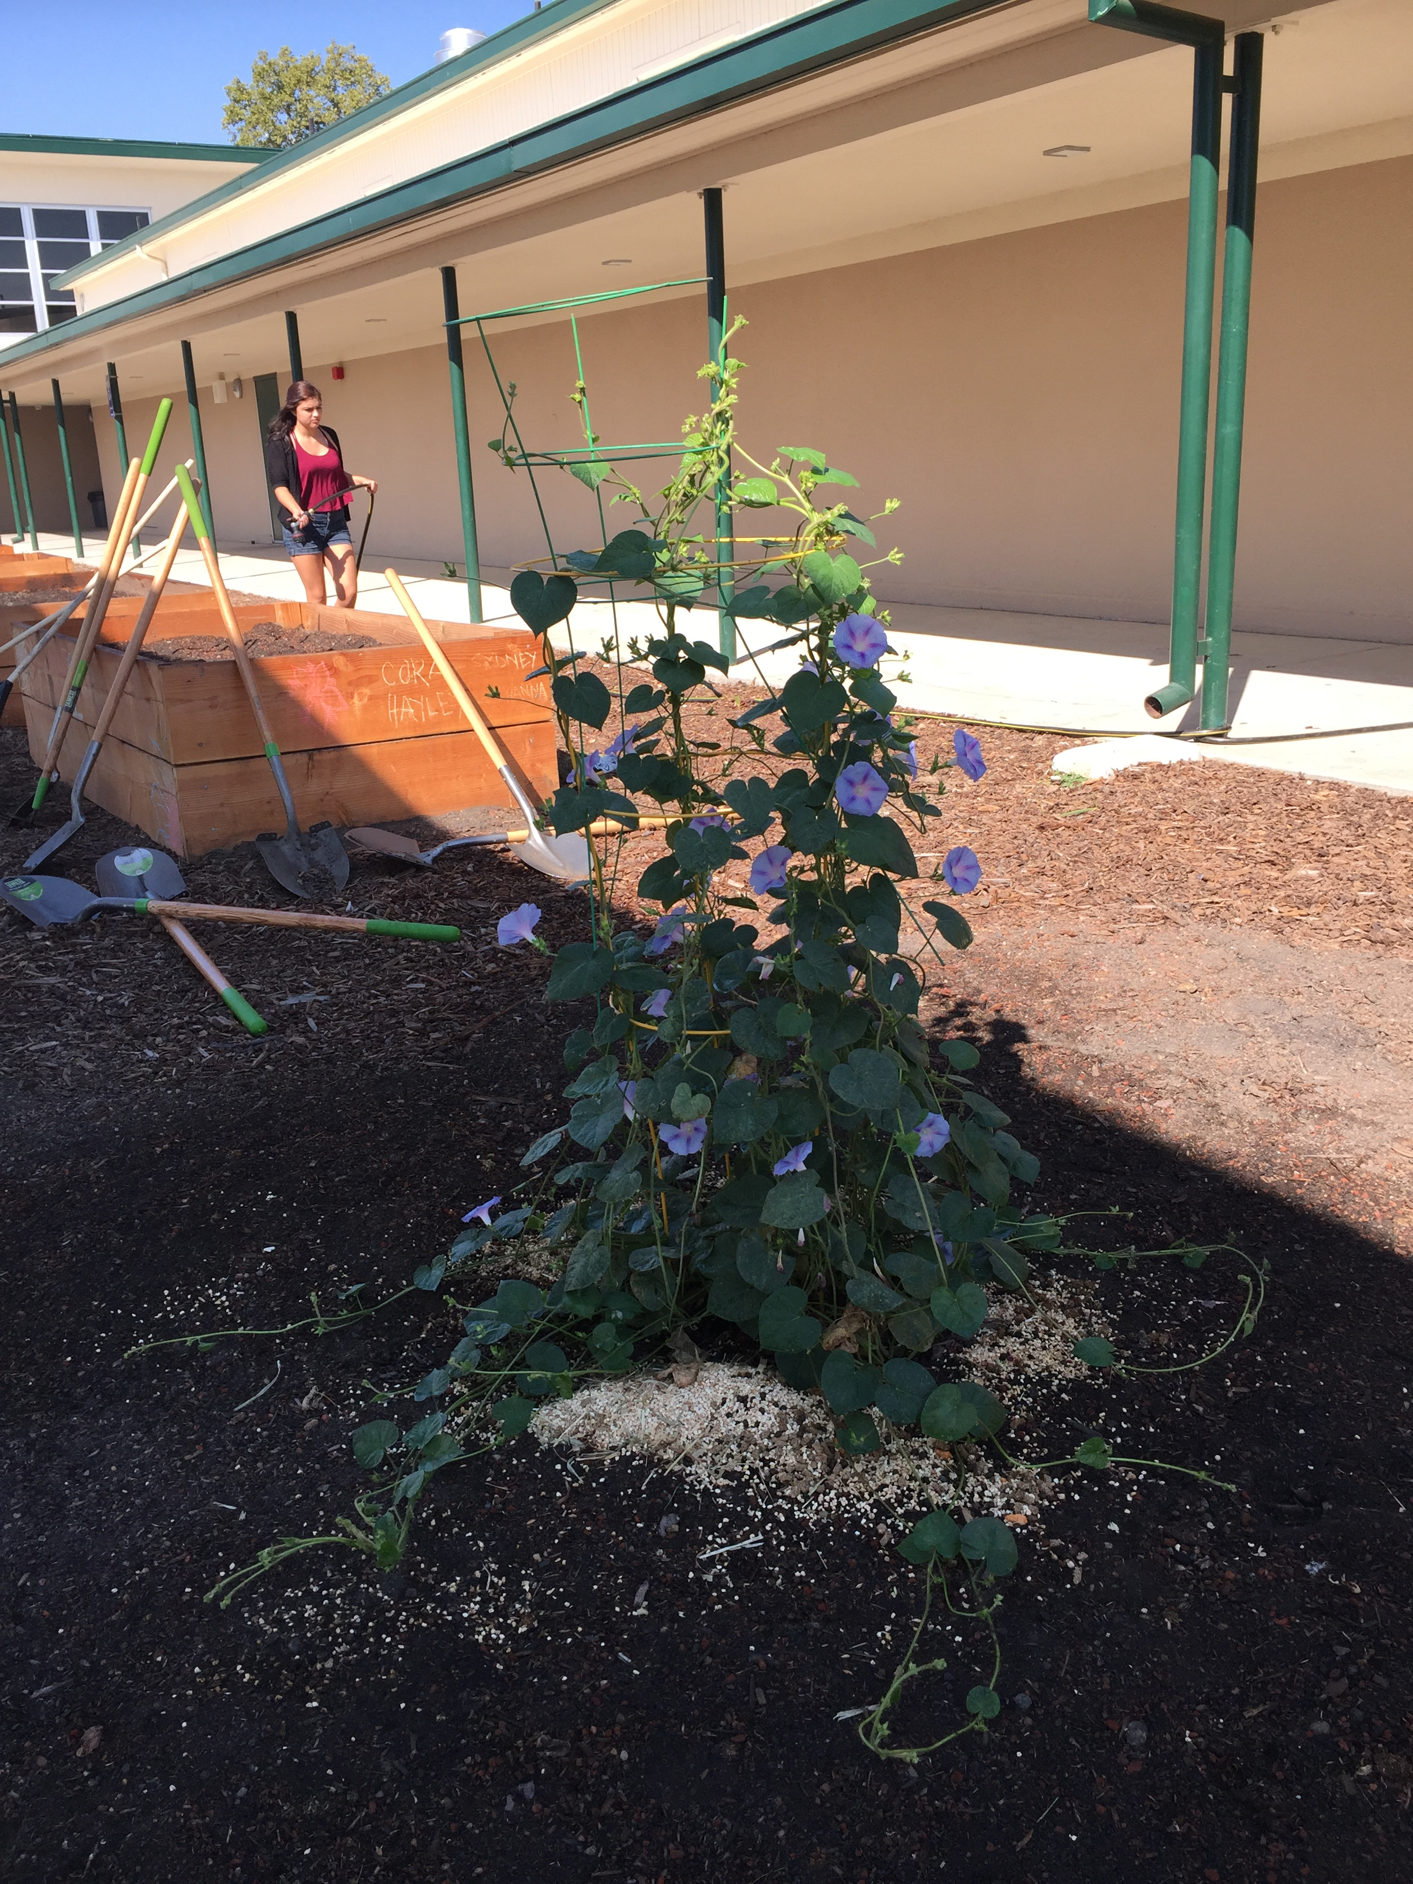
Ag Biology
Week 5
Body Systems –Test , FFA – Officer Speeches & Election friday, Choose SAE’s, Prepare for F2F Service Learning – F2F Fest., Digestive System Project
Compare and Contract a domesticated animal to the Human digestive system, Slide 14

Slide 2
Patty Power
Control group is Group B
The Independent Variable is the NEW Sauce.
The measurement of gas production is the Dependent Variable.
Mr. Krab’s conclusion be that the new sauce helped decrease gas production in the customers.
The 8 people in Group B had a Placebo effect.

Slide 3
The number of paper clips is the Independent Variable.
The distance the plane will fly is the Dependent Variable.
The plane without the paper clips is the Control.
The plane itself, the types of paper clips, the same person threw the plane.

Slide 4
FFA Officer Elections
Present Video/ Presentation 3 – 5 minutes on week of September 12th.
  Who you are?
  What year are you in school?
  What positions you are running for.
  Presentation for each different office to run for.
  Why you want the officer position.
Hold our meeting during 2nd class for Election. Sept. 16th.

Slide 5
FFA Officer Responsibility Activity
Use FFA.org
FFA Manual
Page 48 in online Manual
Write down 3 key responsibilities for each of the offices on 3x 5 cards
We will use flashcards and travel around to say the responsibilities and see if another person can name that officer position.
Tape your card to page P. 19 NB

Slide 6


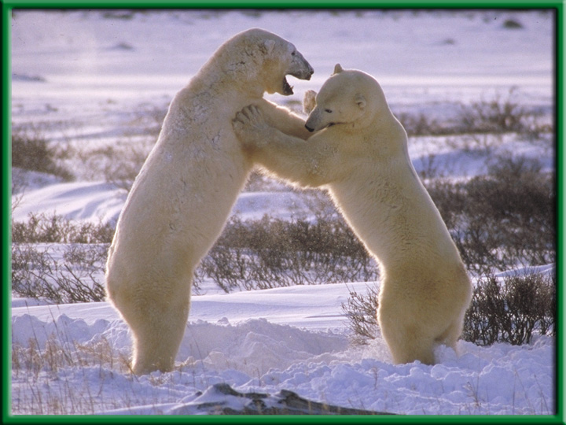
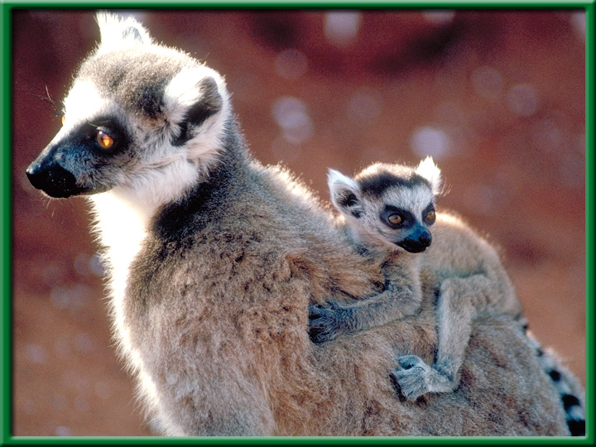
Section 1.1 Summary – pages 3-10
Characteristics of Living Things
All living things:
have “Cells”
produce offspring “Reproduction”
Grow and Develop
Stimulus & Response
Homeostasis
Energy to maintain Metabolism

Slide 7
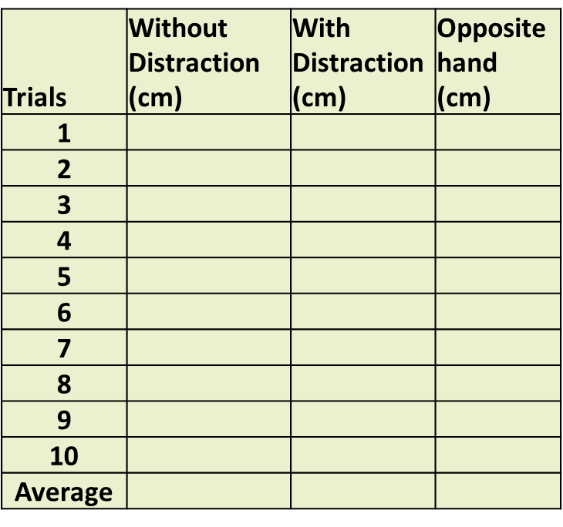
HW – send me (Email) the Data section of the Distraction Reaction Lab
Data: (12 Font, Times new roman)
  Table 1: (12 Font, Times new roman)
  Distance in (cm) measured with no Distraction, with Distraction and Opposite hand catching a meter stick. (10 font, TNR)

Slide 8
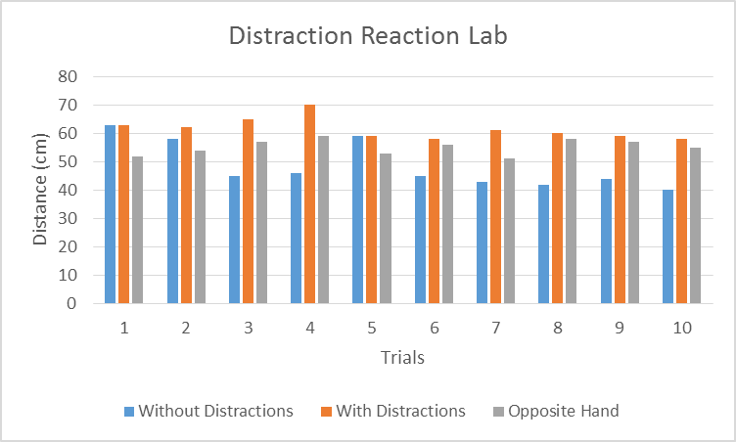
Data: (12 Font Times New Roman)
Graph 1
Catching the meter stick without distractions, with distraction and with the opposite hand varied over the trials, however without distraction did get faster by the last trial. (10 font TNR)

Slide 9
Mouse Party Activity
With a partner go to a computer and log onto it using your new User name and password.
Once you are logged onto the computer go to: http://learn.genetics.utah.edu/content/addiction/
Click on Mouse Party
Take a few notes about how addiction happens on page 17 NB.
Worksheets:
http://teach.genetics.utah.edu/content/addiction/

Slide 10
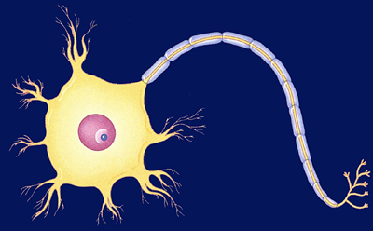
Nerve Impulse Poster p. 944, 949 BB
Write the standard (9E): Students will know the roles of sensory neurons, interneurons, & motor neurons in sensation, thought & response.
Draw the three neurons, labeling all the parts, define each on the poster.
Show an Impulse (Ex. Bright light, touch, pie or hot plate) that includes the sensory, interneuron, and motor neuron response.
Make sure to describe a Reflex Reaction.

Slide 11
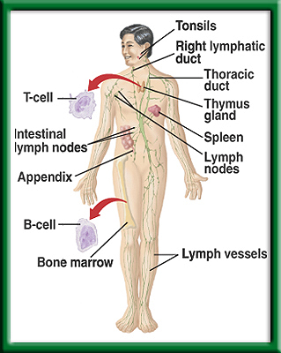
Defense Against Infectious Diseases 39.1 & 39.2
9/2 TSW understand and explain the role of antibodies in the body’s response to a bacterial infection during the warm up. P. 26 NB
What is a pathogen?
Identify cells, tissues and organs that make up the immune system.
Explain the role of antibodies in response to infection.
T – cell production

Slide 12
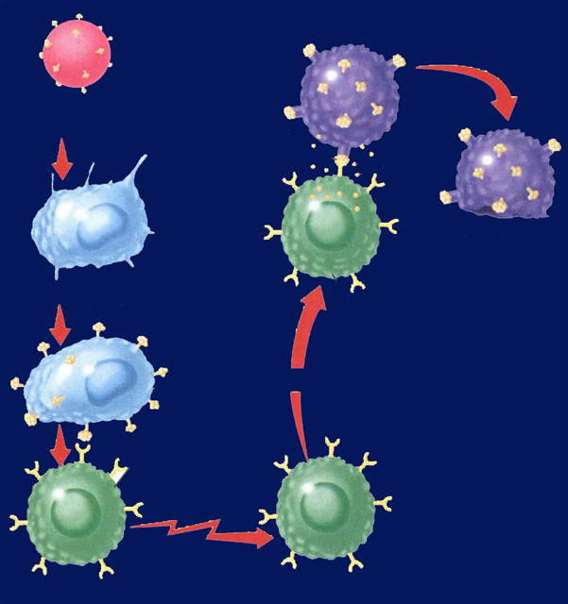
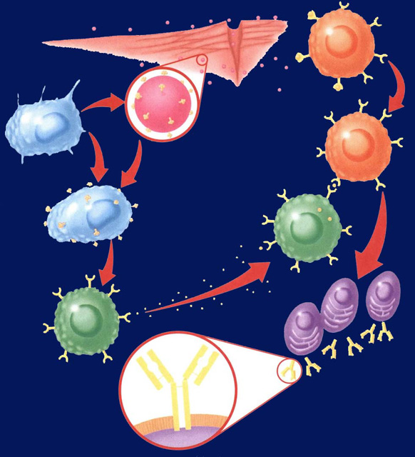
Immune System Responses 39.2
9/6 Obj. TSW compare and contrast Antibody Immunity and Cellular Immunity by diagraming the process in their NB and drawing a Cartoon applying nonspecific & specific immune responses. P.28 NB
? Immunity
Identify two types of lymphocytes in Antibody Immunity.
Explain the process of Antibody Immunity.
Explain the process of Cellular Immunity.
In Agriculture, why are antibiotics used in large scale Production – CAFLO?
? Immunity

Slide 13
Distraction Reaction Lab
Create your title page today
Start your Background information by doing online research and cite your sources.
Copy and Paste Excel Data Table 1 and Graph 1 into word document.
Bar graphs are used, not line.
Page 23NB
Notes CH 39

Slide 14
The Effect of growing Radish Seeds with Lettuce Seeds
Germination of lettuce seeds when grown with Radish seeds
My First & Last Name
Date
Class & Period
Mrs. McAllister
12 Font only

Slide 15
Allelopathy Lab
Objective: Using the Scientific Method, test whether different seeds (Radish and Lettuce) impact each others growth.
Essential Question: Can radish seeds impact the growth of lettuce seeds?
Background: (Paragraph) Explain Vocabulary: Germination, Competition for Resources
  Cite Sources: Allelopathy: How Plants Suppress Other Plants (Ferguson, Rathinasabapathi, Chase, 2013)
Hypothesis/ Purpose: If radish seeds are grown with lettuce seeds, then the lettuce seeds will not germinate.

Slide 16
Allelopathy Lab
Materials: Petri Dishes, Pipettes (2mL), Petri dish paper, Radish seeds, Lettuce seeds
Procedure: (Make sure your procedure can be duplicated exactly by someone who has never done this lab – Be very specific.)
  Step 1:
  Step 2:
  Step 3:
  Step 4:
  Step 5:

Slide 17
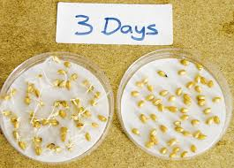
Allelopathy Lab
Data: (Qualitative & Quantitative – numbers, values)
  Table 1: The table below shows the different germination rates of radish and lettuce seeds when grown together and separately. (10 font)

Slide 18
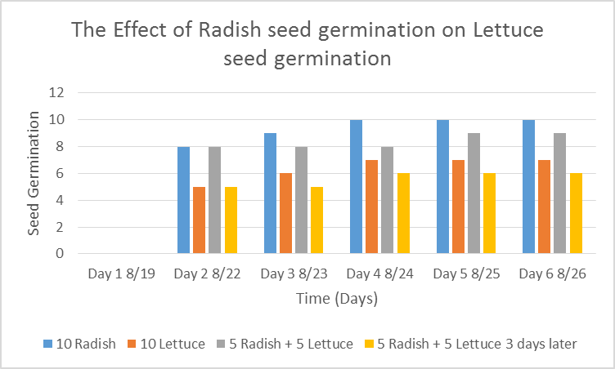
Allelopathy Lab
Data: (Qualitative & Quantitative-numbers, values)
  Graph 1:
  The radish seeds over 6 days showed increased germination compared to the lettuce seeds. (10 Font)

Slide 19
Allelopathy Lab
Data: (Qualitative – descriptive words & Pictures)
  The radish seeds looked …… they smelled….
  The lettuce seeds roots were longer and had more root hairs.

Slide 20
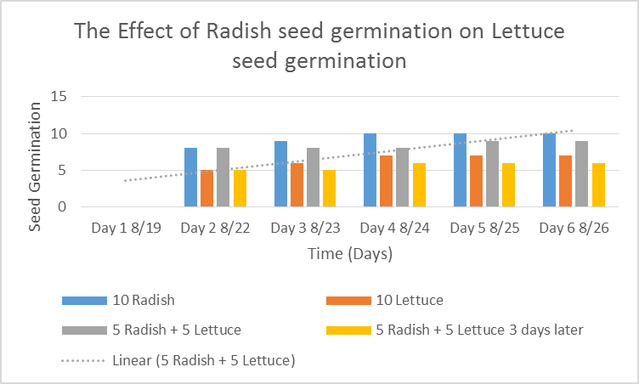
Allelopathy Lab
  Data Analysis: (Paragraph)
  Explain your data - results. Why did we see the results in the graph? Discuss any trends.
  Cite Sources: Allelopathy: How Plants Suppress Other Plants (Ferguson, Rathinasabapathi, Chase, 2013)

Slide 21
Allelopathy Lab
Conclusion: (Paragraph)
  Restate hypothesis and explain if it was supported or not. Tie your Data Analysis to your Background and hypothesis. Did your data support what you thought would happen? How? Explain why allelopathy is important. At the very least, write an AXES paragraph about Allelopathy between radish and lettuce seeds and how it applies to Agriculture.
  Cite Sources: Allelopathy: How Plants Suppress Other Plants (Ferguson, Rathinasabapathi, Chase, 2013)

Slide 22
Works Cited
James J. Ferguson, emeritus professor; Bala Rathinasabapathi, professor; and Carlene A. Chase, associate professor, Horticultural Sciences Department, Cooperative Extension Service, Institute of Food and Agricultural Sciences, University of Florida, Gainesville, FL 32611.
Yes – one more
Yes – still one more ☺
Done!

Slide 23
Notebook – Specific Immunity
P. 25 NB Antibody Immunity P. 1037BB
P. 27 NB Cellular Immunity P. 1038 BB
Write a 4 – 5 sentence summary using specific vocabulary to explain the process.
Antibody Immunity
Cellular Immunity

Slide 24





Section 39.2 Summary – pages 1031-1041
Antibody Immunity – Specific Immune Response, Builds Antibodies
E. B cells can bind to antigens directly.
Pathogens enter
tissues through a wound.
B cell
F. Helper T cells bind to antigens on B cells.
B. They are attacked
by macrophages
at the infection site.
Pathogen
Macrophage
G. T cells release chemicals that cause B cells to produce
clones of plasma cells.
C. Antigens of the pathogen are displayed
on the surface of the macrophage.
Antigen
receptor
site
H. Each plasma cell secretes more than 2000 antibodies per second in the blood. Memory B cells and antibodies remain in the blood and respond to future invasions by the same pathogen.
D. Helper T cells have
receptor sites that
recognize and bind to the antigens on the
macrophage.
T cell
Plasma
cells
Antibody
Surface of
plasma cell

Slide 25
Section 39.2 Summary – pages 1031-1041
#3.Cellular Immunity
Specific Immune Response that blows up infected body cells.
Infected cells
Pathogen
engulfed by
Perforin
Foreign
antigen
Infected cell lyses
Macrophage
Cytotoxic T cell
Displays antigens
on surface and
stimulates T cell
Attacks infected
cell
Stimulates
Helper T cell
Cytotoxic T cell

Slide 26
Immune System Poster
Make a cartoon with captions, showing the body’s Immune Response to an infection.
Make 4 Stages:
  Stage 1: How the Pathogen gets into the body.
  Stage 2: Show the Nonspecific Immune Response.
  Stage 3: Show the Specific Immune Response.
  Stage 4: Show the Memory Cells Warding off a previous infection.

Slide 27
Foldable (29 NB) P. 1037BB
Macrophage – Definition & Picture inside
  A white Blood cell that is nonspecific against pathogens.
T – Cell
B – Cell
Plasma Cell
Antibodies
Antigens

Slide 28
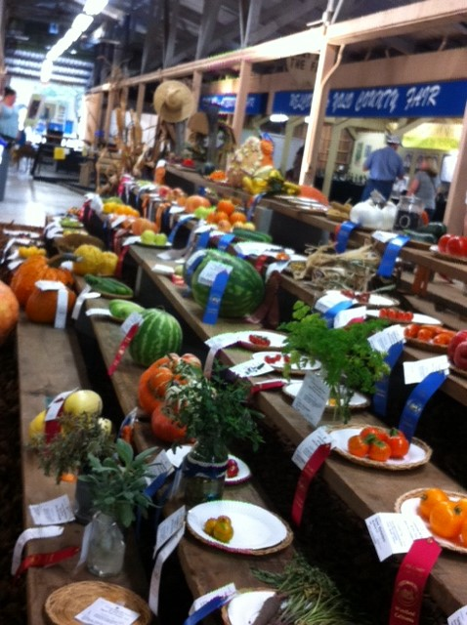
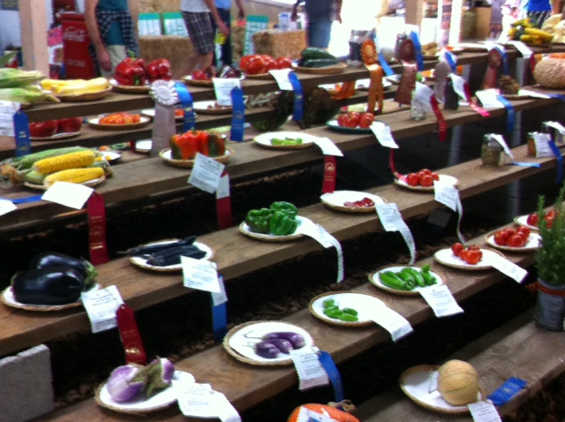
Farm to Fork Food Drive
Breaking the world record in donated fresh food to others.

Slide 29
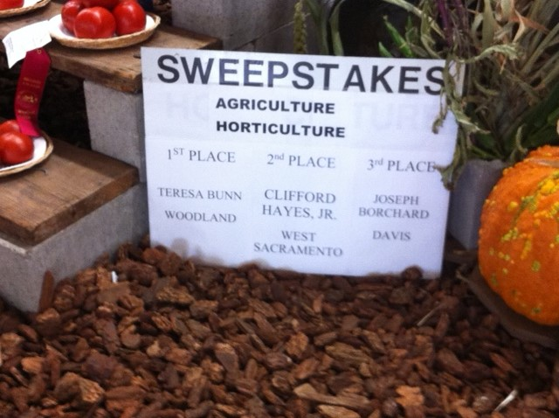
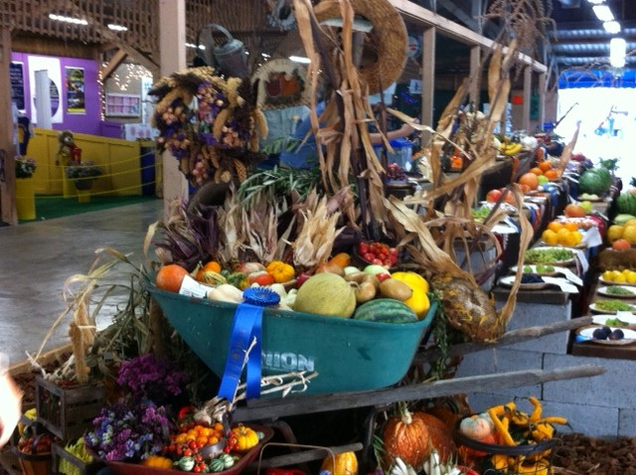
Agricultural displays
Does anyone know Clifford Hayes Jr?

Slide 30
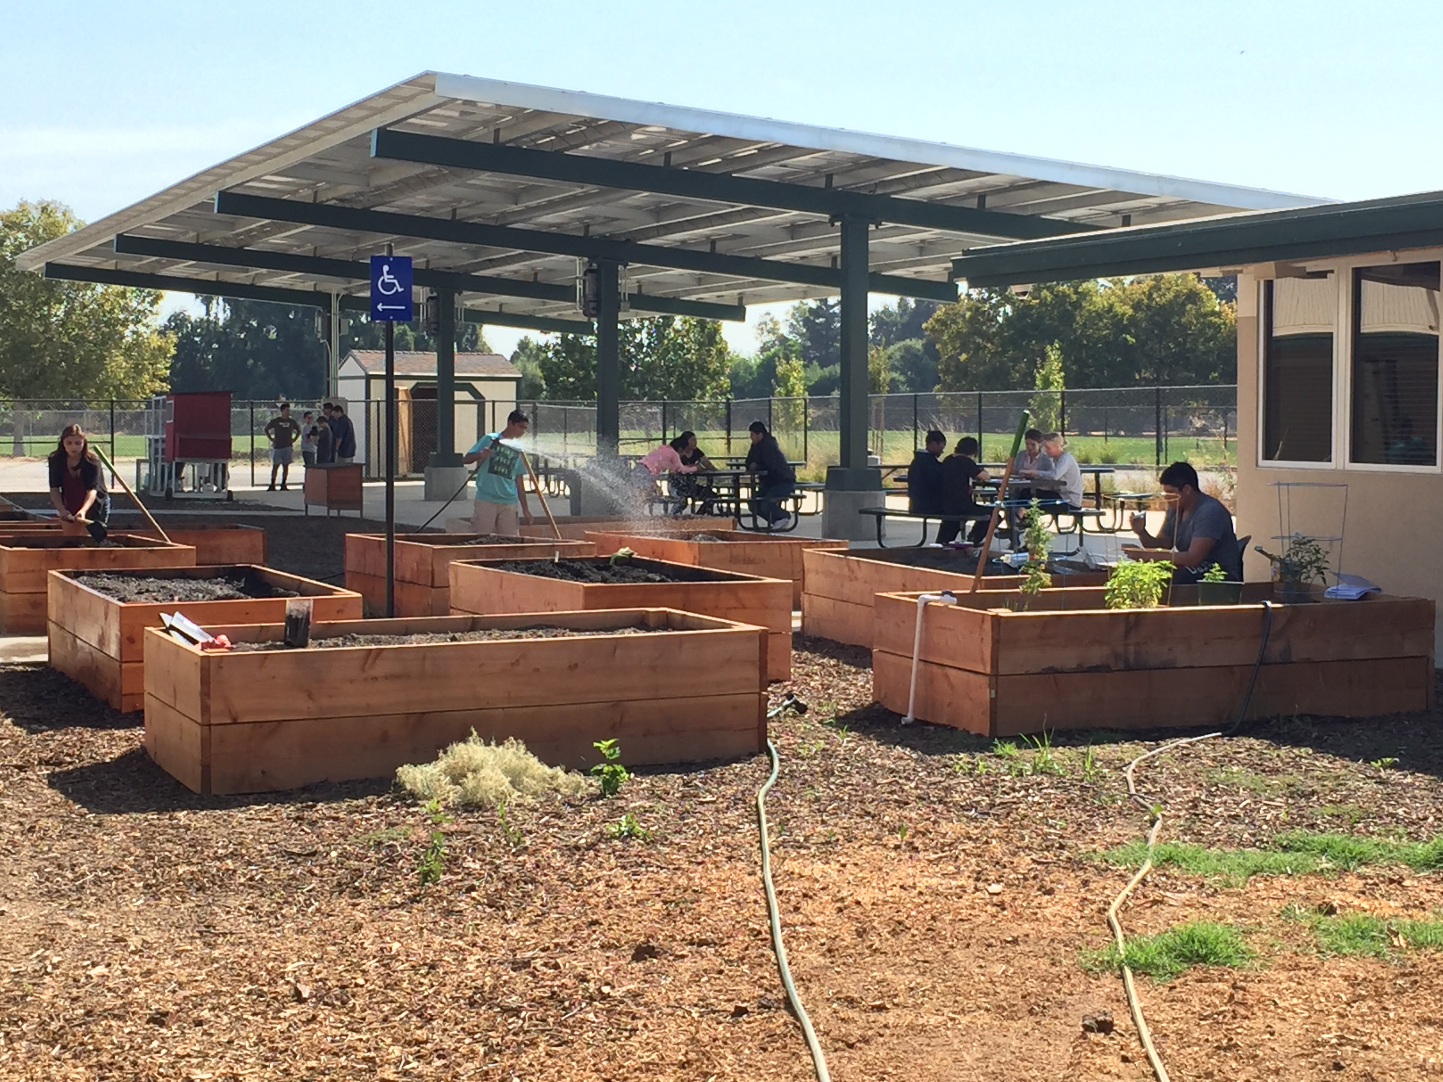
Just another day at work ☺

Slide 31
Measuring your Pulse & Respiration P.31 NB
Respiration – Breaths / minute
Pulse – Heart Beats/ minute
Measure your pulse & respiration and write them down on page 29 NB.

Slide 32
Exercise Lab p. 31 NB
Choose a partner
Choose an exercise
  1 minute in length (5 times)
    Count strides, Jumping Jacks, Push ups
  Duration (Time)- (5 repetitions) or (Time minutes)
    Plank, Wall Sit
Control?
What was constant?

Slide 33
Data Table & Graph
When do muscles fatigue? P. 31 NB
Time (minutes) | Number of repetitions Sit ups, Push ups, Jumping Jacks Calf Raises Squats
1st minute 1 minute | 10
2nd minute 1minute | 20
3rd minute 1minute | 30
4th minute 1minute | 40
5th minute 1minute | 50
Intervals Wall Sit Plank Superman | Time (seconds)
1 | 30
2 | 45
3 | 50
4 | 20
5 | 15

Slide 34
Muscle Fatigue Lab p. 31 NB
Trials | Number of Repetition | Pulse
1
2
3
4
5

Slide 37
Data Table for Pulse P. 31 NB
 | Trial 1 | Trial 2 | Trial 3 | Trial 4 | Trial 5
Pulse | 68 | 68 | 69 | 72 | 75

Slide 38
Graph your Pulse Rate P. 31NB
When does muscle fatigue set in?

Slide 39
The Heart, Lungs & Components of the Blood P. 35 NB P. 982 BB
Draw & Label & Color the components of the Heart & Lungs.
Copy the following Notes:
  Red Blood Cells -transports O₂ & CO₂
  White Blood Cells- T & B cells Immune system
  Platelets – cell fragments involved in blood clotting (Vitamin K)
  Plasma – Most of the liquid of blood- proteins, nutrients, enzymes, hormones, salts

Slide 40
Blood Cells Notes P. 35NB
Red Blood Cells
  Made in the Red Marrow
  Circulatory & Respiratory System
  Smaller
  More numerous
  No nucleus
  O2 & CO2
  Contain Hemoglobin (Iron – Fe)
White Blood Cells
  Made in the Yellow Marrow
  Circulatory & Immune System
  Larger
  Fewer cells
  Nucleus
  T & B & Macrophage Cells

Slide 41
Exercise Lab
Title: Short – 5 words
Introduction: Exercise & Cardiovascular/ Respiratory system, O₂ & CO₂, pH, pulse
Objective
Hypothesis
Materials: List
Procedure: Specific. Step 1, Step 2, Step 3…
Safety concerns: don’t run with scissors.

Slide 42
Exercise Lab
Constants
Control:1st data point
Data table: Independent & Dependent Variable
Graph:
Data Analysis: What happened over time and why is it important?
Error Analysis:
Conclusion:

Slide 43
Questions to answer in the conclusion
Yes in addition to the one’s in the lab report.
How did your steps change with the different activities you did?
What effect did repeating the exercise over time have on the muscle group.
How did your muscles feel?
What physiological factors are responsible for fatigue?
How does the amount of rest you have affect the recovery of the muscles?
How did your results compare to others.

Slide 44
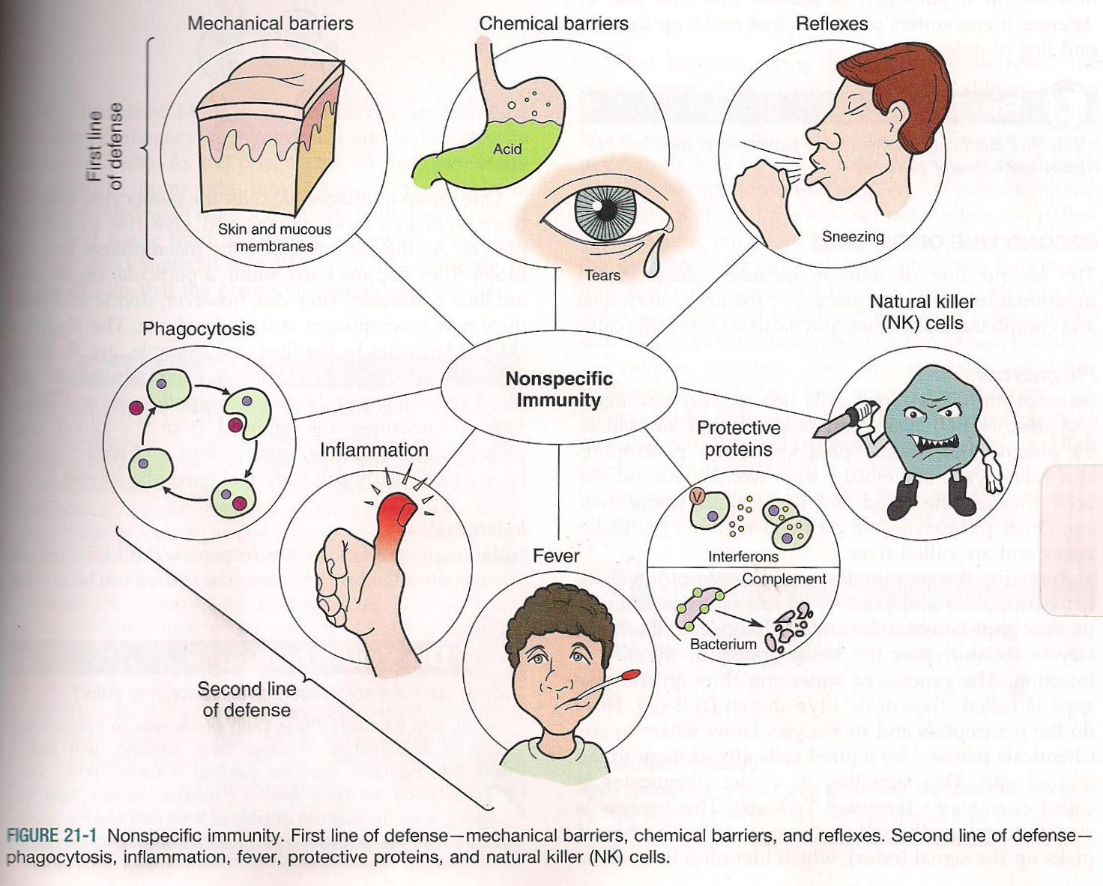
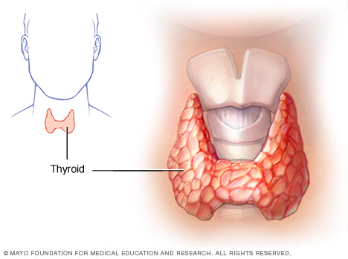
9/12 Metabolism & Homeostasis CH 35
Obj. TSW understand how the body regulates chemical reactions to maintain homeostasis. P. 36NB
Define metabolism.
The thyroid controls what process in the body?
How does the immune system respond to an infection in a nonspecific way?

Slide 45
FFA Officer Presentations
Present Video/ Presentation/ Speech 3 – 5 minutes on week of September 12th.
  Who you are?
  What year are you in school?
  What position(s) you are running for.
  Presentation for each different office to run for.
  Why you want the officer position.
  What qualifications do you have?
Hold our meeting during 2nd class for Election. Sept. 16th.

Slide 46
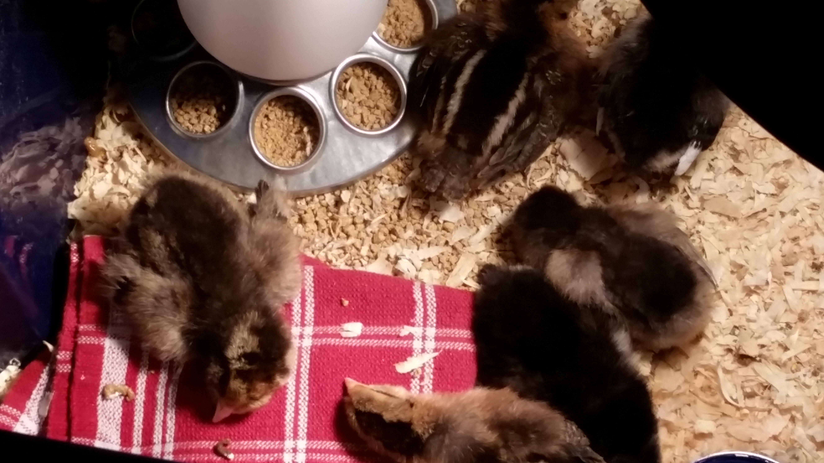
Jacob’s baby chicks

Slide 47
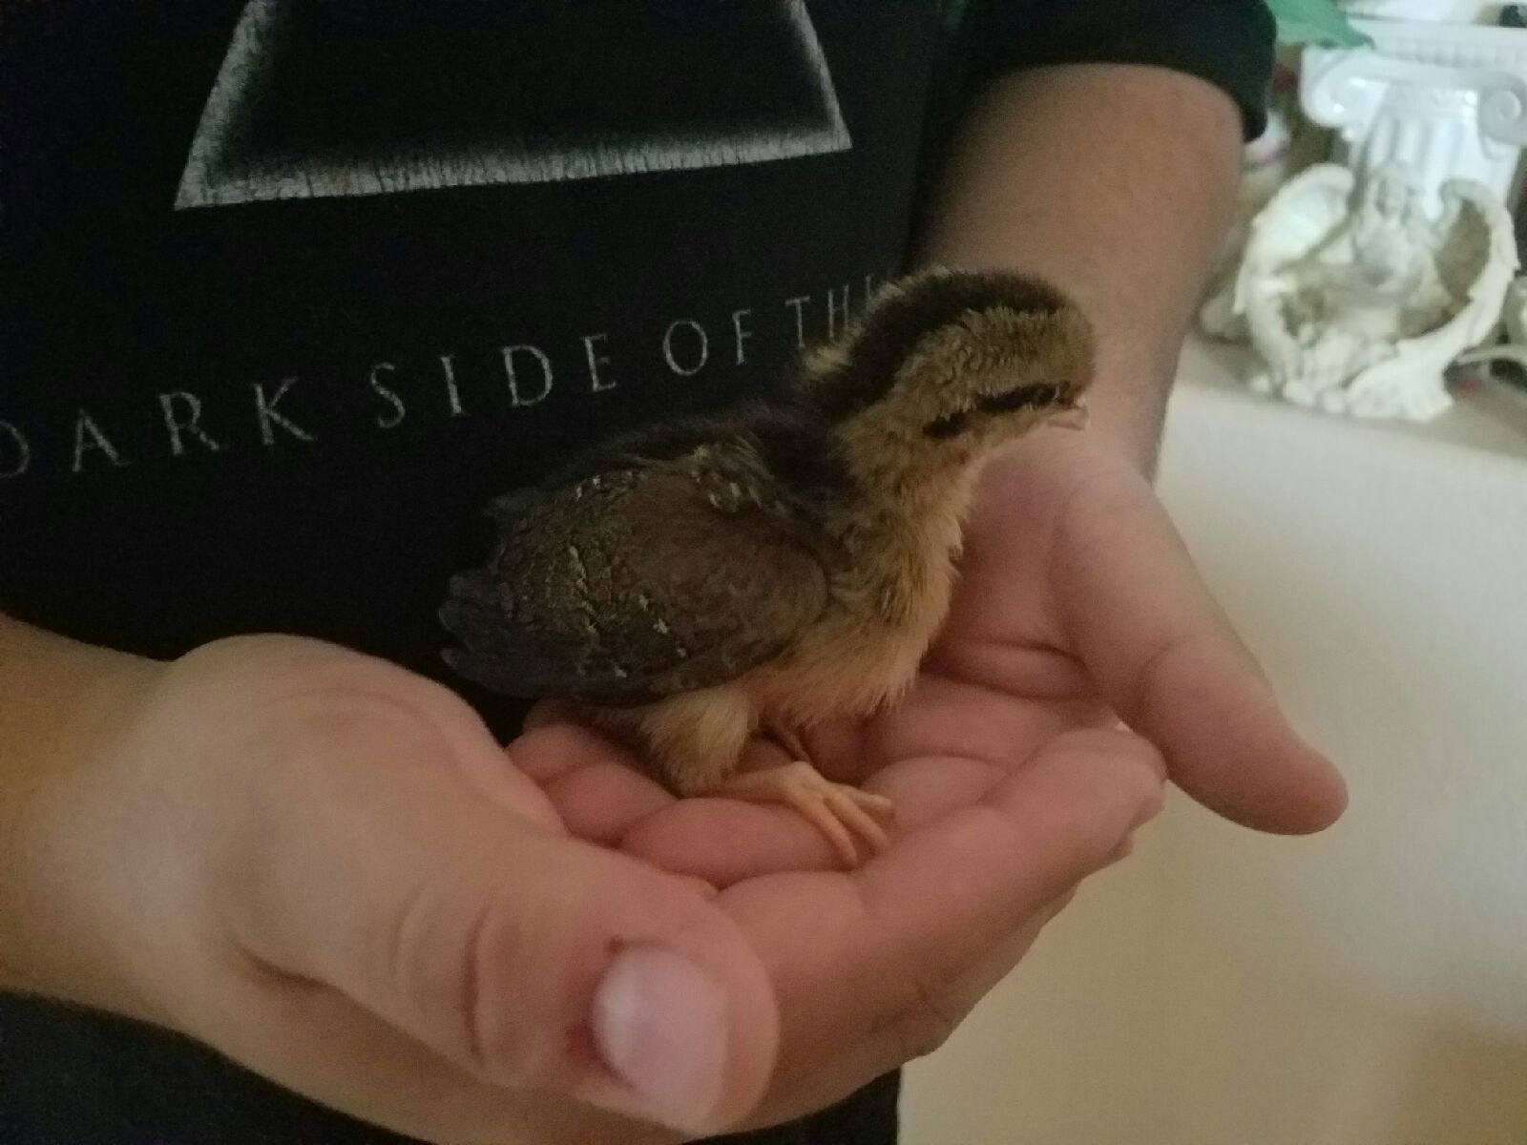
YES!

Slide 48
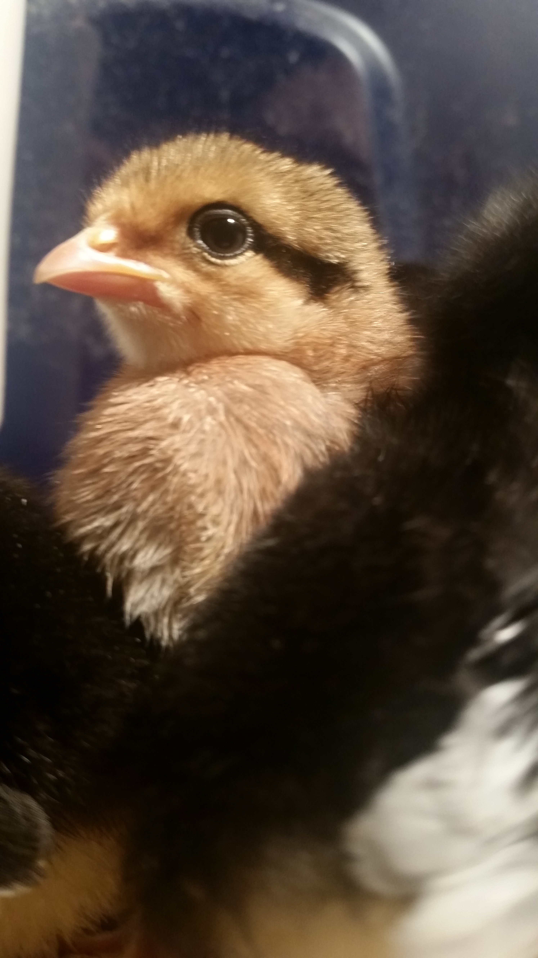
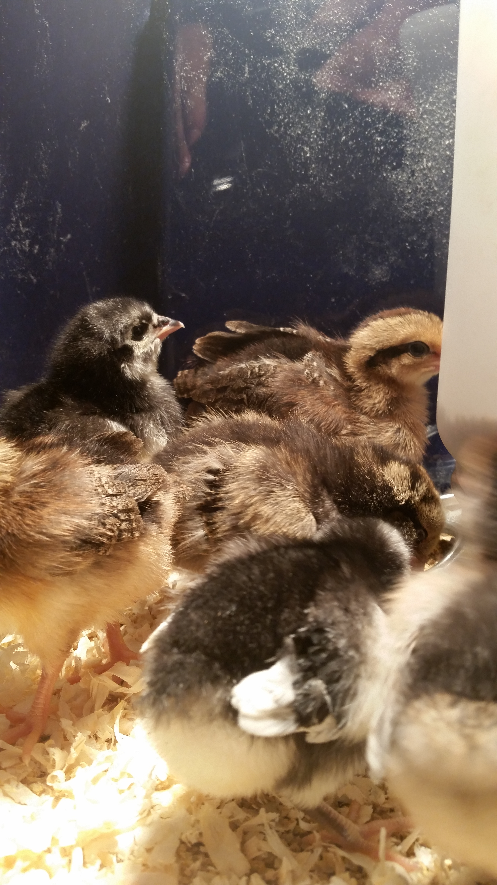
More little chicks

Slide 50
Physiology Test on Thursday
Review your notebook Warm Ups.
Review your worksheets – Body Systems
Review how to make a Data Table & Graph and Scientific Method

Slide 51
Body Systems Interactive Worksheet
Respiratory & Endocrine: Allergies – Breathing & Wheezing
Muscular & Immune: Sick & no exercise – muscles atrophy. Broken Bone.
Urinary & Nervous System: feel the urge to go to the bathroom
Skeletal & Cardiovascular: Increase heart rate during exercise
Cardiovascular & Muscular: Pump blood to muscles to deliver oxygen.

Slide 52
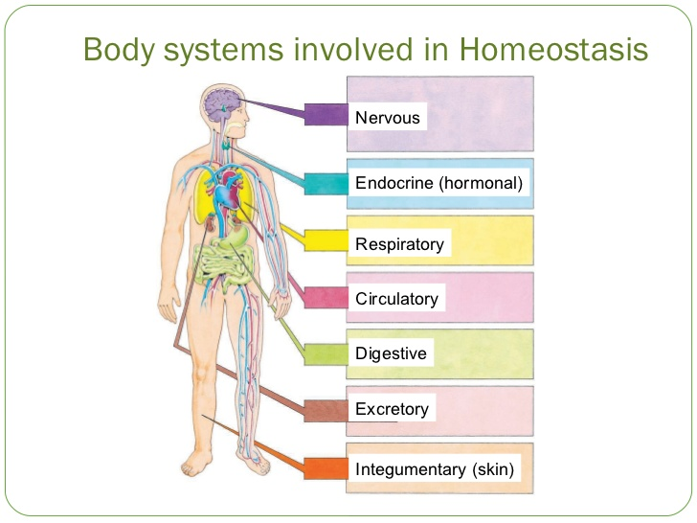
9/13 Review for Physiology Test
Obj. TSW demonstrate understanding of how the body maintains homeostasis. p. 38NB
CH 39 Explain the function of the immune system, name a cell, tissue and organ.
CH 36 Explain the function of the nervous system, name a cell, tissue and organ.
Name any two body systems and explain how they work together to maintain homeostasis.

Slide 53
Answers to Warm UP
Immune system helps protect the body from disease causing pathogens. The T & B cell are two cells, the lymph and thymus gland are tissues, and the organs are spleen, Tonsils, Appendix.
Nervous System communicates with the outside world and sends messages inside the body. The three types of nerve cells are sensory neuron, Interneuron (brain or in spine), Motor neuron. Tissues would surround the spine, the Organ is the Brain.
The Respiratory system works with the Circulatory system to maintain homeostasis by the blood carrying O2 to the muscles, and then it will carry away CO2 to the Lungs to be exhaled.

Slide 54
Reading a Table and Graph Practice
Obj. TSW learn how to read a graph and interpret data from it. P. 39 NB
Trials | Without Distractions | With Distractions | Opposite Hand
1 | 63 | 63 | 52
2 | 58 | 62 | 54
3 | 45 | 65 | 57
4 | 46 | 70 | 59
5 | 59 | 59 | 53
6 | 45 | 58 | 56
7 | 43 | 61 | 51
8 | 42 | 60 | 58
9 | 44 | 59 | 57
10 | 40 | 58 | 55
In the data table, What can be concluded from the data without distractions? With Distractions?
In the graph, What was the independent and dependent variables. What was the control for the lab?
Create a better title for the graph that represents the true nature of the lab.

Slide 55
Answers to WU
The conclusion to the data without distractions is that it got faster as more trials were done. With the distractions, the reaction time did not get faster.
The Independent Variable is the number of trials, (X – axis). The Dependent Variable is the Number of repetitions, (Y – axis). The control in the lab was my original resting respiration rate, or pulse rate.
A better title for the lab could be: Reaction Lab with meter sticks, Distraction/Reaction Meter Stick Lab, How quick can you catch a meterstick?

Slide 56
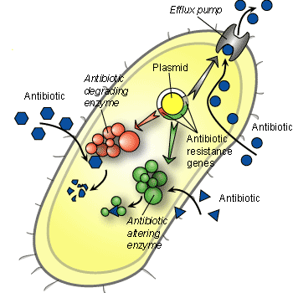
9/14 Body Systems
Obj. TSW relate the knowledge they learned about body systems to Frogs. P. 40 NB
Name 3 body systems you will see in the frog.
For each Body System explain it’s function.
Explain how two of those body systems work together to maintain homeostasis.
How bacteria create a resistance to antibiotics.

Slide 57
NOTES: How does Bacteria build a resistance to antibiotics? P. 37 NB
1.Antibiotic Degrading Enzymes break up absorbed antibiotics.
2.The Bacteria builds a Efflux Pump to immediately pump out any absorbed antibiotic.
3. Antibiotic altering Enzyme surrounds the absorbed antibiotics and renders it useless & ineffective.

Slide 58
Marijuana: Breaking down the Buzz by: Scholastic.com, 2014
Claim: Smoking marijuana on a regular basis can harm the developing teen brain.
Evidence: Cigarette smoking causes cancer. Studies show…, Research says…
Reasoning: Legalizing marijuana may make it easier to get, but teens may not fully understand its harmful effects.

Slide 59
Fist Bumps Article
Claim: Fist bumps are cleaner than handshakes.
Evidence: A handshake transferred more that 2 x as muny bacteria as high Fiving. A fist bump was 1/10 as much bacteria .
Reasoning: A fistbump is likely to put far less skin in contact with another person, transferring less bacteria that could cause health concerns.

Slide 60
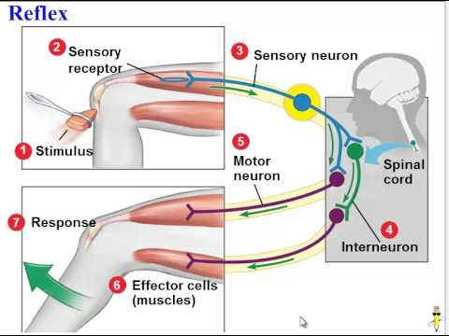
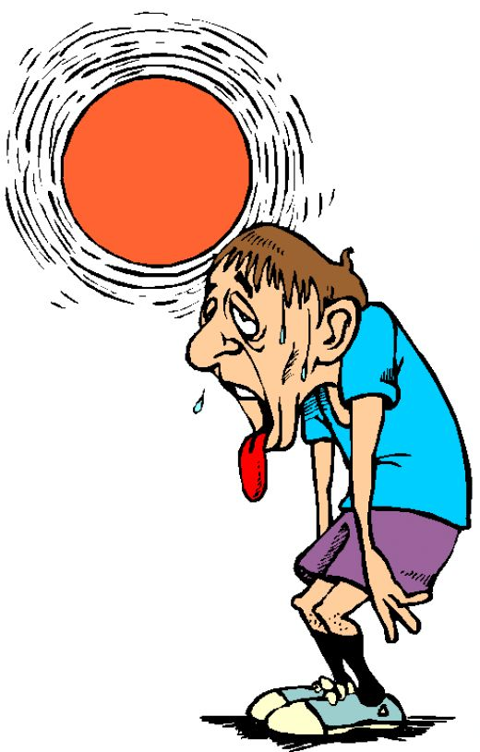
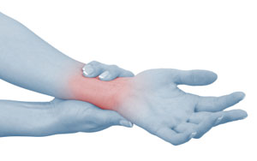
9/15 Physiology/ Body Systems
Obj. TSW achieve proficiency taking the Physiology benchmark test. P. 40 NB
Explain and give an example of a reflex reaction.
How does the skin help maintain homeostasis?
Name the reaction by tissues involved in inflammation.

Slide 61
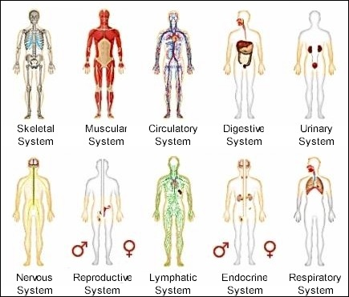
2/13 Scientific Articles: How to read critically.
Obj. TSW write a well thought out response to a written question about body systems, and accurately find the Claim, Evidence, Reasoning and AXES paragraph for a scientific article. P. 38 NB
What is a claim? How do you know when you have found it in an article?
What is evidence? How do you know when you have found it in an article?
What is the reasoning? How do you know when you have found the support for the evidence?
Notebook Check Today P. 22 - 35

Slide 62
Animal and Body Systems Project
50 point Project Due February 9, 10th & 13th
You may work alone or with a partner.
Choose a domestic farm Animal, choose a Body System.
On a Poster Board, or Power Point Show both systems, label the parts. You can use pictures or draw.
During your presentation explain how the systems are similar, and how they are different.
Explain in detail why it is important that we understand that system in your animal, and for us as a human.
Have a works cited page.

Slide 63

Learning about FFA Officer Positions Activity
Obj. TSW distinguish between different officer positions after reviewing each positions’ responsibilities online. P. 31 NB
Use the FFA.org website or the Official Manual P. 46 - 48 and Name 5 of the 9 Officer positions.
What responsibilities/ behavior would you expect from the all the River City High School Bryte CCT Chapter FFA officers?
Would you like to run for an office next year in Farm to Fork 1?
Why or why not?

Slide 64
FFA Officer Responsibility Activity
Use FFA.org
FFA Manual
Page 48 in online Manual
Write down 3 key responsibilities for each of the offices on 3x 5 cards
We will use flashcards and travel around to say the responsibilities and see if another person can name that officer position.
Tape your card to page P. 31 NB

Slide 65
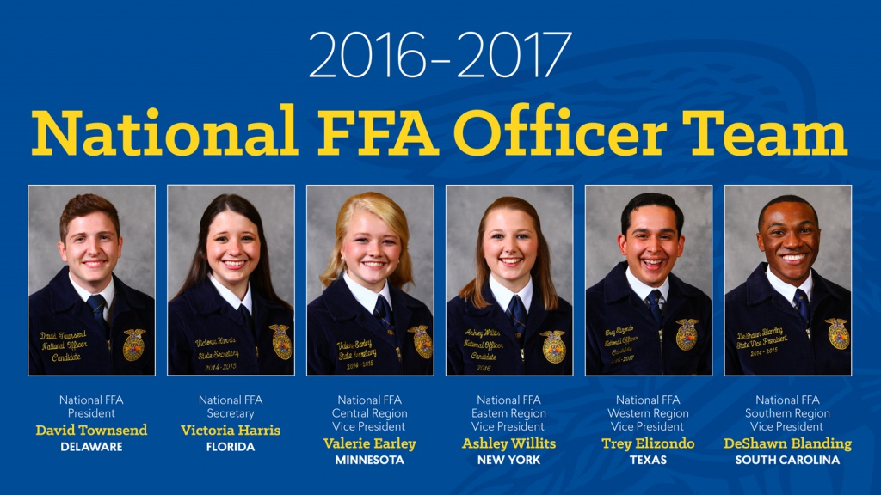
FFA Officer Responsibilities
Obj. TSW learn the FFA offices, the officer responsibilities. P. 40 NB
Name 5 of the 9 FFA Officer positions.
What 6 Officers participate in Opening & Closing Ceremonies?
Describe the responsibilities of three officers of your choosing.

Slide 66
Garden Planning Sheet
Choose from any of the 4 Projects ( all must get done today)
  Bunnies- Move Tanks enclosure, Feed Both, water both, Clean both enclosures, place new wood chips under each.
  Garden – Please pick all yellow/ yelling leaves off of plants. Pull any weeds in beds or on ground.
  Chickens – Move Tractors, Feed, ADD shavings, Water..
  Wood Chips –Under bunnies, spread in sparse area’s
  Enclosure – Move to Front of Classroom & plug in.

Slide 67
Quiz Today –
Notebook Check
Pages 22 – 35 ( Points)
Study Warm ups
Read Dairy Herd Management Article
  CERC- Claim, Example, Explanation, Conclusion (AXES Paragraph)

