Slide 1
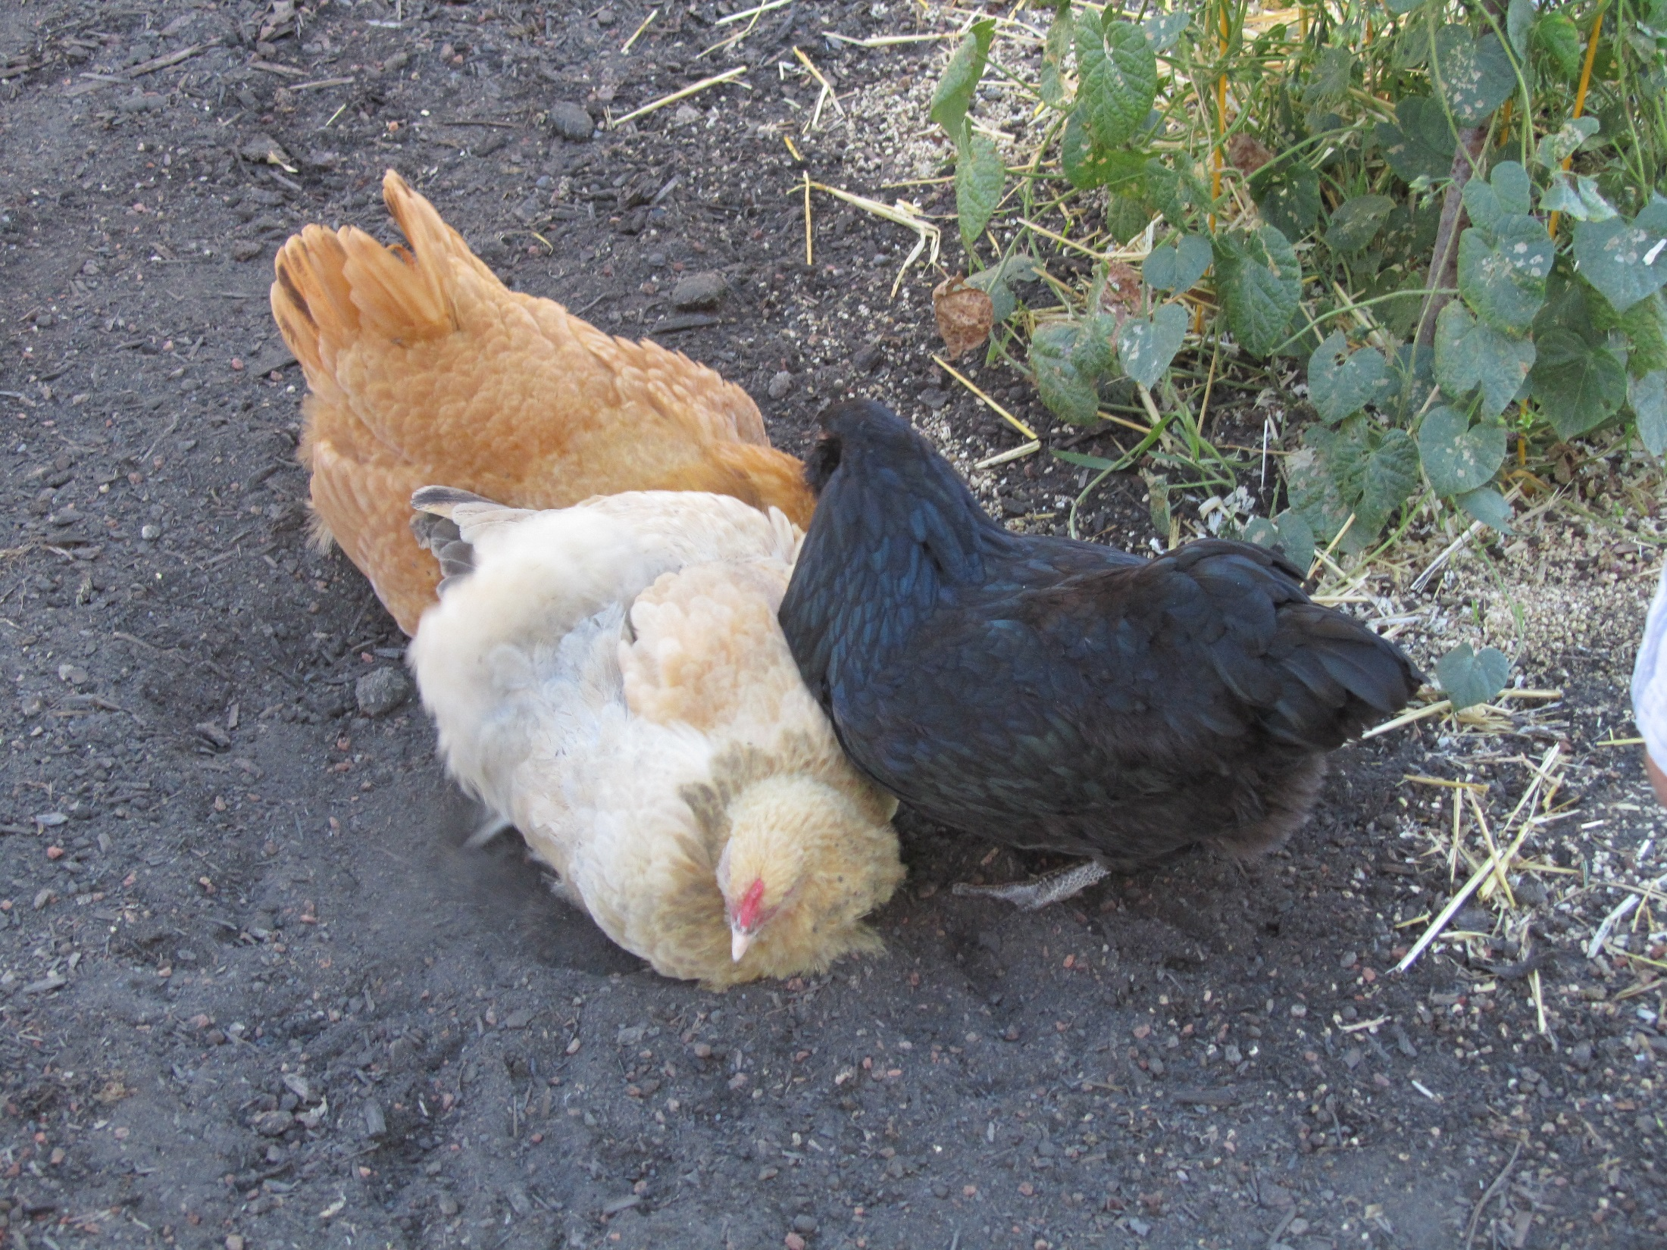

Slide 2
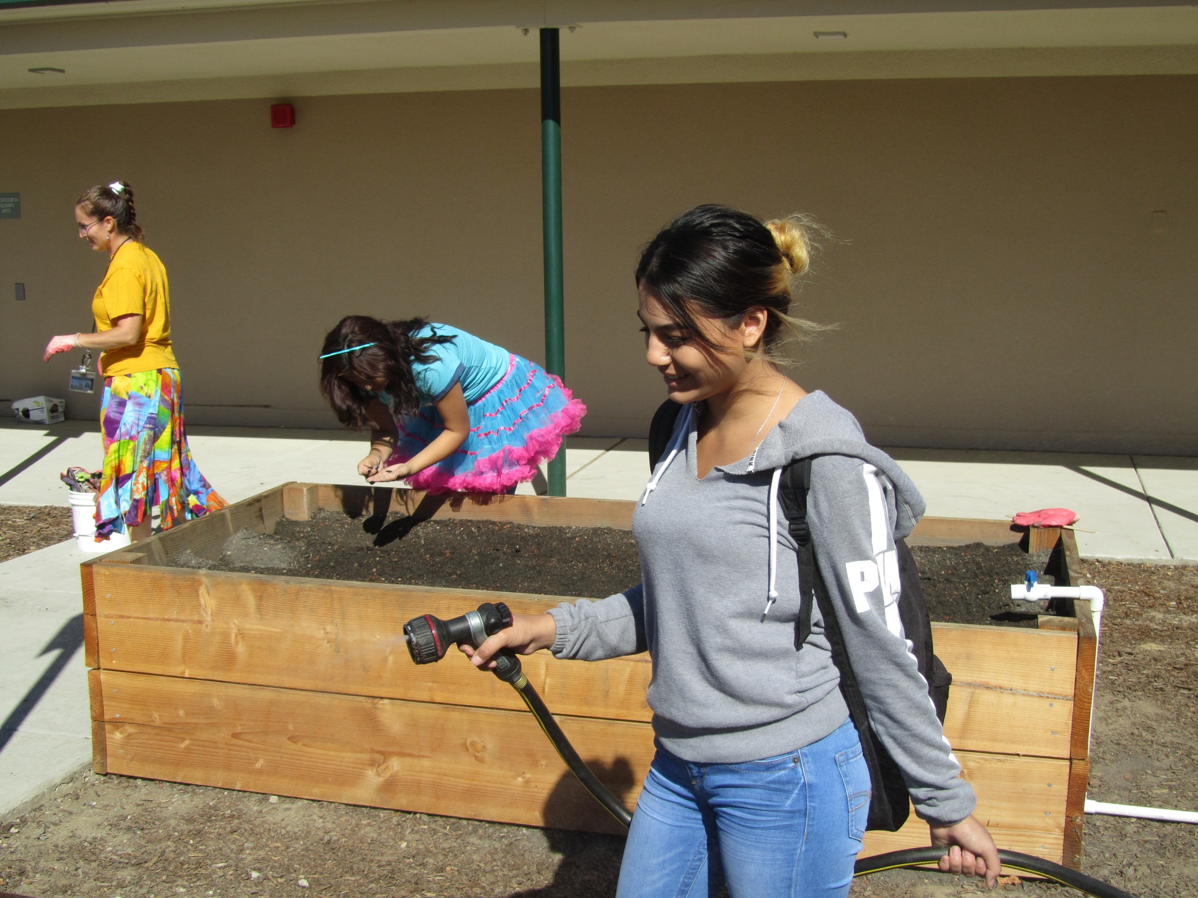

Slide 3
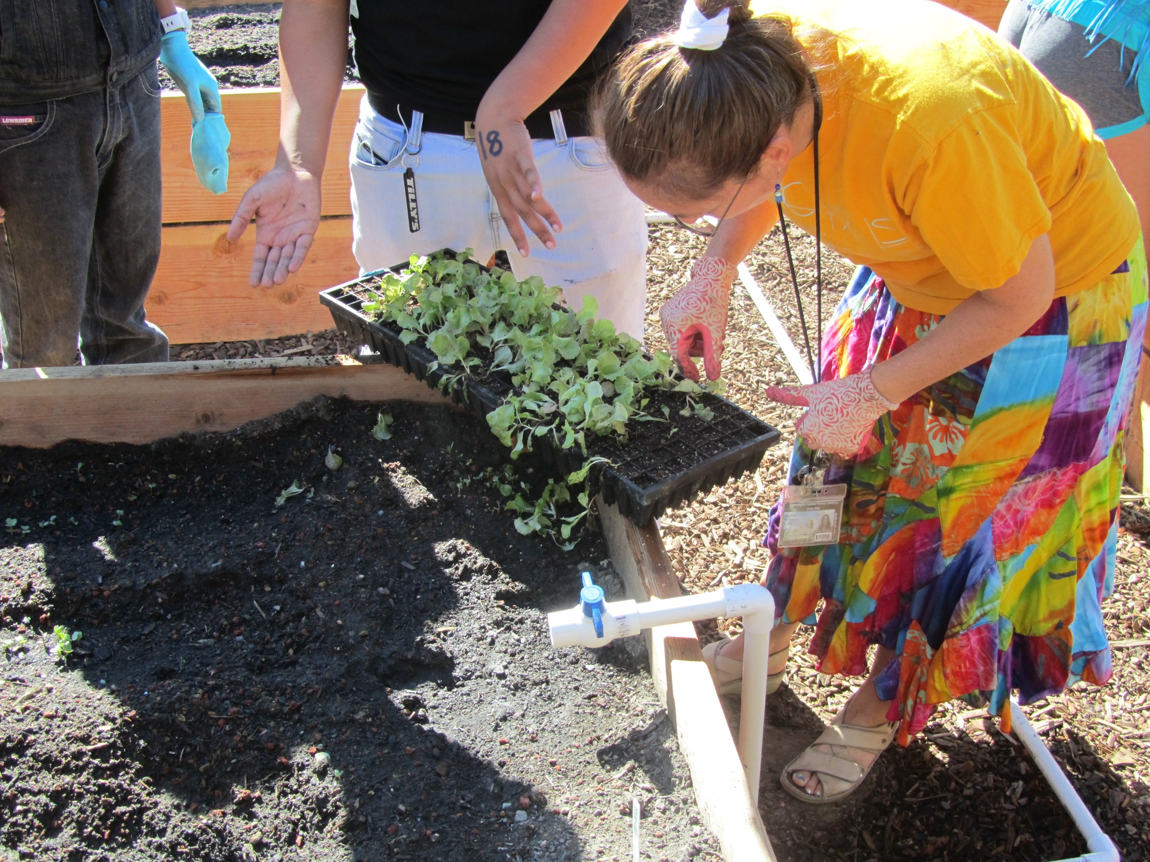

Slide 4
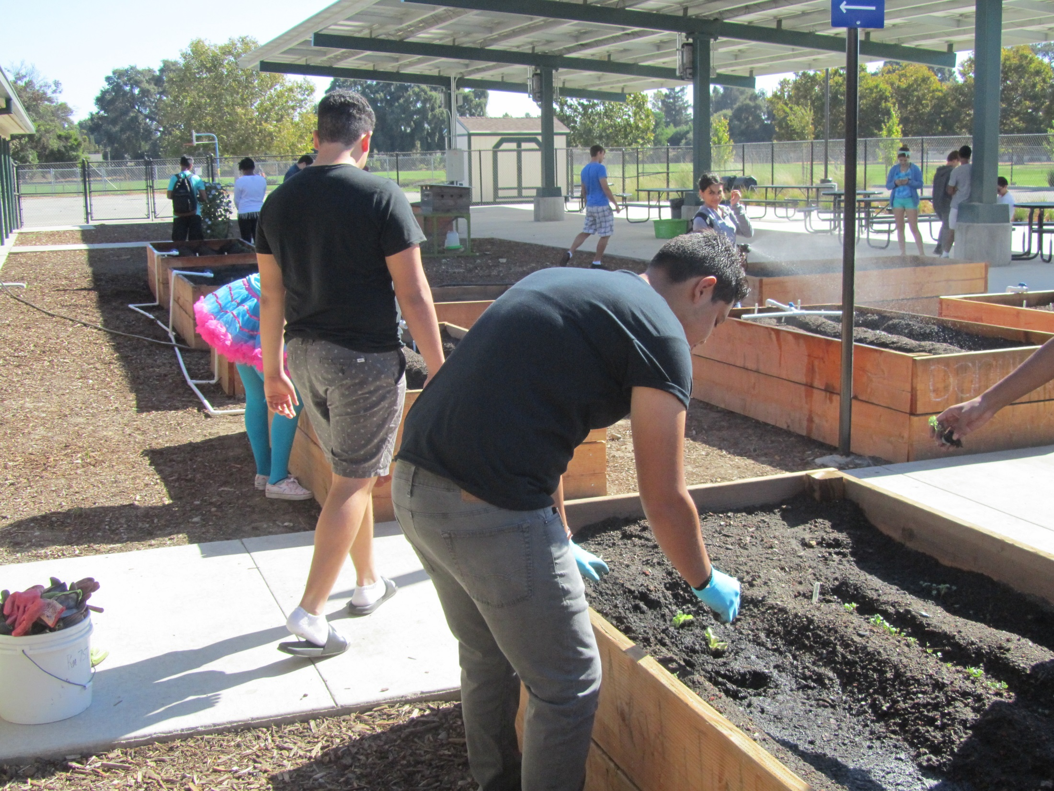

Slide 5
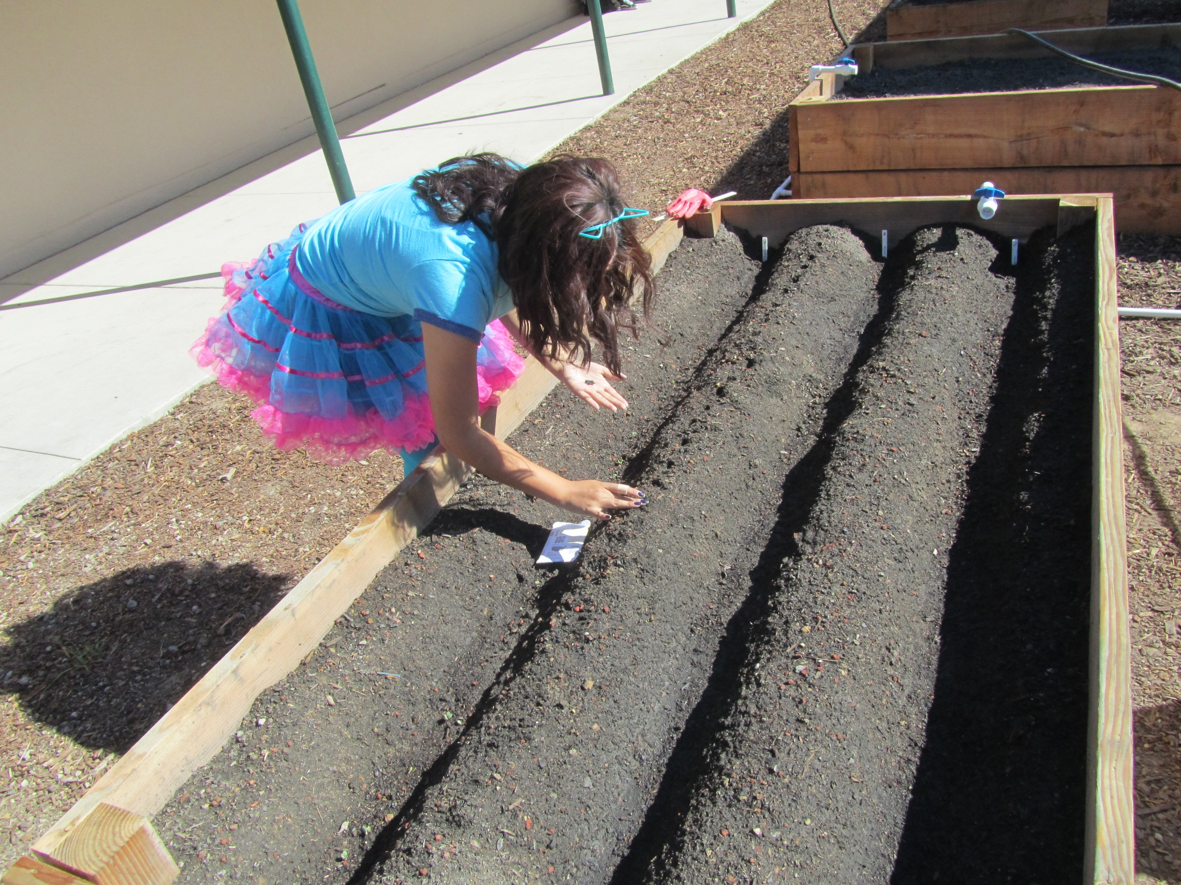

Slide 6
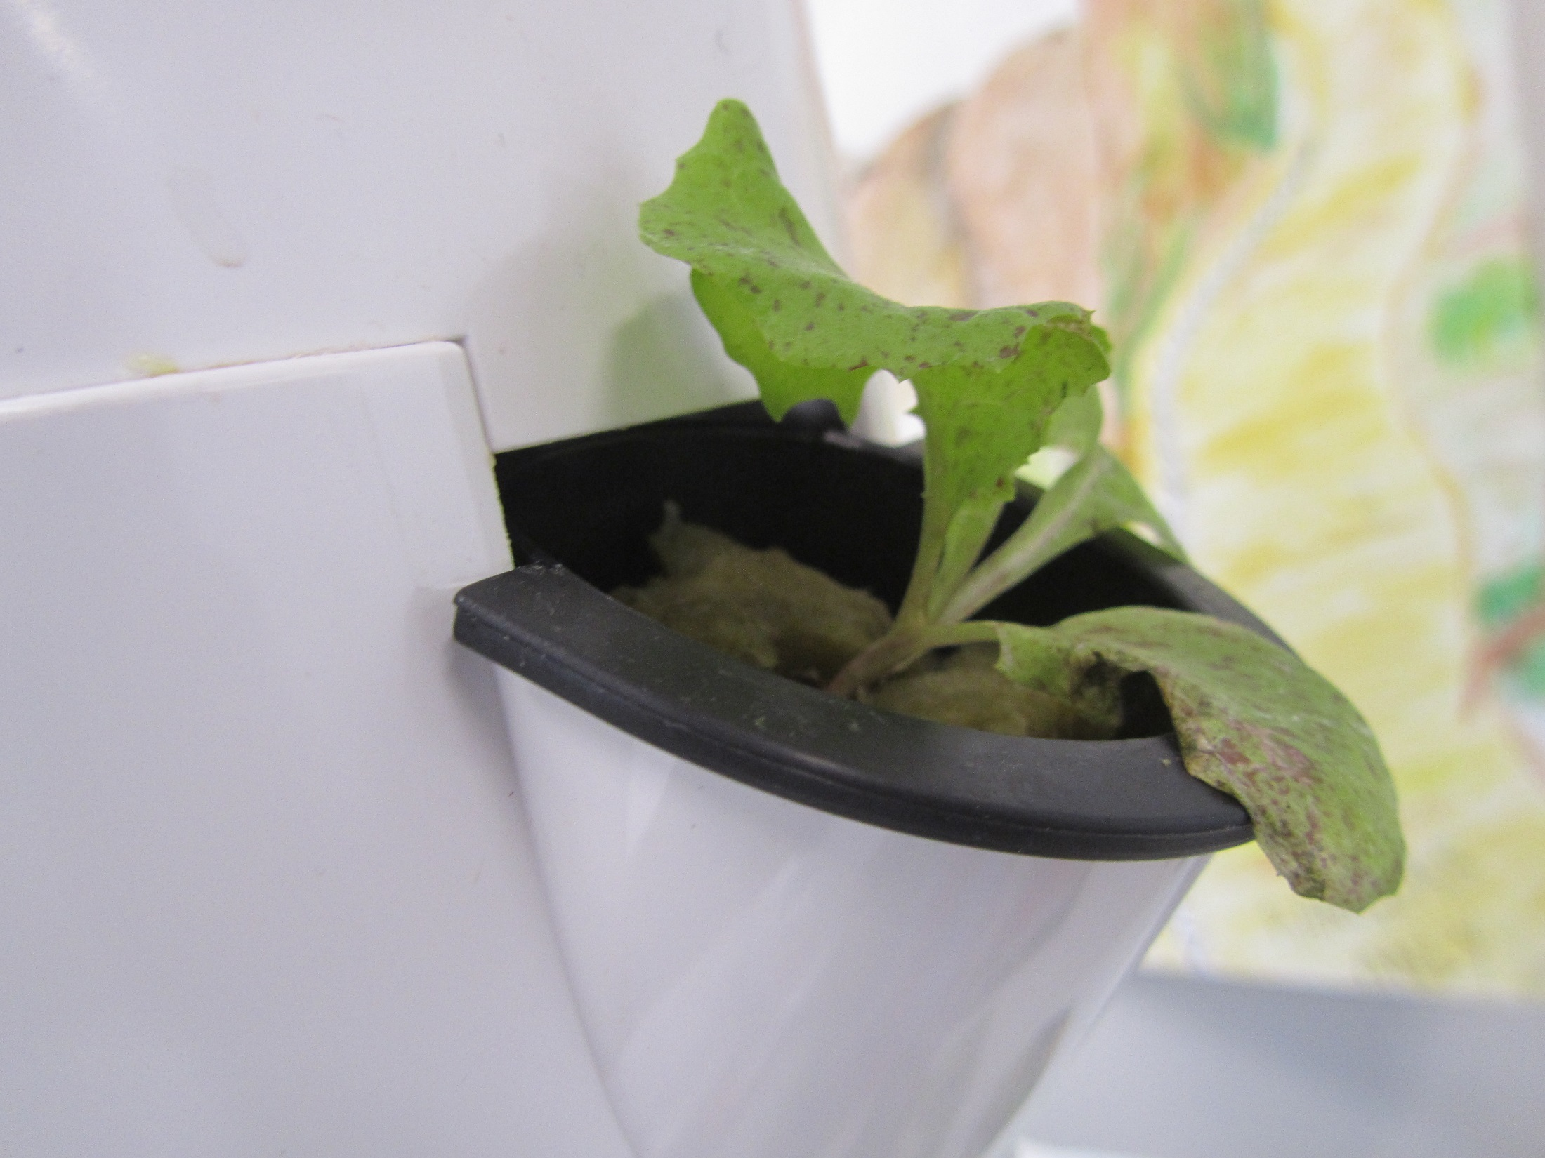

Slide 7
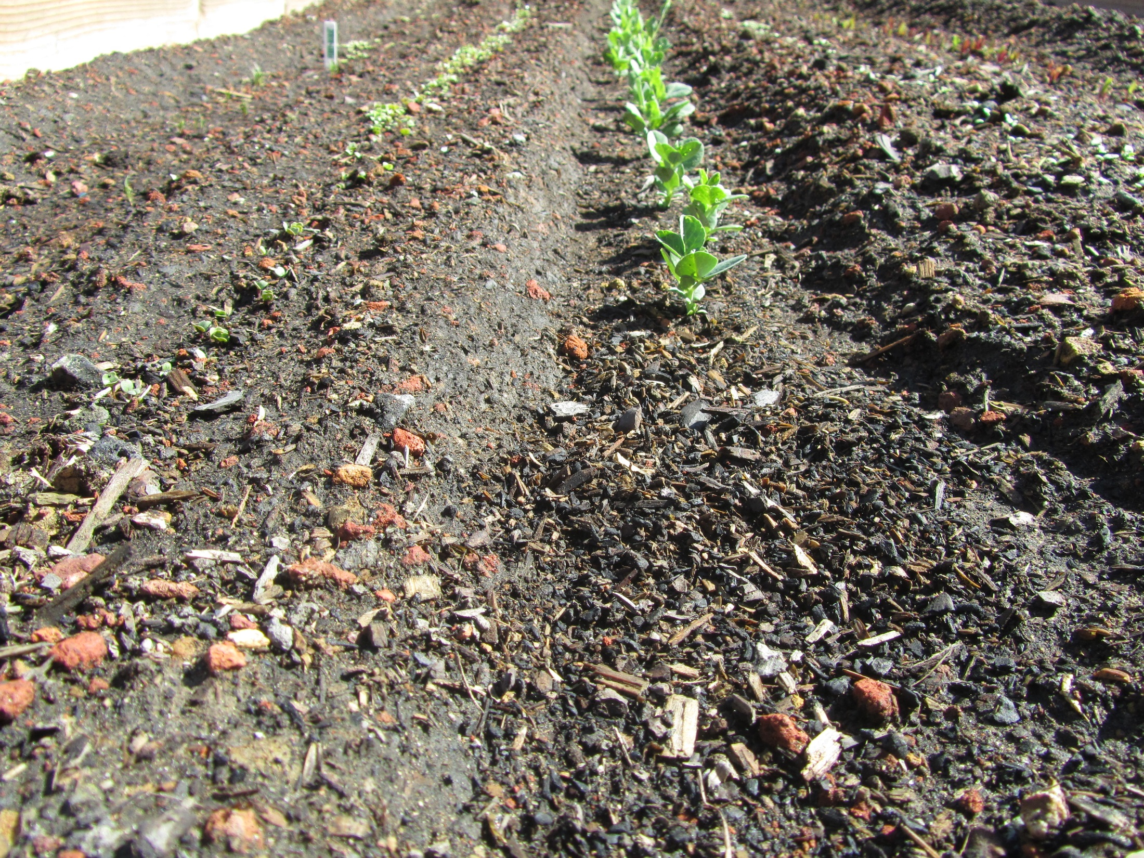

Slide 8
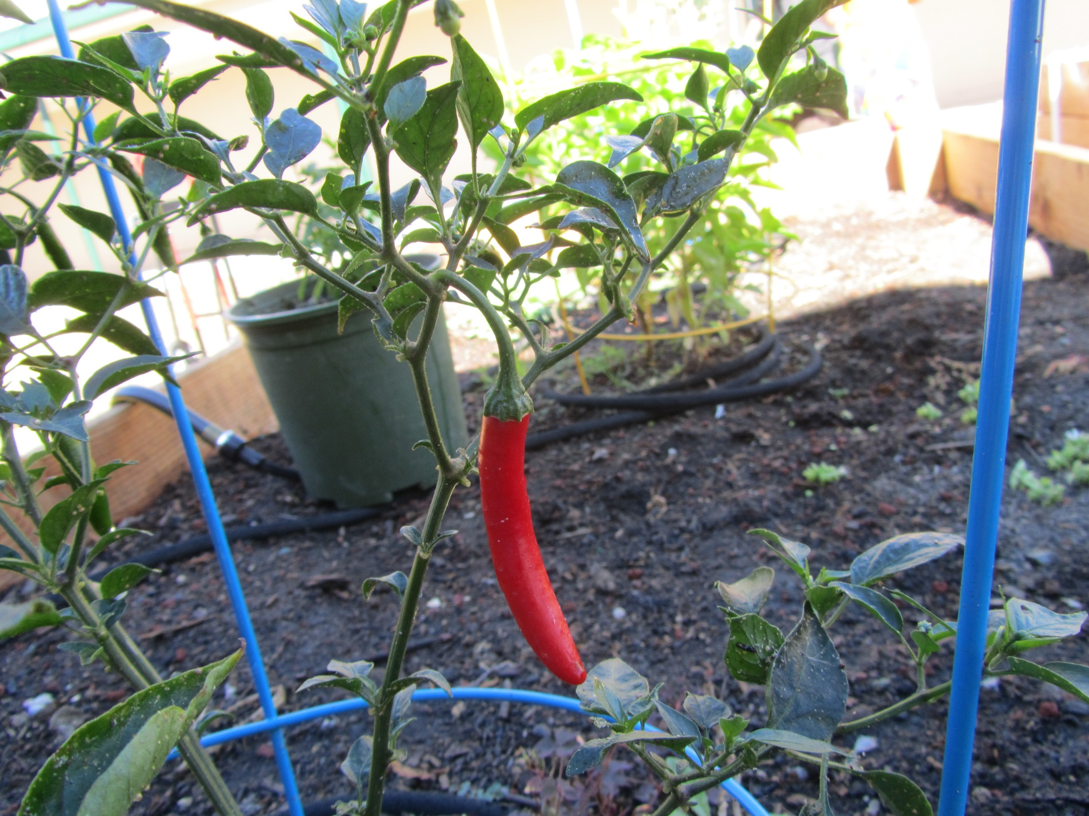

Slide 9
Protein Synthesis
Transcription Practice p. 69NB
Directions: Using the DNA strand as a template, transcribe mRNA. Make sure to use the correct Nitrogen bases.
ATA CCT TAA CGC GTC
TAT TAG GCA AAA TTC
GTG TGA TTA ATA GCC
CTA AAG GAA TAG GAT
GAT GAA TAC CCA CGA
TAA TAT GCA CAT TAC
GAA CCT TAC GGG GTG
TAT AAC CAG GAG TTT
ATC CGT AGT GTA AAT
GGA TTA CCC TTA CCA

Slide 10
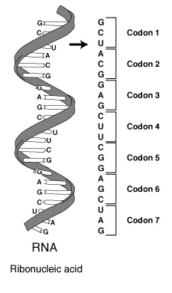
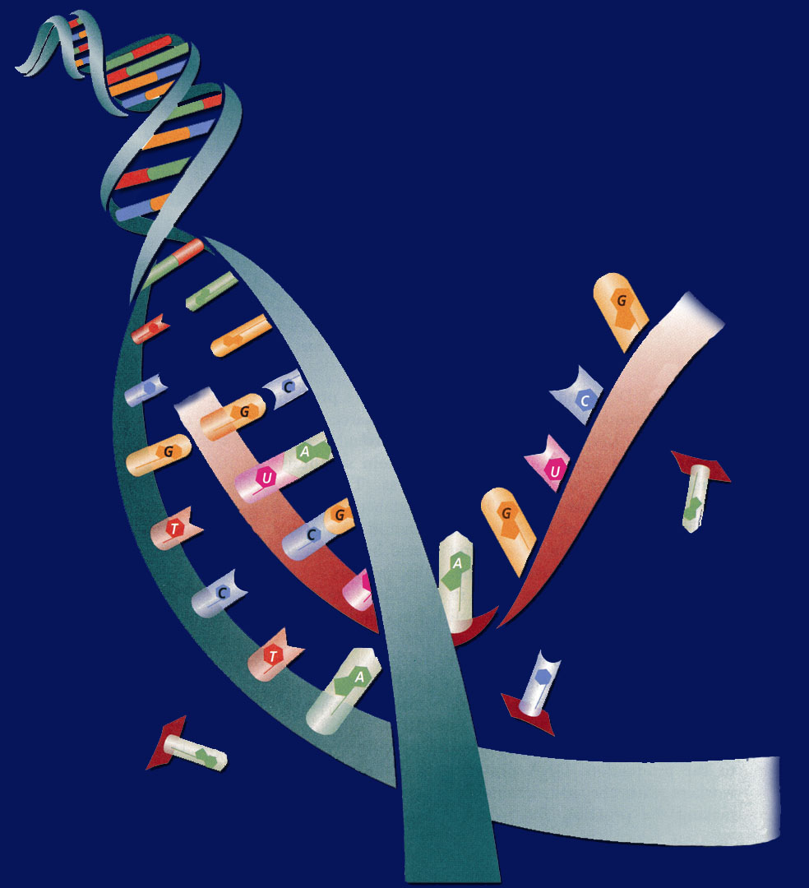
10/3 Protein Synthesis: Transcription 11.2
Obj. TSW explain the process of Protein Synthesis by transcribing and translating DNA sequences from their Mini Lab 11.1 P.64 NB
Learn.genetics.utah.edu/
What is transcription?
Where does Transcription happen?
Why is a codon important to making a protein?
HW – Study for the DNA Quiz tomorrow
Cell Lab is due Thursday/ friday

Slide 11
Cracking the Code
Students will take a page of notes on Notebook Paper and tape into their NB page 69NB

Slide 12


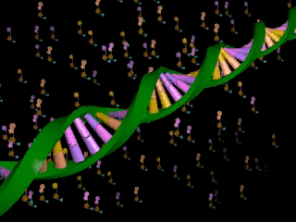






Section 11.2 Summary – pages 288 - 295
Transcription
In the nucleus, enzymes make an RNA copy of a portion of a DNA strand in a process called transcription.
Click image to view movie

Slide 13
Section 11.2 Summary – pages 288 - 295
Transcription
A
DNA strand
RNA strand
RNA strand
C
B
DNA strand

Slide 14
Section 11.2 Summary – pages 288 - 295
Transcription
The main difference between transcription and DNA replication is that transcription results in the formation of one single-stranded RNA molecule rather than a double-stranded DNA molecule.

Slide 15
Section 11.2 Summary – pages 288 - 295
RNA Processing = Gene Expression
Not all the nucleotides in the DNA of eukaryotic cells carry instructions—or code—for making proteins.
Genes usually contain many long noncoding nucleotide sequences, called introns, that are scattered among the coding sequences.

Slide 16
Protein Synthesis Honors Biology
1 large bag M &M’s – Maria
1 large bag of Gummy Bears – Yanna
4 Bags of Marshmallows – Claudia, Sarahi, Fabio, Aisha
1 Box of Rice Krispies Cereal – Abby
1 stick of Butter – Dru & Sopear

Slide 17



Chapter Assessment
Question 1
How does DNA control the structures and functions of a cell?
Answer
DNA determines the structure of proteins. Some proteins become important cell structures. Other proteins, such as enzymes, control chemical reactions that perform key life functions.
CA: Biology/Life Sciences
5a

Slide 18
HW CH 11 DNA & Genes p.41 NB
Deoxyribose
Nitrogenous Base
Nucleotide
Base Pair
Hydrogen Bond
Phosphate
Adenine (A) & Nitrogen Bases
Cytosine
*Nucleotides
DNA Replication
Double Helix

Slide 19
HW CH 11 DNA &Genes*
DNA – Double RNA – single
DNA – Deoxyribose RNA – Ribose
DNA – ATCG RNA – AUCG
Amino Acids
Amino Acids
Proteins
Codon*
Threonine

Slide 20
QUIZ
8. What is DNA Replication?
9. What are the two functions of DNA?
10. What are three differences of RNA from DNA?
11. What RNA has stop codons, and what is their function?
12. How are codons and anticodons different?
13. Write the equation for Protein Synthesis.
14. Transcribe & Translate the DNA sequence:ATC, TCA, TAC

Slide 21
DNA Quiz
7. What is the backbone of the molecule made of?
8. What is a gene?
9. What does DNA code for? What is it’s purpose?
10. Write the formula for Protein Synthesis
When you are finished turn you paper upside down and wait quietly to
have me pick it up.

Slide 22
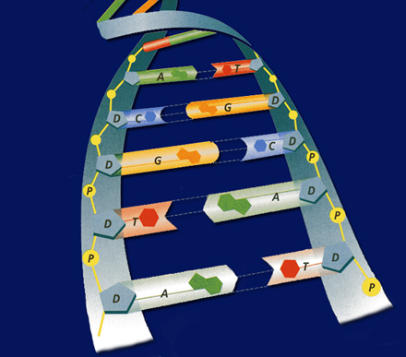
POP QUIZ Write your name on your binder paper.
What is this molecule? Spell it out.
What is the shape of the molecule?
What are the two purposes/ functions of this molecule?
Write the three names for the parts of a nucleotide. Be specific.
The Nitrogen bases are: Adenine, Cytosine, Guanine, & Thymine – Base Pair them together correctly.
What holds the Nitrogen bases together?
DNA is a Nucleic Acid, write an example of another one.
Can a Nucleic Acid leave the nucleus?
9. What is DNA Replication?
What is the name for how DNA
Replications?

Slide 23
Chapter Assessment
Question 2
The process through which the order of bases in messenger RNA codes for the order of amino acids in a protein is:
A. transcription
B. translation
C. replication
D. point mutation
The answer is B.
CA: Biology/Life Sciences
4f

Slide 24
Chapter Assessment
Question 3
Why would scientists use nucleotide sequences to identify bodies of crime victims?
Answer
In comparing nucleotide sequences in the DNA of a crime victim with nucleotide sequences from a possible close relative of the crime victim, scientists can determine if the two are related.
CA: Biology/Life Sciences
4e

Slide 25
HW CH 11
9.Phenylalanine Codon are (UUU) (UUC)
10. Codon
11. Amino Acid
12. Amino Acid
13. Stop codons = UGA, UAG, UAA
14. Tryptophan & Methionine

Slide 26
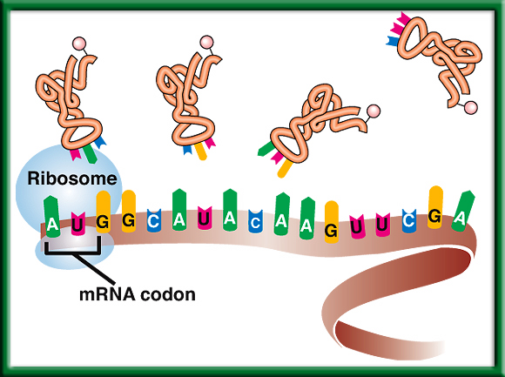
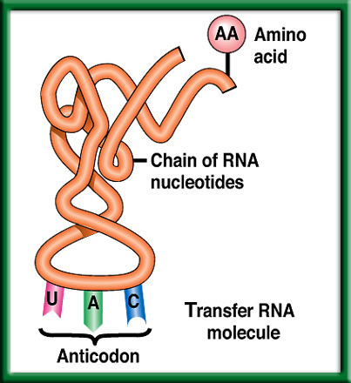
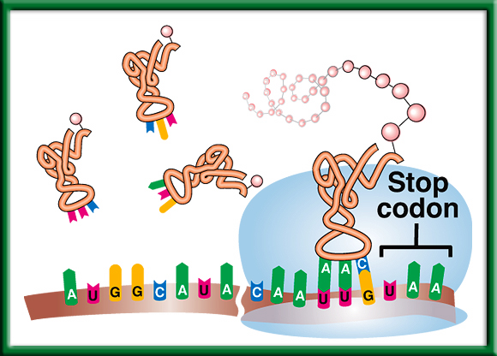
10/4 Protein Synthesis: Translation 11.2
Obj. TSW explain the process of Protein Synthesis by drawing it in their notebooks. p.66 NB
Learn.genetics.utah.com.edu/
Compare & Contrast Codon and Anticodon.
What is the role of tRNA in Protein Synthesis?
Why are Stop Codons important in Translation?
http://www.dnatube.com/video/3448/DNA-Replication

Slide 27
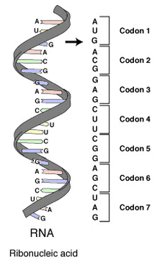
#1. Codon & Anticodon
A Codon is a nucleotide triplet sequence on mRNA, it codes for an amino acid.
  AUG ACG GAG
An Anticodon is a nucleotide triplet sequence on tRNA that carries the Amino acid
  UAC
Both are RNA & Each triplet pairs to code for a particular Amino acid to form a protein.

Slide 28
Section 11.2 Summary – pages 288 - 295
#2. The role of transfer RNA - tRNA
As translation begins, a ribosome attaches to the starting end of the mRNA strand. Then, tRNA molecules, each carrying a specific amino acid, approach the ribosome.
When a tRNA anticodon pairs with the first mRNA codon, the two molecules temporarily join together.
Usually, the first codon on mRNA is AUG, which codes for the amino acid methionine.

Slide 29
#3. Stop Codons
Without the stop codon, the protein would continuously be made.
More Protein is not necessarily better.
Name the 3 codons for STOP:
  UAA, UAG, UGA

Slide 30
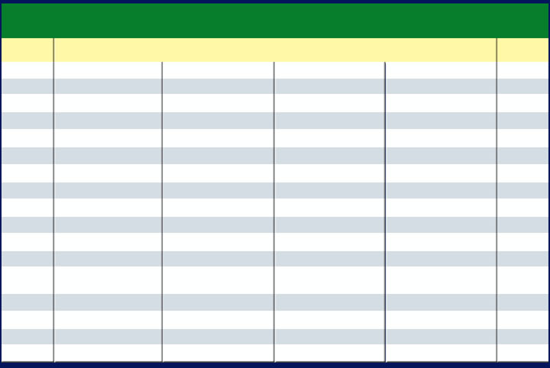
Section 11.2 Summary – pages 288 - 295
The Genetic Code P.292 BB
The Messenger RNA Genetic Code
First Letter
Second Letter
Third Letter
U
C
A
G
U
Phenylalanine (UUU)
Serine (UCU)
Tyrosine (UAU)
Cysteine (UGU)
U
Phenylalanine (UUC)
Serine (UCC)
Tyrosine (UAC)
Cysteine (UGC)
C
Leucine (UUA)
Serine (UCA)
Stop (UAA)
Stop (UGA)
A
Leucine (UUG)
Serine (UCG)
Stop (UAG)
Tryptophan (UGG)
G
C
Leucine (CUU)
Proline (CCU)
Histadine (CAU)
Arginine (CGU)
U
Leucine (CUC)
Proline (CCC)
Histadine (CAC)
Arginine (CGC)
C
Leucine (CUA)
Proline (CCA)
Glutamine (CAA)
Arginine (CGA)
A
Leucine (CUG)
Proline (CCG)
Glutamine (CAG)
Arginine (CGG)
G
A
Isoleucine (AUU)
Threonine (ACU)
Asparagine (AAU)
Serine (AGU)
U
Isoleucine (AUC)
Threonine (ACC)
Asparagine (AAC)
Serine (AGC)
C
Isoleucine (AUA)
Threonine (ACA)
Lysine (AAA)
Arginine (AGA)
A
Methionine;Start (AUG)
Threonine (ACG)
Lysine (AAG)
Arginine (AGG)
G
G
Valine (GUU)
Alanine (GCU)
Aspartate (GAU)
Glycine (GGU)
U
Valine (GUC)
Aspartate (GAC)
Glycine (GGC)
Alanine (GCC)
Glycine (GGC)
C
Valine (GUA)
Alanine (GCA)
Glutamate (GAA)
Glycine (GGA)
A
Valine (GUG)
Alanine (GCG)
Glutamate (GAG)
Glycine (GGG)
G

Slide 31
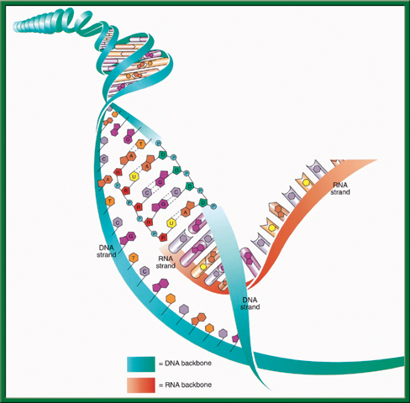
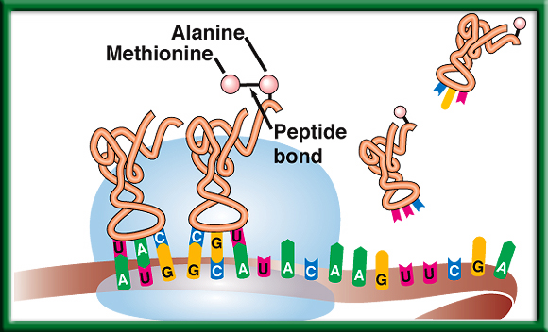
Protein Synthesis p. 71 NB
DNA -> transcription -> RNA -> translation -> Proteins

Slide 32
Molecular Genetics p. 71NB
DNA Replication – make more DNA for more cells to replace other cells.
Protein Synthesis – to make proteins
DNA-DNA
A = T
T = A
C = G
G = C
DNA RNA
A = U
T = A
C = G
G = C
Protein Synthesis
DNA: TAC CAC AAC
Transcription (nucleus)
mRNA: AUG GUG UUG
Translation (ribosome)
Protein: Methionine, ________, ________ Amino Acid Sequence

Slide 33
Protein Synthesis – Gene Expression Practice P. 71NB
1. DNA: ATA CCT TAA CGC GTC
2. DNA: TAT TAG GCA AAA TTC

Slide 34
10/5 Protein Synthesis: Translation 11.2
Obj. TSW explain the process of Protein Synthesis by making Rice Krispie treats through the process of Protein Synthesis. P. 68 NB
When making proteins, If a template DNA strand read TAC GGT, AGT what would a complementary strand of mRNA be?
What Amino Acids would the 3 codons code for?
Do the same for: GCA, TGC, ATC (DNA).
HW – Cell Lab is due tomorrow/ Friday.
Learn.genetics.utah.edu/

Slide 35
Mini Lab 11.1 P. 75NB P. 293 BB
DNA → transcription →RNA →translation → Protein
 | A | B | C | D | E
DNA Base Sequence | Process | mRNA Codon | Process | tRNA Anticodon | Amino Acid
AAT
GGG
ATA
AAA
GTT

Slide 36
Mini Lab 11.1 P. 75NB P. 293 BB
DNA → transcription →RNA →translation → Protein
 | A | B | C | D | E
DNA Base Sequence | Process | mRNA Codon | Process | tRNA Anticodon | Amino Acid
AAT | Transcription | UUA | Translation | AAU | Leucine
GGG |  | CCC |  | GGG | Proline
ATA |  | UAU |  | AUA | Tyrosine
AAA |  | UUU |  | AAA | Phenylalanine
GTT |  | CAA |  | GUU | Glutamine
Answer Analysis Questions 1 – 3
A.DNA instructions are located in the nucleus.
Transcription happens in the nucleus.
Translation happens in the Ribosome.
tRNA looks like a triangle with an Amino Acid on the end, and the other side has the Anticodon that base pairs with the codon on the mRNA.
Mutations would be more common, if the sequence of DNA was not strictly adhered to.

Slide 37
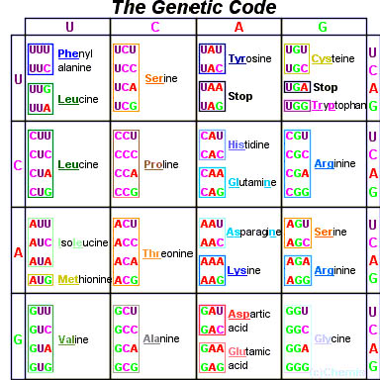
Page 292 Biology Book

Slide 38
Rice Krispie Treat
Protein Synthesis Lab – Thursday
1 Boxes of Rice Krispies
4 Bags of LARGE MARSHMELLOWS
1 large bag of Mini M&M’s
1 large bag of Gummy Bears
1 stick of Butter
1 Microwave?

Slide 39
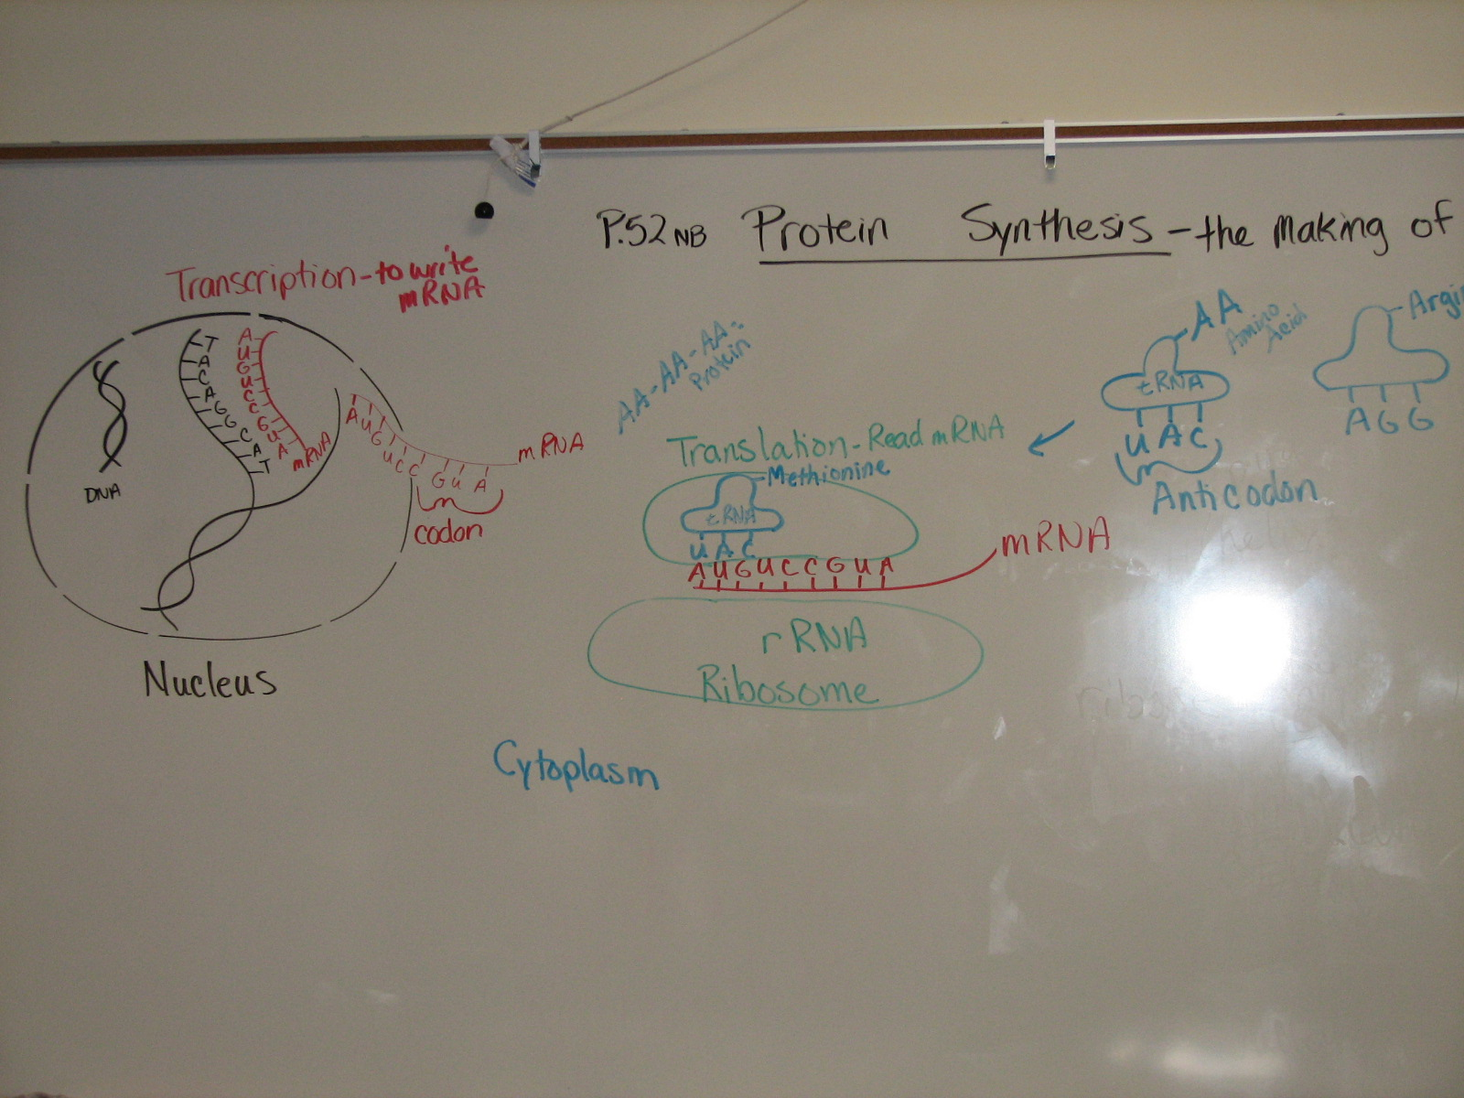
Page 73 NB

Slide 40
1st Period P. NB
Write a paragraph after building your DNA molecule that include the vocabulary words: Double helix, Nitrogen bases, Hydrogen bond, Nucleotide, Backbone, Deoxyribose, Phosphate, Adenine, Thymine, Cytosine, Guanine.

Slide 41



Collect 3 sheets of paper and layer them about 1.5 cm apart vertically. Keep the edges level.
P. 53 NB
To return to the chapter summary click escape or close this document.

Slide 42


Fold up the bottom edges of the paper to form 6 equal tabs.
P. 53NB
To return to the chapter summary click escape or close this document.

Slide 43


Fold the papers and crease well to hold the tabs in place. Staple along the fold. Label each tab.
P. 53NB
RNA – draw & label 3 differences from DNA p. 289
TRANSCRIPTION: from DNA to RNA P. 290
RNA Processing (Introns & Exons) P.291
The Genetic Code p. 291 - 292
TRANSLATION: from mRNA to PROTEIN p. 294 11.9A
PROTEIN SYNTHESIS
DNA->transcription->RNA ->translation->Protein
To return to the chapter summary click escape or close this document.

Slide 44
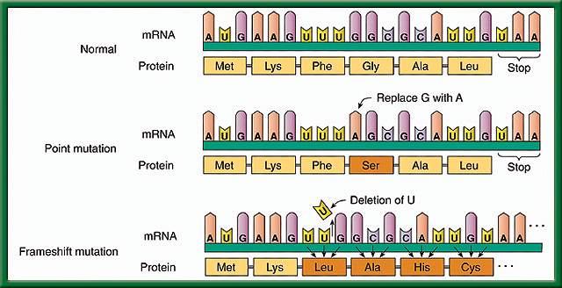
10/6 Mutations: A change in a gene 11.3
Obj. TSW learn how mutations happen, and explain the difference between point & Frameshift mutation from WU, notes & conclusion of Protein Synthesis Lab. P. 70 NB
What are some causes of mutations?
Compare & Contrast the effects of a point mutation & a frameshift mutation.
Which mutation is worse and why?

Slide 45
#1. Causes of Mutations
Mutagens- change in the DNA caused by the Environment – Pollution, UV Radiation, Drugs, Stress
Random mistakes- proofreading enzymes are not working
#2. Gene Mutations – Point & Frameshift Mutations p.298 BB
Which mutation is worse? Why?
#3. Frameshift Mutation is worse because it changes every amino acid after the deletion or addition of the nucleotide.

Slide 46
Rice Krispy Protein Synthesis P.75NB
My protein looks like: Round, Flat, Color, M&M or Gummi Bears
Deleting the fifth nucleotide of your DNA will cause a frameshift mutation that changes every amino acid after the deletion. Change how many marshmallows were used.
Changing the 11th nucleotide of your DNA sequence from G to T would be a point mutation and will change the amino acid Serine to STOP codon, however, this is bad because the protein is not complete. Marshmellows would not be smooth.
If the 19th, 20th, 21st nucleotides of your DNA sequence were deleted the 7th codon were deleted the rice krispie treat would not have color.
Two proteins are different by some were flat, round, some were red, some blue, some M&M’s &/ gummy bears.
Conclusion
1.If you were given the

Slide 47
Classwork – Transcription & Translation p. 53 NB
Work on worksheet about Protein Synthesis.
Transcribe the DNA sequence.
Then, translate the Amino Acid sequence to the right of the Codons.

Slide 48
Draw Protein Synthesis
P. 73 NB
Turn your book Landscape Style ←------→
Have 4 different colored pencils.
Write on the RED line at the top: Protein Synthesis: the making of Proteins
Use ¾ of the page
The last ¼ of the page will be a summary/ AXES paragraph.

Slide 50
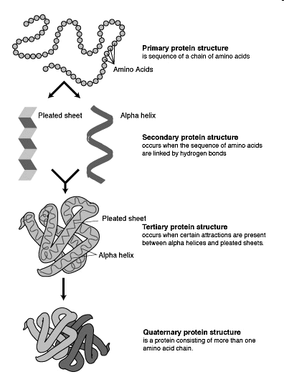
Proteins Notes P. 81 NB
Proteins can come in
many different shapes
and sizes
The number & sequence of
amino acids determine its
a proteins shape.
An example of
proteins: ENZYMES!
Proteins must have a
specific structure in order
to function properly.

Slide 51
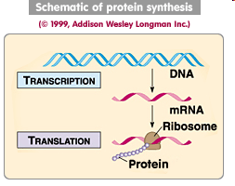
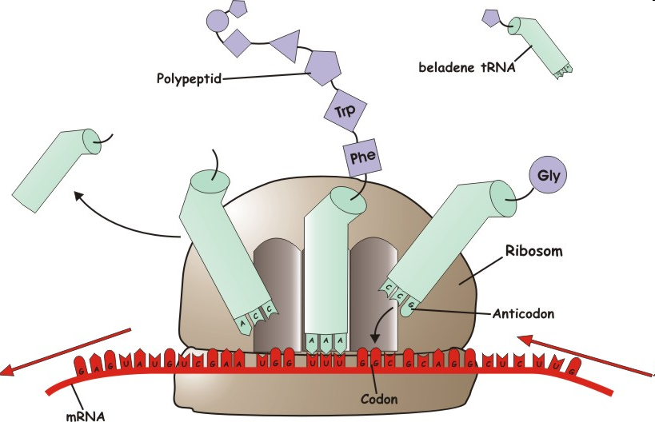
Warm Up Answer

Slide 52
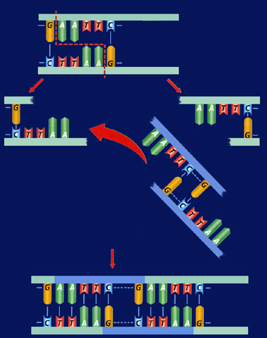
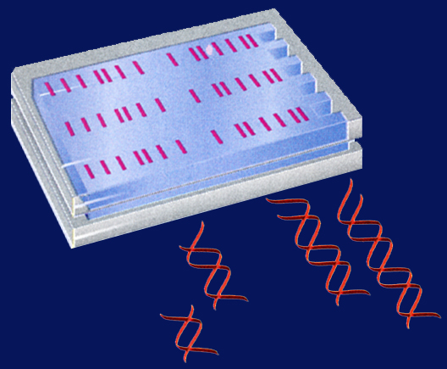
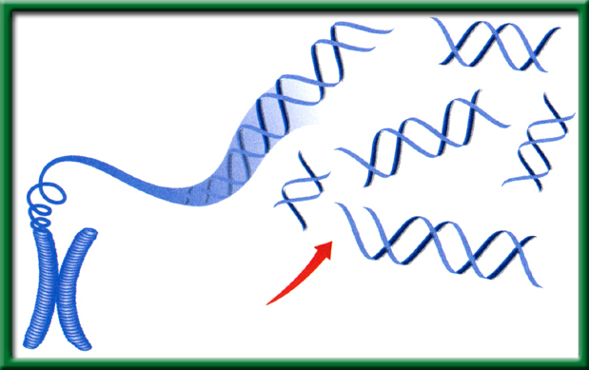
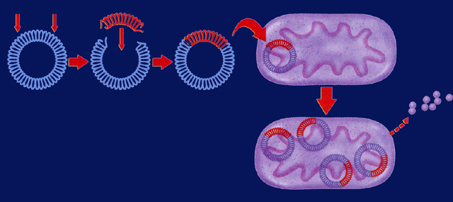
10/07 Applied Genetics 13.2
Obj. TSW be able to explain how basic DNA technology is used to construct recombinant DNA molecules in a Minilab 13.1 p.72 NB
HHMI.org
NOVA.pbs.org
HW – Read CH 13
1pg notes P. 81 NB
Finish Study Guide
Genetic Engineering uses Recombinant DNA, explain.
Explain a transgenic organism.
Explain two ways in which recombinant bacteria are used for human applications.

Slide 53
Genetic Engineering
#1. Recombinant DNA is DNA that has one or more genes from another organism in it’s genome.
#2. A transgenic organism has Recombinant DNA.
#3. Bacteria is a transgenic organism that can have the gene to make insulin for people who have Diabetes. They also can have the gene for Growth Hormone to help people who have Dwarfism be a more normal range of height.

Slide 54

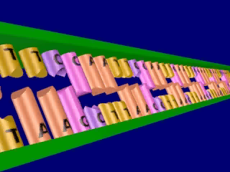
Section 13.2 Summary – pages 341 - 348
Restriction enzymes cleave DNA
Click image to view movie

Slide 55
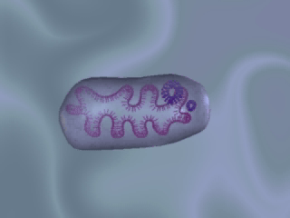
Section 13.2 Summary – pages 341 - 348
Vectors transfer DNA
Biological vectors include viruses and plasmids. A plasmid, is a small ring of DNA found in a bacterial cell.
Click image to view movie

Slide 56
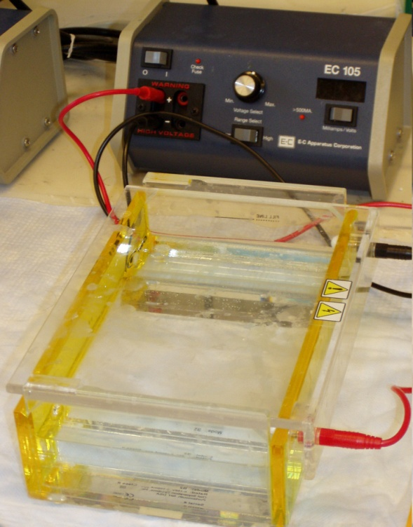
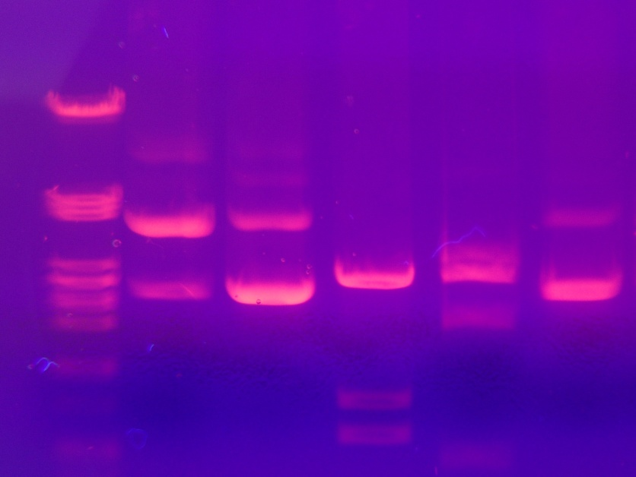
10/10 Gel Electrophoresis CH 13.1
Obj. TSW learn how to build a protein from an amino acid sequence using the hydrophobic and hydrophilic properties of the amino acids. P. 74 NB
What is Gel Electrophoresis?
Why is DNA fingerprinting important?
Explain the field of Genetic Engineering and how a Gel Electrophoresis applies.
Watch Gel Video
HW CH 13
HW Study Guide
Final 10/15

Slide 57
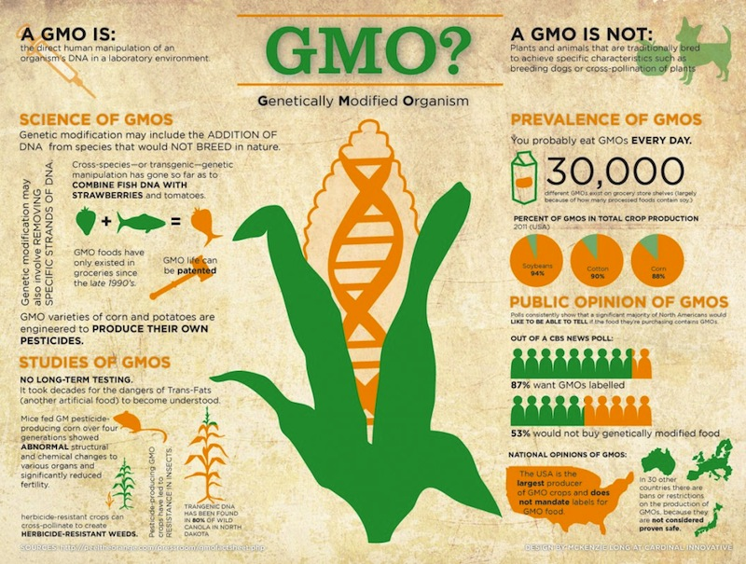
10/11 Genetically Modified Organisms EEI Curriculum
Obj. TSW demonstrate the pros and cons of Genetically Modified Organisms. p. 76 NB
What does GMO stand for?
What are some concerns about GMO’s.
What are some benefits to GMO’s.

