Slide 1
Ag Biology
Week 1 January 17th – 20th
Agriculture, FFA, & SAE

Slide 2
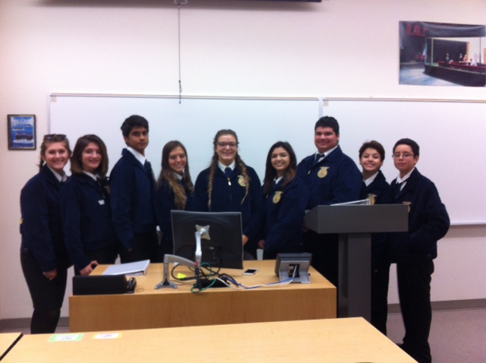
West Sacramento FFA Chapter Officers

Slide 3
Science Notebook
Front Cover:
Name, Ag Biology, Rm.3 Bryte McAllister, Spring Term, 2017
Table of Contents: page 1 - 7:
Date, Title, Page #
Page 8, 1st Warm – Up
Agriculture in California

Slide 4
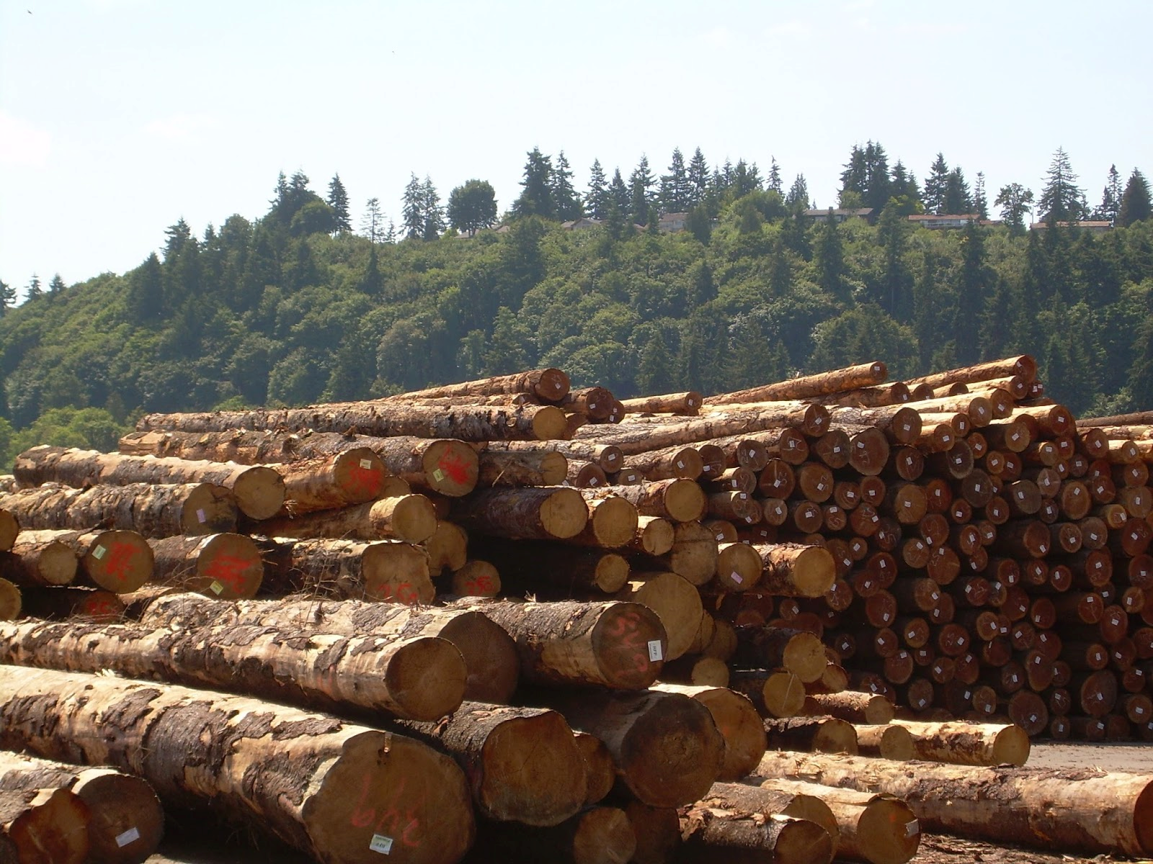
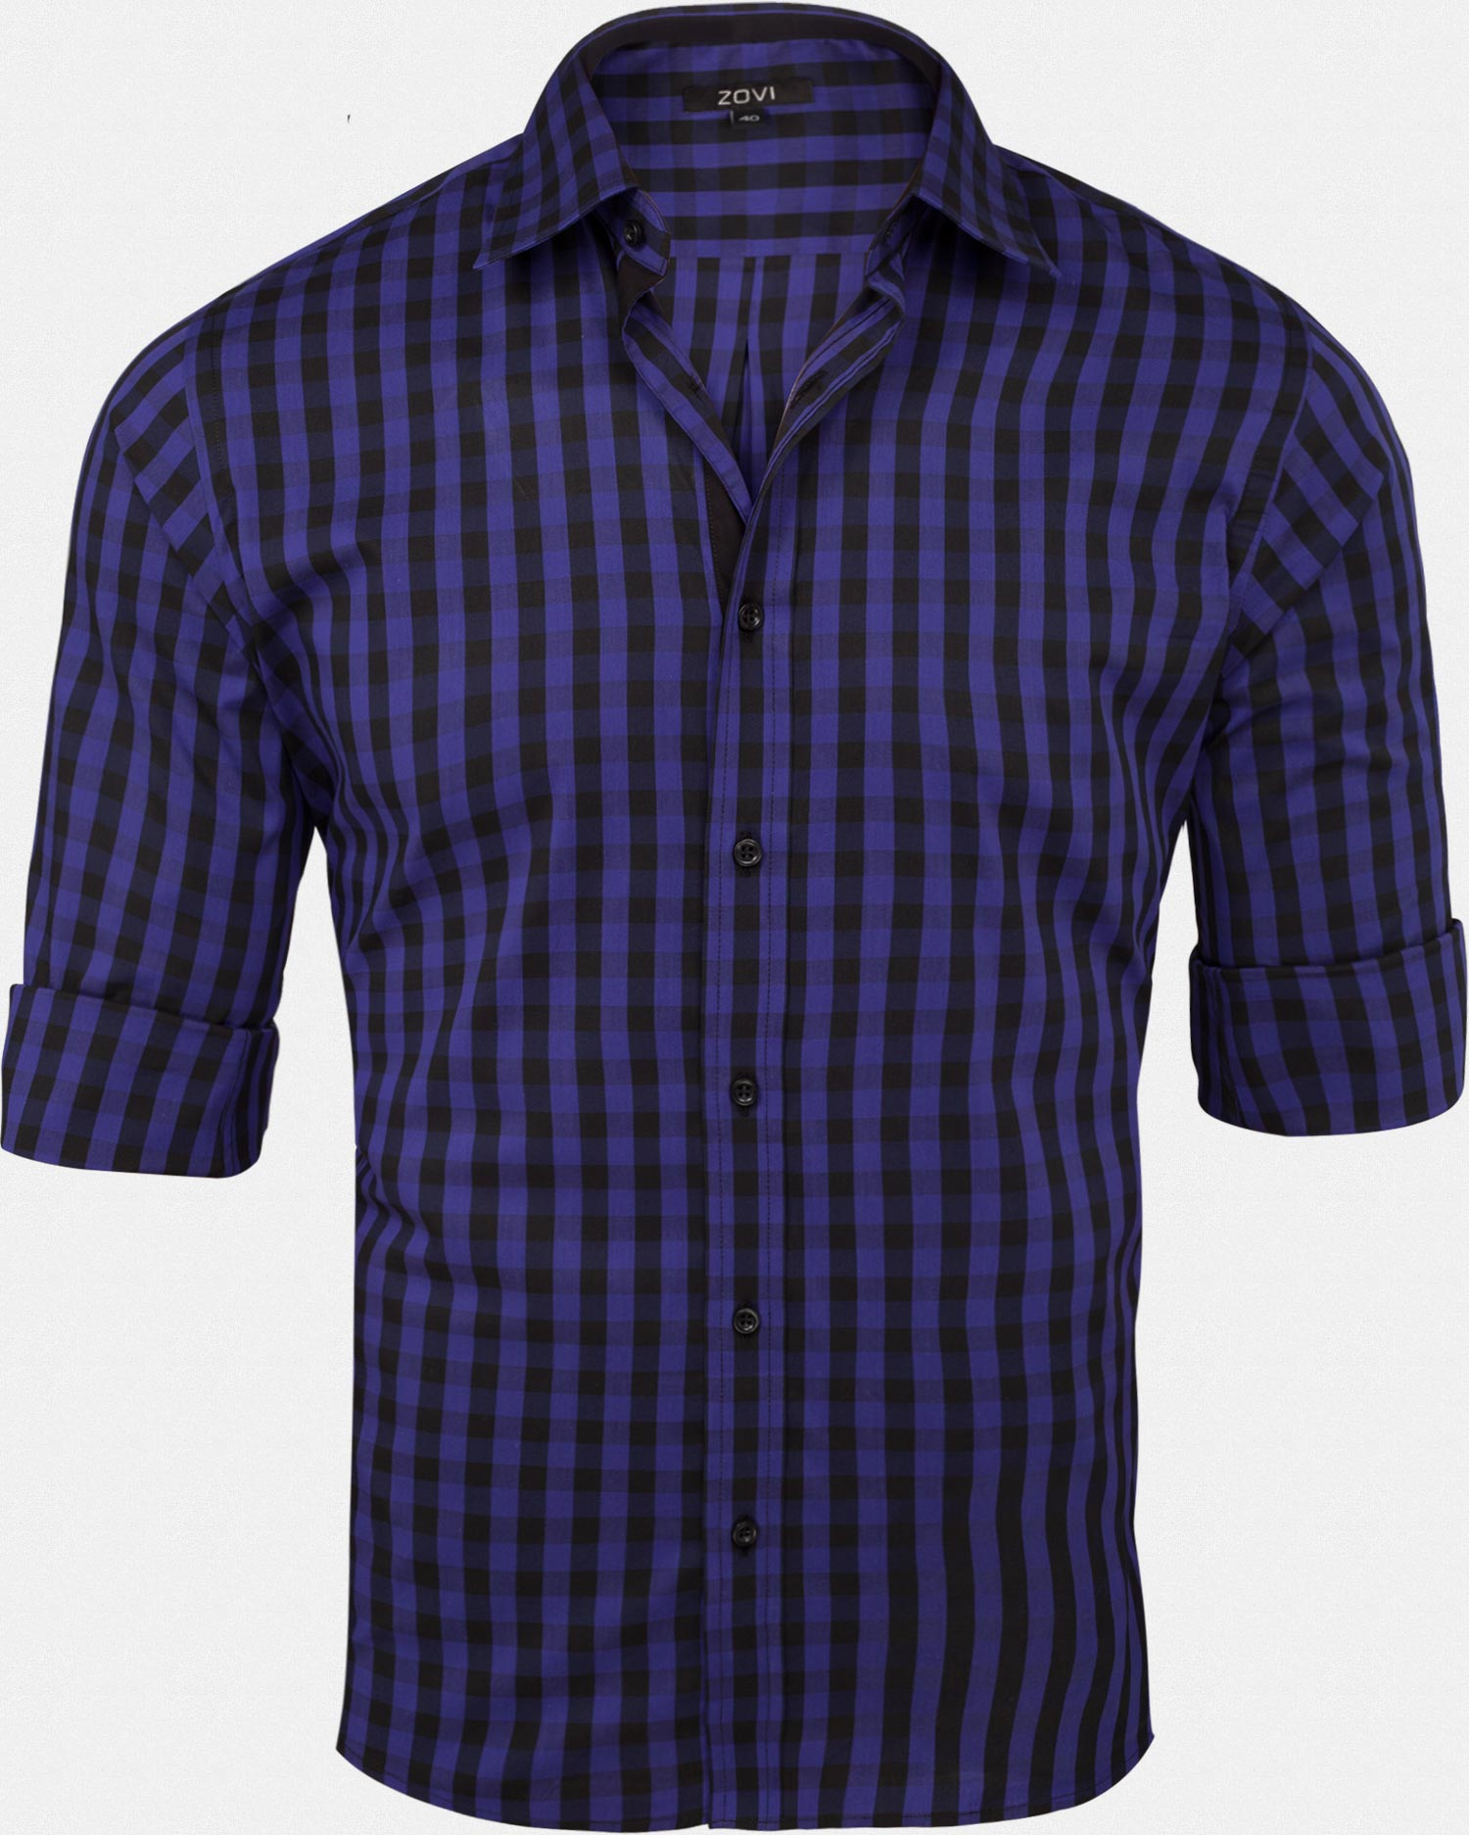
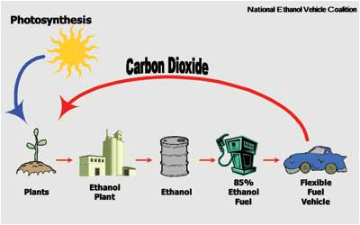
The 5 F’s of Agriculture
Food – Sandwich
Fiber – Shirt (cotton)
Flowers – S. Cal. Largest producer
Forest – Lumber
Fuel - Ethanol

Slide 5
California Agriculture Quiz
Working together, discuss what you think the answers are and why? If you can’t come up with a good reason why – leave it blank, for now. NO GUESSING.
Lastly, work with this partner to go over any answers you may not have, or just to talk about the answers and reasons why your have those answers.

Slide 6
California Agriculture Quiz Answers
T
T
T
T
T
California $43 B, Iowa $29.9B, Texas $22.7 B
Milk & Cream, Almonds, Grapes, Cattle & Calves, Nursey Products, Strawberries, Hay, Lettuce, Walnuts, Tomatoes
78
81
312
420
43.5

Slide 7
Top 10 Commodities in California Leading US state with $47 Billion in 2015
Milk- $6.29 Billion
Almonds - $5.33 Billion
Grapes - $4.95 Billion
Cattle, Calves - $3.39 Billion
Lettuce - $2.25 Billion
Strawberries - $1.86 Billion
Tomatoes - $1.86 Billion
Poultry/ Eggs - $1.71 Billion
Walnuts - $977 Million
Hay - $945 Million

Slide 8
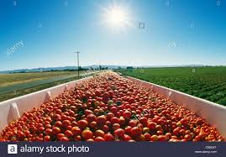
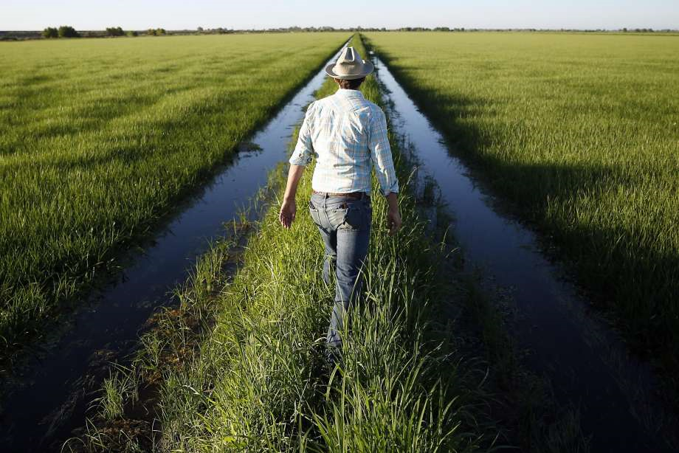
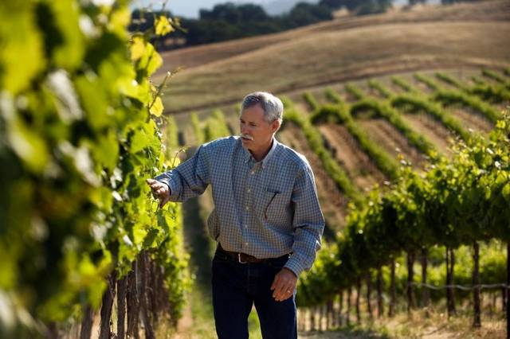
Top 3 Commodities in Yolo County
Rice
Tomatoes
Wine Grapes

Slide 9
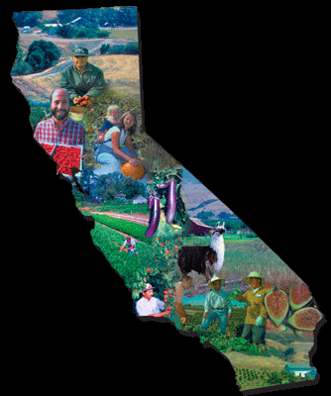
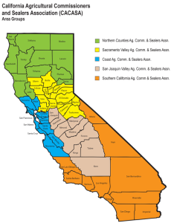
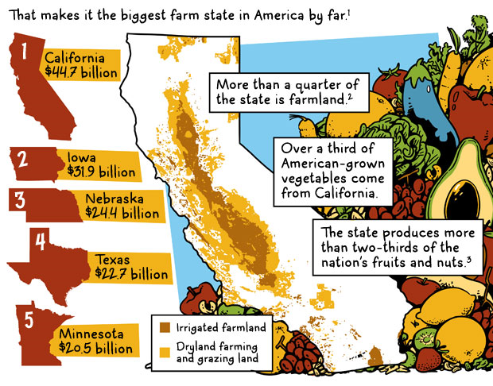
1/18 Agriculture in California Objective: The Student will develop a better understanding of how Agriculture is important in California. P. 8 NB
Describe 3 of the 5 F’s in Agriculture.
Where does Ethanol come from?
Describe 3 of the top 10 Commodities produced in California.

Slide 10
Get to know your fellow Agriculture students…
Working with a new friend, introduce yourself and EXPLAIN your favorite fruit.- Don’t say it.
Your partner has to guess the fruit. When they are right – Give them a High Five! Your turn.
Now swap partners, Introduce yourself by sounding like your favorite animal☺ When they guess the animal, give them a another High Five! Your turn.

Slide 11
Ag Biology Blackout Bingo
With your Bingo paper, walk around the room and find fellow students that meet the criteria in the box.
Write their name in the box.
Now see if you can fill in any of their boxes.
The first person will all the boxes filled in with names gets M&M’s.

Slide 12
1/19 Learning about FFA Obj. TSW learn about the emblem, motto, creed, colors and salute of the FFA. P. 10 NB
After reviewing the website and seeing the video, What are the 5 main parts to the emblem? What is their significance?
Write the FFA Motto.
Describe the colors and the salute of the FFA.

Slide 13
FFA
Future Farmers of America Video
https://www.ffa.org/sitecollectiondocuments/ffa_official_manual_english.pdf
Search the above website or FFA.org on your laptop to answer the following questions on page 13 NB.
What does FFA stand for?
How can you benefit?
How many FFA members are there in the US?
Find the Emblem, Motto, Creed, Colors, Salute

Slide 14
Edible Plant Game
Have 1 or 2 partners.
Get 1 card to share among the 2 – 3 of you.
Someone starts by reading the description at the bottom.
Whoever’s description is on someone else’s card Identifies what it is: “ Carrot”
Then the “Carrot” reader reads the description on the bottom of their card, etc.

Slide 15
Squishy Fruit Name Game
Everyone stand in a circle.
McAllister starts by saying “Mandarine McAllister” and tosses the “squishy” to another student who says “Mandarine McAllister”, then they say their name with a “fruity” adjective before their name.
Each person has to say the persons before them.
The last person has to say everybody.
Then we add more “squishies!”

Slide 16
How to feed the bunny and chickens…
Follow McAllister outside.
The key is hanging on the CO2 sensor.

Slide 17
Kahoots Ag Biology

Slide 18
1/23 Supervised Agricultural Experience (SAE) Obj. TSW familiarize themselves with the different types of SAE’s. P. 12 NB
Using the website FFA.org, What are the four different types of SAE’s?
Which one are you most interested in? Why?
What other questions do you still have about SAE’s?

Slide 19
Theaet.com FFA Record Book TSW learn how to keep accurate records of their work, hours involved with SAE’s & FFA. P. 14 NB
Profile
Experience Manager (Gears)
Experience Manager (Pencil)
Description, Time Investment (Hours), Learning Objectives
Journal
Time in your AET Experiences

