Slide 1
Opening Ceremonies:
All Members in Unison:
“To practice brotherhood, honor agricultural opportunities and responsibilities and develop those qualities of leadership which an FFA member should possess.”
All Officers memorize your parts.
Greenhand FFA Degree: See FFA Manual page 26.

Slide 2
10/3 | WU – Protein Synthesis: Transcription CH 11.2 | 64
10/3 | Transcription Practice | 65
10/4 | WU – Protein Synthesis: Translation | 66
10/4 | The Genetic Code | 67
10/5 | WU – Protein Synthesis: Translation CH 11.2 | 68
10/4 | DNA Quiz | 69
10/6 | Mutations: A change in a gene CH 11.3 | 70
10/5 | Molecular Genetics –Protein Synthesis Practice | 71
10/10 | WU – Applied Genetics CH 13.2 | 72
10/6 | Mini Lab CH 11.1 p. 293 BB | 73
10/11 | WU – Gel Electrophoresis CH 13.1 | 74
10/5 | Draw Protein Synthesis | 75
10/12 | WU – Genetically Modified Organisms EEI Curriculum | 76
10/6 | Molecular Genetics AXES Paragraph | 77 Notebook Check P.64 – 77 (70 Points)

Slide 3
Protein Synthesis
Transcription Practice p. 65NB
Directions: Using the DNA strand as a template, transcribe mRNA. Make sure to use the correct Nitrogen bases.
ATA CCT TAA CGC GTC
TAT TAG GCA AAA TTC
GTG TGA TTA ATA GCC
CTA AAG GAA TAG GAT
GAT GAA TAC CCA CGA
TAA TAT GCA CAT TAC
GAA CCT TAC GGG GTG
TAT AAC CAG GAG TTT
ATC CGT AGT GTA AAT
GGA TTA CCC TTA CCA

Slide 4
Cracking the Code
Students will take a page of notes on Notebook Paper and tape into their NB page 71 NB

Slide 5








Section 11.2 Summary – pages 288 - 295
RNA Processing = Gene Expression
Not all the nucleotides in the DNA of eukaryotic cells carry instructions—or code—for making proteins.
Genes usually contain many long noncoding nucleotide sequences, called introns, that are scattered among the coding sequences.

Slide 6
HW CH 11 DNA & Genes p.41 NB
Deoxyribose
Nitrogenous Base
Nucleotide
Base Pair
Hydrogen Bond
Phosphate
Adenine (A) & Nitrogen Bases
Cytosine
*Nucleotides
DNA Replication
Double Helix

Slide 7
HW CH 11 DNA &Genes*
DNA – Double RNA – single
DNA – Deoxyribose RNA – Ribose
DNA – ATCG RNA – AUCG
Amino Acids
Amino Acids
Proteins
Codon*
Threonine

Slide 8
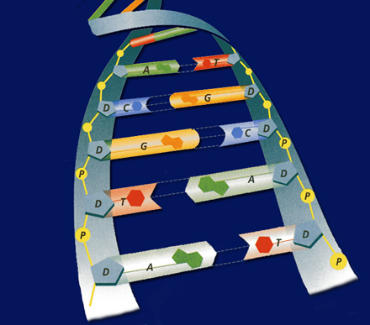
POP QUIZ Write your name on your binder paper.
What is this molecule? Spell it out.
What is the shape of the molecule?
What are the two purposes/ functions of this molecule?
Write the three names for the parts of a nucleotide. Be specific.
The Nitrogen bases are: Adenine, Cytosine, Guanine, & Thymine – Base Pair them together correctly.
What holds the Nitrogen bases together?
DNA is a Nucleic Acid, write an example of another one.
Can a Nucleic Acid leave the nucleus?
9. What is DNA Replication?
What is the name for how DNA
Replications?

Slide 9



Chapter Assessment
Question 2
The process through which the order of bases in messenger RNA codes for the order of amino acids in a protein is:
A. transcription
B. translation
C. replication
D. point mutation
The answer is B.
CA: Biology/Life Sciences
4f

Slide 10
Chapter Assessment
Question 3
Why would scientists use nucleotide sequences to identify bodies of crime victims?
Answer
In comparing nucleotide sequences in the DNA of a crime victim with nucleotide sequences from a possible close relative of the crime victim, scientists can determine if the two are related.
CA: Biology/Life Sciences
4e

Slide 11

Section 11.2 Summary – pages 288 - 295
The Genetic Code P.292 BB p. 67 NB
The Messenger RNA Genetic Code
First Letter
Second Letter
Third Letter
U
C
A
G
U
Phenylalanine (UUU)
Serine (UCU)
Tyrosine (UAU)
Cysteine (UGU)
U
Phenylalanine (UUC)
Serine (UCC)
Tyrosine (UAC)
Cysteine (UGC)
C
Leucine (UUA)
Serine (UCA)
Stop (UAA)
Stop (UGA)
A
Leucine (UUG)
Serine (UCG)
Stop (UAG)
Tryptophan (UGG)
G
C
Leucine (CUU)
Proline (CCU)
Histadine (CAU)
Arginine (CGU)
U
Leucine (CUC)
Proline (CCC)
Histadine (CAC)
Arginine (CGC)
C
Leucine (CUA)
Proline (CCA)
Glutamine (CAA)
Arginine (CGA)
A
Leucine (CUG)
Proline (CCG)
Glutamine (CAG)
Arginine (CGG)
G
A
Isoleucine (AUU)
Threonine (ACU)
Asparagine (AAU)
Serine (AGU)
U
Isoleucine (AUC)
Threonine (ACC)
Asparagine (AAC)
Serine (AGC)
C
Isoleucine (AUA)
Threonine (ACA)
Lysine (AAA)
Arginine (AGA)
A
Methionine;Start (AUG)
Threonine (ACG)
Lysine (AAG)
Arginine (AGG)
G
G
Valine (GUU)
Alanine (GCU)
Aspartate (GAU)
Glycine (GGU)
U
Valine (GUC)
Aspartate (GAC)
Glycine (GGC)
Alanine (GCC)
Glycine (GGC)
C
Valine (GUA)
Alanine (GCA)
Glutamate (GAA)
Glycine (GGA)
A
Valine (GUG)
Alanine (GCG)
Glutamate (GAG)
Glycine (GGG)
G

Slide 12
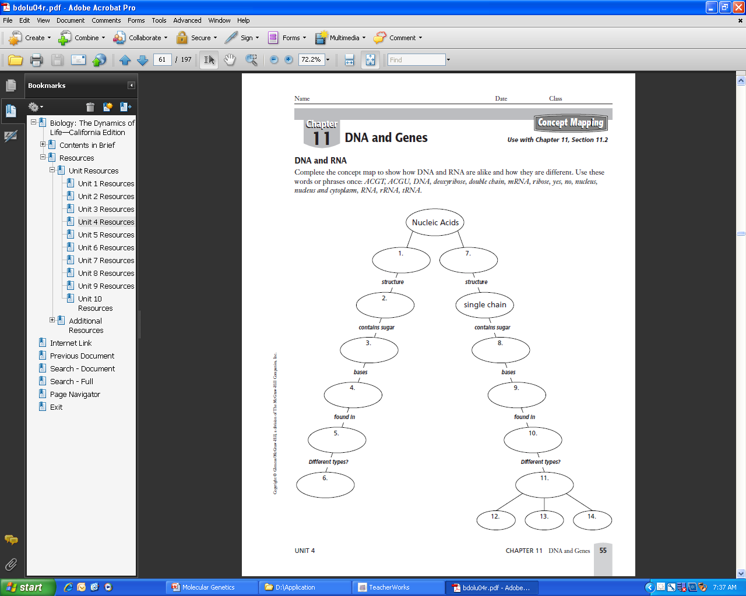
Write a 4 sentence summary
P. 67 NB
ACGT
ACGU
DNA
Deoxyribose
Double chain/ Helix
mRNA
Ribose
Yes
No
Nucleus
Nucleus & Cytoplasm
RNA
rRNA
tRNA

Slide 13
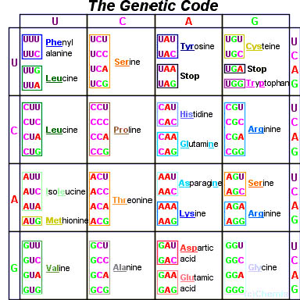
Page 292 Biology Book

Slide 14
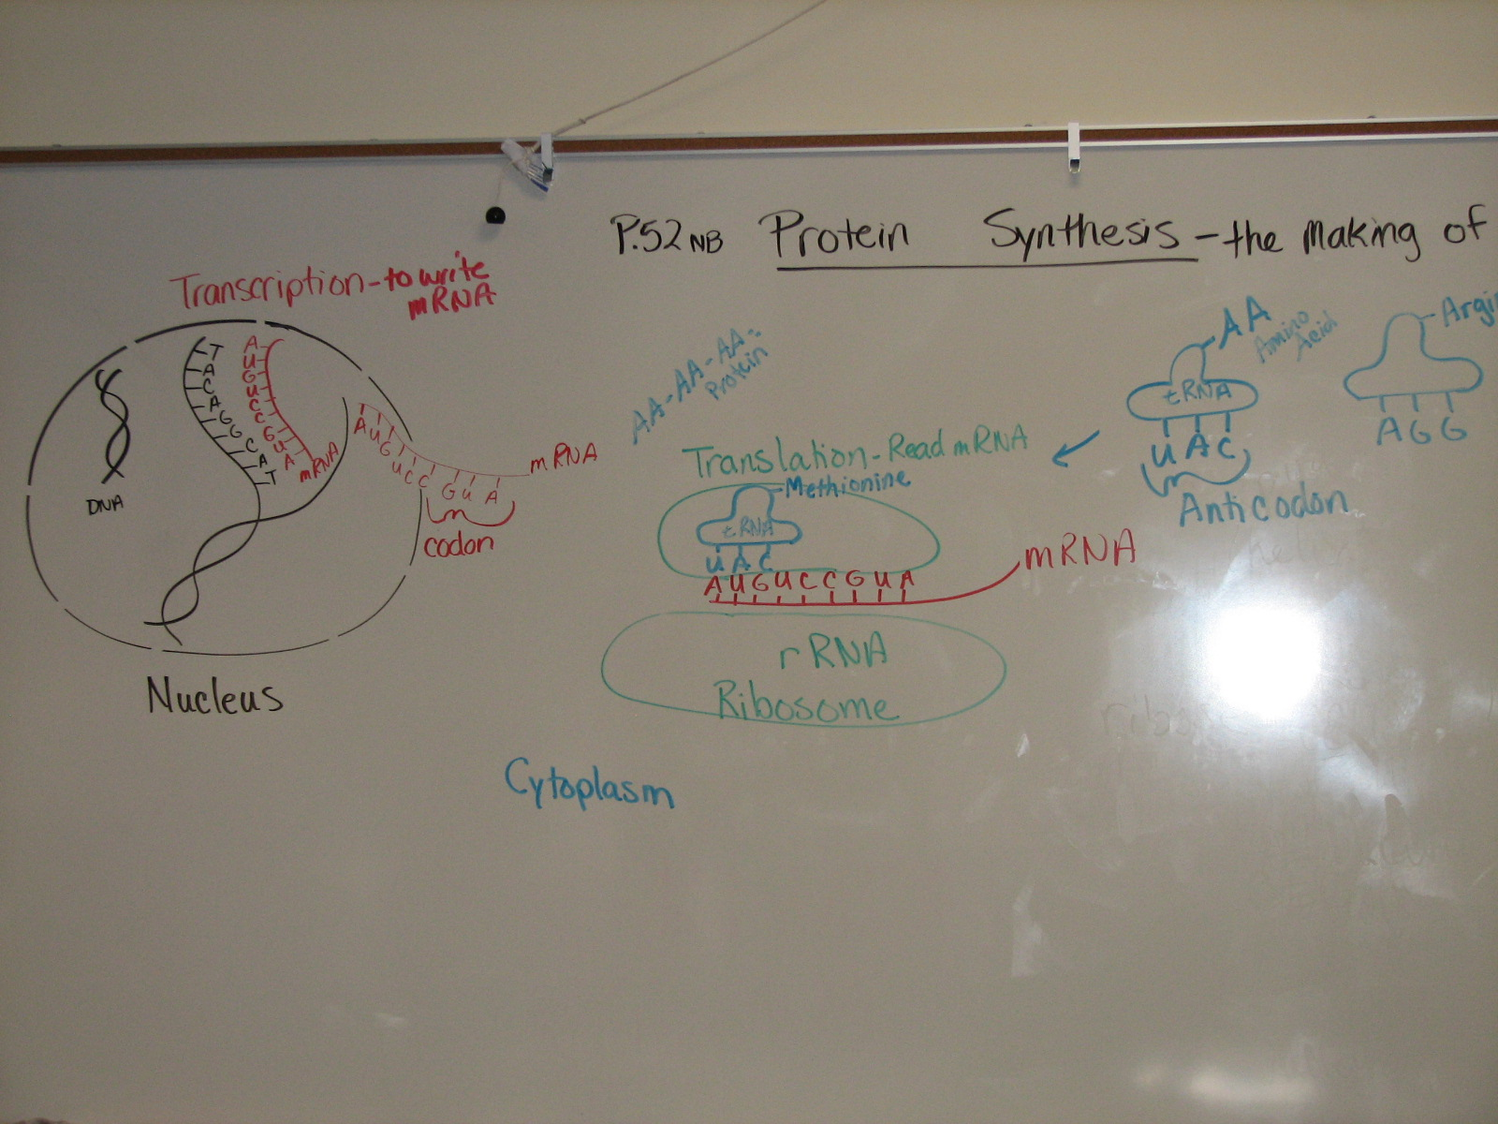
Page 75 NB

Slide 15
1st Period P. 77 NB
Write a paragraph after building your DNA molecule that include the vocabulary words: Double helix, Nitrogen bases, Hydrogen bond, Nucleotide, Backbone, Deoxyribose, Phosphate, Adenine, Thymine, Cytosine, Guanine.

Slide 16



Collect 3 sheets of paper and layer them about 1.5 cm apart vertically. Keep the edges level.
P. 53 NB
To return to the chapter summary click escape or close this document.

Slide 17


Fold up the bottom edges of the paper to form 6 equal tabs.
P. 53NB
To return to the chapter summary click escape or close this document.

Slide 18


Fold the papers and crease well to hold the tabs in place. Staple along the fold. Label each tab.
P. 53NB
RNA – draw & label 3 differences from DNA p. 289
TRANSCRIPTION: from DNA to RNA P. 290
RNA Processing (Introns & Exons) P.291
The Genetic Code p. 291 - 292
TRANSLATION: from mRNA to PROTEIN p. 294 11.9A
PROTEIN SYNTHESIS
DNA->transcription->RNA ->translation->Protein
To return to the chapter summary click escape or close this document.

Slide 19
Rice Krispy Protein Synthesis P.79 NB
My protein looks like: Round, Flat, Color, M&M or Gummi Bears
Deleting the fifth nucleotide of your DNA will cause a frameshift mutation that changes every amino acid after the deletion. Change how many marshmallows were used.
Changing the 11th nucleotide of your DNA sequence from G to T would be a point mutation and will change the amino acid Serine to STOP codon, however, this is bad because the protein is not complete. Marshmellows would not be smooth.
If the 19th, 20th, 21st nucleotides of your DNA sequence were deleted the 7th codon were deleted the rice krispie treat would not have color.
Two proteins are different by some were flat, round, some were red, some blue, some M&M’s &/ gummy bears.
Conclusion
1.If you were given the

Slide 20
Classwork – Transcription & Translation p. 53 NB
Work on worksheet about Protein Synthesis.
Transcribe the DNA sequence.
Then, translate the Amino Acid sequence to the right of the Codons.

Slide 21
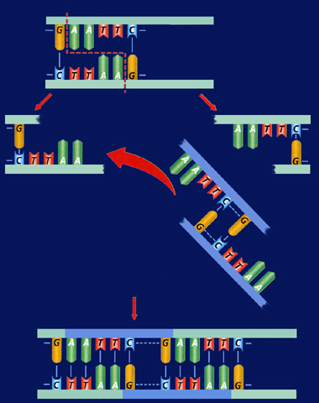
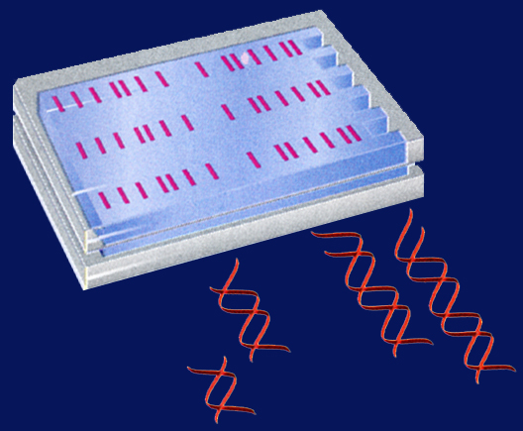
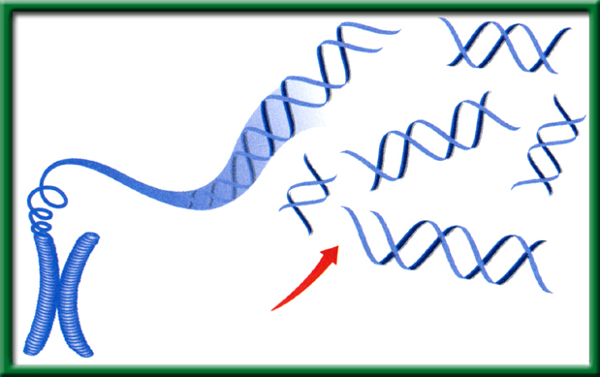
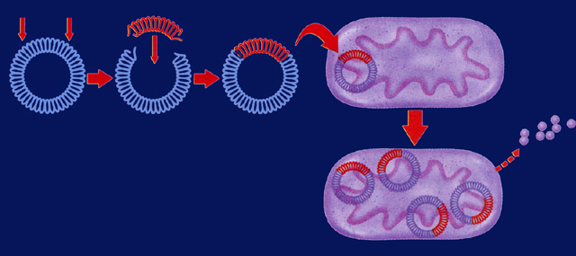
10/10 Applied Genetics 13.2
Obj. TSW be able to explain how basic DNA technology is used to construct recombinant DNA molecules in a Minilab 13.1 p.72 NB
HHMI.org
NOVA.pbs.org
HW – Read CH 13
1pg notes P. 81 NB
Finish Study Guide
Genetic Engineering uses Recombinant DNA, explain.
Explain a transgenic organism.
Explain two ways in which recombinant bacteria are used for human applications.

Slide 22
Genetic Engineering
#1. Recombinant DNA is DNA that has one or more genes from another organism in it’s genome.
#2. A transgenic organism has Recombinant DNA.
#3. Bacteria is a transgenic organism that can have the gene to make insulin for people who have Diabetes. They also can have the gene for Growth Hormone to help people who have Dwarfism be a more normal range of height.

Slide 23
Draw Protein Synthesis
P. 75 NB
Turn your book Landscape Style ←------→
Have 4 different colored pencils.
Write on the RED line at the top: Protein Synthesis: the making of Proteins
Use ¾ of the page
The last ¼ of the page will be a summary/ AXES paragraph.

Slide 25
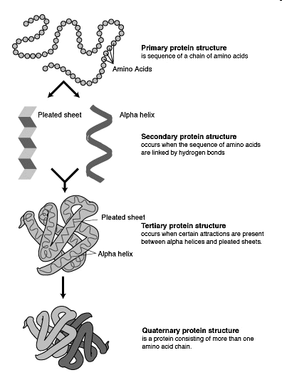
Proteins Notes P. 81 NB
Proteins can come in
many different shapes
and sizes.
The number & sequence of
amino acids determine its
a proteins shape.
An example of
proteins: ENZYMES!
Proteins must have a
specific structure in order
to function properly.

Slide 26
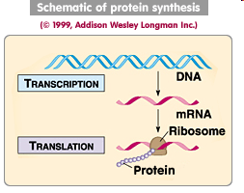
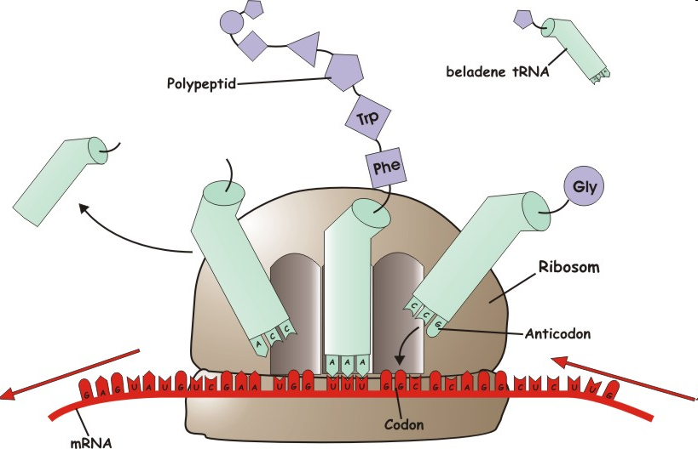
Warm Up Answer

Slide 27
Building a Protein
Choose the sequence you had when you did the Rice Krispy Protein Lab. Transcribe and Translate your DNA sequence. Then form a tertiary protein based on the chemical characteristics of the proteins you have. When you are finished, explain to McAllister what you have done.
Gene #1: TAC-CAC-AAC-AGC-TAG-AGT-CTA-TGC-GTA-ACG-ACC-CCT-ATT
Gene #2: TAC-CAC-AAC-AGC-TAG-AGT-CTA-TGC-ATA-ACG-ACC-GGG-ATC
Gene #3: TAC-CAC-AAC-AGC-TAG-AGT-CGA-TGC-GTA-ACG-ACC-GGG-ACT
Gene #4: TAC-CAC-AAC-AGC-TAG-AGT-CGA-TGC-ATA-ACG-ACC-CCT-ATT
Gene #5: TAC-CAC-AAC-AGC-TAG-AGT-TTT-TGC-GTA-ACG-ACC-CCT-ATC
Gene #6: TAC-CAC-AAC-AGC-TAG-AGT-TTT-TGC-ATA-ACG-ACC-GGG-ACT
Gene #7: TAC-CAC-AAC-AGC-TAG-AGT-TCT-TGC-GTA-ACG-ACC-GGG-ATT
Gene #8: TAC-CAC-AAC-AGC-TAG-AGT-TCT-TGC-ATA-ACG-ACC-CCT-ATC

Slide 28

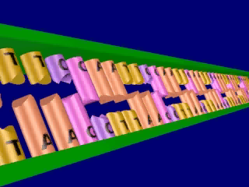
Section 13.2 Summary – pages 341 - 348
Restriction enzymes cleave DNA
Click image to view movie

Slide 29
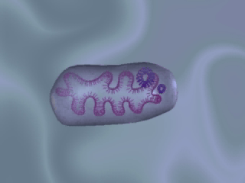
Section 13.2 Summary – pages 341 - 348
Vectors transfer DNA
Biological vectors include viruses and plasmids. A plasmid, is a small ring of DNA found in a bacterial cell.
Click image to view movie

Slide 30
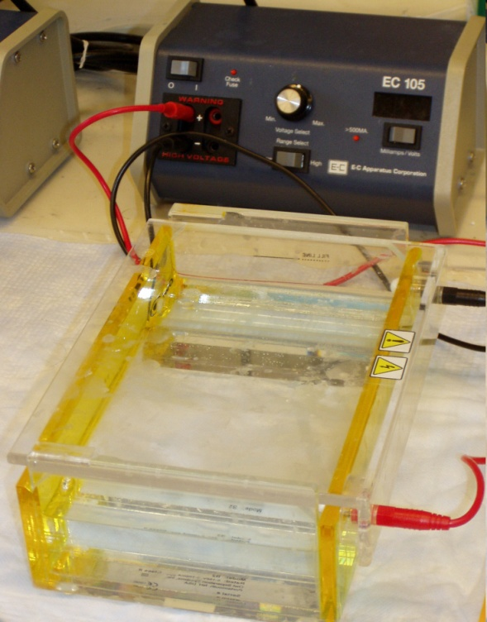
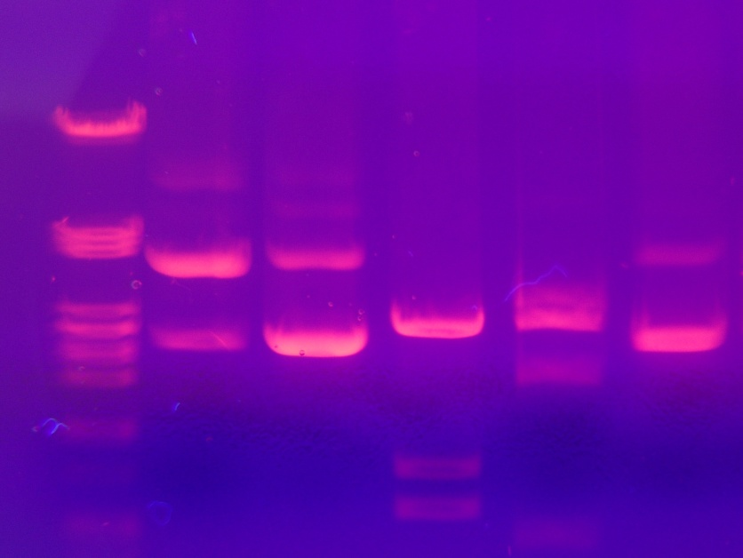
10/11 Gel Electrophoresis CH 13.1
Obj. TSW learn how to build a protein from an amino acid sequence using the hydrophobic and hydrophilic properties of the amino acids. P. 74 NB
What is Gel Electrophoresis?
Why is DNA fingerprinting important?
Explain the field of Genetic Engineering and how a Gel Electrophoresis applies in the agricultural field.
Watch Gel Video
HW CH 13
HW Study Guide
Midterm Final 10/20

Slide 31
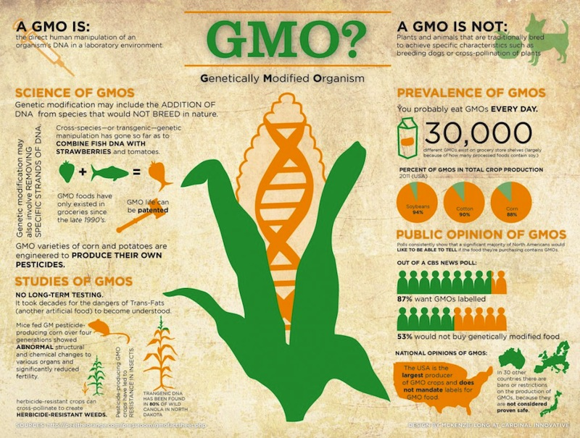
10/12 Genetically Modified Organisms EEI Curriculum
Obj. TSW demonstrate the pros and cons of Genetically Modified Organisms. p. 76 NB
What does GMO stand for?
What are some concerns about GMO’s.
What are some benefits to GMO’s.

Slide 32
Genetically Modified Organisms
Bt Corn Concerns: Not good for peoples health, outcompetes native species and decreases Biodiversity.
  Benefits: This corn is genetically resistant to the corn borer beetle. The farmer does not have to spray pesticides. Income for communities and increased tax base.
Malaria Resistant Mosquitos Concerns: Not sure about the impact of the genetically modified mosquitos. They might impact animals they bite in negative ways. What happens when a malaria resistant mosquito breeds with a normal mosquito?
  Benefits: People would live without fear of malaria- hopefully.
Golden Rice Concerns: Not good for peoples health, outcompetes native species and decreases Biodiversity.
  Benefits: Vitamin A nourishing people, people are not deficient anymore.

Slide 33
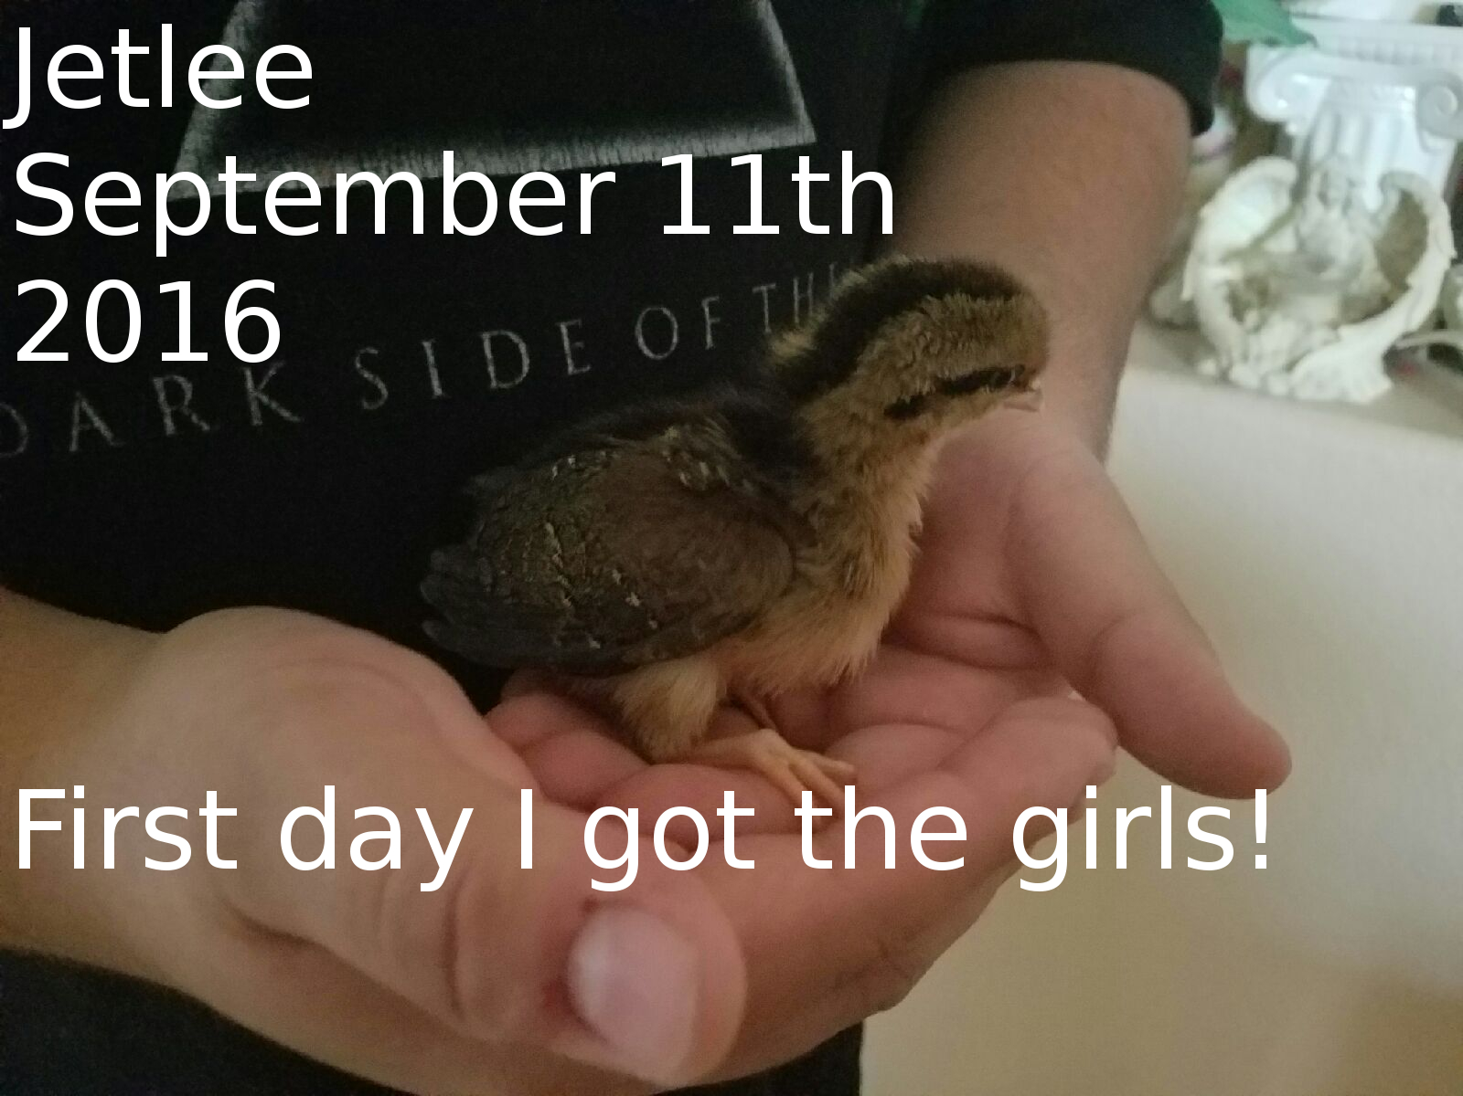

Slide 34
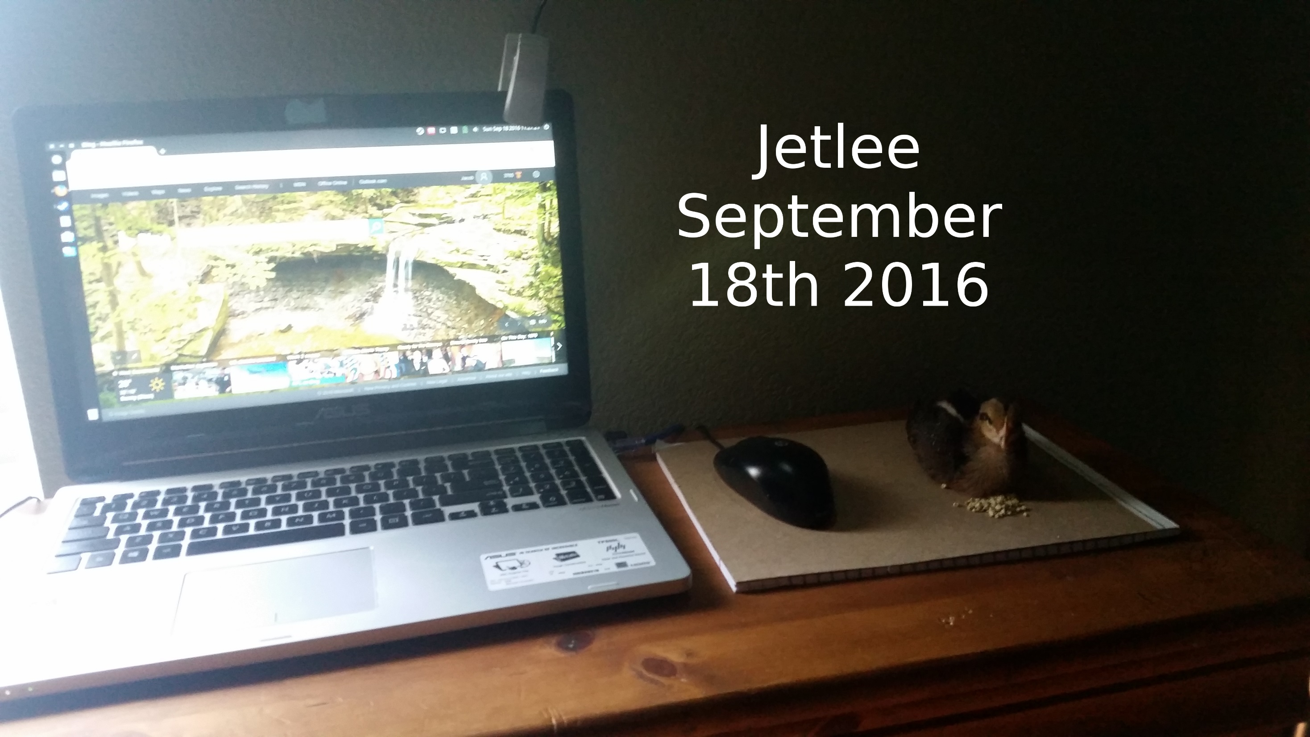

Slide 35
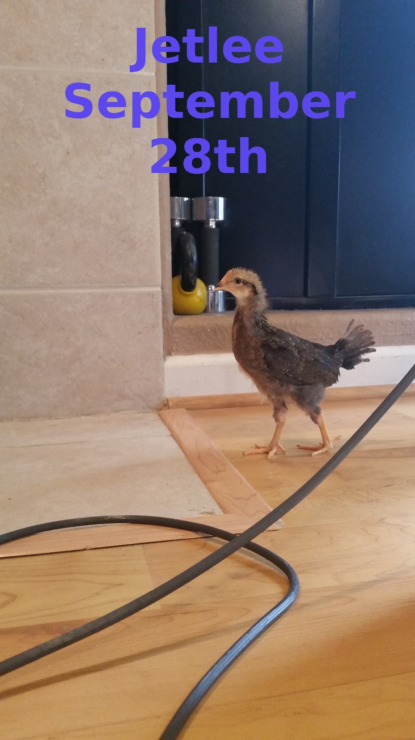

Slide 36


Slide 37
2015 Midterm Study Guide answers
A. Age in Years
b. Number of Teens
2. The trend is increasing for teens with phones.
3. As teens get older, more have cell phones.
4. A decrease in 60 teens who have cell phones.
5. Eukaryotic: Nucleus, Membrane Bound Organelle, Animal cell, Plant cell
Prokaryotic: No Nucleus, Bacteria
Both: DNA, Ribosomes, Cell Wall, Plasma Membrane,

Slide 38
Study Guide for Midterm Final Biology
6. a. Proteins: Carbon Hydrogen and Oxygen, Nitrogen, Sulfur
b. Lipids: Carbon, Hydrogen, Oxygen
c. Carbohydrates: Carbon, Hydrogen, Oxygen
d. Nucleic Acids: Carbon, Hydrogen, Oxygen, Phosphorus, Nitrogen, Sulfur
7. The Mitochondria converts Glucose into ATP (energy) and it produces Heat, CO2 & H2O.
8. The Chloroplast captures light energy and converts it to sugar ( C6H12O6), Chemical Energy.
9. An Enzyme is a Protein, that speeds up chemical reactions.
10. Draw☺
11. Environmental Factors: Temperature, pH, Ionic Conditions
12. Plant – Cell Wall, Large Vacuole, Chloroplasts,
Animal – Small vacoule
Both: Eukayotic, Cell Organelles, Plasma Membrane, Nucleus, Mitochondria

Slide 39
A type of nucleic acid that has a double helix and contains thymine.
This process uses glucose and oxygen to produce ATP, CO2 (carbon dioxide), and water.
This is a three nucleotide sequence found on tRNA that codes for a specific amino acid.
This macromolecule is composed of amino acid chains.
This type of macromolecule that includes glucose, fructose, and other saccharides. It has oxygen, carbon, and hydrogen atoms.
This type of eukaryotic cell does not have cell walls or chloroplasts.
This type of cell has cell walls, mitochondria, chlorophyll, and it utilizes both cellular respiration and photosynthesis to convert solar or organic energy into ATP.
This nucleic acid is single stranded and contains uracil.

Slide 40
A three base sequence that corresponds with a specific amino acid for protein synthesis.
This is a pathogen that infects other cells and it hijacks a host cell’s machinery to replicate.
This process uses carbon dioxide and water to produce glucose and oxygen.
This is a change in a nucleotide sequence that can cause the readings of the codons after the change to code for different amino acids. Can cause an abnormally short or abnormally long amino acid chain.
This molecule is a pigment found in the chloroplasts of plants and is vital in the process of photosynthesis.
These proteins increase the rate of chemical reactions and are affected by environmental conditions.
This is a type of RNA that makes up part of the ribosome and is essential in protein synthesis.

Slide 41
A process that occurs in the cytosol and involves different forms of RNA. It occurs at the ribosome where the mRNA is read.
This organelle is used in cellular respiration and it is found in both animal and plant cells.

Slide 42
Study Guide
13. AXES Paragraph about folded membranes:
Having folded membranes in cells is better. Organelles in the cell that have folded membranes are: Mitochondria, Golgi Apparatus, Endoplasmic Reticulum, and Chloroplasts. The folded membranes increase the chemical reactions in the cell because it has more surface area. In addition, the chemical reactions are more efficient due to the increased surface area. The chemical reactions help maintain homeostasis in the body.

Slide 43
Study guide
14.Photosynthesis: Glucose & O2 as a Product, Chloroplast, Needs Sunlight, CO2 & H20 as a reactant,
Cellular Respiration: Glucose & O2 as a Reactant, animals, CO2 & H2O as a product,
Both: Mitochondria, Plants
15.

Slide 44
Study Guide
16. DNA: Adenine=Thymine
Cytosine=Guanine
17. RNA: Adenine= Uracil
Cytosine=Guanine
18. Frameshift Mutation: changes every amino acid after the addition or deletion, deletion of a nucleotide, addition of a nucleotide, is more severe
Point Mutation: changes one nucleotide, changes on amino acid,
Both: type of mutation

Slide 45
19. AXES paragraph:
Selective permeability allows some molecules in and out and other not. Glucose is a molecule that the cells need for energy. Carbon dioxide and water are released from the cell. Passive transport allows molecules across the cell membrane without energy. Active transport requires energy. Glucose provides energy for the body to perform cellular respiration, and maintains homeostasis for the body.
20. Virus – pathogen, needs a host cell to live and replicate.

Slide 46
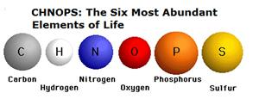
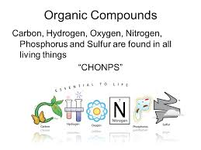
10/13 Building Molecules & Enzymes CH 6.3
Obj. TSW identify the macromolecules living things are made of and describe their properties. P. 78NB
What are the 6 main elements that make up the 4 macromolecules?
What is an Enzyme? CH 6.3
What three environmental factors determine the enzymes function? CH 6.3

Slide 47
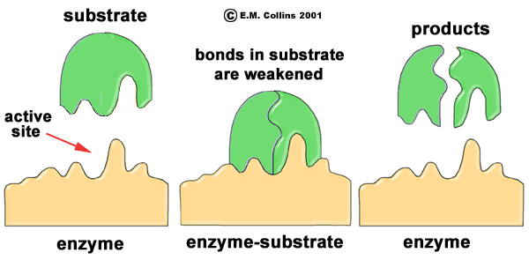
Enzymes
1. CHONPS- Carbon, Hydrogen, Oxygen, Nitrogen, Phosphorus, & Sulfur.
2. Enzymes are a type of protein that catalyze chemical reactions. This means they speed up the rate of chemical reactions.
3. There are three things that impact how well an enzyme will work:
  pH
  Temperature
  Amount of Substrate &/or the amount of Enzyme

Slide 48

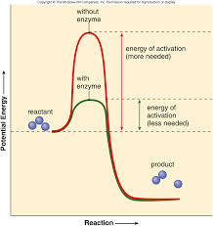
6.3 Section Summary 6.3 – pages 157-163
Take notes P. 85 NB
The structure of proteins
Enzymes are important proteins found in living things. *An enzyme is a protein that changes the rate of a chemical reaction.
They speed the reactions in digestion of food.
Made up of Amino Acids (20)
Enzymes can be used again and again without being used up.
Click image to view movie.

Slide 49
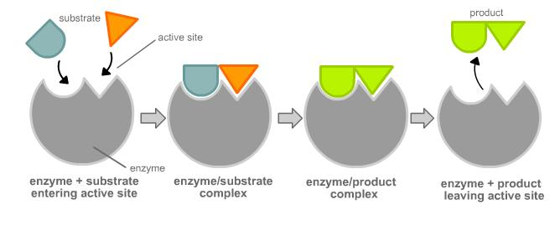
Enzyme Activity
You will be given a substrate or a part of an enzyme.
Find the matching part, that fits your active site.
Bring your matching Enzyme/ Substrate combinations (Lock & Key) to McAllister
I will quiz you on your knowledge of monomers and polymers in endergonic & exergonic reactions.

Slide 50
10/14 Enzymes CH 6.3
Obj. TSW learn how enzymes function and the environmental factors that influence them in and activity/ lab. P.80NB
What type of macromolecule is an enzyme?
What is the purpose of an enzyme?
Name 3 environmental factors that influence an enzymes function.
                Please Draw this picture on your Warm Up.

Slide 51
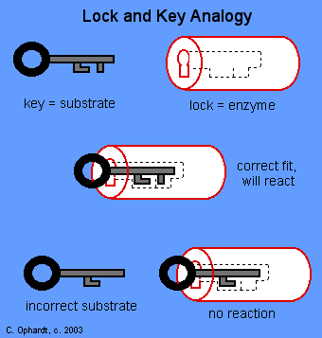
Macromolecules & Subunits Notes p. 85NB
Draw this
Write down these notes below.
Lipid – Fatty Acids
Carbohydrate- Saccharides
Protein( Enzymes)– Amino Acids
  Temperature
  pH
  [Substrate ] & [Enzymes]
  [Salt]
Nucleic Acid - Nucleotides
***[ ] means concentration, or amount.

Slide 52
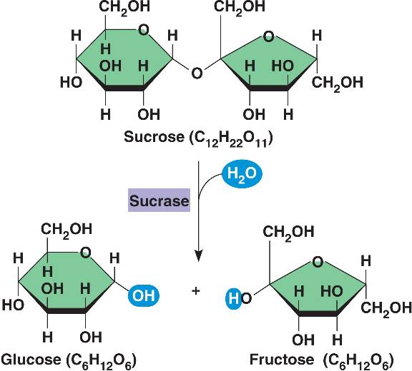
Enzymatic Reaction of Sucrase on Sucrose

Slide 53
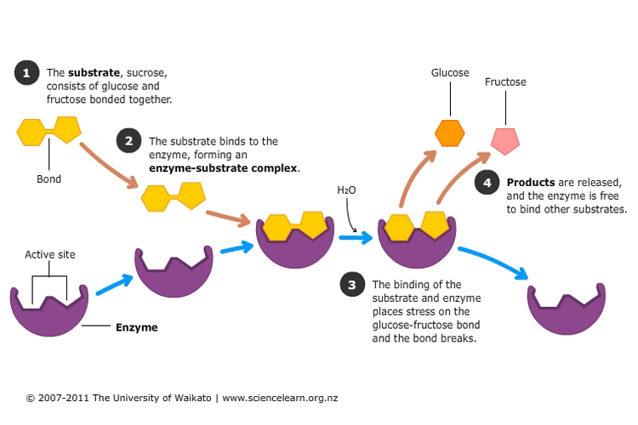
Enzymatic Reaction of Sucrase on Sucrose

Slide 54
Catalase Lab
ml H2O2 | Person 1 | Person 2 | Person 3 | Person 4 | Person 5
5 | 100
6
7 |  | 120
8 |  |  | 120
9 |  |  |  | 170
10 |  |  |  |  | 140

Slide 55
Catalase Lab P. 27
1 flask / 2 people
GLX
Pressure Probe
Yeast – 1 tsp.
Hydrogen Peroxide 5ml
Swirl
Make observations.
Write a summary paragraph about the function of enzymes with a picture of a substrate & enzyme & active site. What factors allow for the enzyme to function? What volume of H2O2 did Catalase work the best? Why does the enzyme speed up chemical reactions? Enzymes can be used again & again (Catalytic), how is this important in chemical reactions? At what volumes (ml) did the Catalase work the best? Write the chemical equation.

Slide 56
AXES Paragraph – Catalase Lab
Assertion What is Exothermic Reactions? Use vocabulary.
eXample Discuss an example of an enzyme. Include details from the lab.
Explanation Describe the function of the enzyme, and factors that influence it.
Significance Why are enzymes important for us?

Slide 57
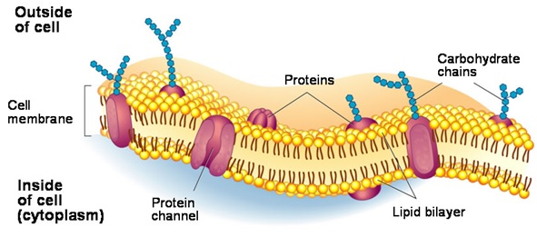
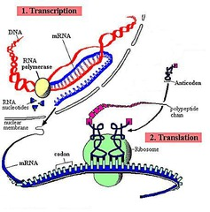
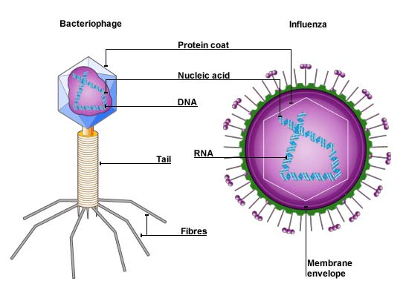
10/17 Review for Midterm Test
Obj. TSW review for the midterm test by answering the following questions relating to their study guide. P. 82 NB
How does selective permeability relate to the plasma membrane?
What is a virus? How does it replicate?
Explain in 3 – 5 sentences the process of protein synthesis.

Slide 58
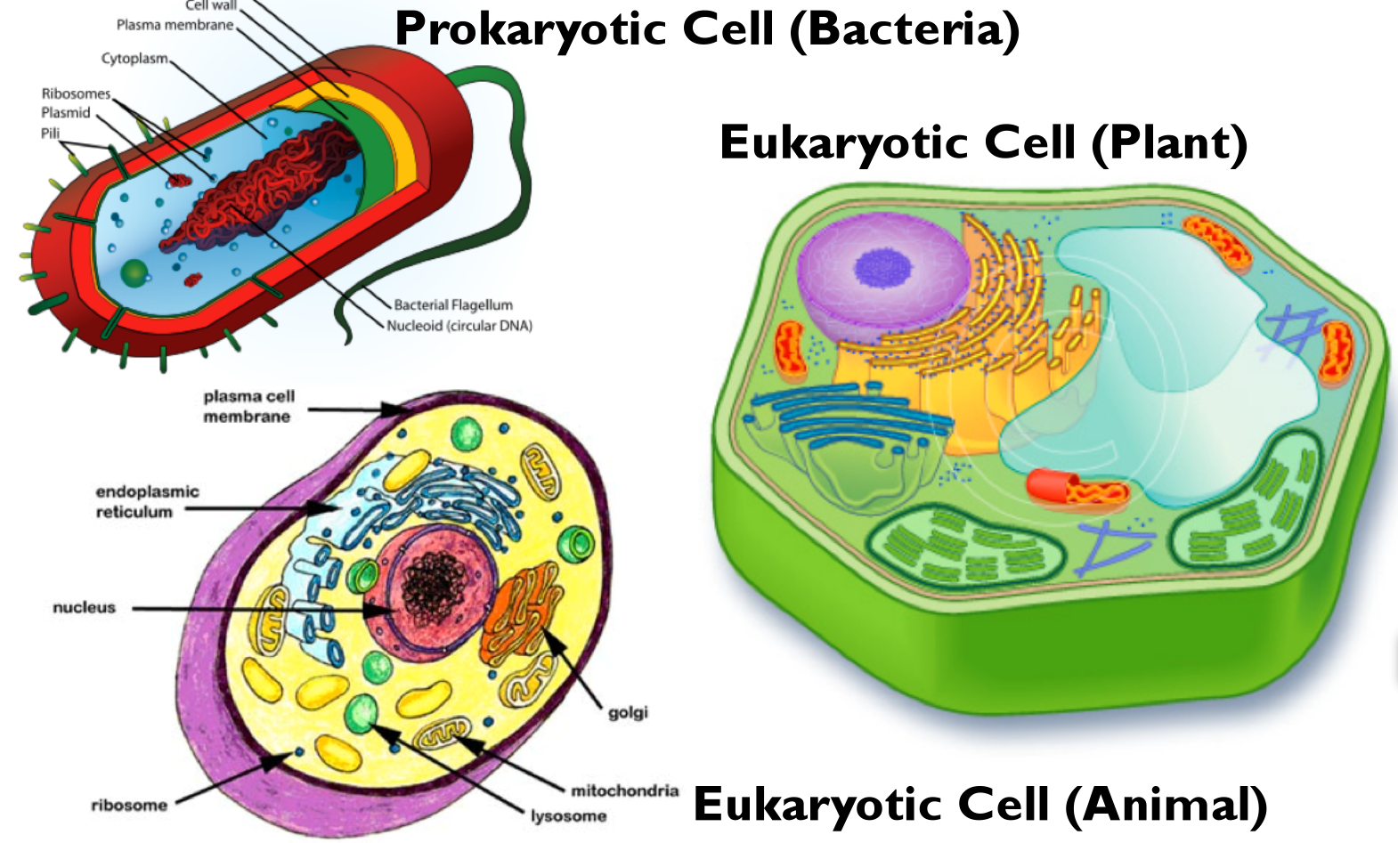
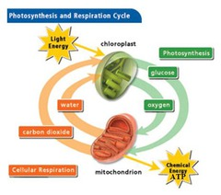
10/18 Review for Midterm
Obj. TSW learn compare and contrast major biological concepts for their study guide. P. 84 NB
Compare & Contrast Eukaryotic and Prokaryotic Cells.
Compare & Contrast Plant & Animal Cells.
Compare & Contrast Photosynthesis & Cellular Respiration.

Slide 59
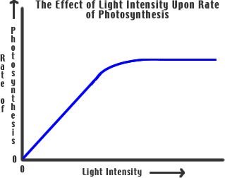
10/19 Review for Midterm
Obj. TSW review variables and the control in a lab and analyze the graph. P. 86 NB
Compare & Contrast Independent and Dependent Variables.
Why is the Control important?
Using the graph, what is the trend? How do you know?

Slide 60
Taboo
Protein Synthesis
Codon
Anticodon
RNA
Amino Acid

Slide 61
Taboo
Photosynthesis
Cellular Respiration
Animal
Eukayrotic
Nucleus

Slide 62
Taboo
Folded Membranes
Osmosis

