Slide 1
Ag Biology Ecology Unit
Week 4
Sept. 5th – 8th

Slide 2
Agricultural Careers
Research 3 Different Careers in Agriculture that have to do with the 5 F’s of Ag: Food, Fiber, Flowers, Forests, Fuel.
Develop 3 questions you have about each career.
They might be about the education/ training you need for that career
About the pay scale
Opportunity for advancement
The best part of the job, or the worst
Describing the job
Recommendations for us as students?

Slide 3
What’s Growing On? Page 19 NB
Who are they?
What is their role in Agriculture?
Think of the 5 F’s: Food, Fiber, Flower, Forest, Fuel
Automation? Data analysis?
Would they be a good guest speaker? Fieldtrip?
Fun fact?

Slide 4
Agriculture can be the solution to many of today’s problems: Stopping Mass Extinction/ Improving Biodiversity/ Improving Farmland/ Healthy Soil
Agricultural Issues:
Monocropping
Eutrophication
Releasing Nitrous Oxides into the air
Barren Land – Does not hold CO2
Synthetic Fertilizers – feed plant but not nourish soil
Methane Production from Cattle
Deforestation to grow farms
Energy – Biodigestion of Animal Waste
Choose an Agricultural Setting
Choose an Agricultural Issue in that Setting
Research a solution to that issue, How can Agriculture be the Hero to major problems that contribute to Habitat Loss, Global Warming, Climate Change, Pollution, Extinction of Species

Slide 5
Agriculture can be the solution
Wildlife Corridors
Wildlife Habitats
Cover Cropping
Introducing Biodiversity into the Farm

Slide 6
Human Population Growth p. 29 NB
Year A.D. | Number of People (in Billions)
1650 | .5
1750 | .7
1850 | 1.0
1925 | 2.0
1956 | 2.5
1966 | 3.3
1970 | 3.6
1974 | 3.9
1976 | 4.0
1980 | 4.4
1991 | 5.5
2000 | 6.0
2004 | 6.4
2010 | 7.0
2015 | 7.2
2020 | Predict- Continue drawing the line
2050 | Predict – Continue drawing the line

Slide 7
Ecological Levels of Organization p. NB
(Smallest) Atom, Molecule, Cell, Tissue, Organ, Organ System, Organism, Population, Community, Ecosystem, Biosphere (Largest).
Adaptations of Organisms – Notes
Ticket out the Door:
Write a paragraph using the following words: Ecology, Niche, Habitat, Organism, Biome, Abiotic, Biotic.

Slide 8
Ecology Paragraph p. 35 NB
Ecology is the study of the living and nonliving things in the environment. A taiga is an example of a Biome. It is the habitat of the Mountain Lion. The Mountain Lions is a biotic organism who’d niche is to hunt prey like squirrels. In the taiga a non living organism or abiotic is the water in the rivers.

Slide 9
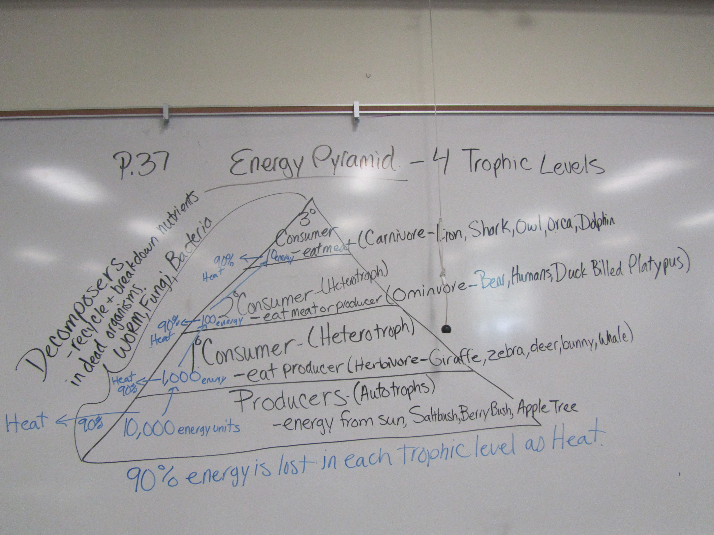
Write a 3 sentence
summary. P.55 NB

Slide 10
Four Corner Activity Stand in the corner for the answer you believe for each statement.
Strongly Agree
Agree
Disagree
Strongly Disagree
Energy is lost to the Environment.
Energy increases as it is passed from one organism to another.
Energy is not lost between organisms in a food chain.

Slide 11
Energy is lost to the Environment. P. NB
Strongly Agree or Agree, because energy at each trophic level is lost as heat.

Slide 12
Energy increases as it is passed from one organism to another. P. NB
Disagree, because the energy decreases as you increase the trophic level. 90% of the energy is lost at each level as heat.

Slide 13
Energy is not lost between organisms in a food chain. P. NB
Strongly disagree or Disagree, because food chains make up the Energy Pyramid. Less organisms exist in the higher trophic levels due to energy loss.

Slide 14
Activity – Popcorn Energy Transfer in the Ecosystem
Energy
Passing off energy to the next trophic level
This represented the organisms daily activities that it would use energy.
The popcorn on the ground is the loss of energy to the ecosystem.
If there was no popcorn to pass off the organism would die.

Slide 15
The amount of energy as we move through each trophic level is lost. Popcorn fell on the ground.
Most food chain only have 3 – 5 organisms because that is the amount of energy that can support those organisms.
Energy Pyramid:

Slide 16
SAE Qualification Questionnaire Your SAE must be agriculturally related, created by you, invested time of at least 8 hours, supervised by your Ag Teacher and be part of your grade.
How does it provide real work situations?
What careers is it related to?
How is it part of your career goal?
List the skills, knowledge and attitudes you need for this career that your SAE might apply to.
How can you grow, and become more competent each year in the Ag program with this SAE?
How does your SAE allow for expansion, and/or change?
Have you kept records of your money, and time?

Slide 17
Cycles in Nature 2 groups/cycle
Water:
Carbon:
Nitrogen:
Phosphorus:

Slide 18
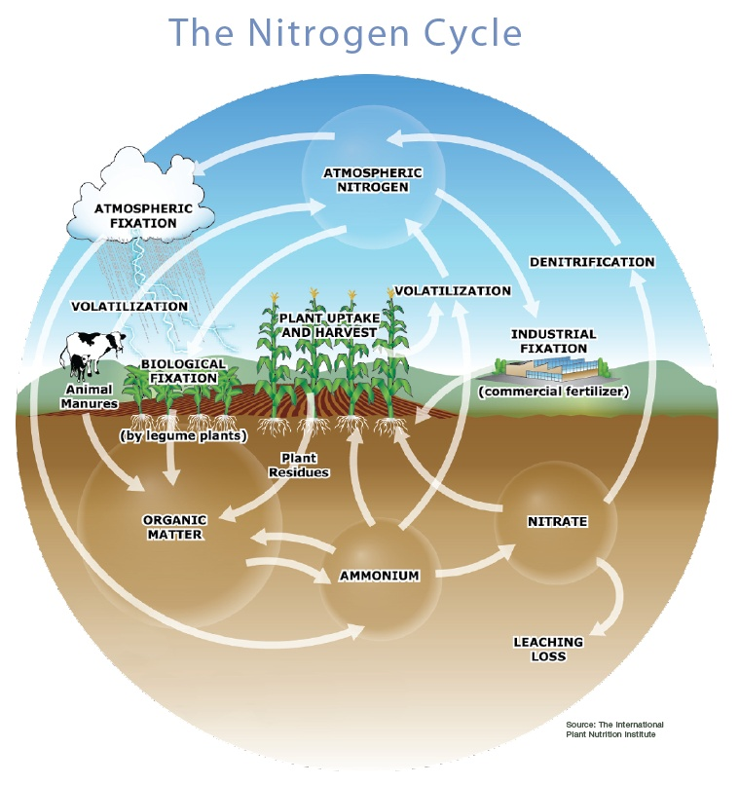

Slide 19
Matter of Fact Notes
Matter, mass, space.
Atom -Ex: H, Hydrogen; N, Nitrogen; Na, Sodium
Molecule, Substance- Ex. N₂ Nitrogen Gas; H₂ Hydrogen gas; O₂ Oxygen Gas
Compound, at least two different, millions.
H₂O water, NH₄⁺ Ammonium, NO₃⁻ Nitrate
5. Oxygen gas, O₂ & Nitrogen Gas N₂ are not considered compounds because they are each composed of the same element. Water, H₂O, is a compound because it is composed of more than one element.
6. Chemical formula, elements, subscripts. Ex: C₆H₁₂O₆ - Glucose

Slide 20
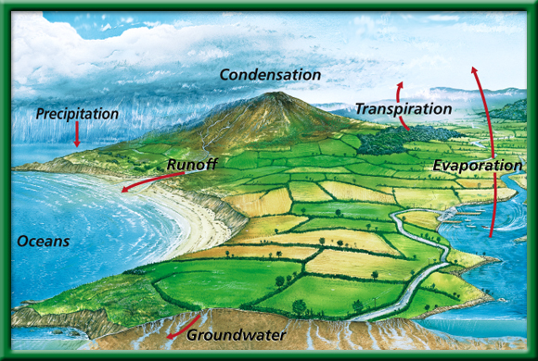
The Water Cycle
P.53 BB
Be able to explain at least 5 parts of the cycle.
Does water leave the planet?
To return to the chapter summary click escape or close this document.

Slide 21
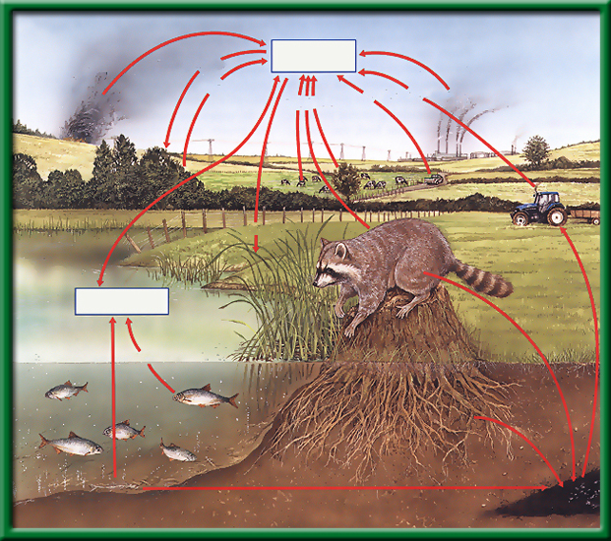
Section 2.2 Summary – pages 46 - 57
The Carbon Cycle
Open burning
Atmospheric CO₂
Photosynthesis
Respiration
Fuel Combustion
Respiration
Fuel Combustion
What is the role of the autotroph?
What is a carbon sink?
What is the role of the heterotroph?
Photosynthesis
Dissolved CO₂
Respiration
Death and decay
Death and decay
Fossil fuels

Slide 22
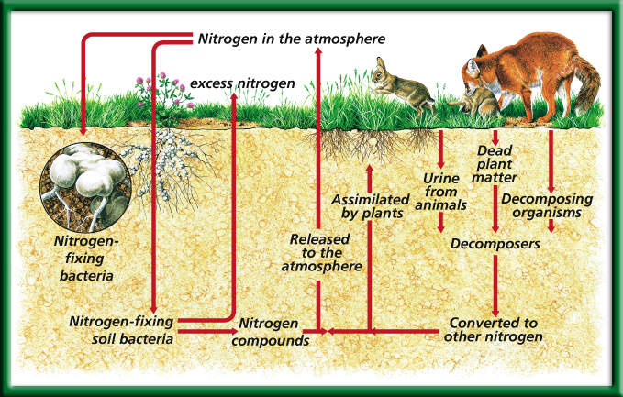
The Nitrogen Cycle
What organism is essential for this cycle?
To return to the chapter summary click escape or close this document.

Slide 23
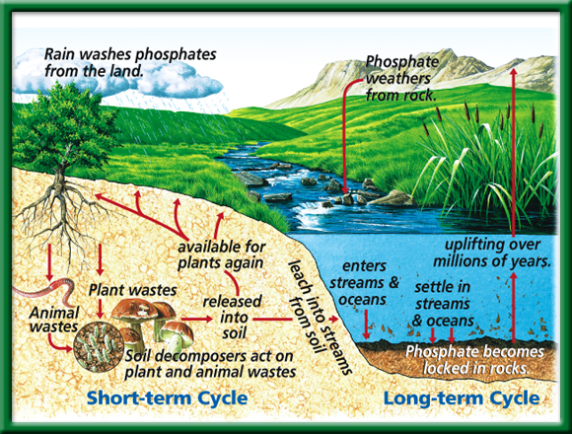
The Phosphorous Cycle
What role do humans play in these cycles?
To return to the chapter summary click escape or close this document.

Slide 24
Cycles in Nature: Conclusion Questions
Summarize the water cycle in at least 5 sentences.
Do you think water is ever lost or gained? Explain.
What is the role of an autotroph in the carbon cycle? A heterotroph? Explain.
What do you think is the most important “player” in the nitrogen cycle? Why?
How do humans play a role in all of the cycles? Do we help or hinder them? Explain.
Why are all three of these processes ( Water, Carbon and Nitrogen cycles) called cycles? Why are they not shown in a pyramid? Explain.

Slide 25
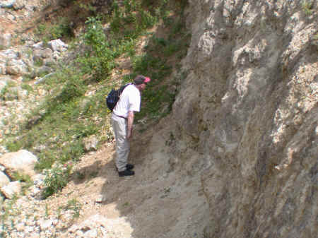
What type of succession is this?
Primary succession is the series of community changes which occur on an entirely new habitat which has never been colonized before.
Examples of such habitats would include newly exposed or deposited surfaces, such as landslips, volcanic lava and debris, elevated sand banks and dunes, quarried rock faces.
A number of stages take place where'pioneer' community will gradually develop through a number of different communities into a 'climax' community, which is the final stage.

Slide 26
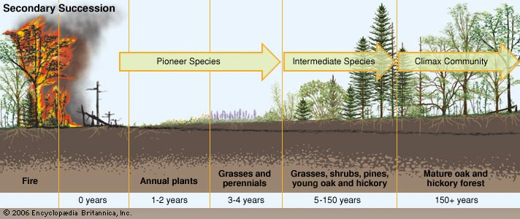
What type of Succession is this?
Secondary succession.
Soil was already formed, and it was a natural disaster that happened before the pioneer species started to take over.

Slide 27
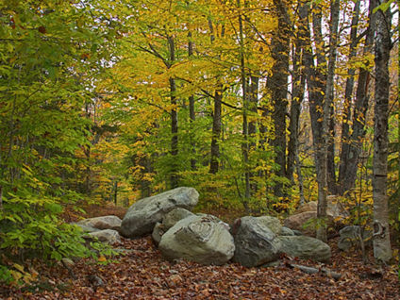
9/6 Succession CH 3 Obj. TSW learn about characteristics of symbiosis in succession. P. 34 NB
Explain a pioneer species.
Give an example of a pioneer species.
What type of symbiosis is it?

Slide 28
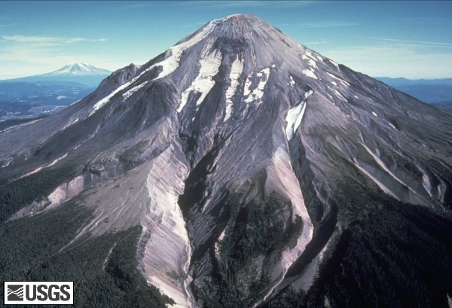
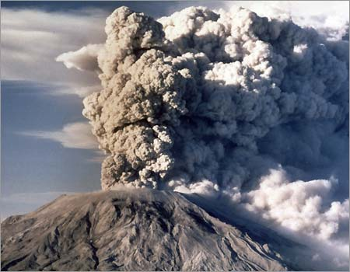
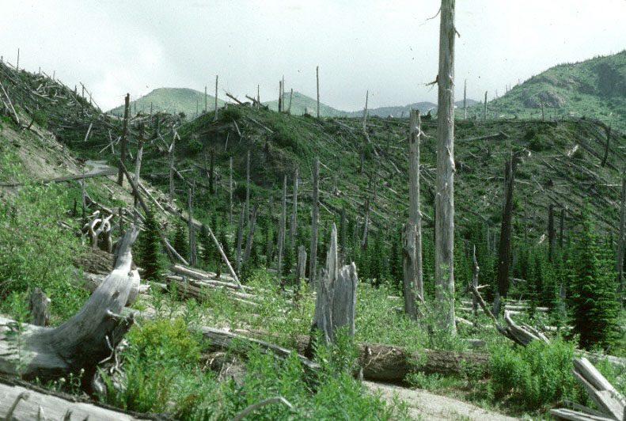
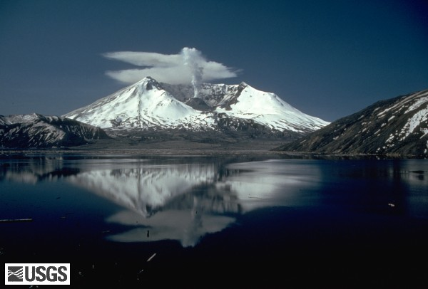
Succession Mt. St. Helens
2010
Pre 1980
2010
Eruption 1980

Slide 29
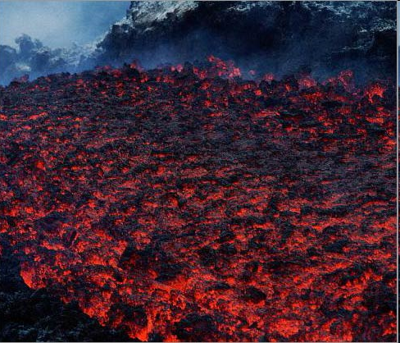
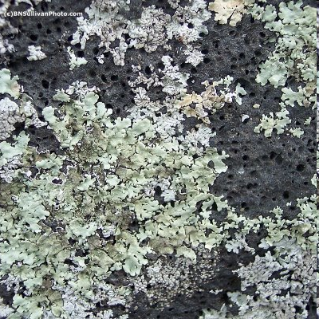
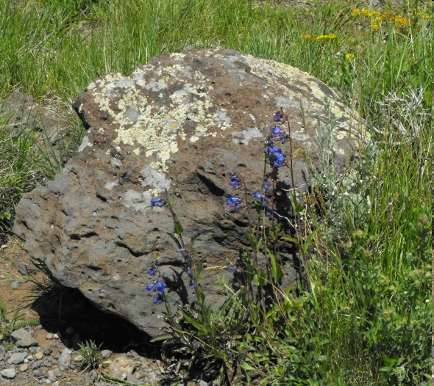
Succession
PRIMARY SUCCESSION
SECONDARY SUCCESSION
LAVA
LAVA COOLED WITH LICHEN
GRASSES/SHRUBS
FOREST
CLIMAX COMMUNITY!

Slide 30
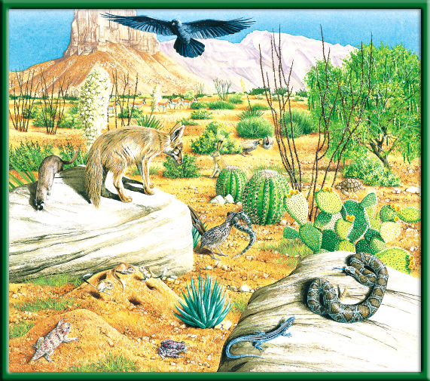
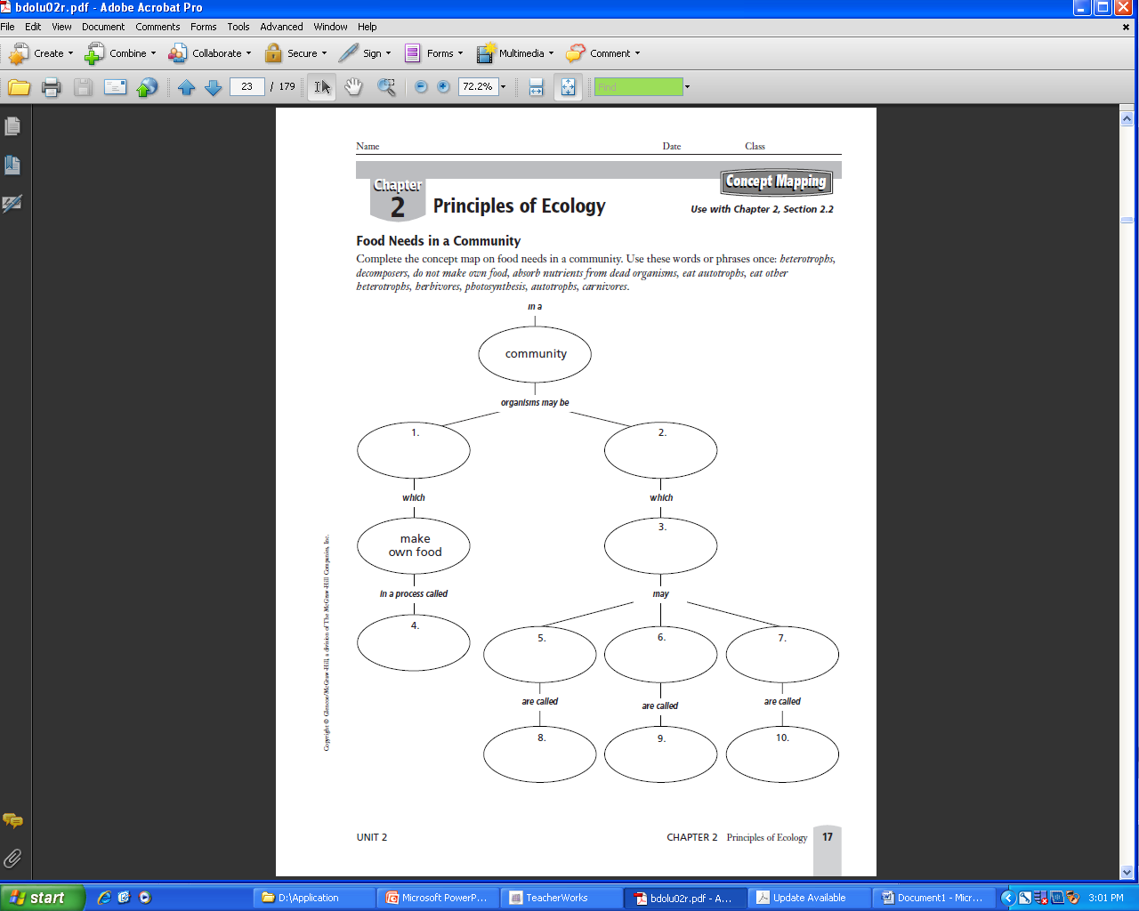
Food Web p.51BB
p. NB
Draw 1 Food chain.
Now add two more to make a Food Web.
Make an Energy Pyramid.

Slide 31
Water is lost to the abiotic parts of the biosphere from the biotic parts by the process of:
Infiltration
Transpiration
Photosynthesis
Precipitation

Slide 32
Transpiration Cougars are predators that often eat weakened or diseased animals. This is a description of the __ of cougars.
Ecosystem
Habitat
Niche
Population

Slide 33
Niche Where is the Biosphere?
Earth’s Crust
Upper Mantle
Core
Mantle

Slide 34
Earth’s crust A relationship between cats and mice could best be described as:
Consumer – Producer
Parasite – Host
Scavenger – Carrion
Predator - Prey

Slide 35
Predator – Prey If coyotes eat a cat that eats a mouse that eats grass, the coyote would be:
Decomposers
Second – order consumers
Third – order consumers
Herbivores

Slide 36
Third- order Consumer A pod of Killer whales (Orca’s) is known as:
Biosphere
Population
Ecosystem
Community

Slide 37
Population Draw an Energy Pyramid including grasses, flowers, grasshoppers, birds, and a fox. Which level has the smallest number of organisms?
Grass
Grasshoppers
Birds
Fox

Slide 38
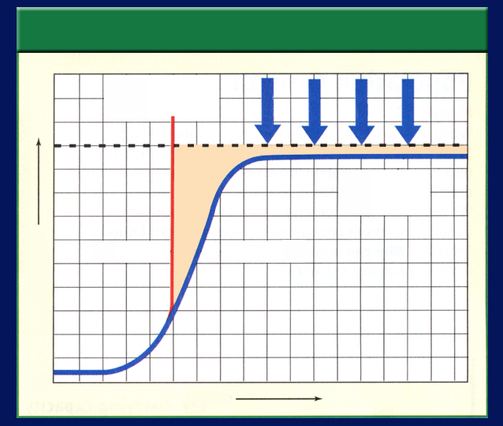
NB
9/7 Population Dynamics 4.1
Obj. TSW understand how fluctuation in population size in an ecosystem is determined by limiting factors such as disease, predation, space, & resources by completing the doing the Problem Solving Lab 4.2 . P. 36 NB
Graph 1
Exponential Growth
Draw, label & ID the two graphs representing the two ways populations grow.
What is Carrying Capacity (Graph 2) and what factors limit it (the arrows).
Describe how density – dependent and density –independent factors regulate population growth.
Graph 2
Linear Growth

Slide 39
Answers to WU #1
Exponential Growth
J – Shape Curve
Rapid Life History Pattern – r Strategist
Ideal conditions – No limiting Factors
1.
Linear Growth
S – Shape Curve
Slow Life History Pattern – K Strategist
Limiting Factors Determine the Carrying Capacity of the population

Slide 40
Section 4.1 Summary – pages 91-99
How fast do populations grow
with unlimited resources?
Population Growth of Houseflies
1 million
500,000
Population size
100
One year

Slide 41
Section 4.1 Summary – pages 91-99
Is growth unlimited?
A J-shaped growth curve illustrates exponential population growth.
Exponential growth means that as a population gets larger, it also grows at a faster rate.
Exponential growth results in unchecked growth.

Slide 42
Section 4.1 Summary – pages 91-99
How fast do populations grow?
The initial increase in the number of organisms is slow because the number of reproducing individuals is small.
Soon, however, the rate of population growth increases because the total number of individuals that are able to reproduce has increased.

Slide 43
Answers to WU #2
#2. Carrying Capacity is the number of organisms that can be supported in that environment indefinitely.
Limiting Factors determine the Carrying Capacity. Examples are: Food water, Shelter, Space, Temperature.

Slide 44
Section 4.1 Summary – pages 91-99
What can limit growth?
Limiting factors, such as availability of food, disease, predators, or lack of space, will cause population growth to slow.
Under these pressures, the population may stabilize in an S-shaped growth curve.

Slide 45
Section 4.1 Summary – pages 91-99
What can limit growth?
Characteristics of Population Growth
Exponential growth
PREDA-TORS
DISEASE
SPACE
FOOD
Carrying capacity
J curve
S curve
Population
0
Time

Slide 46
Section 4.1 Summary – pages 91-99
Carrying capacity
The number of organisms of one species that an environment can support indefinitely is its carrying capacity.
When a population overshoots the carrying capacity, then limiting factors may come into effect.
Click image to view movie.

Slide 47
Section 3.1 Summary – pages 65-69
Limiting factors
Factors that affect an organism’s ability to survive in its environment, such as the availability of water and food, predators, and temperature, are called limiting factors.

Slide 48
Section 3.1 Summary – pages 65-69
Limiting factors
Common Limiting Factors
A limiting factor is any biotic or abiotic factor that restricts the existence, numbers, reproduction, or distribution of organisms.
Sunlight
Climate
Atmospheric gases
Temperature
Water/ Flood/ Drought
Nutrients/Food
Fire
Soil chemistry
Space
Other organisms

Slide 49
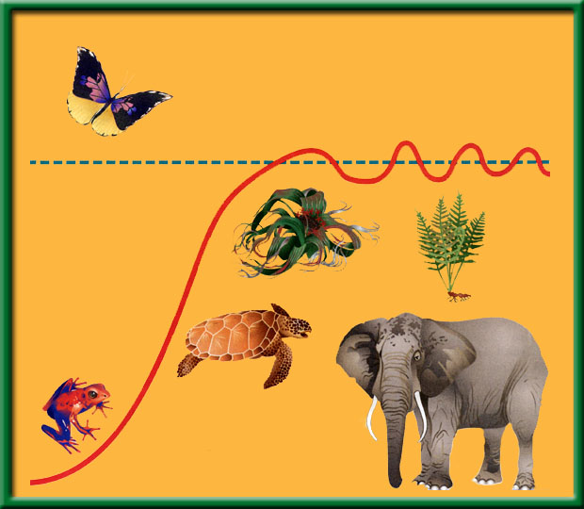
Section 4.1 Summary – pages 91-99
Carrying capacity
Deaths begin to exceed births and the population falls below carrying capacity.
Carrying capacity

Slide 50
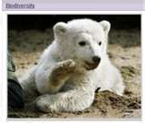
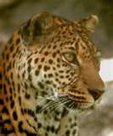
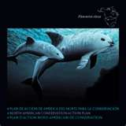
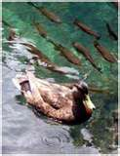
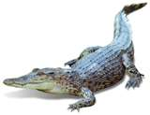
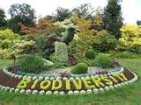
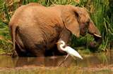
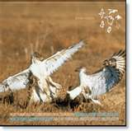
Biological Diversity and Succession 5.1 9/8 Obj. Stds. will know biodiversity is the sum total of different kinds of organisms and is affected by alteration of habitats by completing their warm up. P.38NB
Explain Biodiversity in your own words.
Why is biodiversity important?
Explain the 7 threats to Biodiversity.

Slide 51
Symbiosis – species interactions p.35NB Place a (+) in the species box if that species benefits. Place a (–) in the box if that species is harmed. Place a (O) in the box if that species neither benefits or is harmed.
Symbiotic Relationship | Species 1 | Species 2
Competition
Mutualism
Parasitism
Commensalism

Slide 52
Agriculture & Cycle in Nature Project Present 1 minute about an aspect of your Cycle in Nature & why it is important to Agriculture
Include a diagram/picture.
Show/Explain the processes of the cycle.
Choose one process of your cycle and show how Symbiosis (Competition, Mutualism, Parasitism, and Commensalism) is a part of your cycle.
Demonstrate how Agriculture has been impacted from this cycle or how the cycle in agriculture will impact then Environment.

Slide 53
Ecosystem Activity Get a White Board & Expo Marker Directions: Make Food Chain, a Food Web, and Energy Pyramid and a Title for this Ecosystem
Tree
Squirrel
Fox
Beaver
Mountain Lion
Mouse
Owl
Grasses
Hawk
Grasshopper
Bird

Slide 54
Quiz Answers
2. Possible answer: Grass-> Mouse-> Fox-> Mountain Lion
3. Beaver, Squirrel, Rabbit, Mouse, Grasshopper
4. Mountain Lion, Hawk, Owl, snake
5. Worms, Fungi, Bacteria – anywhere, even grass gets decomposed.
6. Arrows indicate the direction of the flow of energy from what just got eaten to who eat it.

Slide 55
Quiz Answers
7. Table 1 Classifying Organisms in Trophic Levels.
PRODUCERS | PRIMARY CONSUMERS | SECONDARY CONSUMERS | TERTIARY CONSUMERS
TREES | BEAVER | FOX | MOUNTAIN LION
GRASS | SQUIRREL | BIRD | HAWK
 | RABBIT | SNAKE | SNAKE
 | MOUSE | FROG | OWL
 | GRASSHOPPER

Slide 56
Quiz Answers
CONSUMER 3 – MOUNTAIN LION, HAWL, OWL
CONSUMER 2 – FOX, BIRD, SNAKE, FROG
CONSUMER 1 – BEAVER, SQUIRREL, RABBIT, MOUSE, GRASSHOPPER
PRODUCERS – TREES, GRASSES

Slide 57
How Wolves Change Rivers
The need for Keystone Species in ecosystems p.33 NB NOTES

Slide 58
Problem Solving Lab 3.1 P. 33 NB P. 68 BB
1.Line 2 is primary succession because it begins with no species.
Line 1 is Secondary Succession because it has some existing species, also it has a drop from a climax community.
C = Climax Community they exist before a disturbance
D – is Pioneer Species have low species diversity.
3. A sudden, disruptive event such as a fire followed by a community recovery.

Slide 59
Northern California Biomes

Slide 60
Section 5.1 Summary – pages 111-120
Importance to nature
#1. Biodiversity is the variety of life or the different types of species
Living things are interdependent.
Living things can be niches for other living things.
Populations are adapted to live together in communities.

Slide 61
Section 5.1 Summary – pages 111-120
#2. Biodiversity brings stability
Biodiversity can bring stability to an ecosystem.
A pest could easily destroy all the corn in a farmer’s field, but it would be far more difficult for a single type of insect or disease to destroy all individuals of a plant species in a rain forest.
Ecosystems are stable if their biodiversity is maintained.

Slide 62
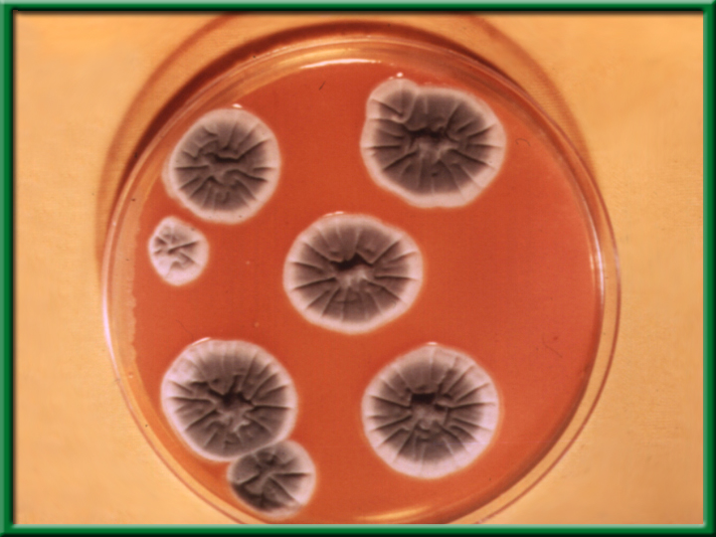
Section 5.1 Summary – pages 111-120
#2. Importance to people
Preserving biodiversity ensures there will be a supply of living things, some of which may provide future drugs.
Penicillium

Slide 63
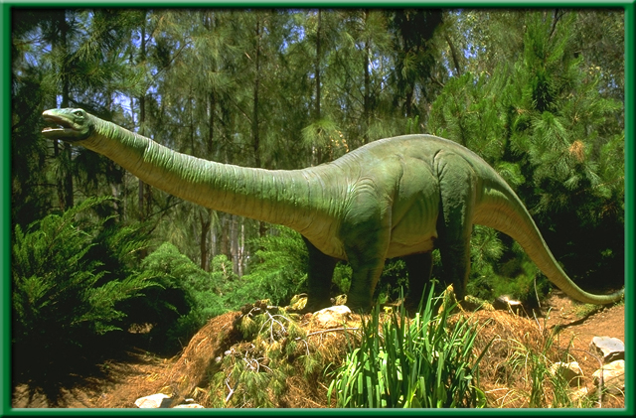
Section 5.1 Summary – pages 111-120
Loss of Biodiversity
Extinction is the disappearance of a species when the last of its members dies.
Extinction is a natural process and Earth has experienced several mass extinctions during its history.

Slide 64
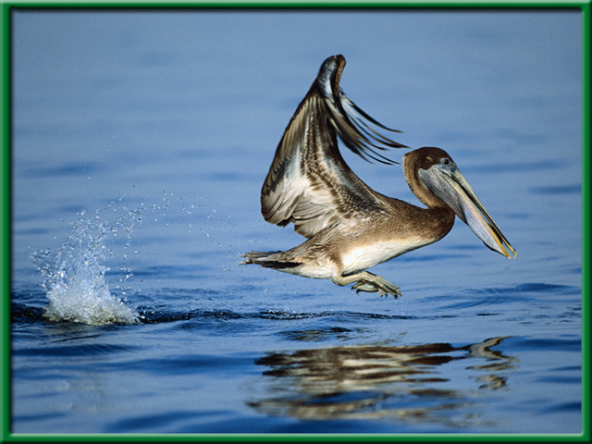
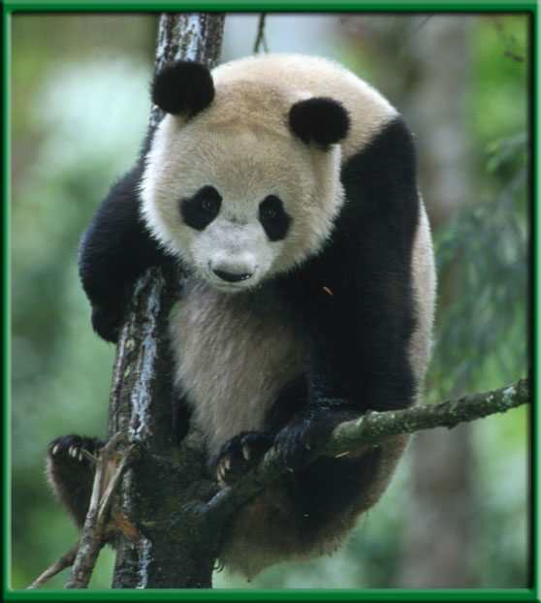
Section 5.1 Summary – pages 111-120
Loss of Biodiversity
A species is considered to be an endangered species when its numbers become so low that extinction is possible.

Slide 65
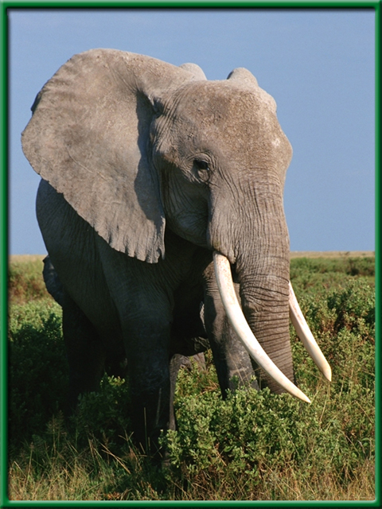
Section 5.1 Summary – pages 111-120
Loss of Biodiversity
When the population of a species is likely to become endangered, it is said to be a threatened species.

Slide 66
Cycles of Nature Posters
1 – 3 people may work on the Poster
Draw the Carbon, Water or Nitrogen Cycle
Answer the following questions for your poster.
How does Carbon, Water or Nitrogen return to the Biotic parts of the Ecosystem?
The burning (CO2), evaporation (H2O)or leaching (N2) of each of these returns them where?

Slide 67
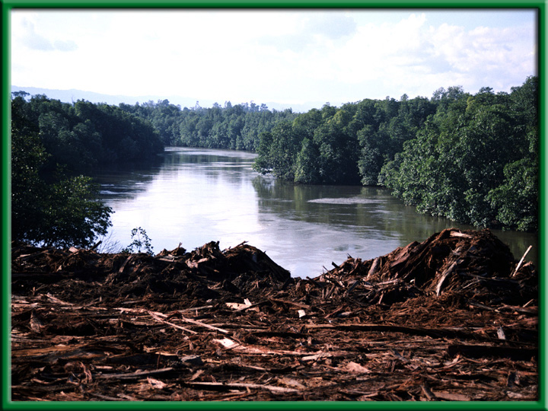
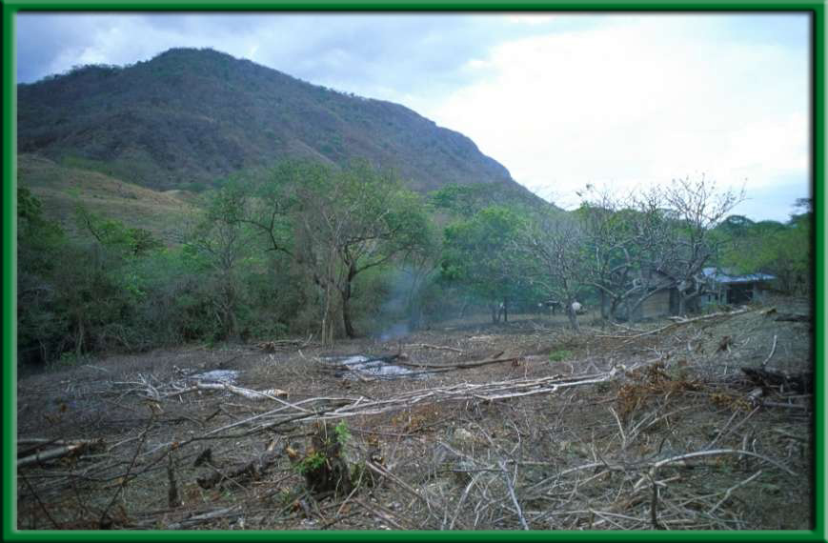
Section 5.1 Summary – pages 111-120
#3. Habitat loss
One of the biggest reasons for decline in biodiversity is habitat loss.

Slide 68
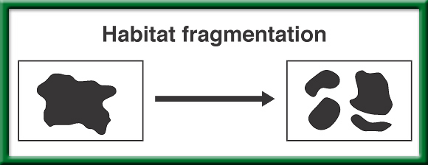
#3. Habitat
Fragmentation
To return to the chapter summary click escape or close this document.

Slide 69
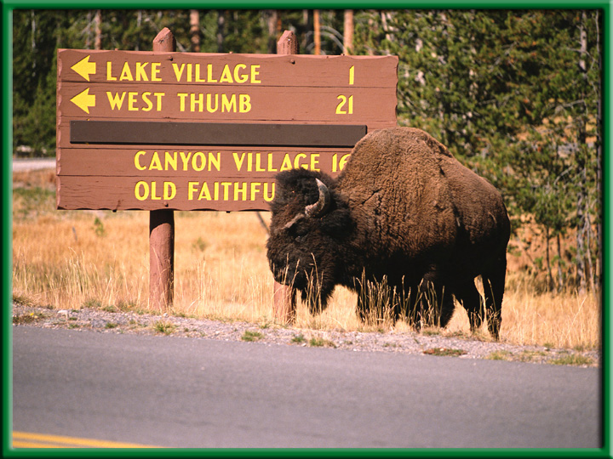
Section 5.1 Summary – pages 111-120
Habitat fragmentation
Habitat fragmentation is the separation of wilderness areas from other wilderness areas.

Slide 70
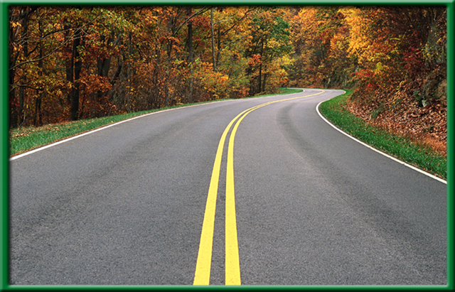
Section 5.1 Summary – pages 111-120
Edge and size
The edge of a habitat or ecosystem is where one habitat or ecosystem meets another.

Slide 71
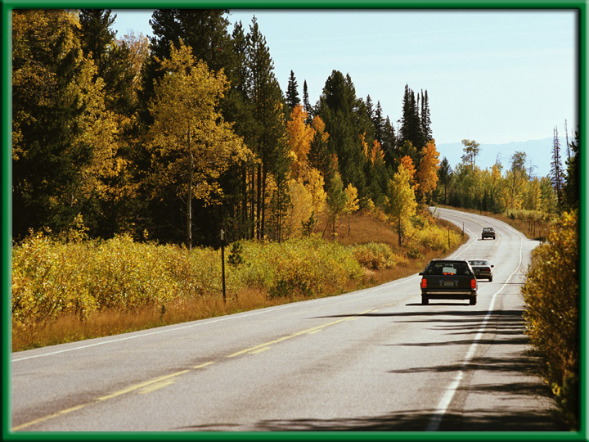
Section 5.1 Summary – pages 111-120
Edge and size
If a road is cut through a wooded area, the shape of the wooded area changes and the edge is changed.
Now there is less distance between the edge and the interior. Some plants might die out.

Slide 72
Section 5.1 Summary – pages 111-120
Habitat degradation
Another threat to biodiversity is habitat degradation, the damage to a habitat by pollution.
Three types of pollution are air, water, and land pollution.

Slide 73
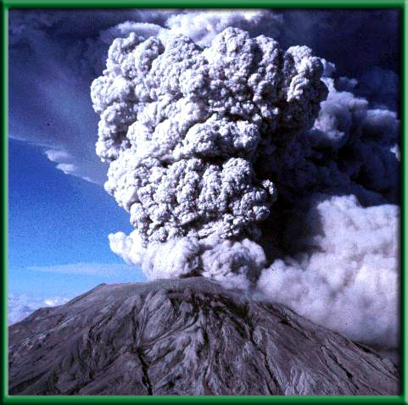
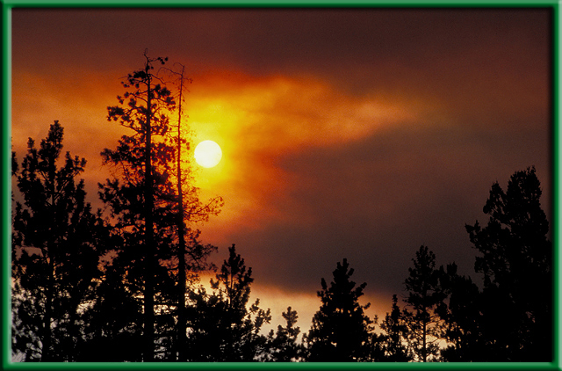
Section 5.1 Summary – pages 111-120
#3. Habitat degradation
Pollutants enter the atmosphere in many ways—including volcanic eruptions and forest fires.

Slide 74
Section 5.1 Summary – pages 111-120
Habitat degradation
Burning fossil fuels is also a major source of air pollutants such as sulfur dioxide.
Acid precipitation—rain, snow, sleet, and fog with low pH values—has been linked to the deterioration of some forests and lakes.

Slide 75
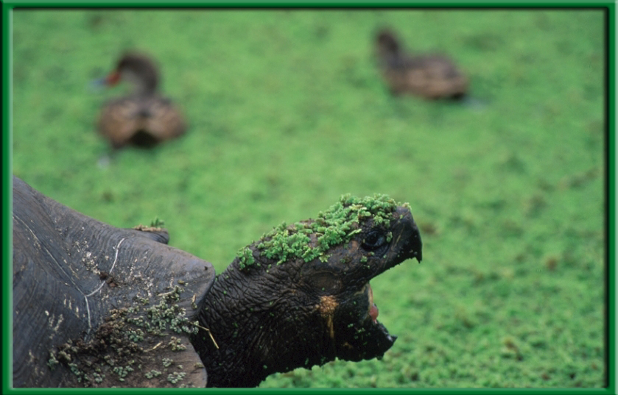
Section 5.1 Summary – pages 111-120
Water pollution
Water pollution degrades aquatic habitats in streams, rivers, lakes, and oceans.
A variety of pollutants can affect aquatic life.

Slide 76
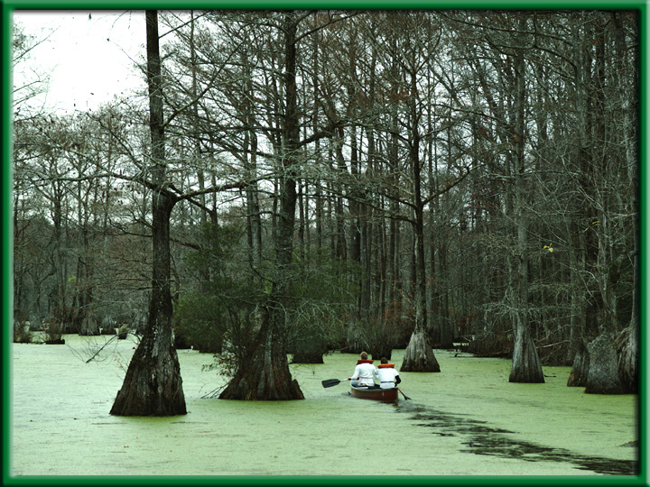
Section 5.1 Summary – pages 111-120
Water pollution
Excess fertilizers and animal wastes are often carried by rain into streams and lakes.
The sudden availability of nutrients causes algal blooms, the excessive growth of algae.

Slide 77
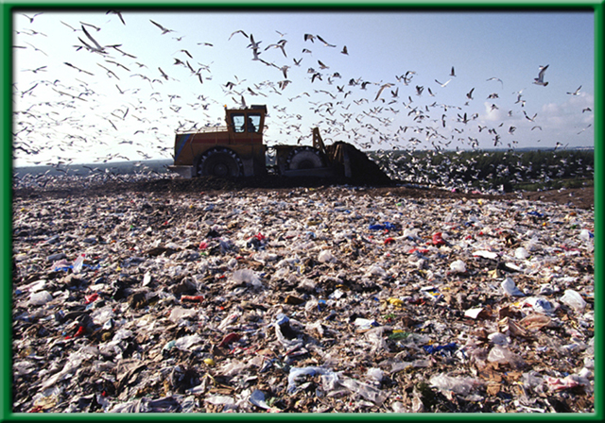
Section 5.1 Summary – pages 111-120
Land pollution
Trash, or solid waste, is made up of the cans, bottles, paper, plastic, metals, dirt, and spoiled food that people throw away every day.

Slide 78
Section 5.2 Summary – pages 121-125
Habitat corridors
A general strategy for protecting the biodiversity of an area probably is to protect the largest area possible.
However, research is showing that keeping wildlife populations completely separate from one another may be resulting in inbreeding within populations.

Slide 79
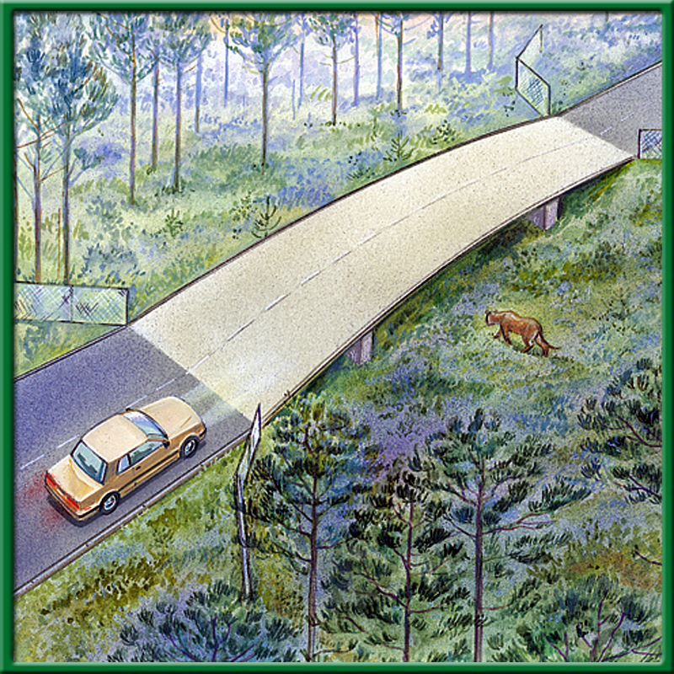
Section 5.2 Summary – pages 121-125
Habitat corridors
Therefore, another strategy for preserving biodiversity is to connect protected areas with habitat corridors.

Slide 80
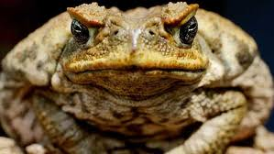
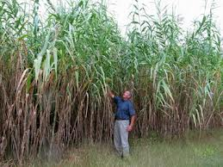
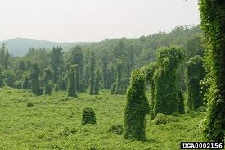
#3. Invasive species
Species that do not belong, and take over, crowding out or out competing the native species.

Slide 81
#3. Global Warming – Climate Change
Rise in CO2 concentration
Increase melting of Polar ice caps
Increase average temperature of ocean
Increase in severe weather events

Slide 82
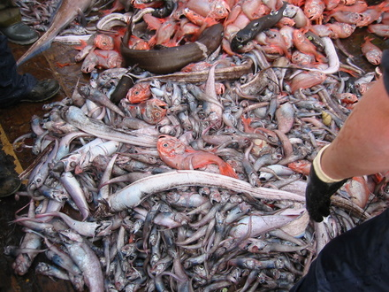
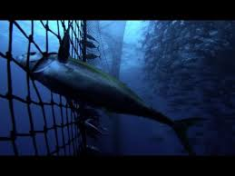
#3. Overharvesting of Resources

Slide 83
CH 4 Population Biology Critical Thinking – the Effect of Predators on Prey Populations p.37NB
a. The number of deer increased from about 7000 to about 100,000.
b. With fewer predators, more young deer survived to become breeding adults. The lack of predators may have make it possible for older and less fit deer to survive longer.
a. From 100,000 to 40,000, or 60%
b. From 100,000 to 20,000, or 80%
c. From 100,000 to 10,000, or 90%

Slide 84
CH 4 Population Biology Critical Thinking – the Effect of Predators on Prey Populations
Predators no longer kept the deer population within the carrying capacity of the land. By the early 1920’s, most of the food available in the area had been consumed, so many deer starved.
The rapidly increasing deer population had consumed most of the food supply. As a result, the land’s carrying capacity was reduced.

Slide 85
Communities vs Populations
*community→ collection of several interacting populations that inhabit a common environment
*population→ group of organisms all of the same species which interbreed and live in the same place at the same time

Slide 86
Limiting Factors
*any biotic or abiotic factor that restricts the existence, numbers, reproduction, or distribution of organisms
*Ex. Sunlight, climate, temperature, water, nutrients/food, fire, soil chemistry, space, other organisms

Slide 87
9/8 Global Warming CH 5 Obj. TSW have a greater understanding of what global warming is and it’s possible effects on us through a class discussion on solutions. P. 38 NB
What is Global Warming?
How does the Carbon Cycle play a role (if any) in Global Warming.
Explain the Greenhouse Effect
Page 128 in Biology Book

Slide 88
Global Warming
Global Warming is the gradual increase in temperature for the planet, due to an increase in CO₂.
The carbon cycle plays a role in taking CO₂ into plants in the process of photosynthesis. However, if there is deforestation, then there is not the availability of plants (trees) to take in CO₂ and it stays in the atmosphere.
The greenhouse effect is how the gas CO₂ traps solar radiation at the lower atmosphere and reradiates it back to the surface, warming the planet in general. However, we see radical severe events in weather instead of just a gradual increase.

Slide 89
The Greenhouse Effect on Natural Systems p. 39 NB
Get into groups of four.
Get a White Board, Expo Marker & Eraser
Read the assigned article and take notes on the board to present to the class.
Students will take notes on page 79 NB
Group 1 - Climate Change in the Golden State Page 2 - 4
Group 2 – Climate Change in the Golden State Page 4 - 6
Group 3 – Water Vapor: A GHG p.7-8
Group 4 – Carbon Dioxide: A GHG p. 9-10
Group 5 – Methane: A GHG p. 11-12
Group 6 – Nitrous Oxide: A GHG p. 13 - 14
Group 7 – What Can Ice Tell Us About the Past Climate? P.15
Group 8 – California’s Global Warming Solutions of 2006 p.16 - 20

Slide 90
Climate Change in the Golden State
Measured temperature wind patterns
Greenhouse gases impact the climate
Earth’s Climate system: Biosphere, Atmosphere, Geosphere, Hydrosphere
Natural
Sierra snowpack is melting earlier
More Air pollution & health effects
Record warmer temperatures
Evidence - Ice ages & Warming, Fossil Record

Slide 91
Water Vapor – A GHG
Water has a bigger influence on Earth’s climate than any other greenhouse gas.
Sources: Evaporation from water sources.
Sinks: Oceans, Ice sheets, claciers, Aquifers, Soil

Slide 92
Carbon Dioxide – a GHG
Soils, Forests and Ocean are sinks for Carbon dioxide.
Sources: Respiration, Forest Fires, Volcanoes, Decomposition, Fossil Fuels
Sinks: Fossil Fuel Deposits, Oceans, Forests, Wetlands, Photosynthesis

Slide 93
Methane – a GHG
Sources: Atmospheric, Produced by cattle, Released during decomposition
Landfill release Methane, we use it for energy
Fossil fuel, stored in the Earth for millions of years
Sinks: Permafrost peat bogs, wetlands, soils

Slide 94
Nitrous Oxide: A GHG
Sources: Atmosphere, Nitrogen based fertilizer, Soil management – Denitrification by Bacteria, decomposition
300 x greater “global warming potential that CO2”
Sink: Photolytic reactions in the stratosphere

Slide 95
CA Global Warming Solutions Act of 2006
Greenhouse gases increasing in the atm.
Increase in .5 Degrees C in one century.
1990’s was the hottest decade in a thousand years.

Slide 96
Footprint network
Video – Global Warming
How many earth’s does it take to support your lifestyle? P 79 NB
Record the number and give to Mrs. McAllister.
Concept map – CH 5 slide 231
Work on study guide.
Foldable – biodiversity.
Classtime – work on project?
Mt. St. Helen’s Video slide 41

Slide 97
The Greenhouse Effect on Natural Systems p. 79 NB
Consider how climate has changed in the past and the fact that climate is continuing to change. How could life be different in the future? What are some of the issues people need to consider when examining climate change?
Use the article you just read and the Graph of the Greenhouse Effect to answer your question.
Here is a picture of America’s
Largest Aquifer – underground
Body of water.

