Slide 1
Ag Biology
Week 2 Jan 23rd – 27th
FFA, Biology – Level of Org. & Scientific Method, SAE

Slide 2
Yolo County Fair
August 17 – 19th, 2016
Woodland FFA
May & June Fairs also – See flyer!

Slide 3
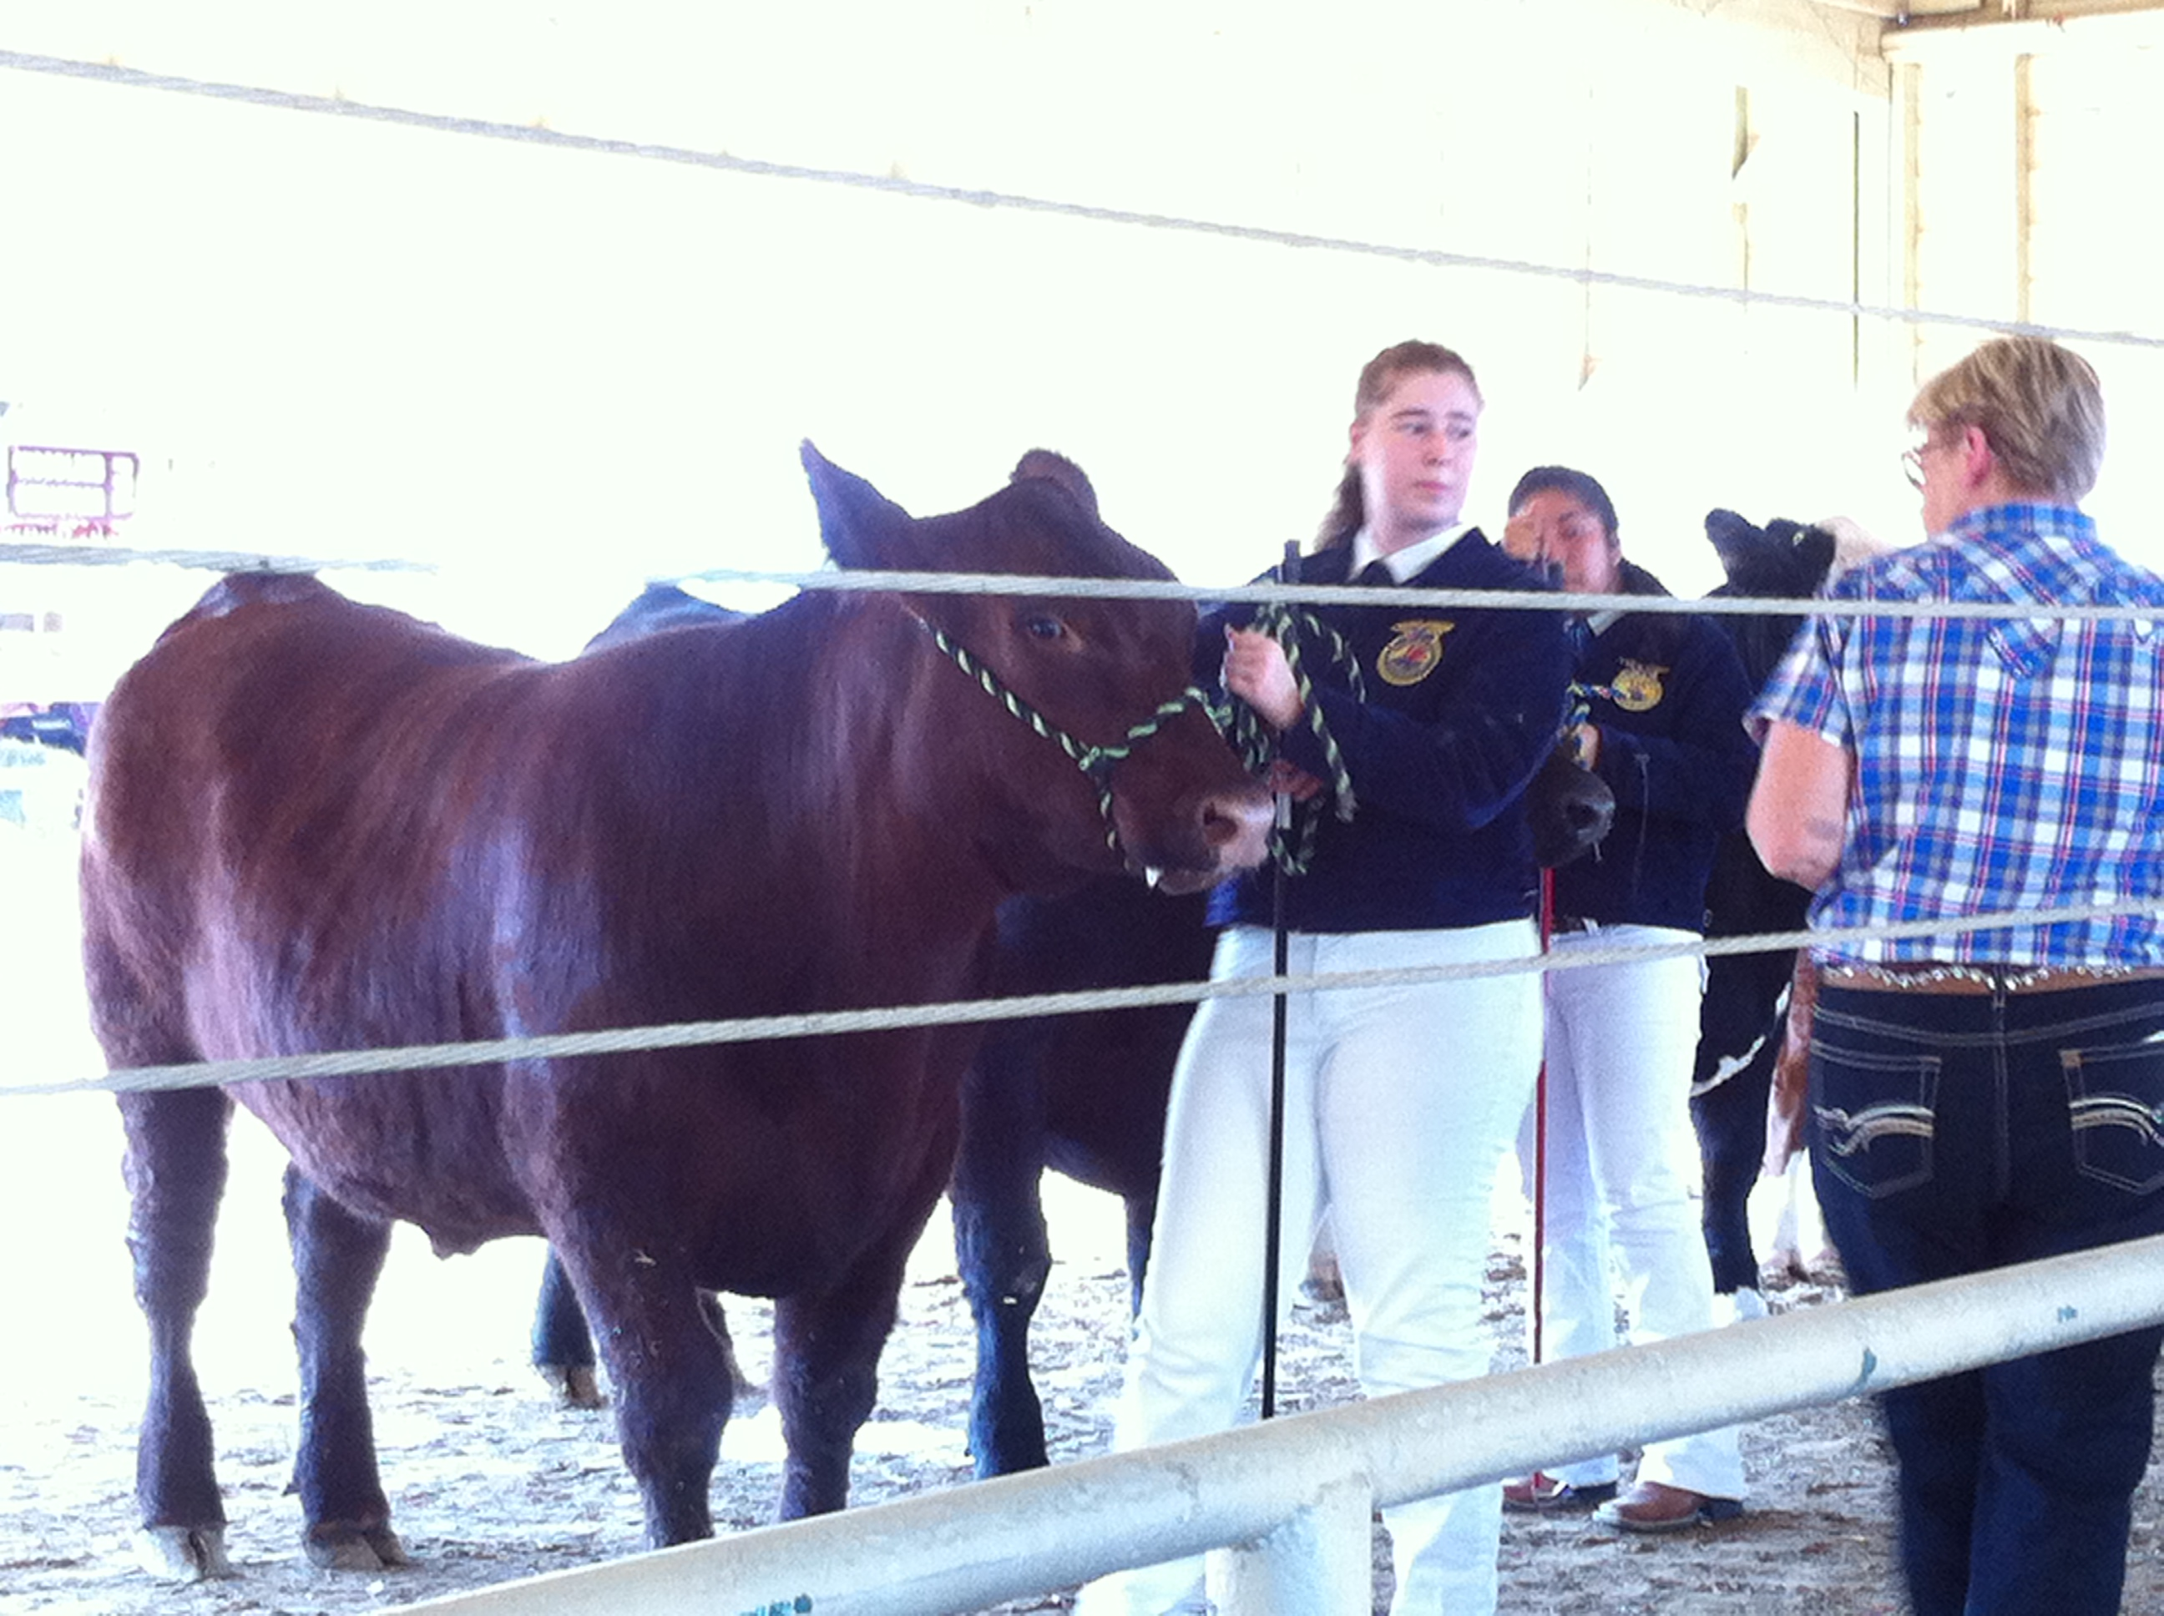
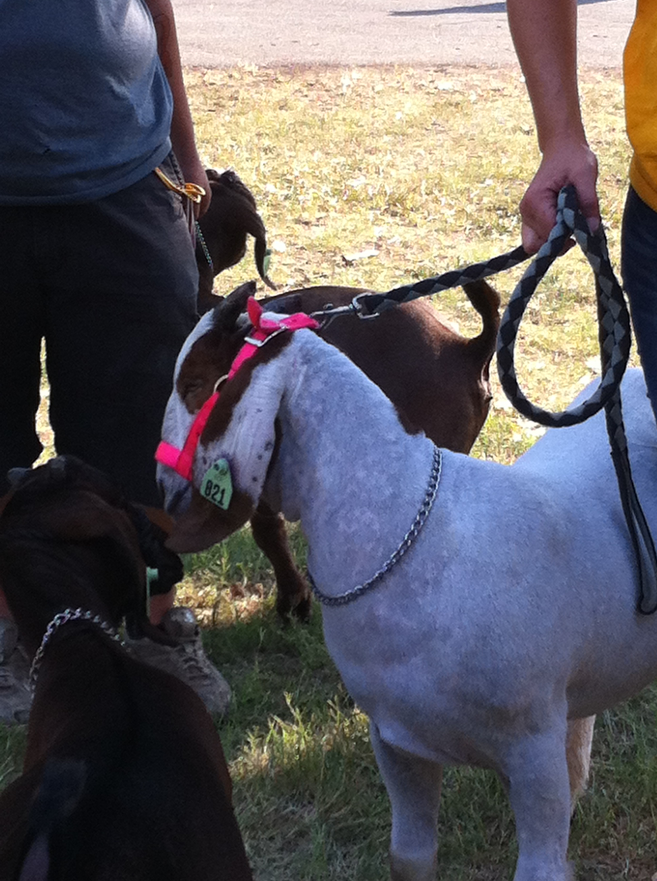
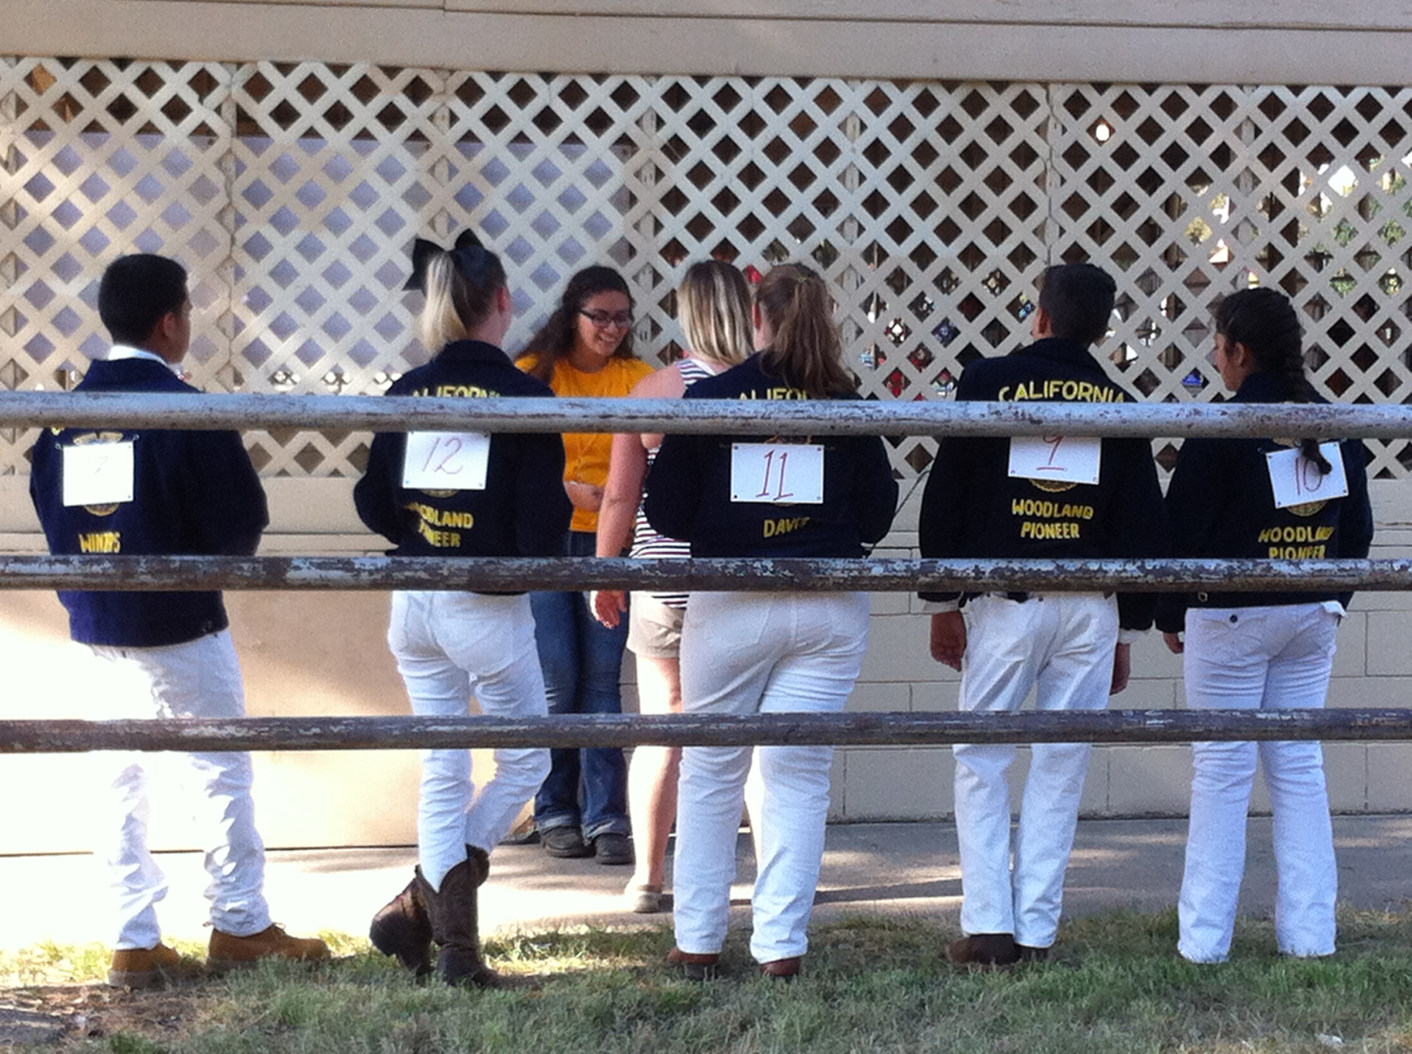
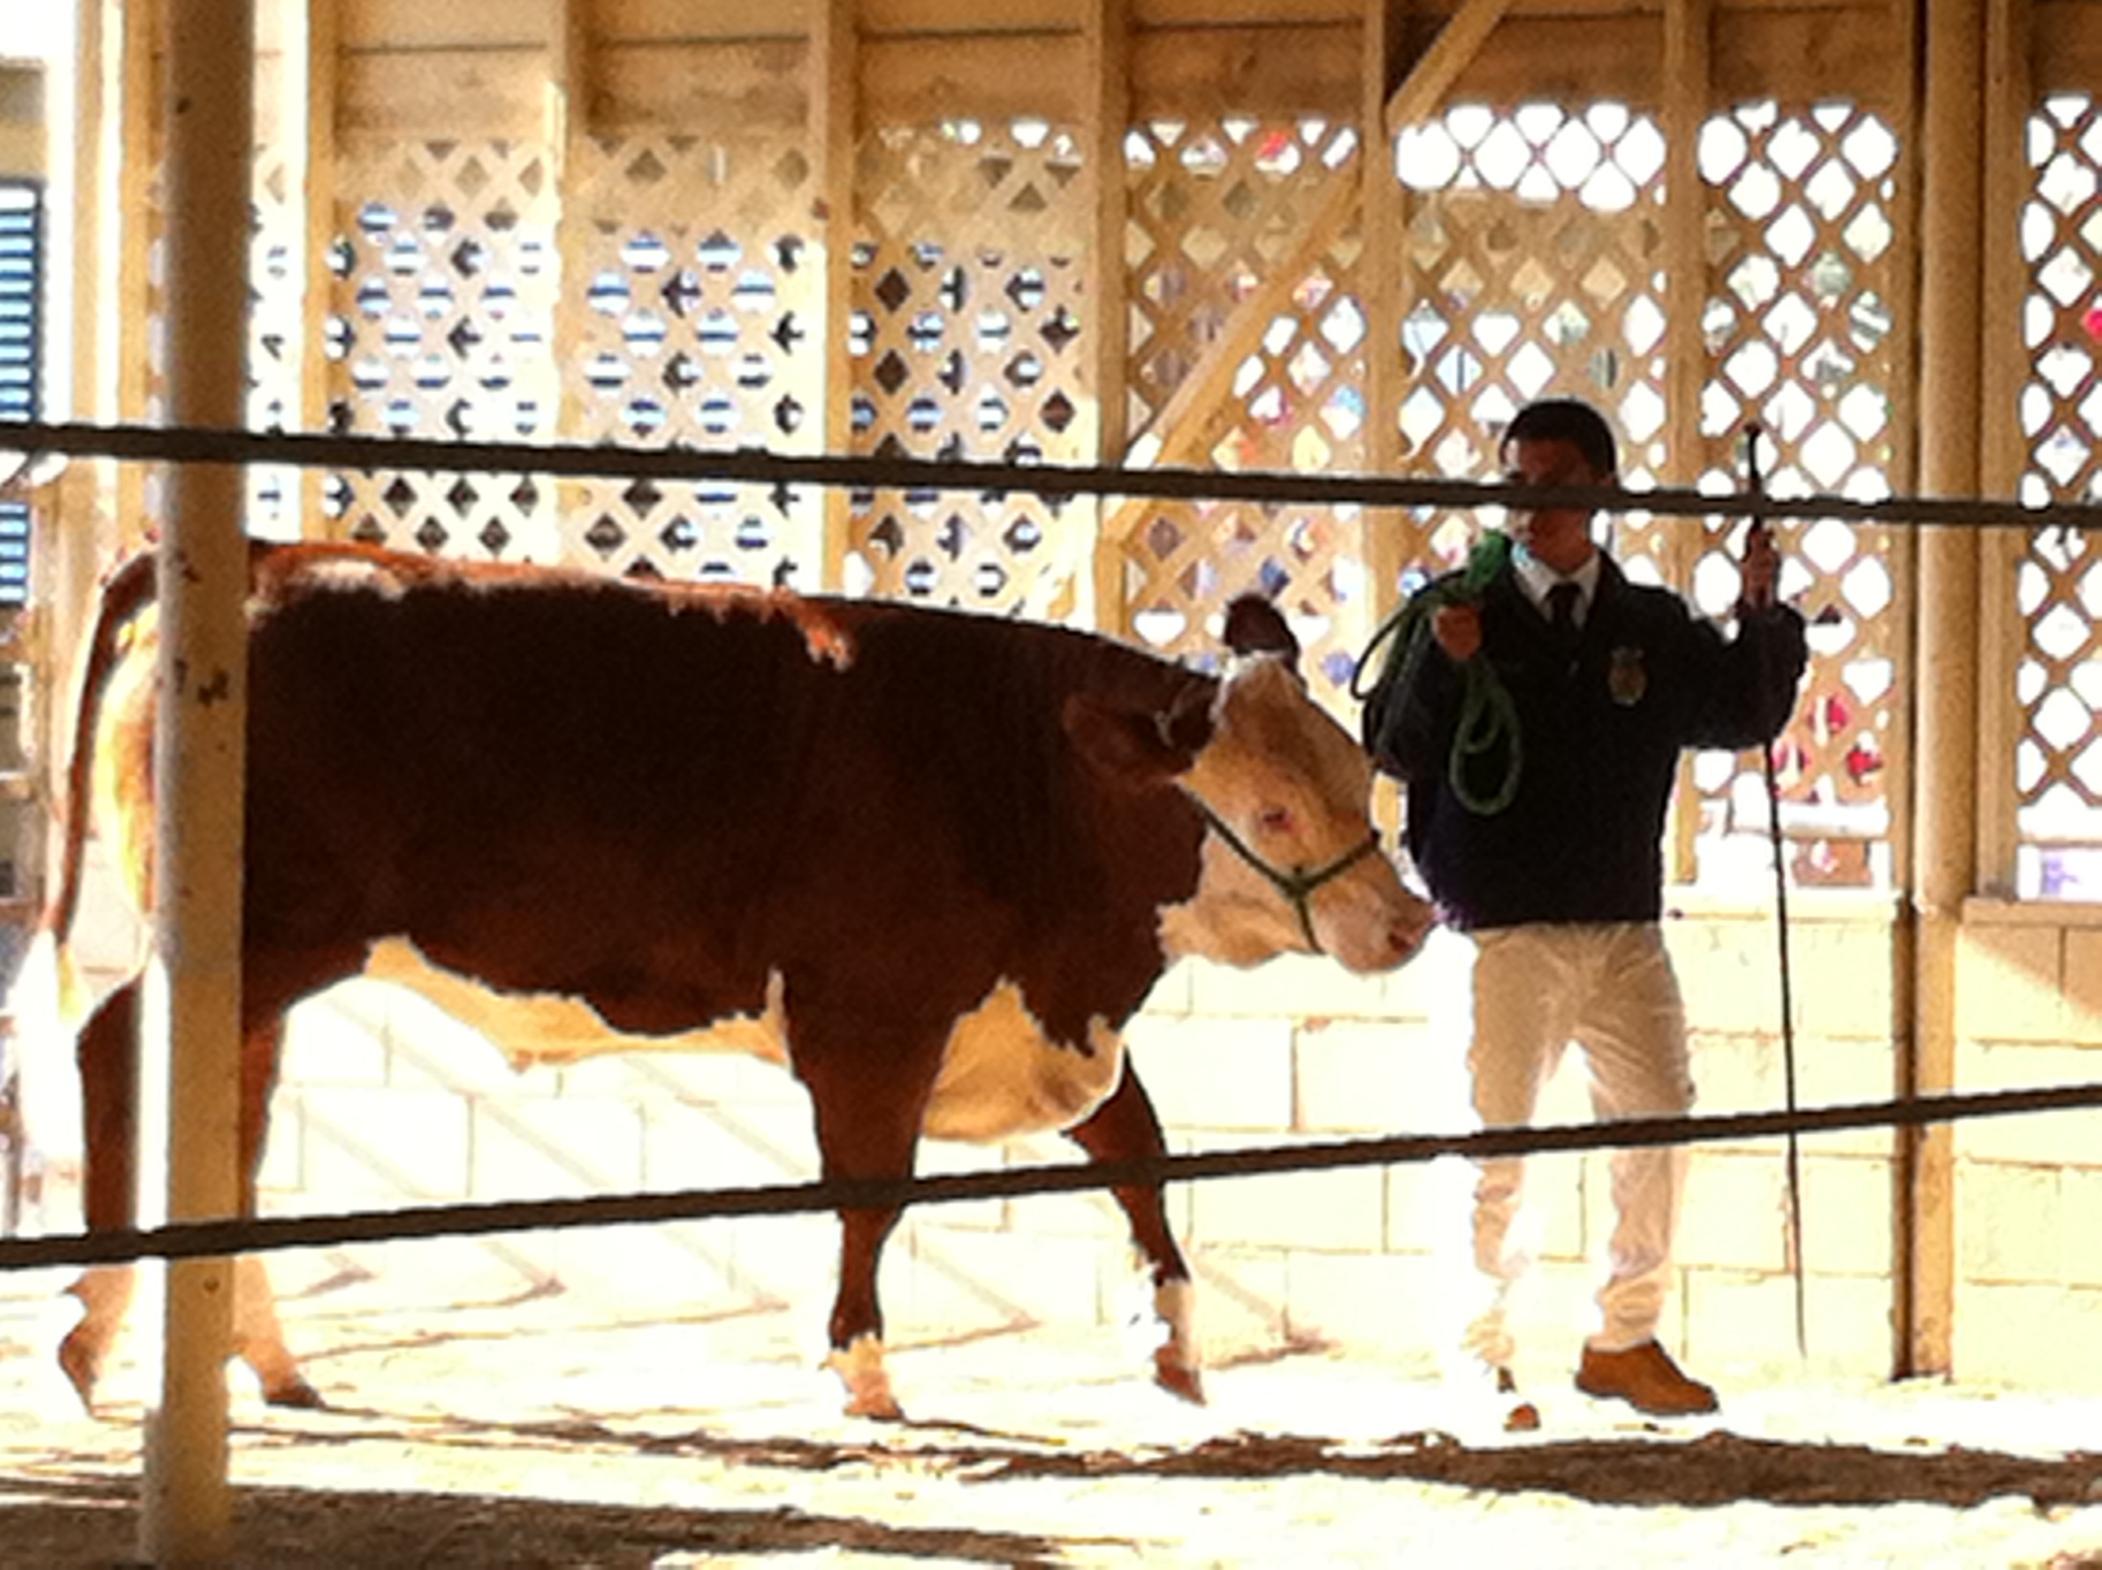
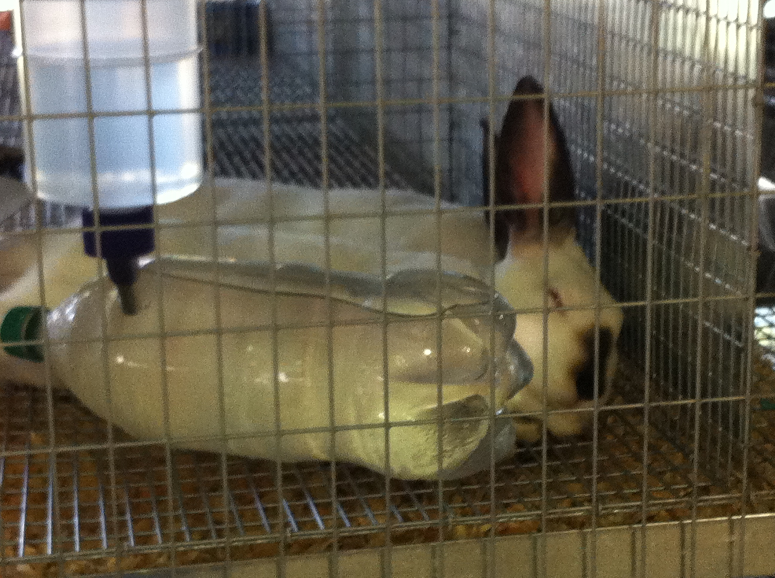
Yolo County Fair

Slide 4
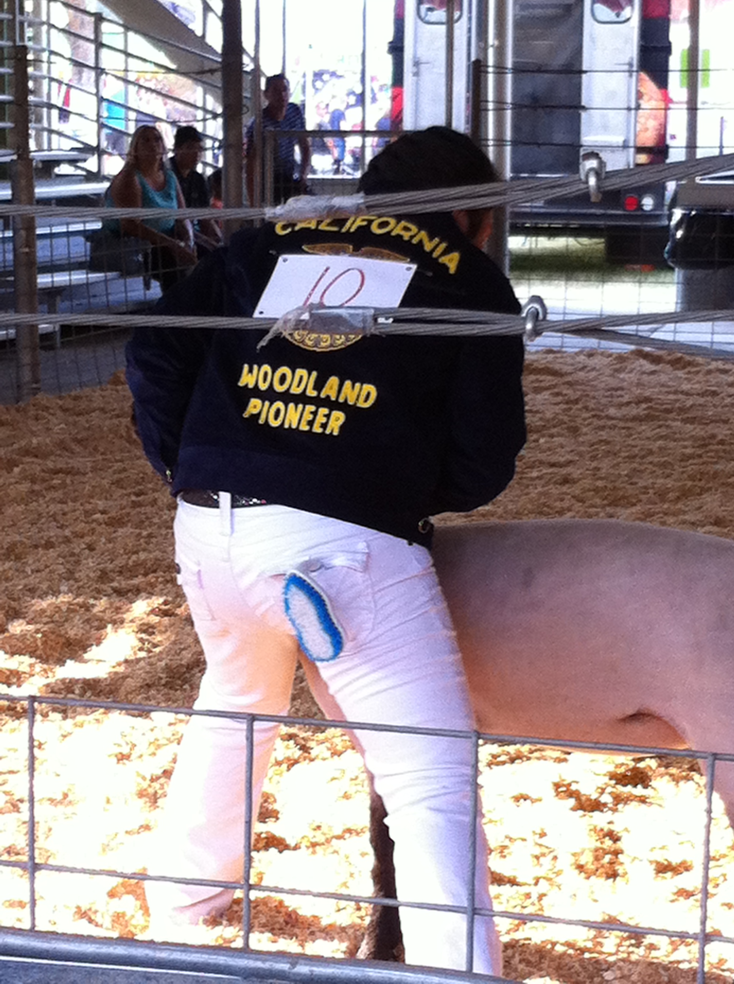
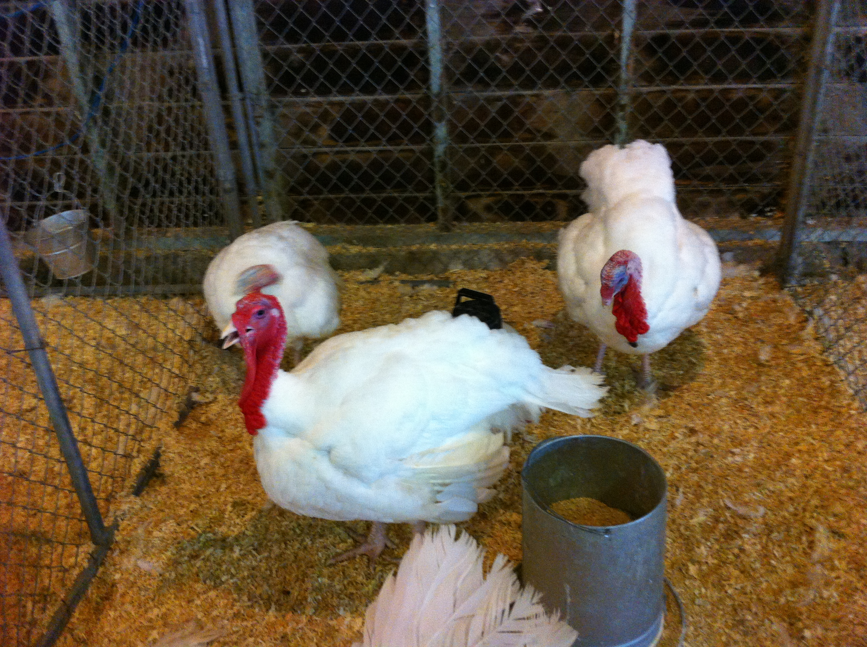
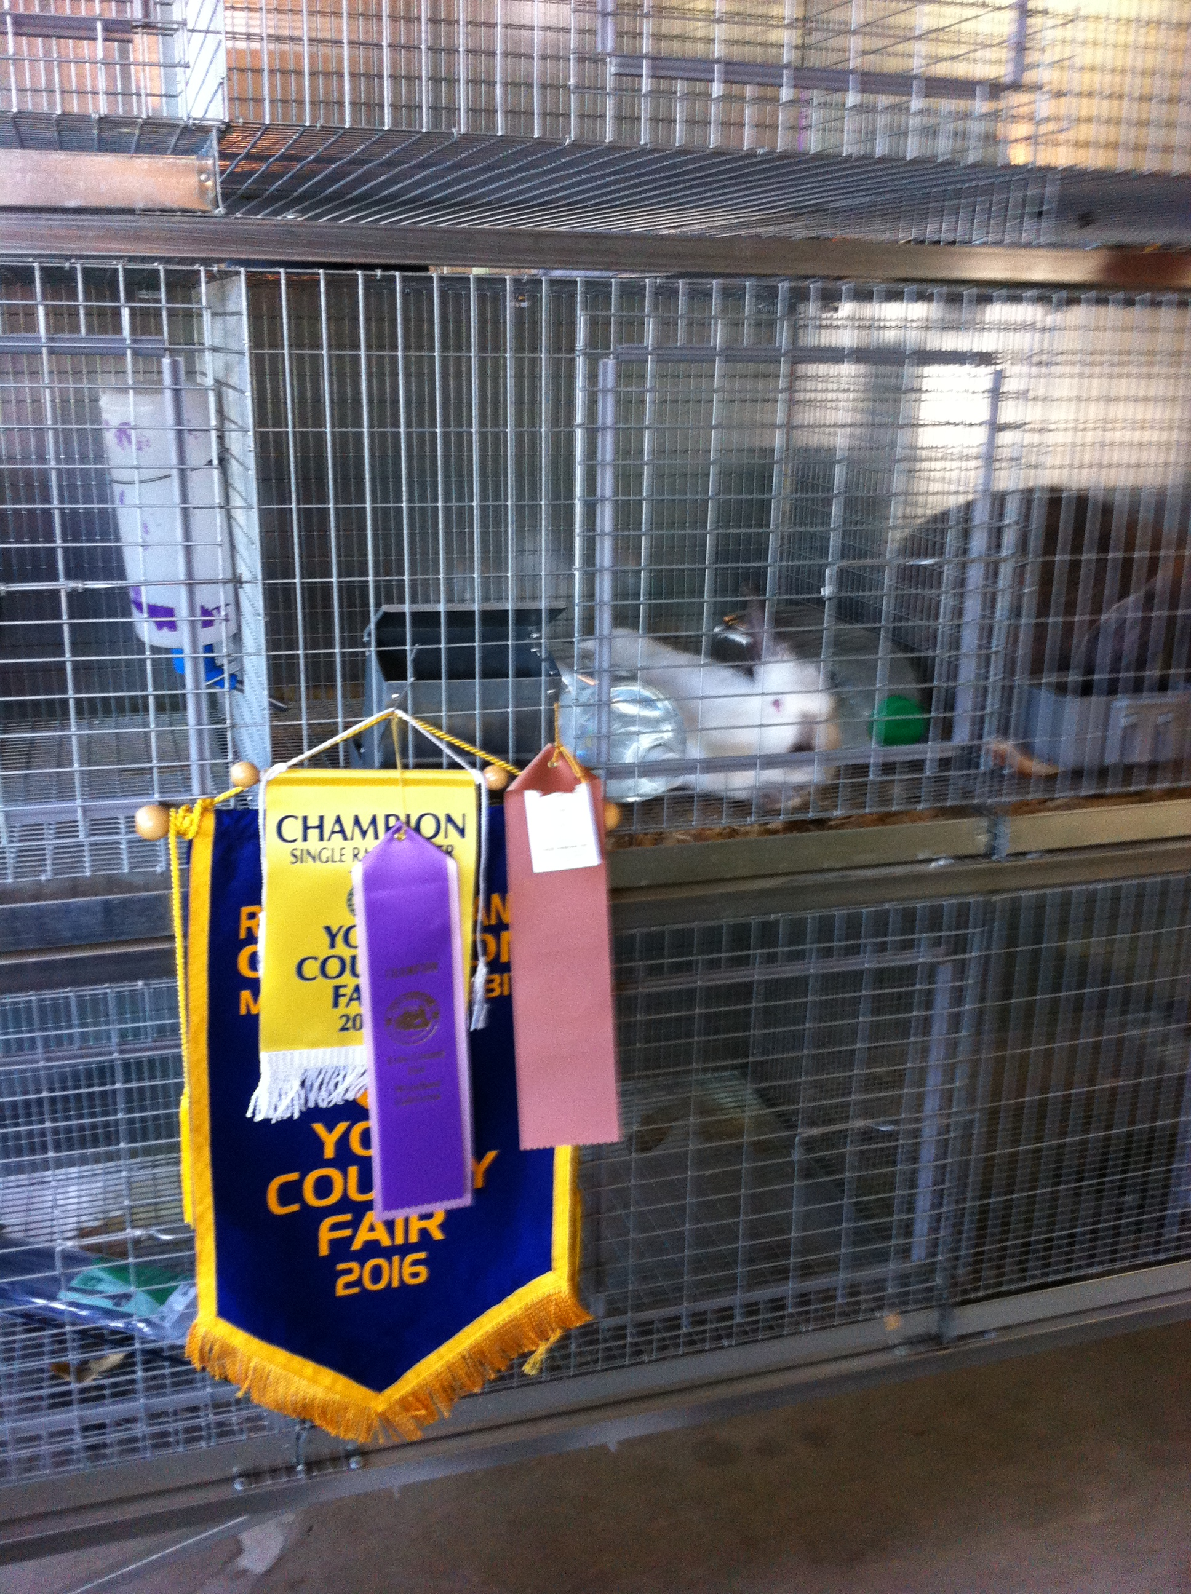
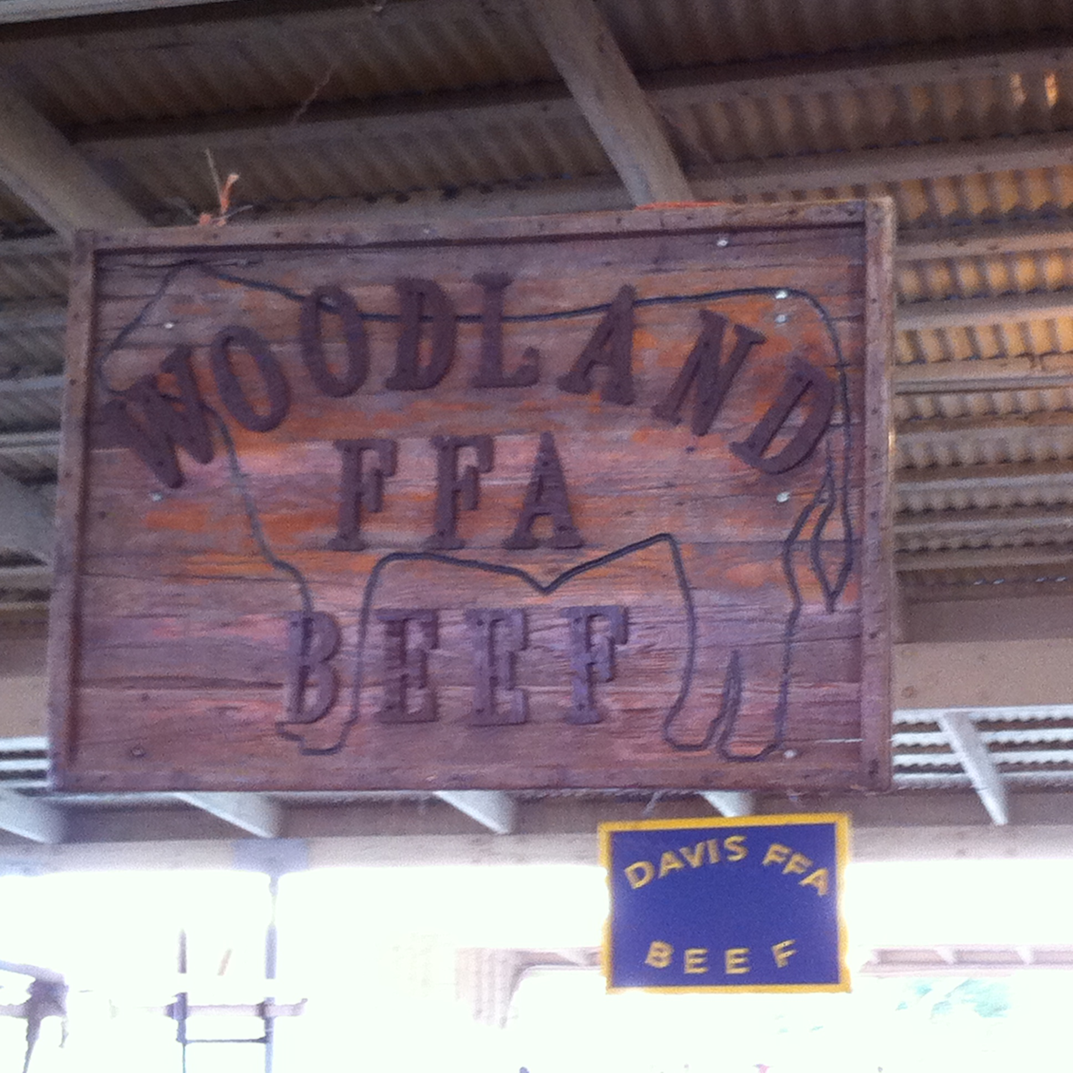
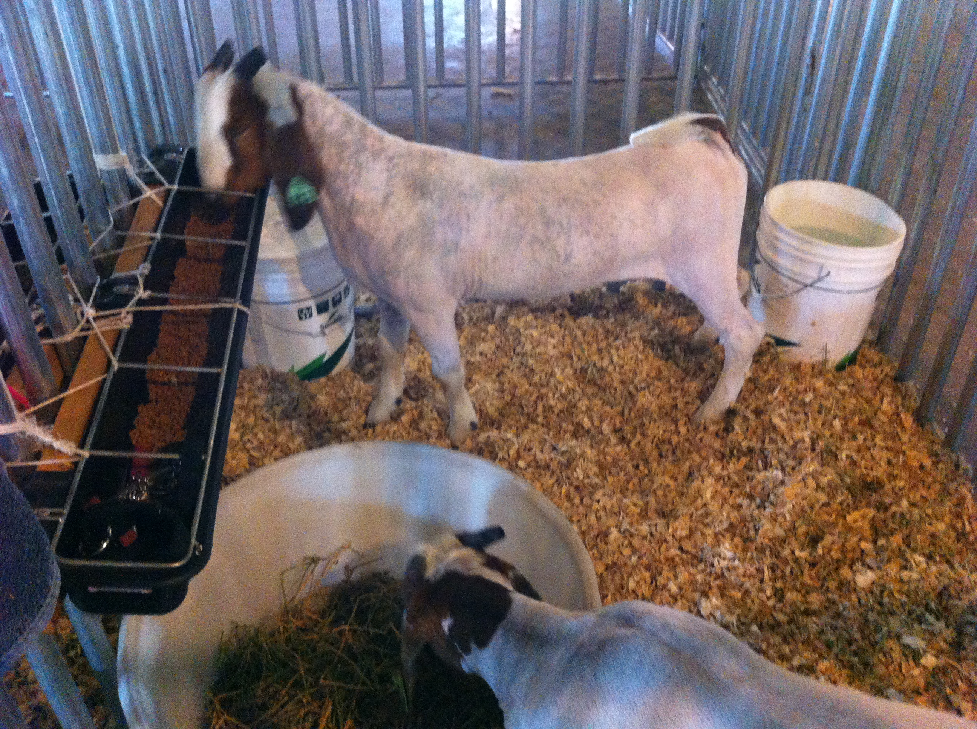
Yolo County Fair

Slide 5
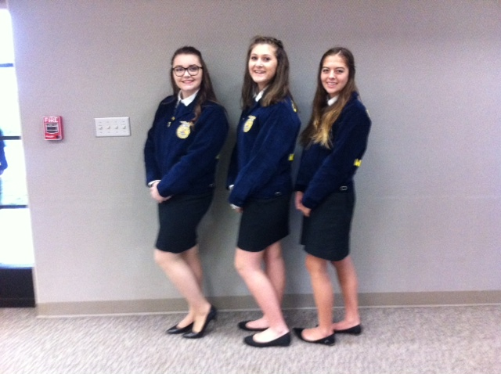
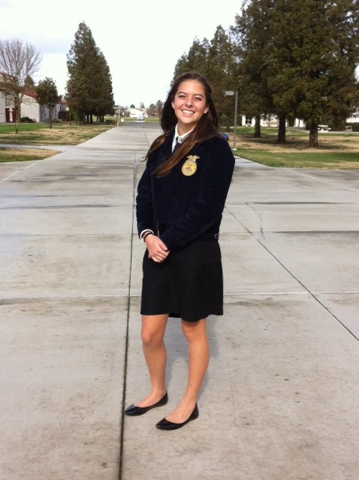
FFA Yolo Sectional Public Speaking Contest

Slide 6
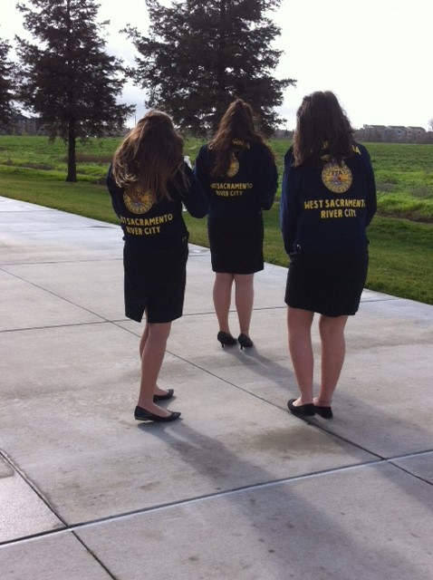
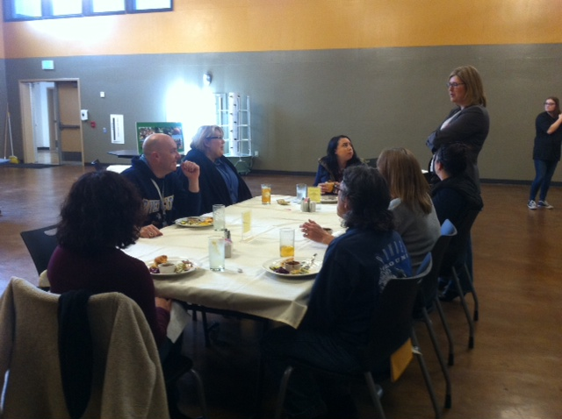
Proud of my Culinary Arts and FFA students!
Great Pulled Pork sandwiches.

Slide 7
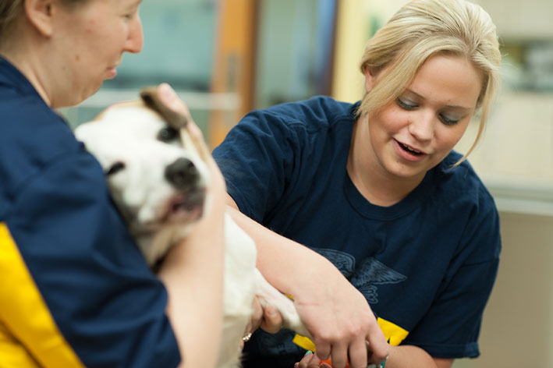
1/23 Supervised Agricultural Experience (SAE)
Obj. TSW familiarize themselves with the different types of SAE’s. P. 12 NB
Using the website FFA.org, What are the six different types of SAE’s?
Which one are you most interested in? Why?
What other questions do you still have about SAE’s?

Slide 8
Cache Creek Tour of our Facility Tomorrow
They are here to look at culinary and hospitality for future employment. 1 – 2 pm tomorrow.
When did the school open up?
How many teachers work here?
What are the plans for the future?
How are the students involved in their education?
Why do students like Bryte?
Explain FFA, & SAE.
Samantha & 1 + student give tour of “Ag” part of the CAFFE

Slide 9
Tour the Garden
Develop talking points with people.
Never make up information or guess. It’s OK to say “I don’t know, but I will find you the answer.”
Always be polite, friendly and helpful. Listening is an important part to any conversation.
Emphase what we are about, “healthy food, knowing where our food comes from, and how it is grown.”
Heart Disease, Diabetes, and Obesity are the three chronic diseases directly linked to food, and how it is consumed.
7 out of 10 America deaths are from chronic diseases - “US Centers for Diseases Control and Prevention.”

Slide 10
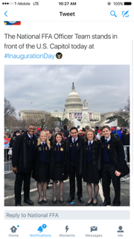

Slide 11
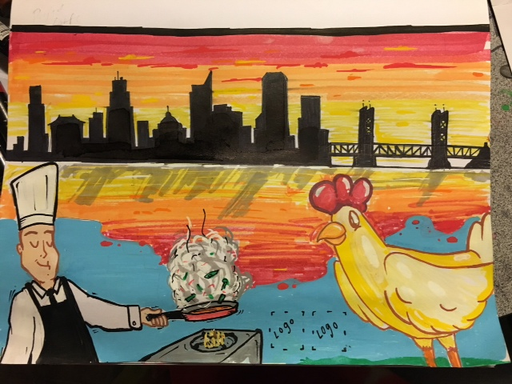
Artist #1 so far…
Last night at the FFA meeting, it was agreed that we also have the CAFFE logo added to the mural.

Slide 12


Slide 13
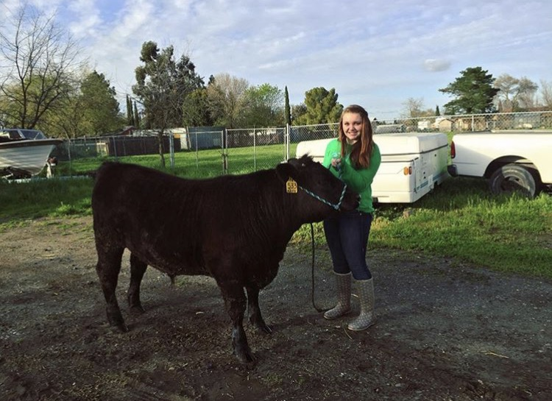

Slide 14
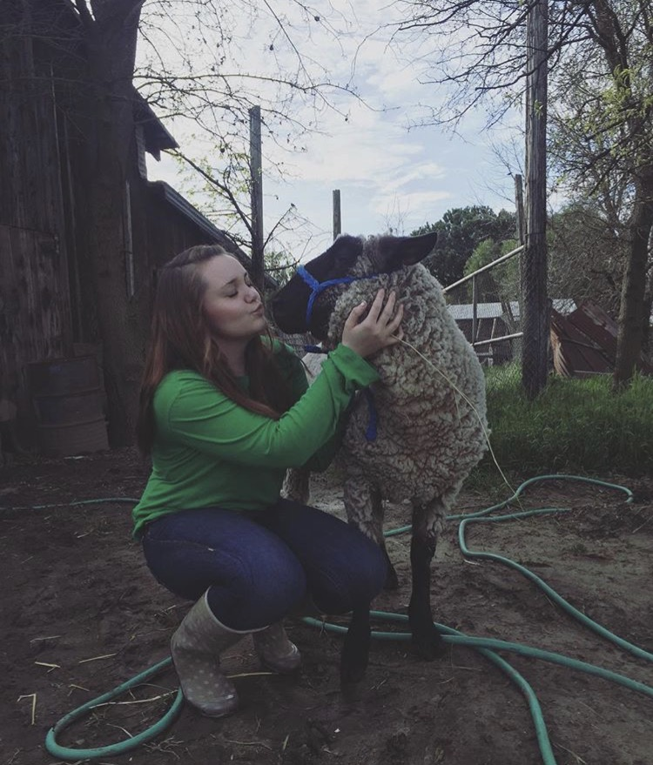

Slide 15
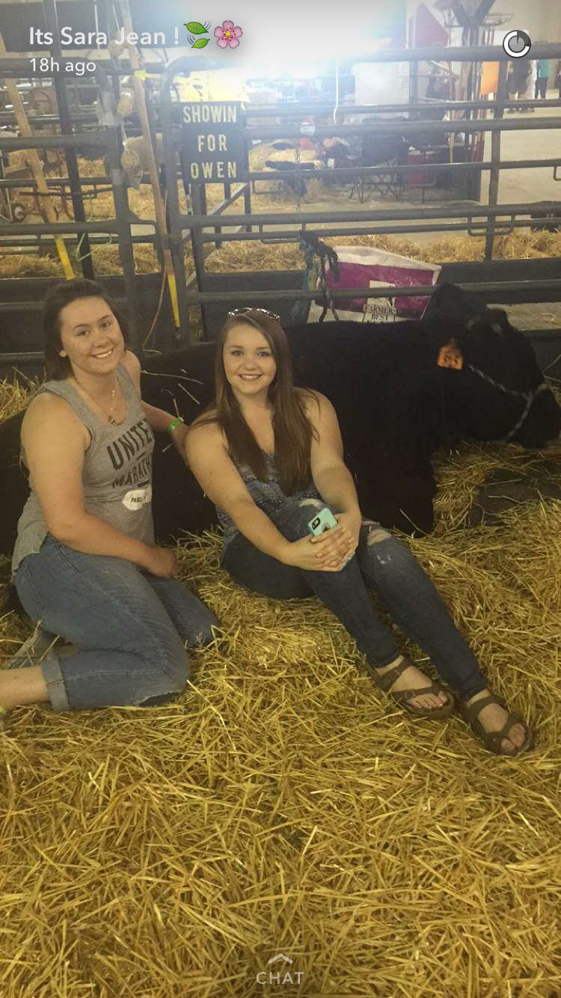
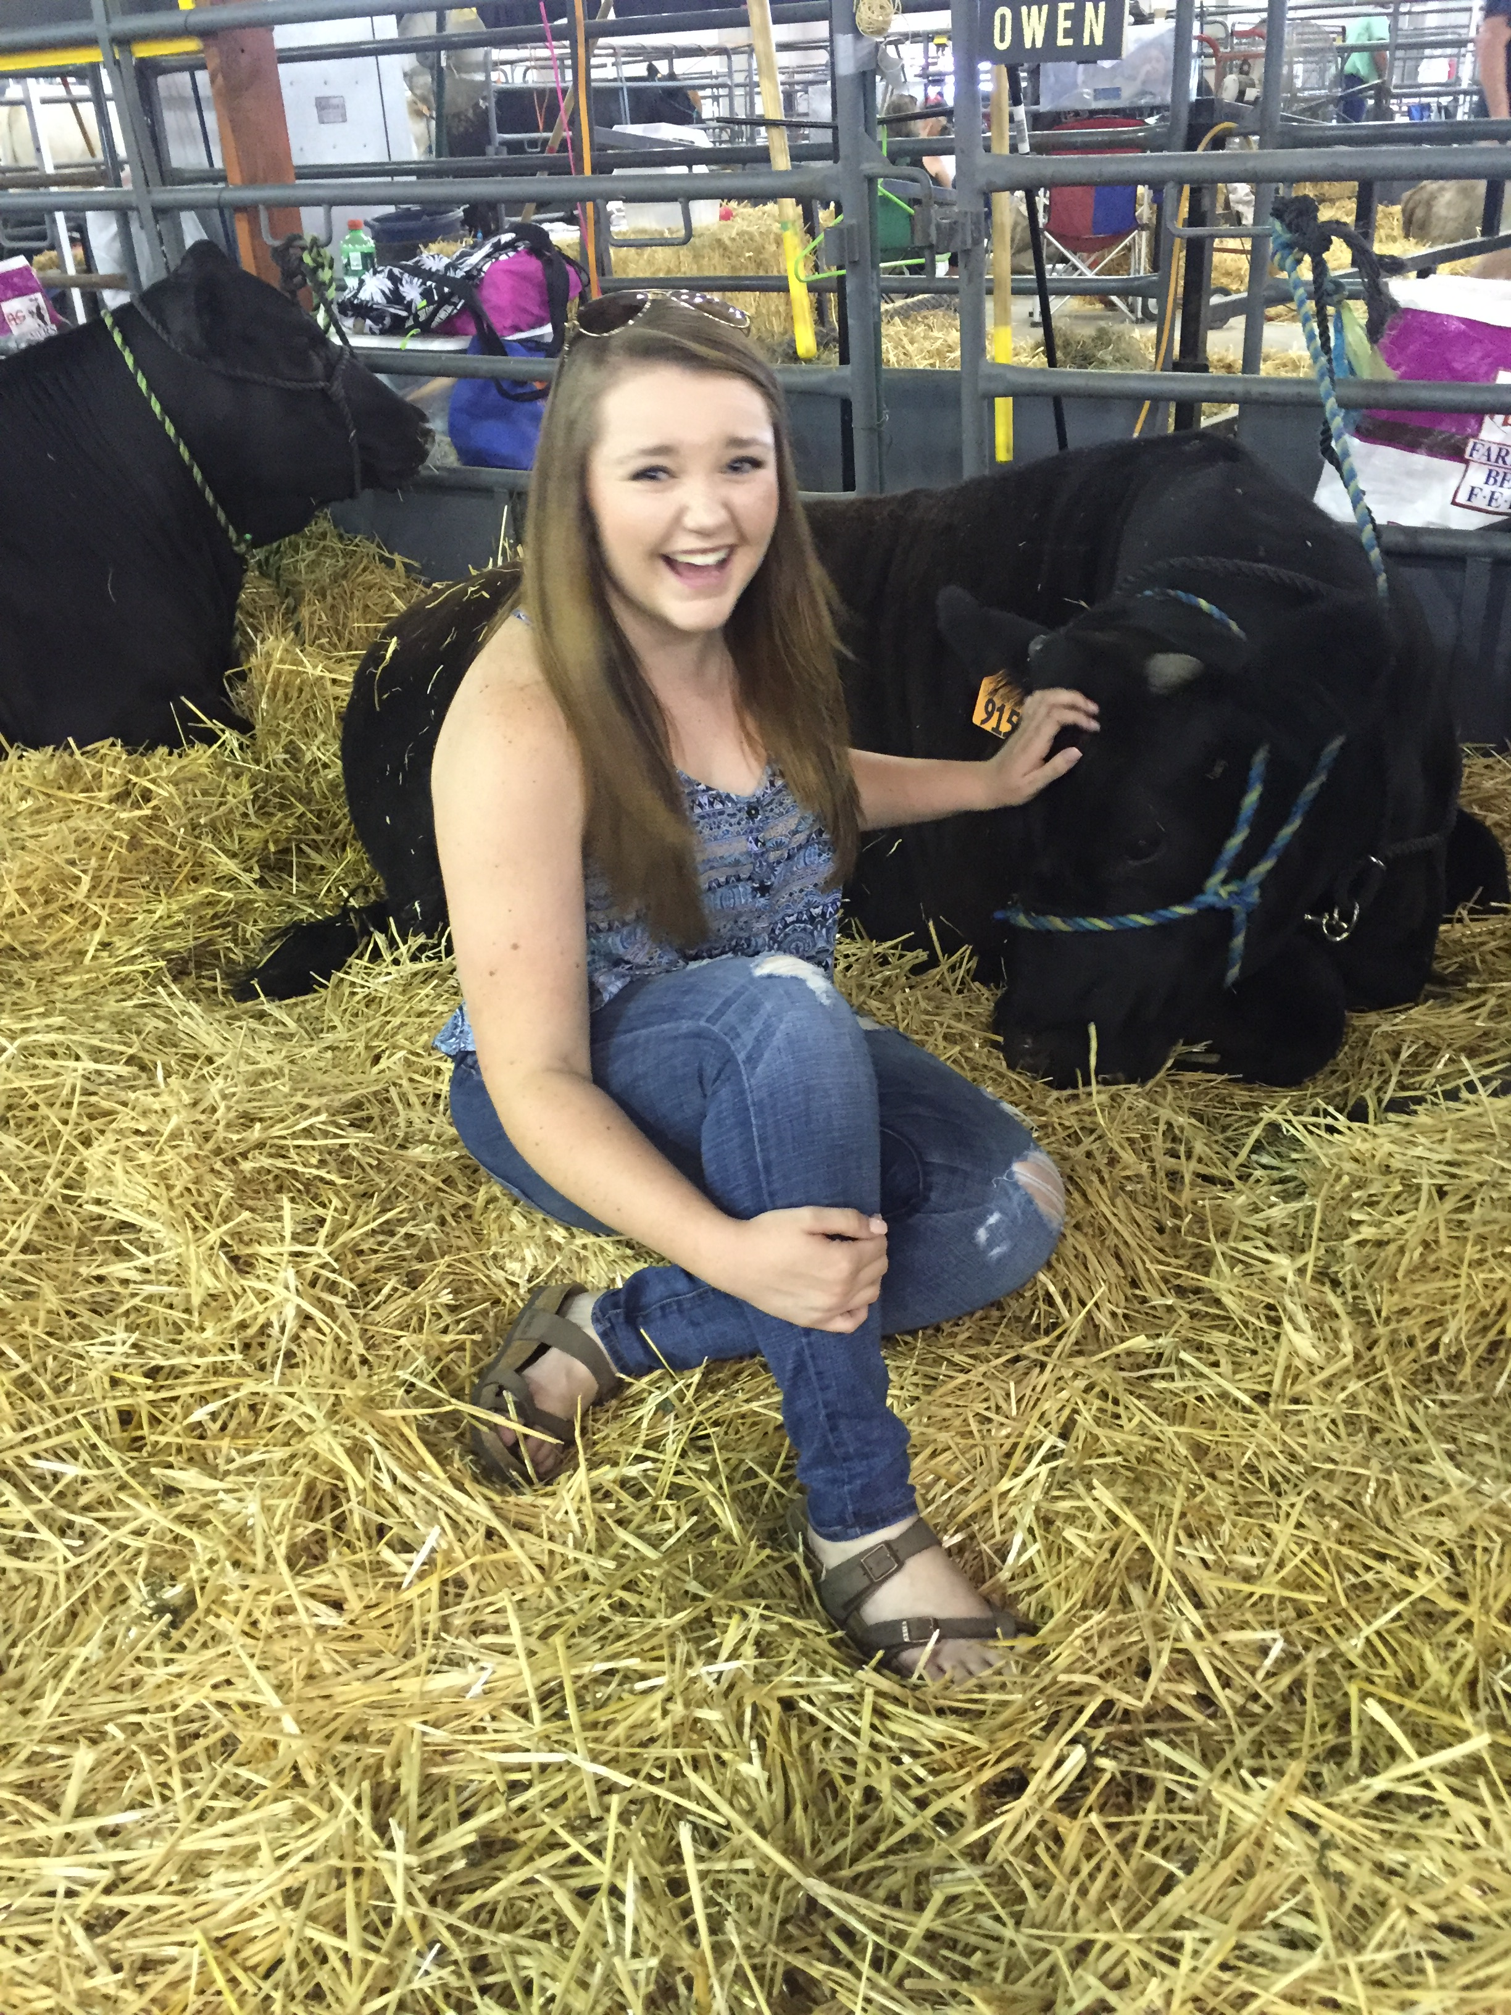

Slide 16
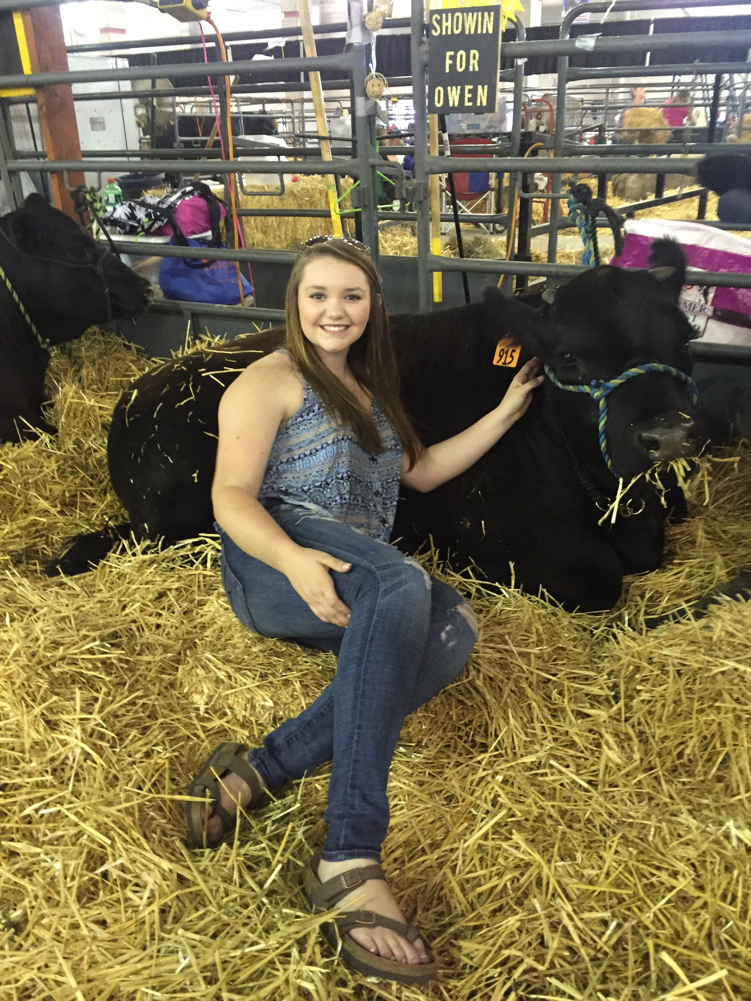
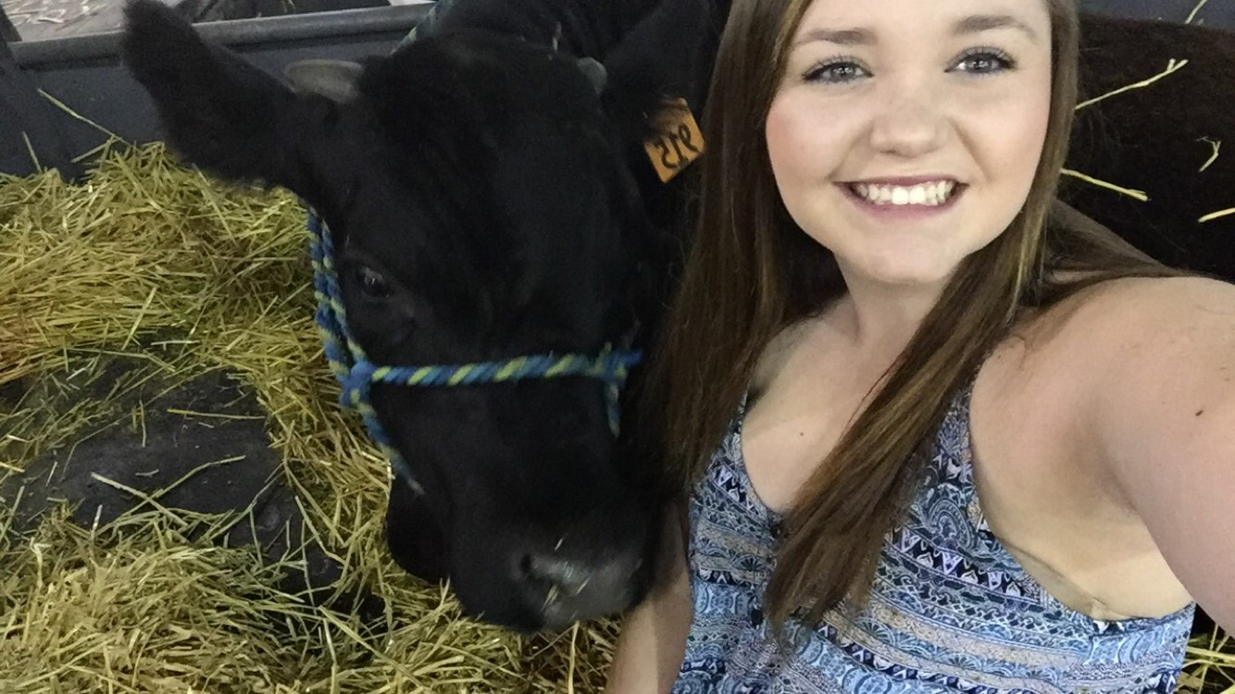
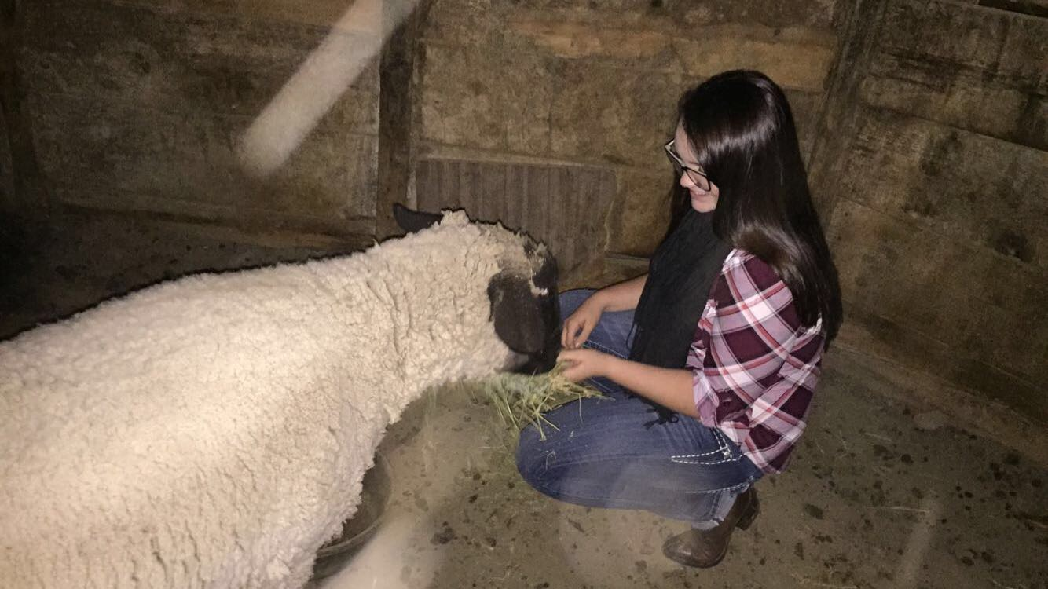

Slide 17
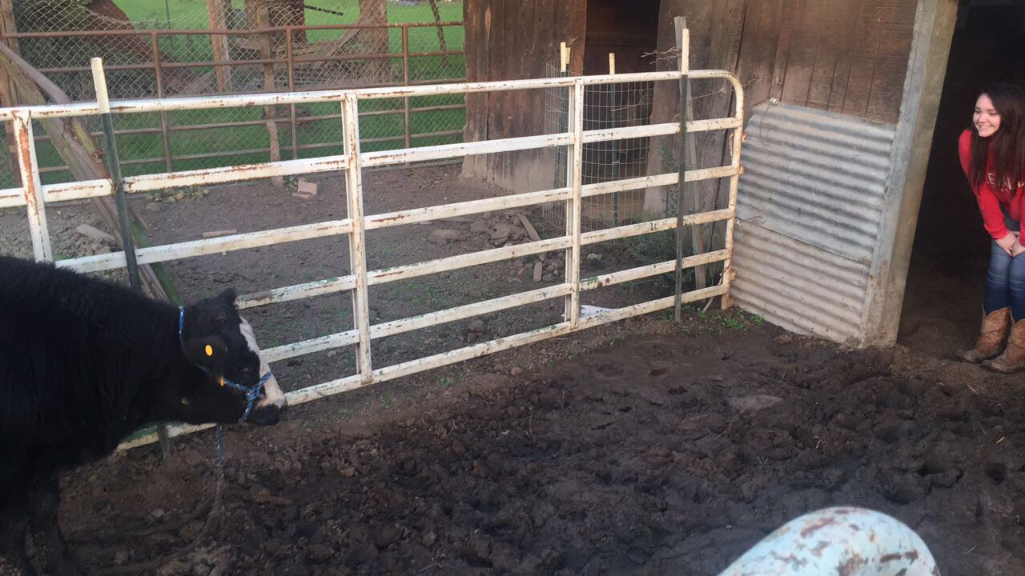

Slide 18
Squishy Fruit Name Game
Everyone stand in a circle.
McAllister starts by saying “Mandarine McAllister” and tosses the “squishy” to another student who says “Mandarine McAllister”, then they say their name with a “fruity” adjective before their name.
Each person has to say the persons before them.
The last person has to say everybody.
Then we add more “squishies!”

Slide 19
Check out our website.
Ag Biology

Slide 20
1/24 Theaet.com FFA Record Book
TSW learn how to keep accurate records of their work, hours involved with SAE’s & FFA. P. 14 NB
Why might it be a good idea to keep a record of your activities with your SAE?
How can a good record book help you get a job?
Awards are earned at the State level for quality record books.

Slide 21
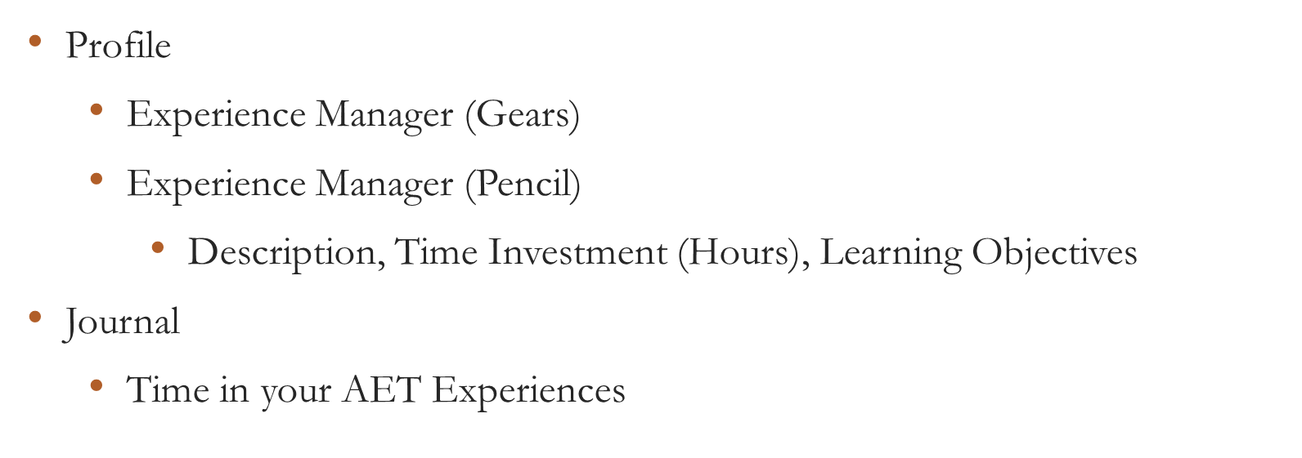
Theaet.com
Set your password. Add Ag Biology as a class, Choose Ag Career & Pathway

Slide 22
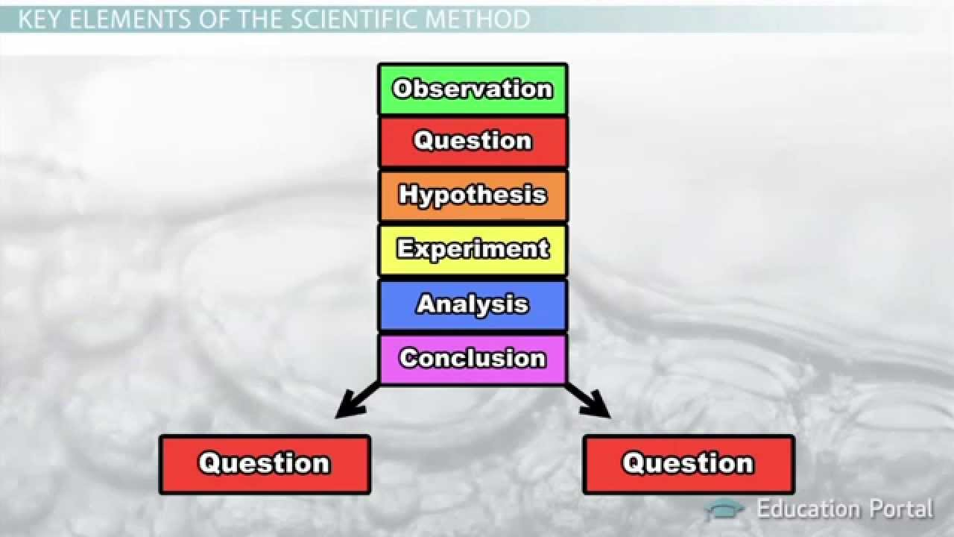
1/25 Scientific Method
Obj. TSW preform a lab using the scientific method. P. 16 NB
What are the parts of the scientific method?
Compare and Contrast a Control and a Variable (Experimental Group) in the scientific method.
Compare and Contrast an Independent Variable and a Dependent Variable.
Homework: Email me your definition of Agriculture and Leadership. Attach a picture that represents how you see Agriculture and Leadership. It can be your own picture too.
jmcallister@wusd.k12.ca.us

Slide 23
Edible Plant Game
Have 1 or 2 partners.
Get 1 card to share among the 2 – 3 of you.
Someone starts by reading the description at the bottom.
Whoever’s description is on someone else’s card Identifies what it is: “ Carrot”
Then the “Carrot” reader reads the description on the bottom of their card, etc.

Slide 24
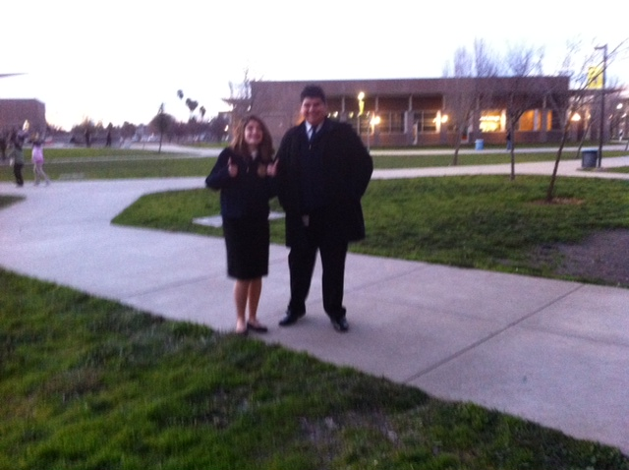

Slide 25
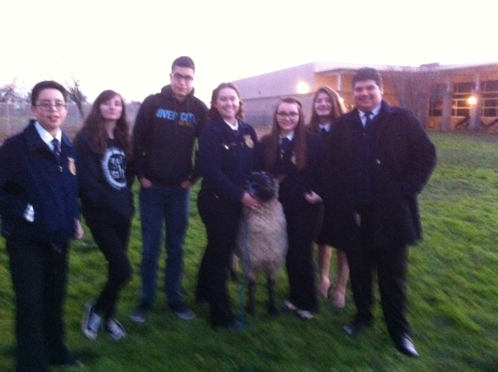

Slide 26
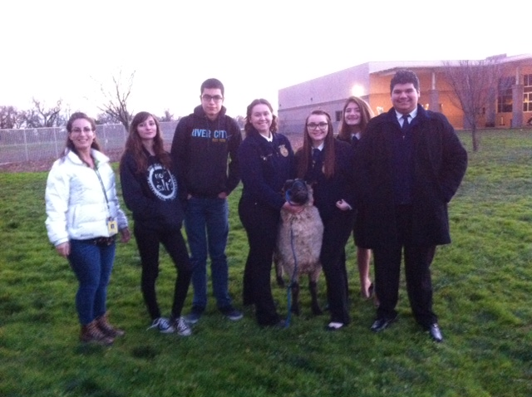

Slide 27
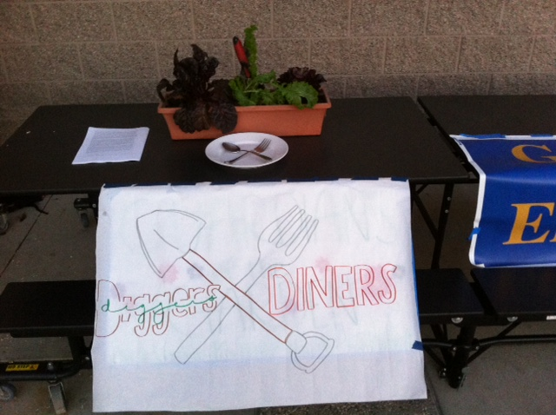

Slide 28
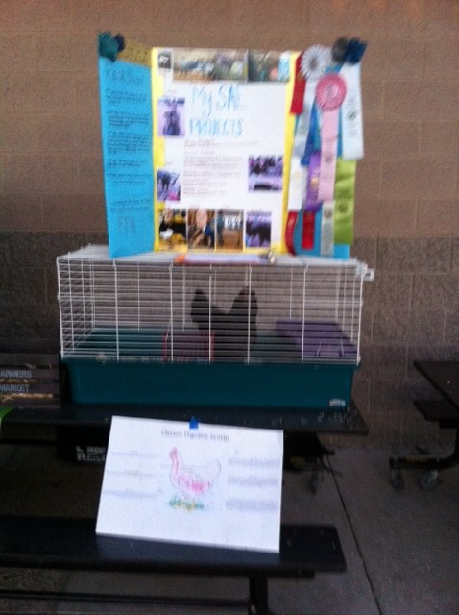

Slide 29
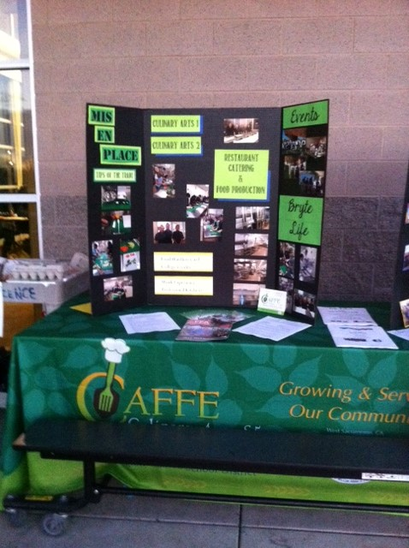

Slide 30
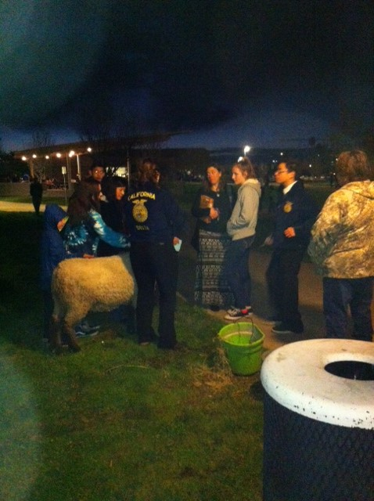

Slide 31
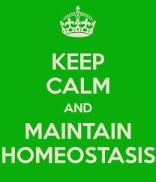
1/26 Body Systems p. 1048BB
Obj: TSW Understand how body systems interact to maintain homeostasis. Pg. 18 NB
Define homeostasis.
Name two body systems that you think of that interact to maintain homeostasis.
For each of the body systems you named in question #2, name a cell, tissue, and organ that make up that body system.

Slide 32
Kahoots
Ag Biology, BUT FIRST…
FFA Website= FFA.org Page 13 NB
What is Official Dress?
List all the parts.
When do you wear it?
Describe your conduct when wearing the Official Dress.
If you are involved in the Back to School Night table (Jan. 25th), and the 9th grade recruitment (Jan. 27th), I expect you to be in official dress.
Sign up with McAllister!☺

Slide 33
6 Types of SAE’s
Ownership/ Entrepreneurship – caring for Chickens, Bunnies, Guinee Pigs, other animals
Placement/ Internship – Fiery Ginger Farms, Dave Vierra Farms, Andrew Codd
Research- best fertilization methods in plants, Aquaculture project
Exploratory – Research possible Careers in AFNR
School Based Enterprise – After or before school, managing working school garden, fresh food drive, research in a greenhouse, Biodigestion, Composting, Tower Gardens, Recycling program
Service Learning – Farm to Fork Festival, Bryte Community Parking Lot Sale

Slide 34
Learning about FFA Activity
Match each of the following FFA words to what they are: P. 15 NB
SALUTE
Written By E. M. Tiffany
I believe in the future of agriculture,…
National Blue and Corn Gold
MOTTO
This consists of 5 symbols: cross section of Corn, the rising Sun, the Plow, the Eagle, the Owl
EMBLEM
Learning to Do, Doing to Learn,
Earning to Live, Living to Serve.
CREED
I pledge allegiance to the Flag of the United States of America and to the Republic for which it stands, …
COLORS

Slide 35
I love my neighbor who…
Everyone clear the center tables to the sides of the classroom.
Place the chairs in a circle, 1 less than the number of people.
McAllister starts, standing in the center, & says “I love my neighbor who…
Then everyone who can agree or has see that, done that, has that, gets to get up from their chair and move to a chair that is NOT next to the chair they are currently sitting in.
If you are the one who is left out, you are the next person to stand in the center and say “ I love my neighbor who…”
If you are in the center, you can not go back to the previous chair you were sitting in before you were the last one without a chair.

Slide 36
Inventory what needs to be fixed in our program with the Bunny Hutch and Chicken Tractors and Garden Beds
Students use measuring tapes and phones to take pictures.
Our Ag Advisory Panel will be here in February. We have to have everything up to snuff.
Clean Chicken Tractors, Bunny hutch, Evaluate Tank – New Bunny☺, Sweep concrete, spray “Bugs” stain. Pull any dead or yellowing leaves & feed to chickens – Yes you can let them out.

Slide 37
Allelopathy Lab
Objective: Using the Scientific Method, test whether different seeds (Radish and Lettuce) impact each others growth.
Essential Question: Can radish seeds impact the growth of lettuce seeds?
Background: (Paragraph) Explain Vocabulary: Germination, Competition for Resources
  Cite Sources: Allelopathy: How Plants Suppress Other Plants (Ferguson, Rathinasabapathi, Chase, 2013)
Hypothesis/ Purpose: If radish seeds are grown with lettuce seeds, then the lettuce seeds will not germinate.

Slide 38
Allelopathy Lab
Materials: Petri Dishes, Pipettes (2mL), Petri dish paper, Radish seeds, Lettuce seeds
Procedure: (Make sure your procedure can be duplicated exactly by someone who has never done this lab – Be very specific.)
  Step 1:
  Step 2:
  Step 3:
  Step 4:
  Step 5:

Slide 39
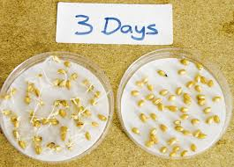
Allelopathy Lab
Data: (Qualitative & Quantitative – numbers, values)
  Table 1: The table below shows the different germination rates of radish and lettuce seeds when grown together and separately. (10 font)

Slide 40
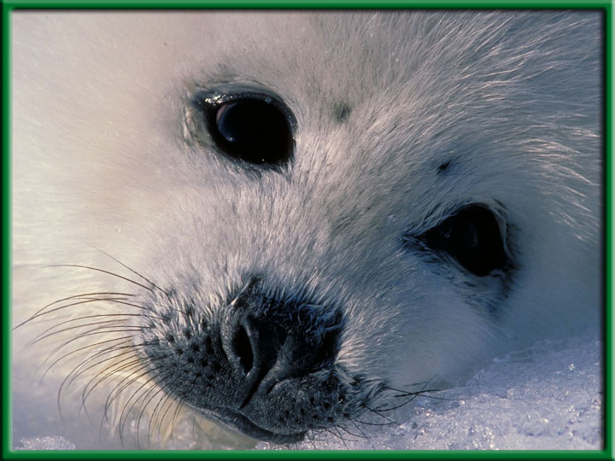
Level of Organization – Activity P.9NB
With your card sort, organize them from smallest to largest.
After your card order is approved, write the order in the pyramid from smallest to largest.
Then write the definition and an example for each level or organization.
Color each level a different color.

Slide 41
Scientific Method
#2.
Control
Definition: the part of the experiment that is the standard that the results are compared. Does not change. Example: Radish & Lettuce Petri dish
Variable: The part of the experiment that is tested (changed)
Example: the 3 day old Radishes with new lettuce seeds

Slide 42
#3
Independent Variable:
  Experimental Group that is tested.
Dependent Variable
  The result of the experimental group. What we are measuring.
  Example: the growth of the lettuce seeds.

Slide 43
Agricultural/Physiology Project
Choose a domesticated farm animal.
Choose 1 of the 11 body systems from Physiology.
Make a Poster/ Presentation with pictures explaining the difference between the animal and the human for that body system.
Write about a disease or illness that affects that system for each the Farm animal and the human, how are they similar/ different.
Choose your animal and body system by Jan. 25th. Be prepared to share what you have learned by Feb 1st - 3rd.

Slide 44
Go to the Library & Check out a Biology Book.
Guest Speaker:
Andrew Codd Monday February 6th
Write down three Internships you might be interested in, page 15 NB.

Slide 45
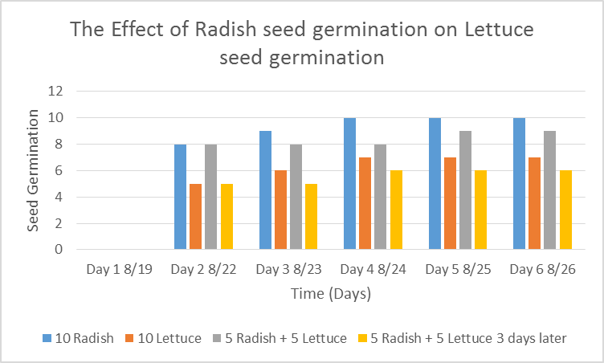
Allelopathy Lab
Data: (Qualitative & Quantitative-numbers, values)
  Graph 1:
  The radish seeds over 6 days showed increased germination compared to the lettuce seeds. (10 Font)

Slide 46
Allelopathy Lab
Data: (Qualitative – descriptive words & Pictures)
  The radish seeds looked …… they smelled….
  The lettuce seeds roots were longer and had more root hairs.

Slide 47
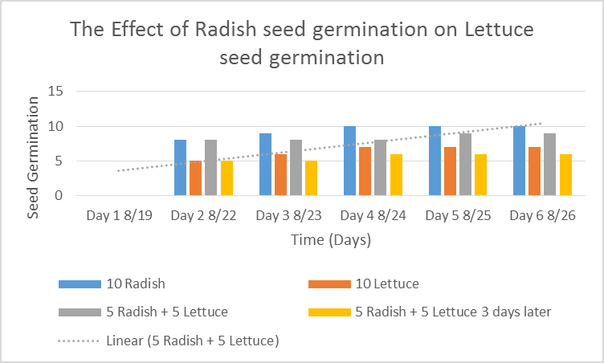
Allelopathy Lab
  Data Analysis: (Paragraph)
  Explain your data - results. Why did we see the results in the graph? Discuss any trends.
  Cite Sources: Allelopathy: How Plants Suppress Other Plants (Ferguson, Rathinasabapathi, Chase, 2013)

Slide 48
Allelopathy Lab
Conclusion: (Paragraph)
  Restate hypothesis and explain if it was supported or not. Tie your Data Analysis to your Background and hypothesis. Did your data support what you thought would happen? How? Explain why allelopathy is important. At the very least, write an AXES paragraph about Allelopathy between radish and lettuce seeds and how it applies to Agriculture.
  Cite Sources: Allelopathy: How Plants Suppress Other Plants (Ferguson, Rathinasabapathi, Chase, 2013)

Slide 49
Works Cited
James J. Ferguson, emeritus professor; Bala Rathinasabapathi, professor; and Carlene A. Chase, associate professor, Horticultural Sciences Department, Cooperative Extension Service, Institute of Food and Agricultural Sciences, University of Florida, Gainesville, FL 32611.
Yes – one more
Yes – still one more ☺
Done!

Slide 50

1/27 Learning about FFA Officer Positions
Obj. TSW distinguish between different officer positions after reviewing each positions’ responsibilities online. P. 20 NB
Name 5 of the 9 Officer positions.
What responsibilities/ behavior would you expect from the all the River City High School Bryte CCT Chapter FFA officers?
Would you like to run for an office next year in Farm to Fork 1?
Why or why not?

Slide 51
FFA Officer Responsibility Activity
Use FFA.org
FFA Manual
Page 48 in online Manual
Write down 3 key responsibilities for each of the offices on 3x 5 cards
We will use flashcards and travel around to say the responsibilities and see if another person can name that officer position.
Tape your card to page P. 19 NB

Slide 52
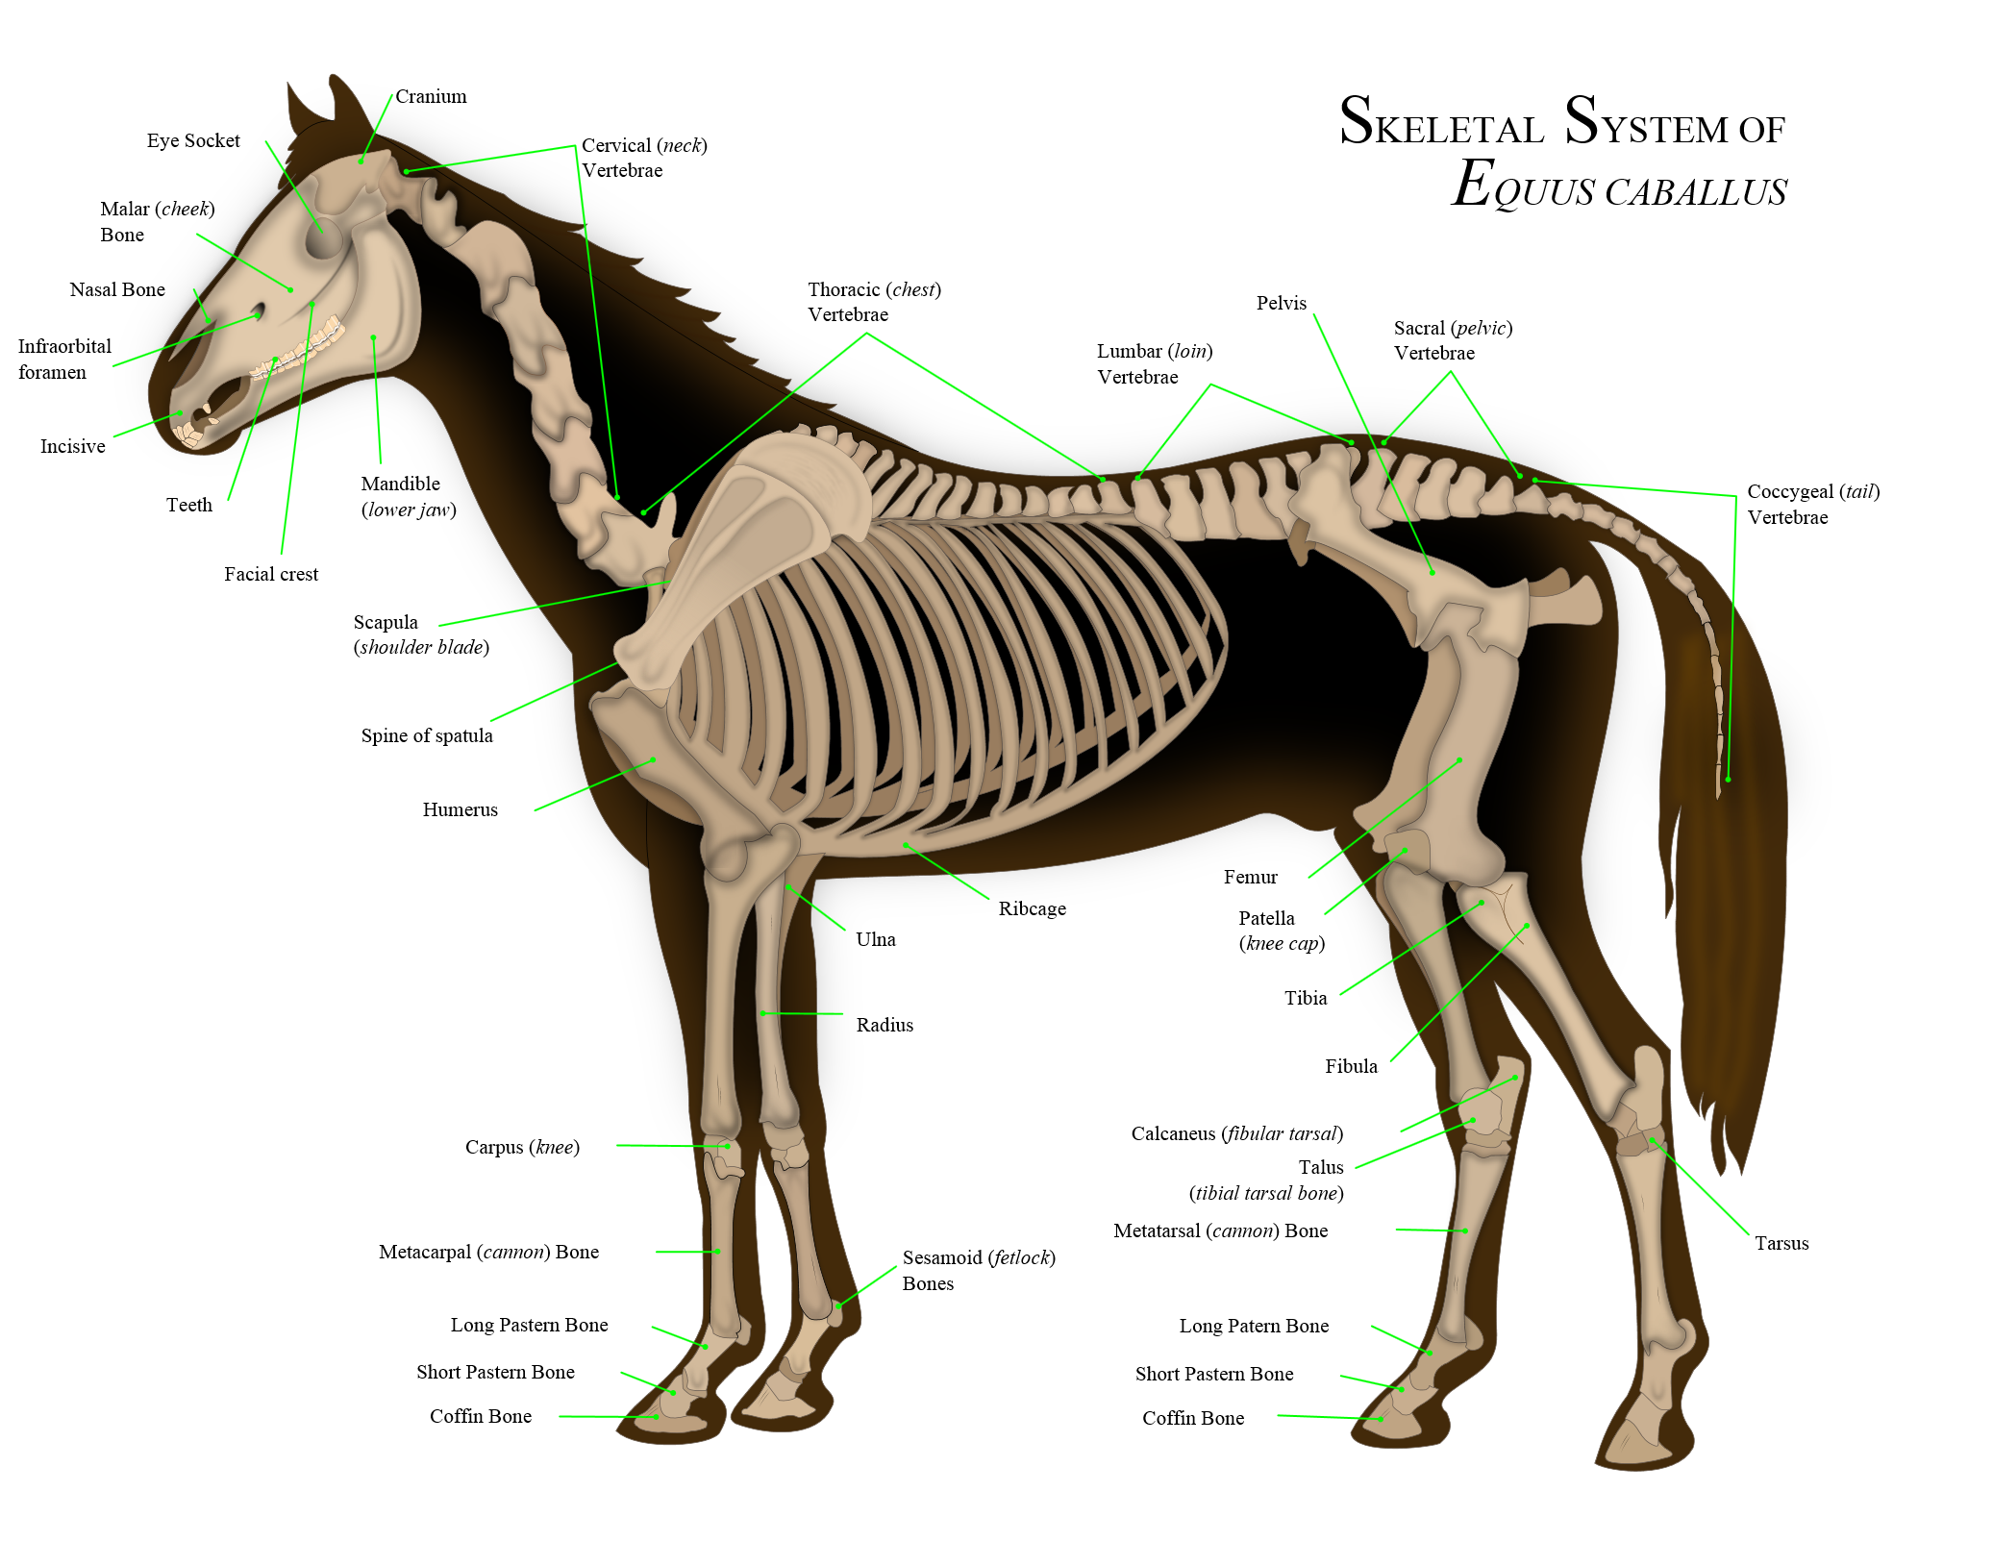
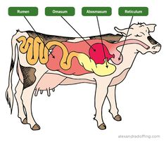
1/30 Physiology – Ag Style
Obj. TSW apply what they have learned about the body systems to what they need to know to care for animals and plants. P. 22 NB
What are the 11 body systems?
What is your favorite body system that you would like to learn more about?
What domesticated farm animal would you like to study? Why?

Slide 53
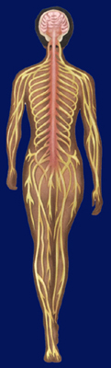
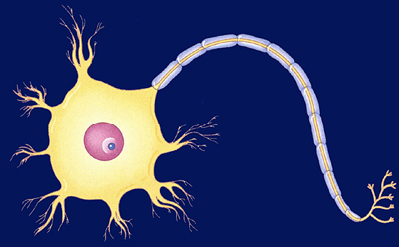
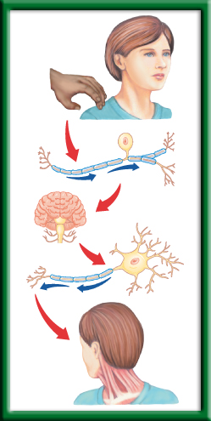
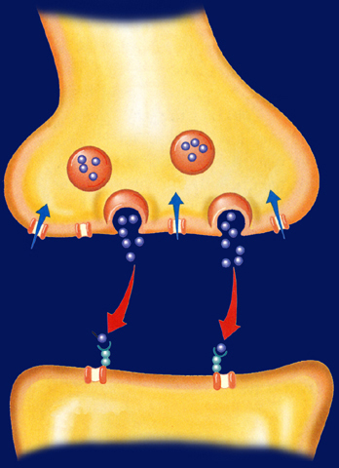
1/31 Nervous System 36.1
Obj. TSW explain the roles of the sensory neurons, interneurons, and motor neurons in sensation, thought and response by doing a lab on reaction response. P.24 NB
Describe, draw, and label a neuron.
Explain the functions of each type of neuron: sensory, interneuron, and motor.
What is a reflex, write an example?

Slide 54








Section 36.1 Summary – pages 943 - 950
#1. Neurons: Basic Units of the Nervous System
Neurons conduct impulses throughout the nervous system. Draw this picture
Dendrite
Myelin sheath
Axon
Nucleus
Axon endings
Cell body

Slide 55
Section 36.1 Summary – pages 943 - 950
#2.Neurons: Basic Units of the Nervous System
Neurons fall into three categories: sensory neurons, motor neurons, and interneurons.
Sensory neurons carry impulses from the body to the spinal cord and brain.

Slide 56
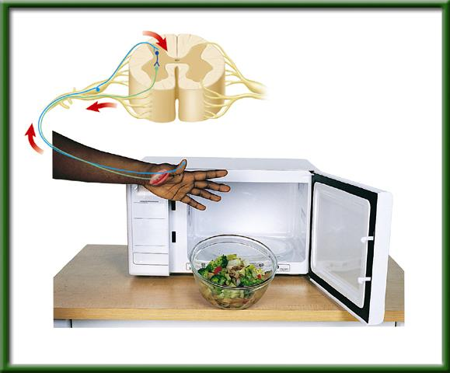
Section 36.1 Summary – pages 943 - 950
Neurons: Basic Units of the Nervous System
Interneurons are found within the brain and spinal cord.
Sensory neuron
Interneuron
Spinal cord
Motor neuron
Receptor in skin
Direction of impulse
Muscle contracts

Slide 57
Section 36.1 Summary – pages 943 - 950
Neurons: Basic Units of the Nervous System
Motor neurons carry the response impulses away from the brain and spinal cord to a muscle or gland.
Sensory neuron
Interneuron
Spinal cord
Motor neuron
Receptor in skin
Direction of impulse
Muscle contracts

Slide 58

Sensory Neuron
-You sense the touch
How the Central Nervous System Works
Interneuron
-The brain processes that you have been touched.
Motor Neuron
-You turn your head to see who touched your shoulder

Slide 59
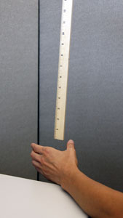
2/1 Distraction/ Reaction Lab CH 36
Obj. TSW calculate reaction times under different conditions. P. 26 NB
What type of neurons will you use in the distraction/ reaction lab?
Is this lab an example of a reflex reaction? Why or why not?
What other body systems work together with your nervous system to help you catch the meter stick?

