Slide 1
Molecular Genetics
Week 9
2016 - 2017

Slide 2
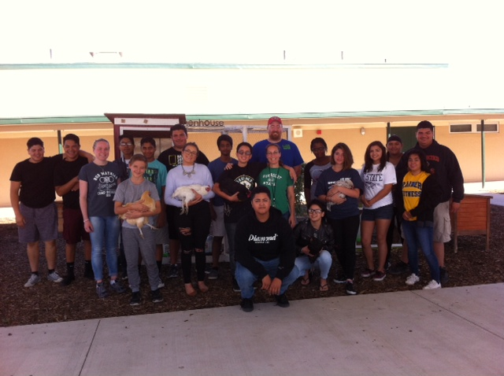
Chris Starr visits his old school and former teacher.

Slide 3
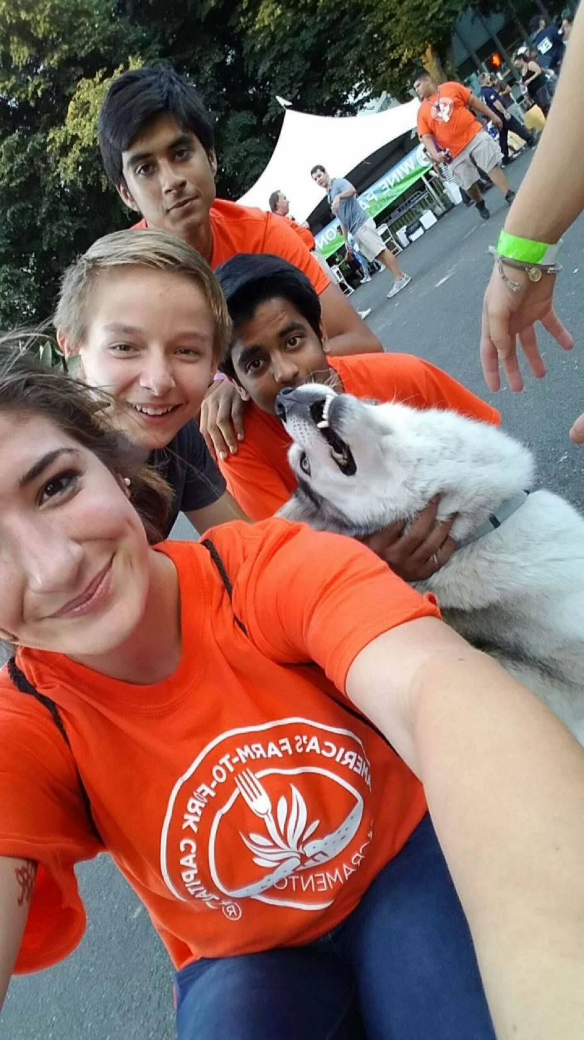

Slide 4
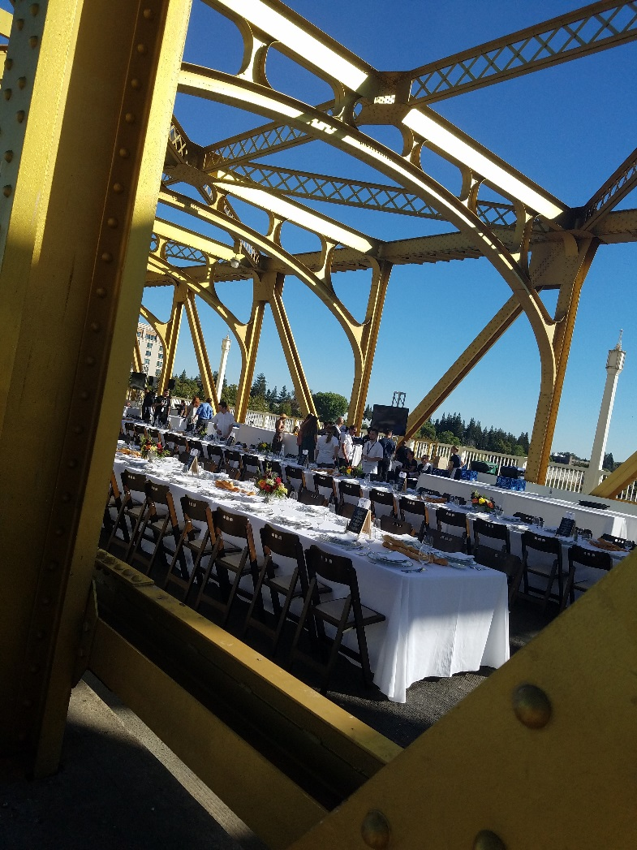
Dinner on the Tower Bridge

Slide 5
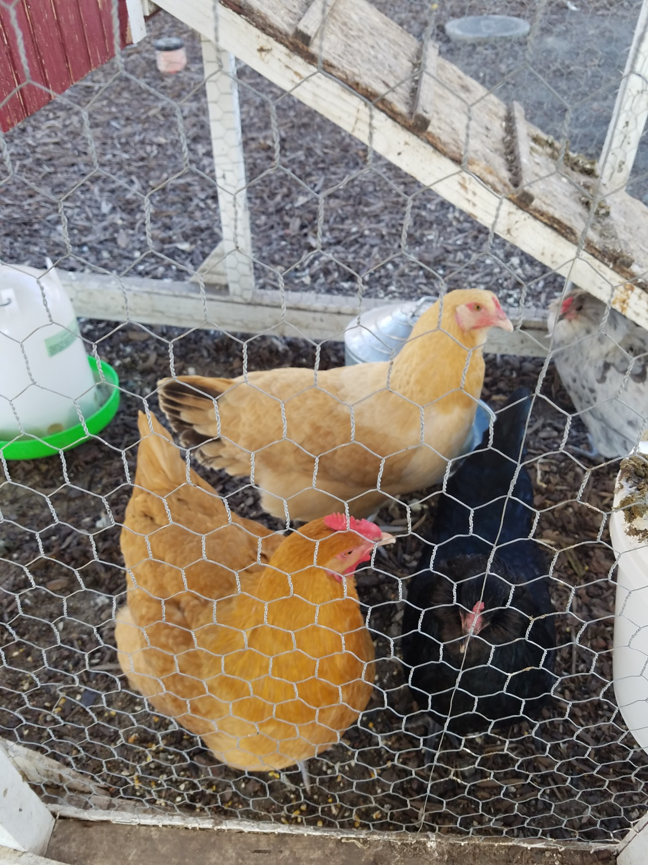

Slide 6
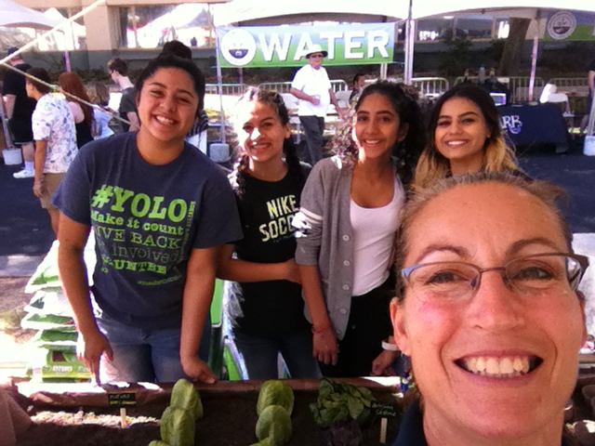

Slide 7
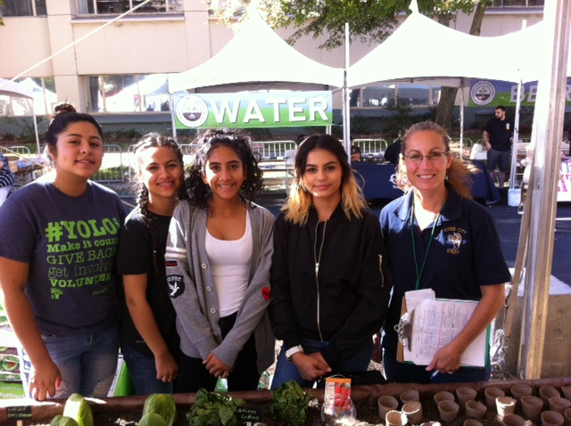

Slide 8
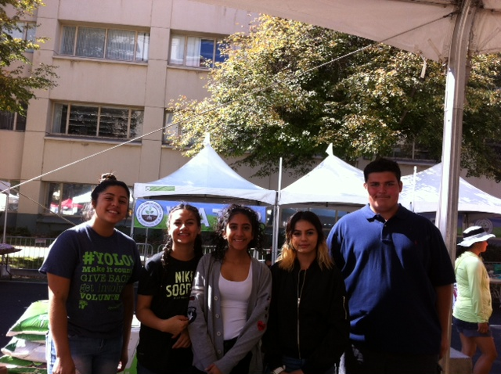

Slide 9
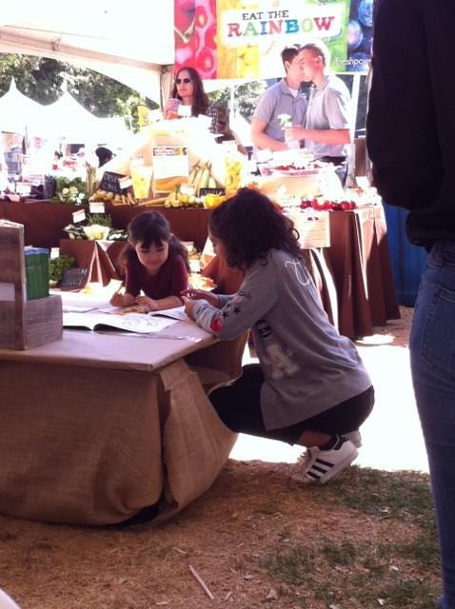

Slide 10
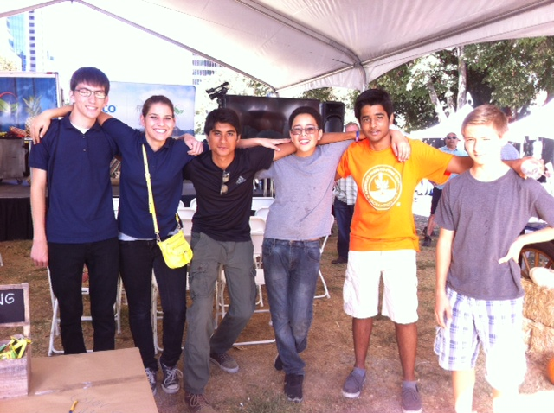
Making new Friends in neighboring FFA Chapters

Slide 11
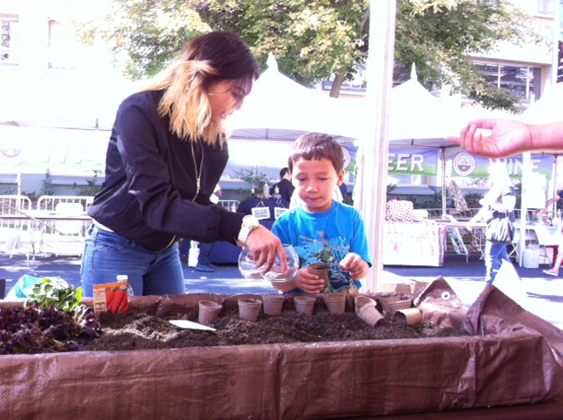

Slide 12
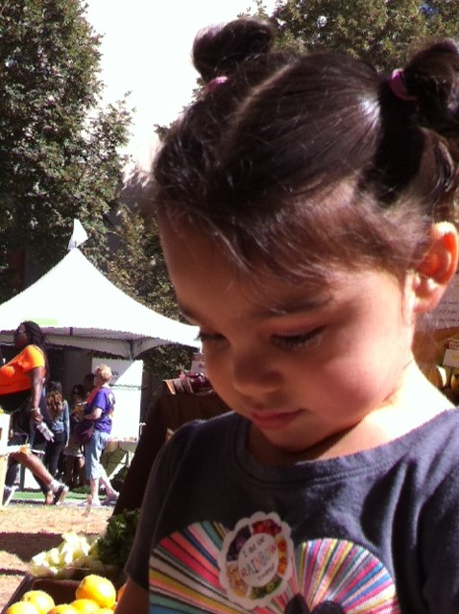
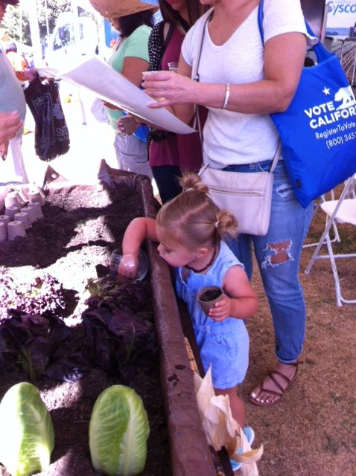
Just being kids

Slide 13
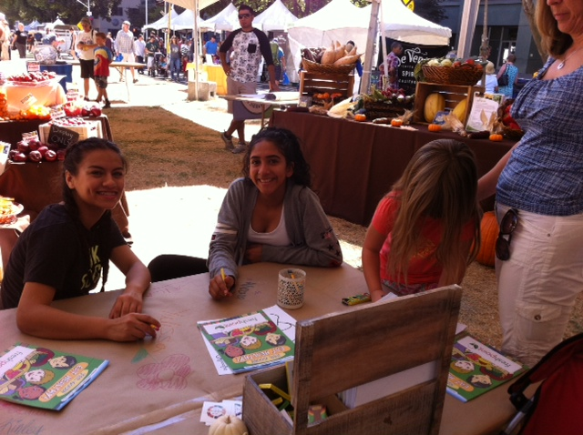

Slide 14
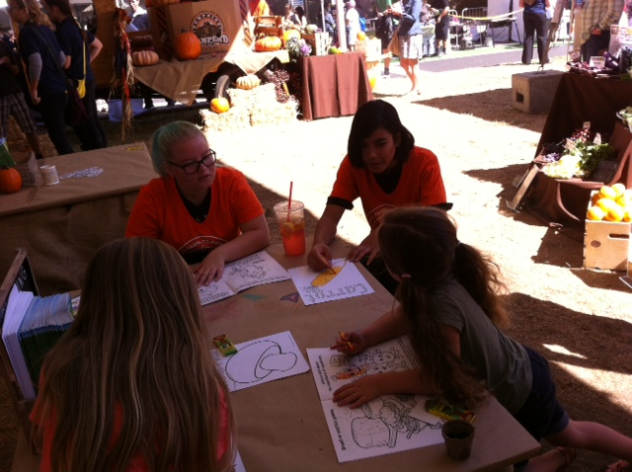

Slide 15
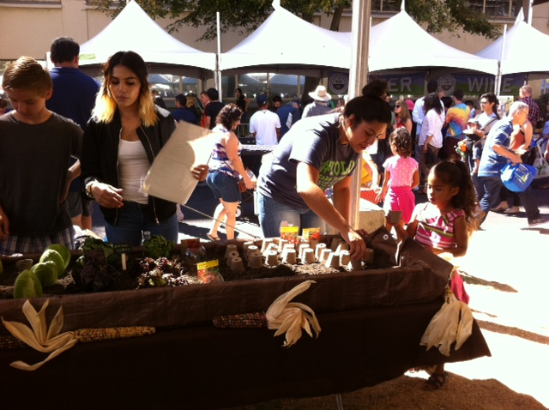

Slide 16
Making root beer Lab
Cellular Respiration

Slide 17
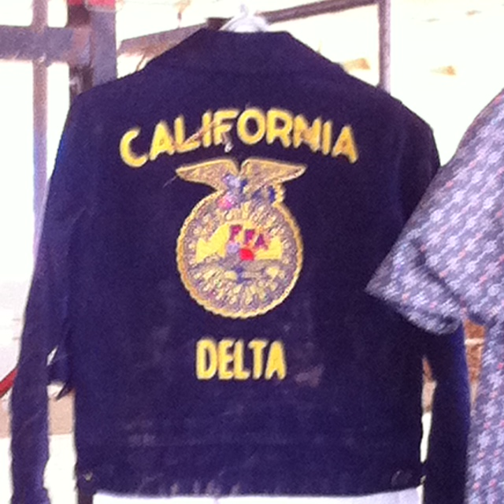
SAE – Supervised Agricultural Experience
Hands On Agriculture
P. 55 NB
Title your SAE
Describe your goal(s) of your SAE(s).
Materials used/ needed for your SAE.
How do you plan to improve your SAE?
How has your SAE helped you learn about Agriculture?
How does the FFA Motto apply to your SAE?
“Learning to do,
Doing to learn,
Earning to live,
Living to serve.”

Slide 18
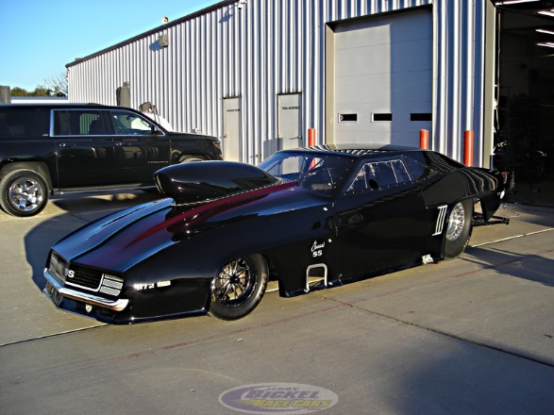
Chris Starr – Guest Speaker, former student of McAllister’s and attended Bryte when he was in 1st – 4th grade.
Did you sign his Thank you Card?

Slide 19
Service Learning Opportunity
Artist: Markos Egure Gallery Event
Promote Bryte CCT & the Brytness Happening Mural
This Saturday – Cookies and Cupcakes at the Gallery
5 pm – 7 pm
917 7th St, Sacramento, Ca
I need 2 – 6 student volunteers:
  You need transportation
  Pass out Brochures about our CAFFE Program
  Pass out Cookies and Cupcakes.

Slide 20
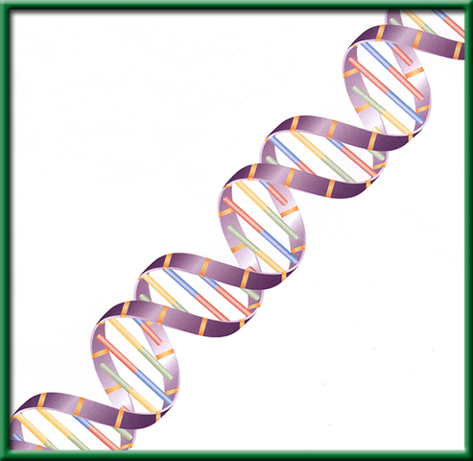
3/6 DNA: The Model of Heredity 11.1
Obj. TSW examine DNA from Strawberries through a process of DNA extraction. P.60 NB
http://learn.genetics.utah.edu/
What Nucleic Acid is responsible for all of our genetic information, please spell it out.
What are the three components (nitrogen bases and backbone) to this Nucleic Acid?
Draw the structure of DNA, describe it in words and label the 3 parts.
HW – Read CH 11 , 1 pg. Notes P. 65 NB

Slide 21







Section 11.1 Summary – pages 281 - 287
The structure of nucleotides
#1. The simple sugar in DNA, called deoxyribose (dee ahk sih RI bos), gives DNA its name— deoxyribonucleic acid.
The phosphate group is composed of one atom of phosphorus surrounded by four oxygen atoms, it has a negative charge.

Slide 22
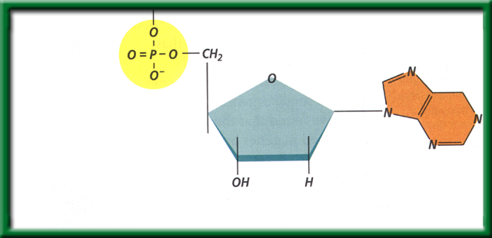
Section 11.1 Summary – pages 281 - 287
The structure of nucleotides
#2. DNA is a polymer made of repeating subunits called nucleotides. The backbone is made up of the Sugar and Phosphate group.
Nitrogenous base
Phosphate group
Sugar (deoxyribose)
Nucleotides have three parts: a simple sugar, a phosphate group, and a nitrogenous base.

Slide 23
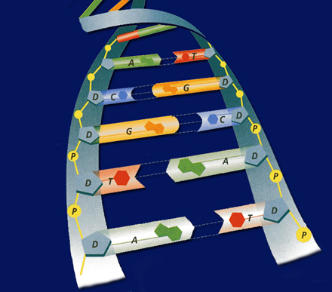
#3. Deoxyribonucleic Acid
Shape= a Double Helix
Backbone =
  Sugar & Phosphate
Nitrogen base
  Guanine
  Thymine
  Adenine
  Cytosine

Slide 24
Strawberry DNA Extraction Lab p. 63 NB
Write the title in your Notebook
Will we extract DNA from the strawberries? If so, what will the DNA look like?
Hypothesis:
  If, then statement that is testable & measurable. For example: If I crush strawberries and add the buffer, then I will extract 2 tablespoons of DNA.)
Materials:
  Ziplock bag
  Strawberries
  Soap: used to dissolve phospholipid bilayers of the cell membrane
  Salt: break up protein chains around the DNA
  Ethanol: DNA is NOT soluble in ethanol (what does this mean?)
  Funnel
  Cheese cloth
  Test tube
  Stirring rod

Slide 25
Procedure
1. Place one strawberry in the plastic bag. Close the plastic bag. Now, squish the strawberry! (*make sure not to break the bag*)
2. Add 10 mls of buffer solution and mix.
3. Place the funnel in the test tube and place cheesecloth on top of the funnel.
4. Strain strawberry mixture
5. OBSERVE MIXTURE in the test tube. Remove Strawberry mush into the trashcan from the cheesecloth. Rinse the cheese cloth in the sink.
6. Add 5 mls of rubbing alcohol.
7. OBSERVE MIXTURE and record results.
8. Place stir rod into test tube to extract DNA.

Slide 26
Continued
DNA Extraction Buffer Contains in 600ml Beaker:
  450 mls of water
  50 mls of soap
  1 tsp salt
As you do the lab, make sure you make your observations!

Slide 27
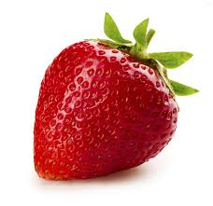
Strawberry DNA Extraction Lab
Prediction: What do you THINK we will have to do in order to extract DNA from a strawberry? Write in complete sentences.

Slide 28
Conclusion And Analysis
Answers
To Precipitate DNA from Solution D
Separate components of the cell A
Break open the cells C
Break up proteins and dissolve cell membranes B

Slide 29
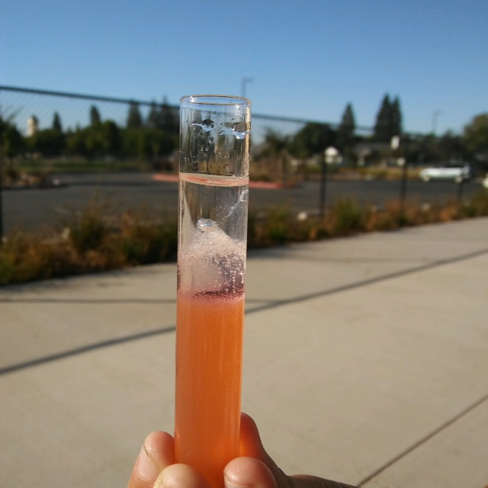
Conclusions! P. 63
Strawberry DNA Extraction AXES Paragraph
What did the DNA look like? What is it’s shape?
How were we able to see it?
Why was it essential to add buffer?
Why was it essential to add ethanol?
What is an example of a Nucleic Acid?
Why is DNA important?

Slide 30
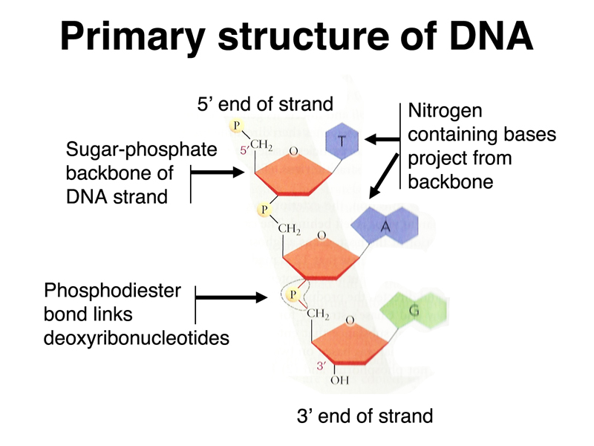
3/9 DNA Structure & Function CH. 11.1
Obj: TSW review DNA structure & function. Pg. 62 NB
Name two functions of DNA.
Draw a nucleotide and label the three components.
Use the base pairing rules you learned yesterday to determine the complimentary sequence of this DNA strand:
5’-TACGGTACT-3’

Slide 31
Section 11.1 Summary – pages 281 - 287
#1. What are the two functions DNA?
Although the environment influences how an organism develops, the genetic information that is held in the molecules of DNA ultimately determines an organism’s traits.
DNA achieves its control by determining the structure of proteins.

Slide 32
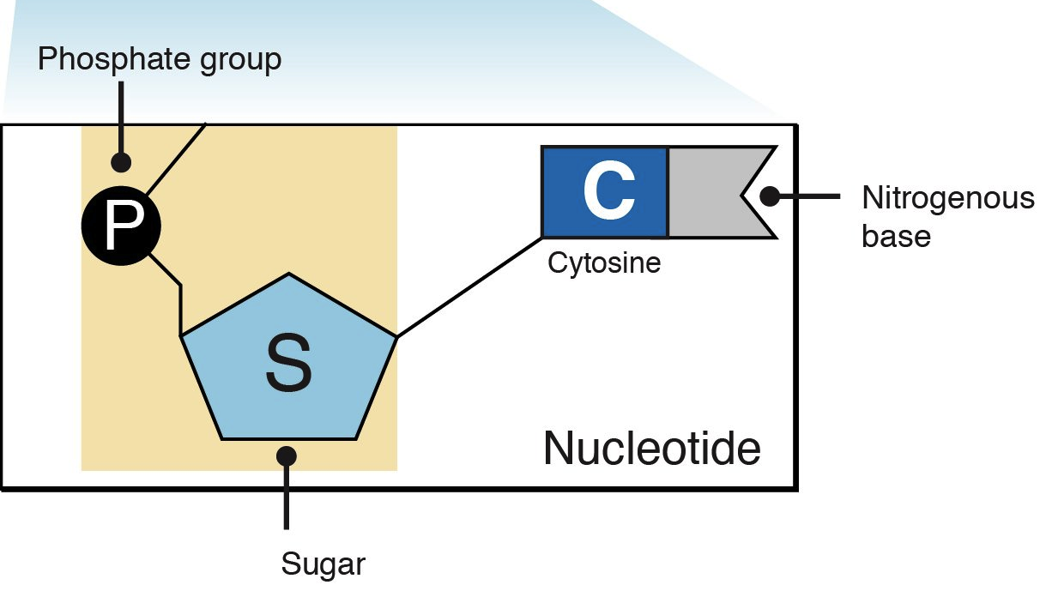
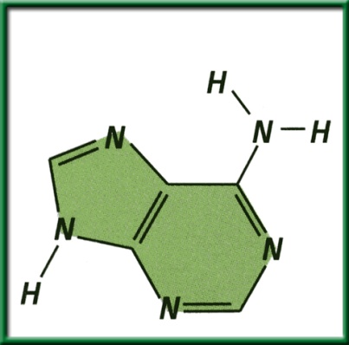
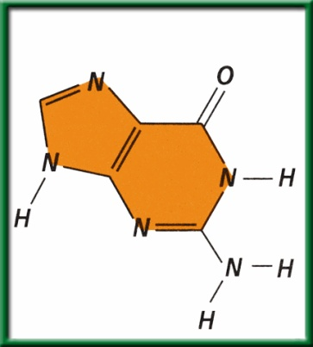
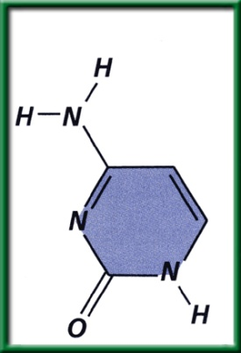
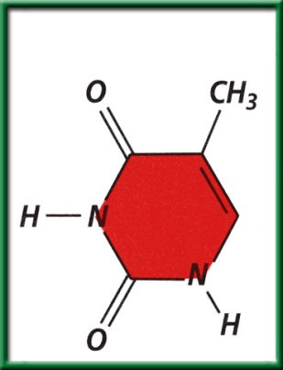
Section 11.1 Summary – pages 281 - 287
2. The structure of nucleotides
A nitrogenous base is a carbon ring structure that contains one or more atoms of nitrogen.
In DNA, there are four possible nitrogenous bases: adenine (A), guanine (G), cytosine (C), and thymine (T).
Adenine (A)
Guanine (G)
Cytosine (C)
Thymine (T)

Slide 33
#3. (DNA)Nitrogen Base Pairing Rules
Hydrogen bonds hold nitrogen bases together
ADENINE = THYMINE
CYTOSINE = GUANINE
G = ?
T = ?
A = ?
C = ?

Slide 34
DNA/ RNA Beads p. 65NB
Backbone= Phosphate & Sugar (Red & White)
Nitrogen Bases= Adenine (Blue)=Thymine (Green)
            Cytosine (Yellow )=-Guanine (Orange)
            Uracil (Pink) RNA
Hydrogen bond (clear barbell)
http://learn.genetics.utah.edu/
WS - DNA Model Discussion questions

Slide 35
DNA Model Discussion Questions p. 65NB
Please write in complete sentences.
What is the general Structure of the DNA molecule?
What are the 3 parts of a nucleotide?
Name the 2 molecules which alternate to make the sides or “backbone” of the DNA molecule.
Name the 4 nitrogen bases.
To which molecules does the nitrogenous base attach?
What are the base – pairing rule for DNA?
If there are three thymine bases on your model, how many adenine bases will there be?

Slide 36
DNA Model Discussion Questions
8. Draw a picture of your DNA. Label the sugar, a phosphate, and all the bases on the left and right side of the molecule you constructed.
9. If you were to open the entire DNA molecule along the hydrogen bonds and attached new bases to the sides you would have two new DNA molecules. Would these 2 DNA strands have the same base pairs?
10. Would the two DNA molecules that resulted from replication be the exact copies of each other? Explain. Why is this important?

Slide 37
Learn.genetics.utah.edu
P. 59 NB
Write a summary paragraph about DNA. Write 3 – 5 sentences about the shape of DNA, the nitrogen bases, the bond that holds them together and what a nucleotide is.
Build a DNA Molecule
Match the nucleotide base pair
  What bases always pair together?
  What holds the base pairs together?

Slide 38
Question
If there is one strand of DNA with the code:
AATCCGGATA
What would its complimentary strand (strand across from it) look like?

Slide 39
Answer
AATCCGGATA
TTAGGCCTAT
A always pairs with T C always pairs with G

Slide 40
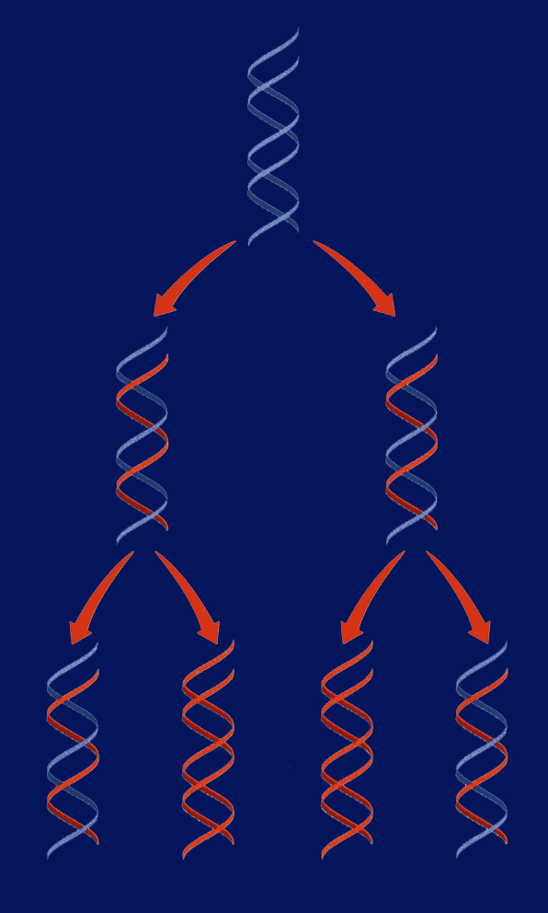
3/10 DNA Replication 11.1
Obj. TSW demonstrate base pairing rules of DNA Replication by constructing a 2-D model of DNA with paper. P.64 NB
What is DNA replication?
Why does DNA replicate?
Diagram DNA being replicated.
Replication Video
HW CH 11
1 page Notes P. 65 NB
Show video DNA Replication
Those of you participating the Gallery Event at 917 7th St tomorrow 5 – 7 pm, Please give McAllister your Permission slip

Slide 41
Section 11.1 Summary – pages 281 - 287
#1. Replication of DNA
Before a cell can divide by mitosis or meiosis, it must first make a copy of its chromosomes.
The DNA in the chromosomes is copied in a process called DNA replication.
Without DNA replication, new cells would have only half the DNA of their parents.

Slide 42
Section 11.1 Summary – pages 281 - 287
DNA
Replication
Replication of DNA
Replication

Slide 43
DNA Replication
DNA replication: the DNA in chromosomes is copied in this process
If I say a strand contains: AATTCC on one side, what will the complementary strand be? You can predict what the bases will be on the other side! Part of replication uses this logic.
During DNA replication, each strand serves as a pattern, or template, to make a new DNA strand.

Slide 44
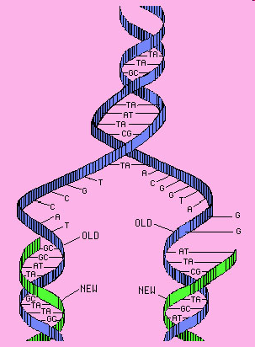
#3. Steps of DNA Replication
STEP 1. Separation of Strands: When a cell begins to copy DNA, the DNA unwinds, and the hydrogen bonds are broken. This allows the bases of nucleotides to be exposed.
Unwinding!
Hydrogen bonds broken!
(like unzipping!)
STEP 2. A new Sugar- Phosphate
backbone forms along the new
strand forms.

Slide 45
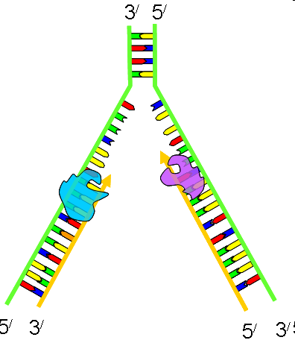
DNA Replication 3’ to 5’ RULE
DNA strands go from 3’ to 5’ or 5’ to 3’
When DNA strands pair,
it is opposite
STEP 3. Base pairing: Free nucleotides pair
with the exposed DNA bases.
STEP 4. Two molecules of DNA are
Formed; each is half original &
Half complementary.

Slide 46
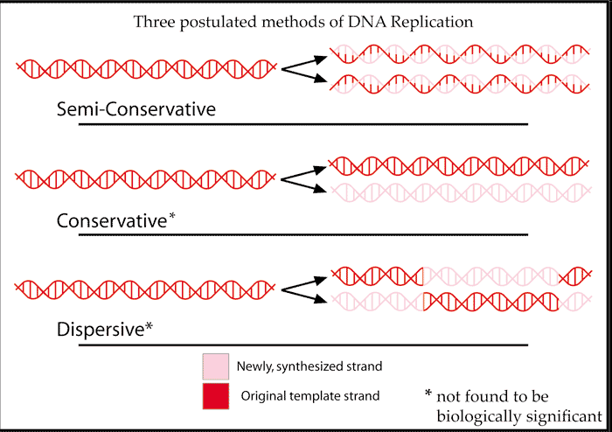
Semi-conservative Replication p. 63 NB
Half of the DNA is Original the other half is new (Complementary)

Slide 47
DNA Replication Practice p. 63 NB
Directions: Using one half of the a DNA helix, show what the correct pairing would be, skip lines in your NB.
ATT CGT TAC CAC CTC
TAT TAG GCA ATA TTC
GTG TGA TTA ATA GCC
CTA AAG GAA TAG GAT
GAT GAA TAC CCA CGA
TAA TAT GCA CAT TAC
GAA CCT TAC GGG GTG
TAT AAC CAG GAG TTT
ATC CGT AGT GTA AAT
GGA TTA CCC TTA CCA

Slide 48
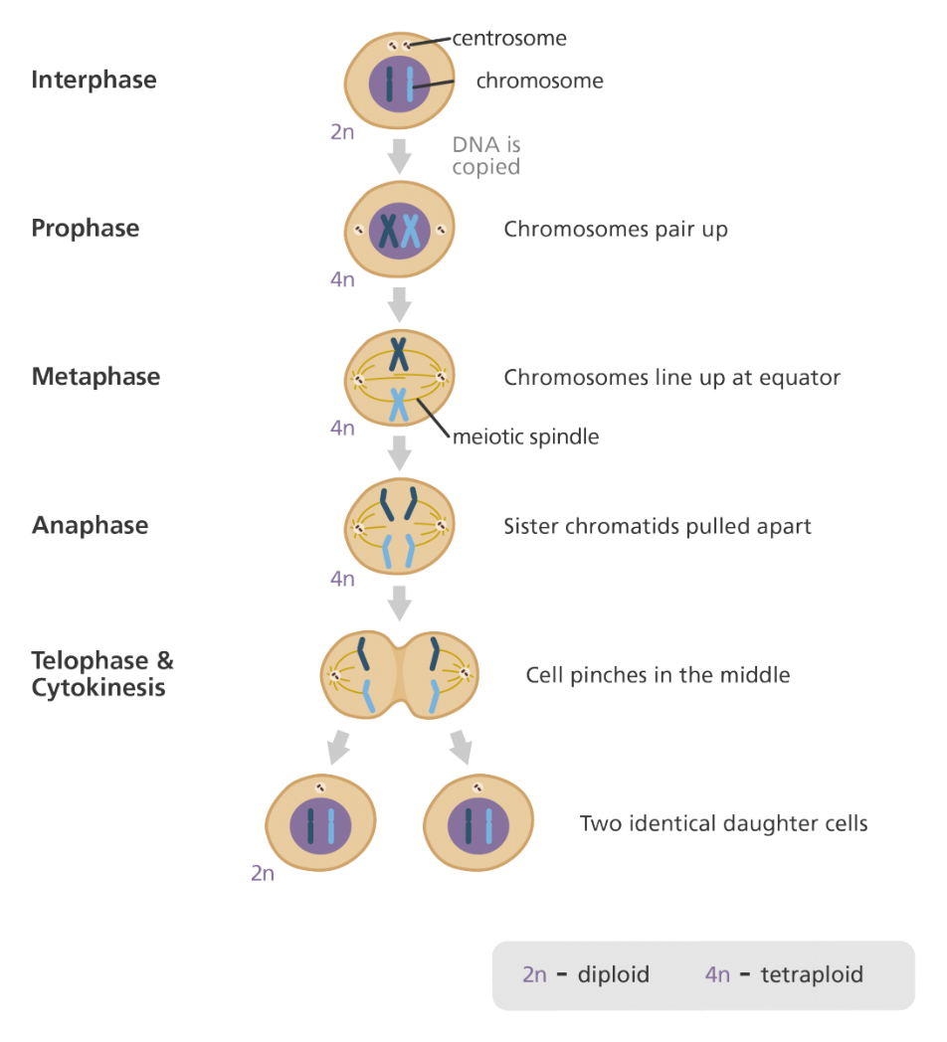
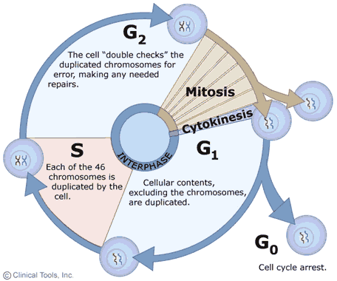
3/13 Cell Growth & Reproduction: Mitosis CH 8.2
Obj. TSW understand the cell cycle and processes at each stage. P. 66 NB
What is mitosis?
Draw the Cell Cycle.
What is the result of Mitosis?
HW - 1 Page Notes
CH 11 P 65NB
STUDY for the MIDTERM
Chapters: 6.3, 7, 8.1, 9, 11

Slide 49
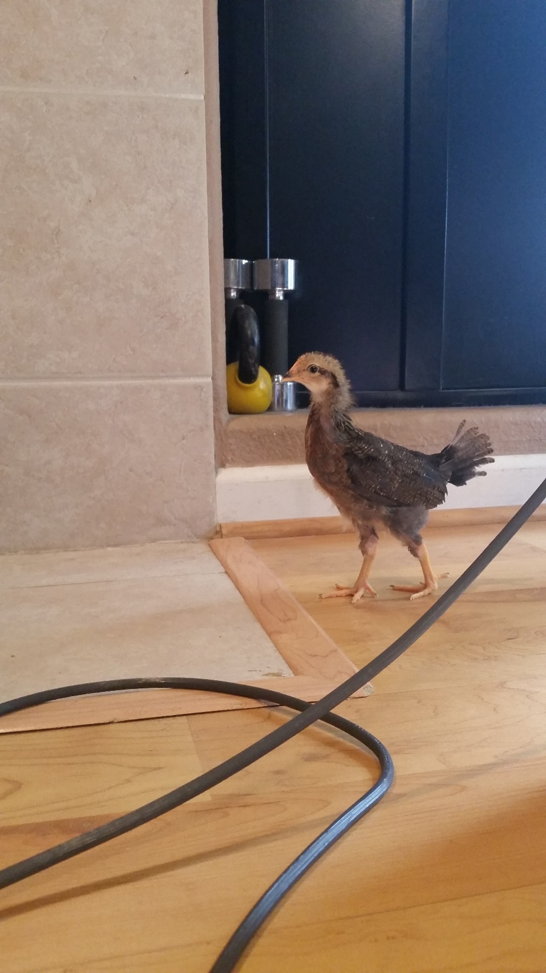
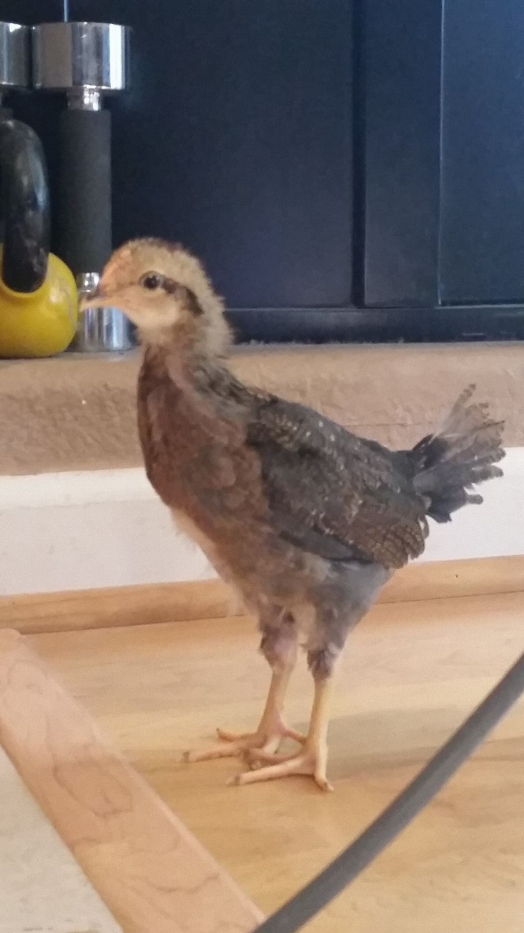
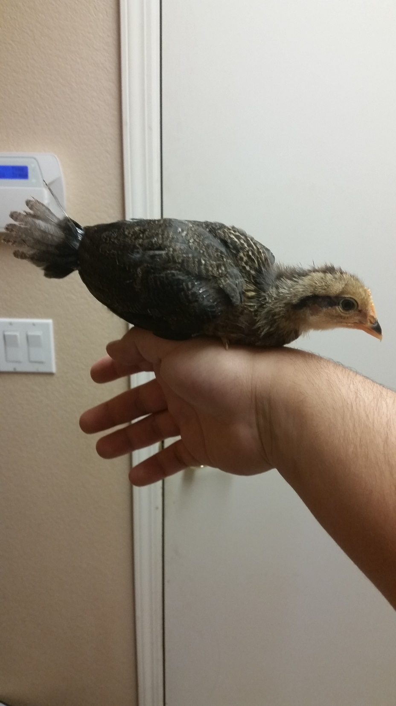

Slide 50
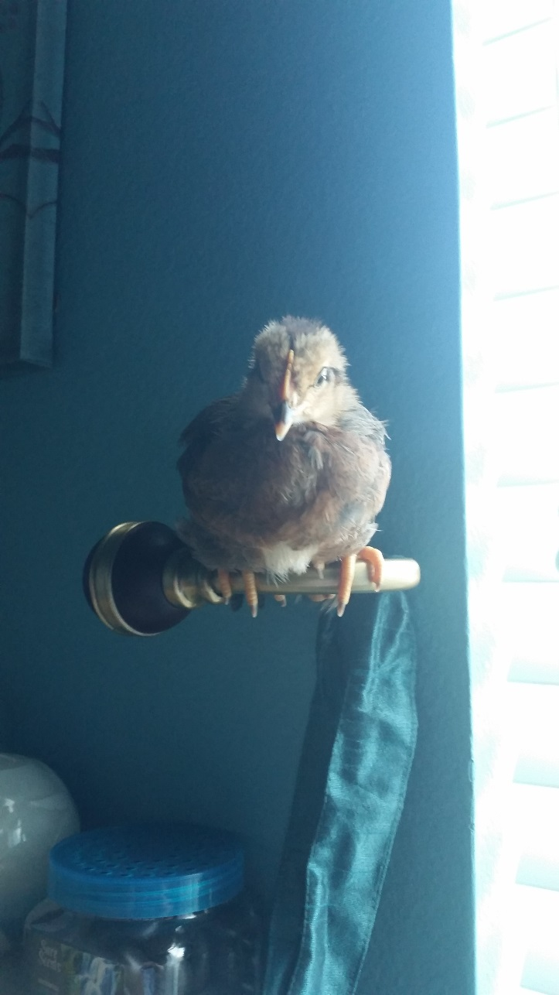
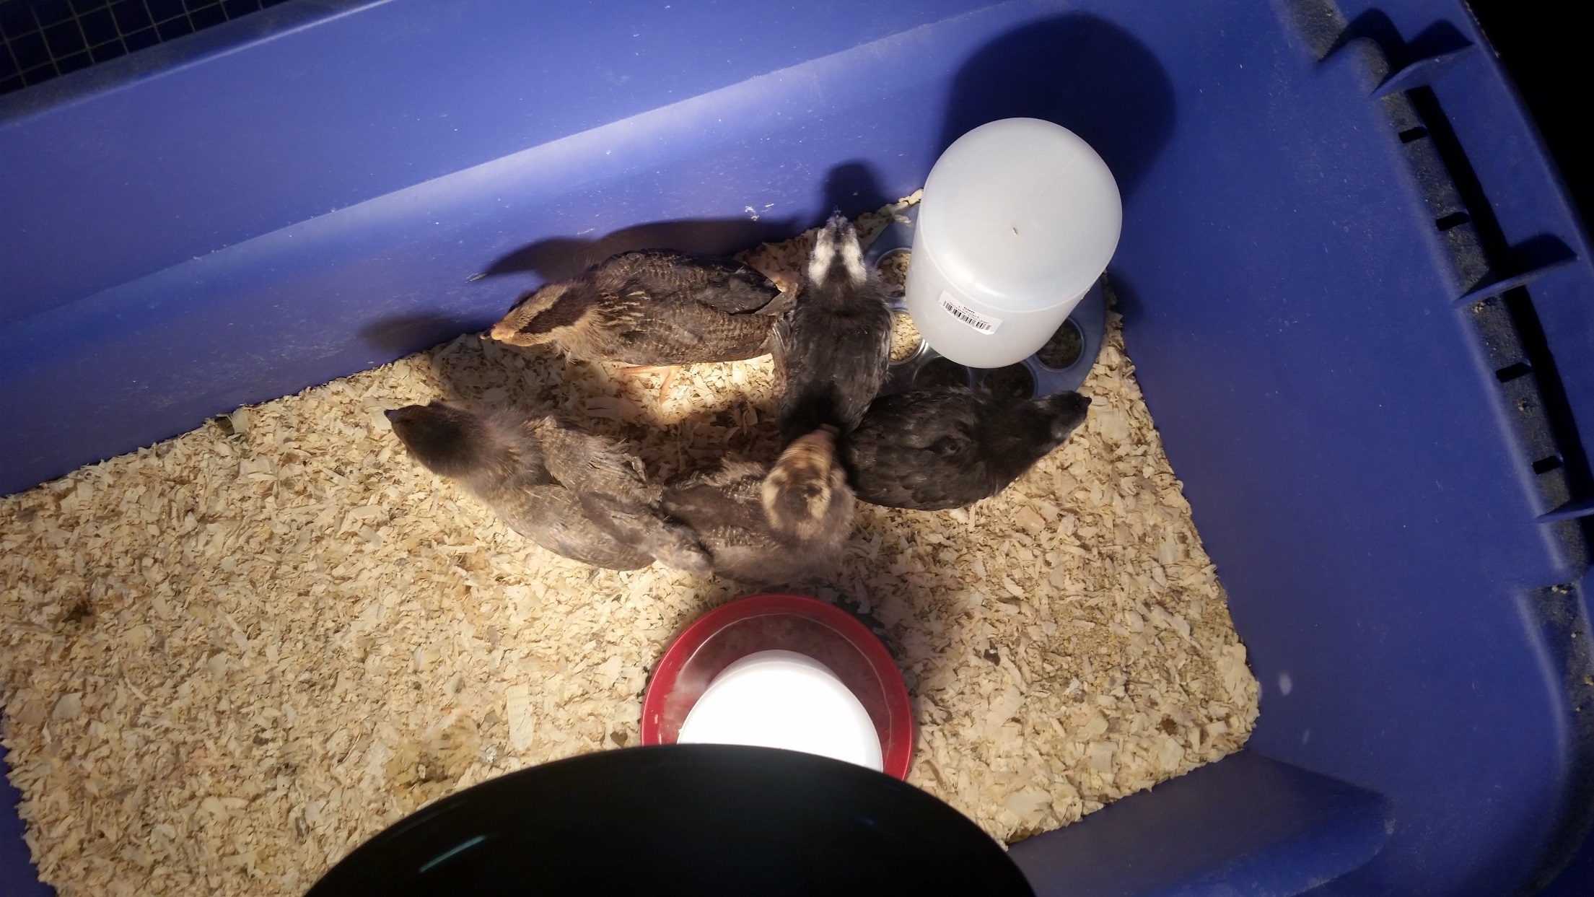

Slide 51
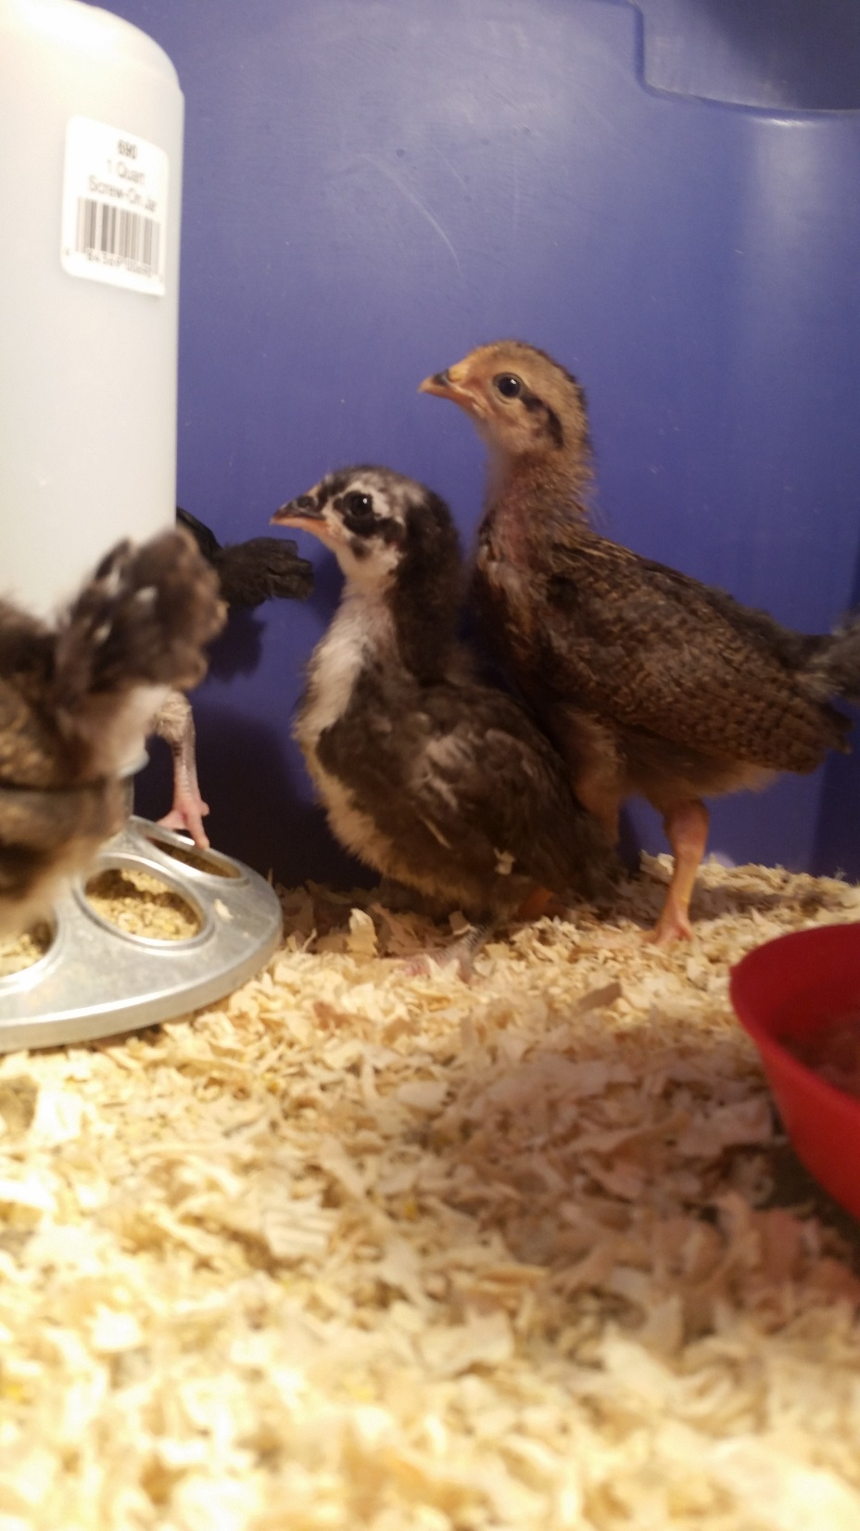

Slide 52
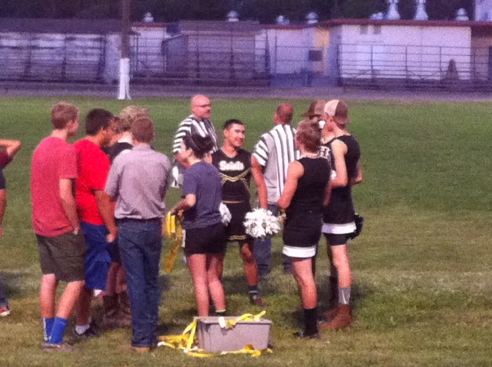
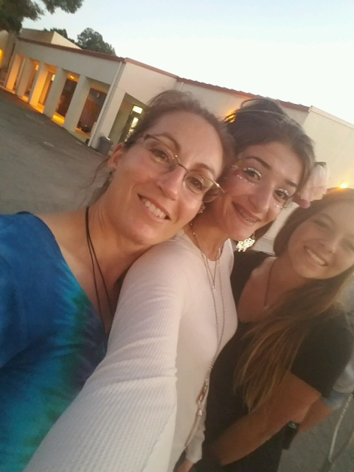
Biomolecules/ Macromolecules
Notes Page 65 NB

Slide 53
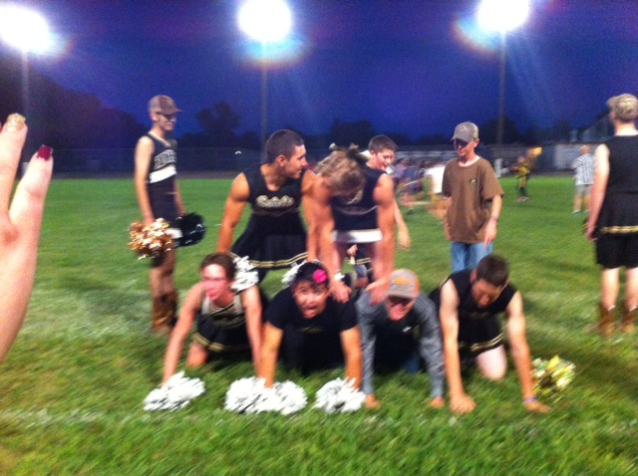

Slide 54
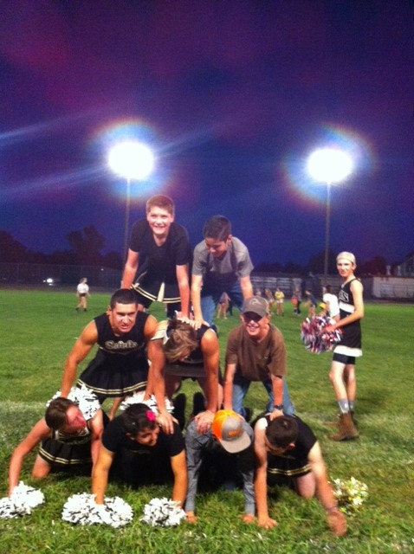

Slide 55
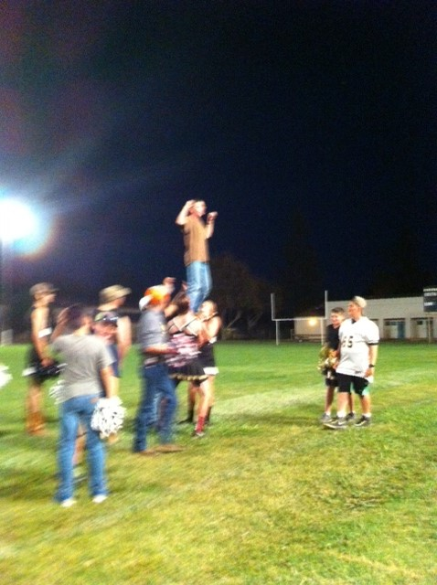

Slide 56
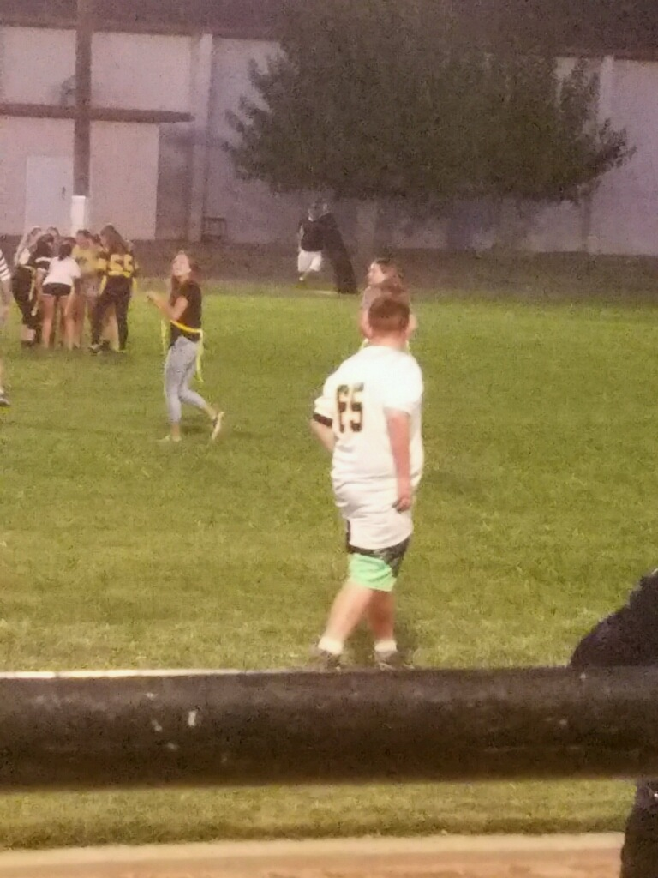
Melina playing flag football

Slide 57
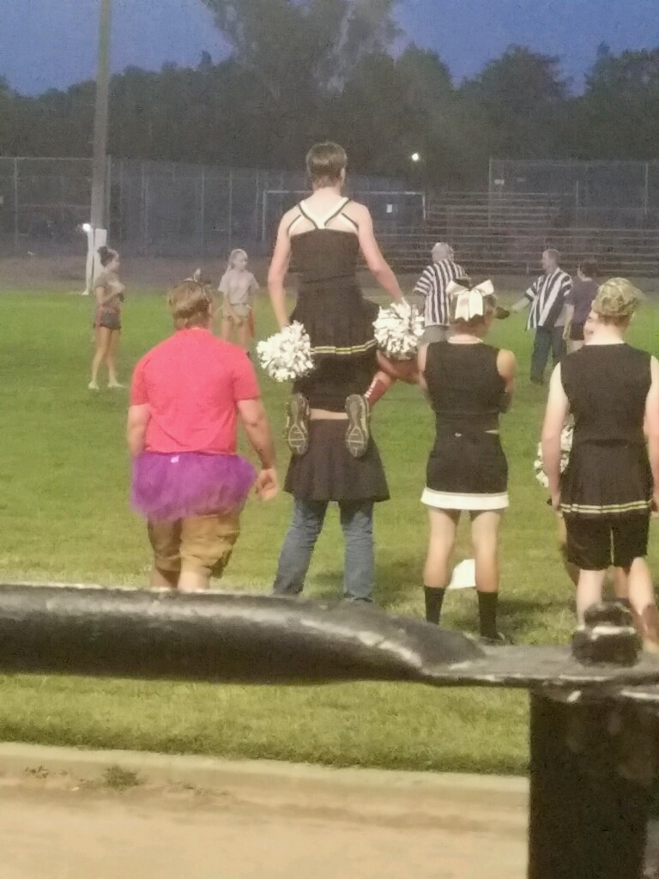

Slide 58
DNA Replication Lab p. 63 NB
Materials:
Scissors, tape, DNA template (on white piece of paper), blank white piece of paper, 4 of each nitrogenous bases (each one different color of paper).
Procedures:
Pair up with a partner
Get supplies: 2 Original Strands of DNA backbone (White), & 1 paper of 4 of each of the Nitrogen Bases
Base pair the nitrogen bases to the Deoxyribose sugar.
Draw your Hydrogen Bonds A=T; C=G
Write Original Strand on the two white DNA Backbones.
After McAllister reviews your model, she will give you 2 Yellow Backbones that are the complementary strands to base pair your Original strand to.
Cut your Original Strand in ½, and base pair the complementary strand to it.
When you have finished your model, answer the questions below in your notebook P.47NB
Questions:
List the 3 functional groups & the 4 nitrogenous bases found in DNA.
List the rules for base pairing in DNA.
What are the two main functions of DNA?
Draw DNA Replication with two different colors.

Slide 59
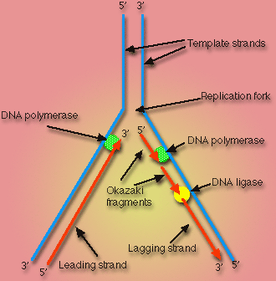
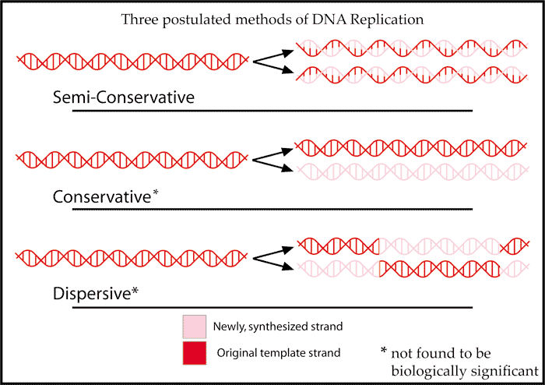
DNA Replication Activity Tape your Replicated DNA p. 63 NB
What is Semi–Conservative Replication?
What are the two main functions of DNA?
Why is DNA Replication important?
List the 3 functional groups & the 4 nitrogenous bases found in DNA.
Draw DNA Replication with two different colors.
List the rules for base pairing in DNA.

Slide 60
Problem Solving Lab 8.2 P. 204BB p. 61 NB
Read the Observe & Infer section.
Read the Solve the Problem.
Answer the three “Thinking Critically” questions p. 61NB
  Growth 1 phase- Rapid Growth & metabolism of Interphase is the most variable in length.
  The two types of cells have different functions and one is more complex than the other.
  The cycle of some types of cells is faster then others because of the complexity of the proteins made by the cell or the need to produce cells due to rapid wear and tear – like skin cells compared to muscles cells or nerve cells in the spine (do not regenerate).

Slide 61
Mitosis Practice p. 65NB
Get 2 white boards/ lab station
Get 1 Expo marker / 2 students
Draw a nucleus and place your replicated chromosomes inside the nucleus.
With the yellow and red chromosomes, practice the 4 stages of Mitosis, drawing and erasing the nucleus as the stages dictate.
After you show them to me/us, Then draw the phases of Mitosis on
page 63 NB.

Slide 62
Mitosis Rules p. 65 NB
Create a Mental model of how a cell cycle works that shows an end result of 2 identical cells after Mitosis with the same number of chromosomes.
Set up rules for what a cell can and can not do.
What steps does the cell have to go through to create two new identical cells.
Result of Mitosis: 2 identical cells with the same # of chromosomes that make tissues, that form organs, that are part of an organ system and make an organism.

Slide 63
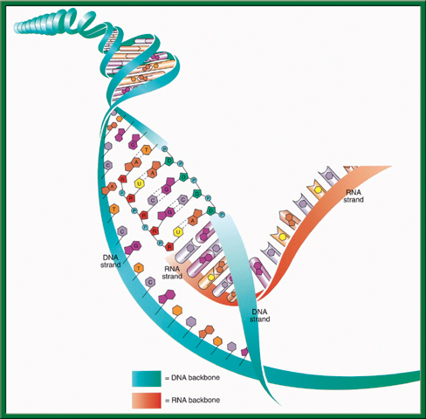


3/14 RNA (Ribonucleic Acid) CH 11.2
Obj. TSW compare and contrast the structure and function of DNA and RNA in the Warm Up, and from the video. P. 68 NB
Describe how RNA’s structure differs from DNA’s structure in three ways?
Identify and describe the functions of the three types of RNA.
What is the main difference between Transcription and DNA Replication?
Study for Midterms!: CH 11 Friday
Work on your Lab – Final Lab due Friday

Slide 64
Science Article: Endosymbiotic Theory p. 65 NB
Read the article quietly.
Read the article out loud.
Pair up and write the Claim, Evidence and Reasoning
Discuss as a class: Endosymbiotic Theory
Turn the Paper over and write the AXES Paragraph on Endosymbiotic Theory

Slide 65



Section 11.2 Summary – pages 288 - 295
#1. RNA
RNA like DNA, is a nucleic acid. RNA structure differs from DNA structure in three ways.
First, RNA is single stranded—it looks like one-half of a zipper —whereas DNA is double stranded.

Slide 66
#1. Transcription
To return to the chapter summary click escape or close this document.

Slide 67

Section 11.2 Summary – pages 288 - 295
#1. RNA
Both DNA and RNA contain four nitrogenous bases, but rather than thymine, RNA contains a similar base called uracil (U).
Uracil forms a base pair with adenine in RNA, just as thymine does in DNA.
Uracil
Hydrogen bonds
Adenine

Slide 68


#1. Second: Chemical Difference of DNA and RNA
Uracil is the Nitrogen base that replaces Thymine
To return to the chapter summary click escape or close this document.

Slide 69

Section 11.2 Summary – pages 288 - 295
#1. RNA
Third: The sugar in RNA is Ribose; DNA’s sugar is deoxyribose.
Ribose

Slide 70


Section 11.2 Summary – pages 288 - 295
#2. RNA
Transfer RNA (tRNA) is the supplier. Transfer RNA delivers amino acids to the ribosome to be assembled into a protein.
Click image to view movie

Slide 71
Section 11.2 Summary – pages 288 - 295
#2. RNA
There are three types of RNA that help build proteins.
Messenger RNA (mRNA), brings instructions from DNA in the nucleus to the cell’s factory floor, the cytoplasm.
On the factory floor, mRNA moves to the assembly line, a ribosome.

Slide 72
Protein Synthesis – Thursday!!!!! 10/6
1 large bag of M & M’s –
1 large bag of Gummy Bears –
4 bags of Marshmallows-
1 stick of Butter – McAllister
1 box Rice Krispy Cereal -

Slide 73
DNA Quiz Friday 9/30
1 piece of Binder Paper & pencil or pen. Write your name on the top right hand side.
1. What is the name of the molecule that holds our genetic information?
2. What is the shape of that molecule?
3. Where is that molecule located in the cell?
4. What are the 4 Nitrogen Bases that code for Amino Acids?
5. Write how the Nitrogen base pair together.
What is the bond that holds the nitrogen bases together?
Draw & Write the three parts of a nucleotide.
8. What is DNA Replication?
9. What are the two functions of DNA?
10. How is RNA different from DNA?

Slide 74
Section 11.2 Summary – page 2888- 295
Genes Expression = Proteins
You learned earlier that proteins are polymers of amino acids.
The sequence of nucleotides in each gene contains information for assembling the string of amino acids that make up a single protein.

Slide 75

Section 11.2 Summary – pages 288 - 295
#2. RNA
The ribosome, made of ribosomal RNA (rRNA), binds to the mRNA and uses the instructions to assemble the amino acids in the correct order.

Slide 76


What Process is this?
What are the steps?
What is the name for this particular type of process?
To return to the chapter summary click escape or close this document.

Slide 77

#3. The difference of DNA Replication & Transcription (Making Proteins)
Transcription – first process of making proteins.
DNA Replication – makes more DNA for more cells.

Slide 79

3/15 Protein Synthesis: Transcription 11.2 Week 8
Obj. TSW be able to explain the process of Transcription by making mRNA strand from DNA through practice. P.70 NB
Learn.genetics.utah.edu/
What is transcription?
Where does Transcription happen?
Why is a codon important to making a protein?
STUDY for the MIDTERM
Chapters: 6.3, 7, 8.1, 9, 11

Slide 80
Cracking the Code
Answer the Questions on the ½ sheet of paper

Slide 81

Section 11.2 Summary – pages 288 - 295
Transcription
In the nucleus, enzymes make an RNA copy of a portion of a DNA strand in a process called transcription.
Click image to view movie

Slide 82
Section 11.2 Summary – pages 288 - 295
Transcription
A
DNA strand
RNA strand
RNA strand
C
B
DNA strand

Slide 83
Section 11.2 Summary – pages 288 - 295
Transcription
The main difference between transcription and DNA replication is that transcription results in the formation of one single-stranded RNA molecule rather than a double-stranded DNA molecule.

Slide 84
Section 11.2 Summary – pages 288 - 295
RNA Processing = Gene Expression
Not all the nucleotides in the DNA of eukaryotic cells carry instructions—or code—for making proteins.
Genes usually contain many long noncoding nucleotide sequences, called introns, that are scattered among the coding sequences.

Slide 85


Chapter Assessment
Question 1
How does DNA control the structures and functions of a cell?
Answer
DNA determines the structure of proteins. Some proteins become important cell structures. Other proteins, such as enzymes, control chemical reactions that perform key life functions.
CA: Biology/Life Sciences
5a

Slide 86

Write a 4 sentence summary
P 71 NB
ACGT
ACGU
DNA
Deoxyribose
Double chain/ Helix
mRNA
Ribose
Yes
No
Nucleus
Nucleus & Cytoplasm
RNA
rRNA
tRNA

Slide 87
HW CH 11 DNA & Genes p.41 NB
Deoxyribose
Nitrogenous Base
Nucleotide
Base Pair
Hydrogen Bond
Phosphate
Adenine (A) & Nitrogen Bases
Cytosine
*Nucleotides
DNA Replication
Double Helix

Slide 88
HW CH 11 DNA &Genes*
DNA – Double RNA – single
DNA – Deoxyribose RNA – Ribose
DNA – ATCG RNA – AUCG
Amino Acids
Amino Acids
Proteins
Codon*
Threonine

Slide 89
QUIZ
8. What is DNA Replication?
9. What are the two functions of DNA?
10. What are three differences of RNA from DNA?
11. What RNA has stop codons, and what is their function?
12. How are codons and anticodons different?
13. Write the equation for Protein Synthesis.
14. Transcribe & Translate the DNA sequence:ATC, TCA, TAC

Slide 90
DNA Quiz
7. What is the backbone of the molecule made of?
8. What is a gene?
9. What does DNA code for? What is it’s purpose?
10. Write the formula for Protein Synthesis
When you are finished turn you paper upside down and wait quietly to
have me pick it up.

Slide 91
POP QUIZ Write your name on your binder paper.
What is this molecule? Spell it out.
What is the shape of the molecule?
What are the two purposes/ functions of this molecule?
Write the three names for the parts of a nucleotide. Be specific.
The Nitrogen bases are: Adenine, Cytosine, Guanine, & Thymine – Base Pair them together correctly.
What holds the Nitrogen bases together?
DNA is a Nucleic Acid, write an example of another one.
Can a Nucleic Acid leave the nucleus?
9. What is DNA Replication?
What is the name for how DNA
Replications?

Slide 92

DNA: being inserted into an egg for cloning

Slide 93


Slide 94
Chapter Assessment
Question 2
The process through which the order of bases in messenger RNA codes for the order of amino acids in a protein is:
A. transcription
B. translation
C. replication
D. point mutation
The answer is B.
CA: Biology/Life Sciences
4f

Slide 95
Chapter Assessment
Question 3
Why would scientists use nucleotide sequences to identify bodies of crime victims?
Answer
In comparing nucleotide sequences in the DNA of a crime victim with nucleotide sequences from a possible close relative of the crime victim, scientists can determine if the two are related.
CA: Biology/Life Sciences
4e

Slide 96
HW CH 11
9.Phenylalanine Codon are (UUU) (UUC)
10. Codon
11. Amino Acid
12. Amino Acid
13. Stop codons = UGA, UAG, UAA
14. Tryptophan & Methionine

Slide 97



2/24 Protein Synthesis: Translation 11.2
Obj. TSW explain the process of Protein Synthesis by working on their Protein Synthesis foldable and transcribing and translating DNA sequences from their Mini Lab 11.1 P. 52NB
Learn.genetics.utah.com.edu/
Compare & Contrast Codon and Anticodon.
What is the role of tRNA in Protein Synthesis?
Why are Stop Codons important in Translation?
http://www.dnatube.com/video/3448/DNA-Replication

Slide 98

#1. Codon & Anticodon
A Codon is a nucleotide triplet sequence on mRNA, it codes for an amino acid.
  AUG ACG GAG
An Anticodon is a nucleotide triplet sequence on tRNA that carries the Amino acid
  UAC
Both are RNA & Each triplet pairs to code for a particular Amino acid to form a protein.

Slide 99
Section 11.2 Summary – pages 288 - 295
#2. The role of transfer RNA - tRNA
As translation begins, a ribosome attaches to the starting end of the mRNA strand. Then, tRNA molecules, each carrying a specific amino acid, approach the ribosome.
When a tRNA anticodon pairs with the first mRNA codon, the two molecules temporarily join together.
Usually, the first codon on mRNA is AUG, which codes for the amino acid methionine.

Slide 100
#3. Stop Codons
Without the stop codon, the protein would continuously be made.
More Protein is not necessarily better.
Name the 3 codons for STOP:
  UAA, UAG, UGA

Slide 101

Section 11.2 Summary – pages 288 - 295
The Genetic Code P.292 BB
The Messenger RNA Genetic Code
First Letter
Second Letter
Third Letter
U
C
A
G
U
Phenylalanine (UUU)
Serine (UCU)
Tyrosine (UAU)
Cysteine (UGU)
U
Phenylalanine (UUC)
Serine (UCC)
Tyrosine (UAC)
Cysteine (UGC)
C
Leucine (UUA)
Serine (UCA)
Stop (UAA)
Stop (UGA)
A
Leucine (UUG)
Serine (UCG)
Stop (UAG)
Tryptophan (UGG)
G
C
Leucine (CUU)
Proline (CCU)
Histadine (CAU)
Arginine (CGU)
U
Leucine (CUC)
Proline (CCC)
Histadine (CAC)
Arginine (CGC)
C
Leucine (CUA)
Proline (CCA)
Glutamine (CAA)
Arginine (CGA)
A
Leucine (CUG)
Proline (CCG)
Glutamine (CAG)
Arginine (CGG)
G
A
Isoleucine (AUU)
Threonine (ACU)
Asparagine (AAU)
Serine (AGU)
U
Isoleucine (AUC)
Threonine (ACC)
Asparagine (AAC)
Serine (AGC)
C
Isoleucine (AUA)
Threonine (ACA)
Lysine (AAA)
Arginine (AGA)
A
Methionine;Start (AUG)
Threonine (ACG)
Lysine (AAG)
Arginine (AGG)
G
G
Valine (GUU)
Alanine (GCU)
Aspartate (GAU)
Glycine (GGU)
U
Valine (GUC)
Aspartate (GAC)
Glycine (GGC)
Alanine (GCC)
Glycine (GGC)
C
Valine (GUA)
Alanine (GCA)
Glutamate (GAA)
Glycine (GGA)
A
Valine (GUG)
Alanine (GCG)
Glutamate (GAG)
Glycine (GGG)
G

Slide 102
2/25 Protein Synthesis: Translation 11.2
Obj. TSW explain the process of Protein Synthesis by diagramming all the steps in their notebook. P. 54 NB
When making proteins, If a template DNA strand read TAC GGT, AGT what would a complementary strand of mRNA be?
What Amino Acids would the 3 codons code for?
Do the same for: GCA, TGC, ATC (DNA).
Learn.genetics.utah.edu/

Slide 103

Protein Synthesis p. 59 NB
DNA -> transcription -> RNA -> translation -> Proteins

Slide 104
Mini Lab 11.1 P. 67NB P. 293 BB
DNA → transcription →RNA →translation → Protein
Copy this table in your notebook.
 | A | B | C | D | E
DNA Base Sequence | Process | mRNA Codon | Process | tRNA Anticodon | Amino Acid
AAT
GGG
ATA
AAA
GTT

Slide 105
Mini Lab 11.1 P. 67 NB P. 293 BB
DNA → transcription →RNA →translation → Protein
 | A | B | C | D | E
DNA Base Sequence | Process | mRNA Codon | Process | tRNA Anticodon | Amino Acid
AAT | Transcription | UUA | Translation | AAU | Leucine
GGG |  | CCC |  | GGG | Proline
ATA |  | UAU |  | AUA | Tyrosine
AAA |  | UUU |  | AAA | Phenylalanine
GTT |  | CAA |  | GUU | Glutamine
Answer Analysis Questions 1 – 3
A.DNA instructions are located in the nucleus.
Transcription happens in the nucleus.
Translation happens in the Ribosome.
tRNA looks like a triangle with an Amino Acid on the end, and the other side has the Anticodon that base pairs with the codon on the mRNA.
Mutations would be more common, if the sequence of DNA was not strictly adhered to.

Slide 106

Page 292 Biology Book

Slide 107
Molecular Genetics p. 69 NB
DNA Replication – make more DNA for more cells to replace other cells.
Protein Synthesis – to make proteins
DNA-DNA
A = T
T = A
C = G
G = C
DNA RNA
A = U
T = A
C = G
G = C
Protein Synthesis
DNA: TAC CAC AAC
Transcription (nucleus)
mRNA: AUG GUG UUG
Translation (ribosome)
Protein: Methionine, ________, ________ Amino Acid Sequence

Slide 108
Protein Synthesis
Transcription Practice p. 69NB
Directions: Using the DNA strand as a template, transcribe mRNA. Make sure to use the correct Nitrogen bases.
ATA CCT TAA CGC GTC
TAT TAG GCA AAA TTC
GTG TGA TTA ATA GCC
CTA AAG GAA TAG GAT
GAT GAA TAC CCA CGA
TAA TAT GCA CAT TAC
GAA CCT TAC GGG GTG
TAT AAC CAG GAG TTT
ATC CGT AGT GTA AAT
GGA TTA CCC TTA CCA

Slide 109


Slide 110
Protein Synthesis – Gene Expression
1. DNA: ATA CCT TAA CGC GTC
2. DNA: TAT TAG GCA AAA TTC

Slide 111
AXES Paragraph P. 71 NB
Write a paragraph after building your DNA molecule that include the vocabulary words: Double helix, Nitrogen bases, Hydrogen bond, Nucleotide, Backbone, Deoxyribose, Phosphate, Adenine, Thymine, Cytosine, Guanine.

Slide 112



Collect 3 sheets of paper and layer them about 1.5 cm apart vertically. Keep the edges level.
P. 53 NB
To return to the chapter summary click escape or close this document.

Slide 113


Fold up the bottom edges of the paper to form 6 equal tabs.
P. 53NB
To return to the chapter summary click escape or close this document.

Slide 114


Fold the papers and crease well to hold the tabs in place. Staple along the fold. Label each tab.
P. 53NB
RNA – draw & label 3 differences from DNA p. 289
TRANSCRIPTION: from DNA to RNA P. 290
RNA Processing (Introns & Exons) P.291
The Genetic Code p. 291 - 292
TRANSLATION: from mRNA to PROTEIN p. 294 11.9A
PROTEIN SYNTHESIS
DNA->transcription->RNA ->translation->Protein
To return to the chapter summary click escape or close this document.

Slide 115
Quiz Corrections #1
Which of the following compounds may be macromolecules (polymers)?
Carbohydrates
Nucleic Acids
Proteins
All of these

Slide 116
Quiz Corrections #2
Which of the following elements is more common in organic life forms?
Water
Hydrogen
Carbon
Nitrogen

Slide 117
Quiz Corrections #3
Unlike carbohydrates and fats, Proteins contain
Nitrogen
Carbon
Hydrogen
oxygen

Slide 118
Quiz Corrections #4
All living things are made up of
Prokaryotic and eukayotic cells
Animal and plant cells
Cells that have a nucleus
None of the above

Slide 119
Quiz Corrections #5
If a cell contains a nucleus, it must be a(n)
Plant cell
Eukaryotic Cell
Animal Cell
Prokaryotic Cell

Slide 120
Quiz Corrections #6
Due to ________________, a cell’s contents are not always the same as its surroundings.
Plasmolysis
Selective Permeability
Phagocytosis
Dynamic equilibrium

Slide 121
Quiz Corrections #7
Which structure in eukaryotic cells sorts and transports proteins?
Golgi Apparatus/ body
Organelle
Ribosome
Chloroplast

Slide 122
Quiz Corrections #8
Which of the following statement about enzymes is NOT true?
Enzymes are catalysts.
Enzymes are Proteins
Enzymes operate most efficient at optimum pH
Enzymes are destroyed during chemical Reactions

Slide 123
Quiz Corrections #9
In Cellular Respiration ______________ is transformed into usable energy in the form of _______________.
ATP; Glucose
Glucose; ATP
Carbon Dioxide; Glucose
Water; Oxygen

Slide 124
Quiz Corrections #10
Plants need a constant supply of _________ for photosynthesis, and they provide ______________ for cellular respiration.
Water, Carbon Dioxide
Carbon Dioxide, Water
Carbon Dioxide, Oxygen
Oxygen, Water

Slide 125
2015 Midterm Study Guide answers
A. Age in Years
b. Number of Teens
2. The trend is increasing for teens with phones.
3. As teens get older, more have cell phones.
4. A decrease in 60 teens who have cell phones.
5. Eukaryotic: Nucleus, Membrane Bound Organelle, Animal cell, Plant cell
Prokaryotic: No Nucleus, Bacteria
Both: DNA, Ribosomes, Cell Wall, Plasma Membrane,

Slide 126
Study Guide for Midterm Final Biology
6. a. Proteins: Carbon Hydrogen and Oxygen, Nitrogen, Sulfur
b. Lipids: Carbon, Hydrogen, Oxygen
c. Carbohydrates: Carbon, Hydrogen, Oxygen
d. Nucleic Acids: Carbon, Hydrogen, Oxygen, Phosphorus, Nitrogen, Sulfur
7. The Mitochondria converts Glucose into ATP (energy) and it produces Heat, CO₂ & H₂O.
8. The Chloroplast captures light energy and converts it to sugar ( C₆H₁₂O₆), Chemical Energy.
9. An Enzyme is a Protein, that speeds up chemical reactions.
10. Draw☺
11. Environmental Factors: Temperature, pH, Ionic Conditions
12. Plant – Cell Wall, Large Vacuole, Chloroplasts,
Animal – Small vacoule
Both: Eukayotic, Cell Organelles, Plasma Membrane, Nucleus, Mitochondria

Slide 127
A type of nucleic acid that has a double helix and contains thymine.
This process uses glucose and oxygen to produce ATP, CO2 (carbon dioxide), and water.
This is a three nucleotide sequence found on tRNA that codes for a specific amino acid.
This macromolecule is composed of amino acid chains.
This type of macromolecule that includes glucose, fructose, and other saccharides. It has oxygen, carbon, and hydrogen atoms.
This type of eukaryotic cell does not have cell walls or chloroplasts.
This type of cell has cell walls, mitochondria, chlorophyll, and it utilizes both cellular respiration and photosynthesis to convert solar or organic energy into ATP.
This nucleic acid is single stranded and contains uracil.

Slide 128
A three base sequence that corresponds with a specific amino acid for protein synthesis.
This is a pathogen that infects other cells and it hijacks a host cell’s machinery to replicate.
This process uses carbon dioxide and water to produce glucose and oxygen.
This is a change in a nucleotide sequence that can cause the readings of the codons after the change to code for different amino acids. Can cause an abnormally short or abnormally long amino acid chain.
This molecule is a pigment found in the chloroplasts of plants and is vital in the process of photosynthesis.
These proteins increase the rate of chemical reactions and are affected by environmental conditions.
This is a type of RNA that makes up part of the ribosome and is essential in protein synthesis.

Slide 129
A process that occurs in the cytosol and involves different forms of RNA. It occurs at the ribosome where the mRNA is read.
This organelle is used in cellular respiration and it is found in both animal and plant cells.

Slide 130


10/13 Gel Electrophoresis CH 13.1
Obj. TSW learn how to build a protein from an amino acid sequence using the hydrophobic and hydrophilic properties of the amino acids. P. 78 NB
What is Gel Electrophoresis?
Why is DNA fingerprinting important?
Explain the field of Genetic Engineering and how a Gel Electrophoresis applies.
Watch Gel Video
HW CH 13
HW Study Guide
Final 10/15

Slide 131

Study Guide
13. AXES Paragraph about folded membranes:
Having folded membranes in cells is better. Organelles in the cell that have folded membranes are: Mitochondria, Golgi Apparatus, Endoplasmic Reticulum, and Chloroplasts. The folded membranes increase the chemical reactions in the cell because it has more surface area. In addition, the chemical reactions are more efficient due to the increased surface area. The chemical reactions help maintain homeostasis in the body.

Slide 132

Study guide
14.Photosynthesis: Glucose & O2 as a Product, Chloroplast, Needs Sunlight, CO2 & H20 as a reactant, Plants
Cellular Respiration: Glucose & O2 as a Reactant, Animals, CO2 & H2O as a product, Plants
Both: Mitochondria, Plants
15.

Slide 133
Study Guide
16. DNA: Adenine=Thymine
Cytosine=Guanine
17. RNA: Adenine= Uracil
Cytosine=Guanine
18. Frameshift Mutation: changes every amino acid after the addition or deletion, deletion of a nucleotide, addition of a nucleotide, is more severe
Point Mutation: changes one nucleotide, changes one amino acid,
Both: type of mutation

Slide 134
19. AXES paragraph:
Selective permeability allows some molecules in and out and other not. Glucose is a molecule that the cells need for energy. Carbon dioxide and water are released from the cell. Passive transport allows molecules across the cell membrane without energy. Active transport requires energy. Glucose provides energy for the body to perform cellular respiration, and maintains homeostasis for the body.
20. Virus – pathogen, needs a host cell to live and replicate.

