Slide 1
2017 Southport 8th Grade Tour
March 31st

Slide 2
Getting set up

Slide 3
What good students!!

Slide 4
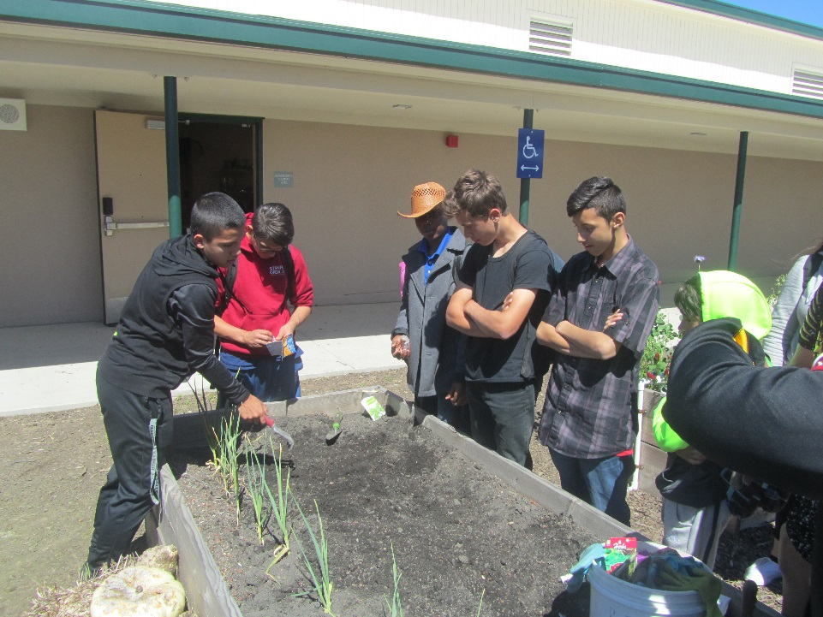
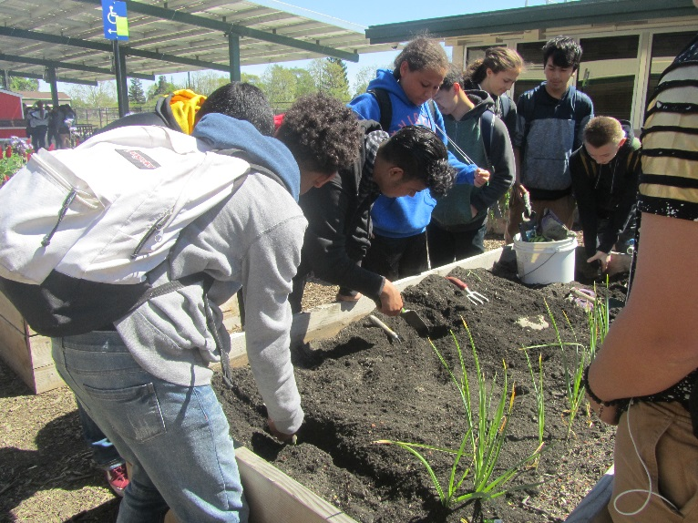
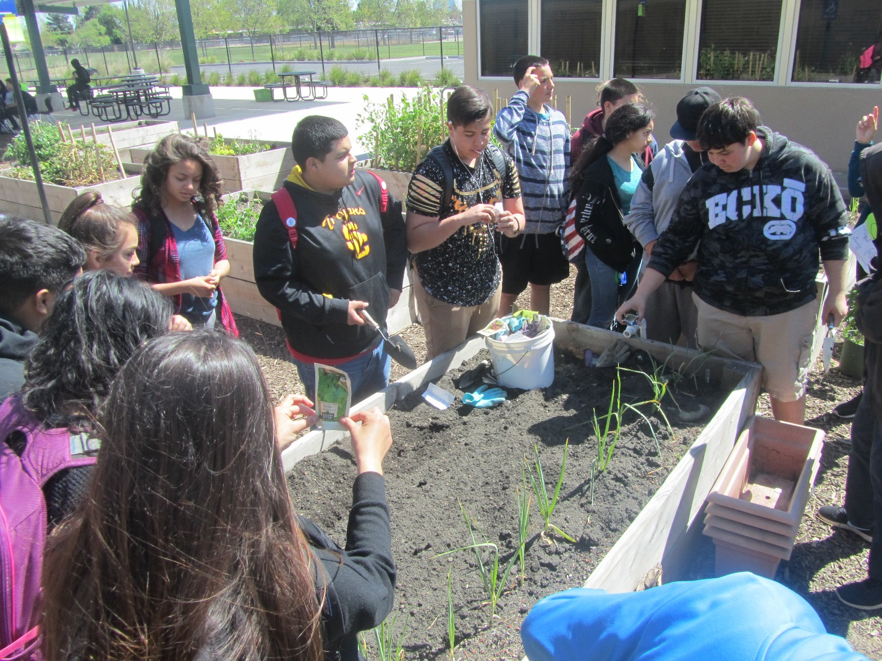
Diggin’ in

Slide 5
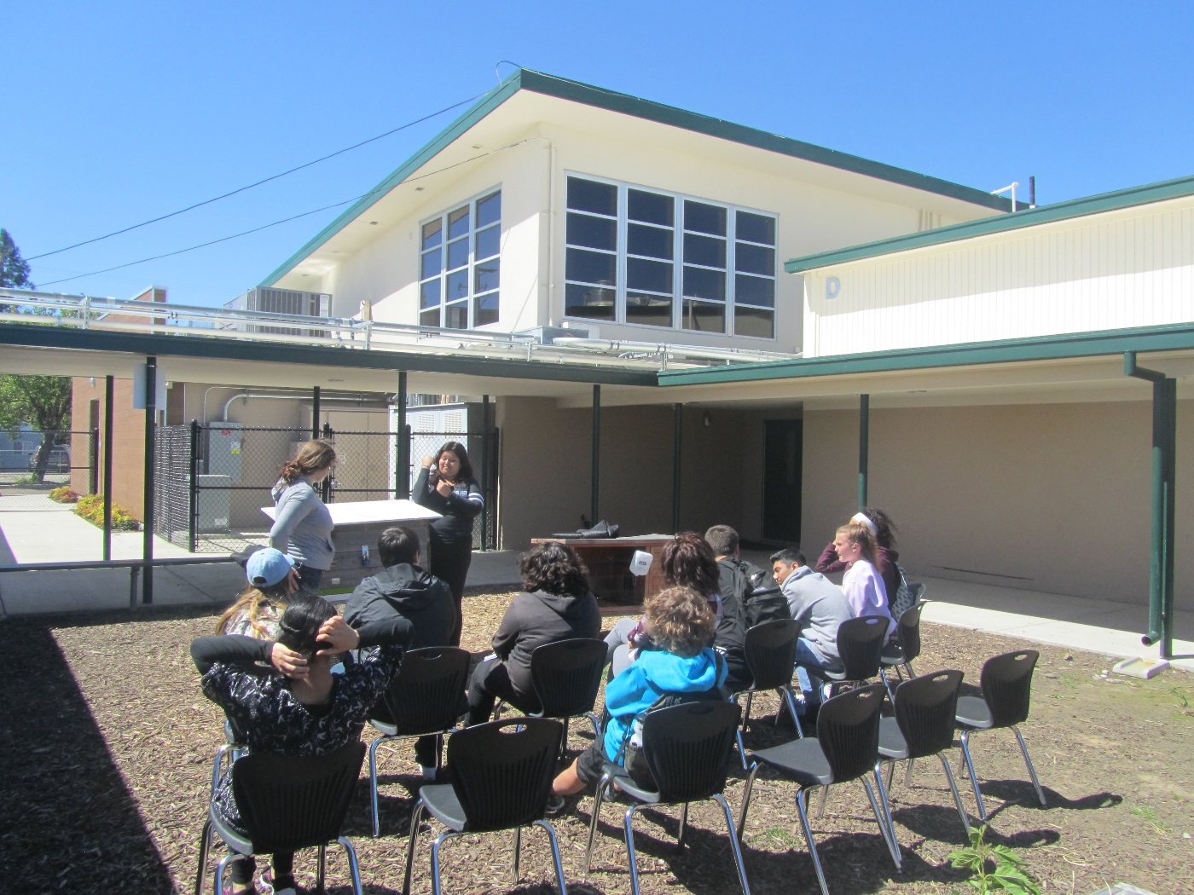
Teaching about bunnies

Slide 6
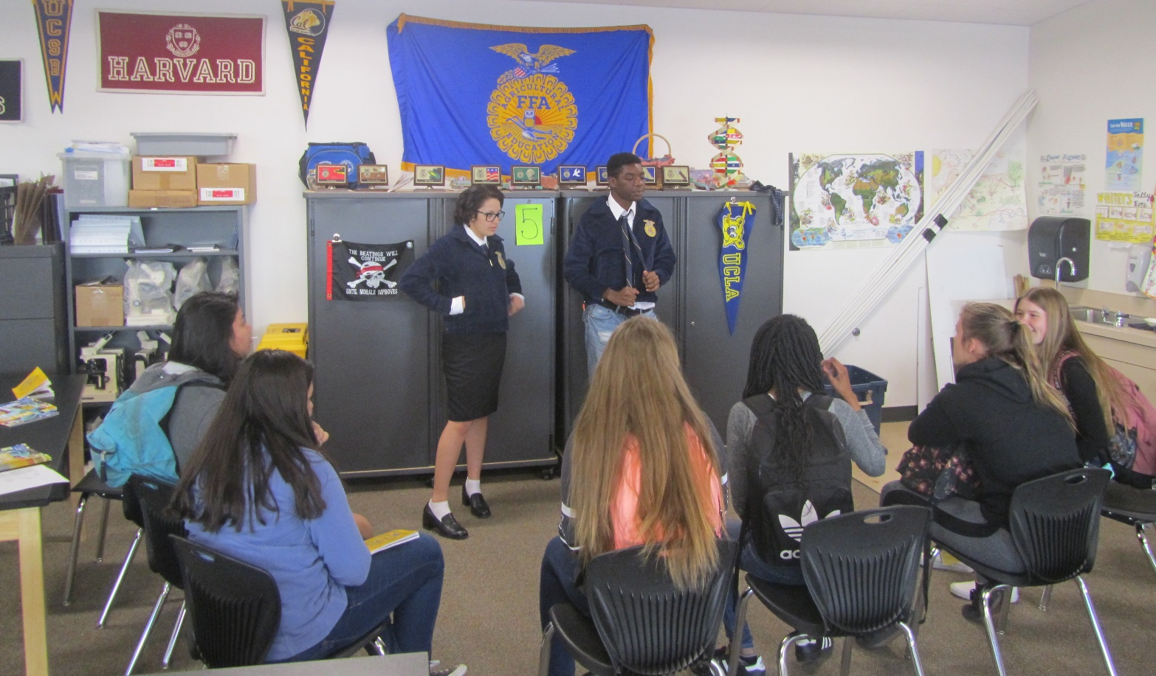
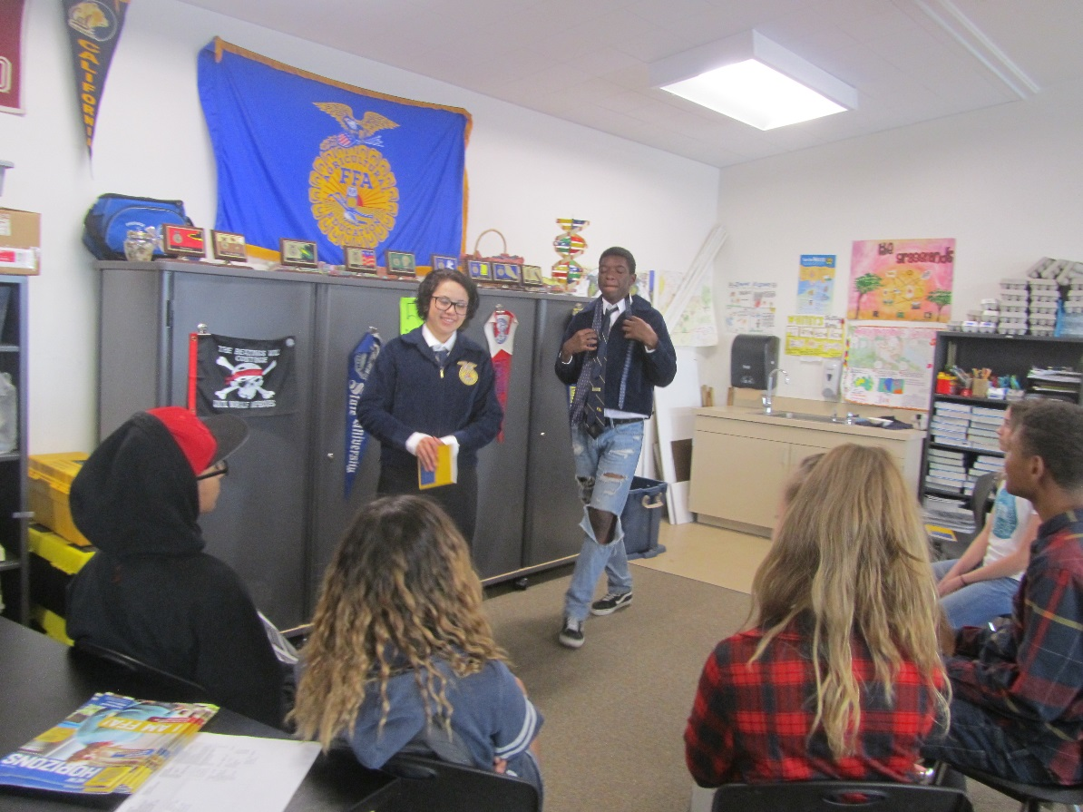
Teaching about FFA

Slide 7
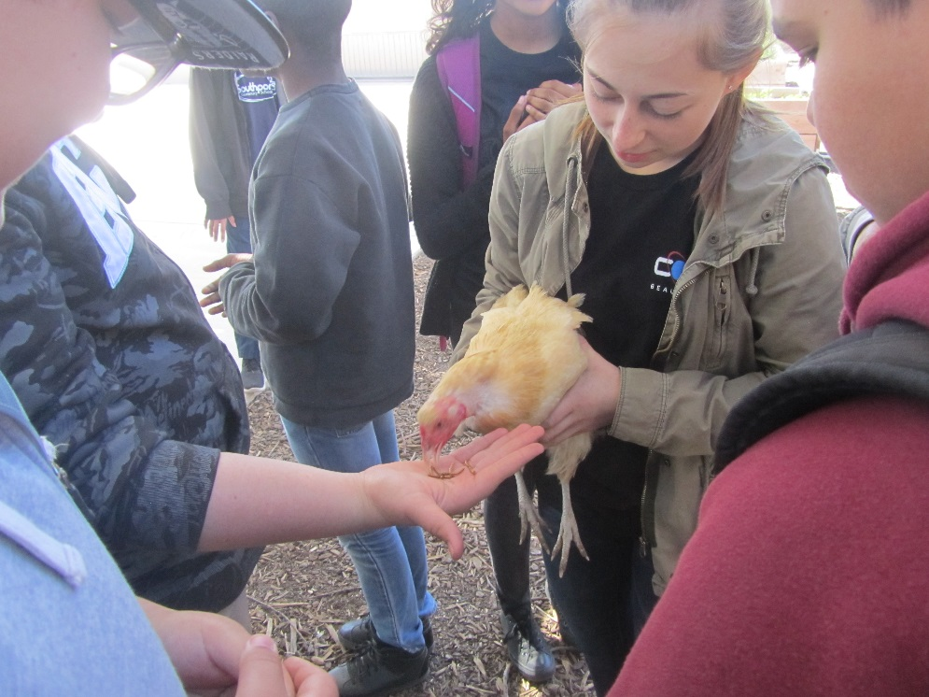
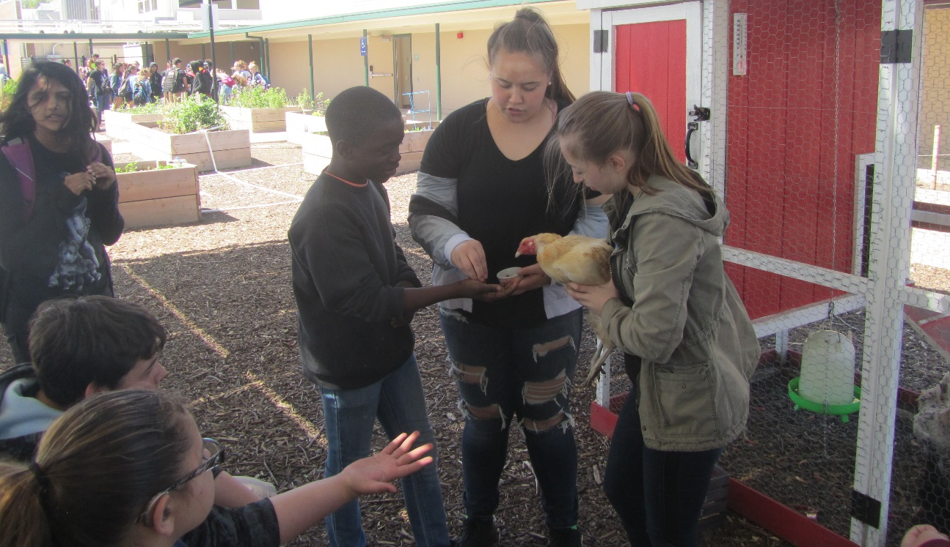
Teaching about the Chickens

Slide 8
Teaching about Composting and Hydroponics

Slide 9
Teaching about the Tower Gardens

Slide 10
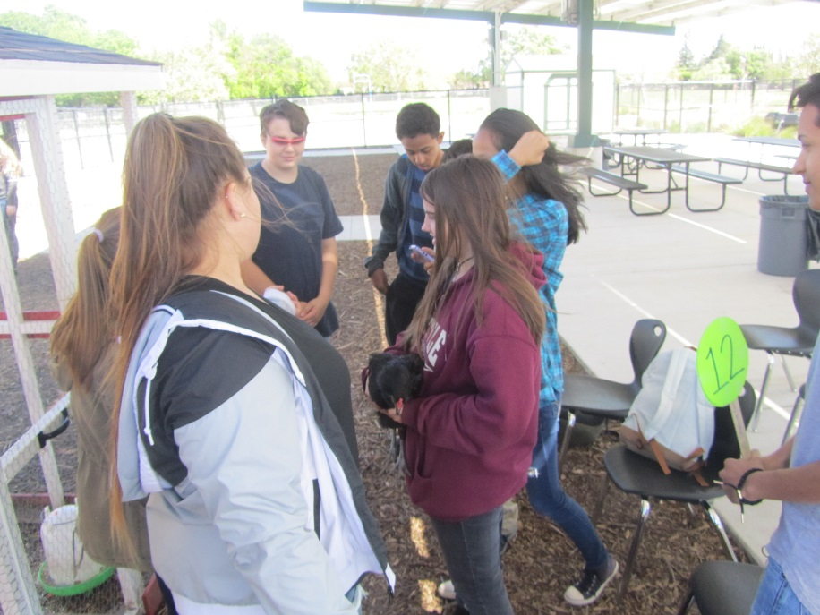
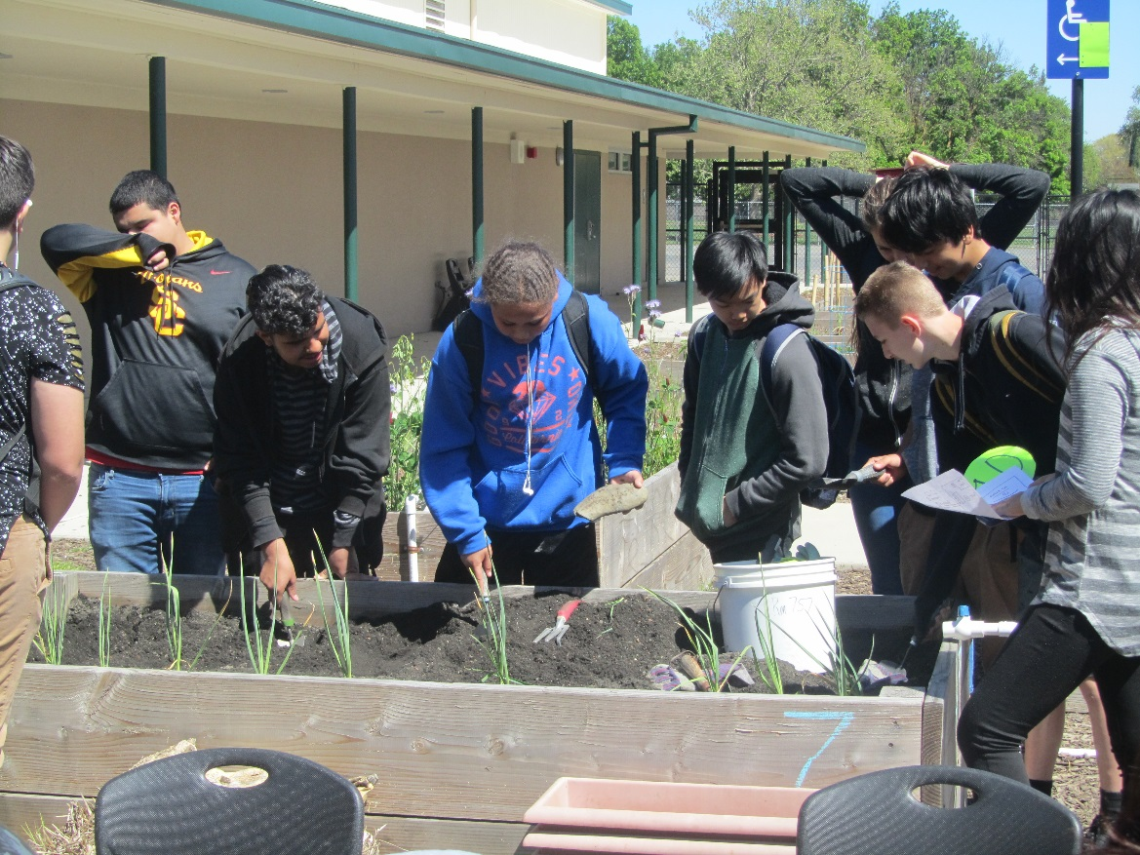
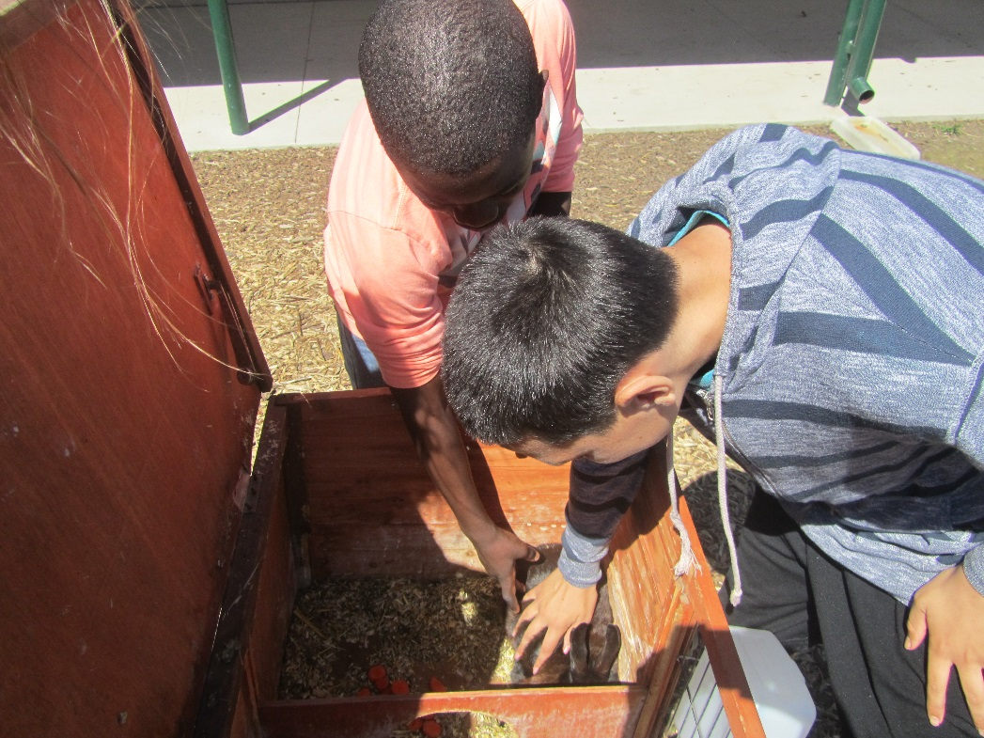
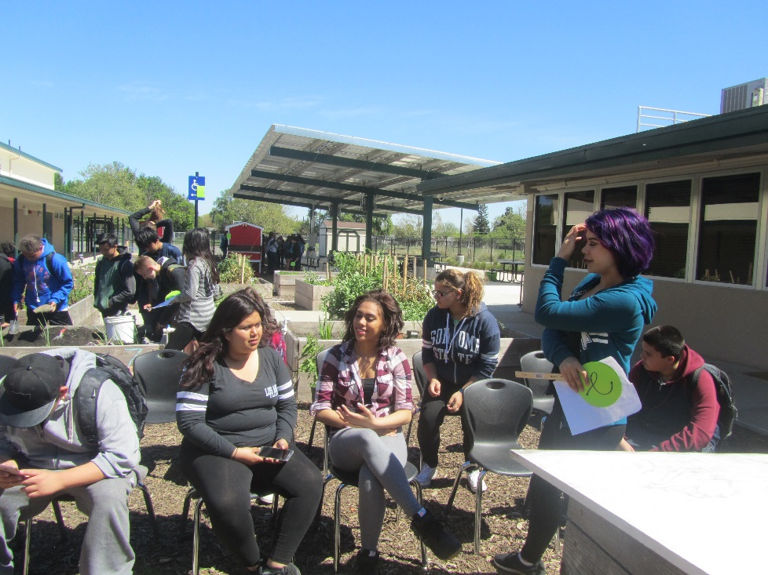
Thank you

Slide 11
Great Job West Sacramento FFA!

