Slide 1
DNA & the future generations

Slide 2
6.3 Section Summary 6.3 – pages 157-163
The structure of nucleic acids
A nucleic (noo KLAY ihk) acid is a complex biomolecule that stores cellular information in the form of a code.
Nucleic acids are polymers made of smaller subunits called nucleotides.

Slide 3
6.3 Section Summary 6.3 – pages 157-163
The structure of nucleic acids
The information coded in DNA contains the instructions used to form all of an organism’s enzymes and structural proteins.
Another important nucleic acid is RNA, which stands for ribonucleic acid. RNA is a nucleic acid that forms a copy of DNA for use in making proteins.

Slide 4
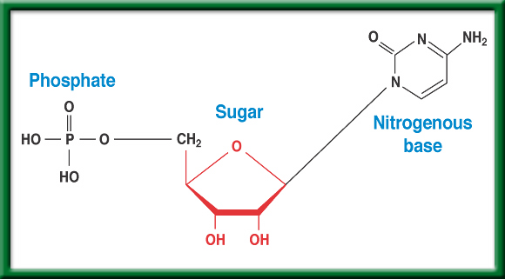
Nucleotides
To return to the chapter summary click escape or close this document.

Slide 5
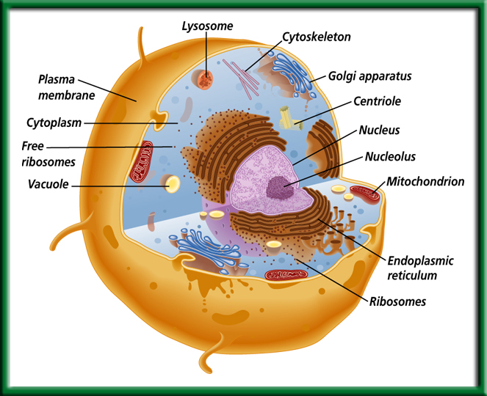
Animal
Cell or Plant cell?
Eukaryotic or
Prokaryotic?
To return to the chapter summary click escape or close this document.

Slide 6
Section 11.1 Summary – pages 281 - 287
The structure of nucleotides
#1. The simple sugar in DNA, called deoxyribose (dee ahk sih RI bos), gives DNA its name— deoxyribonucleic acid.
The phosphate group is composed of one atom of phosphorus surrounded by four oxygen atoms, it has a negative charge.

Slide 7
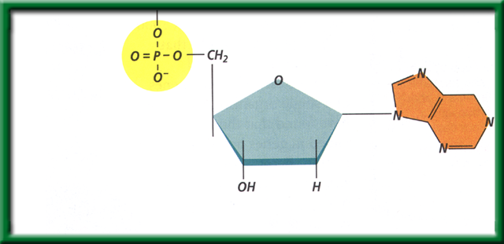
Section 11.1 Summary – pages 281 - 287
The structure of nucleotides
#2. DNA is a polymer made of repeating subunits called nucleotides. The backbone is made up of the Sugar and Phosphate group.
Nitrogenous base
Phosphate group
Sugar (deoxyribose)
Nucleotides have three parts: a simple sugar, a phosphate group, and a nitrogenous base.

Slide 8
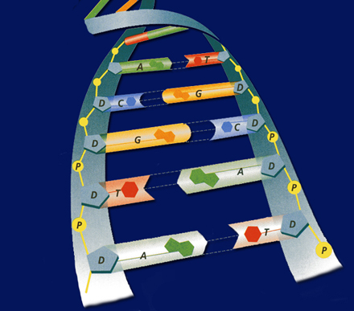
Section 11.1 Summary – pages 281 - 287
#2. What are the two functions DNA?
Although the environment influences how an organism develops, the genetic information that is held in the molecules of DNA ultimately determines an organism’s traits.
DNA achieves its control by determining the structure of proteins.

Slide 9
DNA/ RNA Beads p. 43NB
Back bone= Phosphate & Sugar (Red & White)
Nitrogen Bases= Adenine (Blue)=Thymine (Green)
Cytosine (Yellow )=-Guanine (Orange)
Uracil (Pink) RNA
Hydrogen bond (clear barbell)
http://learn.genetics.utah.edu/
WS - DNA Model Discussion questions

Slide 10
DNA Model Discussion Questions p. 43NB
What is the general Structure of the DNA molecule?
What are the 3 parts of a nucleotide?
Name the 2 molecules which alternate to make the sides or “backbone” of the DNA molecule.
Name the 4 nitrogen bases.
To which molecules does the nitrogenous base attach?
What are the base – paring rule for DNA?
If there are three thymine bases on your model, how many adenine bases will there be?

Slide 11
DNA Model Discussion Questions
8. Draw a picture of your DNA. Label the sugar, a phosphate, and all the bases on the left and right side of the molecule you constructed.
9. If you were to open the entire DNA molecule along the hydrogen bonds and attached new bases to the sides you would have two new DNA molecules. Would these 2 DNA strands have the same base pairs?
10. Would the two DNA molecules that resulted fro replication be the exact copies of each other? Explain. Why is this important?

Slide 12
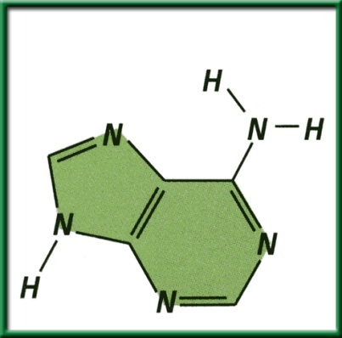
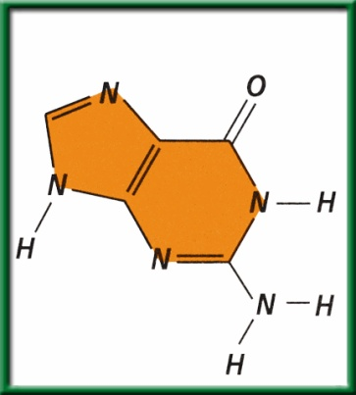
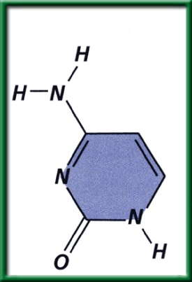
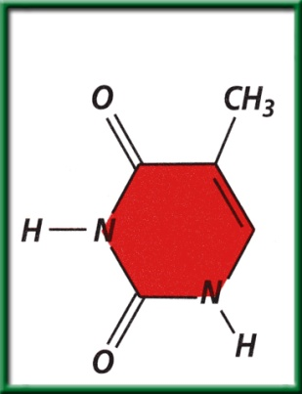
Section 11.1 Summary – pages 281 - 287
The structure of nucleotides
A nitrogenous base is a carbon ring structure that contains one or more atoms of nitrogen.
In DNA, there are four possible nitrogenous bases: adenine (A), guanine (G), cytosine (C), and thymine (T).
Adenine (A)
Guanine (G)
Cytosine (C)
Thymine (T)

Slide 13
Learn.genetics.utah.edu
Build a DNA Molecule
Match the nucleotide base pair
What bases always pair together?
What holds the base pairs together?

Slide 14
Cracking the Code
Answer the Questions on the ½ sheet of paper

Slide 15
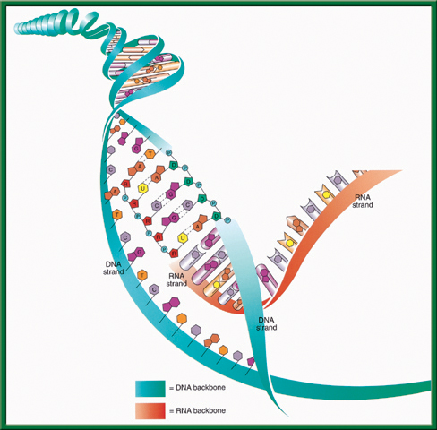
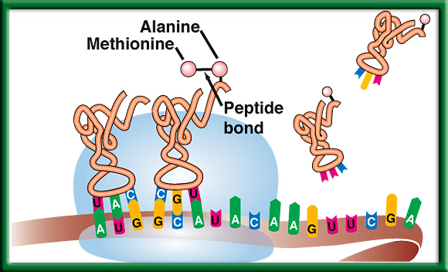
Protein Synthesis
DNA -> transcription -> RNA -> translation -> Proteins

Slide 16
Section 11.2 Summary – pages 288 - 295
The Genetic Code P.292 BB
The Messenger RNA Genetic Code
First Letter
Second Letter
Third Letter
U
C
A
G
U
Phenylalanine (UUU)
Serine (UCU)
Tyrosine (UAU)
Cysteine (UGU)
U
Phenylalanine (UUC)
Serine (UCC)
Tyrosine (UAC)
Cysteine (UGC)
C
Leucine (UUA)
Serine (UCA)
Stop (UAA)
Stop (UGA)
A
Leucine (UUG)
Serine (UCG)
Stop (UAG)
Tryptophan (UGG)
G
C
Leucine (CUU)
Proline (CCU)
Histadine (CAU)
Arginine (CGU)
U
Leucine (CUC)
Proline (CCC)
Histadine (CAC)
Arginine (CGC)
C
Leucine (CUA)
Proline (CCA)
Glutamine (CAA)
Arginine (CGA)
A
Leucine (CUG)
Proline (CCG)
Glutamine (CAG)
Arginine (CGG)
G
A
Isoleucine (AUU)
Threonine (ACU)
Asparagine (AAU)
Serine (AGU)
U
Isoleucine (AUC)
Threonine (ACC)
Asparagine (AAC)
Serine (AGC)
C
Isoleucine (AUA)
Threonine (ACA)
Lysine (AAA)
Arginine (AGA)
A
Methionine;Start (AUG)
Threonine (ACG)
Lysine (AAG)
Arginine (AGG)
G
G
Valine (GUU)
Alanine (GCU)
Aspartate (GAU)
Glycine (GGU)
U
Valine (GUC)
Aspartate (GAC)
Glycine (GGC)
Alanine (GCC)
Glycine (GGC)
C
Valine (GUA)
Alanine (GCA)
Glutamate (GAA)
Glycine (GGA)
A
Valine (GUG)
Alanine (GCG)
Glutamate (GAG)
Glycine (GGG)
G

Slide 17
Genetically Modified Organisms
Rice
Corn
Soybeans
Cotton
Canola

Slide 18
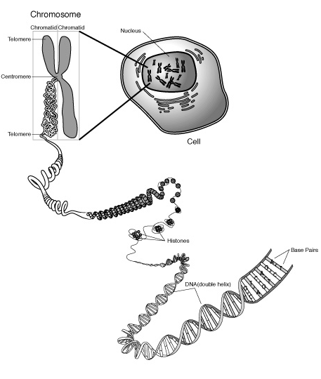
Place the following in order from smallest to largest: chromosome, nucleotide, cell, DNA, nucleus

Slide 19
Epigenetics
Ghost in your genes
Video
After watching this video, what are the implications of how environmental factors can alter the way your genes are expressed?
HW – Find other videos/ cite them and take notes. Write a summary paragraph for each one.

Slide 20
What would you like to learn next time?

Slide 21
Works Cited
Glencoe, The Dynamics of Life, McGraw-Hill Companies, Inc., 2005
NOVA
PBS

