Slide 1
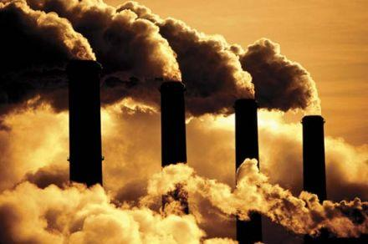
Chemistry
Hydrocarbons

Slide 2
Hydrocarbons Write the Molecular Formula.

Slide 3
Petroleum – Crude Oil
Coal Oil & Natural Gas are all forms of fossil fuels we use for energy.
500 million years ago, dead animals and plants were buried in sediment. Pressure, heat, & microbes converted the dead organisms into Fossil Fuels.
Non renewable, only because we use it too fast, if we could just wait a few million years….?

Slide 4
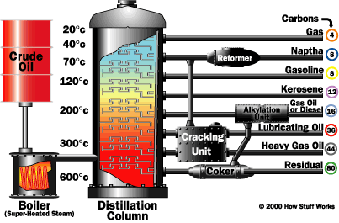
Petroleum – Crude Oil
We can not use it in its natural state, it has to be refined.
In order to refine it, we must transport it, ship, rail, barrel etc.
Refining entails separating out in to simpler mixes of fuel.

Slide 5
Uses of Petroleum in US
Gasoline 89%
Power our vehicles and transportation systems
Petroleum Based Products 7%
It is used as a raw material to make: CD’s, sports equipment, clothing, automobile parts, plastic Credit Cards, carpeting, and even prescription drugs.
Lubricants 4%
Road paving materials, vaseline

Slide 6
Petroleum Efficiency
For every gallon of gas you pump into your car, only 20% is actually used to move your car.
The rest is used to move the engine parts, wasted as friction (tires on the road), lost as heat energy.
Typical for the industry
20% efficient, for every gallon of gas used to produce something, 5 gallons are burned.

Slide 7
Activity: Chemical Equations Build these molecules with the atoms and bonds from the kit.
CH₄ + 2O₂ -> CO₂ + 2H₂O + Energy
2C₂H₆ + 7O₂ -> 4CO₂ + 6H₂O + Energy

Slide 8
Activity – On line pHET
Chemistry
Balancing Chemical Equations
Build a Molecule
Build an Atom
Molecular Shapes
Molecular Shapes: Basics

Slide 9
Current Event
Keystone Pipeline
CBS
FOX
Huffington Post
Fox derailment
Alaskan Pipeline

Slide 10
Adult Ed Project – Hydrocarbons .5 credits
Hydrocarbons such as Petroleum are a source of Nonrenewable Energy
Write a 2 – 3 page paper on types of Fossil Fuels, provide possible solutions to our addiction to burning fossil fuels.
Include in your paper why there are different viscosities of Motor oil used in cars around the world.

Slide 11
Works Cited
Chemistry in the Community, p. 208 - 230, 2006, W.H. Freeman Co.
Chemistry Matter & Change, p. 696 - 725 – 726, 2005, McGraw Hill, Glencoe

