Slide 1
Chemistry States of Matter
Physical Science

Slide 2
States of Matter – physical state of matter
Solids
Liquids
Gases
Plasma
Chemistry Matter & Change, Glencoe Science P. 58 - 60

Slide 3
States of Matter

Slide 5
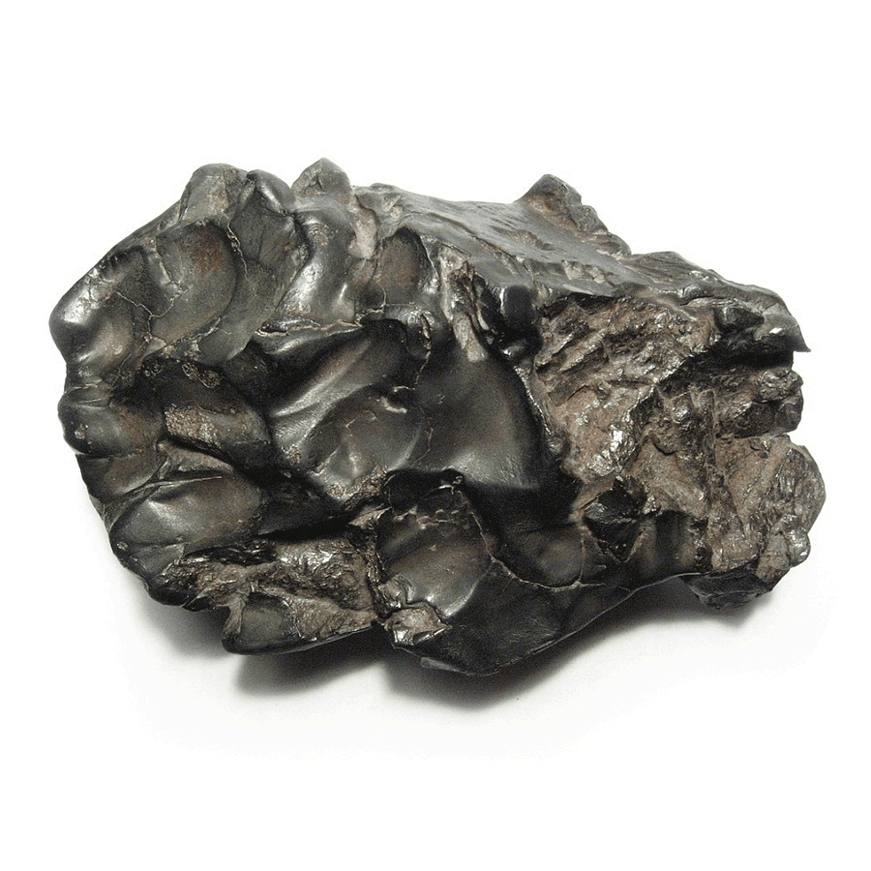
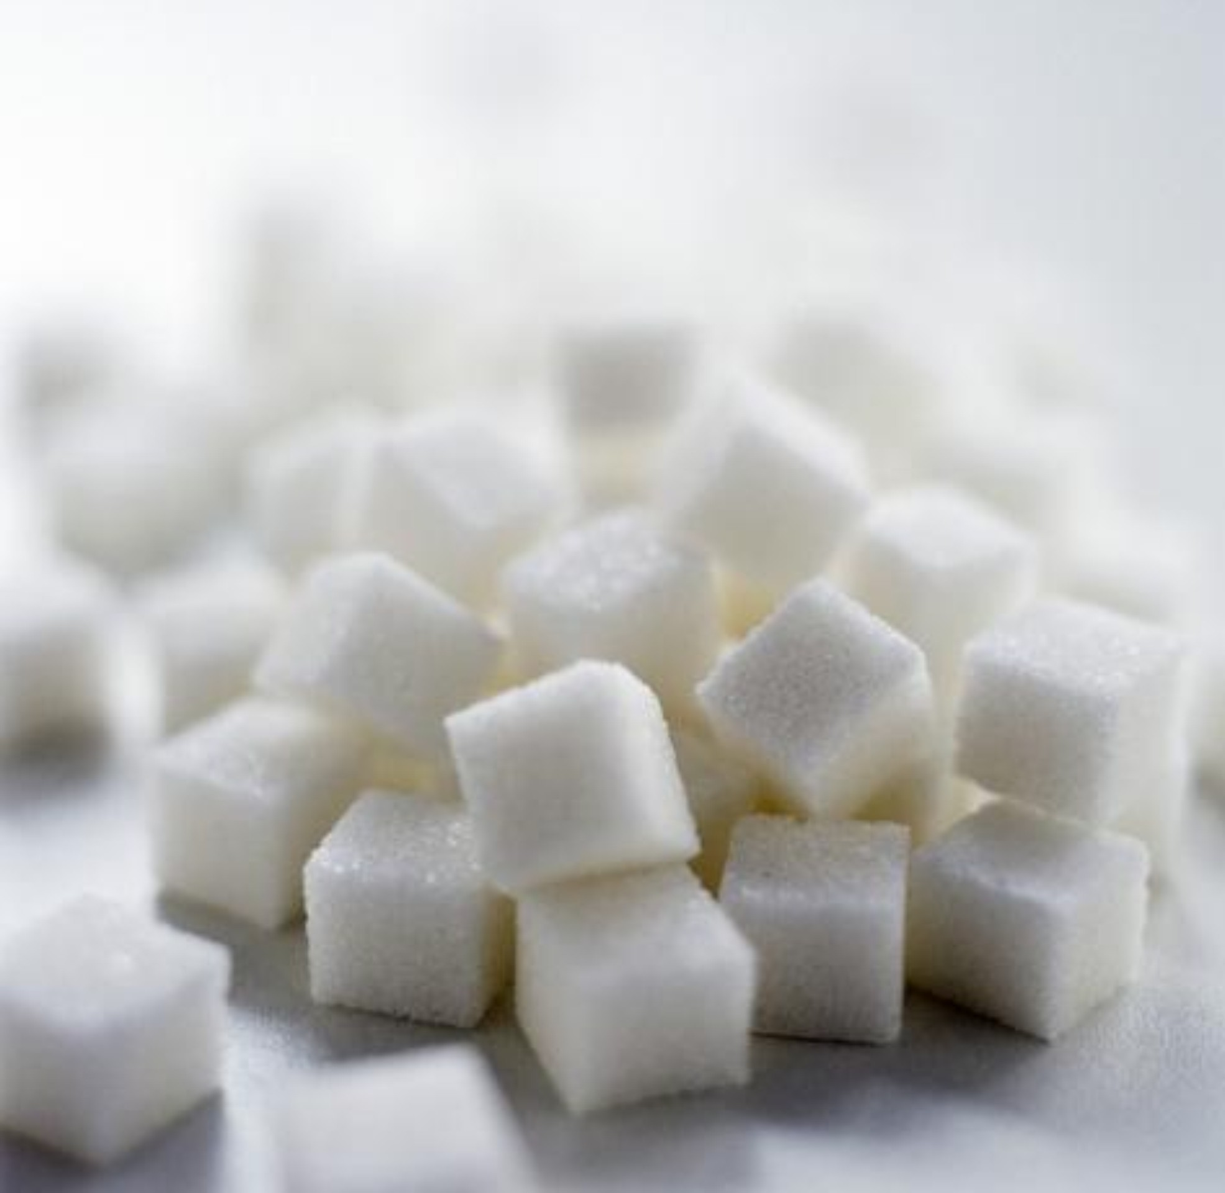
Solids
Solids – a form of matter that has its own definite shape and volume.
Example: Wood, Sugar, Iron

Slide 6
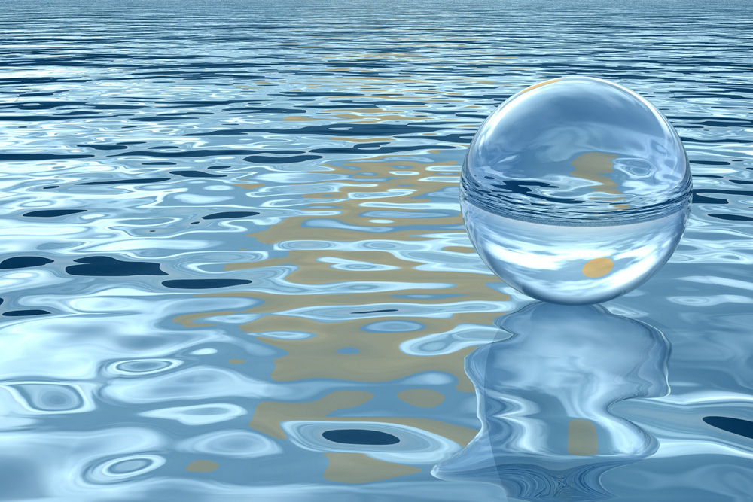
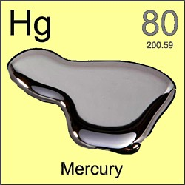
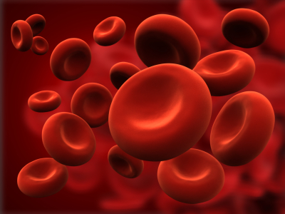
Liquids
Liquids – a form of matter that flows, has a constant volume and take the shape of its container.
Ex.: Water, Blood, Mercury

Slide 7
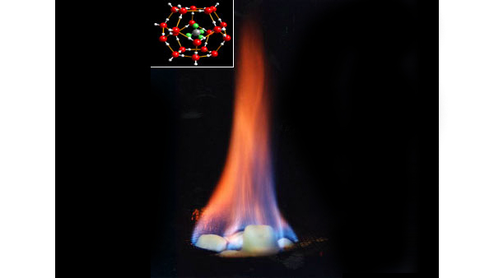
Gases
Gases – a form of matter that flows to conform to the shape of its container and fills the entire volume of its container.
Ex.: Neon, Methane, Air
Vapor – gaseous state of a substance that is a solid or a liquid at room temperature
Ex: Steam from water.

Slide 8
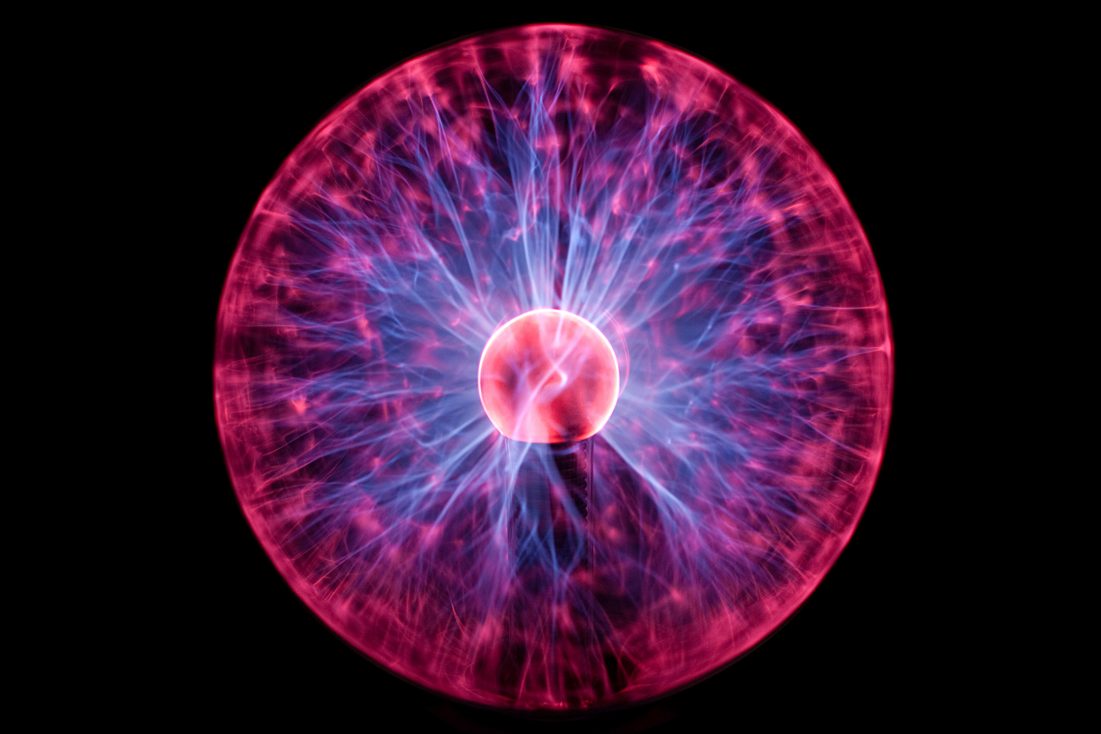
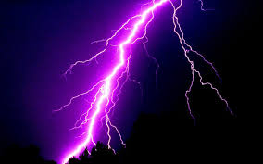
Plasma
Plasma – Does not form naturally on Earth
Ex.: lightning bolts

Slide 9
Activity – Find your partner
http://www.chem.purdue.edu/gchelp/atoms/states.html
Take a piece of paper.
Read your paper and find someone that matches your characteristic of that State of Matter
When you find someone write their description under the correct state of matter in your notes.

Slide 10
Demonstration/ Lab
Materials:
Candle
Match
Vinegar
Baking Soda
Beaker
Procedure:
1. Light your candle
2. Place 30 g of baking soda in the beaker
3. Add 10 – 15 ml of vinegar into the beaker
4. Hold the beaker over the candle & act like you will pour the liquid out (but don’t).
5. What happens to the flame of the candle?
6. Why?

Slide 11
Adult Ed - State of Matter Project .25 Credits
Design a Coin
Research what materials coins are made of.
What images would you have on the heads side and on the tails side? Why?
What anticounterfeiting features will you include in your design?
How large should your coin be? Show the size in a drawing.
What should be its mass? What is the typical mass of a coin?
What would happen if the materials in the coin were worth more than the face value of the coin?
Lastly, Consider the life cycle of the coin.
How long will it be expected to stay in circulation? How will it be obtained and processed once it has served it’s purpose?

