Slide 1
Chemistry
Endothermic & Exothermic Reactions

Slide 2
Collision Theory
Reactants in chemical reaction come together to form products.
CO₂ + NO → CO + NO₂
(Reactants) (Products)
Atoms. Ions & Molecules must collide in order to react.
They must collide in the correct orientation
They must collide with sufficient energy to form the activation Complex.

Slide 3
Activation Energy & Reactions
In order for a chemical reaction to take place, even it has a favorable orientation of the molecules, if there is not enough energy, the activation complex can not form.
Analogy:
Pushing a cart up a hill, have to have enough energy to get it to the top.
Refrigerator cools and decreased the chemical reactions of decomposition of food
Stove & Oven heat and increase the rate of chemical reaction to cook the food.

Slide 4
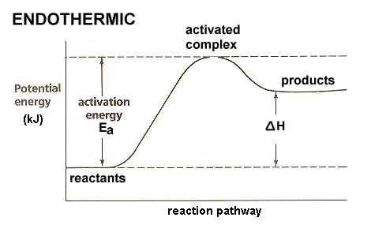
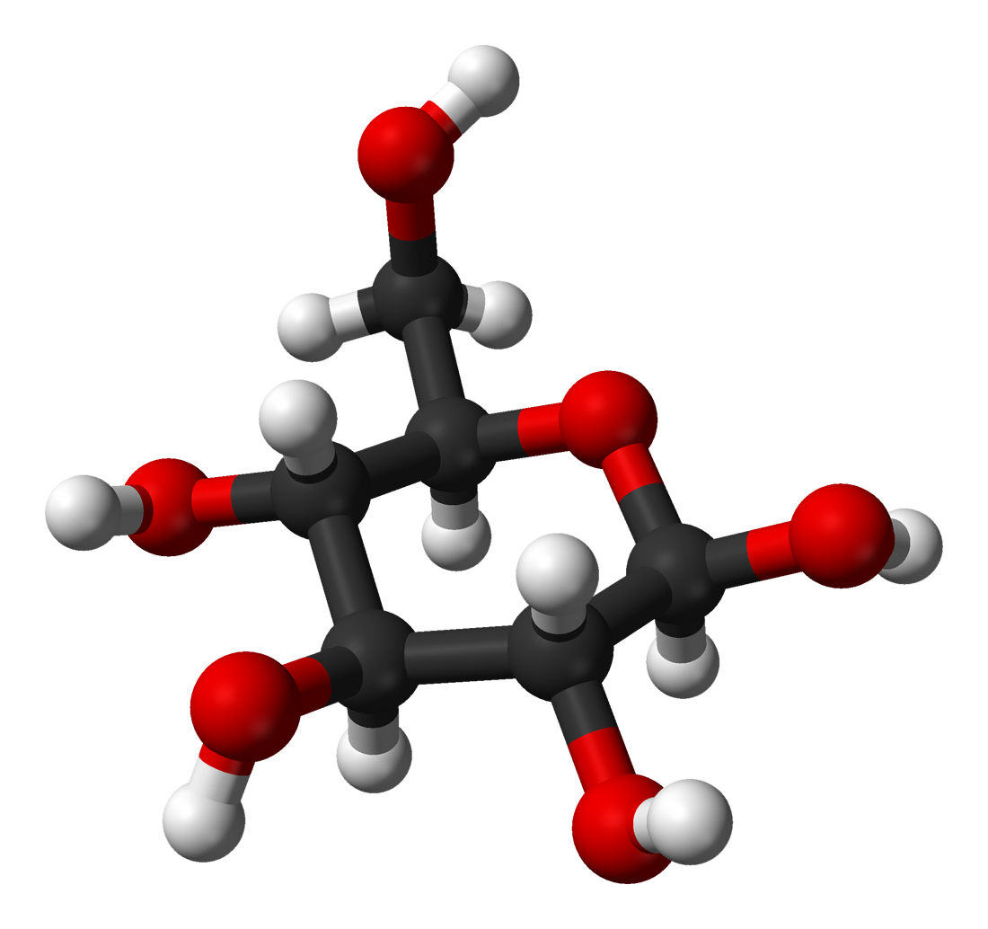
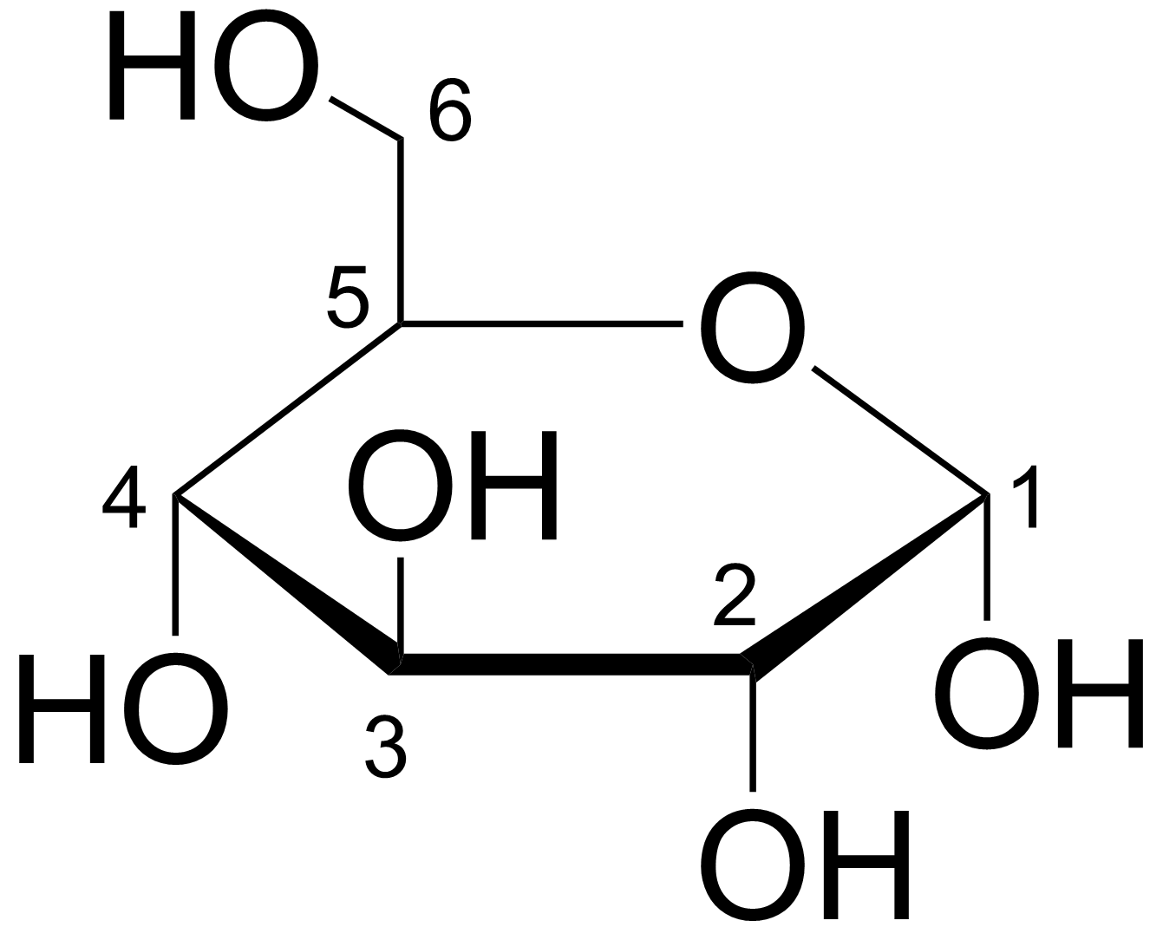
Endothermic Reactions
CO₂ + NO → CO + NO₂
6CO₂ + 6 H₂O → 6O₂ + C₆H₁₂O₆

Slide 5
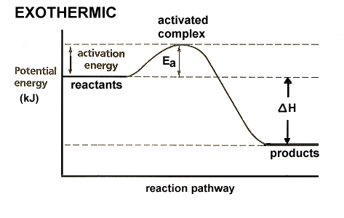
Exothermic Reactions
CO + NO₂ → CO₂ + NO
6O₂ + C₆H₁₂O₆ → 6CO₂ + 6 H₂O + energy (heat)

Slide 6
Endothermic & Exothermic Reactions
Activity: Your Turn Is it and endothermic or exothermic reaction?
Materials:
Get a partner
Flask
Balloon
Sugar cube
20 ml warm water
Procedure:
In your Flask: Combine the 20 ml H2O, 1 sugar cube, 1 tsp yeast
Place the balloon on the flask
Swirl the flask
Data:
What is happening?
What do your feel on the bottom of the flask?
What type of reaction is it?

Slide 7
Activity #2 – More Fun
After Cleaning up your previous mess from Activity #1, get a model kit.
In this model kit identify what color balls represent what atoms.
Make any of the following molecules with your kit:
CO₂,
H₂0,
CH₄,
NO,
NO₂,
N₂

Slide 8
Computer Simulation Activity
Google.com
pHET - Chemistry
Practice running each of the 3 simulations:
States of Matter
Chemical Equations
Balloons & Buoyancy
Gas Properties
Take notes on what you learned for each one.

Slide 9
Adult Ed Project – Endothermic & Exothermic Reactions .50 Credits
The world around us is a constant state of Chemical Reactions. Whether we are eating, or planting a garden, thousands of chemical reactions are happening. Two such examples are: Photosynthesis and Cellular Respiration
On a piece of paper Title the top with each of the two examples. (2 pieces of paper)
Under the Title give a definition of what each is.
Write an example of each and explain how it happens. (Research)
Write the Chemical Equation for each.
Explain each reaction as Endothermic or Exothermic and why.
Draw the appropriate graph for that reaction labeling the Activation Energy, Reactants and Products, and the change in heat energy.

Slide 10
Works Cited
Chemistry in the Community, p. 240 - 260, 2006, W.H. Freeman Co.
Chemistry Matter & Change, p. 530 – 540, 2005, McGraw Hill, Glencoe

