Slide 1
Physical Science
Physics – Newton’s Three Laws of Motion

Slide 2
Isaac Newton 1642 - 1727

Slide 3
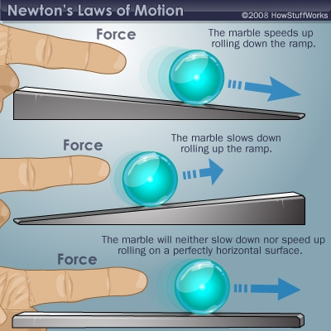
Newton’s First Law of Motion
An object at rest tends to stay at rest.*
An object in motion tends to stay in motion, straight, at constant speed.*
Inertia – resistance to changes in motion.

Slide 4
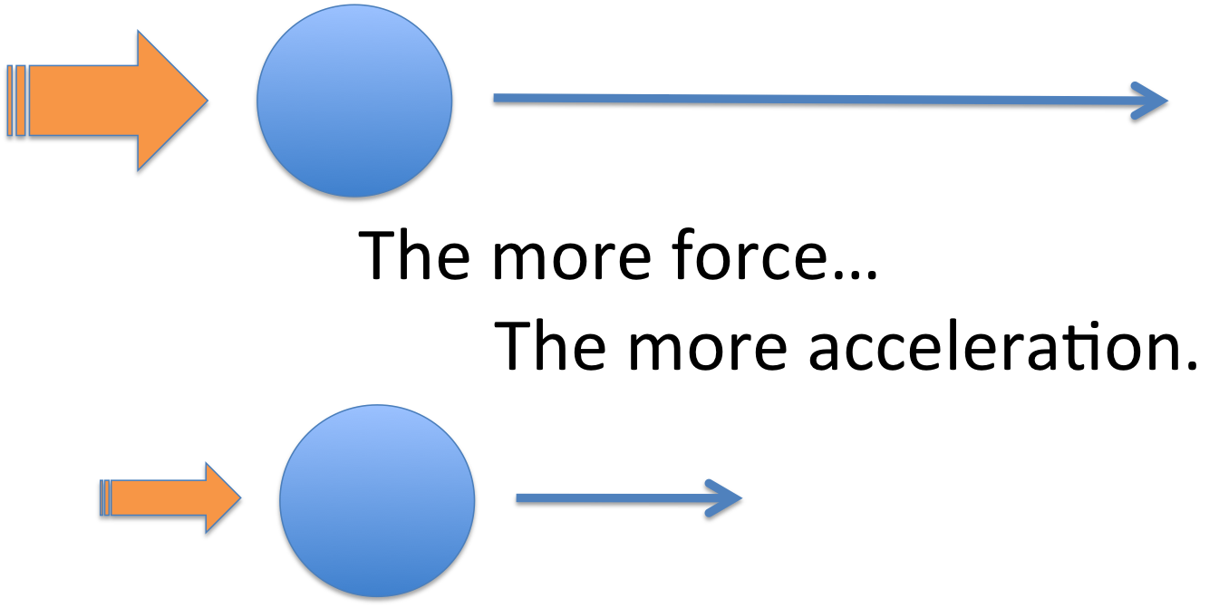
Newton’s Second Law of Motion
Force = Mass x Acceleration

Slide 5
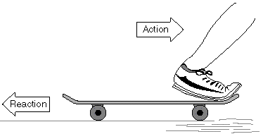
Newton’s Third Law of Motion
Every action has an equal and opposite reaction.
When one object exerts a force on an object, it exerts an equal and opposite force on the first.
Explains the Earth & the Moon

Slide 6
Newton’s Three Laws of Motion
Watch video.

Slide 7
Activity - pHET
Forces & Motion
Forces & Motion Basics

Slide 8
Adult Ed – Newton’s 3 Laws of Motion .25 credits
Choose two examples from your everyday life that are different from the examples shown in the lesson. Demonstrate how each of Newton’s three laws of motion are everyday occurrences.
Name the Law you are demonstrating, describe the example (there should be two), explain Newton’s Law and how it works (just once for each law). Lastly, discuss the significance, What would be different in the world if Newton’s laws did not exist?
This project written and should be 1 – 2 pages.

Slide 9
Works Cited
Gonick, Larry; Huffman, Art; The Cartoon Guide to Physics. Harper Perennial Publishers, 1990. p. 21*
Merril; Physics Princiles & Problems.Macmillan/ McGraw- Hill, 1995. p. 88 - 95

