Slide 1
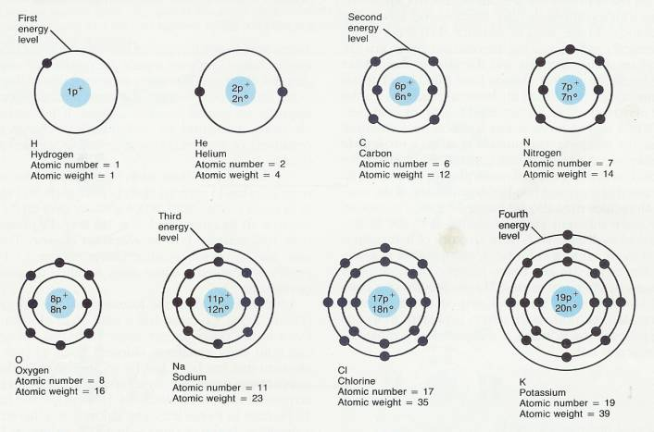
Matter & Atomic Structure

Slide 2
Review
Pollution & Recycling
Projects?
Next Physical Science Class
Jan. 8th
Finals Class Jan. 15th
4 pm
.5 for passing the Final
All Power Points will be on line on my web site
You will be given back your notes, you can use the ppts.
You will have all 2 hours to finish your Final.

Slide 3
Matter
Matter is anything that has mass and occupies space.
Air is matter, atoms are matter
Light and Sound are not matter

Slide 4
Atomic Structure Elements are made of atoms; Carbon
Atom – tiny unit that determines the properties of all matter.
Examples: Hydrogen, Carbon, Oxygen
Atoms have a nucleus and an outer shell

Slide 5
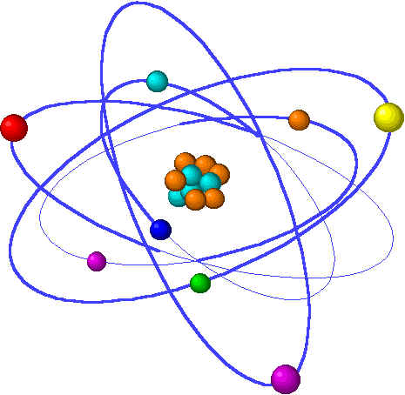
Atoms
Protons- a subatomic particle that has a positive charge and that is found in the nucleus of an atom.
Neutrons – a subatomic particle that has no charge and that is found in the nucleus of an atom.
Electrons – a subatomic particle that has a negative charge and that is found in the outer orbital outside of the nucleus.

Slide 7
Families of Elements
Elements are classified into 3 groups:
Metals: shiny solids that can be stretched and shaped.
Nonmetals: On the right of the periodic table, can be solids, liquids or gases, dull brittle and poor conductors of heat and electricity.
Semiconductors: metalloids (Boron, Silicon, Germanium, Arsenic)

Slide 8
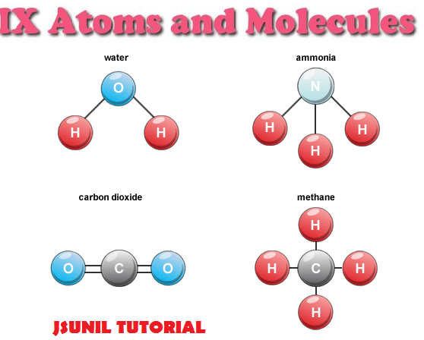
Compounds & Molecules
Atoms build Molecules
Made of the same element
Examples: O₂, H₂, Cl₂, N₂
* water is a molecule (H₂O),
Atoms build Compounds
Substance made of atoms of two or more different elements that are chemically combined
Examples:
Ammonia (NH₃)
Carbon Dioxide (CO₂)
Methane (CH₄)

Slide 9
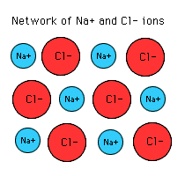
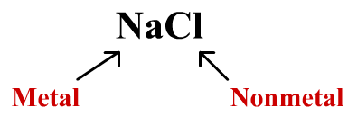
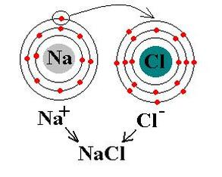
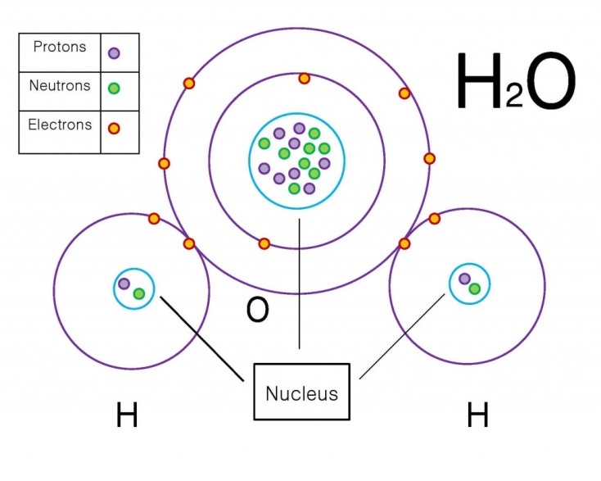
Ionic & Covalent Bond
Ionic Bond – gain or loss of an electron
– sharing of an electron. H₂O, CO₂, O₂

Slide 10
Build a Molecule Activity
Log onto the PhET website
Click on Chemistry
Click on Build a Molecule

Slide 11
Adult Ed Matter & Atomic Structure Project .25 credits
Choose 6 Elements from the Periodic Table
1 Alkali Metal – Group 1
1 Alkali Earth Metals – Group 2
1 Semi conductors – (Boron, Silicon, Germanium, Arsenic)
1 Transition Metal – Group 3 - 12
1 Halogen – Group 17
1 Noble Gas Group 18
For each element: Write the name, Atomic Number, Atomic Mass, Symbol, a molecule or compound it is part of, at room temperature is the element a solid, gas, or a liquid?

