Slide 1
Chemistry
Gases in the Atmosphere

Slide 2
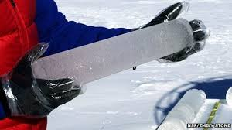
Layers of the Atmosphere
Troposphere – Where our weather occurs
78% Nitrogen
21% Oxygen
1 % Argon
.03% Carbon Dioxide
Studies in Ice Cores can show ancient atmosphere on Earth.

Slide 3
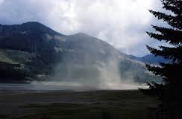
Water Vapor
Considered a greenhouse gas
Humidity
Keeps Earth at a relatively constant temperature
1 – 3% water vapor is average for Earth.

Slide 4
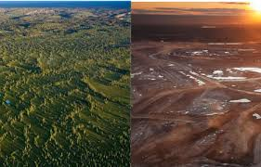
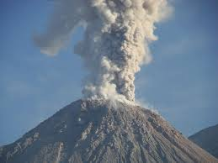
Changes in Atmospheric Composition- [CO₂] Increase
Human
Anthropogenic CO₂ increase
Burning Fossil Fuels
Driving cars
Factories
Cutting down rain forests
Natural
Volcanic eruptions
Fires
Decomposition

Slide 5
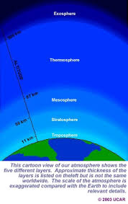
Layers of the Atmosphere
Our atmosphere changes in interesting ways as it increases in altitude.
Closest to the Earth: Trophoshere
Stratophere
Mesosphere
Thermosphere
Exosphere – Farthest away, closest to Space

Slide 6
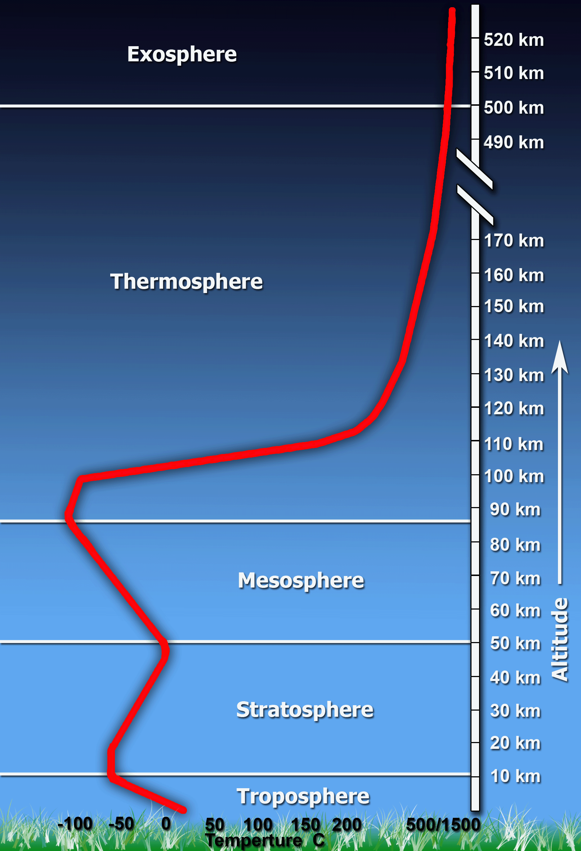
Layers of the Atmosphere

Slide 7
Our Atmosphere changes in 3 ways:
Temperature
Air Pressure [mmHg]
Mass of Air
Today we will only graph the temperature changes with altitude.

Slide 8
Skill Building Activity - Excel
Click on Programs on the Windows Icon
Click the Microsoft Office 2013 icon
Click on the green Excel Icon
Follow the instructions on the paper after Mrs. McAllister does a quick Demo.

Slide 9
Air in our Atmosphere
Air has Matter
Air exerts Pressure
Demo – Balloon with Vanilla
Air Pressure is measured by a Barometer – 1 atm
At sea level 1 atm = 100 kPa = 760 mmHg
What happens when you increase in elevation?
How can a change in air pressure predict our weather?

Slide 10
Do the Math
Barometric Pressure reads 27.2” Hg
What is the atmospheric Pressure in mmHg, as a result, Predict the weather. Given: 1” = 25.4 mm
1” = 25.4 mm x 27.2“ Hg = 690 mmHg
What is the atmosphereic Pressure in , as atm?
1 atm = 760 mmHg = .90 atm
X = 690 mmHg
What is the atmospheric Pressure in kPa?
1 atm = 100 kPa = 90 kPa
.90 atm = X kPa

Slide 11
Computer Simulation Activity
Google.com
pHET - Chemistry
Practice running each of the 3 simulations:
States of Matter
Balloons & Buoyancy
Gas Properties
Take notes on what you learned for each one.

Slide 12
Project – Solutions to our Pollution .25 Credits Paper – 2 pages
Air Pollution can be dangerous for health reasons & to the environment.
Research a current event within the last year that discusses the dangers of air pollution.
Example: China’s Air quality
What is causing China’s pollution?
How long has it been going on?
Why is it a problem?
How did it get so bad?
What are three possible steps toward a solution?

Slide 13
Works Cited
Chemistry in the Ces in ommunity, p. 300 – 333, 2006, W.H. Freeman Co.

