Slide 1
Electricity
Terms to learn: Ohms Law (founder George Ohm) is the relationship between Current, Voltage and Resistance
Current (I) amps;
Resistance (R), ohms;
Voltage (V) volts
V= IR
Conductors, superconductors, semiconductors and insulators

Slide 2
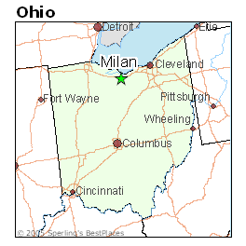
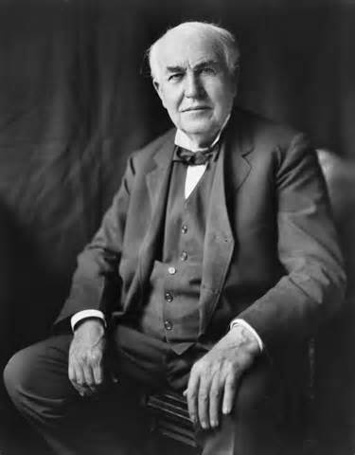
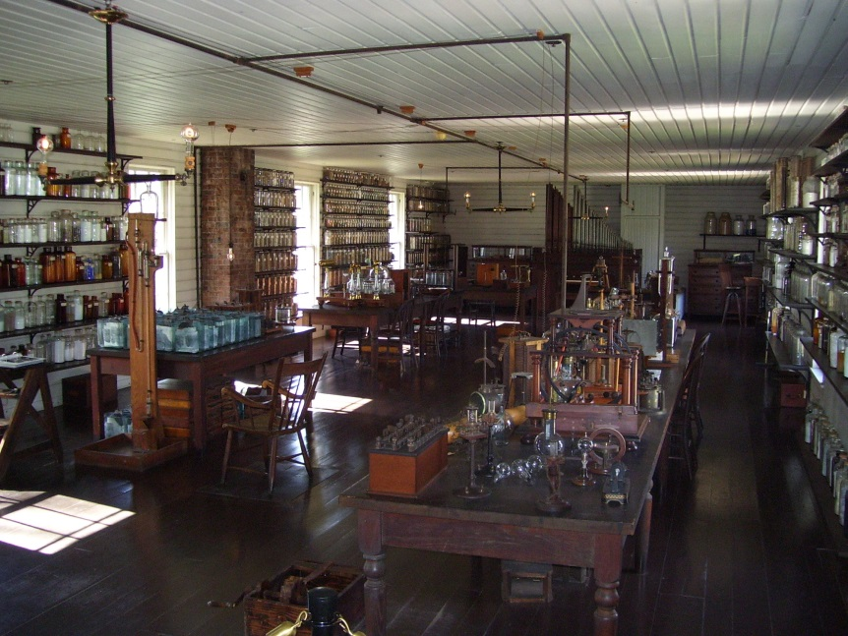
Thomas Edison
Born February 11, 1847
Milan , Ohio
Inventor of the Electric Light Bulb
Died of complications due to diabetes at age 85.

Slide 3
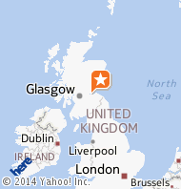
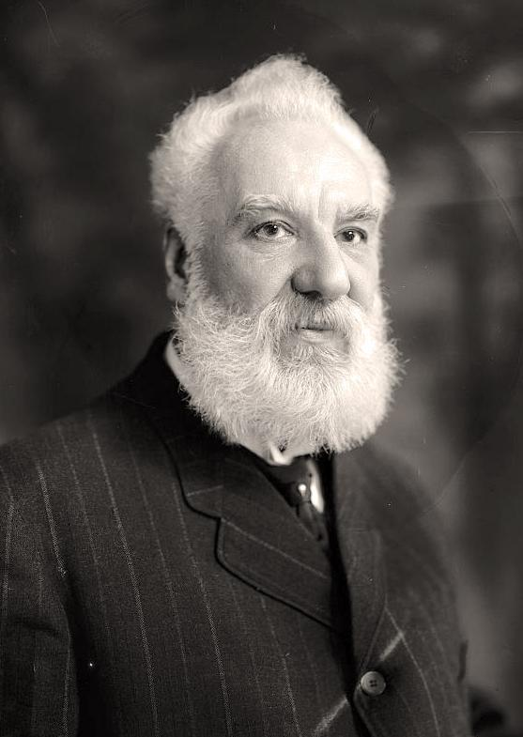
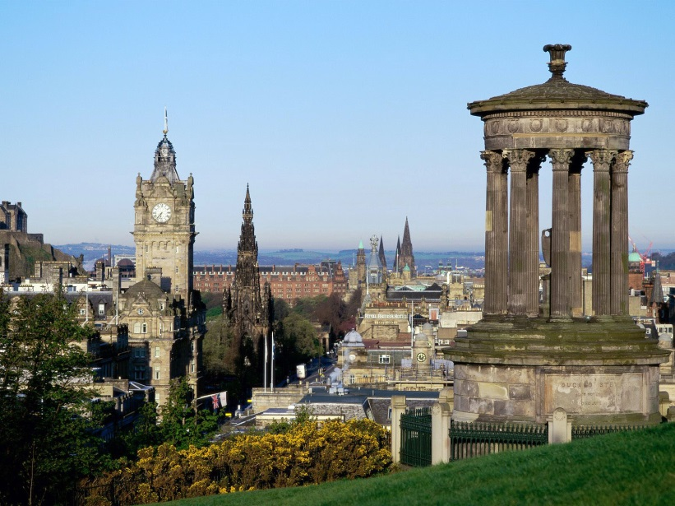
Alexander Graham Bell
Born March 3rd, 1847
Edinburgh Scotland
Inventor of the phone
Friends with Helen Keller
Advocator for people who were blind or deaf or both.

Slide 4
Current
Current represented by the letter( I) is the flow of electricity.
Unit of measurement is Ampere represented by letter(A)
Voltage is the push or force that makes electrons move ( V or E). Voltage also known as electro motive force (EMF) or Potential difference. Unit is Volts(V)
Resistance ®is the opposition to current flow.
Unit is Ohms represented by Omega symbol
Electrical Potential Energy between two negative charges decreases as the distance between the increases.

Slide 5
Types of Electric Cells
Electrical cell | Basic Principle | Uses
Electrochemical | Electrons are transferred between different metals immersed in an electrolyte | Common batteries, Automobile batteries
Photoelectric and Photovoltaic | Electrons are released from a metal when struck by light or sufficient energy | Artificial satellites, calculators, streetlights
Thermoelectric | Two different metals are joined together, and the junctions are held at different temperatures, causing electrons to flow | Thermostats for furnaces and ovens
Piezoelectric | Opposite surfaces of certain crystals become electrically charged when under pressure | Crystal microphones and headsets, computer keypads, record cartridge
Source: Holt Science Spectrum Physical Sciences, 2004

Slide 6
Activity – Let there be Light!
Hypothesis:
Materials:
Procedure:
Data:
Conclusion:

Slide 7
Home Energy Audit
How much Energy do you use?
SMUD or PG & E
https://www.pge.com
http://bcove.me/5rhw93qz
http://www.cemexusa.com/Sustainability/EnergyEfficiencyBuildings.aspx
Home Energy Check up

Slide 8
How can we be more energy efficient?
SMUD Why do we have to be more energy efficient?

Slide 9
California Academy of Sciences
SF Public Museum

Slide 10
Sustainability
http://www.epa.gov/sustainability/
http://water.epa.gov/infrastructure/greeninfrastructure/index.cfm
http://farmtoforkcapital.com/
30% Renewable Energy by 2020

Slide 11
Take home activity
PG& E Web site
Username & Password
Do your own evaluation of your home and how much energy you use.
Write a summary of what and how you can conserve energy usage in your home and why it is important.

