Slide 1
Electromagnetism
Adult Ed – Physical Science - Physics

Slide 2
Roygbiv

Slide 4
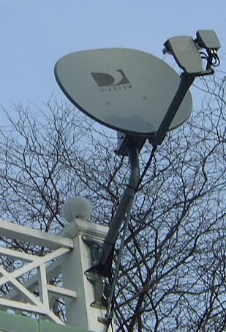
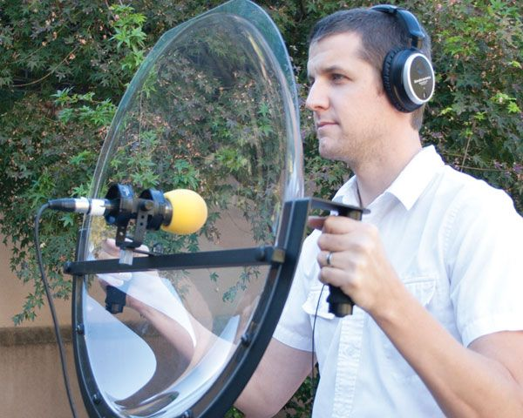
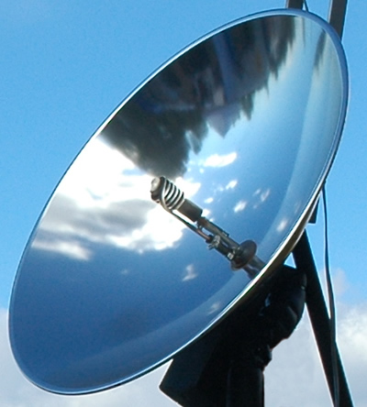
Parabolic Dish Antennas detect Radio waves from space, even distant galaxies. We use electromagnetic waves to send signals for satellite & TV’s.

Slide 5
Electromagnetic Video

Slide 6
Greenhouse Effect
Greenhouse Gases: CO₂, CH₄, H₂O vapor, NO & CFC.
Sun shines light in short wavelengths. Earth radiates energy in longer wavelengths (heat) back into Atmosphere.

Slide 7
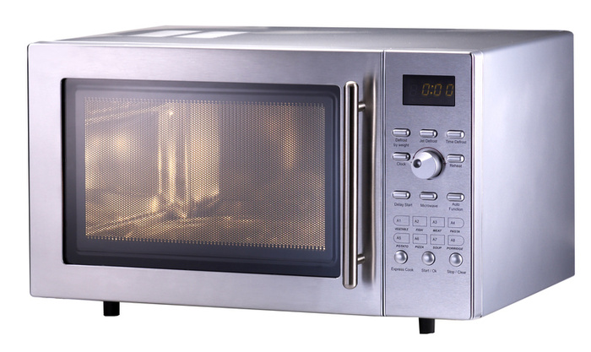
Waves carry Energy & Information
Microwaves
Infrared
Electromagnetic waves are converted to thermal energy to heat food.
Heat – longer wavelengths
Ultraviolet radiation
Increased frequency causes many chemical reactions in the body
Sunburn & tanning

Slide 8
Activity: PHET Website
Faraday’s Electromagnetic Lab
Radio Waves and Electromagnetic Fields
Electric Field Hockey
Write a 1 paragraph summary and turn in at 5:40
Get your Project = .5 Credits

Slide 9
Adult Ed Physics Project .5 Credits
Examine the Electromagnetic Spectrum online. Draw or print it. For each of the types of Radiation: State the Name of the radiation, the wavelength it is part of, Explain what it is used for or involved in. This should be about 1 – 2 pages in length.

Slide 10
Works Cited Physics Principles and Problems, Merrill, P 534 – 560, 2002

