Slide 1
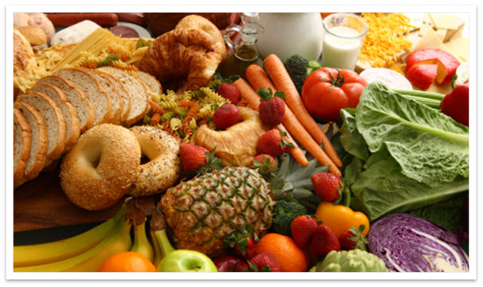
Chemistry - MACROMOLECULES
Carbohydrates & Lipids

Slide 2
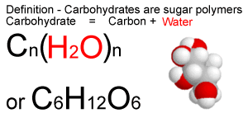
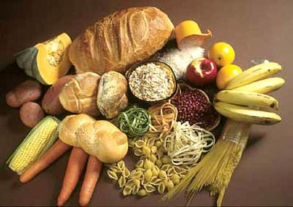
Carbohydrates – C H & O
Examples of your diet that are Carbohydrates:
Milk fruit, bread, Potatoes, Pasta, Grains, Beans, and Yogurt
Function of Carbohydrates:
Energy
Immediate & Stored
45 – 65% of Diet

Slide 3
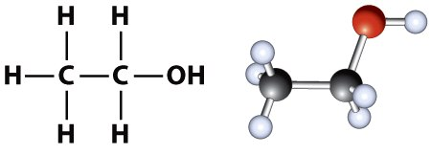
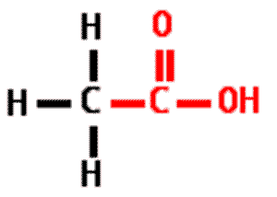
Carbohydrate Groupings
Hydroxyl Group (-OH)
Carbonyl Functional Group (C=O)

Slide 4
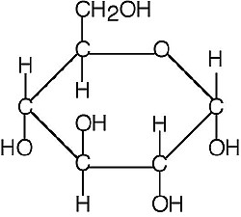
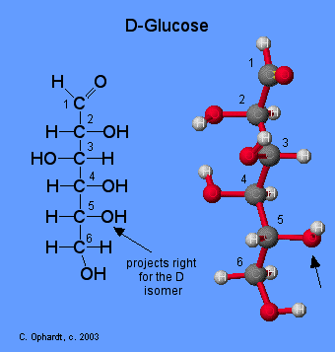
Types of Carbohydrates
Monosaccharide -
Single Molecule (C6H12 O6) – Glucose (Blood sugar), Immediate energy
Disaccharide –
Two molecules – Lactose & Sucrose (Table Sugar)
Lactose = Glucose & Galactose
Sucrose = Glucose & Fructose
Polysaccharide – Complex Carbohydrates
Starch - Pasta
Cellulose – Fiber (Wood)
Glycogen – made by animals to store energy in the liver and muscles

Slide 5
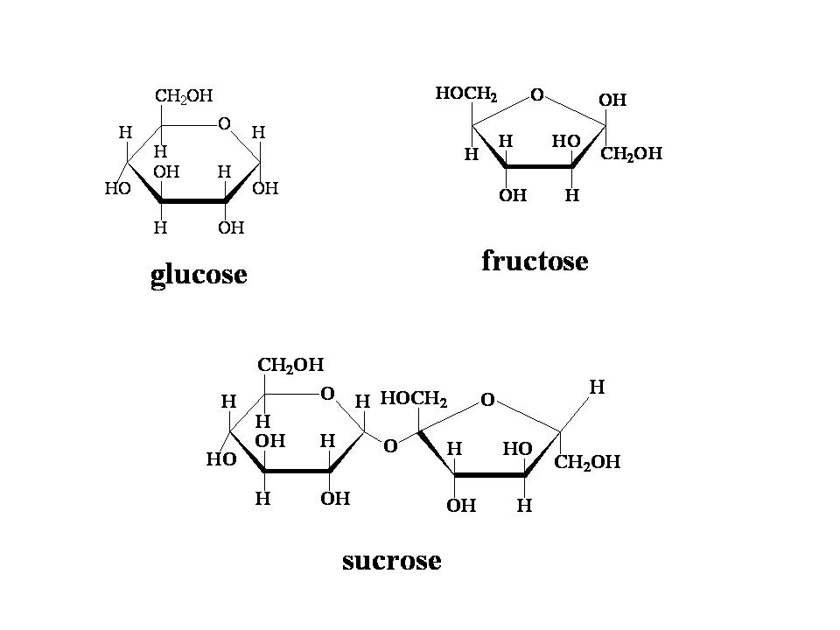
Sucrose is a disaccharide

Slide 6
Digestion of Carbohydrates
Starts in the mouth with enzymes & mechanical digestion
Then continues in the stomach with more enzymes
Finally in the Small Intestine, Sucrase enzymes breaks down disaccharides into monosaccharides
Lactase breaks down lactose into glucose and galactose

Slide 7
Activity – Use the molecules to make a Carbohydrate
pHET Activity
Biology
Eating & Exercise

Slide 8
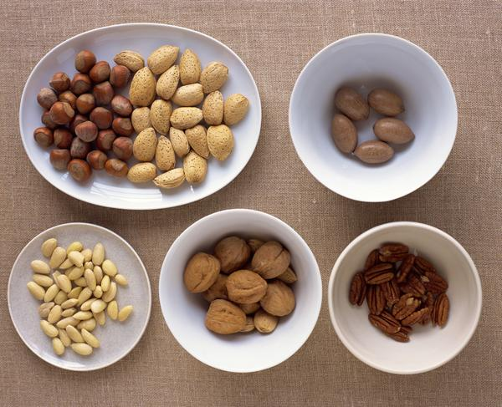
Macromolecules – Fats 20 – 35% Diet
Examples: Meat, Fish, Poultry, Oils, Dairy, Nuts, Grains
Excess food energy is stored in the body as fat.
Fats are nonpolar – hate water
Have long hydrocarbon chains - Fatty Acids – COOH
Palmitic Acid
Linolenic Acid

Slide 9
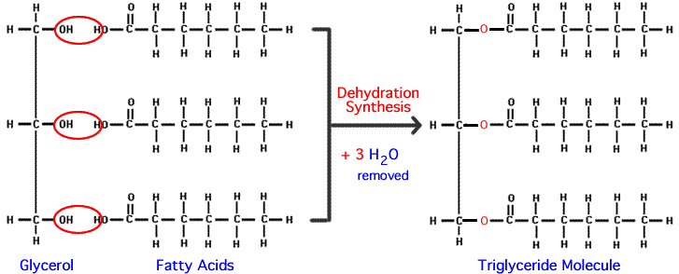
Triglycerides
Glycerol molecules + 3 Fatty Acids

Slide 10
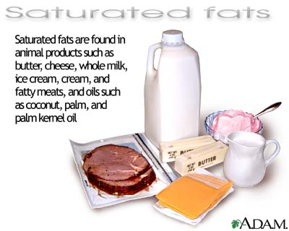
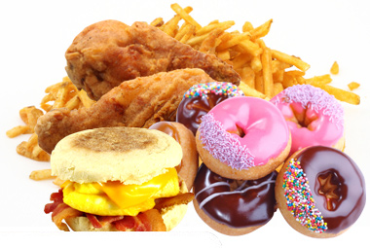
Saturated & Unsaturated Fats
Saturated – No double bonds - Coconut Oil
Mostly from animal fat, solid at room temperature
Arterial plague
Hardening of the arteries
Atheroscrosis
Coronary Artery Disease
Heart & Brain
Unsaturated – has a double or triple bond
Plants, oils, Liquid at room temperature

Slide 11
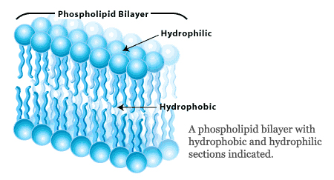
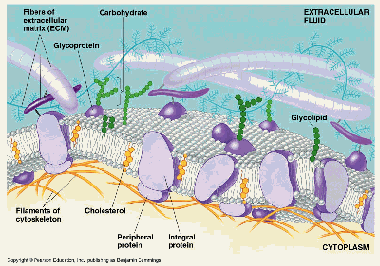
Good Fats in the Body
Phospholipid Bilayer
You must have fat in your plasma membranes of your cells – all 3 Trillion of them.
Steroids
Sex Hormones
Cholesterol – creates stability in the plasma membrane
Vitamin D – helps with the formation of bone and the absorption of Calcium

Slide 12
Energy in Food
Carbohydrates = 4 Cal/gram 45 – 65 % Diet Carbohydrate
Fat = 9 Cal/ gram 30% Diet Fat
Protein = 4 Cal /Gram 12 – 20% Diet Protein

Slide 13
Activity – Use the molecules to make a Fat
pHET Activity

Slide 14
Project – Macromolecules Monitoring your Diet .5 Credits
For three days make a diary of everything you eat.
Make a column for the Food you ate, the quantity, the calories, & the macromolecule (Protein, Carbohydrate, or Fat)
Calculate how much of your diet is Protein, Carbohydrate, and Fat
12 – 20% Diet Protein
45 – 65 % Diet Carbohydrate
30% Diet Fat

Slide 15
 | Day 1 | Day 2 | Day 3
Foods you ate/ drank
Size of portions (grams)
Calculate the calories: Carbohydrate (4 Cal/gram) Fat (9 Cal/ gram) Protein (4 Cal/ gram)
What % of your daily diet was Carbs, Fat, Protein?

Slide 16
Works Cited
Chemistry – Matter & change P. 781 – 786
Chemistry in the Community P. 583 - 601

