Slide 1
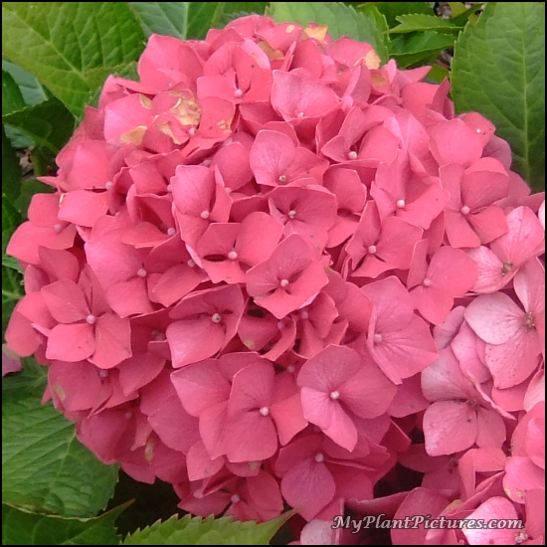
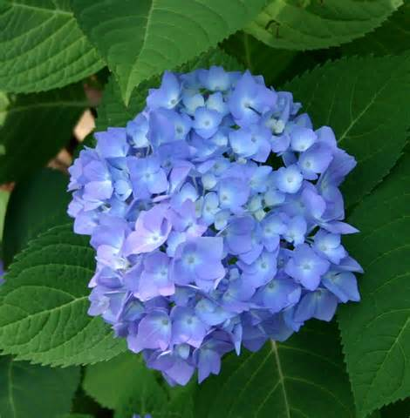
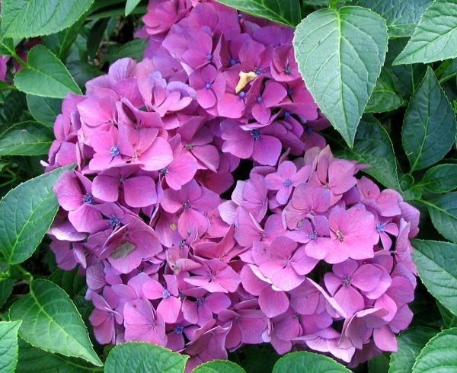
Chemistry
Acids & Bases
Why are these Hydrangea’s different colors if they are all the same type of flower?

Slide 2
ACIDS & Bases
↑ [H+]
Increase in Hydrogen Ions = decrease in pH
pH less than 7 is ACIDIC
Bases = Increase in pH
Decrease in Hydrogen Ions
pH greater than 7 in BASIC

Slide 3
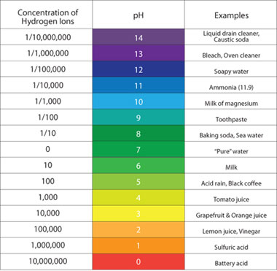
pH Scale – potential Hydrogen ions

Slide 4
How do Buffers resist a change in pH?
The Buffer contains a weak acid and a strong base or a strong acid and a weak base.
Buffers resist a change in pH when limited amounts of acid or bases are added.
There are enough Hydrogen or hydroxide ions to add to an acid or a base, but not to change it significantly.

Slide 5
Blood – Real world reason for a buffer
Our Blood has to be maintained around 7.4.
If our blood gets out of range then Proteins (enzymes) lose their ability to function.
It will not fluxuate below 7.1 or above 7.7.
If the blood drops to 7.1 then acidosis occurs
Due to overexerted cramps in leg
Lactic acid in the muscle tissue
If the blood raises to 7.7 then alkadosis

Slide 6
Body helps maintain 7.4 blood pH in 3 ways.
Excess acids or bases will be excreted in the urine.
Carbonic Anhydrase (enzyme) releases 600,000 molecules of CO₂ per minute.
The body contains buffering systems

Slide 7
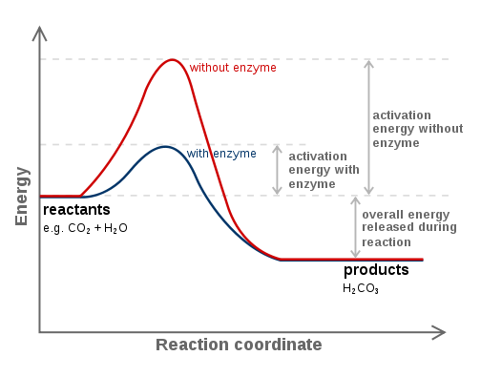
Blood must maintain an Acid – Base balance
Acids and bases are deposited into the bloodstream from normal everyday chemicals from metabolic reactions.
During this metabolic rate:
H₂CO₃/ HCO₃- equilibrium will shift
Lungs will alter the rate [CO₂] from the body
Kidneys can alter the rate and removal of HCO₃-

Slide 8
Stomach
Stomach acid must be maintained around 1.6 – 1.8 pH
Antiacids treat indigestion and heartburn
Bases that neutralize digestive acids

Slide 9
Activity
Vinegar + Baking Soda
25 ml + 1 gram = ?
Learn about Conservation of Mass

Slide 10
Activity – Measuring the pH of various substances
Without smelling any of the liquids, measure the pH
Write the Letter of the substance on your paper in the first Column
In the second column, write the pH of that substance.
Identify where it is an Acid or a Base in the third Column.
Substance | pH | Acid or Base
A
B
C
D
E

Slide 11
Adult Ed Project Chemistry Research Batteries .5 credits
What is a battery?
What types of Batteries are there, name and discuss 3.
What chemicals do batteries store, name and discuss 3.
How do batteries work, explain in detail, using diagrams if need be.
This assignment should be about 2 – 3 pages in length.

Slide 12
Works cited
Chemistry in the Community, p. 370 - 380
Chemistry Matter & Change, p. 622

