Slide 1
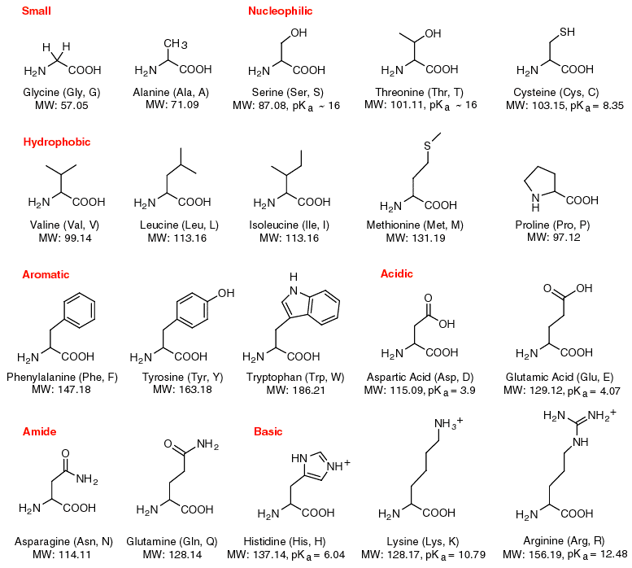
Macromolecules Proteins

Slide 2
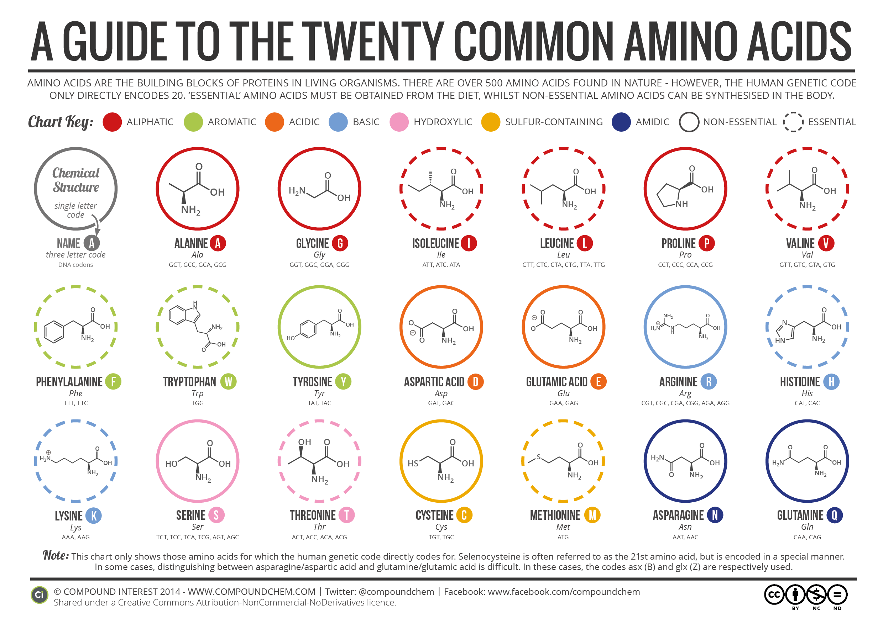
Proteins are made from amino acids
Proteins are polymers
Amino acids are called monomers
20 Amino Acids

Slide 3
How a protein is structured
Primary –Amino Acids form a chain and are peptide bonded
Secondary
Tertiary – 3D shape
Quaternary

Slide 4
Activity #1
Build a Protein molecule from a sequence of Amino Acids
20 Amino Acids
Can build any protein due to any sequence and # of Amino Acids.
Characteristics of Amino Acids
Hydrophilic
Hydrophobic
Acidic
Basic
How does the sequence of Amino Acids change the shape of the protein?

Slide 6
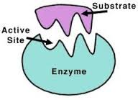
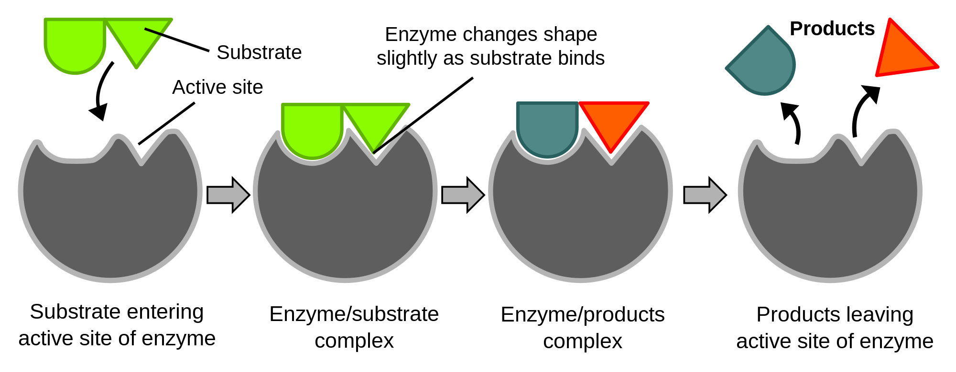
Functions of proteins
Enzymes – speed up chemical reactions
Are not used up and can be used again & again

Slide 7
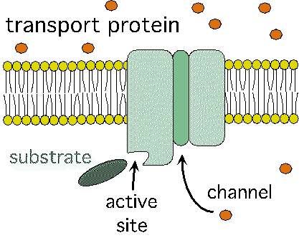
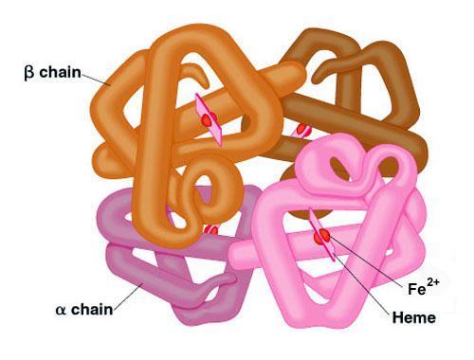
Functions of proteins
Transport Proteins
Hemoglobin – O₂
Sickle Cell Anemia

Slide 8
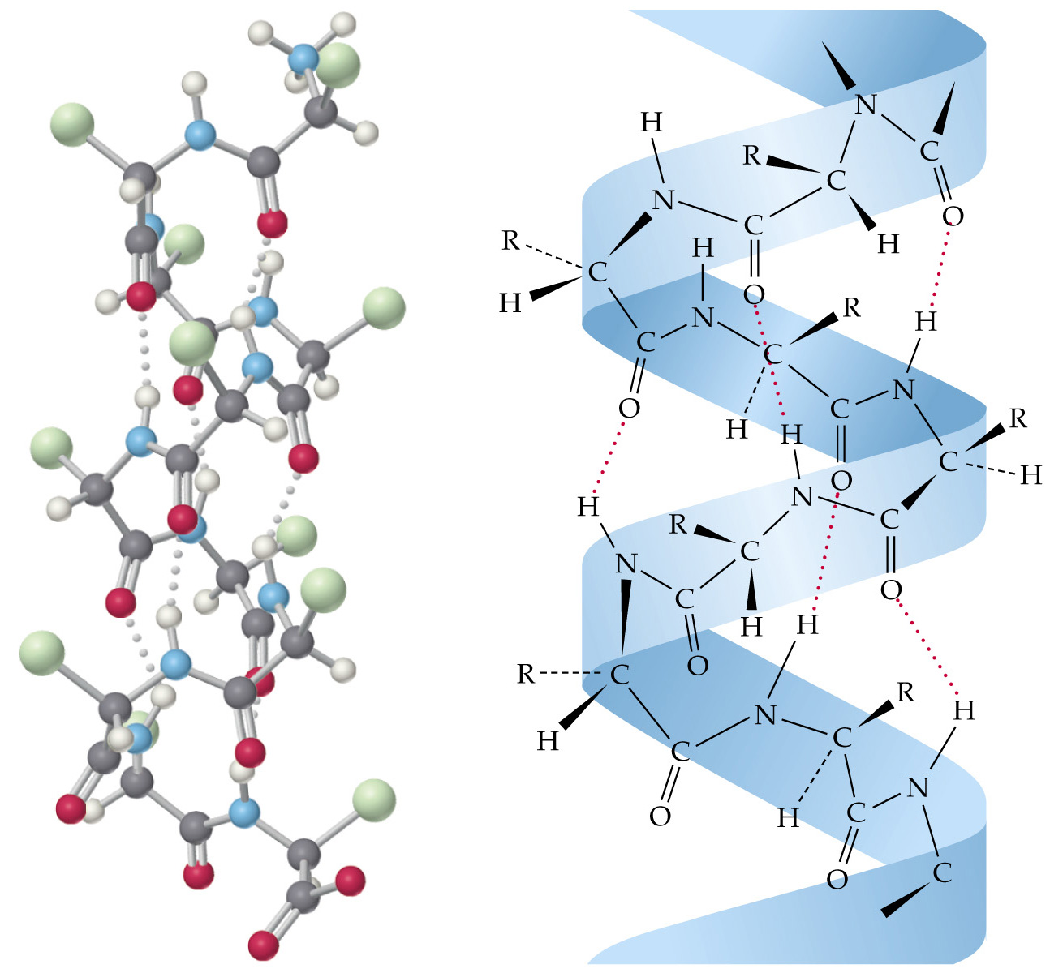
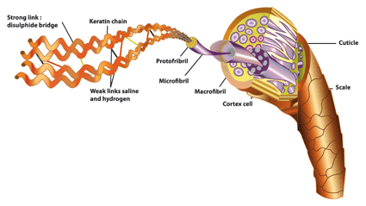
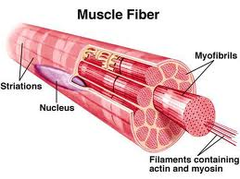
Functions of proteins
Keratin
Structural Proteins
Collagen
Skin, ligaments, tendons, bone, hair, fur, wool, hooves, fingernails, cocoons, silk, feathers,
Muscle
Formation of DNA

Slide 9
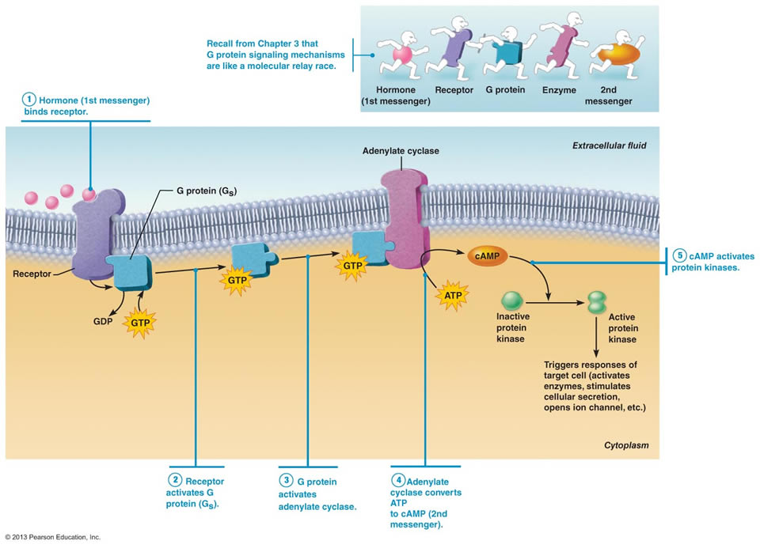
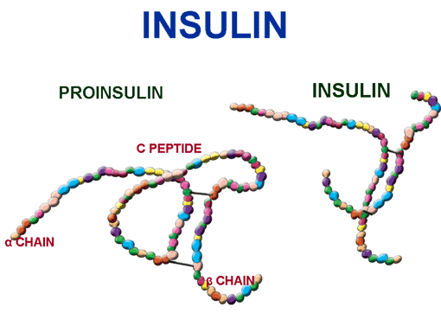
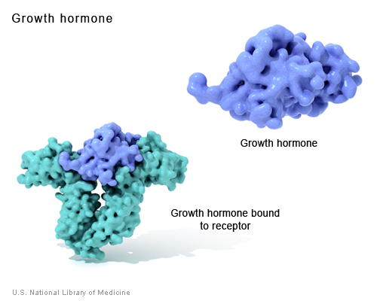
Functions of proteins
Hormones
Messenger molecules that carry signals
Insulin – 51 Amino Acids, regulates uptake of sugar in the bloodstream
Thyroid Hormones
Growth Hormones

Slide 10
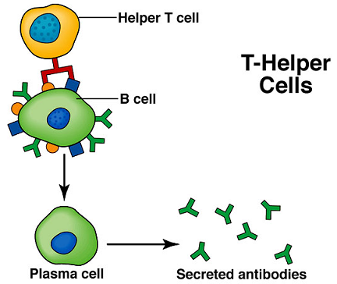
Functions of proteins
Protective Proteins – Antibodies (Immune System)

Slide 11
9 Essential Amino Acids Copy this list on your project paper
Your body can make 11 of the 20 Amino Acids
9 of them however, you must get from your diet to represent a complete protein (Animal Protein)
Histidine (Infants)
Isoleucine
Leucine
Lysine
Methionine
Phenylalanine
Threonine
Tryptophan
Valine

Slide 12
Activity #2
PhET Website
Biology
Gene Expression - the Basics

Slide 13
Project Credit = .25
Research 9 foods that contain one of each of the 9 Essential Amino Acids
Identify the food
Identify the Amino Acid that it contains
What is the recommended daily allowance for that food
1 cup, 6 ounces
What is the result if there is a deficiency in that Amino Acid
Nine Essential Amino Acids:
Histidine (Infants)
Isoleucine
Leucine
Lysine
Methionine
Phenylalanine
Threonine
Tryptophan
Valine

Slide 14
Works Cited
Chemistry in the Community, P. 604 – 618
Chemistry – Matter and change P. 775 - 780

