Slide 1
Physical Science Physics
Series and Parallel Circuits
&
Magnetism

Slide 2
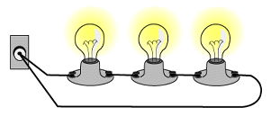
A series circuit
The total resistance of a series circuit is equal to the sum of the individual resistances.
Christmas lights

Slide 3
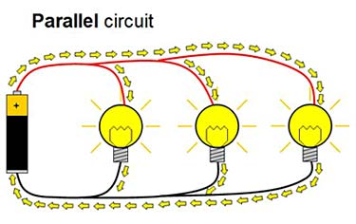
A parallel circuit
Can unscrew one light and the other 2 still are lit.

Slide 4
Activity making a Magnet
How to make a Magnet
Get one 4” nail
5 feet of thin copper wire
Wrap the wire around the nail, leaving 2” at each end
Use the sand paper to scrape the insulation off the ends.
Attach the ends of the copper wire to each end of the battery.
Place a rubber band around the ends of the terminals of the battery to hold the copper wires in place.
Try and pick up the paper clips. How many can you pick up?

Slide 5
Adult Ed Project – Research Thomas Edison & Nikolas Tesla .5 Credits
Who were Thomas Edison & Nikolas Tesla?
How did they meet?
What did they invent &/ or develop? Together or separately?
What challenges did they have to overcome?
How did there friendship/ business relationship end?
How would the world be different without them?

Slide 6
pHET
Electric Field

Slide 7
Works Cited
Gonick, Huffman; The Cartoon Guide to Physics, 1990, Page 95 – 195.
Merrill; Physics Principles & Problems,1992, p.468 – 486 & 490 – 509.

Slide 8
Resistor Problem

