Slide 1
Ocean Acidification

Slide 2
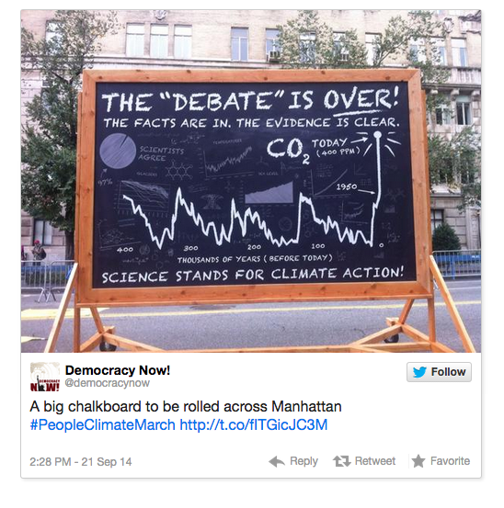
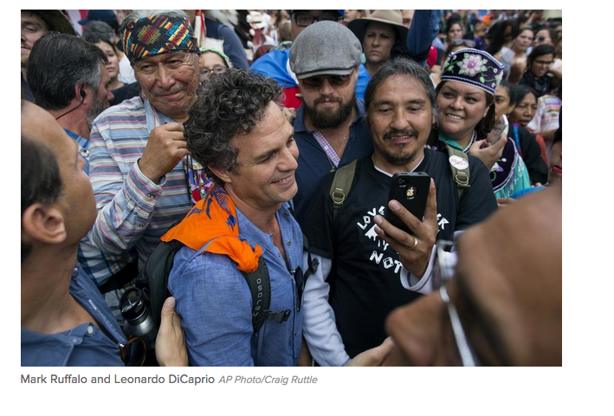
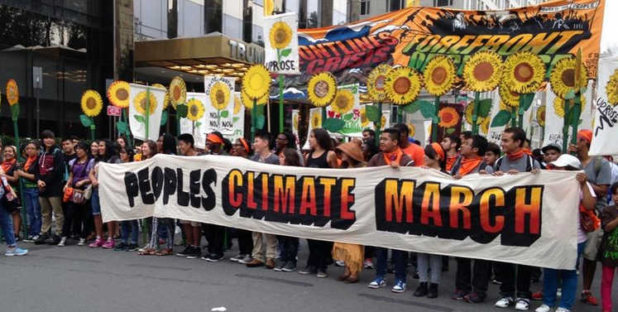
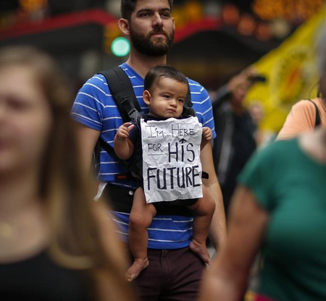
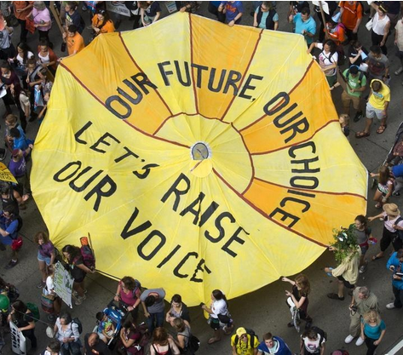

Slide 4
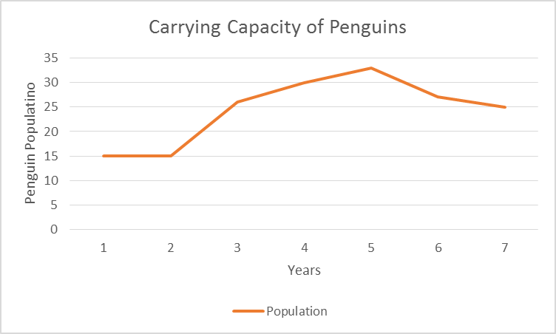
Carrying Capacity Notes pg. 53
What is the carry capacity for penguins?
What factors could affect future generations of penguins?
Are they these factors density-dependent or density-independent?

Slide 5
2/24 Ocean Acidification P. 52 NB OBJ. TSW be able to identify the negative effects of ocean acidification and explain the processes that causes ocean acidification.
Based on the two articles you have…
After reading the articles, what do you think is the biggest challenge preventing ocean acidification?
What are some other threats to the ocean described in the article from Nature?
Brainstorm how ocean acidification could put marine organisms at a higher risk of damage from these threats.

Slide 6
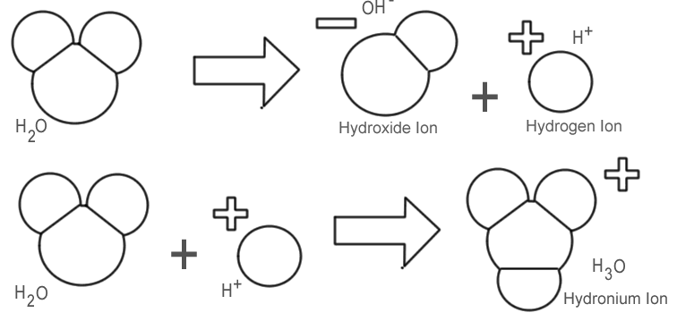
Background: Acids & Bases
Notes:
Water is made of hydroxide and hydrogen ions combine to make water

Slide 7
Background: pH
pH is a measurement of acidity
The lower the pH, the more hydrogen ions (H⁺) are present and the more acidic the solution.
The higher the pH, the more hydroxide ions (OH⁻) are present and the more basic the solution.

Slide 8
Notes:
Source: Feely, Richard A., et al. (2006) Carbon Dioxide and Our Ocean Legacy. Pew Trust
Ocean essentially a sink tank for carbon dioxide
As more and more CO2 dissolves into ocean, water becomes more acidic
3) More acidic sea makes for less amount of dissolved carbonate available to form that calcium carbonate shell and skeleton we see on coral reefs
4) A 26% change increase in acidity
This is 2-2.5 times more acidic than pre-industrial levels
LAST: Cannot adapt quick enough and Marine life is at severe risk from this rapid change

Slide 9
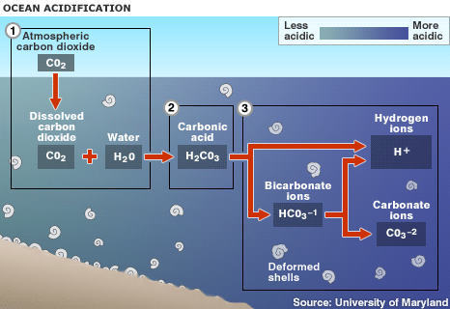
The Chemistry of Ocean Acidification p. 53 NB
(1) CO2 reacts with H2O to produce Carbonic Acid (H2CO3)
-Releases (+) charged Hydrogen Ions (H+)
(2) Extra ions= cause problems!
-Bind with dissolved carbonate ions (CO3-2) to form bicarbonate (HCO3-1)
-Fewer free carbonate ions= Organisms cannot build shells and skeletons

Slide 10
The Chemistry of Ocean Acidification
When CO2 is added to seawater, it undergoes an acid-base reaction
Increase in hydrogen ions in to the water
Lowering the pH of the seawater.
Most pH change happens in shallower surface waters.
CO₂ + H₂O H₂CO₃ H⁺ + HCO₃⁻

Slide 11
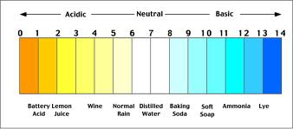
A More Acidic Ocean
Pre-industrialization: pH 8.21 → Now: pH of 8.10
MORE acidic → by 26-29%
Decreased amount of dissolved carbonate available=
Coral grow slower AND skeleton is weaker
By 2100: pH predicted to drop an additional 0.3-0.5 units
Notes:
pH scale is logarithmic (pH = -log[H⁺]), a change of one pH unit corresponds to a ten-fold change in hydrogen ion concentration
Ocean essentially a sink tank for carbon dioxide
As more and more CO2 dissolves into ocean, water becomes more acidic
3) More acidic sea makes for less amount of dissolved carbonate available to form that calcium carbonate shell and skeleton we see on coral reef;
4) A 26% change increase in acidity
This is 2-2.5 times more acidic than pre-industrial levels
LAST: Cannot adapt quick enough and Marine life is at severe risk from this rapid change

Slide 12
Dissecting Coral Reefs
Made of “polyps”
Top layer of coral reefs are made of thousands of polyps living close together
Growing within the coral polyps is zooxanthellae (Small algae)
Polyps and zooxanthellae worked together in a symbiotic relationship
Notes:
**Coral reefs I will be talking about are called tropical coral reefs but there is such thing as a cold water corals
1) Polyps characteristics
Hard outer skeleton made of calcium
Stay fixed in one spot
Main structure of reef
3) What is symbiotic relationship? → work together
3a) Polyps provide Algae Z with shelter and nutrients;
Zooxanthellae provides food for coral (90% of energy from Algae Z)
The zooxanthellae provides polyp with food through photosynthesis by turning light energy from the sun into food; thus the algea needs sunlight to live and why we see tropical coral reefs in shallow and clear water

Slide 13
At least 19% of the world’s coral reefs are already gone
An additional 15% could be dead within 20 years
Notes:
Coral Bleaching
** At least 19% of the world’s coral reefs are already gone, including some 50% of those in the Caribbean
An additional 15% could be dead within 20 years
14% decrease in coral growth in the Great Barrier Reef since 1990
Most significant decrease in coral growth in the last 400 years
3) More acidic sea makes for less amount of dissolved carbonate available to form that calcium carbonate shell and skeleton we see on coral reef;
25% of marine species
Rainforests of the ocean

Slide 14
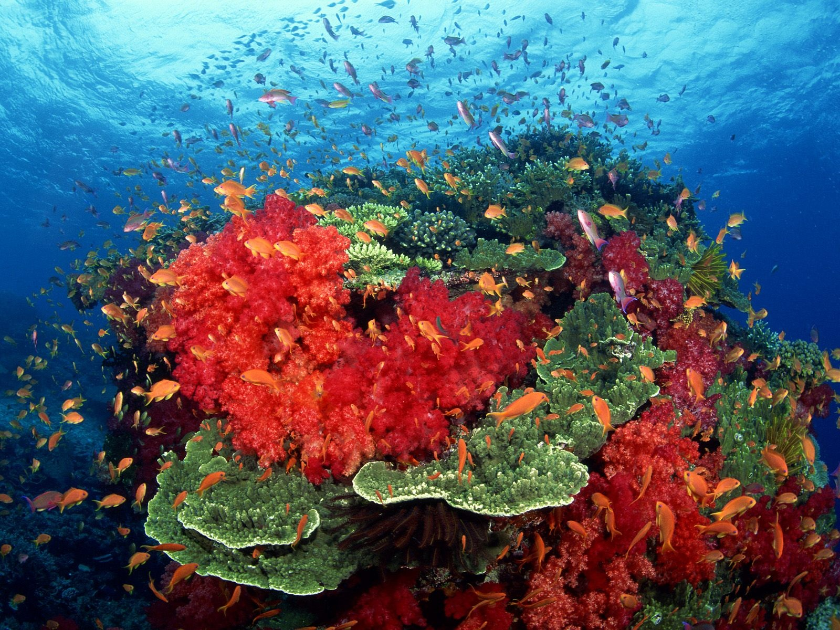
Why should we care?
Provide food and income to over HALF a billion people around the world
Provide close to $375 BILLION each year in goods and services:
Fisheries
Tourism
Costal Protection
Medicine
Notes:
Say: Well lets see what is at risk?
Thus if coral reefs are lost it will effect economies worldwide

Slide 15
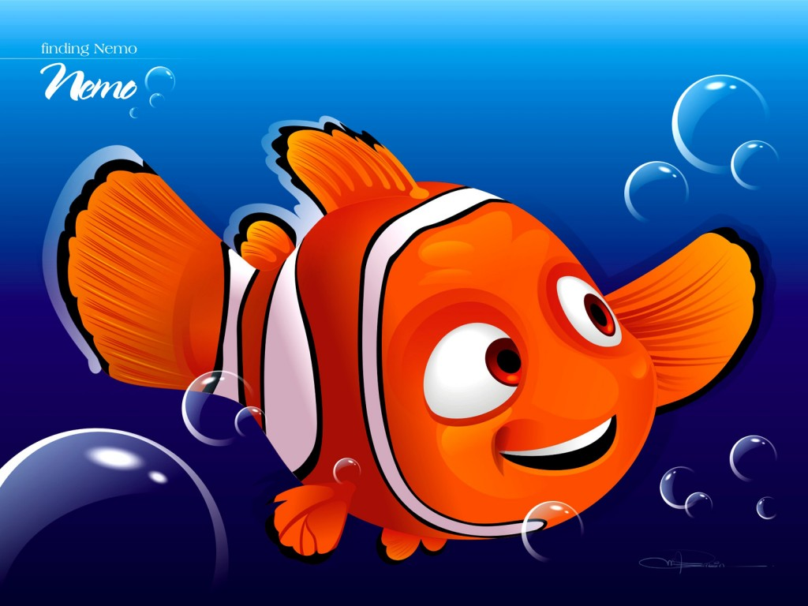
Fisheries
Provide a “nursery” for about 25% of ocean’s fish
Direct correlation between a loss in coral reefs and a loss in reef fish
About 1 billion people have some dependence on coral reefs for income and/or food

Slide 16
Tourism
Loss for people who depend on income from tourism
Hawaii
Generates $800 million a year
Australia’s Great Barrier Reef
Generates $1 Billion a year
Florida Keys
Generate at least $3 Billion a year
Notes:
Loss in employment in tourism, marine recreation, and sport fishing industries
Impoverished countries/ developing countries that can maintain their coral reefs stand to make this type of

Slide 17
Costal Protection
Break powerful waves during storms, hurricanes, typhoons, even tsunamis
Help prevent coastal erosion, flooding, and loss of property on shore
Equates to BILLIONS of dollars
Avoid insurance and reconstruction costs
Reducing the need to build costly coastal defenses
Notes:
This is an important aspect that many people don’t really think about to....
People want to live along the coastline because it is beautiful and there is close access to a beach
But there is always the risk of a storm, hurricanes, typhoons, even tsunamis
Coral Reefs can provide that protection and are fairly less expensive to maintain than building up things like sea walls
You hear the term Barrier Reef, they are literally a barrier between the strong waves of the ocean and the shore

Slide 18
Notes:
State what picture is of

Slide 19
Medicine
Coral reef have been found to help in the treatment of:
SKIN CANCER
HIV
ULCERS
CARDIOVASCULAR DISEASE
LEUKEMIA
Notes:
-More than HALF of all new cancer drug research focuses on marine organisms
-Without healthy coral reefs we cannot continue to explore these types of medical advances
http://www.nature.org/ourinitiatives/habitats/oceanscoasts/save-coral-reefs-save-lives.xml

Slide 20
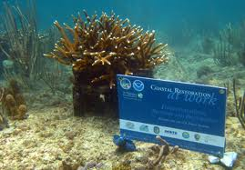
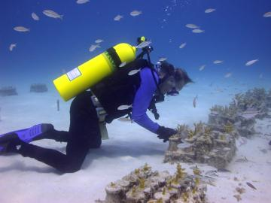
What is being done?
EPA has several programs that contribute to the protection of coral reefs
Creation of Marine Protected Areas
Restoration Projects
Notes:
Environmental Protection Agency
Research into the causes of coral reef deterioration
Regulatory control programs for wastewater discharges, storm water runoff, and ocean dumping of wastes
MPAs
Activities are restricted here so the natural habitat can thrive
Natural resources are protected
Activities such as fishing
Restoration
Non-profits (Coral Restoration Foundation= domestic and international restoration projects that have been successful), government agencies such a NOAA

Slide 21
What can I do to help?
1. Help reduce pollution
2. Dispose of your trash properly
3. Conserve water
4. Volunteer for a coral reef/beach clean up
5. Spread the word!
6. Adopt a coral reef
Notes:
1. Bike, walk, or ride the bus= reduce fossil fuel emissions
2. Anything left on the beach has the potential to harm coral reefs
3. Less water you use the less runoff and wastewater will pollute our oceans
4. Enjoy the beach and help coral reefs
5. Share with your friends one fact you learned today!
6. The Nature Conservancy allows you to adopt a reef which is really awesome!

Slide 22
Activity: Acid Breath p. 51 NB
You will receive:
An Erlenmeyer flask
A straw
Brom thymol blue indicator
Fill the flask with a small amount of Bromothymol blue (15-20 mL). Place the straw in the solution and blow through it. Observe the liquid for changes and take notes in your notebook.

Slide 23
Activity: Acid Breath
Put on pg. 51 NB
Need Table:
pH water before methyl blue
pH after methyl blue added
pH after they had blown in to it (at green color)
pH after blown in to and water is yellow
What happened when you blew into the flask?
Why do you think this happened?
What effects do you expect an increase in CO₂ could have on ocean organisms?

Slide 24
Acid Test: The Global Challenge of Ocean Acidification
Video
Answer questions on the half sheet and attach to (PAGE 53) in your notebook.
FRQ Ocean Acidification Page 53 NB

Slide 25
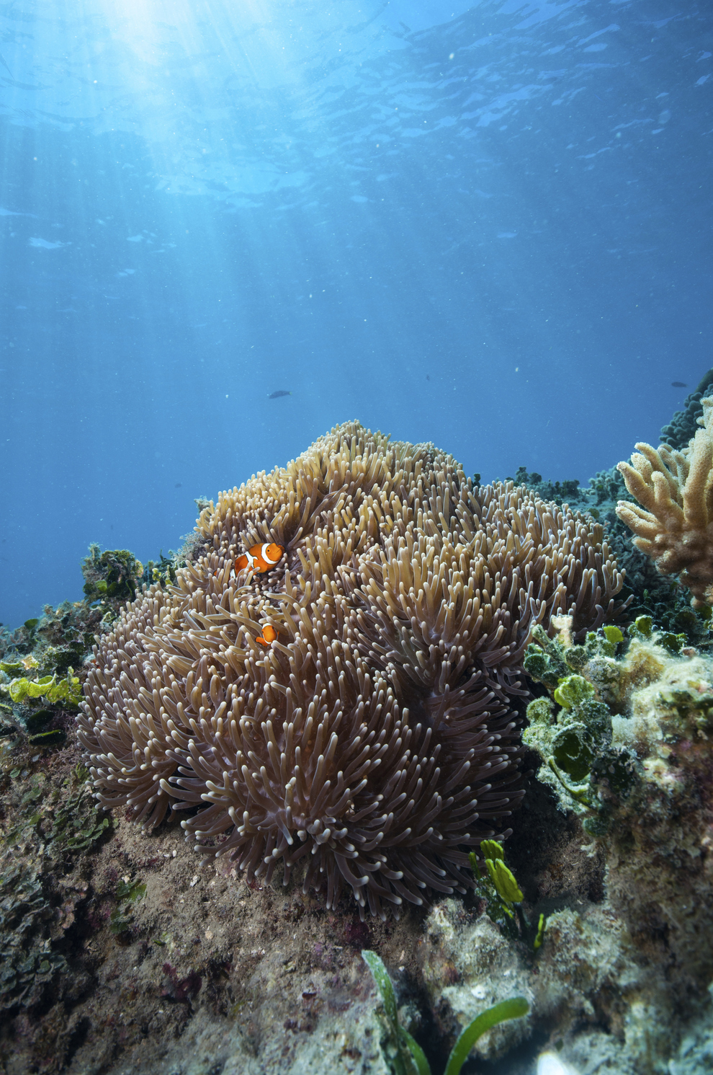
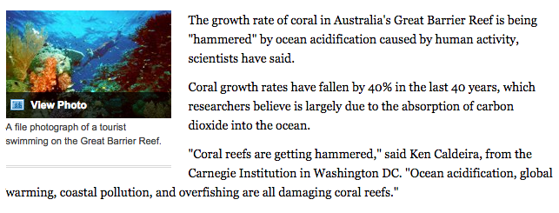
In the News...
Notes:
http://www.buzzfeed.com/jennaguillaume/35-spectacular-photos-that-highlight-the-importance-of-savin#ep7q5i
http://phys.org/news/2014-09-sharks-behavior-exposed-acidic.html

