Slide 1
Topic IV
Ch 9: water resources

Slide 2



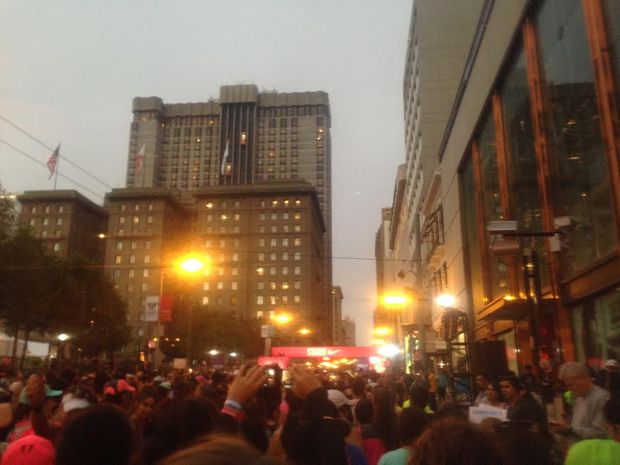

Slide 3
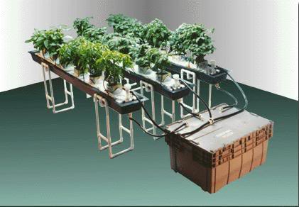
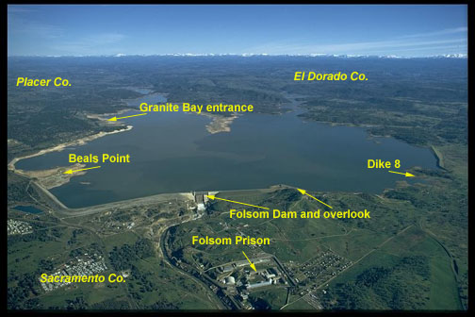
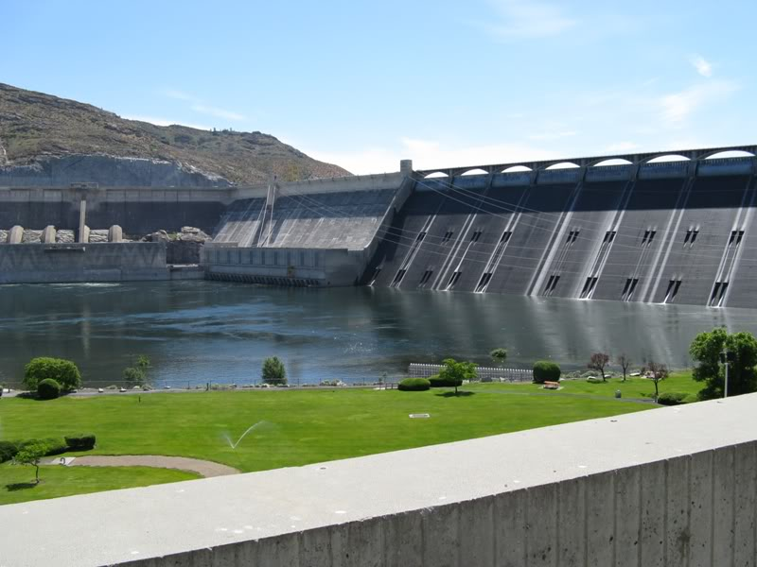
3/28 Water Resources CH 9
Obj. TSW identify and describe water resources and the management of the water from their notes, lab, and homework P.8 NB
1. Identify & describe Earth’s Natural Sources of water.
2. How do humans alter the availability of water?
3. How is water used by humans in agriculture, industry, and in the house?

Slide 4
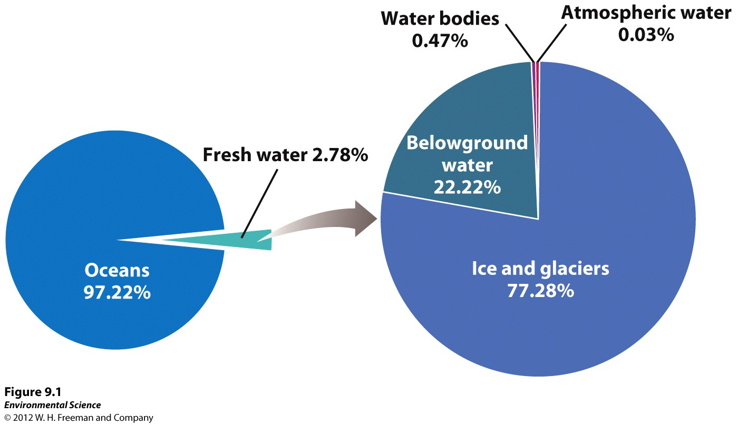
Usable Water is Rare

Slide 5
Groundwater
Aquifers- small spaces found within permeable layers of rock and sediment where water is found.
Unconfined aquifers- an aquifer that is simply porous rock covered by soil.
Confined aquifers- an aquifer surrounded by a layer of impermeable rock or clay.

Slide 6
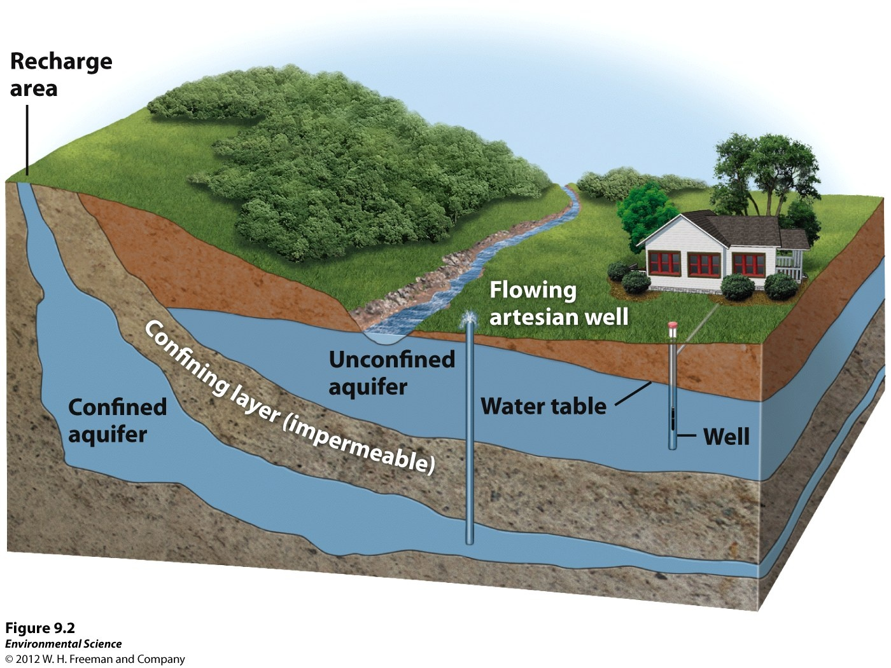

Slide 7
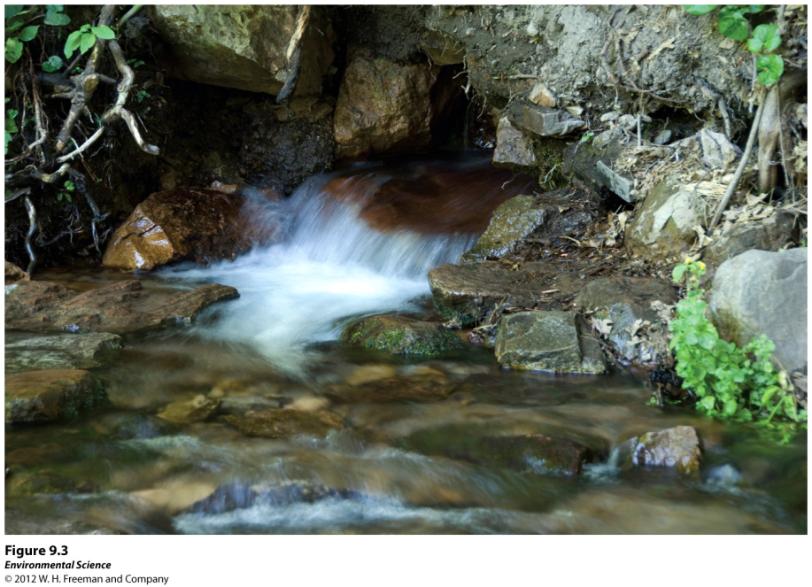
Groundwater
Water table- the uppermost level at which the water in an area fully saturates the rock or soil.
Recharge- the input process of water percolating into an aquifer.
Springs- water from an aquifer that naturally percolates up to the surface.

Slide 8
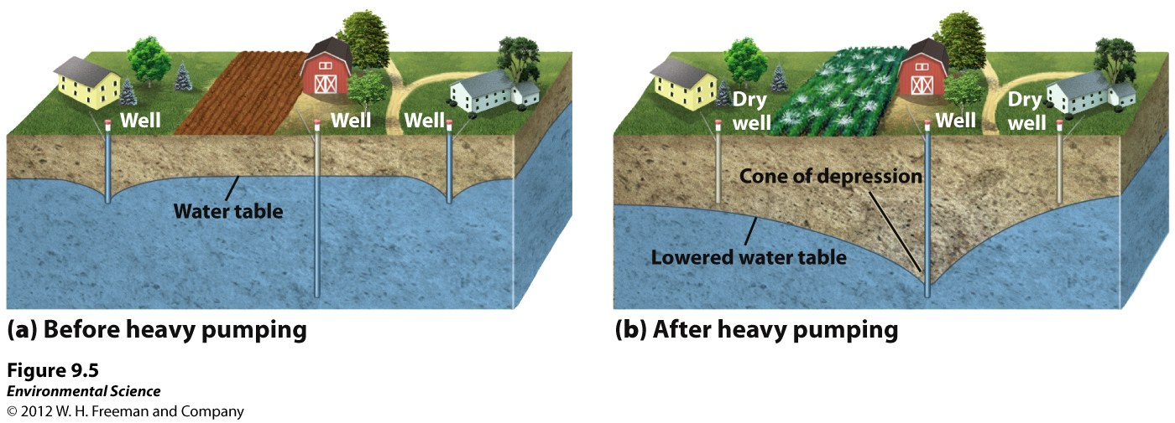
Groundwater
Cone of depression- an area where there is no longer any groundwater.

Slide 9
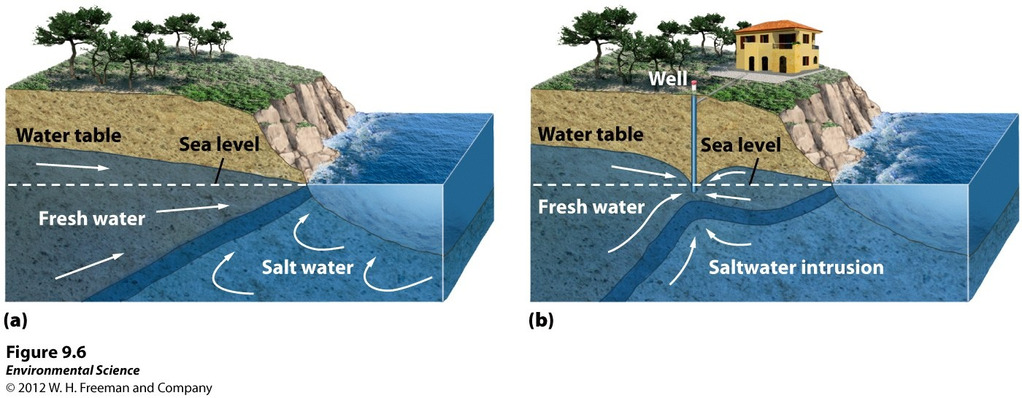
Groundwater
Saltwater intrusion- when the pumping of fresh water out of a well is faster than the recharge. Near coastal areas this can cause salt water to infiltrate the aquifer.

Slide 10
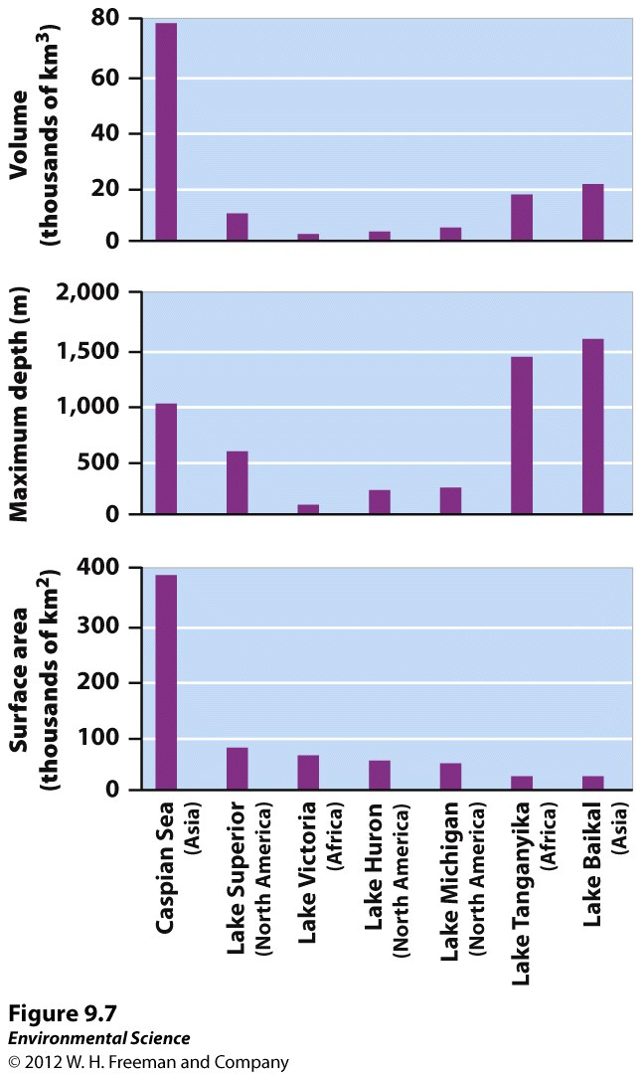
Surface Water
Streams, rivers, ponds, lakes and wetlands.

Slide 11
Altering the Availability of Water
Humans have learned to live with variations in water availability in several ways:
  Channel the flow of rivers with Levees;
  Block flow of rivers with Dams to store water
  Divert water from rivers and lakes and transport it to distant locations
  Obtain fresh water by removing salt from salt water (Desalination)
  Also Dikes and Aqueducts, Weirs

Slide 12
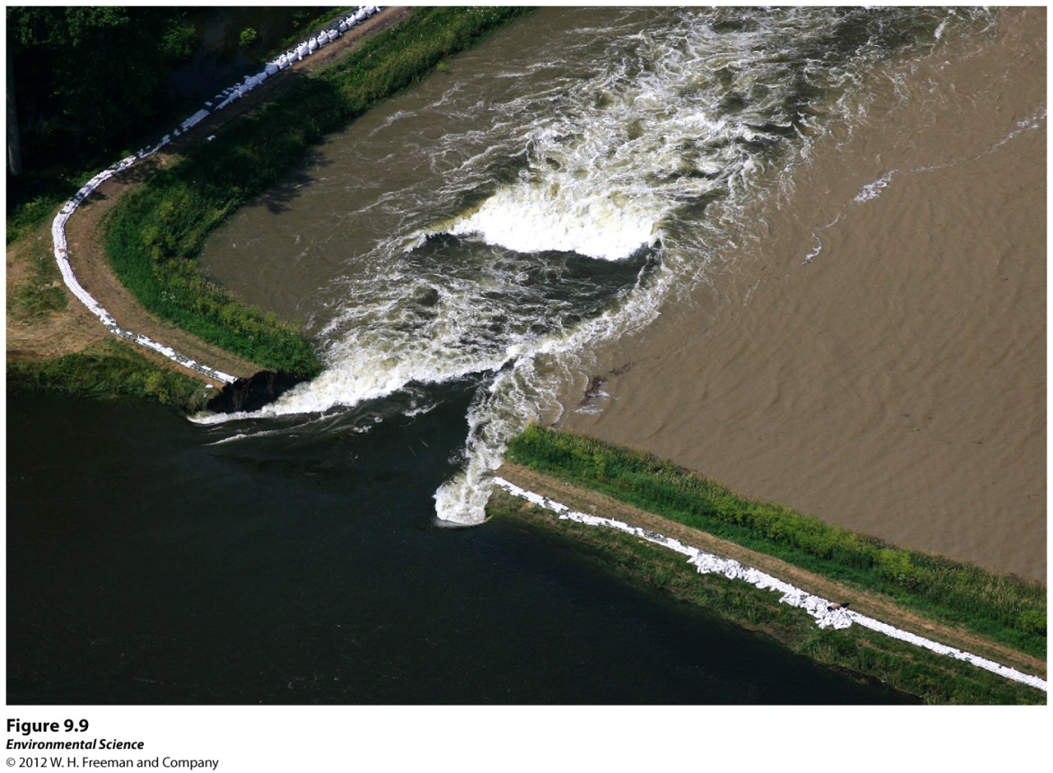
Altering the Availability of Water
Levees- an enlarged bank built up on each side of the river. Army core of engineers
Dikes- similar to a levee but built to prevent ocean waters from flooding adjacent land.

Slide 13
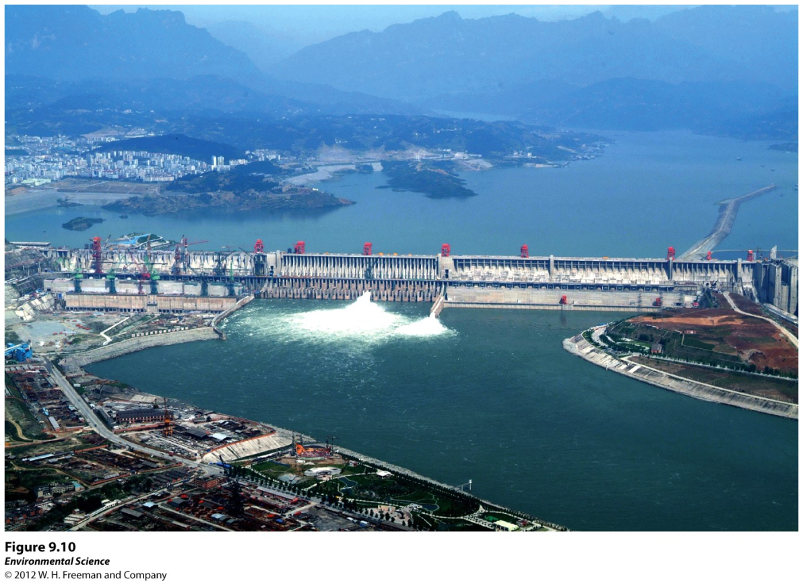
Altering the Availability of Water
Dams- a barrier that runs across a river or stream to control the flow of water. 95% energy efficient
Detrimental to surrounding habitat, & fish in turbine.
Reservoir- the area where water is stored behind the dam.

Slide 14
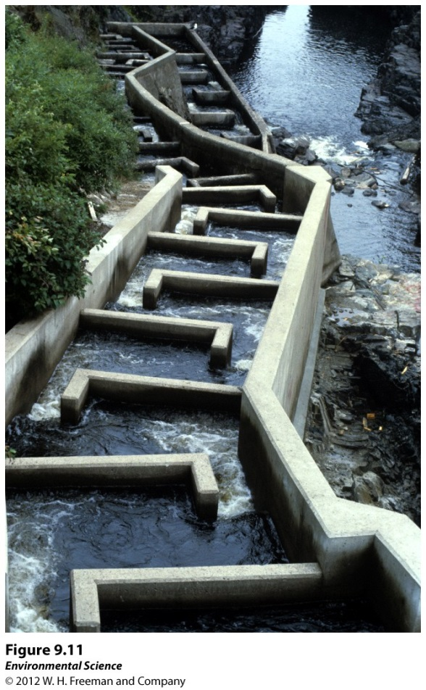
Altering the Availability of Water
Fish ladders- a set of stairs with water flowing over them that have been added to some dams to help migrating fish such as salmon get upstream.

Slide 15
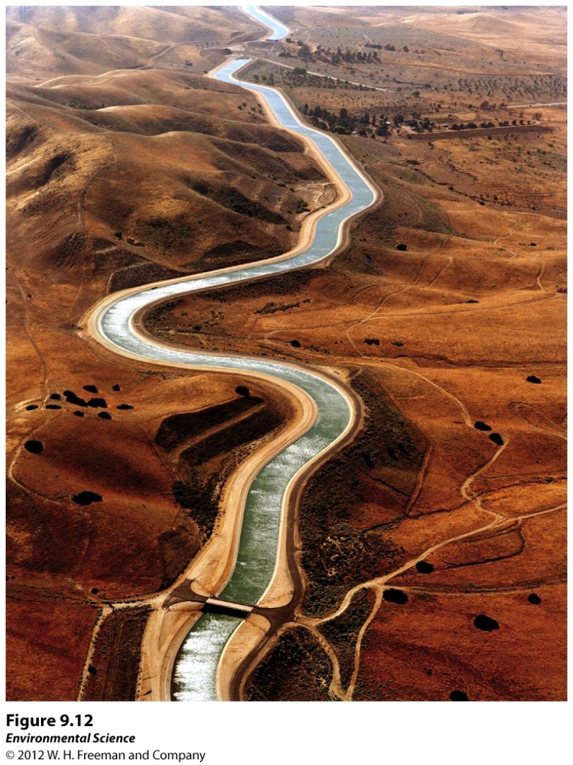
Altering the Availability of Water
Aqueducts- canals or ditches used to carry water from one location to another.
LA Aqueduct / Colorado River
Efficiency?

Slide 16
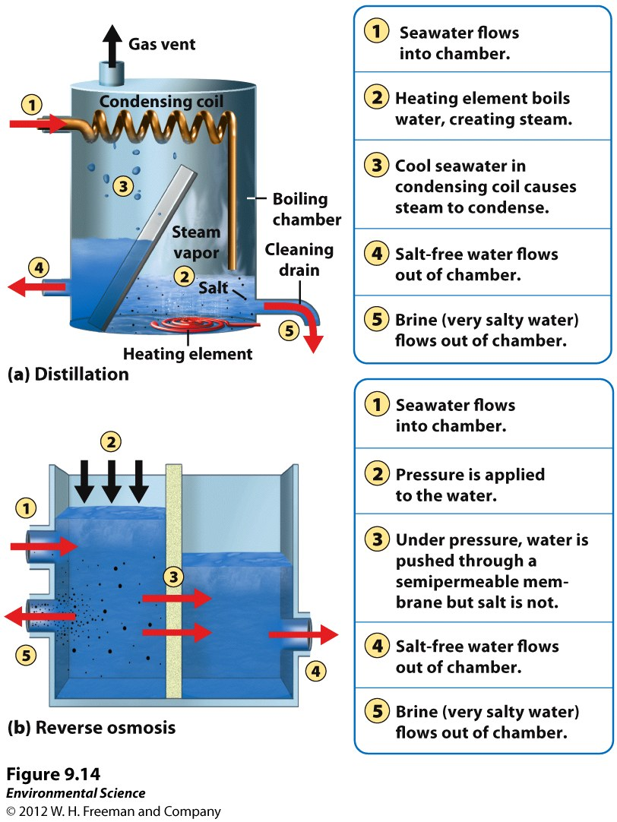
Altering the Availability of Water
Desalination- removing the salt from salt water to obtain fresh water.
Saudi Arabia

Slide 17
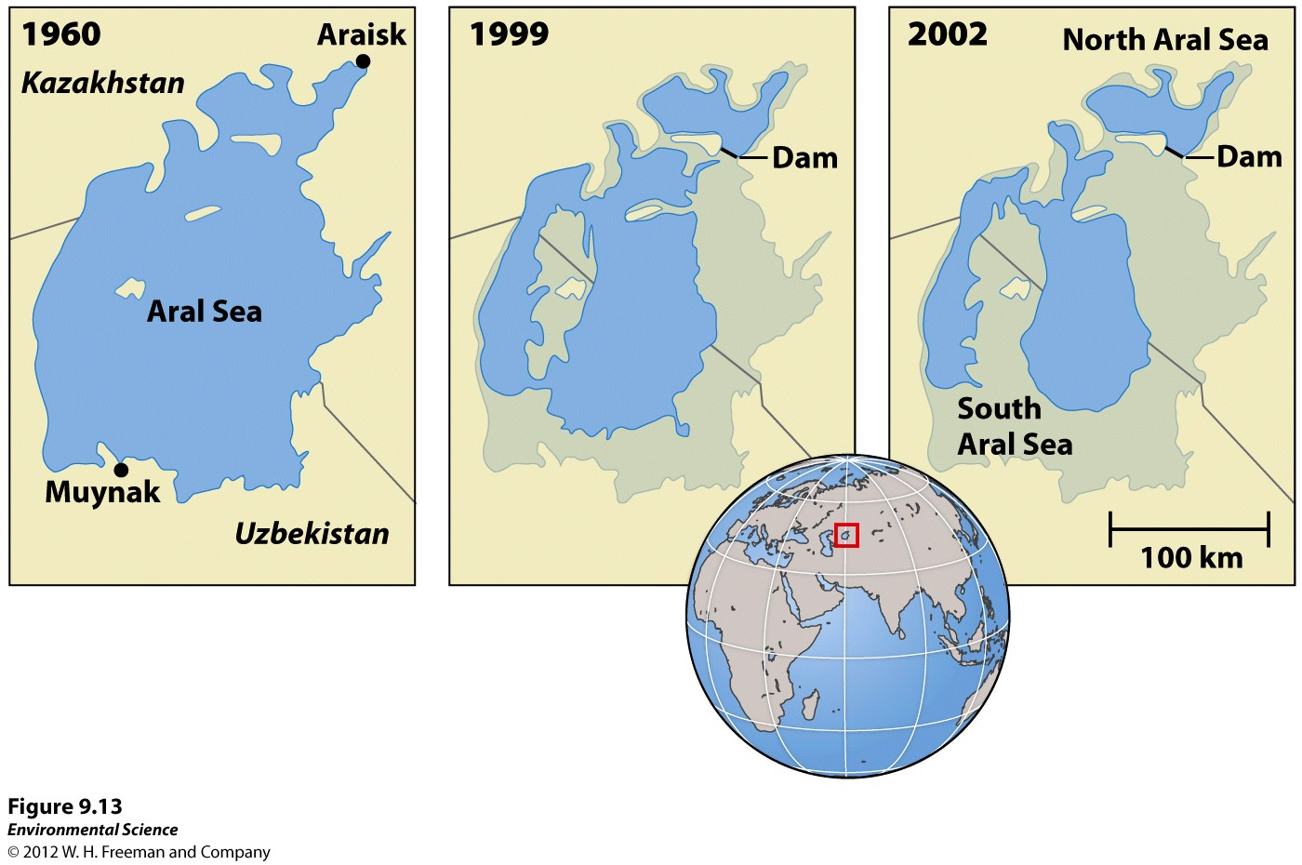
Consequences of River Diversion
Aral Sea once the 4th largest lake in the world.
The two rivers that fed the Lake were diverted, this is the result.
60% less lake surface area & habitat loss. Two distinct lakes exist now.

Slide 18
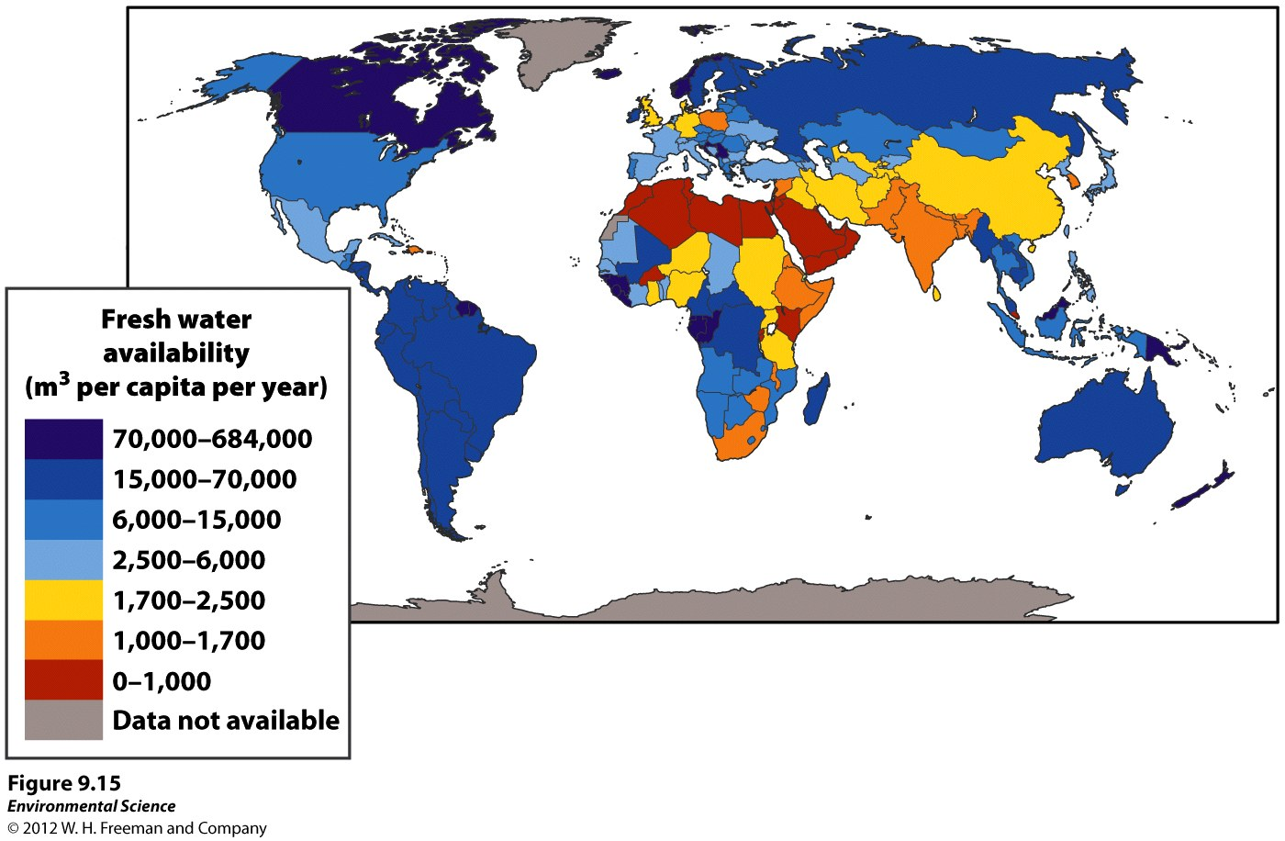
Freshwater Availability

Slide 19
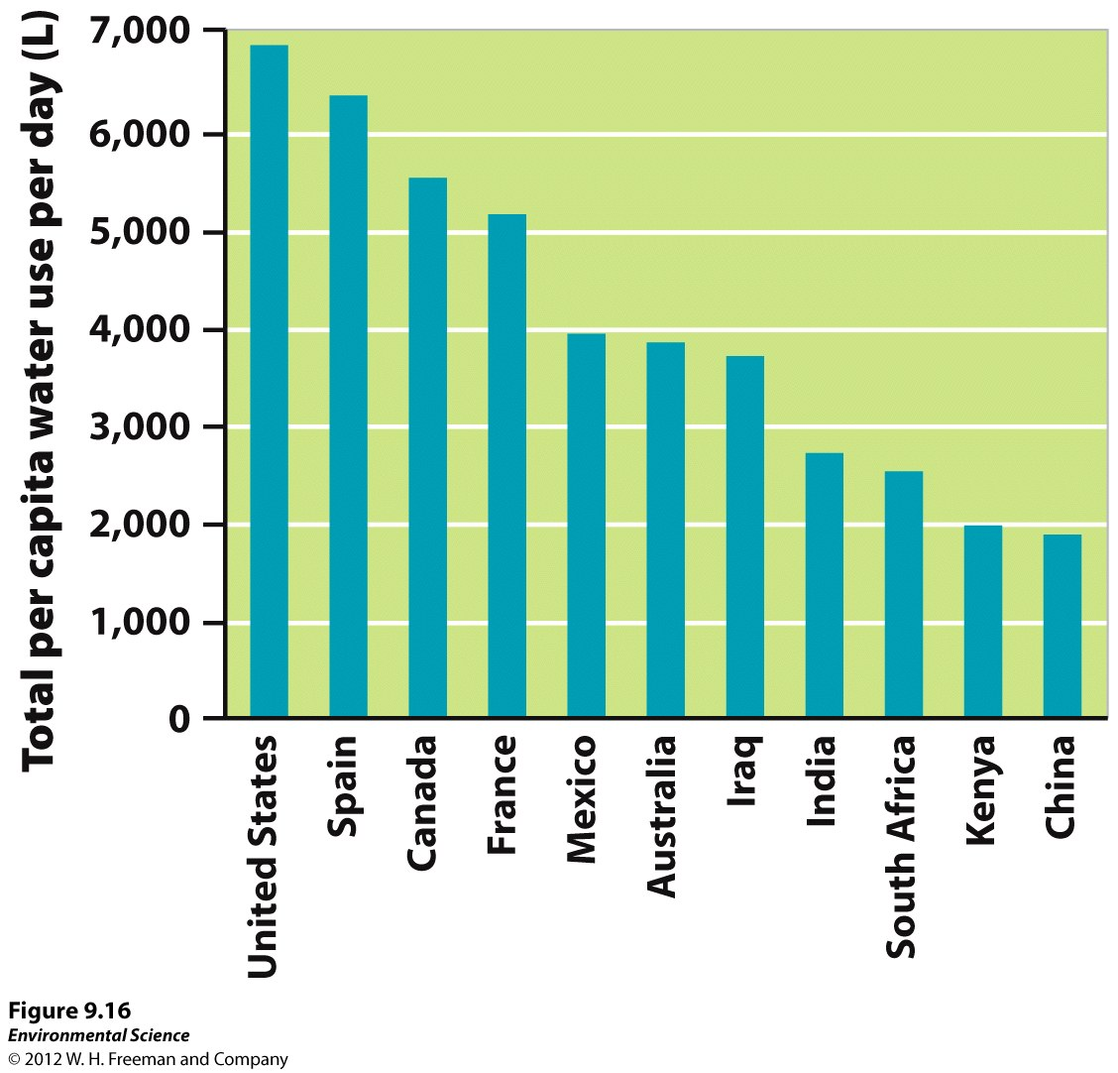
Total per capita water use per day (L)

Slide 20
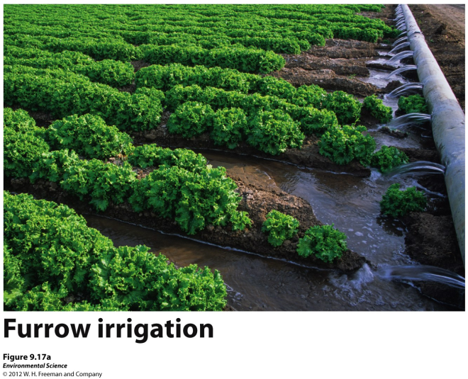
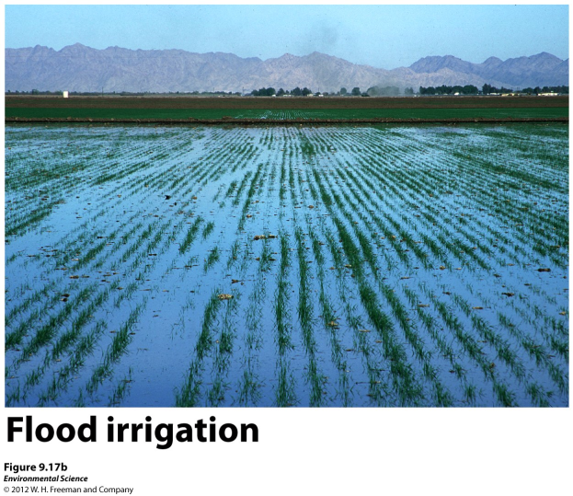
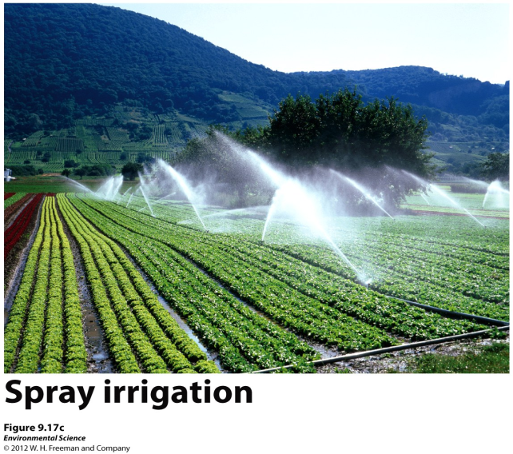
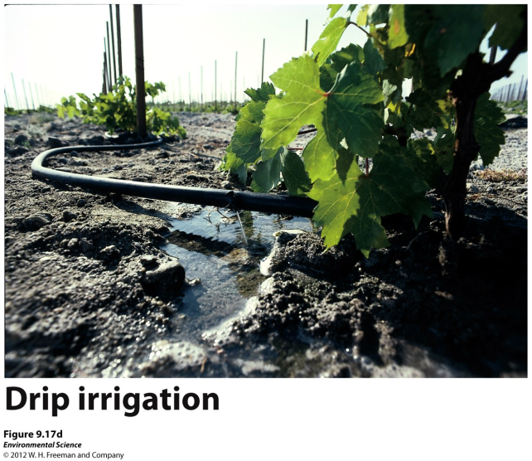
Agriculture, Industry and Household Needs
Agriculture- the largest user of water around the world.

Slide 21
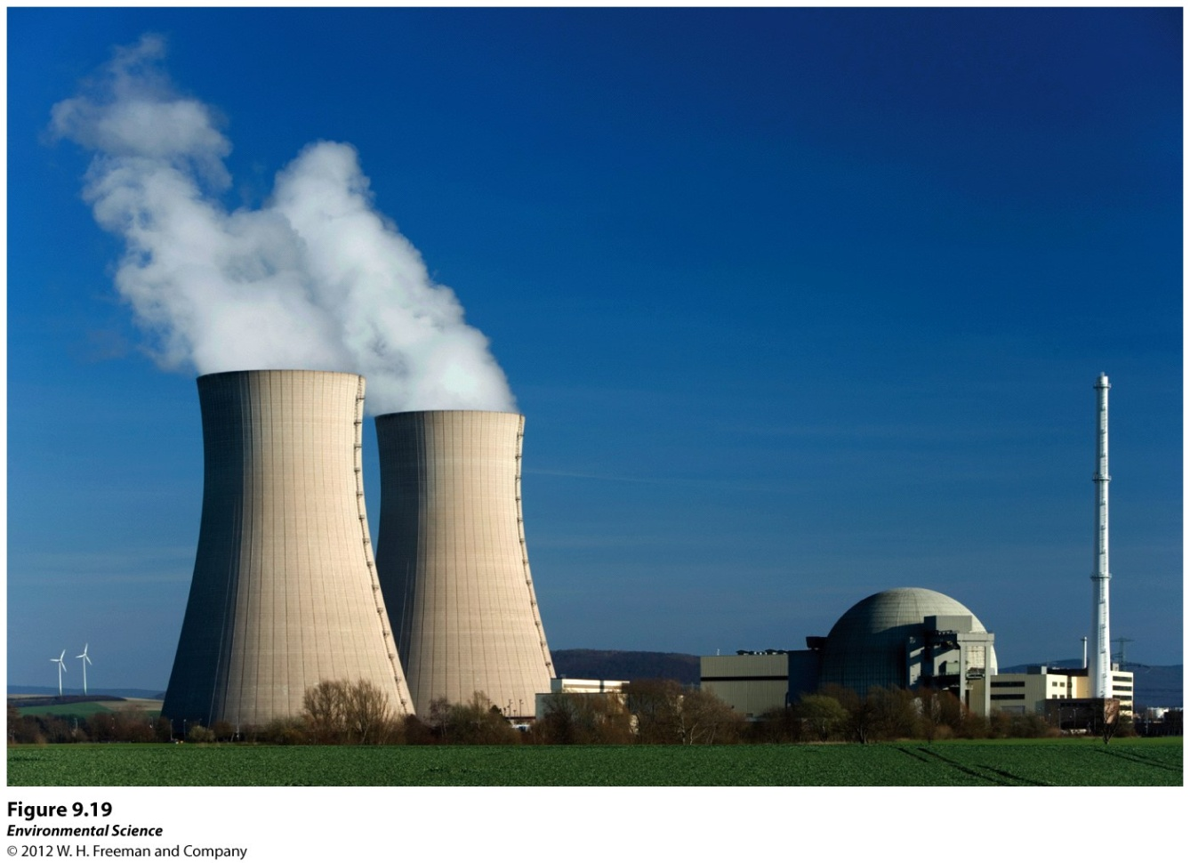
Industry- the second largest user of water worldwide.
Nuclear reactors heat water to make steam that turn electrical turbines and then the steam is cooled back down. Water vapor is released in the process.
Industrial uses:
Making paper, refining metals, use large amounts of water.

Slide 22
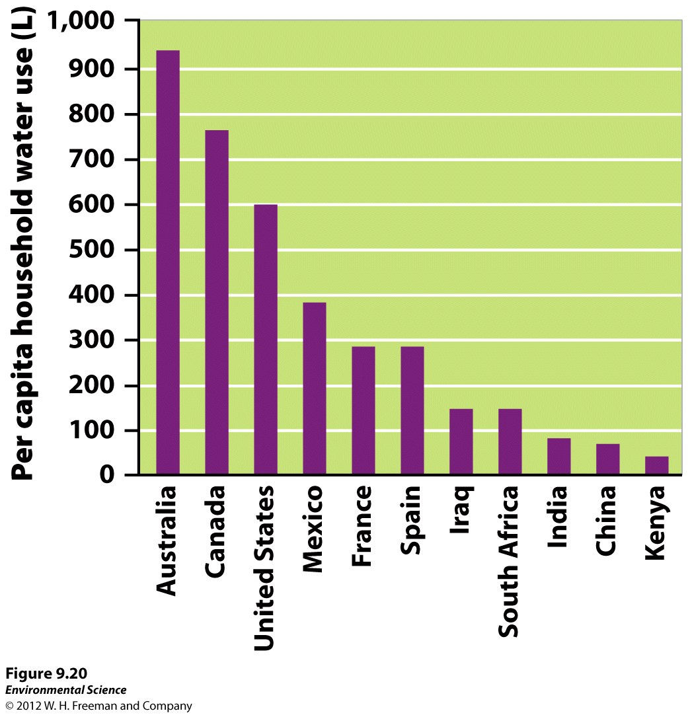
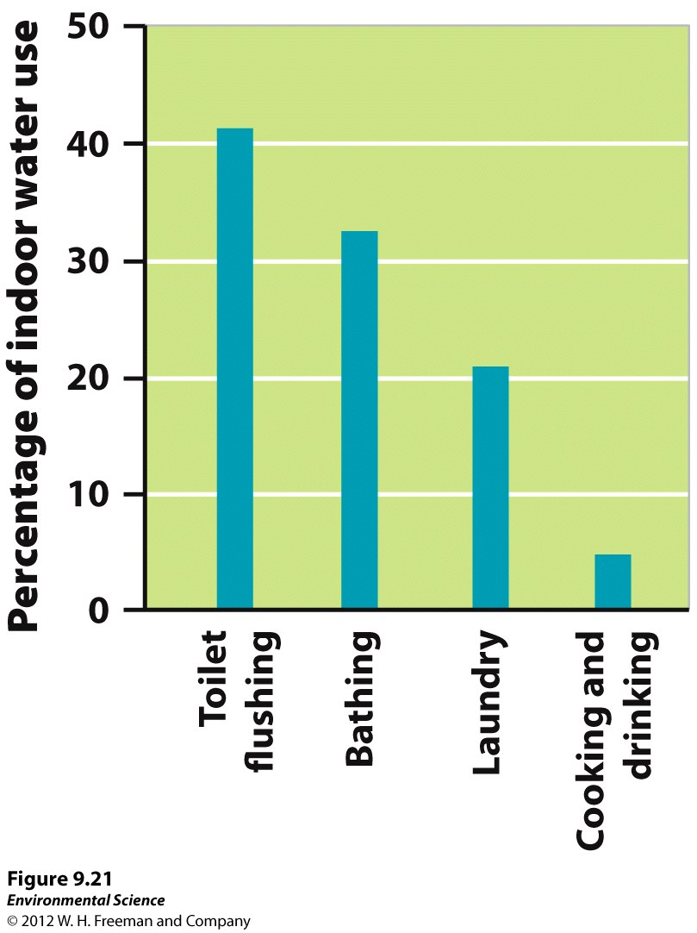
Households- the third largest user of water worldwide .
Grey Water use

Slide 23
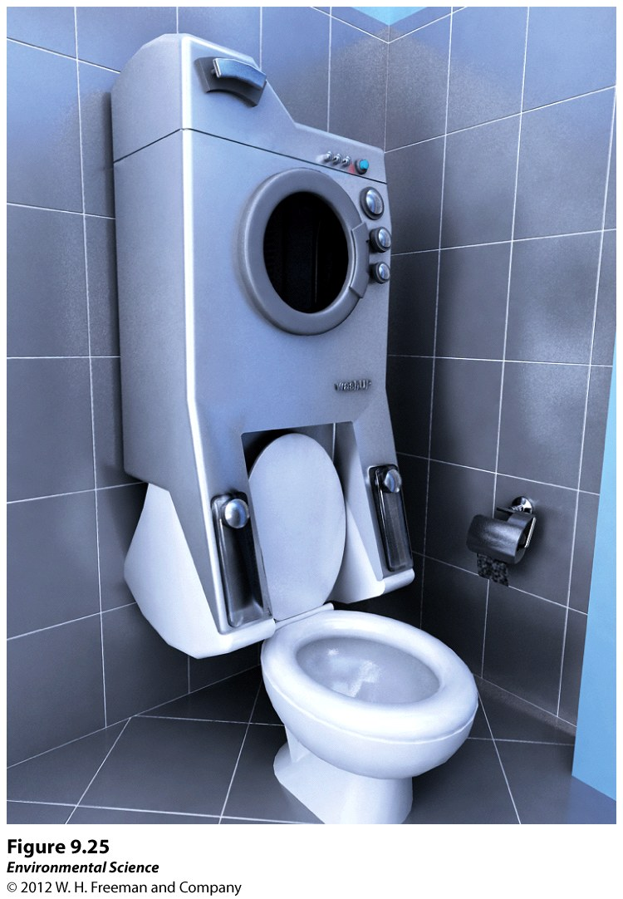
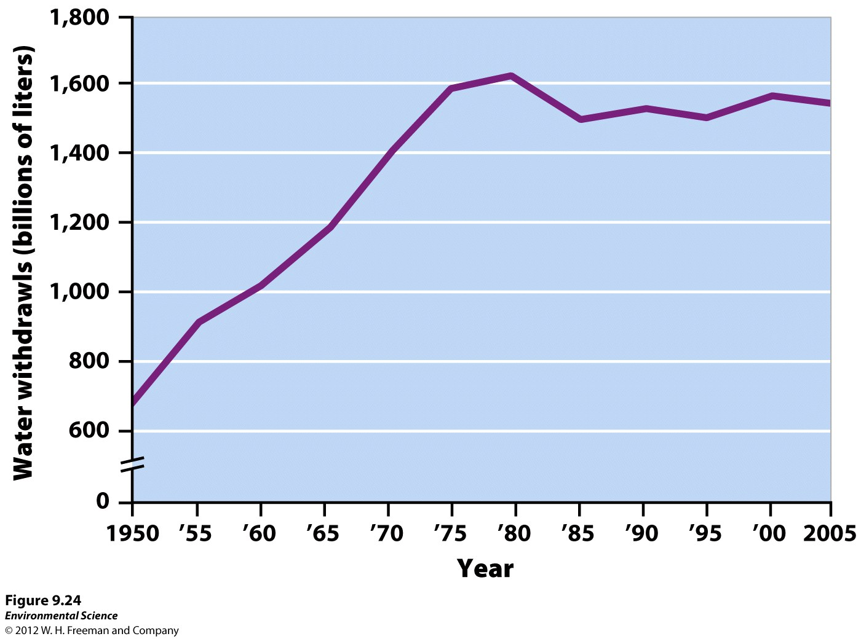
Activity – Water Conservation
Despite a growing population in the US, due to increased water conservation and new water efficient technology, water use has leveled off.

Slide 24
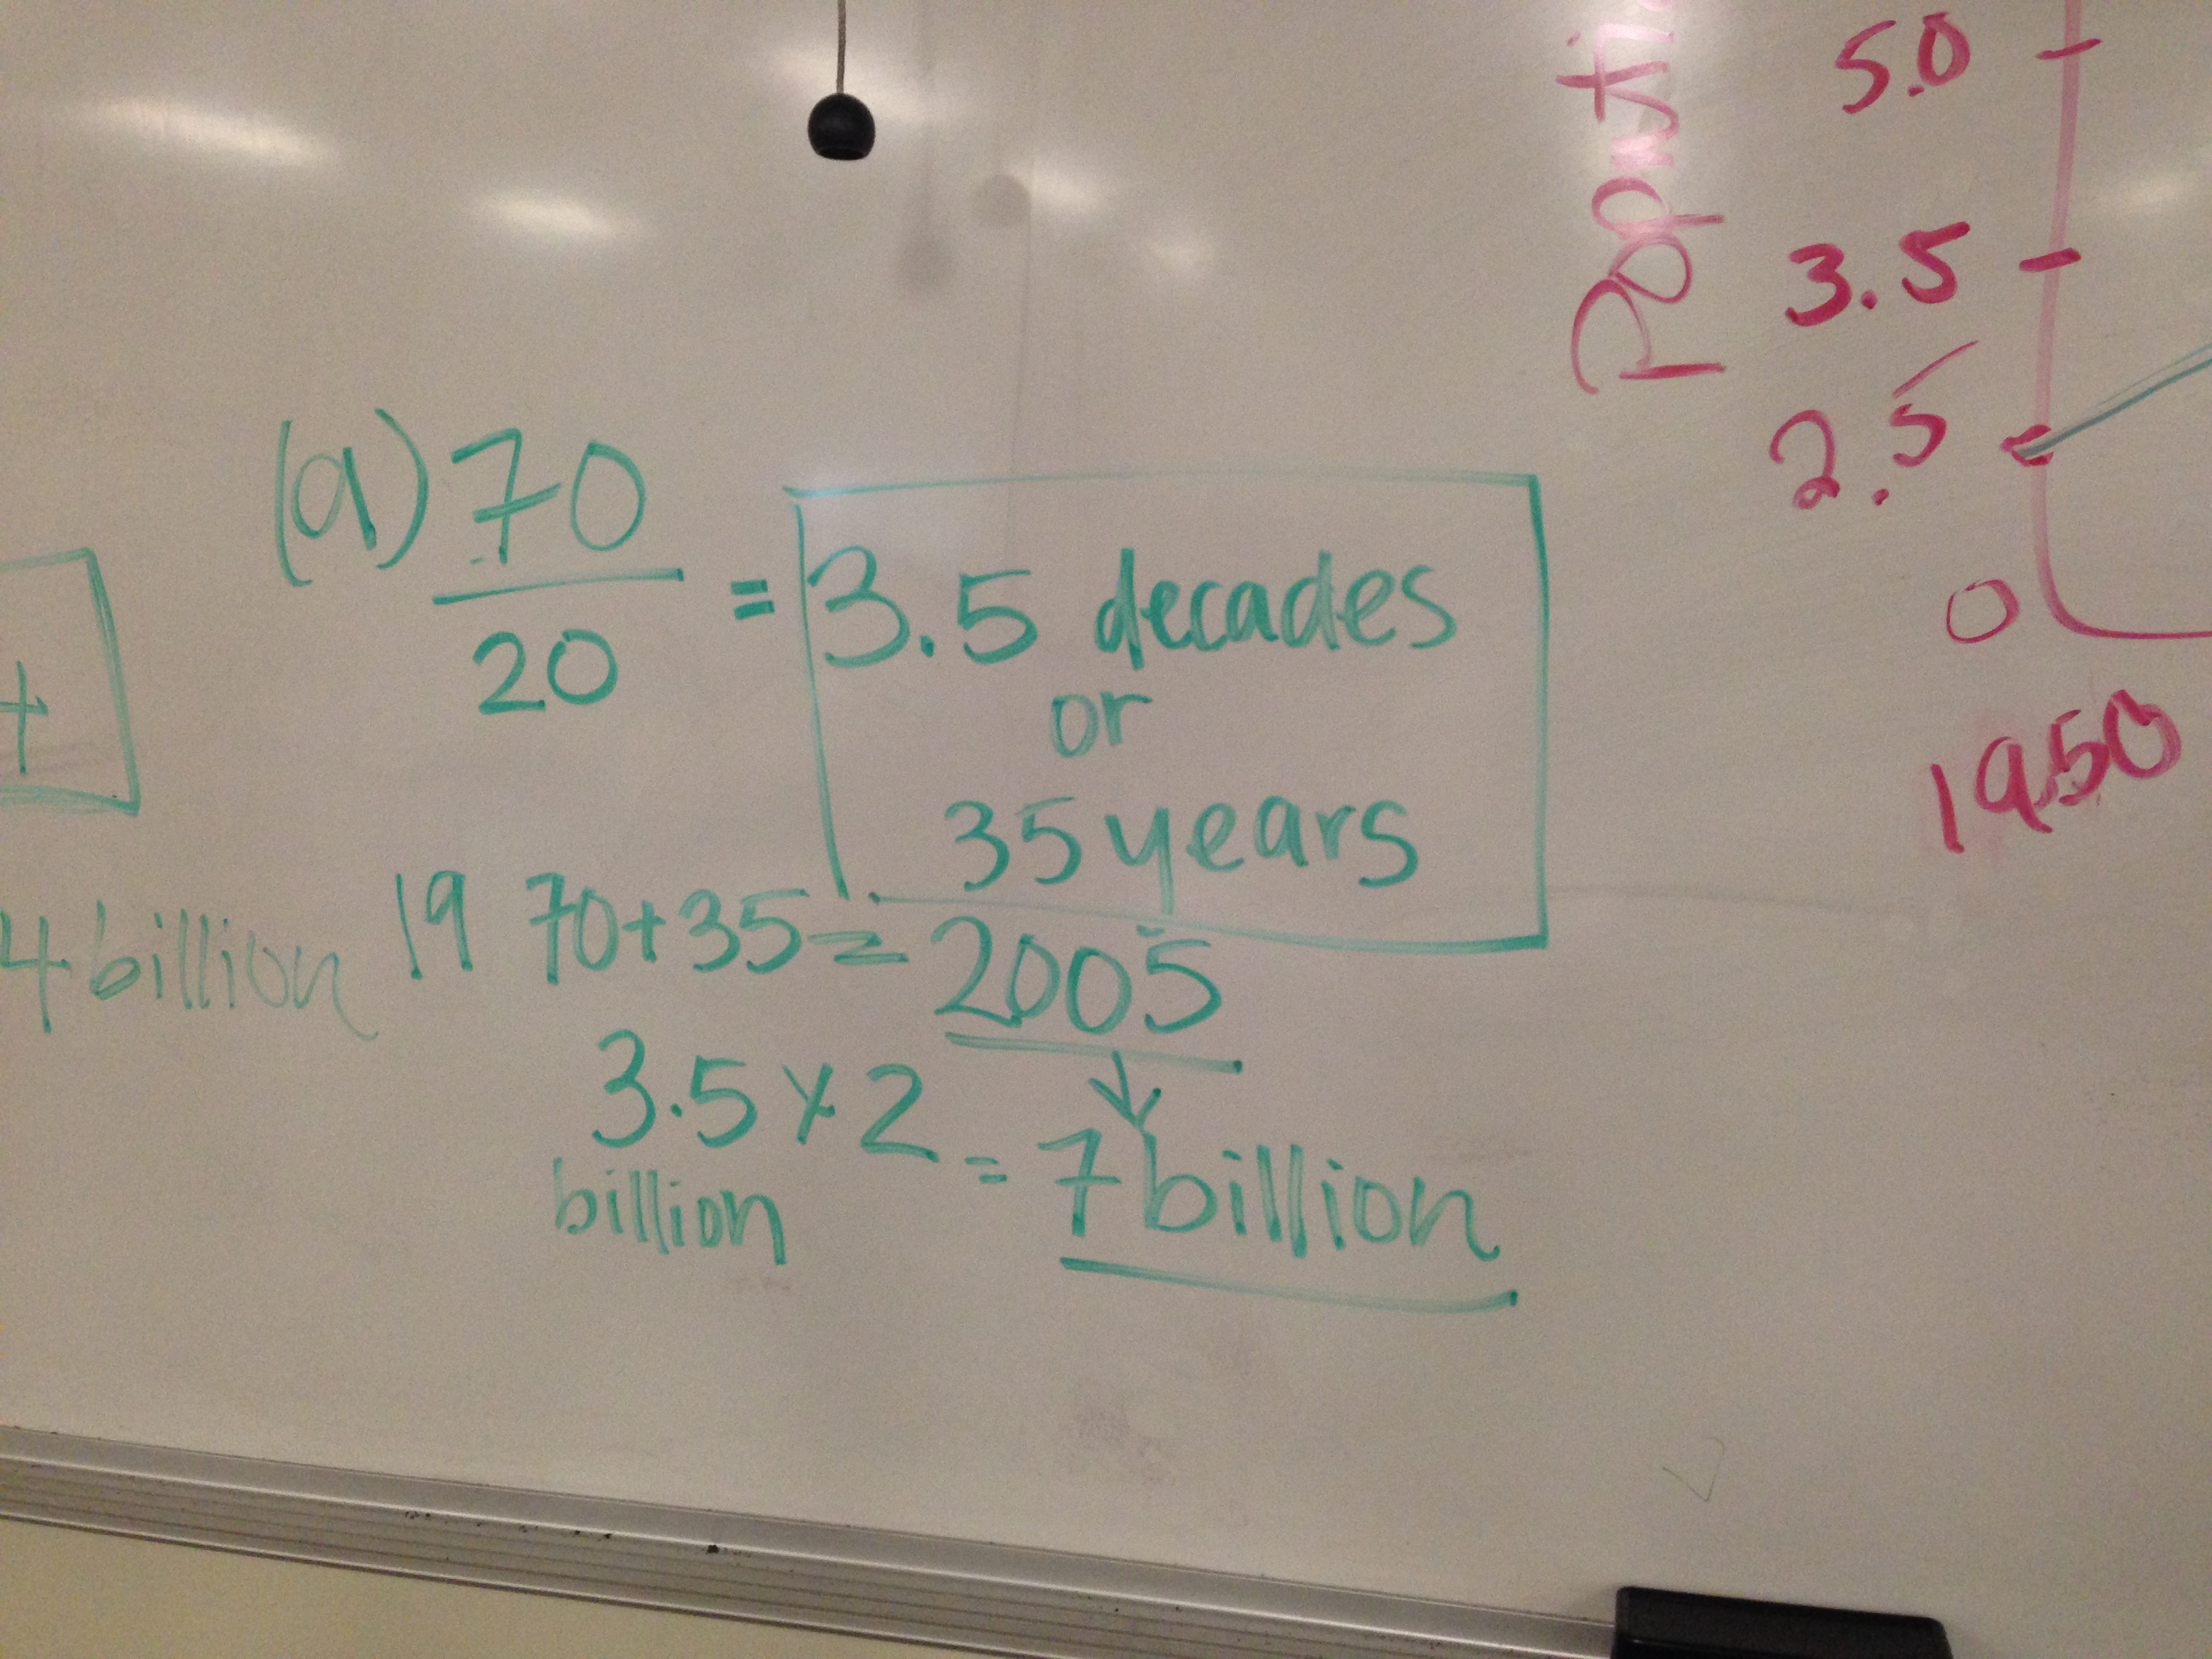
Midterm: FRQ B

Slide 25
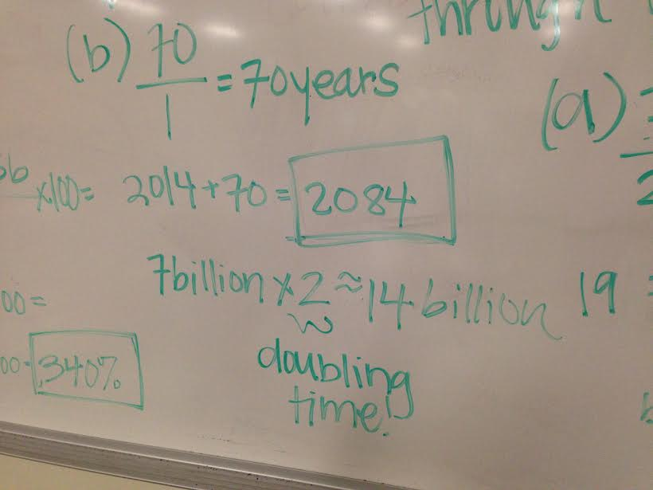

Slide 26
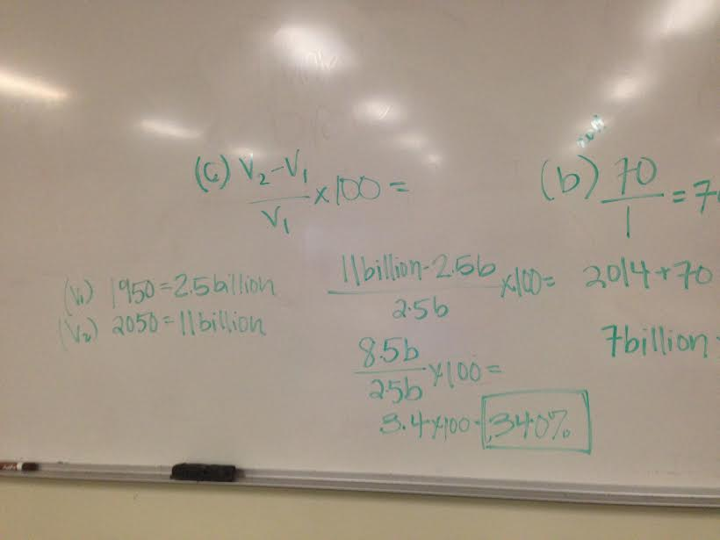

Slide 27
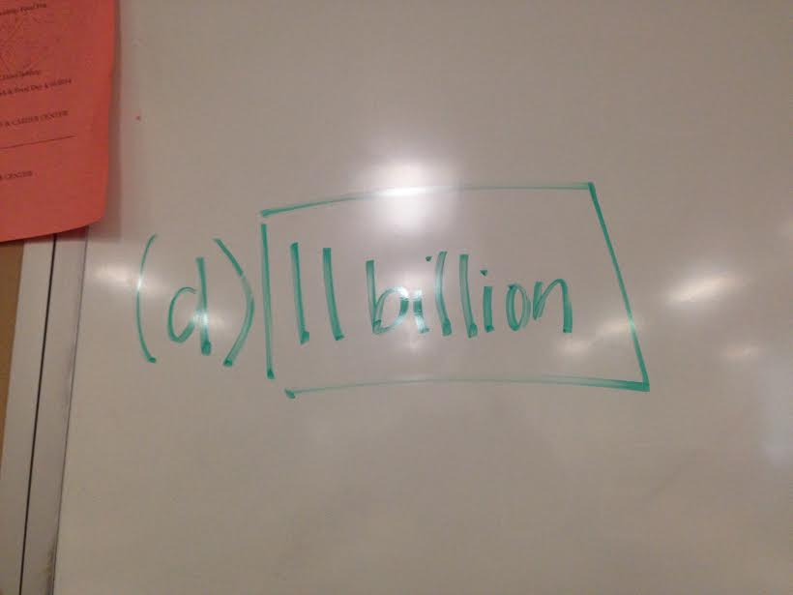
-Some people drew a curved line= answer wasn’t correct
-Just needed to draw a straight line through the points to get around 11 billion
-Range between 9-11.5 billion

Slide 28
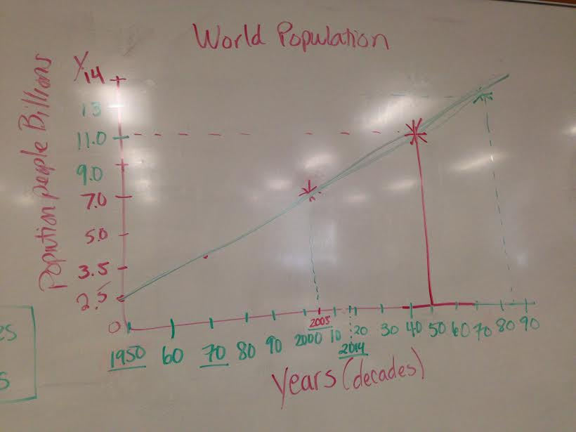

Slide 29
Tips:
Read through ENTIRE problem before doing anything!
Box answers
  Clearly show answers/how you got to answer
Write/ show work NEATLY
  I will stop hunting for answers next time
Reason through answers
  Decades vs. years
    3.5 years vs. 3.5 decades for part A
    70 years vs. 70 decades for part B
      Which makes more sense?
    Jonathan picked up on this!

Slide 30
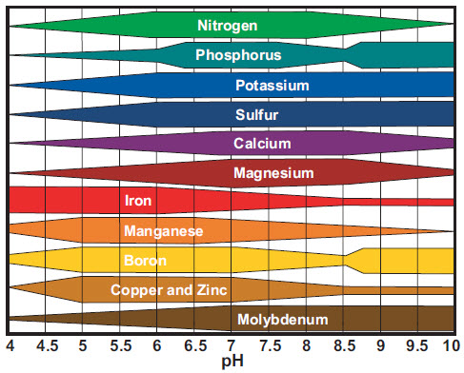
What’s your pH? Lab due Thursday, pg. 13
Notes:
-No soil pH test

Slide 31
Data Table:
-Record in pg. 9 NB
-Find the Average soil pH for each farmer
Farmer | A | B | C | D | E | F
Soil PH

Slide 32
What’s your pH?
Lab due Thursday, pg. 9
Farmer | A | B | C | D | E | F
Soil pH
Known Substance
How does the pH alter the availability of nutrients in the soil?
Why would it be important for farmers to know the pH of their soil?
Notes:
Alice= acidic
Benny= basic
Carlotta= neutral
In different soils there are different nutrient availability
***Alkaline: more basic
Top 6 elements: (nitrogen, phosphorus, potassium, sulfur, calcium, magnesium) Macronutrients
Bottom 6 elements: (iron, manganese, boron, cooper & zinc, molybdenum) micronutrients
Higher pH: more phosphorus, potassium, nitrogen (things that are really needed)
Lower pH: less phosphorus, potassium, nitrogen
Need to figure the limiting factors
Ex: if they have a very acidic soil= everything but iron will be a limiting factor aka it will limit the growth of their plants
Farmers will have to add a certain amount of things, students will have to address this
Ex: if their soil has a low pH= there going to have to add something more alkaline to it
-Biological processes such as nitrogen fixation and decomposition of dead plant matter is optimal when pH is close to neutral
-Elemental sulfur may be added to alkaline soils to lower the pH
-Add lime to raise the pH

Slide 33
Liquid Gold:
California’s Water
Group 1 Taking Charge of the Bay – Delta Isabel
Group 2 California’s water Supply and Demand & Use Angel & Adrian
Group 3 Moving California’s Water Sierra
Group 4 Salt and Smelt – Feeling the Effect of California’s Thirst Elona
Group 5 Visions of California’s Water Future Julian

Slide 34

3/29 How Humans alter the availability of Water CH 9
Obj. TSW learn how levees, dikes, dams, aqueducts & desalination makes water available to us. P. 10 NB
How do levees, dikes, dams & aqueducts differ from one another?
What is the primary purpose of each?
Why is it necessary to desalinize water?

Slide 35
Altering the Availability of Water
Levees- an enlarged bank built up on each side of the river. Hurricane Katrina devestation
Dikes- similar to a levee but built to prevent ocean waters from flooding adjacent land.
Used to manage or prevent water flow into specific land regions

Slide 36
Altering the Availability of Water
Dams- a barrier that runs across a river or stream to control the flow of water. 95% energy efficient
  Detrimental to surrounding habitat, & fish in turbine.
  Purpose of retaining water
Reservoir- the area where water is stored behind the dam.

Slide 37
Altering the Availability of Water
Fish ladders- a set of stairs with water flowing over them that have been added to some dams to help migrating fish such as salmon get upstream
Efficient as they can be
Blocking the natural flow of fish populations
No matter what you do, not the same!

Slide 38
Altering the Availability of Water
Aqueducts- canals or ditches used to carry water from one location to another.
LA Aqueduct / Colorado River
Efficiency?
Putting band-aid over developing
communities in water resource
insufficient locations
Notes:
Not enough water to power a huge city, more people keep moving there, need to keep pumping water there because we need water, as long as people keep moving to LA, which they will, we need to keep delivering water there

Slide 39
Altering the Availability of Water
Desalination- removing the salt from salt water to obtain fresh water.
  Cannot drink the sea
  Very expensive
Saudi Arabia
  Big desert= scarcity of fresh water
  Need water for drinking,
  Washing, growing crops, etc.
Notes:
http://www.desalinatedwater.info/home.php

Slide 40
Consequences of River Diversion
Aral Sea once the 4th largest lake in the world.
The two rivers that fed the Lake were diverted, this is the result.
60% less lake surface area & habitat loss. Two distinct lakes exist now.

Slide 41
Porosity & Permeability Lab, pg. 15
Students include this in your lab write up.
How does the pH of the soil affect the nutrient availability for plants?
How does the porosity and permeability affect the pH or contaminant?
Explain what aquifer is and why it is important. How can it be polluted?
Discuss several benefits of having wetlands.

Slide 42
How does Ground Water filter contaminants?
6 Stations, Get into groups of 3. Everyone should have a lab. Describe your contaminant (qualitative data). Measure the pH of your contaminant 15 ml in a 50 beaker. Record pH & observational data on page 15 NB

Slide 43
Gravel Filters- Porosity & Permeability Lab P. 15 NB
Record pH & observational data
Contaminant | pH Before Filtration | pH After Filtration
Lime juice | 4 | 7
Red Wine Vinegar | 5 | 7
Water Control | 8 | 7
Bleach | 9 | 7
Sodium Bicarbonate | 9 | 9
Dishwasher Detergent | 11 | 11
Ammonia | 12 | 10

Slide 44
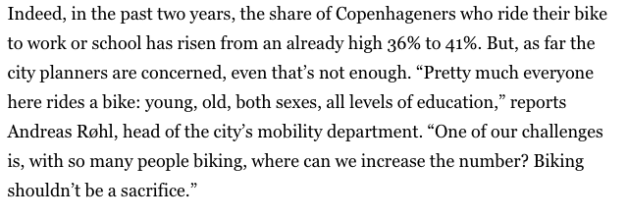
In the News...
Notes:
Denmark
Cophenhagen

Slide 45
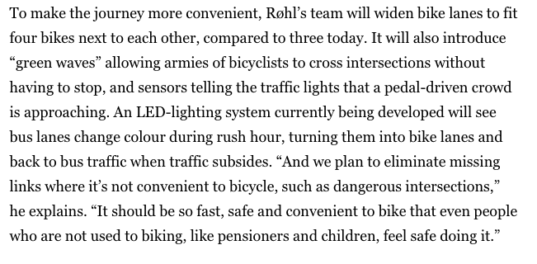

Slide 46
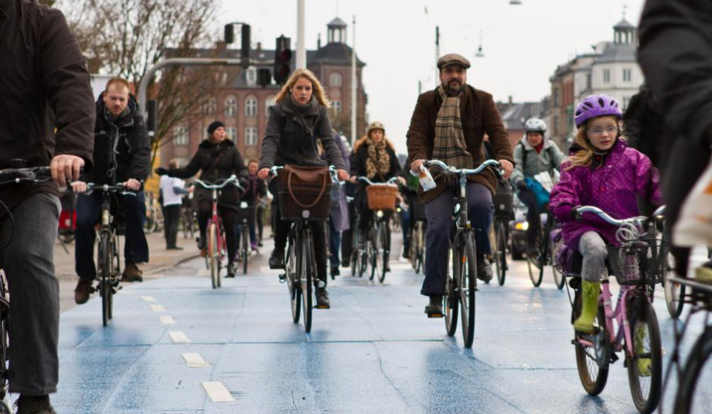

Slide 47

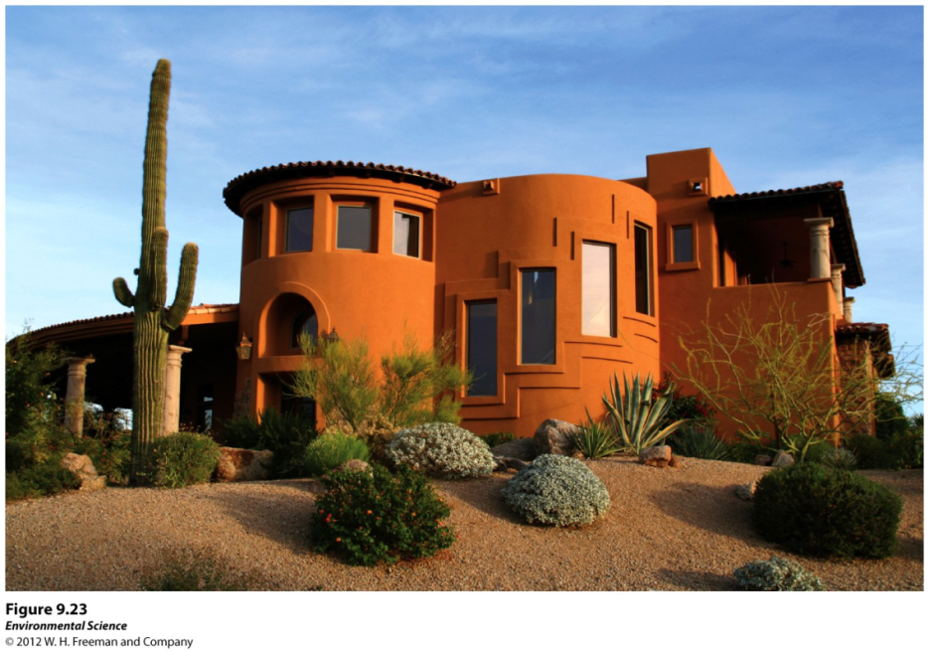
3/30 Water usage in Agriculture, Industry & Households
CH 9
Obj. TSW learn how water is used in Agriculture, Industry & household use. P. 12 NB
Compare and Contrast Confined and unconfined aquifers?
ID some irrigation techniques that use water. Which is more efficient?
Discuss water conservation, why is it important?

Slide 48
How does Ground Water filter contaminants?
Soil would moderate the pH of your solution
  Trying to get as close to neutral as possible (pH 7)
If you had a very basic solution, soil would decrease the pH
If you had a very acidic solution, soil would increase the pH
Those of you who put TONS of clay:
  Mimicked a confined aquifer (must talk about in lab report if you had this!)
Reason we didn’t see huge changes:
  Not enough soil to moderate the pH

Slide 49
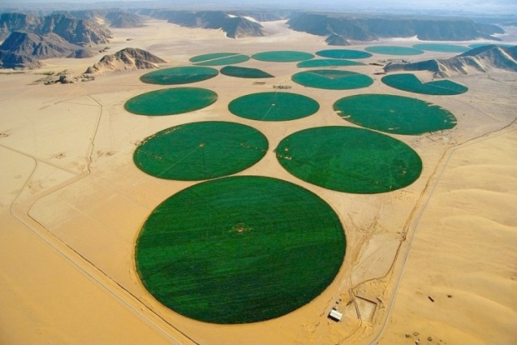
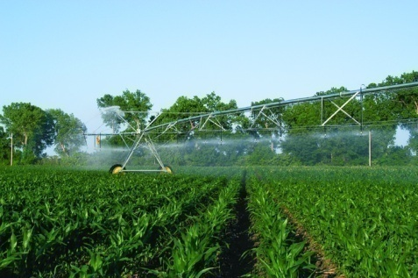
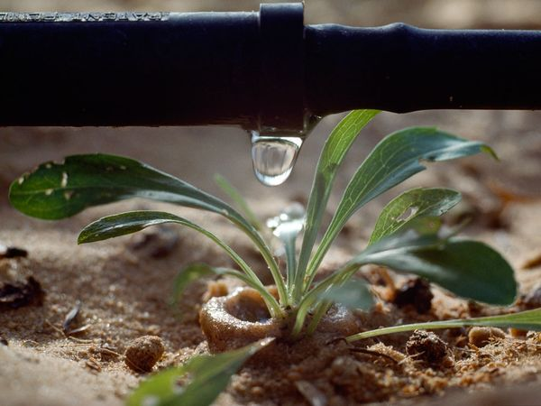
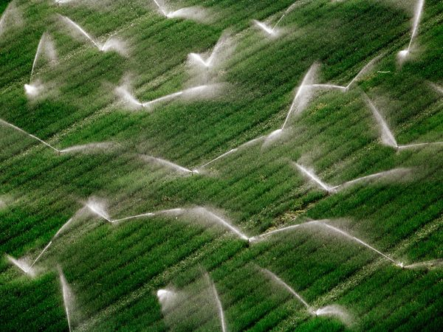
Agriculture, Industry and Household Needs
Irrigation techniques-
    Furrow irrigation- a trench that is flooded with water.
    Flood irrigation- the entire field is flooded with water.
    Spray irrigation- an apparatus that sprays water across a field.
    Drip irrigation- using a slow dripping hose that is laid on or buried beneath the soil.
    Hydroponic agriculture- crops grown in fertilized water and no soil.

Slide 50
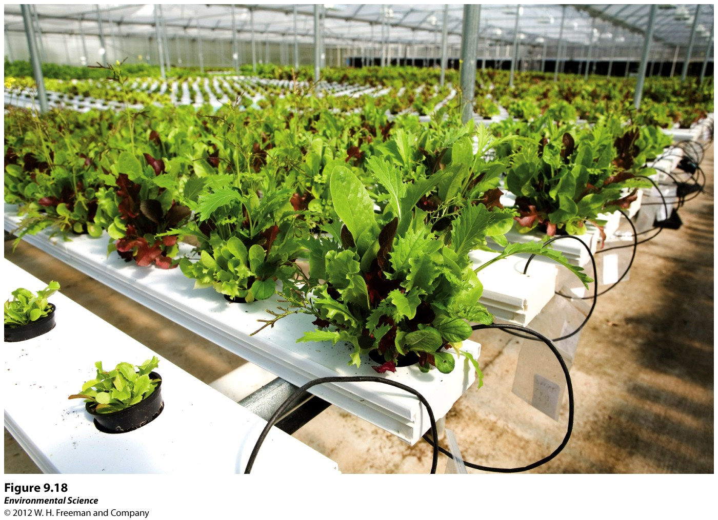
Hydroponics
Can us up to 95% less water than traditional farms
While it can produce more plants per hectare=
Can cost more because the equipment is so expensive

Slide 51
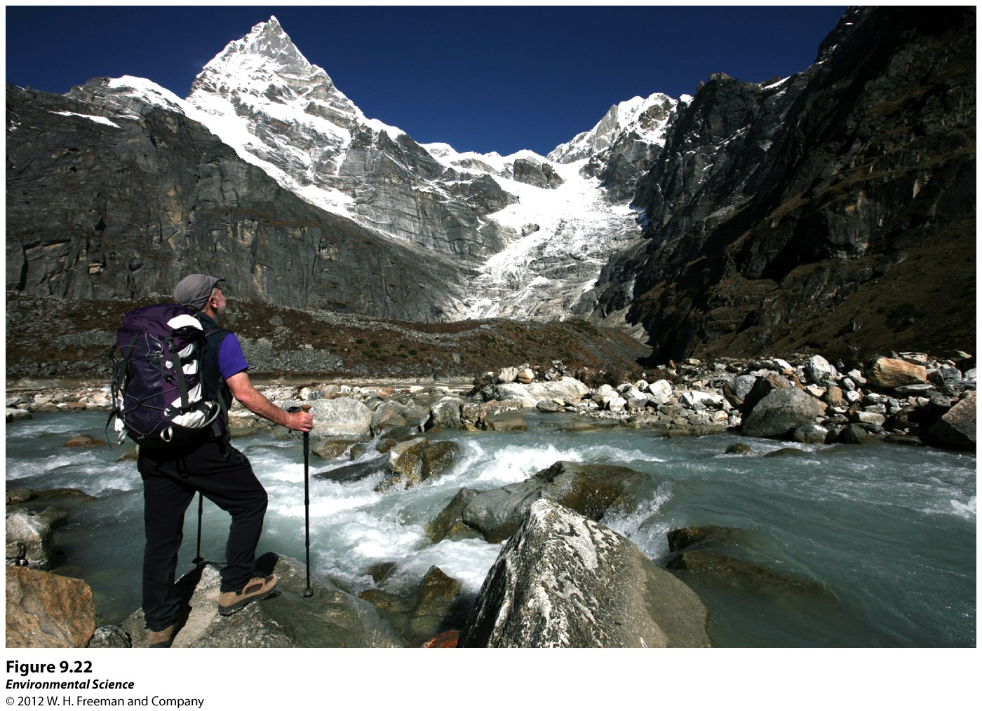
Himalayan River – India
Who owns it?

Slide 52

The Future of Water Availability
Water ownership- people can have rights to water use, but they do not own the water.
Water conservation- using techniques such as more efficient water fixtures, faucets and washing machines.

Slide 53
Modern Marvels: Water
Flood Control on the Mississippi (3 minutes)
  What are the benefits of the Atchafalaya Swamp?
  What could be concerns to laying concrete mats?
  What are some possible job opportunities in the Field of Env. Sci?
Hoover Dam (4 minutes)
  List & explain three benefits and three costs to building a dam.

Slide 54
How to Cite Your Sources, pg. 21 NB
Take 2 minutes to discuss these questions with a partner:
Could anything bad happen to you if you copied someone else’s idea or words and didn’t give them credit?
How does it help YOU when you cite sources? How might it help your reader if you cite sources?
How would you feel if you posted something really cool on Facebook and a bunch of people shared it as if it was their own witty comment, not giving you credit?
Notes:
-Actor Shia LeBouf= copied someone else movie and got in to trouble (bad grade, kicked out of college, lose your credibility, pay a fine, go to jail)
-(shows you know what you are talking about, credible sources give you authority)
-(can learn more from the books you read, know if they can trust your arguments)

Slide 55
Give Credit When Credit is Due
Give credit whenever you use:
1. Another person's idea, opinion, or theory.
2. Any facts, statistics, graphs, drawings-any pieces of information-that are not common knowledge.
3. Quotations of another person's actual spoken or written words.
4. Paraphrases of another person's spoken or written words

Slide 56
In-text citations: Author-page style
MLA format follows the author-page method of in-text citation. This means that the author's last name and the page number(s) from which the quotation or paraphrase is taken must appear in the text, and a complete reference should appear on your Works Cited page. The author's name may appear either in the sentence itself or in parentheses following the quotation or paraphrase, but the page number(s) should always appear in the parentheses, not in the text of your sentence. For example:
(1)Wordsworth stated that Romantic poetry was marked by a "spontaneous overflow of powerful feelings" (263).
(2) Romantic poetry is characterized by the "spontaneous overflow of powerful feelings" (Wordsworth 263).
(3) Wordsworth extensively explored the role of emotion in the creative process (263).
Notes:
If there is no author, put the title instead, this happens sometimes but not always

Slide 57
Resources
MLA vs. APA
Purdue Online Writing Lab (OWL)
  https://owl.english.purdue.edu/owl/resource/747/01/
Easy bib
  http://www.easybib.com/
  EX)
  http://www.cnn.com/2014/08/05/tech/gulf-of-mexico-dead-zone/

Slide 58
What to include in your lab reports?
In-text citations!!!
Works Cited page
  Easy bib can do this for you very easily
  Googlescholar
If you do not have either of these you will receive NO CREDIT for your lab reports

Slide 59
Cite Your Source Activity p. 23 NB
(1) Use one of the computers in the room to find a source
(2) Write a sentence or two that use the information
(3) Then cite it in a Works Cited page/area
It should be for your Permeability/Porosity lab
Must include AUTHOR (or title if no author) and DATE within your sentences
Must include WORKS CITED page
Worth 10 points of your project/homework grade! P. 23 NB

Slide 60

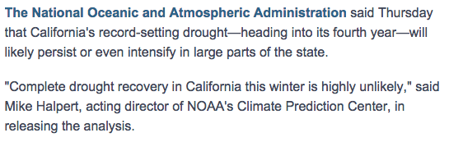
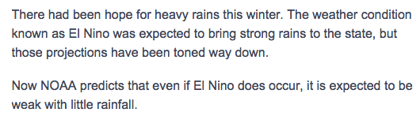
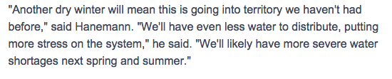
In the News...

Slide 61
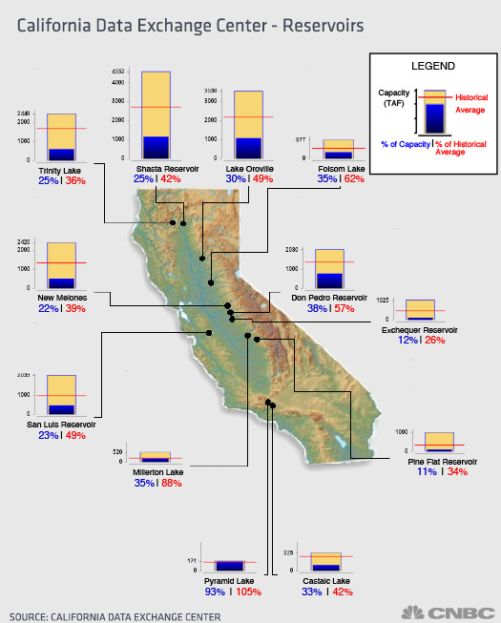

Slide 62
Topic IV
Ch 8: Mining

Slide 63
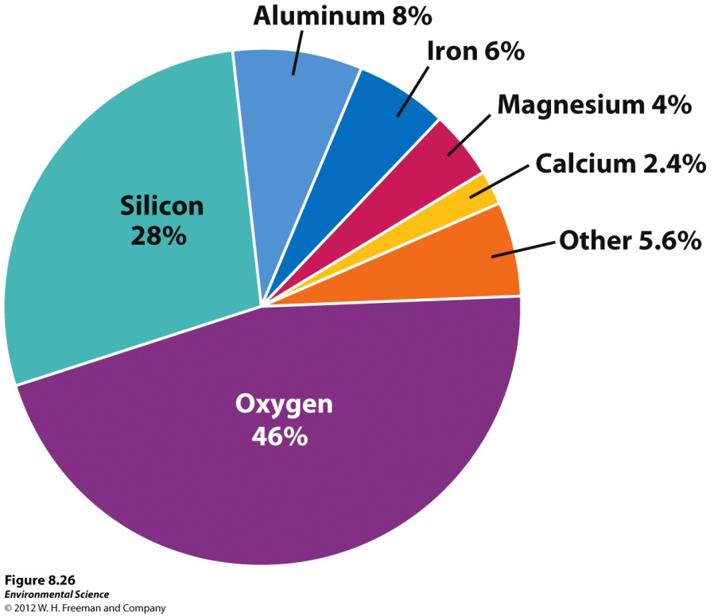
3/31 Mineral Resources CH 8
Obj. TSW identify and explain the different mineral resources in mining and the types of mining. P. 14 NB
Why are economically valuable mineral resources distributed unevenly on the planet?
Explain Surface Mining and give examples.
Explain Subsurface Mining and give examples.

Slide 64

Distribution of Mineral Resources
Tectonic Cycle, Rock Cycle, Soil Formation, Erosion
Early Earth cooled and differentiated into distinct vertical zones
Heavy elements sank toward core → lighter elements rose toward the crust

Slide 65
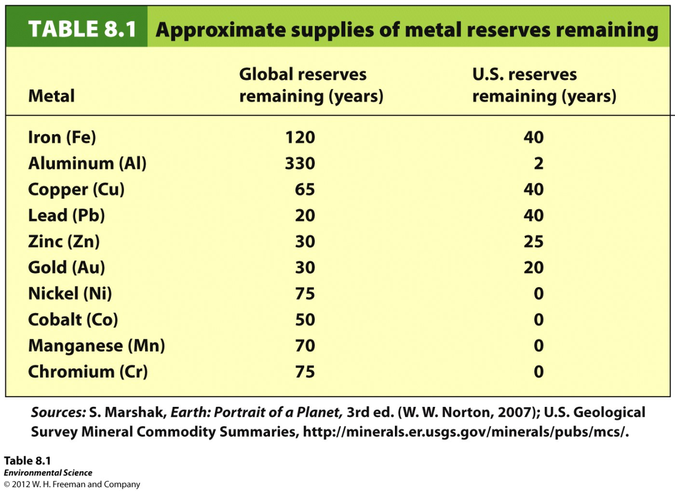
Reserves
The known quantity of a resource that can be economically recovered.
Within those reserves= Ores
Naturally occurring solid material from which a metal or valuable mineral can be profitably extracted
65

Slide 66
Types of Mining
Surface mining- removing minerals that are close to Earth’s surface.
    Strip mining- removing strips of soil and rock to expose ore.
    Open pit mining- the creation of a large pit or hole in the ground that is visible from the surface.
    Mountain top removal- removing the entire top of a mountain with explosives.
    Placer mining- looking for metals and stones in river sediments.
66

Slide 67
Types of Mining
Subsurface mining:
  Mining for resources that are at least 100 meters below Earth’s surface
  Begins with a horizontal tunnel dug into the side of the mountain or feature containing the resource
  Vertical shafts are drilled
  Elevators are used to bring miners down to resource and back up
  Deepest= 2.2 miles
  Coal, diamonds, gold
67

Slide 68
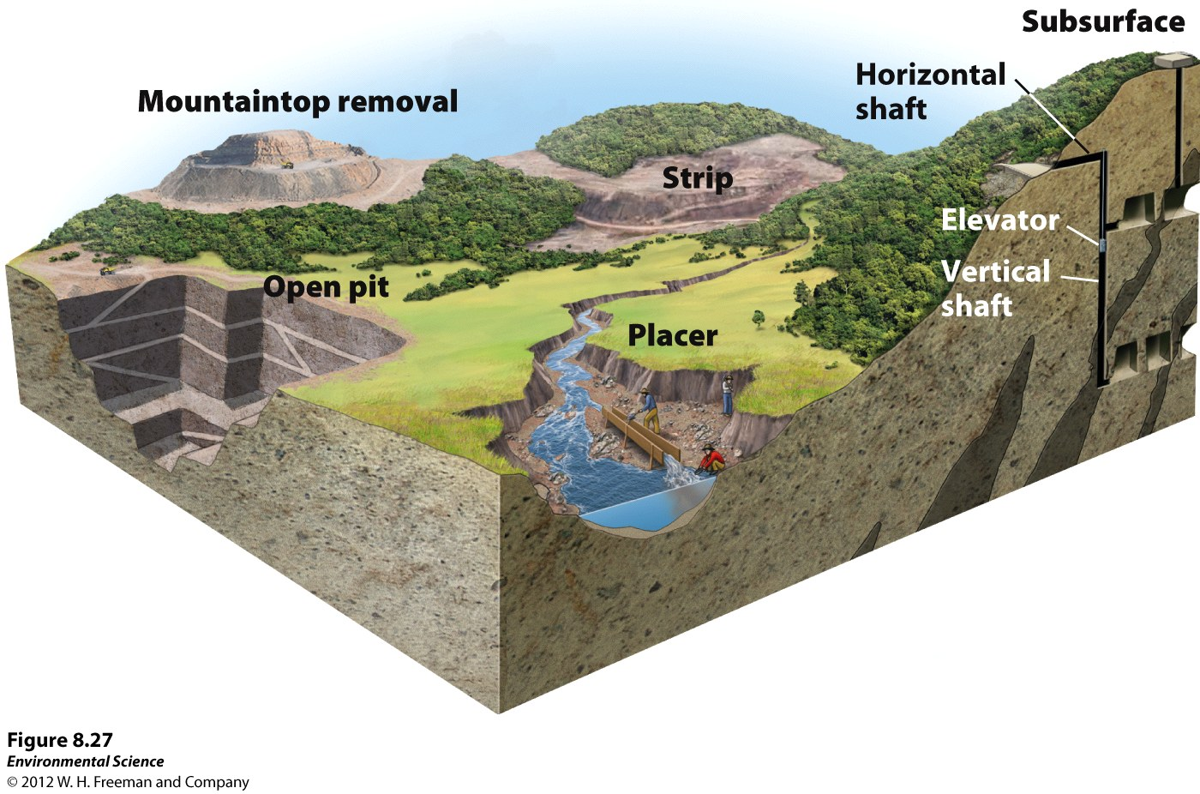
Surface & Subsurface

Slide 69


The Sky is Pink pg. 21
Documentary about Fracking
Take notes:
  Things you learned
  How it relates to our mining chapter
  How the main dude (Josh Fox) asks you to question how we get our information

Slide 70






In the News...

Slide 71

4/1 Mineral Resources CH 8
Obj. TSW identify and explain the various environmental impacts and consequences of different mining techniques and legislation that tries to reduce those impacts. P. 16 NB
What are the consequences of surface and subsurface mining?
How has mining legislation tried to reduce the impacts above?
Identify the four steps in the formation of coal (CH 12)

Slide 72

Consequences of Surface and Subsurface Mining

Slide 73
Legislation
Mining Law of 1872
  Allowed individuals/companies to recover ores or fuels from federal lands
  Written primarily to encourage development and settlement in the Western US
  Contains very few environmental protection provisions
  Consequences=
    Abandoned mines
    Polluted waters

Slide 74
Legislation
Surface Mining Control and Reclamation Act of 1977
  Regulates surface mining of coal and surface effects of subsurface coal mining
  Mandates that land be minimally disturbed during the mining process and reclaimed after mining is completed
  Does not regulate all of the mining practices that can have harmful effects on air, water, land,
  Clean Air Act, Clean Water Act, Superfund Act try to address these impacts to some extent

Slide 75

Four types of Coal

Slide 76
Chocolate Chip Cookie Mining
Coal is the compressed remains of ancient plants
For millions of years buried plants were heated and compressed
Converted to a material that is mostly carbon
Made from ancient forests= call it a fossil fuel
  More abundant than the other two fossil fuels (Oil and natural gas)
Four types of coal: Lignite, Subbituminous Bituminous and Anthracite (best).

Slide 77
Procedure pg. 19
Cookie represents environments that contain a source of energy
Chocolate Chips represent coal
ONE Chocolate Chip cookie to each group of 2
Trace your cookie on the graph paper
Use your toothpick to mine out the chocolate chips
How many chips do you think you can dig out from your environment? Record prediction
Notes:
Get 1 piece of paper & 1 Choc. Chip Cookie, 1 tooth pick/ person & Trace the Choc. Chip Cookie on the graph paper.
1,000/ chip
Pile chips to one side
Count chips

Slide 78
Procedure Part 1
You will have 2 minutes to extract as many Chocolate Chips as you can, using the toothpicks as mining tools, pile to the side
  $1000/ whole choc. chip removed
Count your Chocolate Chips:
  Record in pg. 19 NB and compare to your previous prediction
  How much money did you make?
Study the impact of mining on your “cookie” environment
Think about how to mine again but with LESS damage to the environment

Slide 79
Procedure Part 2
Now get another cookie.
You will have 2 minutes to extract as many Choc. Chips as you can, using the toothpicks as mining tools
  $1000/ whole choc. chip removed
  $200 for each piece broken off of the cookie. 2 minutes – GO!
Count your Chocolate Chips and broken pieces:
  Record data, how much money did you make and lose?
Compare your Choc. Chip piles. Write observational data on P. 19NB
If you damage/ destroy a “mining tool” it costs you $100.

Slide 80
Chocolate Chip Mining Activity p. 19NB
How would you change your mining techniques to make more money next time?
How did your mining techniques change when you were fined for breaking the cookie?
How does all this relate to real mines?
Trace your surface area after each mining of each cookie.
How much surface area was destroyed for each cookie?

Slide 81


In the News...

Slide 82
TED Talk
http://www.ted.com/talks/garth_lenz_images_of_beauty_and_devastation#t-31236
Take notes on pg. 23

