Slide 1
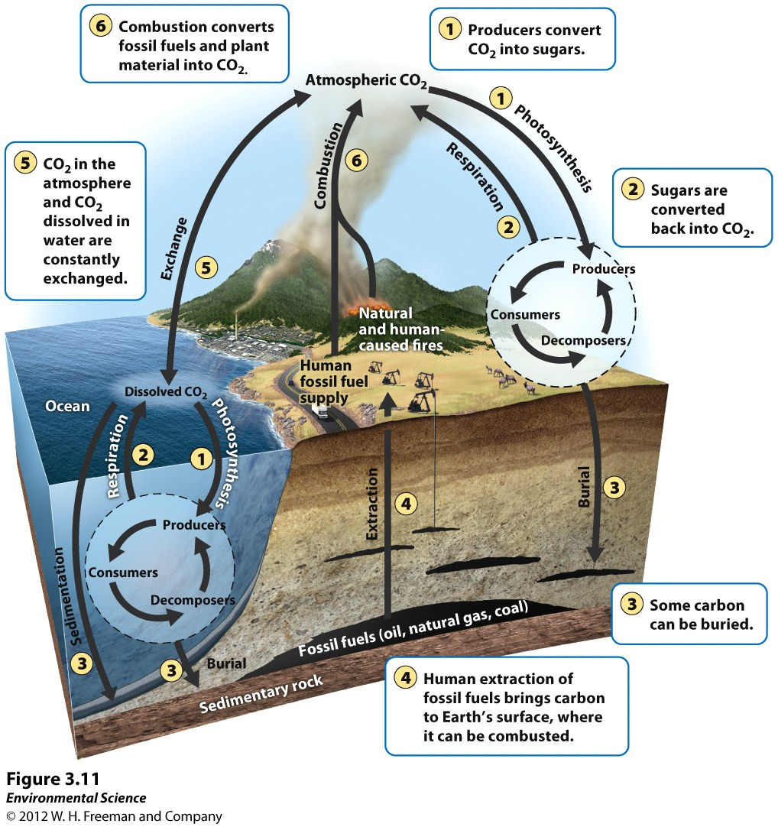
LAB: Waste and its effect on atmospheric carbon dioxide
P. 59 NB
P. 89 Env. Sci book
Obj. to evaluate the effect of the presence of pollutants such as sewage, agricultural runoff etc. on atmospheric carbon dioxide. How does Bacteria play a role in greenhouse gases, including Methane?

Slide 2
Procedure
In pairs, Get a GLX and a CO₂ sensor probe.
Turn on your GLX, plug in your CO₂ sensor probe. Note the value in the air.
Using a graduated cylinder, add 5 ml of tap water to the 250 –ml plastic CO₂ collection bottle.
Add 10 ml of milk to the 250- ml gas sampling bottle and set aside.
Noting the time, add 1ml (1/4 tsp) of yeast mixture to the 250ml gas sampling bottle and swirl to mix.
Connect the probe to the bottle and record the data every minute for the next 4 minutes.
Now, repeat the 1 – 6 steps, but add 30ml of milk.

Slide 3
Things to think about…
What is the Milk an example of in a landfill?
What is the Yeast an example of in a landfill?
What is the CO₂ an example of in a landfill?
What is it’s impact on global warming/greenhouse effect?

Slide 4
Data:
CO₂ level in the classroom _________
Time | 0 (Control) minutes | 1 minute | 2 minute | 3 minute | 4 minutes
10ml Milk [CO₂]
30ml Milk [CO2]
Qualitative data: Did you feel heat from the 250ml gas sampling bottle? Why?
Qualitative data: Did you feel heat from the 250ml gas sampling bottle? Why
Lab due: Thursday April.24th

Slide 5
Waste & CO₂ Lab
Due Thursday

Slide 6
Topics/ Concepts discussed
Throw away society & waste
Planned Obsolescence
Decomposition – microorganism
Landfill Structure – clay liner, methane collectors, leachate collection
Global Warming
BMP – Best Management Practices
Carbon Sink/ Carbon Flux & Carbon Cycle

Slide 7
Topics/ Concepts discussed
Ocean Acidification
Point & nonpoint Source Pollution
Ozone Layer? (Affect of CFC’s not CH₄ or CO₂)
Remediation
Agricultural Runoff
Industrial Revolution
Photosynthesis & Cellular Respiration
Sustainability

Slide 8
Topics/ Concepts discussed
Methane Production
Fossil Fuels
Biological Assimilation
Waste Management
Leaching
Anthropogenic Activities
Septic Tank
Metabolism

Slide 9
Topics/ Concepts discussed
Treatment Plant
Aerobic & Anaerobic Organisms
Oxidation
Sewage Treatment
Biodegradable Material
Biofiltration
Natural & Constructed Wetlands
Greenbelts
Treatment Ponds
Riparian Areas

