Slide 1
Salinization Lab
Salt buildup is an existing or potential hazard on almost all of the 42 million acres of irrigated farmland in the United States. Much of the world’s unused land is in arid and semiarid regions where irrigation will be necessary. Excessive salinity is presently costing the U.S. billions of dollars in lost food crops. This is becoming a huge problem in our own Central Valley, running from Bakersfield, CA to Fresno, CA.

Slide 2
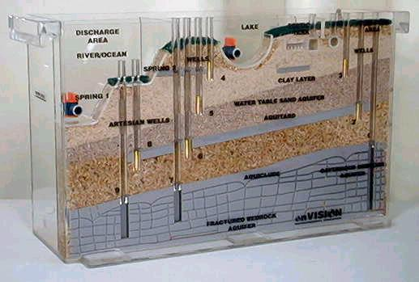
Ground Water Water Model Demonstration
Salt water intrusion to field crops along the central valley.

Slide 3
1.0 % = 1 g NaCl Calculate the % [NaCl] in 300 ml H₂O
 | 100 ml H₂O | 300 ml H₂O | Germination # | % Change Germination
Dates | % NaCl | % NaCl | 1 – 10 seeds | V2 –V1/V1 x 100
8/25 8/26 8/27 8/28 | 0
8/25 8/26 8/27 8/28 | 0.5
8/25 8/26 8/27 8/28 | 1
8/28 | 1.5
 | 2
 | 2.5
 | 3
 | 3.5
 | 4

Slide 4
Salinization
Irrigated water contains salt. The ground where the crops are planted increases in salt concentration.
Type of soil, and drainage can impact water quality.
Evaporation of water leaves salt behind.
In our Lab, what is the Control? 0% [NaCl]
Independent Variable: [NaCl] (what you changed)
Dependent Variable: Germination Rate (the result of your change)

Slide 5
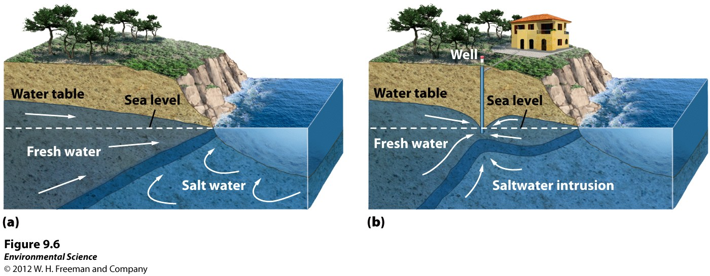
Groundwater
Salt water intrusion
Saltwater intrusion- when the pumping of fresh water out of a well is faster than the recharge. Near coastal areas this can cause salt water to infiltrate the aquifer.

Slide 6
Lab Report - Salinization
Introduction: Research 3 recent articles about salinization with in the last 10 years. Preferably at least one in CA. Cite your sources. APA (McAllister, 2016)w/ works cited page.
What Materials did you use? List them:
Petri dish
Salt
Blah Blah

Slide 7
Lab Report - Salinization
Hypothesis: If, than & testable.
Procedure: List Steps…
Step 1: Blah Blah
Step 2: Still Blah Blah
Step 3: etc.
Date:
Data Table 1: Explanation Sentence above Table 1
Data Graph 1: Explanation sentence below Graph 1

Slide 8
Lab Report - Salinization
Data Analysis
Refer to your data: As you can see in Data Table 1.
Discuss your data and what it means.
Discuss the implications of Salinization for the State, Country and World.
Discuss any potential problems with your lab/ mistakes etc. What would you do differently next time?
What solutions are there for Salinization?

Slide 9
Lab Report - Salinization
Conclusion:
What did you learn, Why is it important, how can it help you better understand the Triple Bottom Line?

