Slide 1
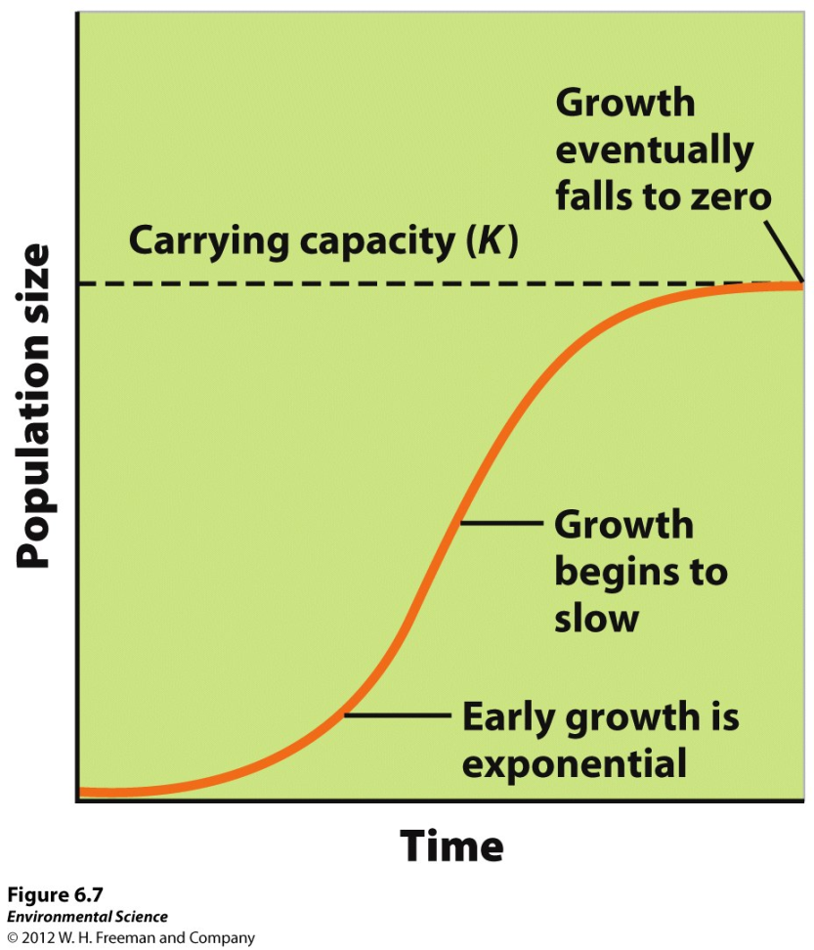
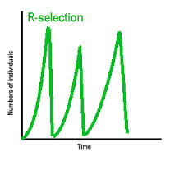
2/26 Population Growth patterns CH 6 Obj. TSW learn about carrying capacity, different growth patterns of species and how different limiting factors contribute to the growth of a population. p. 56NB
What is Carrying Capacity? Give an example and draw a graph.
What are the two types of growth patterns of species?
Compare & Contrast Density Dependent and density Independent Factors that Limit the size of a population.

Slide 2
Carrying Capacity Page 53
What is the carrying capacity of the Deer?
What is the carrying capacity of the wolf?
Why did the system crash?

Slide 3
Decomposing – Soil page 27 NB Write up your soil analysis.
1. How is your soil different now?
2. How does your soil smell? Why?
Did you over water?
3. What type of soil do you have?
Clay Sand or Silt ? Loam? Use your book.
4. Did any of your worms live? Why?
5. Plant 4 seeds, evenly spaced in separate corners
Put your name on the pot.

Slide 4
Eutrophication P. 49NB

Slide 5
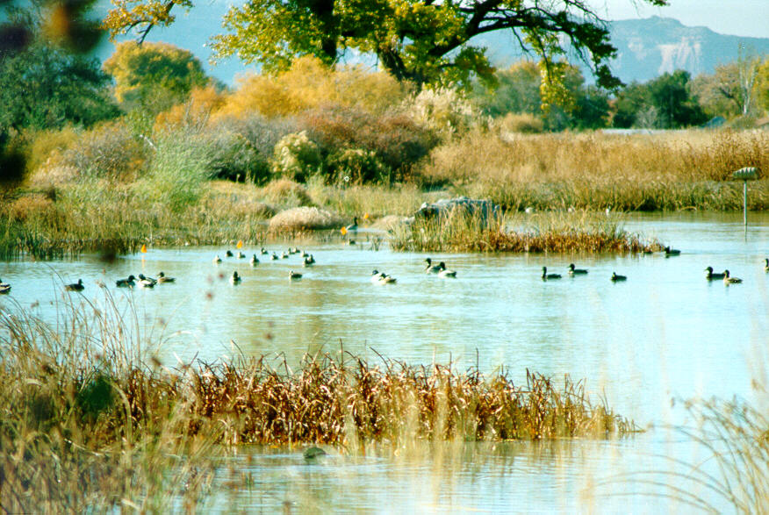
2/29 Population Characteristics CH 6 Obj., TSW identify population characteristics, other factors that influence them, and identify factors that affect wetland diversity, pg. 58NB
1. Explain metapopulations
2. What are some population characteristics?
3. What are some factors that affect wildlife diversity in wetlands?

Slide 6
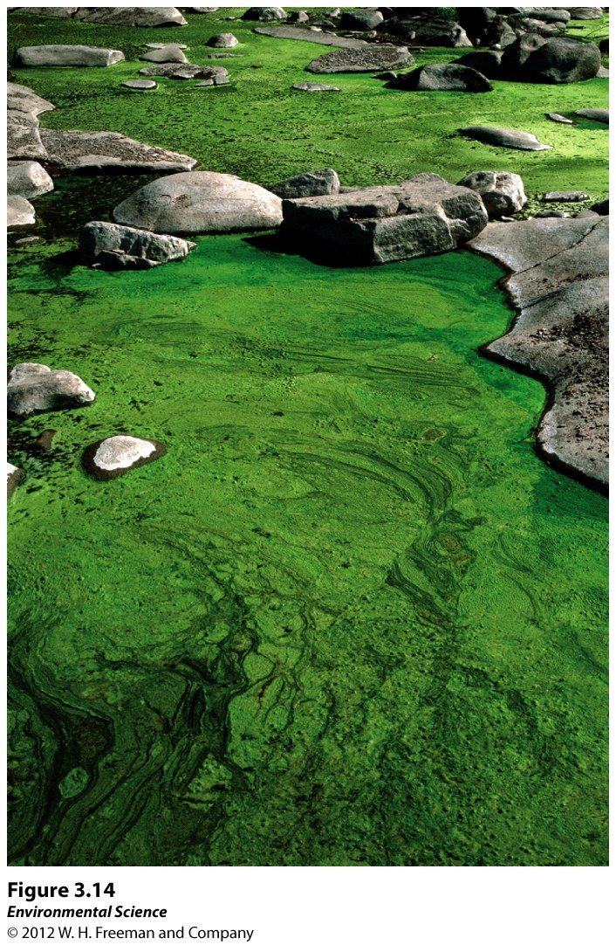
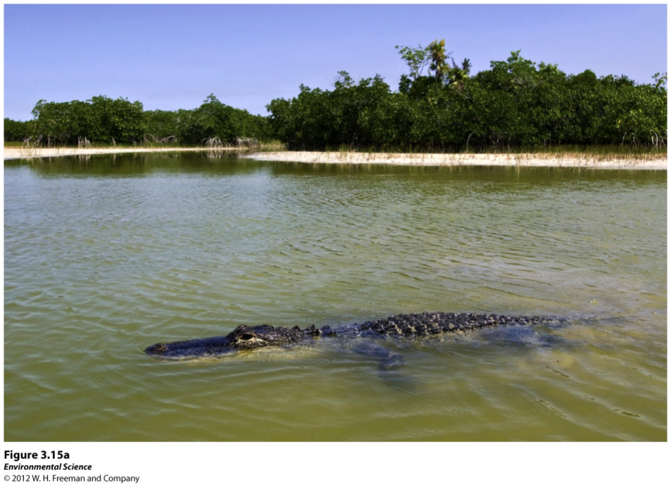
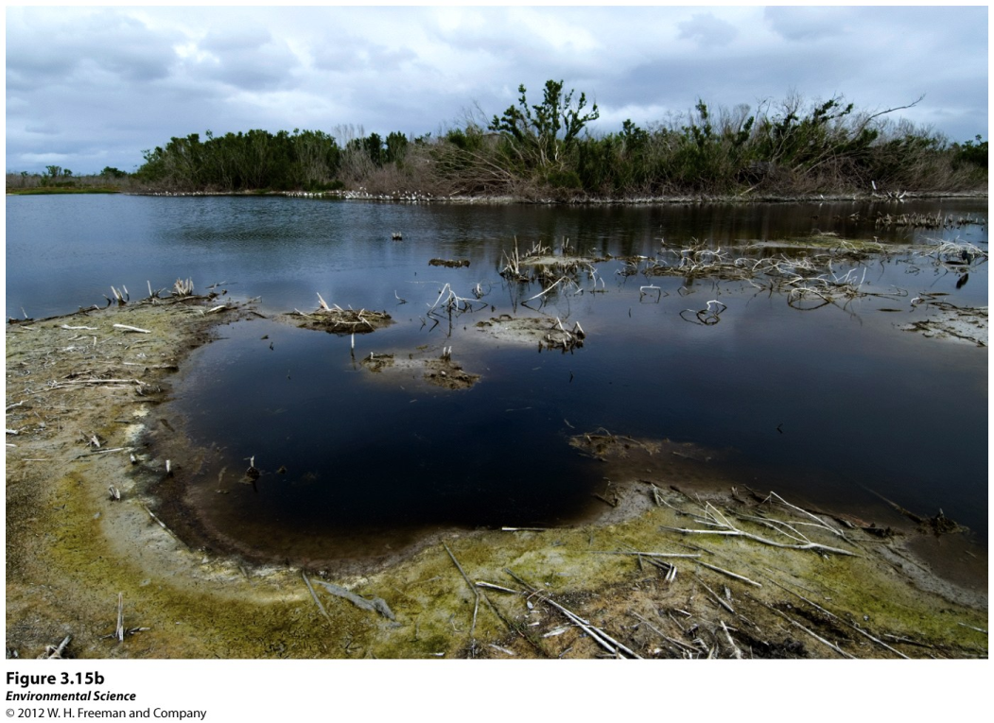
Ecosystems respond to disturbance
Disturbance- An event caused by physical, chemical or biological agents that results in changes in population size or community composition.
Natural and anthropogenic disturbances.
Algal Bloom – excess phosphorus enters waterways, increases Algal growth, eventually they die because they consume all the nutrients, increasing decomposition, this decreases the O₂ content that triggers a die off of fish and shell fish, resulting in decreased biodiversity in the ecosystem.
Before hurricane Katrina After hurricane Katrina

Slide 7
Factors that Regulate Population Abundance and Distribution
Population size- the total number of individuals within a defined area at a given time.
Population density- the number of individuals per unit area at a given time.
Population sex ratio- the ratio of males to females
Population age structure- how many individuals fit into particular age categories.
Population distribution- how individuals are distributed with respect to one another.

Slide 8
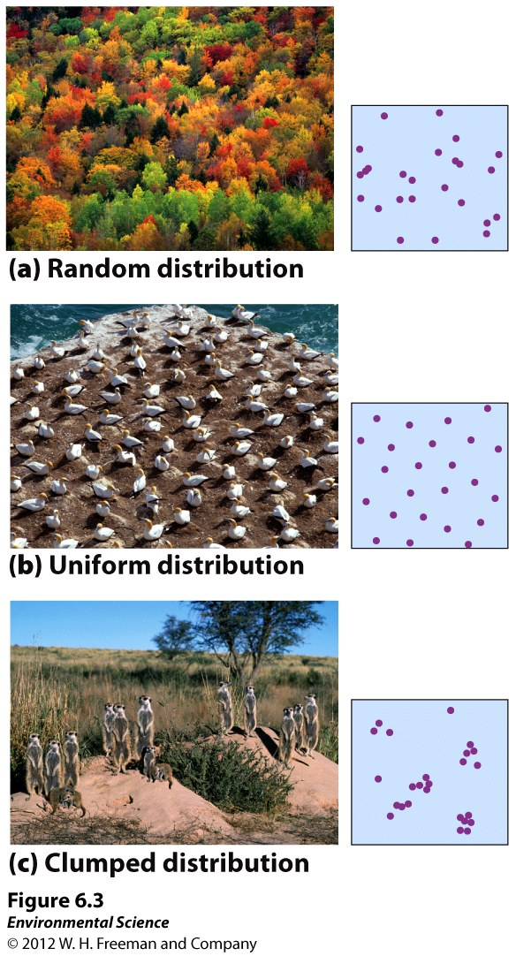
How Populations are distributed.

Slide 9
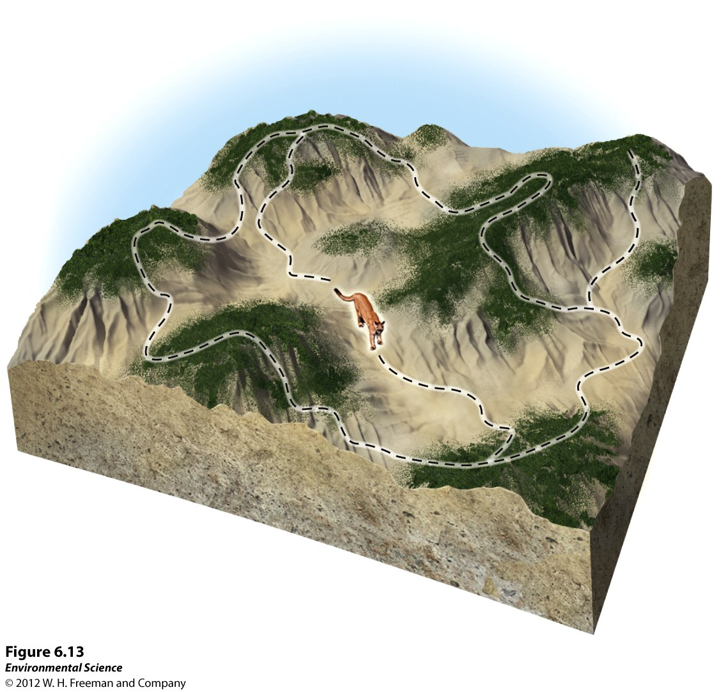
Metapopulations
Metapopulations- a group of spatially distinct populations that are connected by occasional movements of individuals between them.

Slide 10
Wetland Presentation pg. 63
Groups of 3 or 4
(1) Intro, Wetland Formation, California’s Wetlands
(2) The Salt Marsh, Adaptations, Why they Matter?
(3) Great Basin
(4) Mojave Desert
(5) Sonoran
Include:
1. What are some factors that affect wildlife diversity in wetlands or your specific wetland?
2. Why is California considered a biodiversity hotspot?
3. Important information in your section, you are the expert!

Slide 11
In the News...

Slide 12
3/1 Human Population CH 7 Obj. TSW learn about age structure graphs, demographic transition & practice population questions. P. 60 NB
Draw an Age Structure graph of a growing population.
RCHS population is 1976 students, 27 transfer in, 5 get expelled. What is the population growth of the high school?
3. What are some factors that affect wildlife diversity in wetlands?
AGE STRUCTURE GRAPHS

Slide 13
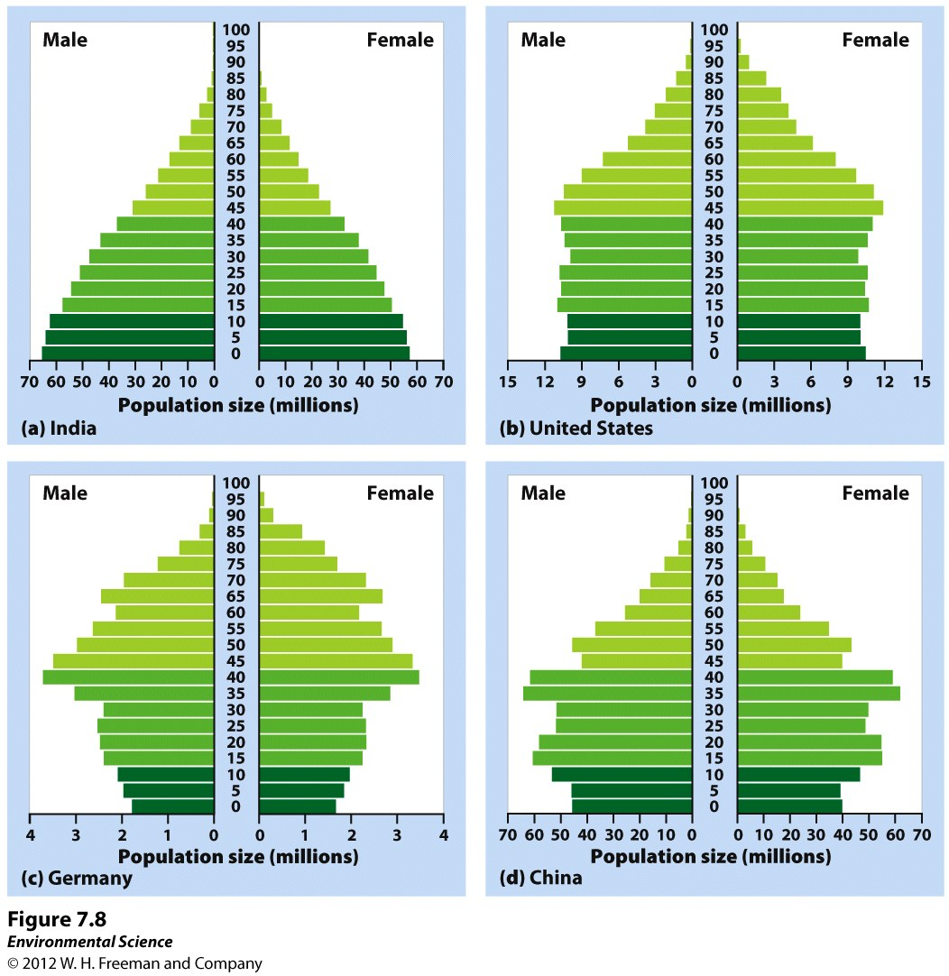
Age Structure
Age structure diagrams (population pyramids)- visual representations of age structure within a country for males and females.

Slide 14
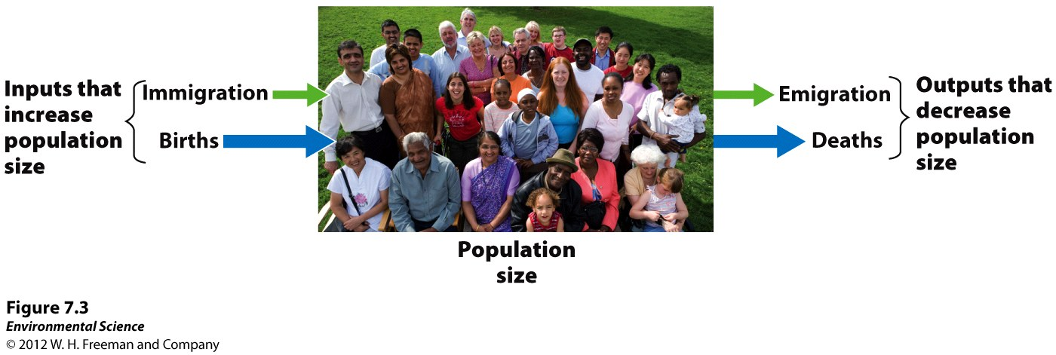
Changes in Population Size
Immigration- the movement of people into a country
Emigration- the movement of people out of a country.
Net migration rate- the difference between immigration and emigration in a give year per 1,000 people in the country.

Slide 15
Growth Rate of a Country
Growth Rate = Births – Deaths
Movement of individuals =
Immigration
Emigration
(births + immigration) – (deaths + emigration) = population change

Slide 16
#2.
Population Growth, NOT Growth rate
(B + I) – (D + E) = 27 – 5 =
The population of RCHS has increased by 22 people.

Slide 17
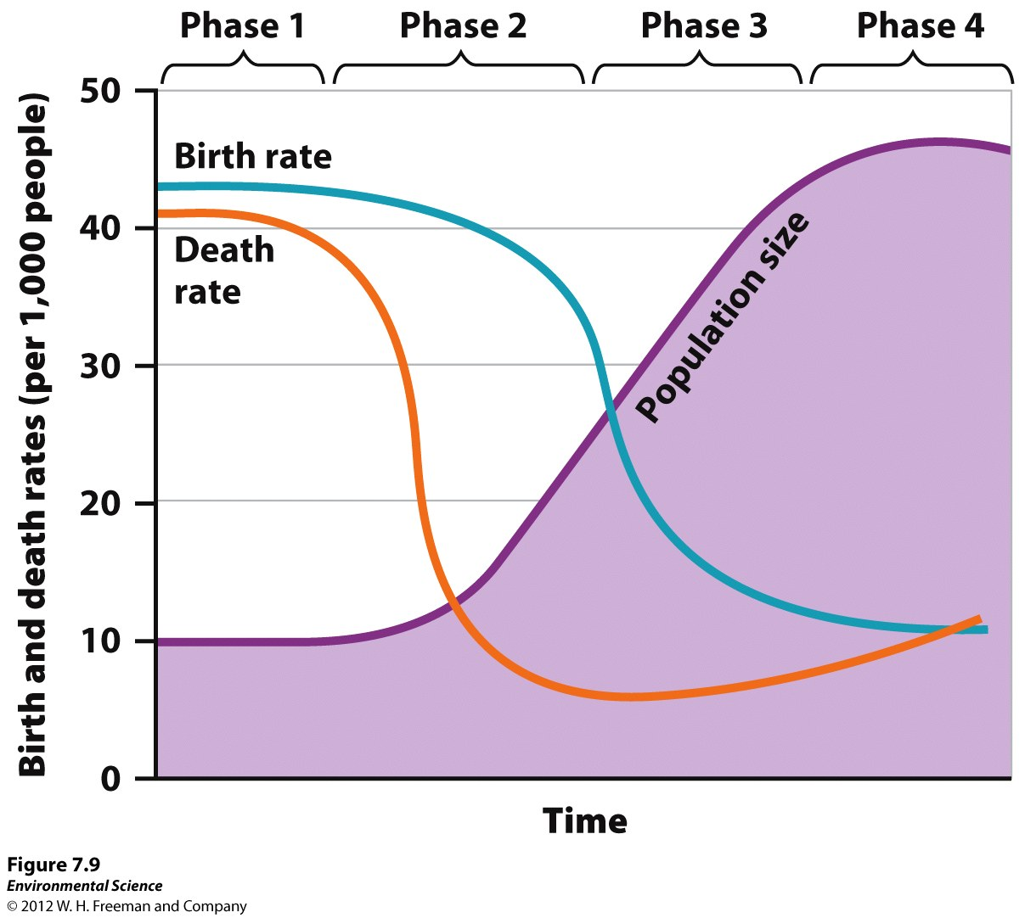
3/2 Human Population CH 7 Obj. TSW identify demography/factors that drive human population, identify the stages of demographic transition, and identify why scientists disagree about reaching the human carrying capacity, pg. 62 NB
1. Explain demography and name the factors that drive human population growth
2. What are the four stages (Names) of demographic transition?
3. Explain the differing views scientist hold on if humans will reach a carrying capacity or not.

Slide 18
Factors that Drive Human Population Growth
Demography- the study of human populations and population trends.
Changes in Population Size
Fertility
Life Expectancy
Age Structure
Migration

Slide 19
The Demographic Transition p. 61 NB
The theory of the demographic transition is the theory that as a country moves from a subsistence economy to industrialization and increased affluence, it undergoes a predictable shift in population growth.

Slide 20
The Stages of the Demographic Transition
Phase 1: Slow population growth because there are high birth rates and high death rates which offset each other.
Phase 2: Rapid population growth because birth rates remain high but death rates decline due to better sanitation, clean drinking water, increased access to food and goods, and access to health care.
Phase 3: Stable population growth as the economy and educational system improves and people have fewer children.
Phase 4: Declining population growth because the relatively high level of affluence and economic develop encourage women to delay having children.

Slide 21
Theory of Demographic Transition
Phase1 – Pre-Industrial – Before the Industrial Revolution
Phase 2 – Transitional - India
Phase 3 – Industrial – US & Canada
Phase 4 – Post Industrial – UK, Germany, Russia, Italy, Japan

Slide 22
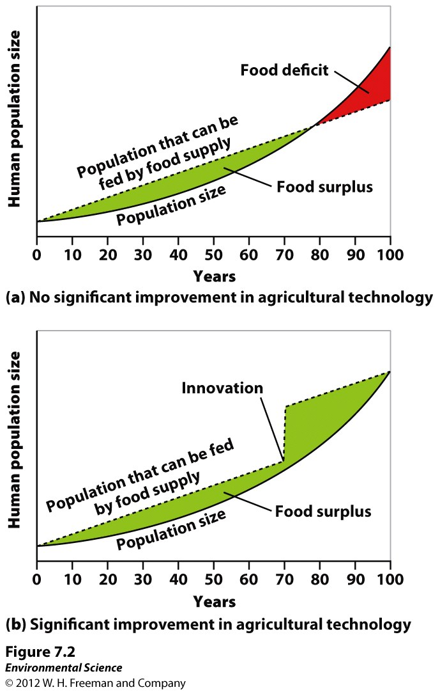
Scientists Disagree on Earth’s
Carrying Capacity
The following graphs show theoretical models of food supply and population size.

Slide 23
Why Scientists Disagree about the Carrying Capacity?
Do not believe there is a carrying capacity for humans
Growing population provides an increasing supply of intellect that leads to increasing amounts of innovation
Inventions/technological advances increase carrying capacity over time
Ex: Development of arrow made hunting more efficient
Believe outgrown OR will eventually outgrow available supply of resources such as food, water, timber, fuel, etc.
Malthus= Human population growing exponentially but food supply growing linearly
Environmental Scientists still believe that we will reach our carrying capacity= human population growth will decline

Slide 24
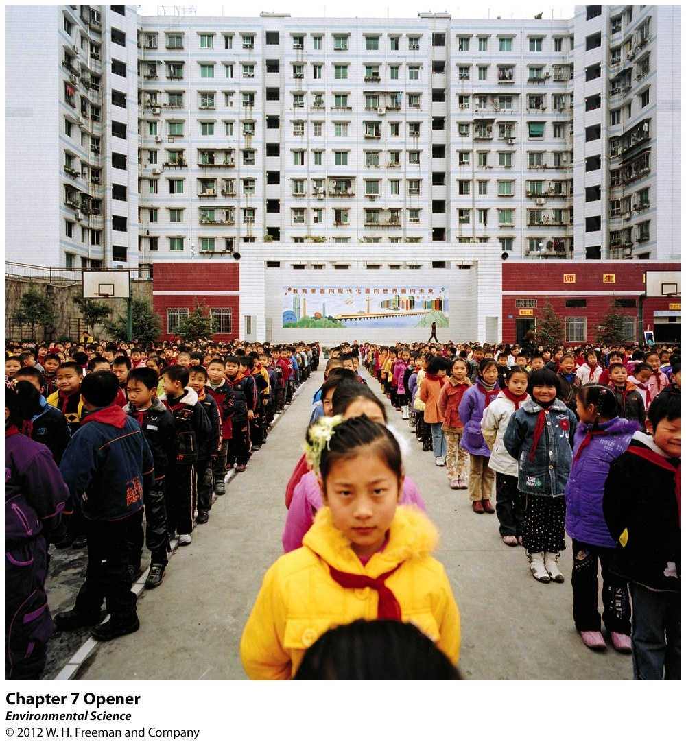
Chapter 7 The Human Population

Slide 25
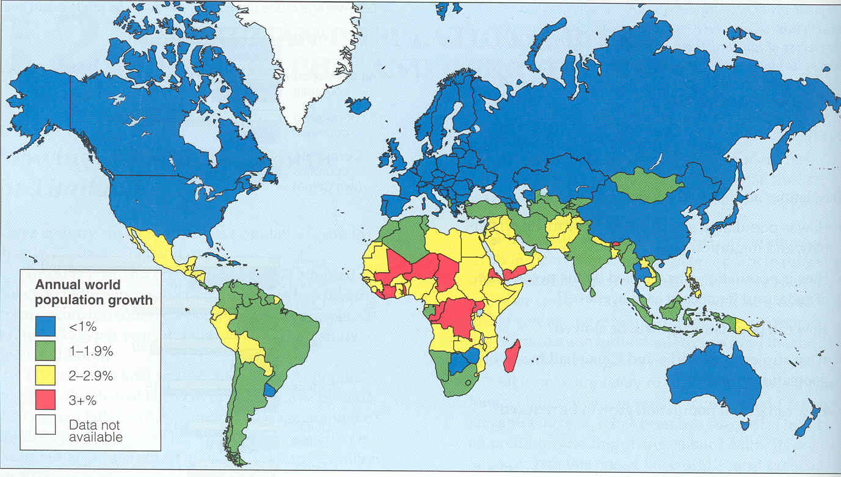
3/3 Human Population CH 7 Obj. TSW be able to explain the relationship between economic development and affluence, the crude birth and death rate at the national and global level, and perform a practice problem, pg. 64
1. Explain both the crude birth and death rates, include the Equation at both the global and national level.
2. In 2050 there are 40 births and 18 deaths per 1,000 people. By what percentage did the global population increase?
3. At that percentage, how many years will it take for the population to double?

Slide 26
Changes in Population Size
Special measurement to determine yearly birth and death rates
Crude Birth Rate (CBR)= # of births per 1000 individuals per year
Crude Death Rate (CDR)= # of deaths per 1000 individuals per year
“Crude”= Does not take age or sex differences among the population
Divide by 10 to represent value as a %

Slide 27
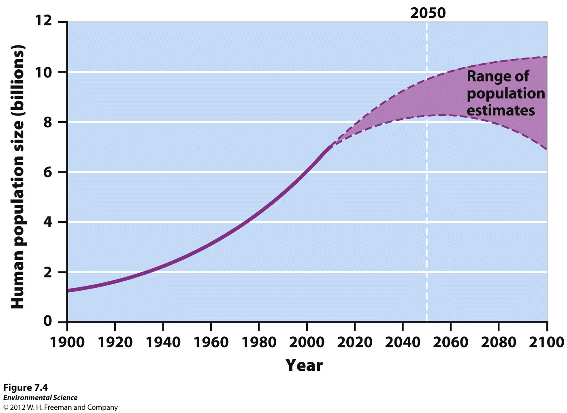
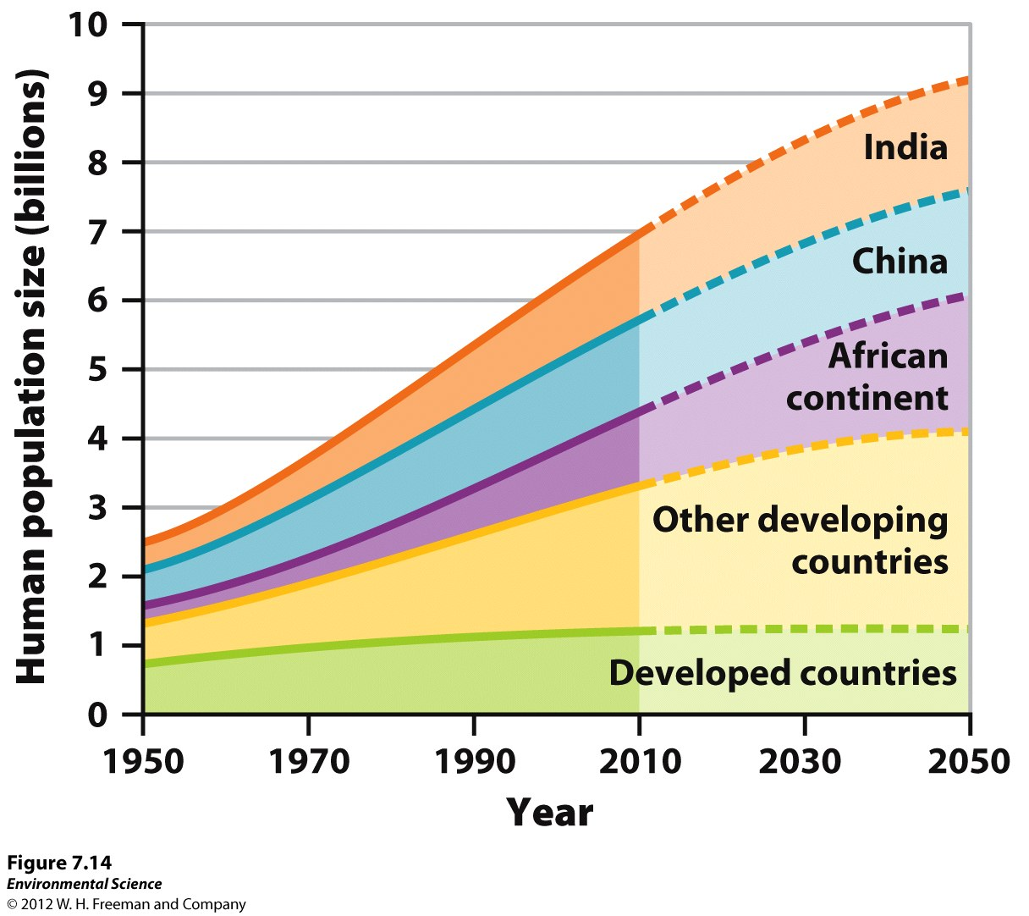
Carrying Capacity of Earth for humans

Slide 28
Changes in Population Size
Global population growth rate =
(CBR- CDR)/ 10
National population growth rate =
(CBR+ immigration) –
(CDR + emigration)/ 10
If we know growth rate of pop.= can calculate the # of years it takes for a population to double
Doubling time (in years)= 70/ growth rate

Slide 29
#3
Global Population Growth Rate=
[CBR- CDR] = [40 -18] = 2.2 percent
10 10
Doubling Time (in years)=
70 = About 32 years
2.2

Slide 30
2003 Q #2. APES FRQ - Population
Work by yourself or with a partner to do all of the FRQ #2
You have 22 minutes
When you are done, We will start to go over answers.

Slide 31
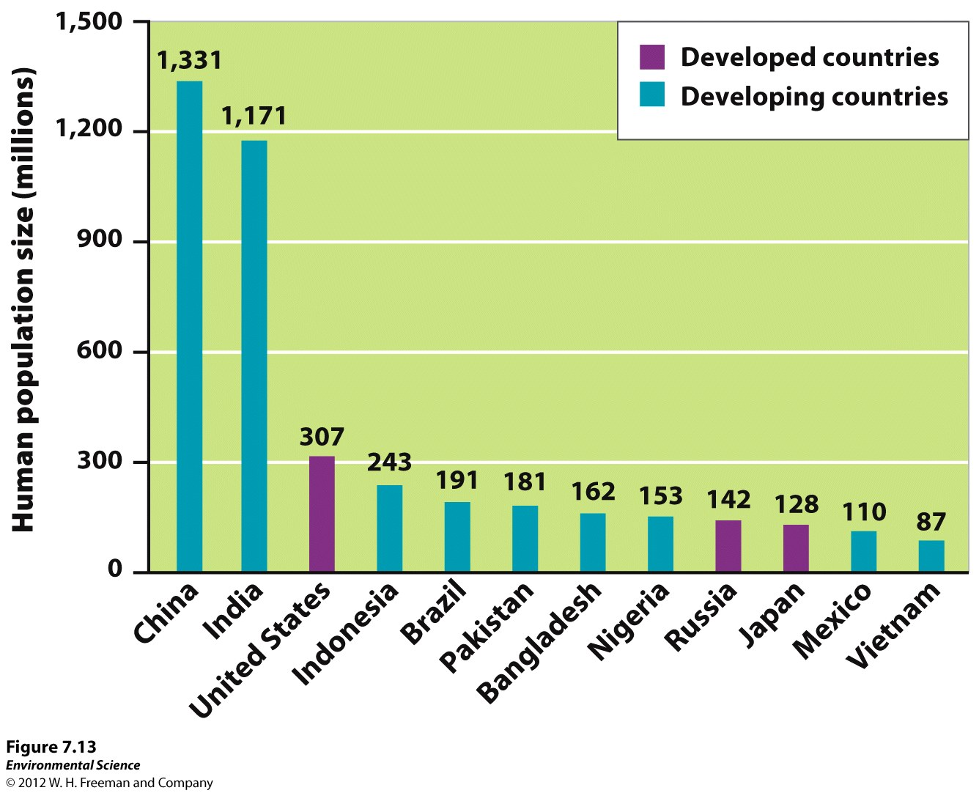
3/4 Human Population CH 7 Obj. TSW identify how fertility, family planning, and life expectancy all affect population size and growth, p.66NB
1. Explain how total fertility rate (TFR) is measured and what is used to gauge changes in population size?
2. Explain what “life expectancy” means and what it is a good predictor of?
3. Why do people produce fewer children as their income increases?

Slide 32
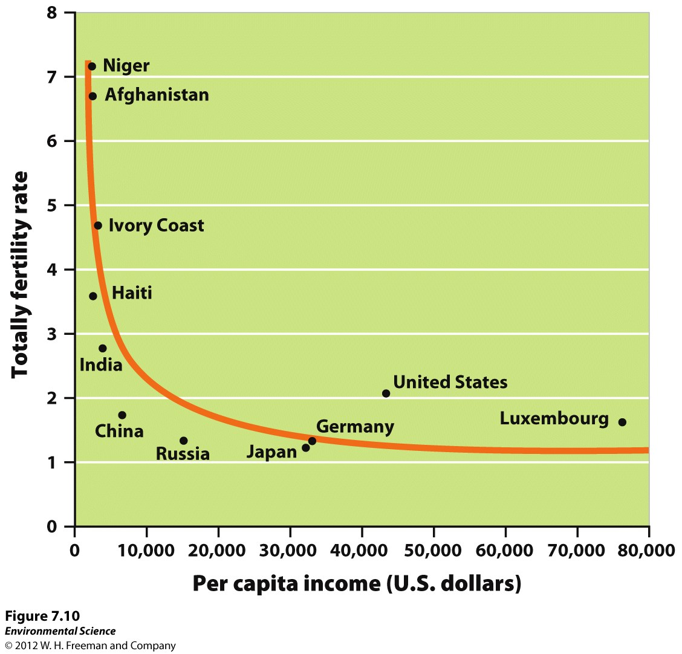
Total Fertility Rate
Estimate of the average number of children that each woman in a population will bear throughout her childbearing years
Measure of births per woman
EX) US is just over 2 children
Replacement-Level Fertility

Slide 33
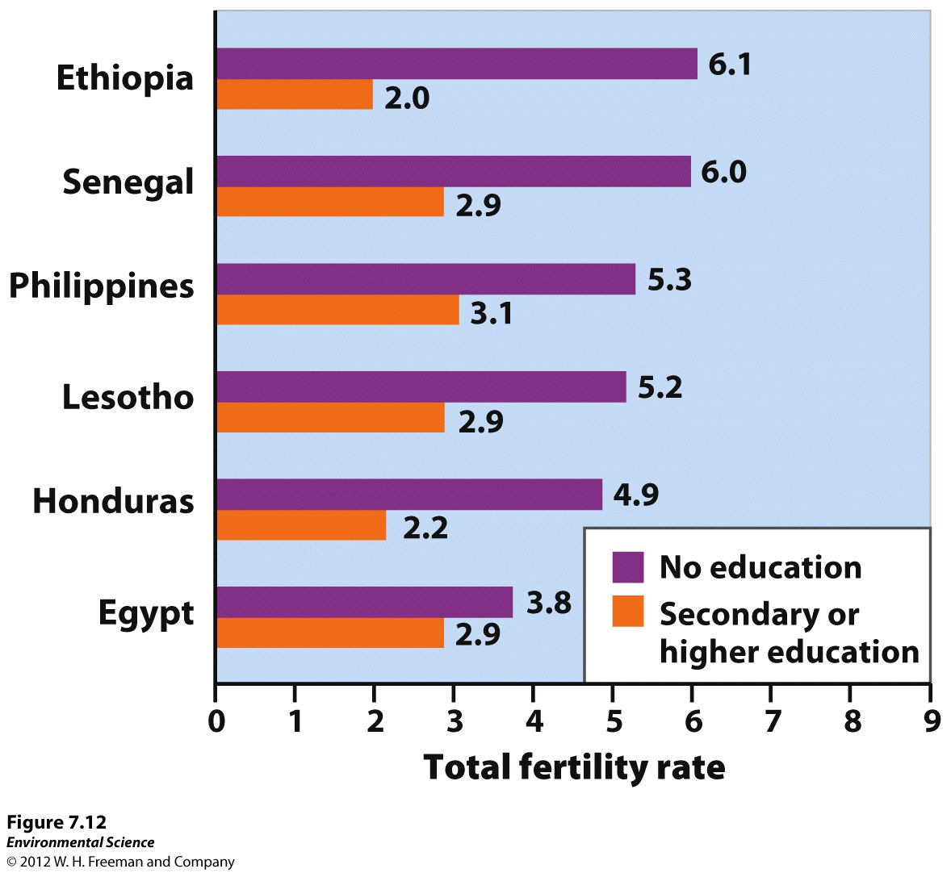
Fertility
TFR= Estimate of the average number of children that each woman in a population will bear

Slide 34
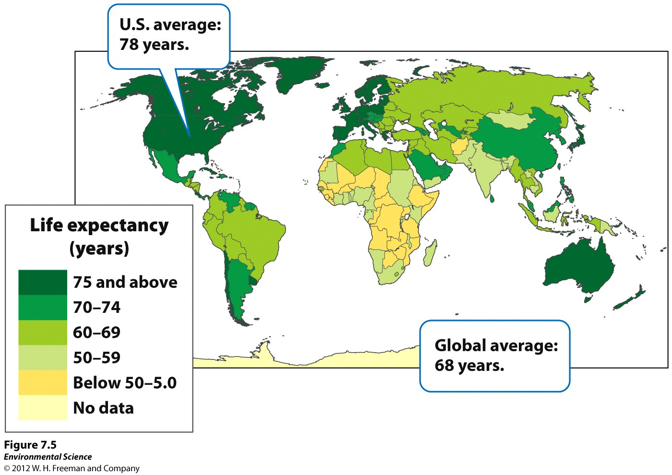
Life Expectancy

Slide 35
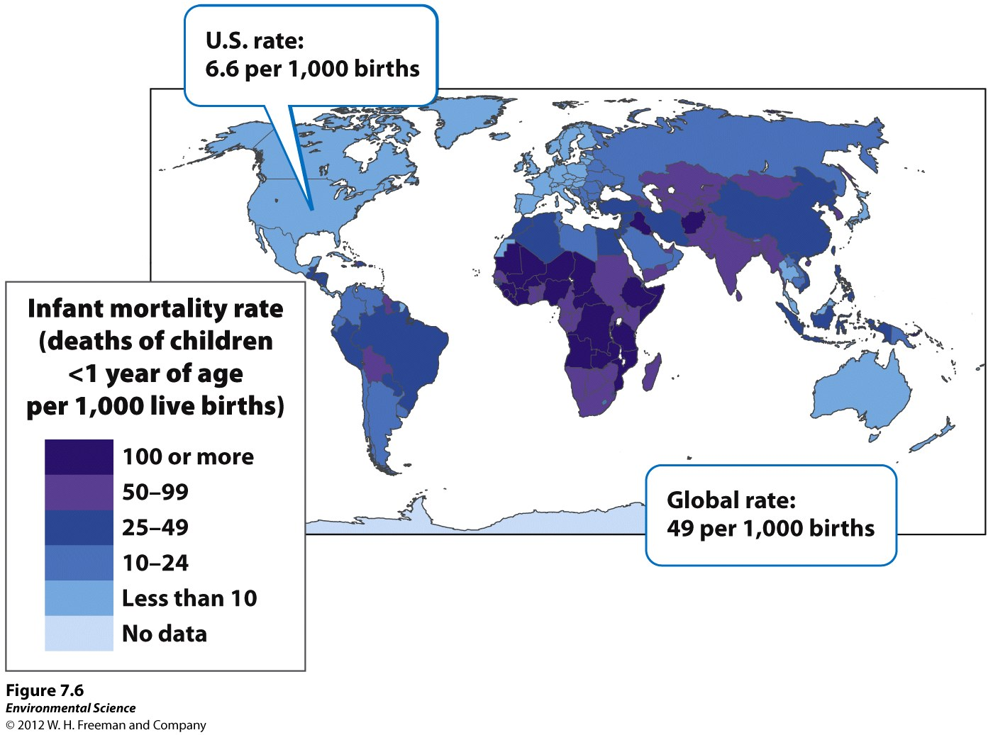
Infant Mortality rates

Slide 36
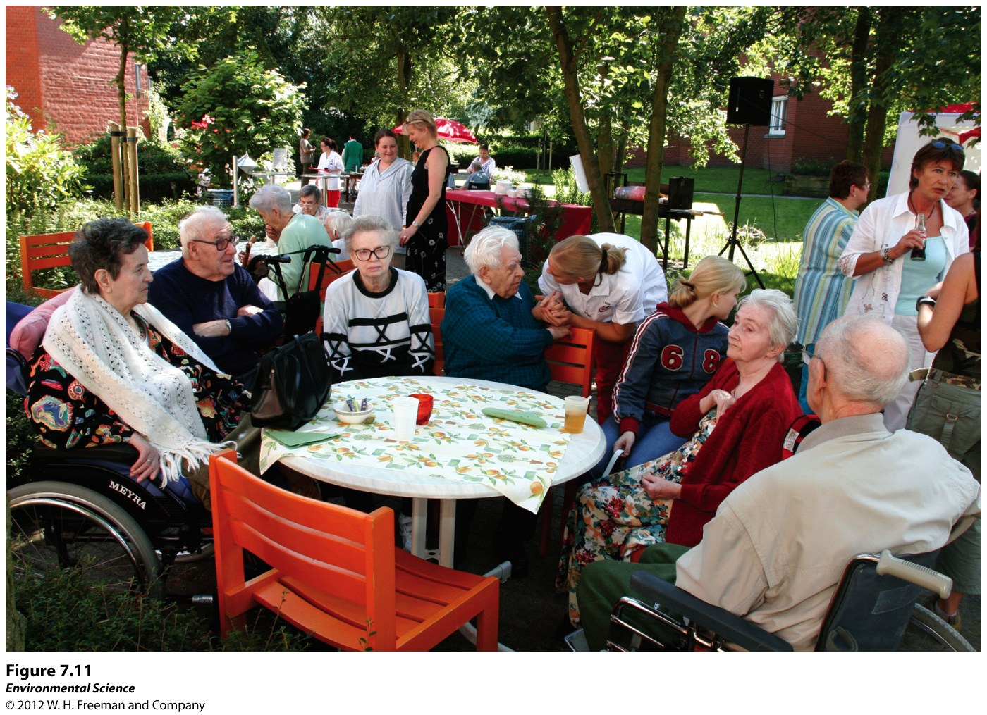
Family Planning

Slide 37
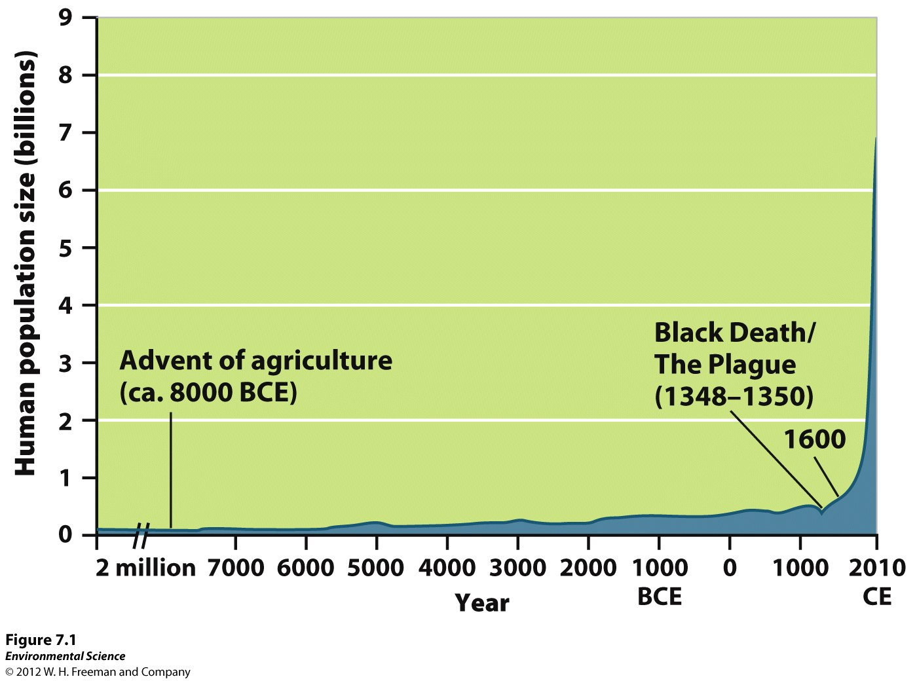
3/7 Human Population CH 7 Obj. TSW identify how ecological footprints are measured and the parts of the IPAT equation, pg. 68NB
1. Explain per capita ecological footprint. How do China’s, the US’s, & Haiti ecological footprint compare?
2. What is the IPAT equation?
3. Calculate the Growth rate of the Planet if CBR= 60 and CDR = 5, in how many years would the planets population double?

Slide 38
Ecological Footprints
Affluence - having a lot of wealth such as money, goods, or property.
Provides a way to measure the effect of affluence on the planet

Slide 39
Ecological Footprint
One person in a developed country can have a greater impact than two or more people in a developing country
EX) Person living in US has more than 5X the environmental impact of a person living in China
18X that of a person living in Haiti
World average= 6.7 acres per capita
US= 22 acres per capita
China= 4.5 acres per capita
Haiti= 1.2 acres per capita

Slide 40
IPAT Impact= Population X Affluence X Technology
Hard to quantify the total environmental impact of the world:
Some people live “green” or unintentionally (poverty)
Some people consume large amounts of resources
Estimates the impact of human lifestyles on Earth
Representation of the three major factors that influence environmental impact

Slide 41
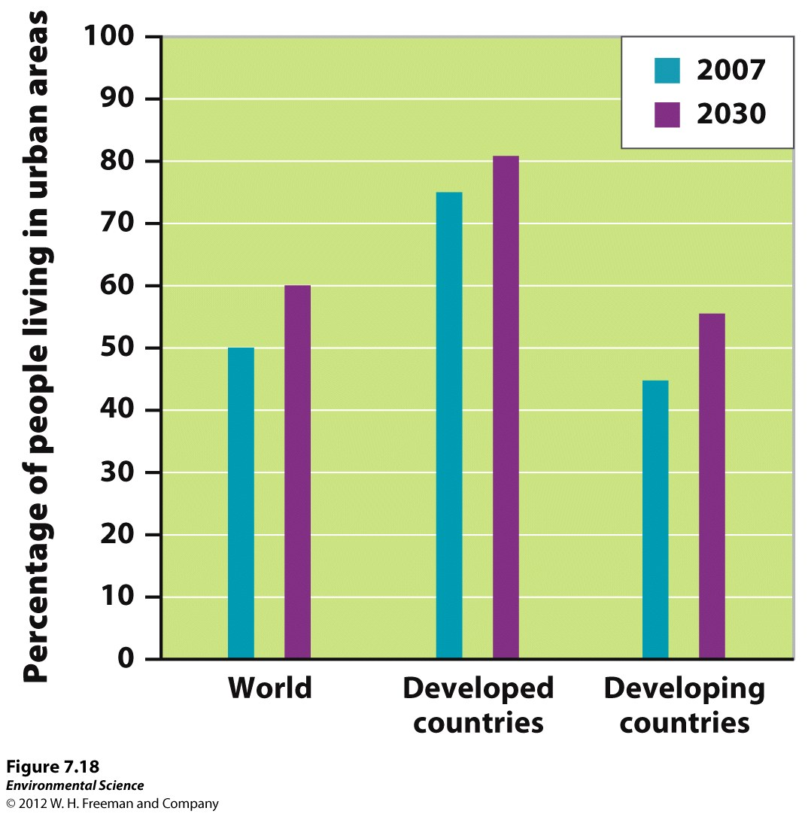
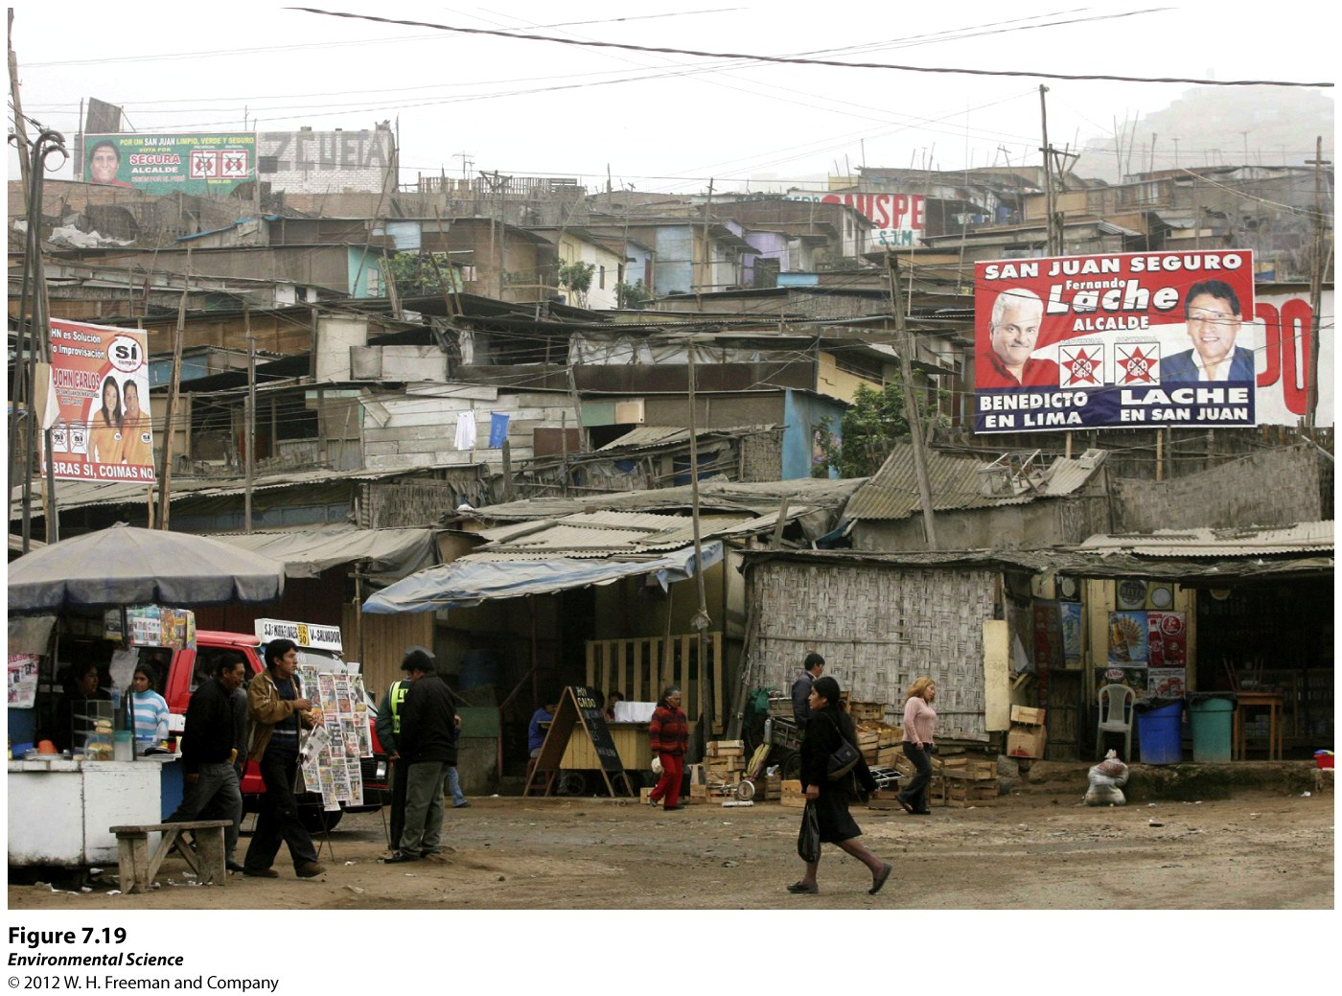

Slide 42
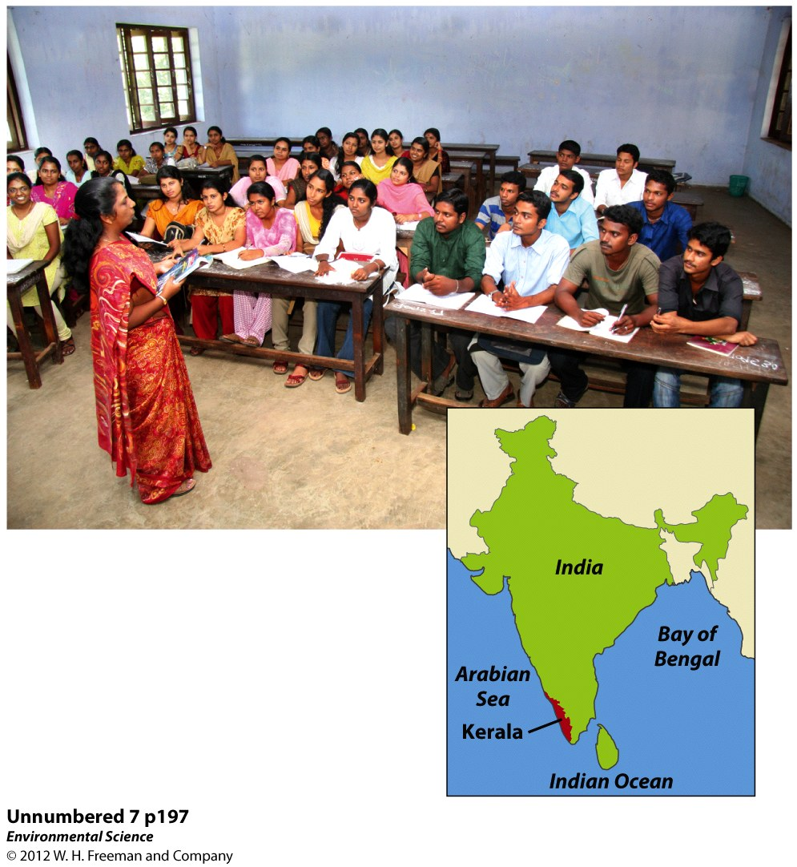

Slide 43
3/8 Population Review, CH 6 & 7 Obj. TSW study, review, and ask questions for their Topic III Test tomorrow p.70 NB
Compare and Contrast a K- selected species and a r-selected species
Explain the different survivorship curves.
Explain the following countries population based on the age structures:
(a) India (b) US (c) Germany (d) China

Slide 44
K- selected vs. r-selected graphs of species growth patterns

Slide 45
Reproductive Strategies
K-selected species- the population of a species that grows slowly until it reaches the carrying capacity. “S” shape curve
Ex. elephants, whales, and humans*.
R-selected species- the population of a species that grows quickly and is often followed by overshoots and die-offs.
“J” shape curve
Ex. mosquitoes and dandelions

Slide 46
Logistic Growth Model
Population whose growth is initially exponential, but slows as the population approaches the carrying capacity.
S-shaped curve- when graphed the logistic growth model produces an “S”.
Usually “K” selected species.

Slide 47
Growth and decline of Reindeer population
25 Reindeer were introduced to St. Paul Alaska in 1910.
What Growth pattern does it show?
Why did the population crash?

Slide 48
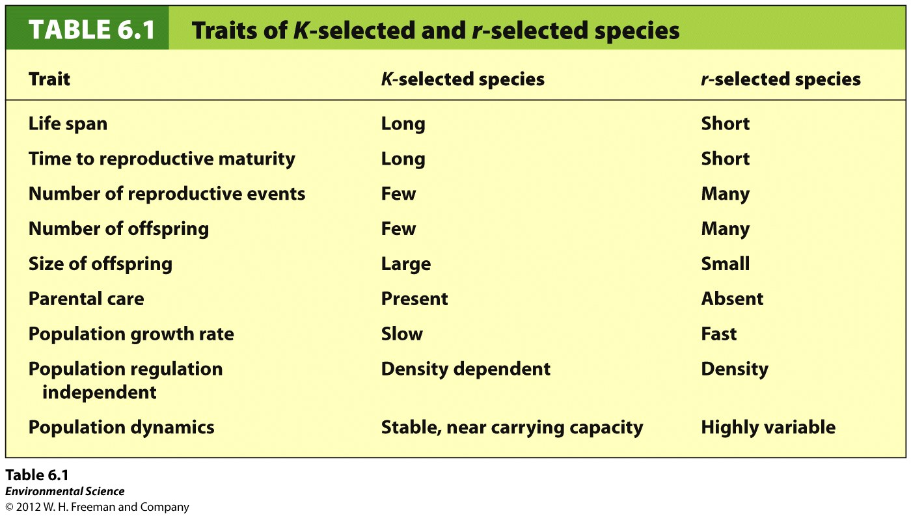
Notes:
R selected= don’t take care of their offspring, bacteria, mosquitos, etc.
K selected= fewer offspring, use resources well

Slide 49
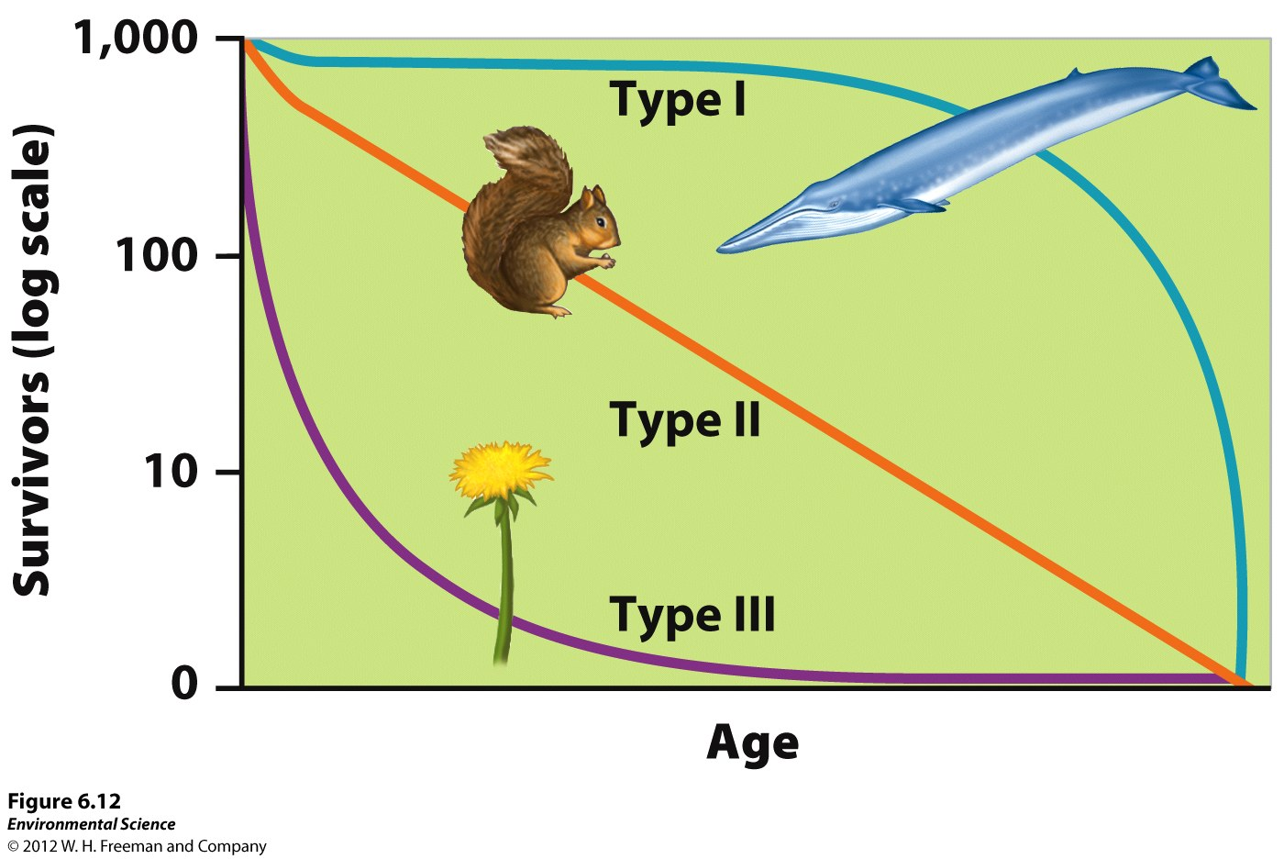
Survivorship Curves
Type I survivorship – Has excellent survivorship until old age. K – selected species.
Type II survivorship –
Exhibiting a relatively constant decline in survivorship over time.
Type III survivorship –
Has low rates of survivorship early in life. r-selected species

Slide 50
Age Structure Graphs
(a) India (2)= (Developing countries) Pyramid shape= Growing populations, more births than deaths
(b) US (3) = Rectangular shape= Stable, similar number of individuals in each age group, deaths and births equal each other, slow population growth
(c) Germany (4)= Declining populations, Narrower at the bottom than at the top, more deaths than births
(d) China= Early stages of a declining population→ pop. control

Slide 51
Taboo Partner 1 face the screen Partner 2 face the wall
K – strategist
“S” curve
Type II Survivalist
Carrying Capacity
Density Dependent Factor
Commensalism

Slide 52
Taboo
Phase 1 of Demographic Transition
Die Off
Resource Partitioning
Doubling Time
Crude Birth Rate
Keystone species

Slide 53
Taboo
Net Migration Rate
Population Momentum
Life Expectancy
Theory of Island Biogeography
Demography
Family planning

Slide 54
Taboo
Predation
IPAT equation
Infant Mortality
Developed Countries
Pathogens
Metapopulation

Slide 55
Taboo
“J” Shaped Curve
Community
Net migration rate
Crude Death rate
GDP – Gross Domestic Product
Primary Succession

Slide 56
In the News…
http://www.thedailybeast.com/articles/2014/10/05/glaciers-lose-204-billion-tons-of-ice-in-three-years.html?utm_content=buffer66e36&utm_medium=social&utm_source=facebook.com&utm_campaign=buffer

Slide 57
Friday:
What are the four stages (Names) of demographic transition?
Crude birth and death rate
Monday: 10/6
Population problem (check)
Relationship between economic development and population
Explain the different viewpoints scientists have on if humans will reach our carrying capacity or not? Pg. 180-181
Tuesday: 10/7
Fertility
Family Planning
Life Expectancy
Wednesday: 10/8
Ecological footprint
IPAT equation
Impact of Affluence
Thursday: 10/9
Review of CH 6, CH 7

Slide 58
3/9 Midterm Studying and Refuel Program Obj. TSW answer questions to improve their studying and brainstorm ideas for Refuel Poster p.72NB
(1) What are your plans for studying for our Midterm next week?
(2) Fill in: For the remainder of the semester, I would like to improve the following:_______. Explain how will you achieve this?
EX) Studying more or not cramming the day before the test, doing test corrections, coming in before school for help, etc!
(3) Pick up Refuel Poster Project

Slide 59
In the News...

