Slide 1
Punctuated Equilibrium
Incorporate ideas about the tempo of speciation in their explanation of what we see in the fossil record.

Slide 2
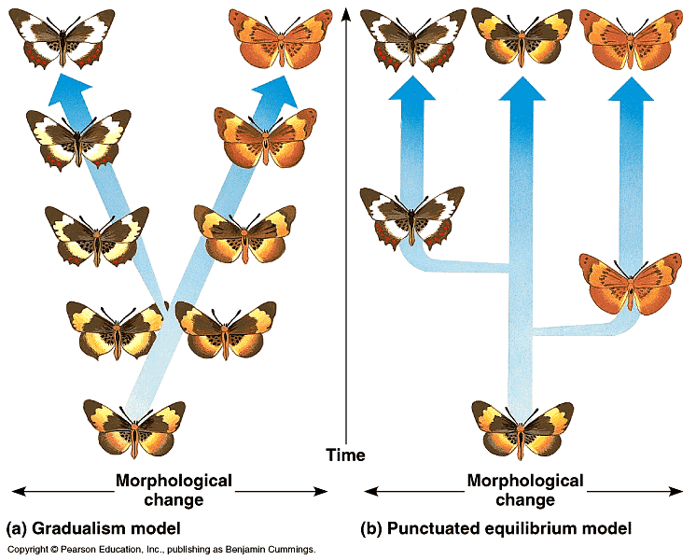
A) Species descended from a common ancestor gradually diverge more and more in morphology as they acquire unique adaptions.
B) A new species changes most of as it buds from a parent species, and then changes little for the rest of its existance.

Slide 3
According to the Punctuated Equilibrium model, species diverge in spurts of relatively rapid change , instead of slowly and gradually.

Slide 4
Species undergo most of their morphological modification as they first bud from parent species and then change little, even as they give rise to additional species. The term punctuated equilibruim is derived from the idea of long periods of equilibruim punctuated by episodes of speciation.

