Slide 1
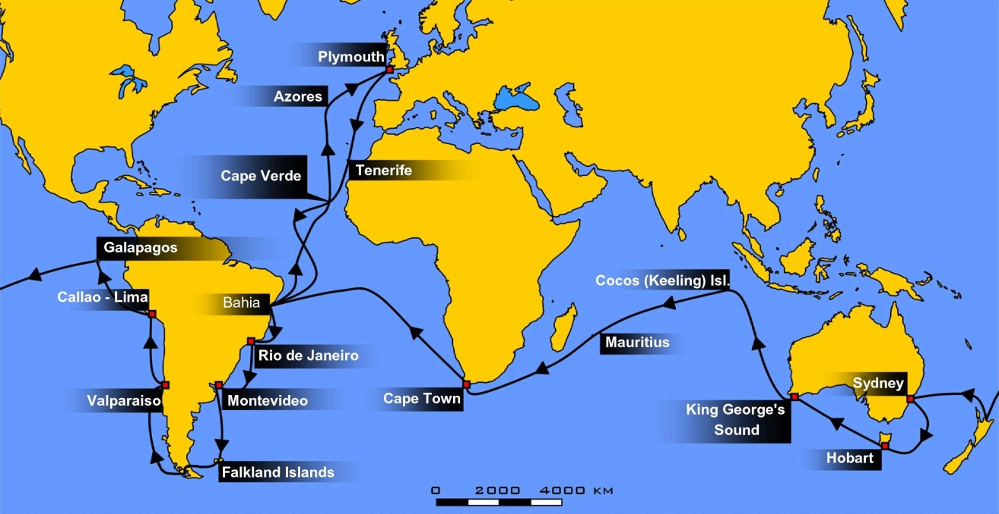
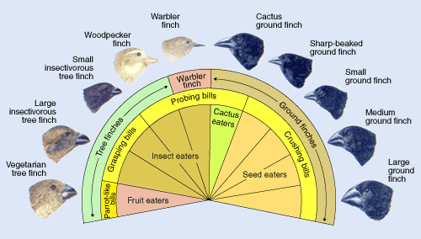
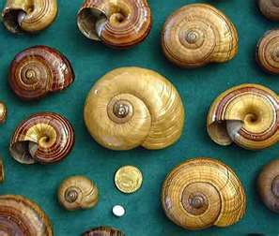
CH 22, 23 & 24
Descent with modification: A Darwinian view of Life
Evolution of Populations
Origin of Species
10/26 Obj. TSW explain how selection works in a variety of ways using examples and they will do the bird beak lab to demonstrate understanding.

Slide 2
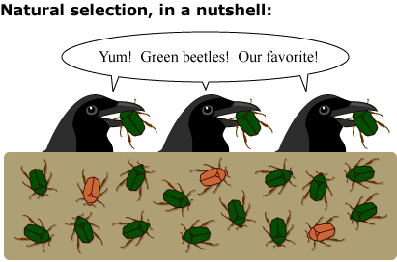
Darwin – The Origin of Species
1st – Species of organisms inhabiting Earth today descended from ancestral species.
2nd – Mechanism for evolution - Natural Selection, populations of organisms change over time & those with favorable characteristics produce more offspring than others.
The result is evolutionary adaptation, inherited characteristics enhance organisms survival.

Slide 3
Historical Context American Revolution 1776, French Revolution 1789, U. S. Civil War 1860
Linnaeus (taxonomy, Genus, species) – Phylogeny, helped Darwin later name species. K,P,C,O,F,G,s
Hutton (gradualism) – profound change in organisms develop in a slow continuous process.
Lamarck (evolution) – wrong (inheritance of acquired characteristics), but on the right track, lines of decent, use & disuse
Malthus (populations) – struggle for existence due to resources available, capacity to overproduce offspring.
Cuvier (paleontology)-but believe that species could never evolve.
Lyell (Uniformitarianism, geologist)- the rates of geologic processes operate the same today as in the past.
Darwin (Evolution Natural Selection)- Strongly influence by Hutton & Lyell. Geologic change – slow & continuous, thus adds up to a substantial change.
Mendel (Inheritance) – Pea plants – Complete dominance, monohybrid X
Wallace (Evolution) – came to the same conclusion as Darwin and asked Darwin to read his paper. As a result it forced Darwin to publish before him.

Slide 4
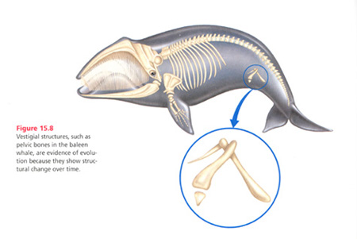

Slide 5
Origin of Species
Occurrence of Evolution – explanation of life’s unity & diversity
Natural Selection is its Mechanism for adaptive evolution.
Darwin did not use the word evolution until the last paragraph of his book, instead he used descent with modification.
Darwin’s Main Ideas: *Read P. 435 Observations & Inferences
Natural Selection is differential success in reproduction (unequal ability of individuals to survive and reproduce).
Natural Selection occurs through an interaction between the environment and the variability inherent amount the individual organisms making up a population.
The product of natural selection is the adaptation of populations of organisms to their environment.

Slide 6
Evidence for Evolution
Example: Camouflage – flower mantid, tree mantid, SA mantid.
Populations in evolution, not individuals
Inherited adaptations that can evolve in a population
Natural Selection in Action – Insecticides and antibiotics, drug resistant HIV
Homology – similarity in characteristics resulting from common ancestry
Homologous structures – structures may have different function, yet have similar structure and show relationship of a common ancestor.
Vestigial Organs – historical remnants of structure that had importance in ancestors, but are no longer used in present day species.
Example – Pelvis of snake or whale
Embryological Homologies – embryological development have pharyngeal pouches at some stage of development
Molecular Homologies – all species of life use the same basic genetic machinery of DNA and RNA, & the Genetic Code is universal.
Homologies & Tree of Life – a branching pattern showing evolutionary relationships of organisms.

Slide 7
Population genetics
A populations gene pool is defined by its allele frequencies.
Hardy Weinberg describes a non-evolving population
Population Genetics – studies the genetics variation within populations & quantifies the variations.
Gene pool – all the alleles of the individual in a population at a certain gene loci.
What is the allelic frequency of a population of 500 flowers R (red) r (white). 20 are homozygous recessive (rr)?

Slide 8
Microevolution
A generation – to – generation change in a population’s frequencies of alleles.
Causes of Microevolution
Genetics Drift – the smaller the sample, the greater the chance of deviation from an idealized result that is due to chance.
Bottleneck Effect – disasters, natural or man made reduce the size of a population drastically. The survivors may not be representative of the original population.
Reduces the overall genetic variability of the population ex. Cheetah
Founder Effect – a few individuals of a larger population colonize an isolated island, lake, or new habitat. Ex. Triatan da Chunha island, retinitis pigmentosa (frequency much higher, than mainland population)
Natural Selection
Differential survival,-predators, pollinators, camouflage, mimicry, defenses
Gene Flow – immigration, emigration of individuals to & from populations
Mutations – change in organism’s DNA, transmitted to gametes can immediately change the gene pool

Slide 9
Genetic Variation
Quantitative variation usually indicates polygenic inheritance ( additive effect of two or more genes on a single phenotype
Polymorphism – Blood types – A, B, O, AB, applies to discrete characters, two or more forms; human height (polygenic) is not an example polymorphism
Geographic variation – differences in gene pools between populations due to some environmental factors.
Mutation – new alleles or change in the nucleotide sequence of DNA.
Sexual Recombination – meiosis, 1 chromosome inherited from each parent, crossing over (prophase 1), segregate randomly into separate gametes, random union of egg and sperm
Diploidy- having 2 alleles for each trait, recessive is hidden by the dominant allele, (not exposed to NS) but if the environment changes, the heterozygote may be selected for or even the homozygous recessive.
Heterozygote advantage – Sickle Cell Anemia, resistant to malaria
Neutral variation – human fingerprints

Slide 10
Natural Selection Mechanism of Adaptive Evolution
Directional Selection – more common during period of environmental change, or migration to a new habitat with different environmental conditions.
Diversifying Selection- environmental conditions are varied that favors individuals of both extremes over the intermediate.
Stabilizing Selection – acts against extreme phenotypes and favors the intermediate.
Sexual dimorphism – distinction in appearance, either size, plumage (intersexual selection), manes, antlers (intrasexual selection)

Slide 11
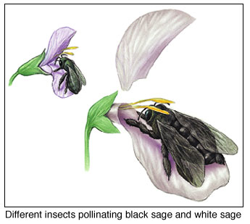
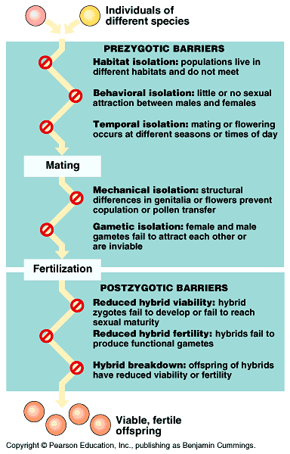
The Origin of species
Prezygotic
Postzygotic Barriers
Modes of speciation
Allopatric speciation
Adaptive radiation
Sympatric speciation
Allopolyploid
Punctuated Equilibrium

Slide 12
Homework!
You get to pick your top 3 schools and look up what AP score is accepted by them. I hope this will give you a real goal for what to work towards. You may be surprised at what you find, be prepared to share out. In addition, find what the school charges per credit hour so that you can see the $$$ savings as well.

Slide 13
2008 Form B FRQ Q#3
Evolution is one of the unifying themes of biology. Evolution involves change in the frequencies of alleles in a population. For a particular genetic locus in a population, the frequency of the recessive allele (a) is 0.4 and the frequency of the dominant allele (A) is 0.6.
(a) What is the frequency of each genotype (AA, Aa, aa) in this population? What is the frequency of the dominant phenotype? (4 pts)
(b) How can the Hardy-Weinberg principle of genetic equilibrium be used to determine whether this population is evolving? (2 pts)
(c) Identify a particular environmental change and describe how it might alter allelic frequencies in this population. Explain which condition of the Hardy-Weinberg principle would not be met. (4 pts)

Slide 15
Data Table 2. Fill in this table during class discussion, recording the average yield for each predator.
Class Results | BEAK TYPES
 |  | Chopsticks | Clothespins | Spoons | Tweezers | Scoopulas | Knife | Straws | Fingers | Scissors
Prey Types | Popcorn Kernels | 4.5 | 7.7 | 15 | 12.6 | 8.3 | 13 | 28.6 | 13.7
 | Packing Material
 | Toothpicks
 | Paper Clips
 | Rubber Bands | 9.5 | 13.7 | 3.3 | 10.6 | 1.3 | 2.3 | 16.6 | 12.3
 | Small Red Beans | 7 | 5.7 | 10.3 | 15.6 | 7.3 | 5.3 | 2 | 13.3
 | Sunflower Seeds
 | Wheat | 31 | 6 | 3.3 | 15.3 | 14.3 | 29.6 | 54.6 | 16.3
 | Lentils | 15 | 8.3 | 5.3 | 14 | 12.6 | 32.3 | 21 | 14.6
 | Small Red & White Beans | 3 | 7.3 | 12.3 | 11 | 7 | 7 | 12 | 16.6
 | Kidney Beans | 9 | 7.3 | 10 | 10 | 4.6 | 7.8 | 19.3 | 18.3
 | Rice | 5.5 | 21.7 | 10 | 24 | 6.3 | 6.3 | 17 | 7.3

