Slide 1
Lab #7 Genetics of Organisms
Fast growth plant
&
Corn

Slide 2
Statistical Analysis Section
What is the phenotypic ratio of a monohybrid cross?
How many would you expect to be homozygous dominant or heterozygous out of 84?
How many would you expect to be homozygous recessive out of 84?

Slide 3
Why do we care?
Is the difference explained by random chance or a variation in the sample?
If we were doing medical studies on people…?
Chi-square analysis is performed to test the validity of a null hypothesis (no statistically significant difference) or a test indicates that the data vary too much from the expected 3:1 then an alternative hypothesis is accepted.

Slide 4
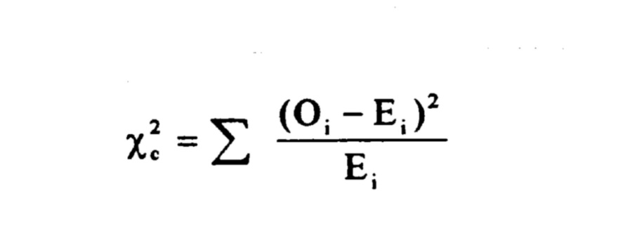
Formula for chi-square
Phenotype | Genotype | # Observed (o) | # Expected (e) | (o-e)
Green | GG or Gg | 72 | 63 | 9
Albino | gg | 12 | 21 | -9
 |  | 84 | 84
Phenotype | Genotype | # Observed (o) | # Expected (e) | (o-e) | (o-e)2 | (o – e)2 e
Long wings | LL | 230 | 250 | 20 | 400 | 1.6
Intermediate wings | Ll | 510 | 500 | 10 | 100 | .2
Short wings | ll | 260 | 250 | 10 | 100 | .4
 |  |  |  |  | Chi-square | 2.2

Slide 5
Chi Square -Corn
Phenotype | Genotype | # Observed (o) | # Expected (e) | (o-e) | (o-e)2 | (o – e)2 e
Dark | DD, Dd | 499 | 470 | 29 | 841 | 1.8
Yellow | Dd | 128 | 157 | 29 | 841 | 5.4
 |  |  |  |  |  | 7.2
 |  |  |  |  |  | <1% statistically valid ☹

Slide 6
Degrees of freedom “a way of keeping score”
Calculate the chi- square value for these data.
How many degrees of freedom are there?
WHY? 2 degrees of freedom. The parameter for the problem is population characteristic, in this case:Phenotypes. We have 3 phenotypes LL – long, Ll- Intermediate, ll- short wings. Each of these phenotypes are independent variables. The degrees of Freedom is calculated by subtracting the parameter from the independent variable, in this case: 3-1 = 2
X² (chi-square) = 2.2
According to the critical value of X², can you accept or reject the null hypothesis?
Accept null hypothesis because the observed data results fit the expected results, and are considered significant. .05 = 5% probability

Slide 7
Carolina Fast Plants
Phenotypes
Purple or Nonpurple
Standard or Rosette Dwarf
Cross F1 x F1 What ratio do you expect for both of the traits?

Slide 8
Yellow | Wrinkled | Dark | Yellow (dark)
384 406 572 412 328 416 516 459 400 928 | 140 132 (8 black) 223 (2 black) 127 (8) 172 110 184 (1 black) 164 127 132 | 491 489 528 467 553 462 541 489 560 409 | 106 124(100 Orange) 150 106 (44 Orgwr) 133 129 163 112 110 149
Total 4821/10=481 | 1511/10=151 | 4989/10=499 | 1282/10=128

