Slide 1
Prezygotic
Katelin King
Amarita Singh
Iann Tharp

Slide 2
Assertion
Prezygotic is one of the two general categories of reproductive isolating mechanisms. Prezygotic takes effect before fertilization occurs.

Slide 3
Example & Explain
1) Habitat Isolation- populations live in different habitats and they don’t meet or have the opportunity to mate. Elephants in Africa cant mate with Elephants in Asia.
2) Behavioral Isolation- Little or no sexual attraction between males and females. Normally Humans don’t have the urge to mate with other species.
3)Temporal Isolation- where mating or flowering occur at different seasons or times of day. Western spotted skunk and eastern spotted skunk cant mate because one mates in the summer and the other in the winter.

Slide 4
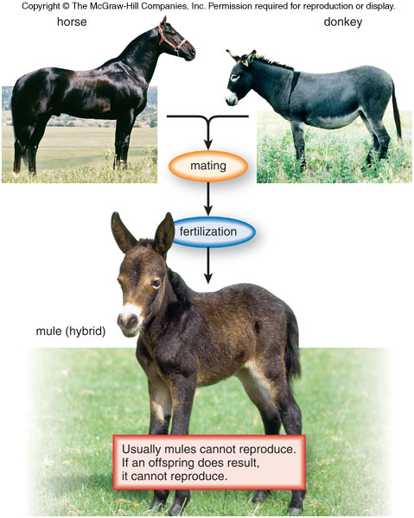
Significance
If the first three barriers fail there are still two other barriers that work to prevent fertilization and reproduction of a cross breed.

