Slide 1
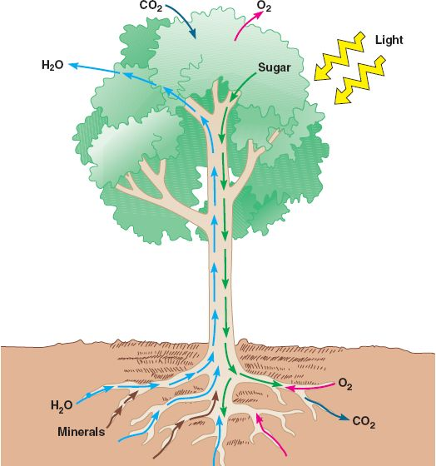
Transport in plants, plant nutrition, plant responses
Obj: TSW understand and demonstrate how plants transport nutrients, and respond to their environment by doing two plant labs.

Slide 2
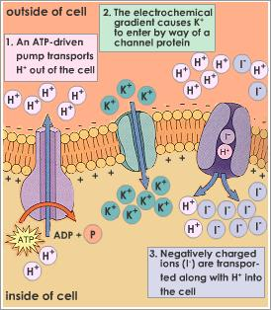
Selective Permeability
Transport proteins- proteins embedded in the cell membrane, diffusion
Selective channels – allow certain ions through, bot not others, K+, not Na+
*Proton pump – hydrolyzes ATP & uses the released energy to pump hydrogen ions (H+) out of the cell. ↑H+ outside the cell, making a membrane potential (charge), inside the cell becomes more negative.
Cotransport – drives the transport of different solutes (H+ downhill, & NO3- uphill) for the uptake of sucrose by plant cells.
Chemiosmosis – unifying principle of cellular energetics
Osmosis – passive movement of water
Water Potential (Ψ)= solute concentration & pressure (cell wall)
Aquaporins – affects the rate at which water diffuses, does not affect the water potential gradient or direction of water flow

Slide 3
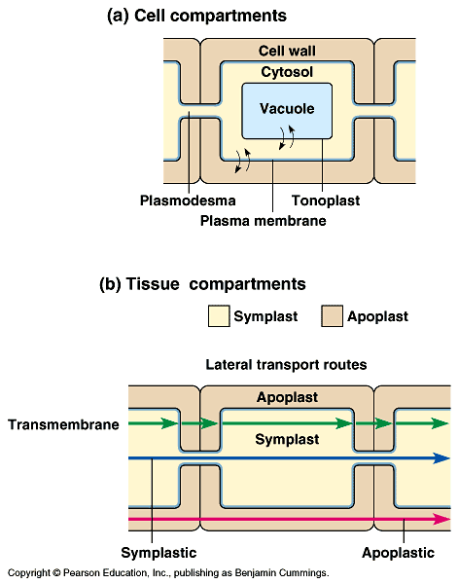
Vacuolated plant cell have three major components
Plasmodesma – connect compartments cytosolic of neighboring cells to form that are continuous to transport certain molecules
Tonoplast – regulates molecular traffic between the cytosol & vacuolar contents- sap
Symplast –, first compartment tissue level, cytoplasmic continuum
Apoplast- second compartment at the tissue level, cell wall
Vacuole – not shared with neighboring cells

Slide 4
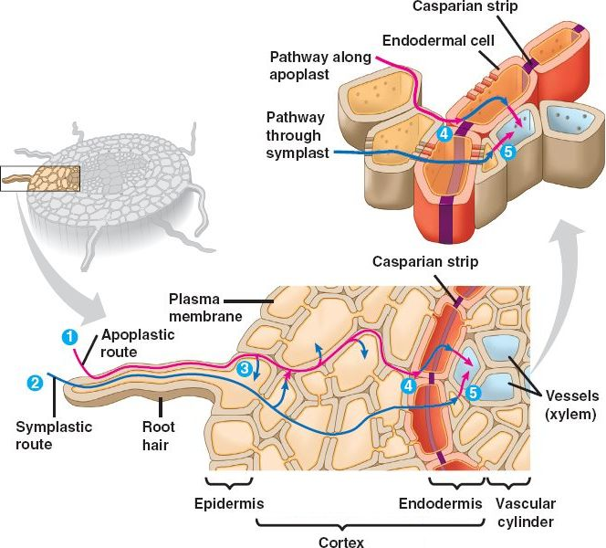
Absorption of water & minerals by roots
Mycorrhizae – symbiotic relationship between the roots of plants and hyphae (filaments) of the fungi, increasing the surface area for the absorption of water and minerals. (mutualism)
Xylem sap flows upward towards leaves, this flow upward brings mineral nutrients to the up the plant also.
Root pressure of water pushes water up the plant only a few meters.
Transpiration- provides the pull, water properties such as cohesion of water due to hydrogen bonding transmits the upward pull of water through the plant.
Stomata – microscopic pores on the surface of the leaf
Transpiration - the loss of water vapor
from leaves
Bulk Flow – long distance transport of water

Slide 5
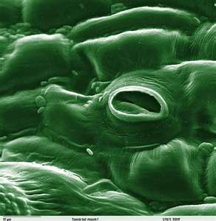
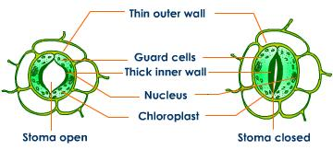
Control of transpiration
Guard cell mediate the photosynthesis – transpiration compromise
Guard cells control the size of the stomata, which controls transpiration, conserves water and with it the requirement for photosynthesis
CO₂ diffuses into the leaf through the stomata, O₂ (by-product) diffuses out.
Transpiration – to – photosynthesis ratio – the amount of water lost/gram of CO₂ assimilated into organic material by photosynthesis
C3 plants ratio 600:1
C4 plants (corn) ratio 300:1
Transpiration also allows for evaporative cooling, so enzymes do not denature
Changes in turgor pressure open and close the stomata due to accumulation of K+ Opens guard cells, exodus of K+ decreases osmotic pressure and stomata close

Slide 6
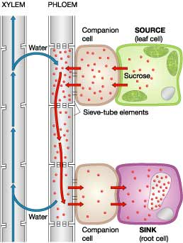
Translocation of Phloem sap
Translocation – the transport of sugar through the plant.
Sugar sink - an organ that is a net consumer or storer of sugar.
Roots, shoots, stems, fruit, tuber or bulb
Phloem sap moves by bulk flow (pressure)

Slide 7
Macronutrients & Micronutients
Major components of plant organic compounds: Carbon, Oxygen, Hydrogen, Nitrogen, Sulfur, Phosphorus, Potassium, Calcium, Magnesium
Minor components of nutrition, (cofactors of enzymatic reactions) : Chlorine. Iron, Boron, Manganese, Zinc, Copper, Molybdenum, Nickel
Fertilizer: N:P:K

Slide 8
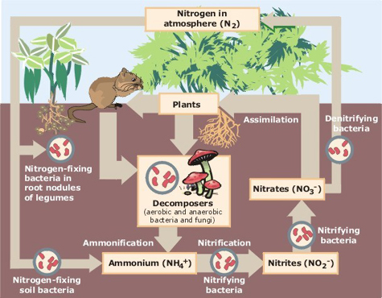
Nitrogen Fixation & Symbiotic Relationships
Nitrogen fixation: Bacteria restock nitrogenous minerals in the souk by converting N2 to NH3 (ammonia)
Enzyme nitrogenase catalyzes the reaction to reduce N2 to NH3 by adding electron along with hydrogen ion.
Ammonia pick up another hydrogen to form ammonium (NH4+) that plants absorb.
(NO3-) nitrate, produced in soil by bacteria that oxidize ammonium
Once it is absorbed, the plant can reduce it back to ammonium to be used for amino acids
Mycorrhizae – modified roots (fungi)
Parasitic relationships
Mistle toe & oak trees, aphids & roses
Carnivorous Plants – venus fly trap

Slide 9
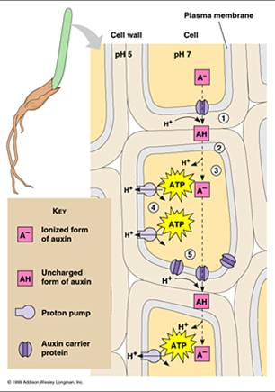
Plants respond to external & internal cues
Plant have Cellular receptors to detect important changes in the environment
Hormones- coordinate growth, development & responses to environmental stimuli
Trophism – to grow in a certain way
Phototropism - growing toward the light
Auxin – cell elongation
Cytokinins – stimulate cell division & differentiation
Gibberellin – stimulate growth in both leaves & stem, little effect on root
Ethylene – hormone plant produced in response to stress (drought, flooding, mechanical pressure, injury or infection)
Ethylene helps with the programmed destruction of cells, organs and the whole plant

Slide 10
Plant responses
Apoptosis – programmed cell death
Very busy time, require new gene expression
Newly formed enzymes break down many chemical components: chlorophyll, DNA, RNA, Proteins, Membrane lipids
Phototropism- growth toward light
Circadian rhythms – internal clock
Photoperiodism
Short day plants- flowers when nights are long
Long day plants – flowers when nights are short
Gravitropism – roots growing downward into the soil, stems exhibit negative gravitropism
Trigmotropism – touch sensitive
Plant defense – physical defense- thorns
Chemical defense – distasteful, poisonous (toxic), airborne attractants that bring animals that destroy herbivores

Slide 11
tropism
Transpiration
stomata
Phloem
guttation
auxin
Osmosis
Xylem
epidermis
Bulk Flow
macronutrients
ethylene

Slide 12
Quick Write- Transpiration
Describe transpiration, include the part of the plant that are involved. Explain how transpiration works and why it is important.

Slide 13
Transpiration Just mL water loss (or gain) in each plant

Slide 14
Transpiration

Slide 15
Symbiotic Relationships p. 42
Identify & Describe a type of symbiotic relationship involving plants, and how each organism benefits. How is this important to coevolution?

Slide 16
Lab #9 Transpiration
Choose 1 or the 2 methods to determine the water loss in mL/m²
Leaf Trace Method
Total surface area is calculated by dividing the total number of blocks coved by 4. ____ = Leaf surface area (m²)
Leaf Mass Method
Cut 1cm2 section out of a leaf
Mass the leaf
Multiple the section by 10,000 to calculate the g/m².
Divide the total mass of the leaves by the g/m² = 83g/m2_____ = leaf surface Area (m²)
Water Loss:m² Wind 1.7mL; Light1.7 mL; Heat & Light .7mL; Humidity .7mL
Wind:14.16 mL/ m²; Light: 14.33mL/m²; Heat & Light 9.39 mL/m²; Humidity: 8.07mL/m²
Record your data in Table 9.2 for the 0 value and the 30 minute value

Slide 17
Final Mass of Leaves
Wind 10.7g
Light 11.9 g
Heat & Light 7.8 g
Humidity 6.7 g

Slide 18
Quick Write
Discuss some hormone effects on plants, give examples and explain how they work, why are they important?

Slide 19
Lab # 12
1st measure Dissolved Oxygen of 3 different temperatures of water. Which one holds more O₂?
7 Groups of students. Materials: GLX, Temperature probe, Dissolved Oxygen Sensor & Absolute Pressure Sensor, 1 small beaker
Hook the 3 probes into the GLX and turn it on.
Press home, press right arrow to select the Digits button, press the checkmark, then Press F2 to see all three values of the probes.
At a temperature of 25°C and a barometric pressure of 760 mmHg, 8.2 mg of oxygen will dissolve in one liter of water at 100% saturation.

Slide 20
DO mgO₂/L at cold temp, Room Temp and hot temp.

Slide 21
Table 12.2 Class Mean Data Productivity

Slide 22
Lab #12 part b
Obtain 3 vials/ group, there should be 7 groups.
Group 1 – I “initial” Get average today only. Dennison
Group 2 – D “dark” (Aluminum Foil) Amrita
Group 3 – 100% (No screens) Chris
Group 4 – 65 % (1 screen) Jai
Group 5 – 25 % (3 screens) Jenna
Group 6 – 10% (5 screens) - Tu
Group 7 – 2% (8 screens)Anna
Average the DO for the three vials, after24 hour period.

Slide 23
Quick Write P. 48NB
What does it mean to have primary productivity in a photosynthetic plant?

Slide 24
Class Data – Mean Productivity Table 12.4
# of Screens | % Light | Gross Productivity | Net Productivity | Respiration
0 | 100 | .3 mgO₂ /L | 6.6 – 5.03 = 1.62mg O₂/L
1 | 65 |  | 6.6 – 5.33 = 1.27mg O₂/L | X
3 | 25 |  | 6.6 – 4.9 = 1.7 mg O₂ /L | X
5 | 10 |  | 6.6 – 3.37 = 3.23 mgO₂/L | X
8 | 2 |  | 6.6 – 3.32 = 3.28 mgO₂/L | X
Initial DO value: 6.6 mgO₂/L x .698 = 4.607 mL O₂/L x .536 = 2.469 mg carbon fixed/L
Dark DO Value: 6.3mg O₂ Net Productivity = .3mg O₂/L
Independent Variable:
Dependent Variable:
*A lake becomes eutrophic when mg carbon fixed/L = 85

Slide 25
Lab #12 Questions
Primary Productivity can be measured by the rate of O2 production, Rate of CO2 uptake, rate of carbohydrate or biomass.
The relationship is that for each milliliter of oxygen produced, .536 milligrams of carbon is assimilated.
The relationship between temperature and dissolved oxygen is an inverse one. As the temp. ina liquid rises, the amount of gas that remains dissolved in the liquid decreases. The most oxygen rich water is shallow, rapidly moving, and cold. 4°C, water can hold approximately 19% oxygen.

Slide 26
4. No gross productivity:
No net productivity:
Water is much thicker than air. This means that the gill muscles must work much harder to move water over the gill’s surfaces. Another factor is that water holds much less oxygen than air does.
You would expect a higher DO reading in a stream than a lake, tumbling action of water over rocks and shallowness increases O2 content.
DO at 7 am is lower than the DO at 5 pm. DO is decreased by respiration of organisms at night, the low levels of light in early morning do not produce as much DO through photosynthesis, as it would later in the day.

Slide 27
8. A would have more oxygen available to the fish. At a particular temperature, only a fixed amount of oxygen could be dissolved in a given volume of water. Since the volume of water is greater, the amount of oxygen dissolved in water would be greater. However, Over the course of the day, the fish would use up the DO in both containers, and the one with more surface area (B) would better sustain the fish.

Slide 28
9. Eutrophication is the increase in concentration of fertilizers such as Nitrogen, Phosphorus, and other nutrients in the bodies of water. By increasing the amounts of these nutrients in bodies of water the types of organisms that are most successful or that have the greatest biomass change. The changes effect the entire ecosystem. Tremendous blooms of algae happen, then they produce large amounts of oxygen during the day, but respire at night and depletes the DO content. The dense algae decrease available light in the photic zone causing anoxia in deeper water. The algae eliminate the natural food of herbivores.

