Slide 1
Allopatric Speciation
By Jai London
And Tu Hoang

Slide 2
Allopatric speciation happens in populations when they are separated geographically.

Slide 3
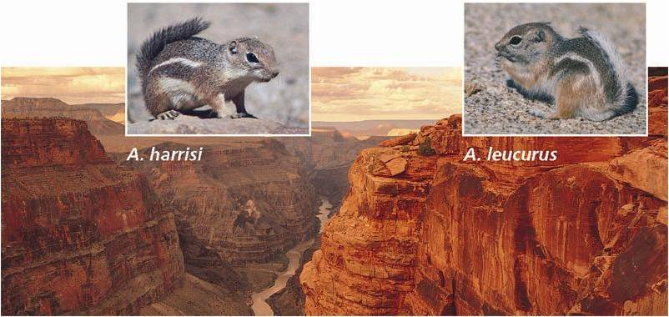
Tu ☺ Jai
In this picture, Tu and Jai look similar, but are different because they were isolated on separate sides of the canyon. The different environments in the canyon caused a change in them; thus you have allopatric speciation

Slide 4
This is important because this allows so many other different types of the same species, causing Genetic Variation O.o

