Slide 1
Day 7 AP Biology Review
Ecology – Interdependence with nature
Lab #12 Dissolved Oxygen & Aquatic Primary Productivity

Slide 2
Ecological interactions
Organisms interact with each other and the physical environment. In a short essay (100 – 150 words), explain how the response of diatom populations to a drop in nutrient availability can affect both other organisms and aspects of the physical environment (such as carbon dioxide concentrations).

Slide 3
Fungi have long formed symbiotic association with plants and with algae. In a short essay (100 – 150 words), describe how these two types of associations may lead to emergent properties in biological communities.

Slide 4
The soil in which plants grow teems with organisms from every taxonomic kingdom. In a short essay (100 – 150 words), discuss examples of how the mutualistic interactions of plants with bacteria, fungi, and animal improve plant nutrition.

Slide 5
In a short essay (100 – 150 words), use specific examples to discuss the role of hormones in an animal’s responses to changes in its environment.

Slide 6
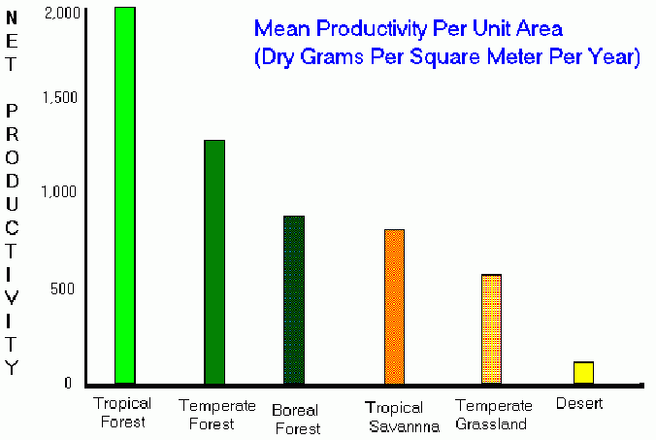
Lab #12 Dissolved Oxygen & Aquatic Primary Productivity
O2 productivity
Carbon fixation -(Growth)
Consumption of CO2
These three quantities can be used to measure the primary productivity of a photosynthetic organism.

Slide 8
Discuss interactions of Biotic & abiotic factors and the carrying capacity of Earth, Who controls the food? Review Science, technology & society again.
Philosophical Chair Debate
Socratic Seminar Discussion

